Slide 1
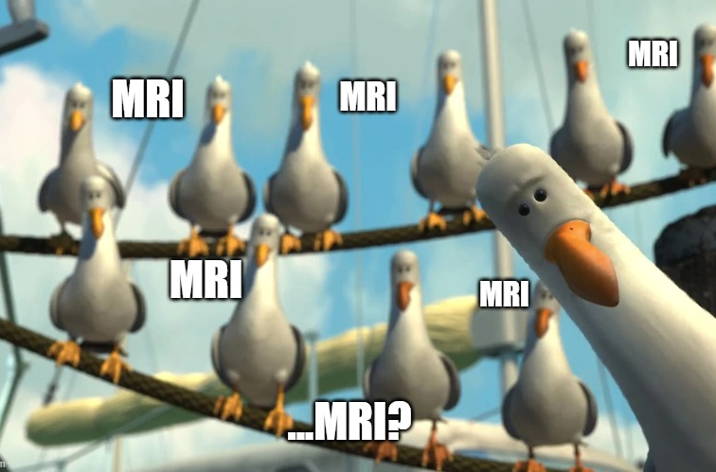
Altered Mental
Status
Kaelin Bernier
Chief Resident
Intern Bootcamp

Slide 2
CC: Altered Mental Status
Objectives
How to evaluate a patient
How to build a differential
Based on differential, order workup and treat

Slide 3
Evaluation
FIRST | check levels of consciousness (are they protecting their airway?), get full set of vitals, check if febrile
HPI questions | baseline mental status Time course/acuity Has this happened before? Hx sundowning or psychiatric history Recent head trauma? Or hx suggestive of brain lesions (ie malignancy) Recent Rx (narcotics, sedative, benzos) ETOH hx and last drink or other recreational substances Focal neuro deficits concerning for CVA, last known well time Any RFs for CVA (ie extreme HTN, hypotension, or is pt on anticoagulation)
Physical exam | Full neuro exam Check for asterixis Check for focal infection Check for respiratory status
Document | Be explicit! That way people reading your note later will know if further changes in neuro status have occurred Don’t just write “pt confused” Discuss if pt awake, alert, oriented, if requires frequent prompting/waking, if somnolent or drowsy but arousable to speech or noxious stimuli, if speech is pressured, slow, or tangential, if pt is aggressive or agitated, whether responding to internal auditory/visual hallucinations,

Slide 4
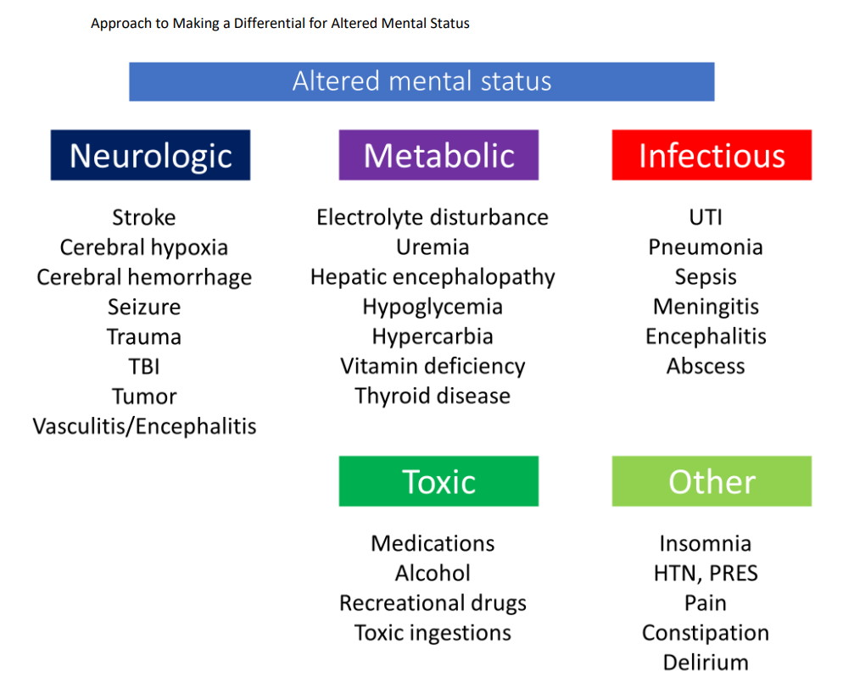
Differential Diagnosis
MIST
  Metabolic
  Infectious
  Structural
  Toxins
MOVE STUPID
  Metabolic
  Oxygen
  Vascular
  Endocrine
  Seizure
  Trauma/tumor/ttp
  Uremia/PSE
  Psychiatric
  Infections
  Drugs
AEIOU TIPS
  Alcohol/Acidosis/Ammonia/Arrhythmia
  Electrolytes/Endocrine/Epilepsy
  Infection
  Overdose/Oxygen/Opiates
  Uremia
  Temperature/Trauma/Thiamine
  Insulin (hypoglycemia)
  Psychiatric/Poisoning
  Stroke/Seizure/Syncope/Space occupying lesions/ Shunt (VP) Malfunction/ SAH

Slide 5
DDx AMS: MIST
Metabolic (acidosis, uremic, hyper/hyponatremic, thyroid, adrenal, PSE, hypoglycemic)
Infectious (pna, uti, encephalitis/meningitis)
Structural (CVA, subdural, cerebral edema, mets)
Toxins (ETOH, opiates, other drugs, salicylates, Rx withdrawal)
Plus some others…
Dementia (rapidly progressive – prion, AIE, vasculitis; neurodegenerative- Alzheimer's, vascular)
Delirium
Psychiatric
Seizures

Slide 6
A/P: please do not write “AMS”
#Acute vs/on chronic metabolic/toxic encephalopathy likely multifactorial 2/2 xyz
vs concern for CVA/TIA
vs seizure-like activity with post-ictal state
vs mild/moderate/severe cognitive impairment
vs severe mania with history of schizophrenia and medication noncompliance
vs alcohol withdrawal, last known drink xxx
vs hyperactive delirium with history of sundowning

Slide 7
Tests and Treatment
Tests | POC glucose CBC CMP, Ca, Mg, Phos ABG/VBG TSH noncon CT-> CTA H/N, COW infectious workup (blood cx, urine cx, CXR, LP) UDS, GC overdose ETOH screen Spot vs cEEG and possible MRI
Treatment | Hypoglycemia: 1 amp d50 Hypoxia/hypercarbia: cxr, treatment dependent on cause, if very altered may not tolerate NPPV and require intubation Seizure: if lasting 2 mins, Ativan 2mg ivp followed by another 2mg if no response and then keppra, monitor airway CVA: see code stroke slide (later in presentation) Meningitis: empiric abx (vanc, cef, /- amp), LP ETOH withdrawal: Ativan/Librium/phenobarb, thiamine (then glucose) Opiate overdose: naloxone Hyponatremia: may need to consider hypertonic (in which case ICU) Elevate head of bed and place orders for aspiration risk and maybe npo Hold sedative medications

Slide 8
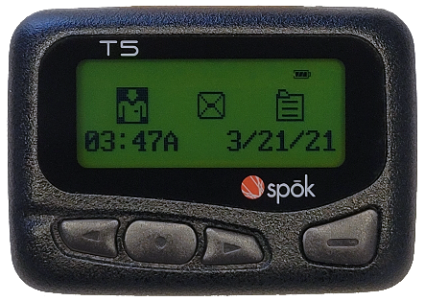
“Hi, could you please come to bedside? I’m worried that our patient is altered…”

Slide 9
Case 1
77 yo M who underwent right BKA yesterday. PMH notable for poorly controlled T2DM and CKD stage 3.
You get to bedside and notice patient is somnolent but protecting his airway. He does not wake to auditory or light tactile stimuli. You perform a sternal rub and patient awakens but falls asleep shortly thereafter.
Vitals: T 36.6, BP 110/68, HR 87, RR 8, spO2 95%
What stands out? What are you concerned about? What questions would you like to ask?

Slide 10
Case 1
Differential
Differential | M: hypoglycemia, hyponatremia, hyperuricemia I: SSTI S: unlikely T: pain Rx
Evaluation/ Tests
Evaluation/ Tests | M: POC glucose, CMP I: blood cultures (but would not order unless febrile or site appears infected) S: would not order CTH unless other workup unrevealing T: ask RN about dosing
Results
Results | Labs: BG 110, Na 132, BUN/Cr 22/1.1 (baseline) “Yes, he’s been taking oxycodone 10mg every 4 hours. Last dose was one hour ago. Patient also received a dose of IV morphine 4mg 30 minutes ago due to breakthrough pain.”
Treatment
Treatment | Naloxone

Slide 11
Case 1: Toxins
Prescription medications: opioids, sedative-hypnotics, antipsychotics, polypharmacy
Nonprescription medications: antihistamines, anticholinergics
Drugs of abuse: ethanol, heroin, hallucinogens
Withdrawal states
Medication side effects: hyperammonemia from valproic acid, confusion from quinolones, serotonin syndrome
Poisons:
  Atypical alcohols: ethylene glycol, methanol
  Inhaled toxins: carbon monoxide, cyanide, hydrogen sulfide
  Plant-derived: Jimson weed, Salvia

Slide 12
Case 1: Toxins
STOP THE OFFENDING AGENT!
IF INDICATED, USE A REVERSAL!
  Naloxone is the reversal agent of choice for narcotics/opioids
  Flumazenil is the reversal agent of choice for benzodiazepines
CONSIDER AN ALTERNATIVE AGENT IF POSSIBLE!

Slide 13
Case 2

Slide 14
Case 2
34 yo F with history of chronic alcohol use disorder who is admitted with acute alcohol withdrawal after having a seizure.
You get to bedside and observe patient walking back to her bed from the bathroom with a wide based gait. The nurse is practically holding her up. Once in bed, you ask her how she is feeling. She looks at you and then glances at the door.. She tells you she just got home from the grocery store and then waves to her “puppy” in the corner.
Vitals: T 36.6, BP 120/80, HR 95, RR 14
What stands out? What are you concerned about? What questions would you like to ask?

Slide 15
Case 2
Differential
Differential | M: hypoglycemia, hyponatremia, hyperurcemia, Wernicke I: unlikely S: unlikely T: ETOH withdrawal, other substance use O: psychiatric? Delirium?
Evaluation/ Tests | M: POC glucose, CMP I: not indicated S: not indicated T: UDS, GC overdose, check CIWA O: look to see if psychiatric hx, if missing psych meds; ask RN about sleep/wake cycle
Evaluation/ Tests
Results
Results | Labs: BG 130, Na 126, BUN/Cr 12/.8 Drug screen only positive for benzos CIWA 6, receiving appropriate benzos No psych history, not missing home Rx, normal sleep/wake cycle
Treatment
Treatment | Thiamine

Slide 16
Case 3

Slide 17
Case 3
58 yo M with EtOH cirrhosis c/b grade II varices, coagulopathy, and abdominal ascites admitted with upper GI bleed who is now s/p variceal banding x3.
You get to bedside and find patient is stuporous and snoring loudly. After shaking his shoulder, patient eventually awakens startled. He starts jabbering with slurred speech before falling asleep again. You get him to wake up once more and ask him orientation questions, to which he states his name is Janice and the year is 1999.
Vitals: T 36.6, BP 102/58, HR 70, RR 12
What stands out? What are you concerned about? What questions would you like to ask?

Slide 18
Case 3
Differential
Differential | M: hypoglycemia, hyponatremia, hyperurcemia, PSE/HE I: SBP, GI infection S: unlikely T: sedative Rx?
Evaluation/ Tests
Evaluation/ Tests | M: POC glucose, CBC, CMP, ammonia? I: if ascites para + fluid studies, blood cx S: not indicated T: check MAR
Results
Results | Labs: BG 101, WBC 6, Hgb stable, Na 126, BUN/Cr 10/.4 Ascites: ANC 10 MAR does not show any sedative Rx given BUT does show pt has missed several doses of lactulose
Treatment
Treatment | Lactulose

Slide 19
Case 3:
PORTOSYSTEMIC ENCEPHALOPATHY/ hepatic encephalopathy
  Grade I: Changes in behavior, mild confusion, slurred speech, disordered sleep
  Grade II: Lethargy, moderate confusion
  Grade III: Marked confusion (stupor), incoherent speech, sleeping but arousable
  Grade IV: Coma, unresponsive to pain
Treatment:
  lactulose (titrate to mentation but generally aim for 2-3BM/day. If unable to tolerate po can give rectal
  Studies have shown miralax can work equally wel
  Can supplement with rifaximin
TIPS can make PSE worse

Slide 20
Case 4

Slide 21
Case 4:
63 yo M PMH COPD on 3L O2 at home admitted with COPD exacerbation
You get to bedside and notice patient is drowsy and frequently drifting back to sleep during conversation.
Vitals: T 36.6, BP 110/68, HR 87, RR 14, spO2 92% on 4L
What stands out? What are you concerned about? What questions would you like to ask?

Slide 22
Case 4
Differential
Differential | M: hypoglycemia, hyponatremia, hyperurcemia, hypercarbia I: unlikely unless new O2 requirements and concern for PNA/asp or if newly febrile S: unlikely T: sedative Rx?
Evaluation/ Tests
Evaluation/ Tests | M: POC glucose, CBC, CMP, VBG I: likely don’t need unless febrile in which case blood cx + CXR + UA S: not indicated T: check MAR
Results
Results | Labs: BG 112, Na 135, BUN/Cr 20/1.1. VBG: 7.19/89/32 MAR does not show any sedative Rx given BUT does show pt has missed several doses of lactulose
Treatment
Treatment | BiPAP

Slide 23
Case 5

Slide 24
Case 5
89 yo M with history of HTN, CAD s/p CABG, and cognitive decline admitted with Pseudomonas aeruginosa UTI being treated with cefepime.
When you arrive at bedside, patient is trying to get out of bed and states he needs to go mow the lawn. He is pleasant and conversant when you speak with him. He tells you his name but states he is in an apartment in Flagstaff and that the year is 1989. The nurse states he has experienced similar bouts of confusion for the past three nights. He occasionally tries to pull out his IV and once walked out of his room and into his neighbor’s.
Vitals are normal, physical exam is reassuring, labs are unremarkable. This is day 7 of cefepime.
What do you think is going on?
Nurse is concerned with patient’s behavior and has a few requests:
  “Could you order restraints for this patient?”
  “Could you put in a benzodiazepine to have available as needed?”

Slide 25
Case 5
Differential
Differential | M: hyponatremia, hyperurcemia I: unlikely since pt treated with appropriate abx S: unlikely T: cefepime? O: delirium? Dementia? Psychiatric? Also make sure not constipated or retaining urine
Evaluation/ Tests
Evaluation/ Tests | M: CMP I: can double check urine cx sensitivities S: not indicated T: no studies indicated O: check with pt's point of contact what baseline cognitive status is, any hx dementia? Sundowning? Psych? PVR. Last BM +/- KUB
Results
Results | Labs: Na 134, BUN/Cr 20/1.1. Urine cx: e colie sensitive to cefepime Stooling and voiding appropriately, PVR 5cc Does have hx of sundowning during prior hospitalizations
Treatment
Treatment | Mitigate factors +/- Rx as necessary. Try to avoid physical restraints as able

Slide 26
Case 5: MANAGEMENT OF DELIRIUM
Avoid factors known to cause or aggravate delirium, including polypharmacy, dehydration, immobilization, sensory impairment, and disruption of sleep-wake cycle
Mitigate risk factors for delirium:
  Orientation protocols
  Cognitive stimulation
  Facilitate physiologic sleep
  Early mobilization
  Minimize use of physical restraints
  Visual and hearing aids for those with impairments
  Avoid and monitor the use of problematic medications
  Avoid and treat medical complications: dehydration, hypoxemia, infections
  Manage pain

Slide 27
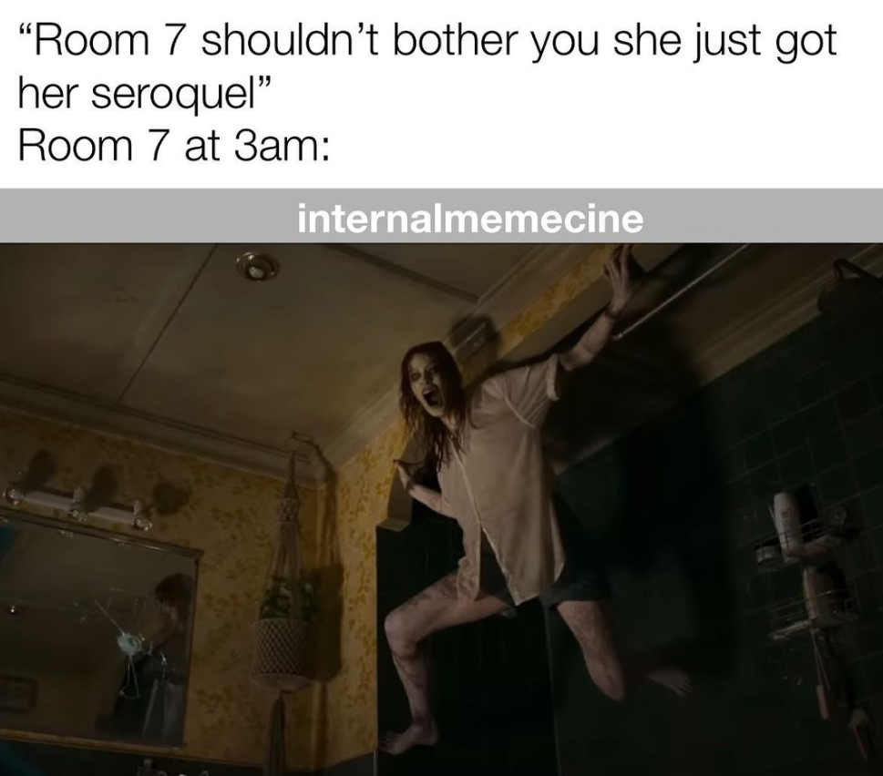
Case 5: Management of Delirium
Identify and treat underlying acute illness
Provide supportive and restorative care to prevent further physical and cognitive decline
Where appropriate, control dangerous and severely disruptive behaviors using low-dose, short acting pharmacologic agents
  Limited data to guide treatment
  Haloperidol o.5 to 1mg as needed (max dose 5mg per day)
  Newer atypical antipsychotics have fewer side effects and, in some studies, similar efficacy: Quetiapine, risperidone, ziprasidone, olanzapine
  Benzodiazepines should be avoided

Slide 28
Case 6

Slide 29
Case 6
76 yo F PMHx HTN, DMT2, CAD
Has new onset R facial droop, and RUE weakness

Slide 30
CODE STROKE- BUMCP
New Tele-Stroke Consult Service- BlueSky
IF you have a routine weekday consult that does not need to be seen emergently or urgently, the inhouse stroke team will gladly evaluate the patient in the morning. Please place a consult in Cerner and a note for the HUC to call consult out at 7am.
For all patients outside of the NeuroICU that need a stroke neurology evaluation:
  Please remain at bedside and activate the stroke alert process (see below)
For NeuroICU patients:
  The provider can consult BlueSky with the assistance of the NeuroICU RN. If this is an acute clinical change, activate the stroke alert process.
For existing stroke neurology patients:
  If the patient has a neurologic or clinical change, stroke alert process should be followed.
What does the BlueSky stroke alert process look like for an inpatient?
  Stroke Alert is activated by a provider. If the provider is not at bedside, a rapid response is called for emergent evaluation of the patient. NeuroICU RN will respond (and if able, so will SWAT RN) to start the stroke alert process and initiate the BlueSky consult. The primary provider for the patient will also need to respond emergently for evaluation, order placement and to communicate provider to provider with BlueSky.
  A neurology resident/NP WILL NOT respond to the stroke alert at this time. (NOTE: staffing shortages have improved and neuro resident may be present at nights now)
ORDERS WILL NEED TO BE PLACED BY PHYSICIAN/PROVIDER at bedside including imaging orders. For ease, these are the orders to use during a stroke alert:
  CT Brain W/O for Stroke Alert
  CT Ang Head/Neck W+orW/O+Rcn+Prf Stk Alt
  If labs need to be sent, please use the emergent lab order in the stroke binder (it is a downtime rec in paper).
  Once imaging is complete and the patient is back to their room, BlueSky will evaluate the patient via video with assistance from the NeuroICU RN and formal recommendations for treatment will be provided. The recommendations will be documented in the patient’s chart and verbal discussed with the provider at bedside.
If the recommendation is for the patient to be given IV tPA, the PROVIDER AT THE BEDSIDE MUST PLACE THE ORDER. There is an inpatient and an emergency department tPA administration order set to use with all appropriate interventions checked. The nurse CAN NOT take a verbal order from Blue Sky.
  Inpatient Stroke Acute Alteplase (tPA) Treatment
  ED Stroke Acute Alteplase (tPA) Treatment
  If tPA is administered, please place a transfer to ICU order in Cerner, review the MAR and discontinue all antiplatelets and chemical DVT prophylaxis.
A consult will also need to be placed in Cerner for stroke neurology to follow up with the patient in the morning.
If the recommend is for IR to evaluate a large vessel occlusion –the on-call pager number for IR is 602-252-0096 (it is in the stroke binder). BlueSky will call the IR team to discuss the case and plan for endovascular intervention.

Slide 31
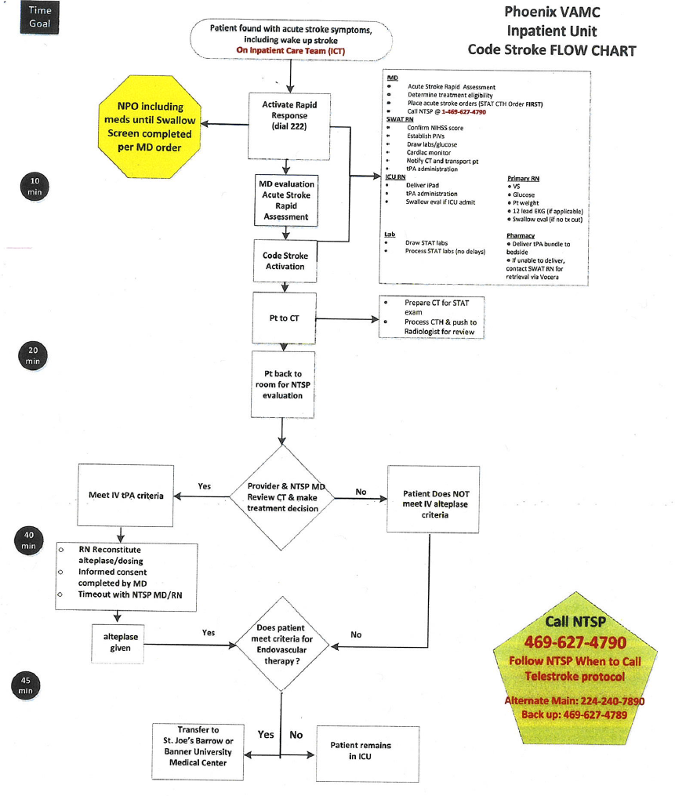
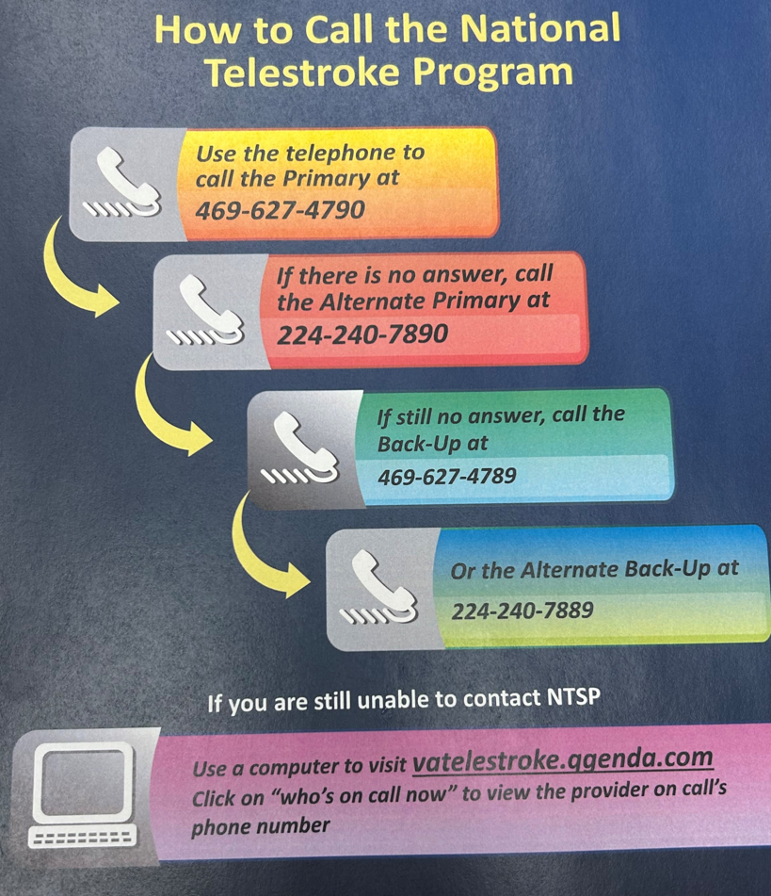
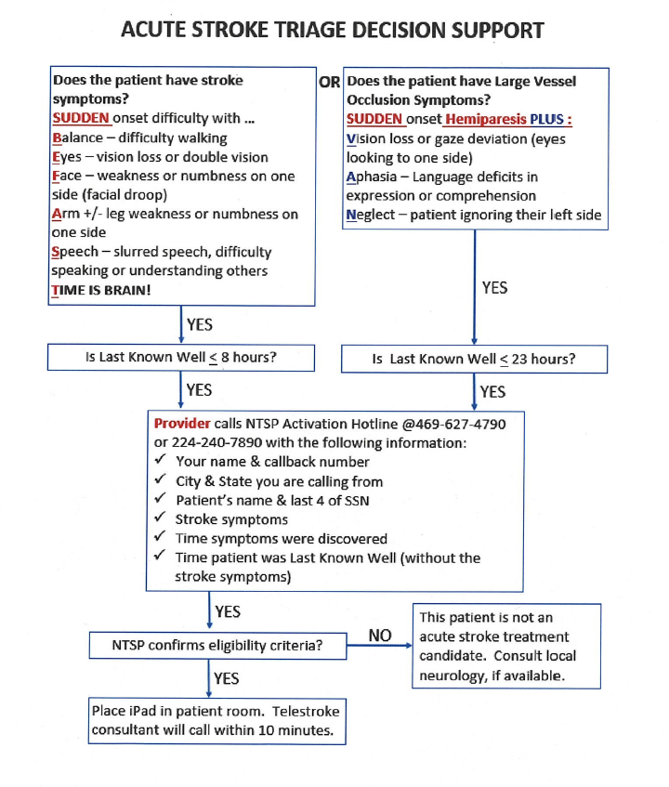
CODE STROKE- VA
NOTE:
If Code stroke called:
-go evaluate patient, call NTSP (469-627-4790)
-the ICU charge nurse will bring the ipad (if they do not, it is located in the ICU, entrance code 8527*)
-send one intern to have COW to place orders (ie STATE CTH)
-do NOT leave pt’s room while workup being performed, usually teleneuro will have you do neuro exam/NIH score with them
-if tpa indicated, will need to alert MICU for upgrade

Slide 32
References
UpToDate
  Diagnosis of delirium and confusional states
  Delirium and acute confusional states: Prevention, treatment, and prognosis
  Acute toxic-metabolic encephalopathy in adults
  Hepatic encephalopathy in adults: Clinical manifestations and diagnosis
  Hepatic encephalopathy in adults: Treatment
  Wernicke encephalopathy

