Slide 1
Proteinuria
Elise J. Barney, DO
Nephrologist
Associate Clinical Professor, Nephrology
University of Arizona College of Medicine-Phoenix
BUMC Internal Medicine Academic Half-Day
October 14, 2025

Slide 2
Learning Objectives
Describe the types of protein and amounts of protein that are found in urine normally and in pathologic states.
Understand how to identify protein in the urine via dip analysis, albumin/creatinine ratio, protein/creatinine ratio, and urine protein electrophoresis and immunofixation.
Categorize the different types of proteinuria by location and pathology.
Understand how the reduction of proteinuria can help to protect the kidneys from GFR decline.

Slide 3
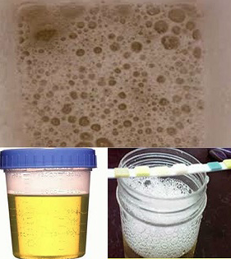
Urine Collection
1st urine of the morning, mid-stream
Cleanse with water (disinfectants can favor cell lysis)
Should be concentrated and acidic
Avoid strenuous exercise 24 hours prior
Avoid during menses

Slide 4
Question
Which of the following are “normal” urinary proteins? (more than one correct answer)
Albumin
Tamm-Horsfall
Bence-Jones
Low molecular-weight proteins

Slide 5
Answer
Which of the following are “normal” urinary proteins? (more than one correct answer)
Albumin
Tamm-Horsfall
Bence-Jones
Low molecular-weight proteins

Slide 6
NORMAL URINARY PROTEINS

Slide 7
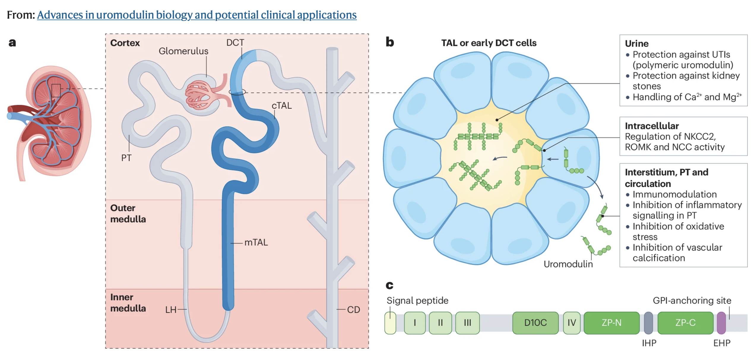
Tamm-Horsfall Protein (Uromodulin)
Notes:
Uromodulin has important roles in urinary and systemic homeostasis – expressed in TAL mostly, also DCT and intestinal tract.
The discovery that uromodulin is associated with a spectrum of kidney diseases, including acute kidney injury, chronic kidney disease and autosomal-dominant tubulointerstitial kidney disease, has accelerated investigations into the role of this protein.
From: Nanamatsu, A., de Araújo, L., LaFavers, K.A. et al. Advances in uromodulin biology and potential clinical applications. Nat Rev Nephrol 20, 806–821 (2024).
https://doi.org/10.1038/s41581-024-00881-7

Slide 8



Factors Affecting Urinary Albumin Excretion
Increased by physiological variables:
Upright posture
Exercise
Fever
Pregnancy

Slide 9
Urinary Protein: How much is “normal”?
Normal mean value for urine albumin excretion in adults ~ 10 mg/day.
Normal mean value for urine total protein ~ 50 mg/day.
Notes:
KDOQI Guidelines

Slide 10
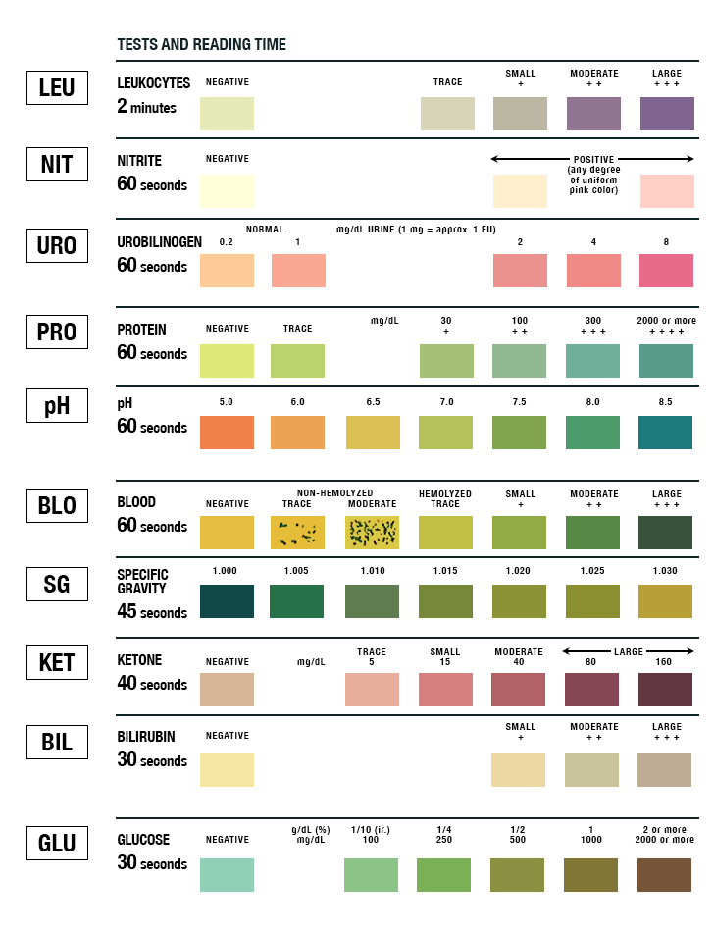

Urine Dipstick
Detects Albuminuria
Threshold = 150 mg/g of albumin/creatinine
Pitfalls:
  Dilute urine → false (-)
  Non-albumin protein → false (-)
  Dehydration, exercise, hematuria, and alkaline urine (pH>8) → false (+)
Notes:
Detects albuminuria, reports proteinuria
For spot urine, need 2 or more samples 1-2 weeks apart to confirm dx “ persistent proteinuria”.
Test strip reagant is bromophenol blue, which is highly specific for albumin

Slide 11
Correlating Dipstick, ACR and PCR
Dipstick Trace or Negative
Proteinuria < 500mg/24 hours
Check urine microalbumin, sensitive at low levels
Dipstick 1+
Proteinuria >500mg/24 hours or >500mg/g
Dipstick 2+ or greater
Proteinuria > 1 gram, probably > 1500 mg/day or > 1500 mg/g
Albuminuria > 600mg/24 hours or > 600mg/g
Albuminuria < 300mg/24 hours
Albuminuria >300mg/24 hours or >300mg/g

Slide 12
Proteinuria Quantification Methods
Spot urine protein/Cr ratio
24-hour urine collection
Easy
Accurate estimate
Early-morning specimen best correlates with 24-hr urine
Lower creatinine in women/elderly/malnourished → overestimates ratio
Higher creatinine in those with high muscle mass → underestimates ratio
Cumbersome
Historically “Gold standard”
Collection errors common
Variation during day
Variation with activity
Variation with hydration
Timed overnight urine is alternative
Clinical Pearl: *Always get a urine creatinine to verify accurate collection
Notes:
Nocturnal collection possible alternative for variations due to recumbency.

Slide 13
Question
Which of the following results identifies pathological proteinuria?
A. Urine protein/creatinine ratio 100 mg/g
B. 24-hour urine protein 145 mg
C. Urine microalbumin/creatinine ratio 20 mg/g
D. 24-hour urine protein 300 mg

Slide 14
Answer
Which of the following results identifies pathological proteinuria?
Urine protein/creatinine ratio 100 mg/g
24-hour urine protein 145 mg
Urine microalbumin/creatinine ratio 20 mg/g
24-hour urine protein 300 mg

Slide 15
NKF KDOQI / KDIGO Definitions
“Microalbuminuria”/ Moderately Increased Albuminuria
UACR
30 – 300 mg/g
Proteinuria (sub-nephrotic) / Severely Increased Albuminuria
UACR > 300 mg/g
24-hr urine albumin > 300 mg
UPC > 150-200 mg
24-hr urine protein > 300 mg
Nephrotic Proteinuria
UPC > 3 grams
24-hr urine protein > 3.5 grams
Notes:
Per KDOQI - Macroalbuminuria defined as UACR > 250 (men) and > 355 (women) mg/g

Slide 16
Categories of proteinuria
Transient
Exercise, fever, extreme cold
Orthostatic
Tubulointerstitial
Overflow
Glomerular

Slide 17
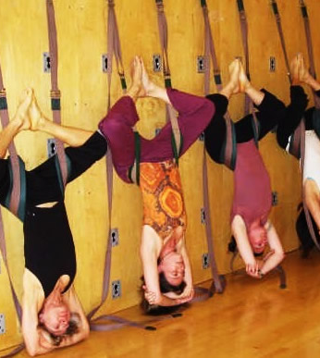
Orthostatic Proteinuria
Patients < 30 years old
Benign condition, 3-5 % of young adults
Increased urinary protein excretion in upright position only
Normal renal function, normal BP, no risk factors for CKD
Bland urinalysis
Urine protein < 1-2 grams / 24 hours
Dx: split 24-hr urine
  Day 16-hr urine collection
  8-hour nocturnal collection < 50 mg
  Alternately check 1st AM urine protein/creatinine ratio

Slide 18
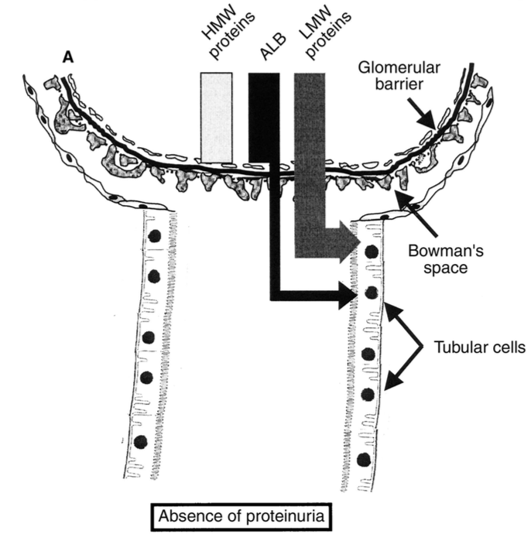
Tubulointerstitial
Pathogenesis:
  Tubulointerstitial diseases lead to decreased proximal tubule reabsorption of low-molecular-weight proteins (part of normal glomerular ultrafiltrate)
Chronic interstitial nephritis
Fanconi syndrome

Slide 19
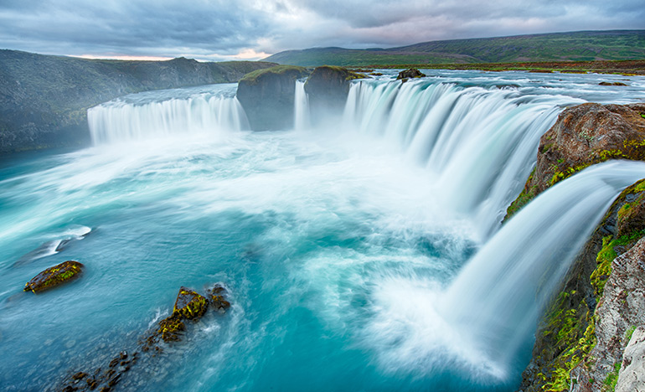
Overflow
Low-molecular-weight proteins overwhelm the ability of the proximal tubules to reabsorb filtered proteins
Myoglobinuria
Myeloma, Amyloid
Hemoglobinuria
Lymphoma

Slide 20
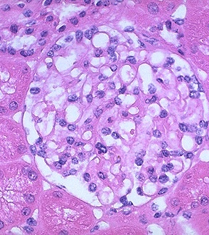
Glomerular
Suspect if active urinary sediment
Suspect if > 300 mg proteinuria
Serological workup
Renal biopsy for diagnosis
Pathophysiology:
  Increased glomerular capillary permeability to protein
  Impaired protein reabsorption by epithelial cells of proximal tubules
Notes:
Most common and important cause

Slide 21
IM Board Question
A 28-year-old woman is evaluated during a follow-up visit. A recent life insurance examination revealed proteinuria on dipstick urinalysis. She is otherwise healthy and has no pertinent personal or family medical history.
On physical examination, temperature is 36.1C, blood pressure is 110/64, pulse is 72 and respiration rate is 12. BMI is 23. The remainder of the exam is normal.
Laboratory studies:
Serum creatinine: 0.8 mg/dl
Estimated GFR: > 60 ml/min/1.73m²
Urinalysis: 1+ protein, 0-2 erythrocytes/hpf, 0 leukocytes/hpf
24-hr urine collection: 320 mg protein / 24 hours

Slide 22
IM Board Question
Which of the following is the most appropriate next step in management?
Kidney biopsy
Repeat 24-hour urine collection for protein
Split urine collection
Spot urine protein / creatinine ratio
Reassurance

Slide 23
Answer
Which of the following is the most appropriate next step in management?
Kidney biopsy
Repeat 24-hour urine collection for protein
Split urine collection
Spot urine protein / creatinine ratio
Reassurance

Slide 24
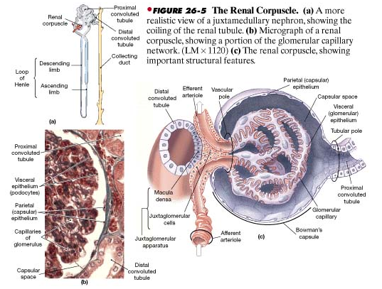
The Renal Corpuscle
http://intranet.tdmu.edu.ua

Slide 25
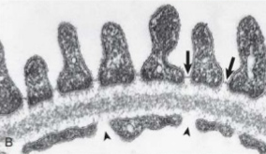
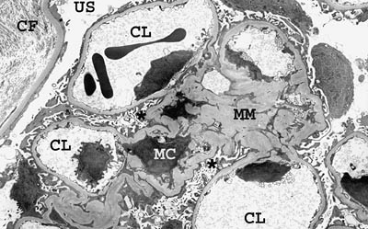
Glomerular Histology
Glomerular capillary wall
GBM
Made of Type IV collagen and laminin
3 layers on EM
Podocyte = VEC
Cytoplasmic foot processes wrap around GBM
Gap b/t podocytes form slit pores
Endothelial cell
Initial barrier b/t capillary lumen & Bowman space
VEGF receptors
Synthesizes NO & Endothelin-1
Mesangium = matrix + mesangial cells
~1-3 cells per capillary
Support, phagocyte properties
Contractile, role in GFR regulation
Notes:
Glomerular capillary wall filter restricts molecules size of albumin or larger and is negatively charged.
BM = type 4 collagen, normally alpha 1 and 2, but GBM has alpha 3,4 and 5 as well.

Slide 26
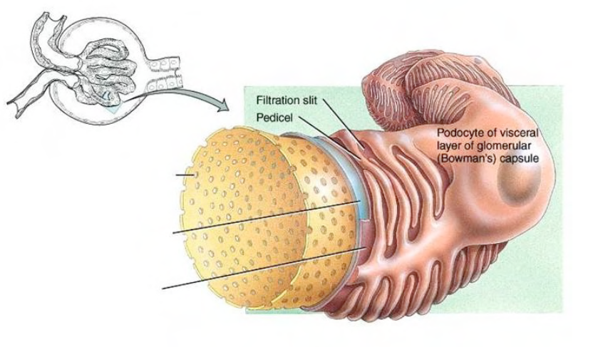
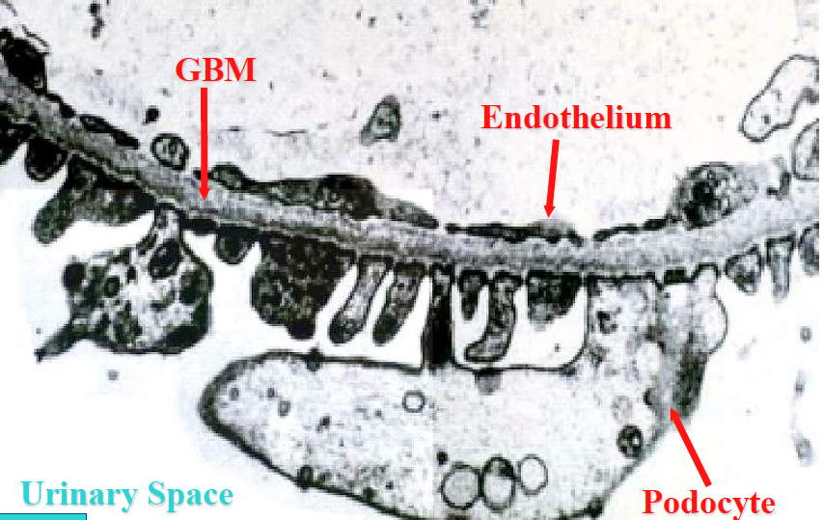
Key Structure in Prevention of Proteinuria: Podocyte
Notes:
The Podocyte: a key cell in the selective filtering action of the glomerular capillary wall

Slide 27
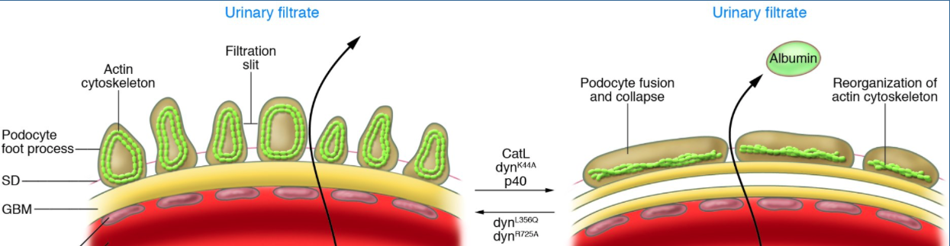
Proteinuria Mechanisms
Podocyte: The space between foot processes is bridged by a porous intercellular junction known as the slit diaphragm. It restricts proteins by size, provides negative charge repulsion and supports the GBM barrier.
Glomerular endothelial cell: glycocalyx albumin barrier; also requires VEGF to function
Normally the GBM restricts passage into Bowman’s space by:
  Molecular size
  Electrical (-) charge
  Sterical configuration
Notes:
In particular, podocyte function is dependent on the cells' actin cytoskeleton: this maintains their complex structure. The cardinal feature of the glomerular capillary wall in proteinuric states is flattening or effacement of the foot processes due to disruption of this precise organization.
Sharma S, Smyth B: From Proteinuria to Fibrosis: An Update on Pathophysiology and Treatment Options. Kidney Blood Press Res 2021;46:411-420. doi: 10.1159/000516911

Slide 28
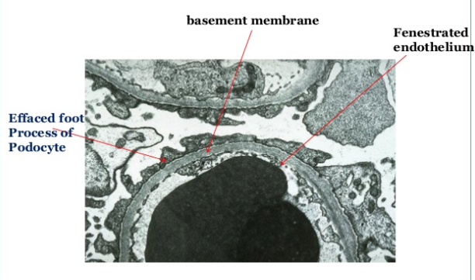
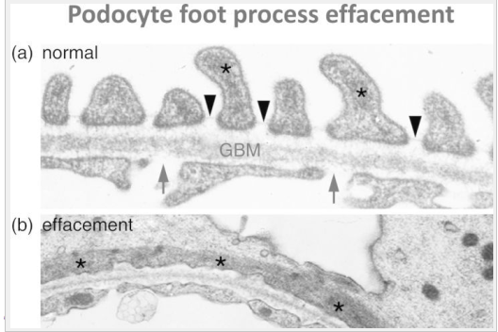
Podocytopathy: Podocyte effacement

Slide 29
Question
Which of the following is a characteristic finding of nephrotic syndrome?
Proteinuria 2500 mg/g
Waxy casts on urine microscopy
Bleeding
Macrohematuria
Urine microscopy with maltese cross formation on polarized light

Slide 30
Answer
Which of the following is a characteristic finding of nephrotic syndrome?
Proteinuria 2500 mg
Waxy casts on urine microscopy
Bleeding
Macrohematuria
Urine microscopy with maltese cross formation on polarized light
Notes:
(oval fat bodies)

Slide 31
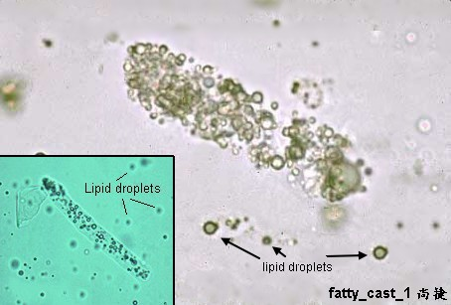
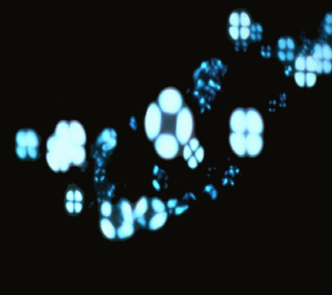
Nephrotic Syndrome
Nephrotic-range proteinuria
  > 3.5 gm / 24-hour urine
  > 3-3.5 gm on UPC
Lipiduria
  Fatty casts, oval fat bodies
Hypoalbuminemia
Edema
Hyperlipidemia
  Elevated TC, TG, & ApoB-containing lipoproteins
Notes:
Oval fat bodies = tubular epithelial cells that have engorged themselves with lipoproteins, cholesterol, TG and proteins leaked from nephrotic glomeruli.
Maltese cross = oval fat bodies under polarized light.

Slide 32
IM Board Practice Question
A 37-year-old woman is evaluated for a headache lasting 1 day. She is in the third trimester of her first pregnancy. Until now, the pregnancy has been unremarkable, including blood pressure and urine protein measurements. Her only medication is a prenatal vitamin.
On physical exam, blood pressure is 166/115 mm hg; other vital signs are normal. There is no papilledema, the patient has a gravid uterus consistent with her stage of pregnancy, and there is no abdominal tenderness.
Lab Test | Result
Hemoglobin | 12.3 g/dL
Platelet count | 70,000 / uL
Alanine aminotransferase | 72 U/L
Aspartate aminotransferase | 80 U/L
Bilirubin | Normal
Creatinine | 1.4 mg/dL
Electrolytes | Normal
Peripheral blood smear | Normal
Urinalysis | 2+ protein

Slide 33
IM Board Practice Question
Which of the following is the most likely diagnosis?
Chronic hypertension
Eclampsia
Gestational hypertension
HELLP syndrome
Preeclampsia

Slide 34
Answer
Which of the following is the most likely diagnosis?
Chronic hypertension
Eclampsia
Gestational hypertension
HELLP syndrome
Preeclampsia

Slide 35
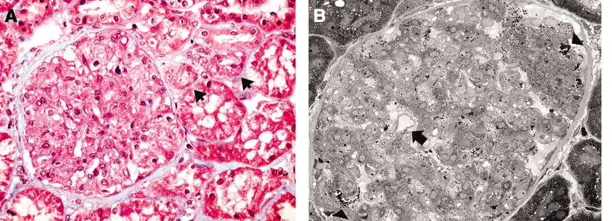
Preeclampsia
New onset hypertension and proteinuria > 20 weeks gestation
Renal path: glomerular endotheliosis (swelling of endocapillary cells & capillary occlusion) and thrombotic microangiopathy (TMA)
LM: Occlusion of capillary lumens by swelling of endocapillary cells
EM: Severe capillary occlusion with only 1 open capillary loop
Notes:
Glomerular endotheliosis: (A) Glomerulus showing occlusion of capillary lumens by swelling of endocapillary cells. There is no appreciable increase in cellularity. Note nearby arterioles (arrows), which are unremarkable. No glomerular or arteriolar thrombosis is seen. (B) Arrow points to the only open capillary loop in this glomerular tuft with otherwise severe capillary occlusion.

Slide 36
Proteinuria Workup
Consider system diseases vs isolated glomerular diseases
Glomerular diseases are typically diagnosed on renal biopsy, not by serologies
Serological workup provides working/likely diagnosis: ANA, ANCA, anti-GBM Ab, anti-PLA2 Ab, HgA1c, Hepatitis B/C serologies, HIV, RPR, SPEP/UPEP

Slide 37
Proteinuria Management
SCREENING
TREATMENT
Urine albumin/creatinine is the screening test of choice
Recommended annually in all patients with diabetes mellitus
Not cost-effective in the general population
Consider in high-risk patients (HTN, smoking, obesity, older age)
Treat the underlying pathology
Salt restriction
Diuretics
  Loops are first line
  Aldactone-receptor antagonists (finerenone)
  Thiazides
RAAS inhibitors
SGLT2 Inhibitors in DM
Statins
Notes:
Mann JF, Green D, Jamerson K, Ruilope LM, Kuranoff SJ, Littke T, et al. Avosentan for overt diabetic nephropathy. J Am Soc Nephrol. 2011;21:527–35.

Slide 38
Proteinuria and Prognosis
Degree of proteinuria is associated with progressive loss of kidney function, in virtually all kidney diseases
Correlates strongly with cardiovascular morbidity and mortality, stroke, and diabetic vascular complications

Slide 39
IM Board Practice Question
A 45-year-old man is evaluated during a follow up visit for membranous glomerulopathy diagnosed 3 weeks ago. He reports persistent lower extremity edema and no weight loss despite adhering to a low salt diet and taking maximal-dose furosemide. He does not have shortness of breath or abdominal discomfort. Other medications are enalapril and simvastatin.
On physical exam, vital signs are normal. The patient weighs 80 kg with a baseline weight of 75 kg. There is no rash. Cardiac examination is normal, and there is no evidence of JVD. The lungs are clear. There is pitting edema in the legs bilaterally to just below the patellae.
Doppler ultrasound of the lower extremities performed 3 weeks ago showed no evidence of DVT.
Lab Test | Result
Albumin | 2.9 g/dL
Blood urea nitrogen | 20
Creatinine | 1.0 mg/dL
Electrolytes | Normal
Urinalysis | No blood; 4+ protein
Urine protein-creatinine ratio | 6100 mg/g

Slide 40
IM Board Practice Question
Which of the following is the most appropriate management?
Add metolazone
Change furosemide to bumetanide
Admit for intravenous diuresis
Repeat lower extremity Doppler ultrasonography

Slide 41
Answer
Which of the following is the most appropriate management?
Add metolazone
Change furosemide to bumetanide
Admit for intravenous diuresis
Repeat lower extremity Doppler ultrasonography

Slide 42
Explanation
Edema management in a patient with newly diagnosed nephrotic syndrome starts with a salt-restricted diet and an oral loop diuretic; when loop diuretics have been maximally uptitrated and weight loss/edema control is insufficient, it is often necessary to add a second diuretic that works distal to the loop of Henle, ie thiazide or potassium-sparing diuretic.

Slide 43
References
Valuation of Laboratory Measurements for Clinical Assessment of Kidney Disease. NKF KDOQI GUIDELINES: Part 5.
Damico g and bazzi c. Pathophysiology of proteinuria. Kidney International, Vol. 63 (2003), pp. 809–825.
P. Mundel and J. Reiser. Proteinuria: an enzymatic disease of the podocyte. Kidney International, vol. 77, no. 7, pp. 571–580, 2010.
Agrawal S, Zaritsky JJ, Fornoni A, Smoyer WE. Dyslipidaemia in nephrotic syndrome: mechanisms and treatment [published correction appears in Nat Rev Nephrol. 2017 Dec 13;14 (1):70]. Nat Rev Nephrol. 2018;14(1):57-70. doi:10.1038/nrneph.2017.155
A. K. Bello, B. Hemmelgarn, A. Lloyd et al., Associations among estimated glomerular filtration rate, proteinuria, and adverse cardiovascular outcomes. Clinical Journal of the 5. American Society of Nephrology, vol. 6, no. 6, pp. 1418–1426, 2011.
Urinary Albumin Excretion Predicts Cardiovascular and Non-cardiovascular Mortality in General Population. Circulation 106(14):1777-1782; 2002
Schwab S et al. Quantitation of Proteinuria by the Use of Protein-to-Creatinine Ratios in Single Urine Samples. Archives Intern Med 1987; 147(5):943-944.
Stillman I and Karumanchi SA. The Glomerular Injury of Preeclampsia. JASN August 2007 vol. 18 no. 8: 2281-2284.

Slide 44
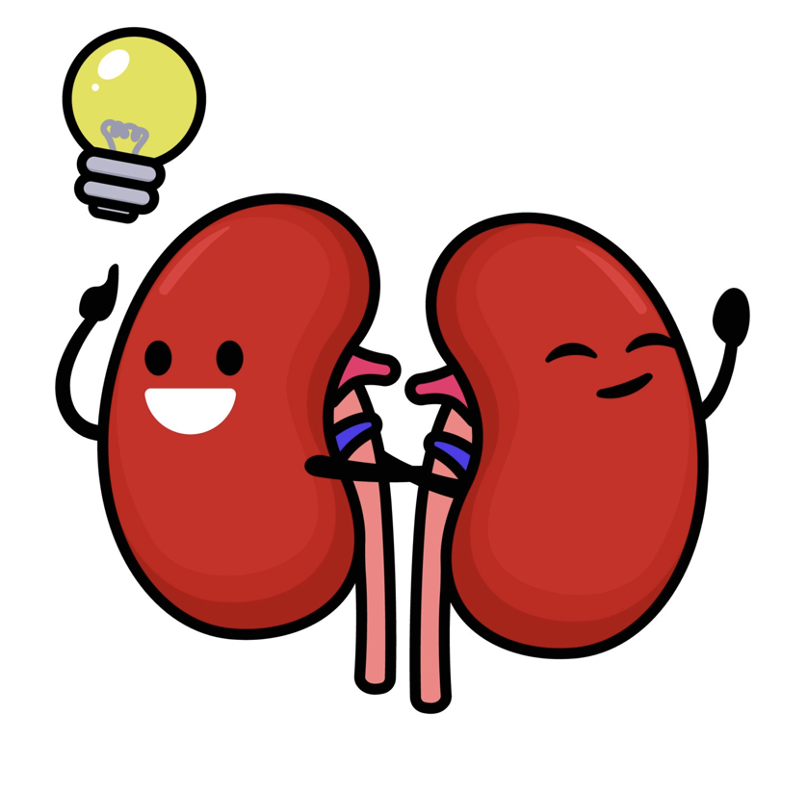
Thank you!
Please do not hesitate to contact me with questions/comments: ejbarney@arizona.edu

