Slide 1
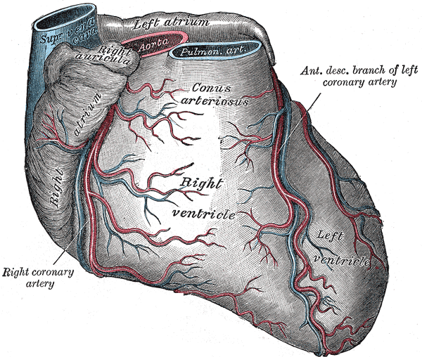
Pulmonary Arterial Hypertension a Disease State Overview
Nafis Shamsid-Deen, MD, FCCP
Associate Clinical Professor | University of Arizona College of Medicine – Phoenix
Assistant Dean | Admissions and Recruitment
Associate Director | Banner Lung Institute Pulmonary Hypertension Program
Associate Program Director | Pulmonary and Critical Care Fellowship
Notes:
Self bio and connection to AZ
Acknowledgement of AZ
- One fo the fastest growing cities
Hub for tech startups biomedical research and sustainability
Rich cultural diversity with strong influences of Latinx, Native and African American roots (food and music)

Slide 2
Conflicts of Interest
Merck Pharmaceuticals – Educational Speaker, Primary Investigator, and Consultant
Johnson and Johnson Pharmaceuticals – Consultant
United Therapeutics Pharmaceuticals – Educational Speaker, Primary Investigator and Consultant
Insmed – Primary Investigator

Slide 3
Objectives
Differentiate pulmonary hypertension phenotypes by integrating clinical presentation, echocardiographic findings, and invasive hemodynamics
Deconstruct the pathobiological mechanisms of PAH, including endothelial signaling dysregulation and vascular remodeling, and relate these to clinical progression
Interpret right heart catheterization waveforms and derived parameters (PVR, CI, PAWP) to accurately phenotype disease and avoid misclassification
Critically appraise diagnostic strategies for suspected pulmonary hypertension
Evaluate patient risk using multiparameter models (e.g., functional status, biomarkers, hemodynamics) to guide initial and longitudinal management decisions
Assess appropriateness of therapeutic pathways based on disease phenotype, vasoreactivity status, and risk profile

Slide 4

CLINICAL PROFILE
Robert
Setting: Initial Office consultation
Symptoms: Progressive dyspnea, lower extremity edema, presyncope, and heart palpitations for 12 months
Past Medical History: Methamphetamine use disorder
Social History: Active Methamphetamine use x 15 years
Physical Exam: 2+ JVD, 3+ holosystolic murmur, 2+ lower extremity edema,
Vitals: BP 110/60 mmHg, HR 92 bpm, SpO2 92% on RA
WHO Functional Class: III
6MWD: 290 meters
Age: 41-year-old man
Race: Caucasian
Height: 5’9”
Weight: 135 lbs
Robert is referred after multiple ED visits for worsening exertional dyspnea, near-syncope, and edema. He notes rapidly declining exercise tolerance over the past several months and increasing anxiety about “almost passing out.”

Slide 5
Group Discussion
What is your differential diagnosis for this patient?
What is the next step in management?

Slide 6
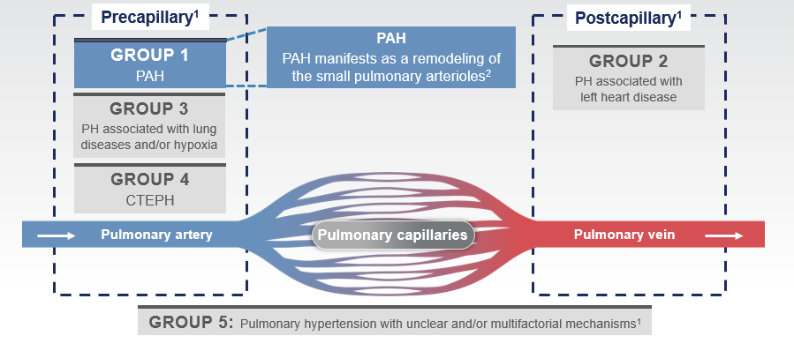
PH is Categorized based on Underlying Cause
Source: Humbert M. et al. Eur Heart J. 2022;43(38): 3618-3731

Slide 7
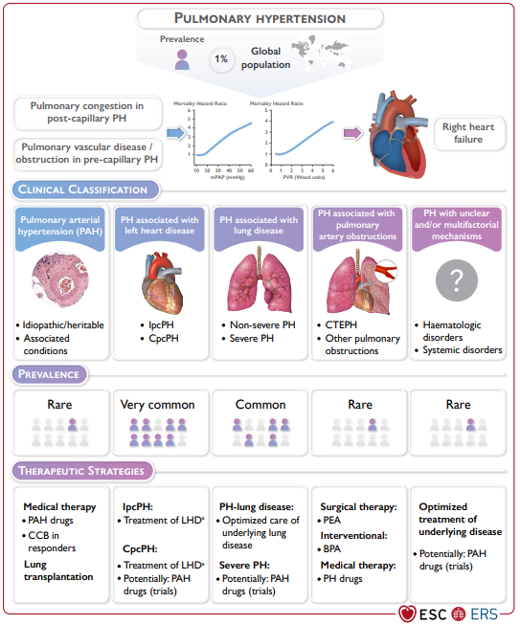
‘Evian’ Group Classification and Epidemiologic Distribution
Source: Humbert M. et al. Eur Heart J. 2022; 43(38): 3618-3731

Slide 8
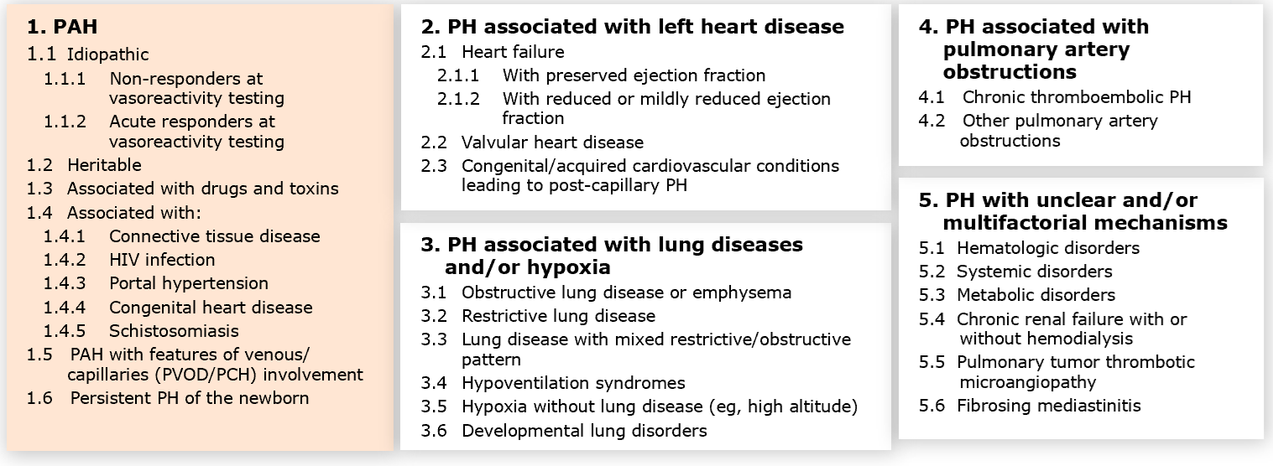
Clinical Classification
Source: Humbert M. et al. Eur Heart J. 2022; 43(38): 3618-3731

Slide 9
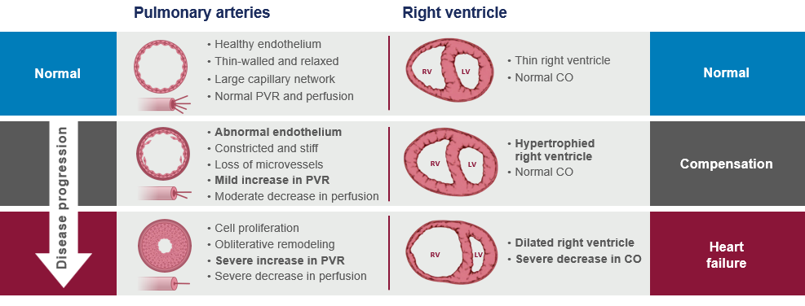
Increased Pulmonary Vascular Resistance Leads to Detrimental Right Heart Remodeling
Source: Champion HC. Et al. Circulation; 120(11): 992-1007

Slide 10
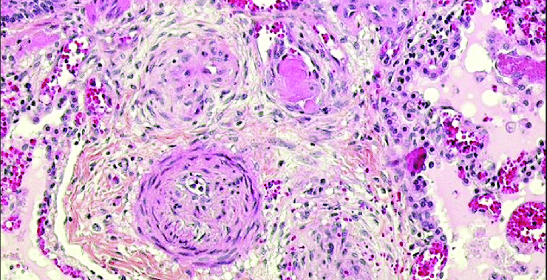

Slide 11
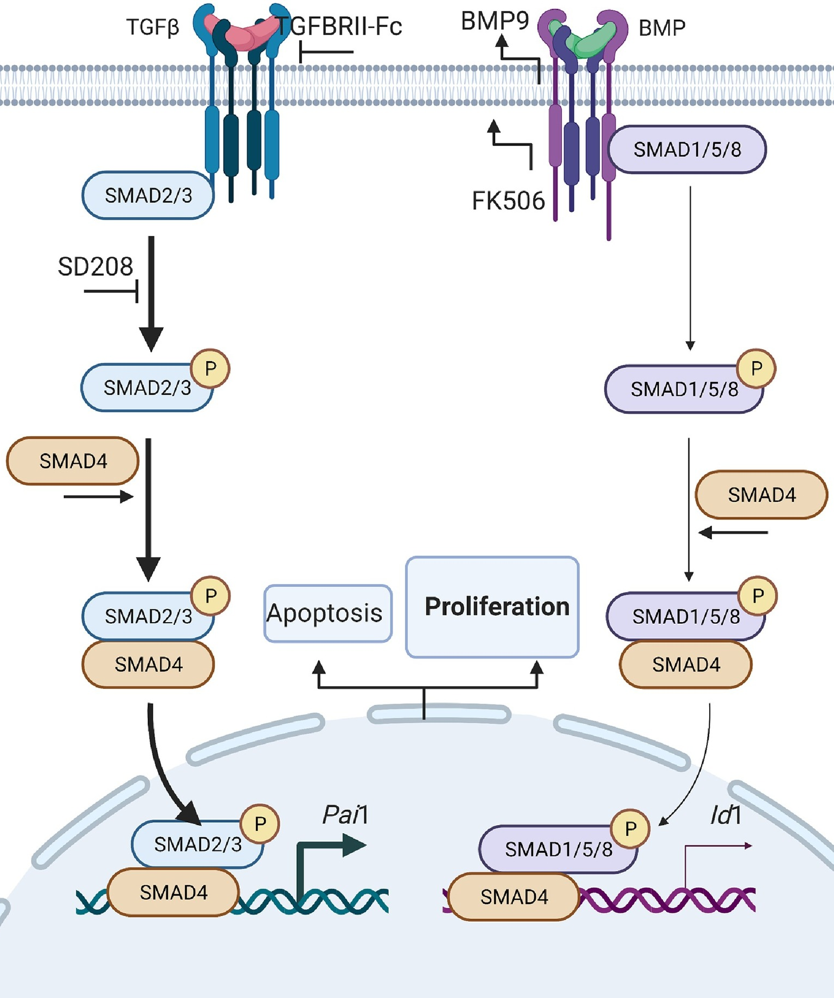
Remodeling is due to Disruption of Complicated Endothelial, PASMC, and other Vascular Signaling
Source: Sharmin, N et al (2021) Trends in Pharmacological Sciences

Slide 12
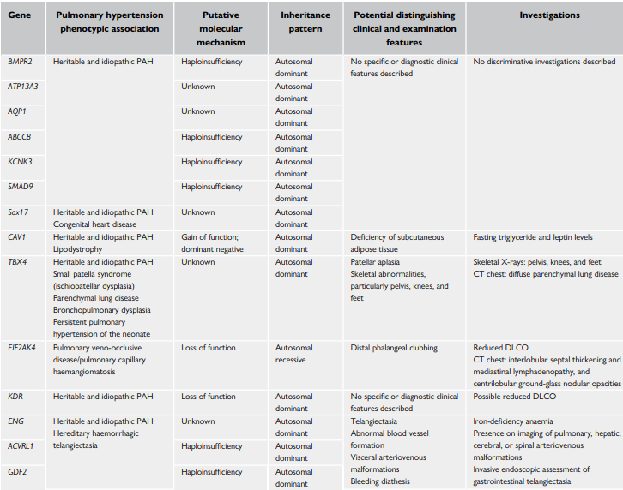
Identified Allele Mutations
Source: Humbert M. et al. Eur Heart J. 2022; 43(38): 3618-3731

Slide 13
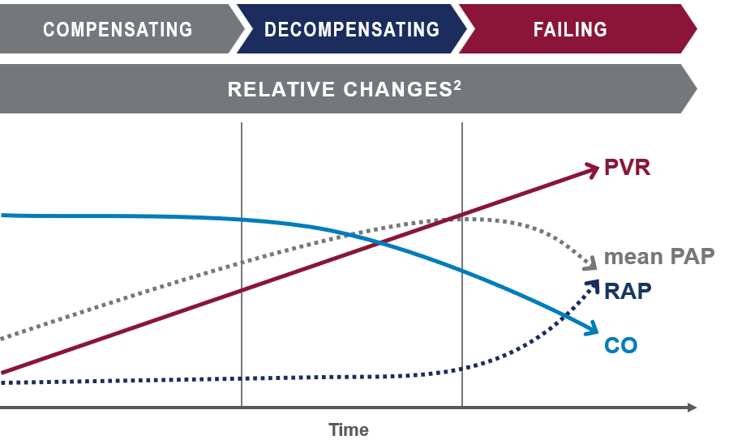
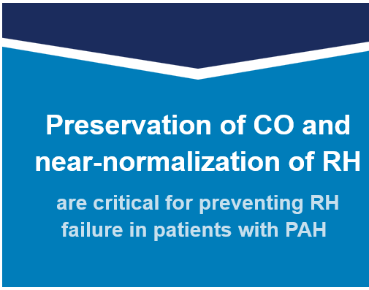
Clinical Disease Course
Source: Champion HC. Et al. Circulation; 120(11): 992-1007

Slide 14
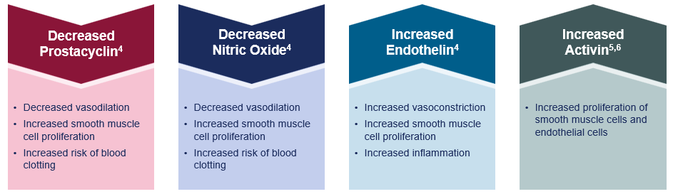
PAH is a Progressive Disease with Dysregulation across Multiple Pathways
Source: Humbert M. et al. Eur Heart J. 2022; 43(38): 3618-3731

Slide 15
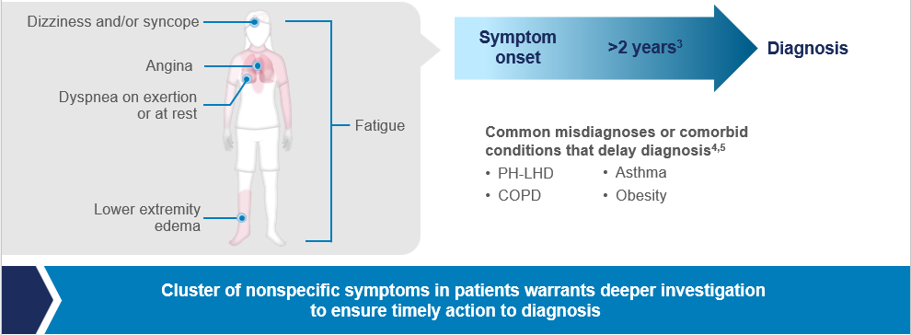
Patients Present with Non-specific Symptoms Requiring Vigilance for Timely Diagnosis
Source: McLaughlin V. et al. J Am Coll Cardiol. 2009; 59(17): 1573-1619

Slide 16
Case Vignette Part II – Initial Work-up
Given his symptoms and physical findings, his primary care physician refers him for a transthoracic echocardiogram to further evaluate his dyspnea.
Echocardiogram Results:
Left Ventricle | EF of 55-60%, Normal size and thickness, E/e’ 6
Right Ventricle | Moderately dilated, TAPSE 1.3, s’ 7 cm/s, RV LSI -12%
Left Atrium | Normal size
Right Atrium | Moderate Enlargement
Tricuspid Valve | Regurgitation Jet Peak Velocity: 3.5 m/s
IVC | Dilated with <50% inspiratory collapse, eRAP 15
Pericardium | No pericardial effusion

Slide 17
Group Discussion
What is your top differential diagnosis now?
What is the next step in management?

Slide 18
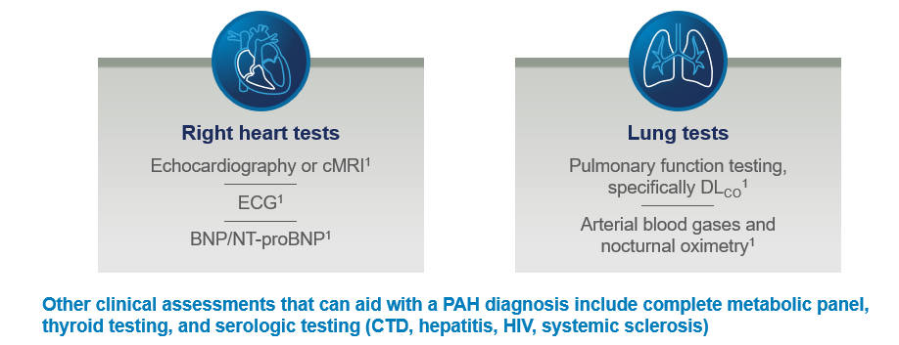
Further Investigation in PH
Source: Humbert M. et al. Eur Heart J. 2022; 43(38): 3618-3731

Slide 19
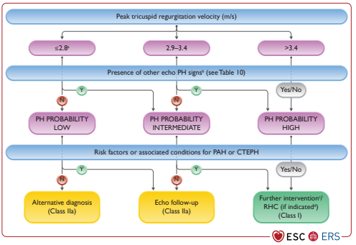
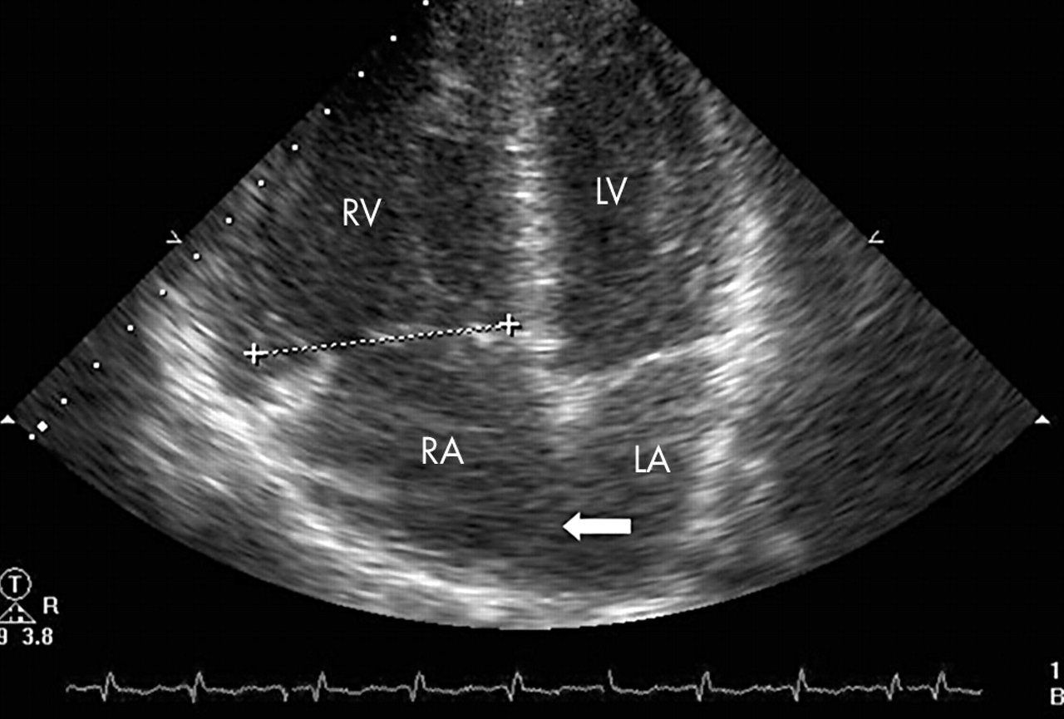
The Best Screening Test for Early Right Heart Changes is Transthoracic Echocardiography
Source: Humbert M. et al. Eur Heart J. 2022; 43(38): 3618-3731

Slide 20
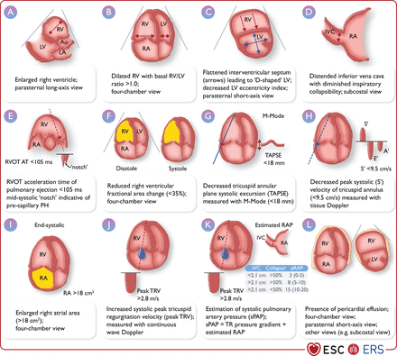
Other Echocardiographic Signs of Pulmonary Hypertension
Source: Humbert M. et al. Eur Heart J. 2022; 43(38): 3618-3731
Notes:
Notably: TAPSE, FAC, s’ (TV Annular velocity), TAPSE:PASP ratio

Slide 21
Case Vignette Part III – Right Heart Catheterization
Given his echocardiogram findings, he is referred to a pulmonary vascular clinic for further work-up. There it is decided that he will undergo a right heart catheterization to confirm the suspected diagnosis of PH. His hemodynamic profile is shown below.
Parameter​ | Value​
Right Atrial Pressure (RAP)​ | 10 mmHg​
Right Ventricular Pressure (RVP)​ | 70/10 mmHg​
Pulmonary Artery Pressure (PAP)​ | 65/25 mmHg (mean 42 mmHg)​
Pulmonary Capillary Wedge Pressure (PCWP)​ | 10 mmHg​
Cardiac Output (Thermodilution)​ | 3.5 L/min​
Cardiac Index​ | 1.9 L/min/m²​
Pulmonary Vascular Resistance (PVR)​ | 9.1 Wood units​
Mixed Venous Oxygen Saturation (SvO₂)​ | 60%​

Slide 22
Group Discussion
This hemodynamic profile is consistent with what type of pulmonary hypertension pattern and what does it mean for his differential diagnosis?
What are the next steps?

Slide 23
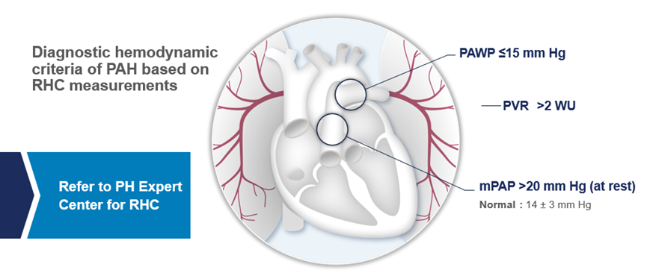
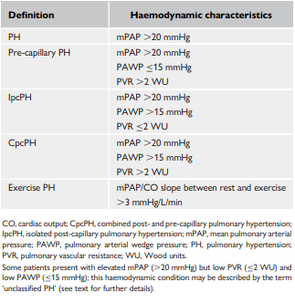
Right Heart Catheterization is Necessary for Definitive Diagnosis of PAH
Source: Humbert M. et al. Eur Heart J. 2022; 43(38): 3618-3731

Slide 24
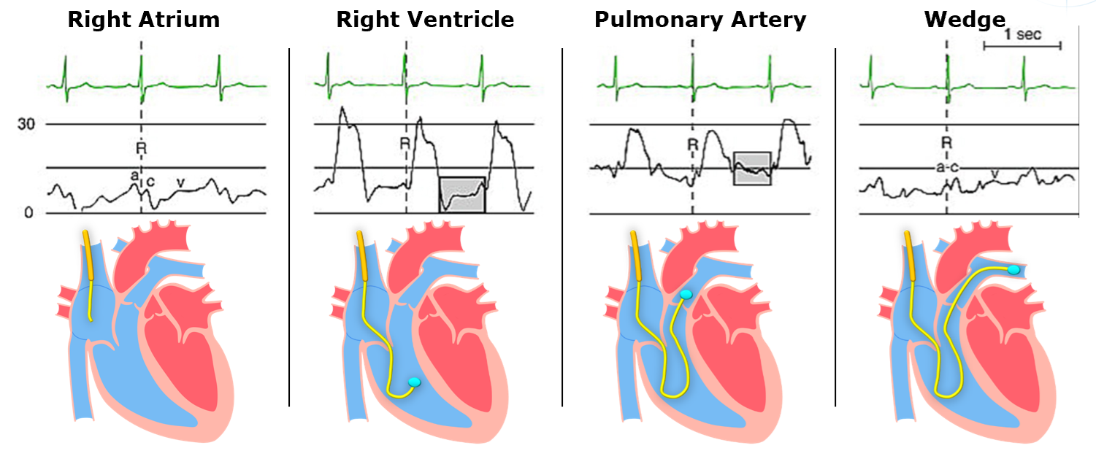
Waveform Analysis
Source: Lambert BC, et al: Encyclopedia of Cardiovascular Research and Medicine, 2018, 298-308
Notes:
All waveforms should be assessed at end-exhalation

Slide 25
Pulmonary Arterial Wedge Pressure
“All pressure measurements, including PAWP, should be performed at end expiration (without breath-holding manoeuvre). In patients with large intrathoracic pressure changes during the respiratory cycle (i.e. COPD, obesity, during exercise), it is appropriate to average over at least three to four respiratory cycles. If no reliable PAWP curve can be obtained, or if the PAWP values are implausible, additional measurement of LV end-diastolic pressure should be considered to avoid misclassification. Saturations taken with the catheter in the wedged position can confirm an accurate PAWP”
ERS 2022 PAH Guidelines

Slide 26
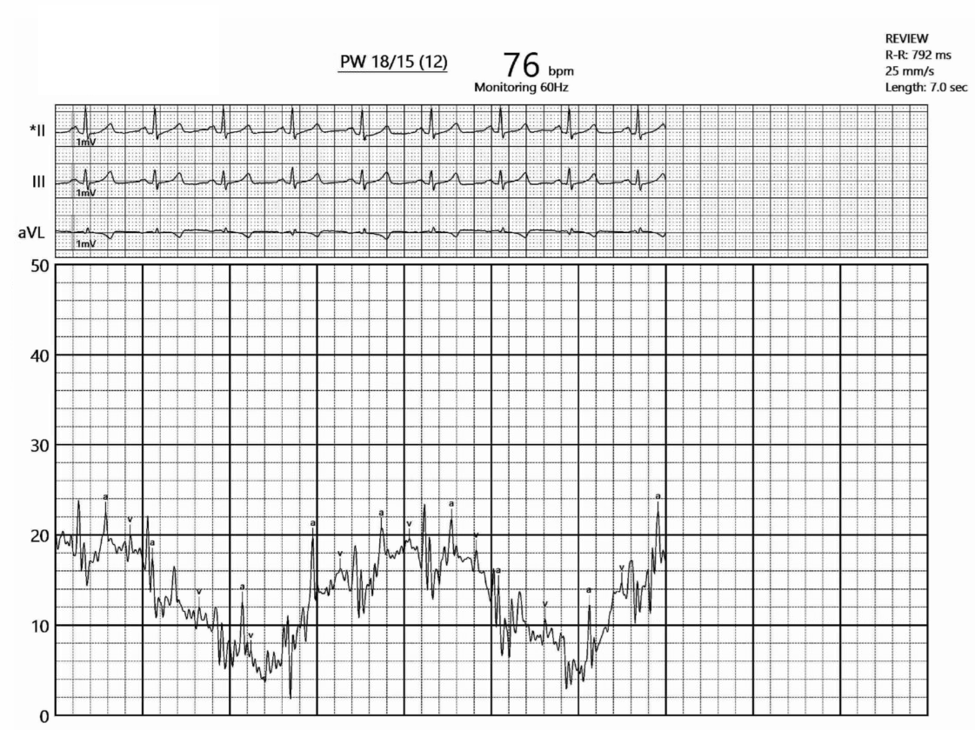
What is the Wedge???

Slide 27
Vasoreactivity Testing
Definition: | Target Audience | Protocol | Agents
mPAP reduction by ≥ 10 mmHg Absolute mPAP ≤ 40 mmHg Sustained or Improved CO | Idiopathic (iPAH) Toxin-Associated (dPAH) Heritable (HPAH) | Inhaled Nitric Oxide 10-20 ppm for 5-10 minutes (preferred) Inhaled Iloprost 5-10 ug for 10-15 minutes (recommended) IV Epoprostenol 2-12 ng/kg/min for 10 minutes (alternative) IV Adenosine (No longer recommended) | Amlodipine (target dose 15-30mg qd) Diltiazem (target dose 240-720mg ER qd) Nifedipine (target dose 120-240mg ER qd)
Source: Humbert M. et al. Eur Heart J. 2022; 43(38): 3618-3731

Slide 28
Case Vignette Part IV – Follow-up
Two weeks after undergoing right heart catheterization, the patient returns to the pulmonary hypertension clinic to review his results.
He appears well and reports no significant change in his symptoms. He continues to experience exertional dyspnea with daily activities, such as walking from the parking lot to her office.
Based on his hemodynamics, imaging data, and symptom burden, a formal diagnosis of pulmonary arterial hypertension (Group 1) is made.

Slide 29
Group Discussion
How would you determine this patient’s risk for disease progression?
What should be our initial treatment strategy?

Slide 30
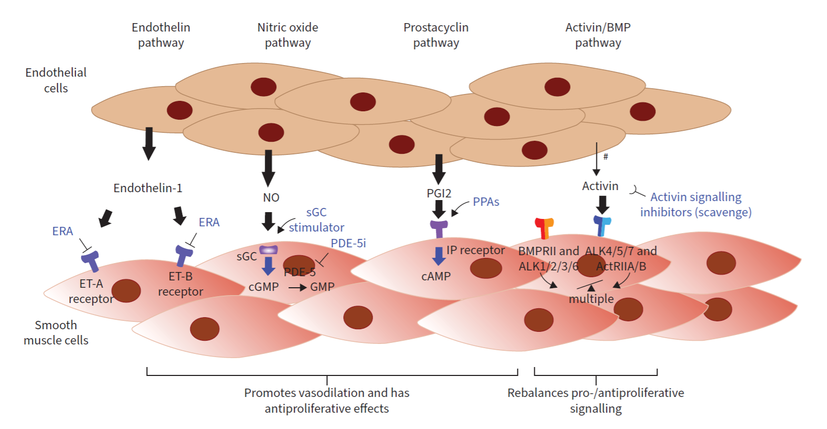
Therapeutic Targets
Source: K.M. Chin et al 7th WSPH ERJ 2024
Notes:
ERA – Bosentan, Ambrisentan, Macitentan
PDE-5i – Sildenafil and Tadalafil
GCs – Riociguat
Prostacyclin – Epoprostinol, Iloprost, Treprostinil, Selexipag

Slide 31
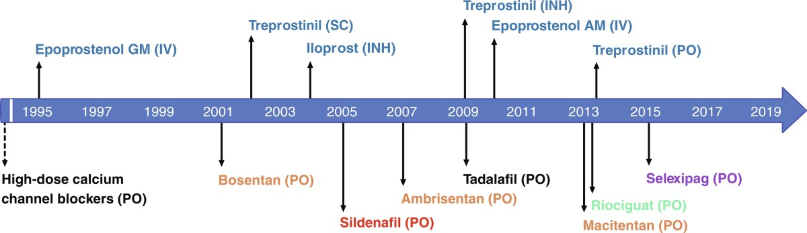
PAH Drug Timeline
2024
Sotatercept (subq)

Slide 32
PAH Drugs and Common Adverse Effects
Drug Class​ | Common Medications​ | Common Side Effects​
Phosphodiesterase-5 Inhibitors (PDE-5i)​ | - Sildenafil (Revatio)- Tadalafil (Adcirca)​ | - Headache- Flushing- Nasal congestion- Dyspepsia- Visual disturbances- Hypotension​
Endothelin Receptor Antagonists (ERA)​ | - Ambrisentan (Letairis)- Bosentan (Tracleer)- Macitentan (Opsumit)​ | - Hepatotoxicity (esp. bosentan)- Anemia- Peripheral edema- Nasal congestion- Headache​
Prostacyclin Analogues / IP Receptor Agonists​ | - Epoprostenol (Flolan, Veletri) (IV)- Treprostinil (Remodulin, Tyvaso, Orenitram) (SC, IV, inhaled, oral)- Iloprost (Ventavis) (inhaled)- Selexipag (Uptravi) (oral IP agonist)​ | - Jaw pain- Headache- Flushing- Diarrhea- Nausea- Site pain (SC)- Hypotension​
Activin Signaling Inhibitors​ | - Sotatercept (Winrevair) (subq)​ | - Headache- Increased hemoglobin- Thrombosis risk- Muscle pain- Injection site reaction​
Calcium Channel Blockers (only in vasoreactive patients)​ | - Amlodipine- Diltiazem- Nifedipine (PO)​ | - Lower extremity edema- Bradycardia (diltiazem)- Hypotension- Constipation (esp. verapamil)​

Slide 33
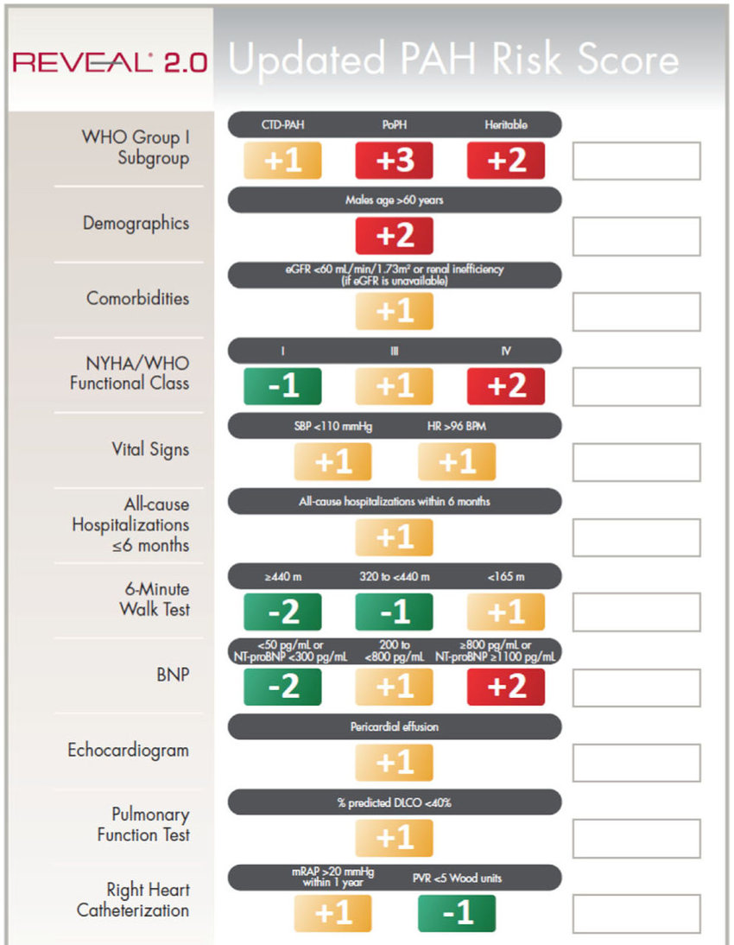
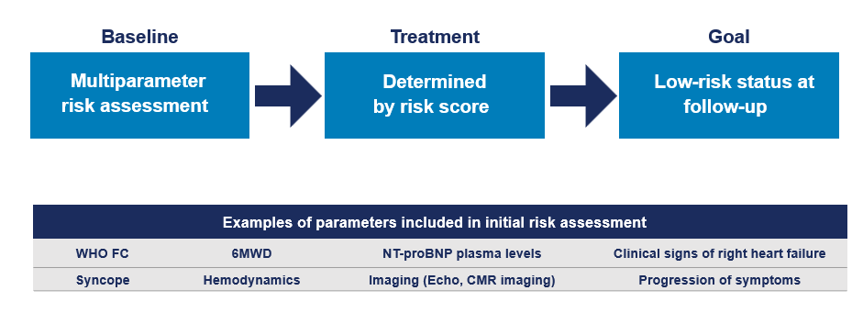
Baseline Multiparameter Risk Assessment Informs Initial Treatment Plan
Source: Benza, R. et al (2019). Chest
COMPERA: Comparative,ProspectiveRegistryofNewlyInitiatedTherapiesforPulmonaryHypertension

Slide 34
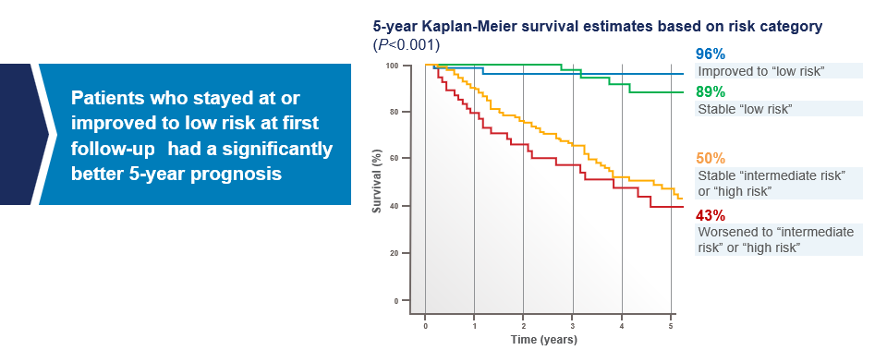
Our Treatment Goal should be Low Risk Status
Source: Kylhammar D, et al. Eur Heart J. 2018;39(47): 4175-4181

Slide 35
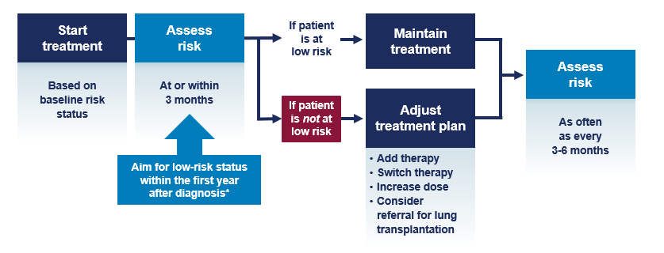
How Risk Guides Therapy Decision Making
Source: Humbert M. et al. Eur Heart J. 2022; 43(38): 3618-3731

Slide 36
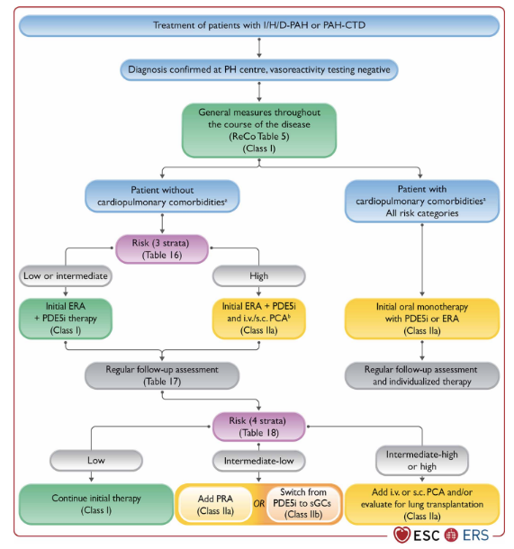
2022 ERS Treatment Algorithm
Source: Humbert M. et al. Eur Heart J. 2022; 43(38): 3618-3731

Slide 37
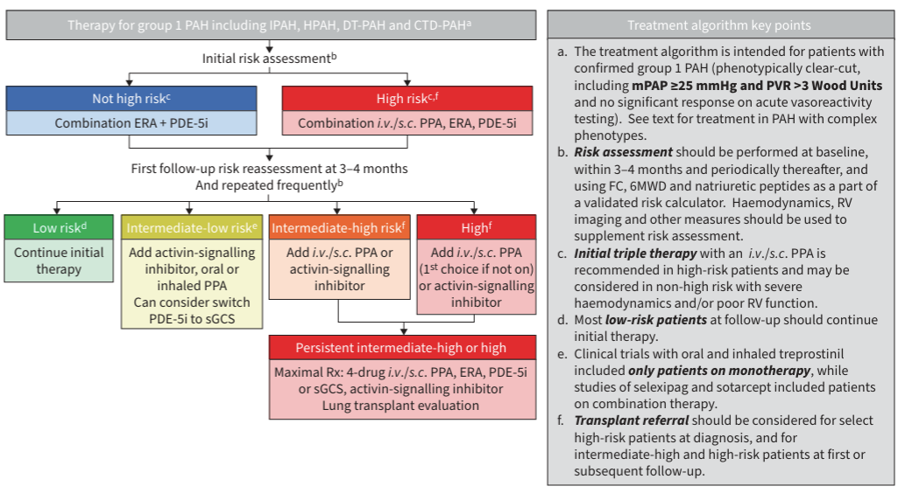
7th WSPH Treatment Algorithm
Source: K.M. Chin et al 7th WSPH ERJ 2024

Slide 38
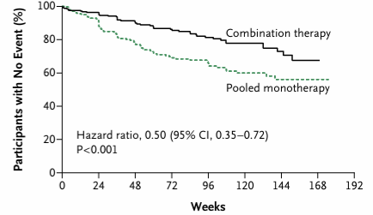
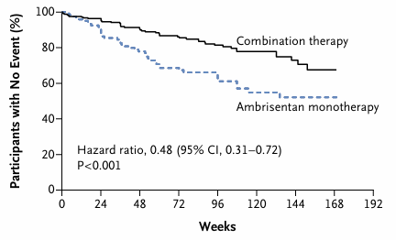
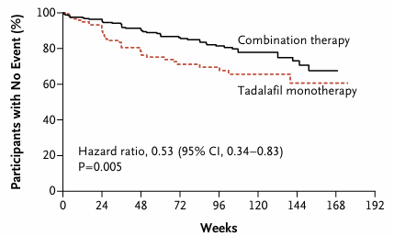
Early Combination Therapy is Key
Source: N. Galie et al AMBITION Trial NEJM 2015

Slide 39
Case Vignette Part V – Follow-up Risk Assessment
You determine that the patient is intermediate risk by REVEAL 2.0 assessment and initiate him on dual oral therapy with PDE-5i and ERA therapy. You see him in clinic at a 3-month follow-up appointment. He mentions that he is “doing great!” You repeat the 4-Strata risk assessment which calculates that he is still at intermediate risk.

Slide 40
Group Discussion
What should your next steps be?

Slide 41
Case Vignette Part VI – Case conclusion
You initiate the patient on an oral PCA and titrate to the appropriate goal dose. The patient on 3-month follow-up feels much better. He is now asymptomatic with limitations consistent with WHO-fc I. His 4-Strata risk when recalculated is now low.

Slide 42
Key Takeaways
PAH is a progressive, multisystem vascular disease driven by endothelial dysfunction, vascular remodeling, and increasing pulmonary vascular resistance leading to right heart failure
Early recognition is challenging due to nonspecific symptoms, requiring a high index of suspicion and systematic evaluation
Echocardiography serves as a critical screening tool, but right heart catheterization remains essential for definitive diagnosis and accurate phenotyping
Hemodynamic interpretation is foundational, distinguishing pre-capillary, post-capillary, and mixed disease states to guide management
Risk stratification is central to care, with treatment strategies aimed at achieving and maintaining low-risk status
Modern therapy targets multiple biologic pathways, and combination, risk-adapted treatment approaches are now the standard of care
Ongoing reassessment is mandatory, as PAH management requires dynamic adjustment to disease trajectory

Slide 43
Q&A

Slide 44

Thank you!
Nafis.Shamsid-Deen@Bannerhealth.com
nshamsid@arizona.edu

