Slide 1
Dermatology 101
Descriptions and Diagnostic Groupings

Slide 2
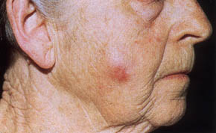
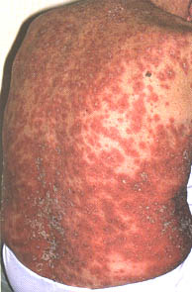
Terminology
LESION
  Describes a discrete area of disease
ERUPTION (or RASH)
  Describes widespread skin involvement
  Composed of several lesions
  May be the primary pathology or due to secondary factors (scratching, infection, etc.).

Slide 3
Your description
Location/Distribution
Size/Configuration
Border (well-marginated/poorly-marginated)
Color
Primary Morphological Term
Secondary Characteristics or other descriptors
Example
  On her right flank, there is a 1.5 cm well-marginated erythematous plaque with silvery scale.

Slide 4
KEY DISTRIBUTIONS

Slide 5
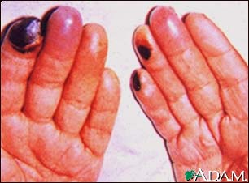
ACRAL
Affects the distal portion of the limbs (fingers and toes) and head (tip of nose and ears)

Slide 6
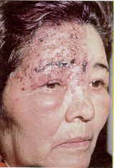
DERMATOMAL
Corresponding with nerve root distribution

Slide 7
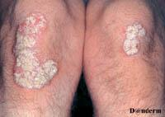
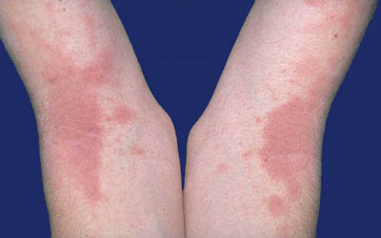
EXTENSOR vs FLEXURAL

Slide 8
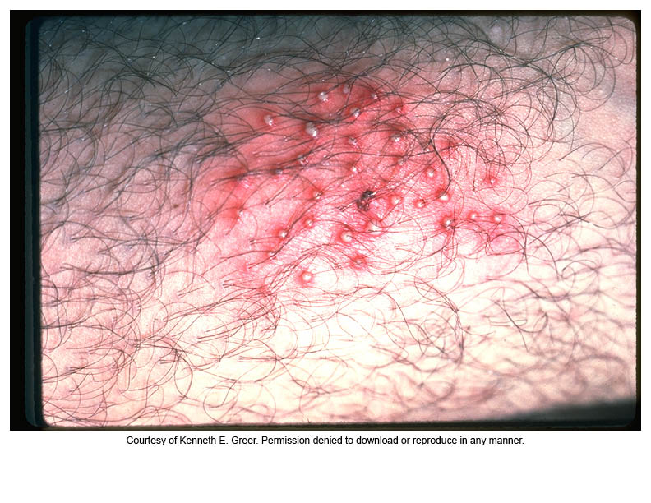
FOLLICULAR
Follicular
  Individual lesions arise from hair follicles. These may be grouped into confluent plaques.

Slide 9
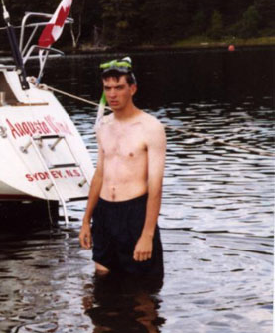
SUN EXPOSED
Does not affect skin that is always covered by clothing.
  Head & neck: spares eyelids, depth of wrinkles & furrows, areas shadowed by hair, nose & chin. Typically involves V of neck.
  Backs of hands: spares finger webs. More severe on proximal than distal phalanges.
  Forearms: extensor rather than flexor.
  Feet: dorsal surface, sparing areas covered by footwear
  Trunk: rarely affected

Slide 10
Other elements of descriptions
COLOR
  Skin coloured, red, pink, violaceous, brown, black, grey, blue, orange, yellow.
MONOMORPHIC or POLYMORPHIC
CONSISTENCY
  Soft, firm, hard, fluctuant or sclerosed
TEMPERATURE
  Warmer or Cooler than surrounding skin.
MOBILITY
  Mobile or immobile.

Slide 11
PRIMARY LESIONS

Slide 12
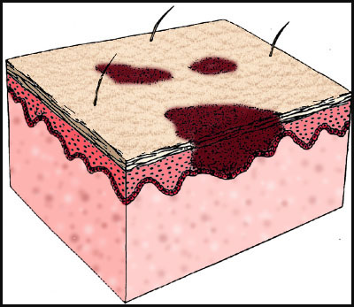
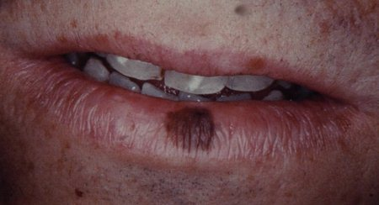
MACULE
  Small
  Flat
  Distinct circumscribed color change
  < 10 millimeters (1 cm) in diameter
  Does not include a change in skin texture or thickness.
  Macules may be the result of
    (A) hyperpigmentation
    (B) depigmentation
    (C) vascular dilation

Slide 13
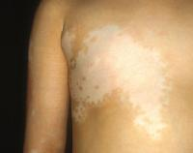
PATCH
  Large
  Flat
  District circumscribed color change
  > 10 millimeters (1 cm) in diameter
  Does not include a change in skin texture or thickness.

Slide 14
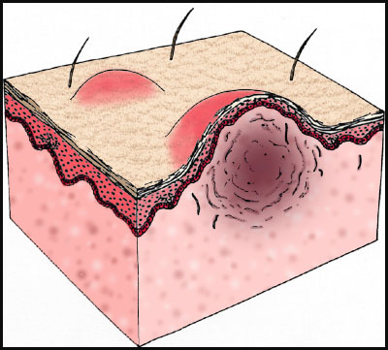
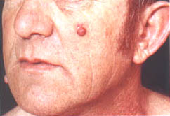
PAPULE
  Small
  Solid
  Raised
  < 10 mm (1 cm) in diameter
    Some literature < 5mm
  Papules may be:
    Acuminate (pointed)
    Dome-shaped (rounded)
    Filiform (thread-like)
    Flat-topped
    Oval or round
    Pedunculated (with a stalk)
    Sessile (without a stalk)
    Umbilicated (with a central depression)
    Verrucous (warty)

Slide 15
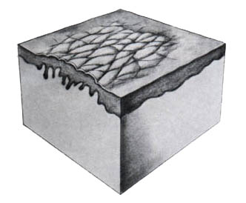
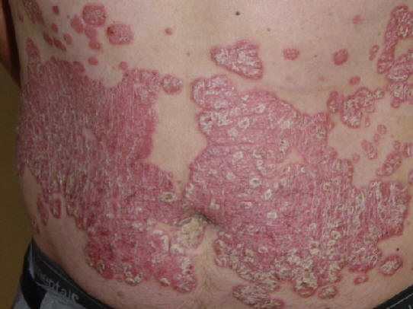
PLAQUE
  Palpable
  Plateau-like elevation of skin
  > 1 cm in diameter (rarely more than 5 mm in height)
  Often formed by a convergence of papules (psoriasis)
  Plaques may be:
    Annular (ring shaped)
    Arcuate (half-moon)
    Polygonal (varied non-geometric shape)
    Polymorphic (varied shape)
    Serpiginous (in the shape of a snake)
    Poikilodermatous (variegated appearance, usually mixed pallor, telangiectasia & pigmentation)

Slide 16
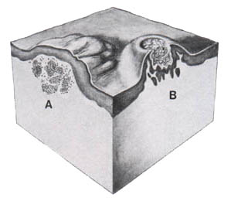
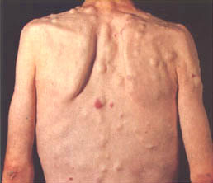
NODULE
  Palpable
  Solid
  DEPTH of involvement and/or ELEVATION differentiate it from a plaque
  > 5 mm diameter
  Nodules can involve any layer of the skin and can be edematous or solid.
  Five types of nodules:
    Epidermal
    Epidermal-dermal
    Dermal
    Dermal-subdermal
    Subcutaneous
  TUMOR – large nodule

Slide 17
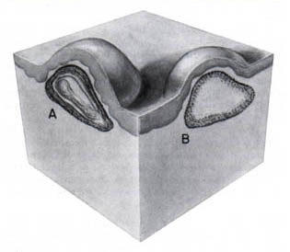
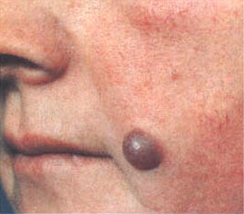
CYST
  Epithelial lined cavity containing liquid or semisolid material
  A spherical or oval papule or nodule may be a cyst if, when palpated, is resilient (feels like an eyeball).

Slide 18
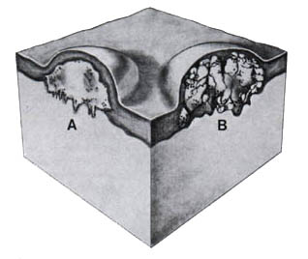
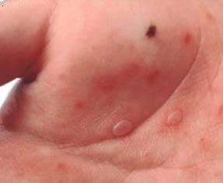
VESICLE
  Circumscribed
  Elevated lesion
  < 5 mm in diameter
  CONTAINS FLUID
  Vesicle walls can be so thin that the contained serum, lymph, blood, or extracellular fluid is easily seen.
  Collarette of scale can indicate vesicle
  Types
    Subcorneal
    Acantholytic
    Subepidermal

Slide 19
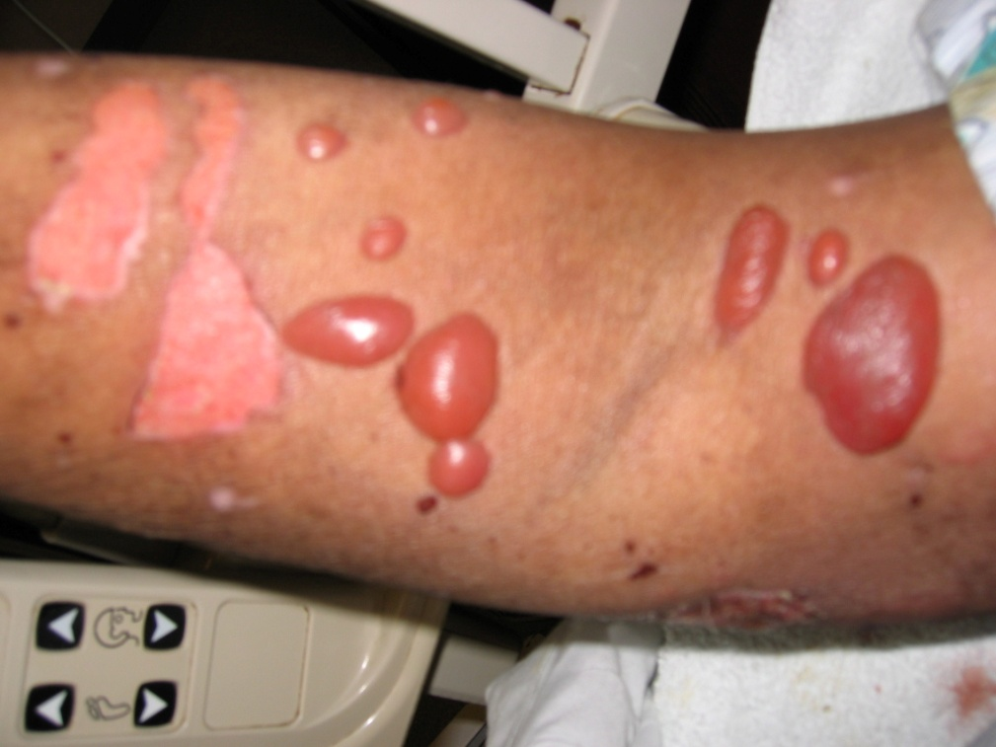
BULLA
  A vesicle with a diameter > 5 mm.

Slide 20
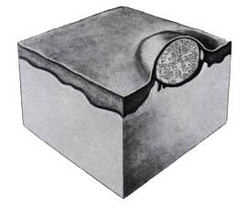
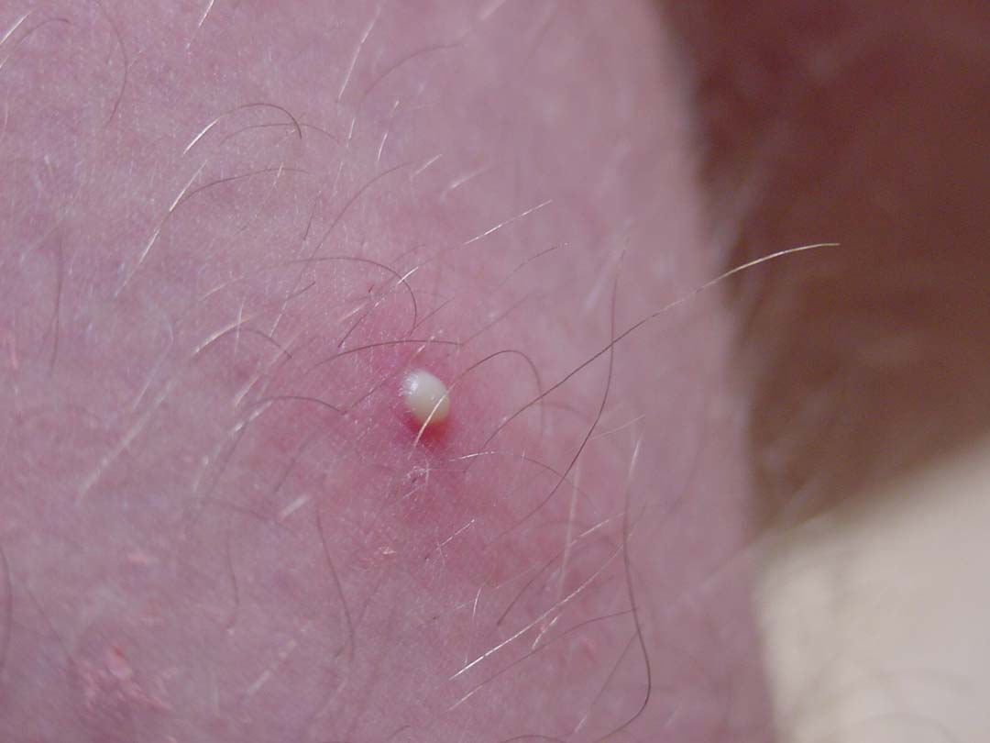
PUSTULE
Pus-filled vesicle/bulla
    Color may appear white, yellow, or greenish-yellow depending on the color of the pus.
    It may also contain bacteria or may be sterile.

Slide 21
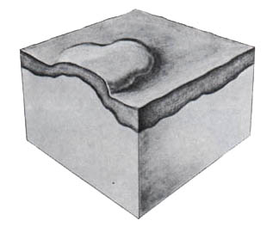
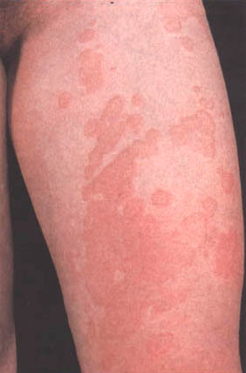
WHEAL
  Transitory
  Compressible papule or plaque of dermal edema
  Rounded or flat-topped, and evanescent, disappearing within hours.
  The epidermis is not affected.
  Wheals can be pale red or white (especially in the center) if edema is sufficient to compress superficial vessels.
  Eruption of wheals = Urticaria

Slide 22
Review of Primary Lesions
FLAT LESIONS
SMALL
MACULE
LARGE
PATCH
RAISED
LESIONS
SMALL
PAPULE
LARGE
WITHOUT
SUBSTANCE
PLAQUE
LARGE
WITH
SUBSTANCE
NODULE
CYST
TUMOR
DERMAL
WHEAL
FLUID-FILLED
LESIONS
SMALL
VESICLE
LARGE
BULLA
PUS-FILLED
PUSTULE

Slide 23
SECONDARY LESIONS

Slide 24
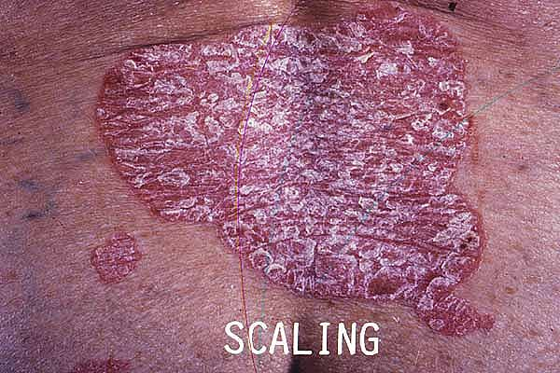
SCALE
  Perceptible accumulation or abnormal shedding of stratum corneum.
  Surface changes indicate epidermal changes are present
  Types
    Psoriasiform
      (large white or silver flakes)
    Pityriasiform
      (branny powdery scale)
    Lichenoid
      (Tightly adherent to skin surface)
    Keratotic (horny scale)
    Exfoliation (peeling skin)
    Maceration (moist peeling skin)
    Verrucous (warty)
    Carpet-tack (confluent)
    Icthyosiform (fish-like)

Slide 25
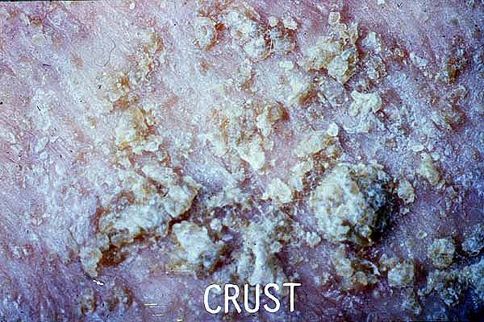
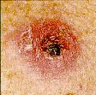
CRUST
  Plasma exudate through an eroded epidermis.
  It is rough on the surface and is yellow or brown in color.
  Hemorrhagic crust appears red or purple
  Eschar is black crust overlying an ulcer

Slide 26
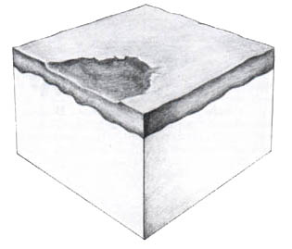
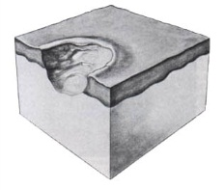
ERODED, FISSURED, ULCERATED
EROSION
  Loss of part or all of epidermis
FISSURE
  Crack within epidermis
    Usually from dryness
ULCER
  Erosion into the dermis and beyond

Slide 27
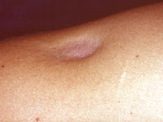
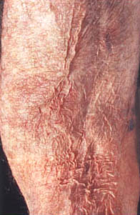
ATROPHY
  Results from loss of epidermis, dermis or both.
  Dermal atrophy manifests as a depression in the skin.
  Epidermal atrophy manifests as paper-thin almost transparent skin.

Slide 28
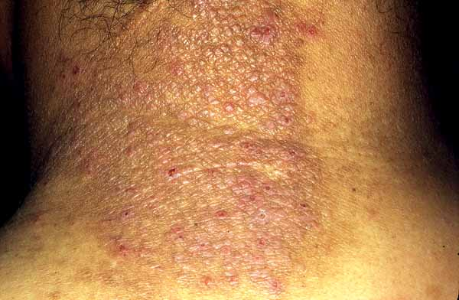
LICHENIFICATION
  Caused by chronic RUBBING
  Result: palpably thickened skin with ACCENTUATED and lichenoid scale.
  Hallmark of chronic eczema

Slide 29
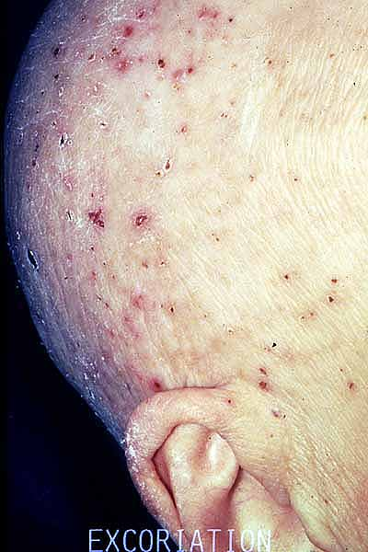
EXCORIATION
  A scratch mark (superficial excavations of epidermis)
  It may be linear or picked (prurigo).
  Excoriations may occur in the absence of a primary dermatosis.

Slide 30
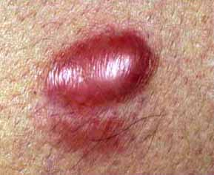
SCAR
  HYPERTROPHIC
    Replacement of normal tissue with fibrous connective tissue within margin of injury
  KELOID
    Fibrous tissue overrunning borders of injury

Slide 31
Other descriptors…
UNIFORMITY
  Monomorphic or Polymorphic
CONSISTENCY
  Soft, firm, hard, fluctuant or sclerosed
TEMPERATURE
  Warmer or Cooler than surrounding skin.
MOBILITY
  Mobile or immobile.

Slide 32
Other Important Terms

Slide 33
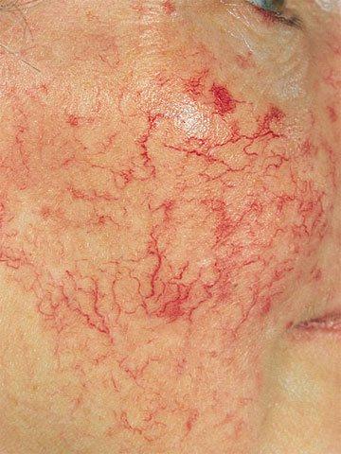
TELANGIECTASIA
  Prominent cutaneous blood vessels

Slide 34
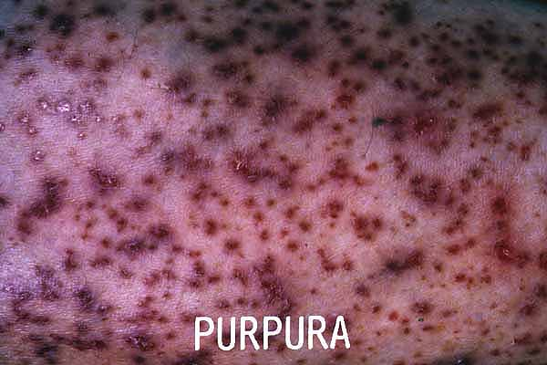
PURPURA
  Bleeding into the skin This may be as petechiae (small red, purple or brown spots) or ecchymoses (bruises).
  Purpura does not blanch with pressure (diascopy).

Slide 35
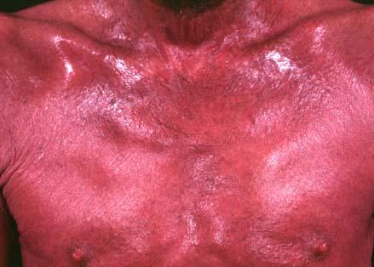
ERYTHRODERMA
  The skin condition affects the whole body or nearly the whole body, which is red all over.

Slide 36
Configuration

Slide 37
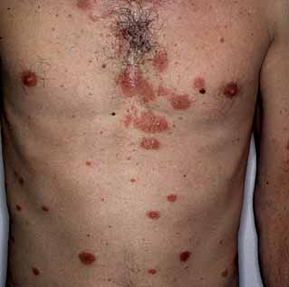
NUMMULAR
  Round (coin-shaped)
  AKA “Discoid”

Slide 38
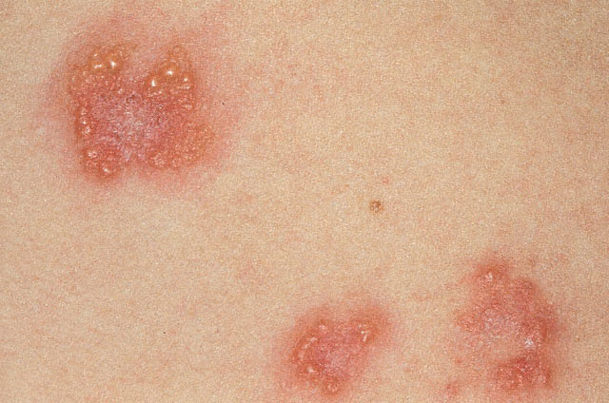
HERPETIFORM
Grouped, umbilicated vesicles

Slide 39
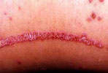
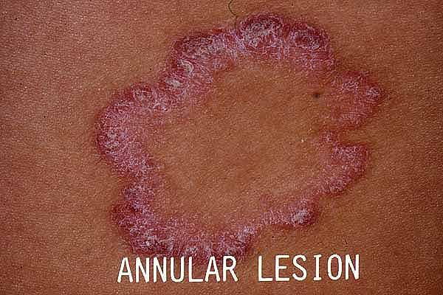
LINEAR, ANNULAR
LINEAR
  AKA STRIATE
  Usually external
    Autoinoculation
    Scratching
    Contact
ANNULAR
  Grouped in a circle.

Slide 40
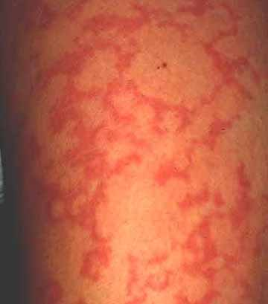
GYRATE
  Whirling in a circle
  Similar to RETICULATED
    Net-like

Slide 41
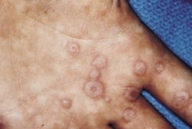
TARGETOID
  Concentric rings like a dartboard

Slide 42
PUTTING IT ALL TOGETHER
Diseases by diagnostic grouping

Slide 43
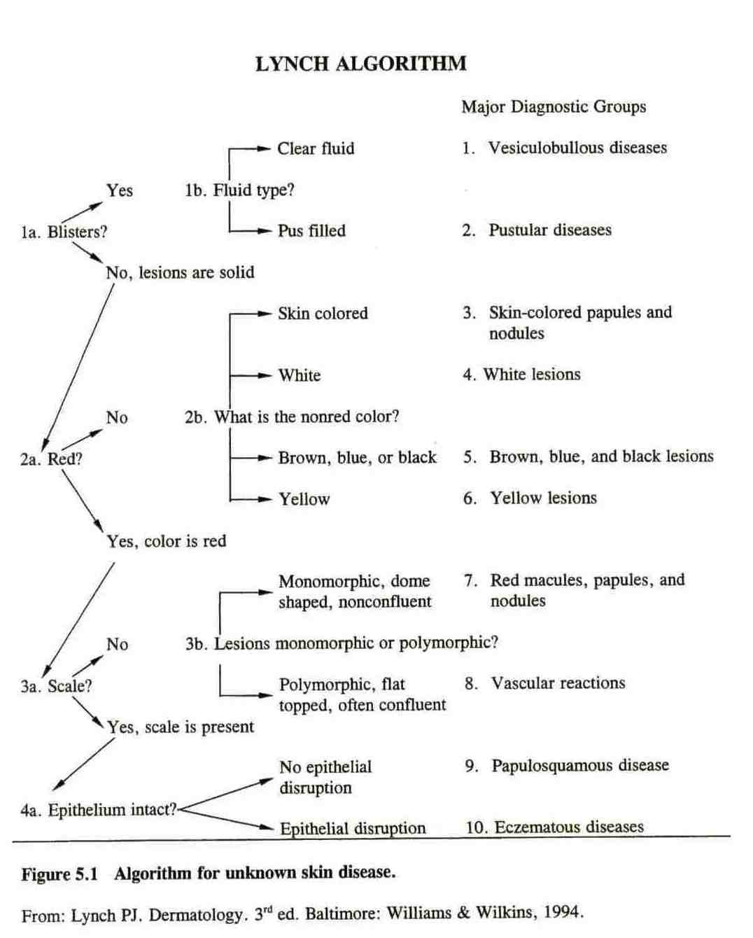

Slide 44
Your description
Location/Distribution
Size/Configuration
Border (well-marginated/poorly-marginated)
Color
Primary Morphological Term
Secondary Characteristics or other descriptors
Example
  On her right flank, there is a 1.5 cm well-marginated erythematous plaque with silvery scale.

Slide 45
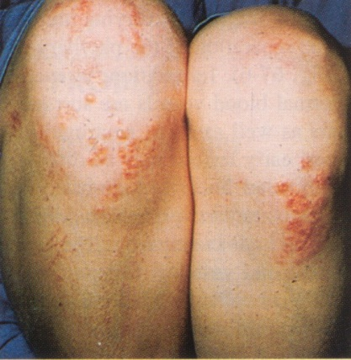
LET’S PRACTICE!
On the bilateral knees, there are many 3-10 mm well marginated erythematous plaques with superimposed clusters of clear vesicles.

Slide 46
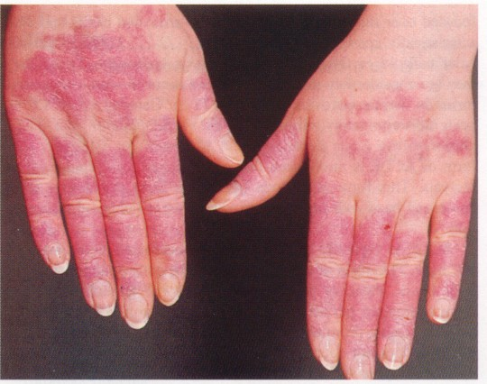
LET’S PRACTICE!
On the dorsal surface of both hands, sparing the knuckles, there are several 2-5 mm erythematous papules coelescing into plaques, with fine scale.

