Slide 1
Intern Bootcamp: Anticoagulation and Blood Products
Ahsan Kamal
7/5/2023

Slide 2
Clotting Cascade

Slide 3
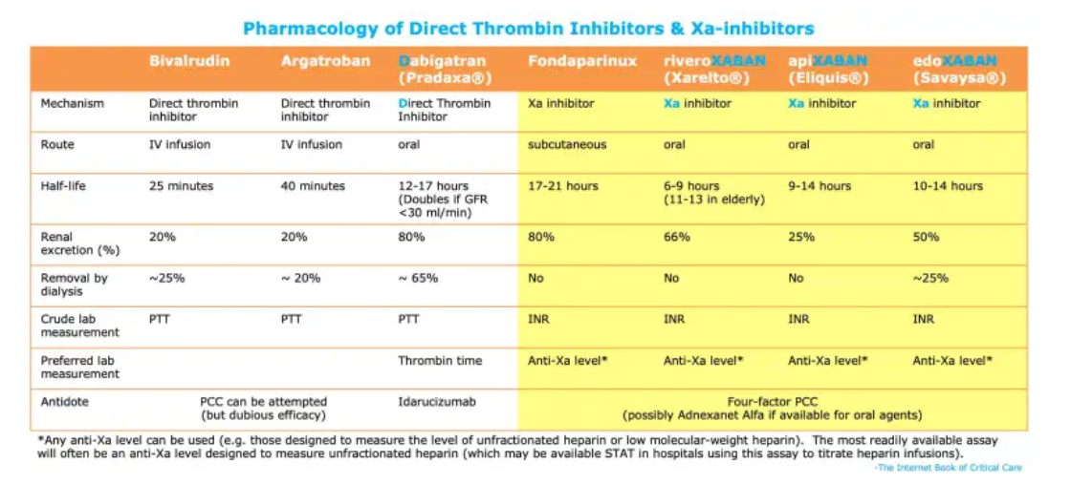
Anticoagulant Overview

Slide 4
Common Indications for AC
Afib
PE/DVT
Prosthetic Valve
There are other more niche uses but >90% will be on it for this reason
Special case: Triple therapy (DAPT + AC) may be used for up to 30 days for pt w/AC indication and recent PCI
Note: Stroke is not reason for pt to be on AC unless underlying reason for stroke that can be addressed (like Afib)

Slide 5
AFib
Remember CHA2DS2-VASc!
CHA2DS2-VASc score of 2 or greater in men or 3 or greater in women, oral anticoagulants are recommended
CHA2DS2-VASc score of 0 in men or 1 in women, it is reasonable to omit anticoagulant therapy
DOAC Not to be used for pts w/valvular Afib (mod to severe MS) or mechanical heart valve

Slide 6
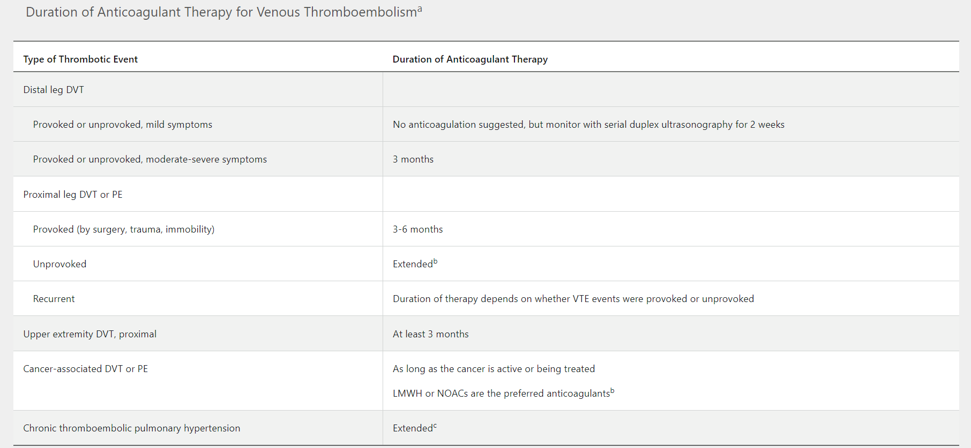
PE/DVT

Slide 7
Prosthetic Valves
Mechanical vs Bioprosthetic: Former is more durable, but higher risk for clot.
General rule of thumb: <50 mechanical, >70 bioprosthetic, in between varies
Mechanical requires lifelong, bioprosthetic 3 to 6 months
Goal INR:
If bioprosthetic (Mitral or Aortic) goal is 2.5
If Mitral or high risk Aortic, 3.0
If low risk Aortic, 2.5
Warfarin only, NO DOACs
Supplemental low dose ASA generally recommended for all cases

Slide 8
DVT Prophy-Who needs it?
Generally err towards chemical for most pts
Remember if on AC already that is their DVT prophy
Most do not require post d/c but may if undergoing major procedure (knee arthroplasty, hip fracture repair, abdominal surgery for cancer) up to 4 wks
IBD pts are at greater risk for DVT; prophy even if presenting w/bleeding! (Within reason)

Slide 9
DVT Prophy
If BMI < 40, depends on Cr clearance (GFR)
> 30, Lovenox 40 mg SQ QD or Hep 5000 units SQ TID
< 30 but < 15, can potentially do Lovenox 30 mg SQ QD
< 15 use Hep
If BMI > 40, Lovenox 40 mg SQ BID or Hep 7500 SQ TID
SCDs: Data does not support using on both extremities vs one
Don’t forget to encourage ambulation!

Slide 10
Periop/Bridging Anticoagulation
Stop AC for most surgical procedures except low risk (cataract, derm, +/- endoscopy)
Stop warfarin 5 days before and start hep 36 hrs after starting, stop hep 12-24 hrs before, resume warfarin 24 hrs after
Stop DOAC 1-2 days before, resume 24 hrs after
Bridge if high risk (most mechanical valves, CHADS2 score > 4, rheumatic heart disease, recent VTE)

Slide 11
Common Doses To Know
For Afib:
Apixaban either 5 mg BID or 2.5 mg BID (next slide)
Xarelto 20 mg or 15 mg QD (renal status)
For PE/DVT:
Apixaban 10 mg BID for first 7 days, then 5 mg BID
Rivaroxaban 15 mg BID for first 21 days then 20 mg QD
Remember the DVT doses: Lovenox 40 mg QD (BID if obese) and Heparin 5000 units TID
Therapeutic Lovenox: 1 mg/kg BID (often used if PO not option)

Slide 12
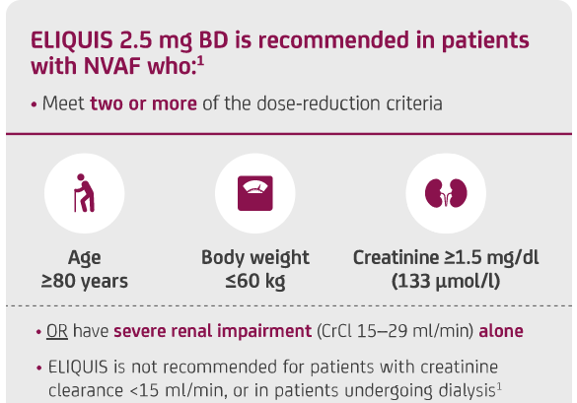
Apixaban Dose Reduction

Slide 13
Heparin ggt
When ordering two options: ACS protocol vs PE/DVT protocol
Both involve bolus + basal rate, but ACS is slightly lower
Advantage is that it can be turned on/off quickly. So commonly used for pts undergoing procedure, or if there is concern may bleed, etc. Often will put them on this first then transition to DOAC
Very common scenario at VA-pt w/CP, some concerning signs, cards recommends put on Hep ggt and will see in AM
Titrated to anti Xa lvls. But if pt was on DOAC not an option, generally use PTT instead
Remember Hep is a classic drug that can cause hyper K

Slide 14
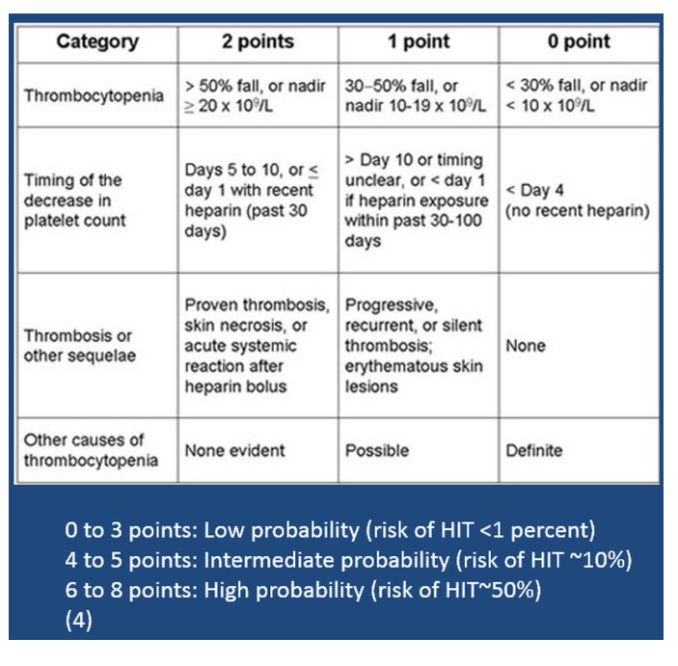
Heparin Induced Thrombocytopenia (HIT)
Unclear why but pts develop autoab to PF4 complexed with Hep, leads to plt activation
Low risk, no additional testing, ok to continue
Intermediate to high risk, switch agents (usually DTI like dabigatran or bivalrudin), pursue testing
PF4 ab very sensitive but not specific. Confirm w/serotonin release assay

Slide 15
Warfarin
Inhibits Vit K dependent synthesis of clotting factors
Factor II, VII, IX and X plus protein C and S
Major CYP interactions (every drug under the sun)
Requires routine lvl monitoring by pharmacy
After starting may initially be hypercoagulable, generally do not need to bridge but may have to consider in high risk pts
C and S have shortest half lves

Slide 16
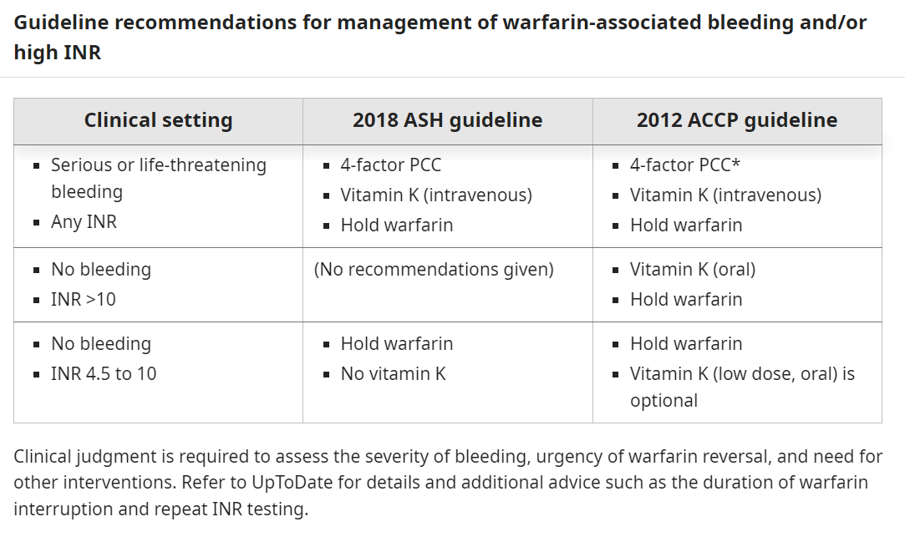
Warfarin Reversal

Slide 17
Transfusing Blood Products
Most commonly RBC and plt. Rarely will transfuse WBC (generally will use Neupogen in select cases for low WBC)
Don’t necessarily have to recheck the same day, ie can wait for morning labs. Often we will recheck later but make sure to wait at least 1-2 hrs post transfusion
Different protocol for ordering at Banner vs VA
VA you are responsible for obtaining consent, paperwork, etc

Slide 18
RBC
Transfusing 1 unit pRBC increases Hg by ~ 1
Hg cutoff < 7, many studies have demonstrating that transfusing above this threshold does not yield mortality benefit
<8 for ‘cardiac patients’
Sickle cell patients have different cutoffs, just be aware for now

Slide 19
Platelets
1 unit of plt increases plt by ~ 30
Common platelet cutoffs:
Neurosurgery, no bleeding-<100
Major surgery, no bleeding-<50
Endoscopic procedure-20 to 50
Central line placement-<20
Paracentesis-<20
Stable, nonbleeding-<10

Slide 20
Other Blood Products
Fresh frozen plasma (FFP)-all soluble plasma proteins and clotting factors. Used for major bleeding when pt has multiple factor deficiencies; do not use for volume expansion
Cryoprecipitate-small fraction of plasma that precipitates when FFP is thawed. Contains Fibrinogen + Factor VIII + vWF, used in DIC. Used in low fibrinogen states/VWD. Generally given in intervals of 5 (ie 1 ‘unit’ contains 5 units)
PCC-can be 4 factor vs 3 factor. 4 factor contains factors II, VII, IX and X, 3 factor does not have factor VII. Used for warfarin reversal

Slide 21
Treating Blood Products
Leukoreduction-Decreases number of leukocytes in product, decreases CMV transmission and transfusion reactions, alloantibody production to product. Very commonly just done routinely (80% of blood banks in US)
Irradiation-Prevents replication of lymphocytes/stem cells in product, important in reducing GVHD and for severely immunocompromised pts/pts on chemo
Washing-Removes residual protein products, used in IgA deficiency, pts at risk for allergic rxns

Slide 22
Transfusion reactions
Acute vs delayed hemolytic transfusion reactions-Usually due to ABO mismatch. Acute is within minutes to hrs, delayed can be 1-2 wks. Watch for fever/chills/hypotension; anaphylaxis is main concern. Tx is stop transfusion/supportive. No evidence supports antihistamine or steroid use but commonly given
TRALI-transfusion related acute lung injury. Defined as noncardiogenic pulmonary edema within 6 hrs of transfusion. Supportive mgmt.
TACO-transfusion associated circulatory overload. More difficult to define, but think of classic CHF signs. Tx w/diuresis
TRALI vs TACO-tough to distinguish. TRALI more associated w/fever and hypotension, TACO more with signs of volume overload (again think classic CHF)

Slide 23
Massive transfusion protocol
Up to 8-10 units of RBC given in 24 hrs, reserved for severe bleeding/shock
Dilutional coagulopathy is common, thus will give ‘balanced’ transfusion. Most common is 1:1:1:1 of pRBC: platelet: FFP: cryo
Hypothermia-blood is cold, pts need to be warmed
Hypocalcemia-citrate in products binds free Ca
Acidosis-even mild acidosis can impair coagulation, correct

