Slide 1
Autoimmune and cholestatic liver disease
Rohit Nathan, DO
Rohit.Nathan@bannerhealth.com

Slide 2
A 44 yo female presents to your clinic as a hospital follow up. She has history of celiac disease and adheres to GFD. She does not drink alcohol, use illicit drugs, or have high risk behaviors. Family history includes sister with Hashimoto thyroiditis. She is generally asymptomatic at this vist.
She had a recent hospitalization for new onset jaundice and progressive fatigue. Lab evaluation at the time was significant for Tbili 6.5, AST 1700, ALT 1300, ALP 225, INR 1.6, IgG 2200, IgM 60. She had no prior history of liver disease or abnormal LFT.
After workup, which included imaging, liver biopsy and serologies, she was started on a medication and asked to follow up with her PCP and hepatology.

Slide 3
A 44 yo female presents to your clinic as a hospital follow up. She has history of celiac disease and adheres to GFD. She does not drink alcohol, use illicit drugs, or have high risk behaviors. Family history includes sister with Hashimoto thyroiditis. She is generally asymptomatic at this visit.
She had a recent hospitalization for new onset jaundice and progressive fatigue. Lab evaluation at the time was significant for Tbili 6.5, AST 1700, ALT 1300, ALP 225, INR 1.6, IgG 2200, IgM 60. She had no prior history of liver disease or abnormal LFT.
After workup, which included imaging, liver biopsy and serologies, she was started on a medication and asked to follow up with her PCP and hepatology.

Slide 4
Which of the following medications was she most likely started on prior to discharge:
  Tenofovir
  Ursodiol
  Prednisone
  Sofosbuvir/Velpatasvir

Slide 5
Autoimmune Hepatitis

Slide 6
Autoimmune Hepatitis
Immune-mediated inflammatory liver disease
Can affect all ages, genders, and ethnicities
  More common in middle age and women
May have concurrent autoimmune disease (thyroid, celiac)
Challenging diagnosis to make

Slide 7
Clinical Manifestations
Variable clinical presentation
  Asymptomatic (25-34%)
  Symptomatic/acute severe hepatitis
    Jaundice; INR 1.5-2
  Cirrhosis (25-33%)
  Acute Liver Failure (<5%)
Non-specific symptoms – fatigue, malaise, arthralgias

Slide 8
Diagnostic Testing
LFTs: AST/ALT elevated of varying degree, mild to marked
Increased serum IgG, positive serologic markers
Exclude other etiologies (viral hepatitis, metabolic, etc)
Liver biopsy

Slide 9
Which of the following auto-antibodies is most associated with autoimmune hepatitis?
  Anti-mitochondrial antibody
  Anti smooth-muscle antibody
  Anti-centromere antibody
  Anti tissue transglutaminase antibody

Slide 10
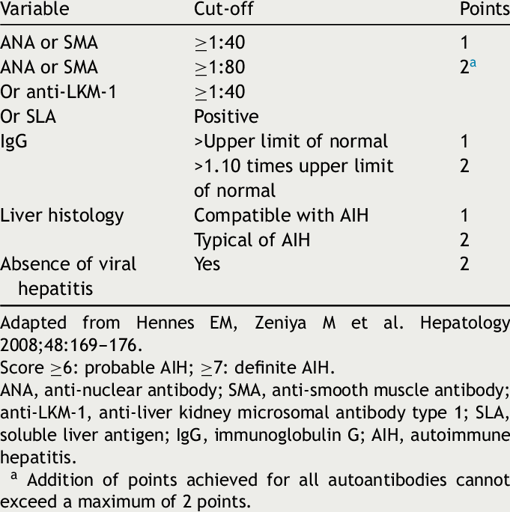
Simplified Diagnostic Criteria for AIH
Good guideline
Patient doesn’t always fit perfectly
  ~20% seronegative
  +antibodies in other conditions
Liver biopsy for definitive dx
  “interface hepatitis”
  “plasma cell infiltrate”
Assess response to treatment

Slide 11
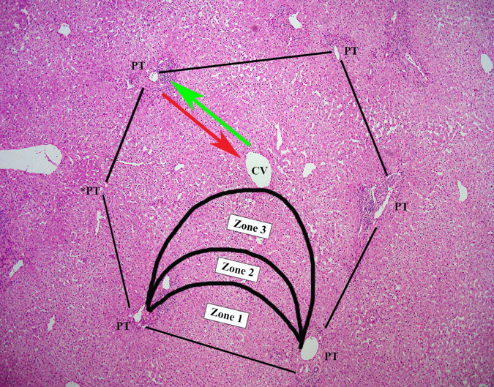
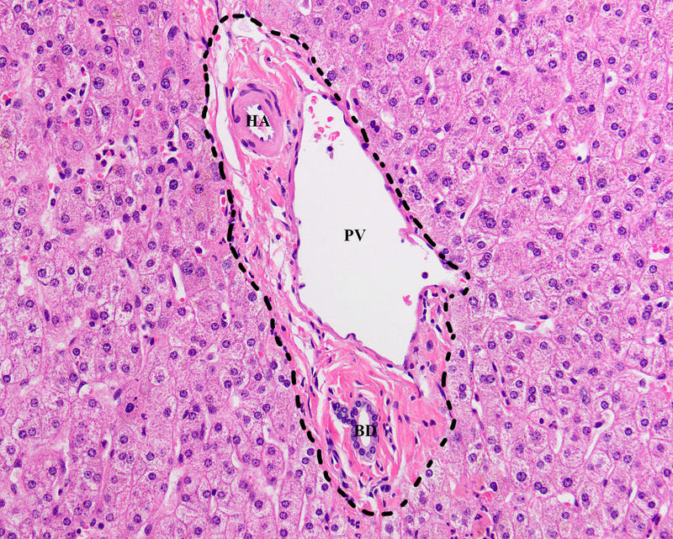
Histology

Slide 12
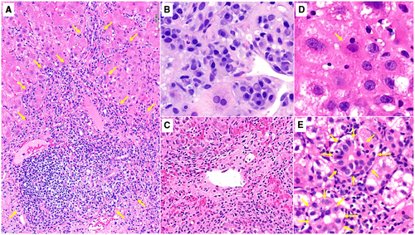
Notes:
AASLD AIH guidelines image
A: interface hepatitis, B: Plasma cell predominance, C: Perivenulitis, D: Emperipolesis, E: Hepatocyte rosettes

Slide 13
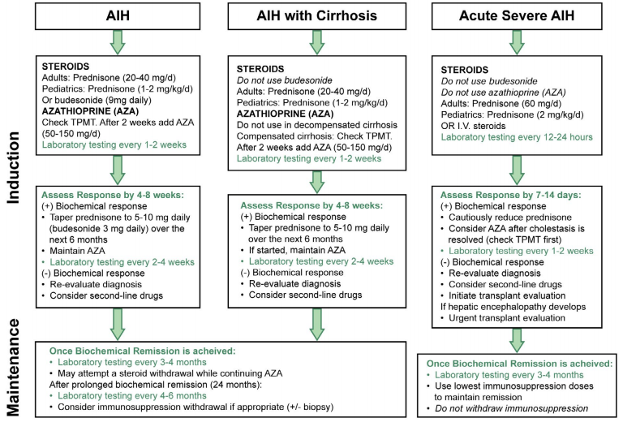
AIH Tx
Mack et al
AASLD Practice Guidelines
Hepatology 2019

Slide 14
Second line treatments
Mycophenolate Mofetil (contraindicated during pregnancy)
Calcineurin Inhibitors (tacrolimus, cyclosporine)

Slide 15
AIH and pregnancy
Ideally, biochemical remission 1 yr prior to conception
Continue maintenance therapy AZA and/or prednisone. No MMF!
Increased risk of flare during pregnancy (5-15%) and post-partum (20-40%)

Slide 16
AIH Potpourri
Azathioprine can cause bone marrow suppression and hepatotoxicity
  Can check thiopurine metabolites
Do not use budesonide in cirrhosis/portal hypertension.
AIH overlap with other autoimmune liver dz: PBC, PSC
Check hepatitis B status and vaccinate if needed
Can be inactive in cirrhosis = no treatment needed
Can recur after OLT

Slide 17
Drug-Induced AIH
Usually acute onset with temporal relationship with drug
  Onset: 1-8 weeks to 3-12 months (nitrofurantoin and minocycline)
Biopsy looks similar to AIH
Treatment:
  Stop offending agent
  Start steroids (20-40 mg qd) and taper 3-6 months
No recurrence after discontinuation of steroids
  If recurs → suggestive of classic AIH
Bjornnson, Talwalkar et al. Hepatology 2010

Slide 18
Checkpoint Inhibitor Liver Injury
Immune-related adverse event
Common culprits: Ipilimumab, Pembrolizumab, Nivolumab
Lack typical laboratory or histological features of AIH
Usually improve with steroid therapy and augmented immunotherapy dosing

Slide 19
AIH Pearls
Various presentations: asymptomatic/symptomatic; cirrhosis to ALF
Antibodies mat not definitively make dx. Biopsy typically recommended.
Initial treatment: Prednisone then AZA (TPMT permitting)
Gradual withdrawal of pred w/goal of biochemical remission on AZA
High recurrence rate off IS
Drug-induced AIH/Checkpoint inhibitor not chronic
  Resolve with shorter course of steroids without recurrence

Slide 20
A 44 yo female presents to your clinic as a follow up from recent lab testing. She has history of celiac disease and adheres to GFD. She does not drink alcohol, use illicit drugs, or have high risk behaviors. Family history includes sister with Hashimoto thyroiditis.
She had presented 2 weeks ago with worsening pruritus over a 6 month span without any rash or initiation of new medications. Topical lotions have not helped.
Lab testing show TBili 1.3, AST 57, ALT 48, ALP 275, IgG 1400, IgM 250, ANA neg, ASMA neg, AMA positive at 1:640
RUQ u/s showed an ‘echogenic’ non cirrhotic appearing liver.

Slide 21
A 44 yo female presents to your clinic as a follow up from recent lab testing. She has history of celiac disease and adheres to GFD. She does not drink alcohol, use illicit drugs, or have high risk behaviors. Family history includes sister with Hashimoto thyroiditis.
She had presented 2 weeks ago with worsening pruritus over a 6 month span without any rash or initiation of new medications. Topical lotions have not helped.
Lab testing show TBili 1.3, AST 57, ALT 48, ALP 275, IgG 1400, IgM 250, ANA neg, ASMA neg, AMA positive at 1:640
RUQ u/s showed an ‘echogenic’ non cirrhotic appearing liver.

Slide 22
Which of the following other conditions does the patient need to be screened for?
  Vitamin D Deficiency
  Coronary artery disease
  SLE
  Polymyositis

Slide 23
Cholestatic Liver Diseases

Slide 24
Basics
Impaired bile synthesis
Impaired bile flow
Obstructed bile flow
Intrahepatic
Extrahepatic

Slide 25

Pathophysiology
Bile salts
Electrolytes
hepatocyte
Desmosomes
Microfilaments
Tight junctions
Bile canaliculi
ALP, GGT
hepatocyte
Notes:
Desmosomes, tight junctions, microfilaments prevent reflux of bile back toward hepatocytes. Bile is toxic, creates apoptosis.
ALP and GGT secreted from hepatocyte plasma membrane, get released with toxic effect of bile salt reflux.

Slide 26
Cholestatic liver diseases
Many
  Intrahepatic
    Immune mediated
    Infectious
    Malignancy
    Miscellaneous
  Extrahepatic
    structural/anatomic

Slide 27
PBC
Autoimmune, chronic cholestatic disease
95% AMA positive
Female predominance, ~4:1
Ethnic predominance, Mediterranean/Hispanic descent
  0.5% of Italians AMA positive
Familial predominance
  Female FDRs 10-20%

Slide 28
Diagnosis
Need 2 of 3
  Elevated ALP
  Positive AMA
    ~5% AMA negative (other autoantibodies {sp100, gp120} not checked typically)
  Histologic findings
Correlative symptoms
  Fatigue (50-70%)
  Pruritus (20-70%, less in UDCA era)
  RUQ pain (15-20%, nonspecific)
Notes:
Histologic evidence of nonsuppurative destructive cholangitis and destruction of interlobular bile ducts.
Symptoms do not correlate with disease activity, but later stage disease typically has more symptoms.

Slide 29
Workup
Fibrosis assessment
  Typically LBx initially for confirmation and staging.
  Elastography
Concomitant diagnoses?
  AIH
  Other autoimmune conditions
  NAFL/DM2
  HLD
  Fat sol Vit deficiency
  BMD
All PBC pts screen for:
Lipid panel
TSH
Vit D
DEXA
Celiac
Notes:
Celiac, Hashimoto, Sicca/ Sjogren, CREST

Slide 30
PBC, pre vs post UDCA
UDCA ~1990
Disease progression was faster pre UDCA
  Difficult to estimate, many asymptomatic pts found later in disease course.
  Median survival 16 yrs (asymptomatic) vs 7 yrs (symptomatic)
  Fibrosis stages progressed on average every 1.5 in paired biopsy studies
Post UDCA
  Progression to cirrhosis 13% vs 49% in early longitudinal studies

Slide 31
Treatment
UDCA
  Dosing – 13 to 15 mg/kg/day in divided doses
  Side effects – GI, leukopenia, sinusitis/cystitis
  Limiting factors?
Obeticholic Acid
  Indication?
  Evidence?
  Side effects?
Notes:
Inadequate urso response after 1 year or urso intolerance.
A larger phase 3 trial included 210 patients who were treated for 1 year in a randomized, placebo-controlled fashion, followed by an optional 6-year, longterm extension phase while continuing UDCA. The primary endpoint was a combination of reaching a serum level of ALP less than 1.67 times the upper limit of normal, with a reduction from baseline greater than 15%, and with normal bilirubin. Patients were randomized to placebo, 10 mg/day OCA, or a titration arm, in which subjects were started at 5 mg/day OCA and could increase to 10 mg/day after 6 months if they were tolerating the medication well and had not achieved the primary endpoint. After 1 year, this primary endpoint was met by 46% of patients in the titration group, 47% in the 10 mg/day group, and 10% of patients in the placebo group.(1

Slide 32
PPAR Agonists!
(Peroxisome Proliferator-Activated Receptor Agonists)
Seladelpar
Elafibrinor
RESPONSE Trial
  10mg daily vs placebo for 12 months
  Urso continued
  61% achieved composite biochemical response vs 20% placebo group
  Also has effect on pruritus (2ndry outcome)
ELATIVE Trial
  80mg daily vs placebo for 12 months
  Urso continued
  51% achieved composite biochemical response vs 4% placebo group
  Anecdotally has effect on fatigue
Notes:
PPAR agnosists decrease bile acid synthesis by downregulating CYP7A1, the rate-limiting enzyme for bile acid production, and upregulate transporters that promote bile acid excretion.

Slide 33

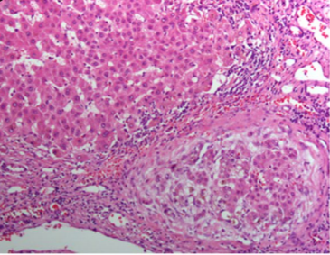
Pre-cirrhotic portal HTN
NRH
Mayo score
Not an indication for transplant
Notes:
Mayo risk score for PBC – age, albumin, PT, Tbil, edema y/n, diuretics y/n. >4.1 is indication to screen.

Slide 34
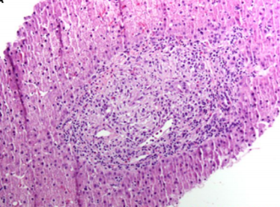
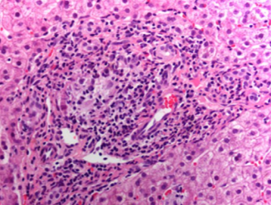
Notes:
Left: Florid duct lesion (intense inflamm and necrosis around bile duct). Right: portal inflammation, focal interface hepatitis

Slide 35
A 44 yo male presents to your clinic as a follow up from recent lab testing. He has history of celiac disease and adheres to GFD. He does not drink alcohol, use illicit drugs, or have high risk behaviors. Family history includes sister with Hashimoto thyroiditis.
He had presented 2 weeks ago with worsening pruritus over a 6 month span without any rash or initiation of new medications. Topical lotions have not helped. He also has subjective fever once every few weeks and intermittent diarrhea despite dietary adherence.
Lab testing show TBili 2.1, AST 57, ALT 48, ALP 475, IgG 1400, IgM 75, ANA neg, ASMA neg, AMA negative
RUQ u/s showed a normal appearing liver and MRCP showed a ‘beaded’ appearance of the intrahepatic bile ducts.

Slide 36
A 44 yo male presents to your clinic as a follow up from recent lab testing. He has history of celiac disease and adheres to GFD. He does not drink alcohol, use illicit drugs, or have high risk behaviors. Family history includes sister with Hashimoto thyroiditis.
He had presented 2 weeks ago with worsening pruritus over a 6 month span without any rash or initiation of new medications. Topical lotions have not helped. He also has subjective fever once every few weeks and intermittent diarrhea despite dietary adherence.
Lab testing show TBili 2.1, AST 57, ALT 48, ALP 475, IgG 1400, IgM 75, ANA neg, ASMA neg, AMA negative
RUQ u/s showed a normal appearing liver and MRCP showed a ‘beaded’ appearance of the intrahepatic bile ducts.

Slide 37
Which of the following does this patient need to be screened for?
  Colon cancer
  Ulcerative colitis
  Gall bladder cancer
  All of the above

Slide 38
PSC
Fibroinflammatory process
  preferentially affects the large, intrahepatic and/or extrahepatic biliary tree
Male 2:1
Assoc with IBD 75%
~5% ‘small duct’ PSC
  Higher correlation with IBD

Slide 39
Diagnosis
MRCP vs ERCP
Who to biopsy?
Notes:
Bx for staging, r/o other causes/overlap, small duct
Large duct can be diagnosed just by imaging.

Slide 40
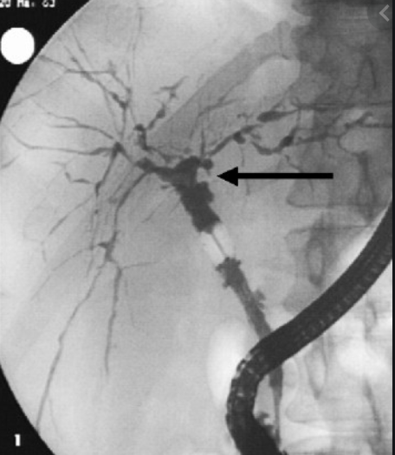
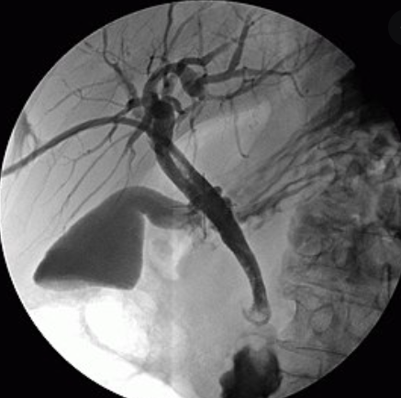

Slide 41
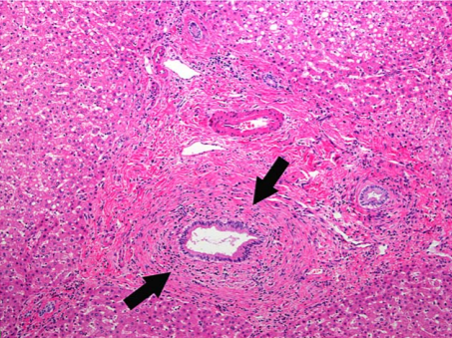
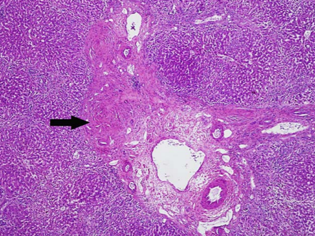
Notes:
Left: Onion skinning, concentric rings of fibrosis. Right: Fibrous plugging, indicates bile duct was present
Notice less inflamm infiltrate than PBC

Slide 42
Treatment
Not much
UDCA didn’t work
Investigational
FXR agonists, PPAR agonists, FGF mimetics – none beyond phase II
Immunomodulators/biologics - No
Gut microbiota altering therapy
  Antibiotics – Vancomycin, metronidazole
  FMT
Notes:
UDCA – late 90s, double blind study, multiyear. LFTs improved but symptoms, disease progression, development of portal HTN and need for transplant did not.
Vanc has reached phase III trials, Initial studies showing improvement in ALP.
Metronidazole improved pruritus but not ALP
Minocycline, tetracycline, rifaximin have been tried unsuccessfully

Slide 43
A patient you follow with non cirrhotic PSC and ulcerative colitis in clinical remission on mesalamine presents to clinic. He notes he recently had a surveillance colonoscopy and was told there were ‘no concerning findings’. He has no acute complaints.
You say wow that’s great and tell him his NEXT colon cancer screening should be in:
  1 year with colonoscopy
  1 year with FIT testing
  5 years with colonoscopy
  5 years with FIT testing

Slide 44
Management
Symptom control similar to PBC
PSC + GB?
  Gallstones more common than general population
  GB polyps
  GB Cancer
PSC + CCA
  Risk factors?
  10 yr cumulative risk ~8%
  Dominant strictures
  CA 19-9 non diagnostic esp if pt symptomatic (unless very high)
  Prognosis is poor, usually found later in course
Notes:
~6% of PSC pts will have a GB polyp. Need to screen with yearly ultrasound. High risk of malignant transformation to adenoCA. Remove gallbladder for GB polyps >0.8 cm, some say any size polyp remove GB.
CCA risk factors: elevated bili, presence/duration of IBD, UC/dysplasia
CCA: surgical resection 3 yr survival <20%.

Slide 45
Management
PSC/IBD/CRC?
  Screen for IBD at time of PSC dx if not known to be present (with protocoled biopsies)
  If no IBD, CRC screening with colonoscopy every 5 years regardless of age
  If yes IBD, annual dysplasia/CRC screening
  IBD activity and PSC progression are not correlative
Overlap syndrome?
Indications for transplant?
  MELD exceptions

Slide 46





Questions?

