Slide 1
Sickle Cell Disease
Michelle Huddleston, MD
September 16, 2025

Slide 2
Objectives
Explain the pathophysiology of sickle cell disease.
List and describe the complications of sickle cell disease by organ system.
Describe the clinical presentation, laboratory findings, and therapeutic management of a patient who presents to the hospital with an acute sickle cell pain crisis.
Describe the indications for simple transfusion and exchange transfusion in a patient with sickle cell disease.
List and describe the medications used to prevent sickling and treat the complications of sickling in the outpatient setting.
Describe the new gene therapy and bone marrow transplant cure for sickle cell disease

Slide 3
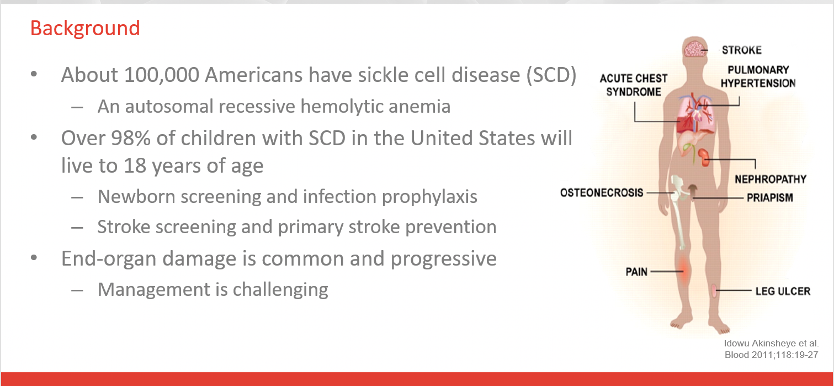

Slide 4
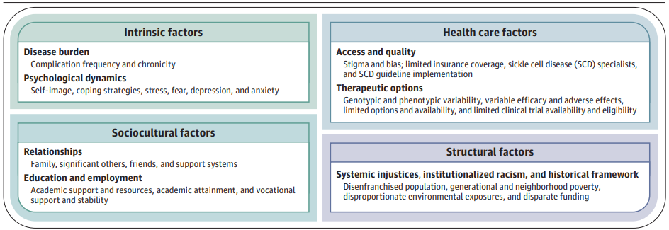
Living with Sickle Cell
Notes:
5 An integral component of an individual living with SCD is the perceived inadequacy of many health care systems,115 underscored by stigma, bias, bidirectional
mistrust, lack of widespread use of evidence-based guidelines,
paucity of therapeutic options, and poor access to SCD clinical
trials.114 In the US, structural systemic injustices and racism experienced by the Black population have perpetuated the disparate outcomes seen in individuals with SCD, as evidenced by the disparate funding between cystic fibrosis and SCD, resulting in fewer treatments and comprehensive care centers, and the inaccurate belief that Black patients perceive pain less than White patients.

Slide 5
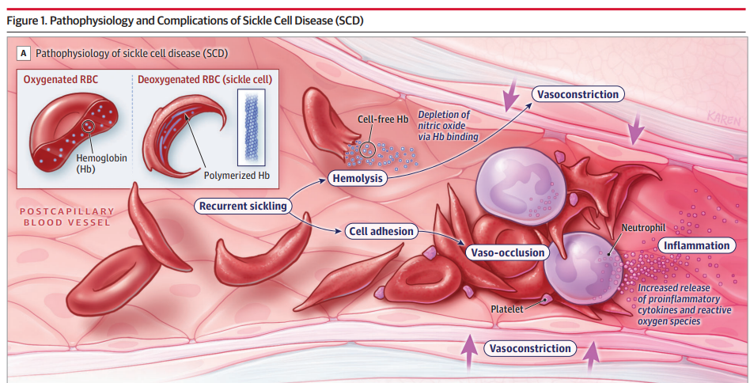
Physiology
Mutation in the Beta Hgb gene
This causes increased Hgb polymerization and sickling of RBC’s
Different genotypes – SS, SC, Sthal
Inflammation, cell adhesion, oxidative injury, hemolysis, vaso-occlusion, endothelial dysfunction
Notes:
A, HbS polymerizes when deoxygenated, inducing recurrent red blood cell (RBC) sickling and hemolysis. The sickled RBCs interact with white blood cells and platelets on vascular endothelium via adhesion molecules which leads to vaso-occlusion. The free Hb and heme released from RBC hemolysis trigger endothelial dysfunction due to depletion of nitric oxide and resultant vasoconstriction. The dual processes of vaso-occlusion and endothelial dysfunction activate inflammatory responses, via increased cytokines and reactive oxygen species, which perpetuates further vaso-occlusion.

Slide 6
Name some complications of sickle cell disease

Slide 7
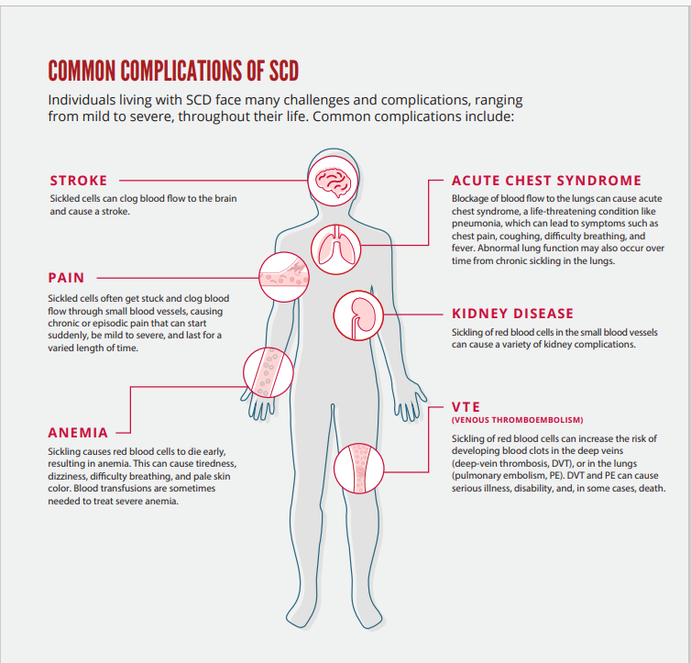

Slide 8
Complications of Sickle Cell Disease
Acute pain and chronic pain syndrome
Functional asplenia and infection
Splenic sequestration
Acute chest syndrome
Cerebrovascular disease and stroke
Neurocognitive deficits
Retinopathy
Priapism
Chronic lung disease
Pulmonary hypertension
Skin ulcers
Osteonecrosis
Chronic kidney disease
Venous Thromboembolism

Slide 9
Acute Chest Syndrome
Diagnostic Criteria
Associated Symptoms
Must have a new segmental infiltrate on CXR that is NOT atelectasis
Fever >38.5
Hypoxia (PaO2<60 mm Hg)
Cough
Wheezing
Tachypnea
Chest Pain

Slide 10
Acute Chest Syndrome
Most common cause of death in sickle cell disease
40% of known causes are infection related
Vaso-occlusion in the pulmonary micro-vasculature
Fat or bone marrow emboli likely involved

Slide 11
Severe Acute Chest Syndrome
High level of mortality
Multiple segmental pulmonary infiltrates
>3L O2 needed in 24 hrs
Multi-organ failure

Slide 12
Management of Acute Chest Syndrome
Simple red cell transfusion for moderate – goal Hgb 10
Red cell exchange transfusion for severe with goal Hgb SS<30%
IVF’s to maintain hydration
Antibiotics – CAP coverage
Incentive Spirometry

Slide 13
Question
A 32 yo female with Hgb SS disease presents with aphasia and hemiparesis that started 2 hrs ago. Her Hgb is 8.5 g/dL. CT head confirms no hemorrhage. What is the next best course of action?
A. tPA only
B. Exchange transfusion only
C. Exchange transfusion and tPA if consistent with institutional guidelines.
D. No further management

Slide 14
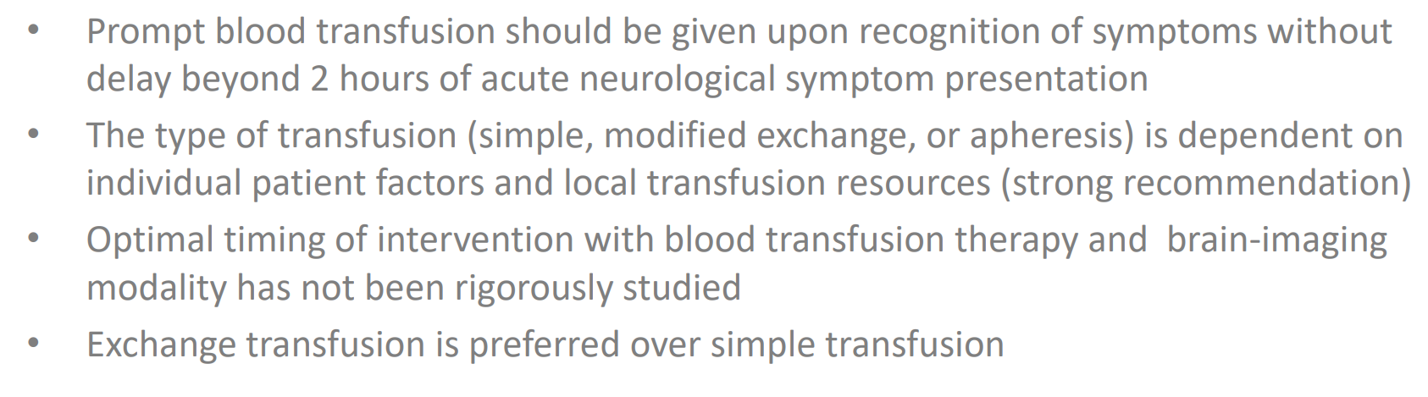
Neurologic Deficits in Sickle Cell Disease

Slide 15
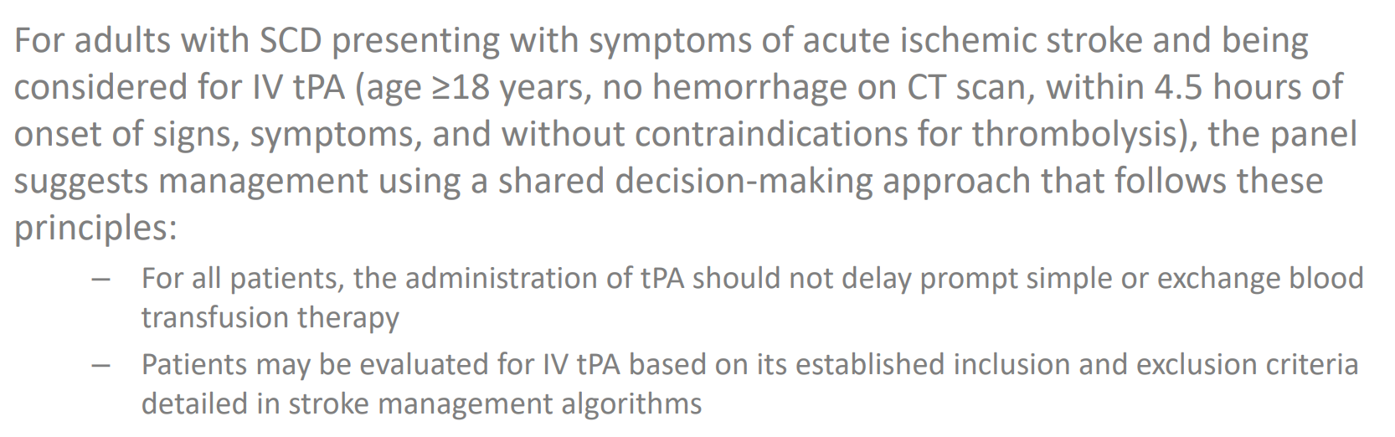
Administration of tPA should never delay prompt blood transfusion

Slide 16
Post Stroke Management
Red cell exchange transfusions every 3-4 weeks – likely for life
Goal is reduce Hgb SS to <30%
Hydroxyurea
Stroke indicates severity of Hgb SS disease and in younger patients is an indication for curative treatment options
25% of sickle cell patients have cerebral infarcts on imaging by adulthood
STOP trial (stroke prevention trial in sickle cell anemia) saw 93% reduction in recurrent stroke with monthly red cell exchanges in the Pediatric population

Slide 17
Pulmonary Hypertension
Present in about 10% of adults with Hgb SS disease
Screen only if symptomatic
ECHO – Elevated PA pressure >20 mm/hg
  if TRVJ >2.9 m/s has 64% PPV alone
  Elevated NT-proBNP>165 can increase PPV
Right heart catheterization for diagnosis
Refer to a pulmonary HTN specialist

Slide 18
Pre-Operative Management
Goal Hgb is 9-10
Increased morbidity & mortality with general anesthesia
Increased risk for ACS
Increased risk for post-op acute VOC

Slide 19
Transfusion Therapy
All patients should have red cell antigen genotyping
Prophylactic red cell Ag matching for Rh and K antigens
They should receive non-Hgb S blood products
Coordination with the blood bank
May require finding matched blood outside of the state

Slide 20
Considerations for Mode of Chronic Transfusion Therapy
Simple Transfusion | Manual Red Cell Exchange | Automated Red Cell Exchange
Peripheral venous access | +/- indwelling central catheter | +/- indwelling central catheter
Least red cell exposure | Intermediate red cell exposure | Most red cell exposure
Iron loading inevitable | Intermediate iron loading | Minimal iron loading
Potential circulatory overload | Minimizes blood volume shifts | Maintains isovolemia
Potential hyperviscosity to reach target HgbS% | Long procedure time to reach target HgbS% | Quickly & precisely reaches target HgbS%
Standard nursing | Requires trained personnel | Requires specialized device and trained personnel

Slide 21
Screening for Iron Overload
Ferritin only if <1,000 – trend is important
MRI T2, R2 of liver every 1-2 years
Consider chelation if liver iron content >5mg/g dry weight
Chelation agents:
  Desferal – IV infusion
  Deferasirox (Exjade) – oral once daily
  Deferiprone (Ferriprox) - oral

Slide 22
Question
A 25-year-old woman with known sickle cell disease (HbSS) presents to the emergency department with severe generalized pain, primarily in her back and limbs. She reports that her usual home regimen of oral hydrocodone and hydration has not relieved her symptoms. She is afebrile, tachycardic, and in visible distress. Her oxygen saturation is 97% on room air, and her physical exam is otherwise unremarkable. What is the most appropriate initial step in management?
A. Begin intravenous fluids and observe for 2 hours before administering analgesia
B. Administer intravenous morphine based on weight and reassess pain within 30 minutes
C. Order a complete blood count and wait for results before initiating treatment
D. Start hydroxyurea therapy immediately
E. Refer to hematology for chronic transfusion planning

Slide 23
ER Management of Acute Pain Crisis
Rapid assessment and analgesia within 1 hour of ED arrival
  Utilization of ED order set and rapid triage is critical
Opioid therapy tailored to prior effective regimens or weight-based dosing
Frequent reassessment every 30–60 minutes to optimize pain control
Use of individualized care plans when available
Some centers have infusion centers to prevent visits to the ER

Slide 24
Diagnosis & Management of Acute VOC in the hospital setting

Slide 25
How do you Diagnose Acute VOC?
There are NO specific labs or images to make this diagnosis
You have to believe the patient is having acute pain over any baseline chronic pain
Recognizing our individual bias towards pain in this population is critical
Their acute pain is almost always undertreated on admission
Initial screening labs
  CBC
  Retic count
  CMP

Slide 26
Name some triggers for an acute VOC

Slide 27
Factors that can cause acute VOC
Infection
Dehydration
Hypoxia
Extreme physical exercise
Psychological stress
Alcohol
Acidosis
Pregnancy
Cold Weather

Slide 28
Mechanisms of Pain
Hypoxia perfusion injury
Inflammation
Increased RBC adhesion
Nervous system sensitization
  Central and peripheral

Slide 29
Management of Acute and Chronic Pain
Individualized approach with an interdisciplinary team
  Individualized Care plan
Pharmacologic
  NSAIDs for 5-7 days
  Opiates
    Continue home opiates
    Within 1 hr of arriving in ER, Q30 mins (intranasal as option) – Care plan
    PCA based on individualized care plan – no basal rate, demand dosing only (in most cases)
    Dose should be higher than their home MME equivalents
  Sub-therapeutic ketamine infusion 0.1 – 0.3 mg/kg/hr up to 1 mg max
  Regional nerve blocks for localized pain
  Duloxetine (SNRI), amitryptiline, gabapentin, muscle relaxants
Non-pharmacologic
  Guided audio-visual, virtual reality, TENS unit, Cognitive Behavioral Therapy
Integrative therapeutic interventions
  Massage, yoga, acupunture

Slide 30
Disease Targeted Therapies

Slide 31
Disease Targeted Treatment
Hydroxyurea – 15mg/kg/day starting dose
CBC monthly with dose adjustments
Increases HgbF, increased RBC size – elevated MCV
Study in NEJM 299 patients – placebo vs. hydroxyurea
  Reduced pain crises by 50%, reduced hospital stays
  Reduced incident of acute chest syndrome
  Reduced need for RBC transfusion
Side Effects
  Thinning of hair, mild hair loss, nausea, nailbed discoloration
  Monitor for leukopenia, low neutrophils
Notes:
Fetal Hgb inhibits Hgb S polymerization, reducing red cell rigidity and hemolysisa.
Hydroxyurea also increases nitric oxide, decreases red cell adhesion and decreases leukocytes that contribute to vasocclusion

Slide 32
Crizanlizumab (Adakveo)
Mechanism of Action
  Ab that inhibits P-selectin
  P-selectin is on the endothelium and surface of platelets
  Prevents RBC’s from sticking inside of smaller blood vessels
Side Effects: nausea, back pain, joint pain & fever
Monthly infusion
Approved for 16 yrs and older
Can be given in addition to hydroxyurea
Reduces number of VOC

Slide 33
L-glutamine
It’s required for the synthesis of glutathione, NAD and arginine
It protects RBC’s against oxidative injury
Dosed 10-30 gms a day divided BID
Reduced hospitalizations by 33%
Reduced mean length of stay from 11 to 7 days
Can be given in addition to hydroxyurea
Side effects: Constipation, nausea, abdominal pain, headache

Slide 34
Curative Treatment
Hematopoietic Stem Cell Transplant (HSCT) in matched sibling donor
Data is in children but some young adult transplants have been done
Improved outcomes in children <13 years of age
Indications:
  Stroke or high risk of a stroke
  Recurrent acute chest syndrome
  Frequent pain
  If no matched sibling donor, join a clinical trial for an alternative match

Slide 35
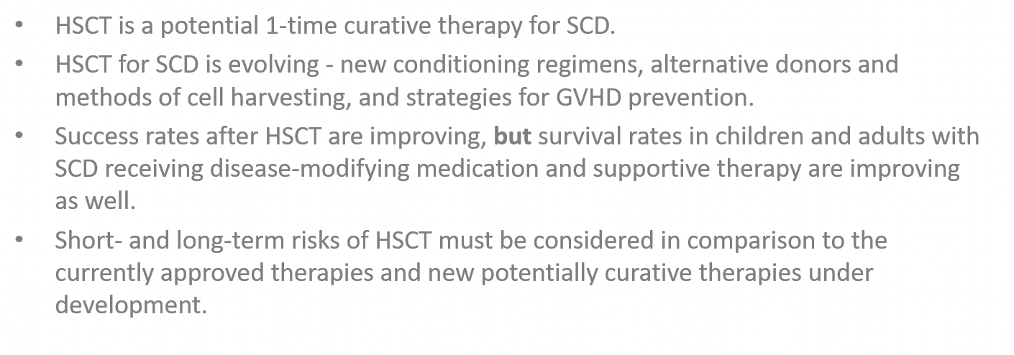
Comparing Stem Cell Transplant and Standard of Care for Sickle Cell Disease

Slide 36
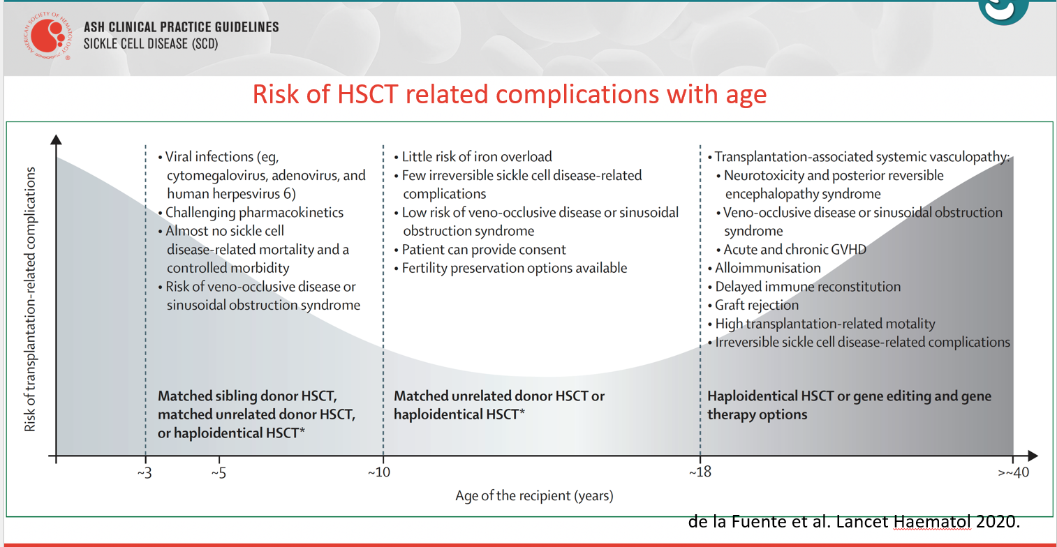

Slide 37
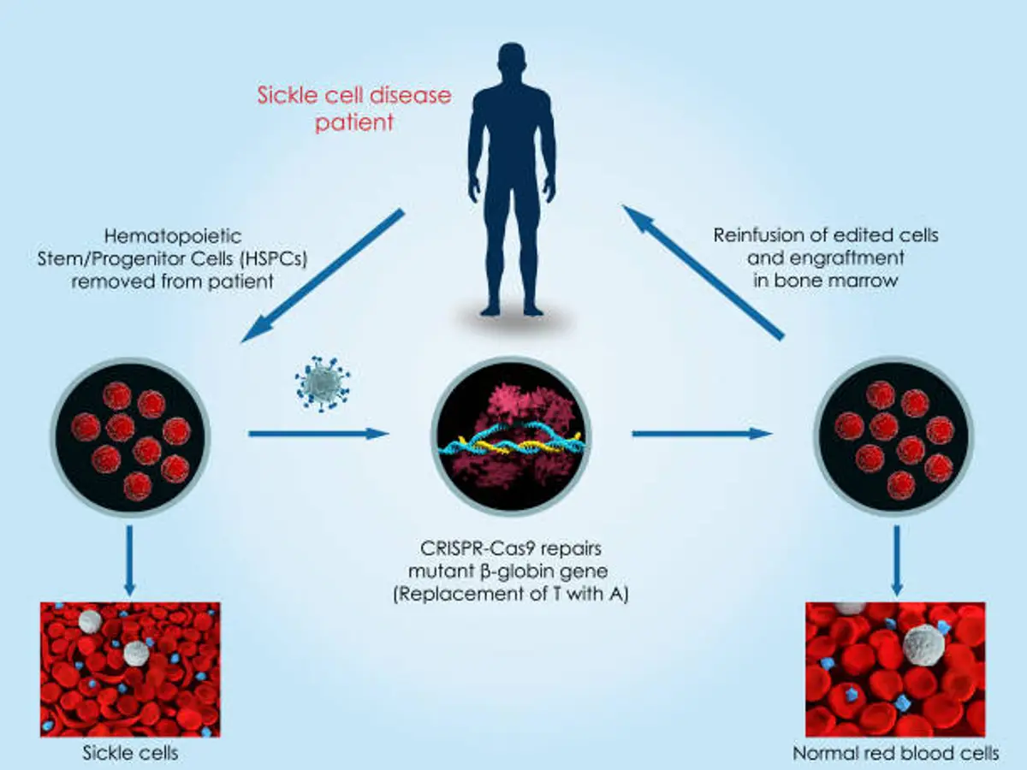
Gene Editing Therapy

Slide 38
Take Home Points
All patients should be on disease targeted therapy
There is no magic lab to diagnose acute pain crisis
Exchange RBC transfusions for severe acute chest syndrome and stroke

