Slide 1
Thrombocytopenia
Shaunak Pandya, MD

Slide 2
Disclosures
None

Slide 3
Learning Objectives
Classify thrombocytopenia by mechanism: decreased production, increased destruction/consumption (ITP, DIC, HIT), and sequestration.
Screen for systemic triggers — viral infection (HIV, HCV), medications, autoimmune disease (SLE), and pregnancy.
Recognize EDTA-dependent pseudothrombocytopenia on the smear before pursuing invasive workup.
Interpret the peripheral smear: schistocytes (TTP/HUS/TMA), giant platelets, and blasts.
Apply secondary tests appropriately — immature platelet fraction, PT/aPTT/fibrinogen, LDH/haptoglobin/DAT.
Identify when bone marrow examination is required for unexplained cytopenias.
Diagnose and urgently treat hematologic emergencies: TTP, HIT, and DIC.
Apply ITP therapy and evidence-based platelet transfusion thresholds — avoiding transfusion in HIT and TTP.

Slide 4
Definition & Clinical Presentation
Thrombocytopenia = platelet count < 150,000/µL.
Platelet-type (primary hemostasis) bleeding involves skin and mucous membranes: petechiae, ecchymoses, epistaxis, menorrhagia, gingival and GI bleeding.
Deep muscle hematomas and hemarthroses suggest a coagulation-factor (secondary hemostasis) defect (Factor VIII or IX deficiency), not isolated thrombocytopenia.
Always correlate the count with the smear and the clinical context.
ASH-SAP, Platelet Disorders.

Slide 5
Bleeding Risk by Platelet Count
< 100,000/µL
Increased bleeding with high-risk major surgery or trauma
< 50,000/µL
Increased bleeding with major invasive procedures
< 20,000/µL
Increased spontaneous mucocutaneous bleeding
< 10,000/µL
Risk of spontaneous intracranial hemorrhage
ASH-SAP, Platelet Disorders.

Slide 6
Platelet Transfusion Thresholds (2025 AABB/ICTMG)
> 10,000/µL
Prophylaxis in stable non-bleeding patients; compressible central-line placement
> 20,000/µL
Lumbar puncture; low-risk invasive/IR procedures
> 50,000/µL
Major surgery; high-risk procedures; active bleeding
> 100,000/µL
Neurosurgery or CNS bleeding
2025 update lowered several prior thresholds — notably lumbar puncture (50k → 20k) and central line (to 10k).
Endoscopy convention: ~20k diagnostic, ~50k for biopsy/polypectomy (ASGE).
Avoid / contraindicated: TTP, HUS, and HIT (thrombotic risk). In ITP, transfuse for severe bleeding, under immunosuppression.
AABB/ICTMG platelet transfusion guideline. JAMA. 2025. • ASGE endoscopy guidance.

Slide 7
Thrombocytopenia in Hospitalized Patients
Often multifactorial — review timing against admissions, procedures, and every new drug.
Common contributors:
  Sepsis and infection
  Medications — antibiotics (linezolid, vancomycin), heparin (think HIT)
  DIC
  Dilution (massive transfusion), cardiopulmonary bypass, mechanical circulatory support
  Liver disease / splenomegaly; underlying hematologic disorder
ASH-SAP, Consultative Hematology.

Slide 8
Thrombocytopenia
Decreased production
Increased destruction / consumption
Sequestration / other
Marrow failure / hypoplasia
Leukemia, lymphoma, myeloma, infiltration
Aplastic anemia, B12/folate deficiency
Medications, alcohol, infection
Immune: ITP, drug-induced, HIT
TMA: TTP, HUS, DIC
Mechanical / infection / sepsis
Hypersplenism (liver disease, portal HTN)
Hemodilution (massive transfusion, bypass)
Gestational thrombocytopenia
Pseudothrombocytopenia (EDTA clumping)
ASH-SAP, Platelet Disorders.

Slide 9
Initial Approach: History, Exam, Smear
History: bleeding, timing/duration, medications (incl. heparin), alcohol, infection, family history, pregnancy.
Exam: mucocutaneous bleeding, splenomegaly, lymphadenopathy, stigmata of liver disease.
CBC with differential: isolated vs. multilineage cytopenia?
Review the peripheral smear
  Clumped platelets → pseudothrombocytopenia (EDTA); repeat in citrate/heparin tube
  Schistocytes → microangiopathy (TTP, HUS, DIC)
  Giant platelets → high turnover (ITP) or inherited macrothrombocytopenia
  Blasts / dysplasia/ leukoerythroblastic changes → primary marrow disorder
ASH-SAP, Platelet Disorders. • Provan D, et al. Blood Adv. 2019;3(22):3780.

Slide 10
Secondary Causes & Antiphospholipid Syndrome
Screen for treatable secondary causes of immune thrombocytopenia: HIV, HCV, H. pylori, SLE, CVID, lymphoproliferative disorders, and medications.
Antiphospholipid syndrome (APS): thrombocytopenia + thrombosis (arterial/venous) + pregnancy loss.
  Antibodies: lupus anticoagulant, anti-cardiolipin, anti-β2-glycoprotein I (persistently positive ≥ 12 weeks apart).
  Thrombocytopenia is usually mild and does not protect against thrombosis — still anticoagulate for events.
Catastrophic APS (CAPS): rapid multi-organ small-vessel thrombosis; can mimic TMA; high mortality.
Evans syndrome: ITP + autoimmune hemolytic anemia (DAT positive).
Treat the underlying condition — thrombocytopenia often improves.
ASH-SAP, Platelet Disorders / Consultative Hematology.

Slide 11
Secondary Testing
Immature / reticulated platelet fraction
High = active production (destruction/consumption); Low = impaired marrow production
Reticulocyte count, LDH, haptoglobin, indirect bilirubin
Screen for hemolysis / microangiopathy (MAHA)
PT/INR, aPTT, fibrinogen, D-dimer
Distinguish DIC (abnormal) from ITP (normal coagulation)
Direct antiglobulin test (DAT)
Coombs+ anemia with ITP = Evans syndrome
HIV, HCV; consider H. pylori
Common, treatable secondary causes of immune thrombocytopenia
SPEP/IFE + serum free light chains; ANA
Plasma cell dyscrasia; SLE / connective tissue disease
ASH-SAP, Platelet Disorders. • Neunert C, et al. Blood Adv. 2019;3(23):3829.

Slide 12
When Is Bone Marrow Examination Needed?
Bone marrow exam is NOT routinely required to diagnose ITP.
Pursue marrow examination when the picture is atypical or a primary marrow disorder is suspected:
  Multilineage cytopenias or unexplained anemia/leukopenia
  Blasts, teardrop cells, or leukoerythroblastic smear
  Lymphadenopathy or unexplained splenomegaly
  Older adults where myelodysplasia is a concern
  Failure to respond to appropriate ITP therapy
In ITP the marrow shows normal or increased megakaryocytes
ASH-SAP, Platelet Disorders. • Neunert C, et al. Blood Adv. 2019;3(23):3829.

Slide 13
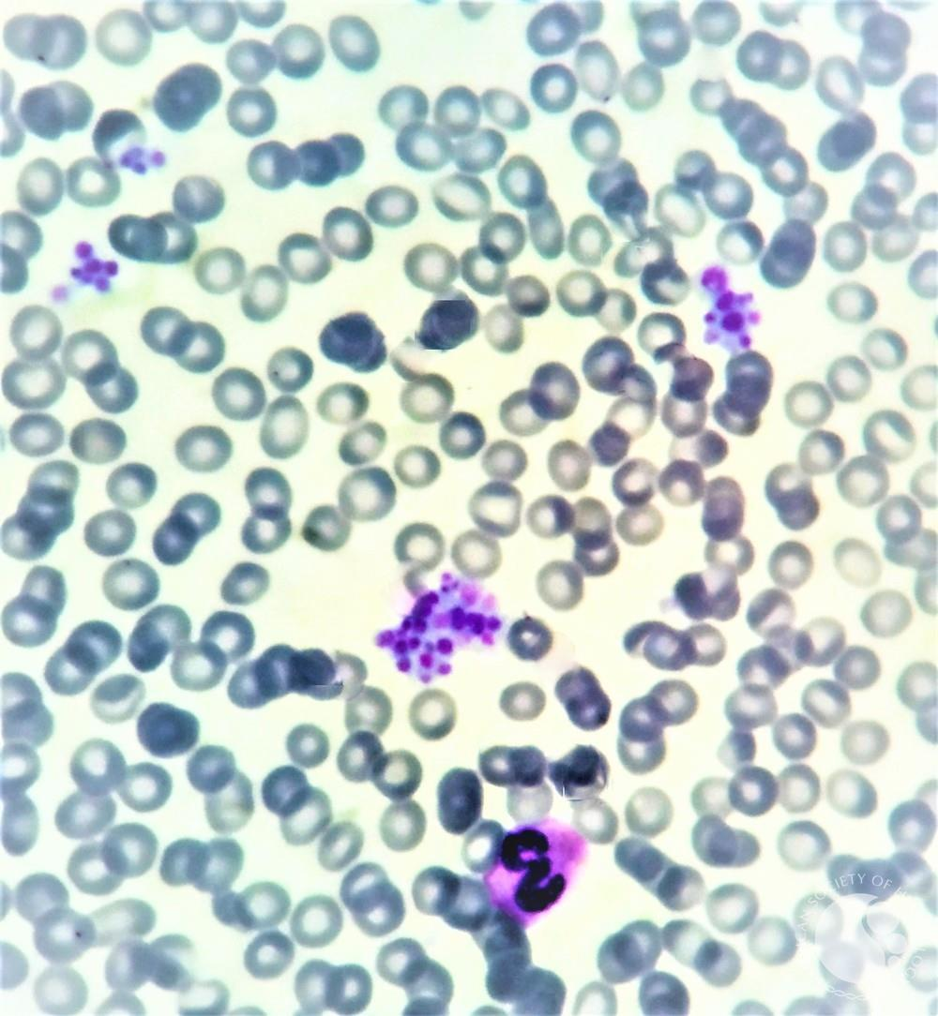
Case 1
A 39-year-old man with no medical history presents for an annual visit. He has no complaints, takes no medications, and does not smoke or drink. Prior labs were normal. CBC with differential now shows new thrombocytopenia with a platelet count of 80,000/µL and is otherwise normal. CMP is normal.
Courtesy, American Society of Hematology Image Bank
Which of the following is the next best step?
A. Obtain antiplatelet antibody testing
B. Start prednisone
C. Review the smear and repeat the count in a citrated or heparinized tube
D. Perform bone marrow biopsy

Slide 14
Case 1 — Answer & Rationale
ANSWER: C — Review the smear; repeat the count in a citrated or heparinized tube
Isolated thrombocytopenia in a well patient with a discrepant count is classic for pseudothrombocytopenia.
Caused by EDTA-dependent agglutinating antibodies → platelet clumping in the EDTA (purple-top) tube; the analyzer undercounts.
The smear shows clumped platelets — confirm before any invasive workup.
Repeat the count in citrate or heparin; the true count is normal.
Recognizing this avoids unnecessary testing, steroids, or transfusion.
ASH-SAP, Platelet Disorders.

Slide 15
Immune Thrombocytopenia (ITP)
Autoimmune disorder: antiplatelet antibodies (e.g., anti-GPIIb/IIIa, anti-GPIb) → splenic/hepatic clearance and impaired production.
A diagnosis of exclusion — isolated thrombocytopenia with an otherwise normal CBC and smear.
Primary (no cause) vs. secondary (HIV, HCV, H. pylori, SLE, CVID, lymphoproliferative disorders, drugs).
Often preceded by viral illness; ~80% of childhood ITP is self-limited, whereas ~75% of adult ITP becomes chronic.
No gold-standard test — antiplatelet antibody assays have only ~50–60% sensitivity and are NOT recommended for diagnosis.
Duration: newly diagnosed (<3 mo), persistent (3–12 mo), chronic (>12 mo).
Neunert C, et al. Blood Adv. 2019;3(23):3829. • ASH-SAP, Platelet Disorders.

Slide 16
Case 2
A 24-year-old psychiatry resident presents with petechiae for 2 weeks. She had COVID-19 one month ago, rarely drinks alcohol, and takes no medications. Vital signs are normal. CBC with differential shows isolated thrombocytopenia with a platelet count of 30,000/µL and is otherwise normal. CMP is normal. Repeat count in a citrated tube and review of the smear confirm true thrombocytopenia with normal-to-large platelets and no schistocytes.
Which of the following is the next best step?
A. Bone marrow biopsy
B. Platelet transfusion
C. Diagnose ITP; observe or treat based on bleeding and count
D. Urgent splenectomy

Slide 17
Case 2 — Answer & Rationale
ANSWER: C — This is primary ITP; manage by count and bleeding
Isolated thrombocytopenia, normal smear (large platelets), recent viral trigger, no other cause → ITP, a clinical diagnosis of exclusion.
Antiplatelet antibody testing and routine bone marrow biopsy are not indicated in this typical presentation.
Management is driven by count and bleeding: observe if ≥ 30,000/µL and asymptomatic; treat with corticosteroids ± IVIG if < 30,000/µL or bleeding.
Neunert C, et al. Blood Adv. 2019;3(23):3829. • ASH-SAP, Platelet Disorders.

Slide 18
ITP — Treatment
When to treat
Second-line/Refractory
Treat if platelets < 30,000/µL or clinically significant bleeding.
Observe stable, asymptomatic patients with counts ≥ 30,000/µL.
Goal is a hemostatic count, not a normal count.
TPO-receptor agonists (romiplostim, eltrombopag, avatrombopag): ~80% platelet response, durable;
Rituximab: ~60-70% initial response; ~20–25% durable at 5 years.
Fostamatinib (Syk inhibitor).
Rilzabrutinib (TKI)
Immunosuppressive agents (MMF, Cyclophosphamide)
Splenectomy: 60–70% durable long-term remission; reserved given effective medical options.
First-line
Corticosteroids (dexamethasone 40 mg × 4 days, or prednisone 1mg/kg).
IVIG 1g/kg daily x1-2 days (or anti-D) when a rapid rise is needed or with bleeding.
ASH 2019: short corticosteroid course over prolonged steroids in adults.
Neunert C, et al. Blood Adv. 2019;3(23):3829.

Slide 19
Drug-Induced & Alloimmune Thrombocytopenia
Drug-induced immune thrombocytopenia
Alloimmune thrombocytopenias
Abrupt, severe thrombocytopenia 1–2 weeks after starting a drug (or promptly on re-exposure).
Classic culprits: quinine, sulfonamides, vancomycin, penicillins/cephalosporins, GPIIb/IIIa inhibitors.
Mechanisms: hapten and drug-dependent antibodies.
Management: stop the drug; recovery usually within ~1-3 weeks.
Post-transfusion purpura: severe thrombocytopenia ~5–10 days after transfusion (anti-HPA-1a); treat with IVIG.
Platelet transfusion refractoriness: HLA alloimmunization in heavily transfused patients → may require HLA-matched platelets.
ASH-SAP, Platelet Disorders.

Slide 20
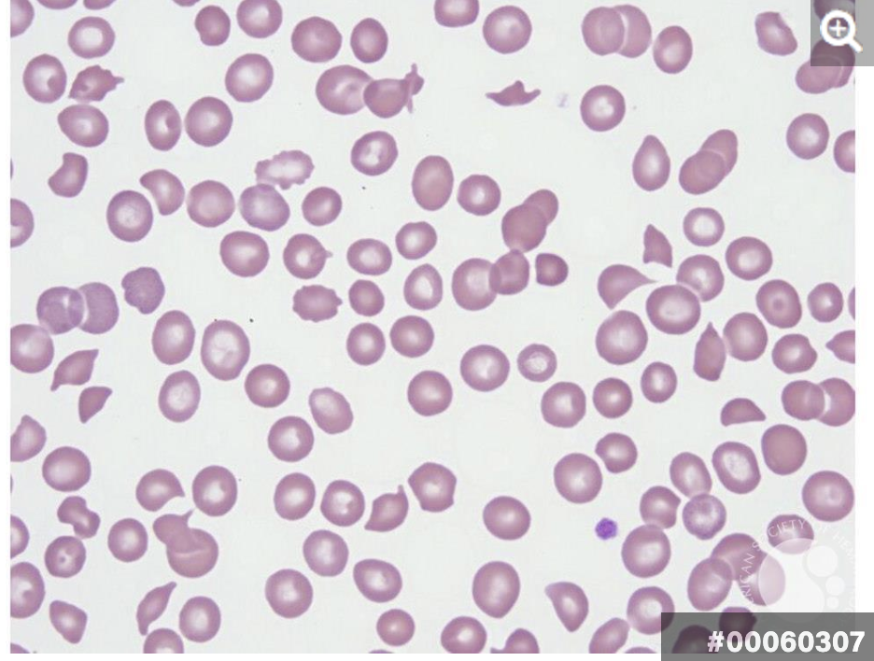
Thrombotic Microangiopathy (TMA)
Suspect TMA when you see MAHA + thrombocytopenia.
Hallmarks: schistocytes, high LDH, low haptoglobin, elevated indirect bilirubin, negative DAT.
Differential of MAHA + thrombocytopenia:
  TTP — severe ADAMTS13 deficiency (neuro/renal, platelets often < 30k)
  HUS — Shiga-toxin (STEC) or complement-mediated (atypical)
  DIC — abnormal coagulation studies distinguish it
  Secondary: pregnancy (HELLP), malignancy, drugs, transplant, APS/SLE
TTP and HIT → platelet transfusion is generally avoided.
George JN, Nester CM. N Engl J Med. 2014;371:654. • ASH-SAP, Platelet Disorders.

Slide 21
Case 3
A 44-year-old woman presents with confusion for 1 hour. She is found to have an acute ischemic stroke and an AKI. CBC with differential shows normocytic anemia (hemoglobin 7 g/dL), normal WBC and differential, and thrombocytopenia with a platelet count of 6,000/µL. Urine pregnancy test is negative. Labs show hemolysis (high LDH, low haptoglobin), and the smear shows 3+ schistocytes.
Which of the following is the next best step?
A. Repeat the count in a citrated tube
B. Administer tPA for stroke
C. Transfuse platelets before further workup
D. Send ADAMTS13, start plasma exchange, and give corticosteroids

Slide 22
Case 3 — Answer & Rationale
ANSWER: D — Send ADAMTS13, start plasma exchange, and give corticosteroids
MAHA + severe thrombocytopenia + neurologic and renal involvement = TTP until proven otherwise — a medical emergency.
Do NOT wait for the ADAMTS13 result to start therapy; untreated mortality approaches 80–90%.
Urgent plasma exchange (PLEX) plus corticosteroids; add caplacizumab and/or rituximab
Avoid platelet transfusion unless life-threatening bleeding — it can fuel microvascular thrombosis.
Send ADAMTS13 and a stool Shiga-toxin study to sort TTP vs. HUS.
Zheng XL, et al. J Thromb Haemost. 2020;18:2486. • Scully M, et al. N Engl J Med. 2019;380:335.

Slide 23
TTP — Pathophysiology & Diagnosis
ADAMTS13 cleaves ultra-large von Willebrand factor multimers.
Severe deficiency (usually < 10%) → uncleaved multimers trap platelets → microvascular thrombosis.
Acquired (autoantibody, ~90%) or hereditary (Upshaw-Schulman).
Classic pentad (rarely all present): MAHA, thrombocytopenia, neurologic signs, renal dysfunction, fever.
Survival with treatment ~85%; without treatment ~10%.
PLASMIC score — pretest probability
Platelets < 30k
Hemolysis (retic/bilirubin/haptoglobin)
No active cancer
No transplant
MCV < 90 fL
INR < 1.5
Creatinine < 2.0 mg/dL
Low 0–4 • Intermediate 5 • High 6–7
High score → empiric PLEX while awaiting ADAMTS13.
Bendapudi PK, et al. Lancet Haematol. 2017;4:e157. • Zheng XL, et al. J Thromb Haemost. 2020;18:2486.

Slide 24
TTP — Management
Plasma exchange (PLEX) — first-line; mortality 80–90% → <10–20%. Start emergently on clinical suspicion.
Corticosteroids for the autoantibody (e.g., methylprednisolone/prednisone).
Steroids: continue through PLEX and clinical response; taper after platelets are sustained > 150k off PLEX (typically over ~2–4 weeks).
Caplacizumab (anti-vWF): HERCULES — faster platelet normalization; composite of TTP-related death, recurrence, or major thromboembolism 12% vs 49% (vs placebo); fewer PLEX days; ↑ mucocutaneous bleeding.
Rituximab: Early/upfront per ISTH reduces relapse risk; also use in refractory/relapsing disease;
Hereditary TTP: plasma infusion or recombinant ADAMTS13.
  Follow-up: ADAMTS13 monitoring to anticipate relapse.
Zheng XL, et al. J Thromb Haemost. 2020;18:2486. • Scully M, et al. N Engl J Med. 2019;380:335 (HERCULES).

Slide 25
Hemolytic Uremic Syndrome (STEC-HUS)
Shiga-toxin–producing E. coli (O157:H7, O104:H4); toxin injures endothelium.
Presents with bloody diarrhea followed by AKI and MAHA; predominantly affects children.
Diagnosis: stool culture / Shiga-toxin PCR.
Treatment is largely supportive — fluids, electrolytes, dialysis as needed.
Avoid antibiotics and antimotility agents — may increase toxin release and HUS risk.
PLEX is not routinely effective (unlike TTP)
Distinguish from TTP (ADAMTS13) and atypical HUS (complement)
George JN, Nester CM. N Engl J Med. 2014;371:654. • ASH-SAP, Platelet Disorders.

Slide 26
Atypical HUS (Complement-Mediated)
Dysregulation of the alternative complement pathway → endothelial injury and TMA.
Often renal-predominant; frequently NO diarrhea. May be triggered by infection, pregnancy, drugs.
Diagnosis of exclusion: ADAMTS13 > 10% (not TTP), negative Shiga toxin (not STEC), exclude secondary TMA.
Diagnostics: Complement Factor H (CFH) Antibody, complement gene testing
  CH50, C5b-9, C3, C4 have low sensitivity/specificity
Treatment: anti-C5 therapy — eculizumab or ravulizumab.
  Improves platelet count, renal function, and TMA event-free survival (Legendre 2013).
  Meningococcal vaccination + prophylaxis before anti-C5 therapy.
  Duration: unknown/indefinitey; may consider discontinuation in selected patients
Legendre CM, et al. N Engl J Med. 2013;368:2169.

Slide 27
Disseminated Intravascular Coagulation
Systemic activation of coagulation → microthrombi + consumption of platelets and factors → bleeding and/or thrombosis.
Triggers: sepsis, trauma, malignancy, obstetric complications, severe pancreatitis.
Labs: thrombocytopenia, prolonged PT/aPTT, low fibrinogen, elevated D-dimer, schistocytes.
ISTH overt-DIC score (platelets, PT, fibrinogen, fibrin markers): ≥ 5 is compatible with DIC.
Treatment
Treat the underlying cause
Transfuse platelets and cryoprecipitate for bleeding (10 units of cryo raises fibrinogen ~50 - 100mg/dL; keep > 100, or > 150 if bleeding).
FFP for factor replacement when bleeding/procedures.
Avoid antifibrinolytics (TXA, aminocaproic acid) in typical DIC.
Taylor FB, et al. Thromb Haemost. 2001;86:1327 (ISTH).

Slide 28
Thrombocytopenia in Liver Disease
Multifactorial: splenic sequestration (portal hypertension), reduced hepatic thrombopoietin, and marrow suppression (alcohol, HCV).
"Rebalanced hemostasis": cirrhosis reduces both pro- and anticoagulant factors — platelet count and INR poorly predict bleeding risk.
Avoid reflexive correction of numbers before low-risk procedures (e.g., paracentesis).
For pre-procedural thrombocytopenia, an oral TPO-receptor agonist can raise the count and reduce transfusions.
  Options: avatrombopag (Doptelet), lusutrombopag (Mulpleta)
ASH-SAP, Consultative Hematology.

Slide 29
Avatrombopag (Doptelet) — Pre-Procedural CLD
Use & dosing
Evidence (ADAPT-1 / ADAPT-2)
Oral TPO-receptor agonist approved for thrombocytopenia in chronic liver disease undergoing a procedure.
Baseline < 40k → 60 mg daily × 5 days; 40–<50k → 40 mg daily × 5 days.
Begin 10–13 days before the procedure; perform procedure 5–8 days after the last dose.
watch for thromboembolism (e.g., portal vein).
Primary endpoint: no platelet transfusion or rescue for bleeding through 7 days post-procedure.
40-mg cohort: ~88% (ADAPT-1) / ~88% (ADAPT-2) vs ~38% / ~33% placebo (p<0.001).
60-mg cohort: ~66% / ~69% vs ~23% / ~35% placebo.
Mean platelets rose ~44 → 81 ×10⁹/L (higher-count cohort).
Alternative: lusutrombopag (Mulpleta).
Terrault N, et al. Gastroenterology. 2018;155(3):705 (ADAPT-1/ADAPT-2).

Slide 30
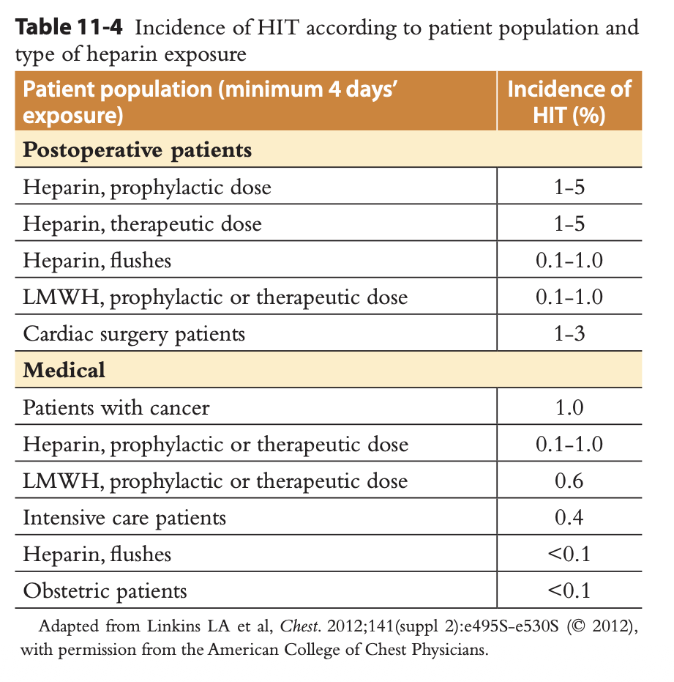
Heparin-Induced Thrombocytopenia — Pathophysiology
Immune reaction to platelet factor 4 (PF4)–heparin complexes.
IgG antibodies against PF4–heparin bind platelets via the FcγRIIa receptor → platelet activation.
Activated platelets generate procoagulant microparticles and thrombin → a prothrombotic state.
This is why HIT causes thrombosis, not bleeding — despite the low platelet count.
Occurs in ~1–5% with unfractionated heparin, less with LMWH.
Cuker A, et al. Blood Adv. 2018;2(22):3360.

Slide 31
HIT — Clinical Features & Diagnosis
The 4 T's (pretest probability)
Confirmatory testing
Thrombocytopenia — magnitude of fall (> 50% typical)
Timing — fall at days 5–10 after heparin (or < 1 day if recent exposure)
Thrombosis — new venous or arterial event
Other causes absent
Score 0–3 low (high NPV) • 4–5 intermediate • 6–8 high
Platelet count typically 50–70k; nadir rarely < 20k.
Anti-PF4/heparin ELISA (immunoassay): detects antibodies to PF4–heparin. Very sensitive (~99%, excellent NPV) but low specificity; reported as optical density — higher OD → higher likelihood of true HIT.
Serotonin release assay (SRA): functional gold standard. Patient serum + donor platelets + therapeutic vs high heparin; measures ¹⁴C-serotonin release. HIT = release at therapeutic heparin
Test only if 4T intermediate/high — a low score effectively excludes HIT.
Cuker A, et al. Blood Adv. 2018;2(22):3360. • Lo GK, et al. J Thromb Haemost. 2006;4:759 (4Ts).

Slide 32
Case 4
A 65-year-old man with hypertension and diabetes presents with a STEMI and undergoes emergent PCI, receiving unfractionated heparin. CBC on arrival: hemoglobin 10.5 g/dL, WBC 13,000/µL, platelets 130,000/µL. Six days later he develops a right leg DVT, and his platelet count has fallen to 60,000/µL. He is otherwise asymptomatic.
Which of the following is the next best step?
A. Transfuse platelets
B. Continue heparin and observe
C. Stop all heparin; start a non-heparin anticoagulant (e.g., argatroban) and send PF4 antibody + SRA
D. Stop heparin and start warfarin now

Slide 33
Case 4 — Answer & Rationale
ANSWER: C — Stop all heparin; start a non-heparin anticoagulant and test for HIT
Platelet fall > 50% at day ~5–10 with new thrombosis and no alternative cause → high 4T score, HIT.
Stop ALL heparin (including flushes/LMWH) immediately and start a non-heparin anticoagulant — argatroban or bivalirudin (DTIs), fondaparinux, or a DOAC.
Send anti-PF4/heparin ELISA and confirm with SRA; image for occult thrombosis to set anticoagulation duration.
Cuker A, et al. Blood Adv. 2018;2(22):3360.

Slide 34
HIT — Management
Stop all heparin exposure (IV, subcutaneous, flushes, LMWH-coated catheters).
Start a non-heparin anticoagulant at therapeutic dose:
  Argatroban or bivalirudin (direct thrombin inhibitors)
  Fondaparinux or a DOAC in appropriate stable patients
Warfarin is contraindicated until platelets recover (≥ 150k) due to transient hypercoagulability; then overlap.
Avoid prophylactic platelet transfusion.
Evaluate for thrombosis (e.g., lower-extremity duplex); anticoagulate ≥ 4 weeks (isolated HIT) or ≥ 3 months (HIT with thrombosis).
Document a heparin allergy; use non-heparin agents in the future.
Cuker A, et al. Blood Adv. 2018;2(22):3360.

Slide 35
Thrombocytopenia in Pregnancy
Occurs in 5–10% of pregnancies; the differential shifts by trimester and severity.
Gestational thrombocytopenia (~75%): mild, usually > 70–100k, 3rd trimester, no fetal effect, resolves postpartum — no treatment.
ITP: can occur any trimester, may be < 50k, may need steroids/IVIG; can cause neonatal thrombocytopenia.
Preeclampsia / HELLP: hypertension + hemolysis, elevated LFTs, low platelets (see next slide).
TTP / aHUS: severe MAHA; TTP often 2nd/3rd trimester; aHUS can occur postpartum.
Platelet count < 70k in pregnancy warrants evaluation beyond gestational thrombocytopenia.
Cines DB, Levine LD. Blood. 2017;130(21):2271.

Slide 36
HELLP Syndrome
Recognition
Management & pitfalls
Severe variant of preeclampsia: Hemolysis, Elevated Liver enzymes, Low Platelets.
3rd trimester or postpartum; RUQ/epigastric pain, nausea, malaise; hypertension may be mild or absent.
Labs: MAHA with schistocytes, high LDH, elevated AST/ALT, platelets < 100k.
Prompt delivery is definitive treatment.
Supportive: BP control, magnesium for seizure prophylaxis, antenatal steroids for fetal lung maturity per OB.
True HELLP improves after delivery — if hemolysis/thrombocytopenia persists > 48–72 h, reconsider TTP or aHUS.
Differentiate: TTP (more neuro, normal LFTs), aHUS (renal-predominant, persists), acute fatty liver of pregnancy.
Cines DB, Levine LD. Blood. 2017;130(21):2271.

Slide 37
Thrombocytopenia Summary
Framework: decreased production vs. increased destruction/consumption vs. sequestration.
1
Confirm it's real — Review smear → clumps = pseudothrombocytopenia (repeat in citrate)
2
Isolated or multilineage? — Multilineage or blasts → marrow disorder; consider bone marrow exam
3
Schistocytes? — MAHA + low platelets → TMA: TTP / HUS / DIC (check coags, hemolysis)
4
Heparin exposure? — Falling count days 5–10 ± thrombosis → HIT (4T score, PF4, SRA)
5
Screen secondary causes — HIV/HCV, meds, SLE/APS, pregnancy, liver disease/splenomegaly
6
Isolated, otherwise well? — Diagnosis of exclusion → ITP; treat by count and bleeding
ASH-SAP, Platelet Disorders.

Slide 38
References
Neunert C, Terrell DR, Arnold DM, et al. American Society of Hematology 2019 guidelines for immune thrombocytopenia. Blood Adv. 2019;3(23):3829–3866.
Provan D, Arnold DM, Bussel JB, et al. Updated international consensus report on the investigation and management of primary immune thrombocytopenia. Blood Adv. 2019;3(22):3780–3817.
Cuker A, Arepally GM, Chong BH, et al. American Society of Hematology 2018 guidelines for management of venous thromboembolism: heparin-induced thrombocytopenia. Blood Adv. 2018;2(22):3360–3392.
Lo GK, Juhl D, Warkentin TE, et al. Evaluation of pretest clinical score (4 T's) for the diagnosis of heparin-induced thrombocytopenia. J Thromb Haemost. 2006;4(4):759–765.
Zheng XL, Vesely SK, Cataland SR, et al. ISTH guidelines for the diagnosis and treatment of thrombotic thrombocytopenic purpura. J Thromb Haemost. 2020;18:2486–2510.
Scully M, Cataland SR, Peyvandi F, et al. Caplacizumab treatment for acquired thrombotic thrombocytopenic purpura (HERCULES). N Engl J Med. 2019;380(4):335–346.
Bendapudi PK, Hurwitz S, Fry A, et al. Derivation and external validation of the PLASMIC score for thrombotic microangiopathies. Lancet Haematol. 2017;4(4):e157–e164.
Legendre CM, Licht C, Muus P, et al. Terminal complement inhibitor eculizumab in atypical hemolytic–uremic syndrome. N Engl J Med. 2013;368(23):2169–2181.
Taylor FB Jr, Toh CH, Hoots WK, et al. Towards a scoring system for disseminated intravascular coagulation. Thromb Haemost. 2001;86(5):1327–1330.
Terrault N, Chen YC, Izumi N, et al. Avatrombopag before procedures reduces need for platelet transfusion in chronic liver disease (ADAPT-1/ADAPT-2). Gastroenterology. 2018;155(3):705–718.
AABB/ICTMG. Platelet transfusion: 2025 international clinical practice guidelines. JAMA. 2025.
Cines DB, Levine LD. Thrombocytopenia in pregnancy. Blood. 2017;130(21):2271–2277.
American Society of Hematology Self-Assessment Program (ASH-SAP): Platelet Disorders; Consultative Hematology.

