Slide 1
Chronic Heart Failure
Radha Gopalan, M.D. FACC.
Clinical Professor of Medicine
Center Director, Advanced Heart Disease
Director, AHF and Transplant Fellowship Program
UA College of Medicine and Banner University Hospital, Phoenix

Slide 2
Definition of HF
HF is a complex clinical syndrome with symptoms and signs that result from any structural or functional impairment of ventricular filling or ejection of blood.
Asymptomatic stages are considered at-risk for HF (stage A) or pre-HF (stage B).
ACC/AHA guidelines 2022

Slide 3
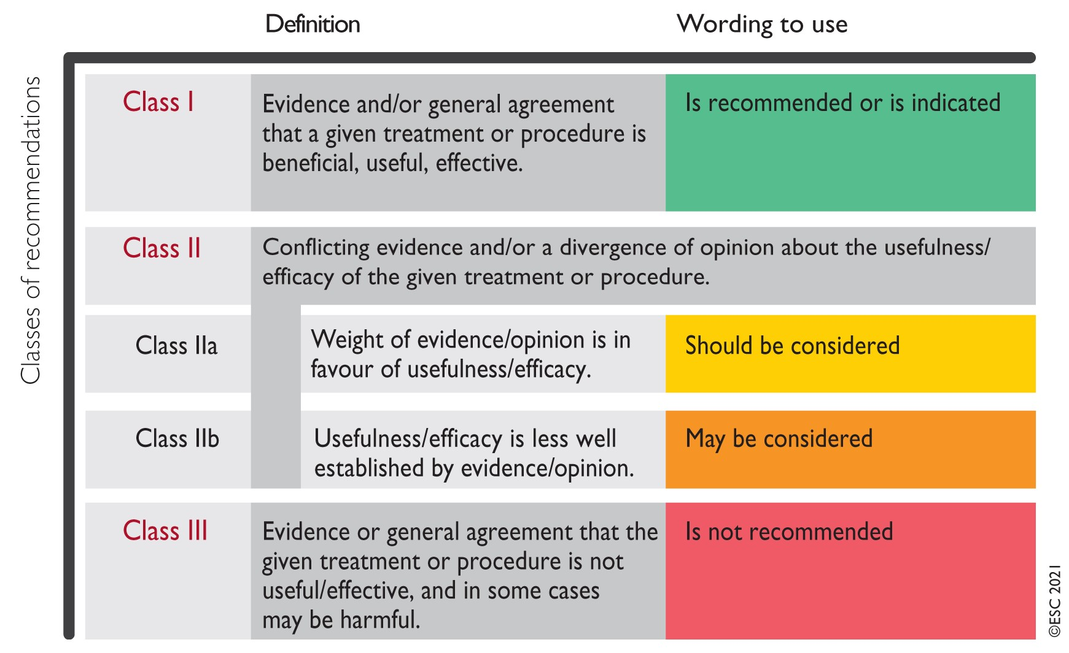
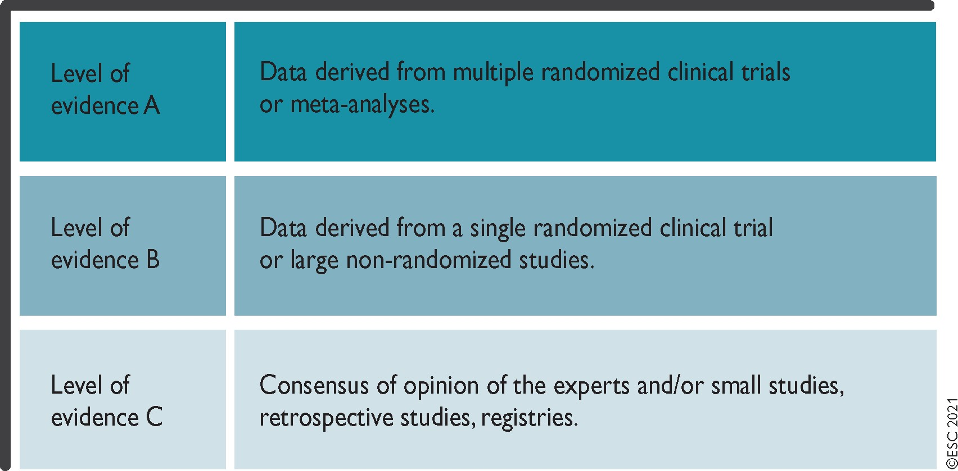
Guide to Recommendations
ESC

Slide 4
Question #1
35 yo woman presents with HFrEF and nonischemic cardiomyopathy. Her older sister also had this condition. One year ago, where she went to the emergency department for swelling of her lips which required an IV medication. Three months ago, she was found to have a painful breast lesion which is still being evaluated. She appears compensated on examination but is breathless at 2 blocks. Blood pressure is 120/75 and HR 54. Her labs are notable for a normal Na, K, Cr and a NT-proBNP of 1300. Which of the following medications should be started now?
A. Sacubitril/valsartan (ARNI)
B. Enalapril
C. Valsartan
D. Carvedilol
E. Spironolactone

Slide 5
Question #2
Which of the following is true regarding beta-blockers (BBL) in HFrEF?
A. Favorable LV reverse remodeling may occur 1 year or longer after BBL are started.
B. If the LVEF does not increase at all, the BBL should be stopped even if patient is otherwise tolerating them
C. If a patient is already on atenolol for hypertension and develops HFrEF, continuing that medication is reasonable
D. In patients with new-onset HFrEF, BBL should be started after hospital discharge once clinical stability is confirmed in the ambulatory setting
E. The average increase in LVEF with Beta-Blockers for all-comers with HFrEF is an absolute 20% increase.

Slide 6

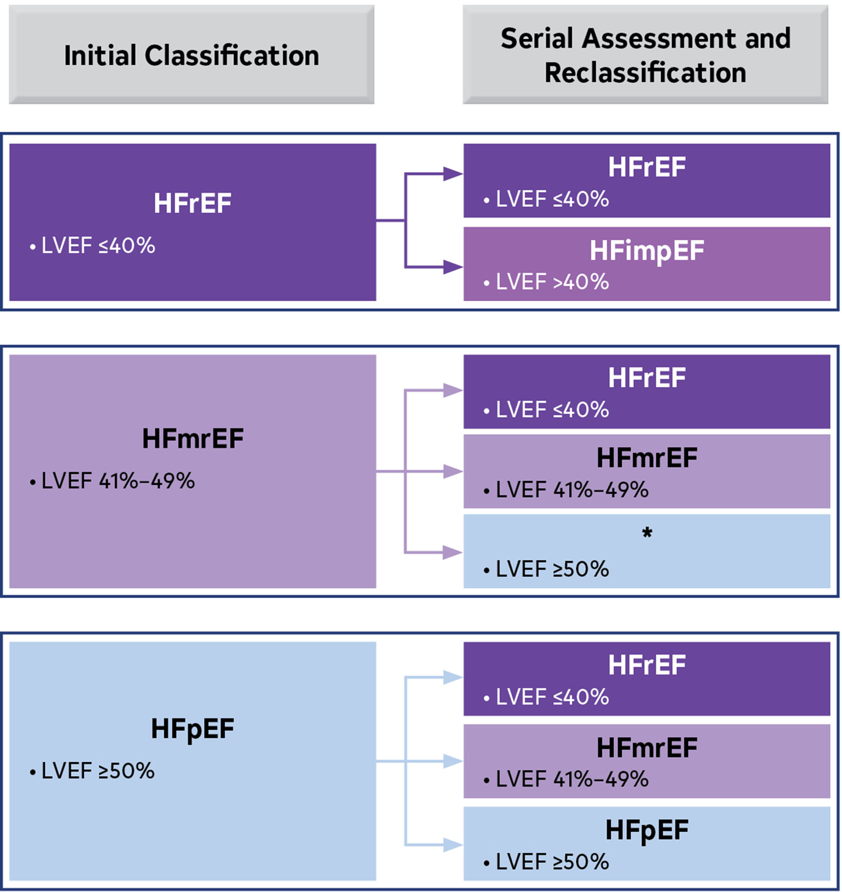
Classification and serial classification by LVEF
Evidence of spontaneous or provokable increased LV filling pressures (eg, elevated natriuretic peptide, noninvasive and invasive hemodynamic measurement)
Evidence of spontaneous or provokable increased LV filling pressures (eg, elevated natriuretic peptide, noninvasive and invasive hemodynamic measurement)
* Limited evidence for treatment guide. Treat as HFmrEF or HFpEF?
ACC/AHA guidelines 2022

Slide 7
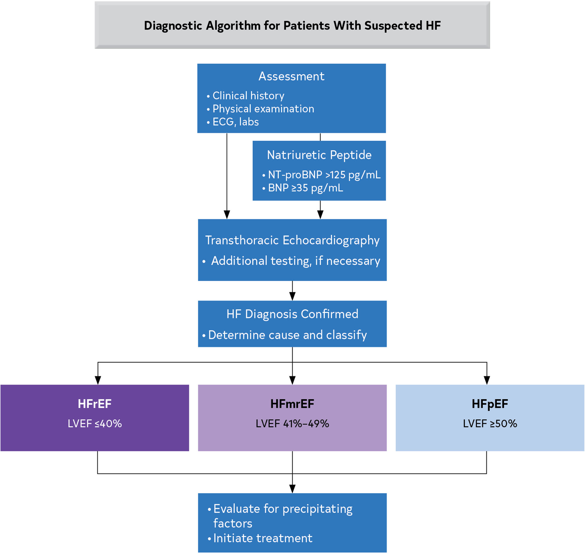
Diagnostic algorithm for suspected HF
ACC/AHA guidelines 2022

Slide 8
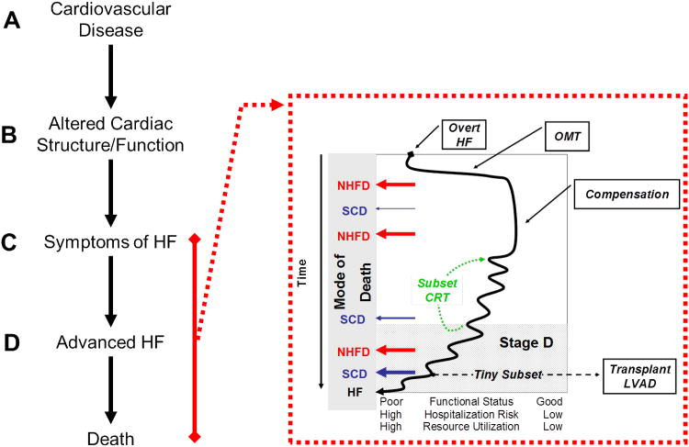
An Overview of
HF Stages and Progression
At Risk
Hypertension, CAD, Diabetes mellitus, Metabolic syndrome, Structural heart disease, Exposure to cardiotoxic agents, Genetic variants for cardiomyopathy,
Family history of cardiomyopathy
A
Pre-HF
Reduced right or left ventricular dysfunction
Reduced EF or strain, ventricular hypertrophy,
Chamber enlargement,
Wall monition abnormalities
Asymptomatic valvular disease
Imaging evidence of increased filling pressures
Elevated BNP, persistently elevated troponin
B
Symptomatic HF
Known structural heart disease
Shortness of breath and fatigue
Reduced exercise tolerance
(Current or previous symptoms)
C
End Stage
Symptoms at rest
despite
maximal
medical
therapy
D
ACC/AHA guidelines 2022
Congest Heart Fail. 2011 Jul-Aug;17(4):160-8. doi: 10.1111/j.1751-7133.2011.00246.x. Epub 2011 Jul 21

Slide 9
Overview of HF Trials supporting Therapies Tailored to
ACC/AHA Stages
Treat HTN, lipids;
smoking cessation, exercise, limit alcohol,
ACE-I/ARB in appropriate populations
A
ACEI/ARB:
CONSENSUS
SOLVD
SAVE
VaL-HeFT
CHARM
VALIENT
I-PRESERVE
HEAAL
BB:
U.S.CARVEDILOL
CIBIS-IIMERIT-HF
CAPRICORN
COPERNICUS
COMET
SENIORS
ALDOSTERONE
RALES
EPHESUS
EMPHASIS-HF
INOTROPES/INODILATORS
DIG
OPTIME-CHF
SURVIVE
B
All measures under “A” and ACE-I,
β-Blockers & ICD (statins, ARBS)
in the appropriate populations
ARNI
PARADIGM-HF
OMEGA 3
GISSI-HF
SGLT2i
DAPA –HF
EMPEROR - reduced
ICDs
MADIT
AVID
MADIT-II
DEFINITE
SCD-HeFT
CRT
MUSTIC
MIRACLE
COMPANION
CARE-HF
MADIT-CRT
RethinQ
LVADS
REMATCH
HeartMate II
MOMENTUM III
TAH
Syncardia Pivotal Trial
The US post market study
C
All under “A” and ACE-I/ARB/ARNI,
β-blockers, diuretics, SGLT2i, digoxin, Bidil
CRT, ICD, Aldactone, Omega 3 Fatty acids
All under
“A,B,C,”
+ inotropes,
transplant,
VAD, TAH
hospice
D
ACC/AHA guidelines 2022

Slide 10
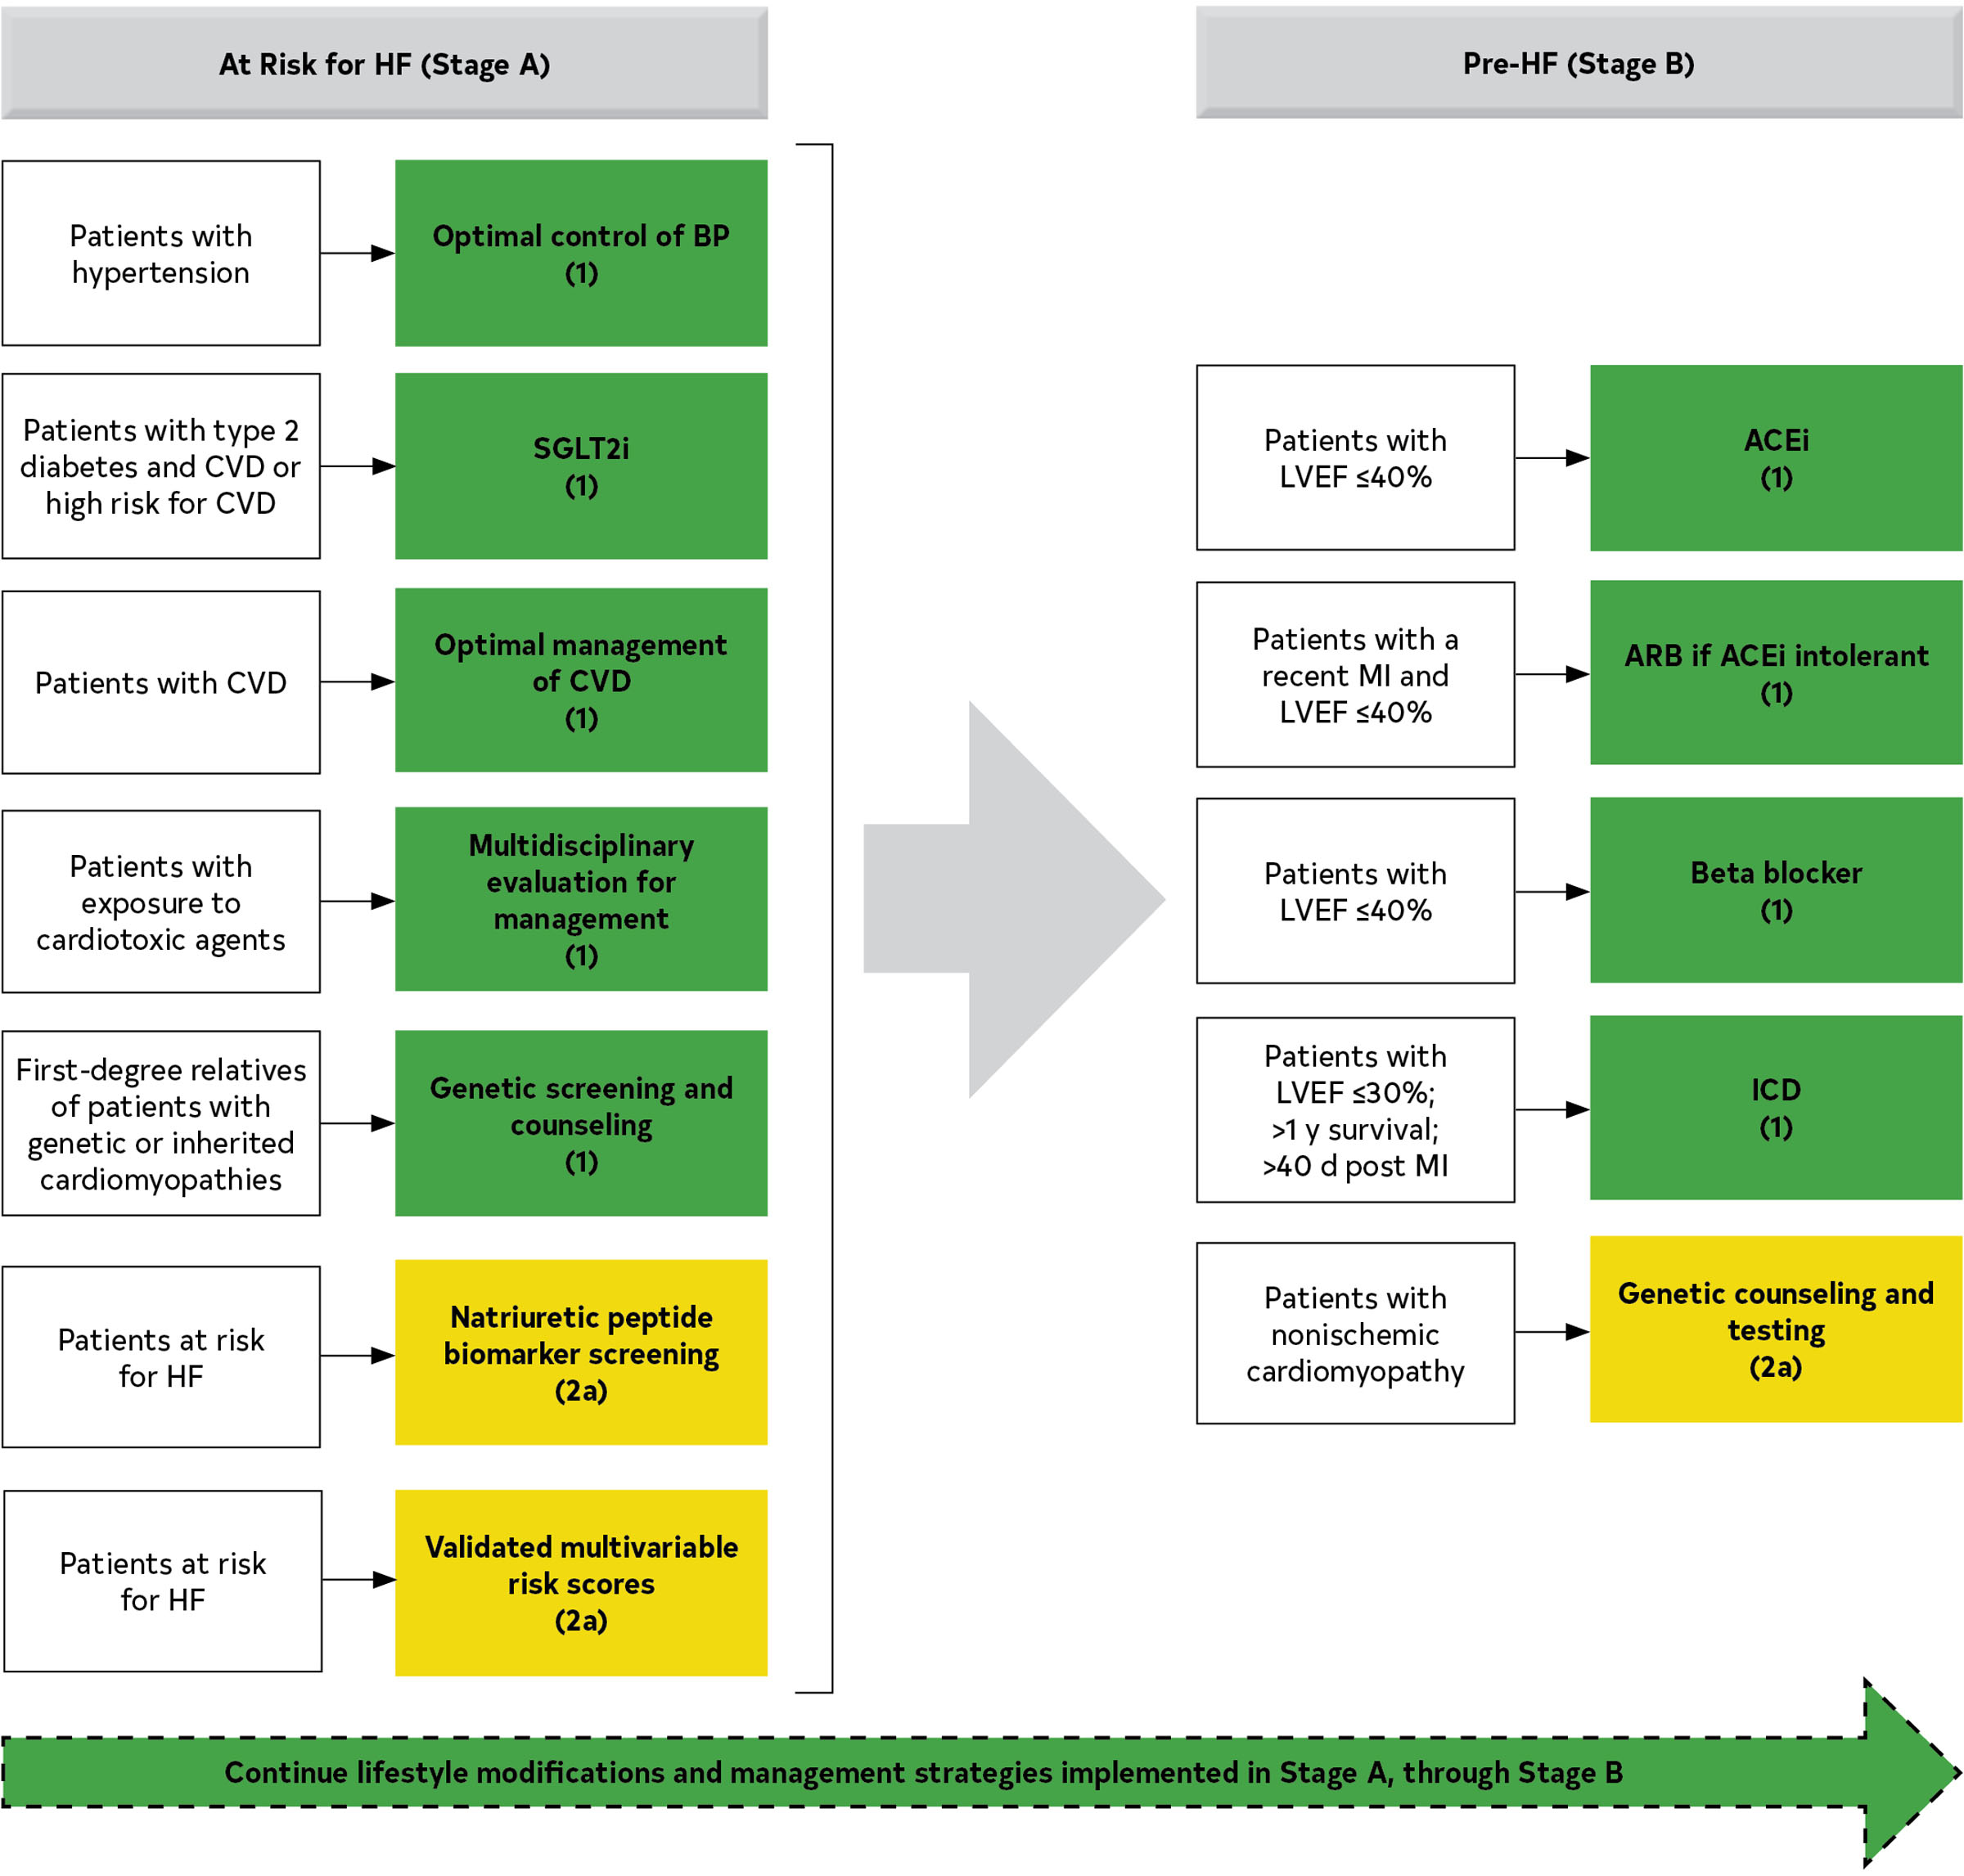
Management of
Stages
A & B
ACC/AHA guidelines 2022

Slide 11
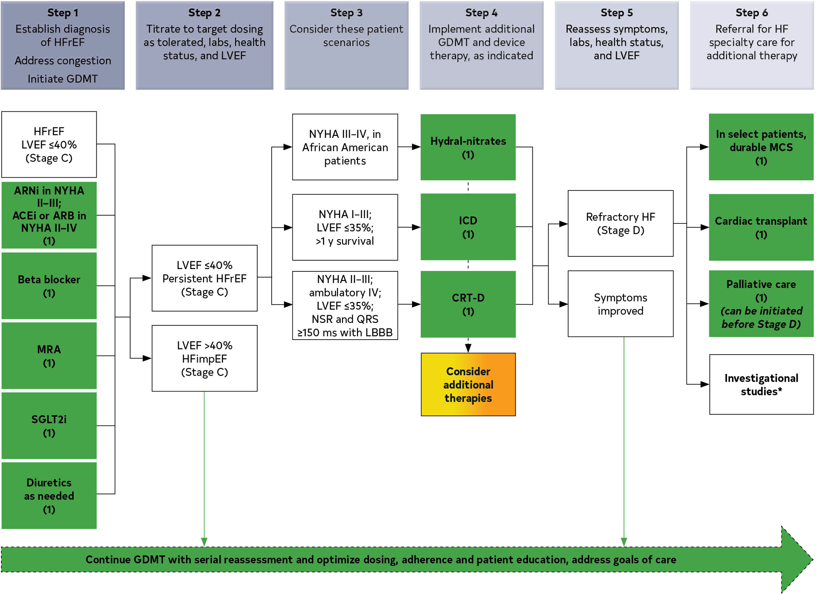
Management of
Stages
C & D
ACC/AHA guidelines 2022

Slide 12
ARNI important points
NOT in patients with history of angioedema (ACEI related or not)
NOT with ACEI (36 hour wash out period before initiation of ARNI)
NOT with concomitant ARB (Valsartan in ARNI) or Aliskiren (Renin inhibitor)
NOT in pregnant patient
NOT immediately post MI (PARADISE-MI) or in advanced/Class IV HF (LIFE)
Raises level of BNP (prevents degradation) but nor proBNP (decreases with clinical improvement)
PARADISE MI – Pfeffer et al, NEJM, 2021, PMID 34758252
LIFE – Mann et al, JAMA Cardiology, 2022, PMID 34730769

Slide 13
ACEI Important Points
The SOLVD (Studies of Left Ventricular Dysfunction) Prevention trial demonstrated that enalapril significantly reduced the development of symptomatic heart failure and hospitalizations in patients with asymptomatic left ventricular dysfunction (LVEF ≤ 35%). The trial's key findings include a 37% reduction in the development of heart failure and a 36% reduction in hospitalizations for heart failure when compared to a placebo. These results led to the recommendation of using ACE inhibitors, like enalapril, in this patient population to prevent heart failure progression.
To prevent development of HF in those with LV dysfunction
Reduction in fatal and nonfatal events
Up titrate to target doses
NOT in Pregnancy
Dose matters (low vs High) – titrate to maximally tolerated dose
When not to use
  Angioedema – do not switch to another ACEi or ARNI
  Pregnancy
  Very low BP (SBP <80)
  Cr > 3 mg/dl | Bilateral renal artery stenosis
  Hyperkalemia
  Intractable cough
Survival and Ventricular Enlargement (SAVE) study
Purpose: To evaluate the effect of the ACE inhibitor captopril in patients with impaired left ventricular function after a myocardial infarction.
Key findings:
  A 19% reduction in all-cause mortality compared to placebo.
  A 21% reduction in cardiovascular death.
  A 25% reduction in myocardial infarction.
  A 37% reduction in the development of severe heart failure.
Conclusion: Long-term administration of captopril improved survival and reduced cardiovascular events in patients with asymptomatic left ventricular dysfunction following a heart attack.

Slide 14
ARB Important Points
Preferentially use ARNI or ACEi
NOT in pregnancy
NOT combined with ACEi or MRA (Hyperkalemia) (Class 3)
NOT combined with ARNI (Valsartan in ARNI)

Slide 15
BB Important Points
Initiate when patient stable – (euvolemia - no tree trunk legs)
No need to max out ACEI/ARB/ ARNI first
Start low dose and up titrate
Use evidence-based BB – Switch to one if not on evidence-based BB
Dose dependent benefits – up titrate to max tolerated even if symptoms resolve
There is efficacy even with low doses even if patient tolerates low dose due to bradycardia or fatigue
If LV reverse remodels, do NOT withdraw BB
If LV does not remodel, do NOT withdraw BB
If hypotensive: reduce diuretics or space out ARNI/ARB/ACEI
Start in hospital before discharge if inotrope not used during admission
Can use in pregnancy

Slide 16
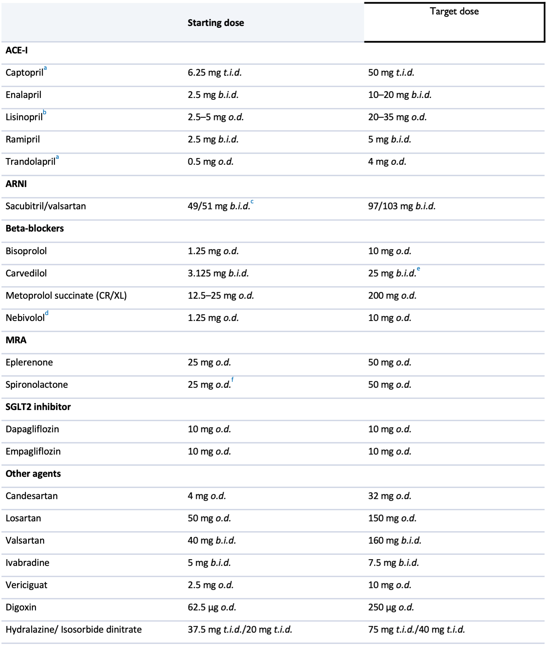
Preferred agents and target doses

Slide 17
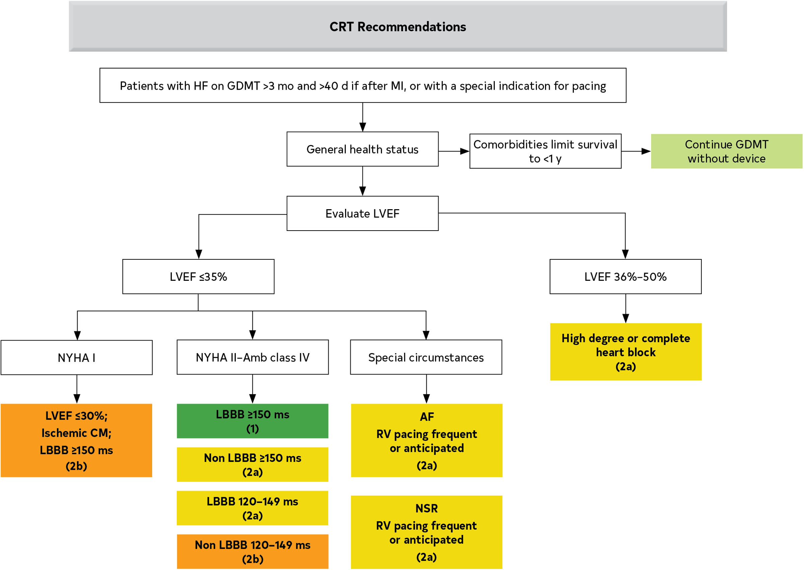
CRT
ACC/AHA guidelines 2022

Slide 18
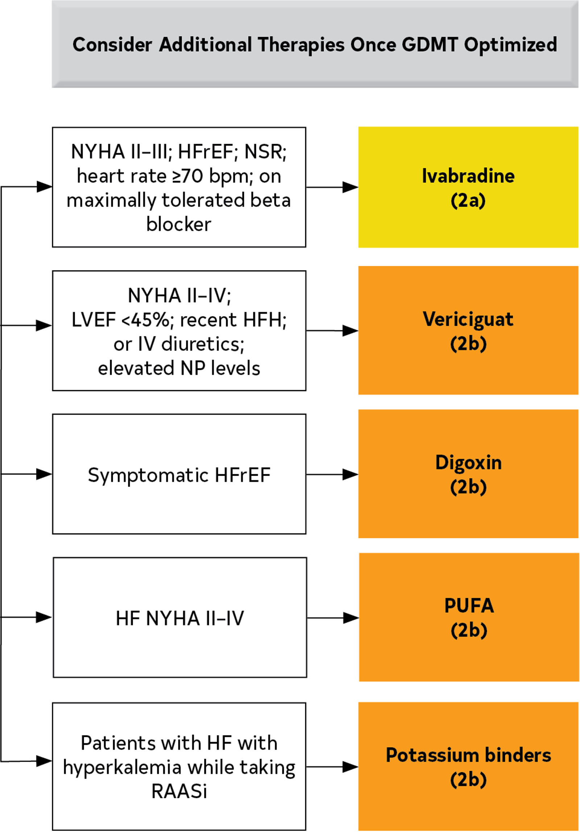
Additional Therapies
ACC/AHA guidelines 2022

Slide 19
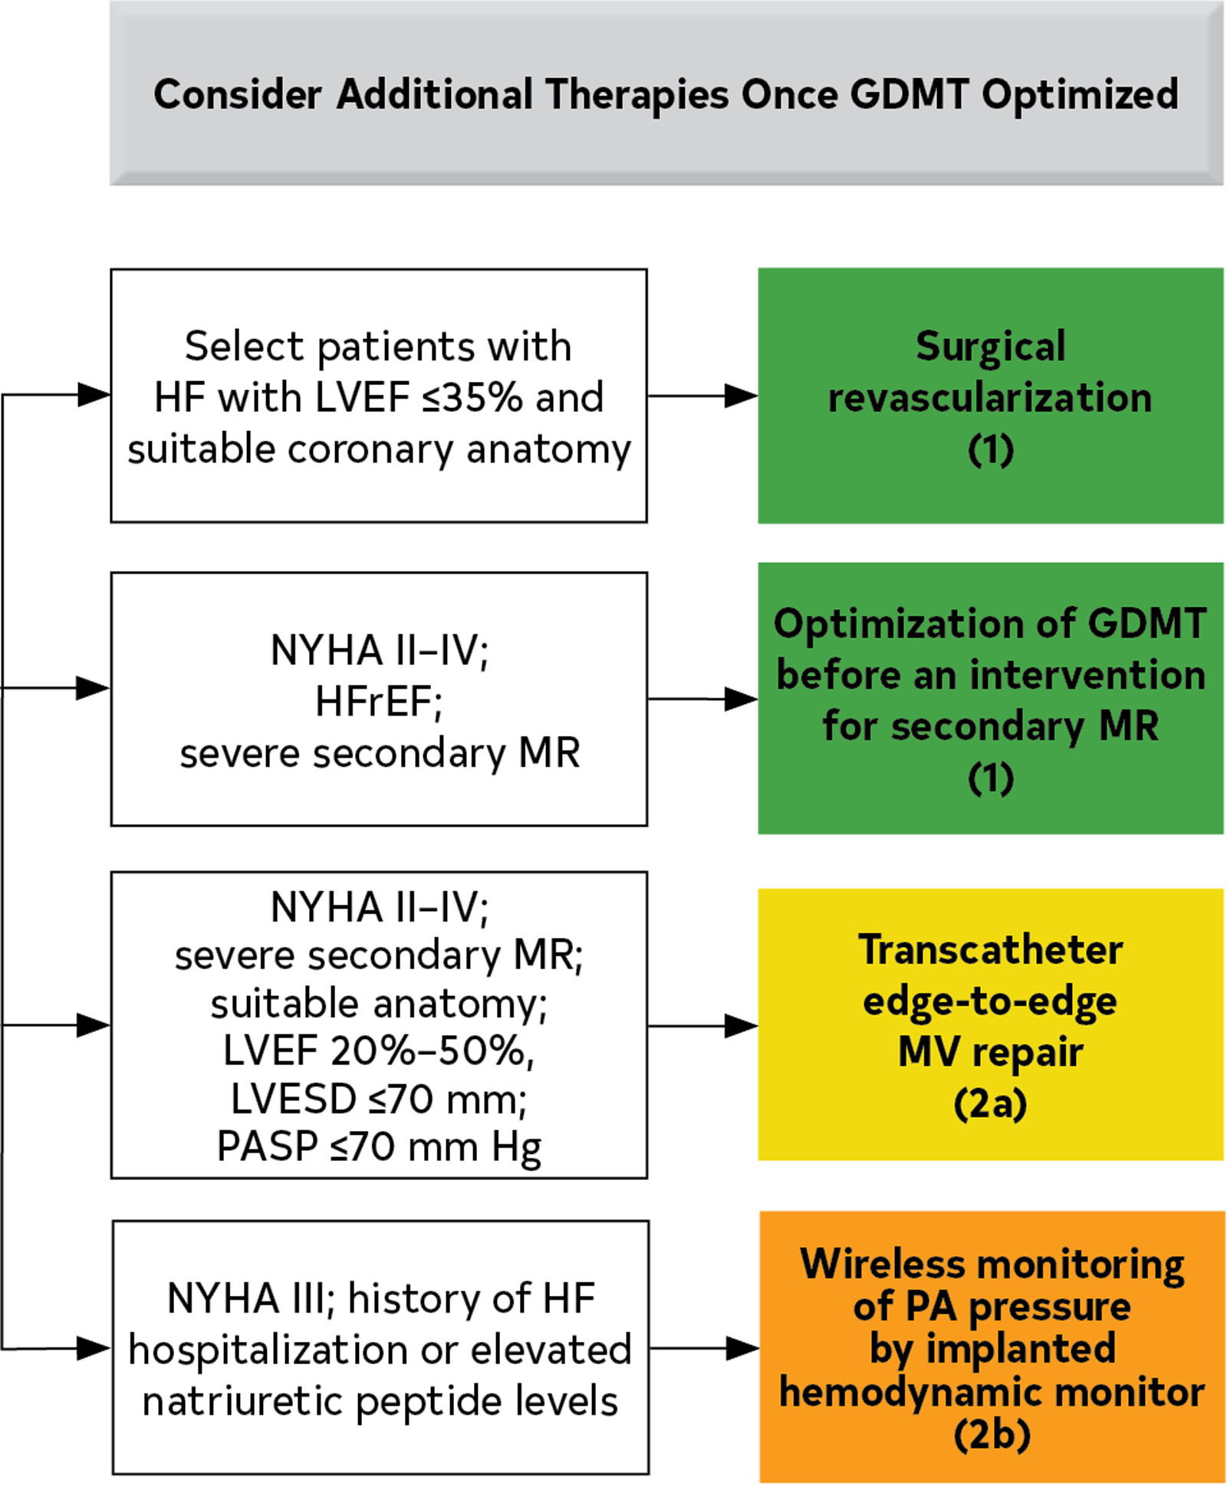
Additional Therapies
ACC/AHA guidelines 2022

Slide 20
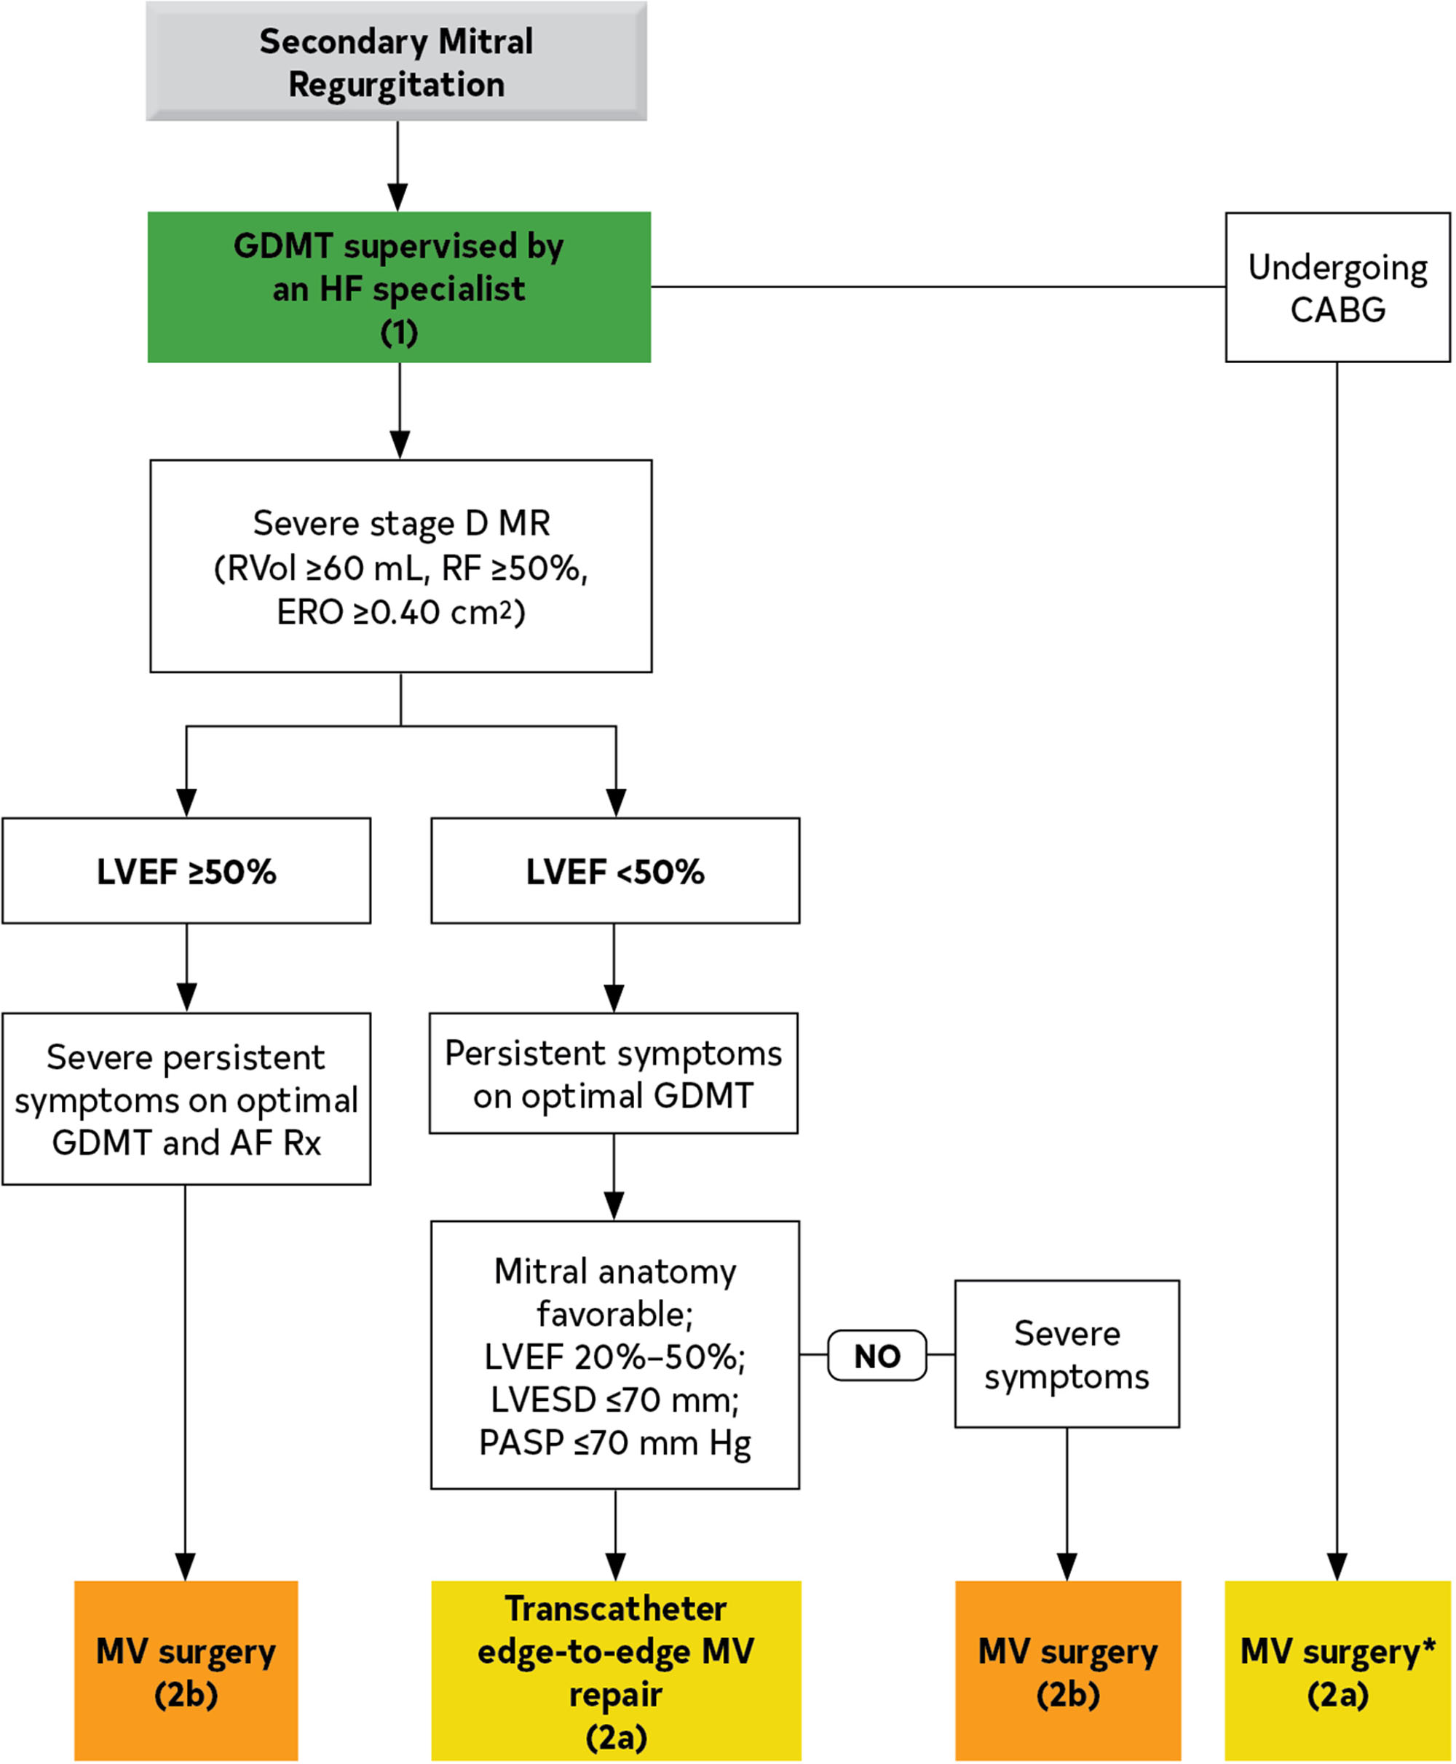
MR Secondary to LV dysfunction
ACC/AHA guidelines 2022

Slide 21
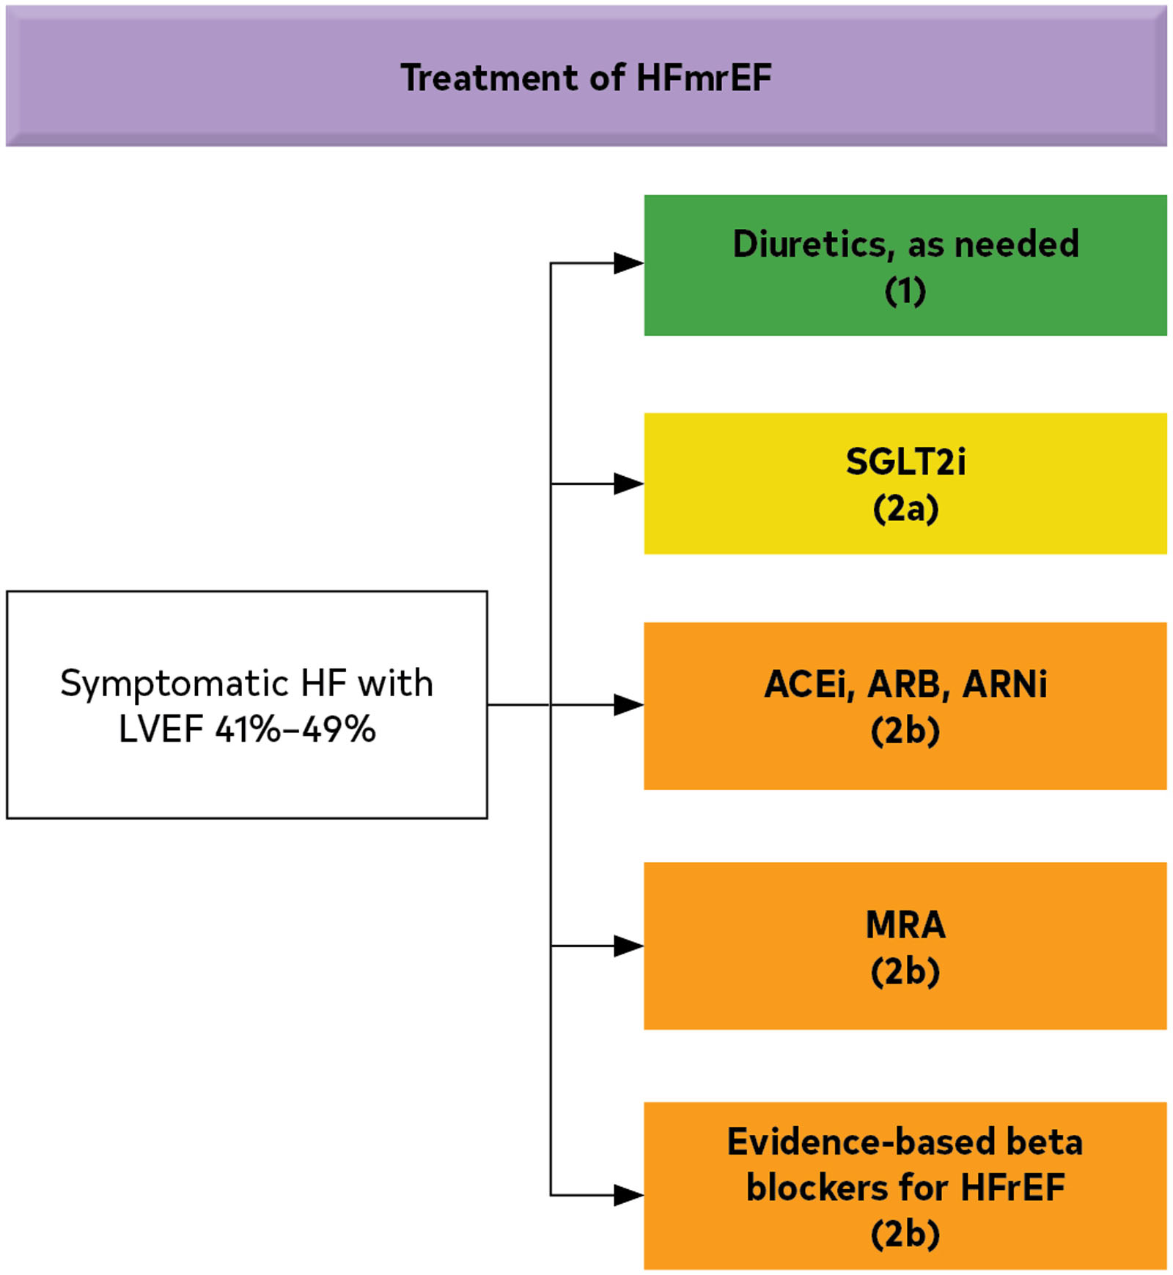
Rx for
HFmrEF
ACC/AHA guidelines 2022

Slide 22
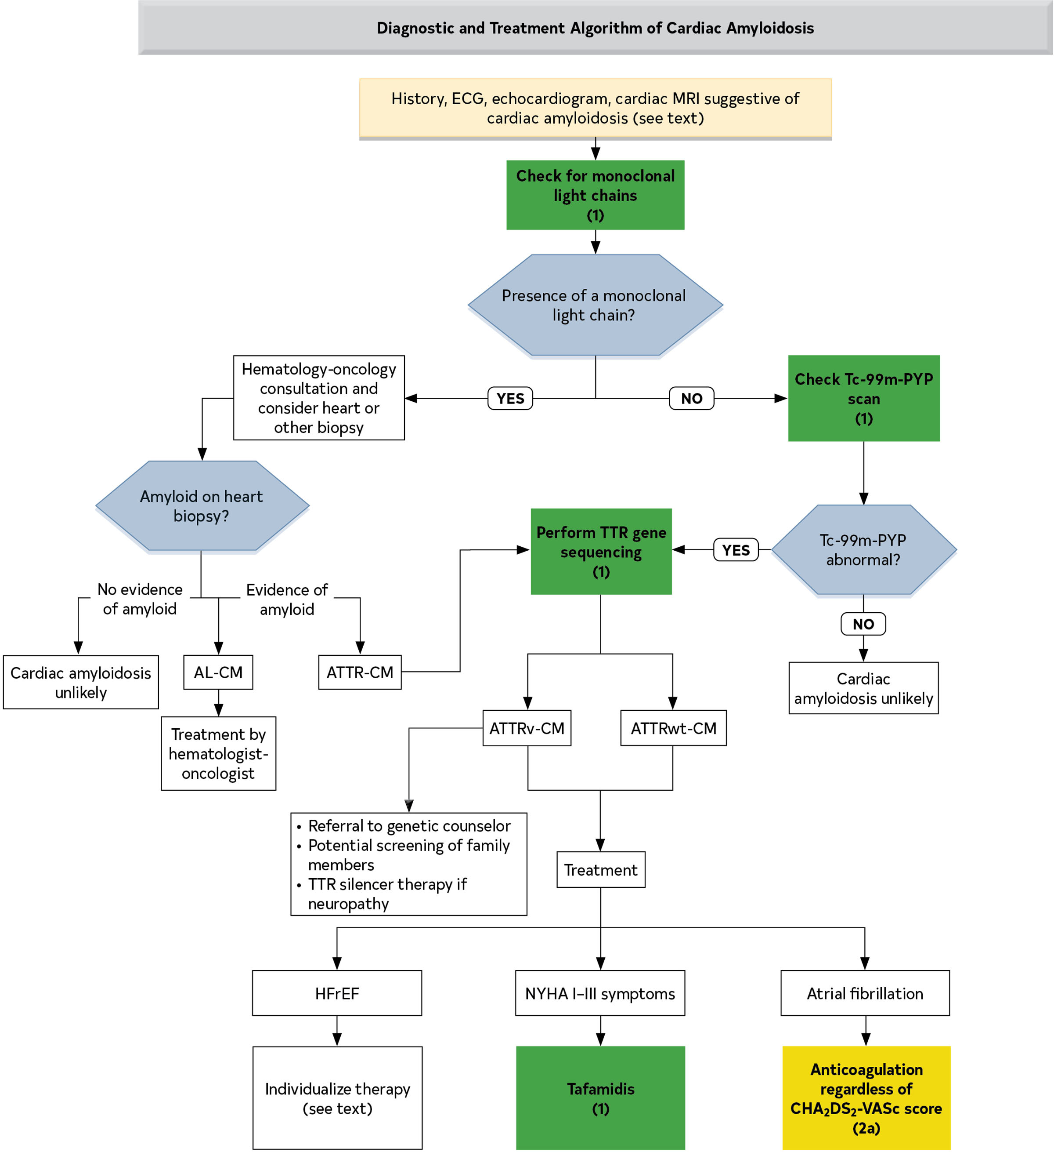
Amyloid
ACC/AHA guidelines 2022

Slide 23
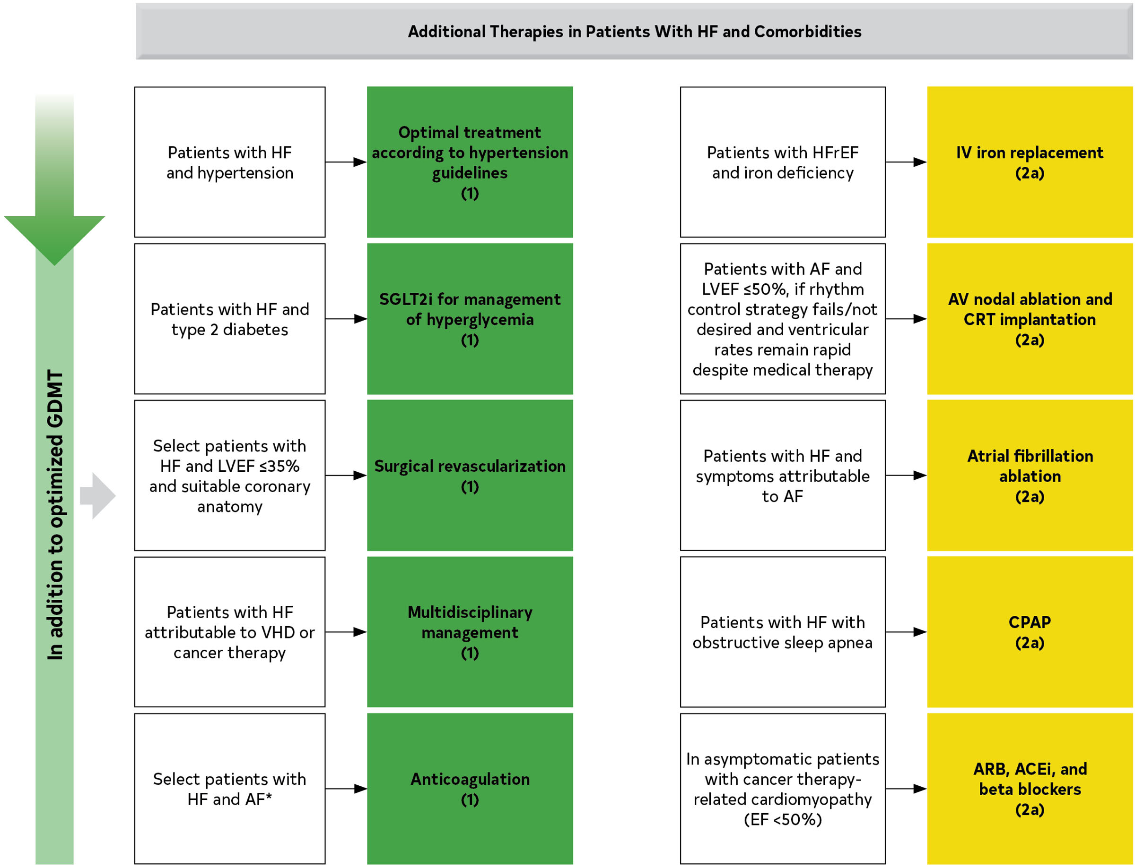
HF Co-morbidities Therapy
ACC/AHA guidelines 2022

Slide 24
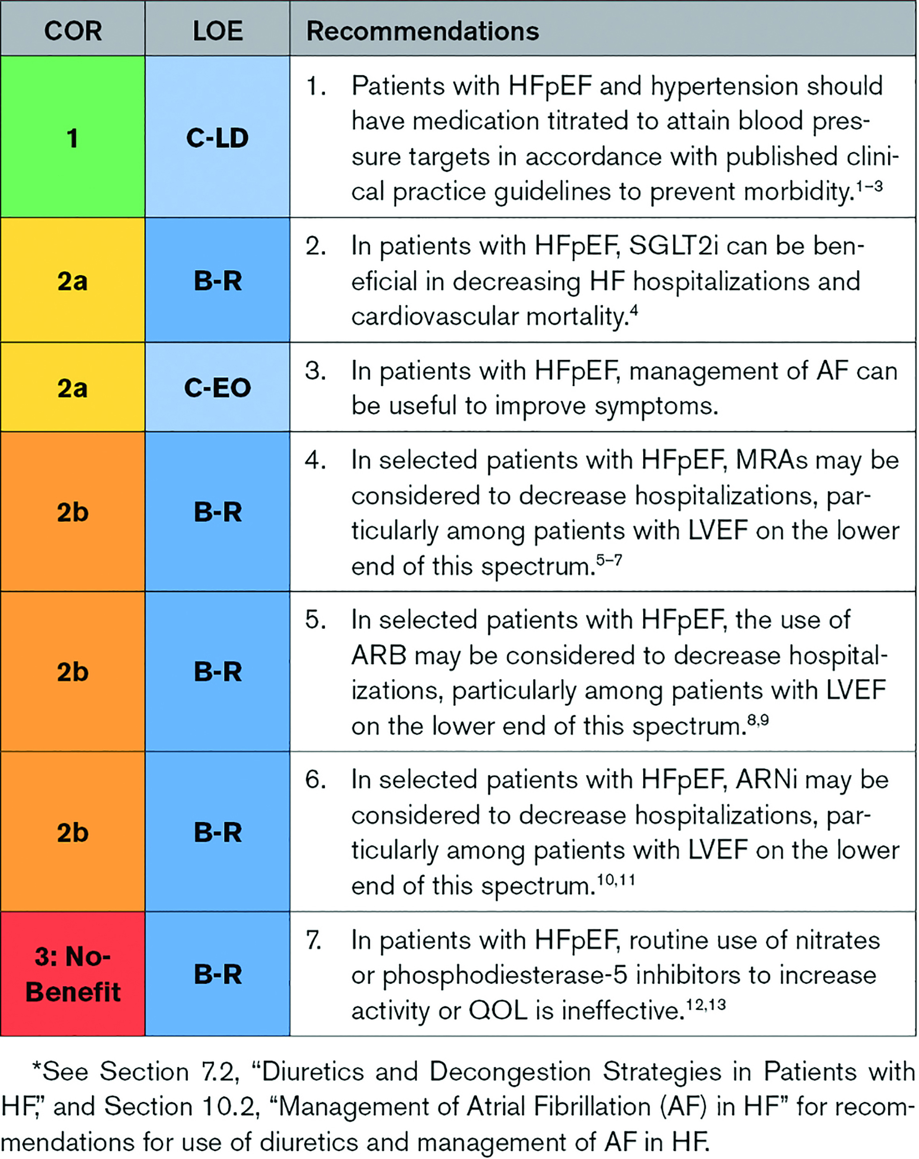
Rx for
HFpEF
ACC/AHA guidelines 2022

Slide 25
Hemodynamic profiles of acute decompensation
Congestion at Rest (Orthopnea, JVD, ascites, edema, S3)
No
Yes
Low
Perfusion
at Rest
Cold Ext
↓ PP
Hypotension
Warm and Dry
PCW normal
CI normal
(compensated)
Warm and Wet
PCW elevated
CI normal
No
Vasodilators
Nitroprusside
Nitroglycerin
Cold and Dry
PCW low/normal
CI decreased
Cold and Wet
PCW elevated
CI decreased
Yes
Normal SVR
High SVR
Inotropic Drugs
Dobutamine
Milrinone

Slide 26
ESC guide for diagnosing Stage D
NYHA Class III-IV Symptoms
• Episodes of volume overload and/or peripheral hypo-perfusion
• Objective evidence of severe cardiac dysfunction (EF<30%, Doppler Pseudo-normal or Restrictive filling pattern, PCWP>16mmHg or RAP >12 mmHg)
• Severely impaired functional capacity (Inability to exercise, 6MWD<300m, Peak VO2<12-14 ml/kg/min)
• HF Hospitalizations (≥1 in past 6 months)
• Above occurring despite attempts to optimize diuretics, RAAS antagonists, BB, CRT or in the setting of intolerance to OMT

Slide 27
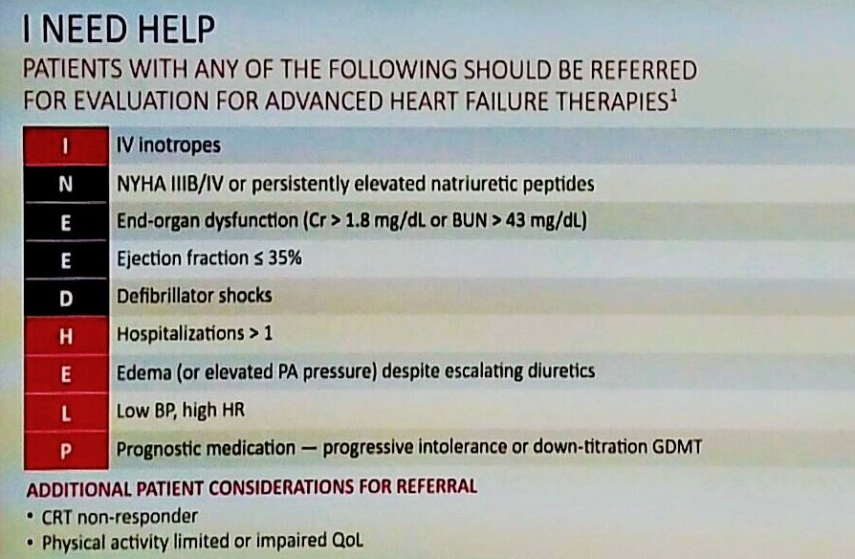
When to Refer to AHF program?
AHA scientific statement 2021

Slide 28
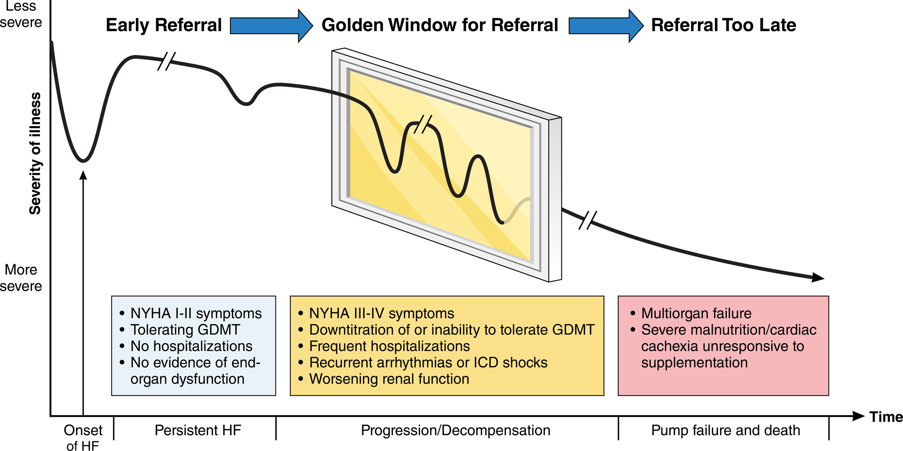
The golden window of referral
AHA scientific statement 2021

Slide 29
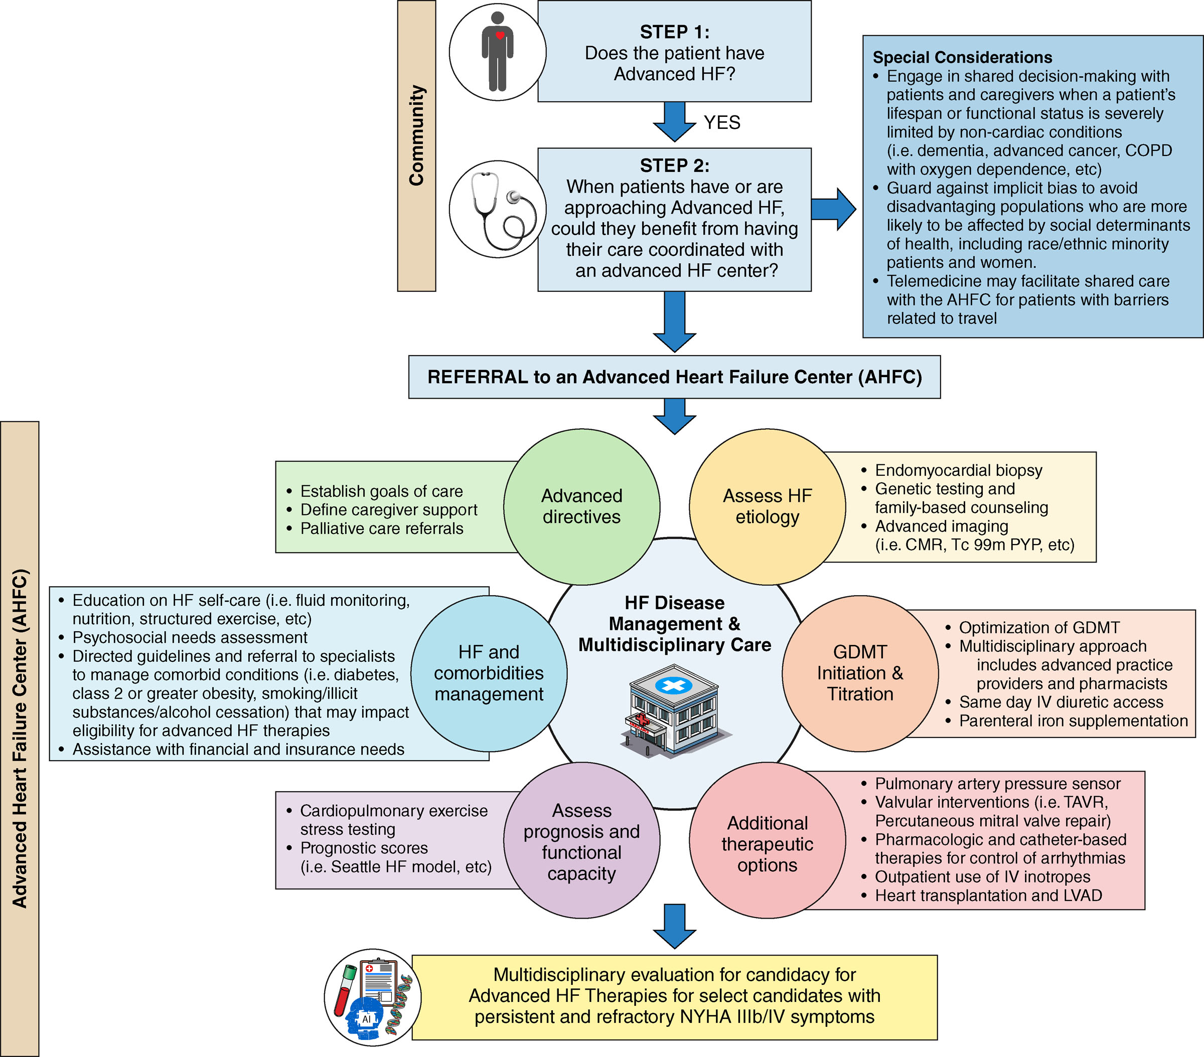
AHF Program. Behind the Curtain
AHA scientific statement 2021

