Slide 1


HIV/AIDS and STI’s
Kent Carpenter, DO, MS
Assistant Clinical Professor
UA College of Medicine – Phoenix
Tuesday August 12, 2025

Slide 2
Highest yield points
Not able to cover all of HIV and STIs in a single lecture
HIV highest yield points:
  Diagnosis
  Opportunistic infections (OI’s) – will ask about diagnosis and not management (you will ask ID for how to manage)
  Long-term and preventative care
STI’s highest yield points
  Genital ulcers
  Diagnosis
  Syphilis, particularly secondary syphilis diagnosis

Slide 3
Q1 – HIV/AIDS
26M with no PMH presents to clinic to establish care. He has no acute complaints. He is sexually active with multiple male partners, does not use condoms consistently. CBC, CMP are completed and normal, other STI testing is negative. His HIV test revealed a positive HIV antibody test. HIV 1-2 antibody differentiation immunoassay is indeterminate, and HIV nucleic acid amplification testing is negative. What do you tell the patient next?
A: Inform him that he has acute HIV infection and to start Bictegravir-emtricitabine-tenofovir alafenamide
B: Inform him that he has subacute HIV infection and to obtain blood work first and then to start Bictegravir-emtricitabine-tenofovir alafenamide
C: Inform him that he may have subacute HIV infection and to return for further confirmatory testing in 4 weeks
D: Inform him that he does not have HIV and offer PrEP with tenofovir-disoproxil fumarate and emtricitabine
E: Inform him that he has subacute HIV infection, to obtain blood work, and then follow up in 4 weeks to determine whether he needs to start ART medication
Notes:
D – patient does not have HIV, the antibody test is a false positive, but may be offered PrEP

Slide 4
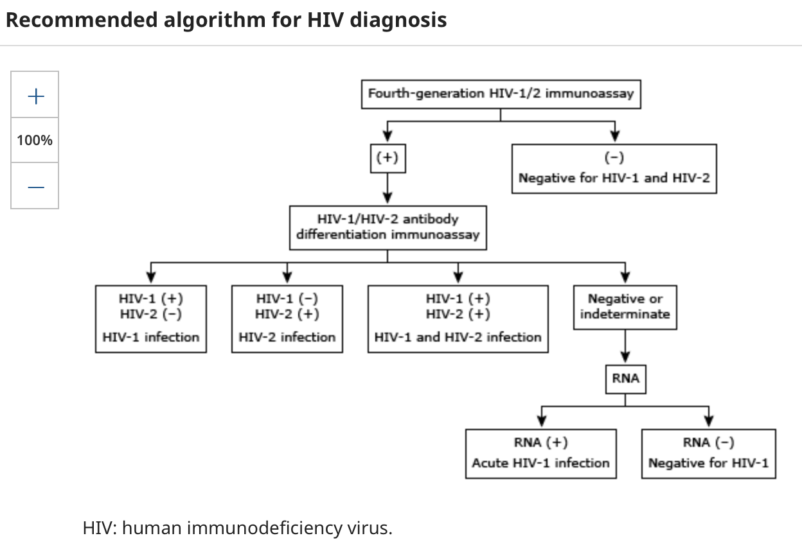
HIV diagnostic algorithm

Slide 5
Q1 Learning points
Have to memorize the HIV diagnostic algorithm and practice with questions!
Essential to correctly diagnose HIV – this is a life altering diagnosis and causes significant patient distress
Acute HIV infection: another commonly tested topic, acute fevers/chills but RNA testing will typically still be positive unless very early (ie less than 5 days)

Slide 6
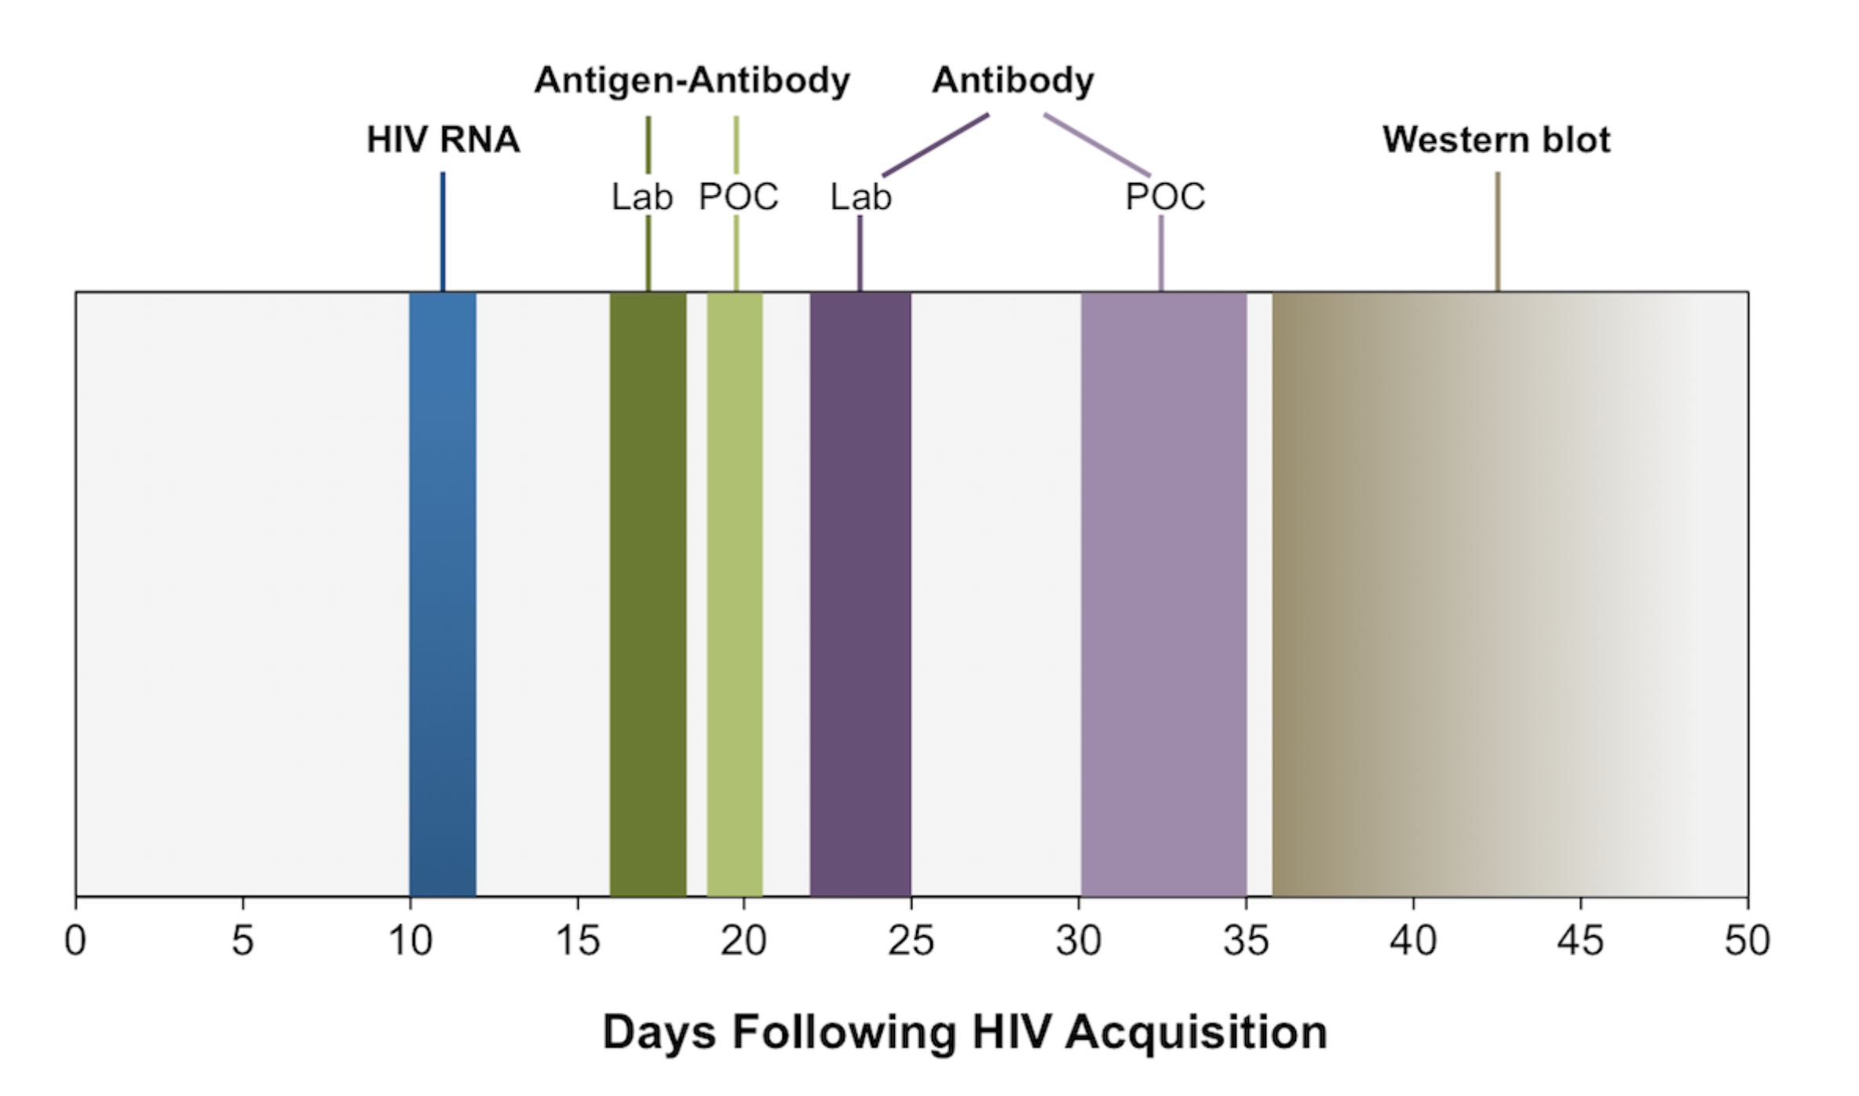
Q1 Learning point – timing of test positivity
Notes:
https://www.hiv.uw.edu

Slide 7
Q2 – HIV/AIDS
33F recently tested positive for HIV on a routine screening test. As part of her initial evaluation, her CD4 count is found to be 192 total, 13.3% with an HIV RNA level of 38,000 copies/mL. Which of the following blood tests is indicated for this woman with newly diagnosed HIV?
A: HSV 1, 2 serological testing
B: Toxoplasma IgG
C: AFB (mycobacterial) blood cultures
D: Hemoglobin A1c
E: Serological testing for Varicella-zoster, human herpes virus 8, and Epstein-Barr virus (EBV)
Notes:
B

Slide 8
Q2 Learning point – hiv entry into care
At entry into care, a number of blood tests are routinely indicated in persons living with HIV (PLWH):
  Serological testing for hepatitis A, B, and C viruses
  Latent tuberculosis
  IgG antibody to toxoplasmosis if CD4 count < 200
  Cryptococcal antigen test if CD4 < 200, especially if < 50
  Cocci screening if CD4 < 200 (in Arizona)
  Other basic labs, CBC, CMP, Lipid panel.
  A1c not necessarily indicated as first line, utilize fasting glucose first

Slide 9
Q3 – HIV/AIDS
58M with PMH significant for essential HTN, DM2 (A1c of 6.8%), CKD 3a (baseline eGFR of 58) is newly diagnosed with HIV infection. CD4 is 320, viral load is 58,758. His medications are semaglutide, metformin, losartan-amlodipine. What is the next appropriate step?
A: Initiate treatment today with tenofovir-disoproxil fumarate, emtricitabine
B: Initiate treatment today with bictegravir, emtricitabine, tenofovir alafenamide
C: Hold off on treatment for now and repeat CD4 and viral load in 4 months
D: Initiate treatment today with abacavir, dolutegravir and lamivudine
E: Initiate treatment today with lamivudine, tenofovir disoproxil fumarate and dolutegravir
Notes:
B

Slide 10
Q3 Learning points
Classes of antiretroviral drugs
  NNRTIs (non-nucleoside reverse transcriptase inhibitors)
  NRTIs (nucleoside reverse transcriptase inhibitors)
  Protease inhibitors
  Integrase strand inhibitors (INSTIs)
  Novel agents: capsid inhibitors
Full treatment regimens are typically 3 drugs each from a different class
Treatment is always started right away now, even in pregnancy with safe agents
  Old guidelines used to include holding off treatment at various intervals, this is no longer the case in any circumstance

Slide 11
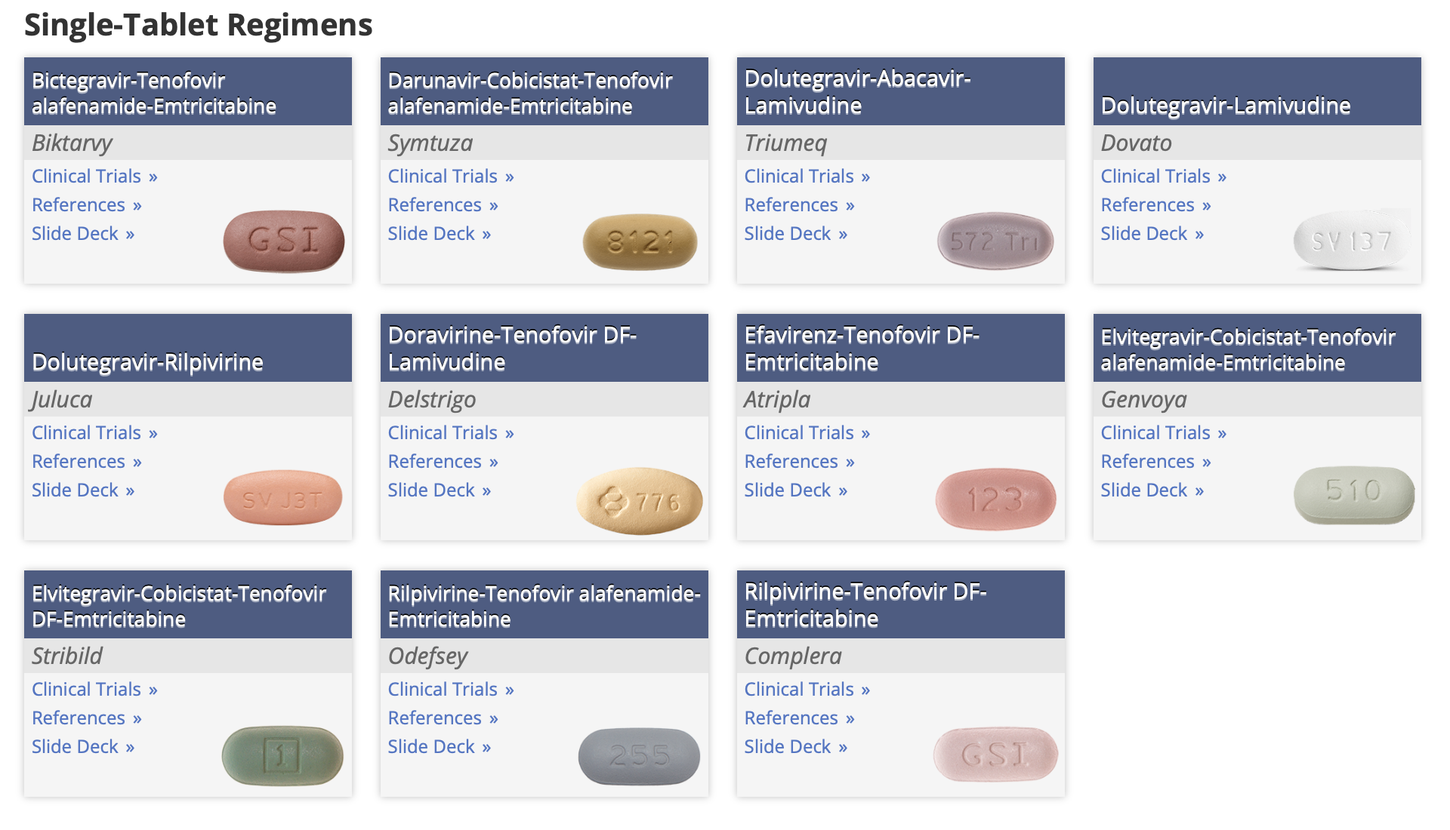
Notes:
https://www.hiv.uw.edu

Slide 12
Q4 – HIV/AIDS
65M is being seen for routine HIV care follow up. He has HIV-1 infection diagnosed about 8 years prior, has been taking abacavir, lamivudine and rilpivirine throughout this time. He reports taking the medication daily but sometimes forgets to take it with a meal. His labs 6 months prior were CD4 of 298 and viral load < 20. Current labs are CD4 of 255 and viral load of 6800 copies/mL. Which is the next appropriate management?
A: HIV p24 antigen testing
B: Repeat the CD4 count and viral load in 4 weeks
C: HLA-B5701 testing
D: HIV genotype testing
E: HIV-2 antibody testing
Notes:
D

Slide 13
Q4 Learning point – HIV drug resistance
Non-adherence to therapy or suboptimal absorption of ART may lead to drug resistance
In prior patient, despite adherence, resistance likely developed because NNRTIs must be taken with meals
Always inquire about supplement use and think about absorption/drug-drug interactions, etc

Slide 14
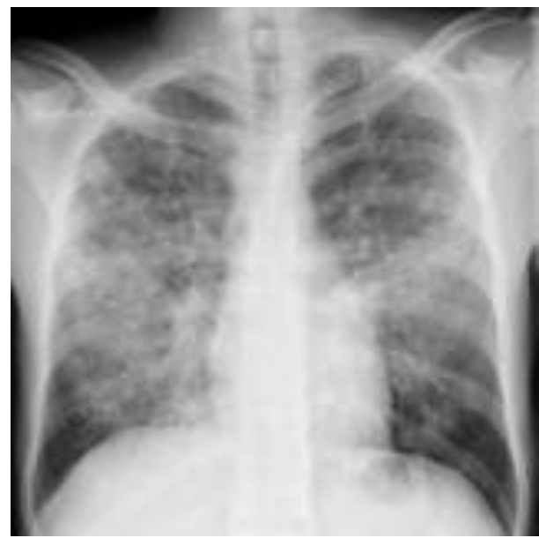
Q5 – HIV/AIDS
55M is admitted to the hospital with a 3 week history of fevers, cough, dyspnea on exertion. Oxygen saturation is 88% on room air, improves with 2L of nasal cannula. CXR shows bilateral diffuse hazy opacities (shown). An ABG shows PaO2 of 55 with an A-a gradient of 45. An HIV 1-2 antigen antibody immunoassay is positive. Serum LDH is 650 and beta-D-glucan is 680. Which of the following is the most appropriate next step?
A: Start treatment with oral TMP-SMX alone
B: Start treatment with oral TMP-SMX and prednisone
C: Start treatment with IV TMP-SMX and prednisone
D: Consult pulmonary to perform BAL for diagnosis, then start oral TMP-SMX and prednisone
Notes:
C

Slide 15
Q5 – Learning point
PJP pneumonia divided into phases:
Mild-moderate – PaO2 > 70, A-a gradient < 35
Moderate – severe PaO2 < 70, A-a gradient > 35
Adjunctive glucocorticoids given with moderate-severe disease. IV TMP-SMX utilized if PaO2 < 60

Slide 16
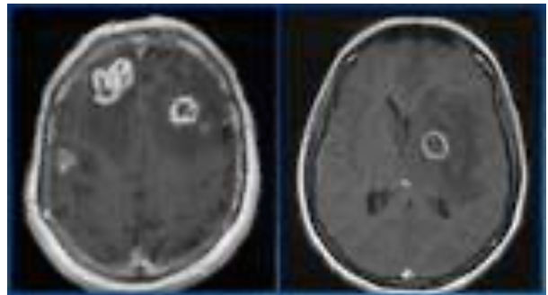
Q6 – HIV/AIDS
36M with HIV presents to the emergency room following a witnessed generalized tonic-clonic seizure. His family notes a general decline in mental status and fevers for the past week. He had not been taking prescribed ART therapy, last known CD4 count is 22. His MRI shows multiple ring-enhancing lesions with vasogenic edema and mass effect. Which if the following is the appropriate next step?
A: Consult neurosurgery for brain biopsy
B: Obtain serum toxoplasma IgG
C: Obtain CT chest/abd/pelvis with contrast to evaluate for primary malignancy
D: Obtain JC virus serum PCR
E: Obtain EBV serologies
Notes:
B

Slide 17
Q6 – Learning point – CNS Toxo
DDX of CNS lesions in HIV/AIDS is a very high yield topic!
CNS Toxo is most common – multiple ring-enhancing lesions
Other DDX include
  Primary CNS lymphoma (usually single lesion)
  Progressive multifocal leukoencephalopathy (non-enhancing, disproportionate white matter findings)

Slide 18
HIV/AIDS OI’s
Not able to cover all OI’s in this lecture and many others are commonly tested
Mucocutaneous candida infections – oral thrush, esophageal thrush
Mycobacterium tuberculosis
Cryptococcus
  Presents with meningitis
  Mgmt includes control of ICP, antifungal therapy with amphotericin/flucytosine
Mycobacterium avium complex
  Disseminated disease
  AFB positivity a clue on questions
CMV
  Commonly presents with retinitis, butcolitis, esophagitis are also possible
Bartonellosis/bacillary angiomatosis
Malignancies
  Non-Hodgkin lymphoma, Kaposi (commonly tested), invasive cervical carcinoma, CNS lymphoma

Slide 19
Q7 – HIV/AIDS
24M is evaluated to establish primary care. He reports multiple male sexual partners with inconsistent condom use, has oral and anal sex. He was treated for syphilis about 1 year prior. HIV 4th generation test is negative, RPR is nonreactive, other STI testing is negative. Which of the following would you recommend today?
A: continued follow up in 1 year
B: Lamivudine and dolutegravir
C: Penicillin G IM x 1 dose today
D: Tenofovir disoproxil fumarate and emtricitabine
E: Elvitegravir/cobicistat and emtricitabine and tenofovir alafenamide
Notes:
D

Slide 20
Q7 – learning point HIV Prep and pep
PrEP regimens include: TDF + emtricitabine (Truvada), TAF + emtricitabine (Descovy) and injectable cabotegravir
HIV PEP regimen typically includes 3 drugs: TDF + emtricitabine (Truvada) + dolutegravir. This is done for 4 weeks following exposure along with serial testing (this is another commonly tested topic)
DoxyPEP: given to MSM with frequent sexual activity to prevent other STIs. Single 200 mg dose taken within 72 hours of activity

Slide 21
Q8 – Other sti’s
29M presents with fever, perineal pain, urinary frequency, dysuria. DRE reveals boggy, and very tender prostate gland. He is sexually active with male partners. He is HD unstable and so being admitted to the hospital. In addition to HIV and other STI testing, what is the most appropriate empiric antibiotic regimen?
A: IV levofloxacin alone
B: IV cefepime and oral doxycycline
C: IV ceftriaxone alone
D: oral levofloxacin with oral metronidazole
E: IV TMP-SMX alone
Notes:
B

Slide 22
Q8 – Learning point – chlamydia
Underdiagnosed and undertreated
Screening recommended for women younger than 25, for MSM yearly
NAAT is preferred for diagnosis
Preferred treatment is doxycycline, for cervicitis, urethritis or prostatitis
Azithromycin is an alternative
Test of cure not necessary except in pregnancy or when using an alternative agent

Slide 23
Q9 – other STI’s
38M is being evaluated for STI screening. He reports no symptoms, feels well. He is sexually active with other men primarily anal sex, does not use condoms consistently. 3 site testing is performed and positive for gonorrhea at the pharyngeal site. Other testing including HIV is negative. Which of the following is the most appropriate next step in management?
A: Treat with IM ceftriaxone 500 mg once. Rescreen in 1 year.
B: Treat with IM ceftriaxone 500 mg once and oral doxycycline x 7 days. Rescreen in 1 year
C: Treat with IM ceftriaxone 500 mg once. Perform a test of cure in 2 weeks, then rescreen in 1 year.
D: Tell the patient he does not require treatment because he has no symptoms and rescreen in 1 year.
Notes:
C

Slide 24
Q9 - learning point - gonorrhea
Test of cure required for pharyngeal gonorrhea specifically
IM ceftriaxone 500 mg for weight < 150 kg, 1 g IM for weight > 150 kg.

Slide 25
Q10 – other sti’s
26 year old sexually active female presents to the hospital with a painful, swollen, and red appearing right knee. She has had intermittent fevers, chills, and some red appearing, small skin lesions on her feet and shins. Prior to this, she had painful arthralgias in her ankles and in the left knee. Which of the following tests is most likely to reveal the diagnosis?
A: Nucleic acid amplification testing, and gram stain/culture of the right knee synovial fluid
B: Urine nucleic acid amplification testing
C: Serum RPR testing
D: Skin biopsy
E: Vaginal swab nucleic acid amplification testing
Notes:
A

Slide 26
Q10 – disseminated gonorrhea
Blood cultures, synovial fluid cultures should be sent in addition to NAAT in order to verify antimicrobial susceptibility when suspecting disseminated gonococcus infection
Disseminated gonococcal arthritis presents as a migratory polyarthritis in younger, sexually active patients, more common in women
Treatment is with IV ceftriaxone longer term

Slide 27
Q11- other sti’s
23F is being evaluated in clinic for acute onset of painful genital and perianal lesions. Physical exam reveals multiple painful lesions with surrounding erythema, ulceration and they appear vesicular. Which of the following is the most appropriate management?
A: Obtain serum HSV 1, 2 serological testing alone and prescribe a 7 day course of valayclcovir.
B: Prescribe a 7 day course of valacyclovir
C: Obtain a swab from one of the ulcers for NAAT testing for HSV 1,2, then prescribe a 7 day course of valacyclovir.
D: Obtain serum RPR and prescribe IM penicillin G
E: Obtain urine NAAT testing for chlamydia/gonorrhea and prescribe ceftriaxone and doxycycline
Notes:
C

Slide 28
Q11 – acute hsv
Should know the appearance of each of these genital lesions:
HSV 1,2 lesions
Primary chancre of syphilis
Condyloma lata
Genital warts (HPV related)

Slide 29
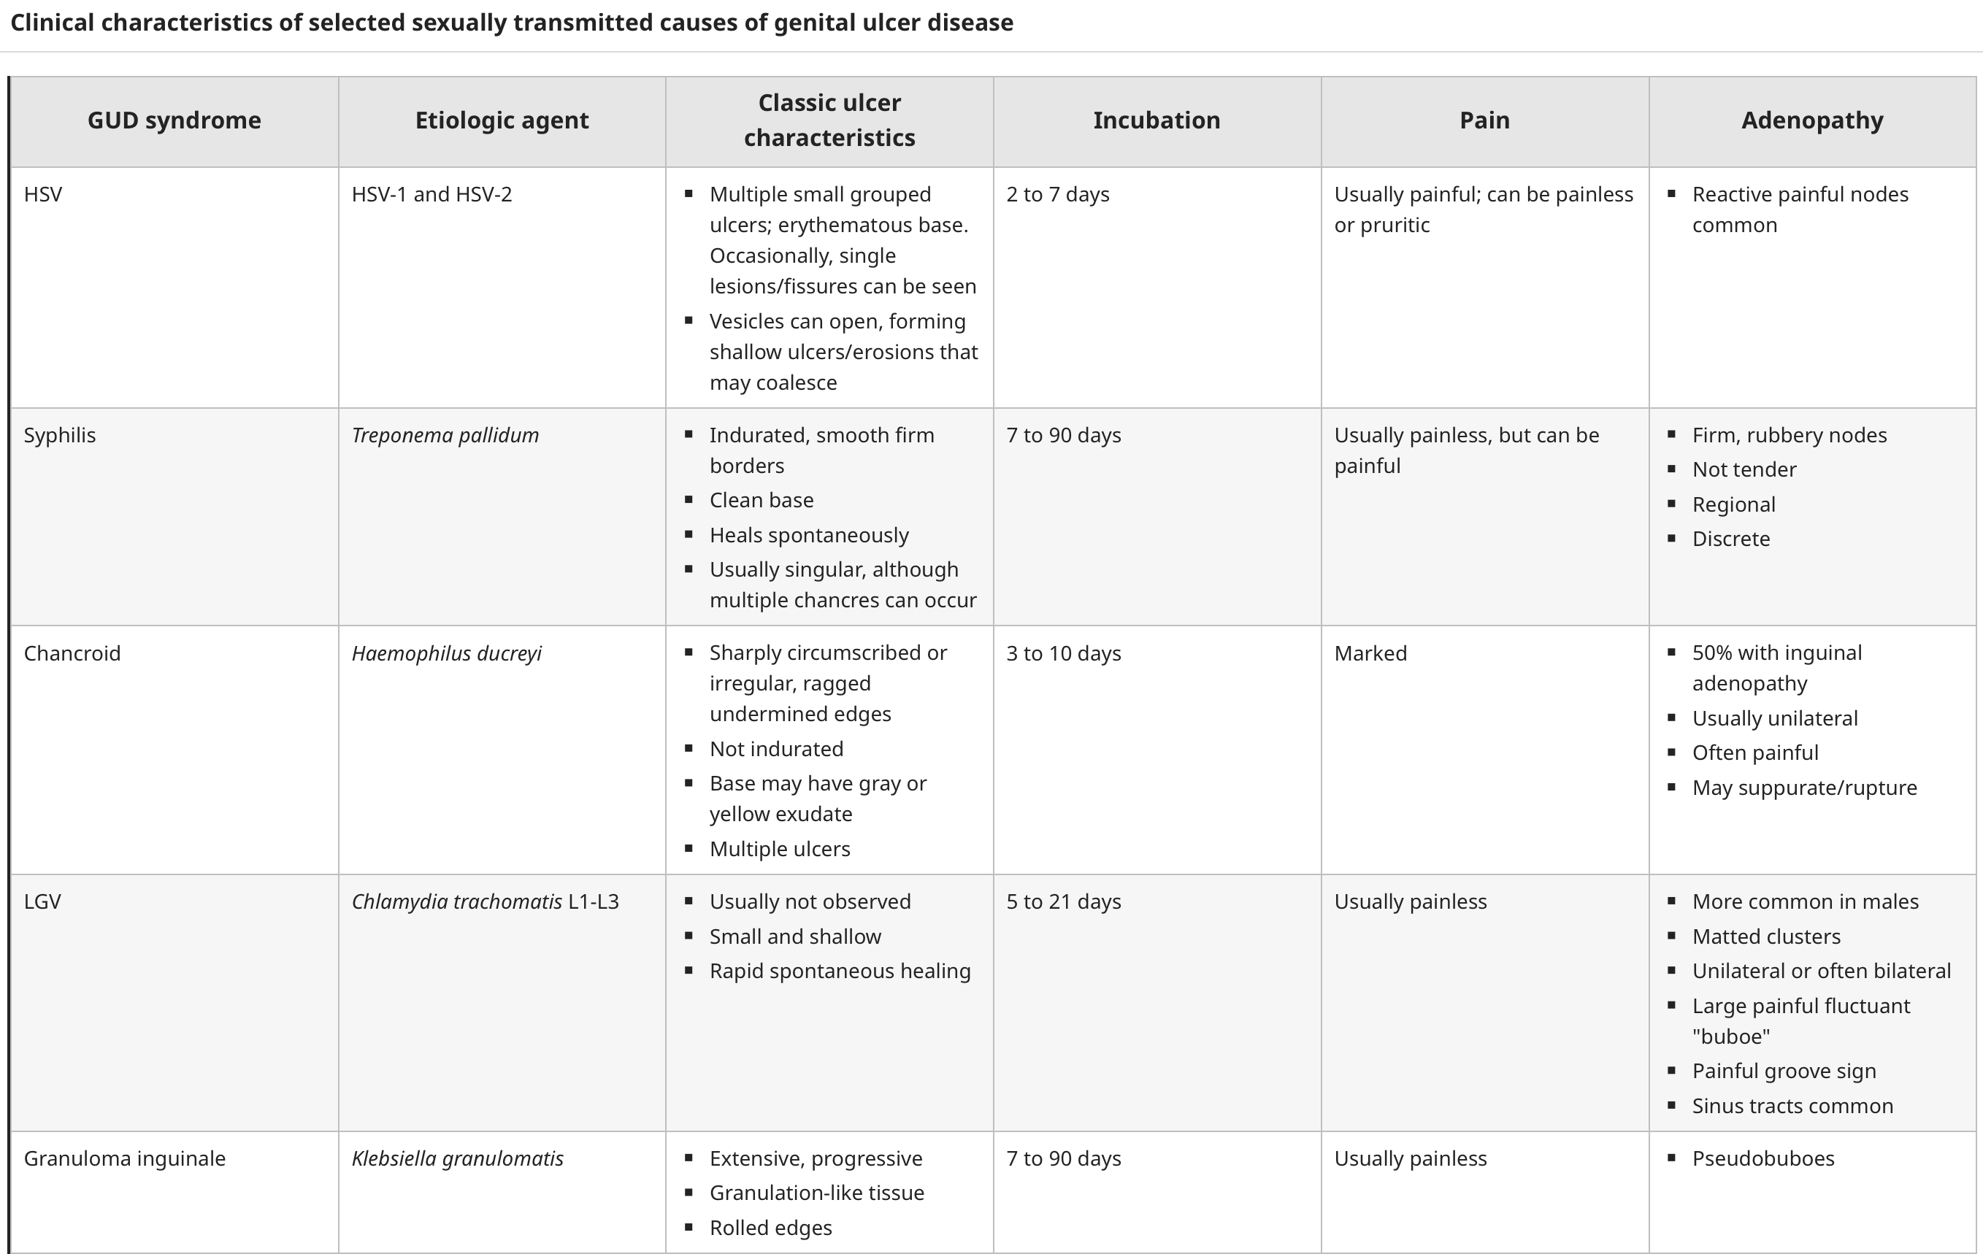

Slide 30
Q12 – other sti’s
23M with HIV and recent CD4 count of 512 is seen for evaluation of fever and a rash. On exam, he has a diffuse macular rash on his trunk, extremities and palms. He has sex with other men, is taking bictegravir-emtricitabine and TAF. He reports no neurological concerns and the neuro exam is normal. He had a prior syphilis test which was negative 6 months ago. Which of the following is the most appropriate testing and treatment recommendation?
A: Repeat syphilis testing, IM penicillin 2.4 million units x 1 dose
B: Repeat syphilis testing, IM penicillin 2.4 million units x 3 doses weekly
C: Obtain LP to evaluate for neurosyphilis.
D: Viral swabs of the skin lesions with NAAT testing, 7 day course of valacyclovir
E: Check urine for chlamydia/gonorrhea NAAT testing, 7 day course of doxycycline
Notes:
A

Slide 31
Q12 Syphilis classification
Primary: painless chancre
Secondary: diffuse macular rash, extremities, trunk, palms/soles. Lymphadenopathy – usually painless
Tertiary: gummas, Argyl-Robertson pupils, aortitis, Tabes dorsalis, dementia (separate from neurosyphilis)
Neurosyphilis

Slide 32
Q13 – other sti’s
48 year old male with PMH of recently diagnosed HIV, current CD4 of 125, recently started on Bictegravir, emtricitabine, TAF presented to the hospital with altered mentation and psychiatric disturbances. Treponemal antibody testing is positive, RPR non-reactive. He undergoes an LP for diagnostic work-up which shows:
CSF WBC of 15, 95% lymphocytes
CSF protein of 120
Serum and CSF crypto antigen are both negative. CSF VDRL is pending as is a meningitis-encephalitis PCR panel.
Which of the following is the most appropriate management?
A: Empiric amphotericin B and flucytosine
B: IM penicillin G x 3 weekly doses
C: Empiric IV ceftriaxone, vancomycin, ampicillin, and acyclovir
D: IV penicillin G for 14 days, followed by IM penicillin G x 1 dose
E: Await serum CSF VDRL, treat with IV penicillin if positive
Notes:
D

Slide 33
Q13 – neurosyphilis
Prozone effect: RPR may be a false negative if treponemal burden is very high
Treatment of syphilis
Early latent: confirmed negative test within 1 year, IM bicillin 2.4 x 1 dose
  Alternative: doxycycline x 14 days
Late latent: everything else (history unclear, treatment history unclear), etc, IM bicillin 2.4 x 3 doses, given weekly
  Alternative doxycycline x 28 days
Neurosyphilis: IV penicillin for 10-14 days followed by early latent treatment. No alternative, if allergic -> desensitize
Neurosyphilis is more common and may present earlier with concurrent HIV infection

Slide 34
Resources
AIDS OI guidelines: https://clinicalinfo.hiv.gov/en/guidelines/hiv-clinical-guidelines-adult-and-adolescent-opportunistic-infections/whats-new
HIV free online curriculum if interested: https://www.hiv.uw.edu
If interested in providing HIV care as an IM primary care provider (not requiring formal ID fellowship training): https://aahivm.org

