Slide 1
Rheumatoid Arthritis

Slide 2
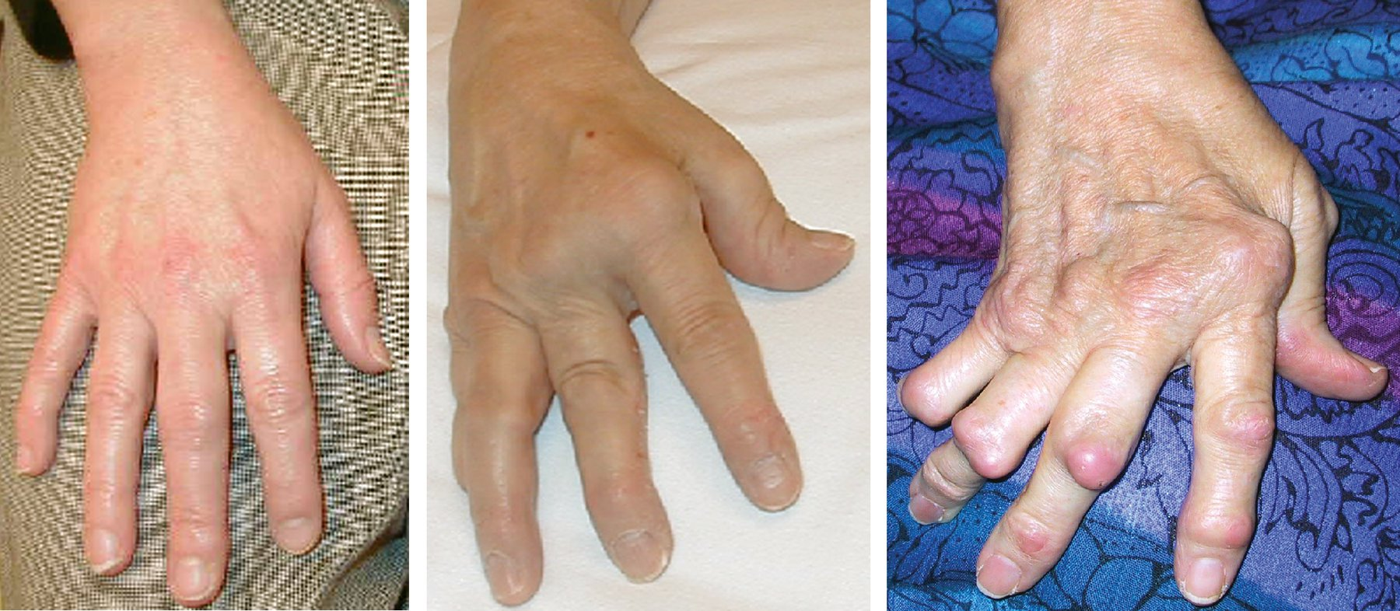
Rheumatoid arthritis Characteristics
Systemic autoimmune disorder
Polyarthritis
Hands, feet and wrists
Extra-articular manifestations
Skin, eyes, pleura, pericardium
Early diagnosis and immunmodulation
1% of the population
Women 2-3x more than men
Any age (most between 30-60)
Increase risk: tobacco , silica, asbestos, infection (??), hormones

Slide 3
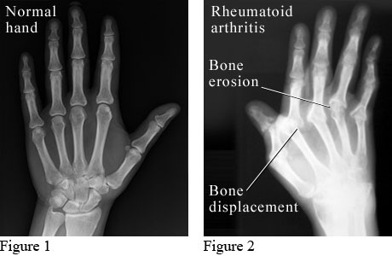
Diagnosis
History, physical exam:
Pain and swelling in multiple joints, morning stiffness. Gradual.
Auto antibodies → Rheumatoid factor and anti-cyclic citrullinated peptide (CCP)
Precede clinical disease by YEARS
RF → Immunoglobulin directed against the Fc portion of IgG
50% of patient with RA have a positive RF
20% of patients with RA are RF negative
Anti-CCP → more specific, against citrulllinated proteins
95% specific - False positives in active TB and chronic long disease
ESR and CRP → disease activity
Plain radiographs
Notes:
Fever//Roth's spots// Osler's nodes// Murmur//Janeway lesions// Anemia// Nail hemorrhage (splinter hemorrhages)// Emboli

Slide 4
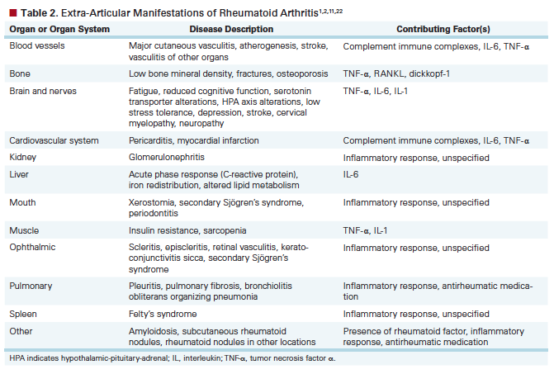
Complications

Slide 5
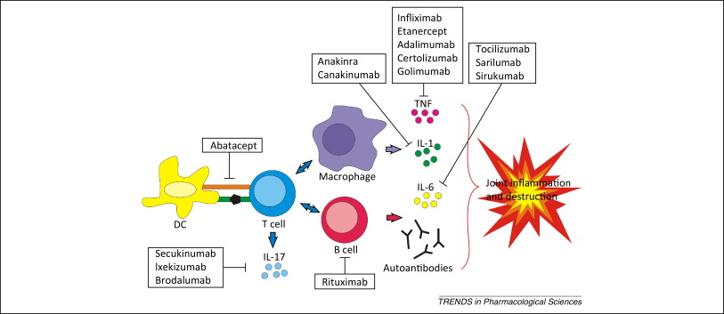
Treatment
^{Methotrexate → initial DMARD}
TNF-a inhibitors and other biologics
new-onset and established disease
reduces risk of radiographic progression, normalize acute phase reactants, and reduce cardiovascular risk
MTX, leflunomide, sulfasalazine, NSAIDS → Anti-TNF a (Enteracept), Anti IL-6 (Tocilzumab), rituximab, Jak inhibitor

Slide 6
MKSAP High Yield
RA typically presents as a symmetric inflammatory polyarthritis affecting small joints and is associated with morning stiffness (> 30 minutes) and extra-articular manifestations.
Risk factors for RA include genetic and environmental factors, autoantibodies, infection, and hormones.
Extra-articular manifestations of rheumatoid arthritis include rheumatoid nodules, rheumatoid vasculitis, keratoconjunctivitis sicca, pleuritis, and pericarditis.
Rheumatoid arthritis is an independent risk factor for coronary artery disease and heart failure!
patients with severe extra-articular disease are at particularly increased risk of cardiovascular death.
Pregnancy:
Methotrexate and leflunomide are absolutely contraindicated in pregnancy and must be discontinued prior to conception
Hydroxychloroquine and sulfasalazine are considered relatively safe in pregnancy.

Slide 7
Value
Rheumatoid factor, anti–CCP antibodies, and inflammatory markers assist in confirming a diagnosis of rheumatoid arthritis
Serologies should never be used as the sole criterion for diagnosis and should be avoided in patients with low pretest probability for disease due to the high rate of false-positive results.
Plain radiography of the hands, wrists, and/or feet is indicated to aid in the diagnosis and to follow progression of rheumatoid arthritis; in contrast, MRI of peripheral joints should not be routinely performed to monitor disease progression.

Slide 8
References
Huizinga, Tom WJ, and Theodore Pincus. "Rheumatoid arthritis." Annals of internal medicine 153.1 (2010): ITC1-1.
Singh, Jasvinder A., et al. "2012 Update of the 2008 American College of Rheumatology recommendations for the use of disease‐modifying antirheumatic drugs and biologic agents in the treatment of rheumatoid arthritis." Arthritis care & research 64.5 (2012): 625-639.
Gibofsky, Allan. "Overview of epidemiology, pathophysiology, and diagnosis of rheumatoid arthritis." The American journal of managed care 18.13 Suppl (2012): S295-302.

