Slide 1
Border Health
Anand Gandhi, PGY-3
Internal Medicine

Slide 2
Learning Objectives
Be able to define border health
Understand the disparities affecting those who live along the U.S.-Mexico border
Build awareness of the current programs working to improve border health
Understand how residents can become involved in programs to improve border health

Slide 3
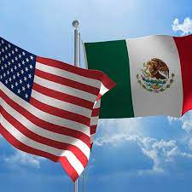
What is Border Health?
Broad term which characterizes the healthcare markets, regulatory environments, health laws, environmental factors, and consumer behavior that shape the health of individuals living along international borders
Affects all aspects of individual and population health
Comprised of both:
Similar facets of the general population
Unique challenges among the border population

Slide 4
Who makes up the border population?

Slide 5
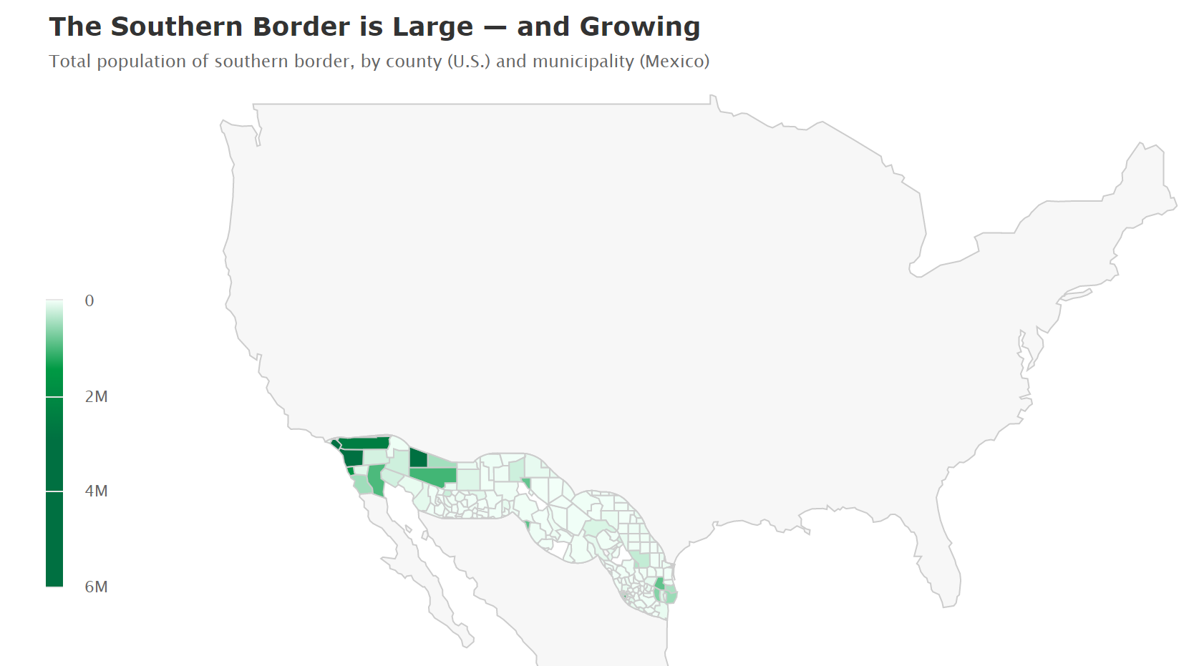

Slide 6
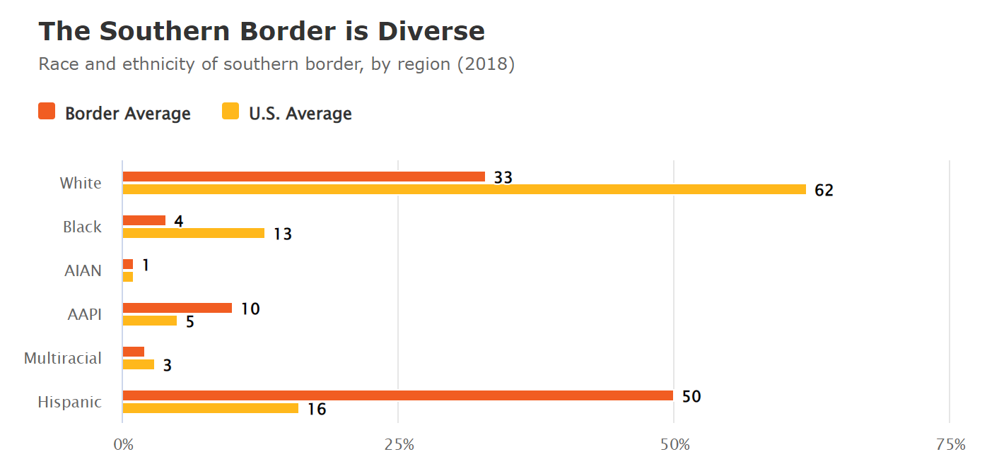

Slide 7
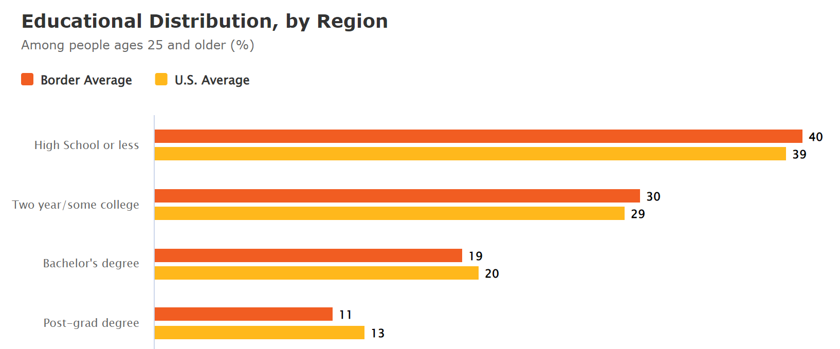

Slide 8
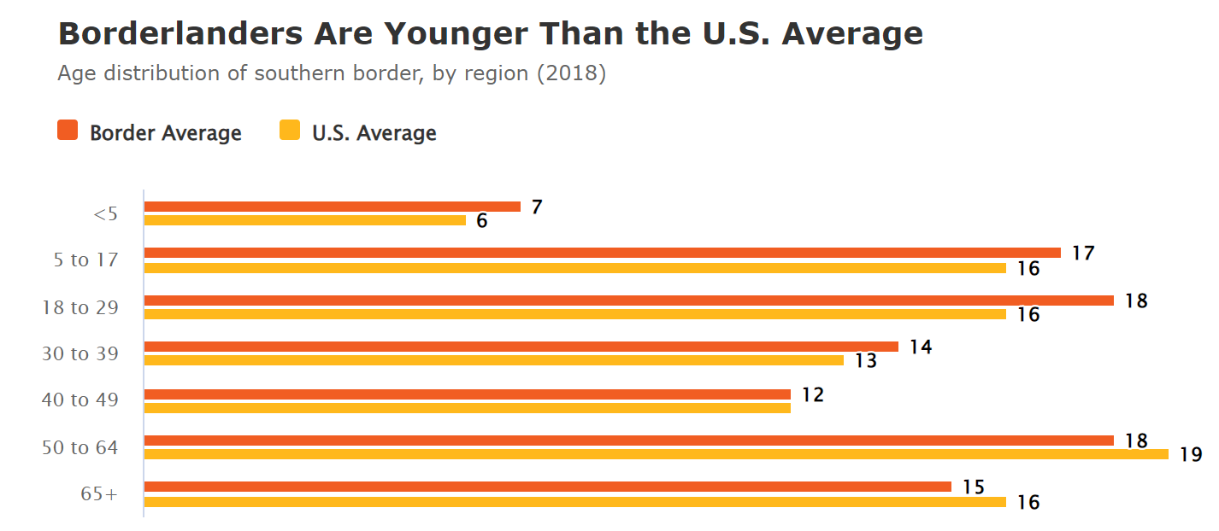

Slide 9
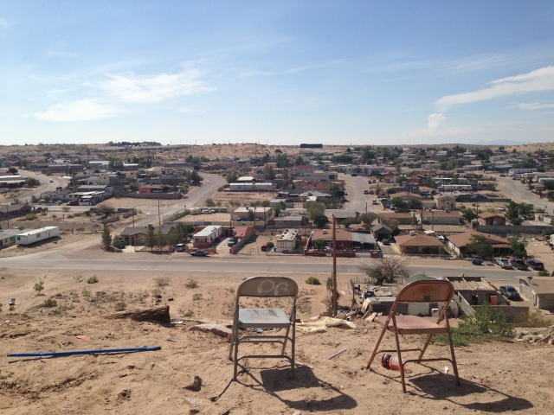
Factors Affecting Border Health
Epidemiological
7.5 million people reside in the U.S.-Mexico border region
Population growth rate of 6.9% between 2010 and 2019
U.S. national growth rate 6.3% for same time period
Financial and Structural
Lower income (average ~$15,000)
Access to healthcare/insurance
Transportation barriers
Poor infrastructure of colonias
Cognitive
Decreased health literacy
Language differences
Perception of disrespect
Propensity for self-treatment/cuanderas
Poor health related behavior

Slide 10
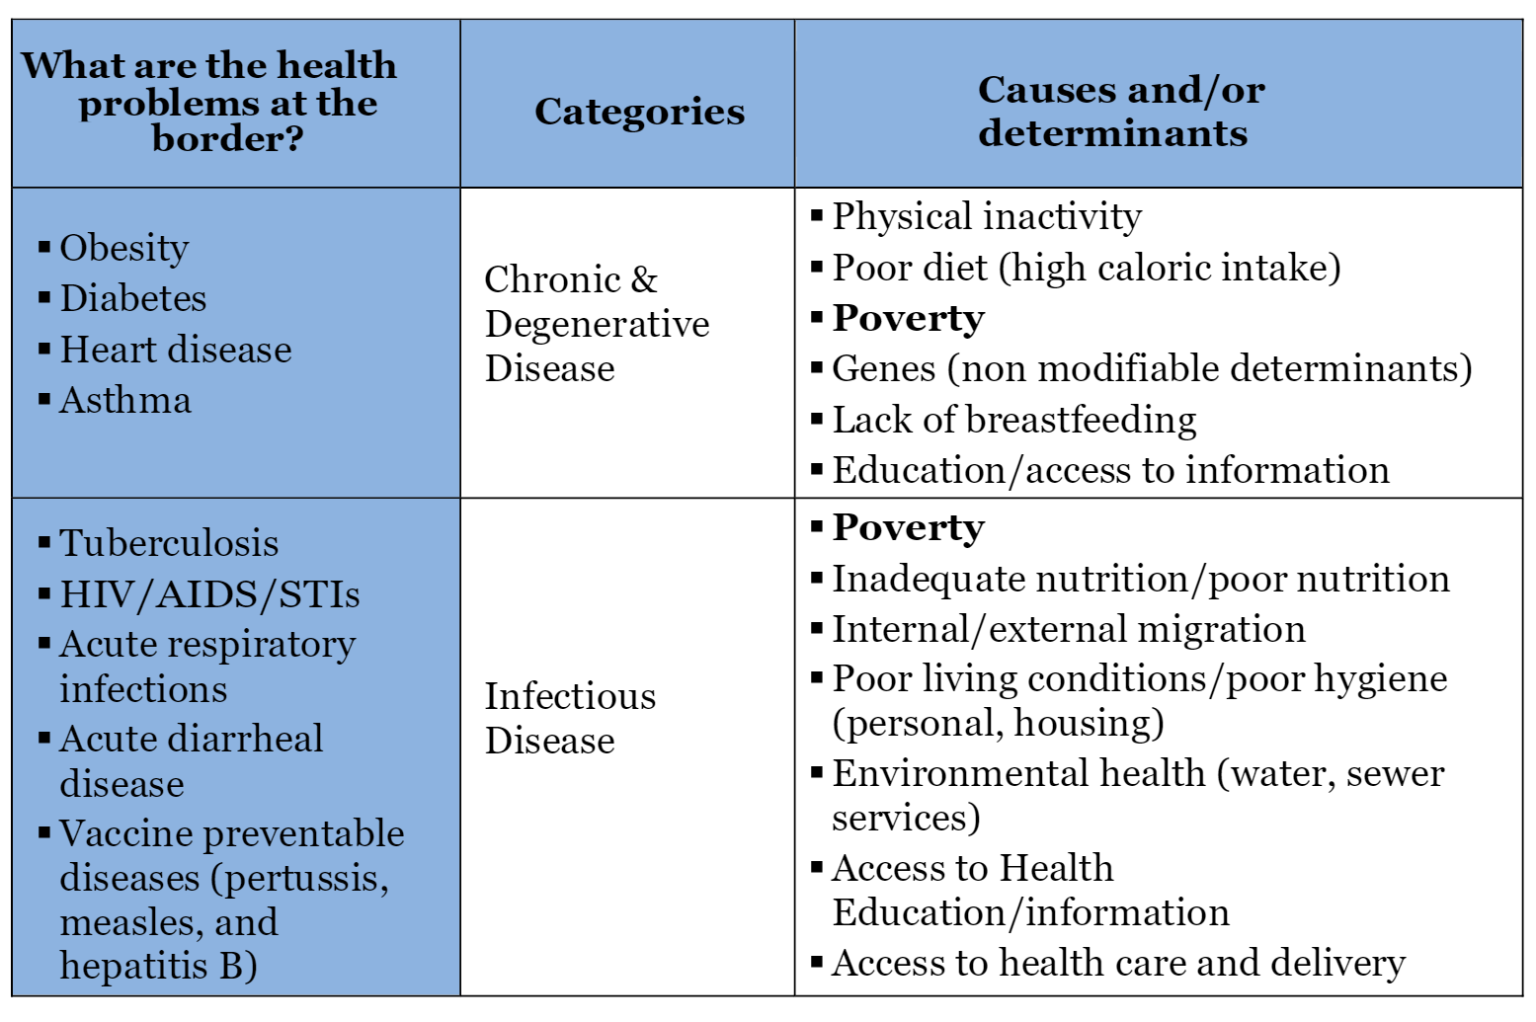
Root Cause Analysis

Slide 11
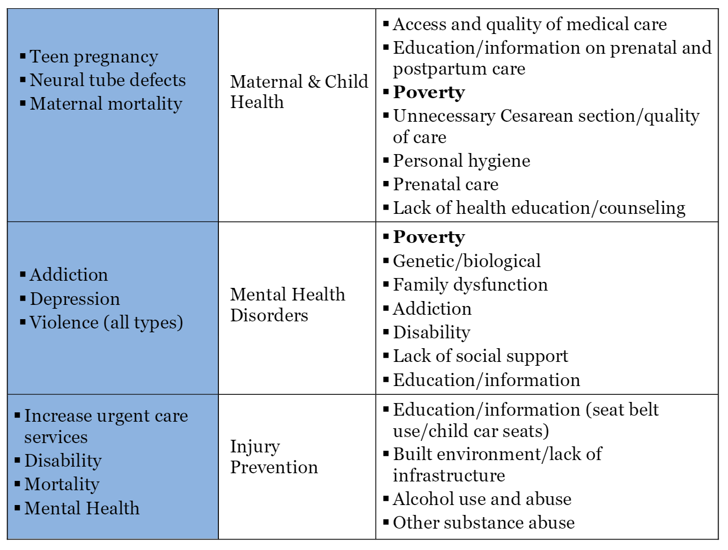
Root Cause Analysis (cont.)

Slide 12
Emergency AHCCCS
AHCCCS provides emergency health care services through the Federal Emergency Services Program (FESP) for non-citizens
Any services billed must meet the federal definition of emergency services as defined in federal law
An acute medical condition of sufficient severity such that the absence of immediate medical attention could place the member’s health in serious jeopardy
Services may be medically necessary, but not meet the definition of emergency service
The type of facility where a member presents or where service is delivered is not a factor in the determination of an emergency condition

Slide 13
Community Initiatives

Slide 14
Southeast Arizona Health Education Center (SEAHEC)
Area Health Education Center (AHEC) program was established by the U.S Congress in 1971 to address health workforce shortages and disparities
SEAHEC established in 1985 to “recruit, train and retain culturally competent health professionals in Cochise, Pima and Santa Cruz counties
Vacunas para todos
Collaboration with Casa Alitas Shelter in Tucson
Vaccine and health education

Slide 15
Refugee Health Alliance
Organized in 2018 in response to increasing medical need at the US-Mexico Border.
Patients receiving care are vulnerable and marginalized
2 stand-alone clinics and care to over 30 shelters
Services available:
Adult and pediatric care
Lab testing
Imaging services (including POC US)
LGBTQIA+ centered care and gender affirmation
Volunteer every Saturday in Tijuana at San Ysidro Border Crossing

Slide 16
100 Angels Foundation
Non profit organization determined on medically assisting indivduals seeking asylum from their home countries
The first half of 2019, Arizona received more than 40,000 individuals seeking asylum
Detention Center → Released by Homeland Security → Shelter
100 Angles coordinates medical care during release into shelters
Medical professional volunteers triage and assess for emergencies
Organize and transport all the needed medical supplies and over-the-counter medication to shelters

Slide 17
Regional Center for Border Health
Nonprofit organization that has created a number of programs to assist broad spectrum of medical care:
Walk-in Clinics – Parker, San Luiz AZ
Asthma camp
Medical mobile unit – Yuma, Mohave, La Paz Counties
Support groups
Promotoras Conference
Nuestros Niños – community census and immunization campaign in the border communities of San Luis, Gadsden, Somerton and Yuma, Arizona.

Slide 18
University of Arizona
Medical student organizations devoted to public/community health
Phoenix Allies for Community Health – free primary care clinic
Cecilia Rosales
Associate Dean of Community Engagement and Outreach
Co-chair of Health Services Committee of Arizona-Mexico Commission
Ventanillas de Salud (Health Windows) program
Improves access to preventive health care, health education, and public health screening at Mexican consular offices throughout the US
5 Ventanillas in AZ (Douglas, Nogales, Phoenix, Tucson, and Yuma)

Slide 19
Summary
Border health is a complex term that encompasses healthcare of individuals living along international borders as a product of their social, legal, economic environment
Individuals living along the border tend to be younger, more racially diverse, with less access to higher level education compared to the U.S. national average
Numerous efforts exist throughout the community exist to improve the lives of the border health population
Get involved!

Slide 20
Links to Programs
SEAHEC
https://www.seahec.org/programs/community-initiatives/border-bi-national-health/
Refugee Health Alliance
https://www.refugeehealthalliance.org/volunteer
100 Angels Foundation
https://onehundredangels.org/phoenix/
Regional Center for Border Health
https://www.rcfbh.org/programs.html

