Slide 1
Poster Instructions
See uaphxim.com → Scholarly activity → Creating a Poster → Template Choice
*Choose the template with the accurate institution affiliations as you cannot change/edit/remove
Before you enter anything on your poster, know that it is set to standard template of 36x48 inches landscape orientation. Due to increased printing costs for non-standard size printing, you must obtain Program Director approval prior to printing.
*If you plan to print a non-standard sized poster, you will need to adjust the size of your PowerPoint slide, instructions for this are on the next slide.
You CAN change the size of font, borders of text boxes, headings of text boxes, and spacing of diagrams.
You CANNOT change the color/background of the poster, logos, or font (must be Calibri or Proxima Nova)
Add faculty member(s) as the last author and send to faculty for final review by 3-4 weeks prior to printing. Every submission needs to have faculty review and input.
Printing submission needs to occur 2 weeks prior to you being able to pick-up in Med Ed, if poster is needed more quickly ( < 1 week) you will need to specify this in your poster printing request and you will be responsible to go and pick up your poster from the printing office itself in South Phoenix:
Prisma Will Call: 2937 E Broadway Rd, Phoenix, AZ (typical weekday hours are 8-5pm, closed Sat/Sun)
*Typical turn around time for standard size poster printing is 3 days and with delivery to hospital will be an additional 3-4 days
7. Email your poster printing request with any additional specifics (non-standard size or % enlargement or urgent printing needs and your plans to pick up the poster if needed in < 1 week) with attached PowerPoint slide to francena.harvey@bannerhealth.com ; debra.mcintosh@bannerhealth.com Please indicate “POSTER” in the subject line and if you do not indicate that you changed the size of the poster it will be printed in 36 x 48 format.

Slide 2
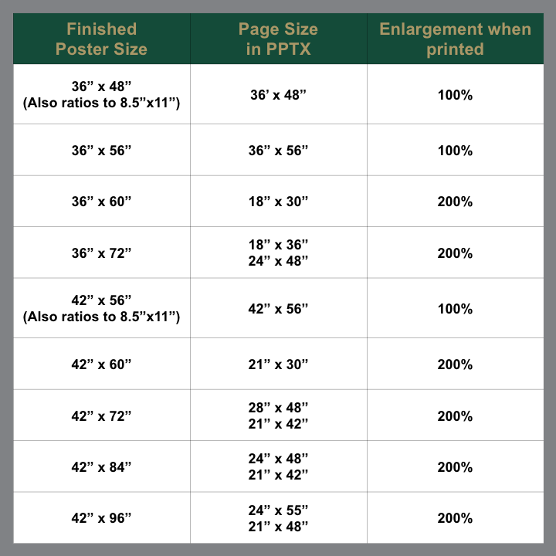
Sizing Instructions for your PowerPoint slide:
Obtain Program Director Approval for non-standard poster size printing and then open PowerPoint Poster Template and click on Design Tab.
On the right side of the Design Tab Ribbon, click on Page Setup, Slide Size, or Page Setup (Terminology will be different based on PowerPoint Version).
In the ‘Page Setup, Slide Size, or Page Setup’ dropdown menu, select Custom, Slide Size, or Page Setup. Do NOT just select "Standard" or "Widescreen" setting in PowerPoint, the dimensions may not be appropriate for your specific poster size.
Enter the dimension in inches in the Height & Width fields (typical is 36 x 48), Orientation: Landscape, and click OK. Don’t forget to save these changes.
If you need a non-standard size, you will need to be very specific in your poster printing request about the size it needs to be printed and at what enlargement as that will not be obvious to the printer.
PowerPoint max size you can set your page is 56 inches so please refer table about any enlargement percentage specifications.
For example, if you need a 42x60 poster you will need to set page set-up to 21 x 30 and specify to staff that you need the poster printed at 200% enlargement for a 42 x 60 poster. (If you do not specify your poster will be printed at the typical 36x48 size and will have significant formatting issues which is not up to the Int Med staff or Prisma staff to remedy
A window may open prompting you to scale your content. If prompted select "scale up" or "maximize", and then click “OK” to close
Email your poster printing request with any additional specifics (non-standard size or enlargement or urgent printing needs and your plans to pick up the poster) with attached PowerPoint slide to francena.harvey@bannerhealth.com; debra.mcintosh@bannerhealth.com. Please indicate “POSTER” in the subject line and if you do not indicate that you changed the size of the poster it will be printed in 36 x 48 format.

Slide 3
Tips and Tricks for a GREAT Poster
Pixels matter—plan to make any and all diagrams you can within the PPT program itself as they will print with good quality images.
Avoid thumbnails or copy and pasted images as they will rarely print well and when enlarged with likely be fuzzy or soft
Consider inputting a QR code for references or your contact information or even a link to full abstract of publication.
Acceptable fonts (proxima nova or calibri)
Branding is VERY important, do not change the logos and UofA naming conventions are VERY important

