Slide 1
Breast Cancer
David Paul, MD
Physician Executive
Banner MDA Cancer Center at BUMC-P

Slide 2
Breast Cancer epidemiology
Most common cancer among women in the US
2nd leading cause of death in women
1 in 8 women will develop breast cancer
Incidence rates are slowly climbing
Mortality rates have declined
White women first, AA second

Slide 3
Breast Cancer risk factors
Breast cancer increases with age (95% > 40 yrs)
Duration of menses without interruption (early menarche, late menopause, late first pregnancy, nulliparity)
Obesity (higher estrogen)
Family hx and family genetics (not necessarily the same)
Prolonged HRT and to lesser extent BCPs
ADH, LCIS
Prior Chest RT (classically NHL and HL)

Slide 4
Male Breast Cancer
<1% of all breast cancer cases
Usually older, > 50 yrs old
Estrogen/androgen ratio disruption
BRCA 1&2 positive, Li-Fraumeni, Cowden’s syndrome, Lynch, syndrome, Klinefelter's syndrome, hepatic dysfunction, marijuana use, prior RT to the chest
ER/PR positive breast cancer

Slide 5
Screening/Imaging
Mammogram
40-49 shared decision making, 50-74 target group
US to clarify fluid filled versus solid lesions
MRI for high risk groups, refined advanced imaging
Contrast enhanced mammography
Routine staging for distant disease is focused on patients with gross lymphadenopathy, Stage III disease and/or symptoms that need investigation

Slide 6
Staging
0- DCIS
I - <2 cm, negative LN
II- < 5cm primary and 1-3 positive LN or >2cm-5 cm with negative LN
III-> 5cm primary or any T with > 4 LNs
IV distant disease

Slide 7
Prognosis
Tumor size
Lymph node status
Hormone receptor status
Her2 neu status
Grade
Molecular profiling

Slide 8
Biomarker Expression
The degree of ER/PR expression is positively correlated with response to endocrine therapy
Her2-positive status is predictive of Her2-targeted therapy
PDL 1 CPS > 10 can allow for immunotherapy plus chemotherapy in MBC

Slide 9
General treatment considerations
Think of breast cancer patients needing a local treatment and possibly a systemic treatment
Local options: surgery (lumpectomy versus mastectomy) and radiation
Breast conservation relates to size of disease in relationship to normal breast tissue from a cosmesis standpoint
Radiation is just directed at the breast and regional LNs
Systemic treatment in 2023 can include endocrine therapy, chemotherapy, Her2 neu antibodies, immunotherapy, and even targeted agents (Olaparib-BRCA)

Slide 10
General treatment considerations
Majority of breast cancers are either ductal (80-85%) or lobular (10-15%). We consider them equivalent as it relates to stage, prognosis and risk for relapse.
They do manifest differently however:
Ductal: tend to calcify, be unifocal, and form palpable masses
Lobular: tend not to calcify, can be multifocal and bilateral, can be prone to elude palpability and definable endpoints at surgery, mostly ER/PR positive

Slide 11
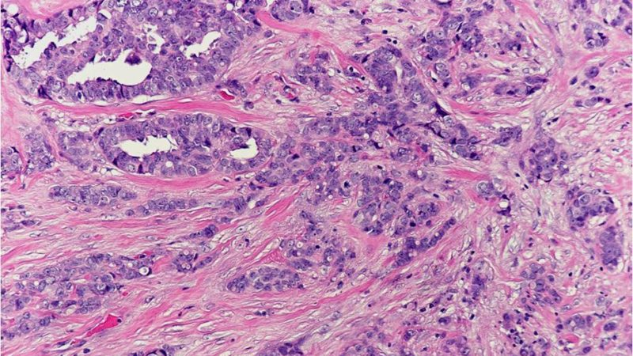
What type of Breast Ca?

Slide 12
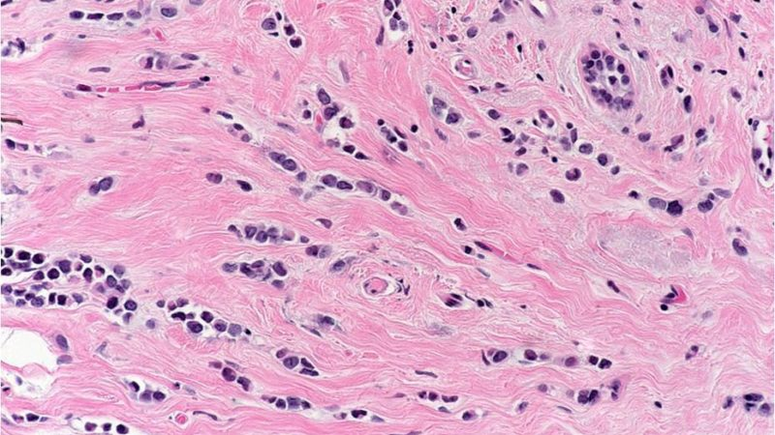
What type of Breast Carcinoma?

Slide 13
Patient Case #1
65 yo woman undergoes a routine screening mammogram which shows calcifications in the left breast that have increased since her last two mammograms
Bx comes back as DCIS, ER/PR positive
She may have lumpectomy/RT or mastectomy
Consideration of “chemoprevention” with endocrine therapy to reduce secondary incidence of invasive and noninvasive ER/PR + disease in either breast

Slide 14
DCIS
Represents a heterogeneous group of neoplastic lesions confined to the breast ducts and lobules
Diagnosis has increased dramatically with the introduction of breast cancer screening mammography
The risk of DCIS increases with age, is uncommon in women younger than 30 and is as high as 88 per 100,000 in women aged 50 to 64 years
The risk of cancer-related death in women with DCIS is low, estimated at 1.9 percent within 10 years

Slide 15
DCIS
Most cases of DCIS are detected on imaging studies (microcalcifications), can be palpable, most aren’t
Percutaneous core biopsy under stereotactic or ultrasound guidance is preferred
Fine needle aspiration biopsy usually cannot distinguish between invasive and in situ disease

Slide 16
Question
DCIS (Stage O Breast CA, intraductal carcinoma) is treated with endocrine therapy in order to prevent metastases?
True or False

Slide 17
LCIS
Lobular carcinoma in situ (LCIS) is a noninvasive lesion that arises from the lobules and terminal ducts
Represents an incidental finding that is diagnosed on a breast biopsy performed for some other reason, such as an area of fibrocystic change or a fibroadenoma
It is considered a “marker lesion” indicative of breast tissue at risk for cancer, not a “precursor lesion” (DCIS)

Slide 18
LCIS
4-times more likely to develop invasive cancer
30% risk of developing cancer over 25 years
Ipsilateral and contralateral breast tissue
May be treated with endocrine therapy for 5 years to prevent an invasive event
Some may choose to have b/l mastectomy

Slide 19
Sentinel Lymph Node Biopsy
Sentinel lymph node is the first lymph node to receive lymphatic drainage from the breast
Lymphatic mapping done by injecting blue dye with radiolabeled tracer into the breast parenchyma near the area of cancer/mass or, alternatively, in a periareolar location
Lymph node(s) detected by the blue dye or radioactivity or are palpably abnormal are removed

Slide 20
Sentinel Lymph Node Biopsy (DCIS)
DCIS with planned mastectomy
DCIS with suspicious features — breast-conserving surgery for DCIS clinically suspected of harboring invasive cancer, including DCIS larger than 5 cm and DCIS with a palpable mass.

Slide 21
Sentinel Lymph Node Biopsy (Invasive Ca)
Early breast cancer with clinically negative nodes
Fewer than three metastatic sentinel lymph nodes on SLNB, otherwise axillary LN dissection is indicated
Patients undergoing breast conserving surgery followed by whole-breast irradiation

Slide 22
Gene Expression (molecular) Profiles
Oncotype Dx
Mammaprint
Endopredict
Breast Cancer Index

Slide 23
Oncotype Dx
The Oncotype Dx 21-gene recurrence score is a prognostic assay and may identify patients who are most and least likely to derive benefit from adjuvant chemotherapy
Indicated for all women with LN negative, ER positive, HER2 negative breast cancer. Focus on cancers 10mm or greater with some exceptions.
Validation in postmenopausal women with up to 3 positive LNs

Slide 24
Oncotype Dx
RT- PCR to generate a recurrence score
Categorizes the tumor as low, intermediate or high risk
Low risk- adjuvant endocrine therapy alone
Tamoxifen versus Aromatase inhibitor
High risk- chemotherapy
TC, ddAC-T

Slide 25
Patient Case #2
54 yo female who presents with a very painful and swollen left breast and palpable lymph nodes
Mammogram confirms a 6.5 cm breast mass and left axillary LN
Biopsy is c/w IDC ER/PR negative, her2neu positive
Now what?

Slide 26
Patient Case #2
CT scan of chest/abd/pelvis and bone scan shows breast mass and left axillary adenopathy but no distant disease
Candidate for neo-adjuvant chemotherapy plus Her 2 neu directed therapy
Surgery to follow with lumpectomy or mastectomy, SLNB or full ax dissection depending on response
Adjuvant RT plus some form of adjuvant Her 2 neu directed therapy up to 1 year (HP vs Kadcyla)

Slide 27
Inflammatory Breast CA
Less than 1% of all breast cancers
Important for PCPs to recognize it and refer to medical oncology/surgical oncology immediately
Often these patients are given a course of antibiotics as a first step. Mastitis is primarily a condition of lactation.
These are treated using all the same principles we have discussed: staging exams, neoadjuvant treatment based on biomarkers, mastectomy and adjuvant RT

Slide 28
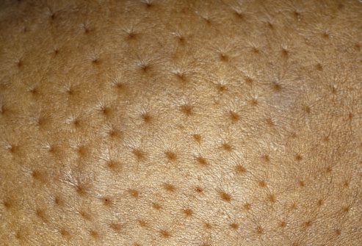
Inflammatory Breast CA

Slide 29
Patient Case #3
54 yo female with history of breast cancer diagnosed 7 years ago
Lumpectomy, SLN followed by radiation and 5 years of Tamoxifen
Back pain for past 3 months
Exam is unremarkable
Treated supportively with NSAIDS, physical therapy
Now what?

Slide 30
Patient Case #3
X-ray and CT scan of her spine- widespread bone mets
PET scan- Bone lesions but no other sites of disease
Biopsy is done and shows IDC ER/PR positive and Her2neu negative
Next best treatment?

Slide 31
Question
For this postmenopausal patient with newly diagnosed bone only MBC with mild to moderate discomfort, treatment should include:
1. Chemotherapy followed by hormonal therapy with denosumab
2. Chemotherapy followed by hormonal therapy with CDK 4/6 inhibitor plus denosumab
3. Hormonal therapy with CDK 4/6 inhibitor plus denosumab

Slide 32
Patient Case #3
Aromatase inhibitor(or fulvestrant) plus a cyclin dependent kinase 4/6 inhibitor until progression
Bisphosphonate (zolendronic acid) or rank ligand inhibitor (denosumab)
Chemotherapy for any evidence of visceral crisis, severe diffuse bone pain or progression on multiple lines of endocrine therapy

Slide 33
Practice changing advances
CDK 4/6 inhibitors have been primarily used to target postmenopausal ER/PR+ and Her 2 negative disease metastatic disease
MonarchE trial begins to change the paradigm. Phase III RCT targeting high risk Stage II/III ER/PR+ pre and post menopausal pts with endocrine therapy for 5 years +/- abemaciclib. Premenopausal pt had to be treated with ovarian suppression.
Invasive disease free survival and distant relapse free survival were both statistically improved at 19 mos (p<0.0001)

Slide 34
Practice changing advances
Stage II/III Pts with TNBC (ER/PR/HER2) can now be approached with chemotherapy plus immunotherapy (pembrolizumab) as standard therapy (Keynote 522)
Pathologic CR 64.8% vs 51% (chemo only arm) (p<0.001)
EFS at 36 months: 84.5% vs 76.8% (p<0.001)
As has been seen time and again, lessons learned in treatment of metastatic disease can be applied in the neoadjuvant and adjuvant setting to improve outcomes

Slide 35
Questions
A 50 yo woman underwent breast conservation surgery and radiation for Stage I triple negative breast cancer. She declined adjuvant chemotherapy. Two years later she is found to have a 1.5 cm ipsilateral relapse that on biopsy is again triple negative. Bone scan and CT scans are all negative

Slide 36
Questions
Which of the following treatment plans would provide the greatest reduction in risk of future relapse?
A) Mastectomy
B) Mastectomy with adjuvant chemotherapy
C) Mastectomy with radiation and adjuvant chemotherapy

