Slide 1
Female Infertility with Special Focus on PCOS
Kathy Mostajeran, DO PGY-7
Maternal Fetal Medicine Fellow
Department of Obstetrics and Gynecology

Slide 2
Financial Disclosure
I (unfortunately) have none.

Slide 3
Objectives
Understand the normal menstrual cycle
Understand the basics about infertility in terms of definition, causes, and evaluation
Understand polycystic ovarian syndrome in terms of diagnosis, proposed pathophysiology, management of infertility, and short- and long-term health consequences

Slide 4
Outline
Normal reproductive physiology and endocrinology
Infertility
  Definition
  Importance aspects of the H&P
  Causes of Infertility
Polycystic Ovarian Syndrome
  Background
  Definition
  Pathophysiology
  Diagnosis and differential
  Treatments
  Long term management

Slide 5
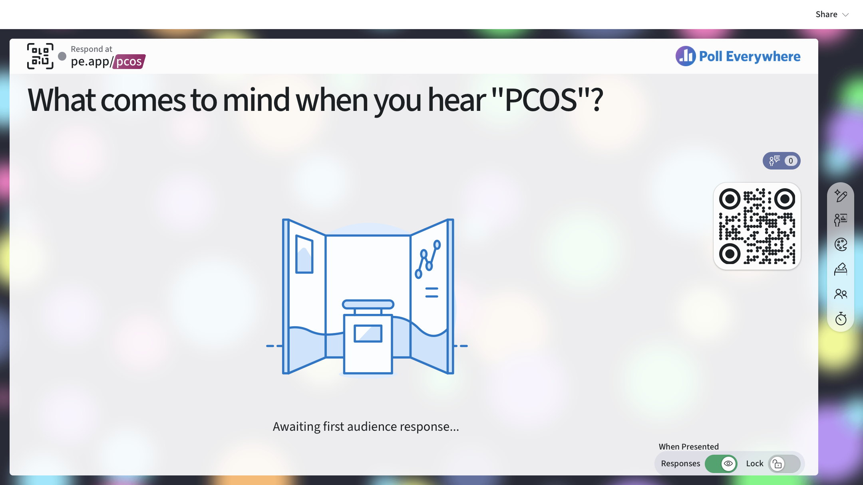

Slide 6
A Review of Normal Menstruation
Sorry!

Slide 7
Normal Menstrual Cycle
Menarche: median age 12.43 years
Normal length of menstrual: 28 +/- 7 days
Normal menstrual flow: 4 - 8 days
First day of menses is designated cycle day 1
<80 mL vaginal blood loss per cycle

Slide 8
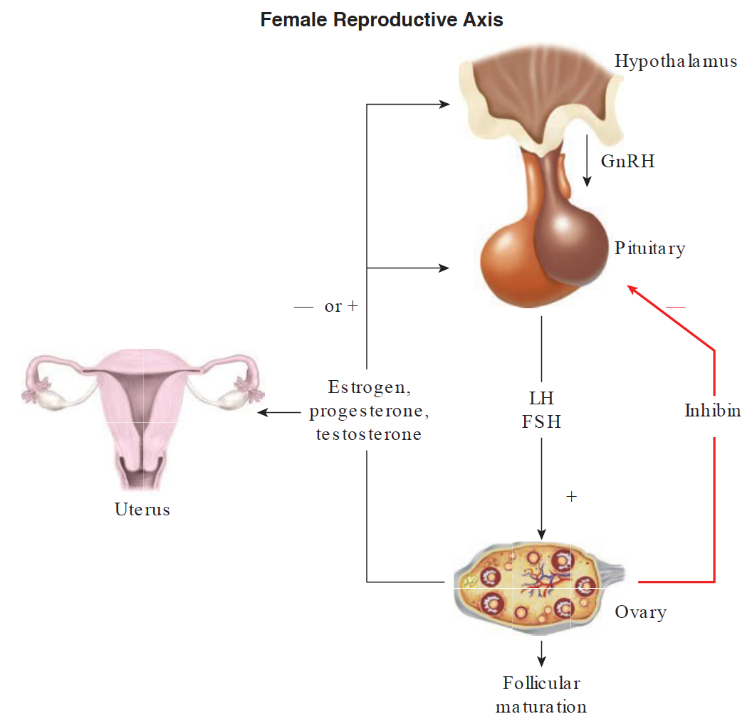
H-P-O AXIS
Notes:
To understand infertility, and particularly how polycystic ovarian syndrome effects fertility, we need to remember a few things about the endocrinology and anatomy of the female reproductive system. Specifically, we need to understand the cyclical hormonal changes required for ovulation and subsequent menses in the normal menstrual cycle and what changes happen when fertilization occurs.
GnRH released pulsatile from hypothalamus → + anterior pituitary to release LH/FSH
FSH --> granulosa cells produce aromatase and convert androstredione into estradiol
LH→ theca cells produce androestridione for the granulosa cell to convert; produce progesterone

Slide 9
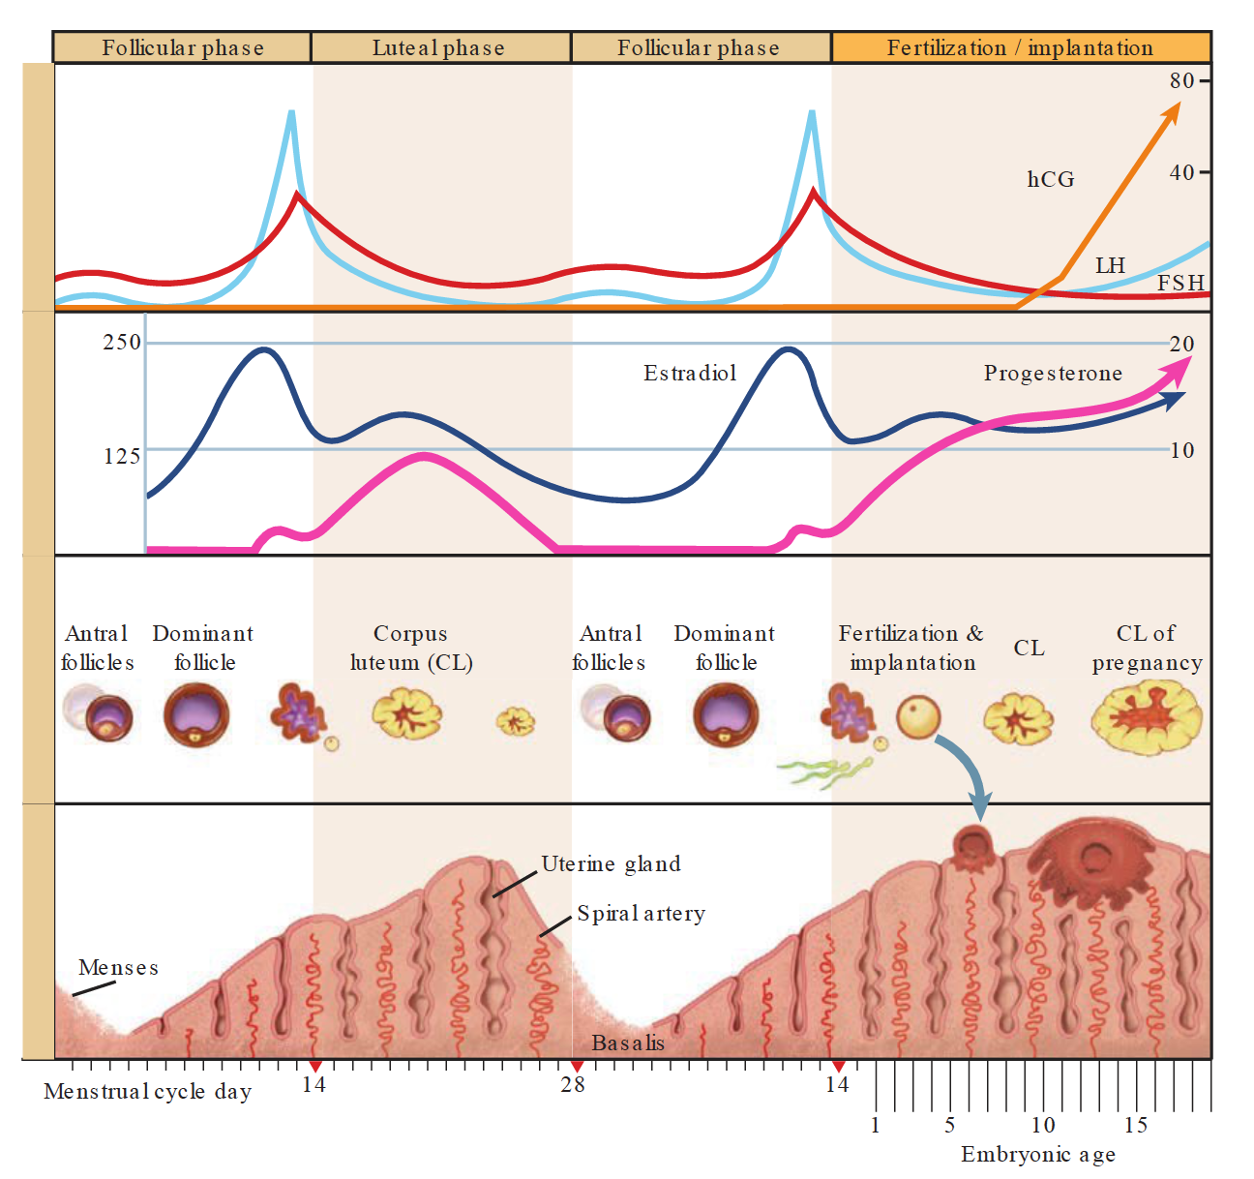
Schorge, John O., ed. Williams gynecology. New York: McGraw-Hill Medical, 2008.
Notes:
So let’s look at things in a little more detail. There are two phases of the menstrual cycle and each phase affects the ovary and endometrium differently. The first phase with respect to the ovary is called the follicular phase.
With respect to the hormonal effects on the endometrium it is called the proliferative phase.
If we assume a normal 28 day cycle, then the first phase occurs from day 1 to 14. Variation in each menstrual cycle is due to variation of the duration of time that this phase requires to take place.
The main hormone during the first phase is estradiol
The second phase of the menstrual cycle starts after ovulation occurs. With respect to the ovary it is known on the luteal phase and with respective to the endometrium is it known as the secretory phase.
2 phases affecting 2 structures during the menstrual cycle
Phase 1
Ovary = follicular phase
Endometrium = proliferative phase
Dominated by estrogen
Ends with ovulation
Variable part of the cycle
Phase 2
Ovary = luteal phase
Endometrium = secretory phase
Dominated by progesterone
Ends with shedding of the lining
Fixed pat of the cycle – always 14 days
First their needs to be a recruitment of a cohort of antral follicles. This is accomplished by FSH stimulation. By cycle day five, ….

Slide 10
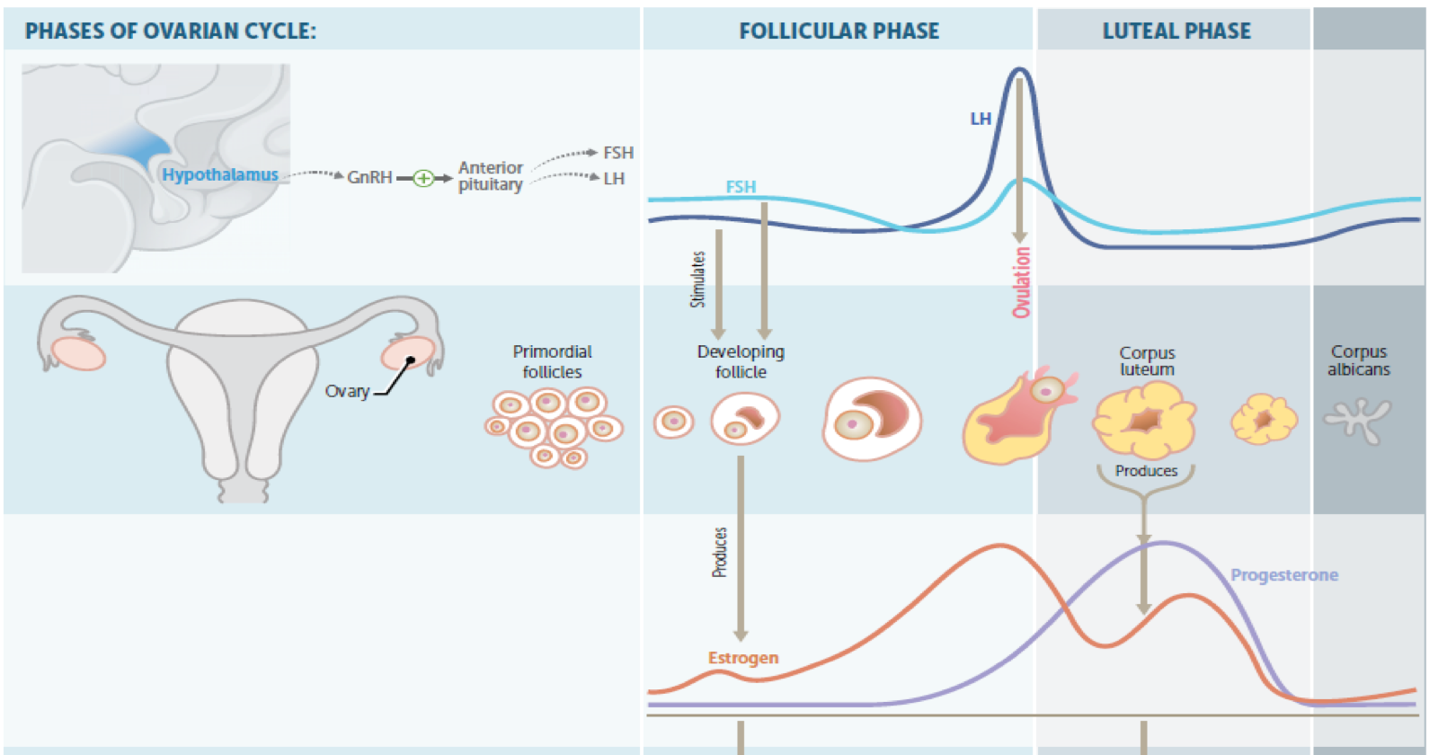
Notes:
So FSH functions to signal recruitment of a cohort of pre-antral follicles.
The circulating FSH stimulates theca interna cells of the ovary to develop LH receptors. When lH binds to these receptors androsterione is produced and diffuses to the granulosa cell layer which contains aromatase. Androesterioone is convereted into estradiol. Estradiol serves to stimulate the increased expression of the FSH receptor. Early in the cycle as estradiol increases, it causes an inhibitory feedback on the production of FSH ad LH. These means that follicles follicles with less FSH receptors will produce less estradiol. Thus, the follicle with the most FSH receptors continues to grow and produce estradiol in the setting of decreased FSH levels while other follicles regress. The dominant follicle is born wich continues to grow and produce more and more estrogen which eventually ovulation occurs
Ovulation generally occurs 14–26 hours after detection of the LH
surge and almost always within 48 hours.³⁷² Consequently, the interval of greatest fertility includes the day the surge is detected and the following 2 days. The day after the first positive test generally is the one best day for timed intercourse or insemination

Slide 11
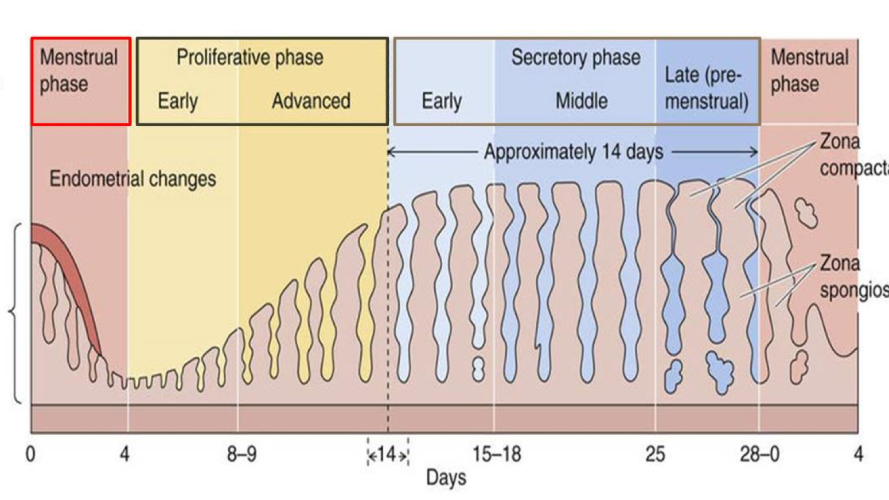
Notes:
The hormones produced by the ovaries have a simultaneous affect on the endometrial lining, preparing the lining for potential implantation of a fertilized oocyte.
The first phase of the menstrual cycle with respect to the endometrium is termed the proliferative phase and is under the influence of estrogen.
Under the influence of estrogens, secreted in large quantities by the ovaries, the stromal cells & epithelial cells proliferate rapidly. The endometrial surface re-epitheliazed within 4-7 days after the beginning of menstruation. Before ovulation the endometrium thickness increases, due to increase numbers of stromal cells & progressive growth of the glands & new blood vessels.
The second phase is the secretory phase which is under the control of the progesterone produced by the corpus luteum. Remember the corpus luteum produces large amounts of progesterone and smaller amounts of estradiol. The estradiol functions to cause a slight proliferation in the endometrium, while progesterone causes an increase in gland tortuosity, increased lipids and glycogen deposits in the stroma cells cytoplasm, and an increase in blood supply along with marked swelling and ultimately secretory development of the endometrium.
Ultimately if fertilization, the corpus luteum regresses, progesterone levels decline and the endometrial lining ultimately involutes and sheds.
If fertilization does occur, the hCG rescues the corpus luteum which continues to provide a source of progesterone for the developing pregnancy up unti approximately 10 weeks, at which point the placenta begins to take over the function of progesterone production.

Slide 12
Important Take Aways
1st day of full flow = day 1 of the menstrual cycle
1st phase of the menstrual cycle = follicular/proliferative phase
  Variable part of the cycle
  Under the influence of estradiol
Ovulation occurs at the end of the first phase and is preceded by an LH surge
  Constant estrogen levels = LH levels are constant = no LH surge = no ovulation
  16h after peak LH an oocyte is release
  The remaining theca and granulosa cells become known as the corpus luteum
2nd phase of the menstrual cycle = luteal/secretory phase
  Fixed part of the cycle : 14 days long
  Dominant hormone is progesterone (produced by the corpus luteum)
  Cessation of progesterone (and estrogen) production by corpus luteum is responsible for menstruation

Slide 13
https://m.youtube.com/watch?v=65BV5dXXxzM

Slide 14
Overview of Infertility

Slide 15
Definition of Infertility
Old Definition
ASRM Committee Opinion & Updated Definition as of 2023:
  A disease, condition, or status characterized by any of the following:
    Inability to achieve a successful pregnancy
    Need for medical intervention to achieve successful pregnancy
  In patient having regular, unprotected intercourse without any known etiology for either partner to suggest impaired reproductive ability , evaluation should be initiated at:
    12 months when female partner is < 35 year of age
    6 months when female partner is ≥ 35 years of
Reasons to refer for evaluation earlier:
1. Oligomenorrhea or amenorrhea
2. Known or suspected uterine, tubal, or peritoneal disease
3. Stage III or stage IV endometriosis
4. Known or suspected male infertility
Notes:
The ACOG definition of infertility has been the inability to achieve pregnancy within 12 months of unprotected intercourse or therapeutic donor insemination in women younger than 35 years or within 6 months in women 35 years or older. Furthermore, the recommend immediate referral for evaluation in patients with high risk factors for infertility, including ovulatory dysfunction demonstrated by oligomenorrhea or amenorrhea, known or suspected uterine, tubal, or peritoneal disease, stage 3 or 4 endometriosis, or known or suspected male infertility.
However, as of 12/2023, The American Society of Reproductive Medicine updated their definition of infertility. Now defined as a disease, condition, or status characterized by any of the following: the inability to achieve a successful pregnancy or the need for medical intervention to achieve a successful pregnancy. They did maintain that referral for evaluation should still occur at 12 months of unprotected intercourse when the female partner is younger than 35, or at 6 months when the female partner is 35 or older in couples without any known etiology in either partner to suggest infertility.

Slide 16
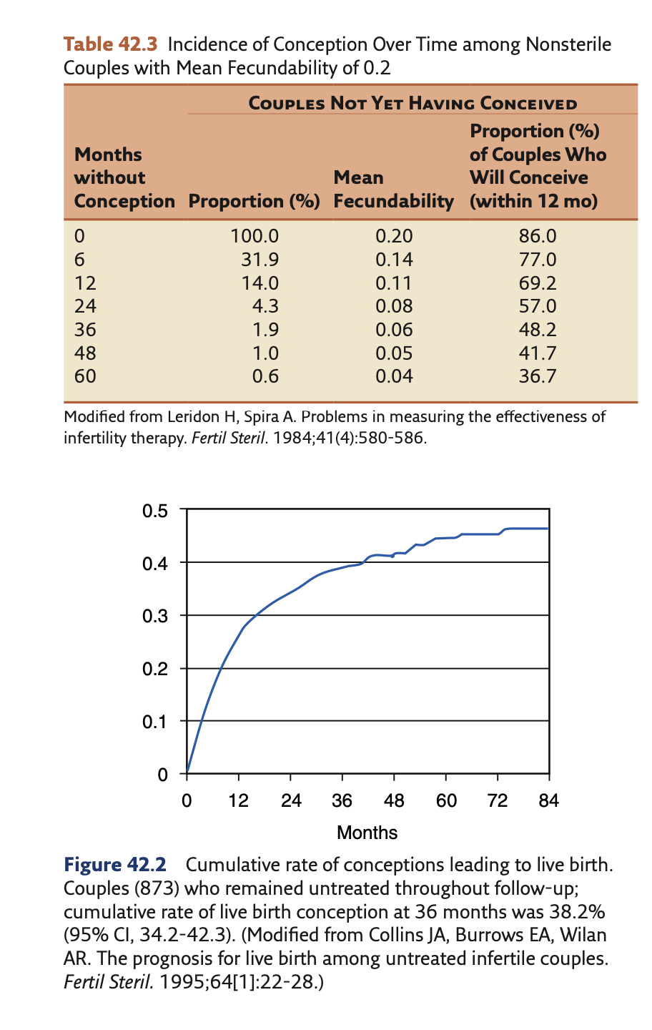
Pregnancy Over Time without Treatment
Analysis of data from fertile couples who stopped using contraceptives to conceive found the following:
  At 3 months ~ 50% conceive
  At 6 months ~ 75% conceive
  1 year ~ 90% have conceived
Smart people did math and say that the fecundity rate in couples able to conceive is about 20%
The longer a couple does not conceive the less likely they are to achieve pregnancy and their fecundity plumets
Lentz, Gretchen M., et al. Comprehensive gynecology e-book. Elsevier Health Sciences, 2012.
Notes:
Analysis of data from presumably fertile couples who stop using contraception to conceive has shown that approximately only 50% of the couples will conceive in 3 months, 75% will con- ceive in 6 months, and by 1 year approximately 90% will have conceived

Slide 17
Causes of Female Infertility:
The 4 Main Categories
Endocrine: Oligomenorrhea or amenorrhea
Anatomy: uterine, tubal, or peritoneal disease
Zebras
Unknown

Slide 18
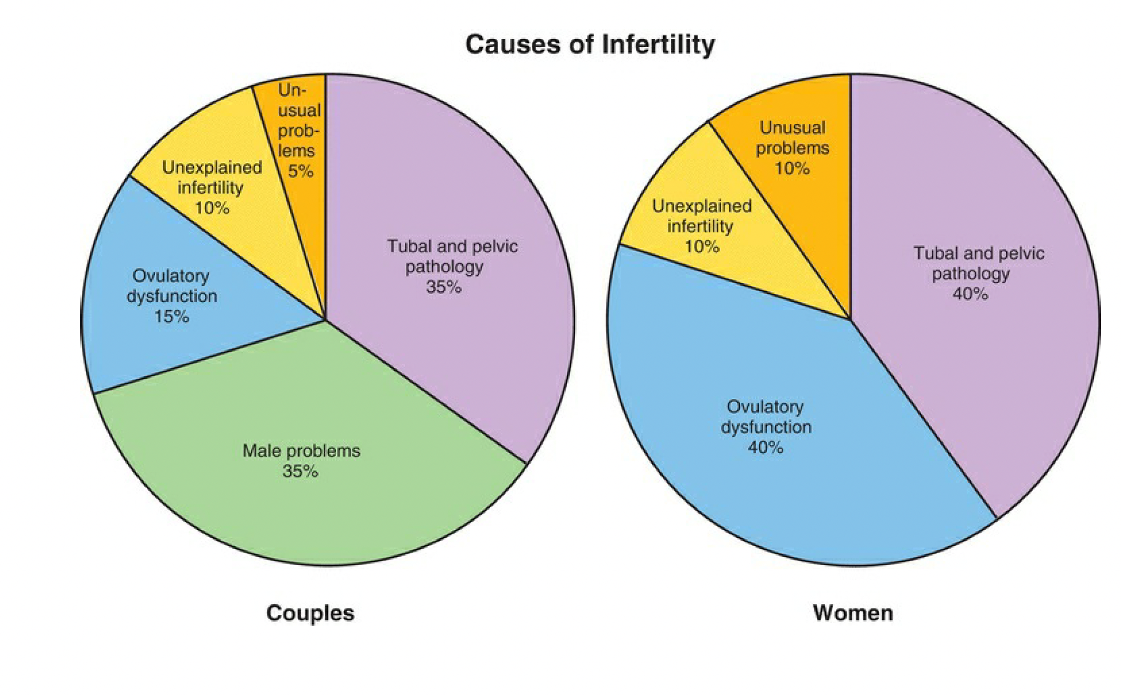
Causes of Infertility by the Numbers
Speroff, Leon, and Marc A. Fritz, eds. Clinical gynecologic endocrinology and infertility. lippincott Williams & wilkins, 2005.

Slide 19
Causes of Infertility: Diminished Ovarian Reserve
“Ovarian reserve” = reproductive potential as a function of the # of oocytes
  # of oocytes available for potential fertilization at that point in time
  May be assessed by serum tests or ultrasonography
  Really a measure of potential response to ovarian stimulation
Evaluation
  Cycle dependent (days 2-5 of menstrual cycle)
    FSH and E2
    Antral follicle count
  Cycle independent:
    Anti-Mullerian hormone
Remember, age is the most important predictor of reproductive potential
Notes:
Ovarian reserve can be assessed by measuring estradiol and FSH between cycle days 2–5. Follicle-stimulating hormone values greater than 10 IU/L are associated with a less robust response to ovarian stimulation 9. Estradiol serves as an aid for interpreting FSH results. Basal estradiol levels typically should be less than 60–80 pg/mL; elevated estradiol levels may have a suppressive effect on FSH levels and are indicative of decreased ovarian reserve Serum AMH is produced by the granulosa cells of antral follicles and, therefore, is another serum marker of ovarian reserve. Because AMH levels remain relatively stable throughout the menstrual cycle, they can be assessed on any day of the menstrual cycle 10 11. Antimüllerian hormone is similar to antral follicle count in its ability to predict response to ovarian stimulation and pregnancy in infertile women 12. Ovarian reserve tests are good predictors of response to ovarian stimulation, but poor results do not necessarily predict inability to achieve a live birth. Ultrasonographic assessment of the antral follicle count is determined by the number of follicles that measure 2–10 mm in both ovaries. Low antral follicle count may be defined as fewer than 5–7 follicles and is associated with poor response to ovarian stimulation 16.

Slide 20
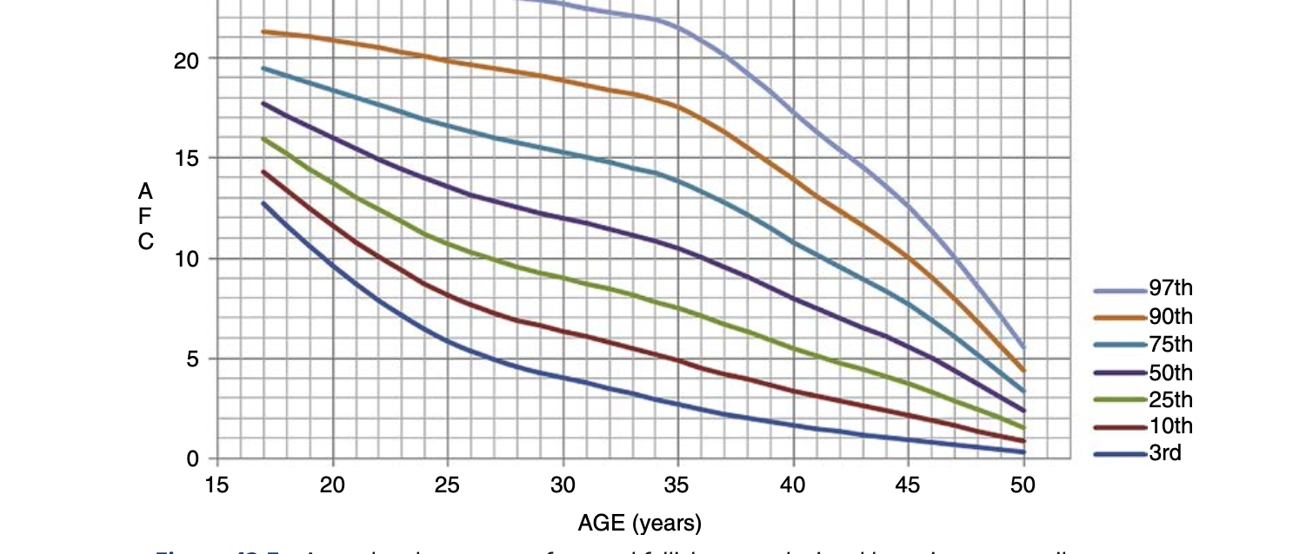
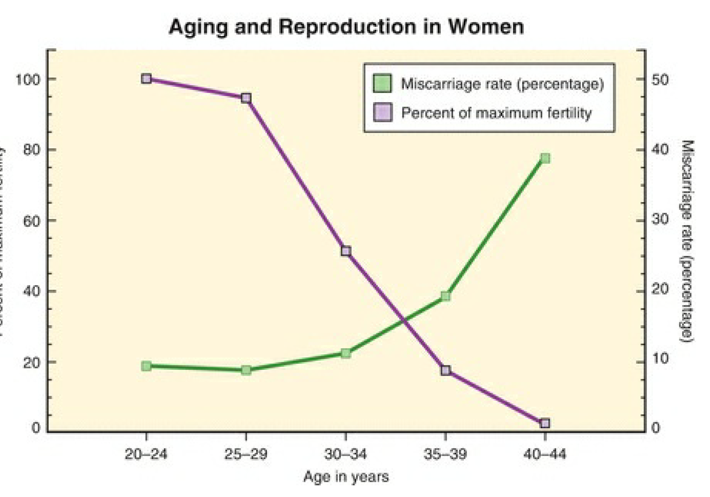
Reproductive Potential by Age
Lentz, Gretchen M., et al. Comprehensive gynecology e-book. Elsevier Health Sciences, 2012.
Speroff, Leon, and Marc A. Fritz, eds. Clinical gynecologic endocrinology and infertility.

Slide 21
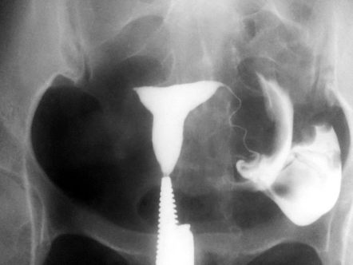
Causes of Infertility: Anatomical
Tubal Factor
Tubal disease in an important factor in infertility
Risk factors: history of STIs/PID, endometriosis, history of ectopic, surgical, removal, prior surgeries in the pelvis
Evaluation:
  Hysterosalpingogram
  Sonohysterosalpingography

Slide 22
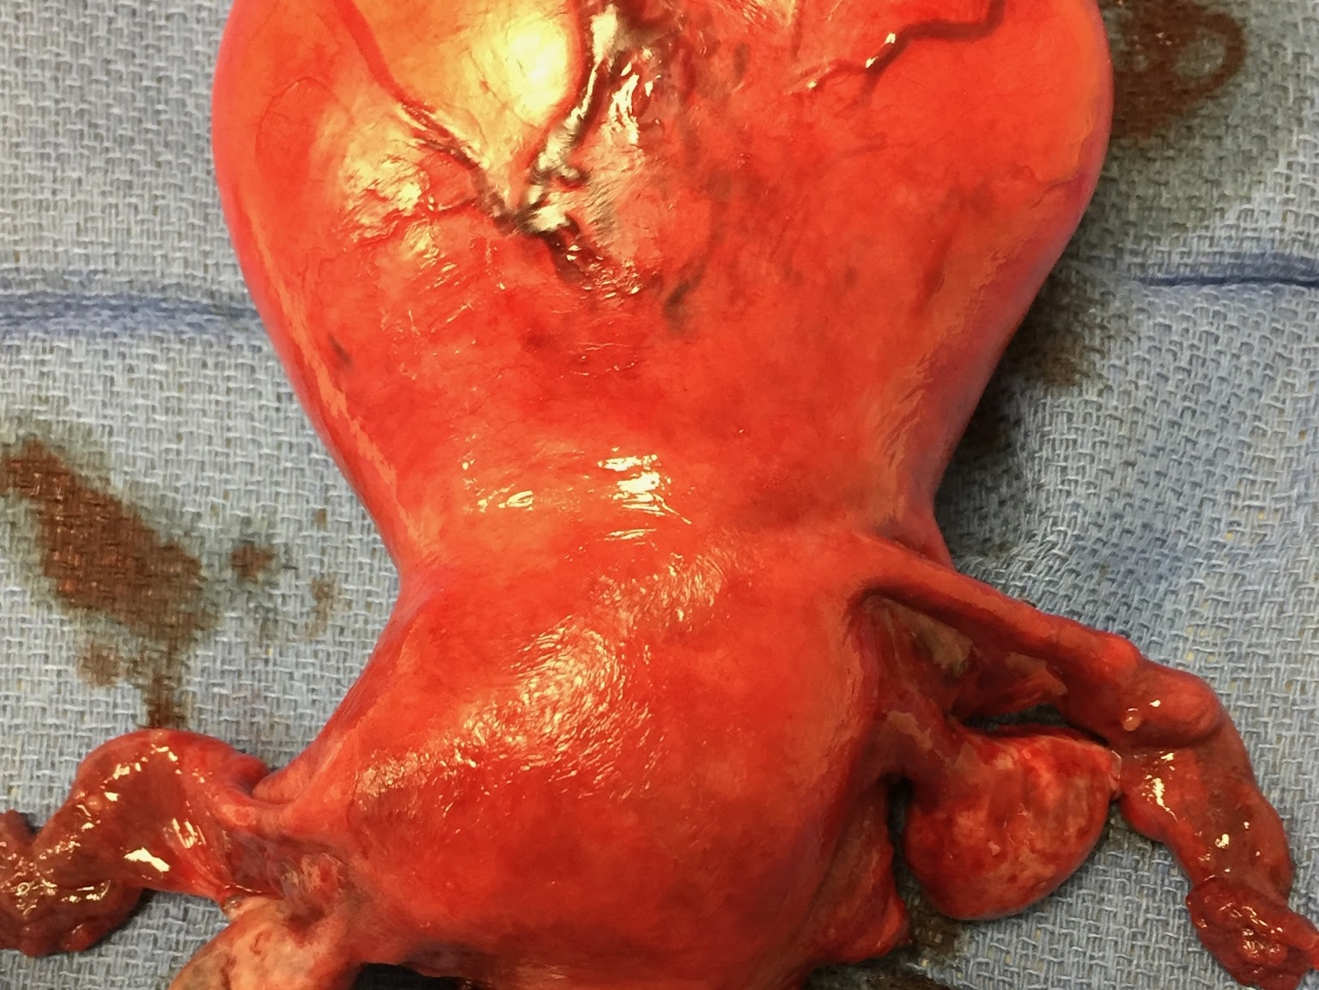
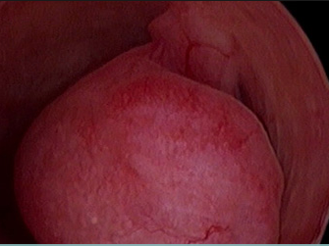
Causes of Infertility: Anatomical
Uterine Factors
Leiomyomas
Endometrial polyps
Intrauterine adhesions
Assessment:
Saline-infused ultrasound
TVUS
Hysteroscopy
hysterosalpingography
Notes:
Transvaginal ultrasonography
Saline infusion ultrasonography
Hysterosalpingography
Hysteroscopy
From an anatomical perspective, we have to consider the uterus itself as a cause of infertility. Endometrial polyps which are hyperplastic growths can cause distortion of the normal lining making

Slide 23
Causes of Infertility: Ovulatory Dysfunction
Definition: a history of oligo-amenorrhea or amenorrhea OR as luteal progesterone levels repeatedly less than 3 ng/mL, or both
How to determine if they are having ovulatory cycles?
  Assessment of menstrual cycles
    Regular: every 25 – 35 days and accompanied by molimina symptoms
    Objective quantification: midluteal progesterone measurement (day 21 progesterone should be greater than 3 ng/mL if they have a normal 28 day cycle and you are still concerned about anovulatory cycles).

Slide 24
Causes of Infertility: Ovulatory Dysfunction
Physiological causes:
  Adolescence
  Perimenopause
  Lactation
  Pregnancy
Pathological causes:
  Hyperandrogenic
  Hypothalamic dysfunction
  Hyperprolactinemia
  Thyroid disease
  Primary pituitary disease
  Premature ovarian failure
  Iatrogenic
  Medications
Notes:
Puberty and the perimenopause typically are associated with ovulatory dysfunction and are physiologic in these circumstances. In puberty, the immature hypothalamic–pituitary–ovarian axis does not develop the necessary hormonal feedback to result in ovulation and a subsequently stable endometrium. As the perimenopausal transition occurs, progressive oocyte depletion and abnormal follicular development lead to anovulatory cycles.

Slide 25
Causes of Infertility: Ovulatory Dysfunction
Most common cause: Polycystic Ovarian Syndrome
Other endocrine disorders that can cause anovulation and subsequent infertility
  Thyroid disease – always assess a thyrotropin in infertile or sub-fertile females, especially in the setting of irregular menstruation
    ASRM recommends targeting TSH of < 4. 0 in women trying to conceive
      Some REIs advocate for targeting <2.5 although data is limited
  Hyperprolactinemia
    Caution: women with PCOS can have slightly elevated prolactin levels.
    >40 ng/mL warrants further investigation
Notes:
Prolactin level testing (If the level is elevated, the test should be repeated in the fasting state.)

Slide 26
Determine the Cause of Infertility:
The H&P Can Guide You
Fertility history
  Current conception attempts
  Prior fertility history
Gynecological History
  Menstrual history
  General gynecological history
Obstetrical history
  Total number of pregnancies
  Use of infertility treatments
  Same partner or new partner
  Obstetrical complications
Medical/surgical History
  Medical problems with special attention to endocrine, genetic, autoimmune, and cancer history
Medication history
  Use of gonadotoxic medications or radiotherapy
  Current supplements
Family history
  Premature ovarian failure (<40)
  Endocrinopathies
  RPL, infertility, genetic conditions
  Heritable cancer syndromes
Social history
Notes:
The first step of evaluating the potential causes for infertility in a patient is getting a good history. For infertility, there are specific things we like to focus on. Fertility history and discussing the current conception attempts is a good starting point. Questions to have answered include how long has the patient been having unprotected intercourse, instead of how long have they been trying to conceive. This is because patient’s may incorrectly identify attempts at pregnancy as only the conscientious effort to conceive as opposed to having intercourse without contraceptive use. How frequently is she engaging in coitus and whether she is using any sort of ovulation monitoring. Is there a presence of any sort of sexual dysfunction like dyspareunia or decreased libido. Additionally prior fertility history should be elicited. Was there a previous attempt as conception, prior periods of intercourse without contraception, or any prior fertility evaluation or management.
Gynecological history is quite important and should include a detailed history of the patient’s menstruation. This includes age of menarche, cycle length as a range, duration and amount of bleeding. The presence of any intermenstrual bleeding dysmenorrhea, and molimina. Other gynecological history that becomes important is a history of pelvic inflammatory disease or sexually transmitted diseases, cervical cancer screening and any subsequent treatments required, and dyspareunia and a history of chronic pelvic pain.
Moving on you should assess in detail any pregnancy history the patient may have. The question to ask is how many times have you been pregnant, regardless of the outcome including spontaneous losses. You should elicit whether this is a new partner they are trying to conceive with if they have successfully conceived previously. Details of any fertility treatment that was needed to conceive and any obstetrical complications during pregnancies, including gestational diabetes, hypertensive disorder of pregnancy, preterm births, stillbirths, any sort of placental complications including fetal growth restriction, and any congenital disease or birth defects in the offspring.
When discussing past medical history, focus on any history of endocrine disorders, autoimmune conditions, genetics diseases or a history of cancer and particular chemotherapies that were used or radiation. For surgeries, ask specifically about abdominal-pelvic surgeries as adhesive diseases could also causes fertility issues. Or maybe they have endometriosis that was diagnosed with laparoscopy-- all important things to know.
For the family history focusing on any history of premature ovarian failure, defined as a cessation of menses before age 40, can be highly suggestive of the underlying pathology. Family history of heritable cancer diseases, infertility, recurrent pregnancy loss, genetic conditions and endocrinopathies are all important. For social history, focusing on tobacco use, alcohol and drug use, toxic exposures in the work place and diet and exercise can all be really important

Slide 27
Determining the Cause of Infertility
The H&P Can Guide You
Skin Examination
  Consider if they complain of menstrual abnormalities or signs/symptoms of androgen excess
    Evaluate for signs of biochemical androgen excess (hyperandrogenemia)
      Acne, hirsutism, alopecia, acanthosis nigricans
Thyroid exam
  Consider if abnormal thyroid function of goiter
    Evaluate thyroid texture, size, presence of nodularity or tenderness, and cervical adenopathy
      Consider a thyroid ultrasound if indicated
Breast Exam
  Consider if there is breast pain, mass or nipple discharge
    Evaluate for masses, palpable tenderness, nipple discharge either expressed or not skin changes
      Any breast abnormality without a known cause warrants evaluation
        <30 – breast ultrasound; ≥30 diagnostic mammography
Notes:
Polymenorrhea
Oligomenorrhea
Amenorrhea
Signs or symptoms of
androgen excess
(e.g., hirsutism, acne, scalp
hair loss)

Slide 28
Determining the Cause of Infertility
The H&P Can Guide You
The Dreaded Speculum Exam
  Consider if patient c/o dyspareunia or postcoital spotting
    Evaluate for vaginal/cervical abnormalities, lesions, cervical polyps
What about the bimanual exam?
  Actually, ASRM doesn’t recommend a bimanual exam for assessment of infertility
    Most pathologies can be better evaluated with TVUS
    Can consider if cost is an issue/barrier to a TVUS

Slide 29
Infertility Evaluation: #1 Rule
RULE OUT CURRENT PREGNANCY
  Get a urine pregnancy test at start of appointment

Slide 30
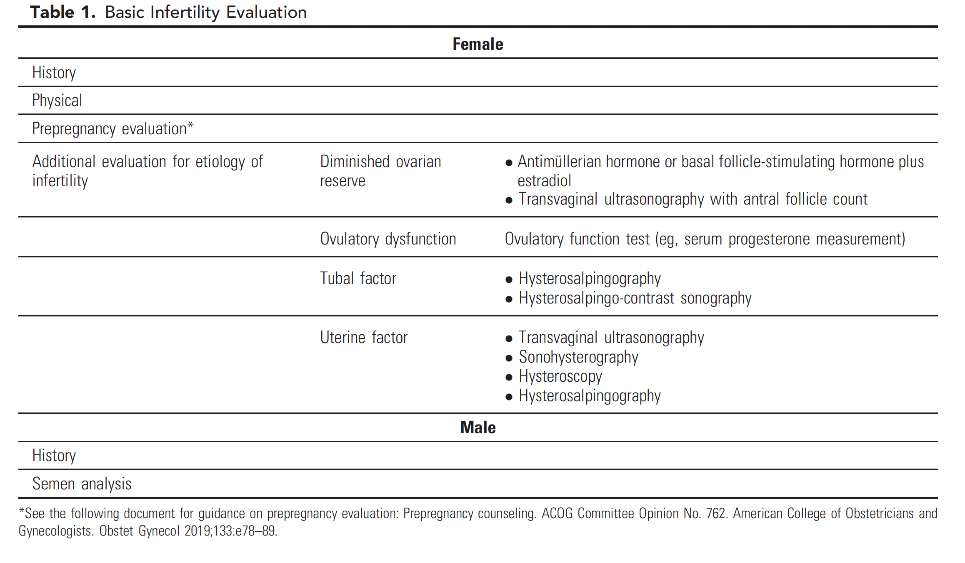
Penzias, Alan, et al. "Fertility evaluation of infertile women: a committee opinion." Fertility and sterility 116.5 (2021): 1255-1265.

Slide 31
Ovulatory Dysfunction: Polycystic Ovary Syndrome

Slide 32
PCOS: General Points
Complex disorder with a heterogenous presentation
The most common endocrinopathy amongst reproductive age women
  Estimated to affect up to 15% of reproductive aged women
Should be considered a lifelong condition and requires multidisciplinary care and management
Often associated with obesity
  20% of patients with PCOS are not obese
Most common cause of anovulatory infertility

Slide 33
Polycystic Ovary Syndrome
Definition - The Rotterdam Criterion
2003 criterion for the diagnosis of PCOS
Must have 2 out of 3 to meet diagnostic criterion
  Irregular period: 8 or less menstruations per year
  Elevated serum androgens or evidence of hyperandrogenism:
    Hirsutism
    Acne
    Androgenic alopecia
  Polycystic ovarian morphology or polycystic ovary
    Ovarian volume >10 mL3 and/or >12 follicles between 2 and 9 mm in size in at least one ovary.
Notes:
Polycystic ovarian syndrome is truly a clinical diagnosis after ruling out other possible causes of hirsutism and/or oligo or amenorrhea. Without getting into too much of the nitty gritty on differing definitions, ACOG endorses the Rotterdam criterion which was initially developed in 2003. Essentially, you must have 2 out of the following 3 to make the diagnosis of PCOS. These include irregular periods, with oligomennorhea defined as 8 or less menstrual cycles per year (remember, a year is 13 menstrual cycles), physical findings of hyperandrogenism or biochemical findings consistent with elevated levels of androgens. For physical findings, these can include hirsutism which is defined as terminal hair growth in a male pattern, including chin, upper lip….

Slide 34
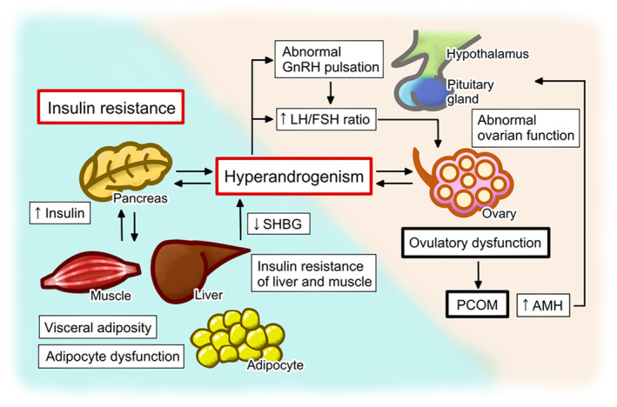
Harada M. Pathophysiology of polycystic ovary syndrome revisited: Current understanding and perspectives regarding future research. Reprod Med Biol. 2022;21(1):e12487
Notes:
This diagram represents a model for the initiation and maintenance of PCOS. Changes in the pulsatile release of GnRH may lead to a relative increase in LH compared to FSH biosynthesis and secretion.
LH, remember, stimulated ovarian androgen production. Simultaneously, the diminished FSH prevents adequate stimulation of aromatase activity within the granulosa cells → androgen conversion to estradiol is decreased.
Increased levels of intrafollicular androgens ultimately results in follicular atresia.
Increased levels of circulating androgens contribute to lipid abnormalities and the development of hirsutism and acne.
Increased levels of serum androgens, primarily androstenedione, are converted peripherally inside stromal cells of adipose into estrone, yielding chronically increased estrogen levels.
This chronic elevation of estrogen results in chronic feedback on the hypothalamus and pituitary instead of the normal fluctuations.
Unopposed estrogen stimulation of the endometrium which can ultimately lead to endometrial hyperplasia
Increased circulating androgens can also be derived from the adrenal gland.
Elevated serum androgens (primarily androstenedione) are converted in the periphery to estrogens (primarily estrone). As conversion occurs
primarily in the stromal cells of adipose tissue, estrogen production will be augmented in obese PCOS patients. This conversion results in chronic
feedback at the hypothalamus and pituitary gland, in contrast to the normal fluctuations in feedback observed in the presence of a growing
follicle and rapidly changing levels of estradiol. Unopposed estrogen stimulation of the endometrium may lead to endometrial hyperplasia.
Insulin resistance due to genetic abnormalities and/or increased adipose tissue contributes to follicular atresia in the ovaries as well as
the development of acanthosis nigricans in the skin.
Lack of follicular development results in anovulation and subsequent oligo- or amenorrhea.
Hyperandrogenism is a key feature in the pathophysiology of polycystic ovary syndrome (PCOS) and has synergistic effect with insulin resistance to induce the development. Hyperandrogenism, ovulatory dysfunction, aberrant gonadotropin‐releasing hormone (GnRH) pulsation and the resulting abnormal gonadotropin secretion, and insulin resistance comprise the vicious cycle that underpins the pathophysiology of PCOS. The abnormalities in the ovarian function of women with PCOS include the hypersecretion of androgens and ovulatory dysfunction, which causes PCOM. The hypersecretion of androgens is caused by intrinsic dysfunction of theca cells and/or the hypothalamus‐pituitary‐ovarian axis, while hyperandrogenism causes abnormal GnRH pulsation and gonadotropin secretion through the aberrant negative or positive feedback of progesterone and estrogen. The abnormal gonadotropin secretion in patients with PCOS is characterized by a high luteinizing hormone (LH)/follicle‐stimulating hormone (FSH) ratio, which induces ovarian dysfunction, including the hypersecretion of androgens. In addition, the high concentration of anti‐Müllerian hormone (AMH), which is secreted by the pre−/small antral follicles that accumulate in the ovaries of women with PCOS, further exacerbates the ovarian dysfunction by having deleterious effects on the follicular microenvironment and/or GnRH pulsation. Hyperandrogenism is further aggravated by hyperinsulinemia, which develops secondary to insulin resistance. Hyperinsulinemia causes an increase in androgen secretion by theca cells and an inhibition of the production of sex hormone‐binding globulin (SHBG) in the liver, thereby increasing the circulating concentration of bioactive free testosterone. Insulin resistance develops in tissues such as liver and muscle, and is associated with visceral adiposity and adipocyte dysfunction, which are exacerbated by hyperandrogenism
1) Increased activity of the GnRH pulse generator stimulates central gonadotrophs and results in an increase in luteinizing hormone (LH) with a concomitant decrease in follicle-stimulating hormone (FSH) (8,9).
2) LH stimulates theca cells of the ovaries to produce testosterone. Low FSH, on the other hand, results in less stimulation of the granulosa cell-mediated conversion of theca cell derived-testosterone into estrogens(10).
3) Reduced levels of circulating sex hormone-binding globulin (SHBG)(11) worsens the degree of hyperandrogenemia, as well. Both hyperandrogenemia and hyperinsulinemia impair hepatic SHBG synthesis(12), and since SHBG binds more avidly to estrogens than it does androgens, low levels of circulating SHBG increases the free androgen to free estrogen ratio.
4) Hyperandrogenemia impairs negative feedback effects of estrogen on the pituitary gonadotrophs, which results in unimpaired LH release and maintenance of a vicious cycle of hyperandrogenemia(13).
5) Adrenal-derived androgens play a contributory role, although the mechanisms are incompletely understood(14).

Slide 35
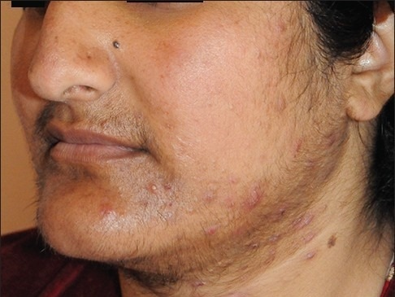
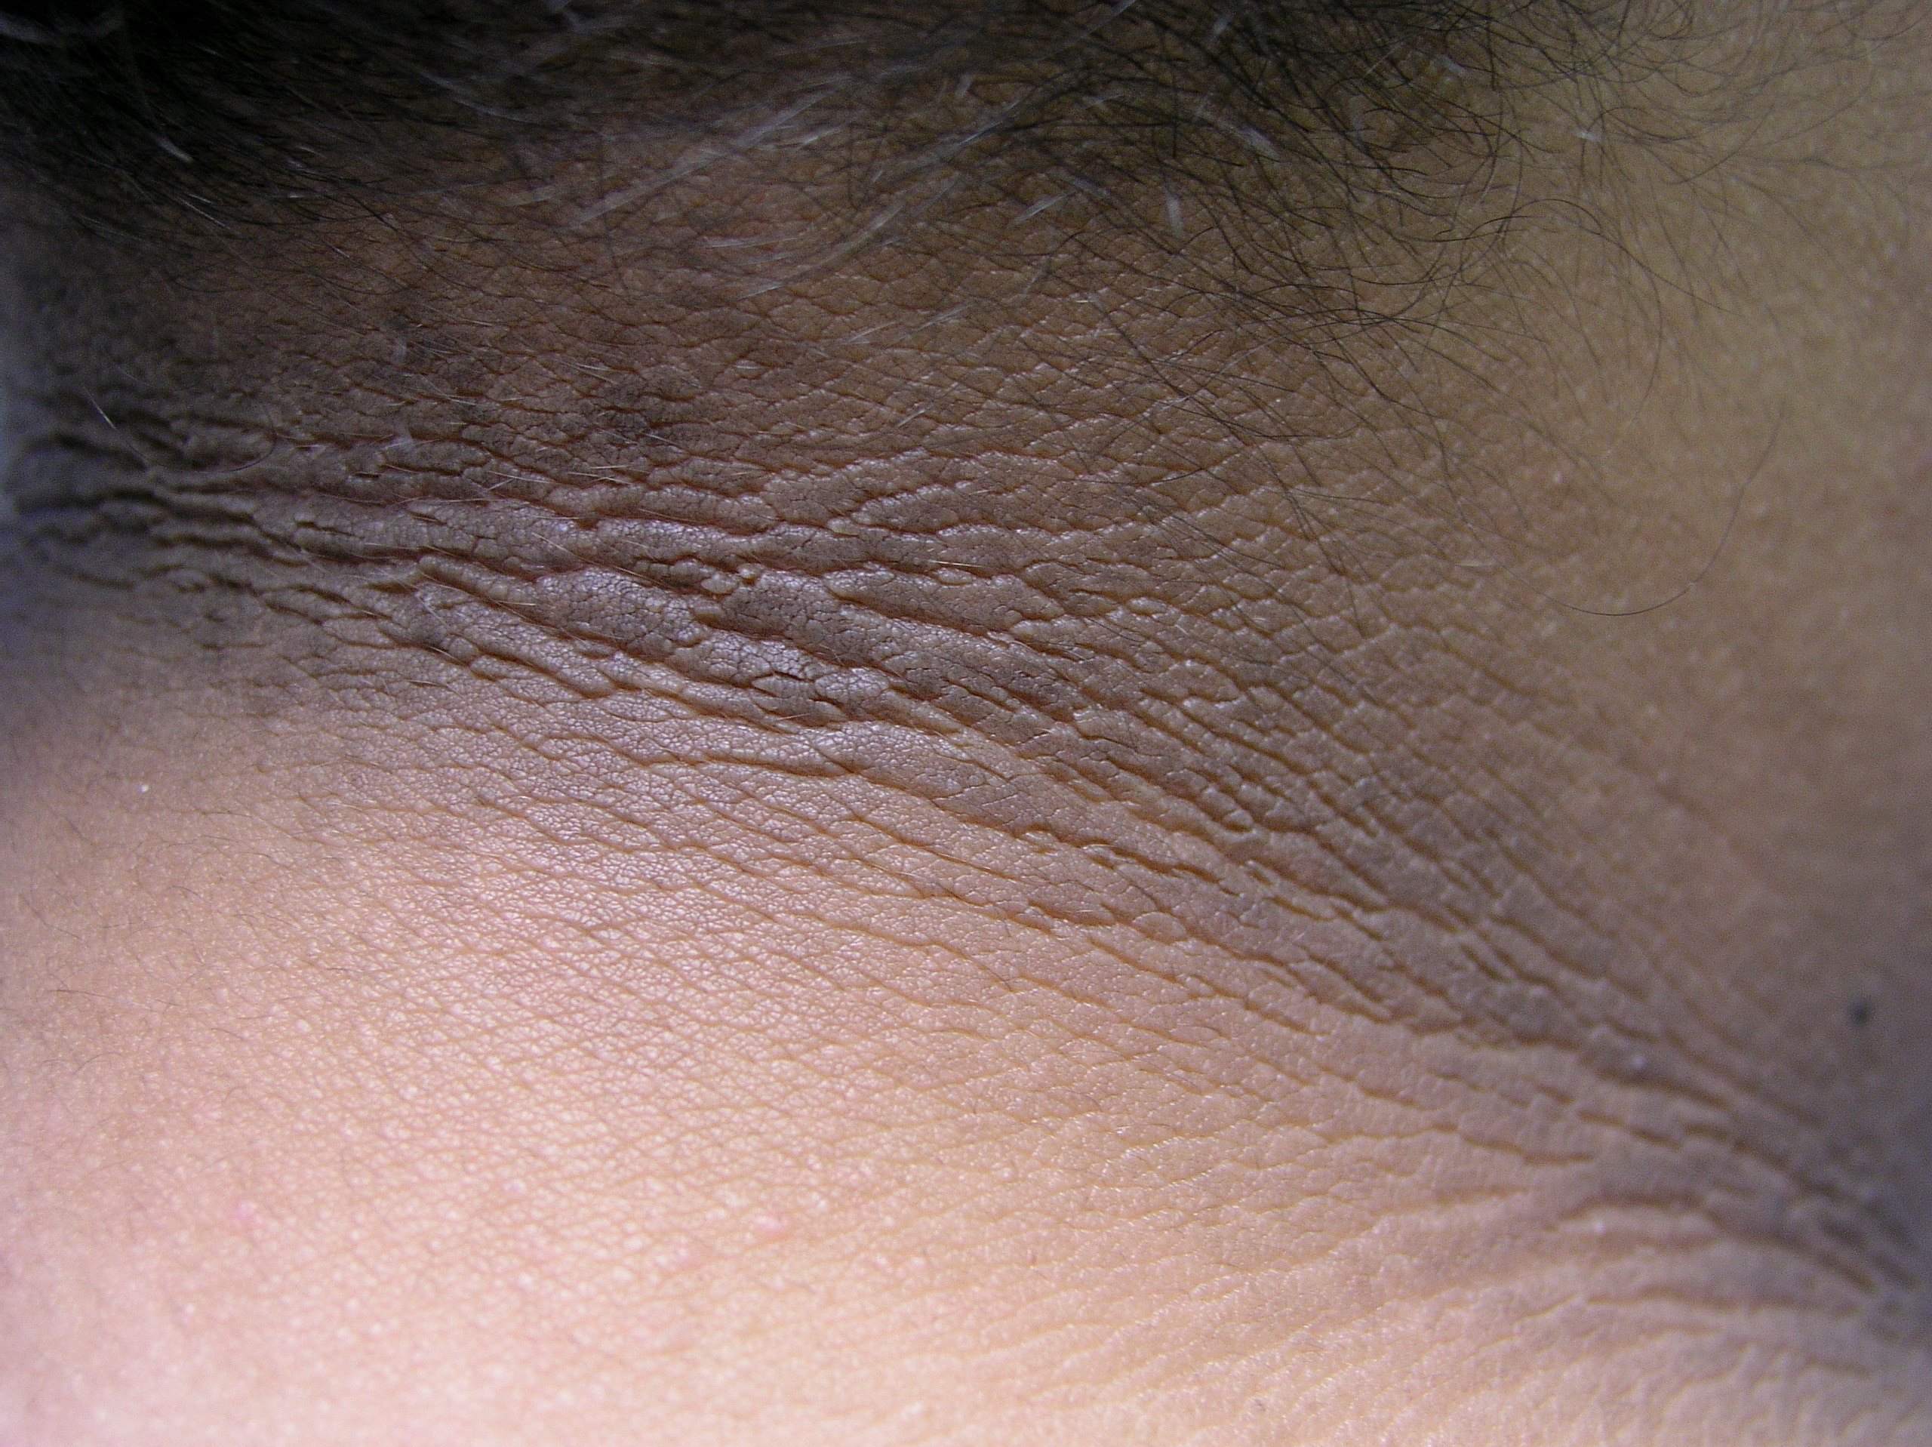
PCOS: Presenting features
Hyperandrogenism (not virilization)
  Hirsutism 70%
  Acne 30%
  Alopecia 10%
Menstrual disturbance 60% – 70%
Infertility 70%
Obesity, particularly truncal 30% – 50%
Polycystic ovaries on ultrasound of asymptomatic women 22% - 33%
Acanthosis nigricans 1% - 3%
Notes:
desogestrel, gestodene,
and drospirenone
desogestrel, gestodene,
and drospirenone

Slide 36
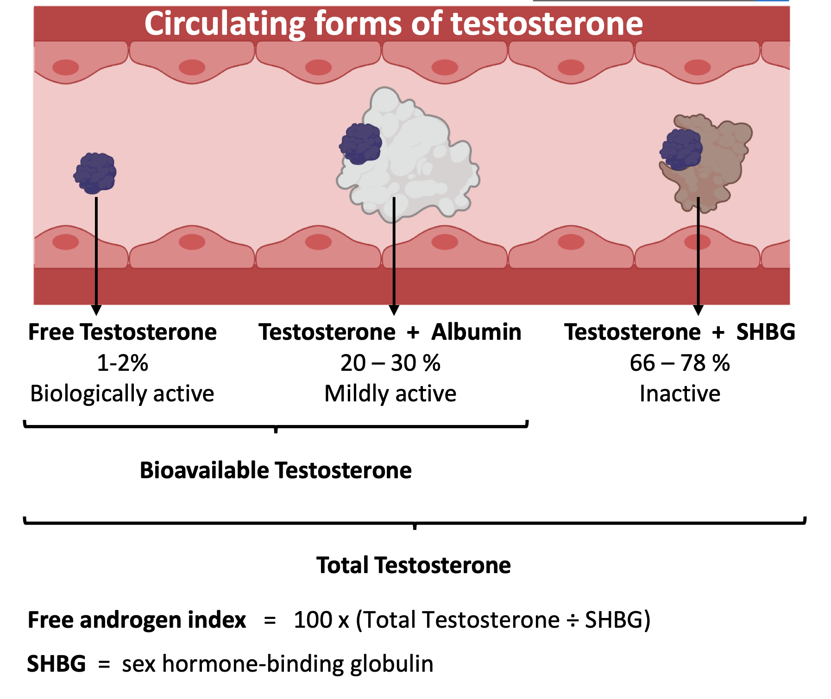
PCOS:
Biochemical Evidence of Hyperandrogenism
Biochemical hyperandrogenism is found in 60% of patients with PCOS
Assess with testing in a step-wise fashion:
Total testosterone and calculated free testosterone
if normal, proceed to:
2. DHEA-S and androstenedione levels
Note: androgen levels can’t be measured while on CHCs.
Note: If markedly elevated investigate for androgen-secreting tumors
Notes:
Biochemical hyperandrogenism is common in PCOS patients (60%). Assess with total testosterone, free testosterone, or free androgen index (total testosterone/SHBG x 100). Normal tests may lead to DHEA-S and androstenedione testing, but diagnosis yield is limited.
Combined hormonal contraceptives (CHCs) affect androgen levels by increasing SHBG and altering gonadotropin-dependent androgen production. This can cause false negatives. Discontinue CHCs for three months before testing if biochemical evidence is crucial.
Consider thyroid dysfunction during androgen evaluation. Treat the disorder and reassess PCOS diagnosis. Total and free testosterone are usually mildly elevated in PCOS patients. Markedly elevated values suggest ovarian or adrenal neoplasm.

Slide 37
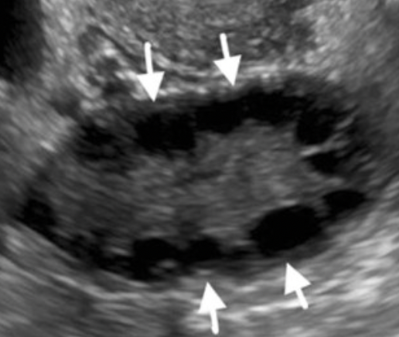
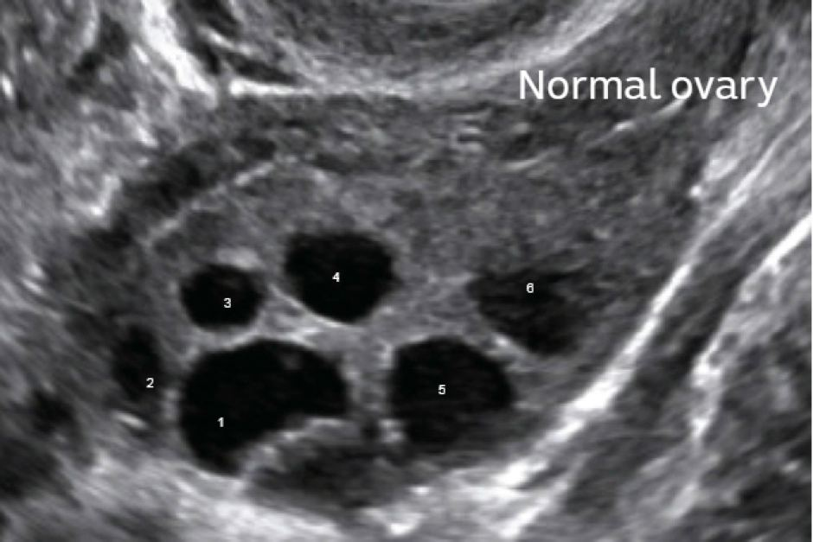
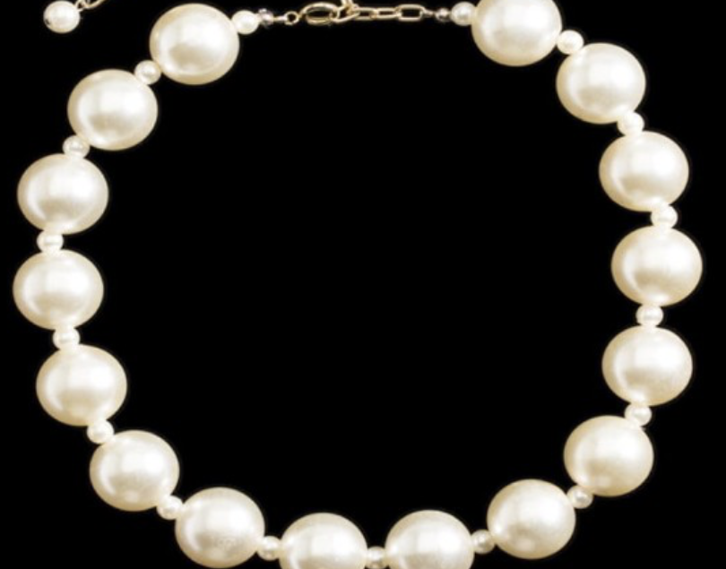
String of Pearls sign
Polycystic ovarian morphology or polycystic ovary
Ovarian volume >10 mL³ and/or >12 follicles between 2 and 9 mm in size in at least one ovary
Notes:
This is the classic 'String of Pearls' sign. >12 follicles (2-9mm) or increased ovarian volume.

Slide 38
PCOS: Testing Used to Exclude Other Diagnoses
Disorders that Mimic PCOS
Thyroid dysfunction/hypothyroidism
  Increased TRH/TSH = increase prolactin secretion = inhibition of GnRH pulses = ovulation dysfunction
  Lab test: measure serum TSH
Prolactinoma (prolactin-secreting tumor)
  Increase prolactin secretion = inhibitions of GnRH pulses = ovulatory dysfunction
  Lab test: measure serum prolactin
Nonclassical congenital adrenal hyperplasia
  21-hydroxylase enzyme insufficiency = excess androgen = ovulatory dysfunction
  Lab test: early morning serum 17-hydroxyprogesterone

Slide 39
PCOS: Treatment of Infertility
Obesity & PCOS
  Weight loss of 5-10% of body weight can restore normal ovulatory function
  PCOS diet – Dr. Jennifer Phy
Addressing insulin resistance
  Start metformin – start with 500 mg and increase by 500 mg every 1-2 weeks to a max dose of 2g (divided)
  Although not indicated specifically for treatment of PCOS infertility, decreasing insulin resistance will cause spontaneous ovulation and regulate cycles
Notes:
Prospective 8-week dietary intervention using an ad libitum low starch/low dairy diet
in 24 overweight and obese women (BMI ≥ 25 kg/m2 and ≤ 45 kg/m2) with PCOS.
An 8-week low-starch/low-dairy diet resulted in weight loss, improved insulin
sensitivity and reduced testosterone in women with PCOS.
Weight loss of just 5-10% can restore spontaneous ovulation. This is the first line. Metformin helps with insulin resistance and can regulate cycles, but it's not a standalone fertility drug

Slide 40
PCOS: Treatment of Infertility
Ovulation induction – 1st line
  Aromatase inhibitors (letrozole) are considered first line in PCOS
    Mechanism of action: block peripheral conversion of androgens into estrogen
      Body notes ↓ E2 levels → ↑ FSH --> stimulates follicle recruitment
    Compared to clomid (SERM) letrozole results in a greater rate of live births in PCOS patients but NOT FDA approved for said indication
    Dosage: 2.5 mg up to 7.5 mg / day x 5 days started on day 3-5 after start of menstruation
      Start at lowest dose and check a day 21 progesterone level to ensure ovulation
Gonadotropins, IVF/ICSI
Notes:
Before starting – As with any ovulation induction agent, one must confirm that the patient is not pregnant before starting therapy. Thus, we suggest a blood pregnancy test before administering letrozole. Based on the half-life of letrozole, administration in the early follicular phase should result in clearance of letrozole before implantation takes place.
●Initial dose – The starting dose is 2.5 mg/day, cycle days 3 to 7, following a spontaneous menses or progestin-induced bleed.
•Ovulatory cycle, no pregnancy – If the cycle is ovulatory, but pregnancy has not occurred, the same dose should be used in the next cycle.
•Anovulatory cycle – If ovulation does not occur or if multiple follicular development is desired, the dose may be increased to 5 mg/day, cycle days 3 to 7. The dose can be further increased to 7.5 mg if necessary. In women with PCOS failing to respond to letrozole five days regimen may respond to an extended regimen of 10 days [20].
Higher doses (7.5 mg) appear to be associated with a thinning of the endometrium similar to that seen with clomiphenecitrate [11]. Two proof-of-concept studies have reported that a single-dose regimen (20 mg) may also be effective [21,22], but we do not suggest this approach at this time, as data are limited and further studies are underway.
Medroxyprogesterone Acetate (Provera): 10 mg taken orally once daily for 5-10 days.

Slide 41
PCOS: Not Planning on Conceiving
Some form of progesterone to protect the uterine lining
  Oral combined contraceptives if estrogen is not contraindicated
    Can use estrogen containing contraceptives
    For the progestin component consider low androgenic formulations
      Good Choice: norgestimate (may be associated with lower risk of VTE)
      Other options: desogestrel, gestodene, and drospirenone
  Just make sure they have a menstrual bleed every 90 days
    Withdrawal (induced) bleed protocol: oral daily doses for 10 days each month
      1. MPA (Provera) 5 or 10 mg
      2. Norethindrone acetate 5 or 10 mg
      3. Micronized progesterone 300 mg
Notes:
The first-line treatment for hirsutism is a combined oral contraceptive (OCP). Estrogen increases sex-binding hormone globulin (SHBG), decreasing free testosterone. Estrogen and progestins decrease luteinizing hormone (LH), reducing ovarian androgen production. OCPs also decrease adrenal DHEAS production and inhibit 5-alpha reductase at the skin. However, the ring and patch avoid first-pass metabolism, so they aren’t ideal for patients with excessive hair growth. A second-line option is spironolactone, an aldosterone antagonist that blocks androgens at hair follicles. It completes with sex hormone-binding globulin (SHBG) for androgen receptor binding. Unfortunately, it can increase menstrual frequency, so caution should be exercised.

Slide 42
Selecting the Best Progestin To Use in PCOS
Androgenic activity | Generic Names
LOW | Ethynodiol
 | Noregstimate
 | Desogestrel
 | Drospirenone
 | Dienogest
MIDDLE | Norethindrone
 | Norethindrone acetate
HIGH | Levonorgestrel
 | Norgestrel

Slide 43
PCOS: Not Planning on Conceiving
Hirsutism
  1st line: OCPs
  2nd line add on therapy: spironolactone
    Teratogen: ensure patient is using effective contraceptive method
    Caution using concurrently with drosperinone
    Consider monitoring electrolytes 3mos after starting and then annually or after dose adjustments
  Topical treatments: 13.0% eflornithine
  Other options: Mechanical/laser hair removal
Metformin
  Can help ↓ insulin resistance and restore ovulation/normal menses
  Okay to use if planning to conceive, but not an infertility treatment
Notes:
The first-line treatment for hirsutism is a combined oral contraceptive (OCP). Estrogen increases sex-binding hormone globulin (SHBG), decreasing free testosterone. Estrogen and progestins decrease luteinizing hormone (LH), reducing ovarian androgen production. OCPs also decrease adrenal DHEAS production and inhibit 5-alpha reductase at the skin. However, the ring and patch avoid first-pass metabolism, so they aren’t ideal for patients with excessive hair growth. A second-line option is spironolactone, an aldosterone antagonist that blocks androgens at hair follicles. It completes with sex hormone-binding globulin (SHBG) for androgen receptor binding. Unfortunately, it can increase menstrual frequency, so caution should be exercised.

Slide 44
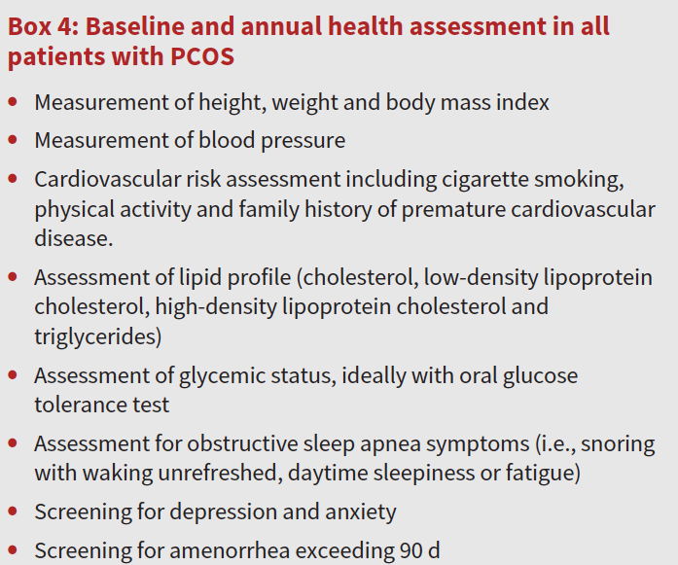
PCOS: Long Term Health Consequences
Tend to appear at younger ages in patients with PCOS than age matched controls
BMI >25 and PCOS: higher risk of long term consequences
Hypertension
T2DM and glucose intolerance
Metabolic syndrome
Non-alcoholic fatty liver disease
Depression/anxiety
Obstructive sleep apnea (independent of BMI)
CVD – ischemic heart disease, myocardial infarction and cardiovascular mortality
Dason ES, Koshkina O, Chan C, Sobel M: Diagnosis and management of polycystic ovarian syndrome. CMAJ 2024, 196(3):E85-E94.
Notes:
Long-term complications such as hypertension, impaired glucose tolerance, type 2 diabetes, metabolic syndrome, non-alcoholic fatty liver disease, depression, anxiety, obstructive sleep apnea and cardiovascular disease (i.e., ischemic heart disease, myocardial infarction and cardiovascular mortality)

Slide 45
Condition | Testing Recommendations at time of Diagnosis | Testing interval
CV risk | Lipid panel BMI | Based on results every 3-5 years for lipid panel; BMI annually
Hypertension | Blood Pressure Measurement | Annually
Impaired Glucose Tolerance T2DM | Most accurate testing: 75 mg OGT Other options: HgA1c and fasting glucose (less accurate) | Repeat every 1-3 years
Obstructive Sleep Apnea | Screening questions & Screening questionnaire (Berlin questionnaire) | Not specified
Anxiety/Depression | Screening questionnaires | Based on clinical judgement During perinatal period
Adapted from Teede, Helena J., et al. "Recommendations from the 2023 international evidence-based guideline for the assessment and management of polycystic ovary syndrome." European journal of endocrinology 189.2 (2023): G43-G64.
Notes:
Teede, Helena J., et al. "Recommendations from the 2023 international evidence-based guideline for the assessment and management of polycystic ovary syndrome." European journal of endocrinology 189.2 (2023): G43-G64.

Slide 46
References
Harada M. Pathophysiology of polycystic ovary syndrome revisited: Current understanding and perspectives regarding future research. Reprod Med Biol. 2022;21(1):e12487. Published 2022 Oct 8. doi:10.1002/rmb2.12487
Dason ES, Koshkina O, Chan C, Sobel M: Diagnosis and management of polycystic ovarian syndrome. CMAJ 2024, 196(3):E85-E94.
Teede, Helena J., et al. "Recommendations from the 2023 international evidence-based guideline for the assessment and management of polycystic ovary syndrome." European journal of endocrinology 189.2 (2023): G43-G64.
Penzias, Alan, et al. "Fertility evaluation of infertile women: a committee opinion." Fertility and sterility 116.5 (2021): 1255-1265.
Schorge, John O., ed. Williams gynecology. New York: McGraw-Hill Medical, 2008.
Speroff, Leon, and Marc A. Fritz, eds. Clinical gynecologic endocrinology and infertility. lippincott Williams & wilkins, 2005.
Lentz, Gretchen M., et al. Comprehensive gynecology e-book. Elsevier Health Sciences, 2012.

Slide 47
PCOS & Infertility competition time
Who wants that $25 for Starbucks??!

Slide 48
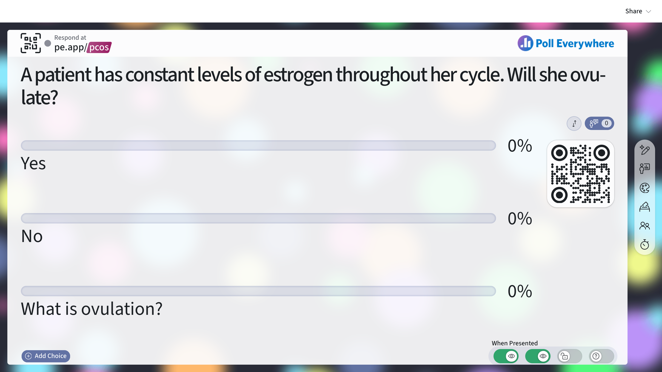

Slide 49
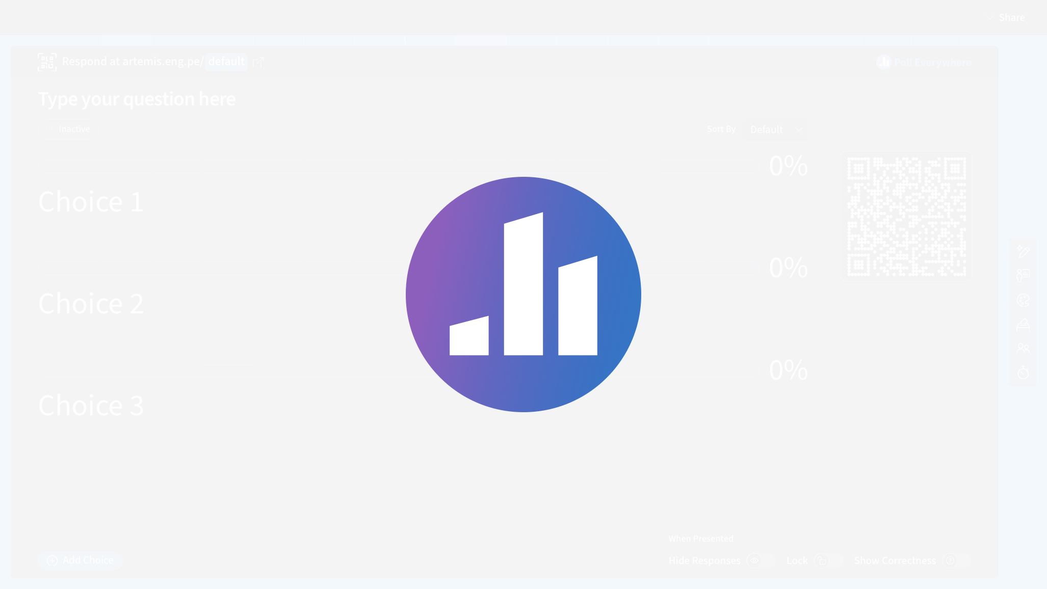

Slide 51
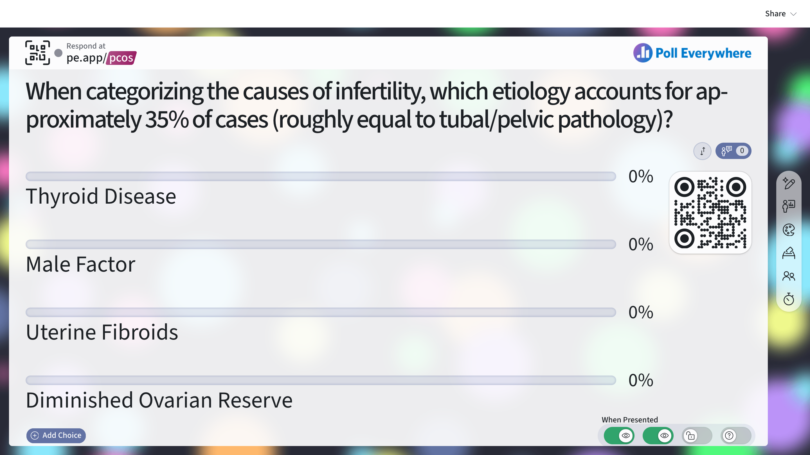

Slide 52


