Slide 1
Hyperkalemia
Alexander M. Nimri, MD
Nephrology & Hypertension
BUMC-P

Slide 2
Potassium Facts
A healthy adult has roughly 50 mEq/kg of K+ in his/her body
70 kg man = 50 meq x 70 kg =3500 mEq
Only 2% found outside the cells and only 0.4% in plasma
Thus serum measurements have limitations at reflecting total body K+ stores.
A 1 mEq/L drop in K+ (from normal 4.0) reflects between 200-400 mEq total body deficit
A K+ of 2.5 means that someone is roughly 300-600 mEq total body negative.
That would require at least 7 boluses of 40 mEq of KCL to make up for this!

Slide 3
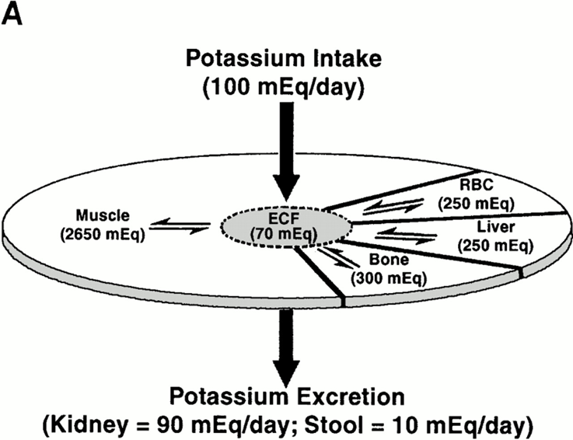
Notes:
Although small amounts of K+ are lost each day in stool (5 to 10 meq) and sweat (0 to 10 meq), the kidney plays the major role in the maintenance of K+ balance, appropriately varying K+ secretion with changes in dietary intake (normal range is 40 to 120 meq/day).
potassium homeostasis depends on maintenance of external and internal potassium balance. External potassium balance is determined by rate of potassium intake (100 meq/day) and rate of urinary (90 meq/day) and fecal excretion (10 meq/day). Internal potassium balance depends on distribution of potassium between muscle, bone, liver, and red blood cells (RBC) and the extracellular fluid (ECF). This distribution is regulated by several hormones and is affected by acid-base balance and tonicity of plasma

Slide 4
Factors affecting K shift (Acute)
Factor | Transmembrane K shift
Insulin | Increase Uptake (intracellular)
Beta-catecholamine | Increase Uptake (intracellular)
Alpha-catecholamine | Decrease Uptake (extracellular)
Acidosis | Decrease Uptake (extracellular)
Alkalosis | Increase Uptake (intracellular)
Hyperosmolarity | Increase efflux

Slide 5
Factors affecting K shift (Chronic)
Factor | Effect on ATP pump density
Thyroid | Enhanced
Adrenal steroids | Enhanced
Exercise (training) | Enhanced
Growth | Enhanced
Diabetes | Impaired
Potassium deficiency | Impaired
CKD | Impaired

Slide 6
Hyperkalemia
Defined as serum potassium greater than 5 mEq/L
Average daily intake of 100 meq/day
Dietary intake of K contributes to pathogenesis of hyperkalemia in patients with kidney defect with GFR less than 20 ml/min/1.73m2
Potassium concentration remains in normal range by increasing the release of aldosterone and resultant enhanced kidney potassium excretion even with high intake up to 280 mEq/day.
$$↑K= <20 GFR$$

Slide 7
Question 1.
A 55 y.o male with ESRD presents to ER with SOB & weakness. He had missed dialysis for 1 week because of transportation. On PE he has bilateral crackles. CXR shows pulmonary edema. EKG is shown. Labs shows potassium of 7.1.

Slide 8
Question 1.

Slide 9
Question 1.
What is the most appropriate management of this patient?
A. Emergent hemodialysis
B. Insulin/D50
C. Calcium gluconate
D. 1 amp Sodium bicarbonate
E. High dose albuterol SVN

Slide 10
Answer 1.
What is the most appropriate management of this patient?
A. Emergent hemodialysis
B. Insulin/D50
C. Calcium gluconate
D. 1 amp Sodium bicarbonate
E. High dose albuterol SVN

Slide 11
Clinical Manifestations of Hyperkalemia
Alterations in cardiac conduction
EKG findings correlates generally with the degree of hyperkalemia
Muscle weakness including paralysis of diaphragm

Slide 12
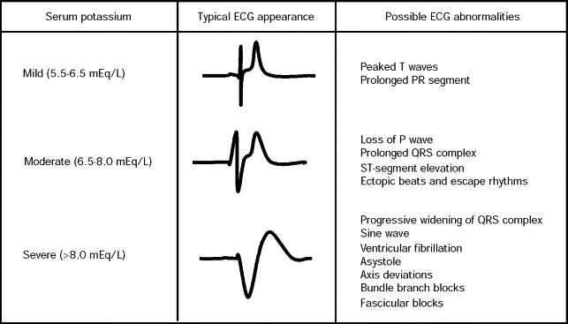
Decreases the threshold for rapid phase-0 Na+-dependent depolarization resulting in an increase in cardiac conduction velocity
Conduction delay becomes prominent in the atrioventricular node and His– Purkinje system due to action potential shortening and prolongation of phase-4 diastolic depolarization.

Slide 13
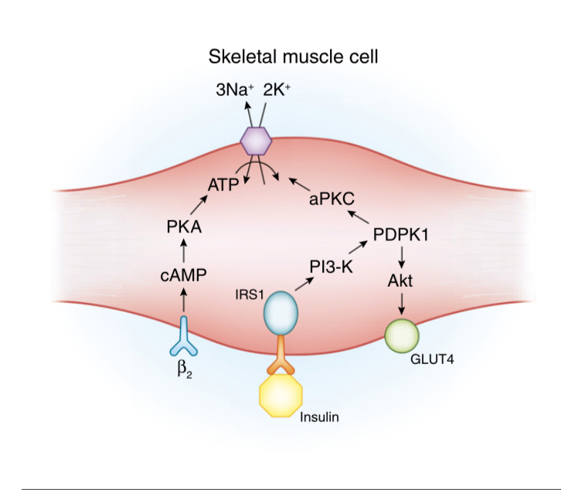
Potassium Shift
The most important factors regulating this movement under normal conditions are insulin and catecholamines
Unlike b-adrenergic agonist and bicarbonate therapy, insulin does not lose its efficacy, and might be enhanced, in the presence of renal failure

Slide 14
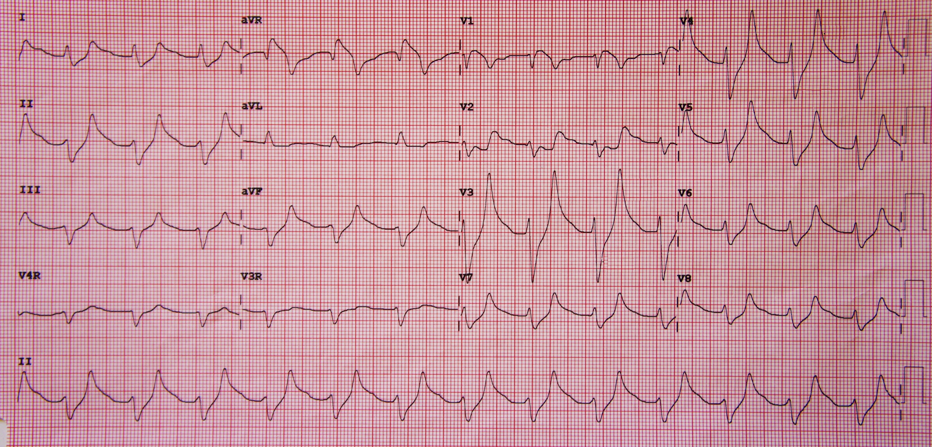
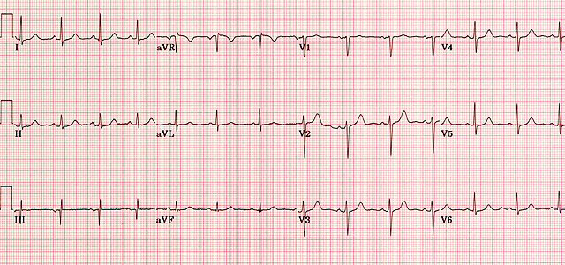
Acute Treatment: 1) Stabilize cardiac membrane: Calcium gluconate
Calcium Gluconate 10 ml of 10 % solution (1Gram) IV slowly over 5-10 min to decrease membrane excitability
Temporarily (1 hour) antagonizes cardiac effects of hyperkalemia while more definitive therapy is begun.
May repeat after 5 mins. If EKG does not improve.

Slide 15
Acute Treatment: 2) Shift potassium into cells: IV Insulin + D50
Glucose/ Insulin 100 ml of 25% glucose solution with 10 units of regular insulin infuse over 15-30 minutes.
Effect of insulin begins within 10 minutes and is sustained for 4-6 hours
Insulin stimulates cellular uptake of K+ by activating Na+K+ ATPase ( Decreasing plasma K+)
Temporarily translocates K+ into cells
Can give insulin alone if blood sugar elevated >250 mg/dL
Start D5 drip if concern for hypoglycemia

Slide 16
Acute Treatment: 2) Shift potassium into cells: High dose Albuterol SVN
B2 agonist (Albuterol) – 10-20 mg (high dose) over 15 minutes via nebulizer.
Promotes cellular uptake of K+
Onset 30 minutes
Lowers plasma K+ by 0.5-1.5 mmol/L and the effect lasts for 2-4 hours.
Potentially dangerous in patients with CAD.

Slide 17
Acute Treatment: 2) Shift potassium into cells: Sodium bicarbonate
NaHCO3 – 1 standard amp (50 mEq) IV over 5-10 mins
Not considered first-line management of hyperkalemia due to controversial data regarding efficacy and safety concerns
Will precipitate with calcium, thus don’t give while using calcium gluconate
Studies have shown that sodium bicarbonate was not able to decrease serum potassium significantly or rapidly, with onset of action potentially taking hours.
Sodium bicarbonate can potentially increase fluid load, causing hypernatremia and metabolic alkalosis, and should therefore be used with caution in patients with heart failure and CKD because of sodium load.

Slide 18
Acute Treatment 3) Remove Potassium
1. Lasix – 40 to 60 mg IV
Especially helpful in aldosterone deficiency states and CKD
2. GI elimination
Kayexelate
(Polystyrene sulfonate)
Veltassa
(Patiromer)
Lokelma
(Sodium-zirconium
cyclosilicate)
3. Hemodialysis
Kayexalate ( Sodium Polystyrene Sulfonate)
15 gm orally 1-4 times daily in water or syrup.
Onset 1-2 hours with duration of 4-6 hours
Bowel necrosis is concern
Patiromer
Calcium based
Can cause hypomagnesemia
Binds cations & other drugs
Lokelma
Sodium based
Can cause fluid overload

Slide 19
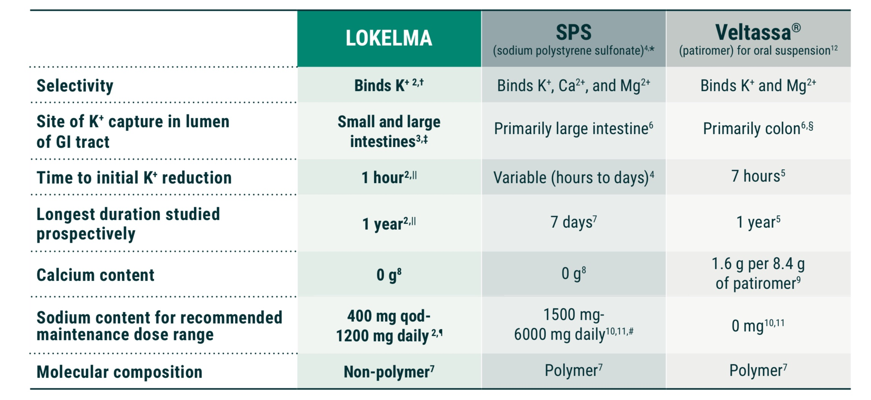

Slide 20
Acute Treatment: 3) Remove potassium SPC
Effect- In intestine (mostly the large intestine). Na ions are released and are replaced by K+ and other cations before the resins is passed from the body.
Each gram may remove 1 mEq K+ in exchange for 1-2 mEq Na+ thus may cause ECF volume overload.

Slide 21
Risk factors for the development of hyperkalemia
Notes:
Patients with GFR less than 30 ml/min require closer monitoring of the serum potassium every 7-10 days after initiation or increase the dose of ACEI or ARB

Slide 22
Question 2.
A 65-year-old man is admitted to the intensive care unit (ICU) with septic shock. Six liters of intravenous lactated Ringers is administered, but the patient remains in shock. He has AKI, and serum K is 5.7 mEq/L.
In choosing an intravenous vasopressor for this patient, which of the following will raise serum potassium concentration and potentially worsen hyperkalemia?
Dopamine
Epinephrine
Norepinephrine
D. Vasopressin E. Phenylephrine

Slide 23
Question 2.
A 65-year-old man is admitted to the intensive care unit (ICU) with septic shock. Six liters of intravenous lactated Ringers is administered, but the patient remains in shock. He has AKI, and serum K is 5.7 mEq/L.
In choosing an intravenous vasopressor for this patient, which of the following will raise serum potassium concentration and potentially worsen hyperkalemia?
Dopamine
Epinephrine
Norepinephrine
D. Vasopressin E. Phenylephrine

Slide 24
Regulation of K+
The kidney is primarily responsible for maintaining total body K+ content by matching K+ intake with K+ excretion.
Adjustments in renal K+ excretion occur over several hours; therefore, changes in extracellular K+ concentration are initially buffered by movement of K+ into or out of skeletal muscle.
After a meal, the postprandial release of insulin functions to not only regulate the serum glucose concentration but also shift dietary K+ into cells until the kidney excretes the K+ load re-establishing K+ homeostasis

Slide 25
Potassium Physiology
Potassium is freely filtered by the glomerulus. The bulk of filtered K+ is reabsorbed in the proximal tubule and loop of Henle, such that less than 10% of the filtered load reaches the distal nephron.
Two principal determinants of K+ secretion are mineralocorticoid activity and distal delivery of Na+ and water.
Circadian rhythm whereby K+ excretion is lower at night and in the early morning hours and then increases in the afternoon
Enteric Sensor of K+: sensors capable of responding to dietary Na+, K+, and phosphate that signal the kidney to rapidly alter ion excretion or reabsorption

Slide 26
Four Categories of Hyperkalemia
Redistribution
Excess intake
Impaired renal potassium secretion
Medications

Slide 27
Question 3.
A 52-year-old woman was hospitalized 3 days ago for laparoscopic resection of the sigmoid colon secondary to recurrent diverticulitis. Diet has been advanced to a full diet. She has a 20-year history of hypertension, stage G3 chronic kidney disease, and migraine headaches.
Medications are amlodipine, heparin, topiramate, and as-needed intravenous morphine.
On physical examination, vital signs are normal. Mild incisional tenderness is present. The remainder of the physical examination is unremarkable.

Slide 28
Question 3.
Laboratory studies:
 | On Admission | Today
Creatinine | 1.6 mg/dL (141.4 µmol/L) | 1.9 mg/dL (168 µmol/L)
Electrolytes :
Sodium | 140 mEq/L (140 mmol/L) | 138 mEq/L (138 mmol/L)
Potassium | 4.9 mEq/L (4.9 mmol/L) | 5.6 mEq/L (5.6 mmol/L)
Chloride | 102 mEq/L (102 mmol/L) | 110 mEq/L (110 mmol/L)
Bicarbonate | 25 mEq/L (25 mmol/L) | 20 mEq/L (20 mmol/L)
Glucose | 116 mg/dL (6.4 mmol/L) | 128 mg/dL (7.1 mmol/L)

Slide 29
Question 3.
Urine output during the past 24 hours is 1400 mL.
Which of the following is the most likely cause of this patient's elevated serum potassium?
A. Acute kidney injury
B. Heparin
C. Hyperglycemia
D. Metabolic acidosis
E. Topiramate

Slide 30
Answer 3.
Urine output during the past 24 hours is 1400 mL.
Which of the following is the most likely cause of this patient's elevated serum potassium?
A. Acute kidney injury
B. Heparin
C. Hyperglycemia
D. Metabolic acidosis
E. Topiramate

Slide 31
Medications Associate with $↑K+$
Drugs which cause translocation of K from the intracellular to the extracellular fluid: these include succinylcholine, isoflurane, minoxidil, and beta-blockers.
Potassium-Sparing Diuretics: drugs such as spironolactone (mineralocorticoid receptor antagonists) and amiloride/triamterene (blockers of the ENaC) .
Inhibitors of renin-angiotensin-aldosterone axis: ACE-inhibitors, angiotensin receptor blockers.
Calcineurin inhibitors (e.g., cyclosporine, tacrolimus): it is postulated that these medications inhibit renal tubular responsiveness to aldosterone.
Heparin & ketoconazole: these drugs may be associated by hyperkalemia by inhibiting aldosterone synthesis.

Slide 32
Question 4.
In an HIV-infected patient with pneumocystis pneumonia that undergoes therapy with intravenous pentamidine, which of the following best describes the mechanism of hyperkalemia noted with this drug?
A. Reduced aldosterone action
B. Reduced renin
C. Epithelial sodium channel blockade
D. Apical membrane potassium channel blockade
E. Reduced insulin secretion

Slide 33
Question 4.
In an HIV-infected patient with pneumocystis pneumonia that undergoes therapy with intravenous pentamidine, which of the following best describes the mechanism of hyperkalemia noted with this drug?
A. Reduced aldosterone action
B. Reduced renin
C. Epithelial sodium channel blockade
D. Apical membrane potassium channel blockade
E. Reduced insulin secretion

Slide 34
Medications Associate with $↑K+$
NSAIDs: NSAIDs can lower renin secretion, which is normally mediated in part by locally-produced prostaglandins.
Trimethoprim & Pentamidine: the hyperkalemia induced by Bactrim is via an ENaC inhibitory effect exerted by the trimethoprim moiety
Digitalis: digitalis inhibits the Na-K ATPase (which pumps 3 Na out of the cell and 2 K in); as such, it can result in cardiac arrhythmias.
Hyperosmolarity: hyperosmolarity induces water efflux out of cells, and by solvent drag increases intravascular potassium concentrations. Drugs such as mannitol can therefore cause translocational hyperkalemia.

Slide 35
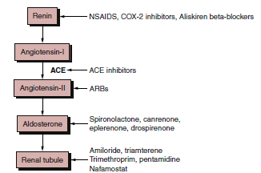

Slide 36
Question 5.
89-yo-man presented with diarrhea and abdominal pain was admitted to a nearby community hospital. He had no prior history of gastrointestinal disease or of the use of any cathartics.
His right kidney was removed at 30 years of age, and his renal function had not changed for 25 years, with a SCr of 1.1–1.2 mg/dl and a BUN of 18–21 mg/dl.
The diarrhea and abdominal pain were successfully treated by fasting and fluid therapy, and the patient appeared clinically much improved. A contrast enema was planned on the ninth hospital day; however, he developed abdominal pain and vomiting that morning.
Large bowel distension was observed on abdominal radiographs, and torsion of the sigmoid colon was suspected. The patient was then transferred to your hospital.

Slide 37
Question 5.
On admission, the patient was lethargic, in pain, and appeared critically ill, with a blood pressure (BP) of 90/50 mm Hg, irregular pulse of 110 beats/min, and a respiration rate (RR) of 31 breaths/min.
The abdomen was distended and diffusely tender with decreased bowel sounds. Abdominal computed tomography indicated bowel loop dilatation, wall thickness, and air–fluid levels that were compatible with ileus.
The patient subsequently died following a cardiac arrest with a suspected diagnosis of intestinal necrosis induced by prolonged hypotension.
Laboratory studies:
WBC: 5710;
Hematocrit: 37.8%
Na: 141 mEq/L;
K: 5.7 mEq/L;
Cl: 102 mEq/L;
CO2: 17 mEq/L
BUN: 25 mg/dl;
Cr: 1.5 mg/dl
Ca: 7.8 mg/dl;
PO4: 4.6 mg/dL;
Albumin: 4.1 g/dl

Slide 38
Question 5.
What do you suspect might be the cause of lethargy, hypotension, hyperkalemia, and hypocalcemia and possibly paralytic ileus?
A. Acute sepsis
B. Unrecognized hypermagnesemia due to magnesium
sulfate given prior to contrast enema
C. Acute myocardial infarction
D. Hypocalcemia due to renal insufficiency with
hyperphosphatemia

Slide 39
Answer 5.
What do you suspect might be the cause of lethargy, hypotension, hyperkalemia, and hypocalcemia and possibly paralytic ileus?
A. Acute sepsis
B. Unrecognized hypermagnesemia due to magnesium
sulfate given prior to contrast enema
C. Acute myocardial infarction
D. Hypocalcemia due to renal insufficiency with
hyperphosphatemia

Slide 40
Hypermagnesemia
There is little information that explains the relationship between hypermagnesemia and hyperkalemia
The exact mechanism by which magnesium affects renal potassium handling is still unclear
Characterized by hypotension, hyperkalemia, hypocalcemia, and, at higher levels, heart block and cardiac arrest

Slide 41
Pseudohyperkalemia
Thrombosis >600,000 x10(9)/L.
Leucocytosis >100,000 x10(9)/L.
In traumatic venipuncture or prolonged tourniquet .
-Level should be repeated in asymptomatic patient
-It is diagnosed by showing the serum potassium concentration is more than 0.3 mmol/l higher than in a simultaneous plasma sample.
Notes:
. Once diagnosed all further potassium levels should be measured in plasma to avoid inappropriate
Thrombosis >600,000 can be established by documenting a simultaneous normal plasma (heparinized sample)potassium level.
Leucocytosis >100,000 is diagnosed by repeating a serum potassium measurement in a sample carefully transported to the lab immediately following phlebotomy or measurement of whole blood potassium in uncentrifuged specimens using ion-specific electrodes.

Slide 42
Question 6.
Which one is preferred for testing?
A. Serum
B. Plasma

Slide 43
Which one is preferred for testing?
A. Serum
B. Plasma

Slide 44
Pseudohyperkalemia
Serum samples (red top tubes) are preferred for chemistry testing
Potassium, phosphate & LDH are higher in serum because of release from cells during clotting
Protein, globulins & fibrinogen are higher in plasma

Slide 45
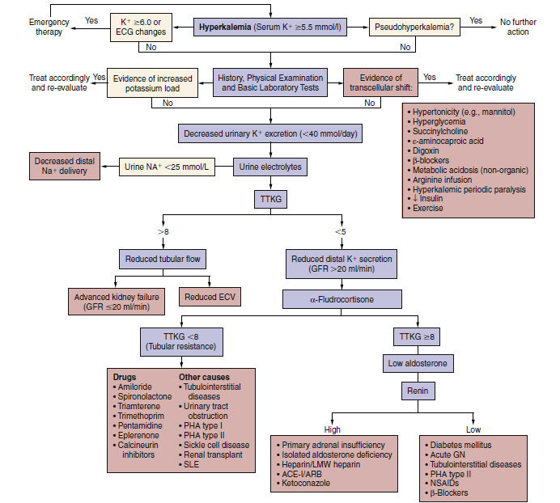

Slide 46
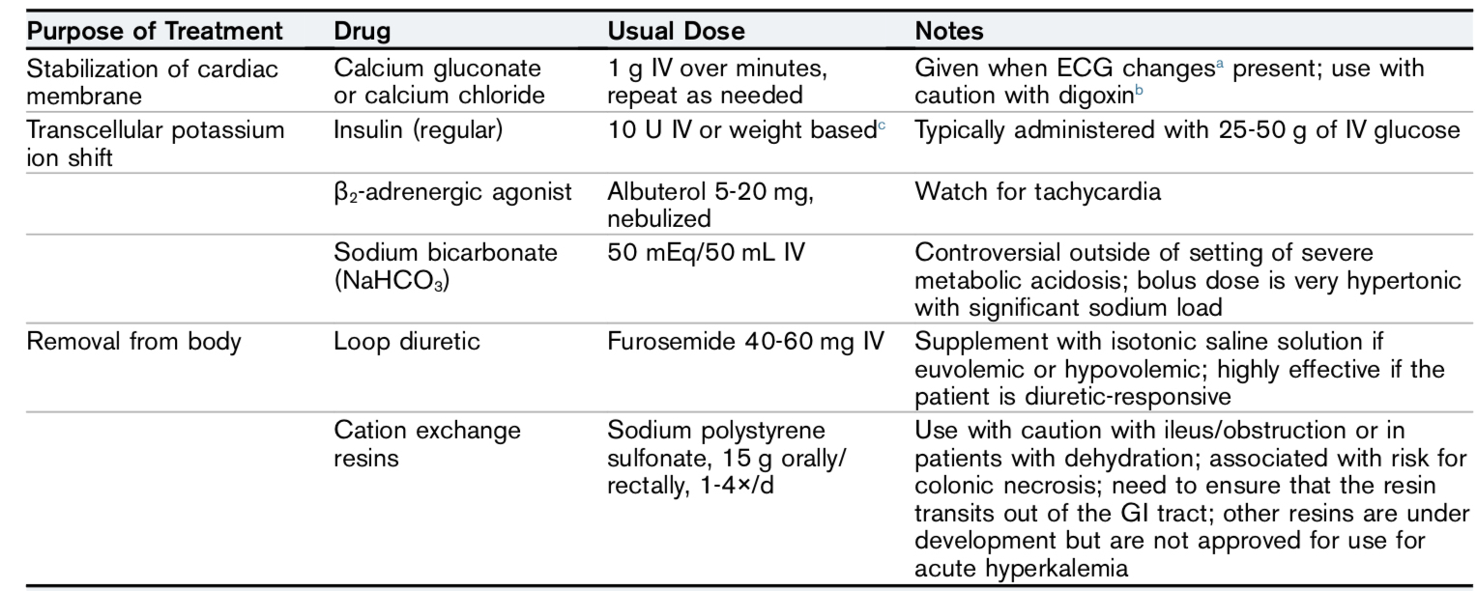
Summary: Treatment of Hyperkalemia

Slide 47
Chronic Hyperkalemia
Dietary modifications
Diuretics
GI cation exchangers
Mineralocorticoids
Discontinue or reduce dose of drugs raising potassium

Slide 48
Case 1
A 46-year-old woman is evaluated during a follow-up visit for hypertension, type 2 diabetes mellitus, and stage G3 chronic kidney disease. She reports no symptoms. Medications are losartan, amlodipine, metformin, canagliflozin, and rosuvastatin.
On physical examination, blood pressure is 124/72 mm Hg. Other vital signs and the remainder of the examination are unremarkable.

Slide 49
Laboratory studies:
Creatinine | 1.6 mg/dL (141.4 µmol/L)
Electrolytes :
Sodium | 136 mEq/L (136 mmol/L)
Potassium | 5.6 mEq/L (5.5 mmol/L)
Chloride | 104 mEq/L (104 mmol/L)
Bicarbonate | 24 mEq/L (24 mmol/L)
Urine albumin-creatinine ratio | 320 mg/g

Slide 50
ECG is normal.
The patient is counseled to start a low potassium diet.
Which of the following is the most appropriate management?
A. Add hydrochlorothiazide
B. Add Patiromer
C. Administer intravenous calcium gluconate
D. No further treatment

Slide 51
ECG is normal.
The patient is counseled to start a low potassium diet.
Which of the following is the most appropriate management?
A. Add hydrochlorothiazide
B. Add Patiromer
C. Administer intravenous calcium gluconate
D. No further treatment

Slide 52
Case 2
A 54-year-old woman is evaluated during a follow-up visit after beginning lisinopril for hypertension 2 weeks ago. History is also significant for chronic kidney disease. Her only other medication is amlodipine.
On physical examination, blood pressure is 128/78 mm Hg; other vital signs are normal. There is 1+ pitting pretibial edema bilaterally. The remainder of the examination is unremarkable.
Laboratory studies:
Creatinine 1.7 mg/dL (150.3 µmol/L); 2 weeks ago: 1.2 mg/dL (106.1 µmol/L)
Potassium 5.7 mEq/L (5.7 mmol/L); 2 weeks ago: 4.4 mEq/L (4.4 mmol/L)
eGFR 33 mL/min/1.73 m2; 2 weeks ago, 50 mL/min/1.73 m2
Two weeks ago, laboratory studies showed a urine albumin-creatinine ratio of 1600
mg/g.

Slide 53
Which of the following is the most appropriate management?
A. Continue lisinopril; add furosemide
B. Continue lisinopril; recheck laboratory studies
in 2 weeks
C. Discontinue lisinopril; add furosemide
D. Discontinue lisinopril; add losartan

Slide 54
Which of the following is the most appropriate management?
A. Continue lisinopril; add furosemide
B. Continue lisinopril; recheck laboratory studies
in 2 weeks
C. Discontinue lisinopril; add furosemide
D. Discontinue lisinopril; add losartan

Slide 55
Thank you

