Slide 1

Perioperative Cardiac Risk Stratification
Sam Galvagno, DO, PhD, MBA, FCCM
Professor and Chair
Department of Anesthesiology
University of Arizona College of Medicine-Phoenix

Slide 2
Objectives
Define the internist’s role in assessing the preoperative risk for adverse cardiac events.
Describe the patient who should be seen by a cardiologist before surgery.
  List indications for additional tests (e.g., echocardiography, stress test).
Recite what constitutes low, intermediate, and high risk for a perioperative Major Adverse Cardiac Event (MACE).
List advantages and disadvantages in using validated risk scores (e.g., RCRI and NSQIP).
List procedures that are considered low, intermediate, and high risk.
Define emergent, urgent, and elective surgery.
Define metabolic equivalent (MET).
Identify activities that require 4 or more METs.
Apply the ACC/AHA algorithm to determine the correct perioperative plan.

Slide 3


Slide 4
Definitions and Risks

Slide 5
Major Adverse Cardiac Event
Myocardial infarction
Cardiac arrest / cardiac death
Myocardial Injury after Noncardiac Surgery (MINS)
Elevated troponin during the first 30 days after noncardiac surgery
  Presumed to be ischemic
  Not included in most perioperative cardiac risk tools
Gupta PK. Circulation 2011.
Liu JB. Anesthesiology 2018.

Slide 6
Major Adverse Cardiovascular and Cerebrovascular Events (MACCE)
In-hospital all-cause death, AMI, or acute ischemic stroke
Most common after vascular, thoracic, transplant surgery
Stroke incidence increasing
  0.5% --> 0.8%
  AMI incidence decreasing
Smilowitz NR. JAMA Cardiol 2017.

Slide 7
Surgical Risk
5%
1-5%
< 1%
High
Intermediate
Low
2024 ACC/AHA
“Elevated risk” = > 1% MACE
This is being questioned due to decreasing procedural risk over time!
Thompson A. Circulation 2024.

Slide 8
Surgical Risk
Higher
Lower
Intraperitoneal
Thoracic
Intrabdominal
Major vascular
Long procedures
Laparoscopic
Endovascular
Orthopedic
Breast
Peripheral
Emergent vs. Urgent vs. Elective
Thompson A. Circulation 2024.
Liu JB. Anesthesiology 2018.
Mullen MG. JAMA Surg 2017.

Slide 9
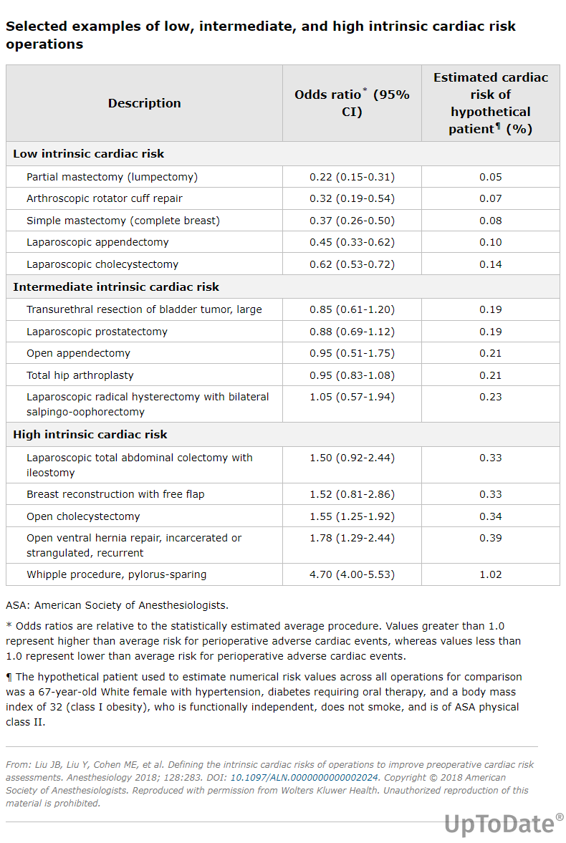
Selected Examples
Liu JB. Anesthesiology 2018.

Slide 10
Surgical Timing
Emergent
Urgent
Time-Sensitive
Immediate threat to life or limb
No time for preoperative eval (<2 h)
Threat to life or limb, but may have time for preop eval (2h-<24 h)
May delay surgery up to 3 months to allow for preop eval
Thompson A. Circulation 2024.

Slide 11
Patient Risk Factors
Existing cardiovascular disease
  AMI < 60 days
  Unstable angina
  Decompensated heart failure
  High-grade arrhythmias
  Hemodynamically impactful valve disease (e.g., AS)
Poor functional status
Older age
Diabetes
Renal dysfunction
Kelly R. J Am Coll Cardiol 2002.
Naesh O. Thromb Haemost 1985.
Duceppe E. Can J Cardiol 2017.
Halvorsen S. Eur Heart J 2022.
Hallqvist L. Br J Anaesth 2020.

Slide 12
Assessment of Functional Status

Slide 13
Duke Activity Status Index (DASI)
12 questions
Max score = 58.2
  Very low risk if > 34
  <25 higher risk
Translated and validated in several languages
Hlatky MA. Am J Cardiol 1989.
Wijeysundera DN. Br J Anaesth 2020.
Dewar A. Anaesthesia 2023.
Wijeysundera DN. Lancet 2018.
Notes:
Hindi, Portugese

Slide 14
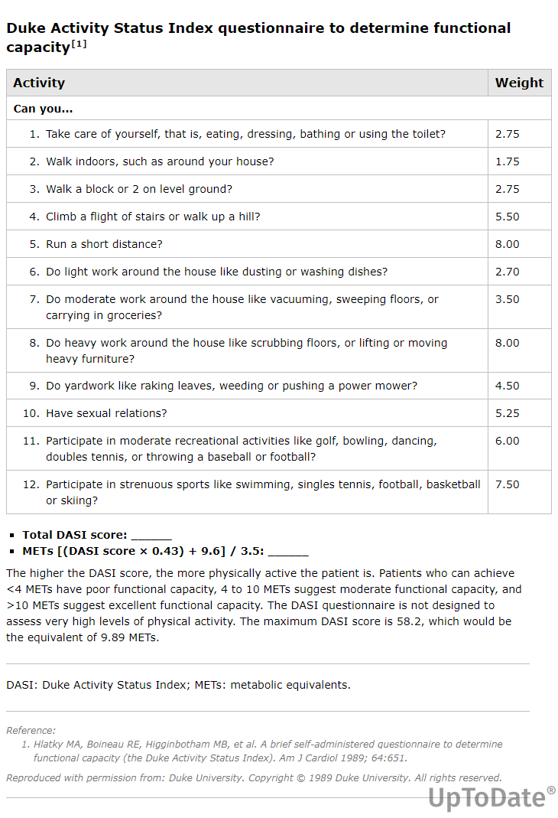
Duke Activity Status Index (DASI)

Slide 15

> 34
Notes:
Austin Matthews

Slide 16

> 25
Notes:
Vince Carter

Slide 17
Metabolic Equivalents (METS)
1 MET = 3.5 mL O₂ uptake/kg/min
  Resting O₂ uptake in a sitting position
Failure to climb 2 flights of stairs may predict MACE
Eagle KA. J Am Coll Cardiol 2002.
Wijeysundera DN. Lancet 2018.
Reilly DF. Arch Intern Med 1999.
Lurati Buse GAL. Br J Anaesth 2021.
Notes:
Lurati trial: prospective cohort in Sweden, n=4500
Inability to climb 2 FOS = independent risk factor for MACE; age > 65 or age > 45 but with h/o CAD

Slide 18

1 MET
1 MET
Notes:
1 MET

Slide 19

4 METS
4 METS

Slide 20

4-10 METS
4-10 METS

Slide 21




> 10 METS

Slide 22

METS Study
1,400 patients with > 1 risk factor for CAD or cardiac complications
Subjective vs. DASI + NT-proBNP
Subjective METS assessment did not predict postop MI
Lower DASI scores predicted 30-day death or MI
Higher NT-proBNP predicted 30-day death or MI
Wijeysundera DN. Lancet 2018.

Slide 23

MET-REPAIR
Prospective cohort, n>15,000
Patient-reported functional status (METS) vs. clinical risk factors
Composite outcome: CV mortality, arrest, AMI, stroke, CHF
MACE occurred in 1.8%
METS no better than clinical risk factors
  Better than RCRI, but not NSQIP or MIPS
Lurati Buse GA. Br J Anaesth 2023.

Slide 24
Screening Tests

Slide 25
ECG
Indications:
  Known cardiovascular disease
  Significant arrhythmia
  Structural heart disease
Timing:
  Within 12 months of surgery
Risk of Surgery?
  Not indicated if low-risk surgery (<1% estimated risk)
Thompson A. Circulation 2024.
Halvorsen S. Eur Heart J 2022.
Van Klei WA. Ann Surg 2007.
Notes:
LBBB and RBB predicted postop MI in a study of 3000 pts > 50 yrs of age, but no better than indicators in patient history and risk of surgery

Slide 26
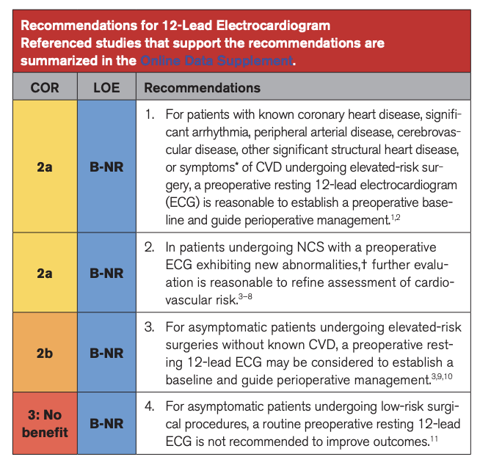
Thompson A. Circulation 2024.

Slide 27
Lab Tests
Should be based on clinical history
(Cr used in some risk calculators)

Slide 28
Brain Natriuretic Peptide (BNP / NT-proBNP)
Helpful in patients for whom decision to undergo more cardiac testing is unclear
Thompson A. Circulation 2024.

Slide 29
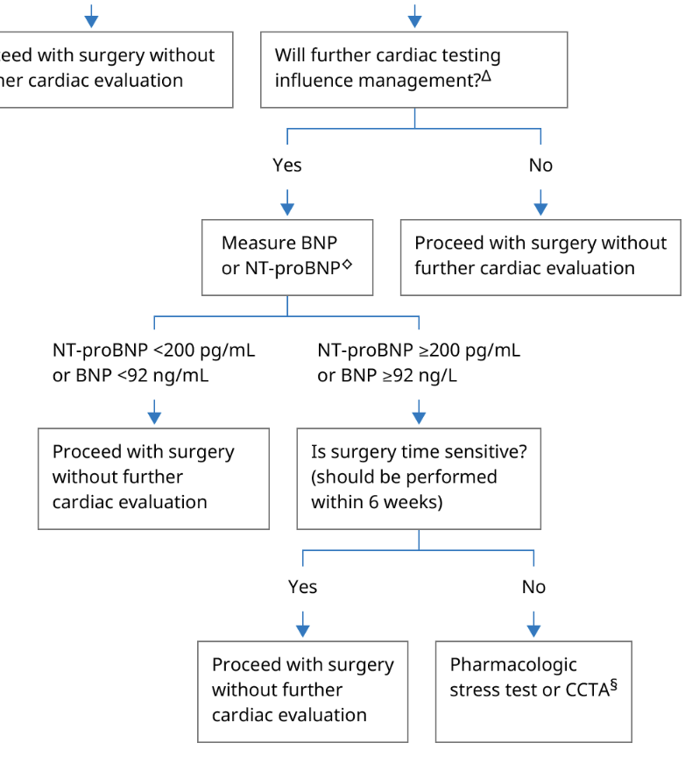
Unable to perform reliable risk assessment
NT-proBNP > 200
BNP > 92
Duceppe E. Ann Intern Med 2020.
Rodseth RN. J Am Coll Cardiol 2014.
Graphic 140786 Version 2.0. 2025. UpToDate, Inc.

Slide 30
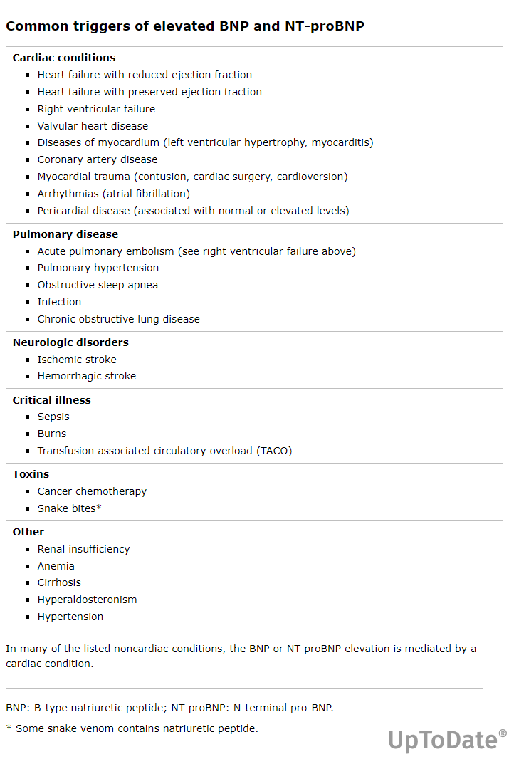
Graphic 99857 Version 5.0. 2025 UpToDate, Inc.

Slide 31
Troponin
Not demonstrated to improve perioperative outcomes
Thompson A. Circulation 2024.

Slide 32
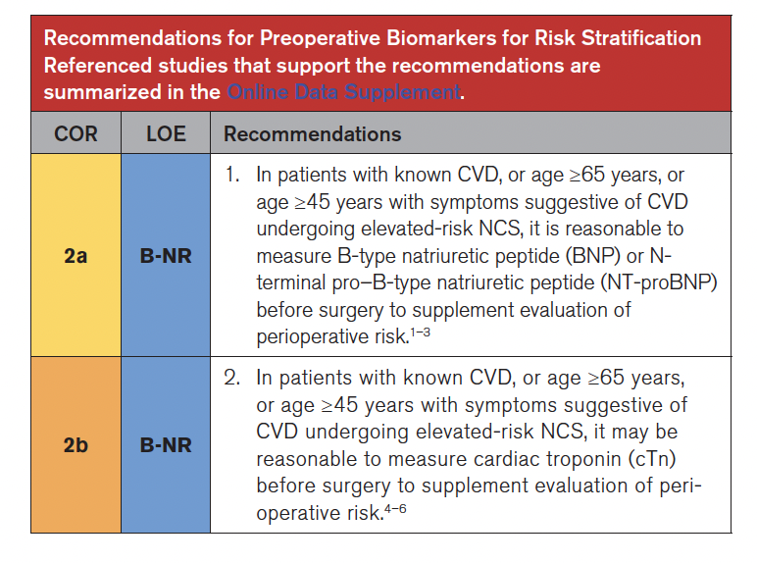
Age > 65
OR
Age > 45 w/ CVD Sx
AND
Elevated risk noncardiac surgery
Thompson A. Circulation 2024.

Slide 33
Risk Tools

Slide 34
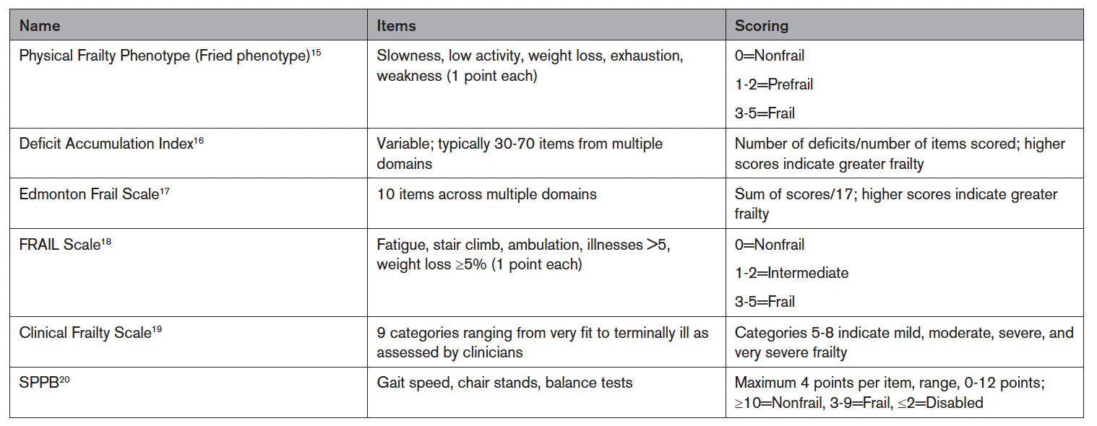
Frailty
Assess in all patients > 65 or in younger patients with signs of frailty AND undergoing elevated risk noncardiac surgery
Thompson A. Circulation 2024.

Slide 35
Revised Cardiac Risk Index (RCRI, “Lee Index”)
PRO
CON
Simplest tool
Fast, 6 items
Studied extensively
Externally validated
Predicts MI, v-fib, pulmonary edema, complete heart block
20 years old
Underestimates risk for vascular surgery (AAA)
Derived from patients with LOS of at least 2 days
Death not an outcome
Validation set ROC: 0.75
Lee TH. Circulation 1999.
Ford MK. Ann Intern Med 2010.
Fronczek J. Br J Anaesth 2019.
Notes:
Originally validated in 4,300 patients at the Brigham, original ROC 0.76.
Model was derived using a two-stage process using logistic regression, with the first stage involving univariable regression to screen for potential predictors, which were then included in the second stage that further selected significant predictors using stepwise logistic regression. Such an approach has since been found to be of questionable reliability and has been largely superseded by other variable selection methods such as LASSO and elastic net regression. Initially, generalizability of the model was limited for a variety of reasons. Death was not part of the outcome

Slide 36
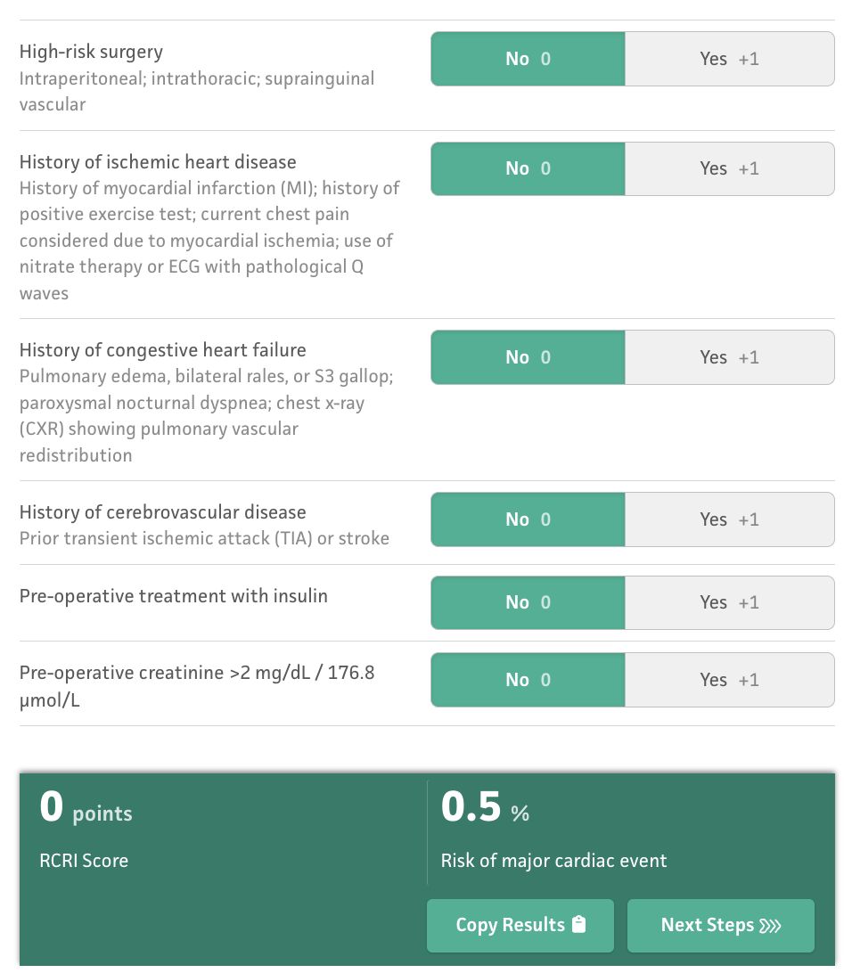

Slide 37
MICA (Gupta) Score
Pros
Derived from > 200K patients in NSQIP database
Goal: identify risk factors associated with intra- or postoperative MI or cardiac arrest within 30 days
Validation ROC: 0.97
Cons
Only validated retrospectively
Likely underestimates MI
Doesn’t account for beta-blockers or stress test results
Gupta PK. Circulation 2011.
Notes:
MICA: Myocardial Infarction or Cardiac Arrest

Slide 38
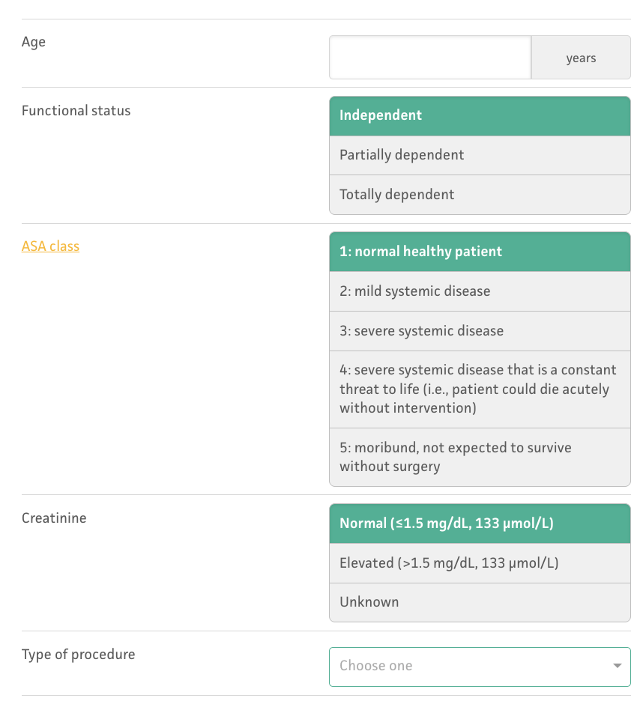
Cardiac risk, % = e^{x} / (1 + e^{x})
Where x = −5.25 + sum of the values of the selected variables.

Slide 39
NSQIP
Pros
Derived from larger database of surgical patients (> 1.4M)
Validation ROC: 0.88 (0.94 for mortality)
Parameters updated continuously
Cons
Takes longer, more variables to input (height, weight)
Definition of MI might underestimate non-q wave MI
Bilimoria KY. J Am Coll Surg 2013.
Notes:
Bilimoria KY, Liu Y, Paruch JL, et al. Development and evaluation of the universal ACS NSQIP surgical risk calculator: a decision aid and informed consent tool for patients and surgeons. J Am Coll Surg. 2013;217:833– 842.e1-3.

Slide 40
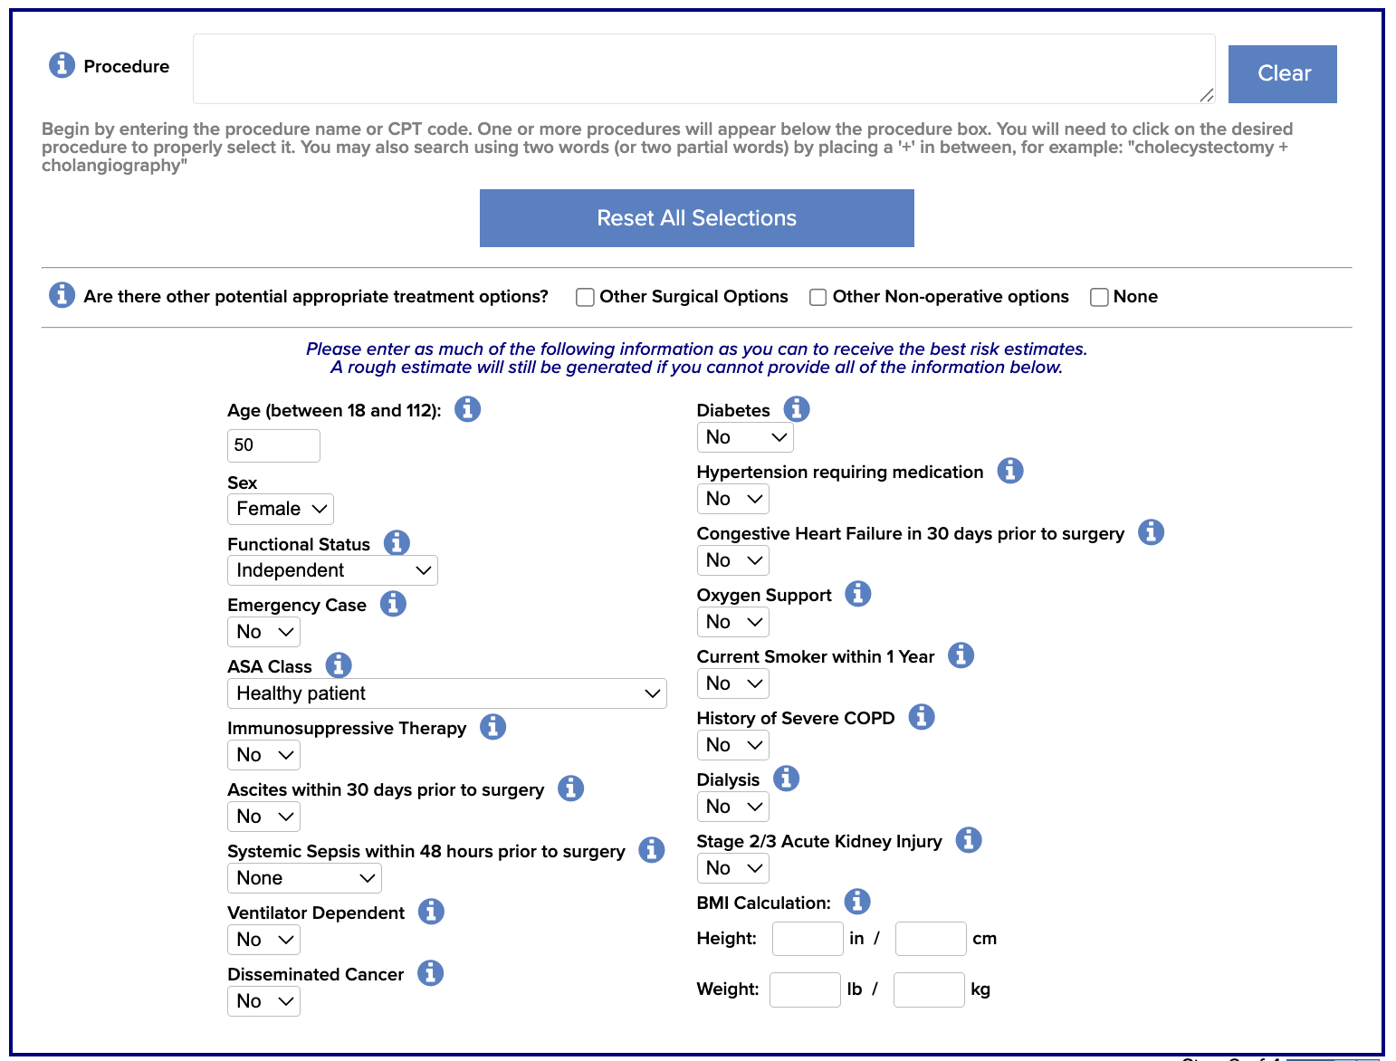

Slide 41
Woo Perioperative Risk

Slide 42

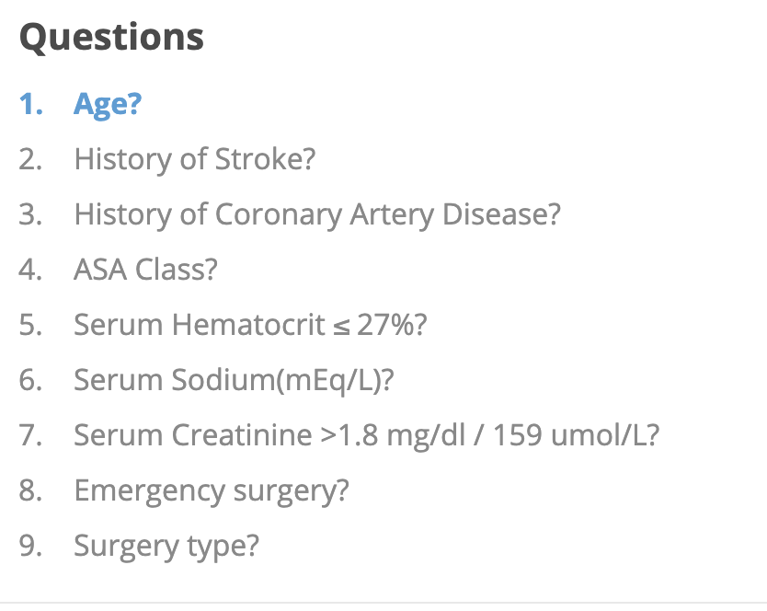
Woo Perioperative Risk
Derived from NSQIP, >1M patients
Accounts for age
Predicts postop 30-day risk of stroke and all-cause mortality in addition to cardiac risk (MI, cardiac arrest)
Good ROCs:
  Stroke: 0.87
  MACE: 0.87
  Mortality: 0.93
Woo SH. J Am Heart Assoc 2021.

Slide 43
Other Risk Scores/Calculators
Goldman (1977)
AUB-HAS2 (2019)
NSQIP Geriatric-sensitive (2019)
Surgical Outcome Risk Tool (2014)
Good summary in Thompson A. Circulation 2024.
Notes:
AUB-HAS2, 6 parameters, derived from > 3200 patients, then validated in over 1.1M
Goldman, old!
NSQIP geriatric, ROCs not as great 0.76 in validation cohort
Surgical Outcome Risk Tool, good ROC, only predicts mortality

Slide 44
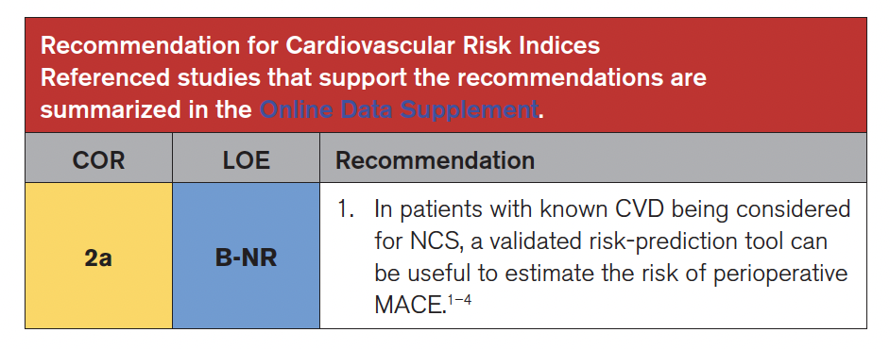
Thompson A. Circulation 2024.

Slide 45
Additional Testing

Slide 46
LV and RV Function (ECHO)
Who needs an echocardiogram?
Risk of perioperative MACE higher in patients with reduced LV function
  HF is an established risk
  Symptomatic HF patients at highest risk
Significant murmur
Dyspnea of unknown cause
LV/RV function can be assessed with FoCUS
Thompson A. Circulation 2024.

Slide 47
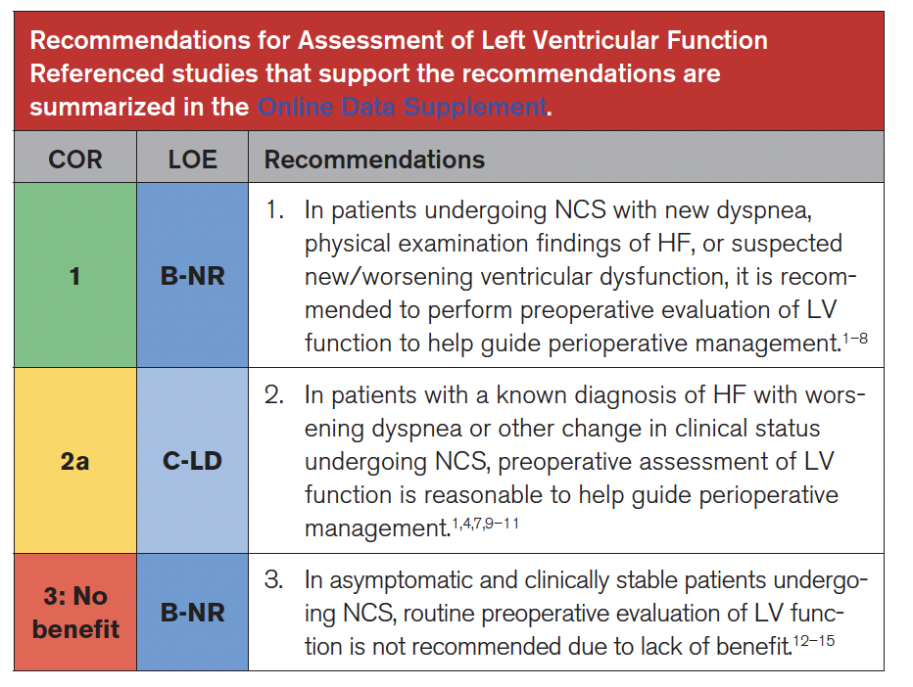
Thompson A. Circulation 2024.

Slide 48
Stress Testing
Not indicated unless decision making will change
Consider for patients with elevated risk of MACE and poor or unknown functional capacity
  If further testing will impact decision making or perioperative care
Preoperative revascularization has not been shown to reduce perioperative MACE or cardiac mortality
Thompson A. Circulation 2024.
Auerbach A. Circulation 2006.
Das MK. J Am Coll Cardiol 2000.
Young EL. Eur J Vasc Endovasc Surg 2012.
Morgan PB. Anesth Analg 2002.

Slide 49
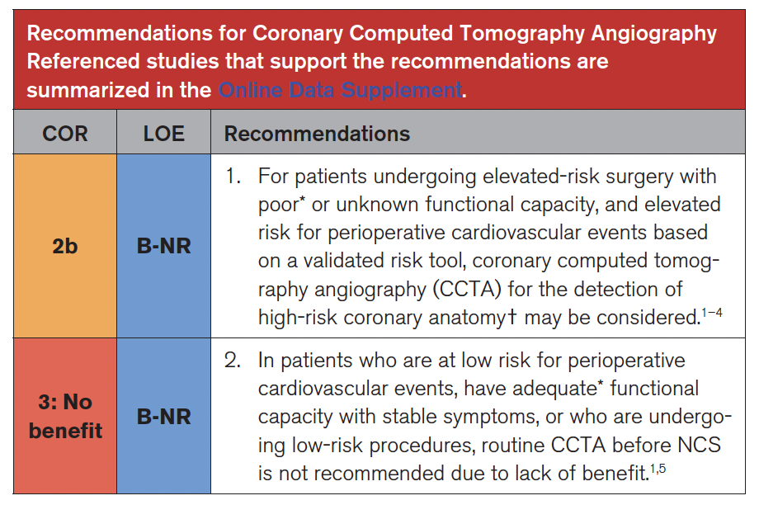
Coronary Artery CT Angiography
DASI < 34
< 4 METs
Thompson A. Circulation 2024.
Notes:
May inappropriately overestimate risk

Slide 50
Putting It All Together

Slide 51
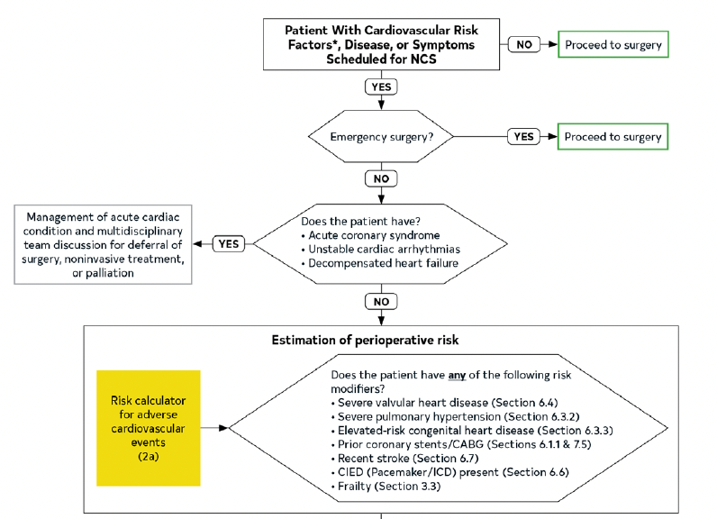

Slide 52
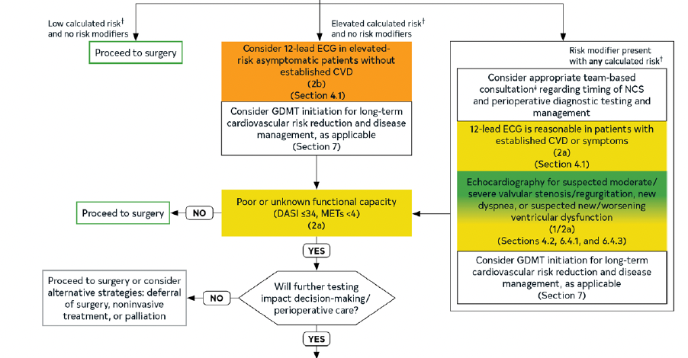

Slide 53
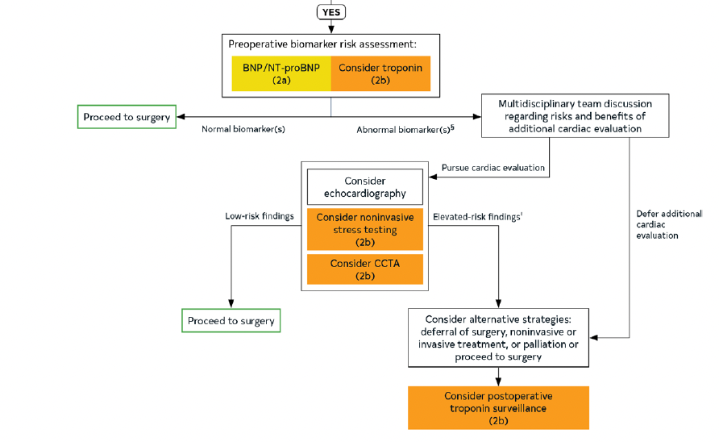

Slide 54
Cases

Slide 55
Case 1
A 62-year-old man with a PMHX of HTN, HLD, and type II DM is diagnosed with Stage II colon cancer. Surgery is scheduled in one week.
Medications: telmesartan-HCTZ, Empagliflozin, and rosuvastatin, and metoprolol.
DASI is 21. He can do light yardwork and climbs 2 flights of stairs without dyspnea. Physical exam is normal.
What is the surgical risk?
What additional tests are recommended?
What if a murmur is detected?
What if he had a LBBB on ECG?
What if he was only on metoprolol and metformin?
Notes:
Higher risk if open, lower if laparoscopic. Timing: NOT urgent.
BNP/NT-proBNP reasonable, if normal, proceed to surgery
If murmur, get ECHO
If LBBBB on ECG--?
If only on metop and metform, should be started on GDMT for LT CV risk reduction, but must weigh risk of Dz progression

Slide 56
Case 2
A 45-year-old man with a history of paraplegia following a prior MVC presents with renal colic and nephrolithiasis. Urology desires to perform a cystoscopy in the next 24 hrs.
Medications: None (nonadherent).
What other information do you need?
What is the surgical risk?
What additional tests are recommended?
Notes:
If not emergency surgery, ACS/unstable arrhythmias/decompensated HF?
If no, risk calculator.
Surgical risk: LOW, but URGENT
Additional tests? 12 lead only if higher risk per NSQIP/Woo
If METs not easy to establish, BNP/proBNP/cTn NOT likely to influence next steps, would NOT consider stress test or CCTA because NOT elevated risk surgery

Slide 57
Case 3
An 88-year-old woman sustains an intertrochanteric fracture after a fall. PMHx is significant only for HTN, but the patient does not follow regularly with a physician. On hospital day 2, the patient develops delirium. The orthopedic surgeons want to operate within the next 24 hrs.
Medications: amlodipine.
Exam: 2/6 systolic murmur at the apex, radiates to axilla, blowing, mild, no edema and exam otherwise normal (inattentive, CAM-ICU positive)
What other information do you need?
What is the surgical risk?
What additional tests would you order?
Notes:
Murmur likely consistent with MR.
ECG: atrial fibrillation, mean rate 84
Are you going to start GDMT?
ECHO? Murmur most consistent with mild mitral regurg, common in a patient of this age, but not unreasonable to obtain
Unable to ascertain METS and DASI
BNP/NT-proBNP are ELEVATED→ could consider echo, but stress testing and CCTA not likely to change outcome
Needs family discussion
Could consider postop cTn surveillance

Slide 58
Case 4
An 57-year-old with a history of Trisomy 21 and prior cardiac surgery for tetralogy of Fallot presents with acute appendicitis. His family informs you that he has developed early dementia and has the cognitive ability of a child.
Medications: levothyroxine.
Exam: 2/6 systolic murmur at the apex, mild, no radiation.
What other information do you need?
What is the surgical risk?
What additional tests would you order?
What if the procedure was a CCTA for CVD surveillance?
What if the procedure was an open reduction and internal fixation for an extremity fracture?
Notes:
Emergency surgery→ proceed!
If not emergent, can try to do risk calc, but will be difficult
12-lead and BNP/pro-BNP, maybe ECHO if not done recently (not indicated as per current guideline)
Would not do stress testing
If procedure was CCTA, do the CCTA!
ORIF-LOWER risk

Slide 59
Case 5
A 62-year-old with a history of Grade 4 (GOLD) COPD, HTN, prior DVT, and DM-2 sustains a hip fracture. Orthopedic surgery consults medicine for “clearance.” The patient was hospitalized for a COPD exacerbation 2 months ago.
Medications: tiotropium, salmeterol, albuterol, valsartan, dapagliflozin
Exam: Appears thin, temporal wasting, malnourished. Moderate expiratory wheezing. Lower extremity abnormally externally rotated.
What other information do you need?
What is the surgical risk?
What additional tests would you order?
Notes:
COPD patients with risk factors for CVD have shown a 280% increased risk of a CV event in the first 30 days after 1 exacerbation, and a 90% increased risk up to 1 year after the onset of exacerbation compared to pre-exacerbation baseline period

Slide 60
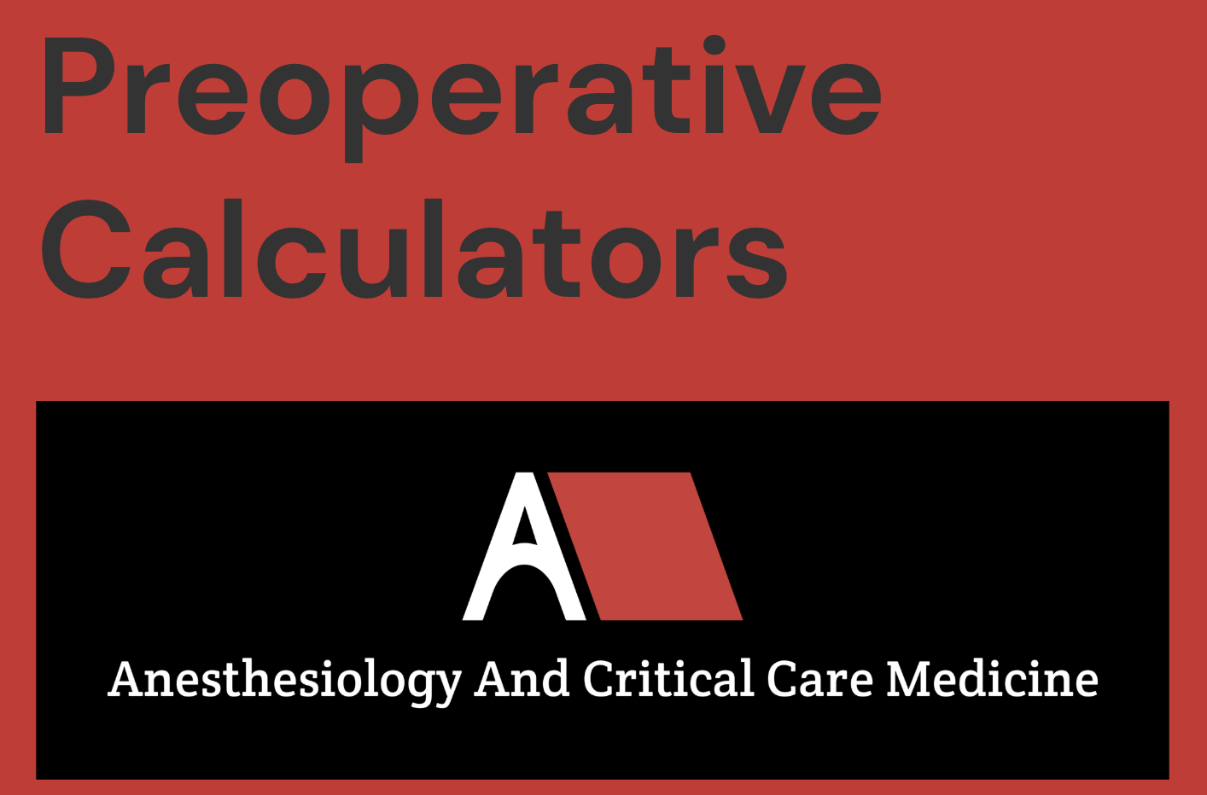
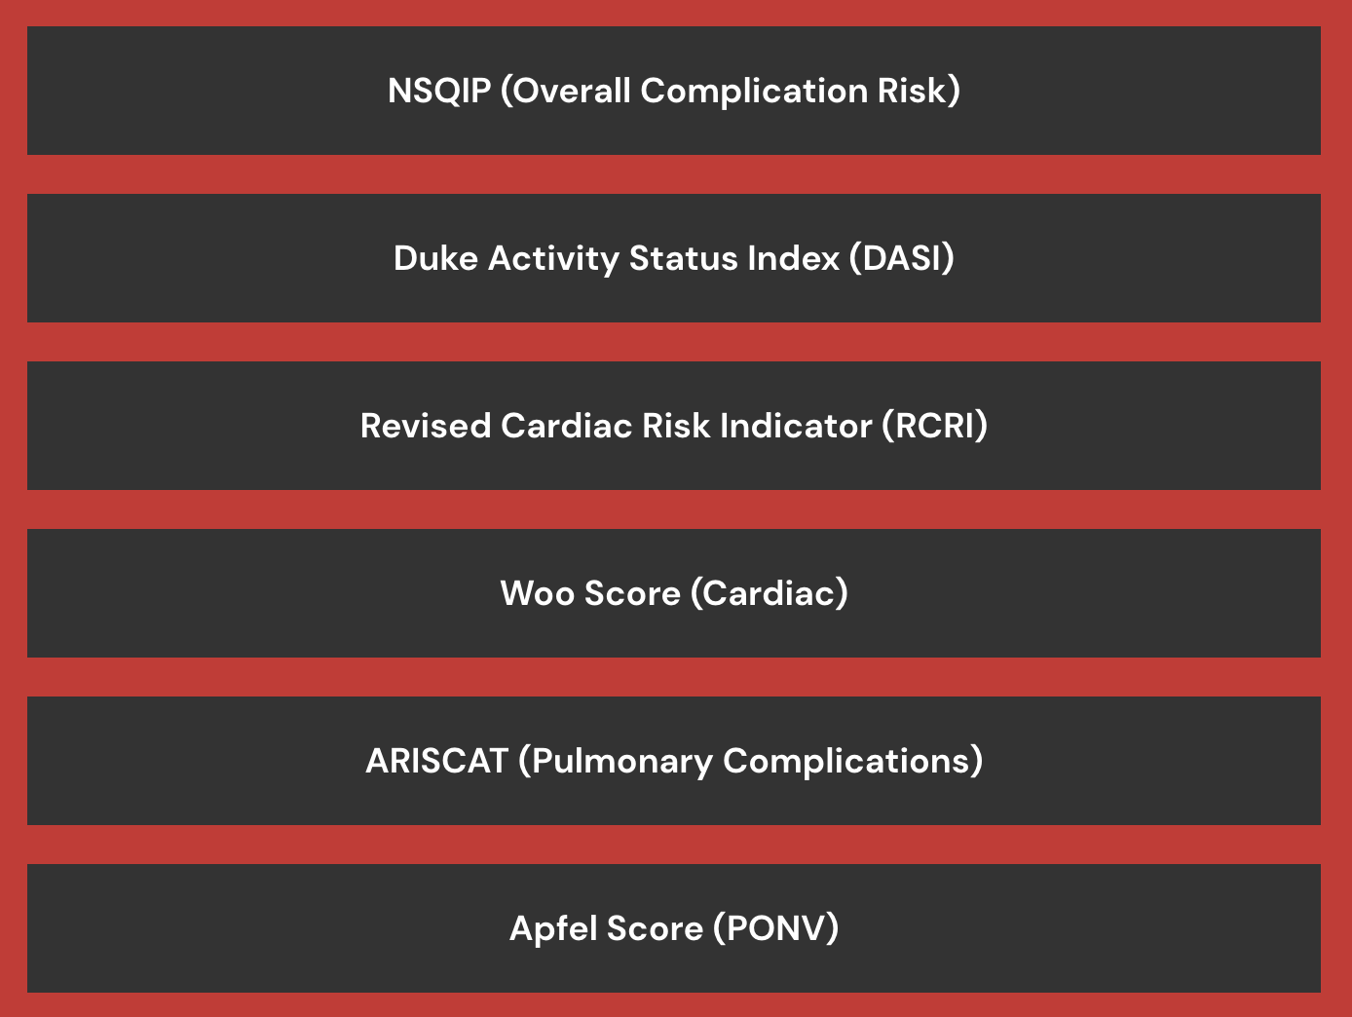
www.mdanescrit.com

Slide 61
Questions?
Sam Galvagno, DO, PhD, MBA, FCCM
Professor and Chair
Department of Anesthesiology
sgalvagno@arizona.edu

Slide 62
