Slide 1
Atrial Fibrillation
Academic Half Day 11/4/2025
Fadi J. Khoury, MD
Cardiology, PGY-4

Slide 2
Outline
Introduction
Pathophysiology
Clinical classification
Acute management - stable patients, unstable patients, cardioversion/anticoagulation
AF with RVR – approach and medications
Anticoagulation
Long-term management: Rate-control strategy
Long-term management: Rhythm-control strategy
Atrial Flutter
Summary sheet

Slide 3
Introduction
Disorganized atrial activity -> Irregularly irregular ventricular response
AF is typically the result of chronic pre-disposing risk factors (diabetes mellitus, HTN, OSA, alcohol use, and obesity)
Age is the most significant risk factor
In patients age > 55 with a stroke/TIA of unclear etiology, AF is present in 25% of cases
  Ambulatory ECG monitoring for 14-30 days
  Loop recorder if above is inconclusive

Slide 4
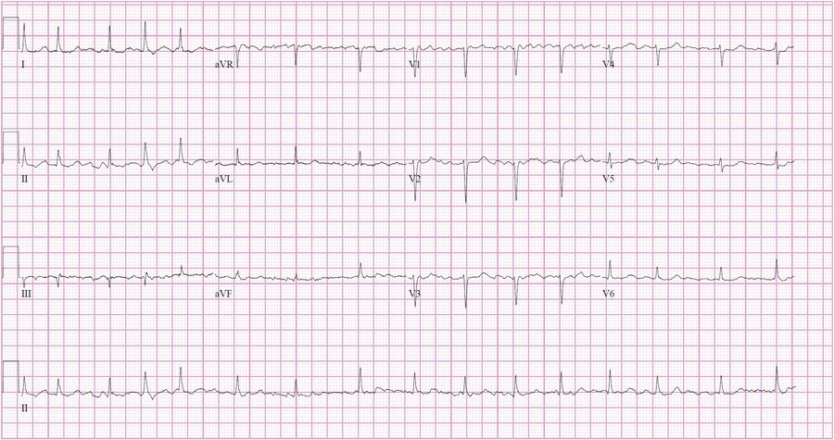

Slide 5
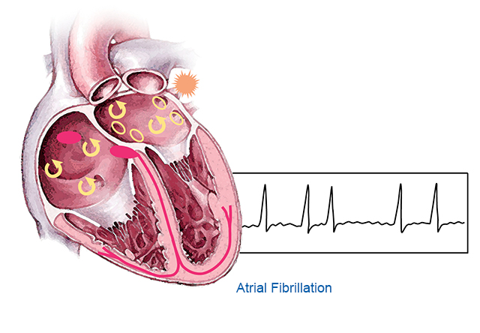
Pathophysiology
Disorganized and irregular atrial re-entrant circuits
Not all the atrial circuits make it through the AV node
HR is determined by AV nodal refractory period

Slide 6
Clinical classification
Classification
Paroxysmal | Terminates < 7 days
Persistent | Continuous > 7 days
Long-standing persistent | Continuous > 12 months
Permanent | When decision is made for no further attempts to restore or maintain sinus rhythm

Slide 7
Question
A 66-year-old man is seen in the office after hospitalization for an embolic stroke 7 days ago. His initial neurologic findings were minimal and have since resolved. An embolic source has not been identified. He has no other pertinent personal or family history. Medications are aspirin and clopidogrel.
Physical examination, including vital signs and neurologic examination, is normal.
Ambulatory 30-day ECG monitoring showed no arrhythmias.
Which of the following is the most reasonable management?
Discontinue aspirin and clopidogrel; begin warfarin
LAA occlusion device
Loop recorder implantation
Test for thrombophilia

Slide 8
Question
A 66-year-old man is seen in the office after hospitalization for an embolic stroke 7 days ago. His initial neurologic findings were minimal and have since resolved. An embolic source has not been identified. He has no other pertinent personal or family history. Medications are aspirin and clopidogrel.
Physical examination, including vital signs and neurologic examination, is normal.
Ambulatory 30-day ECG monitoring showed no arrhythmias.
Which of the following is the most reasonable management?
Discontinue aspirin and clopidogrel; begin warfarin
LAA occlusion device
Loop recorder implantation
Test for thrombophilia

Slide 9
Acute management – stable patients
What to prioritize:
  Prevent strokes
  Achieve heart rate control
  Minimize symptoms
  Modify risk factors
Testing:
  Thyroid function
  Echocardiogram – LA size, valvular disease, ejection fraction
  STOP-BANG score – OSA evaluation
Elective cardioversion in hemodynamically stable patients

Slide 10
Acute management – unstable patient
What is unstable?
  Acute hypotension (SBP < 90 mmHg or SBP decreased > 30 mmHg)
  Acute myocardial infarction
  Decompensated heart failure
  End organ hypoperfusion (chest pain, AMS, and SOB)
The above are indications for urgent cardioversion

Slide 11
Acute management – cardioversion and anticoagulation
Stable patients – not undergoing urgent cardioversion – no need for IV anticoagulation
If cardioversion is planned:
  Duration of AF < 48 hours, low risk of thromboembolism
  Anticoagulation for at least 3 weeks prior to procedure
  If above are uncertain, TEE to ensure no LAA thrombus
Post-cardioversion -> at least 4 weeks of anticoagulation

Slide 12
AF with RVR – Approach

Slide 13
AF with RVR – medications
Medication table for AF with RVR
 | Medication | MOA | Dosing | BP Effect | Caution
First Line | Metoprolol Tartrate | Beta blockers. Inhibit AV node and are negative inotropes | IV – 2.5-5 mg q 5 mins (max 15 mg) PO – 12.5-37.5 mg PO q 6 hrs | ↓↓ | Decompensated HF or Sepsis **may be used acutely in low EF without clinical HF
 | Diltiazem | Calcium channel blocker, non-DHP. Inhibit AV node. Negative inotrope. | IV – 10-20 mg followed by gtt 5-15 mg/hr PO – 30-90mg q 6 hrs | ↓↓ | Decompensated HF, Hx of HFrEF, or Sepsis
Second Line **decomp HF or borderline BP | Digoxin | Na/K ATPase inhibition. Blocks AV node and is a positive inotrope | IV – Loading dose 0.25 – 0.5 mg IV push, 0.25 mg q 6 hrs (must be renally dosed) then 0.125 – 0.25 mg per day | ↔ | Renal failure, HypoK/HypoMg
 | Amiodarone | Class III antiarrhythmic. Inhibits AV node. | IV – 150 mg IV push and gtt per protocol | ↓ | Long-standing persistent/Persistent A. Fib due to toxicity (liver, thyroid, lung)

Slide 14
AF with RVR - medications
Other medications for AF with RVR
Medications | MOA | Dosing | BP effect | Caution
Esmolol | Beta blocker. Very short duration of action. | Loading dose (optional): 500 mcg/kg over 1 min; followed by a 50 mcg/kg/min infusion for 4 mins. Infusion continued at 50 mcg/kg/min if the response is inadequate, titrate up in 50 mcg/kg/min increments (don’t increase more frequently than every 4 mins) (max to 300 mcg/kg/min) | ↓↓ | Decompensated HF or Sepsis
Phenylephrine | First line Vasopressor in A. Fib with RVR, Activation of alpha-1 receptors which results in reflexive bradycardia | 0.1 to 10 mcg/kg/minute; titrate to clinical end point | ↑ | Utilized in ICU settings

Slide 15
AF with RVR - medications
AF rate control in the setting of HF
No HF | Beta blocker or CCB
Decompensated HF with low EF | No beta blockers or CCB IV digoxin or amiodarone Start beta blockers once compensated
Decompensated HF with normal EF | Okay to use beta blockers or CCB
Compensated HF with low EF | Beta blockers

Slide 16
Anticoagulation
Risk Stratification:
CHA2DS2VASc Score 0 (men) and 1 (women) → AC not indicated Score 1 (men) and 2 (women) → AC based on clinical judgement Score > 2 (men) and > 3 (women) → AC indicated Do not use in mitral stenosis or mechanical heart valve → AC always indicated with Warfarin | CHF Hx? No = 0; Yes = 1 HTN Hx? No = 0; Yes = 1 Age? <65 y/o = 0; 65-74 y/o = 1; >75 y/o = 2 Diabetes Hx? No = 0; Yes = 1 Stroke Hx? No = 0; Yes =2 Vascular Dz (MI, PAD, Aortic plaque)? No = 0; Yes = 1
HAS-BLED Stratifies bleeding risk in patients who require anticoagulation Score > 3 represents significant bleeding risk Regardless of score, this does not represent a contraindication to AC in A. Fib, but could help guide goals-of-care discussions

Slide 17
Anticoagulation
AC agents in A. Fib
Non-valvular | DOAC (Eliquis, Xarelto) > Warfarin
Valvular (moderate-to-severe mitral stenosis) or Mechanical heart valve | Warfarin
Nonvalvular A.Fib + PCI | Low ischemic risk: DOAC + ASA + P2Y12 Inhibitor at discharge for 1 week → ASA then stopped AUGUSTUS Trial DOAC + P2Y12 inhibitor to be continued for 12 months AFIRE trial → DOAC can be continued as monotherapy (Xarelto studied) 12 months after discharge High ischemic risk: DOAC + ASA + P2Y12 Inhibitor at discharge for 1 month → ASA then stopped DOAC + P2Y12 inhibitor to be continued for 12 months

Slide 18
Question
A 76-year-old woman is evaluated during a wellness visit. She reports that she fatigues easily, and her husband notes that she snores loudly. Medical history is significant for hypertension. Her only medication is metoprolol.
On physical examination, pulse rate is 75/min and irregular; other vital signs are normal. Cardiac examination reveals irregular heart sounds with no murmurs or gallops. No signs of heart failure are present.
An ECG shows atrial fibrillation at 75/min without ischemic changes.
Which of the following is the most appropriate management?
Add Aspirin
Emergent Cardioversion
Increase Metoprolol dosage
Initiate oral anticoagulation
Reassurance

Slide 19
Question
A 76-year-old woman is evaluated during a wellness visit. She reports that she fatigues easily, and her husband notes that she snores loudly. Medical history is significant for hypertension. Her only medication is metoprolol.
On physical examination, pulse rate is 75/min and irregular; other vital signs are normal. Cardiac examination reveals irregular heart sounds with no murmurs or gallops. No signs of heart failure are present.
An ECG shows atrial fibrillation at 75/min without ischemic changes.
Which of the following is the most appropriate management?
Add Aspirin
Emergent Cardioversion
Increase Metoprolol dosage
Initiate oral anticoagulation
Reassurance

Slide 20
Question
A 69-year-old woman is evaluated during a follow-up visit 7 months after coronary stent placement for non–ST-elevation myocardial infarction. History is also notable for paroxysmal atrial fibrillation, hypertension, and gastrointestinal bleeding due to diverticulosis 5 years ago. Medications are aspirin, clopidogrel, rivaroxaban, metoprolol, lisinopril, and rosuvastatin.
On physical examination, vital signs are normal. The patient weighs 80 kg (176.4 lb). Bruising is present on the arms and legs. The remainder of the examination is unremarkable.
Serum creatinine level is 1.0 mg/dL (88.4 μmol/L).
Which of the following is the most appropriate management?
Discontinue aspirin
Discontinue rivaroxaban
Switch rivaroxaban to reduced dose apixaban
Switch rivaroxaban to warfarin

Slide 21
Question
A 69-year-old woman is evaluated during a follow-up visit 7 months after coronary stent placement for non–ST-elevation myocardial infarction. History is also notable for paroxysmal atrial fibrillation, hypertension, and gastrointestinal bleeding due to diverticulosis 5 years ago. Medications are aspirin, clopidogrel, rivaroxaban, metoprolol, lisinopril, and rosuvastatin.
On physical examination, vital signs are normal. The patient weighs 80 kg (176.4 lb). Bruising is present on the arms and legs. The remainder of the examination is unremarkable.
Serum creatinine level is 1.0 mg/dL (88.4 μmol/L).
Which of the following is the most appropriate management?
Discontinue aspirin
Discontinue rivaroxaban
Switch rivaroxaban to reduced dose apixaban
Switch rivaroxaban to warfarin

Slide 22
Long-term management – rate control
AFFIRM trial → Rate control is non-inferior to rhythm control in nonvalvular A. Fib, but rhythm control trended toward increased mortality
RACE II trial → Lenient HR control (HR < 110) is noninferior to strict HR control (HR < 80) in prevention of cardiovascular events
  Strict HR control may be beneficial in younger patients and patients with concomitant HF
Pharmacologic agents: Beta blockers, CCB, digoxin, and class III antiarrhythmics (i.e. amiodarone; modest effect)

Slide 23
Long-term management – rhythm control
EAST-AFNET 4 trial:
  Studied early rhythm-control strategy (within 1 year of AF diagnosis) vs conventional rate-control in patients considered “high risk” for adverse cardiovascular events.
  High risk definition:
    Age > 75 and a hx of a TIA/Stroke
    Meeting any 2 of the following criteria – age older than 65, female gender, diabetes, heart failure, HTN, severe CAD, CKD, and LV hypertrophy
  Conclusion: Early rhythm control (drugs or ablation) reduced the primary composite end point of cardiovascular death, stroke, or hospitalization for heart failure or acute coronary syndrome, compared with usual care.

Slide 24
Question
A 70-year-old man is evaluated for recently diagnosed paroxysmal atrial fibrillation that is mildly symptomatic. Medical history is significant for hypertension and previous stroke. Medications are rivaroxaban and metoprolol. He has experienced no episodes of bleeding on anticoagulation therapy.
On physical examination, blood pressure is 128/74 mm Hg and pulse rate is 72/min and regular. The remainder of the examination is unremarkable.
An echocardiogram reveals an enlarged left atrium and normal left ventricle. Forty-eight–hour ambulatory ECG monitoring shows atrial fibrillation prevalence of 10% with a controlled ventricular rate less than 90/min and no other abnormalities.
Which of the following is the most appropriate treatment?
LAA Occlusion
PPM implantation
Rhythm control
Switch rivaroxaban to warfarin
No additional therapy

Slide 25
Question
A 70-year-old man is evaluated for recently diagnosed paroxysmal atrial fibrillation that is mildly symptomatic. Medical history is significant for hypertension and previous stroke. Medications are rivaroxaban and metoprolol. He has experienced no episodes of bleeding on anticoagulation therapy.
On physical examination, blood pressure is 128/74 mm Hg and pulse rate is 72/min and regular. The remainder of the examination is unremarkable.
An echocardiogram reveals an enlarged left atrium and normal left ventricle. Forty-eight–hour ambulatory ECG monitoring shows atrial fibrillation prevalence of 10% with a controlled ventricular rate less than 90/min and no other abnormalities.
Which of the following is the most appropriate treatment?
LAA Occlusion
PPM implantation
Rhythm control
Switch rivaroxaban to warfarin
No additional therapy

Slide 26
Question
A 65-year-old woman is evaluated in the office after several visits to the emergency department for paroxysmal atrial fibrillation and acute heart failure. Medications are apixaban, metoprolol, furosemide, and losartan.
Vital signs are normal. Cardiopulmonary examination and the remainder of the physical examination are normal.
Results of laboratory studies show a normal serum thyroid-stimulating hormone level.
An ECG shows sinus rhythm with a heart rate of 58/min. An echocardiogram reveals a left ventricular ejection fraction of 45%.
Which of the following is the most appropriate treatment?
AV node ablation with PPM placement
ICD placement
LAA occlusion
Rhythm control

Slide 27
Question
A 65-year-old woman is evaluated in the office after several visits to the emergency department for paroxysmal atrial fibrillation and acute heart failure. Medications are apixaban, metoprolol, furosemide, and losartan.
Vital signs are normal. Cardiopulmonary examination and the remainder of the physical examination are normal.
Results of laboratory studies show a normal serum thyroid-stimulating hormone level.
An ECG shows sinus rhythm with a heart rate of 58/min. An echocardiogram reveals a left ventricular ejection fraction of 45%.
Which of the following is the most appropriate treatment?
AV node ablation with PPM placement
ICD placement
LAA occlusion
Rhythm control

Slide 28
Long-term management – rhythm control
Subgroups that benefit from rhythm control:
  Heart Failure patients (particularly HFrEF)
  Young patients
  Patients with fewer comorbid conditions
  Symptomatic A. Fib
  Diagnosis within 1 year

Slide 29
Long-term management – rhythm control
Antiarrhythmic medications (AAD):
  No structural heart disease → “pill-in-pocket” approach: flecainide/propafenone
  CAD → Dofetilide, Dronedarone, or Ibutilide
  HF → Amiodarone
AF catheter ablation (CA)
  Re-entrant circuit ablation surrounding Pulmonary vein outlet into the LA
  Generally, AAD attempted first and CA considered in refractory A. Fib
  CASTLE-AF Trial: Patients with AF and symptomatic HF, CA showed 16.1% absolute risk reduction in death or hospitalization compared to medical therapy alone (rate and/or rhythm control)

Slide 30
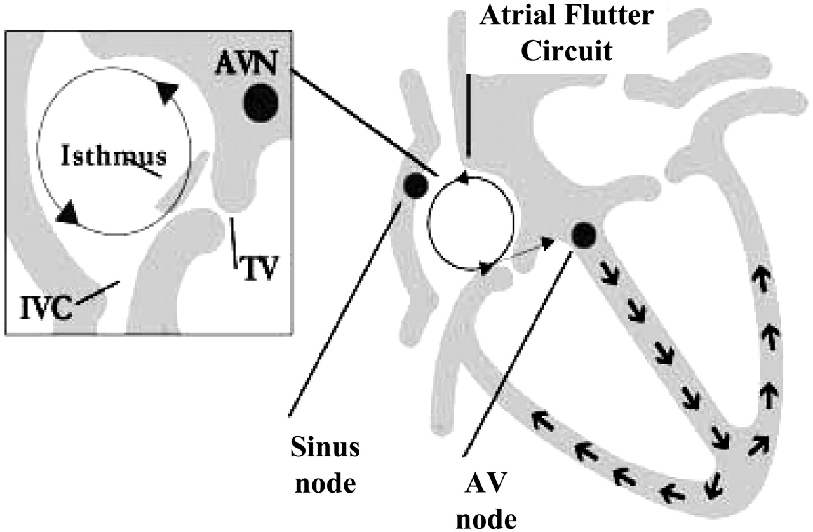
Atrial Flutter – similarities and key distinctions
Afib and Aflutter are both supraventricular tachyarrhythmias
Aflutter results from an organized macro-reentrant circuit
Typical Aflutter is most commonly from counterclockwise reentry around the tricuspid annulus along the Cavo-tricuspid isthmus (CTI)
Anticoagulation -> similar approach as Afib
Rate-control -> similar approach but more difficult to achieve than Afib
Rhythm-control -> CTI ablation (>95% success rate)

Slide 31
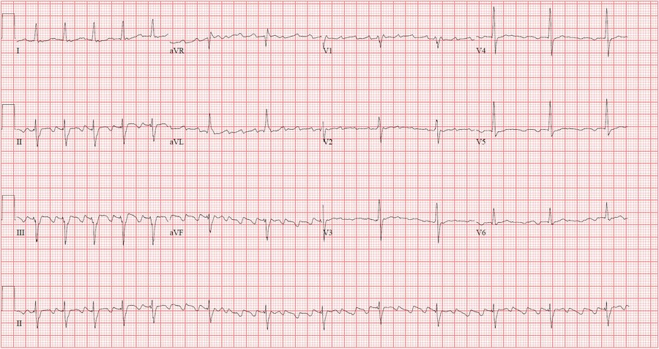

Slide 32
Atrial Flutter – Recognize on ECG
P waves appear in “saw-tooth” pattern. Also referred to as Flutter waves (F waves). Atrial fluttering rate of 250-300.
Regularly irregular rhythm → equidistant interval between QRS complexes
  Most common is a 2:1 AV block → 1 in 2 flutter waves is conducted to the AV node → HR = 300/2 = 150 bpm
  Variable AV block can be seen with 4:1, 3:1, or 1:1 pattern
Typical (type I) A. Flutter with counterclockwise re-entry (most common) – II, III, AVF with inverted flutter waves; V1 with upright flutter waves
Typical (type I) A. Flutter with clockwise re-entry – II, III, AVF with upright flutter waves; V1 with inverted flutter waves

Slide 33
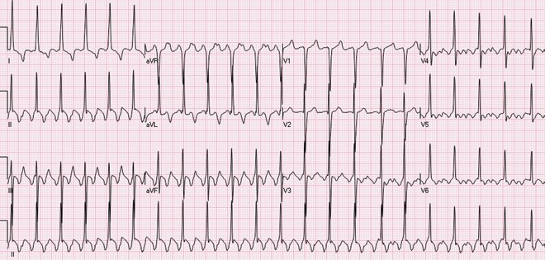
Question
A 56-year-old man is evaluated in the emergency department for acute shortness of breath and the sensation of a racing heart. His only medical problem is hypertension treated with chlorthalidone.
On physical examination, blood pressure is 89/52 mm Hg and pulse rate is 150/min. Cardiac examination reveals a regular tachycardia. Jugular venous distention and pulmonary crackles are present.
ECG is shown. The patient is successfully cardioverted.
Which of the following is the most appropriate additional treatment?
Amiodarone
Catheter ablation
Flecainide
Metoprolol
No additional treatment

Slide 34
Question
A 56-year-old man is evaluated in the emergency department for acute shortness of breath and the sensation of a racing heart. His only medical problem is hypertension treated with chlorthalidone.
On physical examination, blood pressure is 89/52 mm Hg and pulse rate is 150/min. Cardiac examination reveals a regular tachycardia. Jugular venous distention and pulmonary crackles are present.
ECG is shown. The patient is successfully cardioverted.
Which of the following is the most appropriate additional treatment?
Amiodarone
Catheter ablation
Flecainide
Metoprolol
No additional treatment

Slide 35
Summary sheet QR code

