Slide 1
Venous Thromboembolism

Slide 2
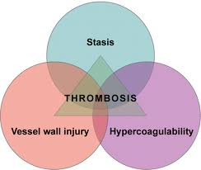
General Characteristics
Risk Factors:
Age > 60
Malignancy
History of previous VTE
Prolonged immobility, major surgery, trauma
Obesity
Cardiac disease, particularly HF
Pregnancy
Hereditary
Clinical Features
Lower extremity pain, swelling
Homan’s sign
Palpable cord
Fevers
Virchow’s Triad

Slide 3
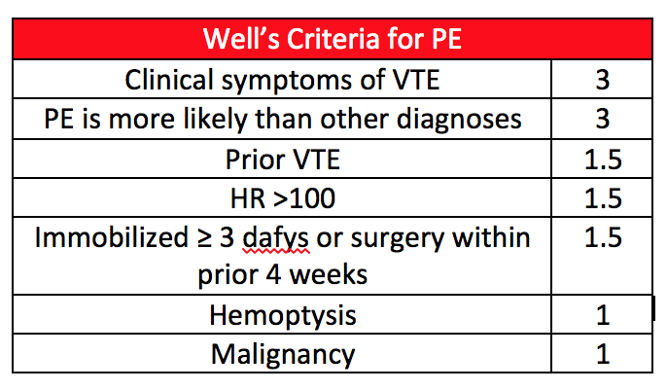
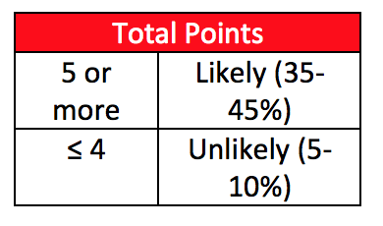
Diagnosis
Imaging Modalities
Doppler US with duplex
High sensitivity and specificity for proximal clots
Venography
Invasive
Impedence plethysmography
D-dimer
High sensitivity, low specificity = good test to rule out PE

Slide 4
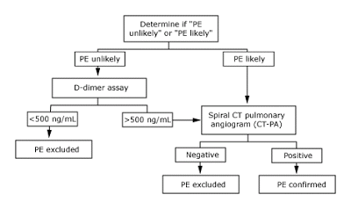

Slide 5
Treatment
Anticoagulation
Heparin
Warfarin
DOAC
Thrombolytics
Reserved for patients with massive PE (obstructive shock, RV strain/failure) without contraindications
IVC filter
Don’t forget about prophylaxis
Mechanical: SCDs
Pharmacologic: Heparin, LMWH

Slide 6
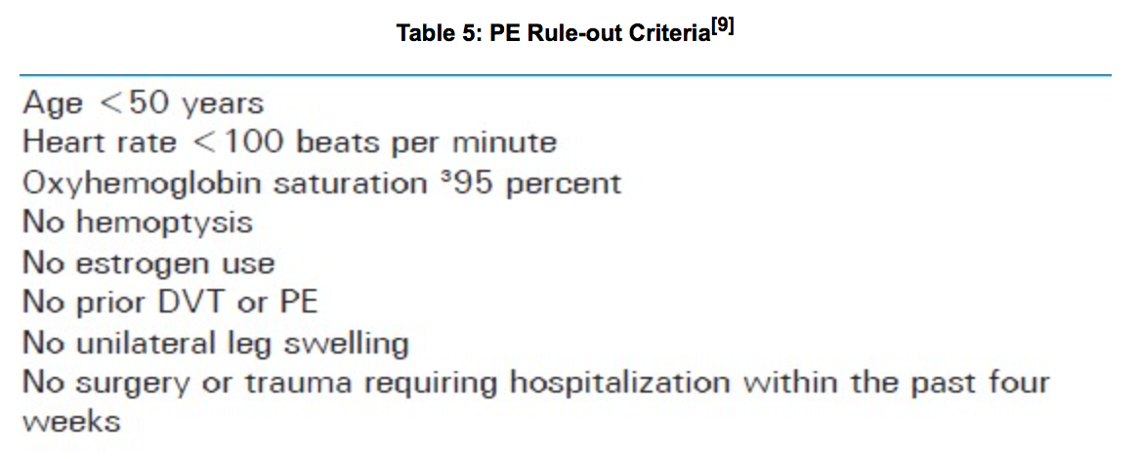
MKSAP High Yield
1. VTE prophylaxis should be considered for every hospitalized patient
2. Low probability Well’s score who meet all PE Rule-out Criteria (PERC) → No D-dimer OR imaging
3. Treatment: 3 months for provoked VTE, longer for unprovoked and 2nd VTE
4. IVC filters should only be used for acute pelvic or proximal leg clots who cannot tolerate anticoagulation
If a patient fulfills all of the PERC criteria and has a low probability of PE by Wells criteria and the gestalt opinion of the evaluating physician, then a PE may be ruled out

Slide 7
Value
Don’t reimage DVT in the absence of a clinical change (Choosing Wisely - Society for Vascular Medicine)
Repeat images to evaluate “response” of venous clot to therapy does not alter treatment
Don’t do work up for clotting disorder for patients who develop first episode of VTE in the setting of a known cause (Choosing Wisely - Society for Vascular Medicine)
Lab tests to look for hypercoagulable disorder will not alter treatment, even if an abnormality is found. DVT is a very common disorder and increased discovery of clotting abnormalities have led to increased testing without proven benefit
Don’t image for suspected PE without moderate or high pre-test probability of PE (Choosing Wisely - American College of Radiology)
While deep vein thrombosis (DVT) and PE are relatively common clinically, they are rare in the absence of elevated blood d-Dimer levels and certain specific risk factors. Imaging, particularly CT angiography, is a rapid, accurate and widely available test, but has limited value in patients who are very unlikely, based on serum and clinical criteria, to have significant value. Imaging is helpful to confirm or exclude PE only for such patients, not for patients with low pre-test probability of PE.

