Slide 1
Acute Kidney Injury
Katharine Dahl, MD
kdahl1@arizona.edu

Slide 2
Learning Objectives
Define acute kidney injury and identify the risk factors and clinical indicators associated with acute kidney injury to facilitate early recognition and intervention.
Understand the limitations of the estimated GFR equations and the FENA when evaluating a patient for AKI.
Differentiate between prerenal, intrinsic renal, and postrenal causes of acute kidney injury utilizing diagnostic tools and clinical assessment to guide appropriate treatment strategies.
Know the indications for emergent renal replacement therapy.

Slide 3
Summary
Definition
Classification of Etiologies of AKI
Prerenal Azotemia
Acute Tubular Necrosis
Acute Interstitial Nephritis
Rapidly Progressive Glomerulonephritis
Post Renal Disease
Cases

Slide 4
Definition
Rapid decrease in GFR (minutes-days)
↓
Metabolic waste rate of production>rate of excretion
↓
Rise in serum markers of renal function: urea and creatinine

Slide 5
Definition: KDIGO Criteria
Stage | Creatinine | UOP
1 | 1.5-1.9x baseline >0.3mg/dL increase | <0.5ml/kg/hr x 6-12h
2 | 2-2.9 x baseline | <5ml/kg/hr > 12h
3 | 3x baseline Creatinine >4 Initiation of dialysis | <0.3ml/kg/hr or Anuria for >24hrs

Slide 6
Creatinine Lags Behind Development of AKI and Recovery of AKI in Estimating GFR
Cannot use eGFR formulas in AKI unless patient is in steady state.
Creatinine on the rise estimates higher GFR than is true
Creatinine falling estimates lower GFR than than is true

Slide 7
Biomarker-Based Classification can identify subclinical AKI
NGAL: Neutrophil gelatinase-associated lipocalin
Produced by renal tubular epithelial cells
Upregulated in distal nephron after tubular injury and released into urine within 2-6hrs
Nephrocheck:
TIMP-2 (tissue inhibitor of Metalloproteinases-2)
IGFBP7 (Insulin-like Growth Factor Binding Protein 7)
Released by stressed renal tubular epithelial cells, induces G1 cell-cycle arrest to stop cell division and allow repair after insults
More a measure of stress than injury

Slide 8
NGAL
Cardiac surgery: NGAL predicted severe AKI, dialysis hospital stay length, mortality
Hepatorenal syndrome:
  NGAL distinguished ATN from HRS
  Patients with low NGAL are more likely to respond to terlipressin
Tribe-AKI Consortium, AASLD guideline

Slide 9
Manifestations
Azotemia progressing to uremia
Hyperkalemia
Metabolic acidosis
Volume overload
Hyperphosphatemia
Accumulation and toxicity of medications excreted by the kidney

Slide 10
Classification of the Etiologies of Acute Renal Failure
Acute
Renal
Failure
Prerenal
ARF
Intrinsic
ARF
Postrenal
ARF
Acute
Tubular
Necrosis
Acute
Interstitial
Nephritis
Acute
GN
Acute
Vascular
Syndromes
Intratubular
Obstruction

Slide 11
Prerenal Azotemia
Functional response to renal hyperfusion
Renal structure and microstructure are preserved
Complete recovery may be seen in 1-2 days after relief of offending lesion (normal perfusion)

Slide 12
Postrenal Azotemia
Obstruction of the urinary tract
Few microscopic changes initially,
  Early hydronephrosis
  Pelvic dilation
  Distention or blunting of the renal papilla
Or no microscopic changes
Complete recovery may be seen in 1-2 days after relief of offending lesion (normal outflow)

Slide 13
Intrinsic Renal Azotemia
Parenchymal injury of the blood vessels, glomeruli, tubules, or interstitium
Recovery may be prolonged

Slide 14
Ischemic Acute Renal Failure: prerenal azotemia and acute tubular necrosis
Prerenal azotemia and ATN account for more than half of the cases of ARF seen in hospitalized patients
Often, the contribution of ischemia is unrecognized because the patient is normotensive

Slide 15
Prerenal Acute Renal Failure:
Clinical Presentation
BUN:Creatinine ratio
  > 20:1
Urine indices
  Oliguria
    usually < 500 mL/24 hours; but may be non-oliguric
  Elevated urine concentration
    U_{Osm} > 700 mmol/L
    specific gravity > 1.020
  Evidence of high renal sodium avidity
    U_{Na} < 20 mmol/L
    FE_{Na} < 0.01
  Inactive urine sediment
  Low NGAL

Slide 16
Response to Hypoperfusion:
Renin-Angiotensin System
Renin
Angiotensinogen → AT-I
AT-I → AT-II
Proximal mechanism Distal mechanism
Constricts efferent arteriole Stimulates zona glomerulosa
↑ glom. hydrostatic pressure to secrete aldosterone.
& ↓ renal blood flow ↑ Na channels in distal &
FF ↑ (FF=GFR/RPF) collecting tubules
↑ Na reabsorption Stimulates Na-K-ATPase pump at basolateral membrane
Notes:
GFR maintained or increased, RPF always down; increased FF leads to increased peritubular oncotic pressure, which increases the driving force for sodium reabsorption.

Slide 17
Role of Antidiuretic Hormone
Synthesized in the hypothalamus
Stored in posterior pituitary
Release stimulated by
  hyperosmolalty (sensitive, 1% change stimulates release)
  volume depletion (less sensitive – only released if enough change in volume to lower blood pressure; renin/sympathetic system will be stimulated first).
Binds to V2 receptor on the basolateral membrane of the principal cells in the collecting tubules → apical membrane insertion of aquaporin-2 channels
Binds to V1a receptors on the vascular smooth muscle cells

Slide 18
Renal Nerves
Sympathetic nerves directly increase afferent and efferent arterial tone
  ↓ both RPF & GFR, favoring sodium retention
Directly stimulate proximal tubules and thick ascending limb segments
Notes:
Stimulation of sympathetic nerves results in increase in proximal sodium absorption even when the filtration rate and renin and angiotensin levels were not changed. Therefore, likely a direct role.

Slide 19
Autoregulation
Autoregulation can maintain GFR with SBP as low as 80.
Glomerular capillary pressure regulated by resistances in afferent and efferent arterioles.
Drop in renal artery pressure leads to prostaglandin mediated drop in afferent glomerular arteriolar resistance which sustains glomerular capillary pressure.
Angiotensin II increases efferent glomerular arteriolar resistance.
Notes:
Stimulation of sympathetic nerves results in increase in proximal sodium absorption even when the filtration rate and renin and angiotensin levels were not changed. Therefore, likely a direct role.

Slide 20
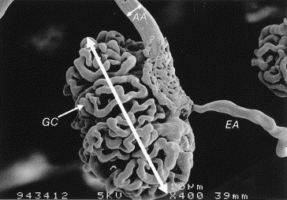
Renal Response to Ischemia: autoregulation
Prostaglandins dilate afferent arteriole
Angiotensin II constricts the efferent arteriole
Image from Annals of Thoracic Surgery, 65:993-8, April 1998
Notes:
Autoregulation can maintain GFR with SBP as low as 80. Glomerular capillary pressure regulated by resistences in afferent (incoming) and efferent (outgoing) arterioles. Drop in renal artery pressure leads to prostaglandin mediated drop in afferent glomerular arteriolar resistance which sustains glomerular capillary pressure, the driving force of filtration. Angiotensin II increases efferent glomerular arteriolar resistance.

Slide 21
Causes of Autoregulation Failure: NSAIDs
Prostaglandins dilate afferent arteriole
NSAIDS
Angiotensin II, Norepinephrine constrict the efferent arteriole unopposed
Image from Annals of Thoracic Surgery, 65:993-8, April 1998

Slide 22
Causes of Autoregulation Failure: sepsis, ↑ca, liver failure, calcineurin inhibitors, radiocontrast
sepsis, hypercalcemia, liver failure, calcineurin inhibitors, IV contrast lead to constriction of afferent arteriole
Angiotensin II, Norepinephrine constrict the efferent arteriole unopposed
Image from Annals of Thoracic Surgery, 65:993-8, April 1998

Slide 23
Causes of Autoregulation Failure: ACE-I or ARB
Prostaglandins dilate afferent arteriole
Angiotensin II constricts efferent arteriole
ACE-I or ARB
Image from Annals of Thoracic Surgery, 65:993-8, April 1998

Slide 24
In Summary: Normotensive Ischemic Acute Renal Failure
Increased renal susceptibility to modest reductions in perfusion pressure
Caused by failure to decrease afferent arteriolar resistance or failure to increase efferent arteriolar resistance

Slide 25
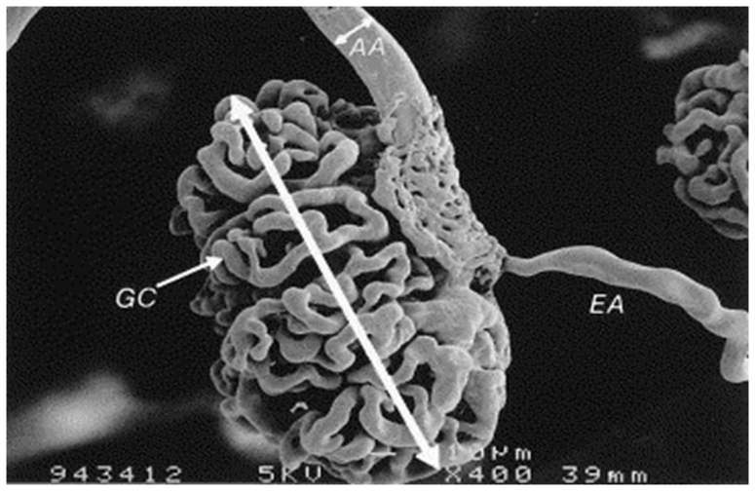
Factors Increasing Susceptibility to Renal Hypoperfusion:
Failure to Decrease Afferent Arteriolar Resistance
Afferent arteriolar constriction
  Sepsis
  Hypercalcemia
  Hepatorenal syndrome
  Cyclosporine or tacrolimus
  Radiocontrast agents
Structural changes in small arteries/arterioles
  Old age
  Atherosclerosis
  Chronic hypertension
  Chronic kidney disease
  Malignant hypertension
Reduction in vasodilatory prostaglandins
  NSAIDs
  COX-2 inhibitors

Slide 26
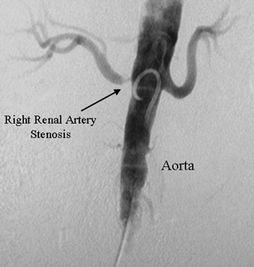

Factors Increasing Susceptibility to Renal Hypoperfusion
Failure to Constrict Efferent Arteriole:
ACE-I
ARB
Structural changes
Renal artery stenosis
Image from Annals of Thoracic Surgery, 65:993-8, April 1998
Image from VascularWeb.org

Slide 27
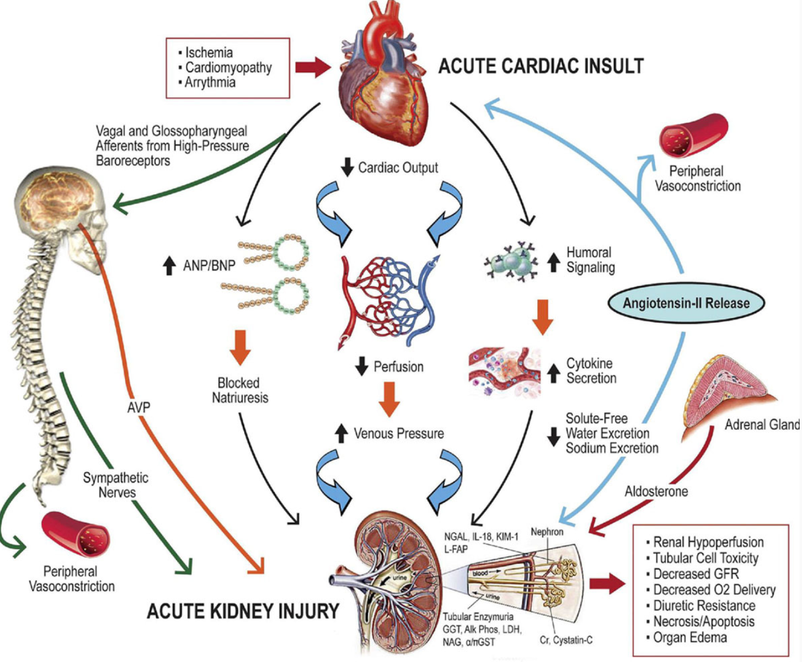
Other Causes of Prerenal State:
Cardiorenal Syndrome
Rangaswami J, Bhalla V, et al. Circulation 2019; 139 e840-e878.

Slide 28
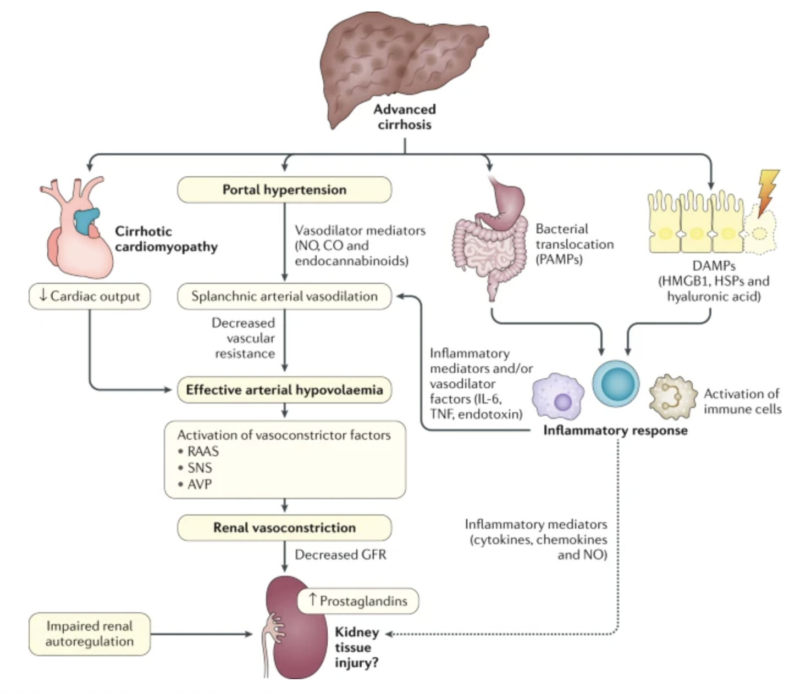
Other Causes of Prerenal State:
Cirrhosis
Ginès, P., Solà, E., Angeli, P. et al. Hepatorenal syndrome. Nat Rev Dis Primers 4, 23 (2018).
Notes:
Circulatory dysfunction is the key mechanism involved in the pathophysiology of hepatorenal syndrome (HRS). Patients with advanced cirrhosis present a marked splanchnic arterial vasodilation triggered by portal hypertension. Splanchnic vasodilation leads to a decreased systemic vascular resistance that, at this stage, cannot be compensated by cardiac output, and therefore, effective arterial hypovolaemia develops. Consequently, there is activation of endogenous vasoconstrictor systems. The intense activation of these systems leads to a marked kidney vasoconstriction, inducing a decrease in glomerular filtration rate (GFR) and the development of HRS. At this advanced stage of cirrhosis, evidence shows that there is a decrease in cardiac output, which may also contribute to the decrease in effective arterial blood volume. There is growing evidence suggesting that systemic inflammation also plays an important role in the pathophysiology of HRS. It is hypothesized that pathogen-associated molecular patterns (PAMPs) and damage-associated molecular patterns (DAMPs) deriving from bacterial translocation and from injured liver, respectively, may activate circulating innate immune cells, leading to the development of a marked inflammatory response. Inflammatory mediators would lead to further impairment of circulatory dysfunction and, eventually, could also cause direct kidney tissue damage, but this has not been demonstrated. Finally, local factors, such as impairment in kidney autoregulation, may also play a role. AVP, arginine vasopressin; CO, carbon monoxide; HMGB1, high-mobility group box 1; HSPs, heat shock proteins; NO, nitric oxide; RAAS, renin–angiotensin–aldosterone system; SNS, sympathetic nervous system; TNF, tumour necrosis factor.

Slide 29
When Autoregulation Fails…
Endogenous vasoconstrictors constrict afferent arterioles
↓
Reduced glomerular capillary pressure
↓
Reduced blood flow and perfusion to postglomerular capillary bed
↓
Tubular ischemia
↓
Acute tubular necrosis

Slide 30
Acute Tubular Necrosis: causes
Ischemic
    prolonged prerenal azotemia
    hypotension
    hypovolemic shock
    cardiopulmonary arrest
    cardiopulmonary bypass
Sepsis
Nephrotoxic
  drug-induced
    radiocontrast agents
    aminoglycosides
    amphotericin B
    cisplatinum
    acetaminophen
  pigment nephropathy
    hemoglobin
    myoglobin

Slide 31
Acute Tubular Necrosis: Contrast Induced Nephropathy
1-2 days after arterial contrast exposure
Usually peaks within 5 days
Usually non-oliguric
Cause: vasoconstriction + direct tubular toxicity
Prevention: IV hydration unless the patient is fluid overloaded
Bicarbonate likely no additional benefit

Slide 32
Risk of AKI from Venous Contrast
Multiple large studies including meta-analyses have not shown increased AKI from venous contrast
Risk of injury uncertain with GFR <30ml/min
American College of Radiology Guidelines recommend prophylactic IV isotonic fuids in patients with AKI or eGFR <30ml/min (when clinically appropriate i.e. not fluid overloaded)
Don’t delay venous contrast administration out of concern for renal injury – the best way to improve kidney function is a prompt accurate diagnosis

Slide 33
Acute Tubular Necrosis: Rhabdomyolysis
Causes:
  Trauma
  Heavy exercise
  Prolonged ischemia
  Statins, antipsychotics, ssri
Diagnosis: urinalysis with blood on dipstick but no RBCs on micro; high CK (>5000)
Treatment:
  IVF – normal saline with goal UOP 3ml/kg/hr

Slide 34
Pathophysiology of ATN:
Tubular Epithelial Cell Injury and Repair
Ischemia/ Reperfusion
Necrosis
Apoptosis
Normal Epithelium
Loss of polarity
Cell death
Differentiation & Reestablishment of polarity
Sloughing of viable and dead cells with luminal obstruction
Proliferation
Adhesion molecules
Migration , Dedifferentiation of Viable Cells
Na⁺/K⁺-ATPase

Slide 35
Acute Tubular Necrosis:
Clinical Presentation
Urine indices
  Urine volume
    may be oliguric or non-oliguric
  Isosthenuric urine concentration
    U_{Osm} ≅ 300 mmol/L
    specific gravity ≅ 1.010
  Evidence of renal sodium wasting
    U_{Na} > 40 mmol/L
    FE_{Na} > 0.02
  Urine sediment
    tubular epithelial cell casts
    Pigmented or “muddy brown” granular casts
  High NGAL

Slide 36
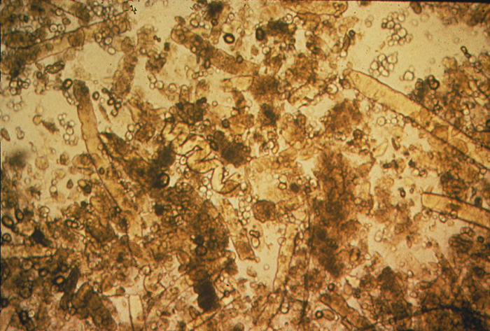
Pigmented Granular Casts
Notes:
Pigmented granular (“muddy brown”) casts are characteristic of acute tubular necrosis. Although the exact pathogenesis of cast formation is not known, the major component is Tamm-Horsfall glycoprotein, a strongly anionic macromolecule secreted by the ascending thick limb of Henle. Hyaline and waxy casts are also prominent in this particular urinary sediment.

Slide 37
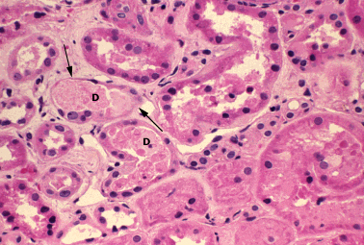
Acute Tubular Necrosis
focal loss of tubular epithelial cells (arrows)
partial occlusion of tubular lumens by cellular debris (D)

Slide 38
Fractional Excretion of Sodium
Enables us to determine the degree to which the tubules are functioning – i.e. capable of absorbing sodium
Etiologies of a fractional excretion of sodium < 0.01
  normal renal function
  prerenal azotemia
  hepatorenal syndrome
  early obstructive uropathy
  contrast nephropathy
  rhabdomyolysis
  acute glomerulonephritis

Slide 39
High Fractional Excretion of Sodium
High FENa simply means tubules cannot absorb sodium.
In ATN, the injured tubules cannot absorb sodium due
Patient can still be prerenal and may not have ATN.
  Diuretics (can check FEurea)
  Chronic kidney disease
  Preceding poluria leading to loss of corticomedullary gradient

Slide 40
Significance of the Fractional Excretion of Sodium: Prognosis
Low FeNa suggests that recovery can occur in hours to days
High FeNa (in the absence of diuretics or underlying CKD) suggests that recovery may be delayed – days to weeks after renal insult stops

Slide 41
Management Ischemic ARF
Identify and deal with risk factors promptly
Any BP on lower end of normal should be corrected
    Correction of hypovolemia
    Discontinuation of antihypertensives
    Discontinuation of other meds that lower blood pressure (narcotics)
Evaluate for occult infection
Stop NSAIDs
Prompt intervention can reverse ARF and prevent ATN

Slide 42
Acute Tubular Necrosis:
Treatment
Supportive therapy: avoid volume depletion, hypotension, nsaids, unnecessary anesthesia, surgery, or contrast
Adjust doses of renally excreted medications
Acute dialysis for:
  volume overload
  metabolic acidosis
  hyperkalemia
  uremic syndrome: pericarditis, encephalopathy

Slide 43
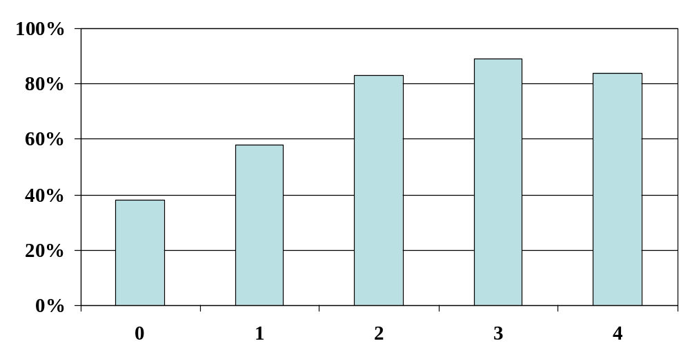
Mortality in Acute Tubular Necrosis
Number of Failed Non-Respiratory Organ Systems
Chertow et al: Arch Int Med 1995; 155:1505-1511

Slide 44
Acute Renal Failure and Sepsis
51% of patients with septic shock with positive blood cultures have ARF
Combination of ARF and sepsis is associated with 70% mortality
Arterial vasodilation mediated by nitric oxide predisposes patients to ARF
Metabolic acidosis and down-regulation of vasoactive hormone receptors leads to resistance to norepinephrine and angiogensin II

Slide 45
Intrinsic Renal Azotemia
ATN
Acute Interstitial Nephritis
Acute Glomerulonephritis

Slide 46
Acute Interstitial Nephritis
Acute renal failure due to lymphocytic infiltration of the interstitium
Classic triad of
  fever
  rash
  eosinophilia

Slide 47
Acute Interstitial Nephritis:
Clinical Presentation
History
  preceding illness or drug exposure
Physical examination
  fever
  rash
Serum Findings
  Eosinophilia
Urine findings
  non-nephrotic range proteinuria
  possibly hematuria
  sterile pyuria (WBC’s without infection)
  WBC casts
  eosinophiluria

Slide 48
Acute Interstitial Nephritis: causes
Drug-induced
  penicillins
  cephalosporins
  sulfonamides
  rifampin
  phenytoin
  furosemide
  NSAIDs
Malignancy
Idiopathic
Infection-related
  bacterial
  viral
  rickettsial
  tuberculosis
Systemic diseases
  SLE
  sarcoidosis
  Sjögren’s syndrome
  tubulointerstitial nephritis and uveitis

Slide 49
Acute Interstitial Nephritis:
Treatment
Discontinue offending drug
Treat underlying infection
Treat systemic illness
Glucocorticoid therapy may be used in patients who fail to respond to more conservative therapy

Slide 50
Rapidly Progressive Glomerulonephritis
Clinical manifestations:
  Macrohematuria
  Oliguria
  Edema
  or insidious onset: fatigue and edema
  With anti-GBM disease or pauci-immune glomerulonephritis (Granulomatosis with poyangiitis), may have pulmonary symptoms

Slide 51
Rapidly Progressive Glomerulonephritis:classifications
Type I: anti GBM disease
Type II: Immune complex
  IgA
  Infection-related GN
  Lupus nephritis
  Cryoglobulinemia
Type III: pauci-immune
  Usually ANCA positive, but can be negative

Slide 52
Post-Renal Failure:obstruction
Risk factors
  BPH
  Abdominal cancer
  Nephrolithiasis with baseline chronic kidney disease
  Abdominal compartment syndrome (maybe)
  Retroperitoneal fibrosis
Diagnosis
  Check bladder scan for post-void residual
  Renal ultrasound

Slide 53
CASES

Slide 54
Case 1
An 87-year old female nursing home resident has been admitted for altered mental status. Records from the nursing home state that she has been more withdrawn lately, not eating, but with no specific complaints.
PMH: HTN, arthritis, dementia, osteoarthritis occasional UTIs.
Meds: HCTZ, lisinopril, naprosyn prn
In ER: pt is awake and moaning, but otherwise noncommunicative.

Slide 55
Case 1…
PE:
VS afeb, 80/40, 120, 18, O2 sat 95% on room air
Dry mucus membranes
No JVD
CTA B
Tachy S1,S2
Abd soft, nontender, normal bowel sounds
No peripheral edema
UOP 5cc/hr
LABS
Sodium 148, K 4.4, Cl 104, CO2 18, BUN 40, Creatinine 1.5 (baseline 0.8)
LFTs normal
WBC 10, HCT 38, Plts 200
UA: sp grav 1.020, pH 6.0, tr protein, lg LE, + nitrites, 1-5 rbc, 20-30 wbc
Urine Sodium 40, creatinine 150
Fractional Excretion of Sodium (FENa) = (UNa x PCr) / (PNa x UCr) x 100
  = 0.3%
Urine eosinophils negative

Slide 56
Which of the following is the most likely diagnosis?
Prerenal acute renal failure
Ischemic acute tubular necrosis
Interstitial nephritis
ANCA-associated pauciimmune glomerulonephritis
Thrombotic microangiopathy

Slide 57
Which of the following is the most likely diagnosis?
Prerenal acute renal failure
Ischemic acute tubular necrosis
Interstitial nephritis
ANCA-associated pauciimmune glomerulonephritis
Thrombotic microangiopathy

Slide 58
How would you treat?
IV fluids
Hold bp meds and start vasopressors
Hold bp meds only
Diuretics

Slide 59
How would you treat?
IV fluids
Hold bp meds and start vasopressors
Hold bp meds only
Diuretics

Slide 60
Case 1 continued…
Hospital course: she is admitted to the ICU, given aggressive hydration and antibiotics for UTI. Over the next 2 days, her weight increases from 66kg to 72kg. BP 120/80, hr 88. She is still lethargic.
Sodium 143, BUN 35, Creatinine 2.6. UOP 0.
Urine Sodium 80, Urine creatinine 60
Fractional Excretion of Sodium (FENa) = (UNa x PCr) / (PNa x UCr) x 100
  = 2.4%
Urine eosinophils negative
Urine Culture >100,000 E. Coli

Slide 61
Now which of the following is the most likely diagnosis?
Prerenal acute renal failure
Ischemic acute tubular necrosis
Interstitial nephritis

Slide 62
Now which of the following is the most likely diagnosis?
Prerenal acute renal failure
Ischemic acute tubular necrosis
Interstitial nephritis

Slide 63
How would you treat?
Continue IV fluids
Start vasopressors
Diuretics
Dialysis
Stop the Zosyn that was started for her UTI.

Slide 64
How would you treat?
Continue IV fluids
Start vasopressors
Diuretics
Dialysis
Stop the Zosyn that was started for her UTI.

Slide 65
Indications for Dialysis
A – intractable Acidosis
E – Electrolyte disturbance
I – Ingestion/Intoxicants (methanol, ethylene glycol, lithium, aspirin)
O – intractable fluid Overload
U – Uremia (nausea, encephalopathy, pericarditis, bleeding)

Slide 66
Case 2
33-year-old woman with advanced cirrhosis secondary to hepatitis C is hospitalized for tense ascites and leg edema.
She undergoes therapeutic paracentesis with removal of 5 L of ascitic fluid and begins treatment with intravenous furosemide and oral spironolactone.
Over the next 3 days, she has a net diuresis of 4 kg during which the creatinine level increases from a baseline level of 0.8 to 1.6 mg/dL. Her urine output decreases to 280 mL/24 h.
On physical examination, blood pressure is 88/40 mm Hg. There is scleral icterus. Pulmonary examination reveals decreased breath sounds at lung bases. She has modest ascites and no edema.

Slide 67
Case 2...
Labs:
INR 2.7
Blood urea nitrogen 21 mg/dL
Creatinine 1.6 mg/dL
Sodium 118 meq/L
Potassium 3.4 meq/L
Chloride 83 meq/L
Bicarbonate 26 meq/L
Total bilirubin 25 mg/dL
Albumin 2.1 g/dL (23 g/L)
Urinalysis Several granular and epithelial casts/hpf
Urine sodium 12 meq/L
Fractional Excretion of Sodium 0.8%

Slide 68
Case 2…
Hospital course: Patient was given a fluid challenge with IV albumin. She remains oliguric with urine sodium 16, and FENa 0.9%.
What is the most likely diagnosis?
Prerenal azotemia
Hepatorenal syndrome
Acute Tubular Necrosis
C3 glomerulonephritis
Infection-related glomerulonephritis

Slide 69
Case 2…
Hospital course: Patient was given a fluid challenge with IV albumin. She remains oliguric with urine sodium 16, and FENa 0.9%.
What is the most likely diagnosis?
Prerenal azotemia
Hepatorenal syndrome
Acute Tubular Necrosis
C3 Glomerulonephritis
Infection related glomerulonephritis

Slide 70
Large volume paracentesis
>5L volume removal carries greater risk of hemodynamic compromise and renal ischemia
Albumin solution 6-8g/L of fluid removed is recommended

Slide 71
Hepatorenal syndrome: criteria
Presence of liver disease
AKI (creat increase 0.3 or more within 48hrs)
Absence of other cause of renal failure
Bland urine sediment
  Urine RBCs <50/hpf
  Urine Protein <500mg/day
Lack of improvement after volume expansion with IV albumin (1g/kg of body weight per day – up to 100g/day) for 2 days

Slide 72
CASE 3
A 56 year old man is admitted to the hospital with shortness of breath and lower extremity edema.
PMH: HTN, coronary artery disease s/p stents, diabetes mellitus, benign prostatic hypertrophy
PE: afebrile, BP 75/45, HR 100, RR 28, Bibasilar rales on lung exam, S1, S2, and S3 gallop, point of maximal impulse laterally displaced, jugular venous pressure is 10cm H20, abdomen is normal, 2+ lower extremity edema.
LABS: sodium 125, potassium 3.8, chloride 89, bicarbonate 25, blood urea nitrogen 46, creatinine 2.4, albumin 3.0, urinalysis 1.020/5.0/1+ protein/no blood, urine protein to creatinine ratio 1.1g/g.
Urine sodium 14, FENa 0.6%.
CXR: bilateral infiltrates, cardiomegaly

Slide 73
Case 3…
What is the most likely diagnosis for his acute renal failure?
A. Prerenal azotemia
B. Acute Tubular Necrosis
C. Acute Interstitial Nephritis
D. ANCA-associated pauci immune glomerulonephritis

Slide 74
Case 3…
What is the most likely diagnosis for his acute renal failure?
A. Prerenal azotemia
B. Acute Tubular Necrosis
C. Acute Interstitial Nephritis
D. ANCA-associated pauci immune glomerulonephritis

Slide 75
Summary:take-home points
Careful history
  Look for factors increasing renal susceptibility to ischemia
Physical exam cues
  Careful investigation of blood pressure trends over the days leading up to the insult.
  Consider causes of normotensive ischemic renal failure
Lab data:
  BUN:Cr ratio
  Urine sodium & creatinine (FENa)
  Urinalysis
  Urine eosinophils

Slide 76
Summary:take-home points (cont.)
Pre-renal does not always mean volume depleted, hemodynamic compromise is a frequent culprit (CHF, too many bp meds, sepsis)
Consider causes of normotensive ischemic renal failure
If no response to volume/bp correction, check renal ultrasound for obstruction.
If there is an active urine sediment, may need biopsy. Low-threshhold for expedient biopsy if renal function deteriorating.

Slide 77
Summary:take-home points (cont.)
In septic shock:
  Early aggressive intervention with pressors
  Avoid significant volume overload; initiate dialysis or CRRT early if indications

