Slide 1


VA Wards Orientation
2023-2024

Slide 2

Welcome to the VA
Thank you for caring for our Veterans!
This can be a challenging month, so take care of each other and help your team whenever possible
Take care of yourself on your days off – do something fun and get some rest!
Get to know the system and reach out to your resources:
  Attendings
  Chief Residents
  Case Managers/Social Workers
  Use Microsoft Teams to communicate with these people
It's a team effort between all members of the team including attendings and residents and important to collaborate.

Slide 3
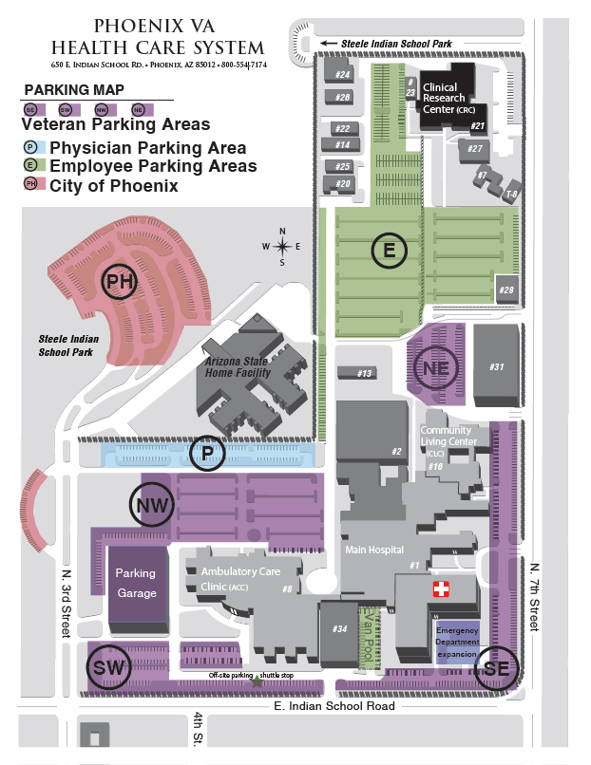
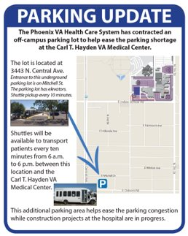

First things first.... Parking!
Don't use the garage!
Park in the area marked by the red box
  Cannot park along west fence
  On the weekends – okay to park in purple areas
There is an off-campus
lot with a shuttle service
  Usually not needed on
  wards

Slide 4
Team Rooms
Key​ | Team​ | Floor | Room​ | Ext.​ | Code​
​ | Blue Team​ | 4th | 4315​ | 6133​ | 7651​
​ | Yellow Team​ | 4th | D432​ | 1003​ | 1933​
​ | Orange Team​ | 4th | C433​ | 5535​ | 1933​
​ | Red Team​ | 2nd | 2315​ | 7351​ | 1933​
​ | White Team​ | 4th | D446​ | 7039​ | 2435​
​ | Green Team​ | 4th | D448​ | 6929​ | 1933​
​ | MICU​ | 3rd | 3C​ | 7448​ | 1120*​
​ | Night Float​ | 4th | D441​ | 6404​ | 6587​
​ | Chief Room​ | 4th | D406​ | 5200​ | 1933​
​ | Physician Dining​ | 1st | 1137​ | ​ | 1137​
​ | Classroom​ | 4th | C435​ | ​ | 7333​
Chief Office
Master Code​​ | 2435​​
Notes:
*Changed as of 2023-2024 Academic year

Slide 5
Team Structure
3 person teams (1 senior, 2 interns)
Goal census 13-15 patients per team (ACGME cap is 20 patients)
Other team members:
  Attending
  Medical Students
  Clinical Pharmacist
  Case Manager
  Social Worker
  Utilization Manager

Slide 6
Daily Workflow
6:00am: Sign Out in NF team room – please be on time!
  Write down new patients' names and last 4 SSN to add to your list
  Change inpatient team in CPRS – Call HUC to add to your team's list
  Post new admits to your inpatient team's Microsoft Teams chat for your attending/CM team
6:00am – 8:00am: Pre-rounds
  Triage SICK patients then NEW ADMITS then rest of the list
  Check telemetry reports – located in Teams Channel or at nursing station
  I/Os are in the paper chart outside patient room
8:00am – 11:00am: Team Rounds
  Interdisciplinary huddle in Team room (CM, SW, UM); time varies for each team
12:15pm –1:00pm: Noon Conference M/W/Th
1:00pm – 5:00pm: Afternoon tasks
  Run the list multiple times, admit new patients, update families, prep DC summaries, teaching time
5:00pm*: Sign out to NF team (*long call team - 5:30PM earliest sign out)
  Print A/B list and use IPASS

Slide 7
Microsoft Teams
Primary means for communication
New admits will be posted in your inpatient team's channel
Post new admits and anticipated discharges to your team's channel every morning
  This helps with CM, SW, UM, Pharmacy, and attending workflow
You may need to be added to the Inpatient Teams channel – let the chiefs know if you don't have access

Slide 8
Interdisciplinary Team Rounds
CM, SW, and UM meeting with all teams in person in the morning
  Red Team: 9:00-9:10AM
  Blue Team: 9:10-9:20AM
  Orange Team: 9:20-9:30AM
  White Team: 9:30-9:40AM
  Green Team: 9:40-9:50AM
  Times above estimates and subject to change
Change made due to team fatigue and thanks to feedback from the residents

Slide 9
Interdisciplinary Team Rounds
Every weekday, 5 minute time slot
Phone number is +1 872-701-0185, meeting ID: 685038335#
  1115-1120 Red
  1120-1125 Orange
  1125-1130 Green
  1130-1135 Blue
  1135-1140 White
  1140-1145 Yellow
  1145-1200 Compensatory time

Slide 10
Conferences
Noon Conference/Resident Report 12:15pm M/W/Th in C435
AHD 9:15am Tuesdays
  Leave the VA by 8:45am
  Reset your status to appear offline and with the following message:
    "I am in mandatory resident lectures from 9:15am until ~1:15pm and am unable to respond to messages & calls during this time. Please contact my attending @AttendingName for all patient-related needs/questions."
  Give your pagers to your attending!

Slide 11
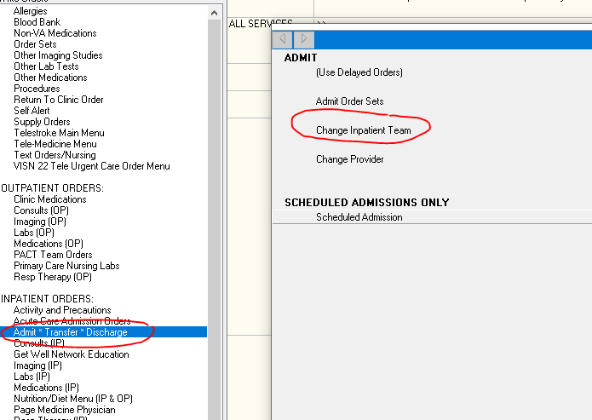
Admissions
Team is responsible for calling the ED to triage new admits
Update the admission order with resident/intern contact
  Use the ”Change Inpatient Team” order (do not change or re-order the admission order)
Use the Medical History & Physical template in CPRS – do not use any other note title
Document CODE status and MPOA on every patient in the H&P and Life-Sustaining Treatment Discussion Note
Overnight admissions/transfers:
  Write a accept note on all service transfers (including from the night team)
  If H&P written after midnight, okay to write addendum to the note but document your own exam & changes to the plan

Slide 12
Discharges
Review medication changes with clinical pharmacist
  Update medications tab & address any remote/non-VA medications
  Discontinue medications patient is no longer taking
  When discharging to a SNF, copy active med list and paste it into the discharge instructions document
    The medications in the MEDS tab will NOT be accurate!
Include follow-up instructions
  Any upcoming appointments, labs, imaging, etc.
  What should be addressed at follow-up appointments
  Wound care and post-procedure care where appropriate
  Be as detailed as possible (i.e., you should receive a call to schedule an appointment with X, but if you don't receive a call within 1 week, call the clinic...)

Slide 13
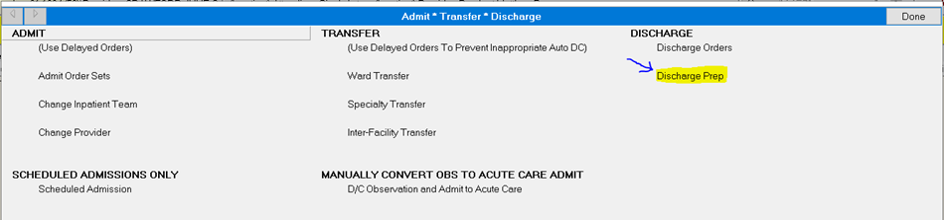
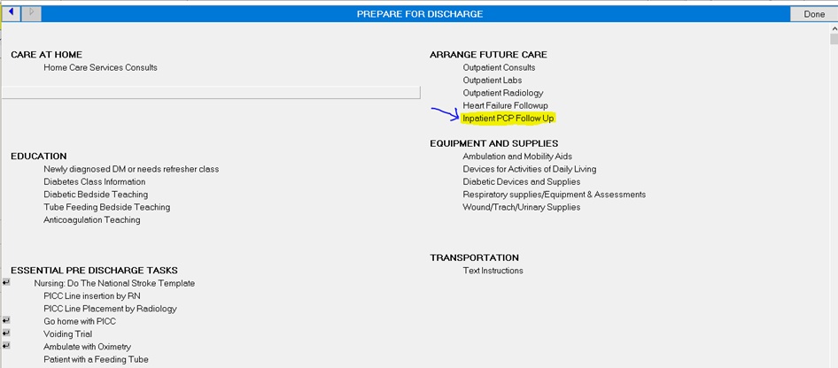
PCP Follow Up
The order boilerplate will automatically appear when completing the Discharge Instructions document if a Return to PCP is indicated in the document
It can also be found on the Admit*Transfer*Discharge Order set

Slide 14
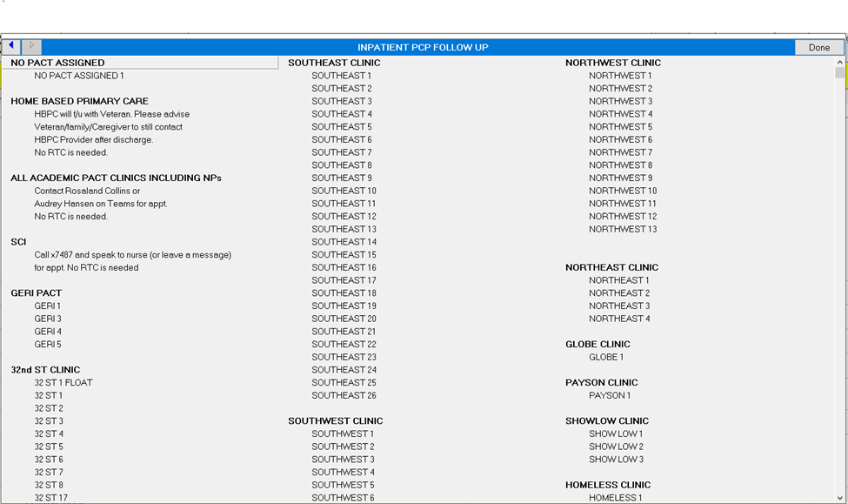
PCP Follow Up
Look at the patient information at the top of the page in CPRS to identify the appropriate Primary Care team
Select the appropriate PC team and you will be prompted to place a Return to Clinic Order

Slide 15
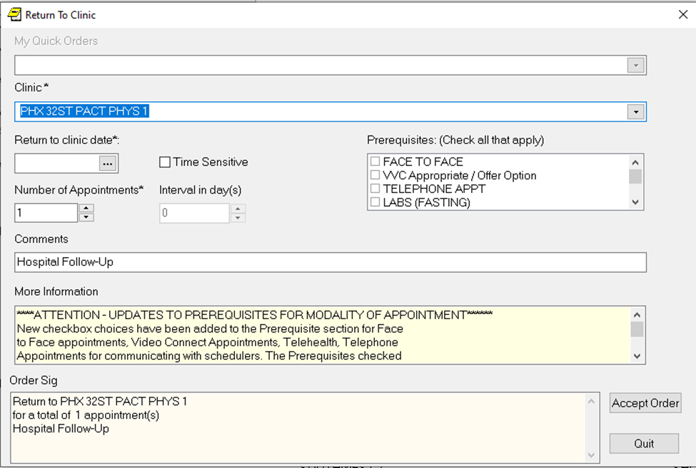
PCP Follow Up – Return to Clinic Order
Select the requested date for RTC and select the appropriate type of visit you are requesting
Consider Face to Face and VVC (video) if appropriate

Slide 16
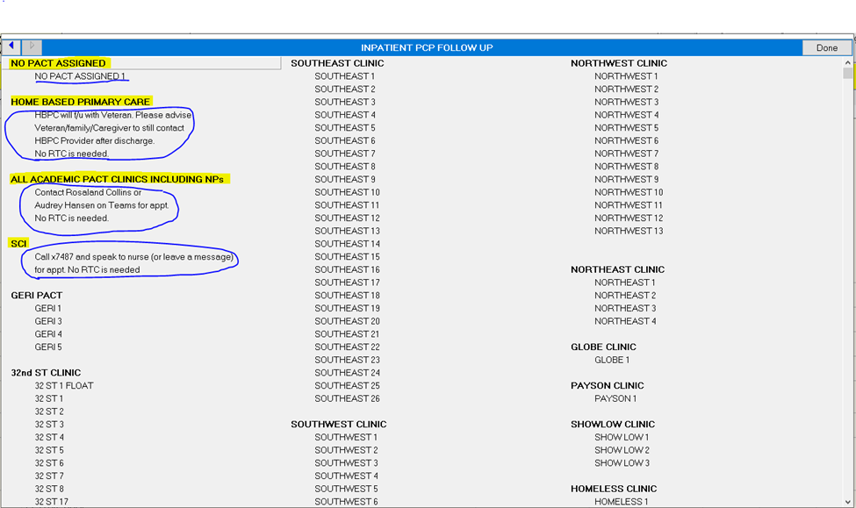
PCP Follow Up – Academic PACT Team
Please note: PC32ST-ACADEMICTEAM is NOT the same as the other numbered 32nd Street Clinics. This is NOT 32 ST 3.
Veterans enrolled in HBPC, APACT, and SCI clinics do NOT need a RTC order. Instead, follow the directions on the order set.
Use the No PACT Assigned RTC order for any Veteran who does NOT have a PCP and needs hospital follow-up. This is not the appropriate order for Veterans who want to change their PCP. They need to communicate that request to their PACT team.

Slide 17
Discharge Summaries
Discharge Summaries – a team effort (interns & residents should help)
  Use the Medicine Discharge Summary Template in CPRS
  Must be completed within 48 hours
  Do NOT abbreviate the discharge diagnoses
  Discharge medications: list that is imported into the system comes from the data that is located in the MEDS tab; this list will NOT be accurate when the patient is transferred to another hospital or discharged to a CNH. Need to copy/paste med list from D/C instructions.
  Don't start discharge summaries until med rec is complete and all orders done. If starting early start in OneNote or Word Doc.
  Submit for verification
  Will show up again in your inbox 1-2 days => review and edit but save without signature and let attending know when summary is ready to be signed

Slide 18
Call Schedule
Cycle Day​ | Weekday​ | Weekend/Holiday​
Post Call | 4 service transfers until 12 pm​ | No Patients/Service Transfers ​
Short Call 1​ | 4+1 admissions until 3:30 pm​ | 4+1 admissions until 12 pm​
Short Call 2​ | 4+1 admissions until 3:30 pm​ | 4+1 admissions until 12 pm​
Short Call 3​ | 4+1 admissions until 3:30 pm​ | 4+1 admissions until 12 pm​
Long Call​ | 4+1 admissions until 5:30 pm​ | 4+1 admissions until 5:30 pm​
Service Transfers: MICU transfers and overnight admissions which have H&Ps already written (i.e., if you get a new admit around 5:50-6am, they are counted as new admissions
4+1 = up to 4 new admissions + 1 service transfer. Service transfers can fill a spot of a new admission.
Long Call Days: Open for admissions all day. Ideally, no more than 2 patients after 4PM and no more than 1 patient after 5PM.
Weekend Signout: sign out to long call team no earlier than 12pm

Slide 19
Weekend Call Team
Takes new admissions/transfers until 5:30pm
Non-call teams start signing out as early as 12pm
  Non-call teams keep pagers on until 5pm
Interns hold the night intern A/B pagers during the day
Signout A/B lists to NF team at 5pm

Slide 20
Weekend Non-Call Team Expectations
Sign out to the call team no earlier than 12pm once all clinical work is completed
Check in with attending prior to leaving
Set Microsoft Teams status to show you are away and to direct any questions/concerns to the appropriate cross cover pager which will be held by the call team
Unlike at Banner, residents will not be expected to handle patient care items at home (assuming all work has been completed prior to leaving)
The expectation is to keep personal pagers on (as at Banner) but to reach out to the call team if any items need to be addressed

Slide 21
Duty Hours
ACGME Rules state a maximum of 80 hr/week averaged over a 4-week period
Log your duty hours in New Innovations every week (we check on Tuesdays)
If you feel you will exceed duty hours (i.e., going over 80 hours more than 1 week in the month) please reach out to the chiefs

Slide 22
Federal Holidays
July 4th | Independence Day
September 4th | Labor Day
October 9th | Indigenous People's Day
November 11th | Veteran's Day
November 23rd | Thanksgiving
December 25th | Christmas Day (observed)
January 1st | New Year's Day
January 15th | Martin Luther King Day
February 19th | Washington's Birthday (President's Day)
May 27th | Memorial Day
June 19th | Juneteenth National Independence Day
11 Federal Holidays
Treated like weekend day schedule

Slide 23
Emergent Transfers
Notify your attending immediately if you think you have an emergent/urgent transfer need (i.e., STEMI, STROKE, emergent surgical need)
HOT PAGER: 602-779-1013
Urgent Transfers: Flow sheet in team room
Emergent Transfers:
  Can transfer to St. Joe's ED with accepting ED physician (don’t need hospitalist) for emergent transfers only

Slide 24
Emergencies – Rapids and Codes
To call an emergency: x2222
Call Team Residents go to RRT for:
  ALL FLOORS of Main Hospital including the basement (Building 1)
If no ED provider present at the rapid or code call team will run the code.
If ED provider shows up to rapid or code then they can step in if necessary and call team can be dismissed at that time
ICU team goes to Codes
If your patient go to the rapid or code
If warranted put on PPE before entering the room
Write a Rapid Response Provider Note

Slide 25
Stroke Code Activation
Call x2222 to activate code stroke
  RRT, ICU, Lab, Radiology will respond
Enter Acute Ischemic Stroke Orders (in order sets)
Order STAT CT Head
Initiate Tele-Stroke consult via iPad call 844.488.NTSP xde (RNs should bring iPad to bedside)
  Have patient identifiers, background info ready and consider NIH stroke scale (or do with TeleStroke provider)
  IF needed, use Amion login "pava telestroke" for direct backup numbers
  Initiate call to TeleStroke provider while patient at CT
Patient comes back to room after CTH (stay near the room while at CT)
Telestroke Neurologist will determine if tPA given
  tPA mixed by bedside RN
  If tPA given, then transfer pt to ICU, discuss with Neurologist whether pt should be transferred to Barrow's
Telestroke Process Video for more info: Telestroke Brief Provider Updates 2023 Final Share.mp4 (sharepoint.com)

Slide 26
PPE & Precautions
Wash hands when entering/exiting a patient's room
Wear PAPR for all airborne precautions
  Talk to the chiefs if you need a PAPR mask or PAPR training
Okay to wear N95 as a face cover if you prefer on the wards, but not adequate for airborne precautions; Need PAPR for all airborne precautions
Isolation Precautions:
  Infection Control or ID need to clear the patient before discontinuing precautions
Notes:
Effective immediately, masking continues to be required for staff, Veterans, and visitors while in the high-risk areas listed below, including waiting areas:
Transplant units
Dialysis
Chemotherapy units
ED & urgent care
Open Bay Medical ICUs
SCI and CLC (staff and visitors only)
Staff may remove masks in these high-risk areas only under the following circumstances:
they are not in a patient room;
they are not within six feet of a Veteran in a congregate area (e.g., shared meals in CLC); or
they are not within six feet of a patient in an open treatment area/room.
Masking also continues to be required:
for those with a suspected or confirmed COVID-19 infection or other viral respiratory infection;
for VA staff during clinical encounters when requested by a Veteran, caregiver or family member; or
where local leadership warrants continued masking is required.
Masking is no longer universally required in the following locations:
Acute inpatient medical/surgical units
Acute inpatient mental health units
Intensive care units with closed rooms
Clinical areas where aerosol generating procedures are performed
Laboratories collecting or handling specimens from known or suspected COVID-19 patients (e.g., areas where staff are manipulating cultures from known or suspected COVID-19 patients)
Congregate settings and bedded residential settings (e.g., blind rehab, residential mental health, homeless shelters)
Outpatient areas where a significant proportion of patients have high-risk for complication

Slide 27
PAPR Training
Prerequisites
  Occupational Health Form
  TMS Training Module (Search for VA 9484) and email certificate to scot.forler@va.gov
Class to be scheduled by chief

Slide 28
CPRS Tips & Tricks
Clear out alerts DAILY
To quickly reformat paragraph – highlight text, right click, and click "Reformat Paragraph"
Booster App – create dot phrases for CPRS – Process of how to in three slides
Write delayed orders for:
  Post-op patients
  ICU patients (downgrade or upgrade)
  Transitioning to/from cardiac step-down
  Admits from ED
Restraints are initiated through initiate restraints note, otherwise order is not placed

Slide 29
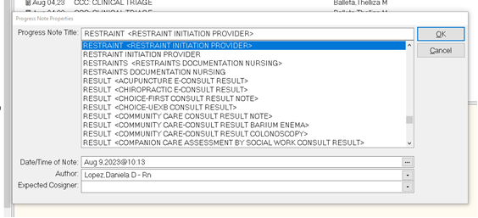
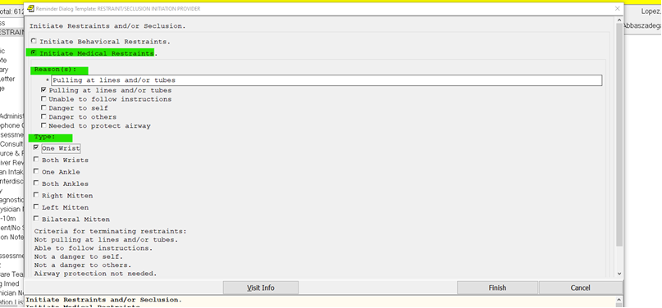
Restraints Orders
To initiate restraint order you have to start by writing a note
Click on New Note
Progress Note Title is Restraint Initiation Provider
Only use medical restraints for inpatient wards

Slide 30
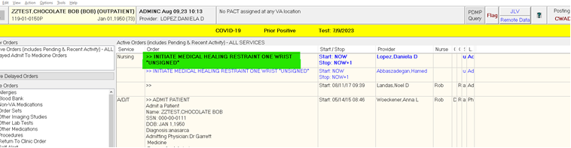
Restraints Orders

Slide 31
Booster App
CPRS Booster training video: https://web.microsoftstream.com/video/c935ad80-37dc-4155-9126-3446c345ca32?channelId=1527ec07-e93e-4321-996e-336cfb24fdbb
Dot Phrases, the Basics: https://web.microsoftstream.com/video/a2807765-eb8d-4a31-a742-88b7407d2f1a
Dot Phrases Demo: https://web.microsoftstream.com/video/27f8307a-8d02-41ed-87d8-e4961c21ca6a

Slide 32
How to get to the Booster App
Go to VA_Shortcuts on the Desktop.
Click on PHO Shortcuts
Click on CPRS Booster

Slide 33
AMA Policy
Decision-Making Capacity:
  If a patient wants to leave AMA and does not have medical decision making capacity, you cannot keep them against their will if they do not have a surrogate decision maker to require them to stay AND if it is not a medical emergency
    Examples:
      Patient with acute delirium = medical emergency --> cannot leave AMA
      Patient with dementia who is medically stable and awaiting placement, without surrogate decision maker --> cannot hold in hospital
  Ultimately it is your attending (day or night) who will have to make this decision and so if any questions/concerns about a patient leaving AMA please contact them ASAP

Slide 34
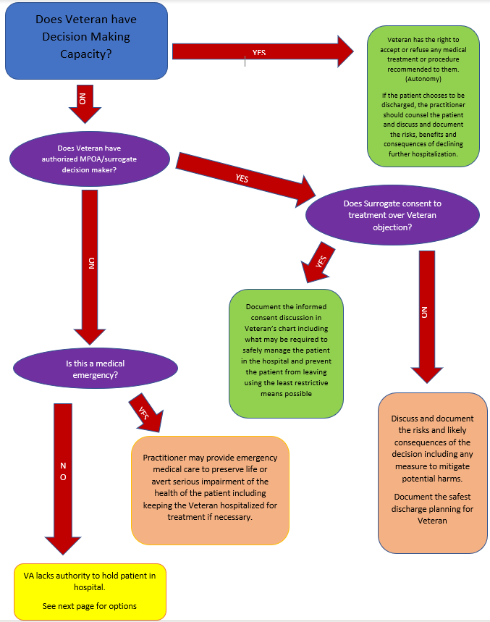

Slide 35
Tobacco/Substance Use Screening
Must ask if patient uses Tobacco/ETOH/Substances - this is a quality measure!
System prompts (don't ignore these!)
  Order nicotine replacement if positive for tobacco
  Offer Tobacco cessation clinic – document if accepts or declines
  SAC clinic referral if positive for ETOH or substance use

Slide 36
PDMP Querry
When discharging a patient with opioids, the attending must click the PDMP Querry button at the top of CPRS to check opioid prescribing tool – please remind them to do this

Slide 37
Incident Reporting
To report disruptive patient or staff behavior, go to https://cfm.vssc.med.va.gov/dbr/main.cfm => Fill out the form
  Ask chiefs if having trouble or need to discuss incident further

Slide 38
HIV Patients
ID wants to know when patients with HIV are admitted to improve continuity of care
Does not need to be a formal consult – can Teams message the attending on call

Slide 39
Inpatient EEGs
As of 3/24/23, we no longer have an EEG tech for inpatient our outpatient studies. The VA is working to fill this role.
For the time being, if you feel an EEG is indicated, please discuss the case with the on-call neurologist, who will determine whether the study is needed. If so, the patient will need to be transferred to another hospital.

Slide 40
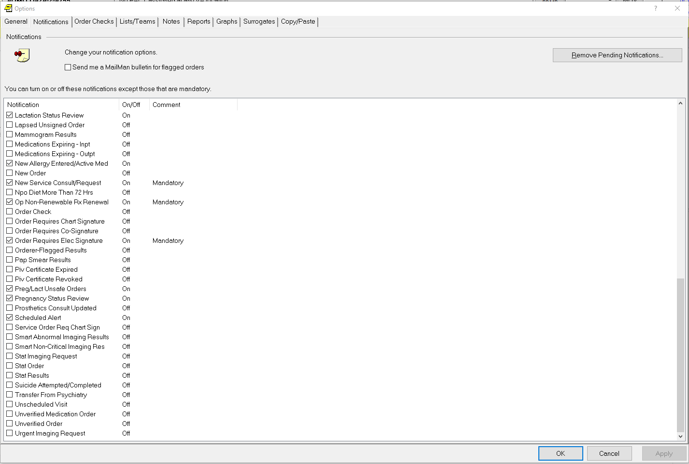
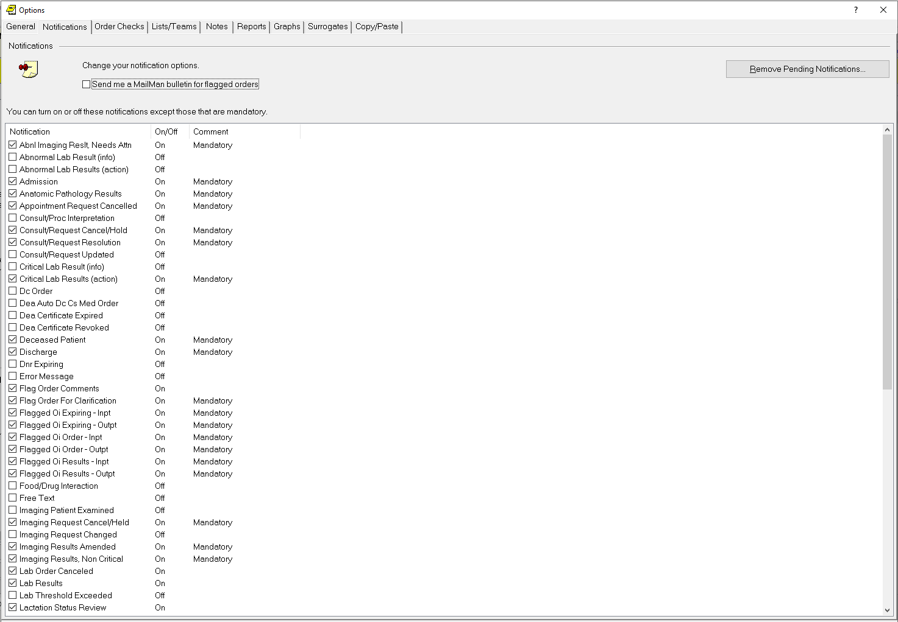
Setting Notification Preferences in CPRS
Notes:
Go to Tools then Options then Notifications. Once there you can uncheck any field that does not say mandatory by it to reduce alert fatigue

Slide 41
Remote Access
New process which started September 2023 where residents granted access by admin
As of now, residents are still not expected to do any work remotely.
Card readers will be checked out to the residents at each orientation for those who have not received one and need one
This process will allow for residents to maintain VA access remotely and to clear outstanding alerts that have not been assigned to a surrogate
For more information and any other questions reach out to the traditional VA chief on duty at the time

Slide 42
Communication Tips
Interact with your care team (SW, CM, PT/OT, etc) to optimize plans for your patient’s discharge
  Don’t delay patient care to wait for the huddle
  Communicate with your patients AND their families every day
Call all consults! Giving a verbal report regarding the consult will help minimize confusion and avoid any missed consults. Remember to see the patient before placing a consult.

Slide 43
General Advice
This is a busy, challenging month
  Take care of yourselves and be supportive of each other
  Be respectful of everyone
  Talk to us if you feel like you are struggling – we are here to help!
Work hard and learn lots of new things!
Quality Improvement and Patient Safety Chief: Ahsan Kamal (402) 570-2446
Banner Chiefs that rotate at the VA:
  Kaelin Bernier (480) 688-1835
  Tara Lanzendorf (406) 451-1914
  Pierce Lewien (720) 431-5019
  Aishwarya Puri (480) 330-4446

