Slide 1
THIS IS THE NAME OF ONE OF THE ITEMS YOU NEED TO ORDER WHEN DISCHARGING SOMEONE WITH INSULIN FOR THE FIRST TIME
Gotta Send 'Em Home · $200

Slide 2
Ordering insulin at discharge is more than just insulin Pens or vials with pen needles or syringes respectively Glucometer for new diabetics Test strips, lancets, lancet device, alcohol pads

Slide 3
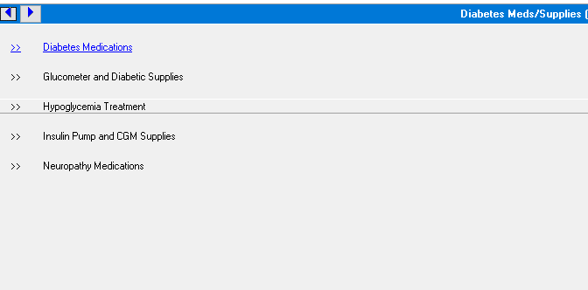
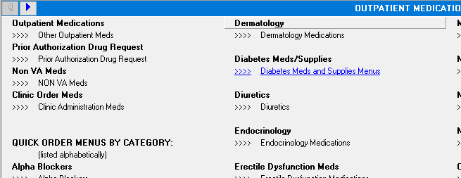
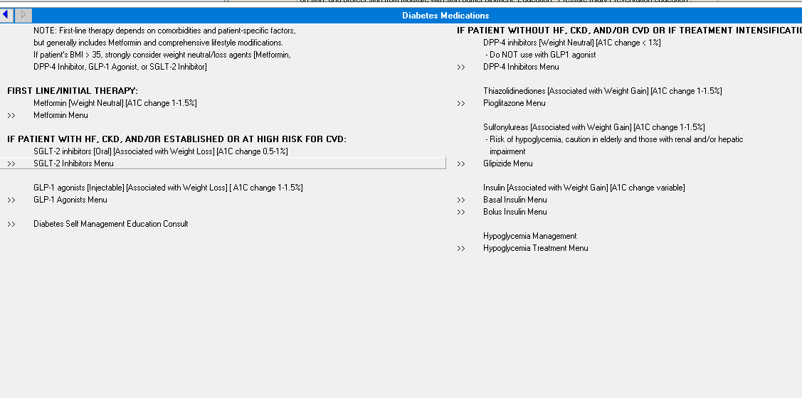

Slide 4
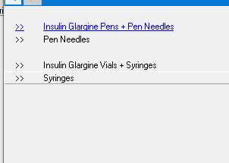
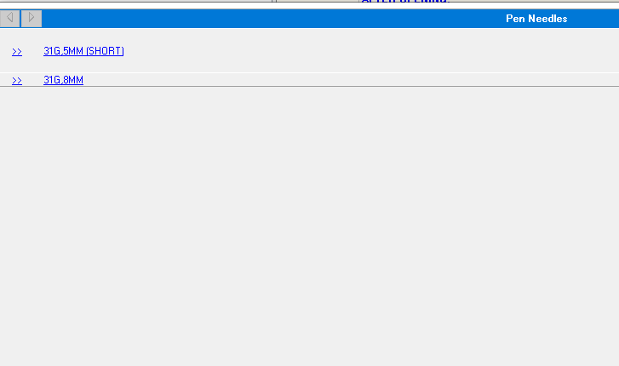
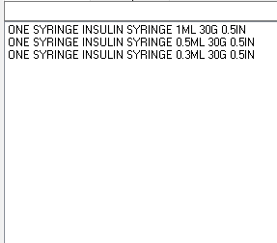

Slide 6
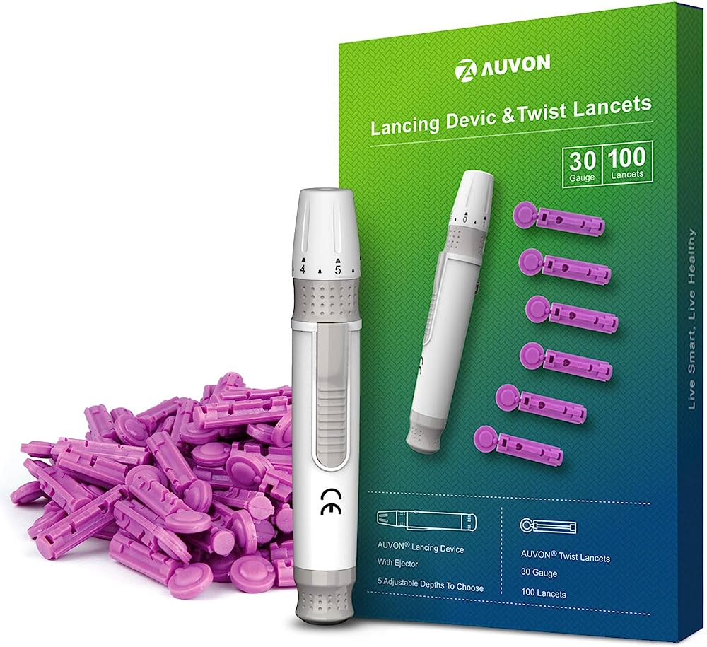
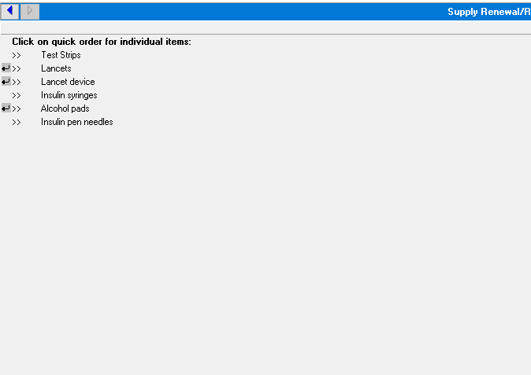
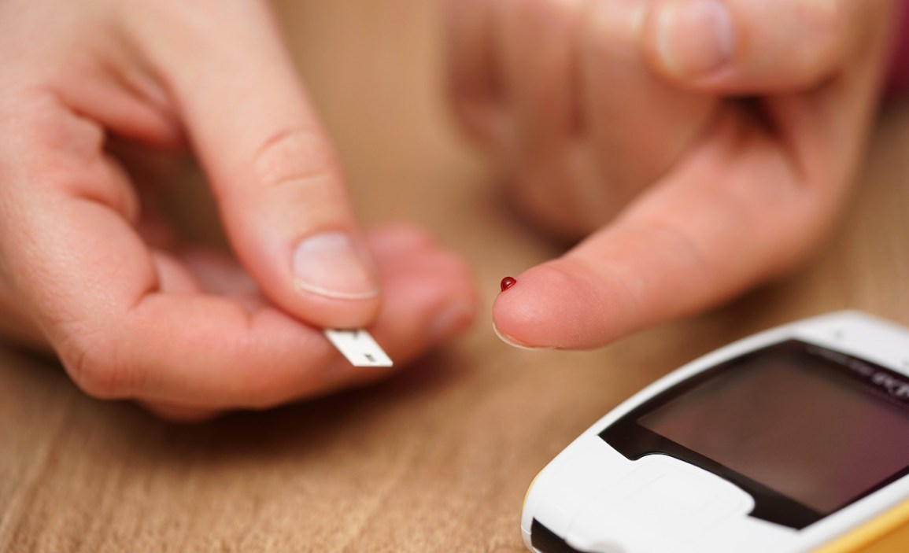

Slide 7
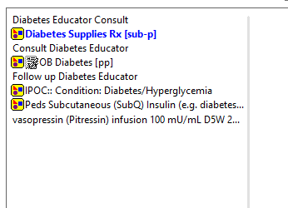

Slide 8
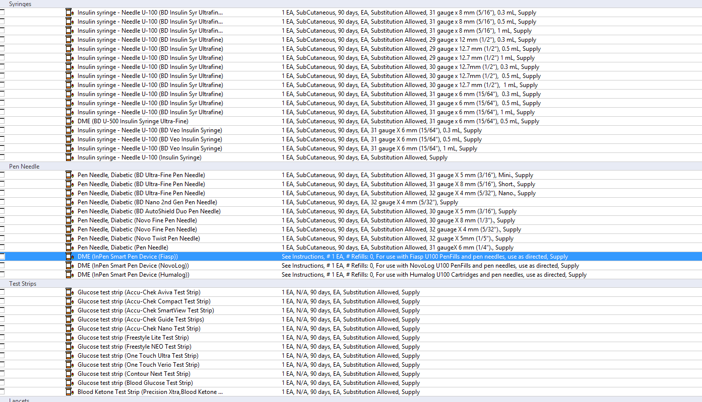

Slide 9
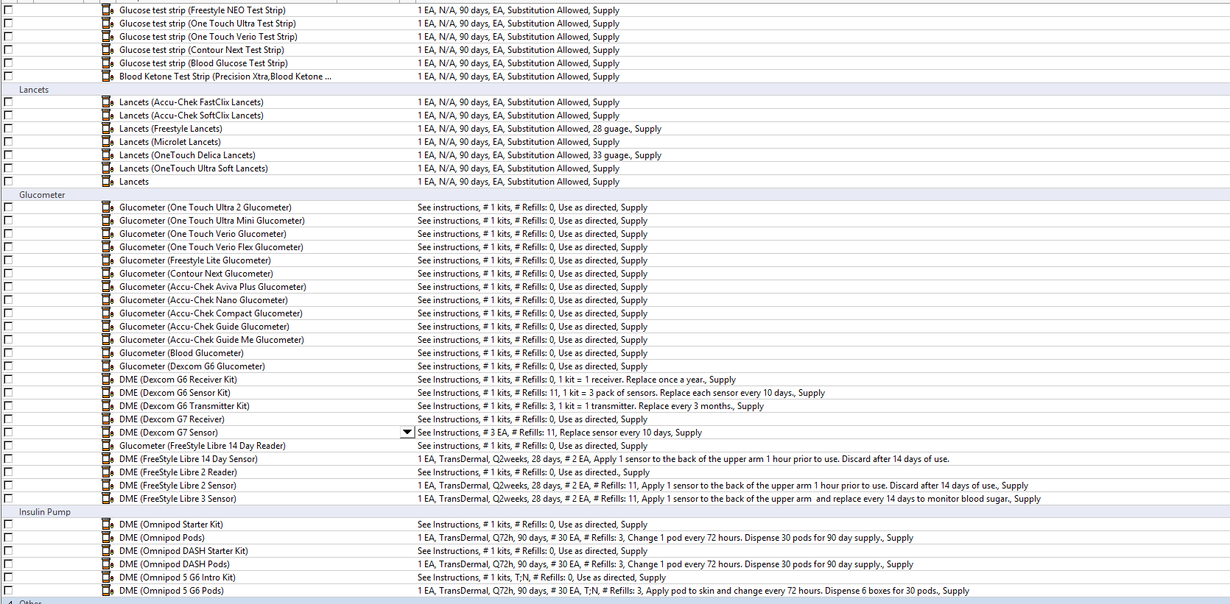

Slide 10
If ordering pens, needles short the better (Longer may only be efficacious if injecting a larger quantity but even then it’s more painful and run the risk of less compliance)
If ordering vials, syringe size guidance 0.3 mL syringe for less than 30U of insulin 0.5 mL syringe 30U-50U insulin 1.0 mL syringe >50U of insulin

Slide 11
THIS IS ONE OF THE SCENARIOS BESIDES MME CUTOFF WHERE YOU SHOULD PRESCRIBE NALOXONE ON DISCHARGE
Gotta Send 'Em Home · $400

Slide 12
Any patient diagnosed with COPD, OSA, reduced kidney or liver function or any other medical conditions that may increase their risk of overdose regardless of dose Any co-prescription of opiates and benzos Receiving medication for opioid use disorder such as methadone, buprenorphine, or naltrexone History of overdose Using illegal drugs including those purchased “on the street” Age 65 or older with non-opioid substance use disorder, report excessive alcohol use, or have a mental health disorder History of opiate use and were released from jail or prison or other controlled settings where opiates may be prevalent

Slide 13
THIS IS ONE OF THE ITEMS OTHER THAN FOLEY CATH THAT YOU SHOULD ORDER ON DISCHARGE
Gotta Send 'Em Home · $600

Slide 14
If ordering straight cath normally just two catheters come from in 14-18 Fr size One cath set Leg bag Urinary drainage bag Latex gloves Urinal Alcohol pads

Slide 15
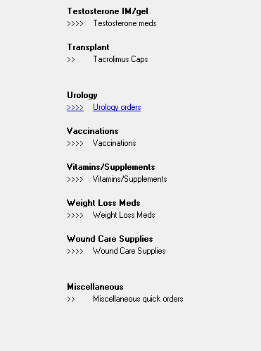
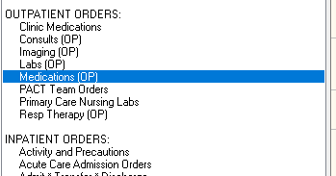

Slide 16
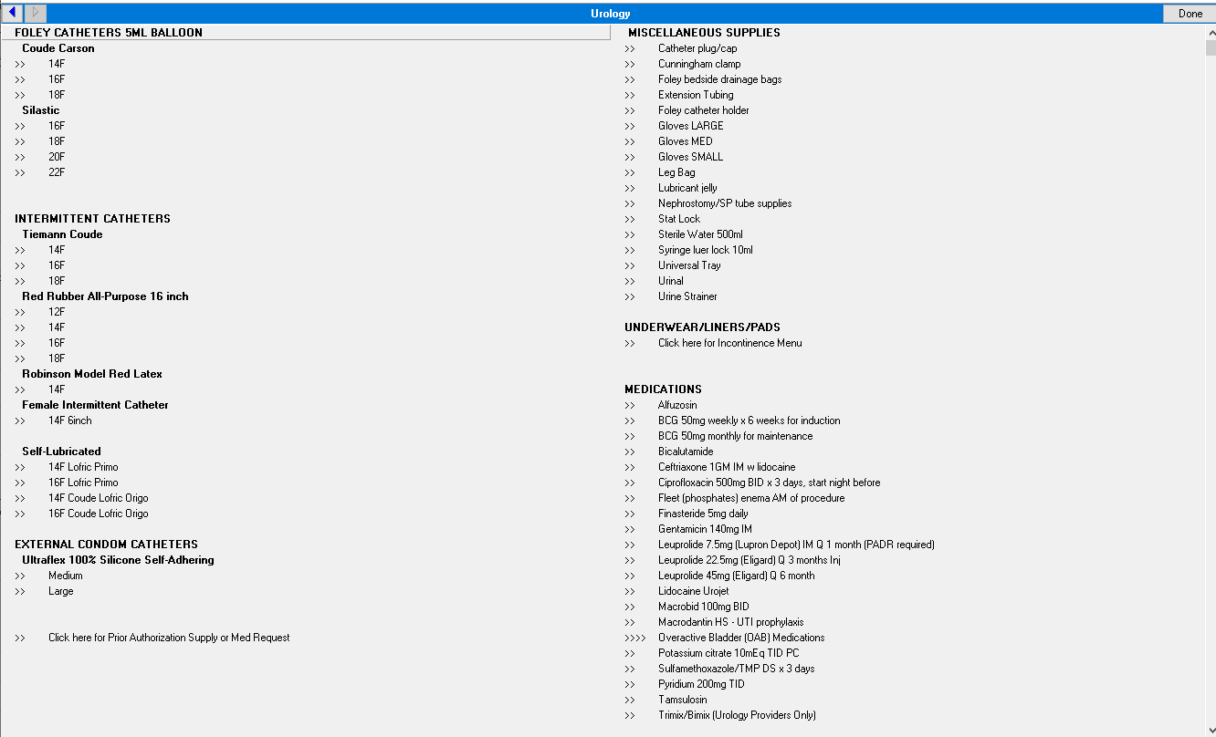

Slide 17
THIS IS ONE OF THE MEDICATIONS THAT NEED A PADR PRIOR TO DISCHARGE WITH MEDICARE/MEDICAID
Gotta Send 'Em Home · $800

Slide 18
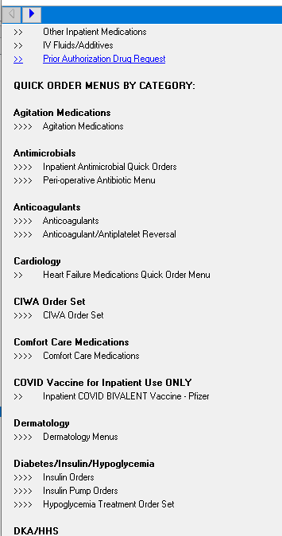
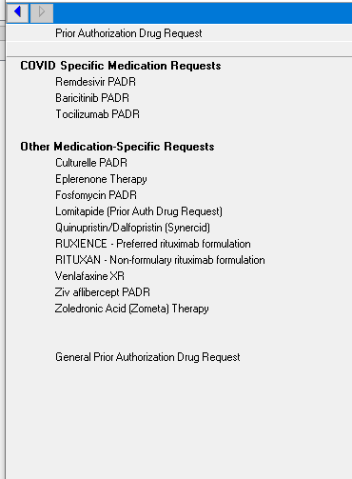
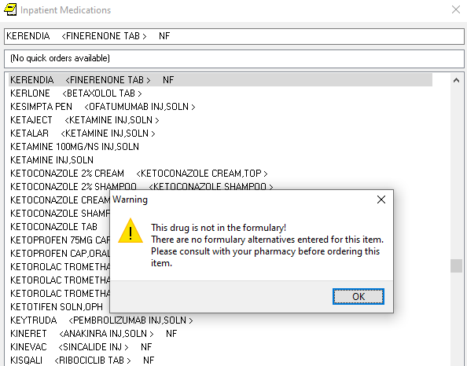

Slide 19
Some Common Meds needing PADR with medicare/medicaid
Long acting opiates
Celecoxib
GLP-1 agonists (Dulaglutide, exenatide, liraglutide)
Ezetimibe
Oral vancomycin
Valacyclovir

Slide 20
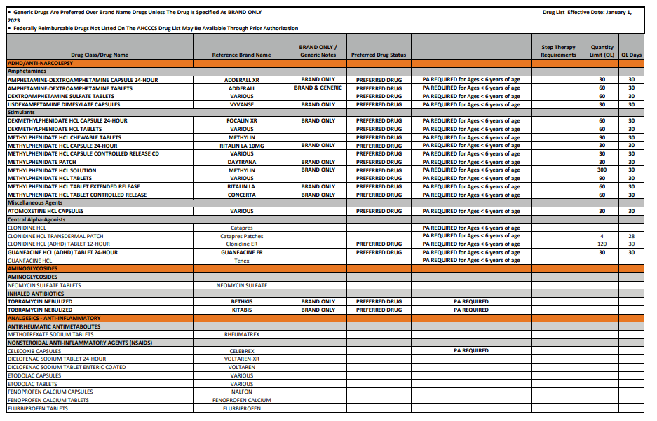
https://www.azahcccs.gov/Resources/Downloads/PharmacyUpdates/AHCCCSDrugList.pdf

Slide 21
THIS IS THE MME CUTOFF FOR PRESCRIBING NALOXONE
Gotta Send 'Em Home · $1000

Slide 22
50 MME

Slide 23
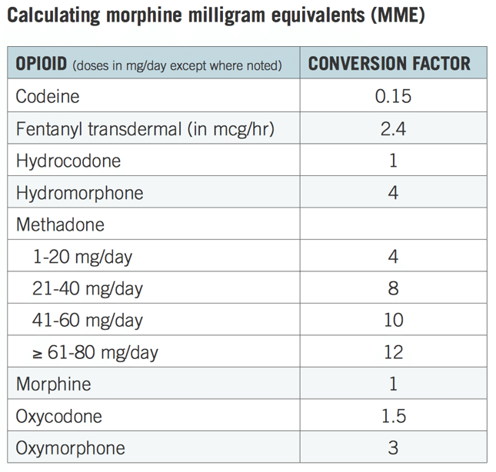

Slide 24
THIS IS HOW YOU ORDER WOUND CARE SUPPLIES AT BANNER/VA
Ouch That Hurts · $200

Slide 25
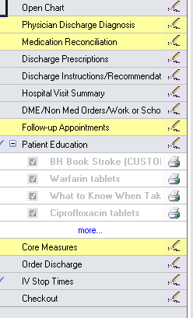

Slide 26
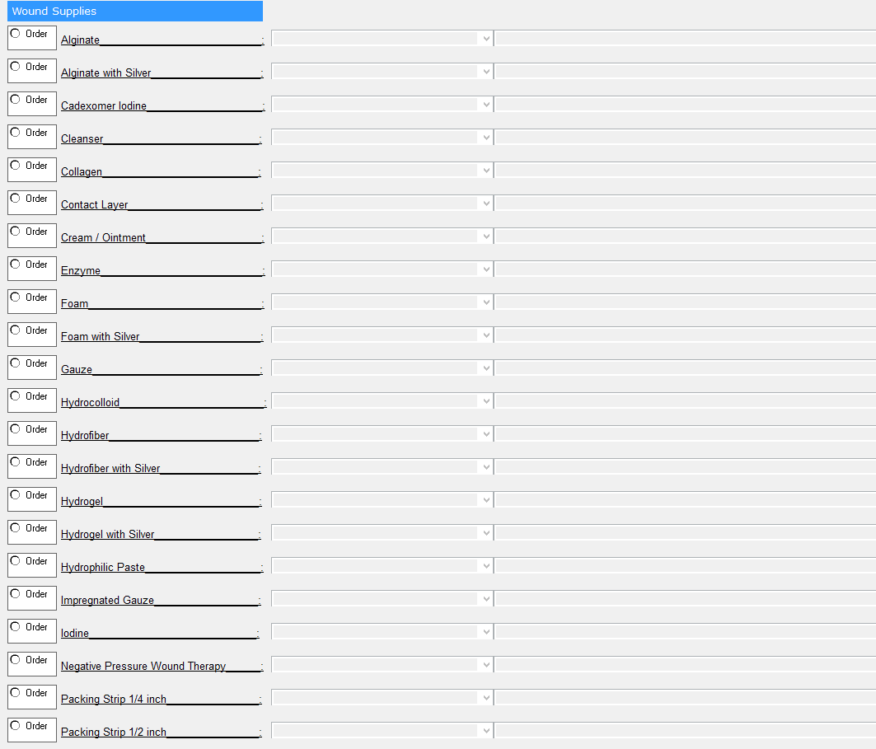

Slide 27
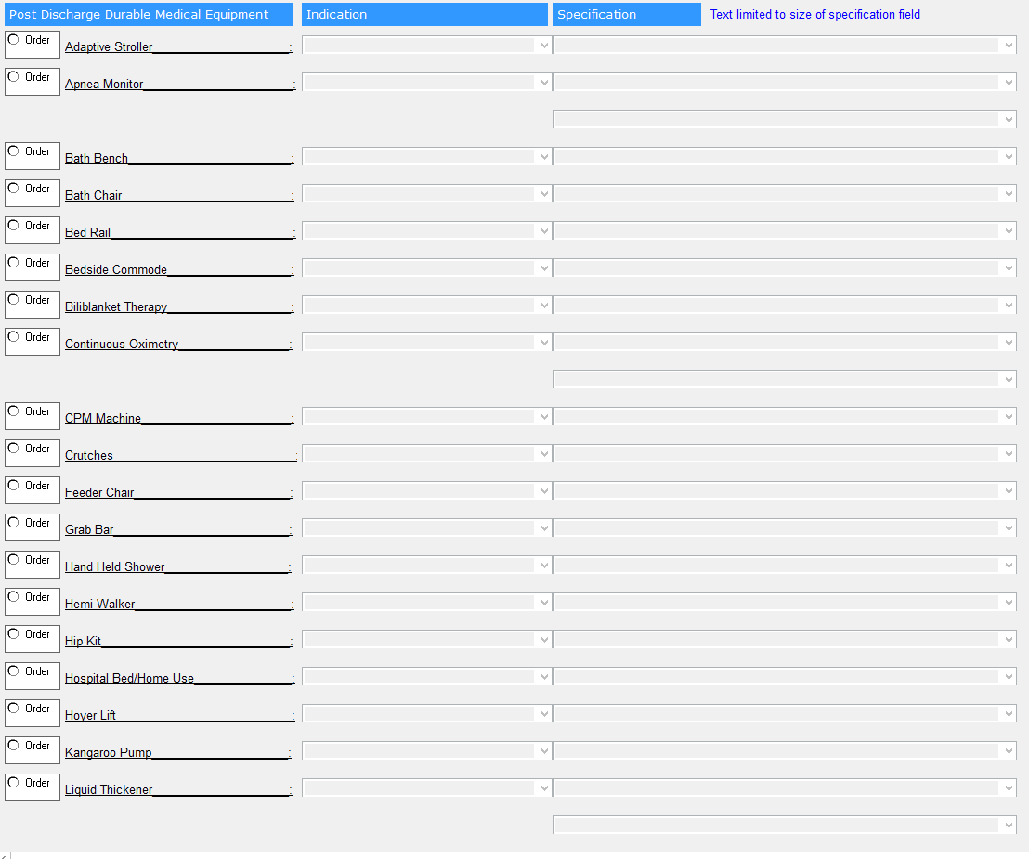

Slide 28
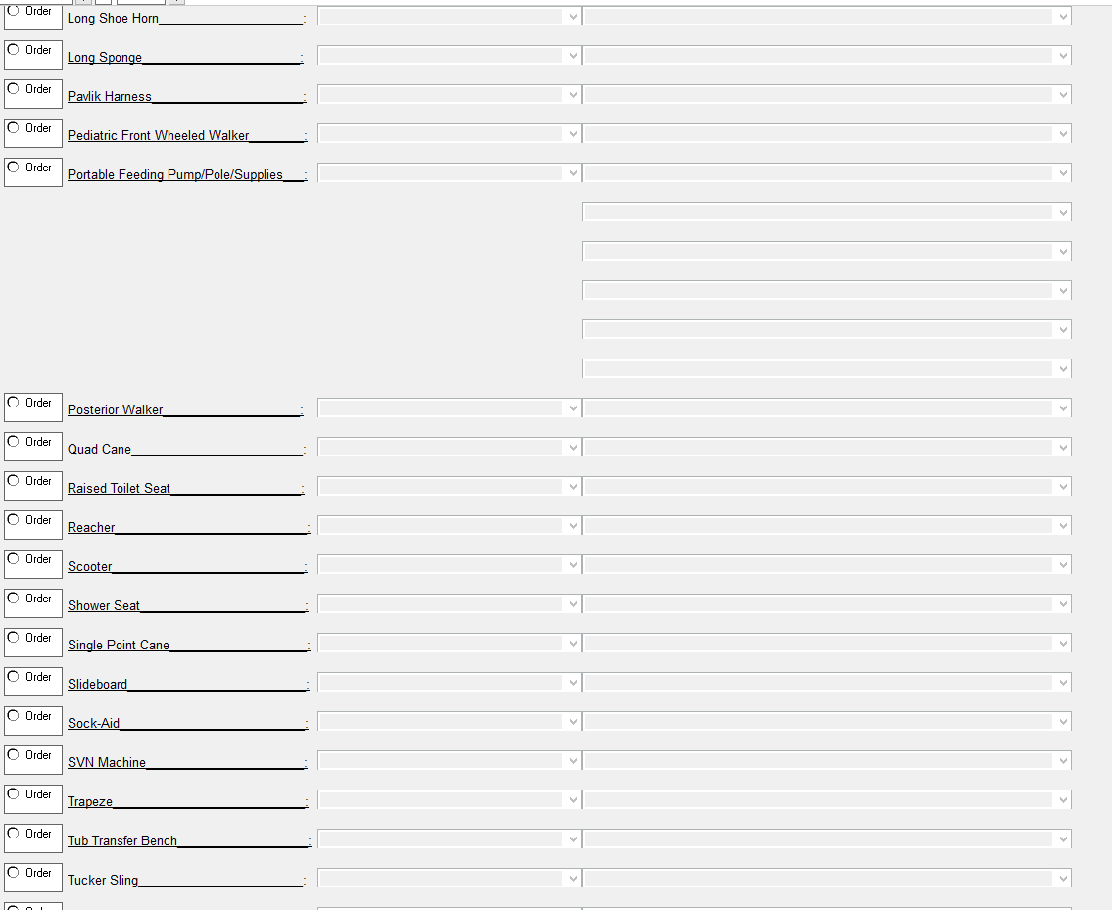

Slide 29
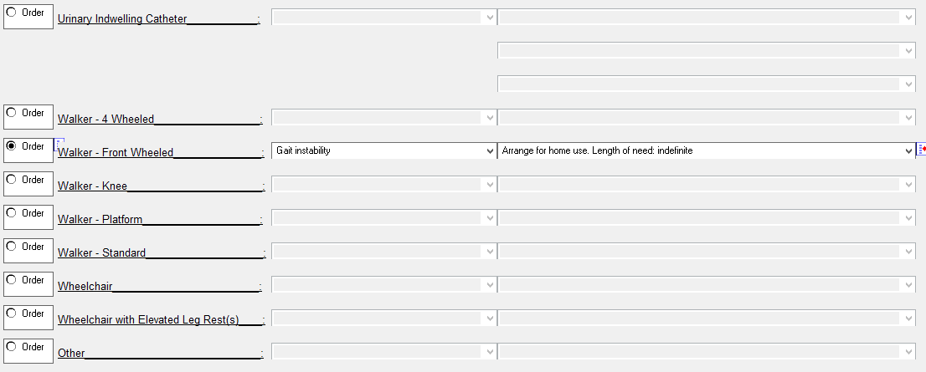

Slide 30
Also DME tab at Banner will have Home health orders Outpatient orders Wound supplies Ostomy supplies Trach supplies Cardiac vest Work and school note
To not bore you with more screenshots

Slide 31
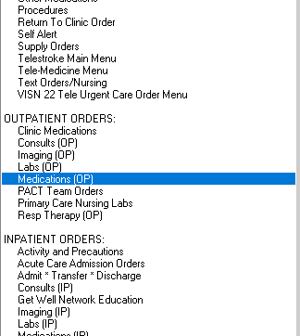
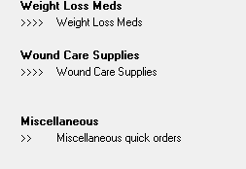

Slide 32
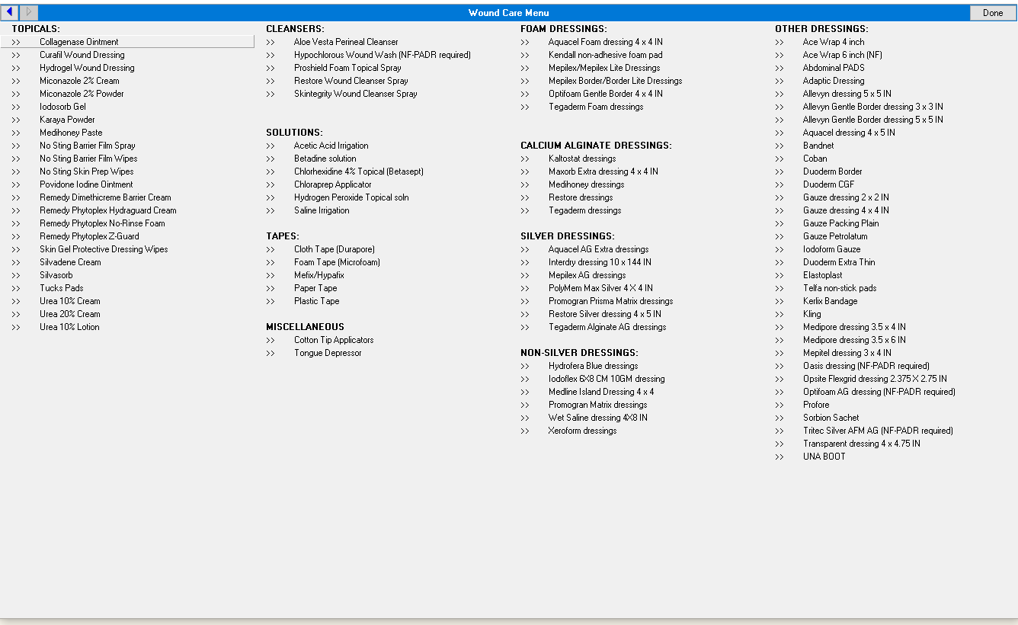

Slide 34
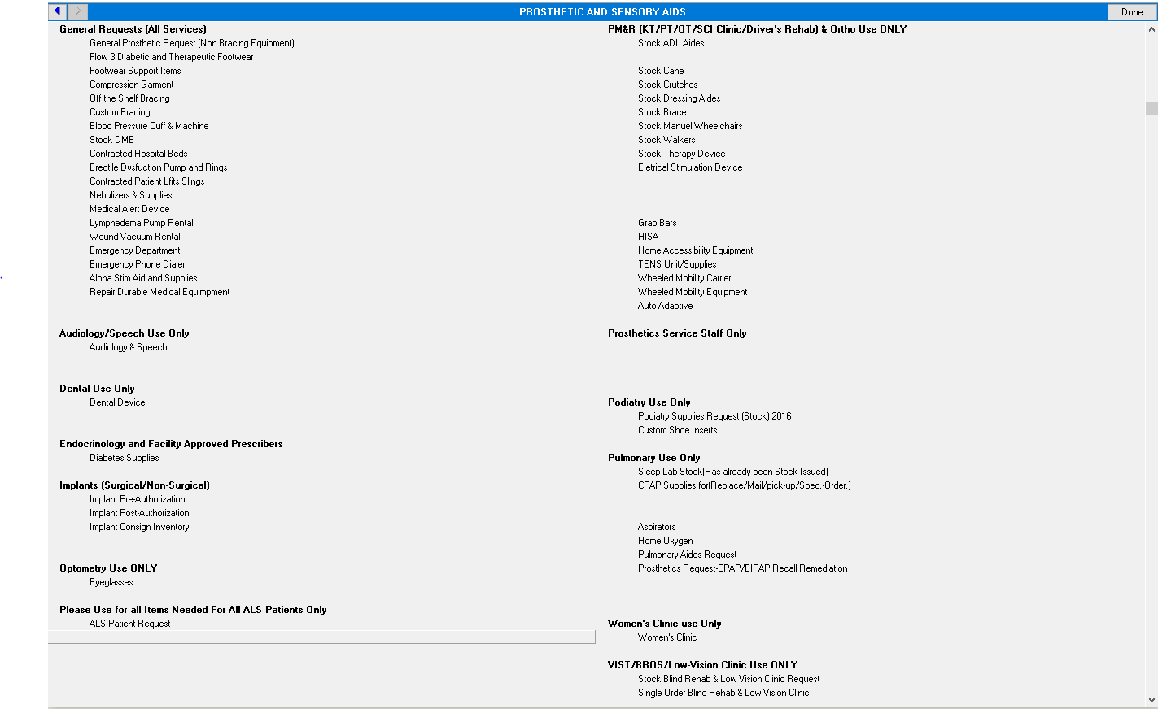

Slide 35
THIS TYPE OF DRESSING DERIVED FROM SEAWEED IS EFFICACIOUS FOR EXUDATIVE WOUNDS
Ouch That Hurts · $400

Slide 36
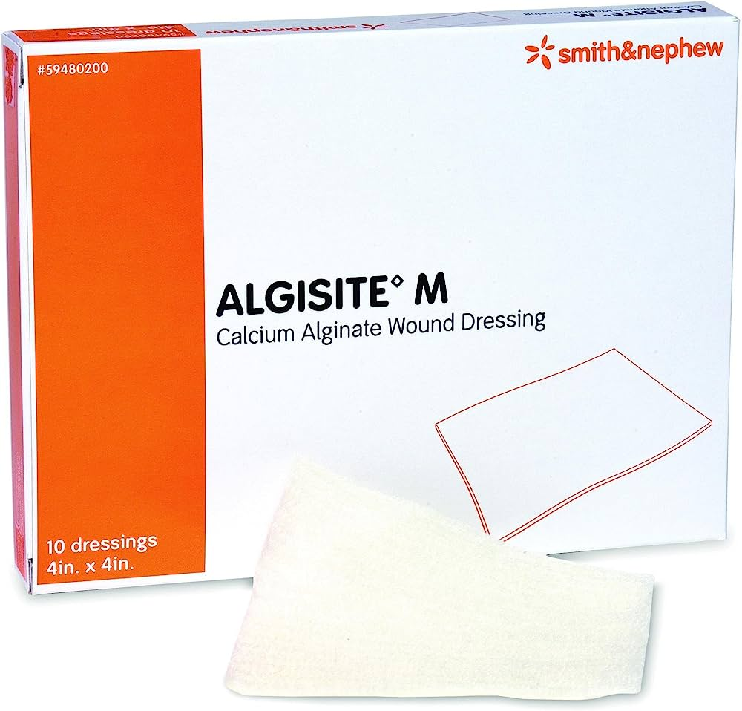
ALGINATE DRESSINGS Provides moisture to prevent wounds from drying out and allows for quicker wound healing Pressure ulcers, diabetic foot ulcers, cavity wounds, venous leg ulcers, post-op wounds, trauma wounds, partial thickness burns Not used in bleeding wounds, minimal exudate or dry wounds, surgical implants or third degree burns Note with silver provides ionic silver complex that provides antimicrobial protection (Mainly for high exudating wounds) May need secondary dressing as it does not hold on its own

Slide 37
THIS IS TYPE OF DRESSING USED FOR EXUDATIVE WOUNDS CHANGES COLOR FROM BROWN TO YELLOW/GRAY WHEN DRESSING NEEDS TO BE CHANGED
Ouch That Hurts · $600

Slide 38
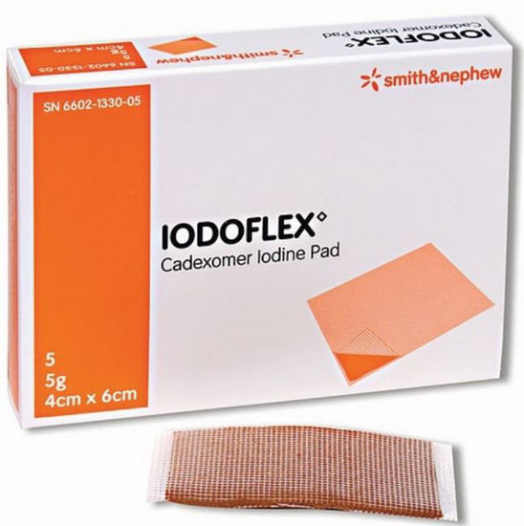
Cadexomer Iodine Dressing Used for exudative wounds, wounds such as venous ulcers, pressure injuries, diabetic ulcers, and traumatic or surgical wounds Do not use in patients with any thyroid disorder, pregnant or lactating women Bactericidal Changes color from brown to yellow/gray when dressing needs to be changed Not effective with dry wounds

Slide 39
THIS TYPE OF DRESSING IS VERSATILE, NOT USED FOR INFECTED WOUNDS, DERIVED FROM PORCINE OR BOVINE
Ouch That Hurts · $800

Slide 40
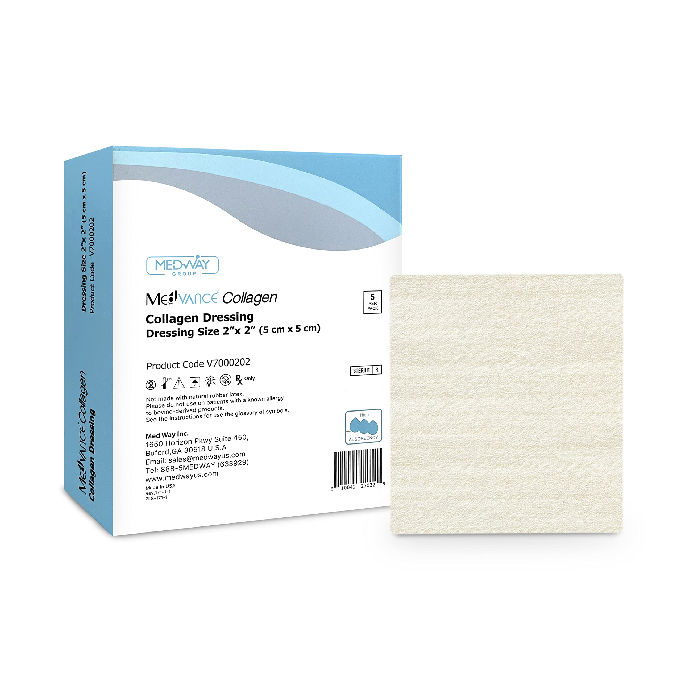
Collagen Dressing Used for partial and full thickness wounds, pressure injuries, venous ulcers, diabetic ulcers, first and second degree burns, abrasions, trauma wounds, dehisced wounds, surgical wounds Cannot be used for third degree burn Not intended for treating infected wounds Do not use if allergic to collagen or silver

Slide 41
Contact layer dressings Hydrocolloid dressings Many more… https://www.woundsource.com/search-page
Other dressings Not covered
Notes:
Contact layer dressings
Used for many different wounds including skin tears, abrasions, lacerations, blisters, partial thickness burns, surgical wounds, and ulcers
Not used in third degree burns, sensitivity to silicone, and not for surgical implantation
Hydrocolloid dressing
Used in uninfected wounds to allow the body to help heal wounds
Only used for wounds that are clean and uninfected
Last longer than most types of dressings

Slide 42
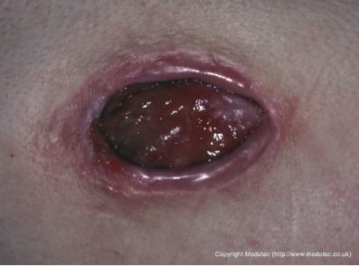
THIS IS THE STAGING OF THIS PRESSURE ULCER
Ouch That Hurts · $1000

Slide 43
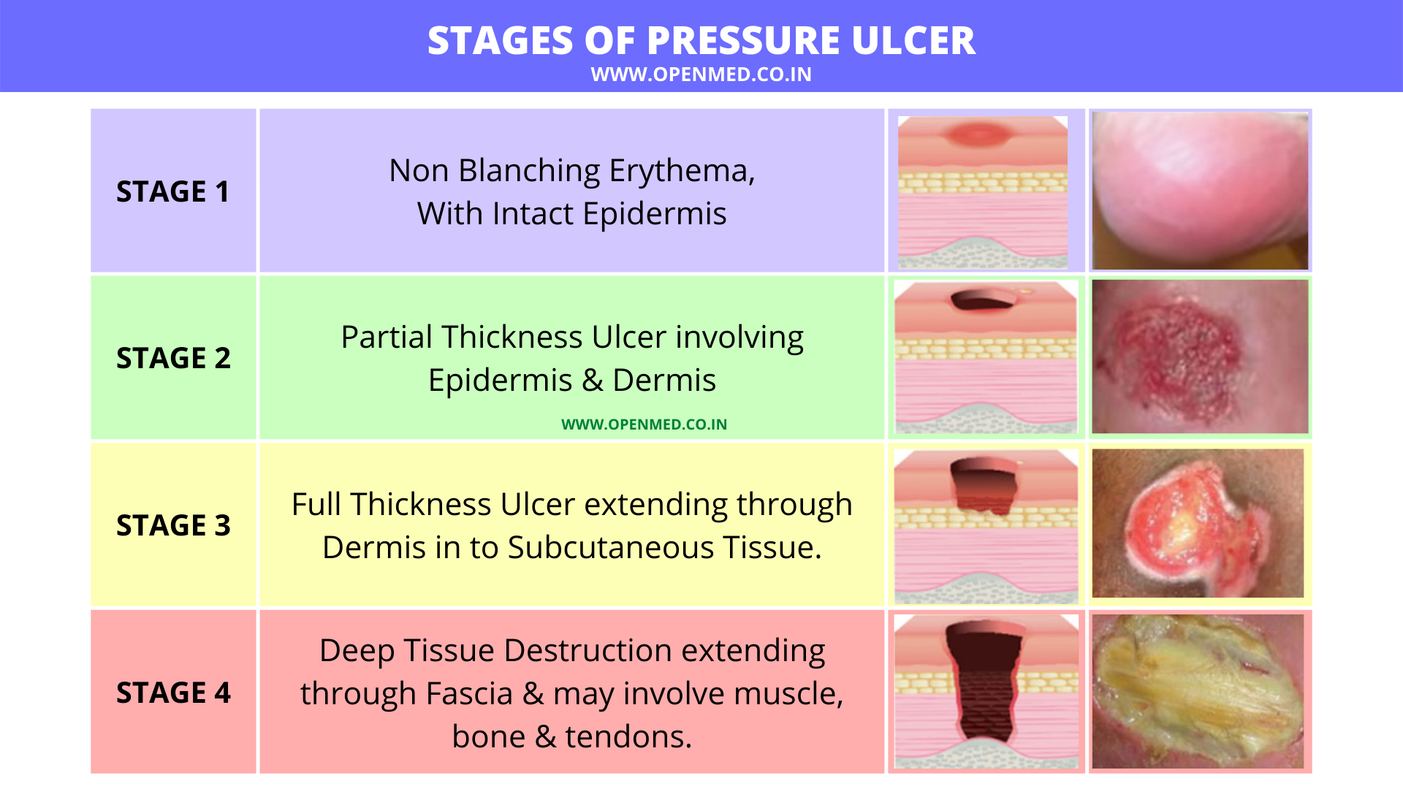

Slide 44
THIS PERSON WILL HELP WITH OPTIONS FOR PLACEMENT
It's Not Just Docs and Nurses · $200

Slide 45
Social Worker Patient needs any social, financial or emotional resources and support Help with discharge and post-hospitalization plans Work with insurance company on placement needs Community resources to provide with basic needs and security such as clothing, food, or place to stay if homeless Mental and behavior health referrals Arranging transportation Help find ways to afford medication

Slide 46
AN RN WHO IS ASSIGNED TO A PATIENT ON ADMISSION AND ENSURES THAT CARE IS COORDINATED AND PATIENT CENTERED
It's Not Just Docs and Nurses · $400

Slide 47
Case Manager Registered nurse who had significant clinical experience in the hospital Assigned to patient on admission Ensure that patient care received is coordinated, safe, timely, and effective, efficient, equitable and patient centered Work on the interdisciplinary team Work with the care team for coordinating safe transition of care out of the hospital Communicate with patient’s insurance to ensure reimbursement for the hospital services that they receive

Slide 48
THIS PERSON DECIDES THE APPROPRIATENESS OF HOSPITAL ADMISSIONS
It's Not Just Docs and Nurses · $600

Slide 49
Utilization Managers Registered nurse Establishes and maintains efficient methods of ensuring the medical necessity and appropriateness of hospital admissions Reviews patient charts to justify the length of stay and that they are accurately documented in the medical record Calculates length of stay and continued stay for patients Identifies problems with quality of patient care and refers them to the quality committee Creates reports for the utilization review committee

Slide 50
THIS PERSON HELPS IMPROVE PATIENT’S ABILITY TO PERFORM ACTIVITIES OF DAILY LIVING
It's Not Just Docs and Nurses · $800

Slide 51
Occupational Therapy Goal focused on activities of daily living Help with self-care, leisure, independent living and work Concerned about overall function of the body rather than just the strength and ability to move Teach patients have to navigate their environment with the new equipment, getting out of bed safely, getting dressed, etc. Use and develop adaptive tech for people who need them

Slide 52
THIS IS THE FIRST PERSON THAT YOU SHOULD CONSIDER CONSULTING IF CONCERNS WITH PROBLEMS SWALLOWING
It's Not Just Docs and Nurses · $1000

Slide 53
Speech therapy Focused on improving or rebuilding particular skill sets like strengthening coordination between the brain and mouth Evaluate and treat swallowing disorders, speech and language problems from neurologic disorders, respiratory issues, and more Conduct and interpret videofluoroscopic exams

Slide 54
Other services not covered in this episode: -Physical therapy -Nutrition -Respiratory -Pharmacy
Notes:
Physical therapy
Nutrition
Respiratory therapy

Slide 55
THIS IS A MEDICATION THAT YOU SHOULD HOLD THE MORNING DOSE PRE-OPERATIVE FROM DR. LANZENDORF’S CROSS COVER LECTURE
Back to the Future · $200

Slide 56
Pre-Operative medication management: anti-hypertensives
Name or Class of drug | Clinical considerations | Recommended strategy
Beta blockers | Abrupt withdrawal => HTN , tachycardia, and MI Perioperative initiation can prevent postoperative MI in high-risk pts but may increase risk for stroke. Contraindications: HR <60, SBP <90, insufficient time for titration. | Continue therapy up to and including day of surgery.
Alpha 2 agonists | Withdrawal => HTN, and MI | Continue therapy up to and including day of surgery.
CCB |  | Continue therapy up to and including day of surgery.
ACEi or ARB | Withholding ACEI or ARBs 24h prior to noncardiac surgery has been associated with a 30-day lower risk for all-cause death, stroke, myocardial injury, and intraoperative hypotension (18% adjusted relative risk reduction) | hold morning dose
Diuretics | Continuation => hypovolemia and hypotension. | hold the morning dose

Slide 57
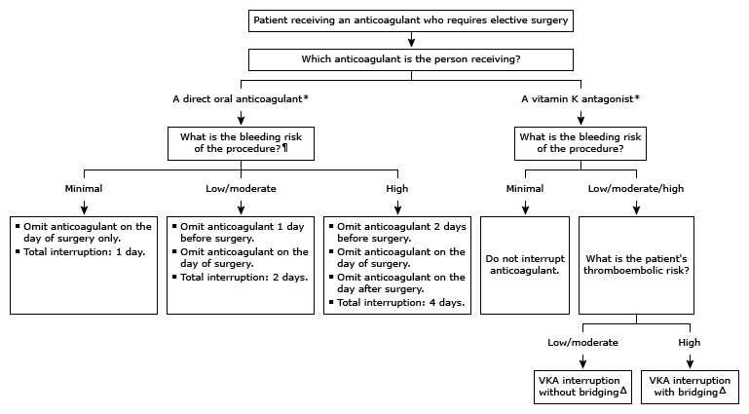
Pre-Operative medication management: Anti-coagulants
Name or Class of drug | Clinical considerations | Recommended strategy
Aspirin | Continuation => hemorrhage. Discontinuation => vascular complications. Discuss with cardiology | Discontinue aspirin approximately seven days prior to noncardiovascular surgery.
P2Y12 receptor blockers (clopidogrel, prasugrel, ticlopidine, ticagrelor) | Continuation => hemorrhage. After cardiac stenting procedure, discontinuation => cardiac ischemia Discuss with cardiology | Delay elective procedures until period of platelet inhibition is completed. When used for long-term stroke prophylaxis, should be discontinued 7 to 10 days.
Warfarin
Dabigatran, rivaroxaban, apixaban, edoxaban

Slide 58
Pre-Operative medication management: Other Meds
Name or Class of drug | Clinical considerations | Recommended strategy
Statins | provides cardiovascular protection. | Continue
estrogen and related hormones- OCPs, Postmenopausal hormone tx, SERMs | Continuation may increase risk of VTE | low to moderate risk of VTE => may continue high risk of VTE => may need to stop 4 weeks before surgery
Prandial Insulin | Continuation => hypoglycemia | Hold
Basal | *Consider DM type* | T1DM- Continue full dose T2DM- reduce dose by 20-50%
Oral hypoglycemics | SGLT2 => ketoacidosis | Hold

Slide 59
THESE ARE THREE ITEMS ON THE DIFFERENTIAL DIAGNOSIS FOR ACUTE DYSPNEA FROM DR. BERNIER’S LECTURE
Back to the Future · $400

Slide 60
Illness Script for acute dyspnea- BREATHE
Bacterial pneumonia or other infections
Reactive airway disease (asthma/copd)
Embolism (PE)
Acute coronary syndrome/arrhythmias/airway obstruction (aspiration, anaphylaxis)/anemia
Tension PTX/ cardiac tamponade
Heart failure or other causes of volume overload/pleural effusions
Everything else (heart structure- severe as or mr, pfos, pulm htn, hps, osa, ohs, ild, lung mass, sedative medications, neuromsk disorders that decrease breathing strength)

Slide 61
THIS IS THE INR GOAL FOR PROSTHETIC VALVES FROM DR. KAMAL’S ANTICOAGULATION LECTURE
Back to the Future · $600

Slide 62
Prosthetic Valves
Mechanical vs Bioprosthetic: Former is more durable, but higher risk for clot.
General rule of thumb: <50 mechanical, >70 bioprosthetic, in between varies
Mechanical requires lifelong, bioprosthetic 3 to 6 months
Goal INR:
If bioprosthetic (Mitral or Aortic) goal is 2.5
If Mitral or high risk Aortic, 3.0
If low risk Aortic, 2.5
Warfarin only, NO DOACs
Supplemental low dose ASA generally recommended for all cases

Slide 63
THIS IS ONE OF THE TWO SCORING SYSTEMS USED FOR COPD SYMPTOM SEVERITY FROM DR. PURI’S COPD LECTURE
Back to the Future · $800

Slide 64
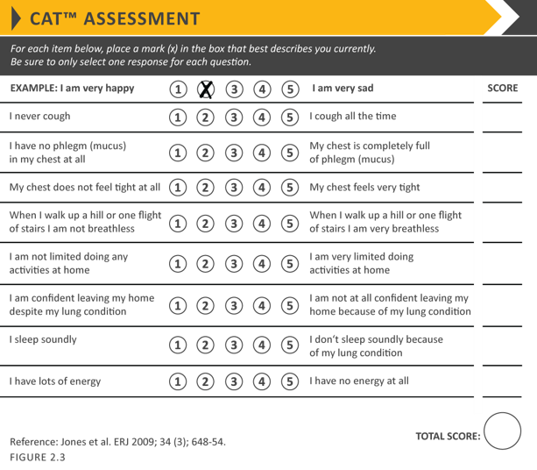
Once you have diagnosed someone with COPD, you have to determine symptom severity
Modified British Medical Research Council

Slide 65
THIS IS WHERE A CENTRAL LINE CATHETER TIP SHOULD TERMINATE AT WHEN READING A X-RAY FROM DR. LEWIEN’S LINES TUBES AND DRAINS TALK
Back to the Future · $1000

Slide 66
Confirming placement
Catheter tip should terminate in the SVC or cavo-atrial junction
Roughly 1-1.5cm above the level of the carina
SVC positioning ok for fluid administration, CVP monitoring
For HD or long term chemo, should be in cavo-atrial junction or RA

Slide 67
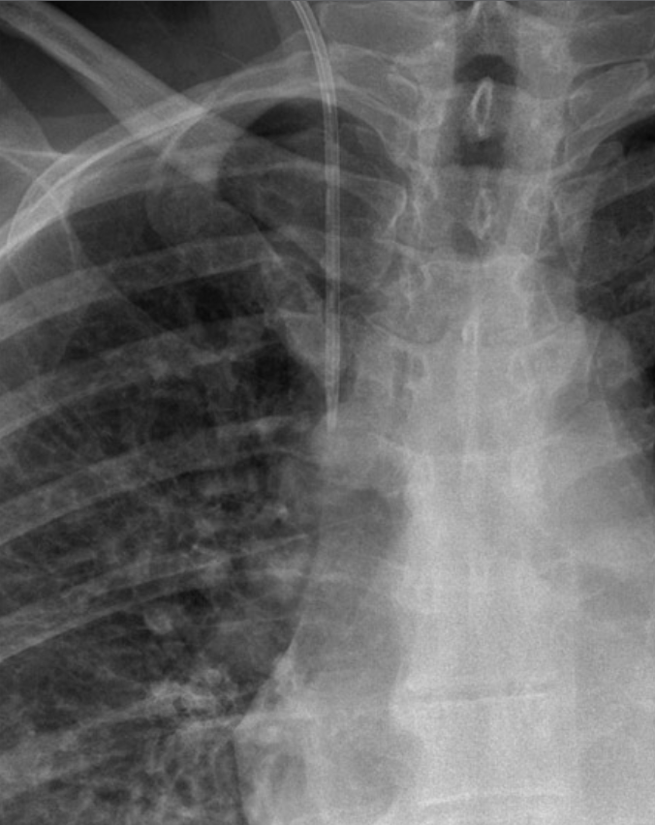

Slide 68
TO QUALIFY FOR THIS FACILITY PATIENTS MUST HAVE A THREE-NIGHT HOSPITAL STAY AND MUST REQUIRE REHAB FOR AT LEAST ONE HOUR DAILY FIVE DAYS A WEEK
Oh the Places You'll Go! · $200

Slide 69
Skilled nursing facility (SNF)

Slide 70
TO QUALIFY FOR THIS FACILITY AVERAGE LENGTH OF STAY >25 DAYS AND MUST REQUIRE DAILY MONITORING AND COMPLEX MEDICAL INTERVENTIONS
Oh the Places You'll Go! · $400
Notes:
Include complex wounds, chest tubes, ventilatory dependency or multiorgan failure

Slide 71
Long-term acute care hospital (LTAC)

Slide 72
THIS CARE IS JUST WHERE THE SERVICES COME RIGHT TO YOU
Oh the Places You'll Go! · $600

Slide 73
Home based care

Slide 74
THIS FACILITY PROVIDES LONG-TERM CUSTODIAL CARE
Oh the Places You'll Go! · $800

Slide 75
Extended care facility (ECT)
Notes:
Provide long term custodial care reimbursed through Medicaid, long term care insurance or personal finances. In order to qualify patient must have used all their assets, require assistance with at least three ADLs, and require skilled nursing supervision

Slide 76
IN ORDER TO MEET CERTIFICATION CRITERIA, 75% OF THEIR PATIENTS MUST HAVE 1 OF 13 SPECIFIED DIAGNOSES
Oh the Places You'll Go! · $1000

Slide 77
Inpatient rehab facilities
Notes:
Must require multidisciplinary therapy (PT, OT, speech, orthotic or prosthetic) and participate in intensive treatment. Physician supervision three times a week

Slide 78
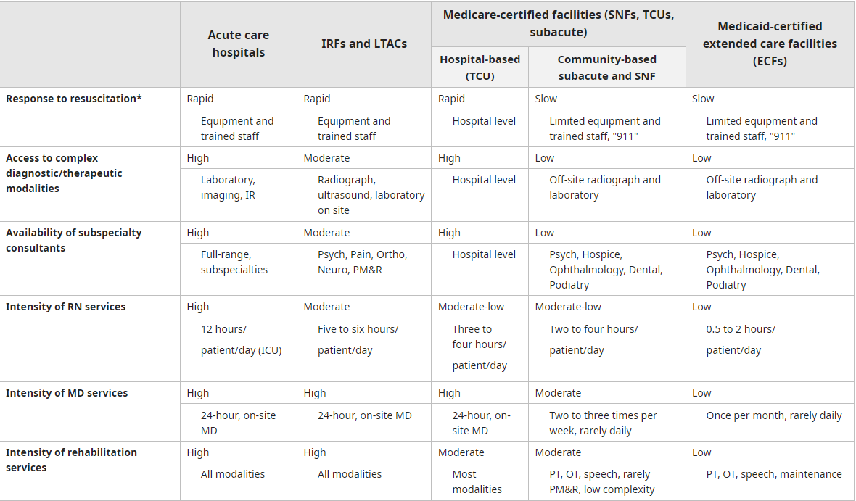

Slide 79
Credits
Special thanks to:
Chris Taylor PharmD
Kiet Giang PharmD

Slide 80
References
https://www.cdc.gov/opioids/naloxone/factsheets/pdf/Naloxone_FactSheet_Clinicians.pdf
https://www.cdc.gov/mmwr/volumes/71/rr/rr7103a1.htm
https://www.woundsource.com/patientcondition/pressure-ulcers-stages-3-and-4
UpToDate

