Slide 1
Electrolyte Replacement
Elle Maureen Newcome, MD – IM PGY3

Slide 2
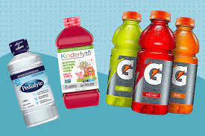
Objectives
Focus on LOW electrolyte management (HIGH out of scope)
Avoid killing your patients when replacing electrolytes
Enjoy basic math

Slide 3
Which electrolytes do we replace?

Slide 4
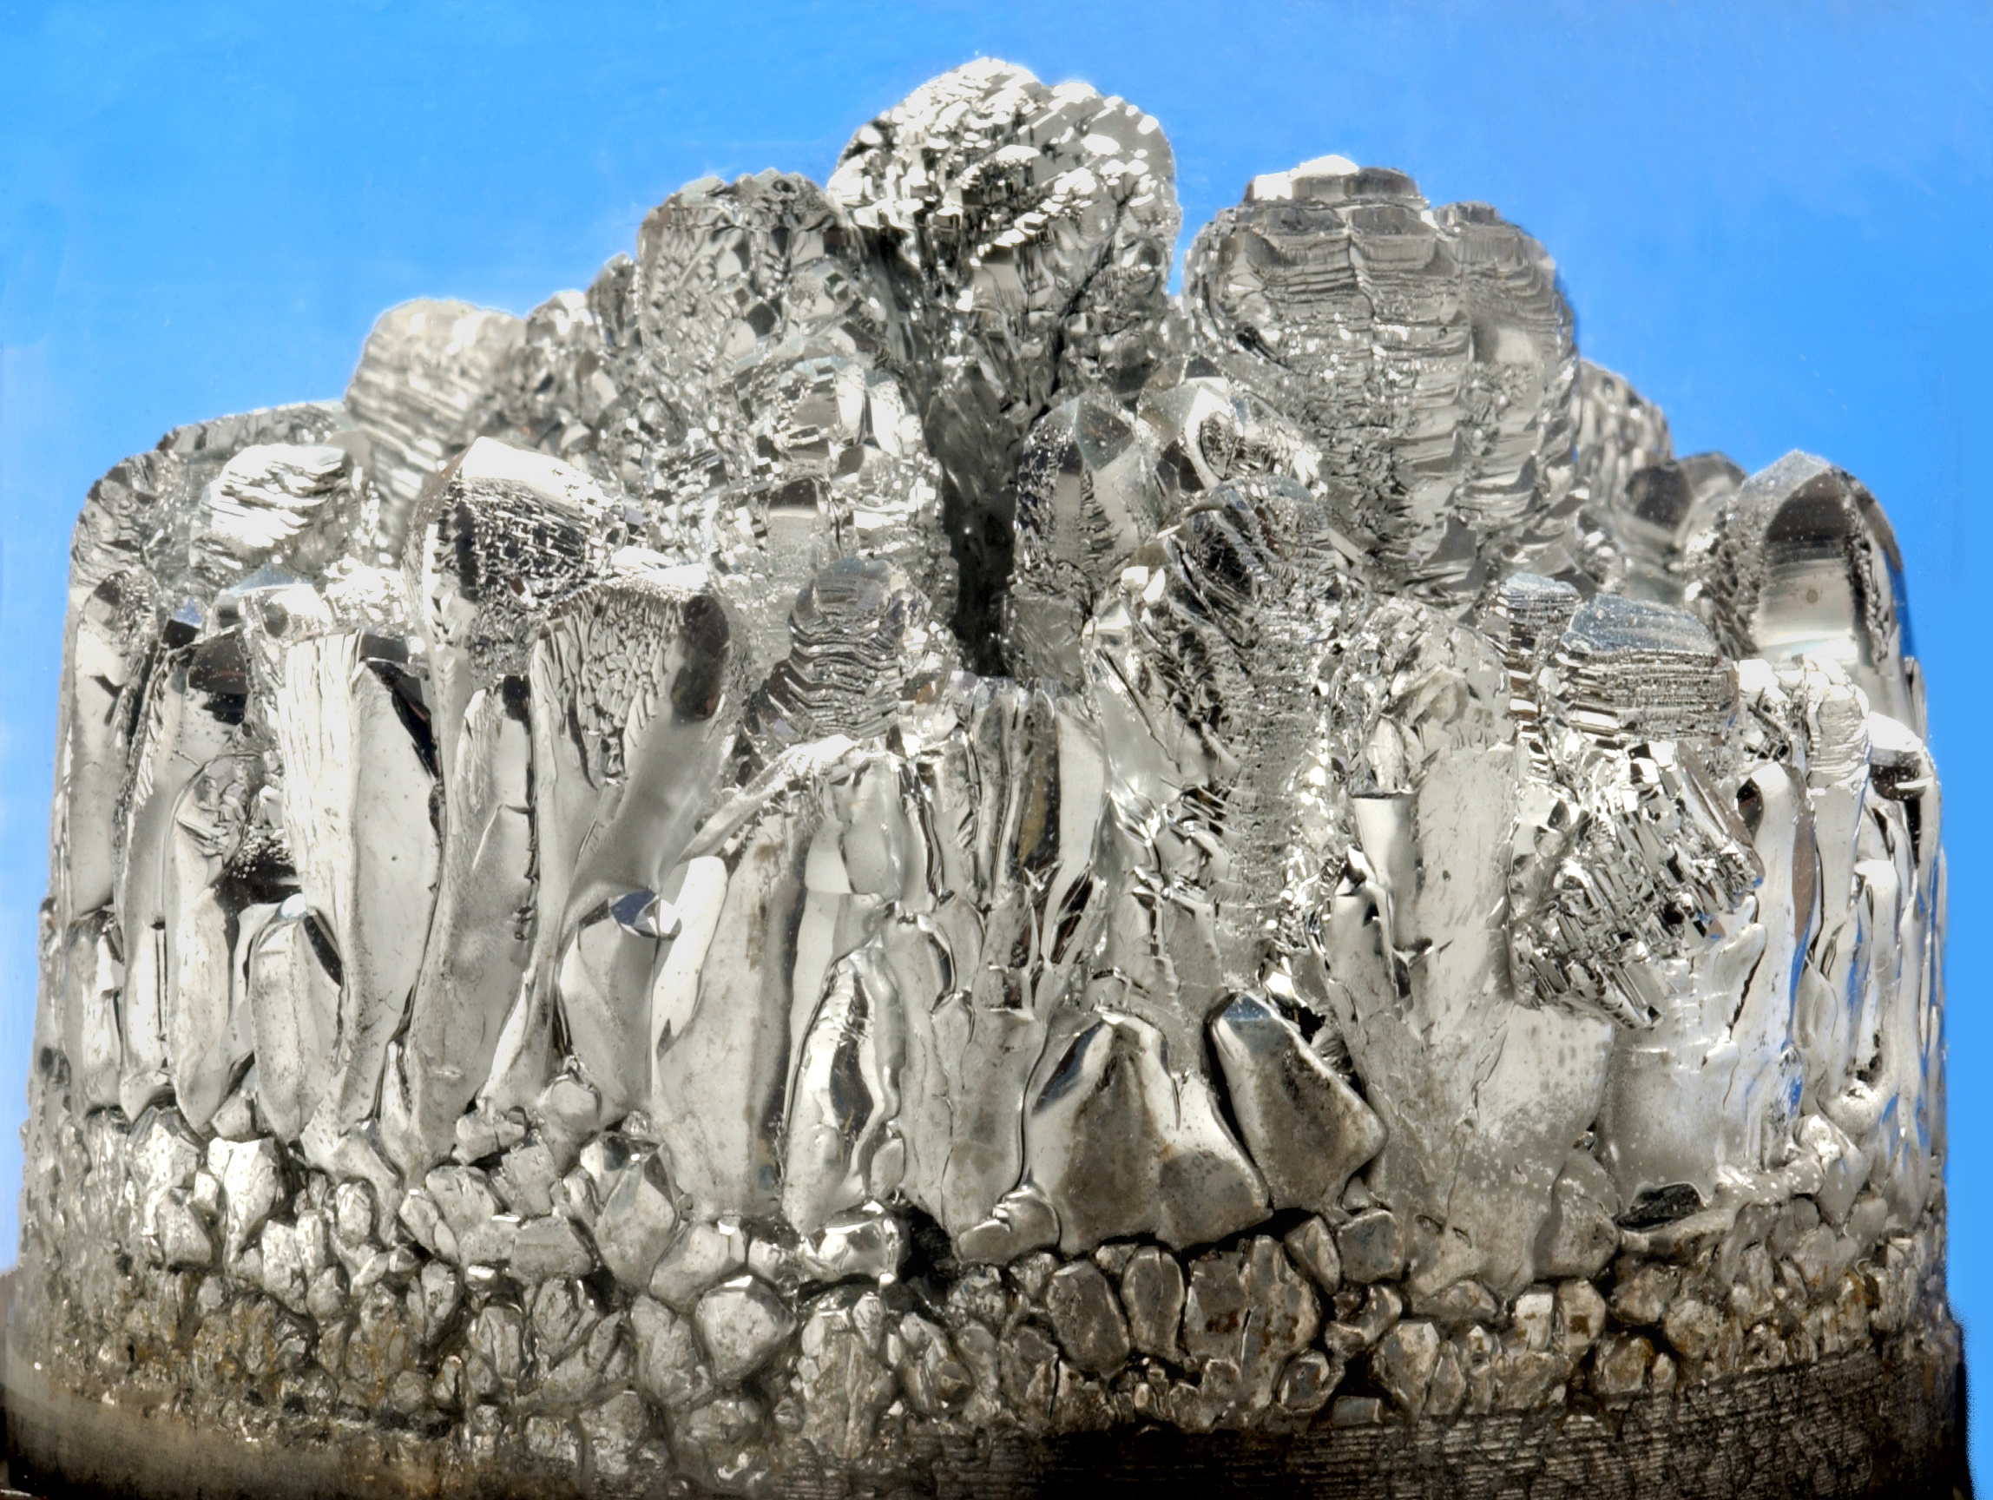
MAGNESIUM
Hypomagnesemia = Mg2+ < 1.8
Cardiac patients, goal Mg 2+ > 2
Caution replacing in renal disease
Notes:
Fun fact: oral Mg+ has been used as an oral laxative since the 17th century. Drinking Mg+ sulfate lead to diarrhea. Called “Epsom Salt” – named after British town in which it was discovered.

Slide 5
Low Mg2+
Risk factors:
GI (malnutrition, malabsorption, diarrhea, NG aspiration)
renal excretion (hyperparathyroidism, post-transplant)
drugs (loop diuretic, aminoglycoside, amphotericin, cisplatin, cyclosporin, tacrolimus
other: pregnancy, DM, post-parathyroidectomy

Slide 6
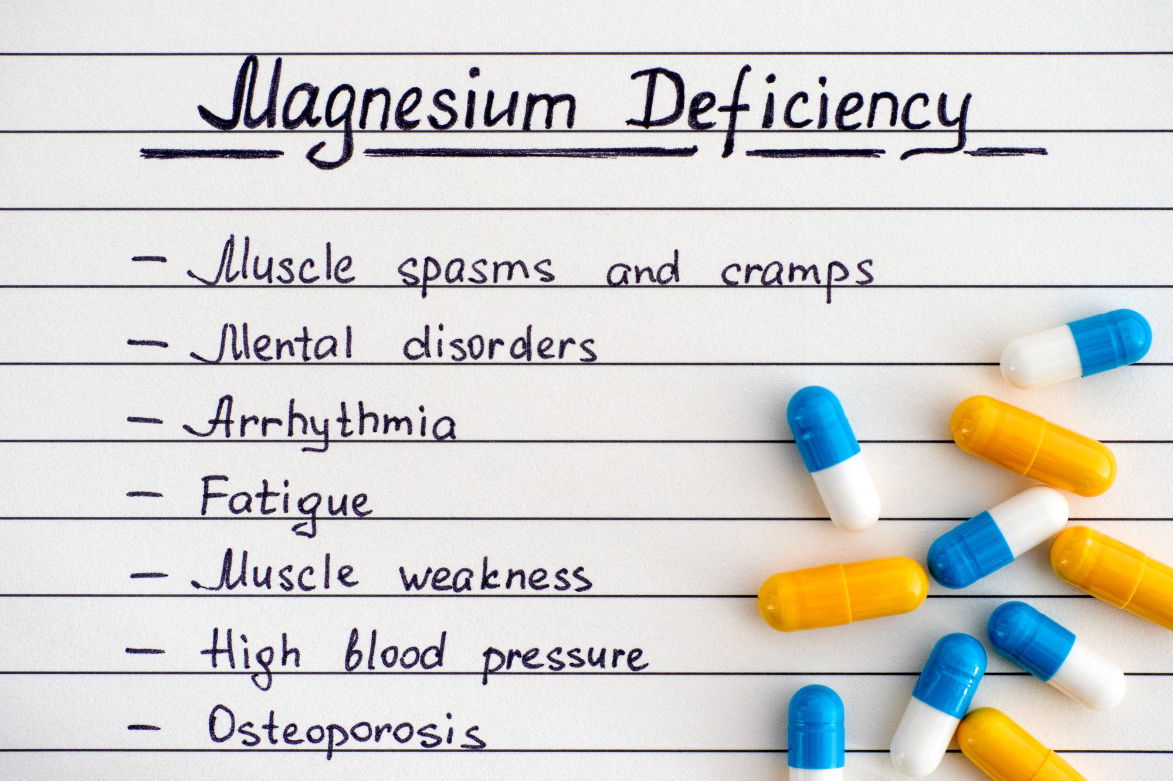
Symptoms

Slide 7
Logistics: replace IV when possible. Oral leads to diarrhea.
Mg2+ helps keep K+ in cells by decreasing membrane permeability and/or inhibiting Na+-K+ ATPase

Slide 8
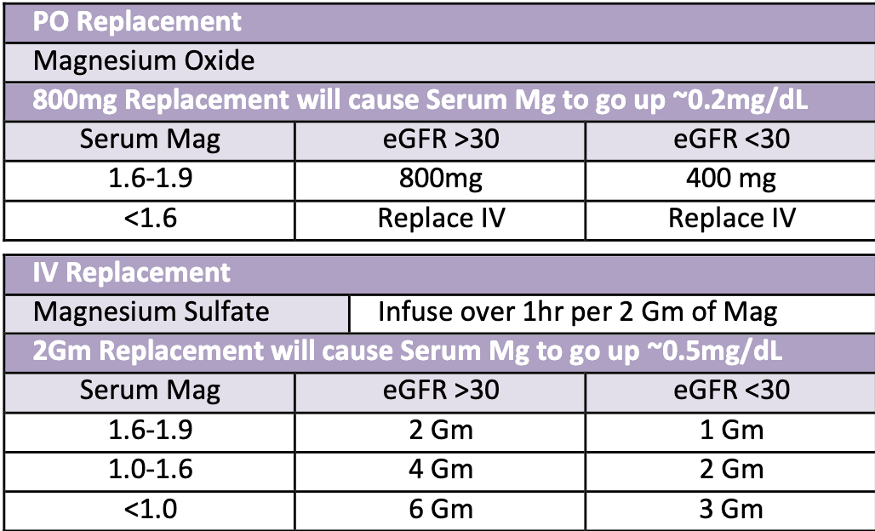
Practice Case
X is a 70F with pmh hyperparathyroidism, HFrEF, and CKD (eGFR 32) who is found to have Mg2+ 1.7 on am labs. How would you replace her Mg2+?
800 mg PO
400mg PO
2 gm IV
1gm IV
Notes:
Answer: C b/c want to avoid diarrhea and because egfr > 30.
What about if she endorses 7 days of constipation? Give PO!

Slide 9
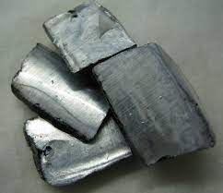
POTASSIUM
Hypokalemia = K+ < 3.5
cardiac patients, goal K + > 4
caution replacing in renal disease

Slide 10
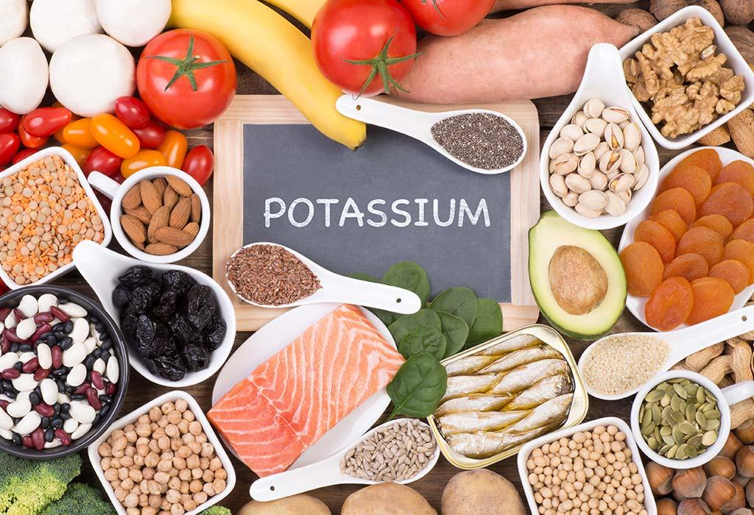
Low K+
Risk factors:
GI (malnutrition, emesis, diarrhea)
Intracellular shift (alkalemia, insulin, B-agonist)
Renal excretion (diuretics, high aldosterone, DKA)
other: DKA: patients present with HYPERkalemia with total body potassium deficit

Slide 11
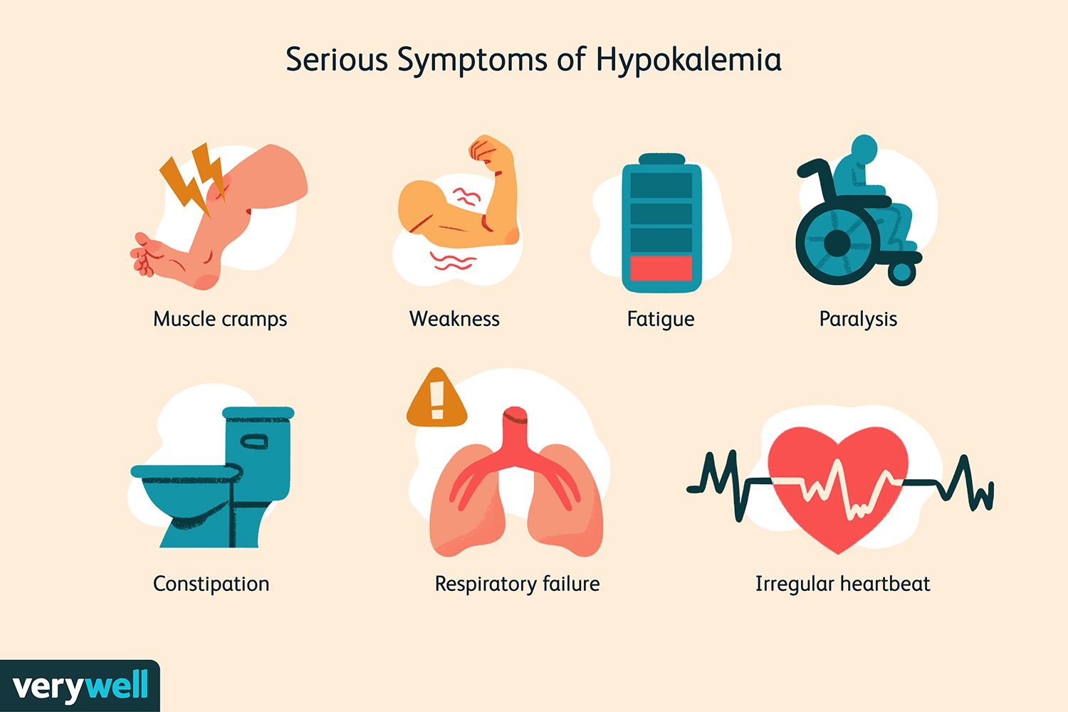
symptoms

Slide 12
be kind: replace oral when possible, IV causes burning. If IV, add 500L NS/LR for comfort. However, oral pill is huge, powder tastes terrible.
math: every 10mEq K+ replaced increases serum K+ by ~0.1
rate: no more than 10mEq/hr through peripheral IV; 20mEq/hr though central is ok
absorb: body cannot absorb > 40meq Q4-6H in IR formulation
Notes:
IV KCL is used in lethal injection – giving too fast can stop the heart. Use the protocols. If in doubt, call pharmacy.

Slide 13
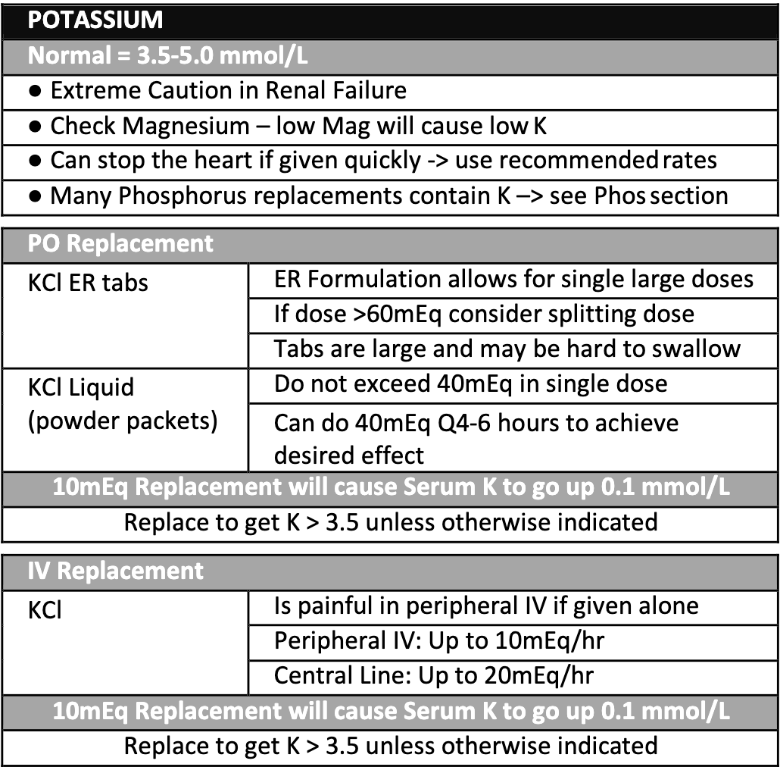
Practice Case
X is a 70F with pmh hyperparathyroidism and HFrEF who is found to have K+ 2.9 on am labs. How many Meq of K+ would you give her?
110 mEq
1.1 mEq
0.6mEq
60 mEq
Notes:
Answer: A. 110mEq. She is a cardiac patient, so goal K+ 4.0.
Follow up: How would you give her this? IV, PO, or both? → BOTH (!!) it is a lot.
Follow up answer: 40meq IR now + 40meq IV = 4 hours; 20 to 40 mEq IR in 4-6 hours.
Follow up part 2: How long would it take her to be replaced to goal? 4-6 hours!

Slide 14
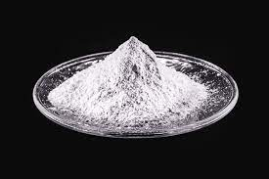
PHOSPHORUS
Hypophosphatemia = Phos < 2.5
cardiac patients, goal phos > 3
caution replacing in renal disease

Slide 15
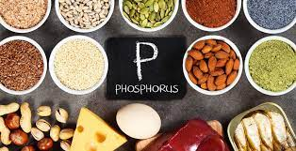
Low Phos
Risk factors:
GI (Vit D deficiency)
drugs (phosphate binder, insulin, glucagon)
other: refeeding syndrome

Slide 16
Low Phos
Symptoms: weakness, rhabdo, paresthesia, seizure, stupor, impaired muscle contractility (smooth and muscular)

Slide 17
logistics: phos replacement often has K+ in it. Include this in calculations of replacement.
Route: Replete Phos < 1.0 via IV; all else PO
Caution: with hypocalcemia, as increased phos increased bone remodeling, decreasing ionized Ca+
If no etiology discerned from clinical picture:
consider Vit D deficiency, Ca+ deficiency, PTH deficiency

Slide 18
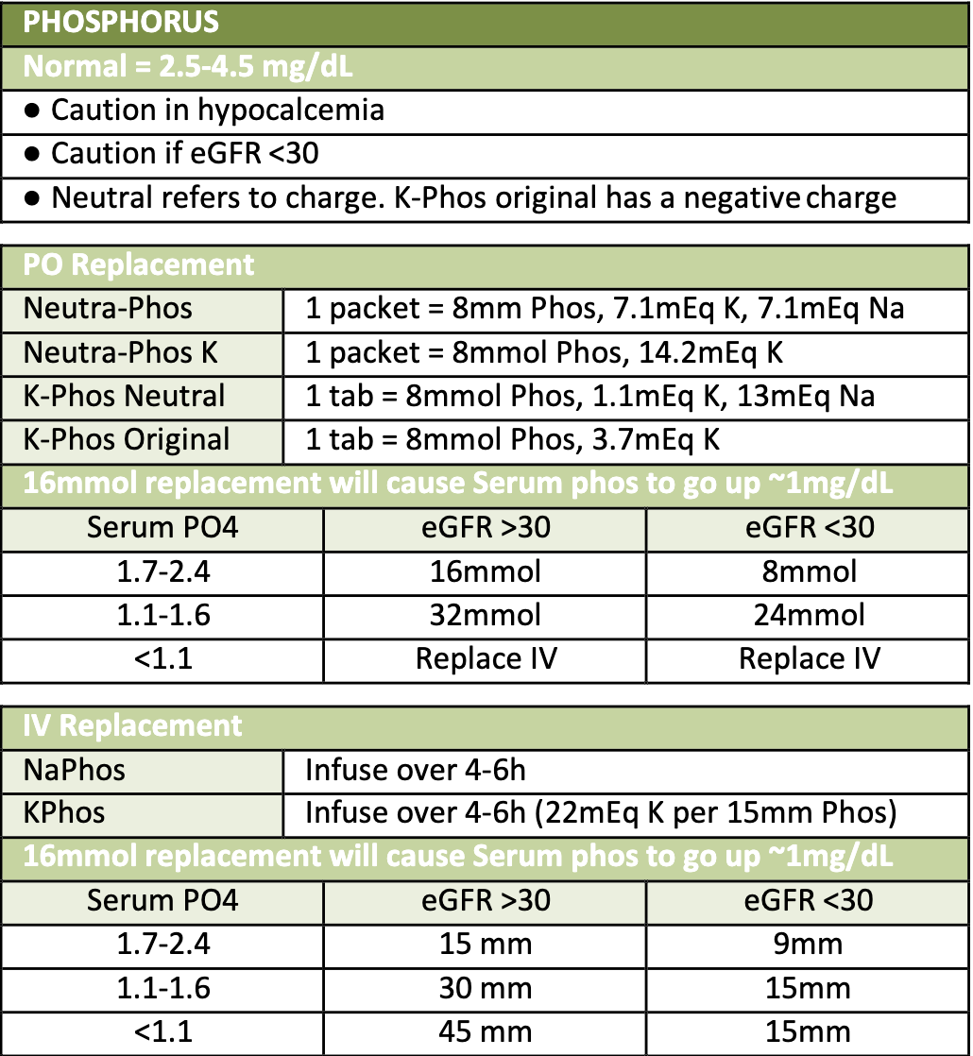
Practice Case
X is a 70F with pmh HFrEF (EF 40%) who is found to have Phos 1.9 and K+ 3.3 on am labs. How would you replace her phos?
K-phos Neutral 2 packets
Neutra-Phos K 2 packets
Neutra-Phos 2 packets
K-Phos Original 2 packes
Notes:
Answer: B. All answers work for the phos. But we want to increase K+ as well to 3.5. So formulation with most potassium is the way to go
Follow up questions: What would her K+ be after replacement with Neutra-Phos K 2 packets?
Follow up answer: ~3.6 because 14+14 = 28 = 2.8 increase!

Slide 19
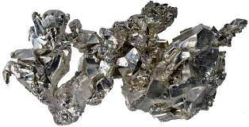
CALCIUM
Hypocalcemia = Ca2+ < 8.5
Ionized Ca2+ < 1.15

Slide 20
Low Ca2+
HIPOCALC
H: hypoparathyroid, hypo/er Mg+, hyperphos
I: infx, esp G– sepsis
P: pancreatitis
O: overload, osteoblastic lesions
C: CKD (Vit D deficient states)
A: absorption issues, alkalosis
L: loop diuretics
C: citrate-containing products (pRBCs)
Notes:
-Vit D deficiency = decreased intestinal Ca2+ absorption
-as pH increases, more Ca2+ binds to albumin, decreasing ical level. For this reason, alkalosis can cause/exacerbate sx of hypocalcemia

Slide 21
symptoms

Slide 22
Math: 1g Ca2+ Glc causes serum iCa2+ to increase by 1mg/dL
Critical care: If patient tanking, or has received a lot of blood product, or persistently hypotensive; check an ical!

Slide 23
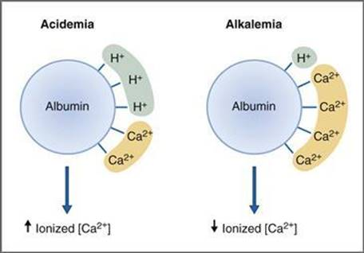
Albumin: Correct Ca2+ for albumin!
-If Albumin < 2, order ical.
-If corrected Ca+ still low, order ical
Math: (albumin)*0.8 + serum Ca2+ = corrected Ca2+

Slide 24
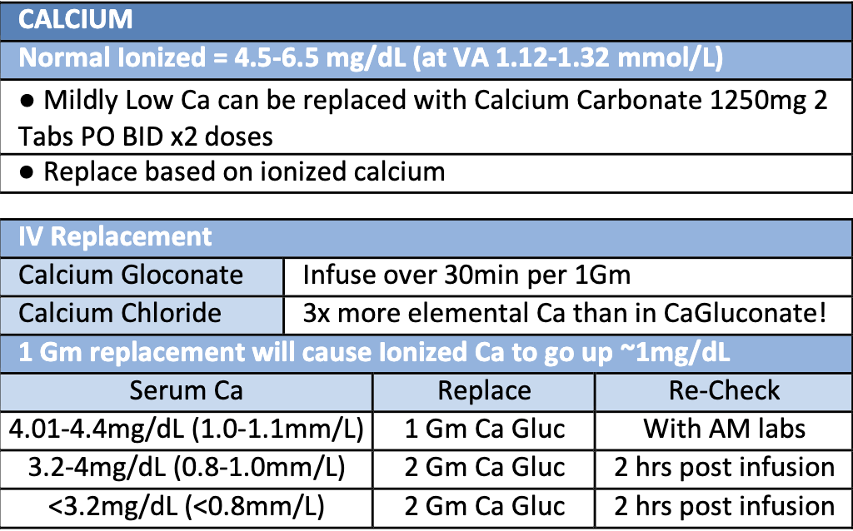
Practice Case
X is a 70F with pmh hyperparathyroidism and HFrEF who is found to have iCal to be 3.3mg/dL. How would you replace her Ca2+?
Ca2+ carbonate PO 1250mg PO BID
1gm Ca2+ gluconate
2gm Ca2+ gluconate
Notes:
Answer: C – you already have ical
Follow up question: when do you recheck?
Follow up answer: 2 hours post-transfusion

Slide 25
Mini Recap
Electrolyte | Goal | Caution with | Preferred formulation
Mg2+ | >2+ for cardiac | Renal | IV
K+ | >4+ for cardiac | Renal, low Mg+ | PO
Phos | >3+ for cardiac | K+ abnormalities (calcuate), low Ca+ | PO
Ca2+ | wnl | NA | IV
-check orders before replacing (so as to not double dip)
-keep track of what you are replacing regularly/daily
-caution in fluid overload
-through people on telemetry for hypokalemia!

Slide 26
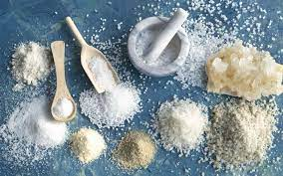
What about Na+?
Hyponatremia: Na+ < 135
Most COMMON electrolyte disorder
-slightly more complicated as involves water balance
-treatment varies: from water restriction to administering normal saline
-inappropriate to replace based on lab value alone

Slide 27
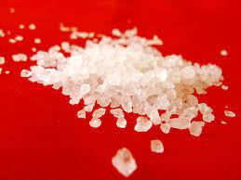
What about Cl-?
Hypochloremia: Cl- < 95
No.

Slide 28
What about Cl-?
Hypochloremia: Cl- < 95
-slightly more complicated as involves water balance
-ddx: diuretic, vomiting, diarrhea, hypotonic saline, Na+ Bicarb
-address volume depletion, less focus on electrolyte itself

Slide 29
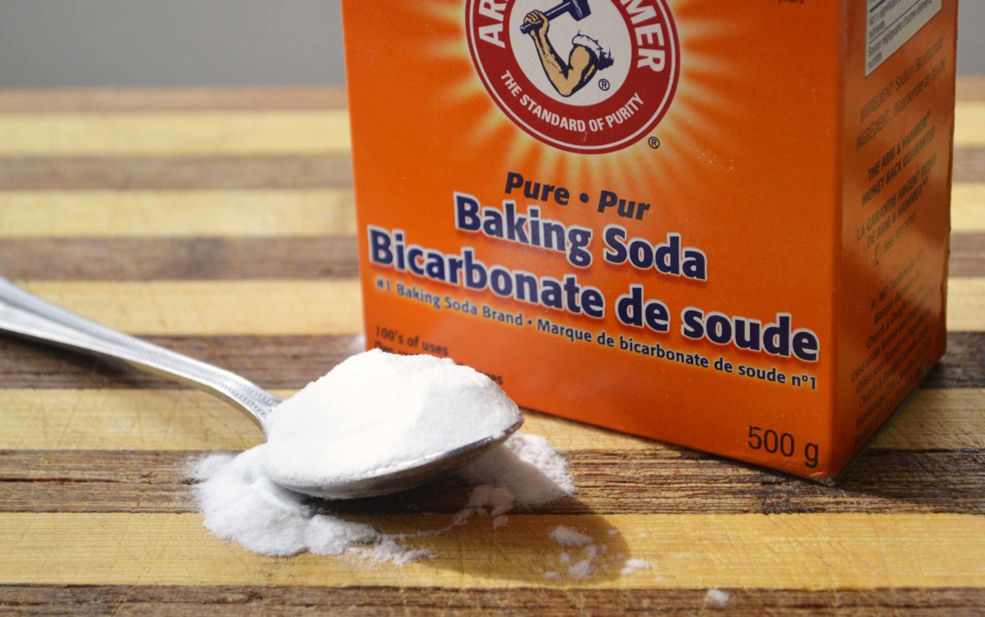
What about HC03-?
bicarb < 22
-slightly more complicated as involves acid-base balance
-replace for pH < 7.15 – patient should be in ICU
-bicarb gtt versus pushes (“amps”) of bicarb
Notes:
-replace for pH < 7.15 EXCEPT FOR DKA. Not indicated in DKA unless pH < 6.9

Slide 30
Mg+
Ca+
K+
phos-
extracellular
Na+
HCo3-
Cl-
intracellular
Notes:
Which electrolytes are intracellular and which are extracellular?

Slide 31
CELLS
Ca+
Na+
K+
HCo3-
phos-
Mg+
Cl-
others:
LDH
DNA/RNA

Slide 32
CASES
Scenario | Diagnosis
60M w/ lymphoma s/p chemo
60M T1DM w/ nausea/vomiting
60M w/ poor PO intake starts TF

Slide 33
CASES
Scenario | Diagnosis | Mechanism
60M w/ lymphoma s/p chemo | Tumor lysis syndrome | Cells explode
60M T1DM w/ nausea/vomiting | DKA | Electrolytes lost through osmotic diuresis, cannot enter cell because no insulin
60M w/ poor PO intake starts TF | Refeeding syndrome | Nutrition received, insulin increase, electrolytes enter cell
Notes:
Key point: insulin helps intracellular electrolytes enter the cell

Slide 34
CASES: Tumor Lysis Syndrome
Scenario | Diagnosis | Mechanism | K+ | Mg+ | Phos | Ca+
60M s/p chemo | Tumor lysis syndrome | Cells explode

Slide 35
CASES: DKA
Scenario | Diagnosis | K+ | Mg+ | Phos | Ca+ | other
60M s/p chemo | Tumor lysis syndrome | high | high | high | low | Uric acid high
60M T1DM w/ nausea/vomiting | DKA |  | X |  | X

Slide 36
CASES: Refeeding syndrome
Scenario | Diagnosis | K+ | Mg+ | Phos | Ca+ | other
60M w/ lymphoma s/p chemo | Tumor lysis syndrome | high | high | high | low | Uric acid high
60M T1DM w/ nausea/vomiting | DKA | High, globally low | Various levels, globally low | High, globally low | Various | Bicarb low, H+ high, Glc high, *Na+ low
60M w/ poor PO intake starts TF | Refeeding syndrome
*correct for glc

Slide 37
CASES
Diagnosis | K+ | Mg+ | Phos | Ca+ | other
Tumor lysis syndrome | high | high | high | low | Uric acid high
DKA | High, globally low | Various levels, globally low | High, globally low | Various | Bicarb low, H+ high, Glc high, *Na+ low
Refeeding syndrome | low | low | low | low
*correct for glc

Slide 38
Thank you! Questions?

