Slide 1
QUESTION BANK
MARCH 17TH
MYOSITIS/ LUPUS/SJOGREN’S/APLAS

Slide 2
QUESTION 1
A 60-year-old woman presents to your clinic for evaluation of weakness and a new skin rash. Over the last several months, she has noted worsening weakness in her arms and legs with difficulty combing her hair and rising from a seated position.
Her rash has involved her chest and eyelids and is purplish in color. On examination, you note 4/5 proximal muscle weakness, heliotrope rash, and "V sign". You diagnose her with dermatomyositis, and subsequent laboratory testing reveals positive anti-TIF-1 gamma antibodies.
She has received a mammogram in the past year and had a Pap smear two years prior; both of these studies were normal.
She has never had a screening colonoscopy.

Slide 3
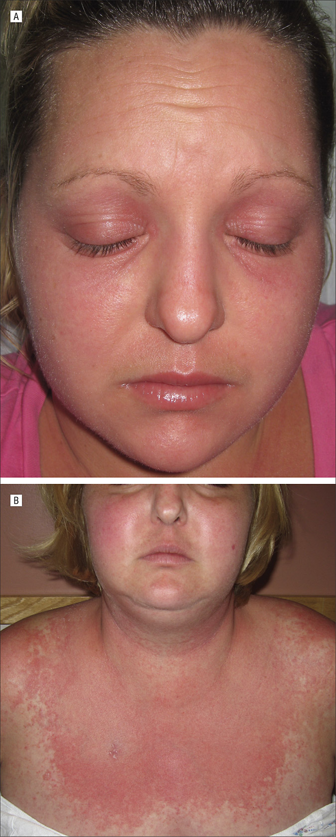

Slide 4
Which one of the following should you recommend for cancer screening at this time?
A. No additional screening necessary
B. Colonoscopy only
C. CT of chest, abdomen, pelvis, CA-125 blood test, pelvic ultrasound, and colonoscopy
D. CT of chest, abdomen, pelvis only
Answer: C

Slide 5
Understanding the Cancer Risk in Dermatomyositis
Patients with dermatomyositis (DM) face a significantly elevated risk of malignancy, with studies showing a 4.66-fold increased cancer risk compared to the general population.
This risk is particularly pronounced within 3 years before and after the diagnosis of dermatomyositis.
The temporal clustering of cancer diagnoses around the time of DM diagnosis is well-documented, with most malignancies occurring within the first year after diagnosis.

Slide 6
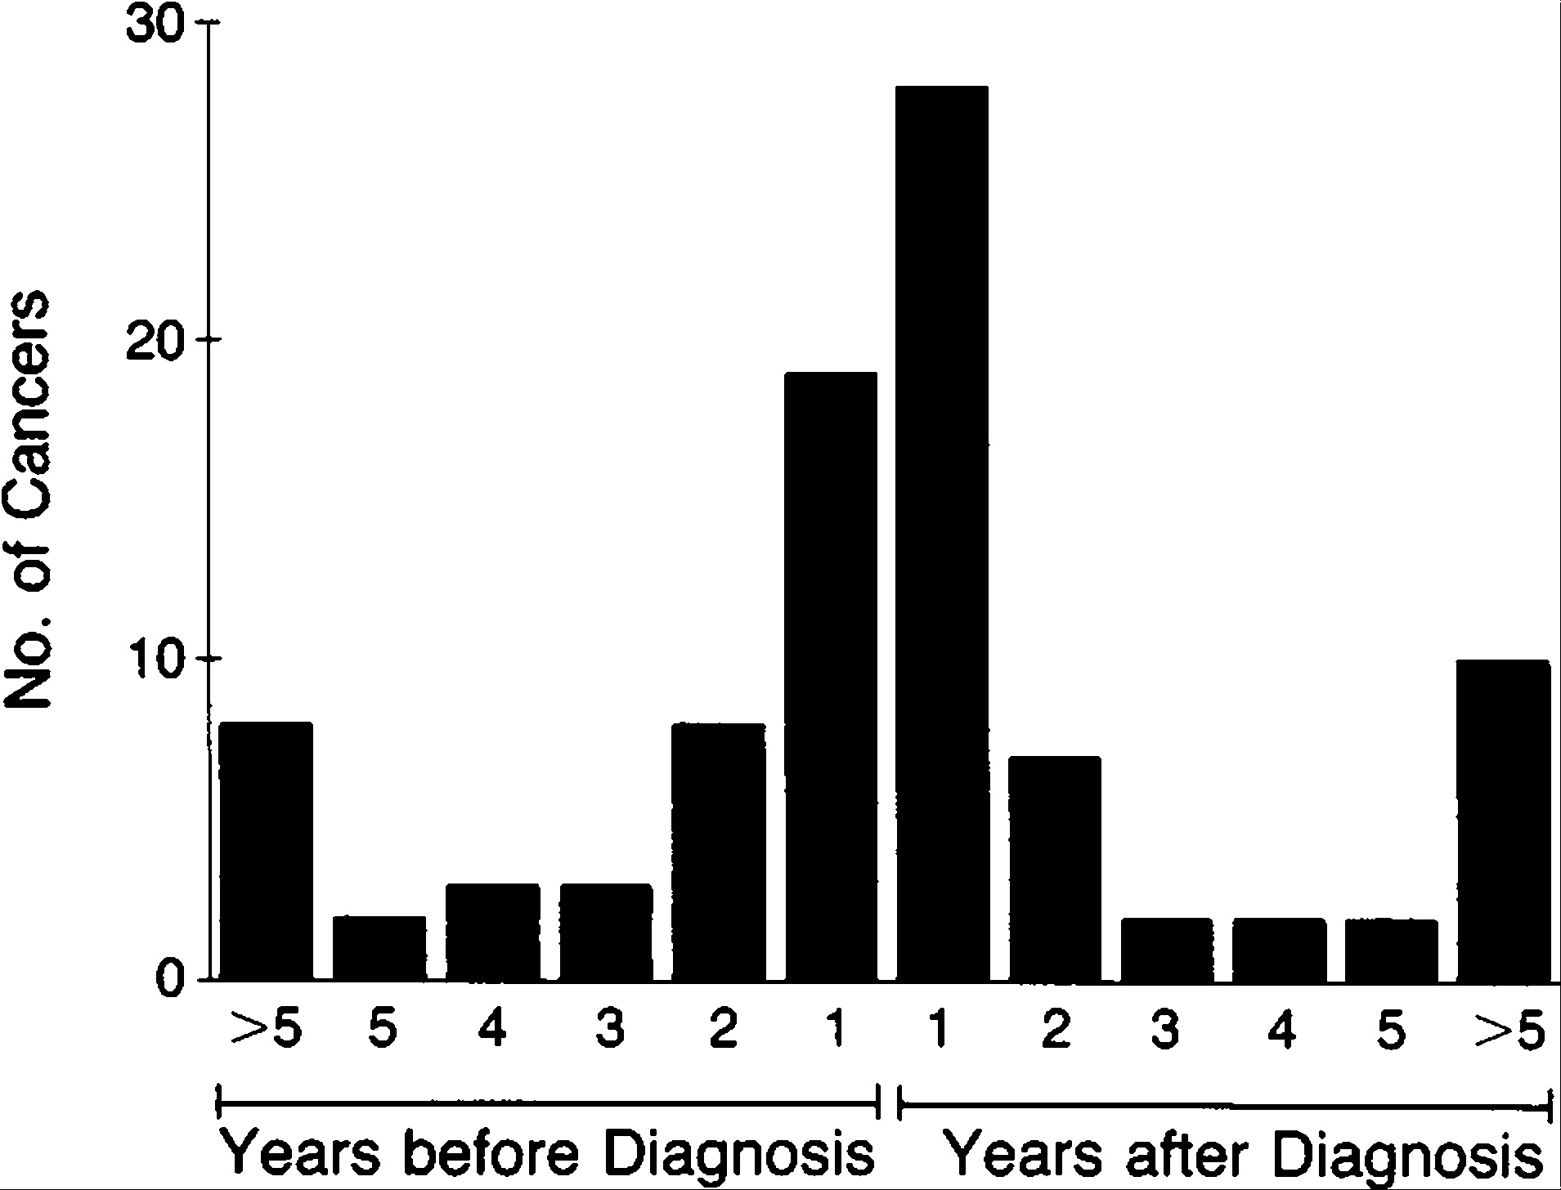

Slide 7
International Guidelines for Cancer Screening
The International Myositis Assessment and Clinical Studies Group (IMACS) published comprehensive guidelines in 2023 for cancer screening in idiopathic inflammatory myopathies. These guidelines stratify patients into standard, moderate, or high risk based on:
IIM subtype
Autoantibody status
Clinical features

Slide 8
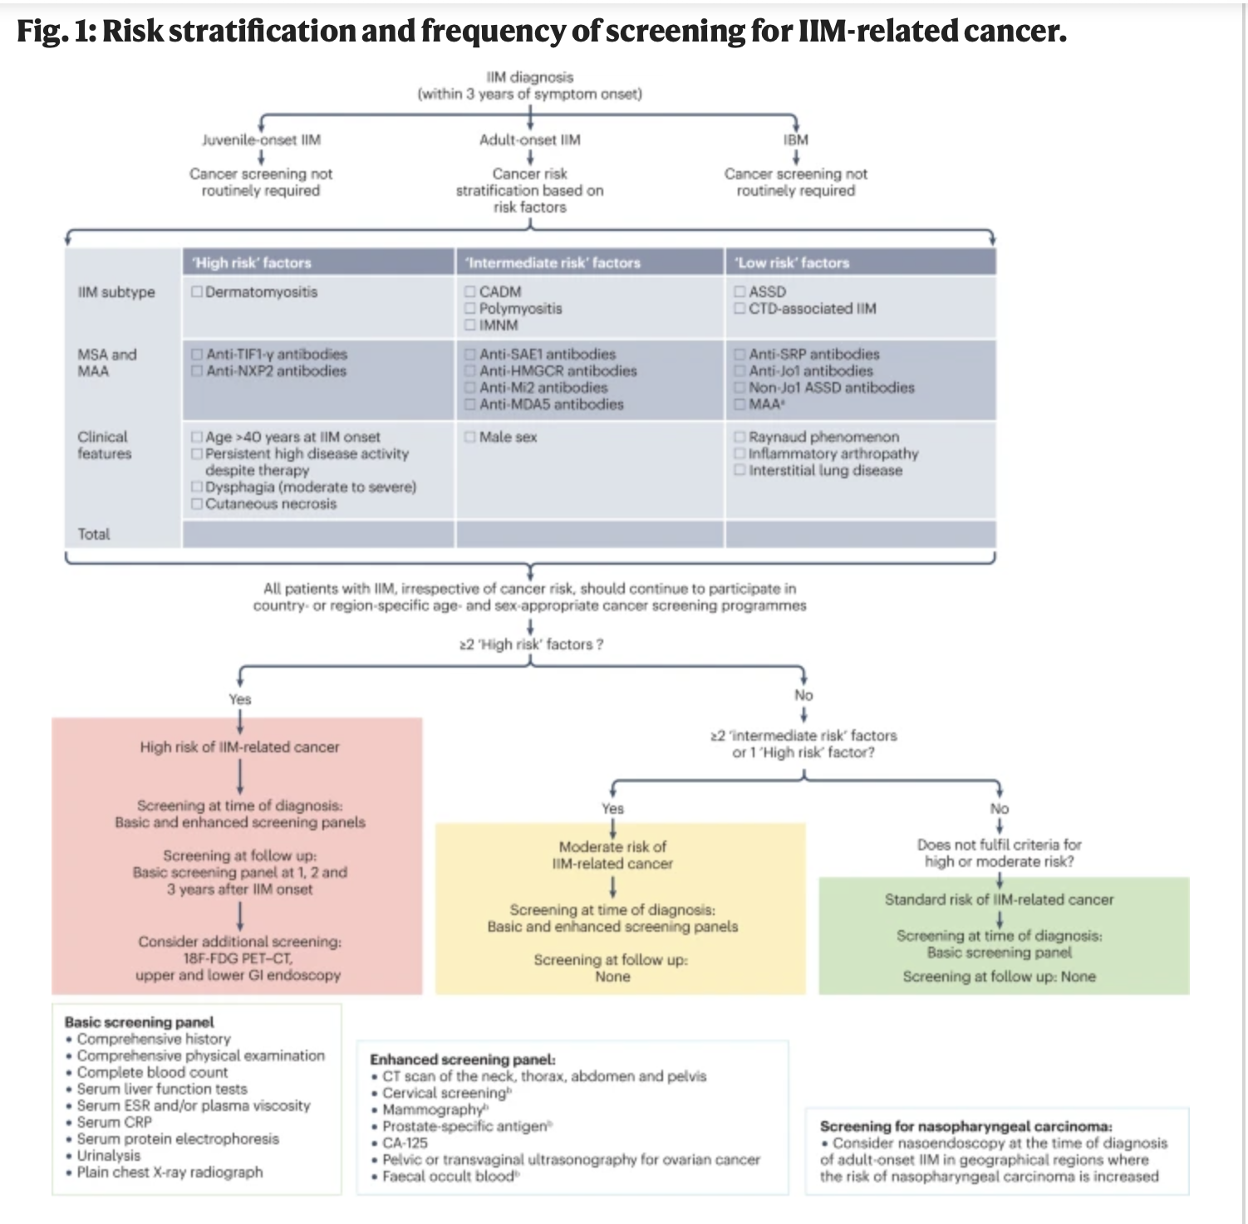

Slide 9
Risk Stratification: Why This Patient is High-Risk ?
This patient has multiple high-risk features that place her in the highest cancer risk category:
-Anti-TIF-1γ antibody positivity: This is the strongest predictor of cancer-associated dermatomyositis, conferring a 9.37-fold increased cancer risk. Patients with anti-TIF-1γ antibodies have particularly elevated risks for ovarian cancer (standardized prevalence ratio 18.39) and breast cancer (standardized prevalence ratio 3.84).
-Age 60 years: Older age (particularly >45 years) is an independent risk factor for malignancy in dermatomyositis.
-Classic dermatomyositis with cutaneous manifestations: The presence of classic DM (rather than clinically amyopathic DM) increases cancer risk, with one study showing 9.9% of classic DM patients had malignancy within 2 years versus only 1.7% of clinically amyopathic DM patients.

Slide 10
Common malignancies in Dermatomyositis
Ovarian cancer (especially with anti-TIF-1γ)
Lung cancer
Breast cancer
Colorectal cancer
Gastric cancer
Pancreatic cancer
Nasopharyngeal cancer (particularly in Asian populations)
Lymphoma

Slide 11
Pearls
No additional screening is incorrect. This patient is at extremely high risk for occult malignancy, hence comprehensive screening needs to be done immediately.
Doing colonoscopy alone is grossly inappropriate for a high-risk dermatomyositis patient. Colorectal cancer is one of several malignancies associated with DM, but ovarian, lung, and breast cancers are equally or more concerning, particularly with anti-TIF-1γ positivity.
CT chest, abdomen and pelvis alone misses ovarian cancer screening and colon cancer screening.

Slide 12
Important message
Patients classified as high-risk (which includes this patient with anti-TIF-1γ positive dermatomyositis at age 60) should undergo enhanced cancer screening that includes :
CT imaging of chest, abdomen, and pelvis
Tumor markers (including CA-125 for ovarian cancer screening in women)
Pelvic ultrasound (particularly important given the high ovarian cancer risk with anti-TIF-1γ)
Age-appropriate screening updated to current recommendations

Slide 13
Clinical pearls
Timing is critical: Most dermatomyositis-associated cancers are diagnosed within 1 year of DM diagnosis, and cancers are often at advanced stages, contributing to mortality.
Anti-TIF-1γ is the strongest predictor: Among all myositis-specific antibodies, anti-TIF-1γ confers the highest cancer risk.
Enhanced screening saves lives: Myositis-associated cancers are often occult and asymptomatic at diagnosis. Enhanced screening with CT imaging has been shown to effectively identify underlying malignancies.
PET-CT may be considered: For very high-risk patients where initial enhanced screening is negative, whole-body PET-CT can be considered as it has shown good performance (AUC 0.87) for detecting occult malignancy.
Follow-up screening: The elevated cancer risk persists for 3 years, so continued surveillance is recommended during this period.

Slide 14
QUESTION 2
A 54-year-old woman presents with progressive weakness and sensory changes.
History of Present Illness:
Three weeks prior: left foot dorsiflexion weakness (“foot drop”).
One week later: distal right arm weakness with wrist drop and painful paresthesias in right hand.
Then: painful burning in both feet and right foot weakness.
Also complains of generalized fatigue and nonproductive cough.
Past Medical History:
No other pertinent medical problems.
History of recurrent sinusitis over past 6 months, treated with repeated courses of antibiotics (most recently fluoroquinolone).

Slide 15
Physical examination
Vital signs: normal
Mental status: normal
Cranial nerves: normal
Motor strength:
  Bilateral foot movements: 2/5
  Right upper extremity distally: 3/5
  Left upper extremity: 5/5
Reflexes:
  Achilles: absent
  Patella and upper extremities: normal
Sensory changes:
  Radial and ulnar distributions of right hand
  Lateral lower legs and dorsum of feet bilaterally

Slide 16
Laboratory results
CBC: Hct 32%, WBC 11,200/uL (normal differential), platelets 456,000/uL
CMP: Creatinine 1.6 mg/dL, albumin 3.1 g/dL
Urine dipstick (office): positive for blood and protein
Inflammatory markers: ESR 80 mm/h, CRP 45 mg/L
Complement: C3 198 mg/dL, C4 42 mg/dL (both normal)
Serologies: ANA, RF, ANCA, ACE pending
Imaging: Chest x-ray: bilateral lung nodules

Slide 17
Question
Which one of the following is the most likely diagnosis of this patient’s neuromuscular symptoms?
A. Guillain-Barré syndrome
B. Antibiotic-induced polyneuropathy
C. Vasculitic neuropathy
D. Idiopathic inflammatory myositis
E. SLE
Answer: C

Slide 18
Explanation and rationale
This case illustrates a presentation most consistent with “mononeuritis multiplex”, which is most often caused by a vasculitic neuropathy.
Features supporting vasculitic neuropathy:
  Progressive, asymmetric weakness in different myotomes
  Pain and altered sensation in individual nerve distributions
  History of recurrent sinus inflammation
  Abnormal chest x-ray with lung nodules
  Elevated inflammatory markers (ESR, CRP)
  Renal dysfunction and abnormal urine
This patient actually had ANCA-associated vasculitis/ GPA (Granulomatosis with Polyangiitis).
Immediate management: start high-dose glucocorticoids.

Slide 19
Differential considerations
Guillain-Barré syndrome (GBS):
  Classically presents as initially distal symmetric lower extremity weakness, ascending proximally
  Diffuse areflexia
  Motor deficits more common than sensory
  Often preceded by viral infection or immunization
Antibiotic-induced peripheral neuropathy:
  Rare complication
  Typically symmetric sensory neuropathy or diffuse small fiber neuropathy, primarily pain
  Fluoroquinolones most commonly implicated (also dapsone, linezolid, metronidazole, nitrofurantoin)

Slide 20
SLE neuropathy:
  Can affect peripheral nervous system and cause nephropathy
  Sinus involvement, lung nodules, elevated WBC/platelets, and high complement levels make SLE less likely in this patient

Slide 21
Why is it not Idiopathic Inflammatory Myositis?
Pattern of Weakness:
  IIM typically causes symmetric, proximal muscle weakness (shoulders, hips) rather than asymmetric, distal weakness in multiple individual nerves (mononeuritis multiplex pattern).
  This patient has foot drop, wrist drop, and distal limb involvement, which is not characteristic of IIM.
Sensory Involvement:
  IIM is primarily a motor disorder; sensory symptoms are usually absent.
  This patient has painful paresthesias in the right hand and burning in the feet, suggesting peripheral nerve involvement, not myopathy.
Reflexes:
  Reflexes in IIM are generally preserved unless severe weakness is present.
  This patient has absent Achilles reflexes, consistent with peripheral neuropathy, not a primary muscle disease.
Timeline and Progression:
  IIM usually develops gradually over weeks to months, often bilaterally.
  This patient’s course is rapid, asymmetric, and sequential in different nerve distributions.

Slide 22
Laboratory Findings:
  IIM is usually associated with elevated creatine kinase (CK) and aldolase.
  No CK or aldolase elevation is mentioned here, and the pattern of renal and inflammatory labs points toward vasculitis rather than primary myositis.
Systemic Features:
  IIM often has skin findings (heliotrope rash, Gottron’s papules in dermatomyositis) or interstitial lung disease.
  This patient has sinusitis, lung nodules, renal involvement, which are more consistent with ANCA-associated vasculitis rather than idiopathic myositis.
Response to Distribution:
  IIM rarely causes mononeuritis-like patterns; asymmetric, distal, painful neuropathy points strongly toward vasculitic neuropathy.

Slide 23
QUESTION 3
A 29-year-old woman with SLE is admitted to the hospital with headache, confusion, and visual disturbance. Her mother reports she had one generalized seizure.
Past Medical History:
Diagnosed with SLE 1 month ago, manifested by fever, adenopathy, arthritis, rash, and nephritis.
Labs at diagnosis: positive ANA, elevated anti-dsDNA antibodies, low complements.
Antiphospholipid antibodies: negative for lupus anticoagulant; IgM anticardiolipin antibody 44 MPL units (nl <40); IgM anti-β2 glycoprotein I 33 MPL units (nl <30).
Kidney biopsy: diffuse proliferative glomerulonephritis.
Treatment started: prednisone 30 mg twice daily.
One week ago: first dose of IV cyclophosphamide (0.75 g/m²).

Slide 24
Medications and Physical exam
Current Medications:
Acetylsalicylic acid 81 mg
Furosemide 80 mg daily
Lisinopril 10 mg daily
Physical Examination :
Pulse: 90/min
Blood pressure: 188/105 mm Hg
Afebrile, mildly Cushingoid
Discoid lupus lesions: right ear, scalp, left upper arm
Cardiac: 2/6 systolic murmur (known)
Neurologic: somnolent, only knows name, does not follow commands well; moves all extremities equally; responds to painful stimuli; diffusely hyperreflexic; 3 beats of nonsustained clonus; negative Babinski
Other: unremarkable

Slide 25
Laboratory studies and Imaging
CBC: Hct 33%, WBC 4600/uL (82% neutrophils), platelets 180,000/uL
Chemistries: normal electrolytes, glucose, calcium, magnesium
Creatinine: 1.7 mg/dL (same as 1 week ago)
Liver tests: normal except albumin 2.7 g/dL
Urinalysis: 2+ protein, 5–10 RBCs/HPF, 0–2 hyaline or granular casts/low PF
CSF: 2 mononuclear cells/uL, protein 66 mg/dL, normal glucose

Slide 26
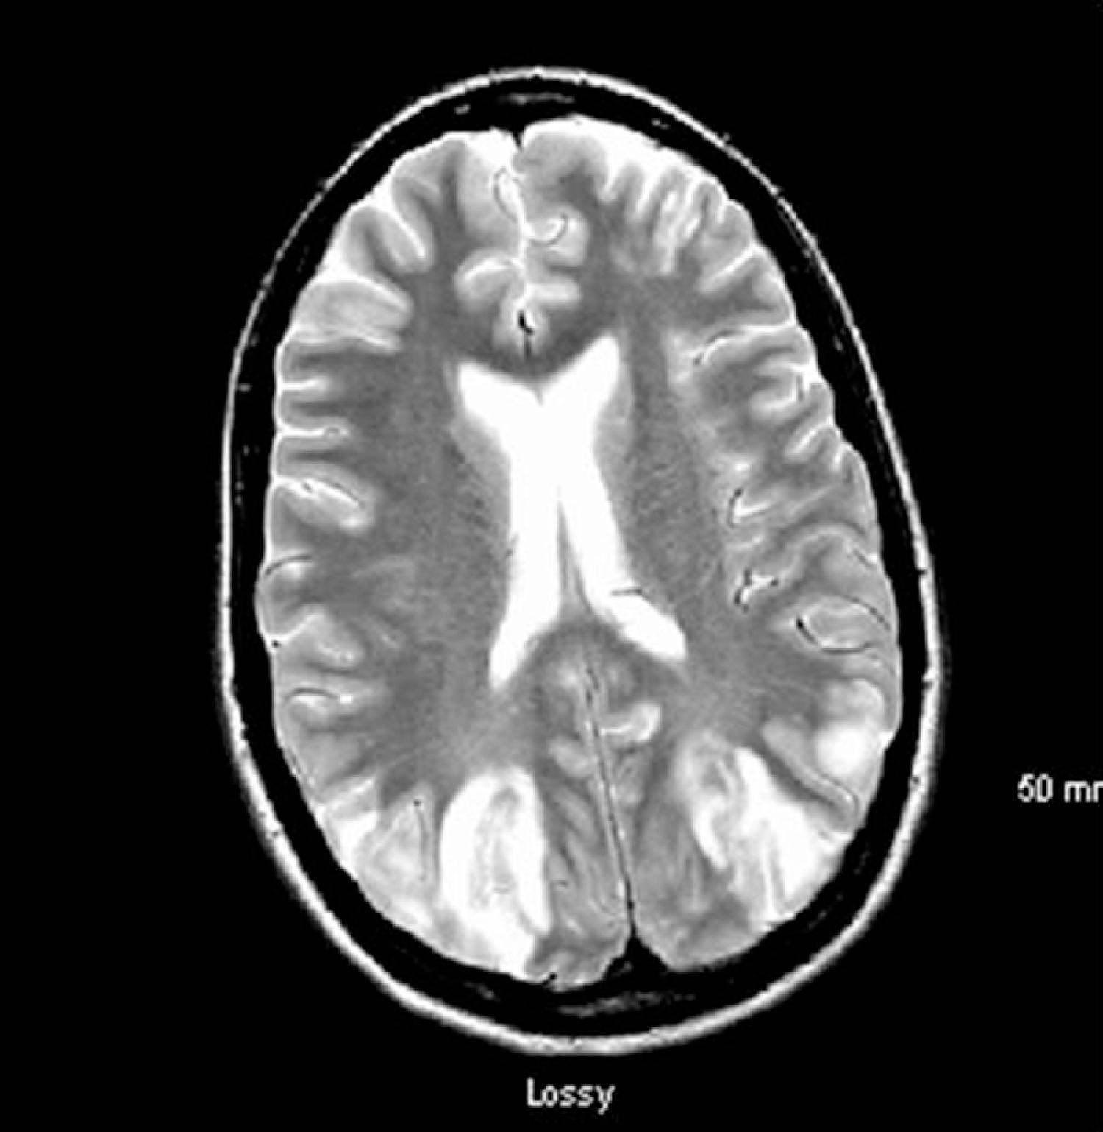
MRI of the brain: radiologist reports posterior leukoencephalopathy

Slide 27
Question
Which one of the following is the most important treatment for this patient?
A. Control BP
B. High dose IV solumedrol
C. Rituximab
D. Heparinization
E. Anticonvulsant therapy
Answer: A

Slide 28
Explanation/Rationale
Posterior leukoencephalopathy syndrome (PLS) / Posterior reversible encephalopathy syndrome (PRES):
  Important reversible secondary cause of neurologic dysfunction in SLE patients.
  Typical onset: seizures, accelerated hypertension, renal insufficiency, headache, visual disturbance, and confusion.
  Over 75% of patients developing PLS/PRES had recent initiation or escalation of immunosuppressive therapy (IV solumedrol, IV cyclophosphamide) within ~7 days before neurologic symptoms.
  MRI findings: majority have posterior circulation brain abnormalities, likely due to vasogenic edema.

Slide 29
Treatment
  Most important immediate therapy: control BP to <140/90 mm Hg.
  Giving more immunosuppression is contraindicated.
  Low titer antiphospholipid antibodies do not contribute to PLS/PRES, so anticoagulation is not indicated.
  Most patients achieve complete resolution of symptoms with BP control.
  Anticonvulsants are only indicated if seizures recur despite BP control.
  In this patient, switching from IV cyclophosphamide to mycophenolate mofetil may reduce relapse risk of PLS/PRES.

Slide 30
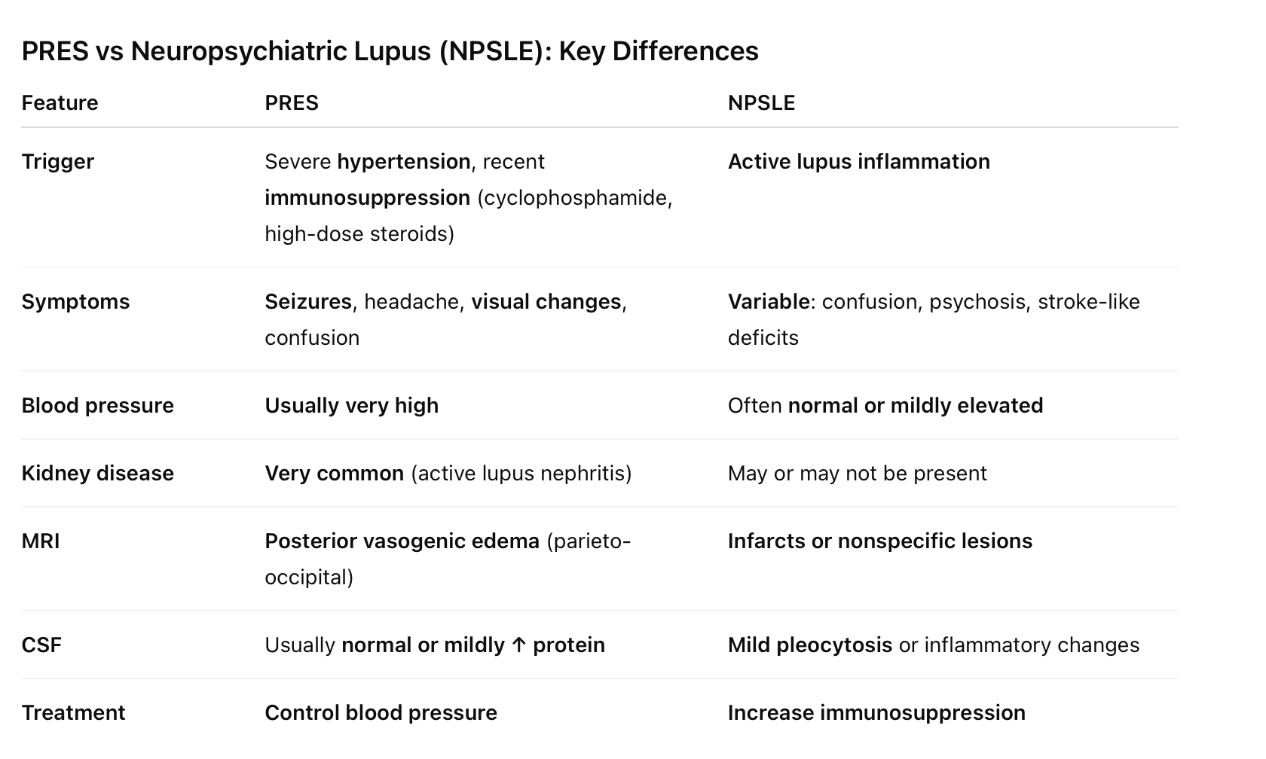
PRES vs
Neuropsychiatric Lupus

Slide 31
QUESTION 4
A 67-year-old woman presents with ocular and oral dryness of 5 years duration. She has a daily gritty sensation in her eyes and uses preservative-free eye drops three times daily to alleviate her symptoms. She wakes up at night with a dry mouth and must sip water in order to swallow crackers and other dry foods.
The patient has never noted enlargement of her salivary glands. She denies fevers, chills, unintentional weight loss, Raynaud's, inflammatory joint pain, photosensitivity, oral or nasal ulcerations, pleuritic chest pain, shortness of breath, or focal neurologic symptoms.
She has mild lower extremity edema which she treats with compression stockings and furosemide as needed. Of note, she has been using this medication over the last two weeks on a more regular basis. She is currently using prescription-strength retinoids topically at night to alleviate photoaging.

Slide 32
Physical examination
Reduced sublingual salivary pooling.
No major salivary gland tenderness or enlargement.
Saliva can be expressed from Stenson's ducts bilaterally.
Tongue is without fissuring or papillary atrophy.
No evidence of synovitis, rash, lymphadenopathy, abnormal breath sounds, or splenomegaly.
Objective Tests:
Unstimulated whole salivary flow: 0.2 mL/5-minutes
Schirmer's test: 1 mm of wetting in each eye after 5 minutes

Slide 33
Laboratory findings
ANA: 1:160 (homogenous staining)
Rheumatoid factor: negative
Anti-SSA antibody: negative
Anti-SSB antibody: negative

Slide 34
Question
What should be the next step to complete a diagnostic evaluation for Sjögren's?
A. Perform salivary gland ultrasound
B. Send her to a cornea expert for a dry eye exam, to include ocular surface staining assessment with both fluorescein and lissamine green
C. Send for labial salivary gland biopsy
D. Order a send-out lab for early markers: salivary protein-1 (SP-1), carbonic anhydrase 6 (CA6), and parotid secretory protein (PSP)
Answer: C

Slide 35
Explanation/Rationale
This patient presents with symptoms of dryness and has low tear and saliva flow rates (by the stringent 2016 American College of Rheumatology [ACR]/European Alliance of Associations for Rheumatology [EULAR] criteria).
To differentiate dryness in the setting of Sjögren's disease (SjD) from other causes, it is imperative to establish that autoimmunity is driving the dryness.

Slide 36
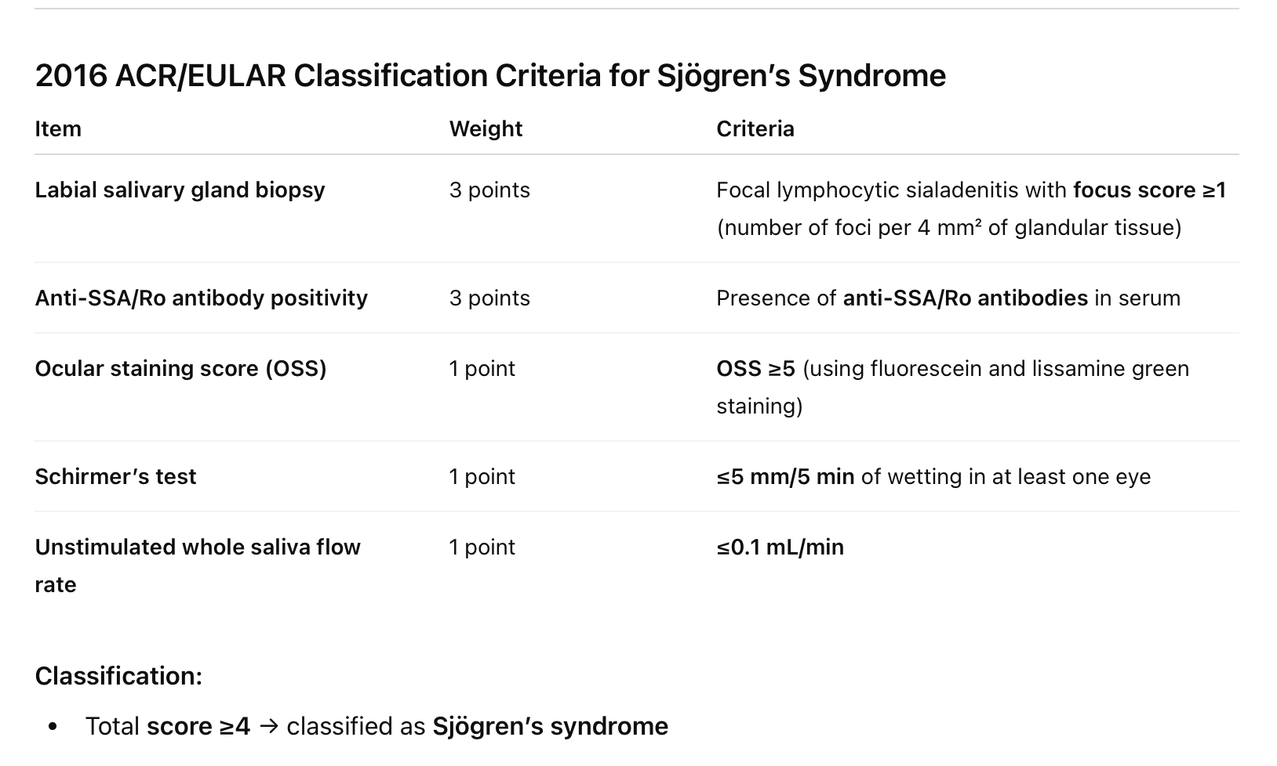
  Currently, labial salivary gland biopsy remains the gold standard for diagnosis of anti-SSA antibody negative Sjögren's patients.

Slide 37
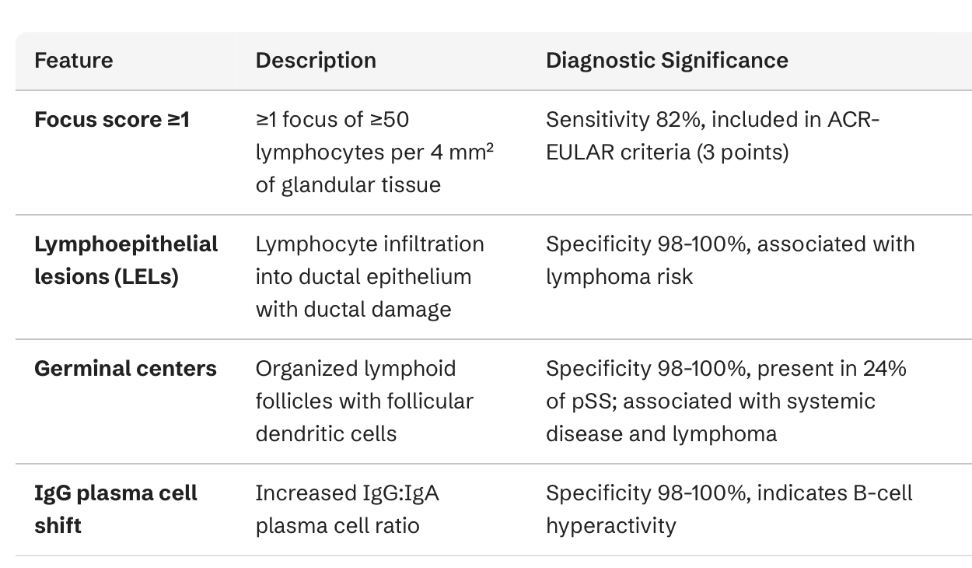
Findings of minor salivary gland biopsy : The characteristic finding is focal lymphocytic sialadenitis (FLS)—periductal aggregates of lymphocytes

Slide 38
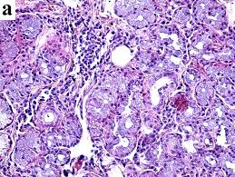
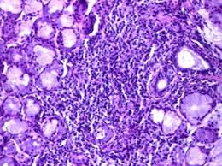
Focal lymphocytic sialadenitis: Dense aggregates of lymphocytes (focus) adjacent to salivary ducts and acini. A “focus” = ≥50 lymphocytes in a 4 mm² area.

Slide 39
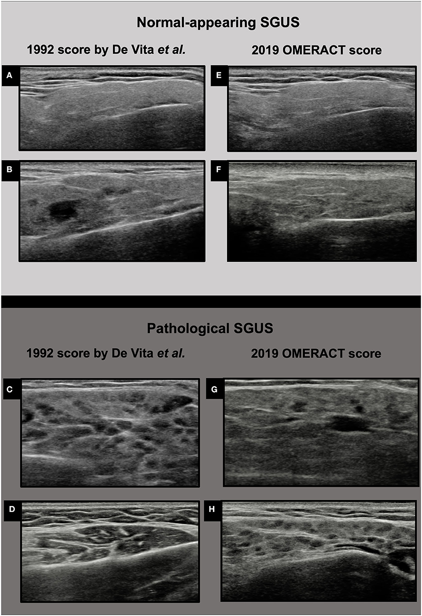
Salivary gland US
Patchy or “honeycomb-like” appearance of normally smooth gland tissue.
Small, multiple, rounded/oval dark spots → lymphocytic infiltration or tissue destruction.
Bright white lines or spots → fibrosis or fatty infiltration.
Gland edges difficult to distinguish from surrounding tissue.
Color Doppler shows increased blood flow in active inflammation.

Slide 40
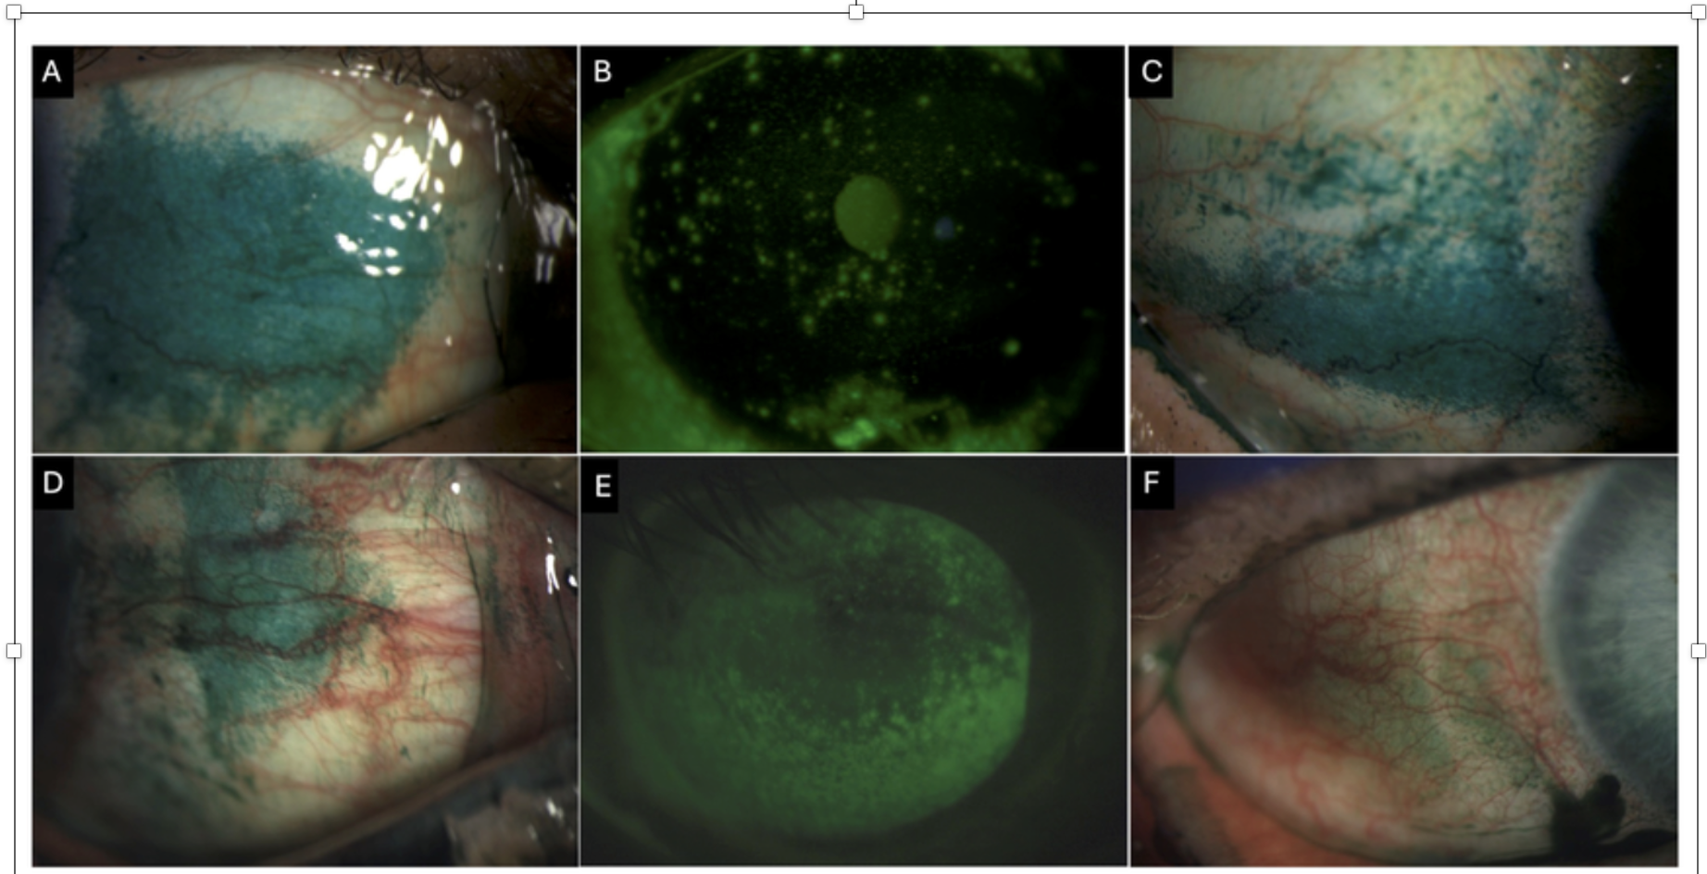
Lissamine green and fluorescein staining are used together to assess ocular surface damage in autoimmune dry eye—lissamine stains devitalized conjunctival cells, fluorescein stains corneal epithelial defects.
Conjunctival lissamine green staining
A,C,D
Corneal fluorescein staining
B,E

Slide 41
QUESTION 5 : SLE AND THROMBOSIS
Age/Sex/Race: 48-year-old white woman
Past Medical History: Systemic lupus erythematosus (10 years)
  Manifestations: arthritis, photosensitivity, discoid rash, leukopenia
  Serologies: ANA positive, anti-SS-A positive, dsDNA negative
  Complement levels: always normal
Lifestyle: Occasional smoker, social alcohol use
Family History: Unremarkable
Recent Event
Presentation: Right lower extremity swelling
Event: Distal DVT (posterior tibial vein) after long plane flight
Current Medications:
  Prednisone 5 mg daily
  Hydroxychloroquine 400 mg daily
  Calcium + Vitamin D
  Rivaroxaban (started 1 month ago)

Slide 42
She denies a history of previous venous or arterial thrombosis.
She has had one normal pregnancy.

Slide 43
Labs & Imaging
CBC: Hct 40%, WBC 3800, Plt 140,000
Renal/Liver function: normal
Urinalysis: normal
PT/PTT: normal
Doppler US: distal posterior tibial vein clot
Physical Exam
Obese
Mild mottling of lower extremities (resolves with warming → cutis marmorata)
Mild alopecia
Healed discoid lupus lesion on left ear
Right lower extremity: swelling below the knee

Slide 44
Which one of the following tests is most likely to be positive if you ordered it today?
A. Anticardiolipin antibody-IgM
B. Anti-B2 glycoprotein I antibody-IgG
C. Lupus anticoagulant
D. Factor V Leiden mutation
E. Elevated homocysteine

Slide 45
Key concepts
1. Thrombosis Risk in SLE
Provoked vs Unprovoked DVT:
  This patient’s DVT is provoked: long plane flight, obesity, smoking, SLE itself
  No history of recurrent thrombosis or pregnancy complications → low suspicion for primary thrombophilia
Laboratory Considerations:
  Lupus anticoagulant (LA): Can be falsely positive with DOACs (rivaroxaban)
  Anticardiolipin & anti-β2 glycoprotein I antibodies: Often negative in isolated provoked DVT
  Genetic thrombophilia: Factor V Leiden, prothrombin mutation, hyperhomocysteinemia → less likely
2. Cutaneous Clues
Cutis marmorata: mottled, blanchable skin that resolves with warming
  Often benign, not associated with hypercoagulability
Livedo reticularis: persistent, non-blanchable → raises suspicion for APS

Slide 46
Answer and rationale
Answer: C. Lupus anticoagulant
Patient is on a DOAC (rivaroxaban) → LA test can be falsely positive
No history of recurrent thrombosis or pregnancy complications → low pre-test probability for APS
Other thrombophilia tests likely negative given provoked nature of DVT
The DVT is considered provoked due to her risk factors of SLE, obesity, smoking, and immobility during a plane flight.
She has no prior history of clot or pregnancy complications and no family history of thrombosis.
Her PTT was normal prior to starting anticoagulation.

Slide 47
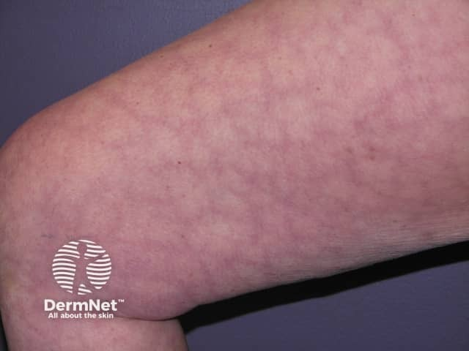
Cutis Marmorata

Slide 48
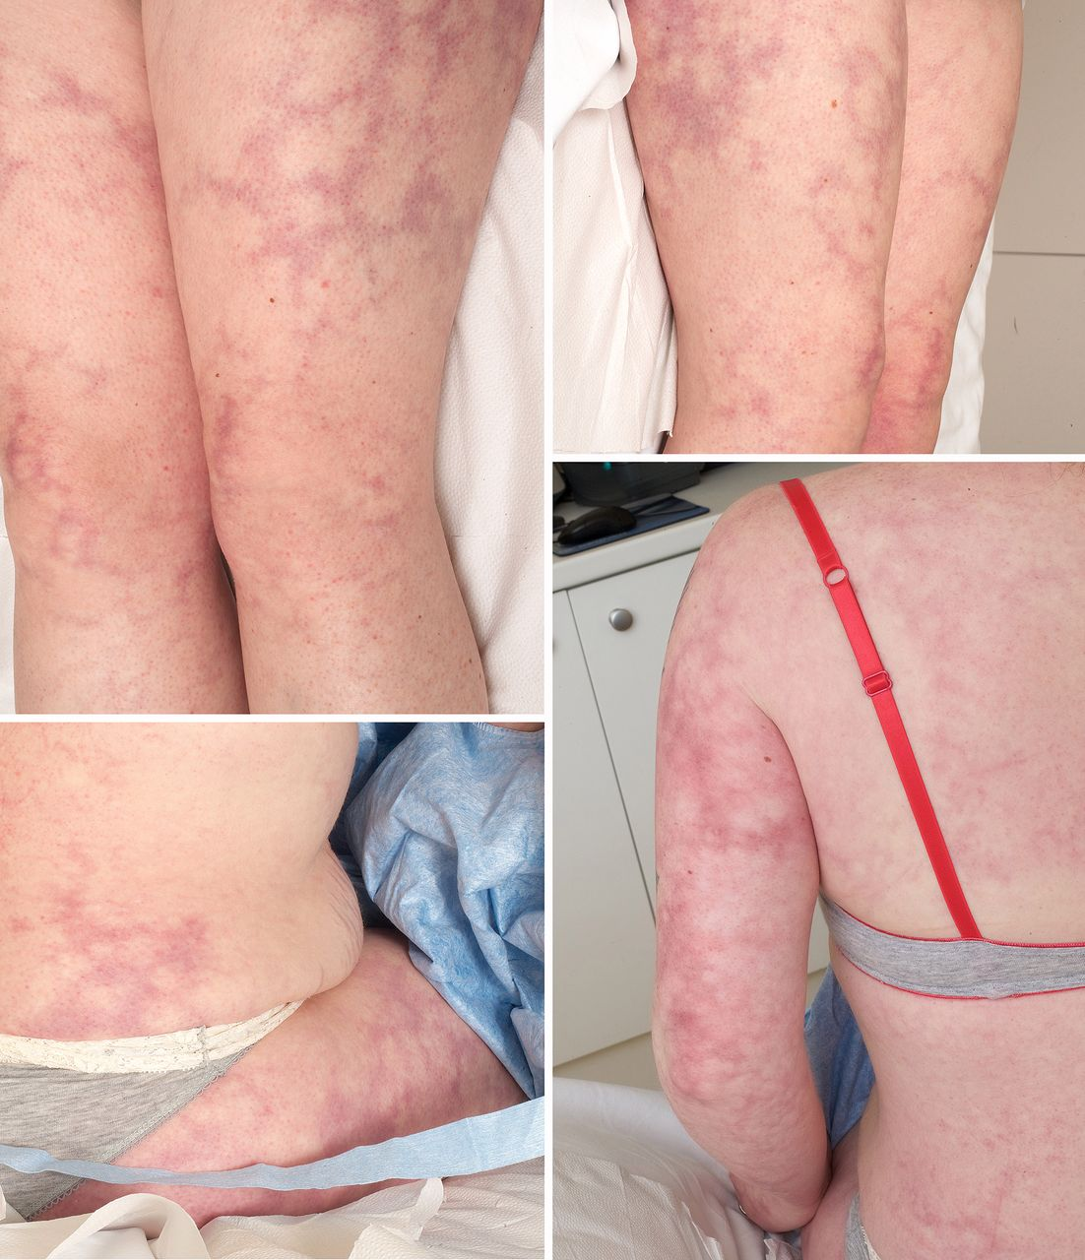
Livedo Racemosa

Slide 49
Test | Likely Result in This Patient | Notes
Lupus anticoagulant | False positive | Due to rivaroxaban interference
Anticardiolipin IgM | Negative | Usually positive in APS
Anti-β2 glycoprotein I IgG | Negative | Usually positive in APS
Factor V Leiden | Negative | Genetic risk; no family history or recurrent events
Homocysteine | Normal | Mild elevations increase risk, not typical in SLE

Slide 50
High-Yield Pearls
DOACs interfere with lupus anticoagulant testing.
Provoked DVT in SLE without history of recurrent thrombosis or pregnancy morbidity generally does not indicate primary thrombophilia.
Cutis marmorata ≠ livedo reticularis → important dermatologic clue. Mottled skin that resolves with warming and rubbing the skin
APS antibodies (anticardiolipin, anti-β2-GPI) are usually checked after anticoagulation is paused for accuracy.

