Slide 1

Cough.
Basic concepts about physiopathology and management
Daniel Puebla, MD.
Clinical Assistant Professor
Pulmonary and Critical Care Medicine
University of Arizona College of Medicine Phoenix

Slide 2
Overview and Objectives
To identify definition of normal and abnormal: Is Cough ‘good’ or ‘bad’?
To describe the Mechanics of Cough and pathophysiology of Cough
To learn about the Differential Diagnosis of Cough
To identify an organized Diagnostic Approach to Cough
To guide principles of Cough Management

Slide 3
CASE
55 yo M comes to PCP clinic with complaints of persistent cough. He does not have any prior medical history, and he is a never smoker. He had a “common cold” 4 weeks ago. His symptoms then were sneezing , rhinorrhea, cough, malaise. All of the symptoms have resolved now but the cough. Denies sputum production, he can’t sleep because of the cough.
How would you categorize his cough? Acute/subacute/chronic
What is his diagnosis?
What treatment options are available for him?

Slide 4
CASE
70 yo woman comes to the PCP clinic with complaints of cough, weight loss, dyspnea with mild activities. Coguh has been present for 1 year, but recently she has noted specks of blood in her sputum. She has a 30-pack/year smoking history. Laboratory test is normal, and in-office spirometry shows a mild obstructive ventilatory defect.
How would you categorize his cough? Acute/subacute/chronic
What is her diagnosis? What diagnostic tests would you order?
Would you refer this patient?
What treatment options are available for him?

Slide 5
Cough Basics
Frequent presenting symptom for medical care
Treatment of an identified ‘cause’ does not always relive cough!
Cough may sensitize the afferent arm of the cough reflex

Slide 6
Why do we cough?
Protective / clearance / host defense mechanism
  Noxious inhalations
  Mucorrhea
  Clearance of normal mucus that has entrapped microorganisms or noxious particulates
Signal of disease
  Bronchitis / pneumonia
  CHF
  Lung cancer
Is there a ‘normal’ cough?
  Mean 4 coughs(0-136) / 24 hours in healthy people

Slide 7
Host Defense
Cough clears mucus and any entrapped particles, or noxious chemicals
Cough is a reflex with many inputs, including volition

Slide 8
Factors associated with increased frequency of cough
Respiratory disease
Cardiac disease
PM10 air pollution
Obesity
Environmental (second-hand) smoke exposure
Living near heavy traffic

Slide 9
Adverse Consequences of Cough
Syncope
Urinary incontinence
Myalgia
Rib fractures
Interference with breathing
Disruption of sleep
Social embarrassment

Slide 10
Sequence of cough
Receptor stimulation
  C-fiber (capsaicin responsive) – broad airway distribution
  RAR (capsaicin unresponsive) – larynx and central airway distribution
  SAR (capsaicin unresponsive) – distal airway and parenchymal distribution
Afferent signal via internal laryngeal nerve (a branch of superior laryngeal, in turn a branch of the vagus)
CNS integration (but no ‘cough center’)
Receptor stimulation
Afferent signal
CNS integration
Efferent signal
Cough Action
Reward

Slide 11
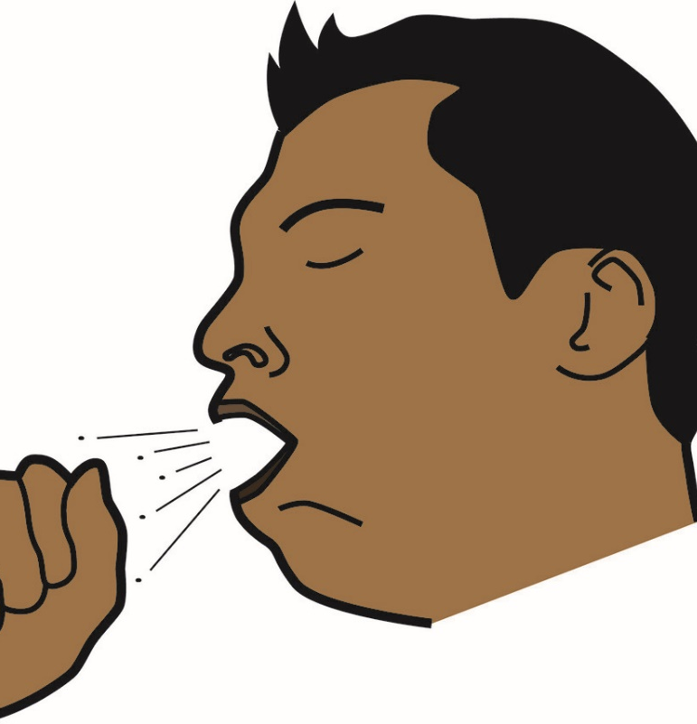
Cough Action
Cough Action
  Contraction of the diaphragm and intercostal muscles produces quick inhalation
  Vocal cords close the glottis
  Abdominal and other expiratory muscles contract with concomitant relaxation of the diaphragm, pressurizing the thorax
  Glottis opens, releasing pressurized air. Nasopharynx closes. Airflow can reach 120 m/s (~250 mph). The glottis may open only once or open and close multiple times during a single exhalation
  Bernoulli effect produces dynamic collapse of non-cartilaginous airways, increasing interaction between rapid airflow and airway mucus
This Photo by Unknown Author is licensed under CC BY-NC-ND

Slide 12
Organ Systems Associated with Cough
Lungs
Parenchyma
Tracheobronchial Airway
Larynx
Pharynx
Nose and Sinuses
Upper GI
Heart
Brain

Slide 13
Stimulus
Receptor
Afferent fibers
Brain stem
Efferent fibers
Muscle stimulation
Cough
Cortical control

Slide 15
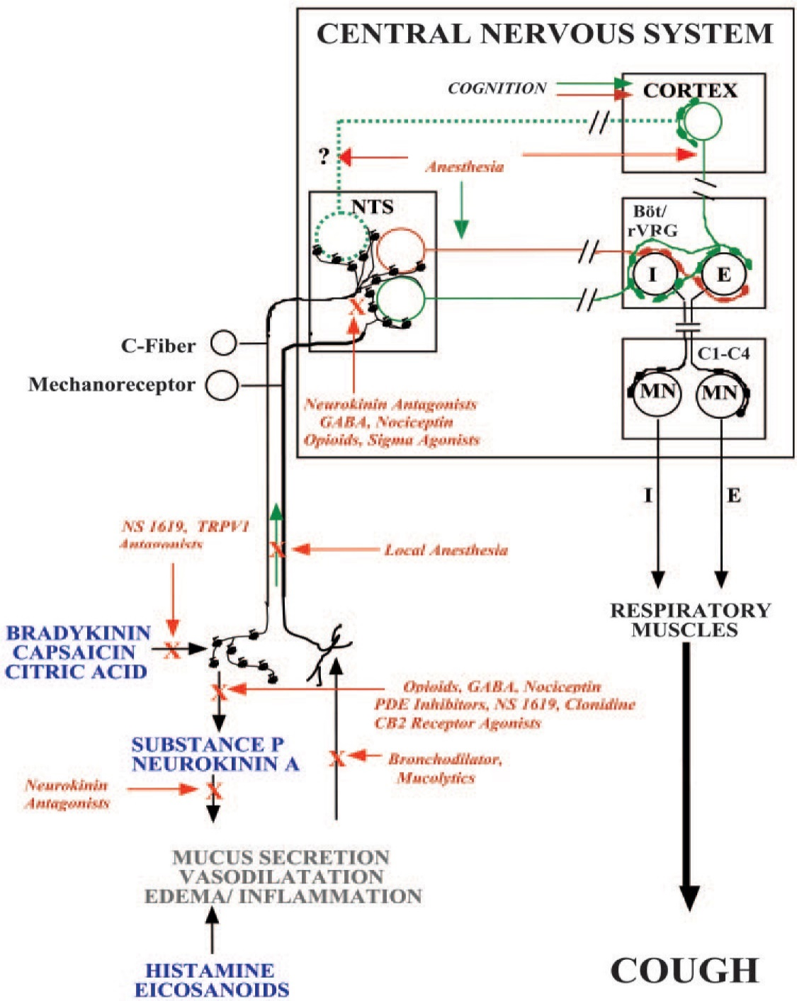
Bronchodilators
Mucolytics
Local Anesthesia
GABA agonists
Opioids
General Anesthesia

Slide 16
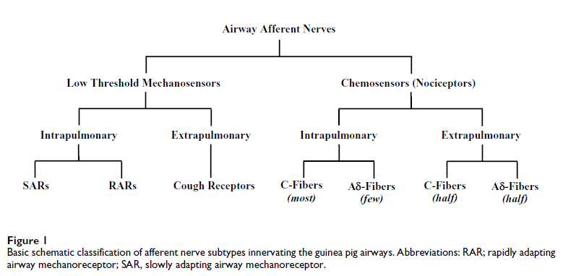

Slide 17

TRPV-1 receptor
Transient receptor potential vanilloid 1
Regulate cellular transmembrane voltage by raising intracellular Ca and Na
Capsaicin an exogenous vanilloid, binds directly to TRPV-1 receptor
TRPV-1 activation causes non myelinated C fibers to be stimulated and evoke cough.
TRPV-1 can also be stimulated by noxious heat (>42C) , low pH and ‘‘endovanilloids,’’ arachidoynlethanolamide (AFA and anandamide), and eicosanoids, leukotriene B4, and 2-arachidonylglycerol (2-AG)

Slide 18
ATP activation of P2X3 receptors
Primary afferent neurons( C-fibers) are activated by extracellular ATP
Acute/chronic injury may cause sensitization of peripheral terminals
Blocking P2X3 receptors suppresses cough

Slide 19
The stimuli
Bronchoconstriction increases cough
Airway inflammation increases cough
Allergen exposure increases cough
Upper airway stimulation induces cough
Airway neuronal dysfunction/sensitization of the cough reflex

Slide 20
Cough research concepts
(E_{max}) :maximum cough response evoked by any concentration of capsaicin
(ED₅₀) capsaicin dose inducing half-maximal response
C2 and C5 (the concentrations of capsaicin inducing at least 2 or 5 coughs, respectively)
PC_{20:} provocative concentration or dose producing a 20% fall in FEV₁ ( methacholine challenge)

Slide 21
Cough research concepts
Capsaicin hyperresponsiveness in asthma due to sensory nerve hyperexcitability: Stable asthma patients show higher Emax and lower ED50 to capsaicin than controls; T2‑low (non‑atopic) asthma shows the largest Emax. ED50 tracks asthma control and IgE; Emax tracks 24‑hour cough frequency.
Bronchoconstriction amplifies cough: Methacholine‑induced bronchoconstriction increases capsaicin‑evoked coughs; as airways reopen, cough sensitivity falls. Cough does not worsen bronchoconstriction.
TRPV1 upregulation: Chronic cough patients have markedly increased TRPV1‑positive nerve profiles; TRPV1 expression correlates with capsaicin sensitivity.
Eosinophil–nerve interactions: Eosinophils cluster around nerves and release MBP, impairing neuronal M2 receptors and removing inhibitory control—promoting cholinergic reflexes and nerve hyperexcitability.
Shared tussive mediators: Histamine, cysteinyl‑leukotrienes, PGD₂, PGE₂, and IL‑8 are elevated across cough phenotypes and sensitize airway afferents.
Allergen, GERD, and viral cofactors: Allergen challenge and GERD lower capsaicin thresholds via eosinophilia or reflux‑mediated sensitization; viral URIs transiently reduce capsaicin thresholds without changing bronchial smooth muscle responsiveness.

Slide 22
Increased cough sensitivity in asthma
Allergen exposure
Airway inflammation
Airway neuronal dysfunction
Bronchospasm
Upregulation of TRP receptors in airway nerves .
ATP activation of P2X3 receptors

Slide 23
Reduce cough burden in asthma
Effective bronchodilator use
TRP and P2X3receptor blockers?
in development
Knowledge Gap:
Addressing Neuronal Dysfunction in Asthma
Treat airway inflammation with steroids and possibly monoclonal antibodies
Allergen avoidance/ desensitization

Slide 24
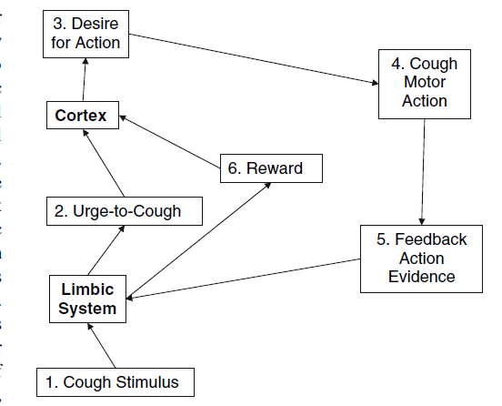
Urge to cough

Slide 25
Urge to cough
10 healthy subjects ( 5 male, 5 female) exposed to capsaicin and saline inhalation challenges
Capsaicin doses tailored to evoke a transient and reversible urge to cough
Functional MRI were obtained during the challenges.
Areas stimulated : insula cortex, anterior midcingulate cortex, primary sensory cortex, orbitofrontal cortex, supplementary motor area, and cerebellum.

Slide 26
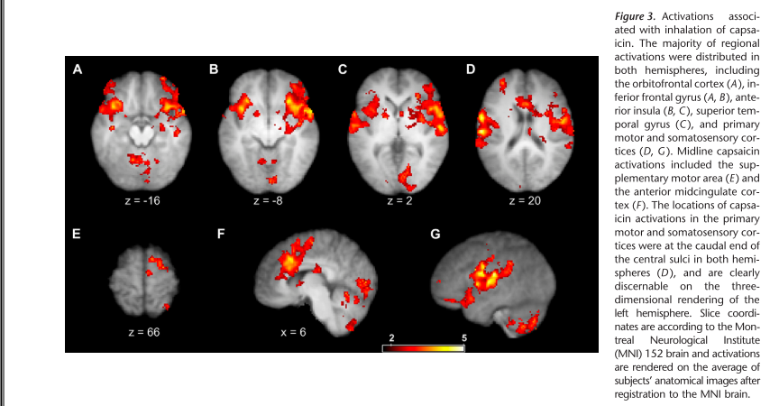

Slide 27
Mechanism of post-viral cough
Viruses block expression of M2 Receptors
Preganglionic parasympathetic nerve
Vagal Nucleus
Postganglionic parasympathetic nerve
Action potential
M2 (-)
M1 (+)
Action potential
Acetyl choline
M3 (+)
Ganglion
Contraction
Post-Ganglionic
Depolarization
Smooth muscle cells
Time
Pre-Ganglionic AP

Slide 28
COUGH DIAGNOSIS
Duration:
  Acute : less than 3 weeks
  Subacute : 3-8 weeks
  Chronic: more than 8 weeks

Slide 29
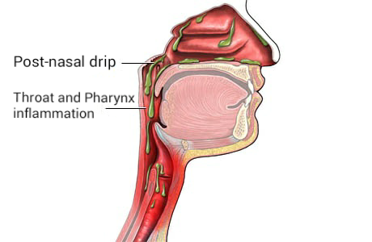
Chronic cough
Etiology ( Most Common)
Post-nasal drip (upper airway cough syndrome)
Gastric reflux( GERD, Laryngopharyngeal reflux disease)
Cough variant asthma (25-40%)
By Mahdy Fouadderivative work: Jeffamaname - Post nasal drip.jpg, CC BY-SA 4.0, https://commons.wikimedia.org/w/index.php?curid=69623564

Slide 30
Chronic Upper Airway Cough Syndrome Secondary to Rhinosinus Diseases
(Previously Referred to as Postnasal Drip Syndrome)
Allergic rhinitis (IgE-mediated, positive skin test for allergens)
Perennial non-allergic rhinitis
  vasomotor > autonomic imbalance. Increased cholinergic tone. Good response to ipratropium bromide
  Non-allergic with eosinophilia. Negative skin test, negative methacholine challenge, eosinophils in nasal secretions, pruritus
Post-infectious rhinitis
Bacterial sinusitis
Allergic fungal sinusitis
Rhinitis due to anatomic abnormalities
Rhinitis due to physical or chemical irritants
Occupational rhinitis
Rhinitis medicamentosa
Rhinitis of pregnancy

Slide 31
Chronic Cough Algorithm
CXR Normal?
No
Yes
No
Reversible?
Obs
Spirometry
Significantly
Restrictive
Yes
Normal
BIG THREE
Not
Hyperresponsive
Hyperresponsive
Empiric
Asthma
Diagnosis
Methacholine
Challenge
Additional Diagnostics

Slide 32
Cough Management
Principle: manage the underlying process
Asthma
Rhinosinusitis / Post nasal drip / Upper airway cough syndrome
GE Reflux
Cough that should be referred to a pulmonologist
Incomplete or no response to presumptive therapy – bronchoscopy is usually indicated
Abnormal CXR/HRCT (mass, infiltrate, interstitial disease, emphysema)
Other common referrals
Cardiology (CHF)
Gastroenterology (refractory reflux)
ENT (surgical considerations)
Neurology (temporal lobe seizures)
Psychiatry (habitual cough, malingering)
Narcotic cough suppression is almost always the wrong idea, except for terminal / hospice care

Slide 33

Overview: Pharmacologic Approaches to Cough
• Antitussives (central & peripheral)
• Expectorants
• Neuromodulators
• Novel receptor‑targeted therapies (P2X3 antagonists)

Slide 34
Benzonatate (Tessalon Perles)
Mechanism
• Voltage‑gated sodium channel blocker (like tetracaine)
• Anesthetizes stretch receptors in the respiratory tract → reduces cough reflex activation
Safety / Cross‑Reactivity
• Structural similarity to ester‑type anesthetics (tetracaine, procaine/Novocain)
• Allergy to ester anesthetics → possible cross‑reactivity with benzonatate

Slide 35
Dextromethorphan
Mechanism
• Depresses medullary cough center via sigma‑1 receptor stimulation
• Decreases sensitivity of cough receptors
• Structurally related to codeine but non‑opioid in standard doses

Slide 36
Guaifenesin
Primary Mechanism
• Gastro‑Pulmonary Reflex: mild gastric mucosal irritation → vagal afferent activation → increased airway gland secretion
Clinical Effect
• Hydrates mucus
• Increases mucus volume
• Decreases viscosity → easier expectoration

Slide 37
Codeine/morphine
Pharmacology
• Pro‑drug → metabolized to morphine in the liver (CYP2D6 dependent)
Mechanism
• Crosses the blood–brain barrier
• Binds mu‑opioid receptors in the medullary cough center
• Raises cough threshold → reduces responsiveness to airway irritants
• Inhibits neurotransmitter release (e.g., substance P)

Slide 38
Gabapentin & Pregabalin
Mechanism
• GABA analogs that bind voltage‑gated calcium channels
• Reduce excitatory neurotransmitter release
Role in Chronic Cough
• Thought to reduce cough via central neuromodulation
• Used in refractory or neuropathic cough phenotypes

Slide 39
P2X3 Antagonists
Rationale
• Chronic cough may involve hypersensitivity of P2X3 receptors on vagal afferent C‑fibers
Early Agents
• Effective but caused significant taste disturbance due to cross‑blockade of P2X2/3 receptors on taste buds
Gefapixant
Most extensively studied P2X3 antagonist
Demonstrated reduction in cough frequency
Approved in Japan, Switzerland, and the European Union
Taste disturbance remains the primary adverse effect

Slide 40
Common Pitfalls in Managing Chronic Cough
Postnasal-Drip Syndrome
Not recognizing that it can present primarily as a cough and phlegm
Assuming all H₁ antihistamines work the same
Overlooking sinusitis when it isn’t obvious
Missing allergic rhinitis and not recommending allergen avoidance when symptoms are perennial
Asthma
Not recognizing that asthma can present as cough and phlegm
Not realizing inhaled medications may worsen cough
Treating a positive methacholine challenge as diagnostic on its own

Slide 41
Common Pitfalls in Managing Chronic Cough
Gastroesophageal Reflux Disease (GERD)
  Not recognizing that GERD can present only as cough and phlegm
  Missing silent reflux, which may take 2–3 months of intensive therapy to improve and 5–6 months to resolve
  Assuming cough cannot be due to GERD if GI symptoms improve while cough does not
  Not realizing that cough may persist despite maximal therapy and that 24‑hour pH monitoring may be needed to assess adequacy of treatment or need for surgery
  Overlooking the impact of coexisting conditions (e.g., obstructive sleep apnea, coronary artery disease) or their treatments (e.g., nitrates)
  Failing to treat coexisting causes of cough that perpetuate the cough–reflux cycle

Slide 42
Common Pitfalls in Managing Chronic Cough
Overlap of Postnasal Drip, Asthma, and GERD
Not considering that multiple conditions may contribute simultaneously
Overlooking these common causes because another “obvious” diagnosis is present

Slide 43
CASE
55 yo M comes to PCP clinic with complaints of persistent cough. He does not have any prior medical history and he is a never smoker. He had a “common cold” 4 weeks ago. His symptoms then were sneezing , rhinorrhea, cough, malaise. All of the symptoms have resolved now but the cough. Denies sputum production, he can’t sleep because of the cough.
How would you categorize his cough? Acute/subacute/chronic
What is his diagnosis?
What treatment options are available for him?

Slide 44
CASE
70 yo woman comes to the PCP clinic with complaints of cough, weight loss, dyspnea with mild activities. Coguh has been present for 1 year, but recently she has noted specks of blood in her sputum. She has a 30-pack/year smoking history. Laboratory test is normal, and in-office spirometry shows a mild obstructive ventilatory defect.
How would you categorize his cough? Acute/subacute/chronic
What is her diagnosis? What diagnostic tests would you order?
Would you refer this patient?
What treatment options are available for him?

Slide 45
Thank you

Slide 46
References
Brooks, S. M. (2008). Irritant-induced chronic cough: Irritant-induced TRPpathy. Lung, 186(SUPPL. 1), 88–93. https://doi.org/10.1007/s00408-007-9068-0
Costello, R. W., Schofield, B. H., Kephart, G. M., Gleich, G. J., Jacoby, D. B., & Fryer, A. D. (2017). Localization of eosinophils to airway nerves and effect on neuronal M2 muscarinic receptor function. American Journal of Physiology-Lung Cellular and Molecular Physiology, 273(1), L93–L103. https://doi.org/10.1152/ajplung.1997.273.1.l93
Davenport, P. W. (2008). Urge-to-cough: What can it teach us about cough? Lung, 186(SUPPL. 1), 107–111. https://doi.org/10.1007/s00408-007-9045-7
Dicpinigaitis, P. V. (2006). Evidence-Based Clinical Practice Guidelines Potential Future Therapies for the. Chest, 129(1), 33S-47S. https://doi.org/10.1378/chest.129.1
Ferrari, M., Olivieri, M., Sembenini, C., Benini, L., Zuccali, V., Bardelli, E., … Lo Cascio, V. (1995). Tussive effect of capsaicin in patients with gastroesophageal reflux without cough. American Journal of Respiratory and Critical Care Medicine, 151(2 I), 557–561.
Ford, A. P., & Undem, B. J. (2013). The therapeutic promise of ATP antagonism at P2X3 receptors in respiratory and urological disorders. Frontiers in Cellular Neuroscience, 7(December), 1–10. https://doi.org/10.3389/fncel.2013.00267
Mazzone, S. B., & others. (2005). An overview of the sensory receptors regulating cough. Cough, 1(2), 1–9. https://doi.org/10.1186/1745-9974-1-2
Mazzone, Stuart B., McLennan, L., McGovern, A. E., Egan, G. F., & Farrell, M. J. (2007). Representation of capsaicin-evoked urge-to-cough in the human brain using functional magnetic resonance imaging. American Journal of Respiratory and Critical Care Medicine, 176(4), 327–332. https://doi.org/10.1164/rccm.200612-1856OC
Satia, Imran, et al. "Allergen challenge increases capsaicin-evoked cough responses in patients with allergic asthma." Journal of Allergy and Clinical Immunology (2019).

Slide 47
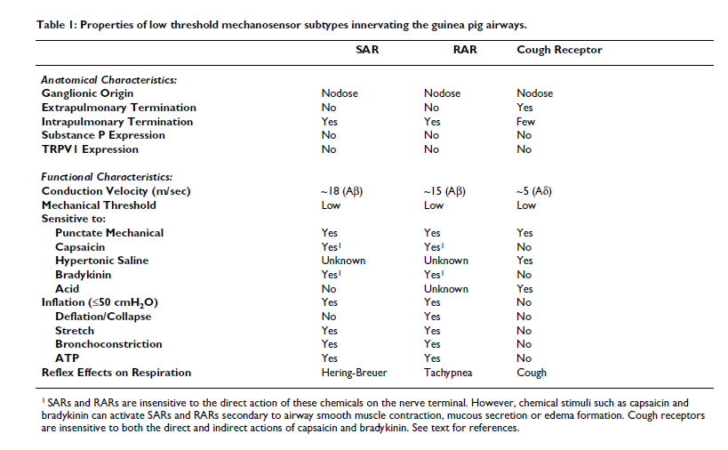

Slide 48
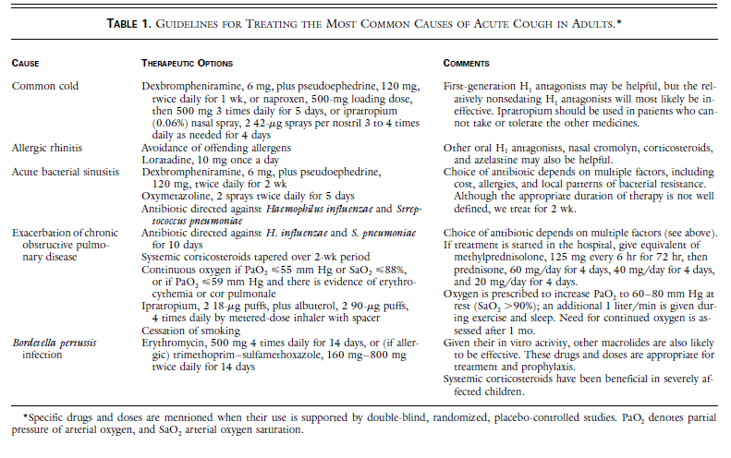

Slide 49
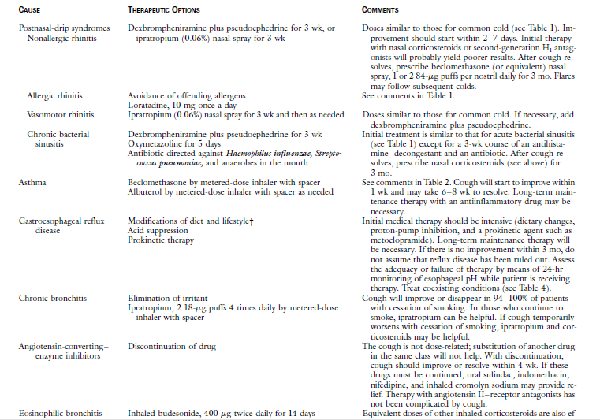

Slide 50
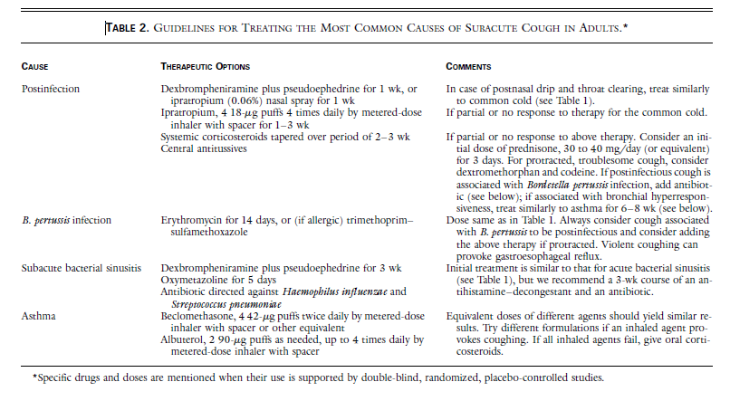

Slide 51
Capsaicin-evoked cough responses in asthmatic patients: Evidence for airway neuronal dysfunction
J Allergy Clin Immunol 2017;139:771-9.)
Study Overview
Participants: 97 patients with stable asthma and 47 healthy volunteers
Objective: Compare cough responses to capsaicin stimulation between asthmatic patients and healthy controls
Key Findings
Asthmatic patients showed significantly higher Emax (maximum cough response) and lower ED50 (capsaicin concentration causing 50% of max response) than healthy volunteers.
Emax was 46% higher in nonatopic asthma patients compared to others.
Atopic asthma patients had 21% lower Emax than nonatopic patients (P ≤ .04).
ED50 values were influenced by asthma control and serum IgE levels.
Emax values correlated with 24-hour cough frequency.
No significant influence of age, BMI, FEV1, PC20, exhaled nitric oxide, blood eosinophils, or inhaled steroid treatment on cough parameters.
Conclusion
Stable asthma patients exhibit exaggerated capsaicin-evoked cough responses, indicating airway neuronal dysfunction.
Abnormal functioning or dysregulation of the nerves that innervate the airways.
The heightened cough response is most pronounced in nonatopic (type 2–low) asthma phenotypes, suggesting a distinct underlying mechanism.

Slide 52
The interaction between bronchoconstriction and cough in asthma
RCT ( single-blind, placebo-controlled, crossover study) to investigate the interaction between bronchoconstriction and cough in asthma.
Capsaicin was administered to evoke coughs and methacholine to induce bronchoconstriction
Acute bronchoconstriction increased capsaicin evoked coughs, which improved as airway caliber spontaneously resolved.
However, capsaicin-evoked coughing had no impact on methacholine-induced bronchoconstriction.
This study provides evidence that bronchoconstriction increases the activation of capsaicin-responsive airway nerves, but the precise mechanisms and mediators involved require further evaluation.
Satia, Imran, et al. Thorax 72.12 (2017): 1144-1146.

Slide 53
Increased Expression of Transient Receptor Potential
Vanilloid-1 in Airway Nerves of Chronic Cough
Expression of TRPV-1 in the airways of patients ( chronic persistent cough of diverse causes + enhanced capsaicin cough response).
Airway mucosal biopsies via bronchoscopy : 29 patients with chronic cough and 16 healthy volunteers without a cough.
Immunostaining anti–TRPV-1 antibody, there was a fivefold increase of TRPV-1 staining nerve profiles (p 0.001).
There was a significant correlation between capsaicin tussive response and the number of TRPV-1–positive nerves within the patients with cough.
Findings indicate that TRPV-1 receptors may contribute to an enhanced cough reflex and the cough response in chronic persistent cough of diverse causes.
Am J Respir Crit Care Med Vol 170. pp 1276–1280, 2004

Slide 54
Localization of eosinophils to airway nerves and effect on neuronal M2 muscarinic receptor function.
Nerve-associated eosinophils were significantly increased in challenged animals compared with controls
Eosinophil density was greatest around airway nerves
M2 receptor function was inversely correlated with the number of eosinophils per nerve,
3 patients with fatal asthma, 196 of 637 eosinophils (30%) were associated with nerves, and release of eosinophil MBP (major basic protein) was evident; conversely, in three control patients 1 of 11 (9%) eosinophils were in contact with nerves.
(Costello et al., 2017)
Notes:
Neuronal M2 muscarinic receptors inhibit acetylcholine release from pulmonary parasympathetic nerves but are dysfunctional in antigen-challenged animals and asthmatics.
Deletion of pulmonary eosinophils protects M2 receptor function in antigen-challenged guinea pigs.
Therefore, the association of eosinophils with airway nerves was investigated.
***Thus eosinophils and their granule proteins are also seen in association with airway nerves in patients with asthma.

Slide 55
Induced sputum inflammatory mediator concentrations in chronic cough.
20 patients with cough variant asthma or eosinophilic bronchitis, 20 nonasthmatic chronic cough, 22 with idiopathic chronic cough, and 18 healthy control subjects.
Measured histamine, cysteinyl-leukotrienes, prostanoids (prostaglandin D₂ and prostaglandin E₂), and interleukin-8 by enzyme immunoassay.
The median sputum histamine concentrations were higher in patients with idiopathic chronic cough and cough variant asthma/eosinophilic bronchitis
Median sputum prostaglandin D₂ and prostaglandin E₂ concentrations were significantly higher in all categories of chronic cough.
Findings support the view that there is release of inflammatory and tussive mediators in patients with chronic cough and suggest that there might be similarities in the mechanism of cough in a diverse range of conditions.
Birring, Surinder S., et al. American journal of respiratory and critical care medicine 169.1 (2004): 15-19.
Notes:
Previous studies have shown evidence of airway inflammation in patients with chronic cough and have suggested that the cough may be due to release of tussive mediators and activation of afferent sensory nerve endings.
Measured the concentration of various proinflammatory and tussive mediators in induced sputum supernatants from

Slide 56
Allergen challenge increases capsaicin-evoked cough responses in patients with allergic asthma.
RCT measure cough responses to inhaled capsaicin in patients with mild atopic asthma after allergen challenge compared with diluent control.
  decrease in percentage of FEV₁ from baseline
  increase in capsaicin ED₅₀ coughs 30 minutes
  coughed more even after 24 hours
  decrease in methacholine PC₂₀ 24 hours
  allergen challenge increased the percentage of sputum eosinophils at 24 hours
Capsaicin-evoked coughs 24 hours after allergen were independently related to sputum eosinophilia and the decrease in FEV₁

Slide 57
Tussive Effect of Capsaicin in Patients with Gastroesophageal Reflux Without Cough
clarify the influence of gastroesophageal reflux (GER) on cough threshold in patients with digestive symptoms but free from respiratory involvement.
esophageal pH monitoring and manometry, upper gastrointestinal endoscopy, pulmonary function tests, and methacholine and capsaicin challenges.
Patients with gastroesophageal reflux but without respiratory symptoms have a reduced cough threshold
Enhanced cough response to capsaicin due to acid reflux rather than to esophagitis;
Acid reflux seems to be only a cofactor of cough

Slide 58
Capsaicin cough sensitivity increases during upper respiratory infection
Capsaicin-induced cough and methacholine-induced airway responsiveness were measured in 103 healthy volunteers.
31 subjects reattended for challenge testing during URI (I) and after recovery (R).
C2 was significantly lower during infection than recovery
C5 was lower during infection than baseline and recovery
FEV, and PC15 methacholine values were unchanged during infection compared to baseline.
Controls did not show change in capsaicin sensitivity.

