Slide 1


INTERNAL MEDICINE ACADEMIC HALF DAY
Infectious Disease
Emergencies
Meningitis, encephalitis, and necrotizing soft tissue infection.
Three emergencies where sequence and speed change outcomes.
Gerardo Gomez-Abundis, MD
Division of Infectious Diseases
Banner University Medical Center Phoenix · University of Arizona College of Medicine Phoenix
Q&A
1
Notes:
Welcome. Session runs about 45 minutes with 7 interactive cases. Ask the room to commit to an answer out loud or by show of hands before each reveal. Update the date on this slide to the actual session date if needed.

Slide 2


Disclosures and acknowledgment
Disclosures
Acknowledgment
I have no relevant financial relationships to disclose.
Some recommendations reflect guideline supported practice that is off label for specific agents. These will be identified where relevant.
This session updates and expands prior Internal Medicine AHD material generously developed by Lise Harper, MD, MPH and Edwin Yu, MD.
Content has been revised against current IDSA and WHO guidance and landmark trials through 2026.
Gomez-Abundis · ID Emergencies · 08/07/2026
2
Notes:
Thirty seconds. Credit the prior authors, then move.

Slide 3
Learning objectives
Recognize
1
Identify the presenting features and the classic pitfalls of meningitis, encephalitis, and necrotizing soft tissue infection.
Sequence
2
Order cultures, corticosteroids, empiric antibiotics, imaging, and source control so that treatment is never delayed.
Treat
3
Select and de-escalate empiric regimens using current IDSA guidance and the landmark trials behind it.
Gomez-Abundis · ID Emergencies
3
Notes:
Frame the hour: three syndromes, one habit. In each one the treatment sequence matters more than any single drug choice.

Slide 4




Three emergencies, one theme: the clock
01
02
03
Bacterial meningitis
Encephalitis
Necrotizing soft tissue infection
Mortality 15 to 25% even with modern therapy. Every hour of antibiotic delay adds to it.
Untreated HSV encephalitis kills 70%. Early acyclovir drops that below 20%.
Mortality 20 to 30%. The only intervention repeatedly tied to survival is early surgery.
Recognition to treatment inside the first hour is the shared thread of today's cases.
van de Beek NEJM 2004. Whitley NEJM 1986. Stevens and Bryant NEJM 2017.
4
Notes:
One minute. Set up the theme, then go straight into the first case.

Slide 5
1 hr
Door to antibiotic goal for suspected bacterial meningitis
Bacterial Meningitis
Gomez-Abundis · ID Emergencies · 08/07/2026
5
Notes:
Section 1 of 3. Pace: about 18 minutes including three cases.

Slide 6
A febrile, somnolent 45 year old
CASE 1
POLL • COMMIT
Which is the most likely pathogen?
45 year old man with diabetes and CKD
24 h headache, fever, neck stiffness
T 39.0 C, HR 118, somnolent, oriented to person only
Nuchal rigidity, Kernig and Brudzinski signs present
A
Haemophilus influenzae
B
Streptococcus pneumoniae
C
Neisseria meningitidis
CSF: WBC 2,500, 80% neutrophils • glucose 30 • protein 310 • Gram stain pending
D
Listeria monocytogenes
E
Escherichia coli
F
Prevotella melaninogenica
6
Notes:
Answer B, Streptococcus pneumoniae. Neutrophilic pleocytosis with low glucose and high protein in a middle aged adult with diabetes. Pneumococcus remains the most common cause of community acquired bacterial meningitis in adults by a wide margin. Poll the room before advancing.

Slide 7

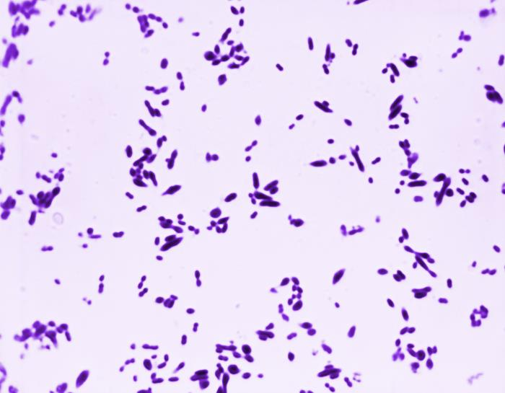


Who causes adult bacterial meningitis
ANSWER B Streptococcus pneumoniae
Neutrophilic, low glucose CSF in an adult with diabetes. Pneumococcus is the most common cause of community acquired bacterial meningitis in adults.
Streptococcus pneumoniae
Neisseria meningitidis
Gram positive diplococci.
Adult community acquired meningitis: think pneumococcus first.
Risks: alcohol use, asplenia, contiguous sinus or ear infection.
Gram negative diplococci. Young adults and congregate settings. Droplet precautions for 24 hours and prophylaxis for close contacts.
Listeria monocytogenes
Haemophilus influenzae
Gram positive rods. Age over 50, impaired cellular immunity, pregnancy. Cephalosporins miss it, so add ampicillin.
Small Gram negative coccobacilli. Now uncommon in vaccinated adults. Think of it after head trauma or with CSF leak.
Tunkel Clin Infect Dis 2004. MKSAP Infectious Disease.
Gomez-Abundis · ID Emergencies · 08/07/2026
7
Notes:
Reveal the answer, then spend a minute on the grid. Emphasize the two actionable rows: Listeria drives the ampicillin (Principen) decision and meningococcus drives isolation and prophylaxis.

Slide 8
The classic triad is the exception
~41-44%
present with the full triad of fever, neck stiffness, and altered mental status
95%
have at least two of four: headache, fever, stiff neck, or altered mental status
van de Beek NEJM 2004. Bijlsma Lancet Infect Dis 2016.
8
Notes:
Key message: absence of the triad means nothing. Two of four symptoms should already put meningitis on the list. The 44 percent figure is from the Dutch national cohort in NEJM 2004.

Slide 9
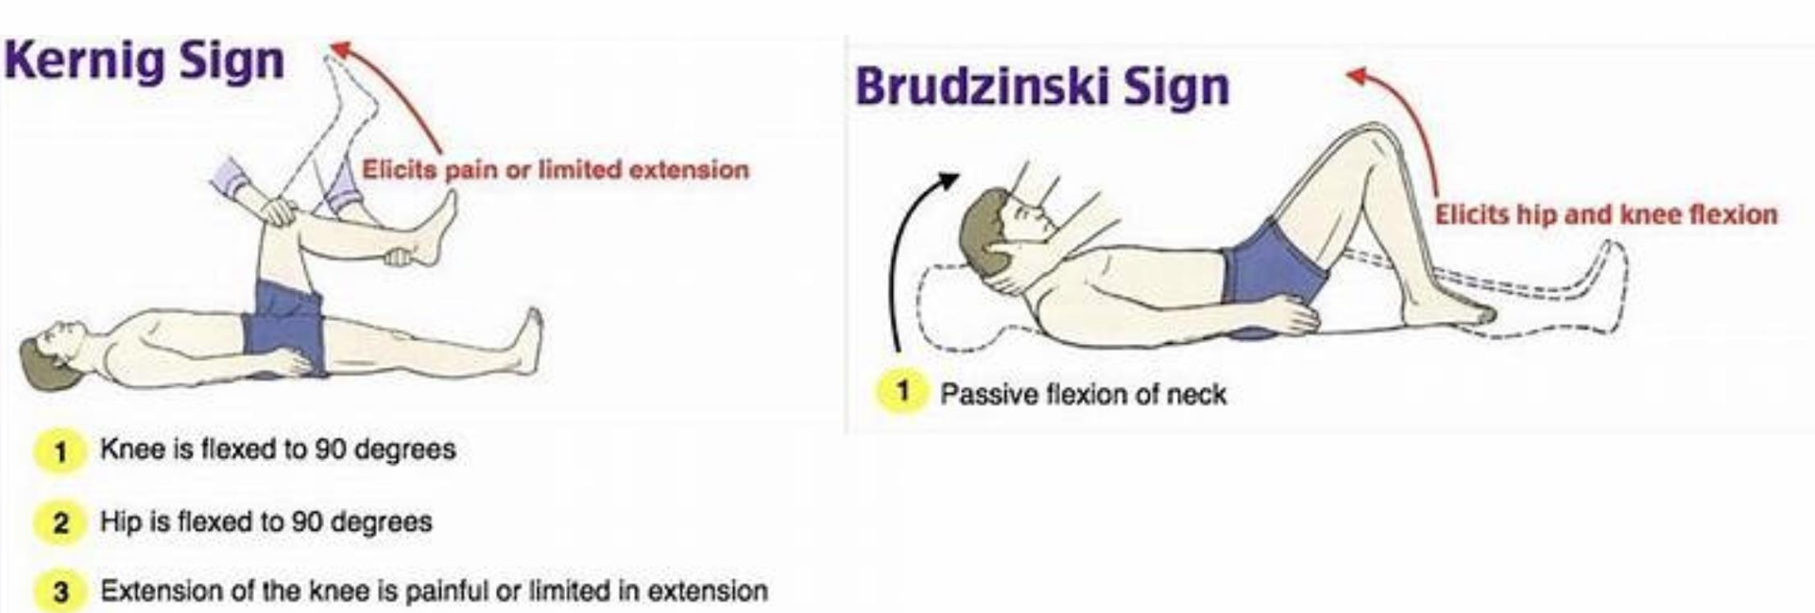
Meningeal signs: specific, not sensitive
Diagnostic value
30% SS
68 % SP
Nuchal rigidity
5% SS
95% SP
Kernig sign
5% SS
95% SP
Brudzinski sign
A negative meningeal sign does not rule out meningitis.
When present, the classic signs are specific. When absent, let the syndrome and CSF drive the diagnosis.
Thomas Clin Infect Dis 2002.
9
Notes:
Fast slide, under a minute. The numbers come from a prospective study of 297 adults undergoing LP. Positive signs help, negative signs do not.

Slide 10



Diagnostics: cultures first, PCR fast
Blood cultures, two sets, STAT
Before any antibiotic. Positive in 50 to 90% and often the only microbiology you will get if the LP is delayed.
Lumbar puncture
Cell count and differential, glucose, protein, Gram stain, culture. Always save an extra tube. Latex agglutination antigen panels are obsolete.
CSF multiplex PCR (meningitis panel)
Result in about one hour. Covers the six major bacteria, seven viruses, and Cryptococcus. Culture is still essential for susceptibilities.
Tunkel Clin Infect Dis 2004. Mandell 9th edition. WHO meningitis guidelines 2025.
10
Notes:
Emphasize sequence: cultures are the only step that must precede antibiotics. The multiplex panel changed practice since the 2004 guideline and is standard at Banner. It does not replace culture because susceptibility testing still drives de-escalation. If asked about antigen testing: latex agglutination is out, but the immunochromatographic pneumococcal antigen test is the exception, with sensitivity and specificity near 99 percent.

Slide 11
CASE 2
What is the next best step in management?
50 year old man with alcohol use disorder
Fever, stiff neck, profound altered mental status
Obtunded, withdraws to pain
Two sets of blood cultures already drawn
Dexamethasone plus empiric antibiotics now
A
B
CT of the head
C
Lumbar puncture
CT wait: 20 min • cultures pending • pharmacy asks what to send now
Serum alcohol level
D
11
Notes:
Answer A. He is obtunded, so he meets criteria for CT before LP. The moment imaging enters the pathway, dexamethasone (Decadron) and empiric antibiotics move ahead of it. Cultures are already drawn, so nothing else should delay treatment. A one hour delay here is the difference this talk exists to prevent.

Slide 12





Who needs a CT before the LP
ANSWER A Dexamethasone plus empiric antibiotics now
He is obtunded, so he needs imaging first. Imaging in the pathway means treatment jumps ahead of it, never behind it.
Immunocompromised state
History of CNS disease
New onset seizure
HIV, transplant, immunosuppressive therapy
Mass lesion, stroke, prior focal infection
Within one week of presentation
Papilledema
Abnormal level of consciousness
Focal neurologic deficit
On funduscopic examination
Unable to follow commands or answer
Gaze palsy, visual fields, limb drift
Hasbun NEJM 2001. Tunkel Clin Infect Dis 2004.
12
Notes:
Hasbun 2001: among 235 adults, none of the patients without these features had a CT finding that contraindicated LP. Any one criterion buys a scan, and a scan buys immediate empiric therapy first.

Slide 13
Management algorithm
SUSPECTED BACTERIAL MENINGITIS
Blood cultures ×2, STAT
NO CT CRITERIA
ANY CT CRITERION
THE RULE
LP immediately
Imaging changes
the order of tests,
not the timing
of treatment.
Dexamethasone +
empiric antibiotics NOW
↓
↓
Dexamethasone +
empiric antibiotics
CT head → LP when safe
ANTIBIOTICS ≤ 1 HOUR
Tunkel Clin Infect Dis 2004. Aronin Ann Intern Med 1998.
13
Notes:
Walk both limbs. Left limb: no CT criteria, tap first, then treat immediately. Right limb: any criterion, treat immediately, then scan, then tap. Aronin 1998 tied treatment delay after arrival to worse outcomes.

Slide 14
Reading the CSF
Parameter | Normal | Bacterial | Viral
Appearance | Clear | Turbid | Clear
Opening pressure (mm H2O) | 90 to 180 | Elevated | Normal or mildly up
WBC (cells/uL) | Below 5 | 1,000 to 5,000, neutrophils | 50 to 1,000, lymphocytes
Glucose (mg/dL) | 50 to 80 | Below 40 | Normal
Protein (mg/dL) | 15 to 45 | Above 200 | 50 to 150
Bacterial disease is near certain when any one is present: CSF WBC above 2,000 · neutrophils above 1,180 · protein above 220 · glucose below 34
>99% probability of bacterial meningitis)
Spanos JAMA 1989. Tunkel Clin Infect Dis 2004.
14
Notes:
Anchor the two patterns: neutrophilic with low glucose is bacterial until proven otherwise, lymphocytic with normal glucose opens the viral differential we cover in section 2. The Spanos thresholds each predict bacterial disease with 99 percent certainty.

Slide 15
CASE 3
Purulent CSF at 80
Which is the most appropriate empiric regimen?
80 year old man with acute headache, stiff neck, and confusion
T 39.0 C, HR 128, GCS 12
CT: pansinusitis, no mass effect
LP completed
Ceftriaxone + ampicillin
A
Ceftriaxone + vancomycin
B
CSF: WBC 3,395, 90% neutrophils • glucose 15 • protein 300 • Gram stain negative
Ceftriaxone + vancomycin + dexamethasone
C
Ceftriaxone + vancomycin + ampicillin + dexamethasone
D
Ceftriaxone + vancomycin + acyclovir
E
15
Notes:
Answer D. Age 80 mandates Listeria coverage with ampicillin (Principen), and frankly purulent CSF meets criteria for adjunctive dexamethasone (Decadron). A negative Gram stain never narrows empiric therapy, its sensitivity is only 60 to 90 percent and lower still for Listeria.

Slide 16
Empiric therapy, meningeal doses
ANSWER D All four: ceftriaxone, vancomycin, ampicillin, dexamethasone
Over age 50 buys Listeria coverage. Purulent CSF buys the steroid. The negative Gram stain changes nothing.
Agent | Dose | Why
Vancomycin (Vancocin) | 25 to 30 mg/kg load, then 15 to 20 mg/kg q8 to 12h, AUC guided | Covers ceftriaxone resistant pneumococcus
Ceftriaxone (Rocephin) | 2 g IV q12h | Meningeal dose, core Gram negative and pneumococcal coverage
Ampicillin (Principen) | 2 g IV q4h | Add if over 50, impaired cellular immunity, or pregnancy, for Listeria
Dexamethasone (Decadron) | 10 mg IV q6h for 4 days | With or just before the first antibiotic dose
Acyclovir (Zovirax) | 10 mg/kg IV q8h | Add whenever encephalitis is on the differential
Tunkel Clin Infect Dis 2004. Rybak Am J Health Syst Pharm 2020 for vancomycin dosing.
16
Notes:
Point out that these are meningeal doses, higher and more frequent than the ward reflex. Vancomycin (Vancocin) is AUC guided per the 2020 consensus, with historic troughs of 15 to 20 in CNS infection. De-escalate the moment culture and susceptibilities return.

Slide 17
Dexamethasone: earn the benefit
The trial
The rules
Give it for suspected or proven pneumococcal meningitis: classic presentation, cloudy CSF, Gram positive diplococci, or CSF WBC above 1,000.
First dose with or just before the first antibiotic dose.
Do not start it once antibiotics are already running. The window has closed.
Continue the 4 days only if pneumococcus is confirmed, otherwise stop.
301 adults randomized to dexamethasone 10 mg IV q6h for 4 days, first dose before or with the first antibiotic dose.
25% to 15%
unfavorable outcome
15% to 7%
mortality, benefit clearest in pneumococcal disease
de Gans and van de Beek NEJM 2002.
17
Notes:
This is the single most commonly missed step in real practice. The mechanism argument for giving it before antibiotics is that bacterial lysis drives the inflammatory surge. Say the phrase: steroid first, then antibiotic, within the same hour. And the MKSAP corollary: if the culture returns anything other than pneumococcus, stop the steroid. It adds nothing for other organisms and may increase mortality in Listeria meningitis.

Slide 18
Adjunctive dexamethasone in adult bacterial meningitis
de Gans and van de Beek, New England Journal of Medicine, published 11/14/2002
Trial design
Outcomes at 8 weeks
Into practice: IDSA 2004
301 adults with suspected bacterial meningitis, randomized, double blind
Dexamethasone (Decadron) 10 mg IV q6h for 4 days vs placebo
First dose 15 to 20 minutes before or with the first antibiotic dose
Dexamethasone (Decadron) 0.15 mg/kg IV q6h for 2 to 4 days
Continue only if pneumococcus is confirmed on Gram stain or culture
Stop if Listeria monocytogenes is identified
Benefit not replicated in resource limited settings (Malawi and Vietnam trials, 2007)
Primary endpoint: Glasgow Outcome Scale at 8 weeks
1
Death
2
Persistent vegetative state
3
Severe disability, dependent
4
Moderate disability, independent
5
Good recovery, resumes normal life
Unfavorable outcome RR 0.59, death RR 0.48. NNT 10 for unfavorable outcome and 12 for death. Benefit concentrated in pneumococcal disease.
Scores 1 to 4 unfavorable, only 5 favorable
Why timing matters
First antibiotic dose
rapid bacteriolysis
Cell wall debris released
peptidoglycan, lipoteichoic acid
Cytokine surge
TNF-alpha and IL-1
Steroid given first
blunts the inflammatory burst
de Gans J, van de Beek D. Dexamethasone in adults with bacterial meningitis. N Engl J Med. 2002;347(20):1549-1556. Published 11/14/2002.
Notes:
Landmark European trial establishing adjunctive dexamethasone in adult bacterial meningitis. Primary endpoint: Glasgow Outcome Scale (Jennett and Bond, Lancet 1975), a 5-point global disability scale scored at 8 weeks. 1 death, 2 persistent vegetative state, 3 severe disability (conscious but dependent for daily activities), 4 moderate disability (independent, may work in sheltered setting), 5 good recovery (resumption of normal life, minor deficits allowed). The trial dichotomized the scale strictly: only a score of 5 counted as favorable, so even moderate disability was an unfavorable outcome. Emphasize timing: the corticosteroid must precede or accompany the first antibiotic dose to blunt lysis-driven cytokine release. Effect concentrated in pneumococcal disease. IDSA 2004 operationalized this as 0.15 mg/kg IV q6h for 2 to 4 days, continued only when pneumococcus is confirmed. External validity caveat: no benefit in the Malawi and Vietnam trials published in 2007.

Slide 19
Bacterial meningitis in four lines
Suspect it with any two of four: fever, headache, stiff neck, altered mentation. The full triad shows up in fewer than half.
1
Cultures, then treat. Dexamethasone and antibiotics within the first hour. A CT changes the order of tests, never the timing of treatment.
2
Vancomycin plus ceftriaxone. Add ampicillin over age 50, in impaired cellular immunity, or in pregnancy.
3
Neutrophilic pleocytosis with low glucose and high protein is bacterial until proven otherwise.
4
Gomez-Abundis · ID Emergencies · 08/07/2026
18
Notes:
Pause here for questions before moving to encephalitis. This is the MKSAP consolidation moment for section 1.

Slide 20
CASE 4
Fever, aphasia, then a seizure
Which is the best treatment for this patient?
47 year old woman with 3 days of fever
New garbled speech and confusion
Generalized seizure in the ED
MRI: mesial temporal T2/FLAIR hyperintensity
Vancomycin + ceftriaxone + dexamethasone
A
B
IV acyclovir
CSF: WBC 92
95% lymphocytes
RBC 156
Glucose 77
Protein 118
C
IV ganciclovir
IV liposomal amphotericin B
D
E
Anti-tuberculous therapy (RIPE)
Gomez-Abundis · ID Emergencies · 08/07/2026
20
Notes:
Answer B. Fever, language disturbance, seizure, lymphocytic CSF with red cells, and temporal lobe signal. This is HSV encephalitis until proven otherwise and IV acyclovir (Zovirax) starts the moment the thought occurs, not when the PCR returns.

Slide 21
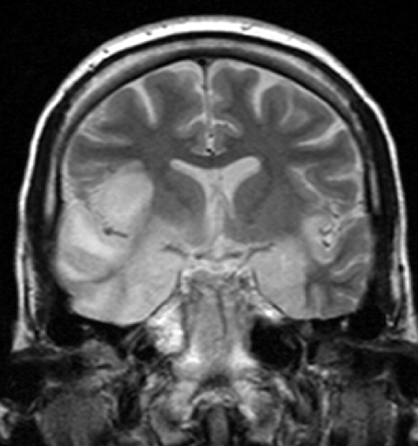
HSV encephalitis: making the diagnosis
Temporal lobe syndrome + lymphocytic CSF. Treat before confirmation.
ANSWER B IV acyclovir, started empirically
1
RECOGNIZE
Fever + altered cognition + seizure or focal language deficit.
2
CONFIRM
CSF HSV PCR is highly sensitive, but can be falsely negative early.
3
DO NOT STOP EARLY
If suspicion remains high, continue acyclovir and repeat PCR in 3 to 7 days.
Coronal T2 MRI: temporal lobe hyperintensity
MRI image: Laughlin Dawes, CC BY 3.0 via Wikimedia Commons
Tunkel Clin Infect Dis 2008. Whitley Lancet 2002.
21
Notes:
The board trap and the real life trap are the same: an early negative PCR taken as permission to stop acyclovir (Zovirax). It is not. Repeat the tap if the story still fits. The reverse move is also fair game on boards: a lymphocytic CSF with negative Gram stain, culture, and bacterial PCR lets the antibacterials come off while acyclovir (Zovirax) continues.

Slide 22

70%
Mortality of untreated HSV encephalitis. Early therapy drops it below 20%
Encephalitis
When the parenchyma itself is infected, cognition, focality, and seizures follow.
Meningitis inflames the lining, so the head hurts but the mind is intact. Encephalitis inflames the brain itself, so mentation changes, focal deficits appear, and seizures declare it. Both can coexist as meningoencephalitis.
Gomez-Abundis · ID Emergencies · 08/07/2026
19
Notes:
Section 2. About 12 minutes with two cases. The definition strip at the bottom is the transition line.

Slide 23
Treat first, confirm second
Mortality
The regimen
70% untreated
Acyclovir 10 mg/kg IV every 8 hours for 14 to 21 days.
Start at first suspicion. Every hour waiting on imaging or PCR is untreated encephalitis.
Protect the kidneys: aggressive hydration, dose by ideal body weight in obesity, adjust for renal function.
In severe disease many experts document CSF PCR clearance before stopping therapy.
below 20% treated early
Outcomes track directly with time to the first dose. Survivors treated late carry the neurologic cost.
Whitley NEJM 1986. Tunkel Clin Infect Dis 2008.
22
Notes:
The 70 percent figure comes from the era before acyclovir (Zovirax), in the vidarabine trials. Modern treated mortality runs 15 to 20 percent, and morbidity remains substantial, which is the argument for empiric speed.

Slide 24
CASE 5
August in Phoenix: tremor and confusion
Which CSF test will confirm the diagnosis?
72 year old man in late summer
Fever, headache, rash, confusion
Facial tremor and witnessed seizure
MRI: basal ganglia enhancement
A
Herpes simplex virus PCR
B
Herpes simplex virus IgM
C
West Nile virus PCR
CSF: WBC 154
60% lymphocytes
Glucose 48
Protein 152
D
West Nile virus IgM
E
VDRL
Gomez-Abundis · ID Emergencies · 08/07/2026
23
Notes:
Answer D. Summer season, extrapyramidal features, basal ganglia involvement on MRI. That is West Nile neuroinvasive disease, and the confirmatory test is IgM in CSF or serum. PCR is insensitive because viremia has usually cleared by the time neurologic disease appears. He should also be on empiric acyclovir (Zovirax) until HSV PCR returns.

Slide 25
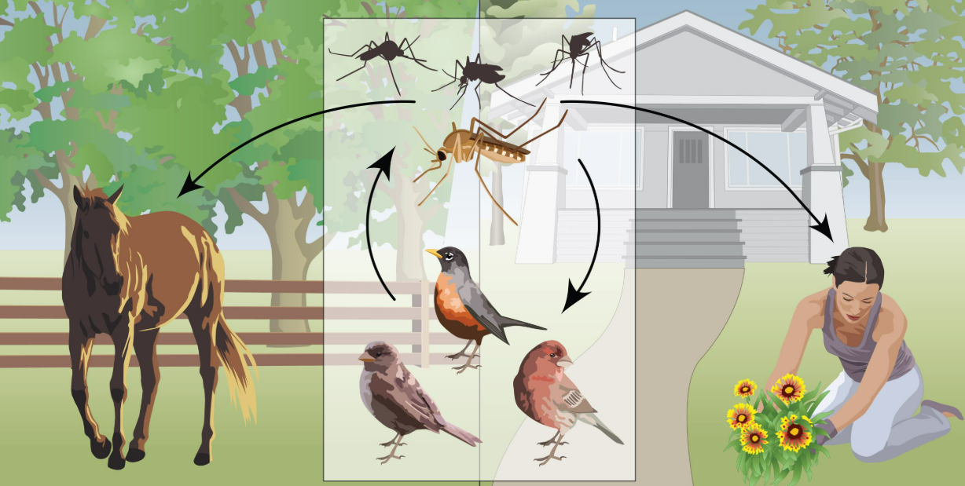
West Nile neuroinvasive disease
ANSWER D West Nile virus IgM in CSF
Antibody, not PCR. Viremia is often gone by neuroinvasive disease.
TREMOR / PARKINSONISM
ACUTE FLACCID PARALYSIS
TEST
A polio like anterior horn syndrome is a classic neuroinvasive presentation.
CSF or serum WNV IgM.
Basal ganglia and thalamic involvement should move WNV high on the list.
ARIZONA 2026
Maricopa County reported 17 human cases and its first WNV death by 06/16/2026, compared with 4 cases at the same point in 2025.
Kretschmer MMWR 2023. Tunkel Clin Infect Dis 2008.
Centers for Disease Control and Prevention. West Nile transmission cycle. CDC Stacks. https://stacks.cdc.gov/view/cdc/37783
24
Notes:
Local hook: many in the audience admitted these patients. The 2021 MMWR report documented 1,487 cases, 1,014 hospitalizations, and 101 deaths. Emphasize the testing logic, IgM rather than PCR, since that is the piece residents miss.

Slide 26
Maricopa County: the U.S. epicenter of West Nile virus
West Nile virus reached Arizona in 2003 and is now enzootic in Maricopa County. Transmission is episodic and monsoon driven, not steady.
1,480
cases in Maricopa County, 2021
The largest focal WNV outbreak recorded in any single U.S. county. County incidence reached 33 per 100,000, and 152 per 100,000 in Scottsdale.
954 (64%)
were neuroinvasive in 2021
1,011 hospitalized and 101 died. Median age 66 years overall, 79 years among those who died. Encephalitis (615) outnumbered meningitis (319).
61 of 113
of all U.S. cases in Arizona, 2026
42 of the 61 neuroinvasive. All five WNV deaths reported nationally were in Arizona. ArboNET, provisional as of 07/28/2026.
Sources: Maricopa County Department of Public Health, West Nile Virus and St. Louis Encephalitis End of Year Reports, 2020 through 2024 (county totals; 2021 report notes one case with 2020 onset, and 10 cases plus one death reported in 2022 that fall outside the year total). 2025 and 2026 counts are preliminary MCDPH weekly dashboard figures. 2004 figure and vector index data from Kretschmer M, Ruberto I, Townsend J, et al. MMWR Morb Mortal Wkly Rep. 2023;72(17):452-457, which reports 1,487 cases on the MMWR data pull. National comparison from CDC ArboNET provisional data as of 07/28/2026 (national total rose to 143 as of 08/04/2026). Slide prepared 08/10/2026.
Notes:
Framing: West Nile is the dominant domestically acquired arboviral disease in this valley and the most common cause of epidemic meningoencephalitis we will see in Phoenix.
Note the shape of the curve. Three cases in 2020, 1,480 in 2021, 42 in 2022. This is episodic, monsoon-driven transmission, not smooth endemicity, which is why clinical suspicion has to be recalibrated every single season rather than carried over from last year.
The 2021 outbreak: MMWR reports 1,487 cases at the time of their data pull, 1,014 hospitalizations and 101 deaths. The county end-of-year report finalized 1,480 cases with 954 neuroinvasive and 1,011 hospitalized. Either way it is the largest focal outbreak documented in a single United States county. If asked about the discrepancy, explain it is a data-pull timing difference, not an error.
The Scottsdale rate of 152 per 100,000 in 2021 is worth pausing on. Risk is not uniform across the valley, and Scottsdale has carried the highest municipal rate in most recent years.
For 2026, Arizona accounts for 61 of 113 national cases and all five reported deaths as of 07/28. National count reached 143 by 08/04. Peak transmission here is August and September, so these numbers will climb.
Caveat to state out loud: non-neuroinvasive disease is heavily underreported. CDC estimates 30 to 70 unreported febrile cases for every reported neuroinvasive case, so these counts are the visible tip.

Slide 27
Neuroinvasive disease and its imaging signature
About 1 in 150 infections becomes neuroinvasive. Recognition is clinical, and imaging supports rather than establishes the diagnosis.
Three overlapping syndromes
Meningitis. Fever, headache and nuchal rigidity, with generally favorable recovery
Encephalitis. Encephalopathy with coarse tremor, myoclonus, parkinsonism and ataxia. Carries the mortality. In Maricopa County it accounted for 83 percent of neuroinvasive cases in 2023
Acute flaccid paralysis. Asymmetric, painless anterior horn cell injury that may progress to respiratory failure
Who develops neuroinvasive disease ?
Age above 60 years dominates, alongside diabetes, hypertension, chronic kidney disease and malignancy
Marked risk with B cell depleting therapy and with solid organ transplantation, including donor-derived transmission
OPTN began requiring seasonal WNV screening of all organ donors from 07/01 to 10/31, effective June 2026
Sources: Petropoulou KA, Gordon SM, Prayson RA, Ruggierri PM. AJNR Am J Neuroradiol. 2005;26(8):1986-1995. Ali M, Safriel Y, Sohi J, et al. AJNR Am J Neuroradiol. 2005;26(2):289-297. Tyler KL, Pape J, Goody RJ, et al. Neurology. 2006;66(3):361-365. Mace KE, Jacobs D, Gould CV, Staples JE, Lyons SL. MMWR Morb Mortal Wkly Rep. 2026;75(29):369-376. Maricopa County Department of Public Health, West Nile Virus and SLE End of Year Report, 2023.
Notes:
Denominator first. Roughly 80 percent of infections are asymptomatic, about 20 percent produce West Nile fever, and about 1 in 150 becomes neuroinvasive. The reason our county reports look so neuroinvasive-heavy, 64 percent in 2021 and 81 percent in 2023, is ascertainment bias. CDC estimates 30 to 70 unreported febrile cases for every reported neuroinvasive case.
Locally, encephalitis rather than meningitis dominates. In Maricopa County in 2023, 48 of 58 neuroinvasive cases were encephalitis, and all 11 deaths were in that group. Nationally in 2024, encephalitis was 63 percent of neuroinvasive WNV, meningitis 21 percent and AFP 4 percent. The median age here has sat at 63 to 66 years, and the median age at death at 79 to 80 years.
Acute flaccid paralysis is the syndrome that gets missed. It is asymmetric and painless with early areflexia and preserved sensation, which separates it from Guillain Barre. In the 1999 New York cohort, 27 percent had objective motor weakness and 10 percent developed diffuse flaccid paralysis.
On imaging, make three points. First, a normal MRI is common and does not exclude disease. Second, if the protocol lacks diffusion-weighted imaging early, you can get a false negative, because DWI picked up lesions before FLAIR in the Cleveland Clinic series. Third, mesial temporal signal appeared in a third of patients and will make people think herpes, but WNV is not necrotizing, so the absence of mass effect, hemorrhage and enhancement is the discriminator. Continue acyclovir until HSV PCR returns negative regardless.
Practical transplant point worth emphasizing to the residents. As of June 2026 OPTN requires seasonal WNV screening of all living and deceased organ donors from July 1 through October 31. In B cell depleted patients on rituximab and in transplant recipients, serology can be falsely negative because they cannot mount IgM, so send CSF and serum RT-PCR in those hosts.

Slide 28
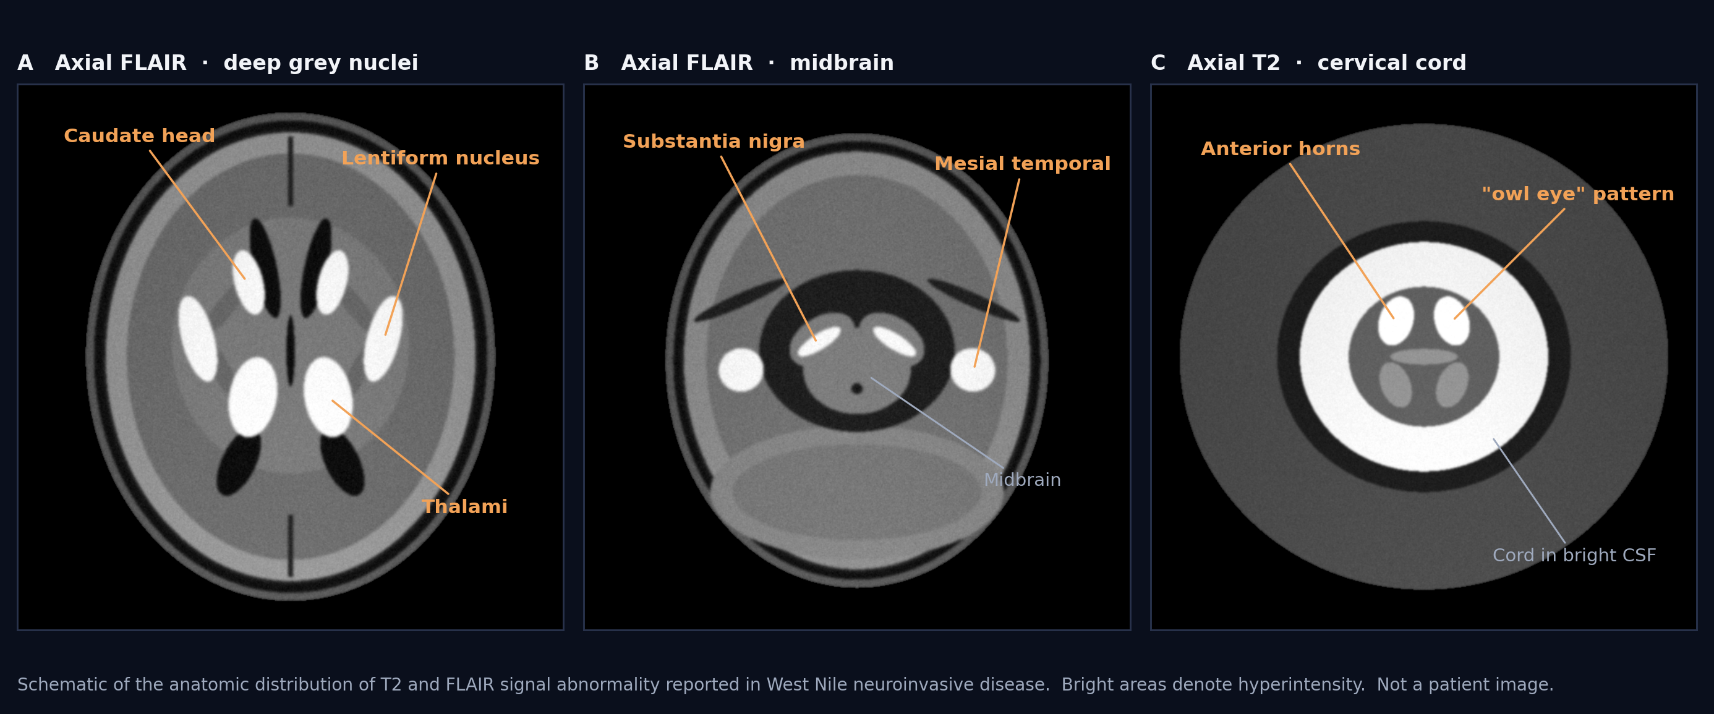
Figure. Schematic distribution of the T2 and FLAIR signal abnormality described in West Nile neuroinvasive disease. Bright areas denote hyperintensity.

Slide 29




Not every lymphocytic CSF is herpes
Enterovirus
HSV-2, recurrent
The most common viral meningitis. May to November, sick contacts, pharyngitis, rash, and myalgia. Self limited, supportive care.
Year round. Genital lesions may precede by about a week. Recurrent benign lymphocytic meningitis (Mollaret) resolves without antivirals.
Varicella zoster virus
Autoimmune, anti-NMDAR
Vasculopathy with stroke, myelitis, or encephalitis. Rash may be absent (sine herpete). CSF VZV PCR, treat with IV acyclovir.
Young adults, psychiatric onset, movement disorder, dysautonomia. Can follow HSV encephalitis. Send the antibody panel when PCR is negative.
Young woman with teratoma
Lyme neuroborreliosis: lymphocytic meningitis with facial palsy in an endemic summer. Rule of 7s flags low risk: headache under 7 days, under 70% mononuclear cells, no seventh nerve palsy.
MKSAP Infectious Disease. Tunkel Clin Infect Dis 2008. IDSA AAN ACR Lyme guideline 2020.
Gomez-Abundis · ID Emergencies · 08/07/2026
25
Notes:
One minute. The teaching point is the negative workup pathway: when HSV PCR is negative and the patient is not improving, think VZV, West Nile, and autoimmune encephalitis rather than simply repeating the same test. If Lyme comes up, treatment for meningitis or radiculoneuritis is ceftriaxone (Rocephin) or oral doxycycline (Vibramycin).

Slide 30
Encephalitis in four lines
Altered cognition, focal deficits, or seizures move you from meningitis to encephalitis. The empiric plan must change with the word.
1
Acyclovir 10 mg/kg IV q8h starts at first suspicion. Never wait for the PCR.
2
An early negative HSV PCR does not end the story. Repeat the tap in 3 to 7 days if the picture still fits.
3
During summers, send West Nile IgM. When herpes testing is negative, think VZV, arboviruses, and autoimmune disease.
4
Gomez-Abundis · ID Emergencies · 08/07/2026
26
Notes:
Consolidation moment for section 2.

Slide 31

Two more you cannot miss: focal pus
Brain abscess
Spinal epidural abscess
Headache, new seizure, or focal deficit plus a ring enhancing lesion. Fever is absent in half.
Streptococci, anaerobes, S. aureus. Sources are contiguous (ear, sinus, dental) or hematogenous.
Lumbar puncture is contraindicated with mass effect. Aspirate lesions above 2.5 cm, it is diagnosis and treatment.
Empiric ceftriaxone + metronidazole, 4 to 8 weeks with follow up imaging.
Back pain plus fever plus any neurologic complaint equals MRI tonight, not in the morning.
S. aureus in about half. Risks: bacteremia, injection drug use, catheters, recent spine procedures.
Blood cultures before antibiotics. They are positive often enough to name the organism.
At least 6 weeks of therapy. Surgery the moment deficits appear. If cultures stay negative, think tuberculosis and brucellosis.
MKSAP Infectious Disease. Mandell 9th edition. Darouiche NEJM 2006.
Gomez-Abundis · ID Emergencies · 08/07/2026
27
Notes:
Ninety seconds, deliberately rapid. These two live on the same differential as tonight's syndromes and both punish delay. The single line to leave with them: back pain, fever, neuro complaint, MRI tonight. One MKSAP neighbor worth naming aloud: infection of a shunt or drain is vancomycin (Vancocin) plus cefepime (Maxipime), and the hardware comes out.

Slide 32
A leg that hurts more than it looks
CASE 6
POLL • COMMIT
What is the most appropriate next step?
56 year old man with poorly controlled diabetes
24 h rapidly progressive leg pain and swelling
Tense erythema, woody induration, exquisite tenderness
T 39.0 C, BP 90/60, HR 110
Urgent surgical consultation for debridement, plus empiric vancomycin and piperacillin-tazobactam or a carbapenem, plus a toxin suppressing agent
A
Broad spectrum antibiotics and ICU admission, observe the response
B
MRI of the leg to confirm the diagnosis first
C
Await blood culture results before starting antibiotics
D
KEY DATA
WBC 22,000 • lactate 5.5 mmol/L • sodium 132 mEq/L
Serial laboratory studies and examinations
E
Gomez-Abundis · ID Emergencies · 08/07/2026
29
Notes:
Answer A. Pain out of proportion, woody induration, hypotension, and a lactate of 5.5 in a diabetic. This is necrotizing infection until a surgeon says otherwise. Imaging and observation are how these patients die. Antibiotics start in the same breath as the surgical call, never instead of it.

Slide 33
Recognition: trust the pain, not the skin
ANSWER A Call surgery now. Start antibiotics on the way to the OR.
EARLY CLUES
WHY THE SKIN CAN FOOL YOU
• Pain out of proportion
• Rapid progression over hours
• Toxicity greater than skin findings
SKIN
SUBCUTANEOUS
infection races along fascia
LATE CLUES
FASCIA
• Woody induration, bullae, necrosis
• Crepitus or anesthesia
• Hypotension or organ dysfunction
MUSCLE
Pain and systemic toxicity can precede dramatic skin necrosis.
PAIN > SKIN = SURGEON
Stevens Clin Infect Dis 2014. Stevens and Bryant NEJM 2017.
30
Notes:
Left column is the window where you can change the outcome. Right column is what the textbook shows and what the morgue confirms. Anesthesia over the lesion is a particularly sinister and underappreciated sign.

Slide 34
20-30%
Mortality in modern series, climbing with every hour of surgical delay
Necrotizing Soft Tissue Infections
The diagnosis is made in the operating room. So is the cure.
Cellulitis sits on top of the fascia and answers to antibiotics. Necrotizing infection travels along the fascia, outruns the visible skin findings, and answers only to debridement. The bedside clue is a patient who is sicker, and in more pain, than the skin explains until later when pain resolves but now maybe too late and already destroy never endings, hence no more pain.
28
Notes:
Section 3. About 12 minutes with two cases. Say the transition line out loud: sicker, and in more pain, than the skin explains.

Slide 35
Diagnosis: the scalpel outranks the score
SCALPEL
>
SCORE
1
EXPLORE
2
DO NOT REASSURE
3
IMAGE ONLY IF SAFE
1
Dishwater fluid, gray fascia, and easy finger dissection confirm the diagnosis.
LRINEC sensitivity is only about 68% at common cutoffs. A low score can miss disease.
CT can map gas, edema, or abscess, but only if it does not delay debridement.
WHEN SUSPICION IS HIGH, EXPLORATION IS THE TEST
Wong Crit Care Med 2004. Fernando Ann Surg 2019. Stevens Clin Infect Dis 2014.
31
Notes:
If the room remembers one number, make it the 68 percent sensitivity of LRINEC in the pooled validation data. A reassuring score in a worrisome patient is a trap.

Slide 36
Microbiology: three stories
Type I, polymicrobial
Type II, monomicrobial
Exposure clues
Mixed anaerobes, Gram negatives, and streptococci.
Group A Streptococcus, and S. aureus including MRSA.
The history names the organism.
Perineum and trunk, Fournier gangrene.
Diabetes, recent surgery, bowel or genitourinary source.
Healthy hosts, extremities, minor trauma.
Watch for streptococcal toxic shock.
Salt water, raw oysters, cirrhosis: Vibrio vulnificus. Treat with doxycycline + ceftazidime.
Fresh water: Aeromonas. Ciprofloxacin + doxycycline.
Trauma or injection drug use: Clostridium species.
Stevens and Bryant NEJM 2017. Stevens Clin Infect Dis 2014.
32
Notes:
The exposure column is where attendings get to look clairvoyant. Vibrio in a cirrhotic after oysters and Aeromonas after fresh water injuries are classic board and real world pairings.

Slide 37
CASE 7
Gas in the thigh, an organism with a name
Which is the most appropriate directed antibiotic therapy?
40 year old man with subcutaneous heroin injection
Rapidly progressive thigh pain and swelling
Ecchymotic bullae, crepitus, induration
OR confirms necrotizing fasciitis and myonecrosis
Culture: Clostridium perfringens
Ceftazidime + doxycycline
A
Ciprofloxacin + doxycycline
B
Penicillin G + clindamycin
C
Continue vancomycin + piperacillin-tazobactam
D
KEY DATA
Current therapy: vancomycin + piperacillin tazobactam
Gomez-Abundis · ID Emergencies · 08/07/2026
33
Notes:
Answer C. Once Clostridium perfringens is identified, directed therapy is penicillin G (Pfizerpen) plus clindamycin (Cleocin), the same pairing used for group A streptococcal necrotizing infection. Clindamycin (Cleocin) suppresses toxin synthesis independent of inoculum. Options A and B are the directed regimens for Vibrio and Aeromonas respectively, which is why they are here.

Slide 38



Management: source control plus smart antibiotics
ANSWER C Penicillin G + clindamycin
Directed therapy for clostridial and group A streptococcal disease. Clindamycin shuts down toxin synthesis.
Source control
Empiric regimen
2026 notes
To the OR without delay. Early debridement is the only intervention repeatedly tied to survival.
Re-explore every 12 to 24 hours until no further necrosis is found.
Vancomycin or linezolid, plus
Piperacillin-tazobactam or meropenem, plus
Clindamycin or Linezolid for toxin suppression.
De-escalate on operative cultures: GAS or Clostridium goes to penicillin G + clindamycin.
Clindamycin resistance in invasive group A strep now exceeds 30% in US surveillance, so linezolid is a rational toxin suppressing alternative.
IVIG in streptococcal toxic shock remains unsettled.
Stop antibiotics about 48 hours after the final debridement once stable.
Stevens Clin Infect Dis 2014. Stevens and Bryant NEJM 2017. CDC ABCs surveillance.
34
Notes:
Stewardship beats: clindamycin (Cleocin) is there for toxin suppression, not coverage, and rising GAS resistance is why linezolid (Zyvox) keeps appearing in modern protocols. Duration is clinical, roughly 48 hours past final debridement with source control achieved, rather than a fixed course.

Slide 39
Necrotizing infection in four lines
Trust the pain, not the skin. Pain out of proportion plus toxicity means a surgeon, not a scan.
1
No lab, score, or image rules it out. Exploration makes the diagnosis, debridement makes the cure.
2
Empiric: vancomycin + piperacillin-tazobactam or meropenem + clindamycin ( or Linezolid).
3
De-escalate once the organism declares itself. GAS or Clostridium: penicillin G + clindamycin.
4
Gomez-Abundis · ID Emergencies · 08/07/2026
35
Notes:
Consolidation for section 3.

Slide 40
If you keep only three things
01
Bacterial meningitis
Cultures, dexamethasone, antibiotics, all inside the first hour. Imaging waits its turn. Treatment does not.
02
Encephalitis
Acyclovir at first suspicion, and a negative early PCR does not end the story. In our desert summers, add a West Nile IgM.
03
Necrotizing infection
Pain out of proportion buys an operation, not an MRI. Every hour to the OR is mortality.
Gomez-Abundis · ID Emergencies · 08/07/2026
36
Notes:
Close with the three lines, slowly. This is what the intern on call repeats at 3 AM.

Slide 41
Key references
Tunkel AR, et al. Practice guidelines for the management of bacterial meningitis. Clin Infect Dis. 2004;39(9):1267-1284.
van de Beek D, et al. Clinical features and prognostic factors in adults with bacterial meningitis. N Engl J Med. 2004;351(18):1849-1859.
Hasbun R, et al. Computed tomography of the head before lumbar puncture in adults with suspected meningitis. N Engl J Med. 2001;345(24):1727-1733.
de Gans J, van de Beek D. Dexamethasone in adults with bacterial meningitis. N Engl J Med. 2002;347(20):1549-1556.
Thomas KE, et al. The diagnostic accuracy of Kernig sign, Brudzinski sign, and nuchal rigidity in adults with suspected meningitis. Clin Infect Dis. 2002;35(1):46-52.
World Health Organization. WHO guidelines on meningitis diagnosis, treatment and care. Geneva: WHO; 2025.
Tunkel AR, et al. The management of encephalitis: clinical practice guidelines by the IDSA. Clin Infect Dis. 2008;47(3):303-327.
Whitley RJ, et al. Vidarabine versus acyclovir therapy in herpes simplex encephalitis. N Engl J Med. 1986;314(3):144-149.
Kretschmer M, et al. Unprecedented outbreak of West Nile virus, Maricopa County, Arizona, 2021. MMWR Morb Mortal Wkly Rep. 2023;72(17):452-457.
Stevens DL, et al. Practice guidelines for the diagnosis and management of skin and soft tissue infections: 2014 update by the IDSA. Clin Infect Dis. 2014;59(2):e10-e52.
Stevens DL, Bryant AE. Necrotizing soft-tissue infections. N Engl J Med. 2017;377(23):2253-2265.
Wong CH, et al. The LRINEC score. Crit Care Med. 2004;32(7):1535-1541. Fernando SM, et al. Ann Surg. 2019;269(1):58-65.
Mandell, Douglas, and Bennett's Principles and Practice of Infectious Diseases. 9th ed. Elsevier; 2020. MKSAP Infectious Disease, ACP.
Image credits: HSV encephalitis MRI, Laughlin Dawes, CC BY 3.0 via Wikimedia Commons. Meningeal signs illustration created for this presentation. Gram stain image source: CDC PHIL.
Gomez-Abundis · ID Emergencies · 08/07/2026
37
Notes:
Leave up during questions.

Slide 42
Thank you
Questions and cases welcome.
Gerardo Gomez-Abundis, MD
Division of Infectious Diseases, Banner University Medical Center Phoenix
With appreciation to Lise Harper, MD, MPH and Edwin Yu, MD for the prior AHD material that informed this session.
Gomez-Abundis · ID Emergencies · 08/07/2026
38
Notes:
End of session.

