Slide 1
Transplant Infectious Disease
What an Internist Needs to Know
Wajih Askar, MD

Slide 2
Objectives
Understand the balance between immunosuppression and infection risk.
Timeline of opportunistic infections after solid organ transplant (SOT).
Post-transplant prophylactic antimicrobials.
Transplant workup
Management of common post-transplant infections.

Slide 3
Background
In 2024, 48,149 organ transplants were performed in the United States, 3.3% increase from the prior year.
Improved immunosuppressive therapies decreased allograft rejection but increased opportunistic infections.
Patterns of post-transplant opportunistic infections are altered by antifungal and antiviral prophylaxis

Slide 4
Question
A 23 yo M s/p renal transplant presented 21 days post transplant with confusion, lethargy, and rapid neurological decline.
On TMP-SMX, Valganciclovir, and Fluconazole for post-transplant prophylaxis.
Blood and urine cultures: negative.
CSF: Lymphocytic pleocytosis (WBC 25), elevated protein with negative gram stain, bacterial, fungal cultures, and meningitis/encephalitis panel.
MRI brain showed encephalitis.
Despite broad antimicrobial coverage (ganciclovir, vancomycin, ampicillin,and ceftriaxone, in addition to TMP-SMX/Fluconazole for prophylaxis), patient died 13 days later.
Donor was previously healthy with a subarachnoid hemorrhage
➢Toxicology screen: + cocaine and marijuana ➢Was recently on a camping trip.

Slide 5
Question-cont’d
The presentation is most consistent with:
1- CMV encephalitis
2- HHV6 encephalitis
3- VZV encephalitis
4- Rabies encephalitis
5- Cryptococcal meningitis

Slide 6
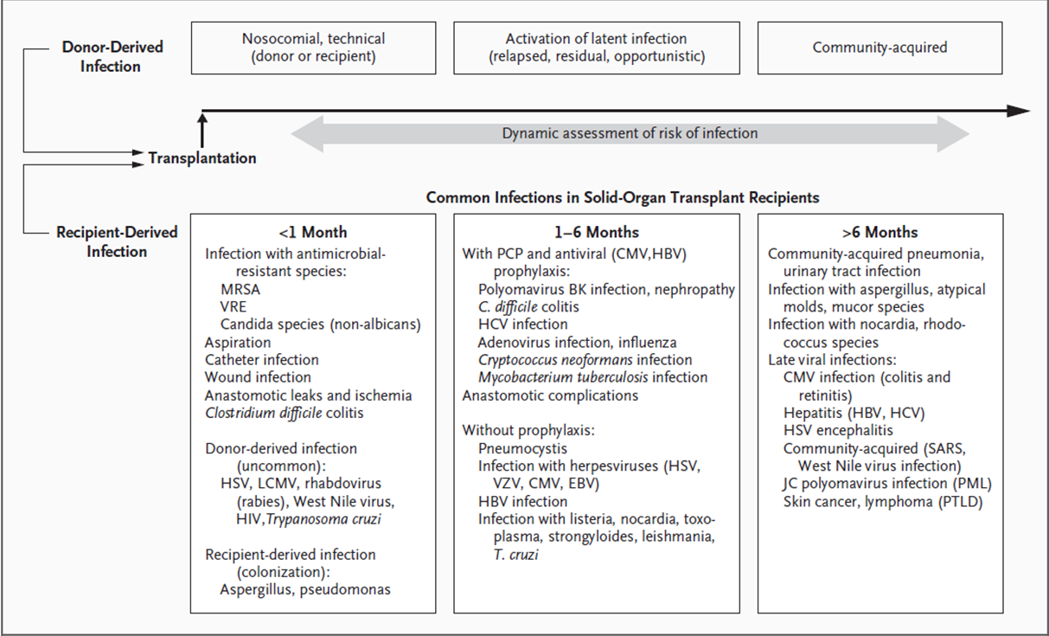
Timeline of Infections After Solid Organ Transplant
Notes:
¡Peri-transplant
÷ Surgical complications, wound infections, CLABSI/CA-UTI
¡Early post-transplant
÷Viral re-activation, PCP, TB
¡Late post-transplant
÷Community acquired infections, viral infections

Slide 7
Infections after Transplantation
Patterns of post-transplant opportunistic infections are altered by the post-transplant antimicrobial prophylaxis.
Early and specific microbiological diagnosis is essential.
Invasive diagnostic procedures are often required for accurate and timely diagnosis (EGD, colonoscopy, excisional biopsy, BAL, etc…).
Drug interactions and toxicities are common

Slide 8
Why Diagnosis is Difficult?
• The DDx is broad, and infection often progresses rapidly.
• Presentations are often complicated by noninfectious causes of fever (rejection, GVHD, lupus, drug fever, transfusion reaction, DVT, etc…).

Slide 9
Immunosuppression: “The Great Balancing Act”
Too little
Side Effects
Infection
Malignancy
Rejection
Too much

Slide 10
The Net State of Immunosuppression
Greater infectious risk:
•Induction therapy–lymphocyte depletion
•High-dose corticosteroids
•Early graft rejection
•Graft dysfunction
•Active/latent donor/recipient infection
Technical complications:
•Anastamotic leaks
•Bleeding
•Wound infection/poor wound healing
•Prolonged intubation/intensive unit care
•Surgical, vascular, or urinary catheters

Slide 11
Phases of Immunosuppression
Phase 1: Induction
Phase 2: Maintenance
Standard double or triple drug regimen depending on organ
Balancing act between risk of infection and risk of rejection
Phase 3: Rescue
Optimization of immunosuppression regimen
Prevent additional rejection episodes
Increased risk of infections
High potency therapy used early post-transplant to reduce the risk of rejection
Agent of choice
Center-specific protocols based on organ and risk factors
Depleting and non-depleting antibody products
The baseline immunosuppression is failing (rejection)

Slide 12
Immunosuppressive Agents Used in Transplantation
Class | Agents | Adverse Effects
Glucocorticoids | Prednisone, others | Osteoporosis, osteonecrosis, HTN, HTN, DM, glaucoma
DNA synthesis inhibitors, antimetabolites | Mycophenolate mofetil | Diarrhea, nausea/vomiting, cytopenia
 | Mycophenolate sodium | Less GI upset, and more expensive
 | Azathioprine | Leukopenia, hepatitis, pancreatitis
 | Cyclophosphamide | hemorrhagic cystitis, pancytopenia, alopecia,
Calcineurin inhibitors | Cyclosporine | Tremor, hirsutism, gingival hyperplasia, HTN, -GFR
 | Tacrolimus | Tremor, hair loss, GI symptoms, PRES, DM, -GFR, HTN
MTOR inhibitors | Sirolimus | Proteinuria, dyslipidemia, DM, cytopenia, pneumonitis, mouth ulcers
 | Everolimus
Lymphocyte co-stimulation blocker | Belatacept | PTLD (use only in EBV+ recipient), increased infection risk
Lymphocyte-depleting antibodies
Polyclonal | Antithymocyte globulins | Infusion reaction, leukopenia, increased infection risk
Monoclonal | Basiliximab (anti-IL-2 receptor) Rituximab (anti-CD20) Alemtuzumab (anti-CD52) | Increased infection risk, cytopenia

Slide 13
Typical OI Prophylaxis Regimen
Viral
PJP/Toxo
Fungal

Slide 14
Question
A 31 yo M with a history of alcoholic liver cirrhosis who just underwent liver transplant. His CMV status is D+/R-.
Which of the following agents is most appropriate for CMV prophylaxis for this patient?
1- IV Foscarnet for 3 months.
2- High dose Valacyclovir for 6 months.
3- Valganciclovir for 1 month.
4- Valganciclovir for 6 months.

Slide 15
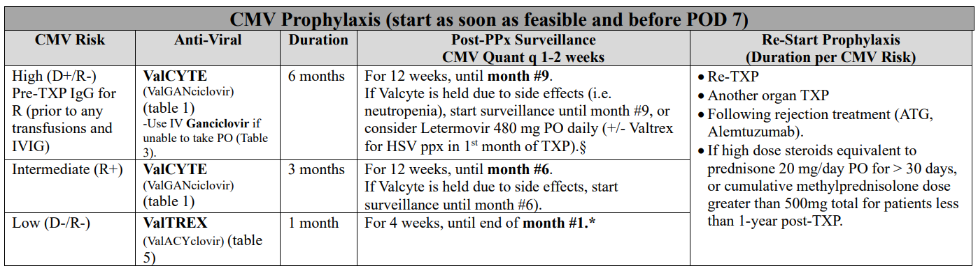
Viral Prophylaxis

Slide 16
Question
A 37-year-old man with a history of alcohol-related liver cirrhosis, and severe pulmonary coccidioidomycosis diagnosed six months ago after presenting with respiratory symptoms and multiple pulmonary nodules. He has been treated with oral fluconazole 800 mg daily, with noted clinical improvement.
He is now undergoing liver transplantation. What is your recommendation for antifungal prophylaxis in the post-transplant period?
1- Stop Fluconazole now.
2- Fluconazole for 6 months.
3- Fluconazole for 12 months.
4- Fluconazole for life.

Slide 17
Fungal Prophylaxis
Characteristic | Coccidiomycosis prophylaxis
Previous history (seroconversion) of Coccidiomycosis
>1 year before transplant | Fluconazole 400 mg PO daily for 12 mo
≤1 year before transplant | Fluconazole 400 mg PO daily for 12 mo, followed by Fluconazole PO daily for lifelong
No history of Coccidiomycosis | Fluconazole 200 mg PO daily for 6-12 mo (depending on the organ)
Candida Prophylaxis (Fluconazole 400 mg PO daily for 1st month post-LIVER transplant) if:
1- Re-transplantation
2- Prolonged OR time (>9 hours) or repeat operation.
3- Renal failure requiring renal replacement
4- Transfusion of ≥40units of cellular blood products including platelets, packed red blood cells, and auto transfusion.
5- Choledochojejunostomy.
6- Candida colonization.

Slide 18
Question
A 62 yo M with a history of ESRD secondary to DM/HTN who is undergoing kidney transplant. Toxo IgG D-/R-.
What do you recommend for Toxo/PJP prophylaxis?
1- Dapsone for life.
2- Primaquine for 12 months.
3- TMP/SMX for 6 months.
4- No indication for prophylaxis.

Slide 19
Toxo/PJP Prophylaxis
 | Toxo D-/R- | Toxo D+ or R+ | Coverage
1st line | Bactrim 1 SS daily for 6 months | Bactrim 1 SS daily for 12 months (Heart D+: lifelong Bactrim) | PJP Toxo Nocardia
2nd line | Atovaquone 1500 mg daily for 6 months | Atovaquone 1500 mg daily for 6 months | PJP Toxo
3rd line | Dapsone 100 mg daily for 6 months. | Dapsone 100 mg daily for 6 months | PJP

Slide 20
Prophylactic Antimicrobials
 | Peri-OP | Viral (CMV/HSV/VZV) | PJP/Toxo | Fungal
HEART | GPC/GNR Vancomycin/Cefepime | CMV (D+/R-) Valcyte for 6 mo CMV (R+) Valcyte for 3 mo CMV (D-/R-) Valtrex for 1 mo | 12 mo (PJP, regardless of R Toxo IgG) Lifelong (if Toxo D+) 1- Bactrim 1 SS qd (if R Toxo IgG+) 2- Atovaquone 1500 mg qd 3- Dapsone 100 mg qd | 12 mo of anti-mold PPx (Posa or Vori)
LIVER | GNR Pip/tazo VRE (if pre-txp Rectal swab +) Daptomycin |  | 6 months (PJP) 12 months (if D or R Toxo IgG +) 1- Bactrim 1 SS qd 2- Atovaquone 1500 mg qd 3- Dapsone 100 mg qd | 6-12 months (or lifelong) of Fluconazole depending on Cocci history. *Candida coverage in the first month for liver txp (if criteria met).
KIDNEY | GPC Cefazolin

Slide 21
Transplant Workup
Cytomegalovirus (CMV) IgG
Epstein-Barr Virus (EBV) serology: VCA IgG and EBNA AB
Toxoplasmosis (Toxo) IgG
Coccidiomycosis: EIA screen and CF.
Tuberculosis (TB): Quantiferon TB Gold
Strongyloides (Strongy) IgG
Syphilis (Reverse algorithm: AB with reflex to RPR)
Hepatitis A IgG
Hepatitis B Virus (HBV) panel (HBsAb, HBsAg, HBcAb)
Hepatitis C Virus (HCV) AB with reflex to NAAT
Human Immunodeficiency Virus (HIV) 4th gen
Varicella Zoster Virus (VZV) IgG
Measles/Mumps/Rubella (MMR) IgG
Chagas IgG (Only in patients from endemic area/Latin America)
VRE rectal screen (Liver only)

Slide 22
Question
A 28 yo M undergoing emergent evaluation for heart transplant after he was found to have severe non-ischemic cardiomyopathy.
Pre-transplant serology: Measles IgG negative, Hepatitis A IgG negative, HbsAb negative, Varicella IgG positive.
All of the following vaccines should be administered to this patient but which of them is contraindicated if he is going to be listed for transplant?
1- Havrix (hepatitis A)
2- Heplisav-B (hepatitis B)
3- MMR
4- Shingrix

Slide 23
Transplant Workup-cont'd
Imaging
  Cardiac stress test/ECHO
  DEXA
  Chest CT
  Colonoscopy
Anesthesia pre-op
Up-to-date on cancer screening
Dental evaluation
Vaccines
  Pneumococcal
  TDaP
  Influenza
  COVID
  HAV/HBV
  MMR (live vaccine)
  Varicella (live vaccine)
  Shingrix
Live vaccines are contraindicated less than 30-days before the transplant.

Slide 24
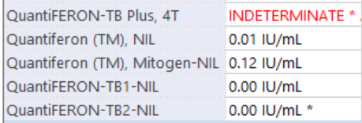
Question
A 51 yo F with a history of alcohol use disorder who was transferred from outside hospital for urgent liver transplant evaluation after she was found to have severe liver cirrhosis.
Pre-TXP infectious workup ordered, and her Quant TB Gold is indeterminate.
No known exposure to TB.
No chronic resp symptoms or B-symptoms.
CT Chest: Small left-sided pleural effusion.

Slide 25
Question-cont'd
Which of the following is the best next step?
1- Do nothing.
2- Obtain TB skin test (TST).
3- Start isoniazid/vit B6 for 9 months to treat latent TB.
4- Start RIPE to treat active TB.

Slide 26
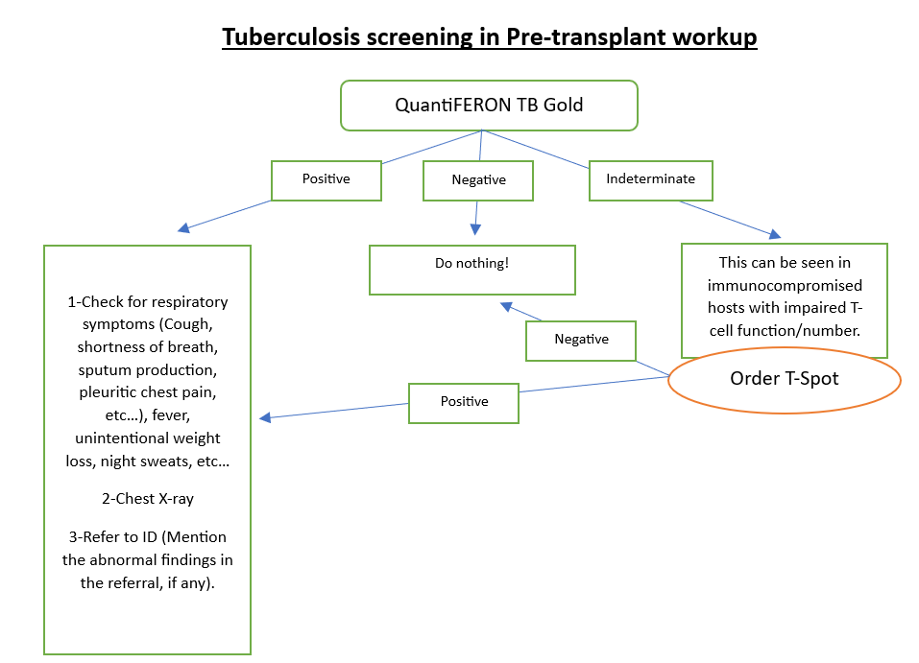
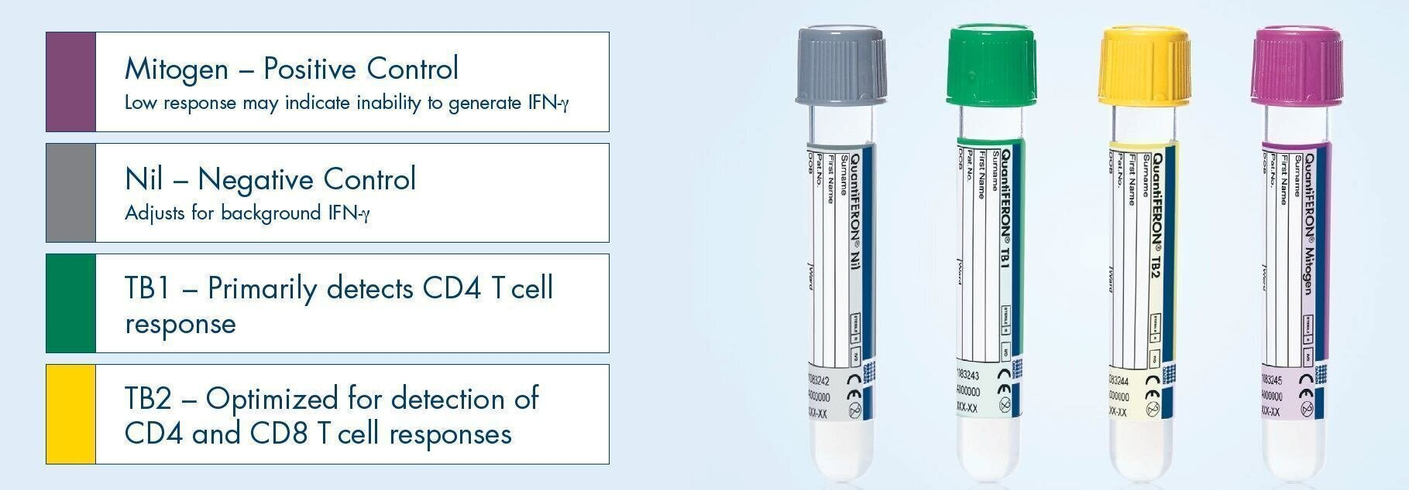
Tuberculosis Screening
1- A current negative screening test, especially in patients with organ failure awaiting transplantation, does not negate a prior positive test result.
2- If IGRA test is indeterminate, attempt to obtain TB skin test.

Slide 27
Latent Tuberculosis
1- If LTBI, treat before transplant if time allows: 3HP (12 weeks), INH (9 months), or RIF (4 months).
2- If not treated/missed→ risk of post-TXP activation is 100%.
3- For liver cirrhosis: use Rifampin in pre-transplant, and INH for post-transplant (if treatment is not completed).

Slide 28
Active Tuberculosis
1- If active TB, avoid transplant.
2- Individuals having a reliable prior history of treated latent TB infection or treated TB disease need not undergo TST, QFT, or T-SPOT.→ Check re-exposure risk, symptoms and CXR.

Slide 29
Question
A 37 yo M with a PMHx of NICMP who presented with SOB and lower extremities edema. Patient was found to have cardiogenic shock and is currently admitted to the CVICU for management.
Heart failure team is considering heart transplant.
Pre-TXP infectious workup revealed positive Strongyloides IgG.
Patient denies fevers, productive cough, and diarrhea.
What is the best next step?
1- Start ivermectin.
2- Asymptomatic; nothing to do.
3- Positive Strongyloides IgG is an absolute contraindication for SOT

Slide 30
Strongyloidiasis Treatment
Positive Strongyloides IgG in an asymptomatic pre-transplant patient:
Treatment: Ivermectin PO 200 mcg/kg x2 days (Day 1 & 2), to be repeated 2 weeks later (Day 14 & 15).
If allergic to Ivermectin, use Albendazole 400 mg PO BID x7 days.
Patient should be delisted from the transplant waitlist until the treatment is completed (A minimum of 1st 2 doses), unless benefits of the transplant outweigh the risks of the disseminated Strongyloidiasis.

Slide 31
Question
A 45-yo M is hospitalized for malaise, a 2-week hx of low-grade fever, and 10-12 episodes/day of watery diarrhea that has worsened over the past week. Medical history is notable for IgG nephropathy, for which he underwent kidney transplantation 9 months ago. Pretransplant testing demonstrated CMV D+/R-. The patient experienced acute cellular rejection ~ 4 weeks ago and was treated with antithymocyte globulin (ATG).
Current medications are tacrolimus, mycophenolate mofetil, and prednisone; he completed Bactrim and Valganciclovir for 6 months following transplantation.

Slide 32
Question-cont'd
On physical examination, temp is 38.2 C (100.8F), blood pressure is 90/60 mm Hg, pulse rate is 100/min, and respiration rate is 14/min. On abdominal examination, he was mild diffuse tenderness to palpation without rebound.
Laboratory studies: WBC 2000µL, PLTS 88,000µL.
Gastrointestinal pathogen PCR and C diff are negative.
The patient received IV fluids, with normalization of his pulse rate and blood pressure.
Which of the following is the most appropriate next step?
1- Colonoscopy with biopsy.
2- Discontinuation of immunosuppressants.
3- PCR of stool for cytomegalovirus.
4- Serology for Epstein-Barr virus.

Slide 33
CMV-Epidemiology and Risk Factors
Double-stranded DNA virus (Herpes virus 5).
Most common opportunistic viral infection in SOT.
Lead to serious illness in SOT due to its immune modulation effect (acute rejection, chronic rejection, allograft dysfunction, and increased risk of fungal infection).
“Troll of Transplantation.”
Risk factors:
CMV D+/R-
Induction therapy–ATG
High-dose corticosteroids
Acute rejection
Advanced age
High risk (D+/R-)→15%–25% of the transplant population
Intermediate (R+)
Low risk (D-/R-).

Slide 34
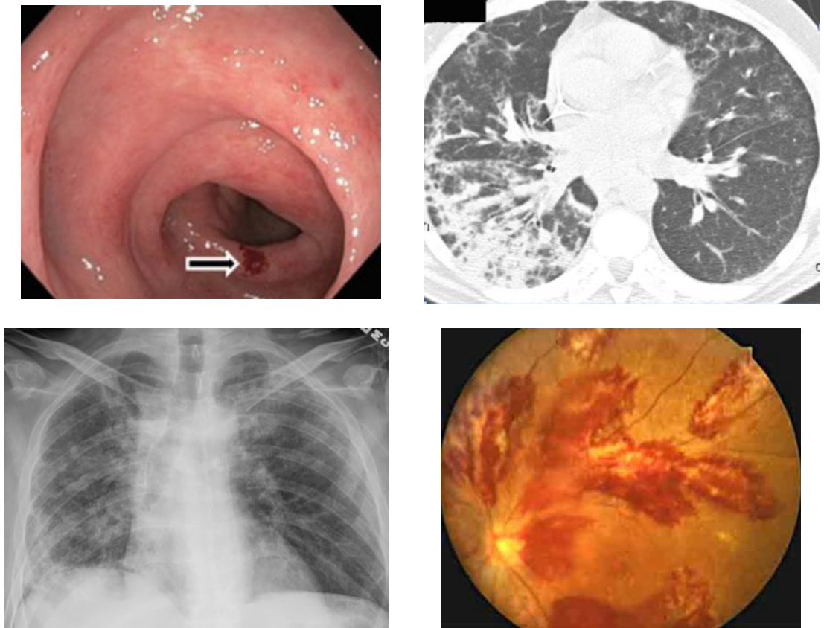
CMV-Definitions
Asymptomatic CMV:
CMV DNAemia/viremia: the detection of CMV DNA in samples of plasm or whole blood in an asymptomatic patient.
Symptomatic CMV:
CMV Disease: End-organ disease (i.e. pneumonitis, esophagitis, hepatitis, retinitis, CNS) +/- CMV viremia.
CMV Syndrome: CMV Viremia + 2 of the following: fever, malaise, leukopenia, transaminitis, thrombocytopenia, 5% atypical lymphocyte.

Slide 35
CMV-Testing
Pre-transplant screening:
-Check CMV IgG.
-Avoid CMV IgM due to low specificity.
Post-transplant testing:
-Blood or Plasma CMV Quantitative→ Diagnostic and prognostic info (use single specimen type).
-No role for CMV antibodies in the diagnosis of CMV.
-No recommendation to use saliva, urine, or stool CMV.
-Use pathology, and IHC to diagnose tissue-invasive disease.

Slide 36
CMV-Treatment
-Valganciclovir (PO) and Ganciclovir (IV) are most commonly used
-Inhibits CMV DNA polymerase
-Used as maintenance (prophylaxis) or Treatment (induction)
-Renally dosed.
-Monitor for pancytopenia (weekly CBC/diff)
-Consider immunosuppression reduction while treating CMV.
-Treatment duration at least 14 days (21 days for CMV end-organ disease) + CMV quant <35 IU/mL.

Slide 37
Question
A 62 yo M undergoes follow-up evaluation for UA results obtained as part of life insurance evaluation. He reports no urinary symptoms of frequency, urgency, or dysuria. Medical history is notable for kidney transplantation 1 year ago. Medications are tacrolimus mycophenolate mofetil.
Vital signs are normal, and physical exam findings are unremarkable.
The previous UA revealed positive Leukocyte esterase, and a leukocyte count of 10/hpf. A reflex urine culture grows >100,000 CFU of pan-sensitive Pseudomonas aeruginosa.

Slide 38
Question-cont'd
Which of the following is the most appropriate management?
1- IV cefepime for 7 days
2- Oral Ciprofloxacin for 3 days
3- Oral Fosfomycin in a single dose
4- No further management

Slide 39
Asymptomatic Bacteriuria (ASB)
ASB is the presence of 1 or more species of bacteria in the urine(≥10⁵ CFU/mL), irrespective of the presence of pyuria, in the absence of signs or symptoms of urinary tract infection (UTI).
Indications to screen/treat in the general population:
1- Pregnancy.
2- Invasive urologic procedures.
In Kidney transplant:
1- First month of kidney transplant: No recommendation for or against screening/treatment of ASB.
2- More than 1 month post kidney transplant: Recommend against screening/treatment of ASB.

Slide 40
Asymptomatic Bacteriuria (ASB)
In non-renal solid organ transplant:
- Recommend against screening for or treating ASB.
What about high-risk neutropenia (absolute neutrophil count <100 cells/mm3 , ≥7 days’ duration following chemotherapy:
No recommendation for or against screening for or treatment of ASB.
However, patients are already on Pseudomonas prophylaxis.

Slide 41
Question
A 33-yo patient is diagnosed with esophageal candidiasis after experiencing pain with swallowing. Treatment with Fluconazole has been initiated. Three years ago, they underwent successful living-donor related kidney transplant for ESRD due to T1DM. Current medications are tacrolimus, prednisone, mycophenolate mofetil, and insulin.
Laboratory studies: Creatinine 0.8 mg/dL
Which of the following medications may require adjustment?
1- Insulin
2- Mycophenolate mofetil
3- Prednisone.
4- Tacrolimus

Slide 42
Important DDI in Transplant
Azole antifungals:
  Inhibits P450 --> increases tacrolimus, sirolimus, cyclosporine
  Itraconazole>Voriconazole>Posaconazole>Fluconazole
Rifampin:
  Induces P450 --> Decreases tacrolimus, sirolimus cyclosporine
Bactrim, Ganciclovir, Valganciclovir, Dapsone:
  Cumulative Myelosuppression with Mycophenolate
Amphotericin B, Vancomycin, Aminoglycosides:
  Cumulative nephrotoxicity with CNI

