Slide 1

Endocrine Emergencies
Aleksandra Schriber

Slide 2

Overview/Objectives
Recognize and differentiate the presentations of DKA and HHS
Formulate plan for treatment of DKA/HHS and recognize common pitfalls in treatment
Recognize thyroid storm and formulate initial treatment plan. Recognize benefits and pitfalls in use of scoring systems for diagnosis
Explain initial steps in management of myxedema coma, focusing on order of medications
Explain discharge instructions to patient with adrenal insufficiency with goal to minimize adrenal crisis

Slide 3
Case 1
79 y/o female with a h/o type 2 DM, HTN, small cell lung cancer presents for hyperglycemia at request of PCP as unable to complete PET.
HPI
Mild abdominal pain
More lethargic per family
Polyuria
Denies chest pain, dyspnea, fevers, chills, diarrhea, constipation, dysuria
Blood sugars at home generally 160-250s
Takes glipizide PRN if BG >250
Day of admission BG 330. Given glipizide improvement 268. Needed BG <250 for PET scan
Medications:
Januvia 100mg daily
Farxiga 10mg daily
Glipizide 2.5mg PRN

Slide 4
Key Findings? Next Steps?

Slide 5
Case Continued
Vitals: BP 150/85, HR 120, RR 16, weight 52.8kg
Exam: Dry mucous membranes. Mild abdominal tenderness
EKG: Normal
CXR: Infiltrate and effusion LLL - similar prior imaging with lung cancer
Labs
BG 310
Na 146, K 4.6, Cl 105, Cr 0.85, eGFR 70, calcium 11.2, albumin 4.1, AST 14, ALT 9, alk phos 137, bili 0.6, A1C 7.9%
BHB 72.8, AG 26, bicarb 15. VBG 7.28, CO2 21, bicarb 10
Lactic acid 0.6, WBC 14.5, neutrophils 12.83 high, platelets 542, Hg 13.6, lipase 60
UA glucose >1000, ketones 80, negative LE and negative nitrates, specific gravity 1.031 high

Slide 6
Diagnosis?
DKA
HHS
Euglycemic DKA

Slide 7
Case Continued
Labs
  4hrs later: AG 20, bicarb 16, K 3.2, BG 158
  12hrs later: AG 13, bicarb 20, Cr 0.61, BG 226, calcium 9.4
  24hrs later: AG 11, bicarb 21, Cr 0.58, BG 170, calcium 9.7
Course:
  Insulin drip requiring 0-3u, 12u in last 6hrs
  12 hrs transitioned off drip with lantus 12, lispro 4u

Slide 8
Case 2
60 year old female with type 2 DM, HTN, CKD who presents for weakness with slurred speech at home.
HPI
Family notes more lethargic and increased sleep
Polyuria without dysuria
Denies fevers, chills, nausea, vomiting, diarrhea, abdominal pain, dyspnea
Not checking BG at home. Outpatient A1C 13% few months ago
Medications
Tresiba 70u
Aspart 6u TIDAC
Jardiance 10mg
Metformin 500mg BID

Slide 9
Case Continued
Exam
  Vitals: BP 118/59, HR 44, RR 14, temp 36.7, weight 80kg
  Mumbled speech, but appropriately answering questions. Mild peripheral edema. No focal neuro findings
Labs
  BG 1160
  Cr 2.79 (baseline 1.8), lactic acid 2.3
  Serum osm 344
  A1C >17
  BHB <0.5, bicarb 19, AG 13, VBG pH 7.35, CO2 15
  Troponin 113 → 116
  UA ketones 300, LE 75 moderate, WBC >50, bacteria present
EKG anterior ST elevation, baseline compared 6 months prior
US R hydronephrosis

Slide 10
Case Continued
Treated antibiotics for UTI
Diagnosed with demand ischemic, no cardiac intervention needed
Treated with IV insulin drip. Lowered BG slowly with transition to subcut following day

Slide 11
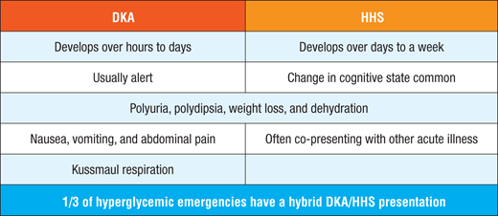
Clinical Presentation
Notes:
Kussmaul respirations - Deep rapid regular respirations reflection compensatory hyperventilation
DKA more rapid onset. HHS usually polyuria, polydipsia, weight loss days before admission
Hyperventilation and abdominal pain - DKA
Neuro symptoms more common HHS
Lethargy, obtundation, coma
Associated plasma osm >320
Focal signs: Hemiparesis or hemianopsia
In DKA less common, be on alter if mental status change
Abdominal pain, nausea, vomiting - DKA
Associated with severity of metabolic acidosis
Possible etiologies delayed gastric emptying, ileus
Volume depletion signs
Fruity odor - exhaled acetone - DKA

Slide 12
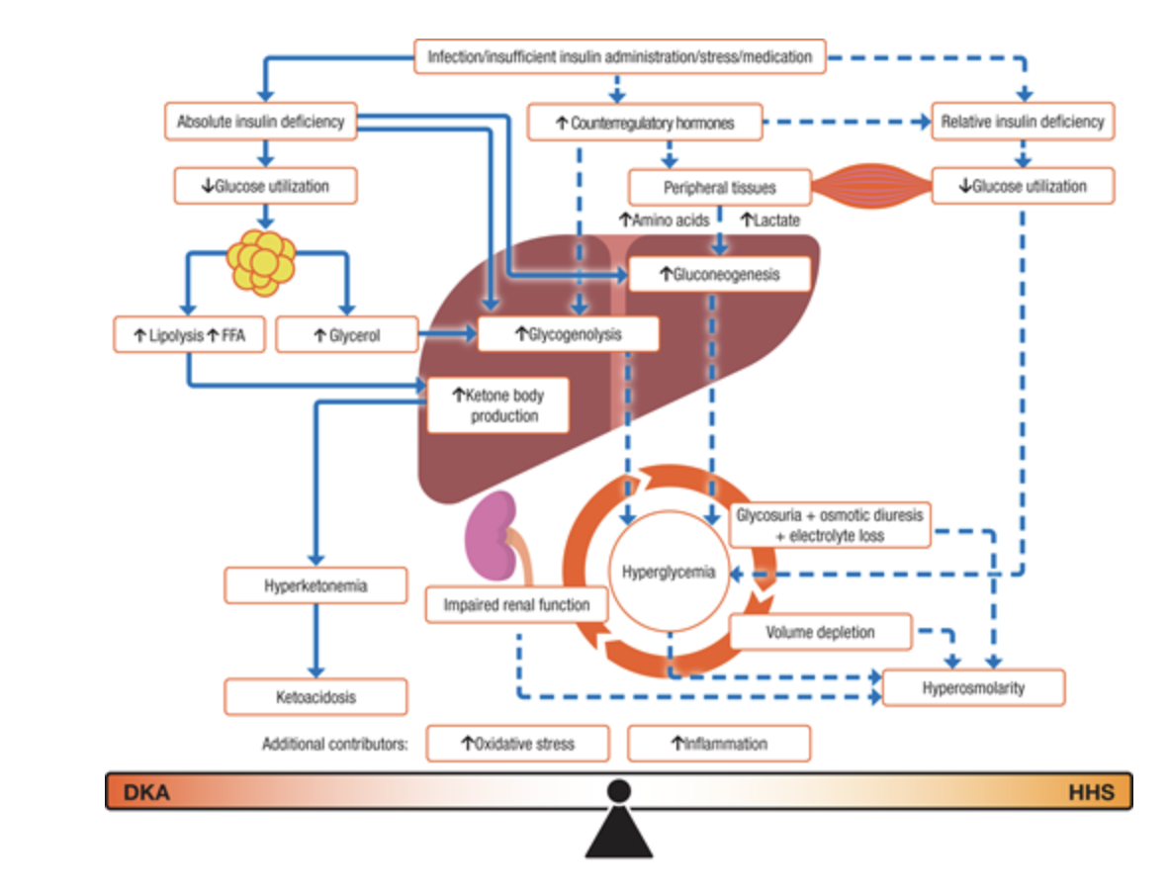

Slide 13
Initial Evaluations
ABCs
Mental status
Precipitating events
Volume status
Labs
  Glucose, CMP, CBC, UA with ketones, plasma osm, BHB, ABG/VBG
  A1C - may be lower if new onset type 1
  EKG
  Additional testing as needed by presentation - ie CXR if PNA suspected

Slide 14
Precipitating Factors
Acute major illness
  MI
  CVA,
  Infection - 30-40% DKA and 30-60% HHS
  Pancreatitis
New onset DM - 20-25% DKA cases
Missed/poor compliance insulin - 20-40% HHS cases
Pump malfunction
Eating disorders - type 1 younger patients
Medications/Drugs
  SGLT2i
  Steroids
  Atypical antipsychotics
  Cocaine use associated recurrent DKA

Slide 15
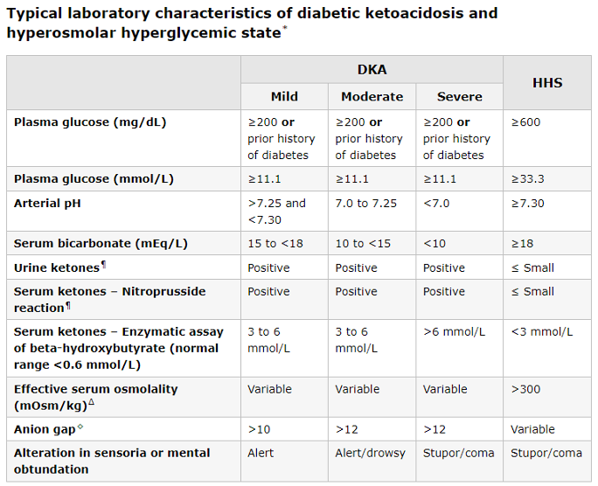
AG = serum Na - (serum Cl + bicarb)
Effective Posm = [2xNa (mEq/L)] + [glucose (mg/DL) / 18]
Notes:
BG >800-1000 HHS. DKA generally 350-500
Ketones bodies produced and accumulate DKA
acetoacetic acid - true ketoacid
BHB - hydroxyacid formed reduction acetoacetci acid
Acetone - derived decarboyxlation acetoacetic acid - true ketone not acid
Nitroprusside test - urine turns purple if acetoacetic acid and acetone
More false positives/negatives
Direct BHB levels - serum ketones
AG can indicate coexisting metabolic alkalosis due vomiting. Less role in monitoring/treatment than BHB
Use actual measured NA (not corrected BG). DKA usually >20, HHS only mild elevation
Compensatory hyperventiation can help prevent fall pH, however severe ketacodisosi pH decreases
Normal serum osm 275-295, normally HHS >320
Equation use actuall NA not corrected
Na multiplied by 2 to account osmotic contribution Na anions (Cl and bicarb). 18 converts glucose mg/dL to mmol/L
Sodium normally mildly hyponatremia - HHS may have elevated - especially hot weather and older individuals impaired thirst
K deficit 300-600mEq - urinary losses due glucose osmotic diureiss and excretion K ketoacid anion salts
Hypokalemia only 5%, serum K normally or elevated due to shift of K from intracellular fluid to ECF from hyperosmolality and insulin deficiciency
Insulin shifts K into cells → lower K contraction → severe hypokalemia if low/normal K
Phosphoate can have same issue -
Amylase and lipase can be elevated in DKA without pancreatitis - 17-24% of patients without pancreatitis on CT, abdominal present 19% patients
Leukocytosis - unrelated to infection - hypercortisolemia and increased catecholamines, if >25000 or 10% bands → higher suspicion infection
Overlap in ⅓ patients DKA/HHS

Slide 16
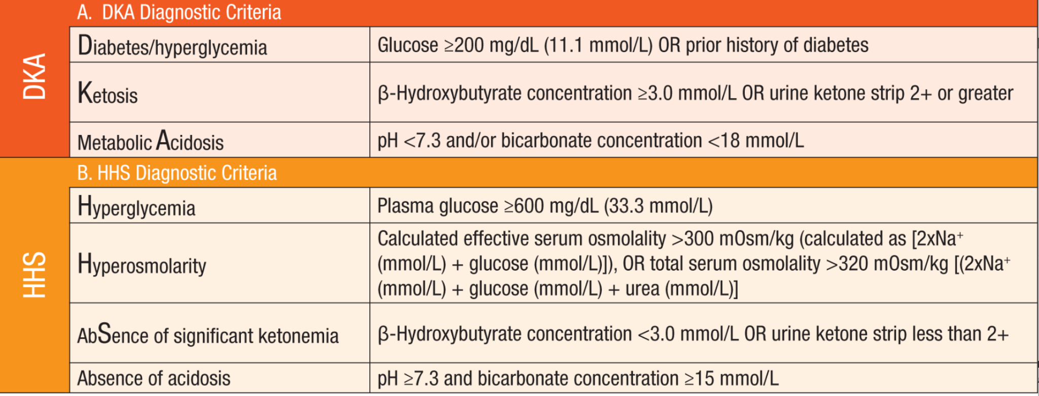

Slide 17
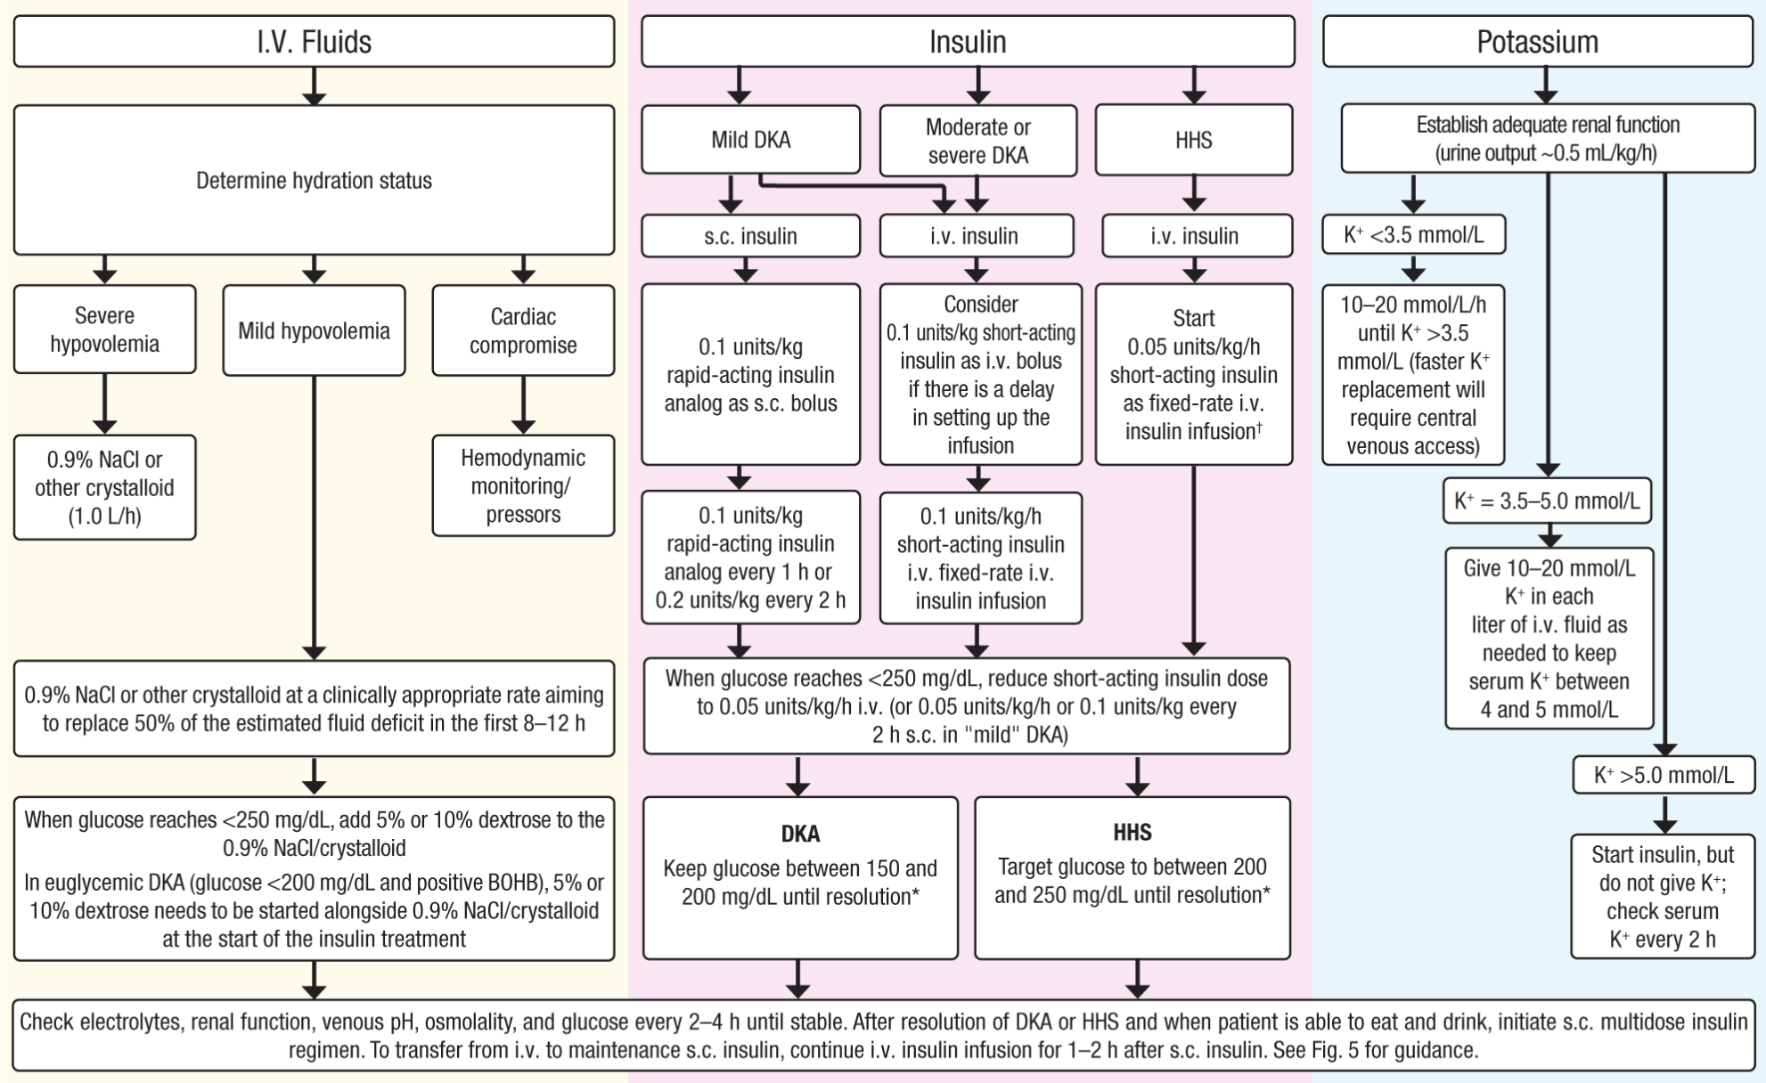
Notes:
First step isotonic fluid to expand extracelliular volume and stabilize CV status
Increases insulin responsiveness by lowering plasma osmolality, reducing vasoconstriction, improving perfusion, reducing stress hormone
2nd step K replacement
Next insulin key if K <3.5 wait to start

Slide 18
IV Fluids
Notes:
NS or LR (isotonic buffered crystalloid) for volume repletion
Buffered crystalloid may reduce time DKA resolution and reduces risk of hyperchloremic non-AG met acidosis often found isotonic saline - however no trials available.
Once BG <250, add dextrose to IVF or if euglycemic DKA
If hypovolemic shock - bolus. If hypovolemia without shock 15-20mL/kg per hour 1L/hr average pt
Switching
2nd-3rd hr change rate
Look corrected Sodium (2mEq for 100 >100)
<135 - 250-500cc/hr
>135 switch ½ isotonic saline 250-500cc/hr
If needing high level K can add 0.45NS

Slide 19
Potassium
Notes:
K <3.5 → hold insulin. give 10-20mEq per hour (10-20mEq in IVF). May increase 30,Eq
K 3.5-5
Add IV K 10-20mEq each liter
Okay start insulin
Goal K 4-5
K >5
No K replacement
IV insulin
K <5 add 10-20mEq per liter

Slide 20
Insulin
Notes:
Insulin –. lower glucose (decrease hepatic glucose production and ehnacing peripheral use). Diminishes ketone production (reduce lipolysis and glucagon secretion) and may augment ketone utilization. Lower insulin can inhibit ketogenesis so if reducing glucose helping ketones
Moderate to severe DKA
Fixed rate 0.1u/kg/hr - ie 7u/hr if 70Kg vs variable rate per protocol
Expect fall 50-70mg/dL per hour
<250 5-10% dextrose and reduce rate 0.05u/kg/hr or protocol. Goal maintain 150-200 until resolution DKA
Mild-moderate
same as above or subcut, but need monitoring BG frequently every 1-2 hours
CGMs ? Not at this time- interstitial glucose - can have 15min delay
Lantus? Wait 2hrs to stop drip
Measure insulin every hour
BMP and BHB every 2-4hrs
HHS goal not more 90-120mg/dL/hr to prevent similar edema
Serum Na should not be great 3-8mOsm/kg/h
Na no more 10mmol/L in 24hrs

Slide 21
Other Treatment Considerations
Routin bicarb not recommended
  Studies without improved outcomes
  Risk hypokalemia, cerebral edema
Bicarb only considered if pH <7
Phosphorus only if <1, muscle weakness, respiratory compromise
  No benefit on DKA replacement

Slide 22
Banner Protocol
Fluids
  NS 500mL/hr (noted goal volume 5L)
  1/2 NS with D5 250mL/hr once BG <250. Notify provider if not meet 5L replacement
Insulin
  Fixed dose insulin 0.1u/kg/hr
  Not to start if K <3.3
  Once BG <250 —> switch 1/2 NS D5
  If BG <200 on dextrose decrease infusion 50%
Potassium
  Monitor K q2hrs
  Hold insulin if K <3.4. If K <3.4 give 10mEq q30 for 8 does (80mEq in 4hrs)
  If K 3.4-4.2 K 10mEq q30mins 4 doses (40mEq q2 hrs)
  If K 4.3-5.3 10mEq q30 for 2 doses (20mEq over 1hr)
  If > 5.3 no potassium monitor 2hrs

Slide 23
Criteria for Resolution
DKA
Plasma ketone <0.6mmol/L AND
Venous pH >7.3 OR
Bicarb >18
Ideally BG <200
Avoid using AG - misleading hyperchloremic metabolic acidosis from NS can lower gap
HHS
Calculated serum osmolality <300mOsm/kg
Hyperglycemia corrected
Urine output >0.5mL/kg/hr
Cognitive status improved
BG <250
Notes:
When to transition
BHB <0.6, bicarb>18, pH >7.3
Do NOT depend on AG - unreliable as hyperchloremic acidosis from NS may falsely lower gap

Slide 24
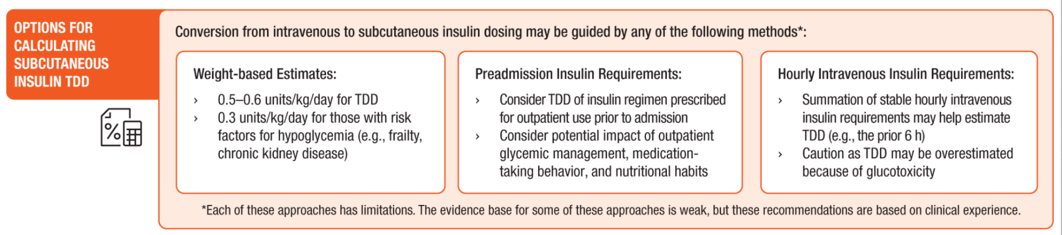
Transition off drip
Case 1:
  Last 6hrsx4 use on drip
    12x4 = 48u TDD → Lantus 24u, lispro 8u
  Weight based dosing - 0.4u/kg, 0.5u/kg, 0.6u/kg
    52.8kgx0.5=26.4kg → Lantus 13u, lispro 4u

Slide 25
DKA and SGLT2i
Increased risk of DKA
Euglycemic DKA = plasma glucose <250
Counsel patients on risk and to hold if nausea, vomiting on SGLT2i
Block SGLT2 → glucosuria that minimizes hyperglycemia, despite low insulin and ketoacidosis occurring
Need insulin! Treat with insulin + glucose (dextrose drip) to reverse ketoacidosis

Slide 26
Case 3
28 yr old woman with history of Prader-Willi Syndrome and hypothyroidism presents to your emergency room with altered level of consciousness, lethargy, and lower extremity edema. She is taken care of exclusively by her caregiver. She ran out of levothyroxine 3 months prior.
Vital Signs:
Temperature 92.9° F, HR: 49, BP: 104/90, RR: 8, O2 Sat: 94%
Physical Exam:
Appears lethargic, bradycardic and with significant nonpitting lower extremity edema. Otherwise unremarkable exam

Slide 27
Key Findings? Next steps?
Vote or Shout Out!

Slide 28
Which patient has Myxedema Coma?
Patient 1:
TSH 15, FT4 0.5
Patient 2:
TSH 240, FT4 0.1
Patient 1
Patient 2
Both
Neither
Need more info

Slide 29
Case Continued
Laboratory Data:
Sodium 129
Blood glucose: 54
TSH 110, Free T4 and Free T3 are undetectable
+ TPO antibodies
Normal renal function, normal CBC, cortisol level

Slide 30
Myxedema Coma
Most severe form of Hypothyroidism
  Altered level of consciousness
  Hyponatremia
  Hypothermia
  Hypoventilation
  Hypoglycemia
  Hypotension
  Rarely heart failure
  Pericardial effusion
Notes:
Frequently altered consciousness - confusion with lethargy. Psychotic features can be seen - myxedema madness

Slide 31
Management
Supportive measures
*** Corticosteroids Initially *** 100mg q8hrs
IV Levothyroxine 200-400mcg loading dose followed 50-100mcg daily
Liothyronine 5-20mcg loading, 2.5-10mcg every 8hrs
  Less clear evidence
Transition to oral once clinical and biochemical improvements
Notes:
ACTH secretion cab be blunted severe hypothyroidism → abnormal cortisol response stress
Also could have central hypothyroidism
Liothyronine - conversion T4→T3 impaired. T3 biologic activity greater and onset rapid
levothyroxine lower dose older or cardiac complication risk
Check T4/T3 every 1-2 days to ensure therapy working (T3 at least 1hr from liothyronine). TSH falls 50% in one week

Slide 32
Case
69 yr old man with h/o Graves off medication comes to your emergency department with palpitations, sweating, heat intolerance, tremor, and anxiety, dyspnea on exertion
Vital signs: Afebrile, P: 152 BP: 125/79. O2 Sat: 99% on RA, temp 38.6
Physical Exam shows: Lethargy, JVD, LLE edema, enlarged thyroid, bilateral tremor, hyperreflexia
EKG showed Atrial fibrillation
Labs: TSH 0.04, FT4 6.2

Slide 33
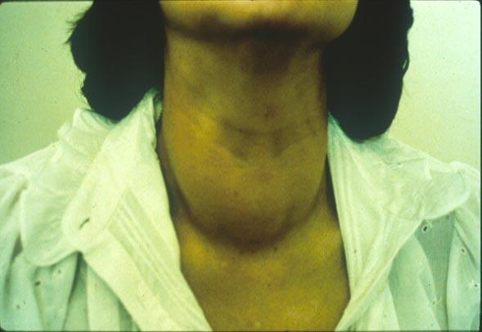

Symptoms/Signs
Diffuse Goiter
Goiter, exophthalmos
Fever
Weakness, muscle wasting
Restlessness
Confusion
Psychosis
Coma - especially elderly
GI symptoms: nausea, vomiting, diarrhea, jaundice
Atrial fibrillation
Heart failure
Thyroid bruit may be present on exam

Slide 34
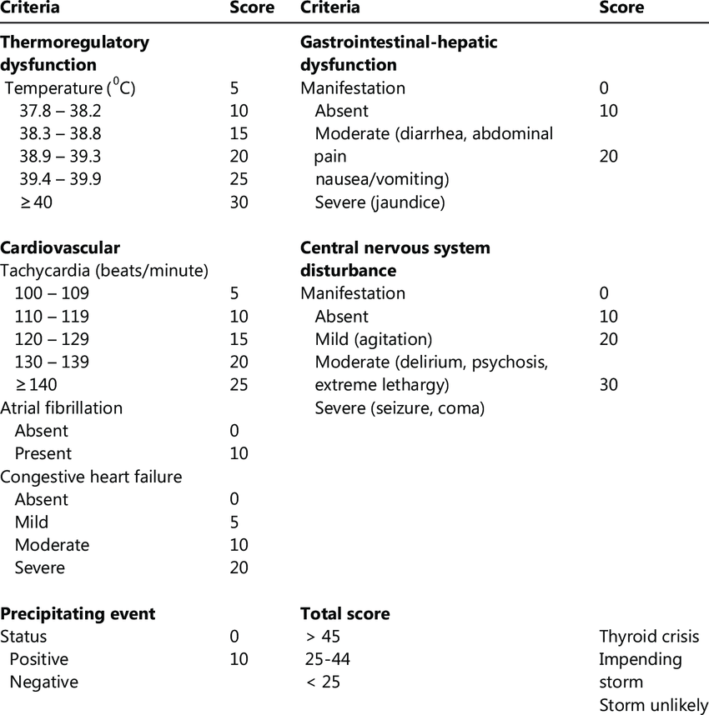
Burch-Wartofsky Point Scale for Thyrotoxicosis
No universally accepted criteria or validated clinical tools
BWPS - sensitive, but no specific
Japanese thyroid associated another scoring system, slightly reduced sensitivity
Notes:
ie if mild hyperthyroidi had flu with fever and nausea → meet criteria for storm

Slide 35
Treatment
ICU admission
Treat precipitating factors - ie infection
Beta blockers - propranolol 60-80mg q4-6 hrs
Thionamide - PTU 200-250mg q4hrs
Iodine solution to block release thyroid hormone - wait 1hr after first thionamide
Glucocorticoids 100mg q8hrs
Bile sequestrants - cholestyramine 5mg QID
Plasmapheresis
Notes:
Propranolol - due high doses inhibits conversion T4 →T3 thru inhibition type 1 deiodinase. Titrate to achieve HR control 60-80 q4-6hrs
Avoid BB if acute decompensated HF with systolic dysfunction. Hyperadrengeric state important for cardiac output
If reactant airway disease consider beta-1 selective (metoprolol, atenolol)
Esmolol alternative as duration action short and selective beta 1 blocker. Some evidence of less mortality with heart failure, but some studies without change
PTU favored as decrease peripheral conversion. Drop T3 45% 24hrs PTU vs 10-15% methimazole. Transition methimazole prior discharge. Consider methimazole if severe hyperthyroidisos - Japan methimazole preferred and no diff mortality. Methimazole 20mg q4-6 hrs
Cholestyramine reduce enterohepatic circulation thyroid hormone
Dexamethasone 1-2mg q6hrs if contraindication thionamides
Iodine
Iodine - wait 1hr to prevent iodine use new hormone synthesis - use cautiously if toxic adenoma. Blocks release T4/T3 gland without hours. Reduced length of sta and cost. Discontinue after clinical improvement - unless thyroidectomy planned 10-14 days

Slide 36
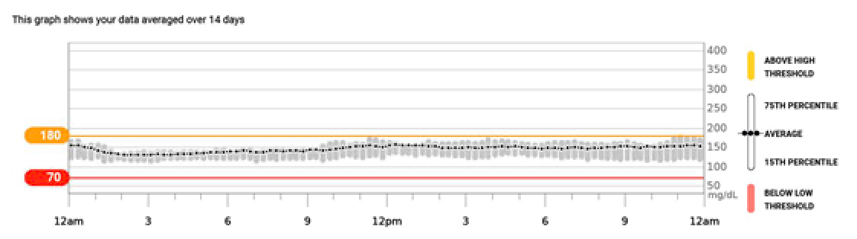
Case:
64 year old male with RCC treated pembrolizumab with subsequent type 1 DM and hypothyroidism presents for follow up of diabetes via telehealth.
BG with excellent control, but notes not eating. Low appetite, nausea, dizziness, significant fatigue. Off BP medications. Only using TDD 14u previously on 30u lantus

Slide 37
Differential? Next Steps

Slide 38
Labs:
Labs
  Cortisol 0.5, ACTH 3
  Na 134, K 4.4
  A1C 6.5%
  Calcium 11.1, PTH 6, PTHrP <2
Course
  Given hydrocortisone with strict precautions for hospital if symptoms not improved. Initially stress dosing hydrocortisone followed by 10mg/5mg
  Significant clinical improvement within few days

Slide 39
Adrenal Crisis
Life threatening episode of acute severe AI with cardiovascular collapse and shock
Symptoms
  Hypotension
  Nausea, vomiting, anorexia
  Fatigue, weakness
  Confusion, loss consciousness

Slide 40
Management
IV access
Draw labs with BMP, cortisol, ACTH. Do NOT wait on labs for treatment
Infusion 1L IV saline. Repeat as needed then
Give hydrocortisone 100mg IV followed 50mg IV q6hrs for 24hrs
Fludrocortisone?
  Only in primary AI
  If hydrocortisone >40mg daily no need fludrocortisone
Supportive measures
Notes:
hydrocortisone hasmineralocorticoid activity
If on methylpred or dexamethasone - would require fludro

Slide 41
Patient Education
Education patient on adrenal insufficiency and steroids
Counsel on medical alert bracelet/necklace
Prescribe injectable glucocorticoid
Educate stress dose steroids 2-3x dose for 2-3 days during illness
Educate need stress dosing for surgeries and procedures

Slide 42
Summary
For DKA/HHS treatment involves fluids, potassium, and insulin. Hold insulin until K replaced >3.5
Thyroid storm focus treatment focus on beta blockers and PTU. Diagnostic scoring tools useful to rule out, clinical suspicion important as well
Myxedema coma ensure steroids before levothyroxine
Adrenal crisis important to give high dose steroids after labs drawn without waiting for labs. Ensure good education for patient to avoid repeat admission

Slide 43
Questions?

