Slide 1
Chronic Kidney Disease
Katharine Dahl, MD
Academic Half Day
October 7, 2025
kdahl1@arizona.edu

Slide 2
Learning Objectives
1. Define chronic kidney disease. Describe the stages of CKD according to the GFR and albuminuria.
2. Describe the appropriate use of creatinine and cystatin C based equations to estimate and monitor glomerular filtration rate. Understand the harm done by historical race-based estimated GFR formulas.
3. Understand the cardiovascular risk to those with CKD and describe the recommendations for hypertension and hyperlipidemia for patients with CKD.
4. Understand the importance ACE-I/ARBs, SGLT-2 inhibitors, mineralocorticoid receptor blockers, and GLP-1 receptor agonists in slowing the progression of CKD and reducing cardiovascular mortality.
5. Describe the pathophysiology of renal osteodystrophy and the resulting secondary and tertiary hyperparathyroidism.
6. Describe the evaluation and appropriate management of the anemia of chronic kidney disease including the indications for erythropoietin stimulating agents and iron supplementation.
7. Describe the syndrome of uremia and the urgent indications for dialysis.

Slide 3
Overview: CKD
Definition
Epidemiology
Risk factors
Pathophysiology
  Most common primary diseases
  Adaptive response by the kidney to the loss of nephrons
Stages of CKD
Treatment to slow progression
CKD impact on morbidity and mortality
Treatment to prevent and manage comorbidities
Preparation for renal replacement therapy and transplant

Slide 4
Overview of Kidney Function
Homeostasis
  Elimination of waste products
  Adjusts water and electrolyte balance via tubular reabsorption or secretion
Hormone secretion
  Systemic and renal hemodynamic
    Renin, prostaglandins, bradykinin
  Red blood cell production
    erythropoietin
  Calcium, phosphorus, and bone metabolism
    1,25-dihydroxyvitamin D3 (calcitriol)
Notes:
Any or all of these functions may be compromised in kidney disease; i.e. DI only concentrating ability impaired; advanced ckd – all functions compromised.

Slide 5
DEFINITION
Which of the following patients have chronic kidney disease?
34-year-old woman with diabetes, GFR 110, urine microalbumin 58mg/g creatinine, urinalysis normal
24-year-old man with bipolar disorder treated with lithium who has polyuria from nephrogenic diabetes insipidus, GFR 95, serum sodium 148 mEq/L, urinalysis normal, urine microalbumin 22mg/g creatinine
56-year-old man with a history of nephrolithiasis, GFR 105, urine microalbumin negative, urinalysis normal.
42-year-old woman with IgA nephropathy, GFR 45, urine protein:creatinine ratio 2.3g/g creatinine, urinalysis with protein and 30-60 RBCs/hpf
All of the above

Slide 6
DEFINITION
Which of the following patients have chronic kidney disease?
34-year-old woman with diabetes, GFR 110, urine microalbumin 58mg/g creatinine, urinalysis normal
24-year-old man with bipolar disorder treated with lithium who has polyuria from nephrogenic diabetes insipidus, GFR 95, serum sodium 148 mEq/L, urinalysis normal, urine microalbumin 22mg/g creatinine
56-year-old man with a history of nephrolithiasis, GFR 105, urine microalbumin negative, urinalysis normal.
42-year-old woman with IgA nephropathy, GFR 45, urine protein:creatinine ratio 2.3g/g creatinine, urinalysis with protein and 30-60 RBCs/hpf
All of the above

Slide 7

Definition of Chronic Kidney Disease
The presence of markers of kidney damage for ≥3 months
  Albuminuria >30mg/24hrs
  Urine sediment abnormalities
  Electrolyte and other abnormalities due to tubular disorders
  Abnormalities detected on histology
  Abnormalities detected on imaging
  History of kidney transplant
OR
The presence of GFR <60 mL/min/1.73 m² for ≥3 months

Slide 8
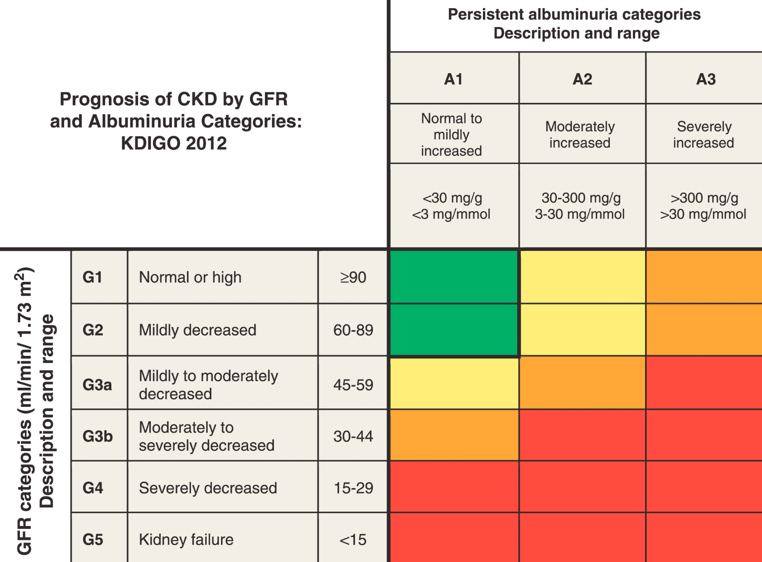
Classification of CKD
Kidney Disease: Global Outcomes Initiative (KDIGO)
KDIGO Guidelines

Slide 9
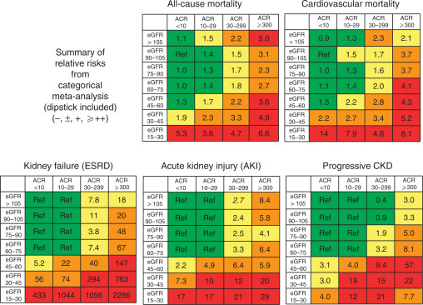
Risks of GFR and Proteinuria on Mortality and CKD Progression
Metanalysis of 45 cohorts involving over 1.5 million participants
Levey AS, et al. Kidney International. Vol 80. Issue 1. 1 July 2011, Pages 17-28.

Slide 10
STAGES OF CKD
A 54year old woman with diabetic nephropathy has a GFR of 50ml/min and urine microalbumin of 250mg/g creatinine. What is the KDIGO stage of her CKD
CKD 2 A2
CKD 3a A1
CKD 3a A2
CKD 3b A2
CKD 4 A3

Slide 11
STAGES OF CKD
A 54year old woman with diabetic nephropathy has a GFR of 50ml/min and urine microalbumin of 250mg/g creatinine. What is the KDIGO stage of her CKD
CKD 2 A2
CKD 3a A1
CKD 3a A2
CKD 3b A2
CKD 4 A3

Slide 12
STAGES OF CKD
A 54year old woman with diabetic nephropathy has a GFR of 50ml/min and urine microalbumin of 250mg/g creatinine. What is the KDIGO stage of her CKD
CKD 2 A2
CKD 3a A1
CKD 3a A2
CKD 3b A2
CKD 4 A3

Slide 13
Referral to Nephrologist
Decreased mortality associated with early referral (CKD 3) (but these patients are less likely to progress to ESRD or develop cardiovascular disease)
Increased mortality if referred <4 months of starting dialysis
Recommendation:
  CKD3 for initial evaluation and treatment plan
  CKD4 for active management
  Glomerular disease
  Persistent proteinuria >300mg/g
  Persistent hyper- or hypopkalemia
  Uncontrolled HTN despite 4 agents
  Recurrent or extensive nephrolithiasis
  Hereditary renal disease

Slide 14
Estimation of GFR
CKD-EPI creatinine-based formulas (2009, 2021)
Cystatin C – based GFR formula

Slide 15
Estimation of GFR:
Older Formulas Incorporated Race
MDRD (Modification of Diet in Renal Disease) formula
CKD-EPI 2009 (Chronic Kidney Disease Epidemiology Collaboration equation) – more accurate for GFR >60
Both equations include a race coefficient (non-Black or Black)
Limitations:
Inaccurate in patients with high or low body size or muscle mass (amputation, malnourished, high muscle mass) or certain diets (vegetarian)
Imprecision: > 10% of eGFR values are more than 30% different from measured GFR
Race-based formula
Gansevoort RT, Anders HJ, et al. Neph Dialysis Transpl, Volume 38, Issue 1, Jan2023, pp. 1–6.

Slide 16
Problems with Race-Based GFR Estimation Formulas
Adults who identify as Black have higher serum creatinine levels on average than those who do not identify as Black which is why race has been included in equations.
Problems with this:
The inclusion of race in these formulas suggests that race is a biologic rather than primarily a social and political construct.
Mixed ancestry is not reflected in categorical characterizations of race.
An accurate estimate of GFR is important for timing of dialysis preparation and transplant (i.e. overestimation of GFR could lead to delayed listing for transplant).

Slide 17
Removing Race from Creatinine-based GFR Equation
The American Society of Nephrology and the National Kidney Foundation formed a group to develop race free formula to estimate kidney function:
GFR-EPI 2021 formula
Imprecision was similar to GFR-EPI 2009
> 10% of eGFR values are more than 30% different from measured GFR
Female and SCr ≤0.7 mg/dL: 143 × (SCr/0.7)^{−0.241} × 0.9938^{age in years}
Female and SCr >0.7 mg/dL: 143 × (SCr/0.7)^{−1.200} × 0.9938^{age in years}
Male and SCr ≤0.9 mg/dL: 142 × (SCr/0.9)^{−0.302} × 0.9938^{age in years}
Male and SCr >0.9 mg/dL: 142 × (SCr/0.9)^{−1.200} × 0.9938 ^{age in years}
Inker LA, Eneanya ND, et al. N Engl J Med 2021; 385:1737–49.

Slide 18
Cystatin C
Cysteine protease inhibitor
Present in all tissue and produced at a constant rate
Filtered freely, not secreted nor reabsorbed in the tubules
Widely available in commercial laboratories

Slide 19
Cystatin C GFR equation is precise and does not require consideration of race or ancestry
Estimation of GFR using serum cystatin C was precise
Inclusion of race or genetic ancestry was not needed to improve precision.
Hsu C, et al. NEJM. 385;19 Nov 4, 2021

Slide 20
Cystatin C
Best marker to use in GFR estimation formulas
Better than creatinine-based formulas for:
  Elderly
  High or low muscle mass or activity level
  GFR >60
  All races and genetic ancestry
Limitations – Cystatin C can be increased with:
  High dose glucocorticoids
  Hyperthyroidism
  Obesity
Cystatin C based eGFR formulas are better at predicting mortality in all groups

Slide 21
PREVALENCE
Approximately what percentage of the general U.S. Population have chronic kidney disease?
5%
15%
30%
50%

Slide 22
PREVALENCE
Approximately what percentage of the general U.S. Population have chronic kidney disease?
5%
15%
30%
50%

Slide 23
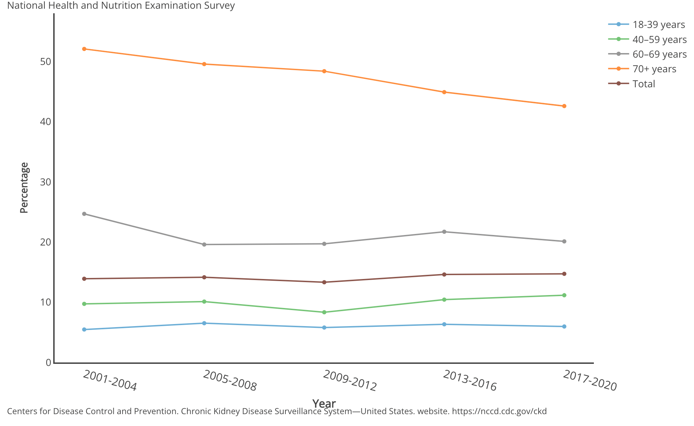
Prevalence of Chronic Kidney Disease
14.7% of adults in the U.S. have chronic kidney disease (31million people)
44% of people over age 65 have chronic kidney disease
Stages 1 and 2 defined by single assessment of albuminuria and eGFR ≥90 and 60-89 ml/min, respectively
Stages 3 and 4 defined as 30-59 and 15-29 ml/min respectively

Slide 24
Progression to CKD
Framingham Offspring Study
  1223 men and 1362 women initially free of preexisting kidney disease
  18.5 year mean follow-up
  9.4% developed CKD (GFR <64 men, <59 women)

Slide 25
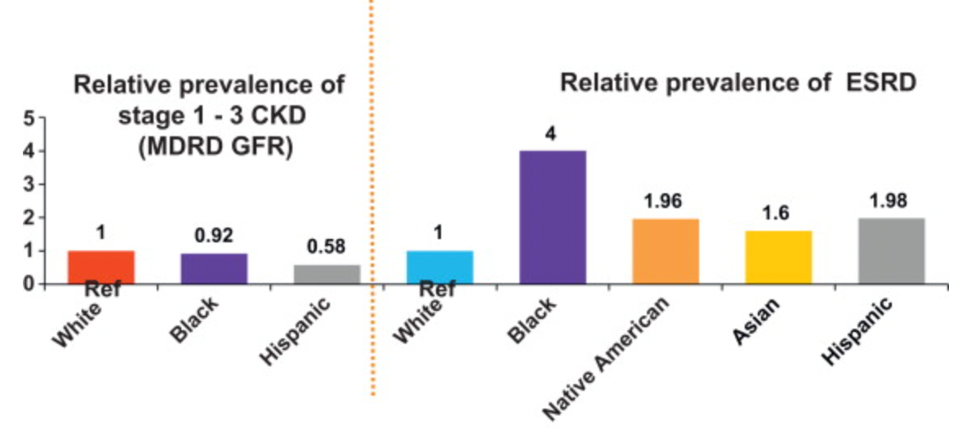
Prevalence of CKD and ESRD by race/ethnicity
Nicholas S.B., Kalantar-Zadeh K., Noris KC: Semin. Nephrology 2013; 33: pp. 409-15.
Collins A.J., Foley R.N., Herzog C., et. al.: US Renal Data System 2012 annual data report. Am J Kidney Dis 2013; 61: pp. A7.
Hsu C.Y., Lin F., Vittinghoff E., Shlipak M.G.: Racial differences in the progression from chronic renal insufficiency to end-stage renal disease in the United States. J Am Soc Nephrol 2003; 14: pp. 2902-2907.

Slide 26
Risk Factors for Susceptibility to CKD and Progression to ESRD
Clinical Factors
Diabetes
Hypertension
Autoimmune diseases
Systemic infections
Urinary tract infections
Urinary stones
Neoplasia
Family Hx of CKD
Recovery from ARF
Reduction in kidney mass
Exposure to nephrotoxic drugs
Low birth weight
Sociodemographic factors
US ethnic minority status
Exposure to certain chemical and environmental conditions
Low income/education
Genetic factors
High risk APOL 1 genotype
Modification of Diet in Renal Disease (MDRD) Study
Eneanya ND, Boulware LE, Tsai J et al. Nature Rev. Feb 2022 (18): 84-94.
Notes:
Modification of Diet in Renal Disease Study

Slide 27
High Risk Apolipoprotein L1 (APOL 1) Genetic Variants
Genetic variation on chromosome 22q has been associated with increased susceptibility to FSGS, HIV-associated nephropathy, and HTN-related renal failure, but decreased susceptibility to African trypanosomiasis (sleeping sickness)
This genetic variant is thought to be a recent selection event in West Africa (high prevalence in Yoruban populations from Nigeria).
Approximately 13% of Black individuals in the US have a high-risk APOL1 genotype
Within Nigeria, the prevalence of high-risk APOL1 variants varies from 2.1% to 49.1%, demonstrating tremendous heterogeneity
Thus, presence of these genetic variants in some individuals of West African descent should not be used to make generalizations about people who are labeled as Black
Eneanya ND, Boulware LE, Tsai J et al. Nature Rev. Feb 2022 (18): 84-94.

Slide 28
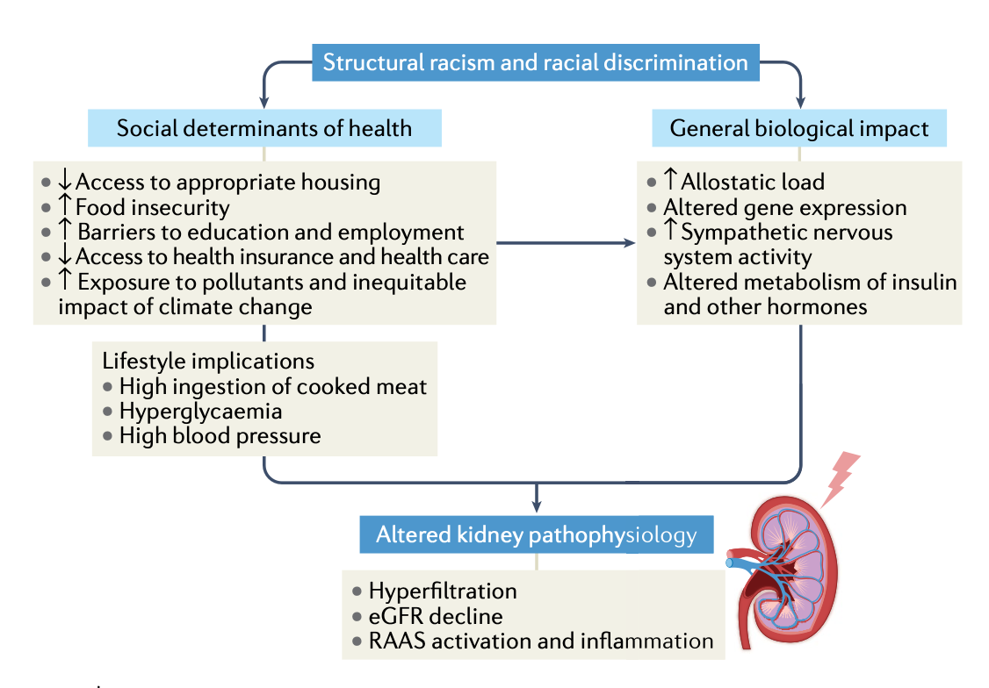
Effects of Racism on Kidney Pathophysiology
Eneanya ND, Boulware LE, Tsai J et al. Nature Rev. Feb 2022 (18): 84-94.

Slide 29
CAUSES
What is the most common cause of CKD?
Diabetic nephropathy
Hypertensive nephrosclerosis
Polycystic kidney disease
IgA Nephropathy
Focal Segmental Glomerulosclerosis
Membranous Nephropathy

Slide 30
CAUSES
What is the most common cause of CKD?
Diabetic nephropathy
Hypertensive nephrosclerosis
Polycystic kidney disease
IgA Nephropathy
Focal Segmental Glomerulosclerosis
Membranous Nephropathy

Slide 31
Most Common Diseases
Secondary
  Diabetic nephropathy
  Hypertensive nephrosclerosis
Primary
  Autosomal Dominant Polycystic Kidney Disease (ADPKD)
  IgA nephropathy
  Focal Segmental Glomerulosclerosis (FSGS)
  Membranous Nephropathy

Slide 32
Goals of Care
Identify cause
Provide treatment to correct the cause or slow progression
Address cardiovascular risk factors
Address metabolic abnormalities
Education

Slide 33
CKD: Mechanisms of Progression
Primary Disease Progression
Secondary Adaptations by the kidney to the loss of nephrons
  Hemodynamic changes
  Structural adaptations

Slide 34
Slowing Primary Disease Progression
Glycemic control
Blood pressure control
Immunosuppressants for secondary immune-modulated diseases

Slide 35
Treating Damage from Secondary Adaptations to Nephron Loss

Slide 36
Remnant Kidney Rat Model
1 kidney is removed, and 2/3 of the remaining kidney is removed
Rats progress to ESRD in 4-6 months
Pathology is diffuse focal and segmental glomerulosclerosis

Slide 37
Human Response to Nephron Loss
Patients with partial nephrectomy in solitary kidney
Human response to nephron loss is similar to the animal model
Degree of secondary injury depends on amount of renal mass remaining
% remaining

Slide 38
Mechanism: hemodynamic changes to adapt to nephron loss
Afferent > efferent arteriolar vasodilation
Decreased arteriolar resistance
Increased glomerular pressure (more systemic pressure is transmitted to the glomerulus)
Increased renal blood flow

Slide 39
Mechanism: structural changes
Glomerular hypertrophy (to increase filtration surface area) without hyperplasia
Decreased density of cells: cells cannot maintain intact podocytes and slit diaphragms
Simplification and fusion of podocytes, denudation of epithelial cells, loss of slit diaphragms
Proteinuria/Focal and segmental glomerulosclerosis
Notes:
Increased size of cells without increased number. No increase in the number of visceral epithelial cells, therefore decreased density.

Slide 40
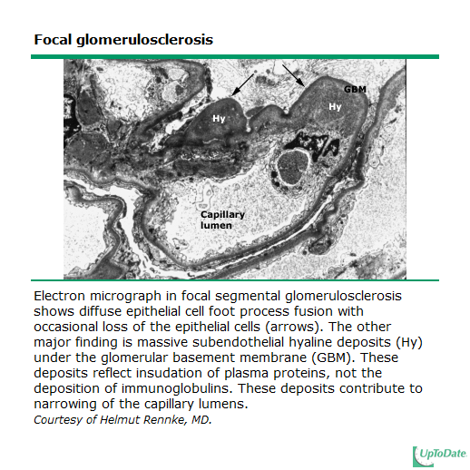
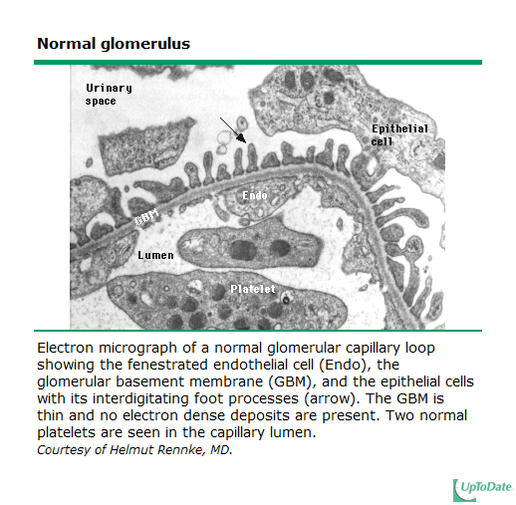

Slide 41
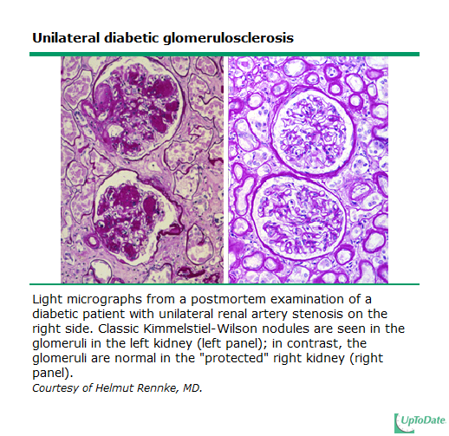

Slide 42
Preventing Progression
A 52-year-old woman with type 2 diabetes mellitus and hypertension comes for a routine office visit. She has a 30-pack-year history of cigarette smoking. Her mother had diabetes and was on hemodialysis.
Medications: insulin, metoprolol, fosinopril, hydrochlorothiazide, atorvastatin and aspirin
Physical examination:
BP165/95
Retinal microaneurysms
CV: RRR, with an S4; no JVD
Lungs: CTA B
Ext: 1+ pedal edema
Labs:
Hgb A1C 7.2%,
Creatinine 1.2 mg/dL
24-Hour urinary protein excretion 1.8 g/24 h.
While all factors may contribute, which of the following factors is most likely to cause this patient's chronic kidney disease to rapidly progress to end-stage renal disease?
A Poorly controlled diabetes
B Family history
C Poorly controlled hypertension
D Proteinuria
E Cigarette smoking
Notes:
Reduction in blood pressure has been shown to influence progression of renal disease and the development of cardiovascular disease in patients with diabetes. The goal of treatment of blood pressure in both type 1 and type 2 diabetes mellitus is to maintain a blood pressure ≤130/80 mm Hg in the absence of significant proteinuria and ≤125/75 mm Hg if accompanied by >1 g/24 h of proteinuria. Angiotensin-converting enzyme inhibitors or angiotensin receptor blockers constitute first-line treatment of hypertension even in patients with advanced diabetic nephropathy.
The beneficial effect of strict metabolic control of diabetes on the progression of advanced renal disease is less established than is strict control of blood pressure. Nevertheless, metabolic control should be improved in this setting in order to minimize the risk for metabolic complications and microvascular and macrovascular complications of diabetes. Native Americans, Mexican Americans, and black patients have an increased burden of diabetic nephropathy and chronic kidney disease, and diabetic nephropathy clusters in families. Proteinuria is a well-recognized risk factor in the progression of renal disease, including diabetic nephropathy. Cigarette smoking has been shown to have significant detrimental effects on the kidney and may cause increased proteinuria and an accelerated decline in renal function.

Slide 43
Preventing Progression
A 52-year-old woman with type 2 diabetes mellitus and hypertension comes for a routine office visit. She has a 30-pack-year history of cigarette smoking. Her mother had diabetes and was on hemodialysis.
Medications: insulin, metoprolol, fosinopril, hydrochlorothiazide, atorvastatin and aspirin
Physical examination:
BP165/95
Retinal microaneurysms
CV: RRR, with an S4; no JVD
Lungs: CTA B
Ext: 1+ pedal edema
Labs:
Hgb A1C 7.2%,
Creatinine 1.2 mg/dL
24-Hour urinary protein excretion 1.8 g/24 h.
While all factors may contribute, which of the following factors is most likely to cause this patient's chronic kidney disease to rapidly progress to end-stage renal disease?
A Poorly controlled diabetes
B Family history
C Poorly controlled hypertension
D Proteinuria
E Cigarette smoking
Notes:
Reduction in blood pressure has been shown to influence progression of renal disease and the development of cardiovascular disease in patients with diabetes. The goal of treatment of blood pressure in both type 1 and type 2 diabetes mellitus is to maintain a blood pressure ≤130/80 mm Hg in the absence of significant proteinuria and ≤125/75 mm Hg if accompanied by >1 g/24 h of proteinuria. Angiotensin-converting enzyme inhibitors or angiotensin receptor blockers constitute first-line treatment of hypertension even in patients with advanced diabetic nephropathy.
The beneficial effect of strict metabolic control of diabetes on the progression of advanced renal disease is less established than is strict control of blood pressure. Nevertheless, metabolic control should be improved in this setting in order to minimize the risk for metabolic complications and microvascular and macrovascular complications of diabetes. Native Americans, Mexican Americans, and black patients have an increased burden of diabetic nephropathy and chronic kidney disease, and diabetic nephropathy clusters in families. Proteinuria is a well-recognized risk factor in the progression of renal disease, including diabetic nephropathy. Cigarette smoking has been shown to have significant detrimental effects on the kidney and may cause increased proteinuria and an accelerated decline in renal function.

Slide 44
Preventing Progression:
HTN CONTROL

Slide 45
HTN from Renal Disease: epidemiology
Most common cause of secondary HTN
Hypertension eventually occurs in 85-90% of CKD patients

Slide 46
HTN from Renal Disease: mechanism
80% - volume expansion is primarily responsible for HTN
≅ 20% - increased renin release is important

Slide 47
HTN from Renal Disease: mechanism of renin-mediated HTN
Primary vascular disease from vasculitis, hypertensive nephrosclerosis, or atherosclerotic renal artery stenosis
Disordered renal architecture causing focal ischemia leading to increased renin release
(extrinsic and intrinsic renin stimulation)

Slide 48
Renal Disease: HTN is necessary for maintenance of homeostasis
Decreased number of nephrons requires that each nephron secrete more sodium
HTN leads to increased renal perfusion pressure which increases sodium excretion
Thus, HTN is the “price paid” for preventing sodium accumulation

Slide 49
HTN from Renal Disease: Treatment
Role of Pressure Natriuresis in renal disease:
  Sodium load
  Suppression of renin Stimulation of ANP
  Excretion of excess sodium
Renin inhibitor, ACE-I, ARB
Focal renal ischemia prevents …
…leading to decreased
diuretics
Hyperkalemia stimulates aldosterone release leading to decreased…

Slide 50
Preventing Progression:
HTN control
ACE-I/ARB
  Traditional recommendation is to continue if the GFR decline over four months is less than 30 percent from baseline value – (there is no study that shows patients benefit from having ACE-I/ARB stopped of eGFR declines by more than 30% - this number was just made up by experts)
Goal SBP <120 in adults with CKD
Notes:
e

Slide 51
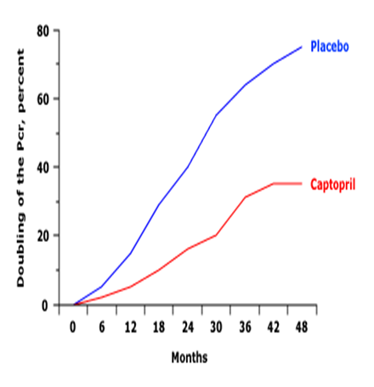
Captopril in Type 1 Diabetes Mellitus (1st landmark study showing slowing of progression of CKD)
Lewis EJ, et al. N Engl J Med 1993;329:1456
Notes:
e

Slide 52
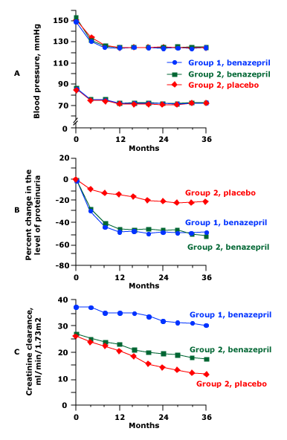
Creatinine clearance over time in mild and advanced CKD
Group 1 – creatinine 1.5-3.0 all got benazepril
Group 2 – creatinine 3.1-3.5 got either benazepril or placebo
Even advanced ckd patients benefit from ACE-I
Hou FF, et al. N Engl J Med 2006; 354:131.

Slide 53
Preventing Progression:
Proteinuria remission
Reduction of proteinuria
  Reduce protein excretion to <500mg/day, or at least a reduction of 60% baseline values
ACE-I/ARB
SGLT-2 Inhibitors
  Canagliflozin, Empagliflozin, Dapagliflozin
Mineralocorticoid Receptor Blockers
  Spironolactone, Eplerenone, Finerenone
,
Notes:
e

Slide 54
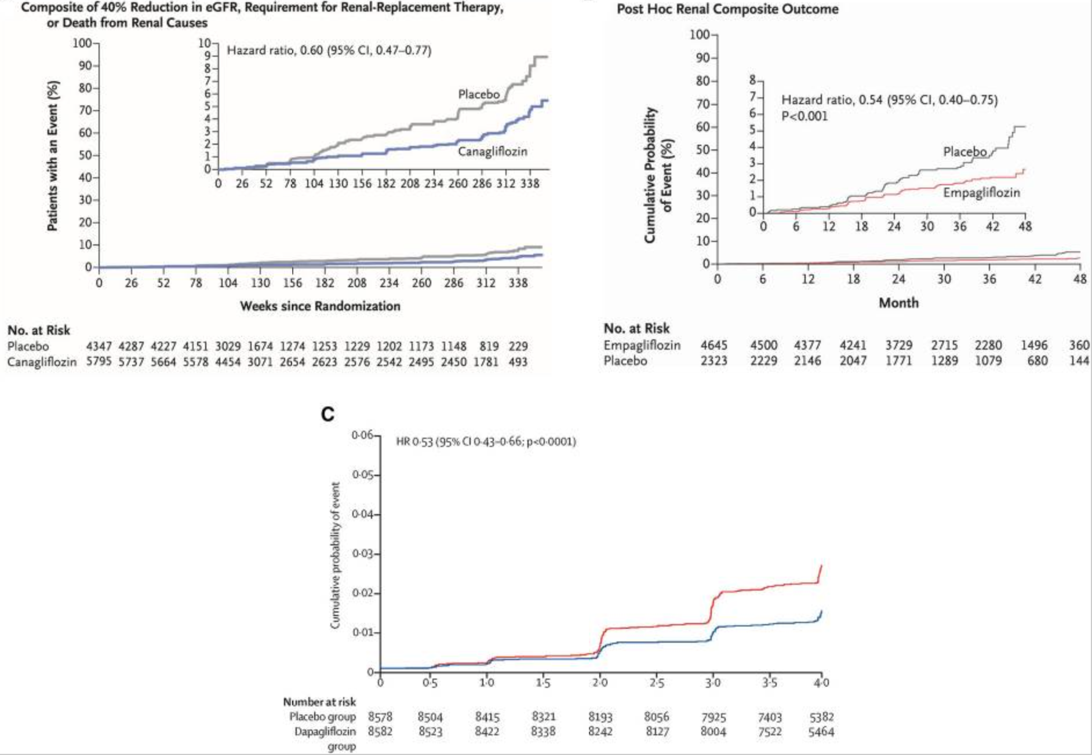
SGLT-2 Inhibitors reduce progression of kidney disease
Wheeler DC, James J, et al. Diabetes Ther. 2020 Dec; 11(12): 2757–2774.

Slide 55
SGLT-2 Inhibitors – How they reduce progression of kidney disease
Reduce intraglomerular pressure (via tubuloglomerular feedback)
Reduce glucose reabsorption and sodium reabsorption in the proximal tubule resulting in natriuresis (leading to euvolemia, reduced BP, weight loss)
Modify pro-inflammatory and pro-fibrotic factors
May reduce kidney hypoxia
May alter mitochondrial metabolism
Larmour, K and Levin, A. CJASN 16(7):p 1117-1119, July 2021.

Slide 56
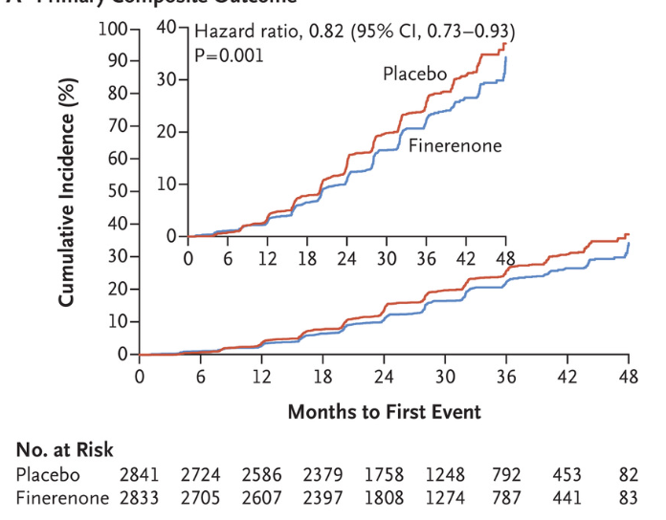
Mineralocorticoid Receptor Blockers reduce progression of kidney disease
Finerenone reduced incidence of composite outcome of kidney failure, 40% decrease in GFR, or death from renal causes
Bakris GL, Agarwal R, et al. N Engl J Med 2020; 383:2219-2229

Slide 57
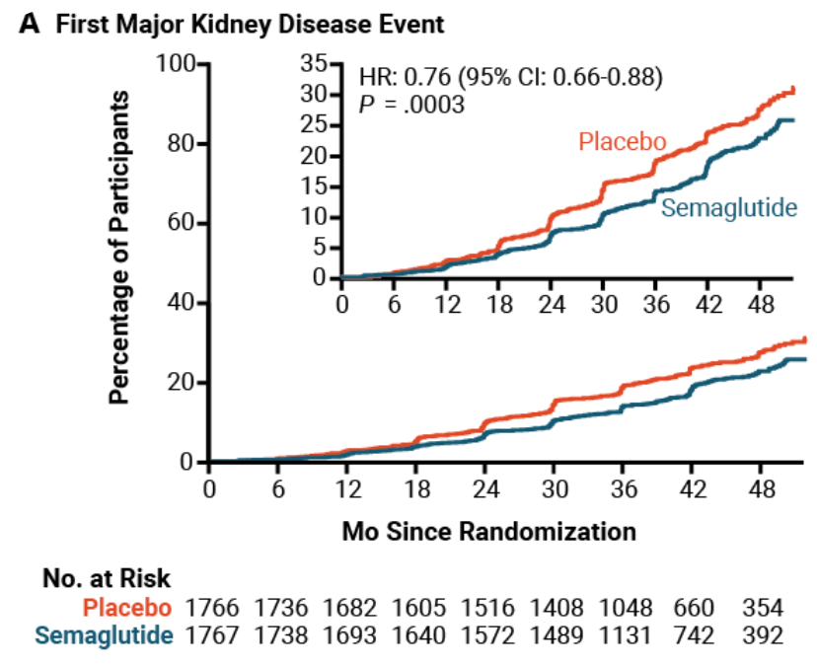
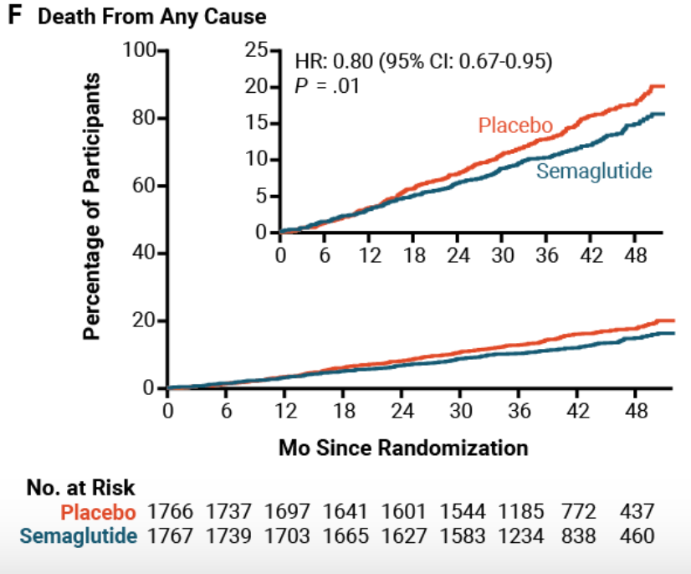
GLP-1 Agonists
Semaglutide reduced incidence of major kidney events by 24%, slowed decline in eGFR by 1.16ml/min, lowered risk of MACE by 18%, and lowered all cause mortality by 20%.
Perkovic V, Tuttle KR, et al. N Engl J Med 2024; 391:109-121.

Slide 58
Preventing Progression: glycemic control
HgbA1c <7 in diabetic patients
More aggressive control than this leads to higher rate of complications (severe hypoglycemia and death)

Slide 59
Preventing Progression: metabolic acidosis
Each surviving nephron must make more ammonia to handle daily acid load
  Activates alternative complement pathway which increases renal inflammation
2024 KDIGO practice guideline: recommends dietary modification +/- oral alkali therapy if bicarbonate <18
DeBrito et al. JASN. 2009; 20:2075-84

Slide 60
Preventing Progression: treatment of dyslipidemia
no prospective evidence that treating dyslipidemia prevents the progression of CKD or diabetic nephropathy
BUT, it lowers cardiovascular risk in these patients and statin is recommended

Slide 61
Preventing Progression: Case
A 47-year-old woman with type 2 diabetes mellitus and hypertension comes for a routine office visit. Her mother had diabetes and was on hemodialysis.
Medications: insulin, chlorthalidone, simvastatin, and aspirin.
BP 140/90 mm Hg, but physical exam is otherwise normal.
Laboratory:
HgbA1C 7.9%
creatinine 1.3mg/dL
potassium 4.0mg/dL
glucose 170mg/dL
24-hour urinary protein 2.1g/24 hours.
Which of the following medications would have the most beneficial effect on slowing the progression of her kidney disease?
A. Atenolol
B. Amlodipine
C. Lisinopril
D. Glipizide

Slide 62
Preventing Progression: Case
A 47-year-old woman with type 2 diabetes mellitus and hypertension comes for a routine office visit. Her mother had diabetes and was on hemodialysis.
Medications: insulin, chlorthalidone, simvastatin, and aspirin.
BP 140/90 mm Hg, but physical exam is otherwise normal.
Laboratory:
HgbA1C 7.9%
creatinine 1.3mg/dL
potassium 4.0mg/dL
glucose 170mg/dL
24-hour urinary protein 2.1g/24 hours.
Which of the following medications would have the most beneficial effect on slowing the progression of her kidney disease?
A. Atenolol
B. Amlodipine
C. Lisinopril
D. Glipizide

Slide 63
Preventing Progression: Case
In addition to starting lisinopril, what other interventions could slow progression of her chronic kidney disease?
Metformin
Dapagliflozin
Atorvastatin
Losartan

Slide 64
Preventing Progression: Case
In addition to starting lisinopril, what other interventions could slow progression of her chronic kidney disease?
Metformin
Dapagliflozin
Atorvastatin
Losartan

Slide 65
Preventing Comorbidities

Slide 66
CKD impact on Morbidity
Retrospective study – 259pts with CKD (females creatinine >1.5, males >2.0)
  87% HTN
  35% DM
  40% CV disease
  14% peripheral vascular disease
  47% were hospitalized over the following year
Modification of Diet in Renal Disease Study
Notes:
Modification of Diet in Renal Disease Study

Slide 67
CKD impact on Morbidity & Mortality
Rates of hospitalization 3 times higher than in the general population
  Risk of hospitalization increases as GFR declines.
CKD 3 patients are 20 times more likely to die of a cardiovascular event than to reach ESRD
2/3 of CKD patients have metabolic syndrome

Slide 68
CKD impact on Cardiovascular Risk
Degree of renal dysfunction affects CV risk
  5-year death rates by stage:
  2 - 19.5%
  3 – 24.3%
  4 – 45.7%
Hyperphosphatemia impacts CV risk
Proteinuria impacts CV risk

Slide 69
Renal Osteodystrophy
Decreased phosphorus excretion
Decreased calcitriol
Secondary hyperparathyroidism
Renal osteodystrophy

Slide 70
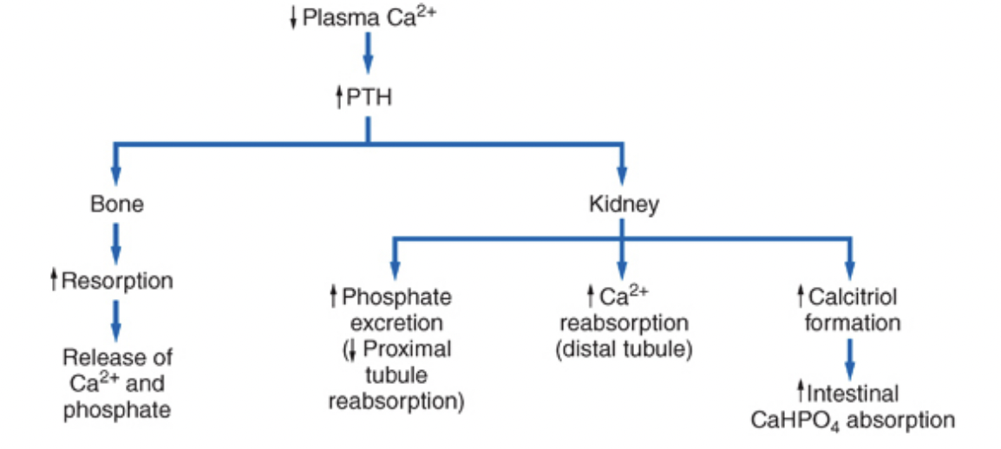
Roles of Hormones - PTH
Increases calcium reabsorption in the distal tubule
Increases calcium and phosphorus exit from bone
Increases 1^{α} hydroxylase in the proximal tubule
  Increases calcitriol
Increases phosphorus excretion
  Inhibits sodium phosphate cotransporter in the proximal tubule
Negative feedback: stimulates FGF-23 which inhibits PTH
Helmut G. Rennke, Bradley M. Denker. Renal Pathophysiology: The Essentials
Linda Costanzo.

Slide 71
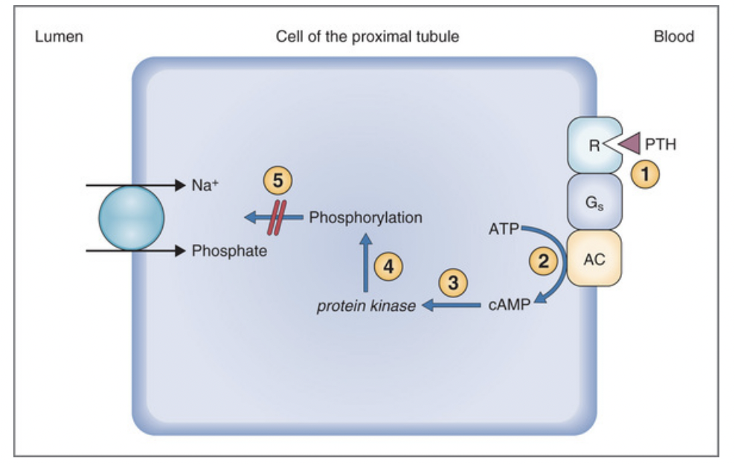
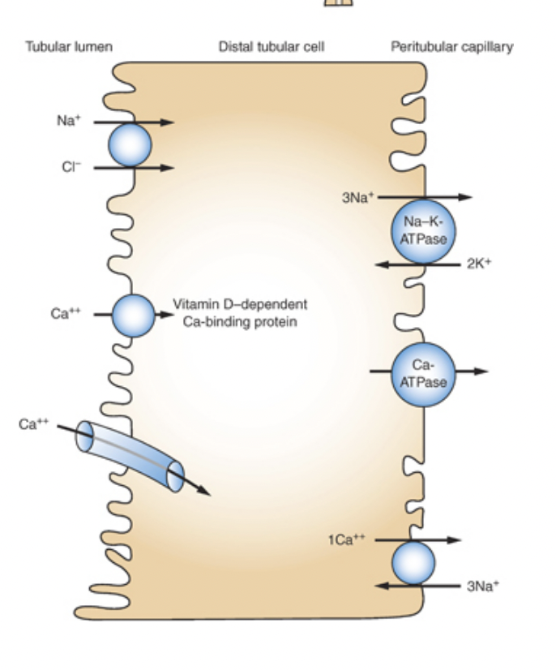
Roles of Hormones - PTH
Increases 1^{α} hydroxylase in the proximal tubule
  Increases calcitriol
Increases phosphorus excretion
  Inhibits sodium phosphate cotransporter in the proximal tubule
  Stimulates FGF-23
Increases calcium reabsorption in distal tubule
Helmut G. Rennke, Bradley M. Denker. Renal Pathophysiology: The Essentials
Linda Costanzo. Physiology

Slide 72
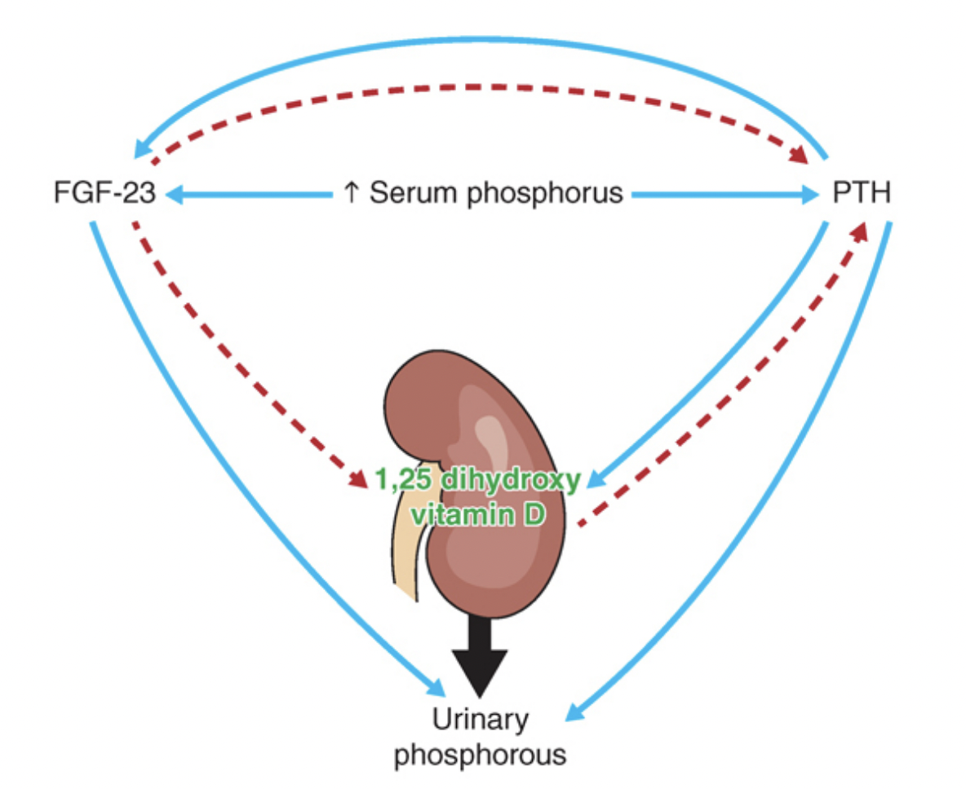
Roles of Hormones – FGF-23
Secreted by osteocytes & osteoclasts
Stimulated by PTH and phosphorus
Inhibits sodium-phosphate cotransporters in proximal tubule
  -->increased phosphate secretion
Negative feedback:
  Inhibits calcitriol
  Inhibits PTH
Helmut G. Rennke, Bradley M. Denker. Renal Pathophysiology: The Essentials

Slide 73

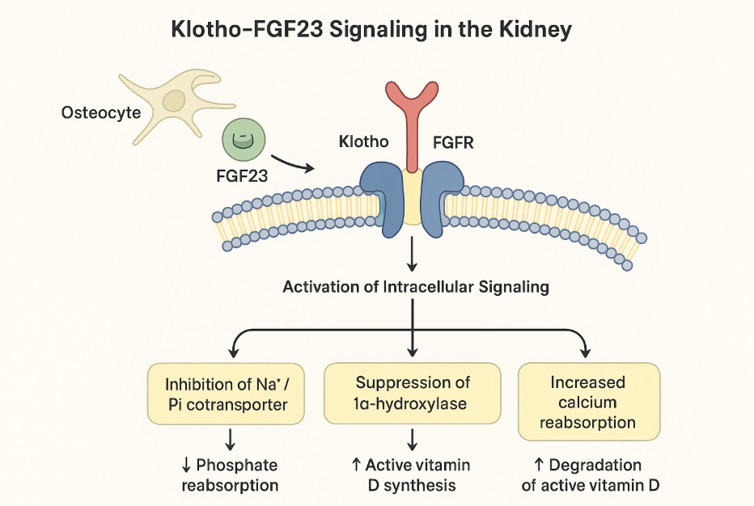
Membrane-bound Klotho
(m-Klotho)
Located in renal distal tubular cells
Co-receptor for FGF23
FGF23 secreted by osteocytes and osteoblasts in bones
  FGF23 has low affinity with it’s receptor, so it needs m-Klotho as co-receptor
  FGF23-FGFR-Klotho complex forms in renal tubular cells
Figure generated by ChatGPT

Slide 74
Klotho-FGF23 Signaling Pathway
FGF23-FGFR-Klotho complex triggers intracellular cascades
  MAPK/ERK (mitogen-activated protein kinase/extracellular signal-regulated kinase) ->regulates phosphate transporter (Na⁺/Pi cotransporter) expression-> decreased phosphate reabsorption
  PI3K/Akt (promotes cell survival and inhibits apoptosis)
  PLC𝛾/Ca²⁺ -> regulates intracellular calcium signaling and gene expression
  Downregulates 1𝜶-hydroxylase ->reduces conversion of 25(OH)D3 to 1,25 (OH)₂D₃
  Upregulates 24-hydroxylase which degrades 1,25 (OH)₂D₃
Figure generated by ChatGPT

Slide 75
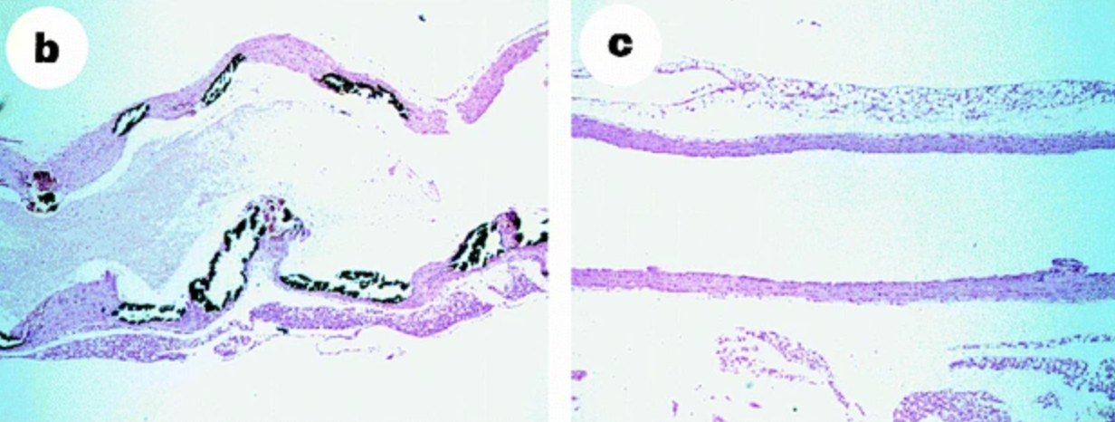
Rescue of the klotho mice by exogenous kl gene expression reverses aortic calcification
Kuro-o, M., Matsumura, Y., Aizawa, H. et al. Mutation of the mouse klotho gene leads to a syndrome resembling ageing. Nature 390, 45–51 (1997).

Slide 76
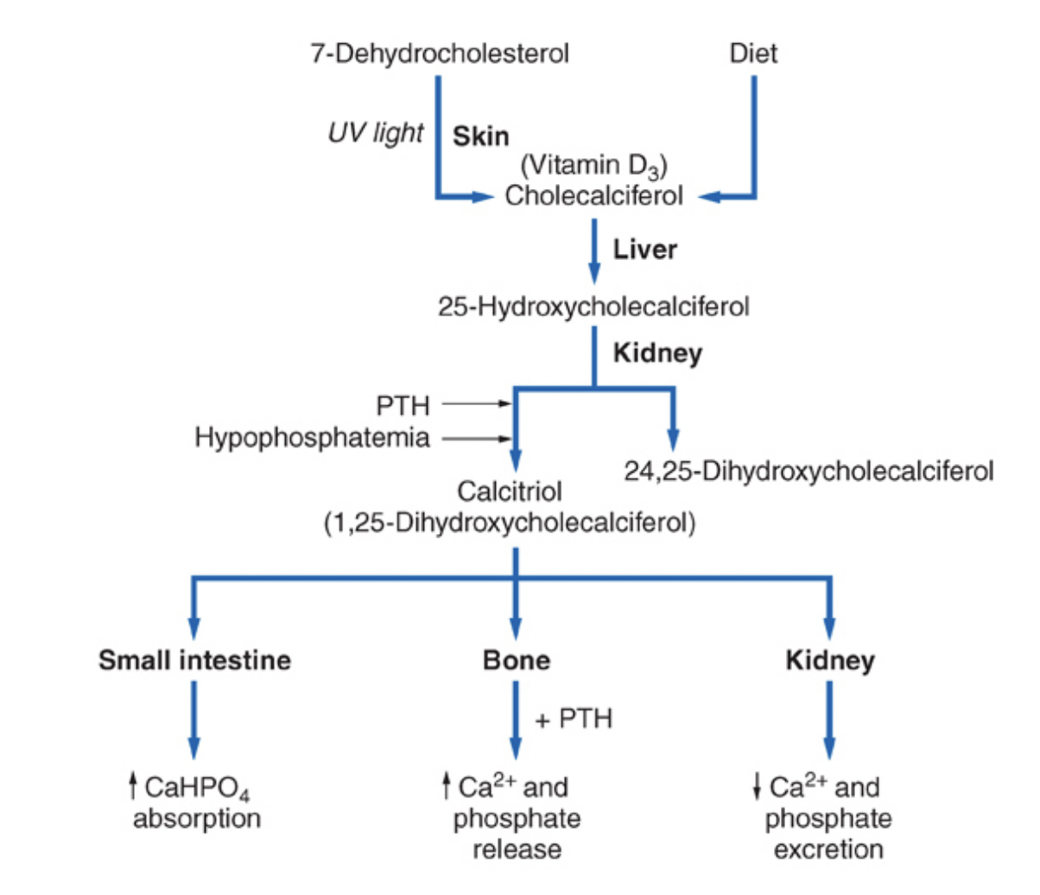
Roles of Hormones - Calcitriol
Increases GI calcium and phosphorus absorption
Promotes osteoclast maturation, increased Ca and phosphate release from bone
Decreases renal phosphate excretion
(negative feedback) Decreases PTH transcription via Vitamin D receptor (VDR) in the parathyroid gland
Helmut G. Rennke, Bradley M. Denker. Renal Pathophysiology: The Essentials

Slide 77
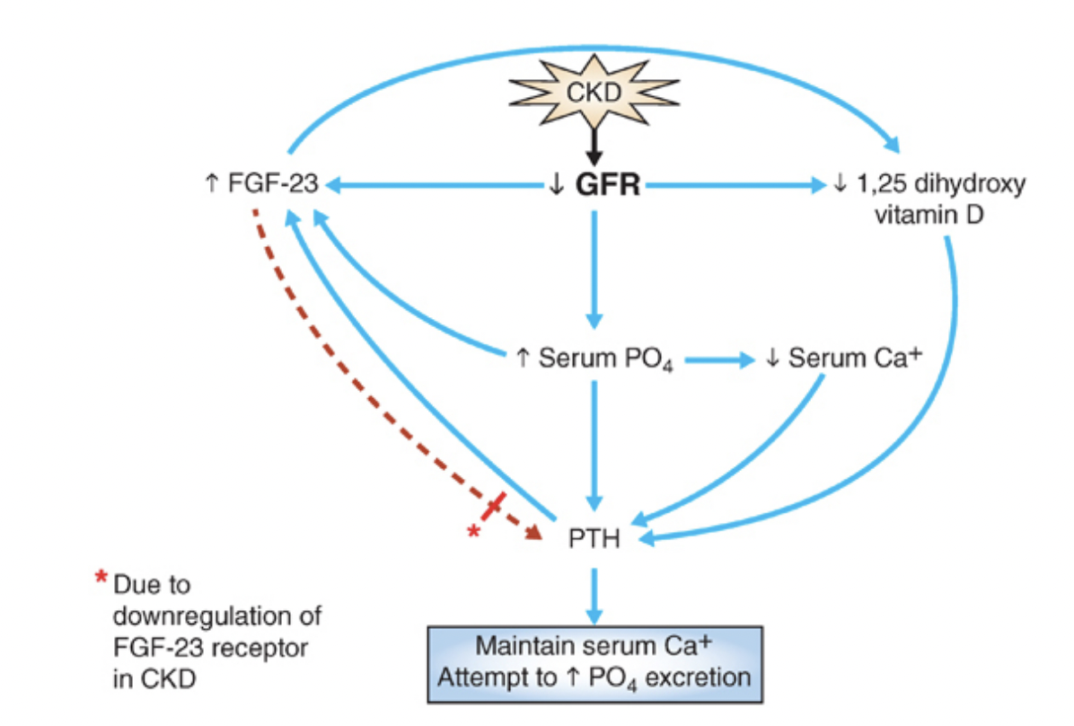
Hormonal Derangements in Renal Failure
Helmut G. Rennke, Bradley M. Denker. Renal Pathophysiology: The Essentials

Slide 78
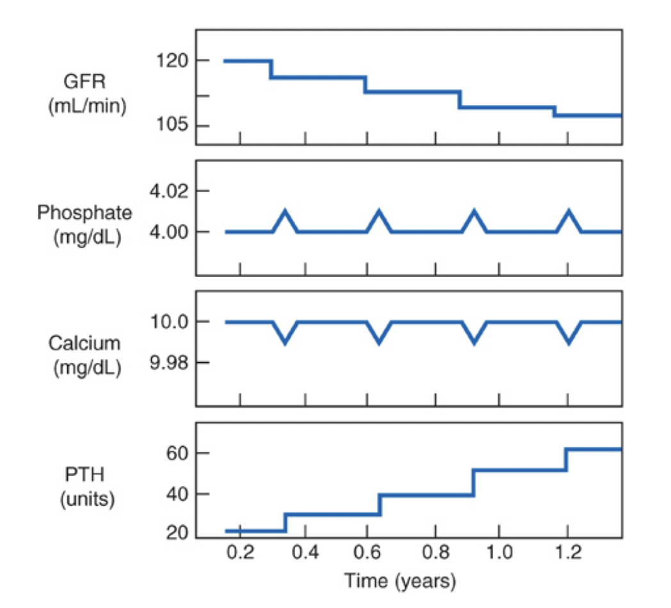
Model for Development of Secondary Hyperparathyroidism
GFR drops
Phosphorus increases, calcium decreases
PTH increases to help phosphorus and calcium return to normal
Homeostasis achieved until GFR drops more
Cycle repeats
Helmut G. Rennke, Bradley M. Denker. Renal Pathophysiology: The Essentials

Slide 79
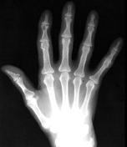
Consequences of Secondary Hyperparathyroidism
Osteitis Fibrosa Cystica
PTH stimulation of osteoclasts and increased osteoblasts leads to increased osteoid surfaces (unmineralized bone)
Helmut G. Rennke, Bradley M. Denker. Renal Pathophysiology: The Essentials

Slide 80
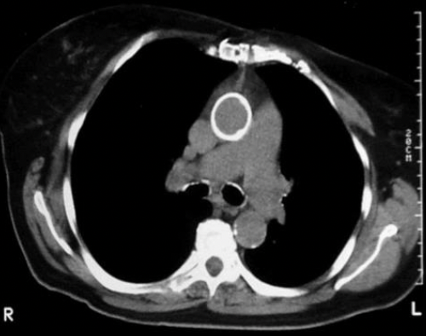
Consequences of Secondary Hyperparathyroidism & Hyperphosphatemia
Vascular calcifications
Calcium phosphate precipitates out of the blood stream and deposits in the tissues
Usually when calcium x phosphorus product > 60-70
Image from Dr. Kristina Bostrom, UCLA
Helmut G. Rennke, Bradley M. Denker. Renal Pathophysiology: The Essentials

Slide 81
Treating Hyperphosphatemia
Phos >3.5-4 is associated with increased mortality
Goal phosphorus normal (2.5-4.5mg/dL)
Role of assessing total phosphorus burden (FGF-23)
Low phosphorus diet
Phosphate binders
  Sevelamer
  Lanthanum
  Sucroferric oxyhydroxide
  Calcium acetate
Restrict calcium-based binder if hypercalcemic, presence of arterial calcifications, or adynamic bone disease

Slide 82
Treating Secondary Hyperparathyroidism
Replace 25 hydroxy vitamin D
Control phosphorus
  Low phosphorus diet
  Phosphate Binders
Generally, the following are not recommended in patients with CKD not on dialysis (only for dialysis patients)
  1,25 dihydroxy vitamin D replacement (unless hyperparathyroidism severe and progressive in CKD 4-5)
    Calcitriol, Paricalcitol, Doxercalciferol
  Calciumimetics – bind to calcium sensing receptor on parathyroid gland to reduce PTH production
    cinacalcet

Slide 83
Managing Comorbidities:
Renal bone mineral disorder
Changing trends over past 20 years: previously predominantly high bone turnover disease, now 40-70% low turnover

Slide 84
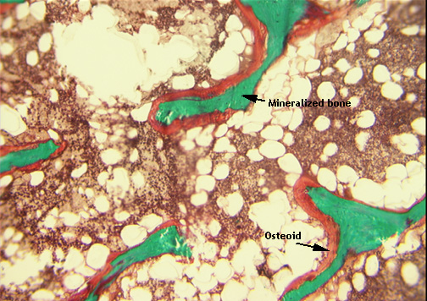
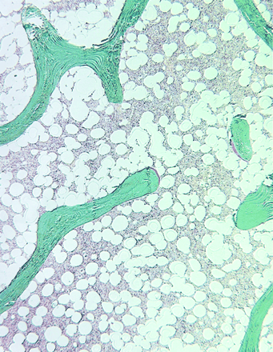
Other forms of bone disease with CKD
Adynamic Bone Disease
Decreased rate of bone formation without mineralization
Decreased number of osteoclasts and osteoblasts
Excess calcium and vitamin D leading to decreased PTH
Osteomalacia
Defective mineralization caused by:
  Aluminum toxicity
  Vitamin D deficiency
  Metabolic acidosis
  Hypophosphatemia

Slide 85
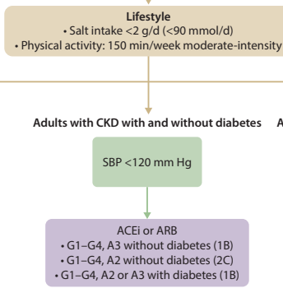
Managing Comorbidities: HTN
KDIGO 2021 Guidelines

Slide 86
Managing Comorbidities: Diabetes
Glycemic control: large RCTs have not shown reduction in cardiovascular events or death from renal disease with aggressive glycemic control (A1C <7); risks outweigh benefits

Slide 87
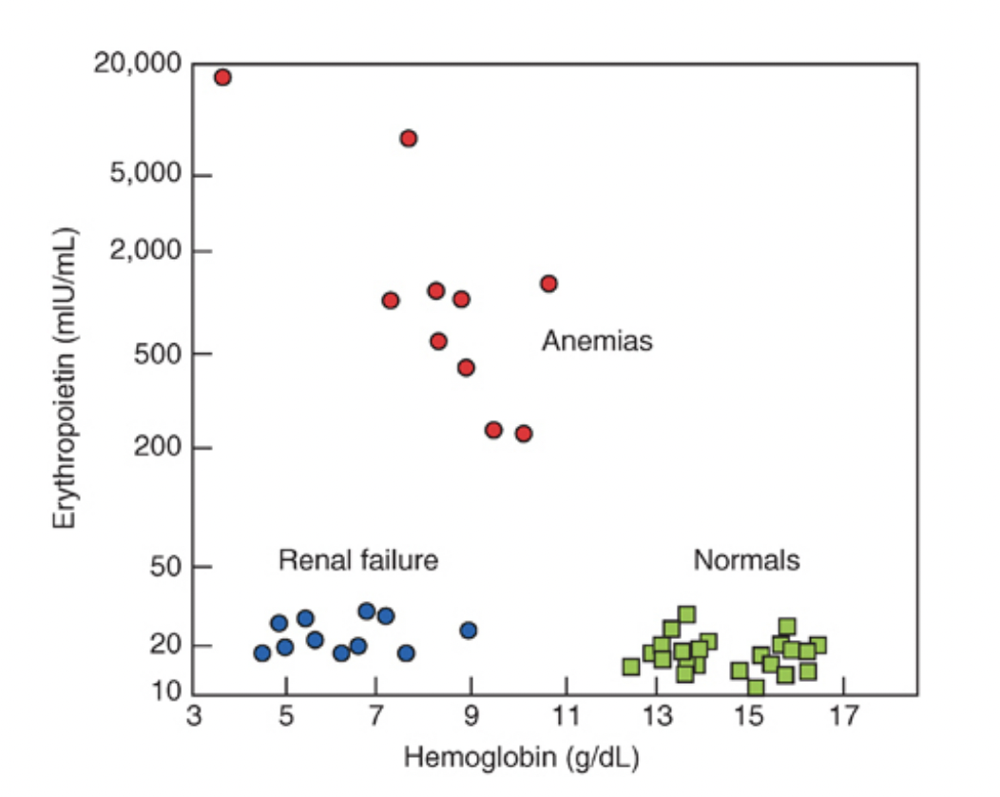
Managing Comorbidities: Anemia
Erythropoietin levels do not appropriately rise in response to anemia in patients with CKD
Helmut G. Rennke, Bradley M. Denker. Renal Pathophysiology: The Essentials

Slide 88
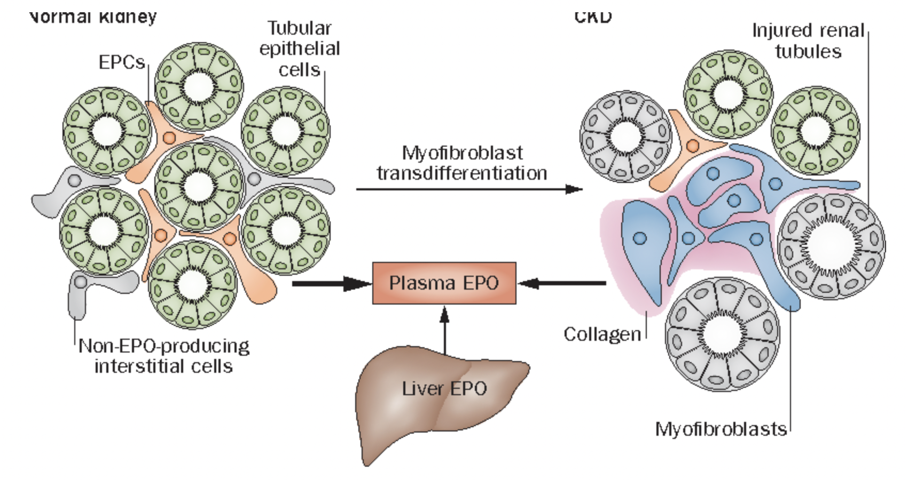
Managing Comorbidities: Anemia
Tissue hypoxia -> chronic inflammatory damage to the peritubular fibroblasts in the renal cortex where erythropoietin is produced
Koury M, et al. Nature Reviews 2015

Slide 89
Managing Comorbidities: Anemia
Synthetic erythropoietin is available for replacement (erythrocyte stimulating agents)
Evidence of increased thrombosis and cardiovascular events with higher hgb levels
Erythropoietin also causes hypertension
KDIGO recommendations:
  Consider iron replacement if Tsat<30% and ferritin <500
  Consider ESA if hgb <10
Singh AK et al.; CHOIR Investigators. N Engl J Med. 2006;355(20):2085-2098.
Drüeke TB et al.; CREATE Investigators. N Engl J Med. 2006;355(20):2071-2084.
Pfeffer MA, et al.; TREAT Investigators. N Engl J Med. 2009;361(21):2019-2032

Slide 90
Managing Comorbidities: Case
A 68-year-old man with a history of hypertension is evaluated in the office for stage 4 chronic kidney disease. He denies uremic symptoms.
Medications: atenolol, chlorthalidone, cholecalciferol, hydralazine, and nifedipine.
The physical exam is normal. BP 118/65
Labs are shown below:

Slide 91
Managing Comorbidities: Case
 | Serum value | Normal
Creatinine | 2.4 mg/dL | 0.7-1.3 mg/dL
Calcium | 8.8 mg/dL | 8.5-10.2 mg/dL
Phosphorus | 5.5 mg/dL | 2.5-4.5 mg/dL
CO2 | 24 mEq/L | 23-29 mEq/L
Parathyroid hormone | 105 pg/mL | 14-65 pg/mL
25-hydroxy vitamin D | 55 ng/mL | 30-125 ng/mL
What is the most appropriate management?
Low phosphorus diet
Sodium bicarbonate
Calcitriol
Cinacalcet
Sevelamer

Slide 92
Managing Comorbidities: Case
 | Serum value | Normal
Creatinine | 2.4 mg/dL | 0.7-1.3 mg/dL
Calcium | 8.8 mg/dL | 8.5-10.2 mg/dL
Phosphorus | 5.5 mg/dL | 2.5-4.5 mg/dL
CO2 | 24 mEq/L | 23-29 mEq/L
Parathyroid hormone | 105 pg/mL | 14-65 pg/mL
25-hydroxy vitamin D | 55 ng/mL | 30-125 ng/mL
What is the most appropriate management?
Low phosphorus diet
Sodium bicarbonate
Calcitriol
Cinacalcet
Sevelamer

Slide 93
Managing Comorbidities: Case
A 70-year-old woman with a history of DM2 and HTN is evaluated in the office for stage 4 chronic kidney disease. Her appetite is slightly decreased but she denies any other symptoms
Medications: atenolol, hydralazine, nifedipine, furosemide, insulin, sevelamer, and cholecalciferol
The physical exam is notable for a left forearm AV fistula with a thrill and bruit. BP 120/62
Labs are shown below:

Slide 94
Managing Comorbidities: Case
 | Serum value | Normal
Hemoglobin | 10.2 g/dL | 12-16 g/dL
Creatinine | 2.4 mg/dL | 0.6-1.1 mg/dL
Potassium | 5.0 mg/dL | 3.5-5.2 mg/dL
CO2 | 17 mEq/L | 23-29 mEq/L
What is the most appropriate management?
Erythropoietin stimulating agent
Dietary modification to eat more vegetables
Sodium zirconium cyclosilicate
High protein diet
Start hemodialysis

Slide 95
Managing Comorbidities: Case
 | Serum value | Normal
Hemoglobin | 10.2 g/dL | 12-16 g/dL
Creatinine | 2.4 mg/dL | 0.6-1.1 mg/dL
Potassium | 5.0 mg/dL | 3.5-5.2 mg/dL
CO2 | 17 mEq/L | 23-29 mEq/L
What is the most appropriate management?
Erythropoietin stimulating agent
Dietary modification to eat more vegetables
Sodium zirconium cyclosilicate
High protein diet
Start hemodialysis

Slide 96
What if kidney disease continues to progress?
Dialysis
  Hemodialysis
  Peritoneal dialysis
Transplant

Slide 97
Clinical Manifestations of CKD
Most people have no symptoms until kidney function is very low
  Problem is discovered on blood or urine tests done for other reasons
Even in advanced kidney failure, many people still make a normal amount of urine

Slide 98
Clinical Manifestations of CKD
In advanced kidney failure, people may develop symptoms of uremia
  Nausea or vomiting
  Taste disturbances
  Poor appetite
  Confusion, drowsiness
  Fluid buildup and inflammation around the heart (pericarditis)
Fluid retention
  Leg swelling
  Shortness of breath

Slide 99
Clinical Manifestations of CKD
In less-severe kidney disease patients may not have symptoms, but can have other complications
  High blood pressure
  Anemia
  Bone disease from vitamin D deficiency and secondary hyperparathyroidism
  Blood chemistry abnormalities (high potassium, high phosphorus)
  Cardiovascular disease (from high phosphorus, secondary hyperparathyroidism, hypertension)

Slide 100
When to Start Dialysis
No benefit to starting dialysis at GFR 10-14 vs 5-7ml/min
Decision should be made based on quality of life and uremic symptoms

Slide 101
Principles of Dialysis
Hemodialysis uses Diffusion
Hemofiltration uses convection
  Movement of solutes across a larger bore hemofiltration drags along solutes that are dissolved in the water that is crossing
    Thus fluid removal is required for solute clearance
Peritoneal dialysis uses Diffusion and Convection
Solute moves across the peritoneal membrane from diffusion and convection
Fluid moves across the peritoneal membrane due to osmotic gradient

Slide 102
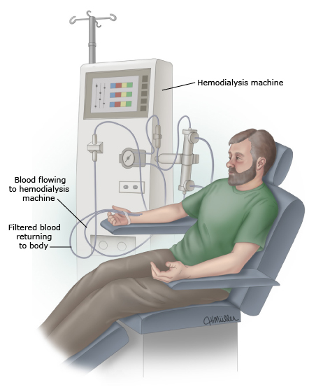
Hemodialysis
2 needles are placed in an “access” in the arm
Blood flows to the dialysis machine, is filtered and is returned to the body
3-5hours, 3-7 times per week

Slide 103
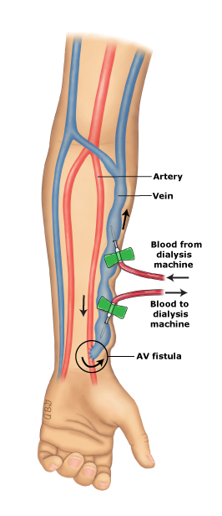
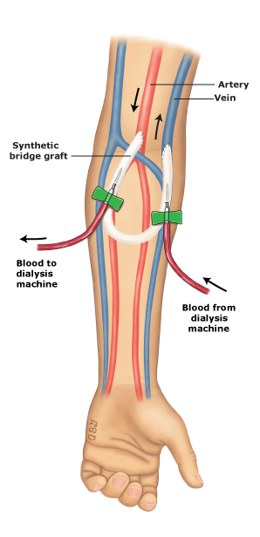
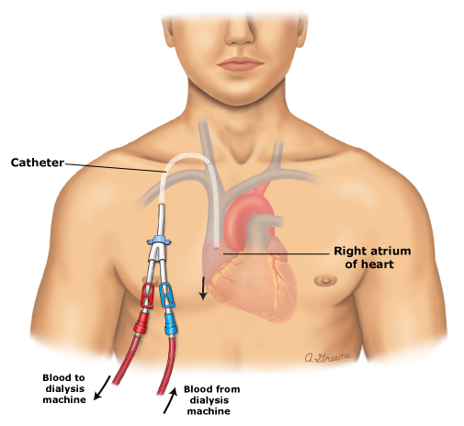
AV fistula
AV graft
Central Venous Catheter

Slide 104
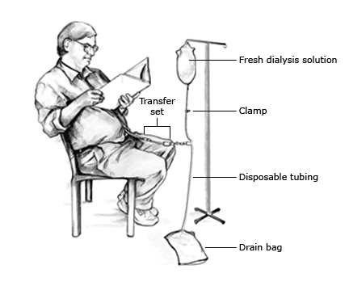
Peritoneal Dialysis
Fresh dialysis solution flows into the person’s belly
It stays there for a period of time and then is drained into a drain bag
A transfer set connects the catheter in the person’s belly to the dialysis equipment

Slide 105
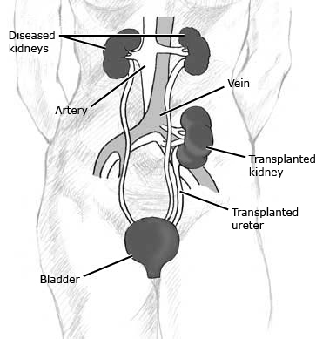
Transplant
New kidney is put in the lower part of the belly
Ureter is hooked up to the bladder
Usually, the old kidneys are left in place

Slide 106
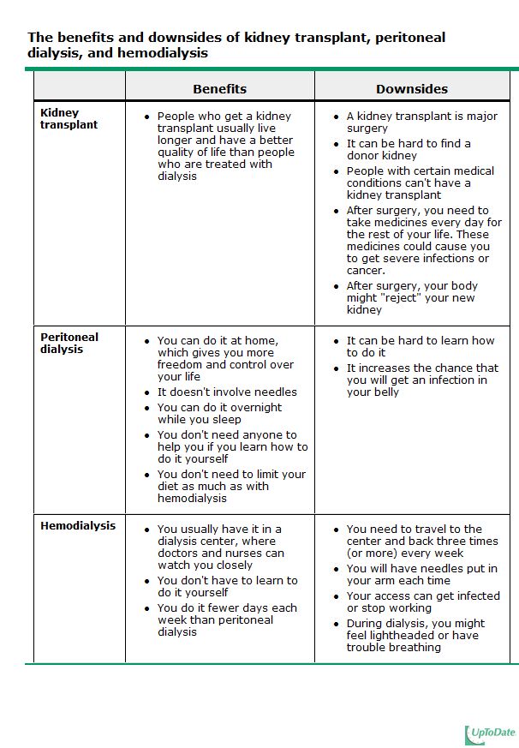

Slide 107
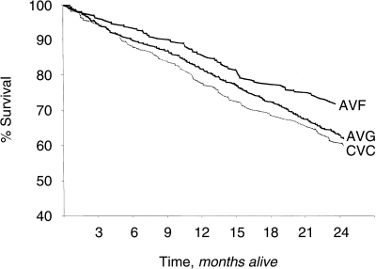
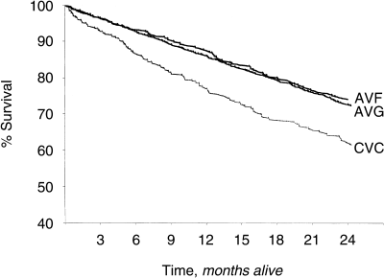
Mortality & Vascular Access
% Survival in diabetics (top) and non-diabetics (bottom)
AVF has significantly less mortality
Dhingra, RK et al. Kidney International (2001) 60, 1443–1451

Slide 108
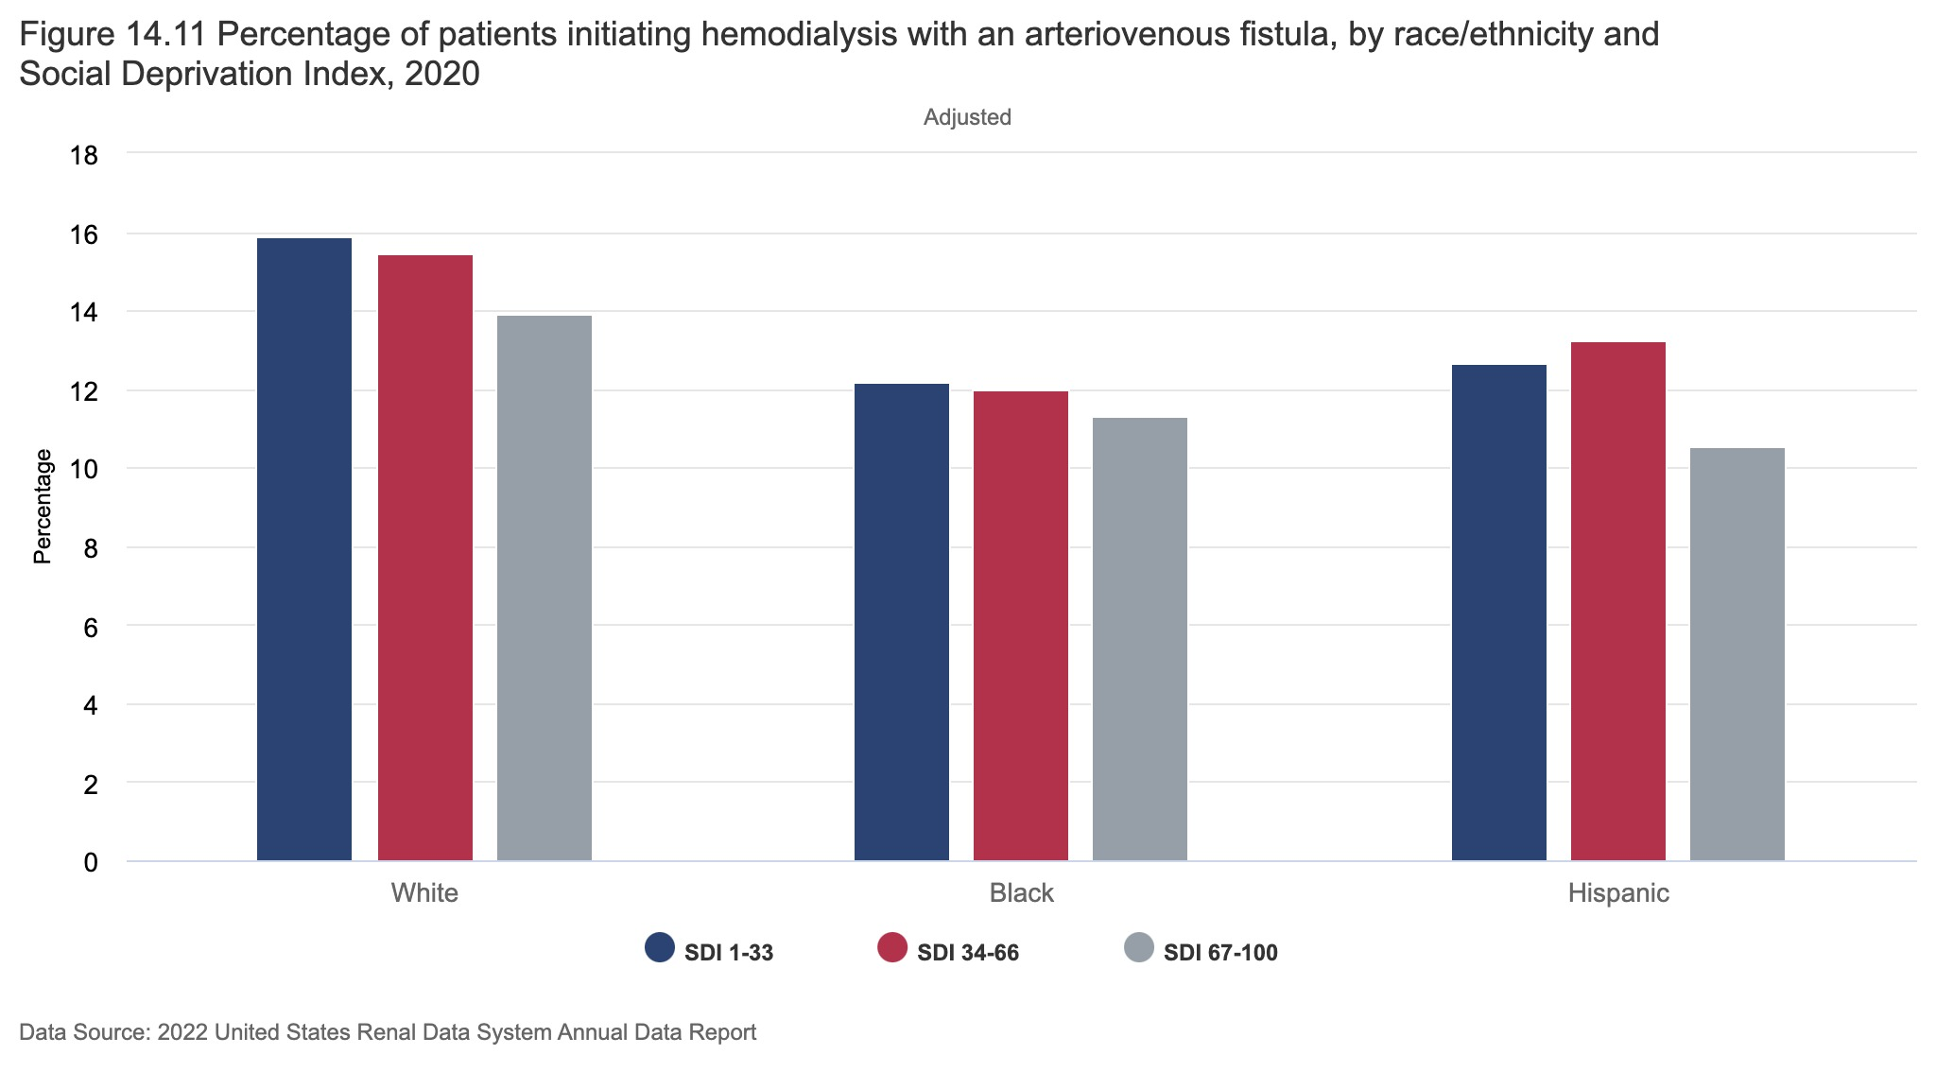
Patients of Minority Status have a Lower Rate of Starting Dialysis with an AV Fistula

Slide 109
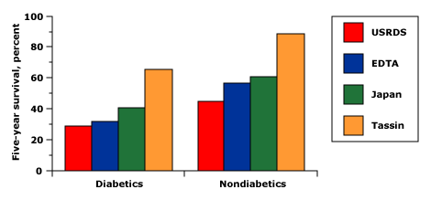
Mortality in ESRD
Hull, AR, Parker, TF III, Am J Kidney Dis 1990; 15:375, and Charra, B, Calemard, E, Ruffet, M, et al, Kidney Int 1992; 41:1286.
Notes:
Five year patient survival rates after the institution of maintenance hemodialysis in the United States (from the US Renal Data System), Europe (from the European Dialysis and Transplant Association), Japan, and Tassin, France. Survival was lowest in the United States and highest in nondiabetics and in Tassin where the patients were more intensively dialyzed.

Slide 110
Mortality in ESRD
Cardiovascular diseases 50%
Infection 15-20%

Slide 111
Take Home Points
The prevalence of CKD is approximately 15%.
Though patients with minority ethnic status do not have increased prevalence of CKD, they have a much higher rate of progression to ESRD due to effects of structural racism
Creatinine-based estimated GFR formulas should no longer include a race coefficient. Cystatin C is a more precise marker to estimate GFR than creatinine.
Albuminuria is associated with increased renal and cardiovascular risk and is used along with estimated GFR to stage CKD
Goal SBP <120 in patients with CKD and HTN
ACE-I or ARB is the preferred antihypertensive
ACE-I, ARBs, SGLT-2 Inhibitors, Mineralocorticoid Receptor Blockers, and GLP-1 agonists all slow progression of CKD and lower cardiovascular risk.
Statins lower cardiovascular risk in patients with CKD but do not slow progression of CKD.

Slide 112
Take Home Points (continued)
Mineral and bone disorder related to CKD is characterized by calcium abnormalities, hyperphosphatemia, and secondary/tertiary hyperparathyroidism, and results in pathologic calcifications.
Lowering phosphorus with dietary modifications and, if needed, phosphorus binders is important for treating both hyperphosphatemia and secondary hyperparathyroidism
Erythropoiesis-stimulating agents can be used with goal hemoglobin 10-11. Targeting hemoglobin levels >11 can increase cardiovascular events.
Dietary modifications and alkali therapy (i.e., sodium bicarbonate) can. be used, if serum bicarbonate level <18
Once GFR is < 30, need to prepare for dialysis and transplant

