Slide 1
Acute Coronary Syndrome:
Diagnosis and Management for the Internist
Zachary Wilson, MD
Heart Failure Fellow PGY-7

Slide 2
Learning Objectives:
1. Describe the categories of chest pain syndromes.
2. Understand the difference in the pathophysiology of type 1 and type 2 MI.
3. Develop a differential diagnosis for ST elevation and elevated troponin.
4. Be able to risk stratify patients based on TIMI and GRACE scoring systems and understand the significance of these scores.
5. Understand the medications used for acute coronary syndrome in the hospital setting and their contraindications.
6. Know the medications to give patients at the time of hospital discharge and their recommended durations depending on the procedure done at the time of angiography.

Slide 3
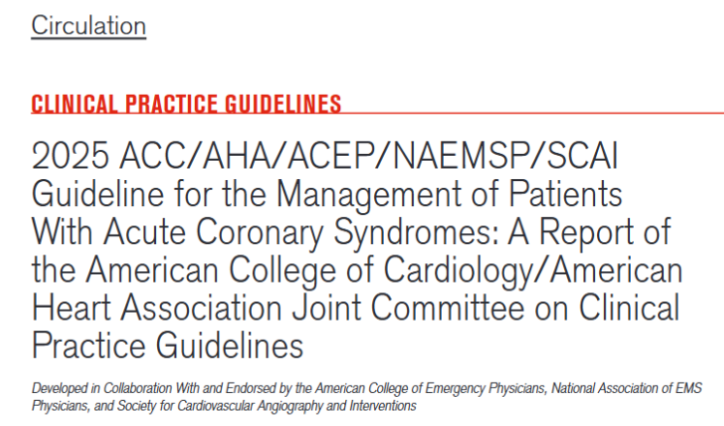
Hot off the press!!!

Slide 4
Case 1:
32 y/o man with GAD presents with 10 hours of right sided sharp chest pain. No association with exertion. No increasing frequency of the pain. No awakening from sleep. No associated dyspnea or diaphoresis. No premature CAD in family. No recent extended travel.
Meds: Amlodipine 5mg QD, and Lisinopril 10mg QD
He is tachycardia to 112BPM and anxious appearing with BP 167/85. He is on room air. Exam demonstrates no JVD, clear lungs and nl S1 and S2.
HS-troponin is pending.

Slide 5
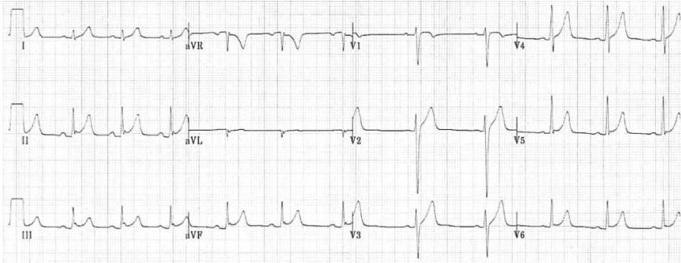

Slide 6
Question 1:
What is the most likely etiology of the ECG changes?
Anterolateral ST elevation MI
Pericarditis
Benign Early Repolarization
LVH

Slide 7
Question 1:
What is the most likely etiology of the ECG changes?
Anterolateral ST elevation MI
Pericarditis
Benign Early Repolarization
LVH

Slide 8
Case 2:
52 y/o man with previous PCI to LAD at unknown time, HTN, HLD and tobacco use presents with 5 hours of left sided crushing chest pressure. It is becoming progressively more intense with each episode of the pain. It woke him from his sleep. There is associated dyspnea and diaphoresis. Premature CAD in the family.
Meds: Amlodipine 5mg QD, and Lisinopril 10mg QD
He is tachycardia to 112BPM and anxious appearing with BP 167/85. He is on room air. Exam demonstrates no JVD, clear lungs and nl S1 and S2.
HS-troponin is pending.

Slide 9
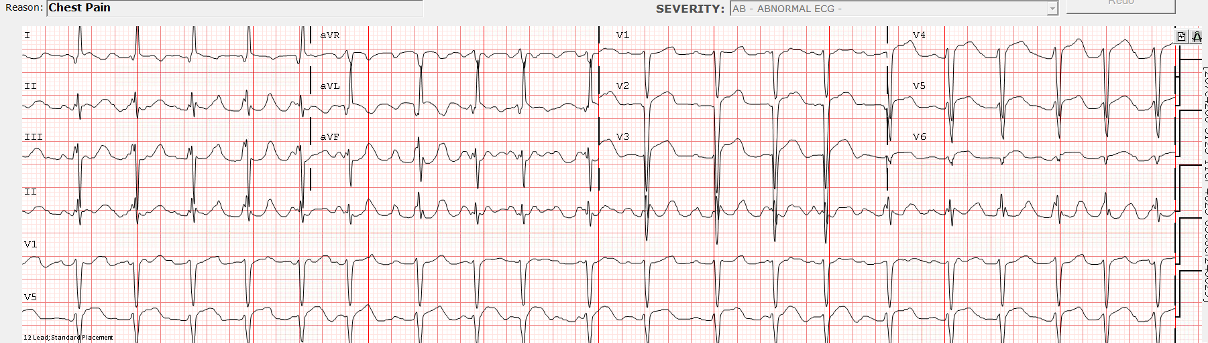

Slide 10
Question 2:
What is the most likely etiology of the ECG changes?
Anterolateral ST elevation MI
Pericarditis
Benign Early Repolarization
LVH

Slide 11
Question 2:
What is the most likely etiology of the ECG changes?
Anterolateral ST elevation MI
Pericarditis
Benign Early Repolarization
LVH

Slide 12

Anterolateral (V2-V6) ST elevations with evidence of completed infarction (pathologic Q waves V1-V3 and I/aVL).
Cath with severe in-stent stenosis of LAD stent (culprit), severe OM disease, and moderate RCA disease

Slide 13
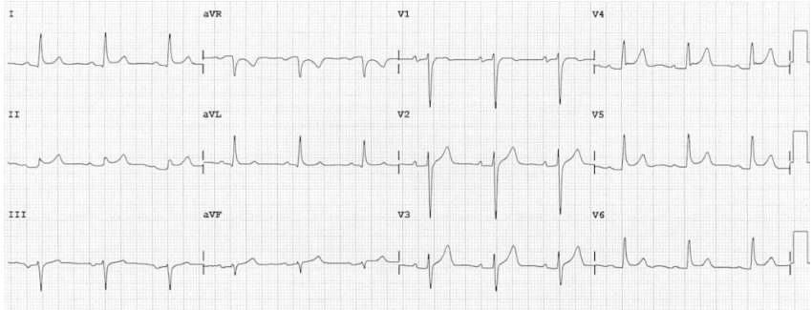
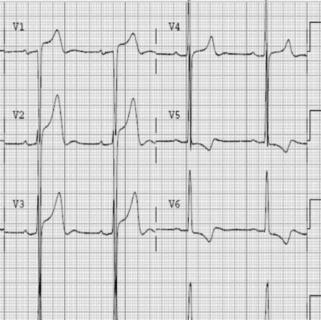

PR elevation
Benign early repolarization
Pericarditis
J-point elevation, upsloping
Fish-hook
PR depression
Differentials for ST elevations
LVH
STEMI
Proportional upsloping ST elevation

Slide 14
Classifications of Chest Pain:
Classical terminology
Typical Angina
  Substernal chest discomfort characterized by all of the following characteristics:
    a typical quality and duration
    provocation by exertion or emotional stress
    relief by rest or nitroglycerin
Atypical Angina
  2/3 of above
Non-cardiac
  ≤1 of above
2021 ACC chest pain guideline recommended terms
Cardiac
Possibly Cardiac
Non-cardiac

Slide 15
Chest pain equivalents?
Shortness of breath
Nausea or vomiting
Lightheadedness
Confusion
Presyncope or syncope
Fatigue
Vague abdominal symptoms
These features are more frequent among patients with diabetes, women, and the elderly.

Slide 16
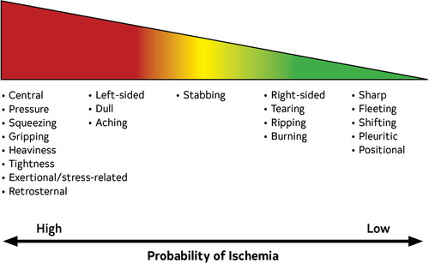

Slide 17
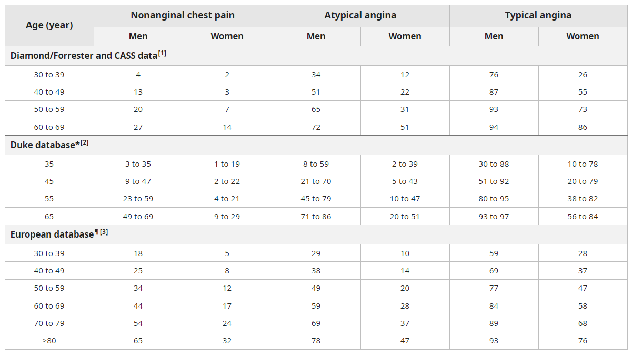
Question 1:
Based on data from Diamond and Forrester published in 1979 in NEJM what is our patient's pre-test probability of obstructive CAD?
94% - 60-69 M with typical angina
72% - 60-69 M with atypical angina
27% - 60-69 M with non-anginal CP
4% - 30-39 M with non-anginal CP
He is a 66-year-old man with atypical chest pain by classic definition.

Slide 18
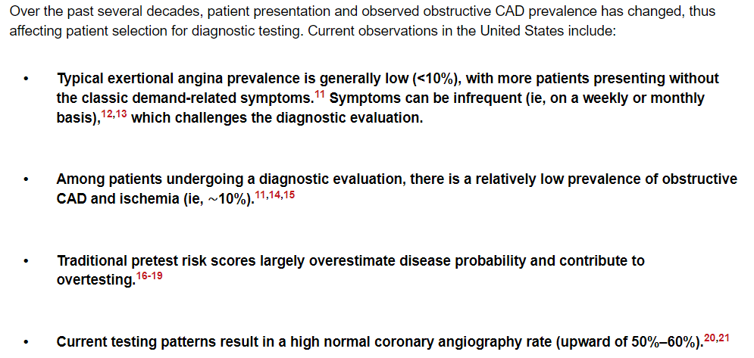

Slide 19
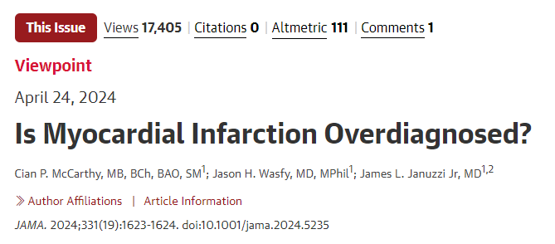
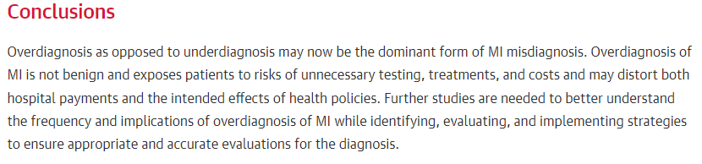
“abnormalities in troponin level in the absence of MI are common; among unselected ED cohorts, approximately 1 in 7 patients will have an elevated concentration”
“the positive predictive value of a troponin test result for MI in the United States is significantly lower (≈16%) than in the United Kingdom (≈60%).^{8”}

Slide 20
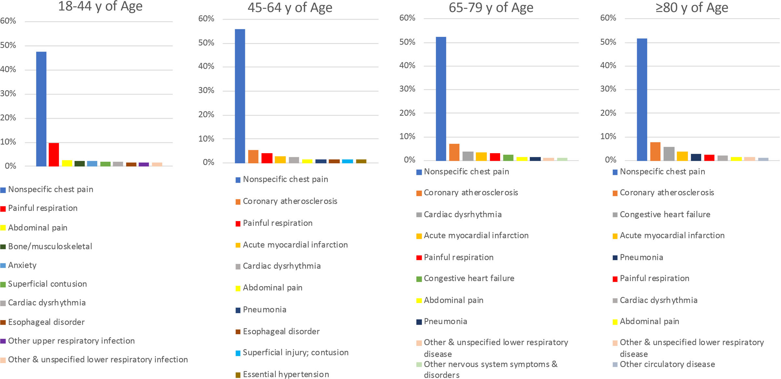
Is all chest pain cardiac?
NO!

Slide 21
Can’t Miss Chest Pain Diagnoses
Acute coronary syndrome
Aortic dissection
Pulmonary embolism
Pneumothorax
Pericardial tamponade
Mediastinitis/Esophageal rupture

Slide 22
Case 3:
A 66 man with CKD3, prior TIA and HTN presents for severe acute onset central chest pain that radiates to both arms after light exertion. The pain improved after resting but lasted for over 20 minutes. He lives a sedentary lifestyle. Denied tobacco, alcohol or illicit drugs use. He just returned from an international trip.
Medications include aspirin, pravastatin, tamsulosin and tadalafil PRN
Vitals: HR 104 BPM, BP 218/130, RR 22 BPM and SpO2 99%.
Exam was notable for obesity, no jugular venous distension, clear lungs, regular rate and rhythm, no murmurs and trace edema.
Labs: white blood cell count was 12.3, Hemoglobin was 16.7, Creatinine 2.8, Troponin-I 0.1 (ref <0.1 is normal) and BNP 409.

Slide 23
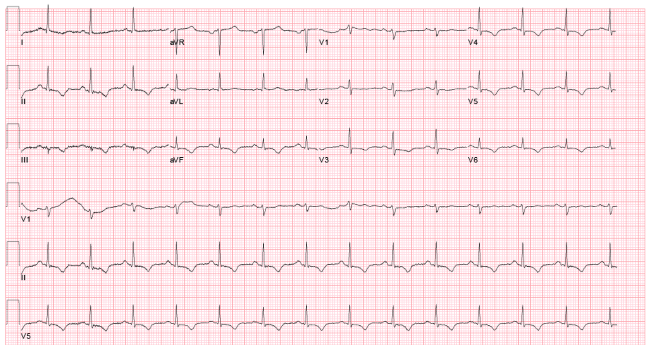
New dynamic ECG ST depressions and TWIs compared to baseline ECG

Slide 24
Question 3:
PE was subsequently ruled out with a negative D-dimer, CXR did not show a widened mediastinum or pneumothorax.
You give our patient 325mg of non-enteric coated aspirin, start a nitroglycerin gtt for hypertensive urgency (initial BP was 218/130 and he hadn’t had any PDE5 inhibitors in the last 24hrs) and trend serial troponins to rule out ACS.
Repeat troponin 6 hours later rises to 5.8 peaking at 7.6.
What would differentiate a type 1 vs type 2 MI?
Symptoms of ischemia
New ECG changes
New pathologic Q wave
Imaging evidence of ischemia
None of the above

Slide 25
Question 3:
PE was subsequently ruled out with a negative D-dimer, CXR did not show a widened mediastinum or pneumothorax.
You give our patient 325mg of non-enteric coated aspirin, start a nitroglycerin gtt for hypertensive urgency (initial BP was 218/130 and he hadn’t had any PDE5 inhibitors in last 24hrs) and trend serial troponins to rule out ACS. Repeat troponin 6 hours later rises to 5.8 peaking at 7.6.
What would differentiate type 1 vs type 2 MI in this patient?
Symptoms of ischemia
New ECG changes
New pathologic Q wave
Imaging evidence of ischemia
None of the above
All of these characteristics can be seen in either type 1 or type 2 MI.
Only the absence of coronary thrombus on angiography and evidence of supply-demand mismatch state can rule in type 2 MI

Slide 26
Definitions:​
Myocardial Injury:
Elevation of troponin above 99th percentile without any findings of infarction.
Acute:
Rise and/or fall
Chronic:
No rise and/or fall
Myocardial Infarction:
All require a rise and/or fall of troponin above 99th percentile +
Type 1:
One of the following:
  Symptoms of ischemia
  new ECG changes
  new pathologic Q wave
  imaging evidence of ischemia
  identification of coronary thrombus by angiography or autopsy.
Type 2:
Must have evidence of supply demand mismatch unrelated to thrombus.
One of the following:
  Symptoms of ischemia
  new ECG changes
  new pathologic Q wave
  imaging evidence of ischemia

Slide 27
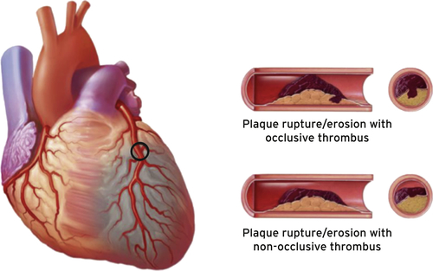
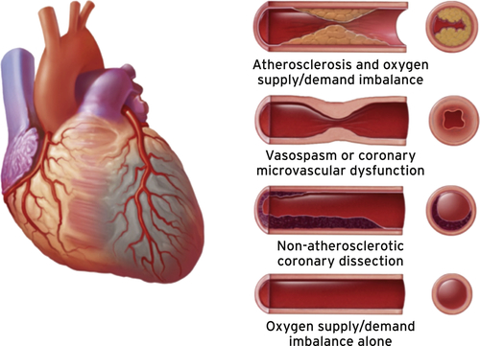
Type 1 vs Type 2 MI?

Slide 28
Type 1 MI/Acute Coronary Syndrome Classification
STEMI
  >1mm ST elevations in 2 contiguous leads except V2-V3 (see below)
  ≥2 mm in men ≥40 years
  ≥2.5 mm in men <40 years
  ≥1.5 mm in women regardless of age
NSTE-ACS or NSTEMI
  Symptoms/signs of ischemia
  Positive biomarkers
Unstable Angina
  Symptoms/signs of ischemia
  Negative biomarkers

Slide 29
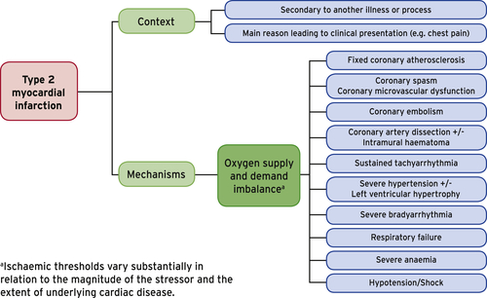

Slide 30
Question 4:
Our patient is diagnosed with NSTE-ACS.
While you are frantically looking up doses of medications for ACS, all you can remember is B-MONA from med school, you are asked a question by your fellow.
“When should we take this patient to the cath lab?”
Immediately his TIMI score is high risk
Within 24 hours, he has dynamic ECG changes and troponin is rising.
Within 72 hours his GRACE score is low risk.
Let's defer as symptoms have improved, and it’s the weekend at the VA. We can stress on Monday.

Slide 31
Case 3:
A 66 man with CKD3, prior TIA and HTN presents for severe acute onset central chest pain that radiates to both arms after light exertion. The pain improved after resting but lasted for over 20 minutes. He lives a sedentary lifestyle. Denied tobacco, alcohol or illicit drugs use. He just returned from an international trip.
Medications include aspirin, pravastatin, tamsulosin and tadalafil PRN
Vitals: HR 104 BPM, BP 218/130, RR 22 BPM and SpO2 99%.
Exam was notable for obesity, no jugular venous distension, clear lungs, regular rate and rhythm, no murmurs and trace edema.
Labs: white blood cell count was 12.3, Hemoglobin was 16.7, Creatinine 2.8, Troponin-I 0.1 (ref <0.1 is normal) and BNP 409.

Slide 32
Question 4:
Our patient is diagnosed with an NSTE-ACS. While you are frantically looking up doses of medications for ACS, because all you can remember was B-MONA from med school, you are asked a question by your fellow.
“When should we take this patient to the cath lab?”
Immediately his TIMI score is high risk
Within 24 hours, he has dynamic ECG changes and troponin is rising.
Within 72 hours his GRACE score is low risk.
Let's defer as symptoms have improved, and it’s the weekend at the VA. We can stress on Monday.

Slide 33
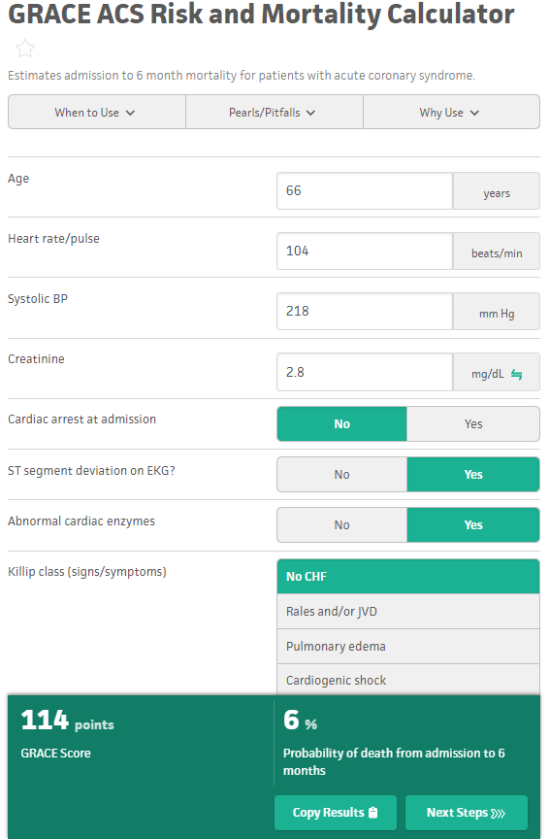
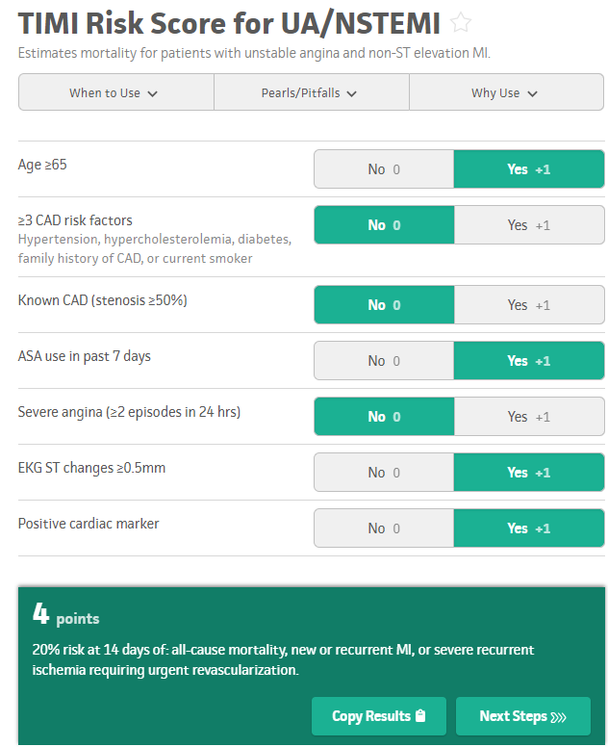

Slide 34
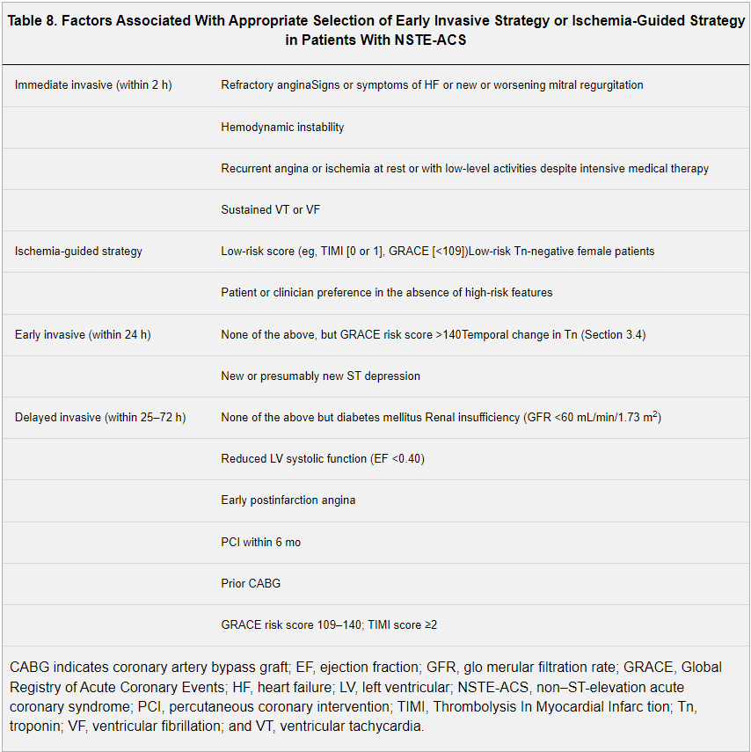
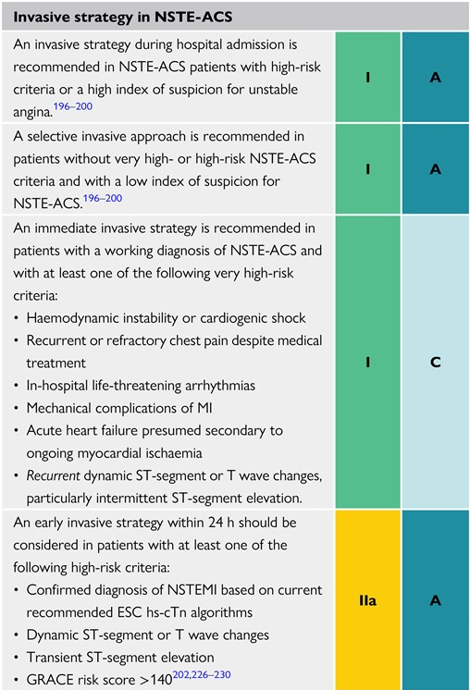
“STEMI Equivalents”

Slide 35
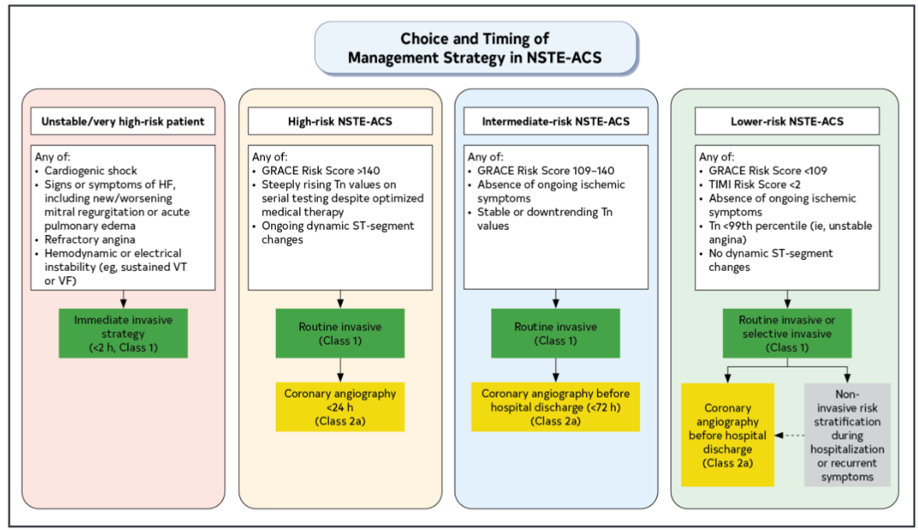

Slide 36
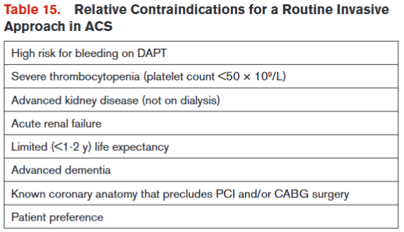

Slide 37
Question 5:
Prior to taking him to the cath lab you decided to load him with a P2Y12 inhibitor, high intensity statin and parenteral anticoagulation.
Which combination is the best choice?
Clopidogrel 300mg and heparin with bolus
Prasugrel 60mg and enoxaparin SQ injection
Ticagrelor 180mg and heparin with bolus
Cangrelor 30mcg/kg bolus and bivalrudin with bolus

Slide 38
Case 3:
A 66 man with CKD3, prior TIA and HTN presents for severe acute onset central chest pain that radiates to both arms after light exertion. The pain improved after resting but lasted for over 20 minutes. He lives a sedentary lifestyle. Denied tobacco, alcohol or illicit drugs use. He just returned from an international trip.
Medications include aspirin, pravastatin, tamsulosin and tadalafil PRN
Vitals: HR 104 BPM, BP 218/130, RR 22 BPM and SpO2 99%.
Exam was notable for obesity, no jugular venous distension, clear lungs, regular rate and rhythm, no murmurs and trace edema.
Labs: white blood cell count was 12.3, Hemoglobin was 16.7, Creatinine 2.8, Troponin-I 0.1 (ref <0.1 is normal) and BNP 409.

Slide 39
Question 5:
Prior to taking him to the cath lab you remembered to load him with P2Y12, high intensity statin and start anticoagulation.
Which combination is the best choice?
Clopidogrel 300mg and heparin with bolus
Prasugrel 60mg and enoxaparin SQ injection
Ticagrelor 180mg and heparin with bolus
Cangrelor 30mcg/kg bolus and bivalirudin with bolus
600mg is preferred
C/I with a hx of CVA/TIA
Expensive reserved for STEMI and shock/poor GI absorption.
Also expensive but a class I alternative agent in setting of HIT. IIa indication otherwise, less bleeding risk. Higher risk of stent thrombosis

Slide 40
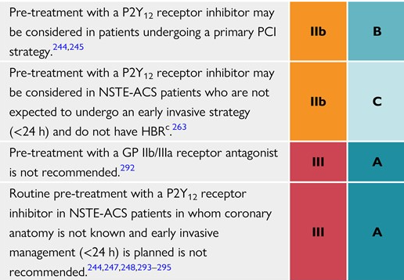
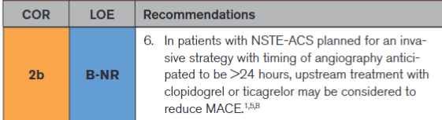
Should we pre-treat with P2Y12?
Would generally defer to cardiology.
Could delay CABG. Need to wait 5 days after clopidogrel.
No strong data that it improves outcomes.
It increases bleed risk.
Based on data from ACCOAST, ISAR-REACT 5 and DUBIUS trials.
ESC
2023
ACC 2025

Slide 41
Which P2Y12 should I use?
Clopidogrel
  Cost is an issue.
  No plans for PCI
  Another indication for anticoagulation. (preferred with DOAC).
  * Variable metabolism/efficacy
  * Avoid with CT surgery
Ticagrelor
  If PCI is planned (preferred)
  If no PCI is planned (preferred)
  If no indication for anticoagulation.
  * Watch for dyspnea
Prasugrel
  If PCI is planned (preferred)
  C/I:
    Age >75
    Previous TIA/CVA
    Wt <60 Kg

Slide 42
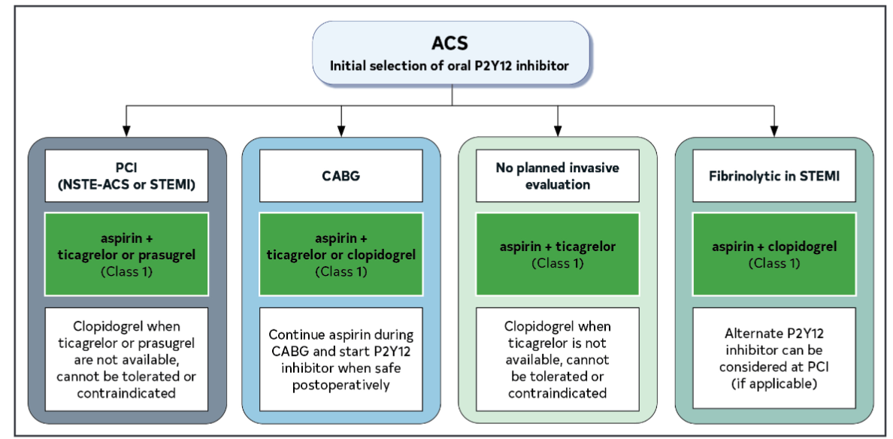
Which P2Y12 should I use?

Slide 43
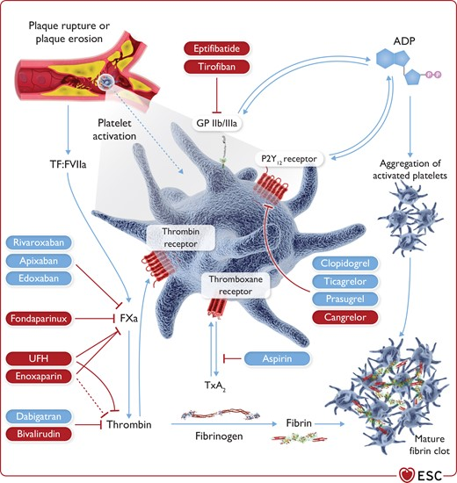
Parenteral Agents:
UFH
  Workhorse, especially if plan for PCI
  Reduces ischemic events (class 1)
LMWH
  NSTE-ACS -> Reduces ischemic events if no plan for PCI (class 1)
  STEMI -> reduced ischemic events (class 2b)
Bivalirudin
  STEMI -> Reduces mortality and bleeding (class 1)
  NSTE-ACS (class 2b)
  High cost
  Higher stent thrombosis
Fondaparinux
  NSTE-ACS -> Reduces ischemic events if no plan for PCI (class 1)
  STEMI -> High risk of stent thrombosis!!! (class 3)
GP IIb/IIIa:
When to use?
PCI is performed and: (class 2a)
  High thrombus burden
  No reflow
  Slow reflow
Improves procedural success and reduces infarct size.

Slide 44
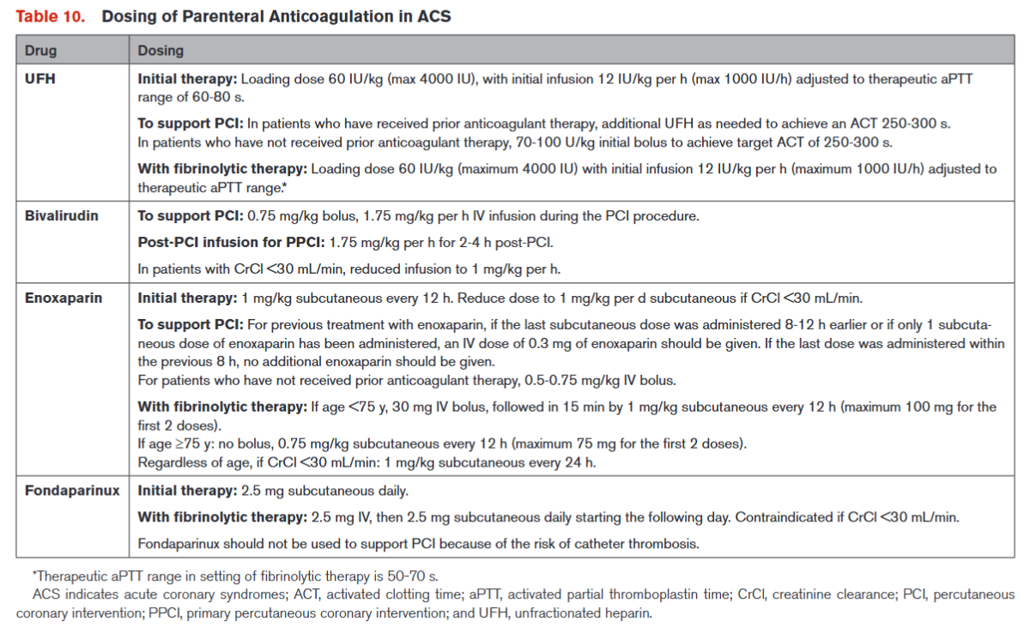

Slide 45
Question 6:
Our patient was found to have severe subtotal occlusion of the RCA and received a single DES. He has no signs or symptoms of heart failure. You ordered a TTE which demonstrated LVEF 39%. He currently is on ASA 81mg QD, Ticagrelor 75mg QD, metoprolol ER 25mg QD and rosuvastatin 40mg QD. BP 125/75, HR 65 and he has stable renal function and creatinine
What needs to be done prior to D/C?
Start lisinopril 5mg QD
Start Entresto 24mg/26mg BID
Send a referral for cardiac rehab and encourage physical exertion and return to work.
Prescribe nitroglycerin SLG tabs to be used for recurrent chest pain.
Administer flu-shot if not up to date.
A, C, D, E
B, C, D, E

Slide 46
Question 6:
Stage B HF. Entresto isn’t indicated.
Our patient was found to have severe subtotal occlusion of the RCA and received a single DES. He has no signs or symptoms of heart failure. You ordered a TTE which demonstrated LVEF 39%. He currently is on ASA 81mg QD, Ticagrelor 75mg QD, metoprolol ER 25mg QD and rosuvastatin 40mg QD. BP 125/75, HR 65 and he has stable renal function and creatinine
What needs to be done prior to D/C?
Start lisinopril 5mg QD
Start Entresto 24mg/26mg BID
Send a referral for cardiac rehab and encourage physical exertion and return to work.
Prescribe nitroglycerin SLG tabs to be used for recurrent chest pain.
Administer flu-shot if not up to date.
A, C, D, E
B, C, D, E

Slide 47

Pre-discharge Checklist for ACS (take a )
ASA 81mg daily (indefinitely) (class 1)
P2Y12 inhibitor (at least 12 months) (class 1)
  Can D/C ASA at 1 month to reduce bleeding risk (class 1)
High intensity atorvastatin 40-80mg or rosuvastatin 20-40mg (indefinitely). (class 1)
  Repeat lipids in 4-8 weeks (class 1)
  Can add non-statin agent
  Goal LDL <55 (class 1)
Beta blocker within 24 hrs (class 1)
  Stop at 12 months if LVEF >50%, (class 2b)
ACE/ARB if LVEF <40%, HTN, DM or anterior STEMI (class 1)
  All others (class 2a)
Nitroglycerin 0.4mg sublingual/spray PRN + education on how to use and when to seek emergency care. Avoid concurrent PDE 5 inhibitors.
TTE performed and LVEF documented (class 1)
Smoking cessation education and aid provided
DASH/Mediterranean Diet, standard exercise recommendations, work and sexual activity (low risk if can tolerate 4 METs of exertion) resumption education
Cardiac rehab referral (class 1)
Outpatient cardiology referral 1-2 weeks post discharge

Slide 48
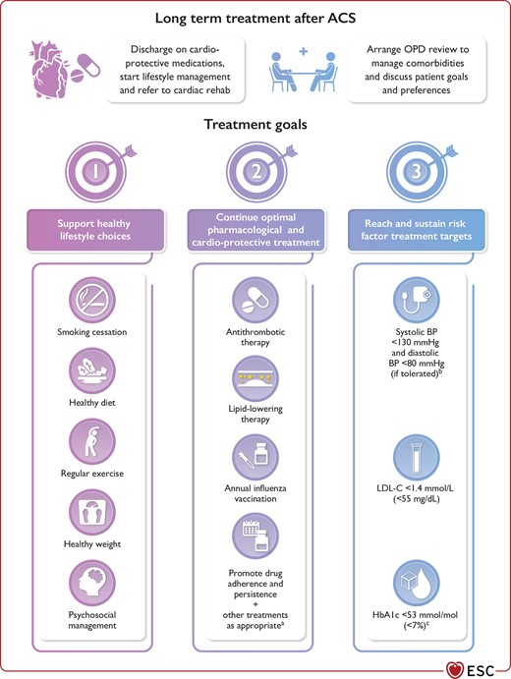

Slide 49
How long should we treat with DAPT?

Slide 50
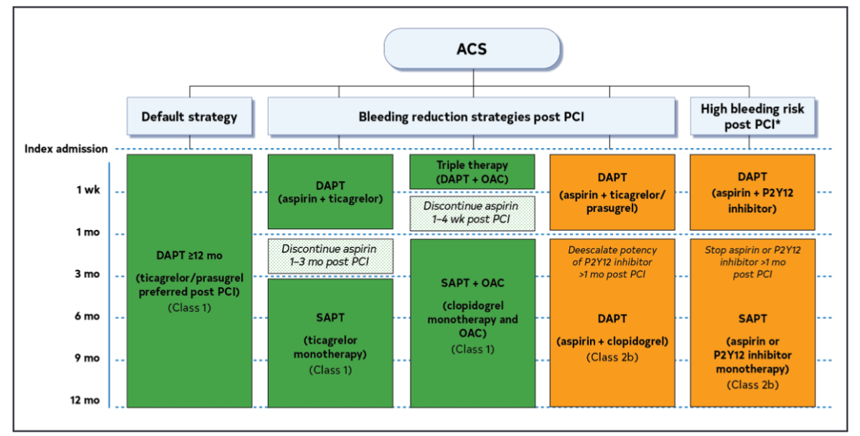

Slide 51
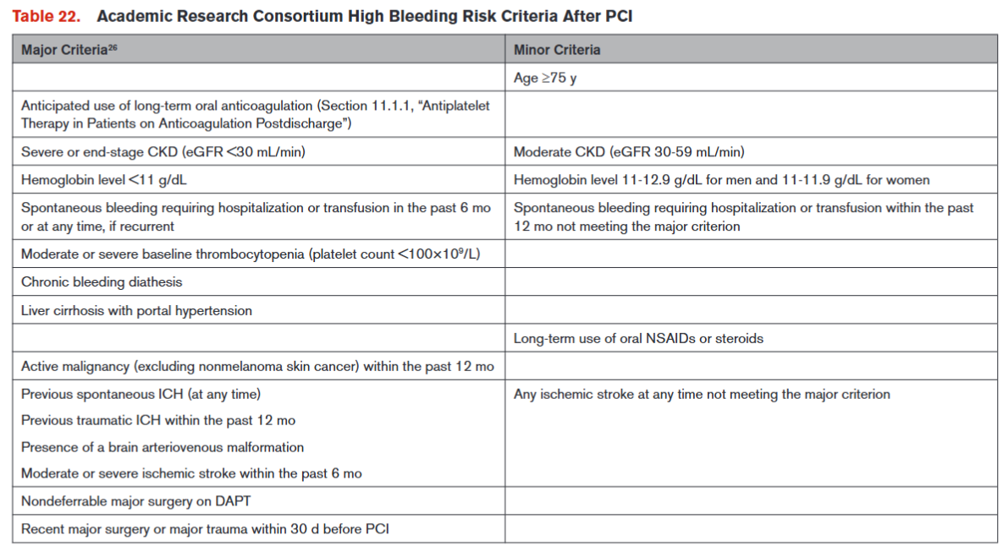

Slide 52
Q&A
Q: What if the initial ECG is negative/equivocal?
A: Serial ECGs when: clinical suspicion of ACS is high, symptoms are persistent, or clinical condition deteriorates. (class 1)
Q: How often should I trend troponin?
A: 1 to 2 hours for hs-cTn and 3 to 6 hours for conventional cTn assays (class 1)
Q: Is supplemental O2 still necessary for MI?
A: Yes, but only if SpO2 <90% (class 1)
Q: Treatment goals for anemia and ACS?
A: Transfuse for Hgb <10 (class 2b)
Q: A patient presents for cardiac arrest, and we achieve ROSC do we cath?
A: If STEMI + full/partial neuro recovery -> immediate cath (class 1)
If STEMI + comatose and poor prognostic features -> maybe (class 2b)
If no-STEMI -> no benefit (class 3)
Q: What is the role of MCS in acute myocardial infarction cardiogenic shock?
A: Impella CP -> DANGER SHOCK Trial (class 2a); IABP -> IABP-SHOCK II (class 3); ECMO -> ECMO-CS (class 3)

Slide 53
References
Thygesen K, Alpert J, Jaffe A, et al. Fourth Universal Definition of Myocardial Infarction (2018). J Am Coll Cardiol. 2018 Oct, 72 (18) 2231–2264.
Martha Gulati, Phillip D. Levy, Debabrata Mukherjee, et al. 2021 AHA/ACC/ASE/CHEST/SAEM/SCCT/SCMR Guideline for the Evaluation and Diagnosis of Chest Pain: A Report of the American College of Cardiology/American Heart Association Joint Committee on Clinical Practice Guidelines. Circulation. 2021;144:e368–e454
Ezra A. Amsterdam, Nanette K. Wenger, Ralph G. Brindis et al. 2014 AHA/ACC Guideline for the Management of Patients With Non–ST-Elevation Acute Coronary Syndromes Circulation. 2014;130:e344–e426
Robert A Byrne, Xavier Rossello, J J Coughlan, Emanuele Barbato, Colin Berry, Alaide Chieffo, Marc J Claeys, Gheorghe-Andrei Dan, Marc R Dweck, Mary Galbraith, Martine Gilard, Lynne Hinterbuchner, Ewa A Jankowska, Peter Jüni, Takeshi Kimura, Vijay Kunadian, Margret Leosdottir, Roberto Lorusso, Roberto F E Pedretti, Angelos G Rigopoulos, Maria Rubini Gimenez, Holger Thiele, Pascal Vranckx, Sven Wassmann, Nanette Kass Wenger, Borja Ibanez, ESC Scientific Document Group , 2023 ESC Guidelines for the management of acute coronary syndromes: Developed by the task force on the management of acute coronary syndromes of the European Society of Cardiology (ESC), European Heart Journal, Volume 44, Issue 38, 7 October 2023, Pages 3720–3826
Levine G, Bates E, Bittl J, et al. 2016 ACC/AHA Guideline Focused Update on Duration of Dual Antiplatelet Therapy in Patients With Coronary Artery Disease. J Am Coll Cardiol. 2016 Sep, 68 (10) 1082–1115.

Slide 54


Be not wise in your own eyes; fear the LORD, and turn away from evil. Proverbs 3:7

