Slide 1
Question #1
A 38-year-old man is evaluated after removing a blacklegged deer tick from his upper left arm 12 hours ago. He lives in Rhode Island. He states that the tick was engorged and was likely present for more than 36 hours. He otherwise feels well, has no medical problems, and takes no medications.
On physical examination, vital signs are normal. The site of tick removal on his upper left arm shows no erythema, swelling, or tenderness.
Which of the following is the most appropriate next step?
A. Doxycycline for 10 days
B. Lyme serology
C. Single dose of doxycycline
D. Observation only
Notes:
IDMCQ24072

Slide 2
Question #1
A 38-year-old man is evaluated after removing a blacklegged deer tick from his upper left arm 12 hours ago. He lives in Rhode Island. He states that the tick was engorged and was likely present for more than 36 hours. He otherwise feels well, has no medical problems, and takes no medications.
On physical examination, vital signs are normal. The site of tick removal on his upper left arm shows no erythema, swelling, or tenderness.
Which of the following is the most appropriate next step?
A. Doxycycline for 10 days
B. Lyme serology
C. Single dose of doxycycline
D. Observation only
Notes:
IDMCQ24072

Slide 3
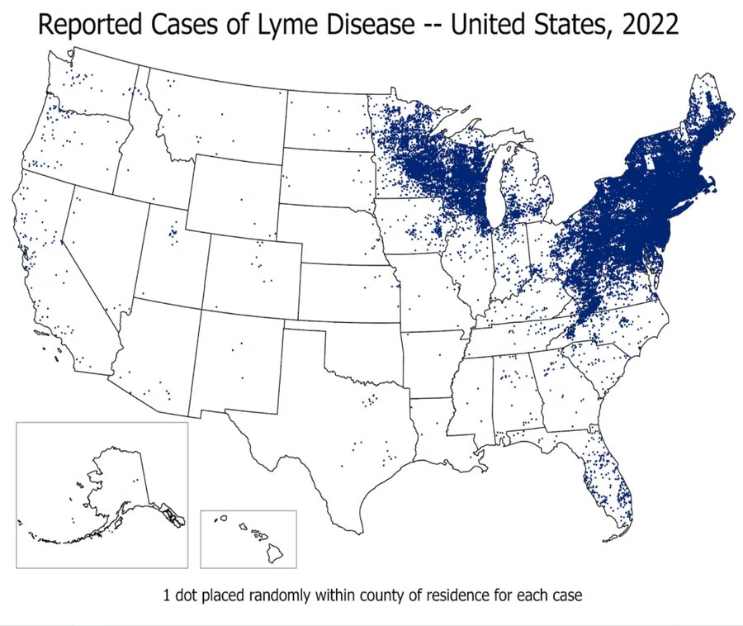
Prevent Lyme disease
Tick-borne infection caused by the spirochete Borrelia burgdorferi, which is transmitted through an Ixodes scapularis (blacklegged deer tick) bite
Most common vector-borne infection in the United States
Antibiotics to prevent Lyme disease after a tick bite are recommended if the following conditions are met:
  The tick can be reliably identified as a blacklegged tick
  Antibiotics can be given within 72 hours of the bite
  The tick was attached for at least 36 hours (transmission of Lyme disease is unlikely if the tick is attached for <36 hours)
  The tick bite occurred in a Lyme-endemic area where B. burgdorferi prevalence exceeds 20% (Northeast, mid-Atlantic, upper Midwest)

Slide 4
Other answers:
A. Doxycycline, 100 mg orally twice daily for 10 days, is the recommended treatment course for a patient with early localized Lyme disease (e.g., erythema migrans rash)
B. Lyme serology is not recommended in asymptomatic persons after a blacklegged deer tick bite
  Lyme antibody testing is often falsely negative in the first days to weeks following exposure because a detectable antibody response generally takes a few weeks to develop
D. Observation alone would be appropriate if the conditions for prophylaxis listed above were not met; that is, more than 72 hours had passed since tick removal, the tick was attached for less than 36 hours, the bite did not occur in a Lyme-endemic area, or the tick bite was not from a blacklegged tick

Slide 5

Question #2
A 38-year-old woman is evaluated in the emergency department for a 2-day history of new fatigue and exercise intolerance. She lives in New Hampshire and recalls removing a few ticks from her body over the past month. She has no other medical history and takes no medications.
On physical examination, temperature is 37.2 °C (99.0 °F), blood pressure is 100/60 mm Hg, pulse rate is 52/min, and respiration rate is 18/min. No rash is seen.
Lyme enzyme immunoassay is positive; Lyme IgM and IgG Western blots are positive.
ECG is shown.
Which of the following is the most appropriate treatment?
A. Ceftriaxone
B. Doxycycline
C. Left ventricular assist device
D. Permanent pacemaker placement
Notes:
IDMCQ24074
2nd degree heart block

Slide 6
Question #2
A 38-year-old woman is evaluated in the emergency department for a 2-day history of new fatigue and exercise intolerance. She lives in New Hampshire and recalls removing a few ticks from her body over the past month. She has no other medical history and takes no medications.
On physical examination, temperature is 37.2 °C (99.0 °F), blood pressure is 100/60 mm Hg, pulse rate is 52/min, and respiration rate is 18/min. No rash is seen.
Lyme enzyme immunoassay is positive; Lyme IgM and IgG Western blots are positive.
ECG is shown.
Which of the following is the most appropriate treatment?
A. Ceftriaxone
B. Doxycycline
C. Left ventricular assist device
D. Permanent pacemaker placement
Notes:
IDMCQ24074

Slide 7
Treat Lyme carditis
Typically manifests 1 to 2 months after a tick bite
  Lightheadedness, palpitations, shortness of breath, chest pain, and syncope; cardiac symptoms may or may not be preceded by erythema migrans or other early Lyme disease symptoms
Hospitalization is indicated for patients with Lyme carditis who are symptomatic, have second-degree or third-degree atrioventricular block, or have a PR interval of 300 milliseconds or greater
Treatment is with intravenous ceftriaxone

Slide 8
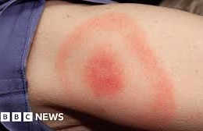
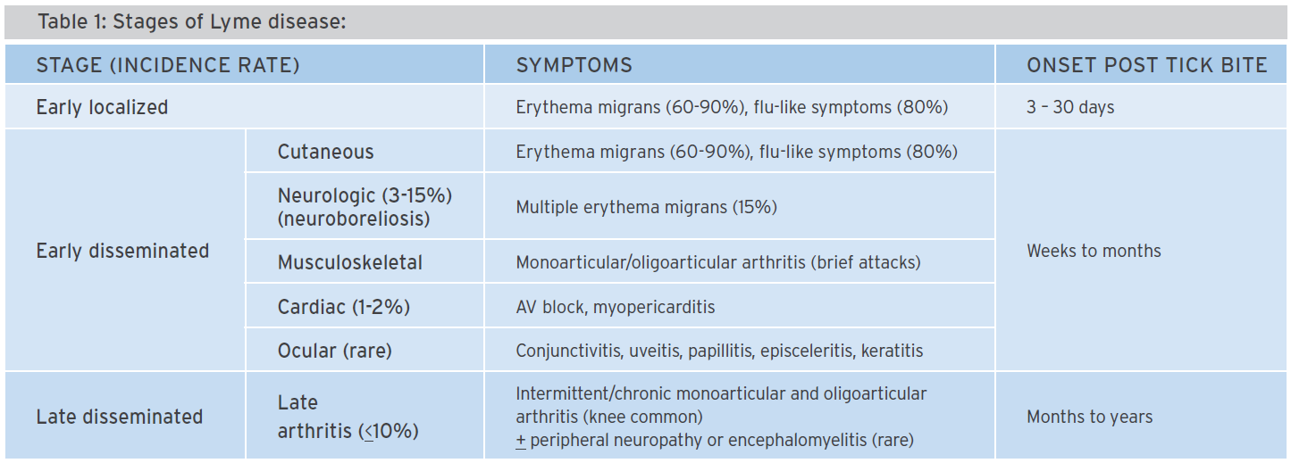
Stages of Lyme disease
Notes:
The EM rash is usually painless, nonpruritic, and circumferentially enlarging

Slide 9
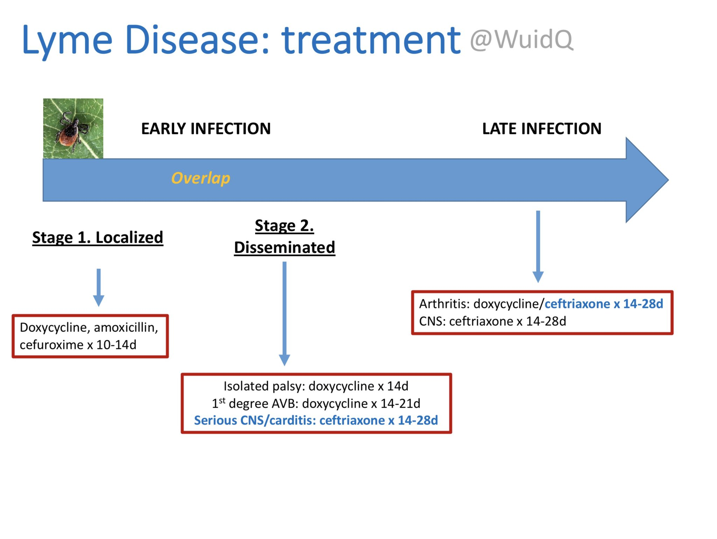
Treatment of Lyme disease

Slide 10
Question #3
A 49-year-old man is evaluated for new-onset erythema and tenderness on the skin surrounding a chronic foot wound. The patient reports no previous foot wounds, need for frequent antibiotics, or previous hospitalizations. Medical history is significant for type 2 diabetes mellitus, peripheral neuropathy, and hyperlipidemia. Medications are metformin, dulaglutide, gabapentin, and rosuvastatin. He reports a remote history of gastrointestinal upset to amoxicillin.
On physical examination, vital signs are normal. A shallow ulcer is present on the plantar surface of the left great toe. The base of the wound is clean and without purulence. Erythema, warmth, and mild induration surround the distal and lateral aspects of the wound, extending to about 1.5 cm. The wound is tender to the touch, but active or passive range of motion of the toe does not elicit tenderness. Both feet are pink and warm, with normal dorsalis pedis pulses.
Which of the following is the most appropriate empiric treatment?
A. Cephalexin
B. Ciprofloxacin
C. Penicillin
D. Trimethoprim-sulfamethoxazole

Slide 11
Question #3
A 49-year-old man is evaluated for new-onset erythema and tenderness on the skin surrounding a chronic foot wound. The patient reports no previous foot wounds, need for frequent antibiotics, or previous hospitalizations. Medical history is significant for type 2 diabetes mellitus, peripheral neuropathy, and hyperlipidemia. Medications are metformin, dulaglutide, gabapentin, and rosuvastatin. He reports a remote history of gastrointestinal upset to amoxicillin.
On physical examination, vital signs are normal. A shallow ulcer is present on the plantar surface of the left great toe. The base of the wound is clean and without purulence. Erythema, warmth, and mild induration surround the distal and lateral aspects of the wound, extending to about 1.5 cm. The wound is tender to the touch, but active or passive range of motion of the toe does not elicit tenderness. Both feet are pink and warm, with normal dorsalis pedis pulses.
Which of the following is the most appropriate empiric treatment?
A. Cephalexin
B. Ciprofloxacin
C. Penicillin
D. Trimethoprim-sulfamethoxazole

Slide 12
Treat a mild diabetic foot infection
Infection severity | Additional factors | Usual pathogen(s)^{b} | Potential empirical regimens^{c}
Mild | No complicating features | GPC | Semisynthetic penicillinase-resistant penicillin (cloxacillin)
 |  |  | 1st generation cephalosporin (cephalexin)
 | ß-lactam allergy or intolerance | GPC | Clindamycin; fluoroquinolone (levo/moxi-floxacin); trimethoprim-sulfamethoxazole; doxycycline
 | Recent antibiotic exposure | GPC + GNR | ß-lactam- ß lactamase inhibitor1 (amoxicillin/clavulanate, ampicillin/sulbactam)
 |  |  | Fluoroquinolone (levo/moxi-floxacin); trimethoprim-sulfamethoxazole
 | High risk for MRSA | MRSA | Linezolid; trimethoprim-sulfamethoxazole; clindamycin; doxycycline, fluoroquinolone (levofloxacin, moxifloxacin)
Notes:
IDMCQ24114

Slide 13
Treat a mild diabetic foot infection
Mild diabetic foot infections without pus or methicillin-resistant Staphylococcus aureus risk factors can be treated with a short course (7-14 days) of a first-generation cephalosporin or anti-staphylococcal penicillin
Mild diabetic foot infections with pus or methicillin-resistant Staphylococcus aureus risk factors can be treated with trimethoprim-sulfamethoxazole or doxycycline and a β-lactam antibiotic that provides coverage against streptococci

Slide 14
Question #4
A 75-year-old man is evaluated for a 24-hour history of severe left knee pain. He has type 2 diabetes mellitus and well-controlled gout. Medications are metformin and allopurinol.
On physical examination, temperature is 37.8 °C (100.0 °F). The left knee is warm, swollen, and tender, and the overlying skin is erythematous. Aspiration is performed.
Analysis shows opaque fluid; extracellular negatively birefringent needle-shaped crystals are present. Gram stain is negative. Culture is pending.
Which of the following is the most appropriate treatment?
A. Canakinumab
B. Low-dose colchicine
C. Intra-articular methylprednisolone injection
D. Vancomycin
Synovial fluid studies:
Leukocyte count | 120,000/µL (120 × 10⁹/L) with 80% polymorphonuclear cells | H

Slide 15
Question #4
A 75-year-old man is evaluated for a 24-hour history of severe left knee pain. He has type 2 diabetes mellitus and well-controlled gout. Medications are metformin and allopurinol.
On physical examination, temperature is 37.8 °C (100.0 °F). The left knee is warm, swollen, and tender, and the overlying skin is erythematous. Aspiration is performed.
Analysis shows opaque fluid; extracellular negatively birefringent needle-shaped crystals are present. Gram stain is negative. Culture is pending.
Which of the following is the most appropriate treatment?
A. Canakinumab
B. Low-dose colchicine
C. Intra-articular methylprednisolone injection
D. Vancomycin
Synovial fluid studies:
Leukocyte count | 120,000/µL (120 × 10⁹/L) with 80% polymorphonuclear cells | H

Slide 16
Treat a suspected septic joint in a patient with gout
New-onset monoarthritis in a patient with well-controlled inflammatory arthritis should prompt urgent arthrocentesis
Negative Gram stain and the presence of crystals do not exclude infection, especially when the visualized crystals are extracellular
Concern for infectious arthritis when the synovial fluid leukocyte count is greater than 100,000/µL (100 × 10⁹/L)
In the absence of positive findings on Gram stain, initial empiric antibiotic therapy for infectious arthritis is guided by risk factors and expected common pathogens
Without a positive Gram stain, initial empiric therapy should include coverage for gram-positive organisms (including increasingly prevalent methicillin-resistant Staphylococcus aureus) and gram-negative organisms if the patient is immunocompromised, is at risk for gonococcal infection, or has joint trauma
Notes:
Gout with concern for the presence of infectious arthritis, considering the synovial fluid leukocyte count of 120,000/µL (120 × 10⁹/L) with a polymorphonuclear predominance

Slide 17
Question #5
A 66-year-old man is evaluated in the emergency department for a 1-month history of productive cough, fever, periodic night sweats, and 5-kg (11 lb) unintentional weight loss. He reports temporarily living in a shelter 9 months ago. He takes no medications.
On physical examination, temperature is 38.3 °C (101 °F) and respiration rate is 20/min; other vital signs are normal. Oxygen saturation is 94% with the patient breathing ambient air. Bilateral crackles are heard in the upper lobes.
Chest radiograph demonstrates bilateral patchy infiltrates in the upper lobes without cavitation.
Which of the following is the most appropriate next step in management?
A. Acid-fast bacilli smear and culture of sputum and nucleic acid amplification testing
B. CT of the chest
C. Interferon-γ release assay
D. Isoniazid and rifampin
Laboratory studies:
Leukocyte count | 11,200/µL (11.2 × 10⁹/L)

Slide 18
Question #5
A 66-year-old man is evaluated in the emergency department for a 1-month history of productive cough, fever, periodic night sweats, and 5-kg (11 lb) unintentional weight loss. He reports temporarily living in a shelter 9 months ago. He takes no medications.
On physical examination, temperature is 38.3 °C (101 °F) and respiration rate is 20/min; other vital signs are normal. Oxygen saturation is 94% with the patient breathing ambient air. Bilateral crackles are heard in the upper lobes.
Chest radiograph demonstrates bilateral patchy infiltrates in the upper lobes without cavitation.
Which of the following is the most appropriate next step in management?
A. Acid-fast bacilli smear and culture of sputum and nucleic acid amplification testing
B. CT of the chest
C. Interferon-γ release assay
D. Isoniazid and rifampin
Laboratory studies:
Leukocyte count | 11,200/µL (11.2 × 10⁹/L)

Slide 19
Diagnose active TB infection
Classic symptoms (productive cough, fever, night sweats, and unintentional weight loss occurring for >2 weeks) and a chest radiograph that suggest active pulmonary tuberculosis infection
3 separate sputum specimens should be obtained at least 8 hours apart; one specimen should be an early morning specimen
  When a sputum smear result is positive for AFB, NAAT for Mycobacterium tuberculosis can be used to verify the organism
Interferon-gamma release assay (IGRA) or tuberculin skin test (TST) is used to diagnose latent tuberculosis infection (LTBI)
  TST and IGRA are not indicated to diagnose active tuberculosis infection and are often negative in active tuberculosis infection

Slide 20
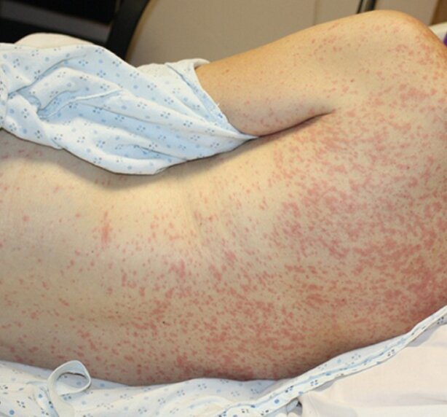
Question #6
A 58-year-old woman is evaluated in the emergency department for fever and a runny nose of 4 days' duration; today, she developed a rash that began on her face and has spread to her neck and upper trunk. She returned from Southeast Asia 5 days ago where she traveled to rural areas where cases of measles were identified. She thinks she received a single dose of the measles, mumps, and rubella vaccine as a child. She did not seek preventive care before travel. She takes no medications.
On physical examination, temperature is 39.5 °C (103.1 °F); remaining vital signs are normal. A rash that appears along the hairline, on the face, and on the upper trunk is shown.
Polymerase chain reaction of a throat swab for measles is pending.
Which of the following precautions is the most appropriate?
A. Airborne
B. Contact
C. Contact and droplet
D. Droplet

Slide 21
Question #6
A 58-year-old woman is evaluated in the emergency department for fever and a runny nose of 4 days' duration; today, she developed a rash that began on her face and has spread to her neck and upper trunk. She returned from Southeast Asia 5 days ago where she traveled to rural areas where cases of measles were identified. She thinks she received a single dose of the measles, mumps, and rubella vaccine as a child. She did not seek preventive care before travel. She takes no medications.
On physical examination, temperature is 39.5 °C (103.1 °F); remaining vital signs are normal. A rash that appears along the hairline, on the face, and on the upper trunk is shown.
Polymerase chain reaction of a throat swab for measles is pending.
Which of the following precautions is the most appropriate?
A. Airborne
B. Contact
C. Contact and droplet
D. Droplet

Slide 22
Prevent measles transmission
Primarily transmitted through aerosolized small droplet nuclei (airborne transmission)
Highly infectious and can be spread from 4 days before onset of the rash to 4 days after onset; 9 of 10 susceptible persons with close contact to an individual with measles will become infected
Two doses of the measles, mumps, and rubella (MMR) vaccine are about 97% effective at protecting against measles
Typical symptoms:
  Cough, coryza and conjunctivitis
  Fever
  Rash
Diagnosis:
  + measles IgM ab on serum or oral sample; generally detectable 3 days after development of exanthem
  RT-PCR on throat or NP swab
Treatment:
  Supportive care
  Vitamin A
  Ribavirin
Notes:
If the patient cannot be placed immediately in an airborne infection isolation room (i.e., negative-pressure room), the patient should be masked in a room with the door closed.

Slide 23
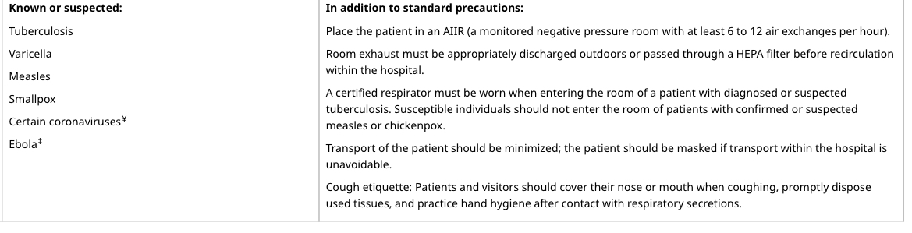
Airborne precautions

Slide 24
Question #7
A 35-year-old man is evaluated in the emergency department for fever, neck stiffness, and photophobia of 2 days' duration. He was recently diagnosed with HIV infection and has initiated antiretroviral therapy with tenofovir disoproxil fumarate plus emtricitabine and dolutegravir.
On physical examination, temperature is 39.1 °C (102.4 °F) and blood pressure is 100/65 mm Hg; other vital signs are normal. Neurologic examination is nonfocal. Photophobia, but no papilledema, is present on funduscopic examination. Nuchal rigidity is noted.
Laboratory studies show a leukocyte count of 12,000/µL (12 × 10⁹/L). Blood cultures were drawn.
Which of the following is the most appropriate diagnostic test to perform next?
A. CT of the head
B. Lumbar puncture
C. MRI of the brain
D. Serum cryptococcal antigen
Notes:
Extension question set 3, #1
I added blood cxs to this question. I also would have liked it to say antibiotics were started after blood cxs!

Slide 25
Question #7
A 35-year-old man is evaluated in the emergency department for fever, neck stiffness, and photophobia of 2 days' duration. He was recently diagnosed with HIV infection and has initiated antiretroviral therapy with tenofovir disoproxil fumarate plus emtricitabine and dolutegravir.
On physical examination, temperature is 39.1 °C (102.4 °F) and blood pressure is 100/65 mm Hg; other vital signs are normal. Neurologic examination is nonfocal. Photophobia, but no papilledema, is present on funduscopic examination. Nuchal rigidity is noted.
Laboratory studies show a leukocyte count of 12,000/µL (12 × 10⁹/L). Blood cultures were drawn.
Which of the following is the most appropriate diagnostic test to perform next?
A. CT of the head
B. Lumbar puncture
C. MRI of the brain
D. Serum cryptococcal antigen
Notes:
Extension question set 3, #1
I added blood cxs to this question. I also would have liked it to say antibiotics were started after blood cxs!

Slide 26
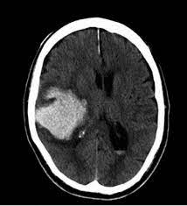
Perform a head CT before lumbar puncture in a patient with suspected meningitis and clinical features associated with elevated intracranial pressure
LP is crucial for dx of meningitis, but in patients with elevated intracranial pressure, concern for brain herniation with withdrawal of CSF
Who needs a head CT prior to LP?
  Immunocompromised
  Hx of CNS infection
  New-onset seizure
  Papilledema
  Altered level of consciousness
  Focal neurologic deficit

Slide 27
Clinical manifestations of bacterial meningitis
Classic triad: fever, nuchal rigidity and altered mental status in 40%
95% will have 2 of 4: HA, fever, stiff neck, and altered mental status
Most common clinical features:
  Headache (84%)
  Fever >38˚C (74%)
  Stiff neck (74%)
  GCS <14 (71%)
  Nausea (62%)
[1] NEJM 2004; 351: 1849
[2] Lancet ID 2016; 16: 339
[3] Ann Intern Med 1998; 129: 862
Notes:
This data comes out of a large registry in the Netherlands – they had about 700 patients with acute bacterial meningitis and they assessed for symptoms; so don’t wait for you patient to have all 3 of these sxs before you do the LP, you will miss > 50% of your cases
If you patient has any combination of 2 of these 4 sxs, HA, fever, stiff neck and AMS, you need to be thinking about doing an LP; and if you’re thinking about doing an LP, you should do an LP

Slide 28
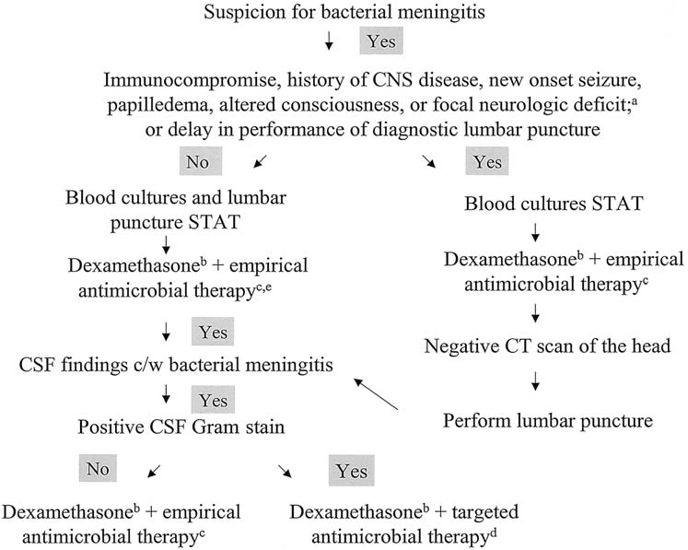
Notes:
50-90% of pts with bacterial meningitis have + blood cxs; CAP – blood cxs + in ~5-16% of pts

Slide 29
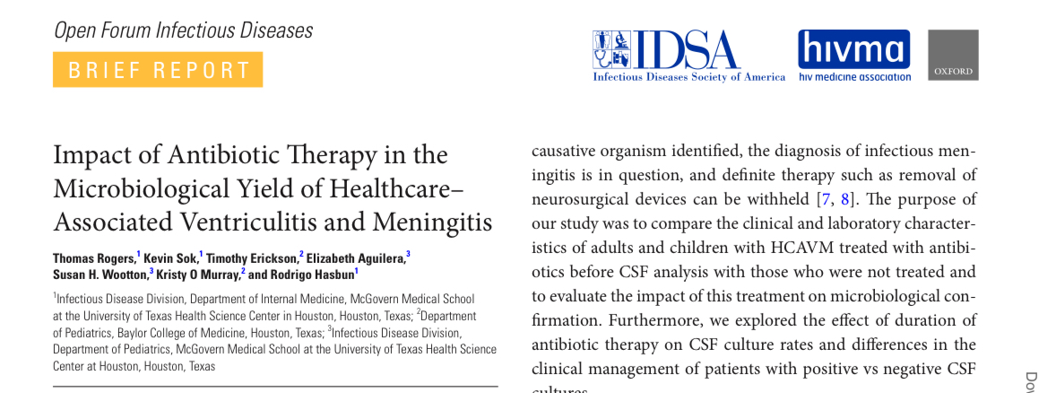
Antibiotic administration prior to LP
Antibiotic administration has minimal effects on chemistry and cytology findings
Antimicrobial therapy prior to LP decreases CSF culture sensitivity from 66.1% to 48.5%
  Blood cultures
  Multiplex PCR in CSF

Slide 30
Question #8
A 48-year-old man is evaluated for persistent calf pain after being bitten by a large dog 2 days ago. Medical history is significant for alcoholic cirrhosis. Medications are furosemide, spironolactone, propranolol, and lactulose.
On physical examination, vital signs are normal. Two 1-cm puncture wounds are located on the right calf without associated edema, spreading erythema, induration, or purulence. Apart from scattered spider angiomata, the remainder of the examination is unremarkable.
Doppler ultrasonography of the right lower extremity shows no abscess or deep venous thrombosis.
Which of the following is the most appropriate treatment measure?
A. 3-day course of amoxicillin-clavulanate
B. 10-day course of amoxicillin-clavulanate
C. 5-day course of ciprofloxacin
D. Observation
Notes:
Extension question set 3, #2

Slide 31
Question #8
A 48-year-old man is evaluated for persistent calf pain after being bitten by a large dog 2 days ago. Medical history is significant for alcoholic cirrhosis. Medications are furosemide, spironolactone, propranolol, and lactulose.
On physical examination, vital signs are normal. Two 1-cm puncture wounds are located on the right calf without associated edema, spreading erythema, induration, or purulence. Apart from scattered spider angiomata, the remainder of the examination is unremarkable.
Doppler ultrasonography of the right lower extremity shows no abscess or deep venous thrombosis.
Which of the following is the most appropriate treatment measure?
A. 3-day course of amoxicillin-clavulanate
B. 10-day course of amoxicillin-clavulanate
C. 5-day course of ciprofloxacin
D. Observation
Notes:
Extension question set 3, #2

Slide 32
Treat an animal bite with prophylactic antibiotics in an immunocompromised patient
Wound infection occurs in ~20% of patients following an animal bite
Pasteurella, Capnocytophaga, anaerobes, Strep, Staph
Who should get antimicrobial prophylaxis?
  Severe injuries (deep puncture wounds, crush injuries, face, hands, joints)
  Underlying conditions that impair wound healing
    Immunocompromise
    Advanced liver disease
    Asplenia
    Chronic edema

Slide 33
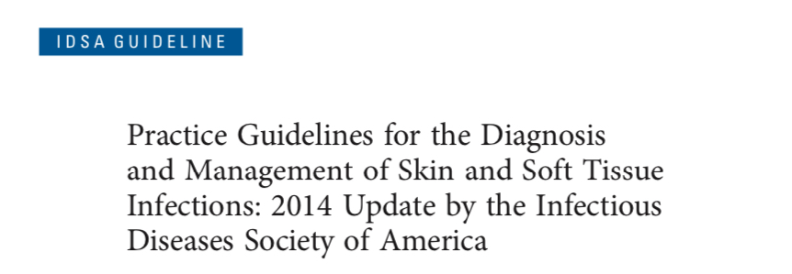
Animal and Human Bite Wounds Prevention and Treatment
XI. What Is the Role of Preemptive Antimicrobial Therapy to Prevent Infection for Dog or Cat Bites?
Preemptive early antimicrobial therapy for 3–5 days is recommended for patients who (a) are immunocompromised; (b) are asplenic; (c) have advanced liver disease; (d) have preexisting or resultant edema of the affected area; (e) have moderate to severe injuries, especially to the hand or face; or (f) have injuries that may have penetrated the periosteum or joint capsule (strong, low).
Postexposure prophylaxis for rabies may be indicated; consultation with local health officials is recommended to determine if vaccination should be initiated (strong, low).
Notes:
Back to the answers…
10 days would be more appropriate if the pt had a significant infection; too long for prophy
What is wrong with choice C?

Slide 34
Question #9
A 34-year-old man comes to the emergency department due to 2 days of fever, chills, and drenching sweats. He has had no sore throat, cough, shortness of breath, chest pain, or dysuria. The patient has a history of Crohn disease and recently underwent abdominal surgery to remove a bowel stricture. The postoperative course was complicated by an enterocutaneous fistula, which has been treated over the past 6 weeks with antitumor necrosis factor therapy. This treatment has reduced the amount of drainage from the fistula. He has had no recent abdominal pain or diarrhea. The patient takes nothing by mouth and receives daily total parenteral nutrition. He has no other medical problems and does not use tobacco, alcohol, or illicit drugs.
Temperature is 38.3 C (101 F), blood pressure is 110/60 mm Hg, pulse is 112/min, and respirations are 18/min. The patient is ill-appearing and diaphoretic. The lungs are clear to auscultation. Cardiac examination reveals tachycardia but is otherwise unremarkable. The abdomen is soft and nontender with clear discharge from the infraumbilical fistula site. The right upper arm peripherally inserted central catheter site has no erythema or tenderness.
Leukocyte count is 18,000/mm³, and serum creatinine is 0.9 mg/dL. Chest x-ray reveals no infiltrates. Urinalysis is normal. Blood cultures are obtained, and empiric broad-spectrum intravenous antibiotics are initiated.
Within the next 24 hours, both sets of blood cultures grow budding yeast.
Which of the following is the most appropriate next step in management of this patient?
A. Change the catheter via guidewire and begin IV fluconazole
B. Keep the catheter and begin IV liposomal amphotericin B
C. Remove the catheter and await species identification of the yeast
D. Remove the catheter and begin IV caspofungin
E. Repeat blood cultures and continue broad-spectrum antibiotics
Notes:
Uworld

Slide 35
Question #9
A 34-year-old man comes to the emergency department due to 2 days of fever, chills, and drenching sweats. He has had no sore throat, cough, shortness of breath, chest pain, or dysuria. The patient has a history of Crohn disease and recently underwent abdominal surgery to remove a bowel stricture. The postoperative course was complicated by an enterocutaneous fistula, which has been treated over the past 6 weeks with antitumor necrosis factor therapy. This treatment has reduced the amount of drainage from the fistula. He has had no recent abdominal pain or diarrhea. The patient takes nothing by mouth and receives daily total parenteral nutrition. He has no other medical problems and does not use tobacco, alcohol, or illicit drugs.
Temperature is 38.3 C (101 F), blood pressure is 110/60 mm Hg, pulse is 112/min, and respirations are 18/min. The patient is ill-appearing and diaphoretic. The lungs are clear to auscultation. Cardiac examination reveals tachycardia but is otherwise unremarkable. The abdomen is soft and nontender with clear discharge from the infraumbilical fistula site. The right upper arm peripherally inserted central catheter site has no erythema or tenderness.
Leukocyte count is 18,000/mm³, and serum creatinine is 0.9 mg/dL. Chest x-ray reveals no infiltrates. Urinalysis is normal. Blood cultures are obtained, and empiric broad-spectrum intravenous antibiotics are initiated.
Within the next 24 hours, both sets of blood cultures grow budding yeast.
Which of the following is the most appropriate next step in management of this patient?
A. Change the catheter via guidewire and begin IV fluconazole
B. Keep the catheter and begin IV liposomal amphotericin B
C. Remove the catheter and await species identification of the yeast
D. Remove the catheter and begin IV caspofungin
E. Repeat blood cultures and continue broad-spectrum antibiotics
Notes:
Uworld

Slide 36
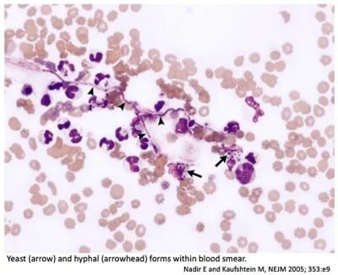
Management of candidemia
RFs for candidemia:
  Trauma and burn patients
  CVCs
  TPN
  Broad-spectrum abx
  High APACHE scores
  ARF
  Prior surgery (abdominal)
  GI tract perfs/anastamotic leaks
  Pancreatitis
  C. diff infections
Notes:
This patient with budding yeasts on blood cultures likely has candidemia, a common hospital-acquired infection that is frequently linked to central venous catheters, total parenteral nutrition, and immunocompromised states (eg, neutropenia). Clinical manifestations are myriad and range from mild fever to full-blown sepsis with or without end-organ involvement (eg, chorioretinitis, endocarditis, meningitis). Blood cultures are the gold standard for diagnosis, but sensitivity is low (~50%) so serum markers (eg, beta-D-glucan) and/or biopsy with histology are sometimes required.
Educational objective:
Candidemia is a common hospital-acquired infection and usually occurs in the setting of a central venous catheter, total parenteral nutrition, and/or an immunocompromised state (eg, neutropenia). The cornerstone of treatment is catheter removal and empiric antifungal therapy with an echinocandin (eg, caspofungin). Candida in blood cultures should never be considered a contaminant.

Slide 37
Management of candidemia
The cornerstone of treatment for candidemia is:
  Central venous catheter removal – catheter removal speeds clearance of candidemia and reduces mortality rates; it should be performed when feasible
  Empiric antifungal treatment – echinocandins such as caspofungin are first-line therapy due to excellent coverage against the most common infective species including Candida albicans, C glabrata, C tropicalis, C parapsilosis, and C krusei
Patients with candidemia should undergo ophthalmologic examination to evaluate for endophthalmitis
Candida in blood cultures should never be considered a contaminant
Notes:
In neutropenic patients, ophthalmologic exam should be deferred until the first week of neutrophil recovery; if endopthalmitis is present a prolonged course of an antifungal agent that achieves adequate intraocular concentration

Slide 38
Other answers:
A; fluconazole has excellent efficacy against C albicans, but does not adequately cover many strains of C glabrata and C krusei; changing the catheter via guidewire increases the risk of septic emboli and may result in inoculation of the new catheter
B; the catheter should be removed if possible; liposomal amphotericin B is considered a second-line agent for candidemia due to a greater risk of side effects (when compared to echinocandins)
C; catheter removal without antifungal treatment is associated with high mortality rates; treatment should not be delayed for species and susceptibility results
E; gram stain evidence of budding yeasts on blood cultures should never be considered a contaminant

Slide 39
Catheter management with blood stream infections
Removal recommended:
  Sepsis
  Hemodynamic instability
  Concomitant endocarditis or evidence of metastatic infection
  Presence of suppurative thrombophlebitis
  Presence of a propagating clot
  Persistent bacteremia after 72 hours of appropriate antimicrobial therapy
  Subcutaneously tunneled central venous catheter tunnel tract infection or subcutaneous port reservoir infection
Always remove the line:
  S. aureus
  Pseudomonas aeruginosa
  Drug-resistant GNRs
  Candida species
Consider catheter salvage therapy:
  CoNS
  Drug-susceptible Enterobacteriaceae (eg, E. coli, Klebsiella species, Enterobacter species)
Antibiotic lock therapy in addition to systemic antibiotics
Guidewire exchange = last resort!
Notes:
ALT refers to instillation of a concentrated antibiotic solution into the catheter lumen with the intention of achieving a drug level high enough to kill bacteria within the biofilm of the catheter.
Guidewire exchange of the catheter is a management approach of last resort (eg, only in patients for whom continued access is essential and alternative vascular access is absolutely impossible due to high risk for mechanical complications or bleeding during catheter reinsertion). These caveats are important since the new catheter is inserted into a likely infected tract, and removing the old catheter will seed the tract if not yet infected.

Slide 40
Question #10
A 78-year-old man was hospitalized 2 days ago for management of lower back pain that has been worsening over the past 4 weeks and remained uncontrolled with oral pain medications. He reports no radicular symptoms, weakness, or bladder or bowel incontinence. Medical history is notable for benign prostatic hyperplasia treated with tamsulosin.
On physical examination, the patient appears in distress from pain. Temperature is 37.9 °C (100.2 °F), blood pressure is 155/85 mm Hg, pulse rate is 82/min, and respiration rate is 18/min. Tenderness to palpation is elicited over the lower lumbar spine. Lower extremity strength is normal, with intact sensation and normal reflexes.
Laboratory studies show a hemoglobin level of 12.2 g/dL (122 g/L) and leukocyte count of 15,600/µL (15.6 × 10⁹/L).
MRI with contrast reveals evidence of L3-L4 discitis with osteomyelitis involving the contiguous vertebral body end plates at L3 and L4, without evidence of epidural abscess.
Blood and urine cultures are negative at 48 hours.
Which of the following is the most appropriate management?
A. Disk space aspiration/biopsy
B. Open bone biopsy
C. Vancomycin
D. Vancomycin and ceftriaxone
Notes:
Question 34

Slide 41
Question #10
A 78-year-old man was hospitalized 2 days ago for management of lower back pain that has been worsening over the past 4 weeks and remained uncontrolled with oral pain medications. He reports no radicular symptoms, weakness, or bladder or bowel incontinence. Medical history is notable for benign prostatic hyperplasia treated with tamsulosin.
On physical examination, the patient appears in distress from pain. Temperature is 37.9 °C (100.2 °F), blood pressure is 155/85 mm Hg, pulse rate is 82/min, and respiration rate is 18/min. Tenderness to palpation is elicited over the lower lumbar spine. Lower extremity strength is normal, with intact sensation and normal reflexes.
Laboratory studies show a hemoglobin level of 12.2 g/dL (122 g/L) and leukocyte count of 15,600/µL (15.6 × 10⁹/L).
MRI with contrast reveals evidence of L3-L4 discitis with osteomyelitis involving the contiguous vertebral body end plates at L3 and L4, without evidence of epidural abscess.
Blood and urine cultures are negative at 48 hours.
Which of the following is the most appropriate management?
A. Disk space aspiration/biopsy
B. Open bone biopsy
C. Vancomycin
D. Vancomycin and ceftriaxone
Notes:
Question 34

Slide 42
Evaluate vertebral osteomyelitis with needle biopsy
Initiation of antibiotic therapy for uncomplicated vertebral osteomyelitis is based on culture results
Image-guided biopsy has a diagnostic yield of approximately 60% for vertebral osteomyelitis and should be used in patients with negative blood culture results

Slide 43
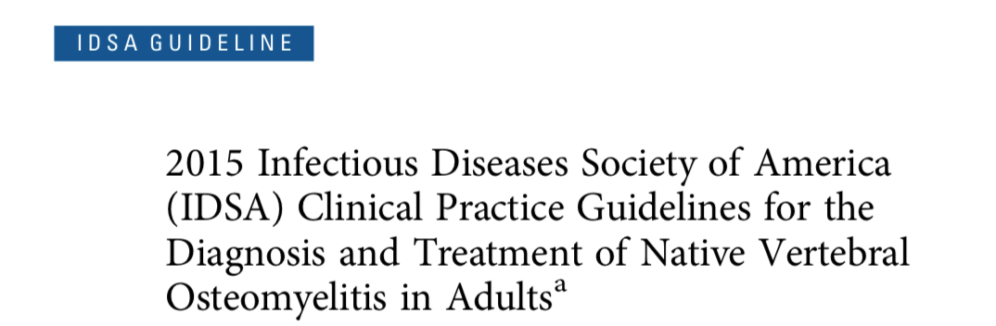
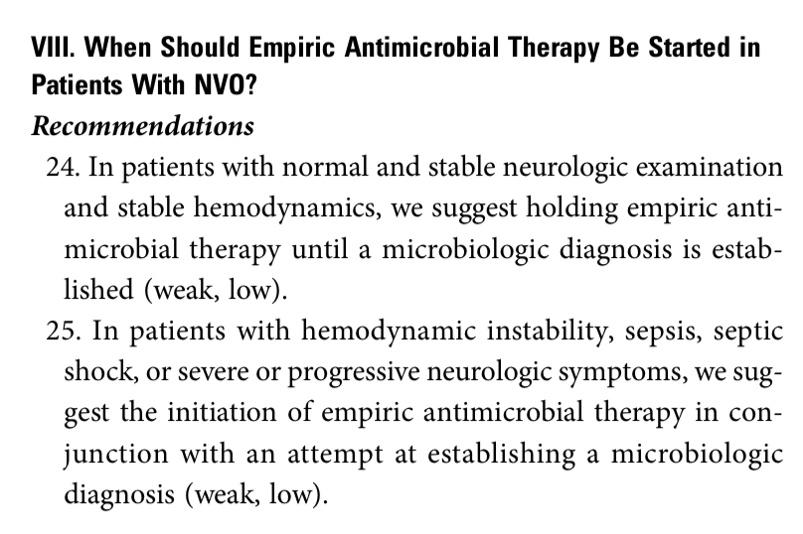
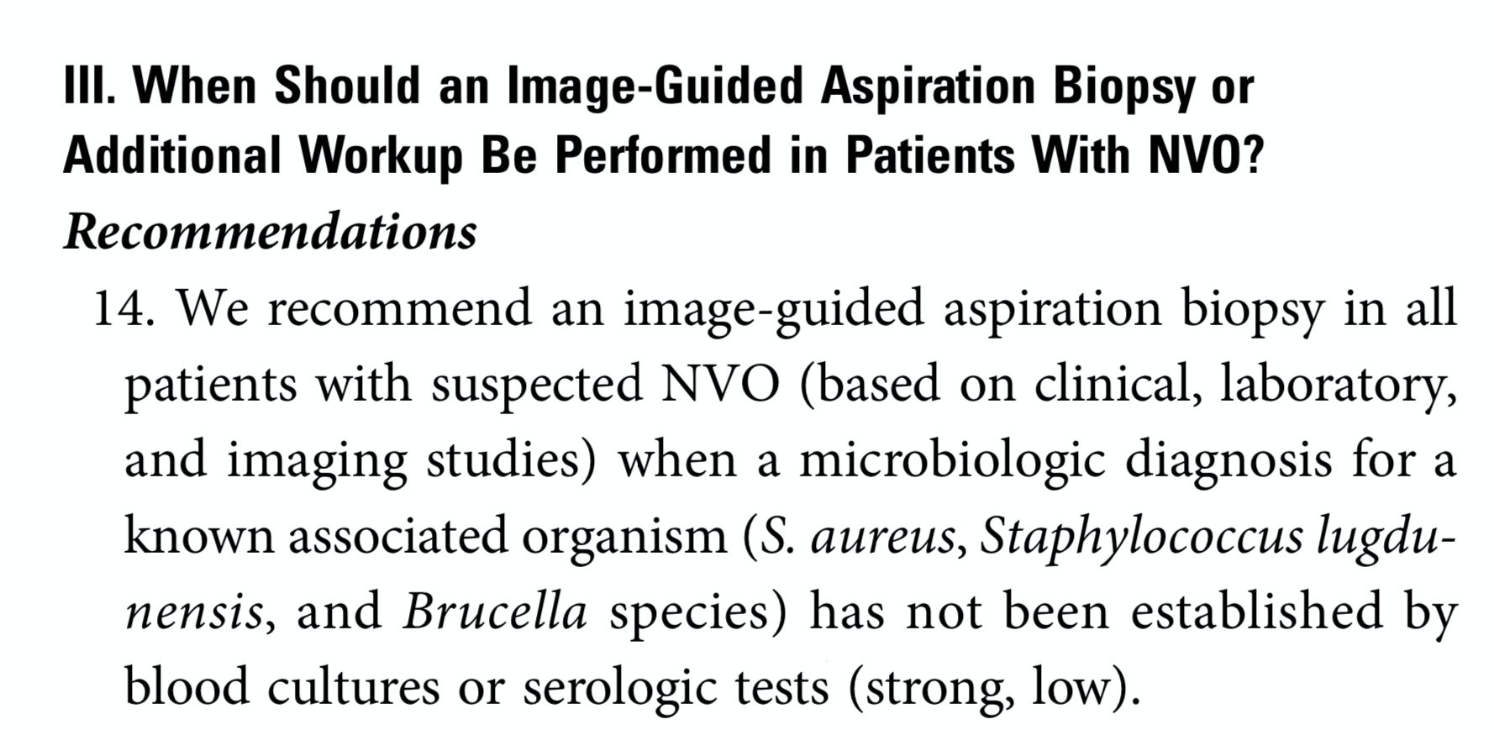
Vertebral osteomyelitis evaluation
Notes:
Really want to get a diagnosis if possible given need for long (6 weeks) abx course and desire for targeted therapy

Slide 44
Question #11
A 33-year-old woman is evaluated before hospital discharge. She was hospitalized 2 days ago with pyelonephritis; her fever, dysuria, and flank pain have improved with empiric ceftriaxone. Urine cultures have grown pan-sensitive Escherichia coli; a course of oral trimethoprim-sulfamethoxazole is planned. Medical history is unremarkable. She takes no other medications.
On physical examination, vital signs are normal. The examination is unremarkable apart from mild right flank pain, which has improved since admission.
Bacillus subtilis is isolated in one of two blood cultures drawn at admission.
Which of the following is the most appropriate management?
A. Add intravenous vancomycin
B. Add linezolid
C. Obtain transthoracic echocardiogram
D. Repeat blood cultures
E. No change in management
Notes:
ID IDMCQ24001

Slide 45
Question #11
A 33-year-old woman is evaluated before hospital discharge. She was hospitalized 2 days ago with pyelonephritis; her fever, dysuria, and flank pain have improved with empiric ceftriaxone. Urine cultures have grown pan-sensitive Escherichia coli; a course of oral trimethoprim-sulfamethoxazole is planned. Medical history is unremarkable. She takes no other medications.
On physical examination, vital signs are normal. The examination is unremarkable apart from mild right flank pain, which has improved since admission.
Bacillus subtilis is isolated in one of two blood cultures drawn at admission.
Which of the following is the most appropriate management?
A. Add intravenous vancomycin
B. Add linezolid
C. Obtain transthoracic echocardiogram
D. Repeat blood cultures
E. No change in management
Notes:
ID IDMCQ24001

Slide 46
Evaluate the significance of Bacillus in a blood culture
Blood culture contamination with skin or environmental bacteria is a common problem, leading to prolonged hospitalization, unnecessary antibiotics, and increased medical costs
Bacillus species are widespread in the environment and, in the absence of trauma, are uncommon causes of human infection
Coagulase-negative staphylococci account for more than 75% of blood culture contaminants
Other common contaminant organisms:
  Bacillus species (except for Bacillus anthracis), most coagulase-negative staphylococci (e.g., Staphylococcus epidermidis), Micrococcus species, most Corynebacterium species, or Cutibacterium acnes are grown in a single bottle or single set of blood cultures

Slide 47
Question #12
A 64-year-old man is evaluated in the emergency department for a 5-day history of fever, cough, dyspnea, and chest pain, which is worse with inspiration. He also reports nausea and vomiting. He has had no sick contacts or unusual exposures. He was assessed at an urgent care clinic 2 days ago. Chest radiograph showed left lower lobe consolidation. He was prescribed amoxicillin for community-acquired pneumonia but has not improved. Medical history is noncontributory, and he takes no other medications.
On physical examination, temperature is 38.7 °C (101.7 °F), blood pressure is 92/60 mm Hg, pulse rate is 85/min, and respiration rate is 22/min. Oxygen saturation is 91% breathing ambient air. Cardiopulmonary examination reveals crackles in the left lung base and tachycardia with a regular rhythm and no murmur.
Testing for SARS-CoV-2 and influenza virus is negative.
Repeat chest radiograph shows left lower lobe consolidation.
Which of the following is the most likely pathogen?
A. Legionella pneumophila
B. Pseudomonas aeruginosa
C. Staphylococcus aureus
D. Streptococcus pneumoniae
Laboratory studies:
Leukocyte count | 12,400/µL (12.4 × 10⁹/L) | H
Alanine aminotransferase | 126 U/L | H
Aspartate aminotransferase | 96 U/L | H
Blood urea nitrogen | 21 mg/dL (7.5 mmol/L) | H
Creatinine | 1.5 mg/dL (132.6 µmol/L) | H
Sodium | 124 mEq/L (124 mmol/L) | L
Notes:
IDMCQ24029

Slide 48
Question #12
A 64-year-old man is evaluated in the emergency department for a 5-day history of fever, cough, dyspnea, and chest pain, which is worse with inspiration. He also reports nausea and vomiting. He has had no sick contacts or unusual exposures. He was assessed at an urgent care clinic 2 days ago. Chest radiograph showed left lower lobe consolidation. He was prescribed amoxicillin for community-acquired pneumonia but has not improved. Medical history is noncontributory, and he takes no other medications.
On physical examination, temperature is 38.7 °C (101.7 °F), blood pressure is 92/60 mm Hg, pulse rate is 85/min, and respiration rate is 22/min. Oxygen saturation is 91% breathing ambient air. Cardiopulmonary examination reveals crackles in the left lung base and tachycardia with a regular rhythm and no murmur.
Testing for SARS-CoV-2 and influenza virus is negative.
Repeat chest radiograph shows left lower lobe consolidation.
Which of the following is the most likely pathogen?
A. Legionella pneumophila
B. Pseudomonas aeruginosa
C. Staphylococcus aureus
D. Streptococcus pneumoniae
Laboratory studies:
Leukocyte count | 12,400/µL (12.4 × 10⁹/L) | H
Alanine aminotransferase | 126 U/L | H
Aspartate aminotransferase | 96 U/L | H
Blood urea nitrogen | 21 mg/dL (7.5 mmol/L) | H
Creatinine | 1.5 mg/dL (132.6 µmol/L) | H
Sodium | 124 mEq/L (124 mmol/L) | L
Notes:
IDMCQ24029

Slide 49
Recognize Legionella pneumophila as a cause of community-acquired pneumonia
Aerobic gram-negative rod that causes atypical community-acquired pneumonia (CAP)
Transmitted through aerosols generated from infected soil or water and can occur sporadically or as part of an outbreak that may involve a contaminated water supply such as air conditioning units or hot tubs
Severe pneumonia with similar clinical and radiologic features to other forms of CAP
Often associated with gastrointestinal symptoms such as nausea, vomiting, and diarrhea
Lab findings of hyponatremia and elevated aminotransferase levels
Notes:
Often have high fevers
Pulm + GI sxs

Slide 50
Legionella PNA/Legionnaires’ disease
Contamination of water supplies in large facilities
1 to 10% of CAP
Whom to test:
  Moderate to severe CAP
  Any patient with CAP or nosocomial PNA with known or possible exposure
  Immunocompromised patients
How to test:
  PCR on lower respiratory tract sample (sputum or BAL)
  Culture
  Urine antigen test - only detects serogroup 1
    Culture of Legionella from patient specimens in Arizona revealed a greater proportion of non-serogroup 1 Legionella pneumophila isolates than in other U.S. isolates examined. (ASM, 2019)
Notes:
Such as hospitals, hotels or apartment buildings
American society of microbiology

Slide 51
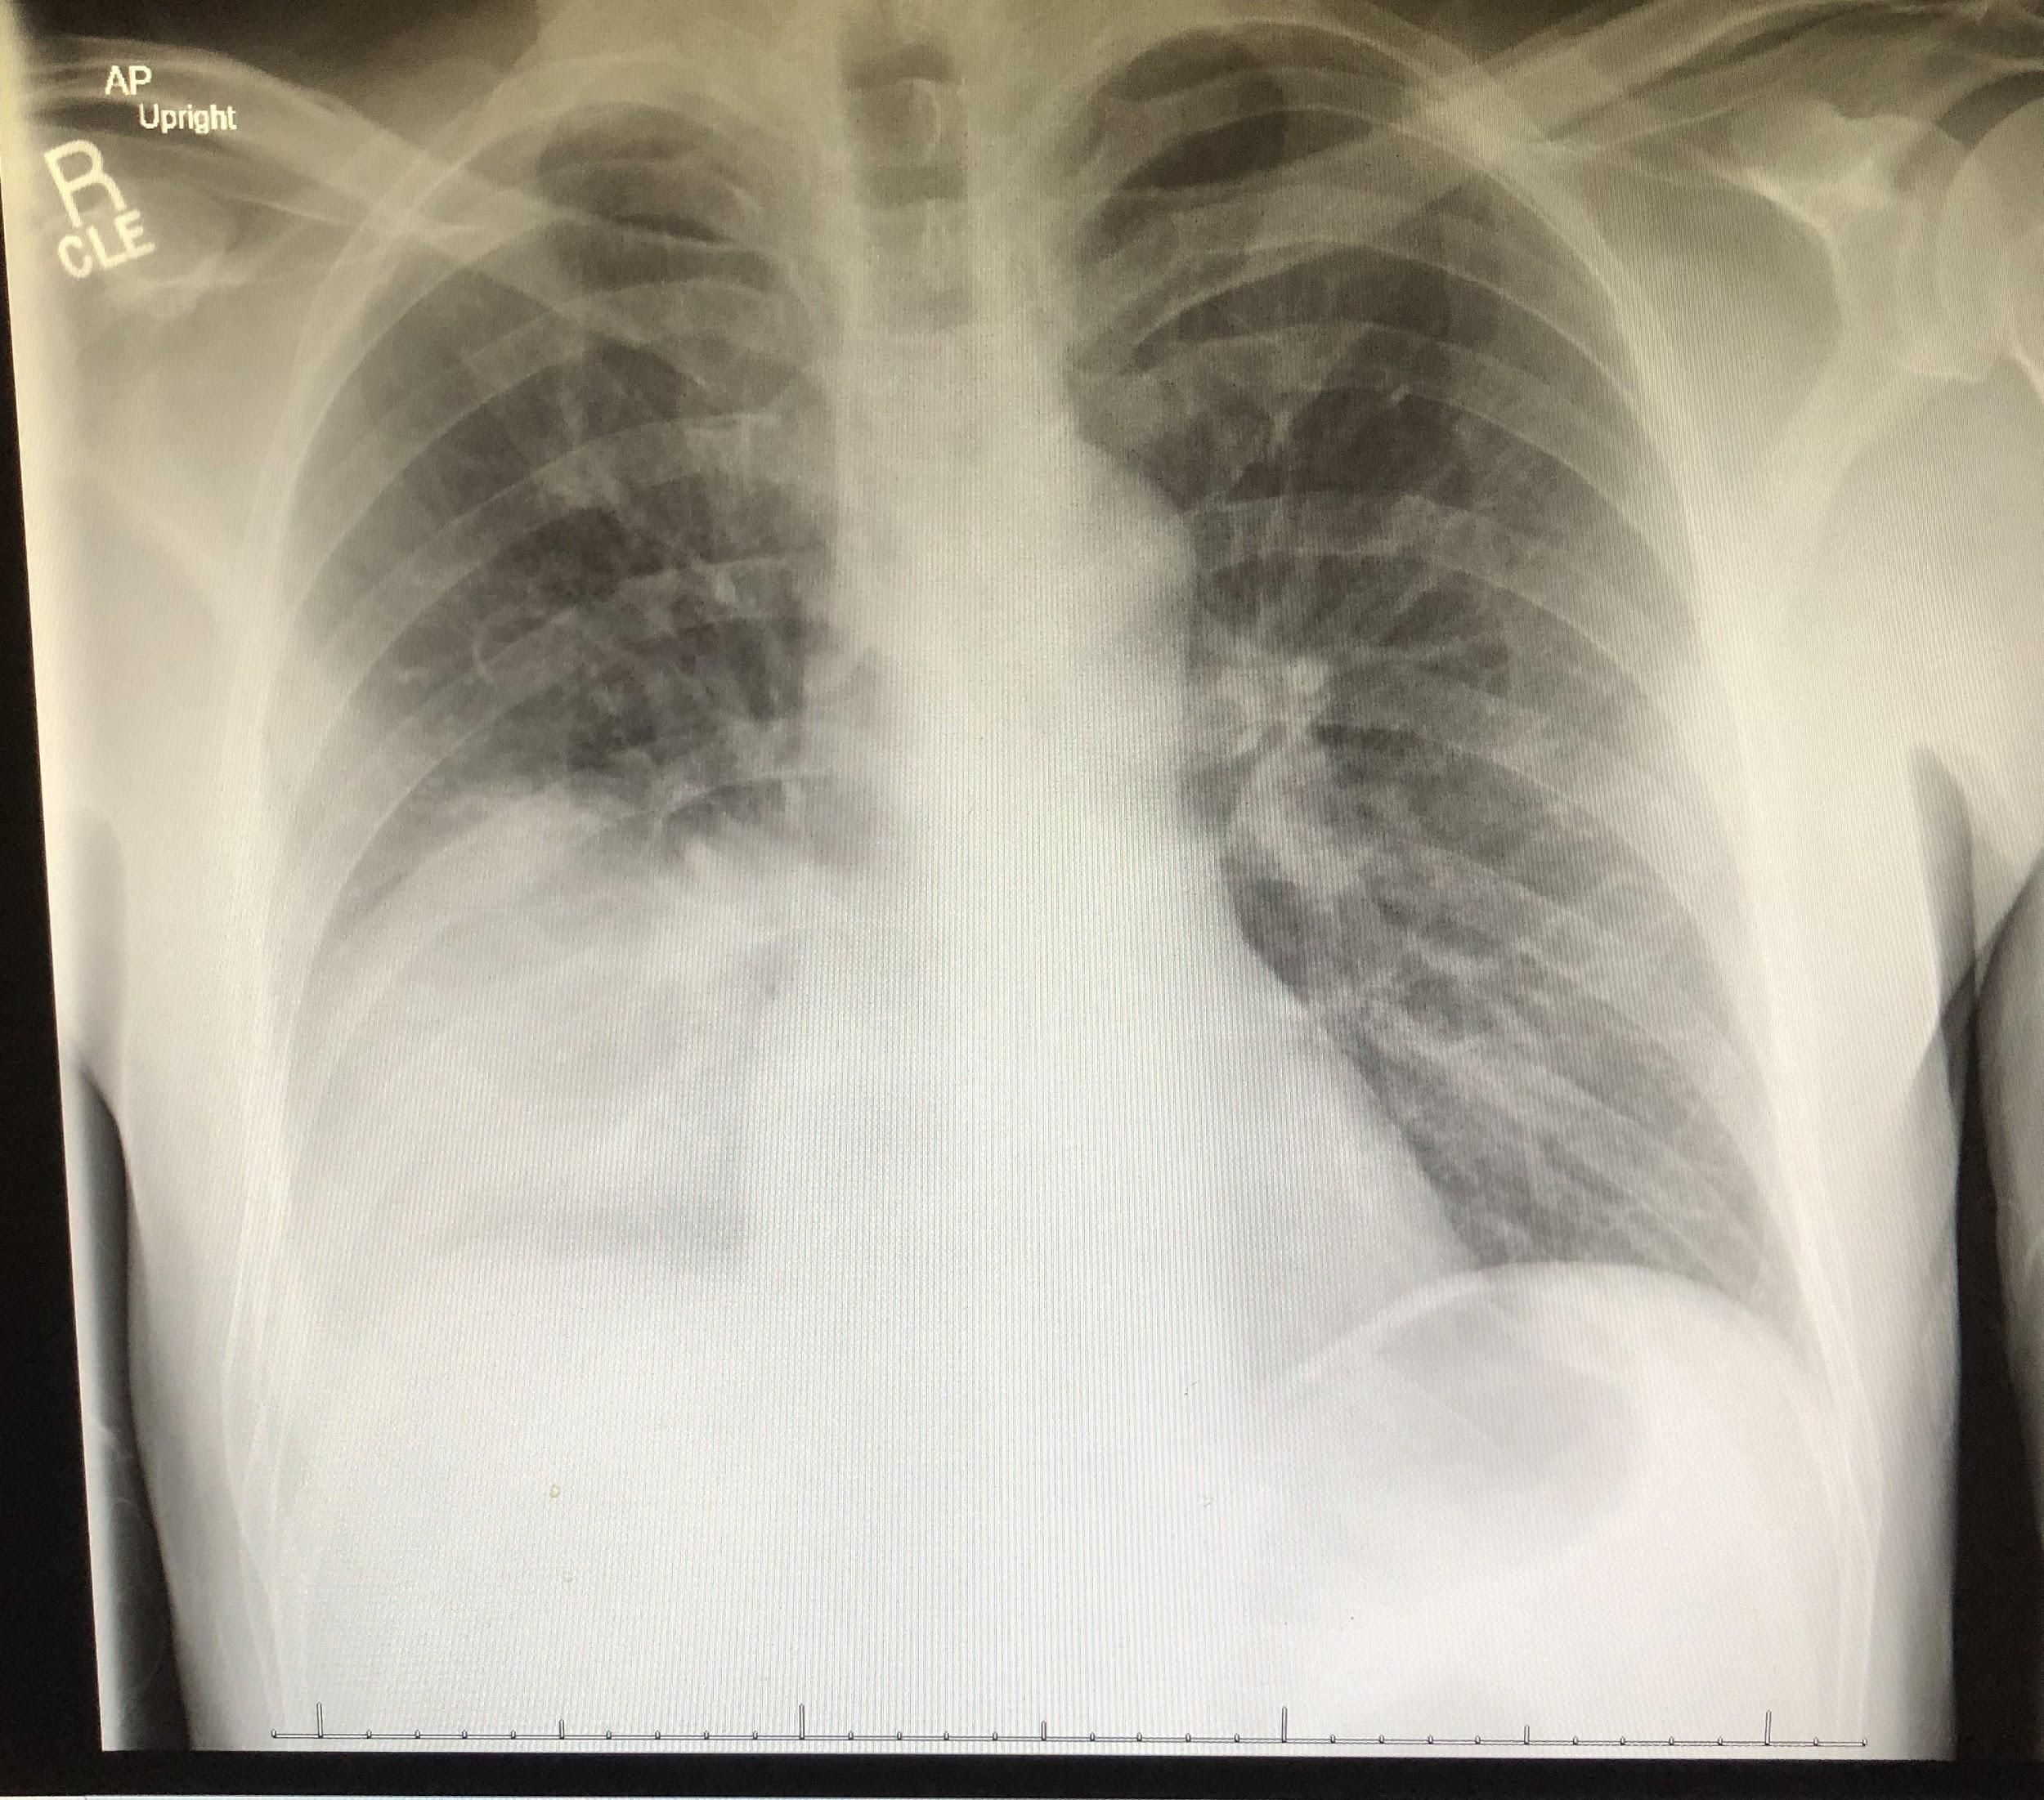
Legionella PNA/Legionnaires’ disease
Treatment:
  Levofloxacin and azithromycin are preferred agents
  Typically avoid doxycycline, as some species R to tetracyclines
  At least 5 days, afebrile for 48 hours prior to stopping, and may need 7-10 days in pts with severe PNA, comorbidities, slow to respond
  Treat immunocompromised patients for 14 days

Slide 52
Question #13
A 63-year-old man is evaluated in the emergency department for lower back pain that has progressively worsened over the past 2 weeks. He reports some difficulty with walking and describes feeling like his legs periodically “give out.” Medical history is noncontributory, and he takes no medication.
On physical examination, vital signs are normal. Palpation of the lumbar spine elicits tenderness. Strength is reduced in the right lower extremity (3/5) compared with the left.
MRI shows vertebral osteomyelitis, diskitis, and epidural abscess in the lumbar spine (L2-L3). Blood cultures are pending.
Vancomycin and ceftriaxone are started.
Which of the following is the most appropriate next step in management?
A. Image-guided percutaneous bone biopsy and aspiration
B. Physical therapy
C. Surgical decompression
D. Transesophageal echocardiography
Laboratory studies:
Erythrocyte sedimentation rate | 75 mm/h | H
Leukocyte count | 14,000/μL (14 × 10⁹/L) | H
C-reactive protein | 4.8 mg/dL (48 mg/L) | H
Notes:
IDMCQ24112

Slide 53
Question #13
A 63-year-old man is evaluated in the emergency department for lower back pain that has progressively worsened over the past 2 weeks. He reports some difficulty with walking and describes feeling like his legs periodically “give out.” Medical history is noncontributory, and he takes no medication.
On physical examination, vital signs are normal. Palpation of the lumbar spine elicits tenderness. Strength is reduced in the right lower extremity (3/5) compared with the left.
MRI shows vertebral osteomyelitis, diskitis, and epidural abscess in the lumbar spine (L2-L3). Blood cultures are pending.
Vancomycin and ceftriaxone are started.
Which of the following is the most appropriate next step in management?
A. Image-guided percutaneous bone biopsy and aspiration
B. Physical therapy
C. Surgical decompression
D. Transesophageal echocardiography
Laboratory studies:
Erythrocyte sedimentation rate | 75 mm/h | H
Leukocyte count | 14,000/μL (14 × 10⁹/L) | H
C-reactive protein | 4.8 mg/dL (48 mg/L) | H
Notes:
IDMCQ24112

Slide 54
Manage vertebral osteomyelitis with epidural abscess
The most appropriate next step in management for a patient who has vertebral osteomyelitis, an epidural abscess, and associated neurologic deficit is surgical decompression
New-onset back or neck pain or progressive worsening of chronic pain that is unresponsive to conservative management should raise concern for vertebral osteomyelitis, especially when accompanied by elevated inflammatory marker levels, focal neurologic findings, bacteremia, or unexplained fever
Neurologic findings can include sensory loss, weakness, or radiculopathy and are reported in up to one third of patients; point tenderness is present in only one third of patients
MRI with and without contrast is the preferred imaging modality to diagnose vertebral osteomyelitis; Blood cultures should be performed in all patients before antibiotics are started
Patients with neurologic compromise or spinal instability should undergo evaluation for immediate surgical intervention
Patients with severe sepsis, progressive neurologic deficit, spinal instability, or epidural abscess should receive empiric antibiotic therapy (generally vancomycin combined with a third- or fourth-generation cephalosporin)

Slide 55
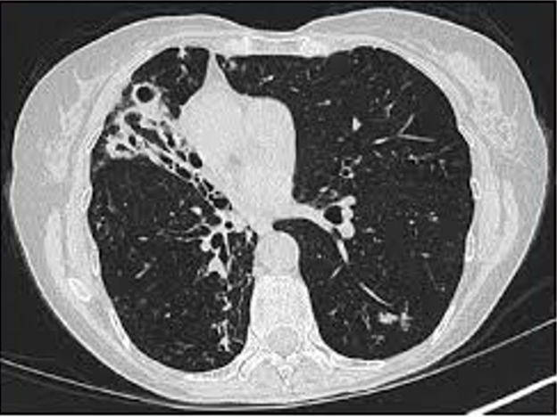
Question #14
A 75-year-old woman undergoes follow-up evaluation for a chronic cough. She has had a nonproductive cough for several years, which over the past year has become intermittently productive of sputum. She reports no hemoptysis. She has lost 2.3 kg (5.1 lb) in the past year and has occasional night sweats; she also notes significant fatigue. The patient has no other medical conditions and takes no medications.
On physical examination, vital signs are normal. BMI is 19. Pulmonary examination reveals bibasilar crackles.
Two sputum cultures are growing Mycobacterium avium complex.
A CT scan of the chest is shown.
Which of the following is the most appropriate next step in management?
A. Antibiotics
B. Bronchoscopy
C. Lung resection
D. Swallow study
E. Observation
Notes:
IDMCQ24021

Slide 56
Question #14
A 75-year-old woman undergoes follow-up evaluation for a chronic cough. She has had a nonproductive cough for several years, which over the past year has become intermittently productive of sputum. She reports no hemoptysis. She has lost 2.3 kg (5.1 lb) in the past year and has occasional night sweats; she also notes significant fatigue. The patient has no other medical conditions and takes no medications.
On physical examination, vital signs are normal. BMI is 19. Pulmonary examination reveals bibasilar crackles.
Two sputum cultures are growing Mycobacterium avium complex.
A CT scan of the chest is shown.
Which of the following is the most appropriate next step in management?
A. Antibiotics
B. Bronchoscopy
C. Lung resection
D. Swallow study
E. Observation
Notes:
IDMCQ24021

Slide 57
Manage pulmonary infection with Mycobacterium avium complex
Most common cause of nontuberculous mycobacteria lung infection worldwide
Typically occurs in older adults
Cough, fatigue, weight loss, fever, and night sweats
Two major types:
  Cavitary disease (men with underlying lung disease who smoke)
  Nodular lung disease with bronchiectasis (nonsmoking women without previous pulmonary disease)
The American Thoracic Society and Infectious Diseases Society of America criteria for diagnosis of MAC infection requires all of the following:
  Pulmonary symptoms
  Microbiologic results (M. avium isolated from more than one sputum culture)
  Characteristic radiologic findings
  Exclusion of other diagnoses
Notes:
The American Thoracic Society and Infectious Diseases Society of America criteria for diagnosis of MAC infection requires all of the following:
Pulmonary symptoms
Microbiologic results (M. avium isolated from more than one sputum culture)
Characteristic radiologic findings
Exclusion of other diagnoses
This patient fulfills these criteria. Specific antibiotic treatment should be initiated and would include azithromycin, rifampin, and ethambutol three times weekly.

Slide 58
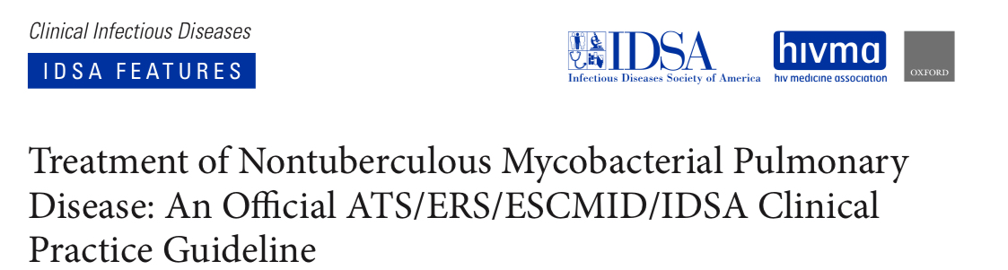
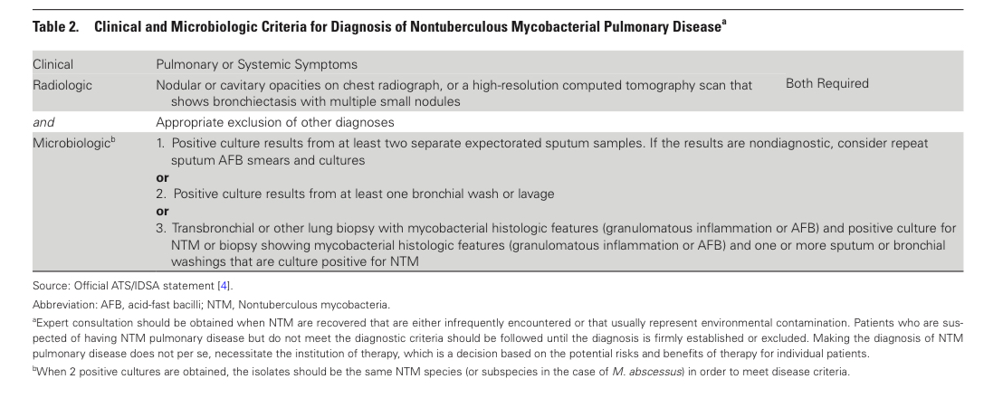

Slide 59
Question #15
A 52-year-old man is evaluated for a 3-week history of “bumps” under the skin on both outer thighs that have intermittently drained clear yellow fluid. He recently traveled internationally from his home in Nevada to undergo outpatient liposuction. He reports no fever or chills. He completed a 7-day course of trimethoprim-sulfamethoxazole without improvement.
On physical examination, vital signs are normal. Violaceous, subcutaneous, tender nodules are present bilaterally on the outer thighs over the liposuction site. A few of the nodules have started to ulcerate.
Which of the following is the most likely diagnosis?
A. Coccidioidomycosis
B. Erythema nodosum
C. Fusarium solani infection
D. Mycobacterium abscessus infection
E. Nocardia nova infection
Notes:
IDMCQ24022

Slide 60
Question #15
A 52-year-old man is evaluated for a 3-week history of “bumps” under the skin on both outer thighs that have intermittently drained clear yellow fluid. He recently traveled internationally from his home in Nevada to undergo outpatient liposuction. He reports no fever or chills. He completed a 7-day course of trimethoprim-sulfamethoxazole without improvement.
On physical examination, vital signs are normal. Violaceous, subcutaneous, tender nodules are present bilaterally on the outer thighs over the liposuction site. A few of the nodules have started to ulcerate.
Which of the following is the most likely diagnosis?
A. Coccidioidomycosis
B. Erythema nodosum
C. Fusarium solani infection
D. Mycobacterium abscessus infection
E. Nocardia nova infection
Notes:
IDMCQ24022

Slide 61
Diagnose cutaneous infection with rapidly growing mycobacteria
Mycobacterium abscessus is a rapidly growing nontuberculous mycobacteria (NTM)
Cutaneous NTM infections are associated with subacute development of painful subcutaneous nodules that often have purplish discoloration
Nodules often appear 1 to 3 weeks after exposure
Association with medical tourism and pedicures has been well documented
Typical skin lesions in setting of typical exposure should prompt further evaluation with skin biopsy for acid-fast bacilli culture

Slide 62
Question #16
A 75-year-old M with progressive dementia presents with red eyes and photophobia. He denies other neurologic symptoms including frequent falls, pain, and weakness. He has been sexually active with multiple partners since his wife died 20 years ago. He denies fevers or chills and has no medication allergies.
Other than his conjunctival erythema, his physical exam is normal.
A CBC and CMP are within normal limits, an HIV test is negative, a treponemal antibody test is positive, and a serum RPR titer is 1:32. Examination of the CSF reveals a leukocyte count of 25 per mm³ (100% lymphocytes) and a protein level of 67 mg/dL. A VDRL test of the CSF is positive.
Which of the following treatments is most appropriate for this patient?
A. IV ceftriaxone for 10-14 days
B. Oral doxycycline for 10 days
C. IV aqueous crystalline penicillin G for 10-14 days
D. Oral amoxicillin for 10-14 days
E. Intramuscular benzathine penicillin once a week for 3 weeks
Notes:
AMBOSS

Slide 63
Question #16
A 75-year-old M with progressive dementia presents with red eyes and photophobia. He denies other neurologic symptoms including frequent falls, pain, and weakness. He has been sexually active with multiple partners since his wife died 20 years ago. He denies fevers or chills and has no medication allergies.
Other than his conjunctival erythema, his physical exam is normal.
A CBC and CMP are within normal limits, an HIV test is negative, a treponemal antibody test is positive, and a serum RPR titer is 1:32. Examination of the CSF reveals a leukocyte count of 25 per mm³ (100% lymphocytes) and a protein level of 67 mg/dL. A VDRL test of the CSF is positive.
Which of the following treatments is most appropriate for this patient?
A. IV ceftriaxone for 10-14 days
B. Oral doxycycline for 10 days
C. IV aqueous crystalline penicillin G for 10-14 days
D. Oral amoxicillin for 10-14 days
E. Intramuscular benzathine penicillin once a week for 3 weeks

Slide 64
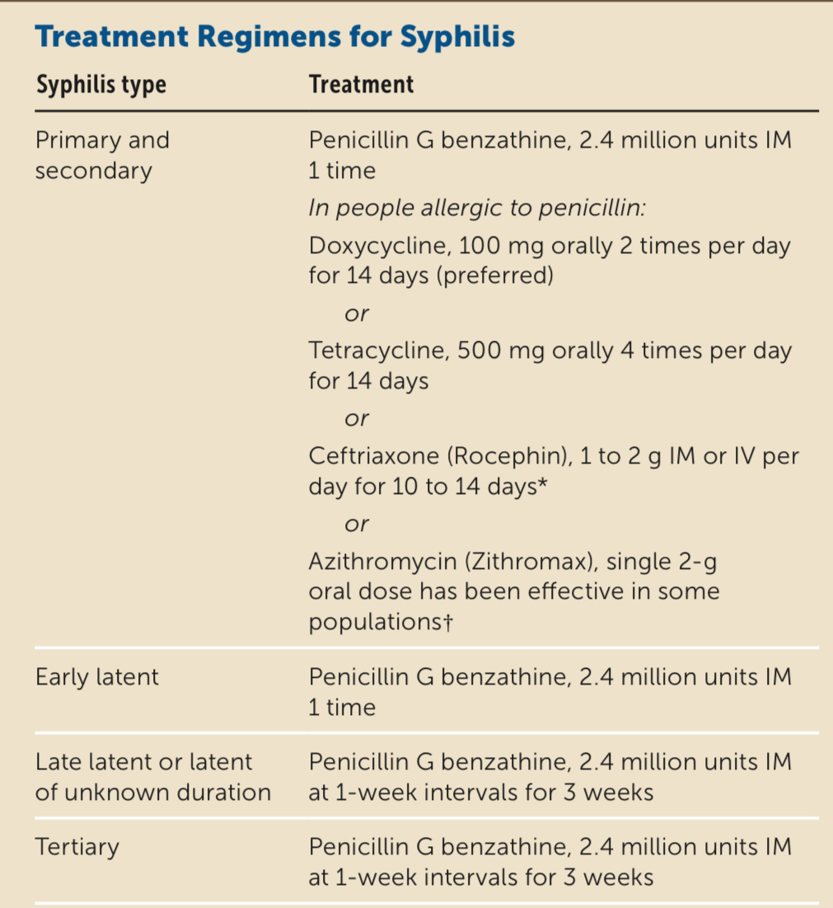
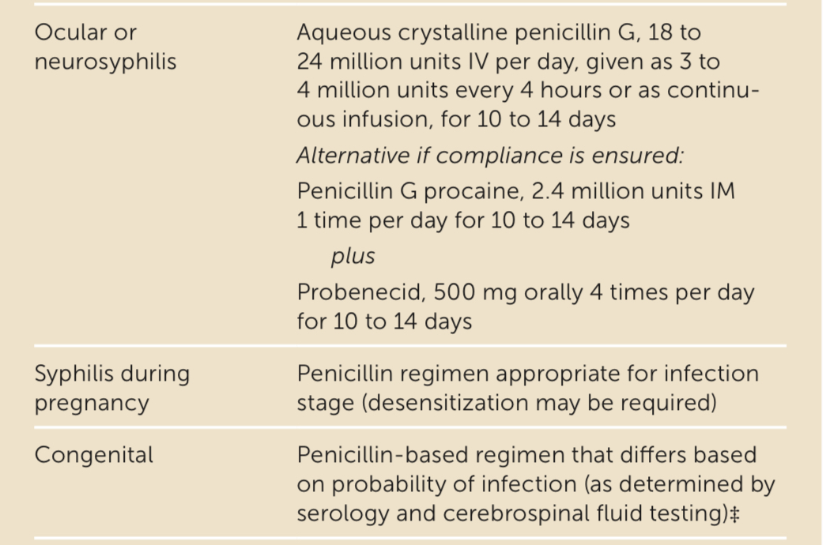
Treatment of syphilis based on stage

Slide 65
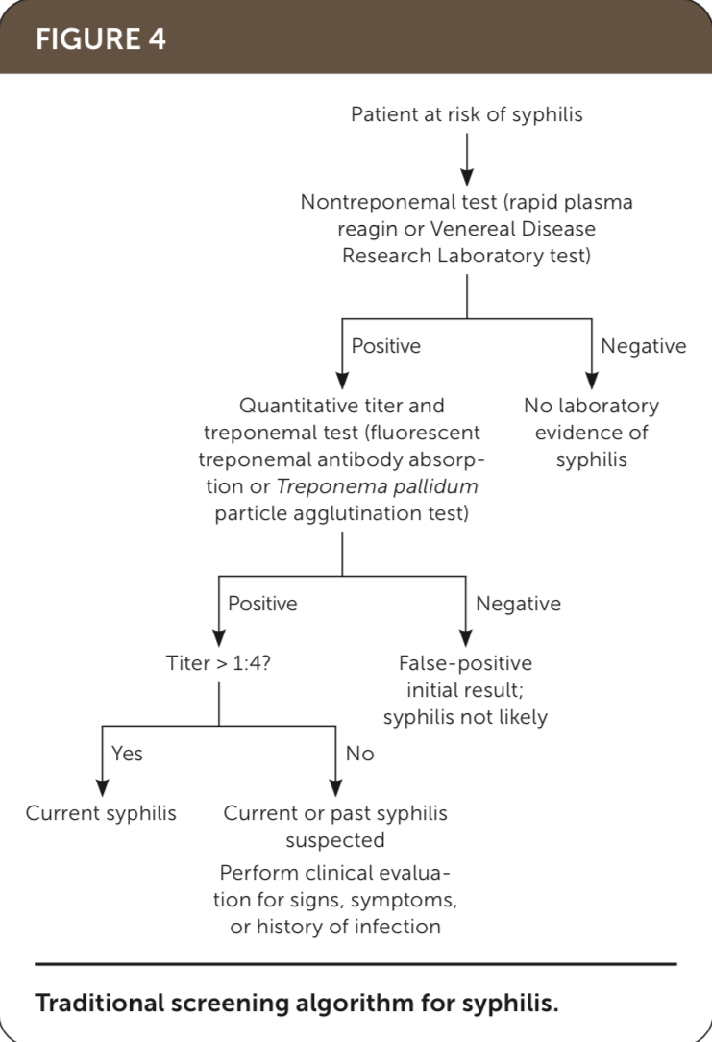
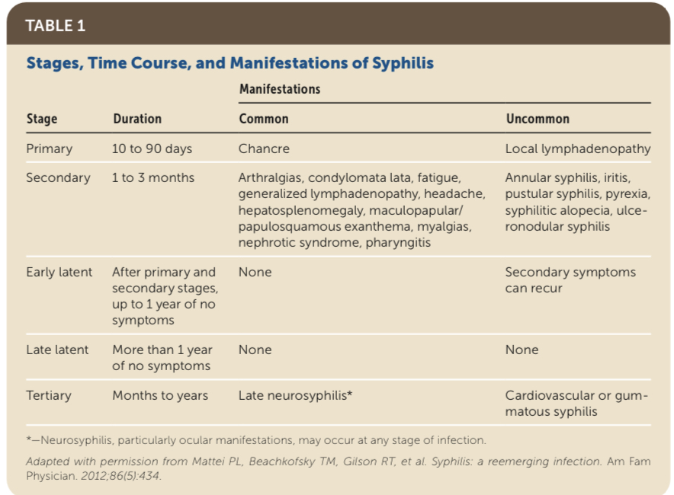
Clinical manifestations and screening
Am Fam Physician. 2020 Jul 15; 102(2):91-98.
Notes:
AAFP article from 2020
Remember the treponemal tests remain positive indefinitely and cannot be used to detect reinfection.
This is the traditional approach, but the reverse approach can be used and may be preferred in high risk populations; initial treponemal test followed by non for reactive samples

Slide 66
Syphilis treatment
Penicillin G is first line therapy for all patients
In patients with neurosyphilis, ocular syphilis, otosyphilis, and/or during pregnancy, initiate allergen desensitization and treat with penicillin in setting of confirmed PCN allergy
  For other patients, consider doxycycline or ceftriaxone
Evaluate and treat sexual partners

Slide 67
Question #17
A 40-year-old man seeks treatment following a positive HIV test. Medical history is otherwise noncontributory, and he takes no medications.
On physical examination, vital signs and the remainder of the examination are normal.
HIV quantitative RNA is 500,000 copies/mL and CD4 cell count is 45/µL.
In addition to antiretroviral therapy initiation, which of the following is the most appropriate prophylactic treatment?
A. Azithromycin
B. Fluconazole
C. Trimethoprim-sulfamethoxazole
D. No additional management
Notes:
Question 104

Slide 68
Question #17
A 40-year-old man seeks treatment following a positive HIV test. Medical history is otherwise noncontributory, and he takes no medications.
On physical examination, vital signs and the remainder of the examination are normal.
HIV quantitative RNA is 500,000 copies/mL and CD4 cell count is 45/µL.
In addition to antiretroviral therapy initiation, which of the following is the most appropriate prophylactic treatment?
A. Azithromycin
B. Fluconazole
C. Trimethoprim-sulfamethoxazole
D. No additional management
Notes:
Question 104

Slide 69
Prevent opportunistic infection in a patient with AIDS
PJP prophylaxis when CD4 count < 200/µL
  TMP-SMX one DS or SS tab daily
  Dapsone – G6PD
  INH pentamidine – less effective
  Atovaquone
Toxoplasmosis when CD4 count < 100/µL and positive serology
  TMP-SMX one DS tab daily
MAC
  No longer indicated in setting of quick ART initiation; use azithro if unable to start ART and CD4 <50/µL
Stop PJP prophylaxis once CD4 > 200/µL for at least 3 months or once CD4 > 100/µL + consistent virologic suppression > 3 months
Notes:
Previously when CD4 <50, azithromycin used
When do we stop PJP prophy

Slide 70
Question #18
A 52-year-old woman is evaluated for a 1-month history of fever, malaise, and weight loss. She has a history of cardiomyopathy, for which she received a heart transplant 5 years ago; 3 months ago, an episode of rejection occurred, and high-dose glucocorticoids were initiated. At the time of transplantation, studies were significant for donor seropositivity for Epstein-Barr virus and cytomegalovirus; the patient was negative for both. Medications are tacrolimus, mycophenolate mofetil, prednisone, and trimethoprim-sulfamethoxazole.
On physical examination, temperature is 37.7 °C (99.9 °F), and other vital signs are normal. Cervical lymphadenopathy is noted. The remainder of the examination is unremarkable.
CT scan of the chest shows an anterior mediastinal mass.
Which of the following infections is the most likely cause of the patient's findings?
A. Adenovirus
B. Epstein-Barr virus
C. Escherichia coli
D. Pneumocystis jirovecii
Notes:
Question 76

Slide 71
Question #18
A 52-year-old woman is evaluated for a 1-month history of fever, malaise, and weight loss. She has a history of cardiomyopathy, for which she received a heart transplant 5 years ago; 3 months ago, an episode of rejection occurred, and high-dose glucocorticoids were initiated. At the time of transplantation, studies were significant for donor seropositivity for Epstein-Barr virus and cytomegalovirus; the patient was negative for both. Medications are tacrolimus, mycophenolate mofetil, prednisone, and trimethoprim-sulfamethoxazole.
On physical examination, temperature is 37.7 °C (99.9 °F), and other vital signs are normal. Cervical lymphadenopathy is noted. The remainder of the examination is unremarkable.
CT scan of the chest shows an anterior mediastinal mass.
Which of the following infections is the most likely cause of the patient's findings?
A. Adenovirus
B. Epstein-Barr virus
C. Escherichia coli
D. Pneumocystis jirovecii
Notes:
Question 76

Slide 72
Diagnose EBV-related PTLD
EBV-driven (most of the time)
Risk factors:
  Degree of immunosuppression
  EBV serologic status of the recipient
  Other RFs: age, time post-transplant, ethnicity
> 80% occur in the first year after transplant (intestinal/multiorgan > lung > heart > kidney > liver)
Weight loss, mediastinal mass
Treatment: reduction of immunosuppression +/- rituximab; chemo and radiation can also be used
Prognosis variable; though published series suggest overall survival rates b/w 25 and 35%
Notes:
Diagnose Epstein-Barr virus–related posttransplant lymphoproliferative disorder
Younger and white populations
Her history of weight loss and presence of a mediastinal mass on imaging is also worrisome for malignancy. It is likely that she acquired primary EBV infection from the donated heart in the first year after transplantation, which may have presented as a mononucleosis-like syndrome. Afterward, intensification of ongoing immunosuppression would be the most significant factor in development of PTLD related to EBV infection. A substantial increase in the EBV viral load supports the diagnosis, which can be confirmed with tissue biopsy of the mediastinal mass or involved lymph nodes. Management of EBV-related complications, including PTLD, focuses primarily on reducing immunosuppression; antiviral therapy is not effective. Late-onset PTLD can also be EBV negative

Slide 73
Question #19
A 40-year-old man presents to the emergency department with a 2-day history of diarrhea occurring six times daily that developed 1 week after completing a course of amoxicillin-clavulanate for diverticulitis. Medical history is unremarkable, and he takes no medications.
On physical examination, temperature is 38.3 °C (100.9 °F); other vital signs are normal. Bowel sounds are present; palpation elicits tenderness but no guarding.
Laboratory studies show a leukocyte count of 17,000/µL (17 × 10⁹/L) and serum creatinine level of 1.6 mg/dL (141 µmol/L).
Stool testing for Clostridioides difficile is positive.
Which of the following is the most appropriate treatment?
A. Intravenous metronidazole
B. Oral fidaxomicin
C. Oral vancomycin and rectal vancomycin
D. Tapered and pulsed vancomycin

Slide 74
Question #19
A 40-year-old man presents to the emergency department with a 2-day history of diarrhea occurring six times daily that developed 1 week after completing a course of amoxicillin-clavulanate for diverticulitis. Medical history is unremarkable, and he takes no medications.
On physical examination, temperature is 38.3 °C (100.9 °F); other vital signs are normal. Bowel sounds are present; palpation elicits tenderness but no guarding.
Laboratory studies show a leukocyte count of 17,000/µL (17 × 10⁹/L) and serum creatinine level of 1.6 mg/dL (141 µmol/L).
Stool testing for Clostridioides difficile is positive.
Which of the following is the most appropriate treatment?
A. Intravenous metronidazole
B. Oral fidaxomicin
C. Oral vancomycin and rectal vancomycin
D. Tapered and pulsed vancomycin

Slide 75
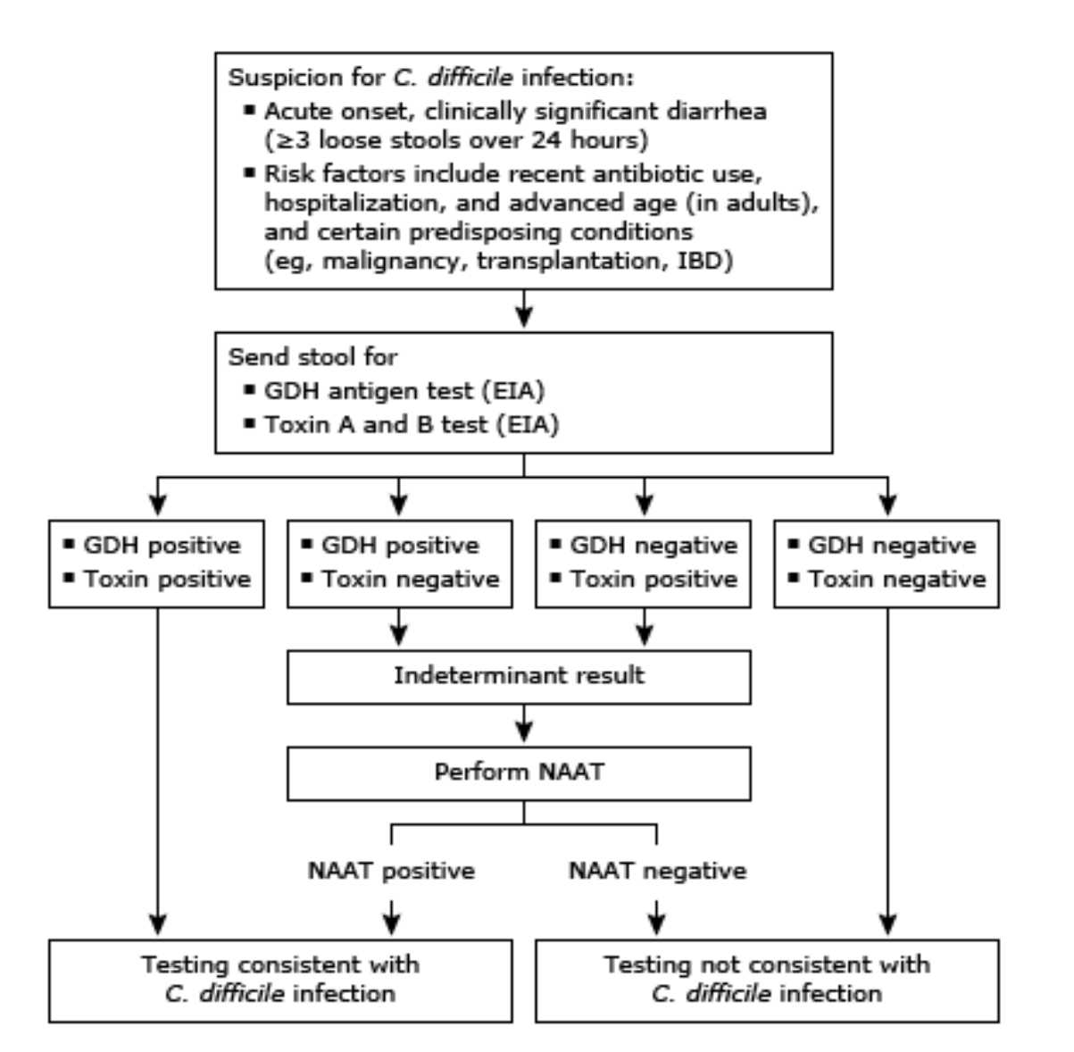
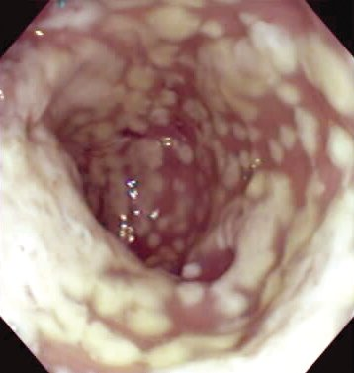
Treat first episode of severe c. diff infection

Slide 76
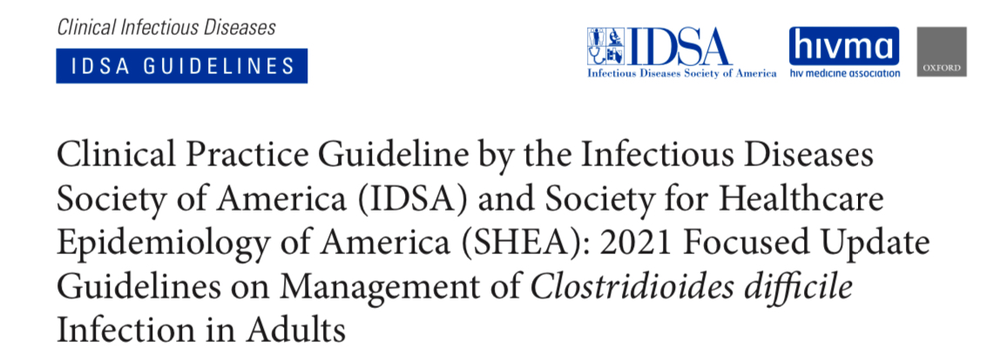
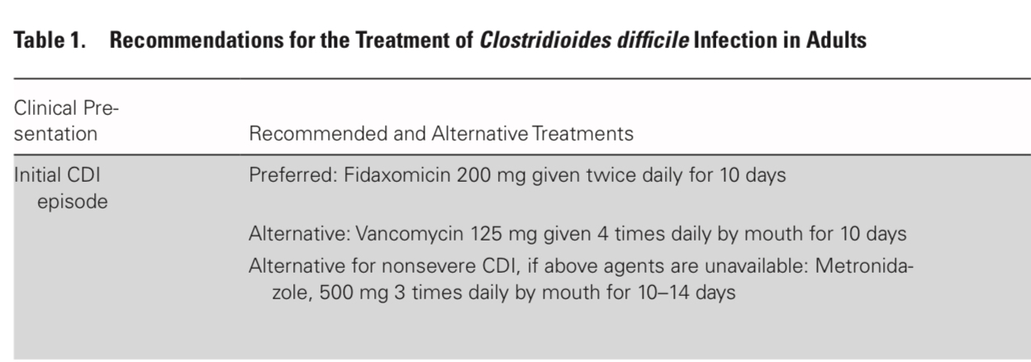
C. diff treatment

Slide 77
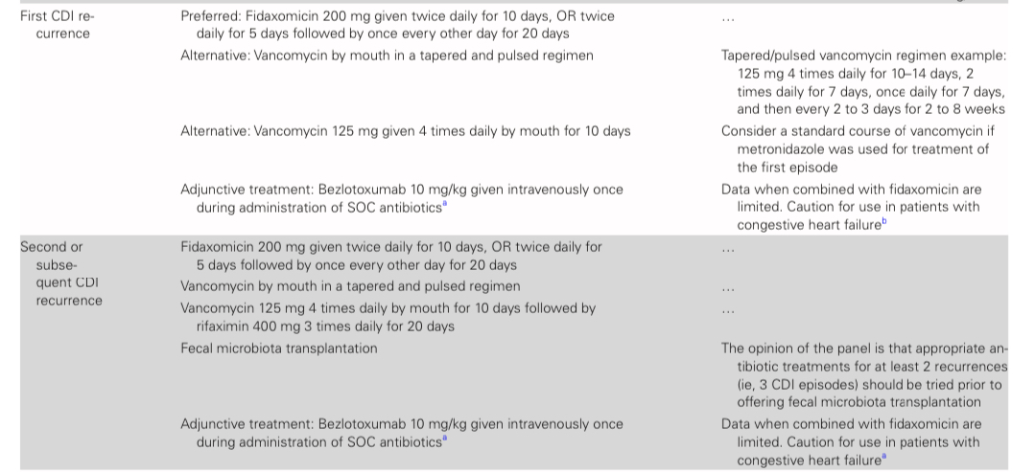
Recurrence
Notes:
Fulminant – vanco (oral +/- rectal vanco if ileus present + IV metro 500 q8h
Hypotension, megacolon, ileus

Slide 78
Question #20
An 88-year-old woman is evaluated in the emergency department in January for a 1-day history of fever, nasal congestion, cough, and severe shortness of breath. She resides in a skilled nursing facility. She received a seasonal influenza vaccination 5 months ago. She has type 2 diabetes mellitus and COPD. Her medications are metformin, tiotropium, and formoterol.
On physical examination, temperature is 39.0 °C (102.2 °F), blood pressure is 130/88 mm Hg, pulse rate is 96/min, and respiration rate is 20/min. Oxygen saturation is 86% breathing ambient air; supplemental oxygen is initiated. Rhinorrhea and bibasilar crackles are present.
Rapid antigen for influenza and SARS-CoV-2 are negative. Polymerase chain reaction is pending.
Chest radiograph shows new bibasilar opacities consistent with pneumonia.
Ceftriaxone and azithromycin are started.
In addition to hospitalization, which of the following is the most appropriate next step in management?
A. Inhaled zanamivir
B. Oral baloxavir
C. Oral oseltamivir
D. No treatment
Notes:
IDMCQ24063

Slide 79
Question #20
An 88-year-old woman is evaluated in the emergency department in January for a 1-day history of fever, nasal congestion, cough, and severe shortness of breath. She resides in a skilled nursing facility. She received a seasonal influenza vaccination 5 months ago. She has type 2 diabetes mellitus and COPD. Her medications are metformin, tiotropium, and formoterol.
On physical examination, temperature is 39.0 °C (102.2 °F), blood pressure is 130/88 mm Hg, pulse rate is 96/min, and respiration rate is 20/min. Oxygen saturation is 86% breathing ambient air; supplemental oxygen is initiated. Rhinorrhea and bibasilar crackles are present.
Rapid antigen for influenza and SARS-CoV-2 are negative. Polymerase chain reaction is pending.
Chest radiograph shows new bibasilar opacities consistent with pneumonia.
Ceftriaxone and azithromycin are started.
In addition to hospitalization, which of the following is the most appropriate next step in management?
A. Inhaled zanamivir
B. Oral baloxavir
C. Oral oseltamivir
D. No treatment
Notes:
IDMCQ24063

Slide 80
Treat influenza in a patient at high risk
IDSA guidelines recommend initiating antiviral treatment as soon as possible for adults with documented or suspected influenza who are hospitalized and for outpatients with severe or progressive illness regardless of illness duration
Diagnosis:
  Rapid antigen tests
    Sensitivity between 59% and 93%
    High specificity
  PCR rests
    Sensitivity nearly 100%
    High specificity

Slide 81
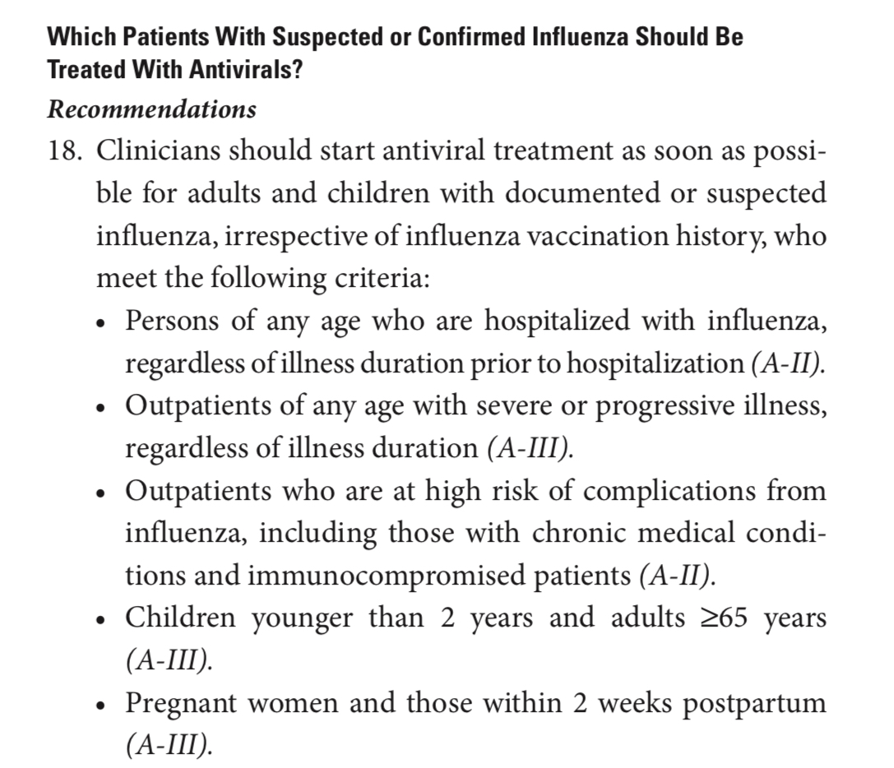
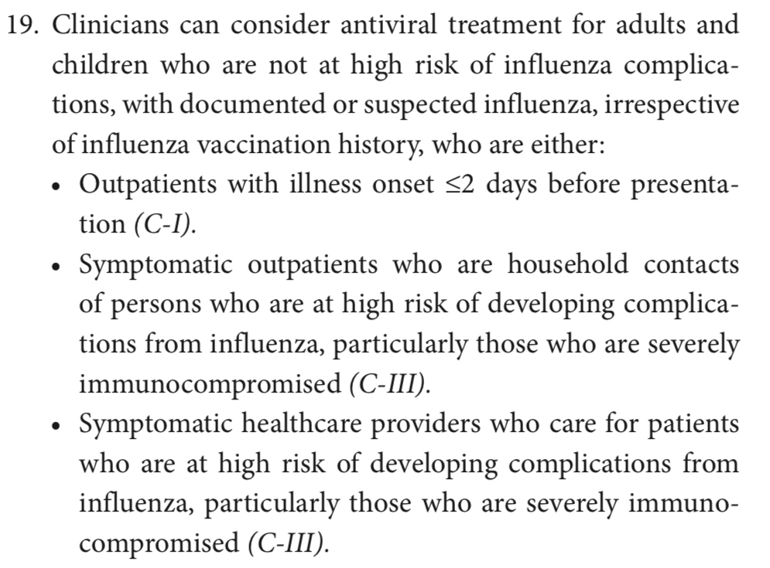
IDSA Guidelines

