Slide 1
GI/Hep Test Review
Lise Harper, MD MPH
1/27/2026

Slide 2
Q1
A 58-year-old woman is hospitalized for dyspnea due to recurrent right-sided pleural effusion. She has autoimmune hepatitis with cirrhosis. Findings on previous thoracenteses during the past 3 months were consistent with hepatic hydrothorax. She has received escalating doses of diuretics for the past year and adhered to a sodium-restricted diet. Medications are furosemide, spironolactone, carvedilol, and azathioprine.
On physical examination, blood pressure is 100/65 mm Hg, pulse rate is 60/min, and respiration rate is 20/min. Oxygen saturation is 92% with the patient breathing ambient air. She is alert and oriented. There are no signs of asterixis. She has decreased breath sounds on the right side. Her abdomen is soft and nondistended.
Labs: Sodium 130 mEq/L
Model for End-Stage Liver Disease (MELD) 3.0 score is 10.
Chest radiograph demonstrates a large right-sided pleural effusion.
Pleural fluid studies: ANC 100/𝛍L, culture negative
Ultrasound shows a nodular liver surface with a round edge and hypoechoic nodules in the liver parenchyma, as well as slight perihepatic ascites. Echocardiogram shows normal cardiac function.
Which of the following is the most appropriate next step in management?
  A. Fluid restriction
  B. Indwelling chest tube
  C. Large-volume paracentesis
  D. Transjugular intrahepatic portosystemic shunt

Slide 3
Q1
A 58-year-old woman is hospitalized for dyspnea due to recurrent right-sided pleural effusion. She has autoimmune hepatitis with cirrhosis. Findings on previous thoracenteses during the past 3 months were consistent with hepatic hydrothorax. She has received escalating doses of diuretics for the past year and adhered to a sodium-restricted diet. Medications are furosemide, spironolactone, carvedilol, and azathioprine.
On physical examination, blood pressure is 100/65 mm Hg, pulse rate is 60/min, and respiration rate is 20/min. Oxygen saturation is 92% with the patient breathing ambient air. She is alert and oriented. There are no signs of asterixis. She has decreased breath sounds on the right side. Her abdomen is soft and nondistended.
Labs: Sodium 130 mEq/L
Model for End-Stage Liver Disease (MELD) 3.0 score is 10.
Chest radiograph demonstrates a large right-sided pleural effusion.
Pleural fluid studies: ANC 100/𝛍L, culture negative
Ultrasound shows a nodular liver surface with a round edge and hypoechoic nodules in the liver parenchyma, as well as slight perihepatic ascites. Echocardiogram shows normal cardiac function.
Which of the following is the most appropriate next step in management?
  A. Fluid restriction
  B. Indwelling chest tube
  C. Large-volume paracentesis
  D. Transjugular intrahepatic portosystemic shunt

Slide 4
Treat refractory hepatic hydrothorax
HH
  Transudative pleural effusion
  SAAG >1.1 g/dL; originates in the peritoneal cavity, drawn into pleural space through diaphragmatic defects by negative intrathoracic pressure with inspiration
  Prevalence of HH in cirrhosis 4-12%
    Right side 73%
    Left side 17%
    Bilateral 10%
  9% do not have clinical ascites
Initial management
  Na restriction
  Diuretics
TIPS/LT
Notes:
AASLD guidelines

Slide 5
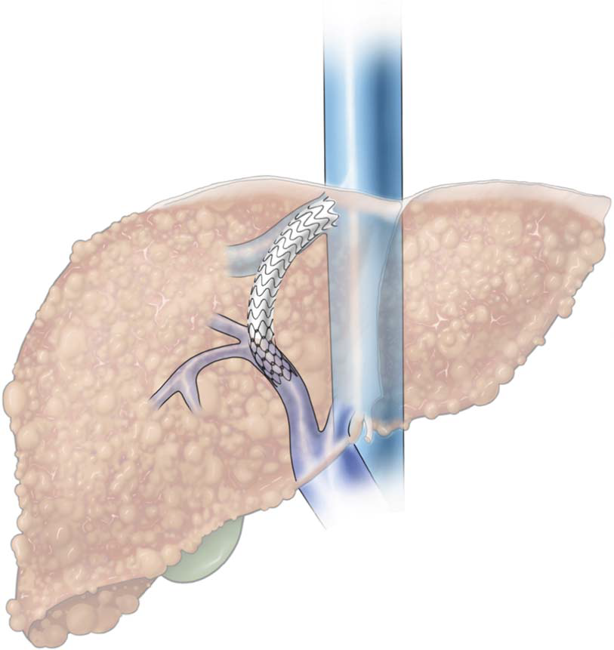
TIPS
Indications
  Refractory ascites/HH
  Variceal hemorrhage
Contraindications
  Congestive heart failure (stage C or D, EF <50%)
  PAH
  Severe uncontrolled hepatic encephalopathy
  Systemic infection or sepsis
Notes:
MELD > 18 have a higher risk of mortality at 3 months after TIPS than those with MELD <18

Slide 6
AASLD guidance statement on HH
First‐line therapy of HH consists of dietary sodium restriction and diuretics plus
thoracentesis as required
TIPS can be considered in selected patients as a second‐line treatment for refractory HH
Chest tube insertion for HH should be avoided, but indwelling tunneled catheters
may be considered in carefully selected patients who do not respond to medical therapy and are not candidates for TIPS
Patients with HH should be considered for LT

Slide 7
Other answers
A; fluid restriction is not routinely indicated in the management of hepatic hydrothorax and should be avoided in this patient; consider in patients with severe hyponatremia (serum sodium <125 mEq/L [125 mmol/L])
B; an indwelling chest tube should be avoided unless it is used for palliative indications or management of empyema
C; large-volume paracentesis is not indicated because of scant perihepatic ascites on imaging and no overt abdominal distention on examination

Slide 8
Q2
A 64-year-old woman is evaluated for confusion and abdominal pain. She has alcoholic cirrhosis with portal hypertension and ascites. Medications are carvedilol, spironolactone, and furosemide.
Temperature is 37.8 °C (100.0 °F), and pulse rate is 78/min. Her abdomen is distended with ascites and tender to palpation. Diagnostic paracentesis shows an ascitic-fluid neutrophil count of 262/µL (0.262 × 10⁹/L) and a total protein level of 0.9 g/dL (9.0 g/L). Gram stain is negative.
Which of the following is the most appropriate initial management?
  A. Begin ceftriaxone
  B. Begin ceftriaxone plus albumin
  C. Hold antibiotics pending culture and sensitivity results
  D. Start piperacillin-tazobactam

Slide 9
Q2
A 64-year-old woman is evaluated for confusion and abdominal pain. She has alcoholic cirrhosis with portal hypertension and ascites. Medications are carvedilol, spironolactone, and furosemide.
Temperature is 37.8 °C (100.0 °F), and pulse rate is 78/min. Her abdomen is distended with ascites and tender to palpation. Diagnostic paracentesis shows an ascitic-fluid neutrophil count of 262/µL (0.262 × 10⁹/L) and a total protein level of 0.9 g/dL (9.0 g/L). Gram stain is negative.
Which of the following is the most appropriate initial management?
  A. Begin ceftriaxone
  B. Begin ceftriaxone plus albumin
  C. Hold antibiotics pending culture and sensitivity results
  D. Start piperacillin-tazobactam

Slide 10
Treat spontaneous bacterial peritonitis
Antibiotics
  3rd generation cephalosporins
    Ceftriaxone, Cefotaxime
  MDROs
Assess for improvement
  Repeat tap in ~48 hrs
  Treatment failure
  5-7 days of IV abx -> SBP prophy
Bacterascites (with ANC < 250/mm³) -> do not treat, repeat tap
Albumin
  AKI is the main predictor of mortality in pts with SBP
  Improves survival and decreases risk of AKI/HRS
  1.5 gm/kg on day 1 and 1 gm/kg on day 3
Notes:
A negative response is defined by a decrease in PMN count <25% from baseline and should lead to broadening the antibiotic spectrum and investigating secondary peritonitis (abdominal imaging studies).

Slide 11
SBP
Symptoms/signs specific to SBP:
  Abdominal pain, tenderness on palpation (with or without rebound tenderness), and ileus
  Up to 1/3 of the patients with spontaneous infections may be entirely asymptomatic or present with only encephalopathy and/or AKI
Diagnosis:
  ANC > 250/mm³
  Bedside culture inoculation improves yield
A diagnostic paracentesis should be performed as soon as a patient with cirrhosis and ascites is hospitalized emergently for any reason, even in the absence of symptoms suggestive of infection or whenever a patient (hospitalized or not) develops signs suggestive of infection
In patients with tense ascites and AKI, a diagnostic paracentesis is recommended to exclude SBP as a cause of the AKI
If pleural effusion is present, a diagnostic thoracentesis should be performed when there is no ascites or when diagnostic paracentesis has ruled out SBP while bacterial infection is suspected

Slide 12
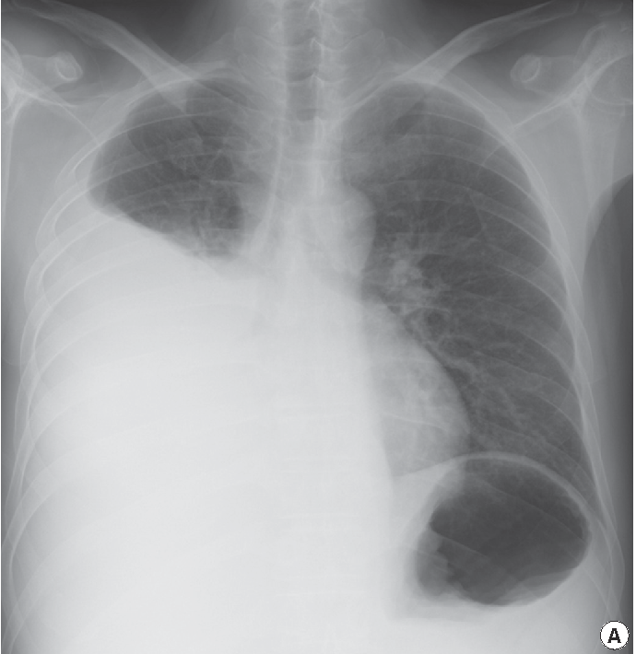
SBEM
Diagnostic criteria
  Positive pleural fluid culture + PMN count > 250/mm³
  Negative pleural fluid culture + PMN count > 500/mm³
  No evidence of pneumonia on a chest imaging study

Slide 13
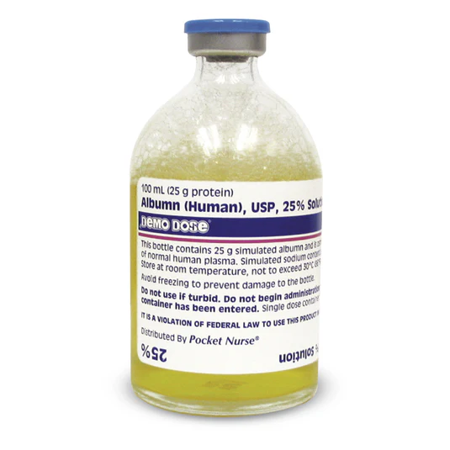
Indications for albumin
Other indications:
  HRS diagnosis and management
    Diagnosis:
      1 gm/kg 25% albumin daily x 2 days
    Treatment:
      ~ 50 gm 25% albumin daily in combination treatment
  LVP
    6 to 8 gm 25% albumin for every liter removed > 5L
    Or 50 gm total for > 5L paracentesis

Slide 14
Q3
A 62-year-old man is evaluated in the office. He was recently diagnosed with diffuse large B-cell lymphoma and is about to begin therapy with rituximab, cyclophosphamide, doxorubicin, vincristine, and prednisone (R-CHOP).
On physical examination, temperature is 37.8 °C (100.1 °F). Bulky axillary, cervical, and inguinal lymphadenopathy is noted. There are no stigmata of advanced liver disease.
Which of the following is the most appropriate next step?
  A. Begin entecavir
  B. Begin high-dose hepatitis B (HBV) vaccination series
  C. Monitor alanaine aminotransferase level monthly
  D. No specific HBV treatment is needed
Albumin | 3.7 g/dL (37 g/L)
Alkaline phosphatase | 91 U/L
Alanine aminotransferase | 31 U/L
Aspartate aminotransferase | 28 U/L
Total bilirubin | 1.1 mg/dL (18.8 μmol/L)
Hepatitis B surface antigen | Negative
Hepatitis B surface antibody | Positive
Hepatitis B total core antibody | Positive
Hepatitis B virus DNA | Undetectable

Slide 15
Q3
A 62-year-old man is evaluated in the office. He was recently diagnosed with diffuse large B-cell lymphoma and is about to begin therapy with rituximab, cyclophosphamide, doxorubicin, vincristine, and prednisone (R-CHOP).
On physical examination, temperature is 37.8 °C (100.1 °F). Bulky axillary, cervical, and inguinal lymphadenopathy is noted. There are no stigmata of advanced liver disease.
Which of the following is the most appropriate next step?
  A. Begin entecavir
  B. Begin high-dose hepatitis B (HBV) vaccination series
  C. Monitor alanaine aminotransferase level monthly
  D. No specific HBV treatment is needed
Albumin | 3.7 g/dL (37 g/L)
Alkaline phosphatase | 91 U/L
Alanine aminotransferase | 31 U/L
Aspartate aminotransferase | 28 U/L
Total bilirubin | 1.1 mg/dL (18.8 μmol/L)
Hepatitis B surface antigen | Negative
Hepatitis B surface antibody | Positive
Hepatitis B total core antibody | Positive
Hepatitis B virus DNA | Undetectable

Slide 16
Prevent hepatitis B reactivation in a patient who will receive immunosuppressive therapy
RFs
  Chronic HBV infection (HBsAg +)
  Resolved HBV infection (HBsAg – and anti-HBc antibody +)
  Regardless of anti-HBs antibody status
American Gastroenterological Association guidelines suggest prophylactic antiviral therapy for patients at moderate risk for reactivation as well, although monitoring could be considered as an alternative strategy
Continue prophylaxis at east 6 months after immunosuppressive therapy completion (and at least 12 months for B-cell–depleting agents)

Slide 17
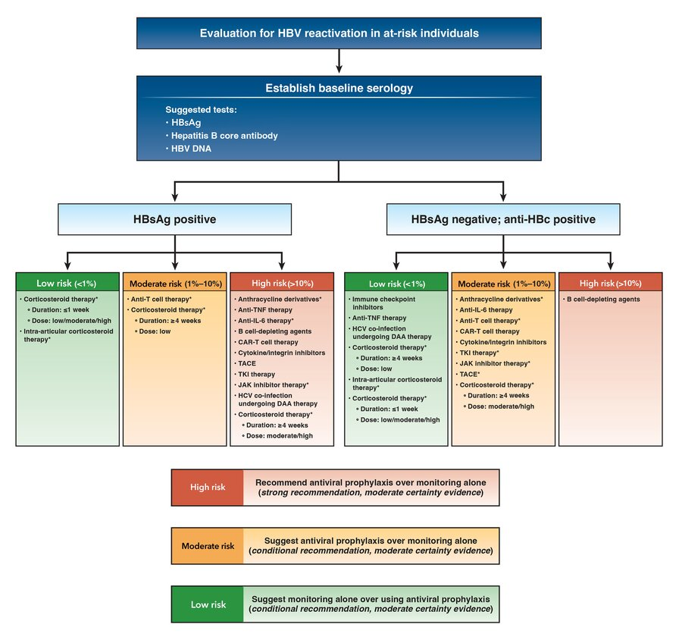

Slide 18
Q4
A 29-year-old man is evaluated for 1 week of right-lower-quadrant abdominal cramping and nonbloody, liquid stools three to four times per day. He has a 2-year history of ileocolonic Crohn disease. He has a good appetite and has had no fever, nausea, vomiting, or weight loss. He does not use NSAIDs and reports no recent antibiotic use, international travel, or sick contacts. The patient has had multiple exacerbations of Crohn disease in the past, and his current symptoms are similar to previous flares. His only medication is adalimumab.
On physical examination, vital signs are normal. The patient has no abdominal distention or tenderness to palpation, and an anorectal examination shows no blood or stool in the rectum.
Which of the following is the most appropriate diagnostic test to perform next?
  A. Abdominal CT
  B. Clostridioides difficile testing
  C. Colonoscopy
  D. Fecal calprotectin testing

Slide 19
Q4
A 29-year-old man is evaluated for 1 week of right-lower-quadrant abdominal cramping and nonbloody, liquid stools three to four times per day. He has a 2-year history of ileocolonic Crohn disease. He has a good appetite and has had no fever, nausea, vomiting, or weight loss. He does not use NSAIDs and reports no recent antibiotic use, international travel, or sick contacts. The patient has had multiple exacerbations of Crohn disease in the past, and his current symptoms are similar to previous flares. His only medication is adalimumab.
On physical examination, vital signs are normal. The patient has no abdominal distention or tenderness to palpation, and an anorectal examination shows no blood or stool in the rectum.
Which of the following is the most appropriate diagnostic test to perform next?
  A. Abdominal CT
  B. Clostridioides difficile testing
  C. Colonoscopy
  D. Fecal calprotectin testing

Slide 20
Evaluate for Clostridioides difficile in a patient experiencing an acute flare of inflammatory bowel disease
Risk for C. difficile infection is up to five times greater in patients with inflammatory bowel disease (IBD) than in the general population
Clinical presentation in patients with IBD often includes atypical features, such as younger age, lack of recent antibiotic use, and community acquisition
May be indistinguishable from a flare of IBD and may also be the trigger of a disease flare
Active C. difficile infection in patients with IBD is associated with increased severity, greater length of hospitalization, and increased likelihood of colectomy and mortality

Slide 21
Hospital management of IBD flare
VTE
  IBD is associated with a threefold increased risk for venous thromboembolism; all patients should receive VTE prophylaxis; rectal bleeding is not a contraindication
Crohn
  IV glucocorticoids
UC
  Patients hospitalized for ulcerative colitis who do not respond to intravenous glucocorticoids within 3 days should be considered for colectomy or a trial of infliximab or intravenous cyclosporine
Notes:
Only in cases of massive bleeding should nonpharmacologic thromboprophylaxis be used instead of anticoagulants.

Slide 22
Q5
A 32-year-old man is evaluated for new onset of mild pruritus. He reports no jaundice, abdominal pain, fevers, or chills. He has ulcerative pancolitis. He takes mesalamine.
Physical examination findings, including vital signs, are normal.
Which of the following is the most appropriate diagnostic test?
  A. Endoscopic retrograde cholangiopancreatography (ERCP)
  B. Endoscopic ultrasonography
  C. Liver biopsy
  D. Magnetic resonance cholangiopancreatography (MRCP)
Laboratory studies:
Albumin | 4.1 g/dL (41 g/L)
Alkaline phosphatase | 388 U/L
 | 1 year ago: 221 U/L
Alanine aminotransferase | 42 U/L
Aspartate aminotransferase | 54 U/L
Bilirubin
Total | 1.2 mg/dL (20.5 µmol/L)
Direct | 0.7 mg/dL (11.9 µmol/L)

Slide 23
Q5
A 32-year-old man is evaluated for new onset of mild pruritus. He reports no jaundice, abdominal pain, fevers, or chills. He has ulcerative pancolitis. He takes mesalamine.
Physical examination findings, including vital signs, are normal.
Which of the following is the most appropriate diagnostic test?
  A. Endoscopic retrograde cholangiopancreatography (ERCP)
  B. Endoscopic ultrasonography
  C. Liver biopsy
  D. Magnetic resonance cholangiopancreatography (MRCP)
Laboratory studies:
Albumin | 4.1 g/dL (41 g/L)
Alkaline phosphatase | 388 U/L
 | 1 year ago: 221 U/L
Alanine aminotransferase | 42 U/L
Aspartate aminotransferase | 54 U/L
Bilirubin
Total | 1.2 mg/dL (20.5 µmol/L)
Direct | 0.7 mg/dL (11.9 µmol/L)

Slide 24
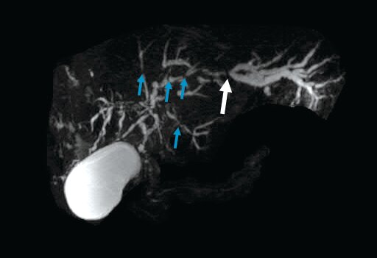
Diagnose primary sclerosing cholangitis in a patient with inflammatory bowel disease
Autoimmune fibroinflammatory disease of bile ducts
PSC is strongly associated with inflammatory bowel disease (IBD) in about 70% of cases (primarily ulcerative colitis); conversely, up to 7.5% of patients with ulcerative colitis have PSC
Patients with IBD and cholestatic liver tests, such as this patient, should undergo MRCP to assess for possible PSC
Patients with PSC have a 15% lifetime risk for cholangiocarcinoma

Slide 25
Q6
A 50-year-old woman is evaluated for worsening heartburn symptoms. She reports no weight loss, dysphagia, vomiting, or diarrhea. She takes calcium carbonate as needed for the heartburn symptoms, which achieves complete resolution. One month ago, after evaluation for symptoms of dyspepsia, she completed treatment for Helicobacter pylori infection with optimized bismuth quadruple therapy. She has a history of gastroesophageal reflux disease. She currently takes no other medication.
Physical examination findings, including vital signs, are normal.
Which of the following is the most appropriate diagnostic test to perform next?
  A. Barium esophagram
  B. ¹³C-urea breath test
  C. Hydrogen breath test
  D. Upper endoscopy

Slide 26
Q6
A 50-year-old woman is evaluated for worsening heartburn symptoms. She reports no weight loss, dysphagia, vomiting, or diarrhea. She takes calcium carbonate as needed for the heartburn symptoms, which achieves complete resolution. One month ago, after evaluation for symptoms of dyspepsia, she completed treatment for Helicobacter pylori infection with optimized bismuth quadruple therapy. She has a history of gastroesophageal reflux disease. She currently takes no other medication.
Physical examination findings, including vital signs, are normal.
Which of the following is the most appropriate diagnostic test to perform next?
  A. Barium esophagram
  B. ¹³C-urea breath test
  C. Hydrogen breath test
  D. Upper endoscopy

Slide 27
Evaluate a patient with Helicobacter pylori infection following treatment
Eradication testing for Helicobacter pylori infection should be performed at least 4 weeks after treatment completion with a ¹³C-urea breath test, fecal antigen test, or gastric biopsy during an indicated upper endoscopy
Patients undergoing H. pylori eradication testing who are taking a proton pump inhibitor should discontinue use before ¹³C-urea breath testing for 2 weeks before testing

Slide 28
Q7
A 65-year-old man is evaluated after a positive stool antigen test for Helicobacter pylori infection obtained to confirm eradication after therapy. H. pylori gastritis was diagnosed in the setting of a duodenal ulcer. Four weeks ago, he completed a 14-day course of eradication therapy with optimized bismuth quadruple therapy. He reports taking all medications as prescribed during treatment and reports no upper gastrointestinal symptoms or melena. He has no known drug allergies.
Which of the following is the most appropriate 14-day treatment regimen?
  A. Amoxicillin, metronidazole, and omeprazole
  B. Amoxicillin, levofloxacin, and omeprazole
  C. Bismuth, metronidazole, omeprazole, and tetracycline
  D. Amoxicillin, rifabutin, and omeprazole

Slide 29
Q7
A 65-year-old man is evaluated after a positive stool antigen test for Helicobacter pylori infection obtained to confirm eradication after therapy. H. pylori gastritis was diagnosed in the setting of a duodenal ulcer. Four weeks ago, he completed a 14-day course of eradication therapy with optimized bismuth quadruple therapy. He reports taking all medications as prescribed during treatment and reports no upper gastrointestinal symptoms or melena. He has no known drug allergies.
Which of the following is the most appropriate 14-day treatment regimen?
  A. Amoxicillin, metronidazole, and omeprazole
  B. Amoxicillin, levofloxacin, and omeprazole
  C. Bismuth, metronidazole, omeprazole, and tetracycline
  D. Amoxicillin, rifabutin, and omeprazole

Slide 30
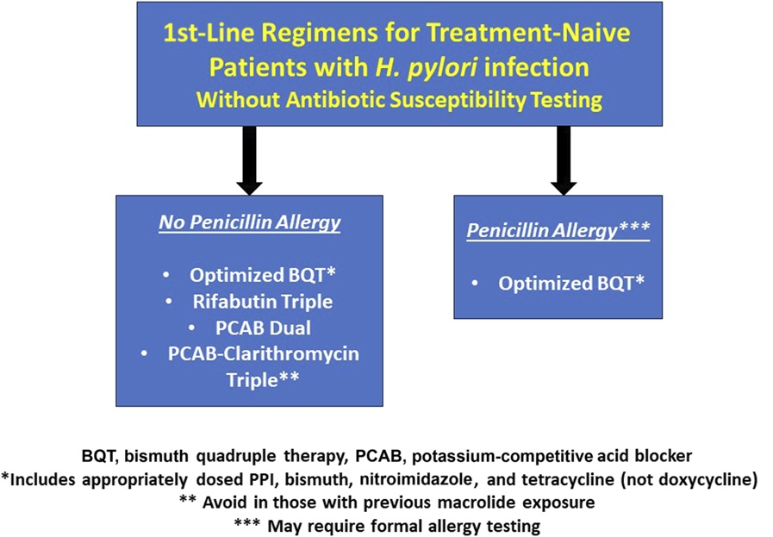
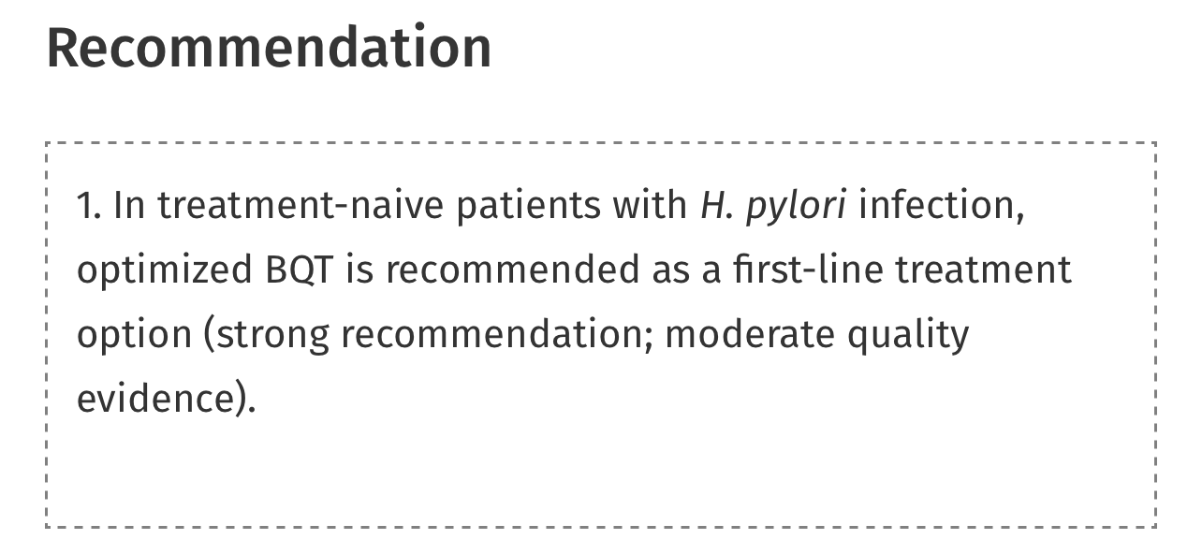
Initial regimen
Notes:
BQT – PPI, bismuth, tetracycline, metronidazole
3. Clarithromycin- and levofloxacin-containing treatment regimens should be avoided in the absence of demonstrated macrolide and quinolone susceptibility, respectively.

Slide 31
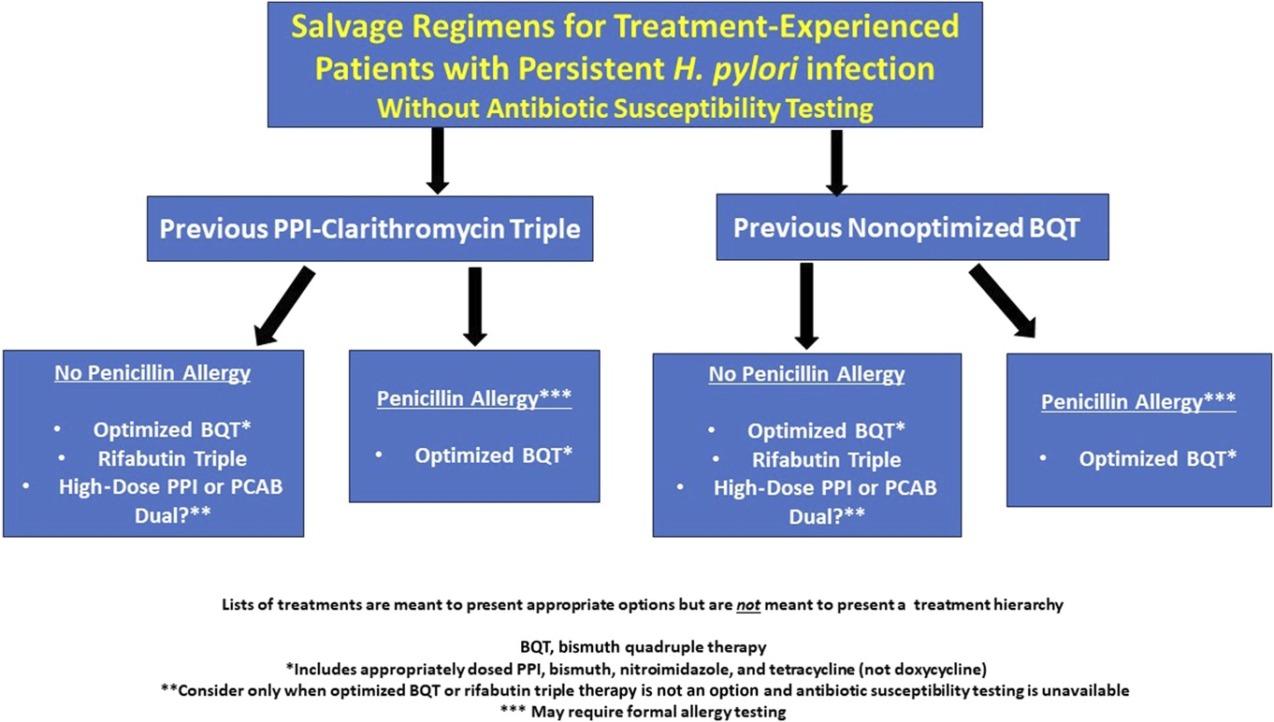
Salvage therapy

Slide 32
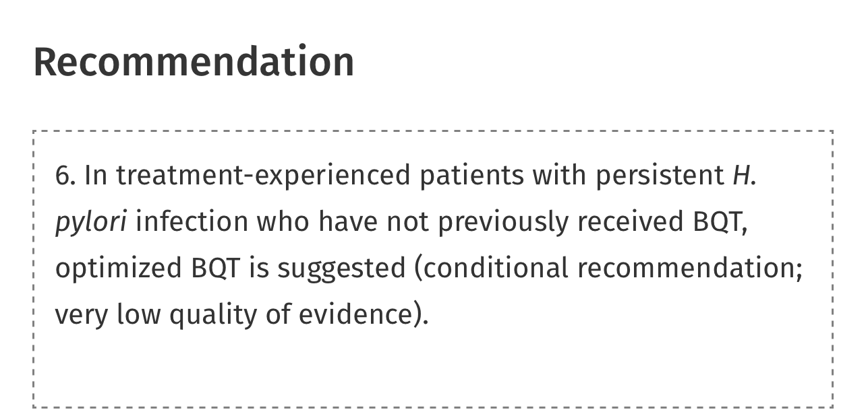
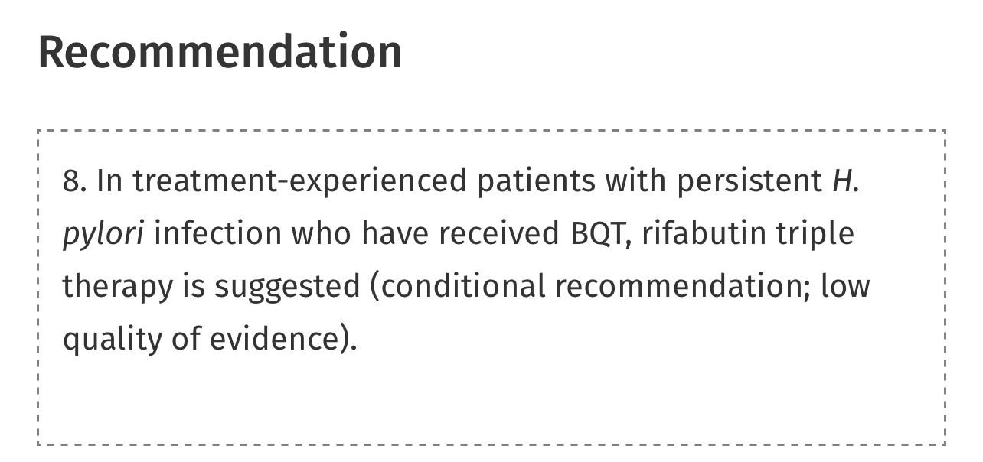
Salvage therapy
Notes:
Rifabutin, amox, PPI

Slide 33
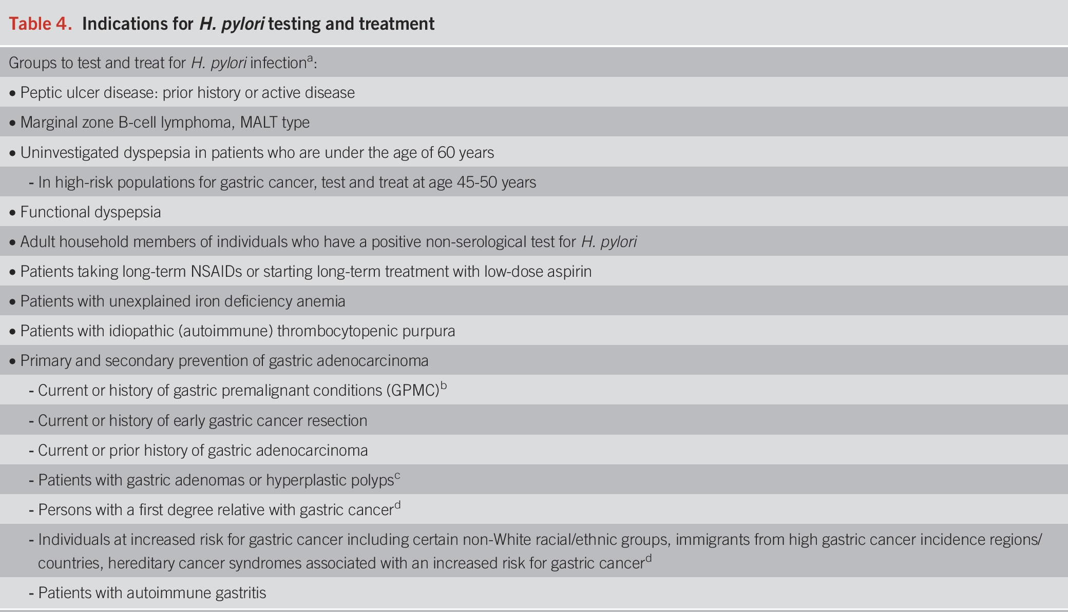
Indications for testing

Slide 34
Q8
A 75-year-old man is evaluated for a 3-year history of difficulty swallowing large pills. He also has developed an intermittent sensation of food being caught in his throat and coughing while eating. His wife reports that he continually clears his throat. He has not lost weight. He has gastroesophageal reflux disease that is well controlled with omeprazole. He also takes a multivitamin.
On physical examination, vital signs and other findings are normal.
Laboratory studies show a normal complete blood count and comprehensive metabolic panel.
Findings on upper endoscopy performed 2 years ago were unremarkable.
Which of the following is the most appropriate diagnostic test to perform next?
  A. CT of the neck
  B. Esophageal manometry
  C. Upper endoscopy
  D. Video fluoroscopy

Slide 35
Q8
A 75-year-old man is evaluated for a 3-year history of difficulty swallowing large pills. He also has developed an intermittent sensation of food being caught in his throat and coughing while eating. His wife reports that he continually clears his throat. He has not lost weight. He has gastroesophageal reflux disease that is well controlled with omeprazole. He also takes a multivitamin.
On physical examination, vital signs and other findings are normal.
Laboratory studies show a normal complete blood count and comprehensive metabolic panel.
Findings on upper endoscopy performed 2 years ago were unremarkable.
Which of the following is the most appropriate diagnostic test to perform next?
  A. CT of the neck
  B. Esophageal manometry
  C. Upper endoscopy
  D. Video fluoroscopy

Slide 36
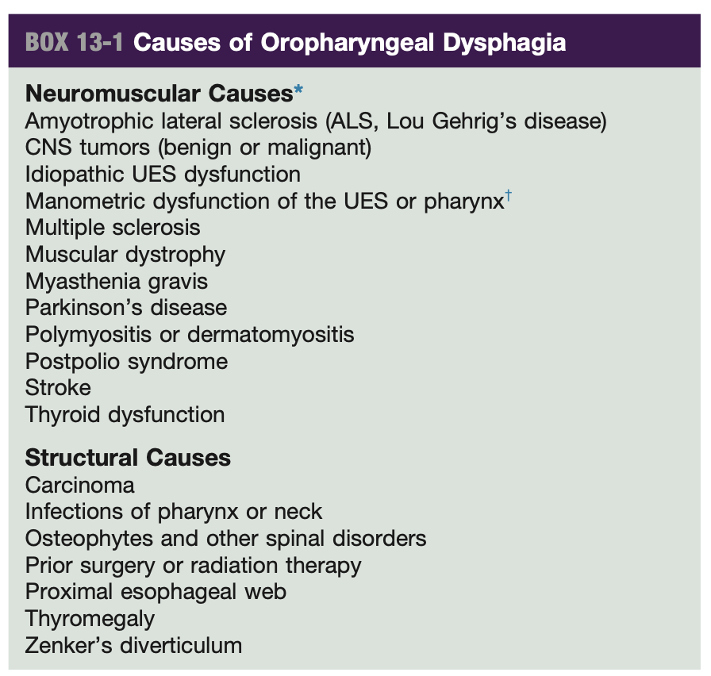
Diagnose oropharyngeal dysphagia
Oropharyngeal dysphagia
  Nasal voice
  Nasal regurgitation
  Coughing, choking
  “food is going into the wrong pipe”
Notes:
The most appropriate diagnostic test to perform next for this patient with probable oropharyngeal dysphagia is video fluoroscopy. Dysphagia is a disruption in the swallowing mechanism, resulting in a bolus not passing from the mouth to the stomach. Determining whether the cause is oropharyngeal or esophageal is important in developing a differential diagnosis and management plan. Oropharyngeal dysphagia occurs when the patient cannot transfer the food bolus from the mouth into the upper esophagus. Common symptoms include choking, coughing, and nasal regurgitation of food and liquids. Patients are at risk for aspiration pneumonia. The initial diagnostic test for suspected oropharyngeal dysphagia is video fluoroscopy, or modified barium swallow, with a range of liquid and solid consistencies. This patient's symptoms of dysphagia are most consistent with an oropharyngeal cause, and he should be further evaluated with video fluoroscopy.

Slide 37
Q9
A 66-year-old patient is evaluated for a 5-month history of progressive dysphagia to solids without odynophagia and occasional chest discomfort with swallowing. They regurgitate undigested food after large meals once per week but do not have symptoms with liquids. They have not lost weight, consume two to three alcoholic beverages per week, and do not smoke. There is no family history of gastrointestinal malignancy.
On physical examination, vital signs and other findings are normal.
Laboratory studies show a normal hemoglobin level.
Which of the following is the most appropriate management?
  A. Ambulatory pH monitoring
  B. Esophageal manometry
  C. Proton pump inhibitor
  D. Upper endoscopy

Slide 38
Q9
A 66-year-old patient is evaluated for a 5-month history of progressive dysphagia to solids without odynophagia and occasional chest discomfort with swallowing. They regurgitate undigested food after large meals once per week but do not have symptoms with liquids. They have not lost weight, consume two to three alcoholic beverages per week, and do not smoke. There is no family history of gastrointestinal malignancy.
On physical examination, vital signs and other findings are normal.
Laboratory studies show a normal hemoglobin level.
Which of the following is the most appropriate management?
  A. Ambulatory pH monitoring
  B. Esophageal manometry
  C. Proton pump inhibitor
  D. Upper endoscopy

Slide 39
Evaluate a patient with esophageal dysphagia
Esophageal dysphagia:
Mechanical vs. motility
Solid or liquid
Acute or chronic progressive
Associated symptoms i.e. weight loss
Comorbidity i.e. connective tissue disease

Slide 40
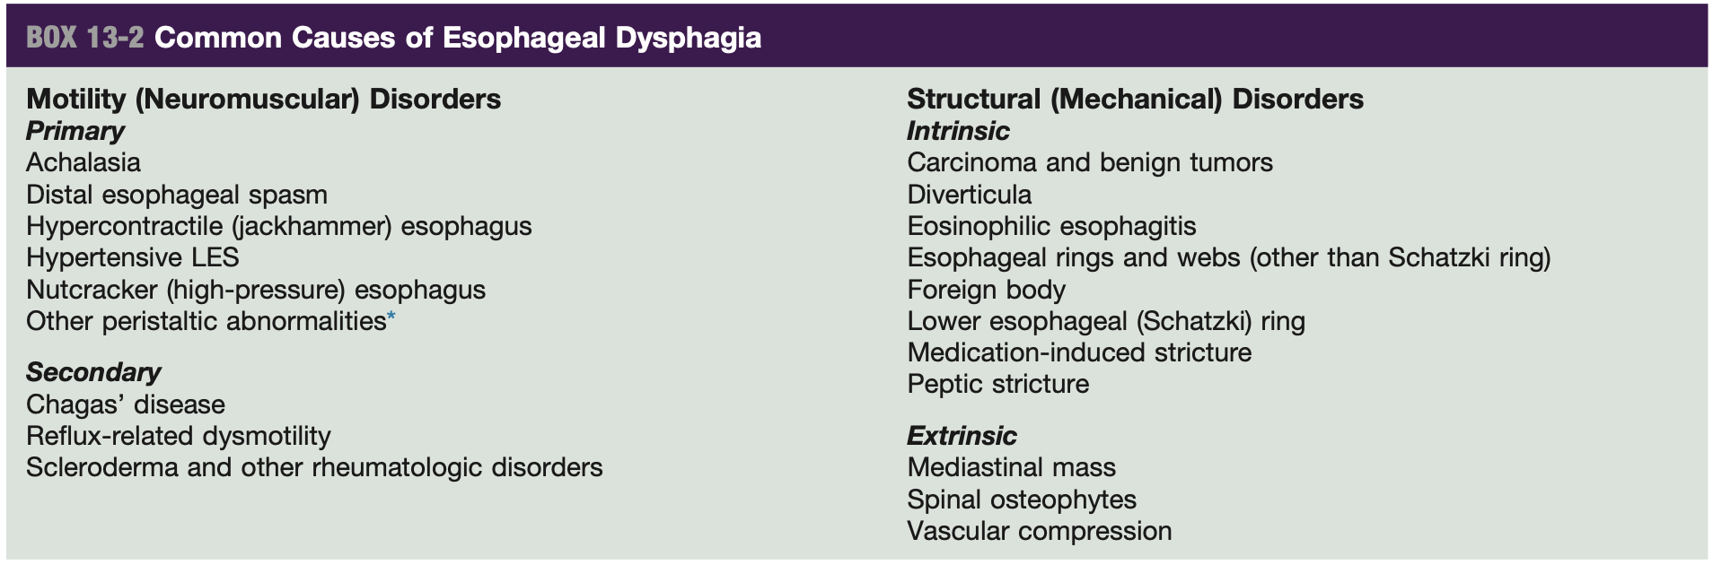
Causes of esophageal dysphagia

Slide 41
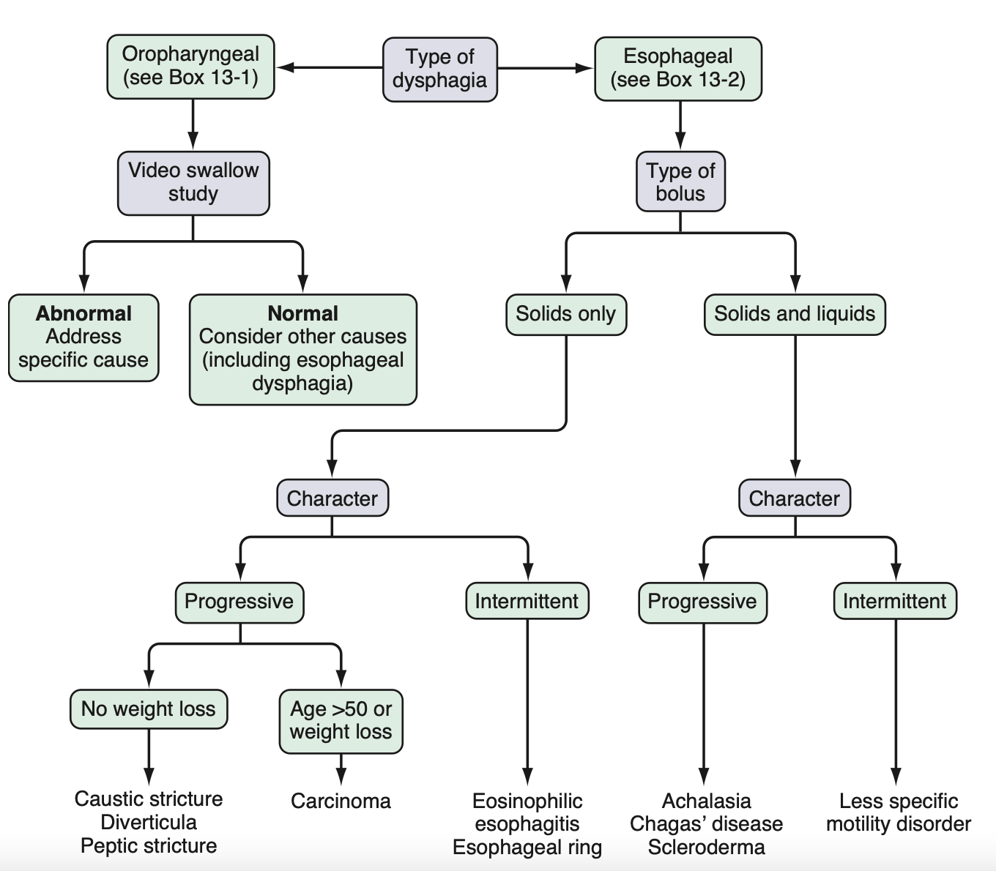
Notes:
Esophageal dysphagia:
Mechanical vs motility
Solid or liquid
Acute or chronic progressive
Associated symptoms i.e. weight loss
Comorbidity i.e. connective tissue disease

Slide 42
Q10
A 26-year-old patient is evaluated for a 5-year history of dysphagia to solids. The patient reports feeling that food "goes down slowly." They eat slowly and avoid dry foods. Medical conditions include allergic rhinitis and childhood asthma. The patient takes no medications.
On physical examination, vital signs and other findings are normal.
Which of the following is the most appropriate test to perform next?
  A. Barium esophagram
  B. CT of the neck
  C. Esophageal manometry
  D. Upper endoscopy with biopsies

Slide 43
Q10
A 26-year-old patient is evaluated for a 5-year history of dysphagia to solids. The patient reports feeling that food "goes down slowly." They eat slowly and avoid dry foods. Medical conditions include allergic rhinitis and childhood asthma. The patient takes no medications.
On physical examination, vital signs and other findings are normal.
Which of the following is the most appropriate test to perform next?
  A. Barium esophagram
  B. CT of the neck
  C. Esophageal manometry
  D. Upper endoscopy with biopsies

Slide 44
Diagnose eosinophilic esophagitis
Chronic, immune-mediated inflammatory condition
Symptoms
  Dysphagia, food impaction, chest discomfort, reflux
Associated with comorbid conditions
  Food allergies, atopic dermatitis, asthma, allergic rhinitis
Adaptive eating behaviors
Diagnostic criteria:
  Esophageal symptoms (dysphagia, food impaction, heartburn, chest pain)
  Histologic examination of esophageal biopsy (minimum of 6 specimens from at least 2 locations showing 15 or more eosinophils/high-power field)
  Exclusion of other causes of eosinophilia
Notes:
Patients with EoE often practice adaptive eating behaviors to cope with chronic symptoms, such as careful and excessive chewing, taking small bites, eating slowly, drinking liquids with meals, and avoiding foods with certain textures
Exclusion of other causes of eosinophilia (such as GERD, pill-induced esophagitis, inflammatory bowel disease, hypereosinophilic syndrome, achalasia, connective tissue or autoimmune diseases, and infection)

Slide 45
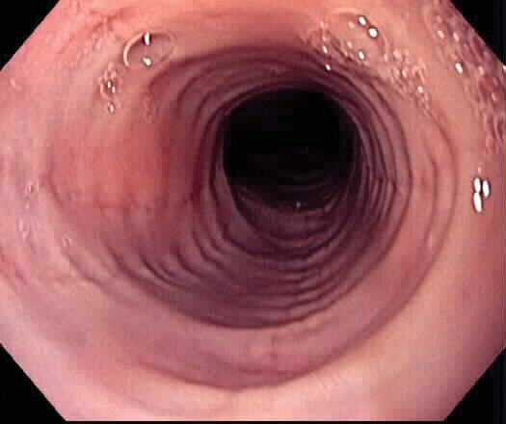
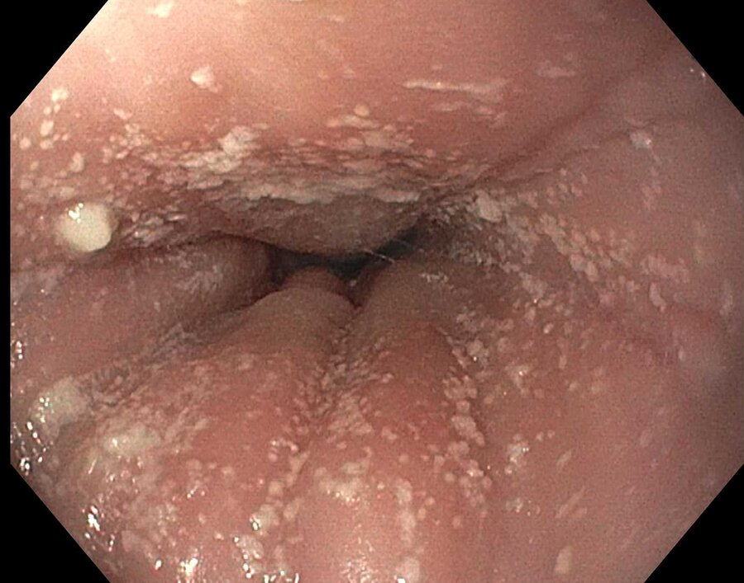
Treat eosinophilic esophagitis
Empiric elimination diet
PPIs
Swallowed topical glucocorticoids
Biologics
Notes:
The characteristic findings of eosinophilic esophagitis on endoscopy include rings and longitudinal furrows; strictures may also be seen. Inflammatory exudates (white plaques) are seen on endoscopy in a patient with active eosinophilic esophagitis.
Treatments for eosinophilic esophagitis include an empiric elimination diet, proton pump inhibitors (PPIs), and swallowed topical glucocorticoids; biologic agents, such as dupilumab, may also be considered in patients who do not respond to PPI therapy.

Slide 46
Q11
A 30-year-old man is evaluated for a 3-month history of persistent dysphagia to solids and liquids. He feels as if food is getting stuck below his sternum several minutes after swallowing, accompanied by chest pain, which has been unresponsive to over-the-counter antacids. He reports no swallowing issues until 6 months ago. He has no history of tobacco use or weight loss. Medical history is unremarkable, and he takes no medication.
Physical examination findings, including vital signs, are normal.
Upper endoscopy reveals a normal structural examination; biopsy shows no eosinophils per high-power field.
Which of the following is the most appropriate next step in management?
  A. Chest CT
  B. High resolution esophageal manometry
  C. Modified barium swallow
  D. Trial of a proton pump inhibitor

Slide 47
Q11
A 30-year-old man is evaluated for a 3-month history of persistent dysphagia to solids and liquids. He feels as if food is getting stuck below his sternum several minutes after swallowing, accompanied by chest pain, which has been unresponsive to over-the-counter antacids. He reports no swallowing issues until 6 months ago. He has no history of tobacco use or weight loss. Medical history is unremarkable, and he takes no medication.
Physical examination findings, including vital signs, are normal.
Upper endoscopy reveals a normal structural examination; biopsy shows no eosinophils per high-power field.
Which of the following is the most appropriate next step in management?
  A. Chest CT
  B. High resolution esophageal manometry
  C. Modified barium swallow
  D. Trial of a proton pump inhibitor

Slide 48
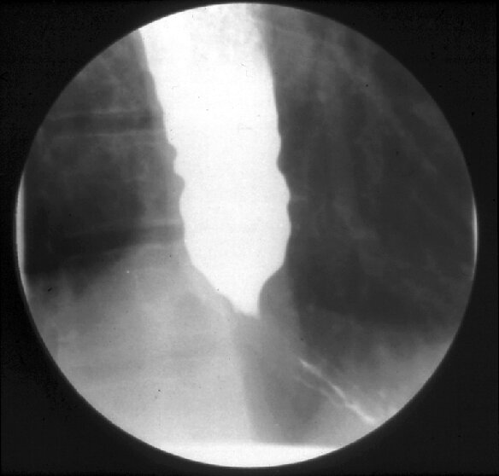
Evaluate achalasia
Inadequate relaxation of the LES and complete aperistalsis
Idiopathic or associated with viral, autoimmune, and neurodegenerative disorders and infection (Chagas disease)
Damage to the ganglion cells and myenteric plexus in the esophageal body and LES -> uncontested cholinergic nerve activation -> prevents LES relaxation
M=F; 30 -60 years of age
Dysphagia with solids and liquids along with regurgitation of undigested food
On barium esophagram, dilation of the esophagus with narrowing at the gastroesophageal junction, known as a “bird's beak”
On EGD, retained food and saliva, dilated esophageal lumen, mucosal stasis changes, no signs of mass or mechanical obstruction
Esophageal manometry shows abnormal and incomplete relaxation of the LES and failed peristalsis

Slide 49
Achalasia treatment
Surgical esophagomyotomy
Peroral endoscopic myotomy (POEM)
Pneumatic dilatation
Botox
Patients with achalasia > 10 years have increased risk for squamous cell CA and may benefit from surveillance endoscopy, but there are no guidelines for frequency of surveillance

Slide 50
Q12
A 55-year-old man is evaluated in the emergency department for a 14-hour history of acute-onset epigastric pain radiating to the back. He drinks six cans of beer several times weekly.
On physical examination, temperature is 37.5 °C (99.5 °F), blood pressure is 105/64 mm Hg, pulse rate is 117/min, and respiration rate is 18/min. Oxygen saturation is 95% with the patient breathing ambient air. Abdominal palpation elicits epigastric pain without rebound or guarding.
Which of the following is the most appropriate next step in management?
  A. Abdominal CT
  B. Aggressive fluid resuscitation
  C. Intravenous antibiotics
  D. Transabdominal ultrasonography
Laboratory studies:
Hemoglobin | 15 g/dL (150 g/L)
Leukocyte count | 15,300/μL (15.3 × 10⁹/L)
Alanine aminotransferase | 90 U/L
Aspartate aminotransferase | 155 U/L
Bilirubin
Total | 0.8 mg/dL (13.7 μmol/L)
Direct | 0.2 mg/dL (3.4 μmol/L)
Blood urea nitrogen | 12 mg/dL (4.3 mmol/L)
Creatinine | 1.0 mg/dL (88.4 μmol/L)
Lipase | 108 U/L

Slide 51
Q12
A 55-year-old man is evaluated in the emergency department for a 14-hour history of acute-onset epigastric pain radiating to the back. He drinks six cans of beer several times weekly.
On physical examination, temperature is 37.5 °C (99.5 °F), blood pressure is 105/64 mm Hg, pulse rate is 117/min, and respiration rate is 18/min. Oxygen saturation is 95% with the patient breathing ambient air. Abdominal palpation elicits epigastric pain without rebound or guarding.
Which of the following is the most appropriate next step in management?
  A. Abdominal CT
  B. Aggressive fluid resuscitation
  C. Intravenous antibiotics
  D. Transabdominal ultrasonography
Laboratory studies:
Hemoglobin | 15 g/dL (150 g/L)
Leukocyte count | 15,300/μL (15.3 × 10⁹/L)
Alanine aminotransferase | 90 U/L
Aspartate aminotransferase | 155 U/L
Bilirubin
Total | 0.8 mg/dL (13.7 μmol/L)
Direct | 0.2 mg/dL (3.4 μmol/L)
Blood urea nitrogen | 12 mg/dL (4.3 mmol/L)
Creatinine | 1.0 mg/dL (88.4 μmol/L)
Lipase | 108 U/L

Slide 52
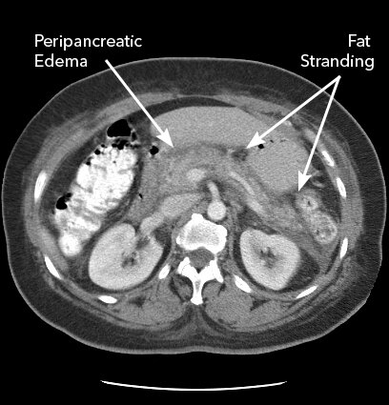
Diagnose acute pancreatitis
2 of 3…
  Acute-onset abdominal pain characteristic of pancreatitis
  Serum amylase or lipase levels at least three times the upper limit of normal
  Characteristic CT or MRI findings

Slide 53
Making the Diagnosis
Definition: Acute inflammatory process of the pancreas
Pancreatitis
Symptoms
Labs
Radiology
Classically with severe epigastric pain radiating to the back.
Amylase or Lipase > 3x upper limit of normal
Imaging suggestive of pancreatitis
Only need 2 of the 3 criteria Avoid imaging unless diagnosis is in question

Slide 54
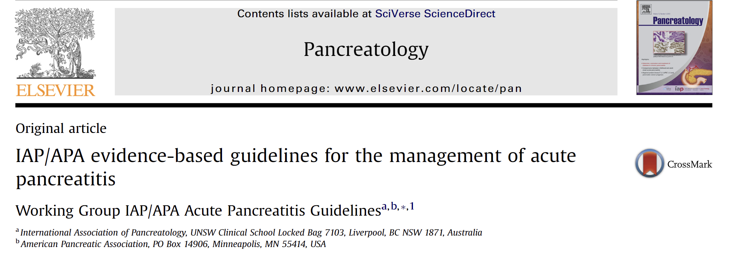
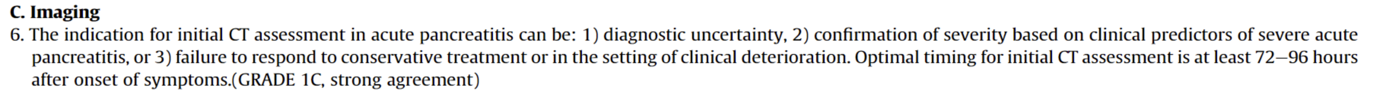
So… When is Imaging Needed?

Slide 55
Q13
A 42-year-old patient is evaluated in the hospital 2 days after admission for gallstone pancreatitis. Abdominal ultrasound obtained in the emergency department revealed cholelithiasis but no choledocholithiasis. The common bile duct was dilated. The patient was initially treated with intravenous fluids; they now tolerate an oral diet. Their pain is improving.
On physical examination, vital signs and other findings are normal.
Laboratory studies show that serum alanine aminotransferase, aspartate aminotransferase, and bilirubin levels have normalized.
Which of the following is the most appropriate management?
  A. Cholecystectomy before discharge
  B. Cholecystectomy in 4 to 6 weeks
  C. Endoscopic retrograde cholangiopancreatography
  D. No further management

Slide 56
Q13
A 42-year-old patient is evaluated in the hospital 2 days after admission for gallstone pancreatitis. Abdominal ultrasound obtained in the emergency department revealed cholelithiasis but no choledocholithiasis. The common bile duct was dilated. The patient was initially treated with intravenous fluids; they now tolerate an oral diet. Their pain is improving.
On physical examination, vital signs and other findings are normal.
Laboratory studies show that serum alanine aminotransferase, aspartate aminotransferase, and bilirubin levels have normalized.
Which of the following is the most appropriate management?
  A. Cholecystectomy before discharge
  B. Cholecystectomy in 4 to 6 weeks
  C. Endoscopic retrograde cholangiopancreatography
  D. No further management

Slide 57
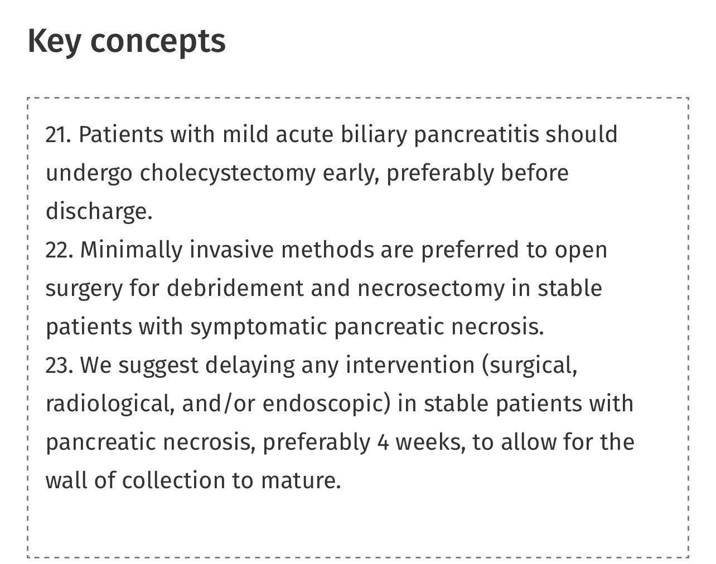
Treat gallstone pancreatitis
Literature review of ~1,000 pts who were discharged without cholecystectomy, 18% were readmitted with recurrent biliary events, including biliary pancreatitis, many with severe disease
Notes:
When evaluating the literature, including 8 cohort studies and 1 randomized trial describing 998 patients who were discharged rather than undergo cholecystectomy compared with early cholecystectomy, 95 (18%) were readmitted for recurrent biliary events (18% vs 0%, P < 0.0001), including recurrent biliary pancreatitis (n = 43, 8%) (¹⁹⁷). Many of these patients experienced severe disease. In addition to a benefit in morbidity, same-admission cholecystectomy results in substantial cost savings to the health care system

Slide 58
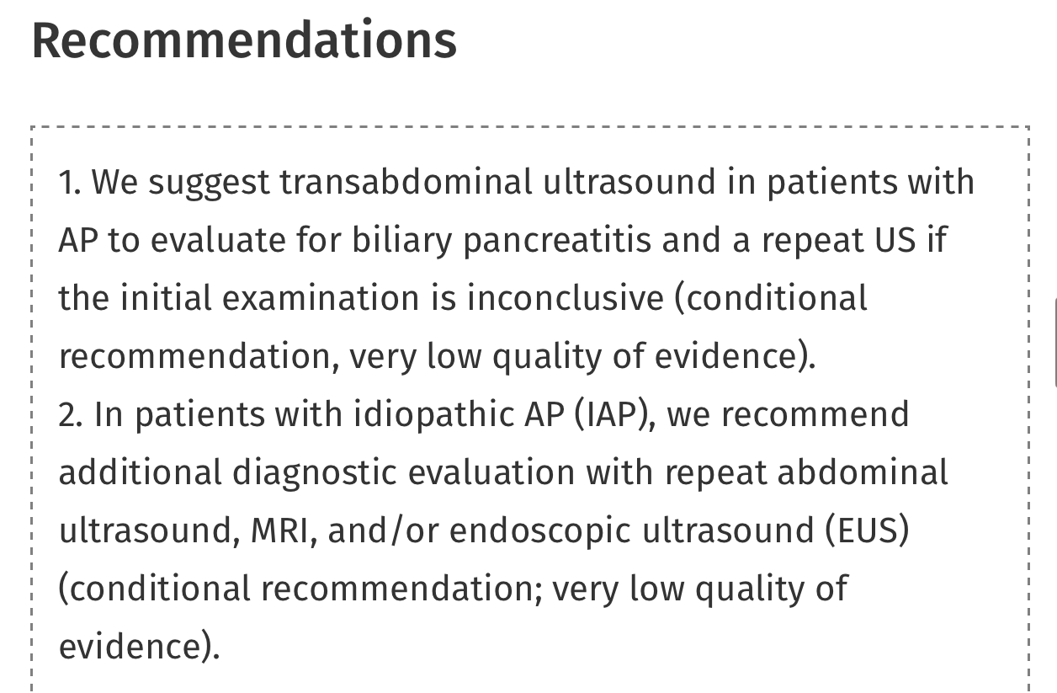
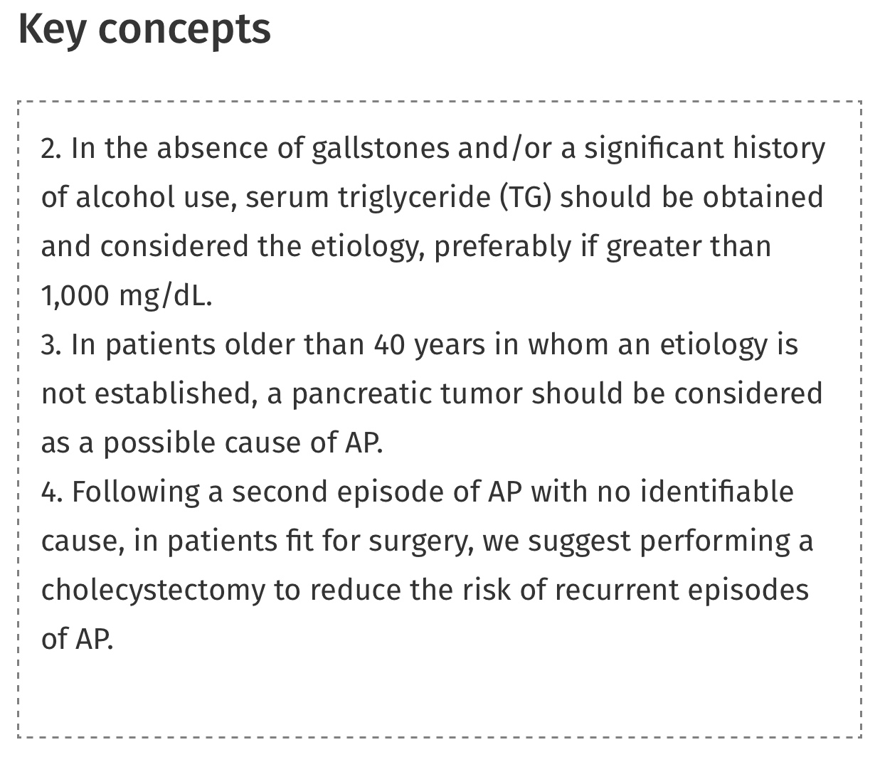
Evaluation for etiology
Gallstones (40-70%)
Alcohol (25-35%)
Notes:
The etiology of AP can be readily established in most patients. The most common causes include gallstones (40%–70%) and alcohol (25%–35%) (^{21–23}). Due to its commonality and importance of preventing a recurrent attack, abdominal ultrasound to evaluate for cholelithiasis should be performed on all patients with AP (²⁴). A large retrospective study confirmed the high accuracy and sensitivity of ultrasound to diagnose a biliary etiology for AP and found that accuracy was even higher when a second ultrasound was repeated 1 week after the initial study if the initial study was inconclusive (²⁵). Identification of gallstones as the etiology should prompt referral for cholecystectomy to prevent recurrent attacks and potential biliary sepsis (^{26,27}). Gallstone pancreatitis is usually an acute event and cured when the stone is removed or passes. Depending on age and comorbidities, patients who have undergone a biliary sphincterotomy should also be referred for cholecystectomy because they remain at risk of recurrent disease (²⁸).

Slide 59
Q14
A 50-year-old man is evaluated for newly developed ascites. He has cirrhosis due to nonalcoholic steatohepatitis. Paracentesis confirms cirrhosis as a cause of the ascites and excludes infection, and a low-sodium diet is implemented. Medical history includes type 2 diabetes mellitus, hypertension, and dyslipidemia. Current medications are metformin, lisinopril, and atorvastatin.
On physical examination, vital signs are normal. The abdomen is nontender and mildly distended, with normal bowel sounds.
Serum creatinine level is 1.1 mg/dL (97.2 μmol/L). Random urine protein-creatinine ratio is 16 mg/g.
Which of the following is the most appropriate additional treatment?
  Discontinue atorvastatin
  Discontinue lisinopril
  Initiate lactulose
  Initiate low-protein diet

Slide 60
Q14
A 50-year-old man is evaluated for newly developed ascites. He has cirrhosis due to nonalcoholic steatohepatitis. Paracentesis confirms cirrhosis as a cause of the ascites and excludes infection, and a low-sodium diet is implemented. Medical history includes type 2 diabetes mellitus, hypertension, and dyslipidemia. Current medications are metformin, lisinopril, and atorvastatin.
On physical examination, vital signs are normal. The abdomen is nontender and mildly distended, with normal bowel sounds.
Serum creatinine level is 1.1 mg/dL (97.2 μmol/L). Random urine protein-creatinine ratio is 16 mg/g.
Which of the following is the most appropriate additional treatment?
  Discontinue atorvastatin
  Discontinue lisinopril
  Initiate lactulose
  Initiate low-protein diet

Slide 61
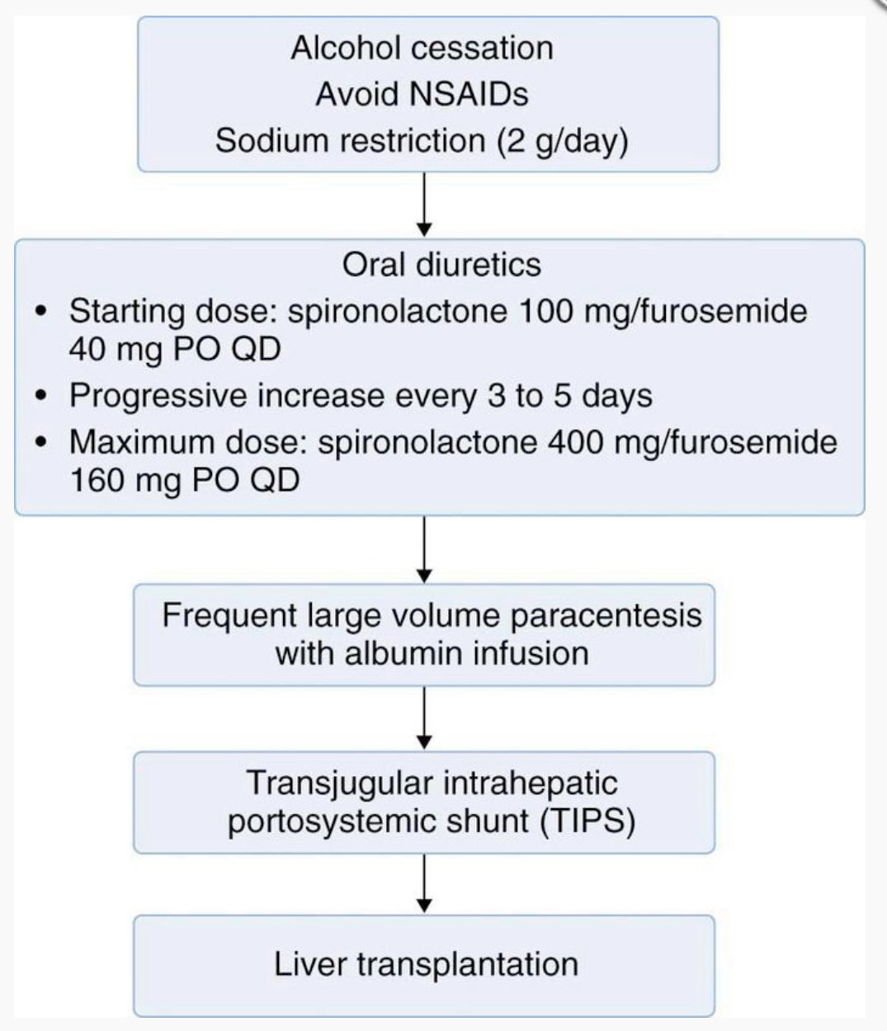
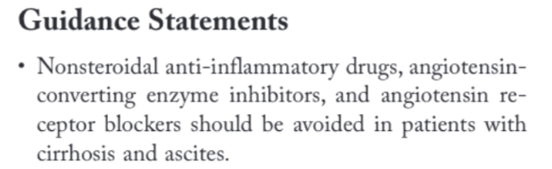
Treat ascites in a patient with cirrhosis by stopping an ACE inhibitor
Ascites results from portal hypertension and functional renal impairment -> ineffective natriuresis and retention of sodium
Medications that decrease renal perfusion pressures, such as ACE inhibitors and angiotensin receptor blockers, can worsen ascites in patients with portal hypertension
NSAIDs, can reduce urinary sodium excretion in patients with cirrhosis and can induce azotemia
*and ACE/ARB
AASLD, 2021
Notes:
The Cleveland clinic foundation
In patients with ascites due to cirrhosis, the initial management of ascites consists of dietary sodium restriction, which may equalize the sodium balance in patients and prevent ascites. If this treatment does not resolve the sodium imbalance, a diuretic regimen with spironolactone and furosemide can be prescribed to increase natriuresis.
Use of ACE inhibitors and ARBs impair the compensatory response to cirrhosis-related hypotension and thereby impair the ability to excrete excess sodium and water
Medications that decrease kidney perfusion, including NSAIDs, ACE inhibitors and ARBs should be discontinued because their use often worsens ascites due to portal hypertension

Slide 62
Other answers
A, the overall benefits of statins typically outweigh the potential harms, especially in patients with risk factors for coronary artery disease
C, lactulose is initiated for the management of hepatic encephalopathy, but should not be initiated in a patient without symptoms of hepatic encephalopathy
D, the dietary protein needs of patients with decompensated cirrhosis exceed those of healthy persons, and dietary protein supplementation is indicated in this patient population
Notes:
Such as in this patient with nonalcoholic steatohepatitis, type 2 diabetes, dyslipidemia, and hypertension. Therefore, discontinuation of atorvastatin is not appropriate. Discontinue or dose reduce in patients with persistent ALT elevation >3 x’s the ULN.

Slide 63
Q15
A 64-year-old man is evaluated in the emergency department for ascites. He has diabetes mellitus and cirrhosis associated with hemochromatosis, as well as a history of hepatic encephalopathy. Current medications are metformin, canagliflozin, lactulose, and rifaximin.
On physical examination, blood pressure is 106/76 mm Hg and pulse rate is 60/min; other vital signs are normal. The patient is alert. Jaundice, spider telangiectasia, and palmar erythema are present. Jugular venous distension and peripheral edema are present. Cardiac sounds are indistinct and lung sounds are diminished. Ascites is present.
Abdominal ultrasound shows a cirrhotic liver, splenomegaly, and abdominal ascites.
Paracentesis with analysis of ascitic fluid shows a leukocyte count of 100/μL (100 × 10⁹/L), albumin level of 2.2 g/dL (22 g/L), and total protein level of 2.6 g/dL (26 g/L). Serum albumin level is 3.5 g/dL (35 g/L).
Which of the following is the most appropriate management?
  Ascitic fluid cytology
  Ascitic fluid triglyceride measurement
  Echocardiography
  Liver biopsy

Slide 64
Q15
A 64-year-old man is evaluated in the emergency department for ascites. He has diabetes mellitus and cirrhosis associated with hemochromatosis, as well as a history of hepatic encephalopathy. Current medications are metformin, canagliflozin, lactulose, and rifaximin.
On physical examination, blood pressure is 106/76 mm Hg and pulse rate is 60/min; other vital signs are normal. The patient is alert. Jaundice, spider telangiectasia, and palmar erythema are present. Jugular venous distension and peripheral edema are present. Cardiac sounds are indistinct and lung sounds are diminished. Ascites is present.
Abdominal ultrasound shows a cirrhotic liver, splenomegaly, and abdominal ascites.
Paracentesis with analysis of ascitic fluid shows a leukocyte count of 100/μL (100 × 10⁹/L), albumin level of 2.2 g/dL (22 g/L), and total protein level of 2.6 g/dL (26 g/L). Serum albumin level is 3.5 g/dL (35 g/L).
Which of the following is the most appropriate management?
  Ascitic fluid cytology
  Ascitic fluid triglyceride measurement
  Echocardiography
  Liver biopsy

Slide 65
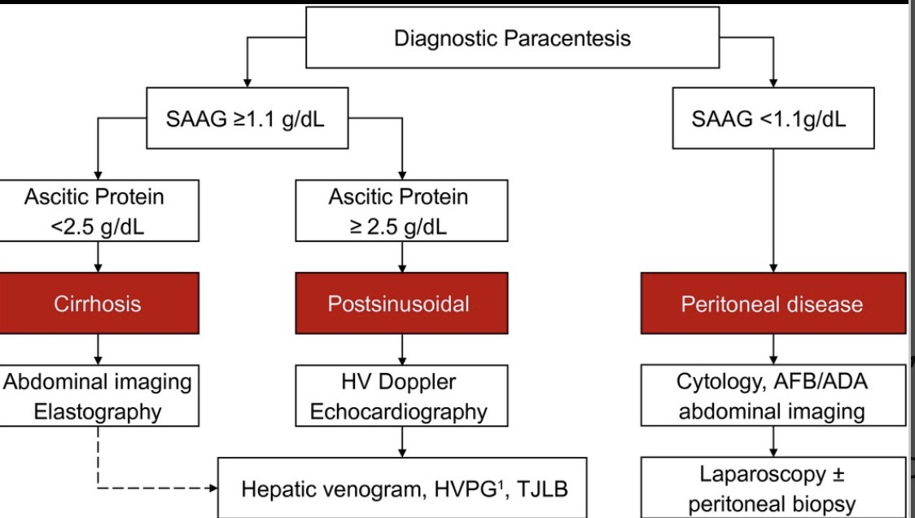
Evaluate cause of ascites
Notes:
Hepatology, 2021 (AASLD)
Biggins, S.W., Angeli, P., Garcia-Tsao, G., Ginès, P., Ling, S.C., Nadim, M.K., Wong, F. and Kim, W.R. (2021), Diagnosis, Evaluation, and Management of Ascites, Spontaneous Bacterial Peritonitis and Hepatorenal Syndrome: 2021 Practice Guidance by the American Association for the Study of Liver Diseases. Hepatology, 74: 1014-1048. https://doi.org/10.1002/hep.31884
A serum albumin ascites gradient ≥1.1 g/dL is highly suggestive of portal hypertension, usually caused by liver disease with an accuracy of approximately 97%, whereas a serum albumin ascites gradient <1.1 g/dL suggests other causes of ascites

Slide 66
Ascites evaluation
HIGH VALUE CARE PEARL:
Initial work up new-onset ascites should include:
1. cell count + culture
  2. ascitic fluid albumin (+ serum albumin level)
  3. ascitic fluid protein
  AND THAT IS ALL!
Notes:
A diagnostic paracentesis should be performed in all patients with new-onset ascites that is accessible for sampling
The initial laboratory investigation of ascitic fluid should include ascitic fluid neutrophil count, ascitic fluid total protein, ascitic fluid albumin, and serum albumin to calculate the serum- ascites albumin gradient
~80% of the time ascites if from cirrhosis, ~3% HF or post-sinusoindal and ~10% is cancer (low SAAG) and things like TB, etc are uncommon and make up the rest

Slide 67
Q16
A 24-year-old woman is evaluated for 3 months of small-volume bloody stools occurring two to three times per day. Mild predefecatory cramping pain in the lower abdomen is relieved with stool passage. She reports no NSAID use, recent antibiotic use, international travel, or sick contacts.
Physical examination findings, including vital signs, are normal.
Laboratory studies show normal complete blood count and C-reactive protein level and negative results on a stool pathogen panel.
Colonoscopy reveals diffuse, mild inflammatory mucosal changes isolated to the rectum, characterized by erythema, edema, loss of vascular pattern, and scattered erosions. Biopsy specimens of the rectum show mucosal inflammation with crypt architectural distortion.
Which of the following is the most appropriate treatment?
  A. Infliximab
  B. Mesalamine suppository
  C. Multimatrix budesonide
  D. Oral mesalamine

Slide 68
Q16
A 24-year-old woman is evaluated for 3 months of small-volume bloody stools occurring two to three times per day. Mild predefecatory cramping pain in the lower abdomen is relieved with stool passage. She reports no NSAID use, recent antibiotic use, international travel, or sick contacts.
Physical examination findings, including vital signs, are normal.
Laboratory studies show normal complete blood count and C-reactive protein level and negative results on a stool pathogen panel.
Colonoscopy reveals diffuse, mild inflammatory mucosal changes isolated to the rectum, characterized by erythema, edema, loss of vascular pattern, and scattered erosions. Biopsy specimens of the rectum show mucosal inflammation with crypt architectural distortion.
Which of the following is the most appropriate treatment?
  A. Infliximab
  B. Mesalamine suppository
  C. Multimatrix budesonide
  D. Oral mesalamine
Notes:
The most appropriate treatment is a mesalamine suppository (Option B). In ulcerative colitis (UC), inflammation can be limited to the rectum (ulcerative proctitis). Rectal inflammation causes frequent defecatory urges and passage of small liquid stools containing mucus and blood. Most patients with UC have a mild to moderate course characterized by periods of activity or remission, and more than 90% of patients with UC are treated with 5-aminosalicylates (5-ASAs) shortly after disease diagnosis. 5-ASAs, such as mesalamine, are the mainstay of treatment of mild to moderate ulcerative colitis (Figure: Treatment Framework for Ulcerative Colitis), with a dose-dependent response when used to induce remission. Patients with proctitis should be offered a 5-ASA suppository as first-line treatment. Patients who subsequently experience ongoing disease activity should be treated with tacrolimus suppositories or beclomethasone suppositories. This patient presented with tenesmus, and colonoscopy revealed chronic mucosal inflammatory changes limited to the rectum; a mesalamine suppository is the recommended treatment.

Slide 69
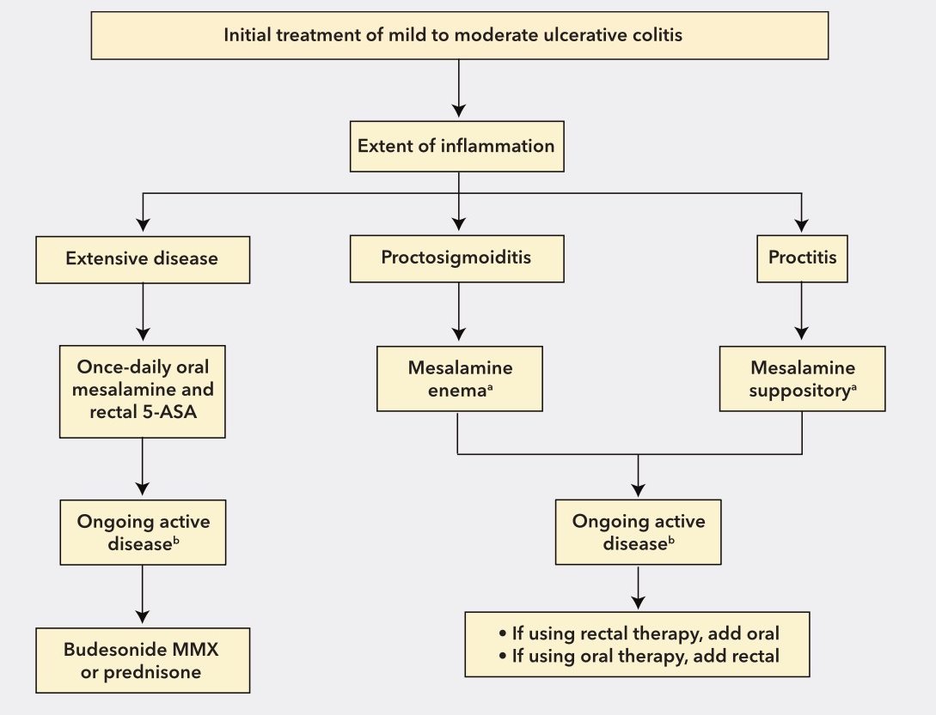

Slide 70
Q17
A 24-year-old woman is evaluated for a 5-day history of jaundice. A family member notes that she has now become combative and confused. Previously, the patient was well, without a history of liver disease.
Vitals signs are normal. She is agitated and confused. Jaundice is present.
Test results for viral hepatitis and acetaminophen use are negative.
Which of the following is the most appropriate next step in management?
  A. Chlordiazepoxide
  B. Cryoprecipitate
  C. Methylprednisolone
  D. Referral to a liver transplant center
Laboratory studies:
INR | 3.2
Aspartate aminotransferase | 284 U/L
Ammonia | 181 µg/dL (129 µmol/L)
Bilirubin, total | 16.4 mg/dL (280.5 µmol/L)
Creatinine | 2.8 mg/dL (248 µmol/L)

Slide 71
Q17
A 24-year-old woman is evaluated for a 5-day history of jaundice. A family member notes that she has now become combative and confused. Previously, the patient was well, without a history of liver disease.
Vitals signs are normal. She is agitated and confused. Jaundice is present.
Test results for viral hepatitis and acetaminophen use are negative.
Which of the following is the most appropriate next step in management?
  A. Chlordiazepoxide
  B. Cryoprecipitate
  C. Methylprednisolone
  D. Referral to a liver transplant center
Laboratory studies:
INR | 3.2
Aspartate aminotransferase | 284 U/L
Ammonia | 181 µg/dL (129 µmol/L)
Bilirubin, total | 16.4 mg/dL (280.5 µmol/L)
Creatinine | 2.8 mg/dL (248 µmol/L)

Slide 72
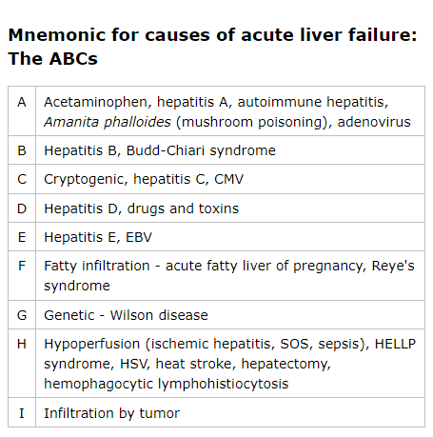
Manage acute liver failure
Definition:
  Development of severe acute liver injury with impaired synthetic function (INR ≥ 1.5) and altered mental status in a patient without cirrhosis of preexisting liver disease
  Illness duration of < 26 weeks

Slide 73
Management
Liver transplant center
Should be managed in ICU if grade II – IV encephalopathy
Close neurologic monitoring and lab monitoring (q4-6 h) CBC, CMP, coags, ABG, ammonia levels
Hemodynamics, TEG
N-acetylcysteine
Nutrition
Infection surveillance
Notes:
We monitor ammonia levels because a level >150 microg/dL has been associated with increased risk of cerebral herniation.

Slide 74
Q18
Laboratory studies:
Hemoglobin | 14.5 g/dL (145 g/L)
Leukocyte count | 12,000/μL (12 × 10⁹/L) | H
Neutrophil count | 7000/µL (7.0 × 10⁹/L)
Platelet count | 375,000/µL (375 × 10⁹/L)
INR | 1.0
A 59-year-old woman is evaluated for a 1-day history of persistent left-lower-quadrant abdominal pain and constipation. She describes the pain as cramping discomfort and states that she has never experienced similar symptoms in the past. The patient has no nausea or vomiting. She has hypertension. Her only medication is lisinopril.
On physical examination, temperature is 36.0 °C (96.8 °F), blood pressure is 120/75 mm Hg, and pulse rate is 80/min; other vital signs are normal. BMI is 24. Abdominal examination reveals mild left-lower-quadrant tenderness with no rebound, guarding, or distention. Anorectal examination shows brown stool in the rectal vault.
CT scans of the abdomen and pelvis with contrast show sigmoid diverticulosis with localized colonic wall inflammation and pericolic fat. Screening colonoscopy performed 5 years ago was negative for colorectal neoplasia.
In addition to analgesics, which of the following is the most appropriate management?
  A. Clear liquid diet
  B. Hospitalization for IV antibiotics
  C. Initiation of probiotics
  D. Oral ciprofloxacin and metronidazole

Slide 75
Q18
Laboratory studies:
Hemoglobin | 14.5 g/dL (145 g/L)
Leukocyte count | 12,000/μL (12 × 10⁹/L) | H
Neutrophil count | 7000/µL (7.0 × 10⁹/L)
Platelet count | 375,000/µL (375 × 10⁹/L)
INR | 1.0
A 59-year-old woman is evaluated for a 1-day history of persistent left-lower-quadrant abdominal pain and constipation. She describes the pain as cramping discomfort and states that she has never experienced similar symptoms in the past. The patient has no nausea or vomiting. She has hypertension. Her only medication is lisinopril.
On physical examination, temperature is 36.0 °C (96.8 °F), blood pressure is 120/75 mm Hg, and pulse rate is 80/min; other vital signs are normal. BMI is 24. Abdominal examination reveals mild left-lower-quadrant tenderness with no rebound, guarding, or distention. Anorectal examination shows brown stool in the rectal vault.
CT scans of the abdomen and pelvis with contrast show sigmoid diverticulosis with localized colonic wall inflammation and pericolic fat. Screening colonoscopy performed 5 years ago was negative for colorectal neoplasia.
In addition to analgesics, which of the following is the most appropriate management?
  A. Clear liquid diet
  B. Hospitalization for IV antibiotics
  C. Initiation of probiotics
  D. Oral ciprofloxacin and metronidazole

Slide 76
Treat uncomplicated diverticulitis
Close observation without antibiotics can be considered in immunocompetent patients with acute uncomplicated diverticulitis
Antibiotics are indicated for patients who are immunocompromised, pregnant, or have significant comorbid diseaseth
Measures to prevent recurrent diverticulitis include the following:
  A high-fiber, plant-based diet
  Smoking cessation
  Physical activity
  Avoidance of NSAIDs, glucocorticoids, and opioid analgesics
No evidence supports restricting foods, such as nuts, berries, and seeds, to prevent recurrent diverticulitis
Notes:
Uncomplicated diverticulitis has traditionally been treated with oral antibiotics (e.g., a fluoroquinolone and metronidazole) and a liquid diet; however, emerging evidence suggests close observation without antibiotics may be considered in immunocompetent patients with acute uncomplicated diverticulitis. Antibiotics are indicated for patients who are immunosuppressed, are pregnant, or have significant comorbid disease. Intravenous antibiotics and hospitalization are required in patients unable to tolerate an oral diet; patients with severe comorbidities, advanced age, or immunosuppression; and patients for whom oral antibiotics have been ineffective.

Slide 77
Q19
A 45-year-old man is evaluated at a follow-up appointment 4 days after being diagnosed with acute sigmoid diverticulitis. He began oral antibiotics at that time and reports that his pain is almost gone. He has no other symptoms. He has never had a colonoscopy. He takes no other medication.
Vital signs are normal. Abdominal examination elicits minimal tenderness on deep palpation in the left lower quadrant without rebound or guarding.
The CT scan of the abdomen from the emergency department shows mild sigmoid diverticulitis with no abscess.
Which of the following is the most appropriate next step in management?
  A. Colonoscopy now
  B. Colonoscopy in 6 to 8 weeks
  C. Colonoscopy in 3 to 6 months
  D. No further evaluation needed

Slide 78
Q19
A 45-year-old man is evaluated at a follow-up appointment 4 days after being diagnosed with acute sigmoid diverticulitis. He began oral antibiotics at that time and reports that his pain is almost gone. He has no other symptoms. He has never had a colonoscopy. He takes no other medication.
Vital signs are normal. Abdominal examination elicits minimal tenderness on deep palpation in the left lower quadrant without rebound or guarding.
The CT scan of the abdomen from the emergency department shows mild sigmoid diverticulitis with no abscess.
Which of the following is the most appropriate next step in management?
  A. Colonoscopy now
  B. Colonoscopy in 6 to 8 weeks
  C. Colonoscopy in 3 to 6 months
  D. No further evaluation needed

Slide 79
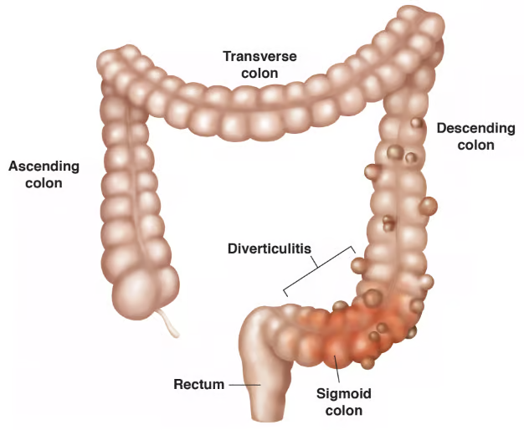
Manage follow-up colonoscopy after uncomplicated diverticulitis
Patients with uncomplicated diverticulitis should undergo colonoscopy 6 to 8 weeks after the episode of acute diverticulitis, when colonic inflammation has resolved
In patients with a recent episode of acute diverticulitis, a follow-up colonoscopy can be deferred if a high-quality colonoscopy has been completed in the last 12 months

Slide 80
Other answers
A; Colonoscopy during the acute phase of illness is contraindicated because acute diverticulitis causes acute colonic inflammation, which may increase the risk for perforation
C; Delaying colonoscopy beyond 6 to 8 weeks places the patient at risk for a missed diagnosis that could be important and time sensitive, such as colon cancer
D; 1 in 67 patients with confirmed acute diverticulitis would have a misdiagnosed colorectal cancer found on follow-up colonoscopy; almost all misdiagnosed colorectal cancers included in the technical review were located in the area of diverticulitis

Slide 81
Q20
A 65-year-old man is evaluated before hospital discharge. During hospitalization, he was treated for massive lower gastrointestinal bleeding. Fluid resuscitation relieved associated hypotension and tachycardia. The bleeding was attributed to diverticulosis, which was successfully treated during colonoscopy. He also has hypertension, type 2 diabetes mellitus, and hyperlipidemia. His medications include low-dose aspirin, hydrochlorothiazide, metformin, and rosuvastatin. Aspirin was held at the time of hospital admission. Family history includes stroke in his father.
Which of the following is the most appropriate management of this patient's aspirin therapy?
  A. Discontinue indefinitely
  B. Restart in 30 days
  C. Restart now
  D. Restart now and add omeprazole
Notes:
#94

Slide 82
Q20
A 65-year-old man is evaluated before hospital discharge. During hospitalization, he was treated for massive lower gastrointestinal bleeding. Fluid resuscitation relieved associated hypotension and tachycardia. The bleeding was attributed to diverticulosis, which was successfully treated during colonoscopy. He also has hypertension, type 2 diabetes mellitus, and hyperlipidemia. His medications include low-dose aspirin, hydrochlorothiazide, metformin, and rosuvastatin. Aspirin was held at the time of hospital admission. Family history includes stroke in his father.
Which of the following is the most appropriate management of this patient's aspirin therapy?
  A. Discontinue indefinitely
  B. Restart in 30 days
  C. Restart now
  D. Restart now and add omeprazole
Notes:
#94

Slide 83
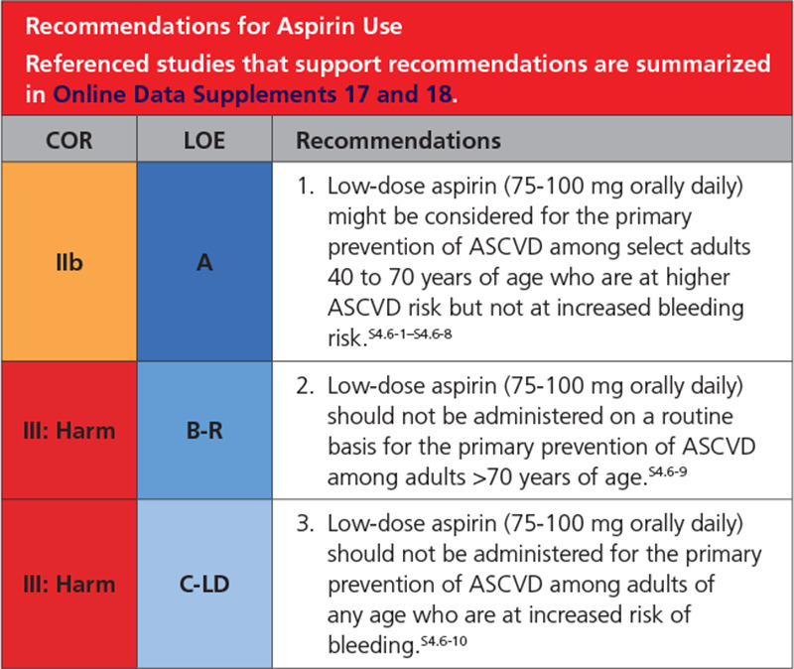
Manage aspirin therapy after lower gastrointestinal bleeding
After an episode of gastrointestinal bleeding, aspirin for primary prevention of atherosclerotic cardiovascular disease should be discontinued
After an episode of gastrointestinal bleeding, aspirin for secondary prevention of atherosclerotic cardiovascular disease should not be routinely stopped; if aspirin is stopped, then it should be restarted as soon as hemostasis is achieved
Notes:
A nonexhaustive list of conditions associated with increased bleeding risk includes: a history of previous gastrointestinal bleeding or peptic ulcer disease or bleeding at other sites, age >70 years, thrombocytopenia, coagulopathy, CKD, and concurrent use of other medications that increase bleeding risk, such as nonsteroidal anti-inflammatory drugs, steroids, direct oral anticoagulants, and warfarin.

