Slide 1

Breast Cancer
Smitha Sagaram, MBBS, MS, MPH
Medical Oncology
Banner MD Anderson Cancer Center at BUMC-P

Slide 2
Outline
Epidemiology, risk factors, screening, high risk
Staging and prognosis
Treatment paradigm
  DCIS
  Early-stage breast cancer
  Metastatic breast cancer

Slide 3
Question # 1
40-year-old woman presents to your clinic to discuss her risk of breast cancer. Which of the following increase her risk of developing breast cancer?
A. Nulliparity
B. Early menarche, late menopause
C. Age at first live birth >30 years
D. Hormone replacement therapy
E. History of chest wall radiation
F. Family history of breast and ovarian cancer
G. All the above

Slide 4
Question # 1
40-year-old woman presents to your clinic to discuss her risk of breast cancer. Which of the following increase her risk of developing breast cancer?
A. Nulliparity
B. Early menarche, late menopause
C. Age at first live birth >30 years
D. Hormone replacement therapy
E. History of chest wall radiation
F. Family history of breast and ovarian cancer
G. All the above

Slide 5
Breast Cancer - Epidemiology
Most common cancer among women in the US
  1 in 8 women will develop breast cancer
  About 300K new cases every year
2nd leading cause of death in women
95% of breast cancer cases > age of 40; median age at diagnosis is 63
Highest incidence is in White women. Second is in Black women but mortality is highest in Black women.
Mortality rates have declined

Slide 6
Breast Cancer – Risk Factors
Female sex
Age >50 years
Reproductive factors (early menarche, late menopause, first full-term pregnancy after 30, nulliparity)
Lifestyle (BMI > 30, lack of exercise, ETOH)
Prior mediastinal radiation (e.g., for Hodgkin’s lymphoma)
Exogenous hormones (OCPs, HRT > 10 years of use)
Breast density (as defined on mammogram)
Atypical breast disease (ADH, ALH, LCIS)
Family history (genetic mutations or family history)

Slide 7
Breast Cancer – High Risk Lesions
Atypical Hyperplasia and Lobular Carcinoma In Situ (LCIS)
Noninvasive lesions that increase risk of developing breast cancer
  4-times more likely to develop invasive cancer
  30% risk of developing cancer over 25-year time range
  Ipsilateral and contralateral breast
Resection (ADH)
Increased screening q6 month imaging
Chemoprevention with tamoxifen or aromatase inhibitor

Slide 8
Question # 2
What age should an average risk woman start screening mammograms?
Age 30
Age 40
Age 45
Age 50
Notes:
Annual mammograms

Slide 9
Question # 2
What age should an average risk woman start screening mammograms?
Age 30
Age 40
Age 45
Age 50
Notes:
Annual mammograms

Slide 10
Breast Cancer - Screening
Annual screening mammograms recommended starting at age 40 for average risk women
High risk of breast cancer (lifetime risk > 20%)
  Tyrer-Cuzick model, Gail model
  Supplemental screening with breast MRI in addition to mammogram
  Genetic testing (BRCA1/BRCA2)
  Chemoprevention with tamoxifen or AI
For patients suspected to be high risk, refer to high risk breast clinic to discuss genetic testing, high risk screening, risk reducing mastectomy, chemoprevention.

Slide 11
Outline
Epidemiology, risk factors, screening, high risk
Staging and Prognosis
Treatment Paradigm
  DCIS
  Early-stage breast cancer
  Metastatic breast cancer

Slide 12
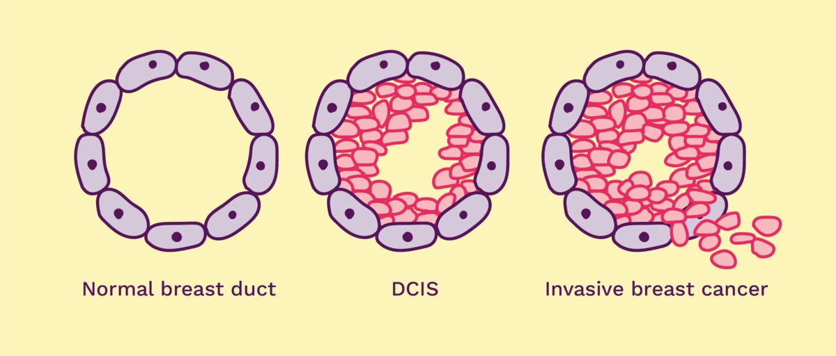
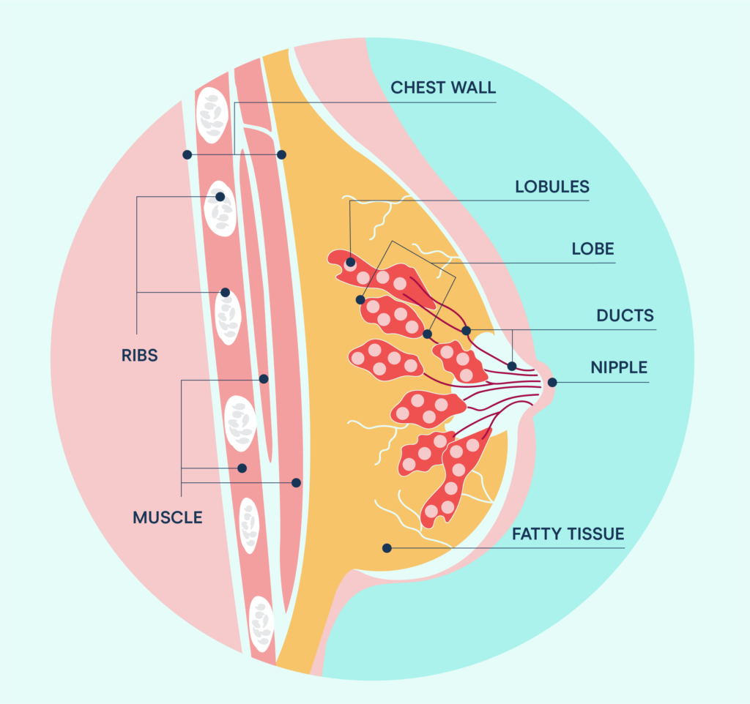
Breast Cancer - Staging
Stage | 5-year survival
0 - DCIS | >98%
I - <2 cm, negative LN | 95%
II- any T with 1-3 positive LN or 2-5cm tumor with negative LN | 85%
III- Any tumor size with > 4 LN, tumors >5 cm with >1 LN, chest wall or skin involvement | 52%
IV- distant metastases | 18%
Lobular Carcinoma
Ductal Carcinoma

Slide 13
Breast Cancer - Subsets
 | Hormone Receptor Positive | Her2 Positive | Triple Positive | Triple Negative
ER | + | - | + | -
PR | + | - | + | -
Her2/neu | - | + | + | -

Slide 14
Breast Cancer - Subsets
 | Hormone Receptor Positive | Her2 Positive | Triple Positive | Triple Negative
ER | + | - | + | -
PR | + | - | + | -
Her2/neu | - | + | + | -
ER/PR positive
70-75% of breast cancers
Degree of ER expression is positively correlated with response to endocrine therapy

Slide 15
Breast Cancer – Subsets (Continued)
 | Hormone Receptor Positive | Her2 Positive | Triple Positive | Triple Negative
ER | + | - | + | -
PR | + | - | + | -
Her2/neu | - | + | + | -
Her2 positive
15% of breast cancers (half of these are ER positive)
Predictive of response to Her2-targeted therapy and indicative of more aggressive, biologically active disease

Slide 16
Breast Cancer – Subsets (Continued)
 | Hormone Receptor Positive | Her2 Positive | Triple Positive | Triple Negative
ER | + | - | + | -
PR | + | - | + | -
Her2/neu | - | + | + | -
Triple Negative
15% of breast cancers
Chemo+immunotherapy is used to treat triple negative cancer

Slide 17
Breast Cancer – Prognostic Factors
Early stage (small tumor size, negative lymph nodes, no distant mets)
Lower grade
Absence of lympho-vascular invasion (LVI)
Positive hormone receptor status (ER/PR), Her 2 neu negative

Slide 18
Question # 3
60-year-old patient was noted to have a 0.9 cm breast mass on recent mammogram which was biopsied, confirming invasive ductal carcinoma, ER/PR positive, Her 2 negative, cT1 N0. Review of systems is negative. What imaging tests would you recommend next?
A. CT C/A/P
B. MRI brain
C. PET/CT scan
D. A/B
E. B/C
F. None of the above

Slide 19
Question # 3
60-year-old patient was noted to have a 0.9 mm breast mass on recent mammogram which was biopsied, confirming invasive ductal carcinoma, ER/PR positive, Her 2 negative, cT1 N0. Review of systems is negative. What imaging tests would you recommend next?
A. CT cap
B. MRI brain
C. PET/CT scan
D. A/B
E. B/C
E. None of the above
Systemic imaging is not recommended for early-stage breast cancer.

Slide 20
Outline
Breast cancer epidemiology, risk factors, screening, high risk
Staging and Prognosis
Treatment Paradigm
  DCIS
  Early-stage breast cancer
  Metastatic breast cancer

Slide 21
DCIS
Neoplastic proliferation confined to ductal system with atypia and risk of progression to invasive cancer. It is a PRECURSOR to invasive disease if left untreated.
Diagnosis
Calcifications on mammogram
Core needle biopsy stereotactic or US guided
FNA inadequate as it cannot distinguish between invasive or in situ disease
Treatment
Lumpectomy (or mastectomy if disease is extensive)
Adjuvant RT for most cases of lumpectomy
If ER positive, (tamoxifen/ aromatase inhibitors) for 5 years
RT and hormonal agents decrease risk of local recurrence but do not change already excellent survival

Slide 22
Outline
Breast cancer epidemiology, risk factors, screening, high risk
Staging and Prognosis
Treatment Paradigm
  DCIS
  Early-stage breast cancer
  Metastatic breast cancer

Slide 23
Treatment Paradigm – Key Concepts
Early-Stage Breast Cancer
Stage IV Breast Cancer
Surgery (Lumpectomy/Mastectomy +/-SLNB)
Radiation (Adjuvant)
Chemotherapy/Targeted therapies/Endocrine therapy
Chemotherapy/Targeted therapies/Endocrine therapy
Palliative radiation
Palliative surgery
Sentinel lymph node is the first lymph node(s) to receive lymphatic drainage from the breast
Lymphatic mapping done by injecting blue dye or radiolabeled tracer into the breast parenchyma near the area of cancer/mass or, alternatively, in a periareolar location
Lymph node(s) are removed
Neo-adjuvant = Before surgery
Adjuvant = After surgery
SLNB = sentinel lymph node biopsy

Slide 24
Treatment Paradigm – Early-Stage Breast Cancer (ER/PR positive)
 | Hormone Receptor Positive | Her2 Positive | Triple Positive | Triple Negative
ER | + | - | + | -
PR | + | - | + | -
Her2/neu | - | + | + | -
ER/PR positive
Surgery
Adjuvant chemo if Oncotype score High or lymph node involvement
Followed By Adjuvant Radiation (if lumpectomy)
Followed By Endocrine Therapy (Tamoxifen or Aromatase Inhibitor)
High risk disease: Addition of CDK 4/6 inhibitors

Slide 25
Treatment Paradigm –Oncotype DX test
The Oncotype Dx 21-gene recurrence score is a prognostic assay and predict patients who are most and least likely to derive benefit from adjuvant chemotherapy
Indicated for women with ER positive, HER2 negative breast cancer
Categorizes the tumor as low, intermediate or high risk
Low risk- adjuvant endocrine therapy alone
  Tamoxifen versus Aromatase inhibitor
High risk- chemotherapy
  TC (Taxotere, Cyclophosphamide)
  AC-T (Adriamycin, Cyclophosphamide-Taxol)

Slide 26
Treatment Paradigm –Tamoxifen and Aromatase Inhibitors
Endocrine therapy: all patients with ER and/or PR + features
  Tamoxifen in premenopausal women (antiestrogen)
    Hot flashes, mood swings, VTE (3%), CVA (3% over 60), vaginal symptoms, uterine CA (0.3%), weight gain
  Aromatase inhibitors in post menopausal women (diminish androgen to estrogen production in adipose tissue and adrenals)
    Arthralgias/myalgias, potential for decreased bone density, hot flashes, vaginal symptoms, weight gain
  Ovarian suppression + Tam/AI (premenopausal high risk)
AI = Aromatase Inhibitor
Tam = Tamoxifen

Slide 27
Treatment Paradigm – Early-Stage Breast Cancer (Her2 positive)
 | Hormone Receptor Positive | Her2 Positive | Triple Positive | Triple Negative
ER | + | - | + | -
PR | + | - | + | -
Her2/neu | - | + | + | -
Her2 positive
Neo-adjuvant chemo + Her2 directed agents
  Chemo +trastuzumab +/- pertuzumab
Surgery
+/- Radiation
Complete one year of Her2 directed therapy + Tamoxifen or Aromatase Inhibitor (If ER/PR positive)

Slide 28
Treatment Paradigm – Early-Stage Breast Cancer (Triple Negative)
 | Hormone Receptor Positive | Her2 Positive | Triple Positive | Triple Negative
ER | + | - | + | -
PR | + | - | + | -
Her2/neu | - | + | + | -
Triple Negative
Neoadjuvant chemo +/- pembrolizumab
Surgery
Radiation
Followed by pembrolizumab +/- capecitabine

Slide 29
Treatment Paradigm – Key Concepts
Adjuvant preferred
Adjuvant preferred
Stage | ER+ |  |  | Her2+ | TNBC
 | Post- menopausal | Pre- menopausal | ? Chemo
I | AI or Tam x 5 yrs | Tam | Based on Oncotype | TH | TC, AC or AC/T
II-node negative | AI x 5 yrs | OFS w/Tam or AI | Based on Oncotype | THP/TCHP | AC/T or TC/AC+pembro
II – node positive | AI x 7 yrs | OFS w/ AI | Based on Oncotype | THP/TCHP | TC/AC+pembro
III | AI x 7 yrs | OFS w/ AI | Yes, chemo | THP/TCHP | TC/AC+pembro
Neo-adjuvant = Before surgery
Adjuvant = After surgery
Neoadjuvant Preferred
TH = Taxane + Herceptin
THP = Taxane + Herceptin + Pertuzumab
TCHP = Taxane + Carboplatin + Herceptin + Pertuzumab
AC = Adriamycin + Cyclophosphamide
TC = Taxane + Cyclophosphamide
OFS = Ovarian Function Suppression
AI = Aromatase Inhibitor
Tam = Tamoxifen

Slide 30
Question #4
60-year-old patient who was diagnosed with ER/PR positive IDC of left breast 7 years ago s/p left lumpectomy, radiation and completed 5 years of aromatase inhibitor therapy, now with progression, noted to have bone and liver metastases recently. What would you recommend next in her management?
Refer to radiation oncologist for palliative radiation
Start chemotherapy
Recommend biopsy of a metastatic lesion
Refer to hospice

Slide 31
Question #4
60-year-old patient who was diagnosed with ER/PR positive IDC of left breast 7 years ago s/p left lumpectomy, radiation and completed 5 years of aromatase inhibitor therapy, now with progression, noted to have bone and liver metastases recently. What would you recommend next in her management?
Refer to radiation oncologist for palliative radiation
Start chemotherapy
Recommend biopsy of a metastatic lesion
Refer to hospice

Slide 32
Question #5
65-year-old woman who is 7 years out post lumpectomy and adjuvant XRT for early-stage ER/PR positive, Her2 negative breast cancer, stopped anastrozole 2 years ago, presents with severe, localized back pain. Alkaline phosphatase is elevated 400 U/L. Bone scan is positive for uptake on thoracic, lumbar spine and ribs. What is your immediate next step?
Refer to radiation oncologist for palliative radiation
Restart anastrozole
Obtain biopsy of a bone met
MRI spine

Slide 33
Question #5
65-year-old woman who is 7 years out post lumpectomy and adjuvant XRT for early-stage ER/PR positive, Her2 negative breast cancer, stopped anastrozole 2 years ago, presents with severe, localized back pain. Alkaline phosphatase is elevated 400 U/L. Bone scan is positive for uptake on thoracic, lumbar spine and ribs. What is your immediate next step?
Refer to radiation oncologist for palliative radiation
Restart anastrozole
Obtain biopsy of a bone met
MRI spine

Slide 34
Special Circumstances
Diagnosis of Breast CA while pregnant?
  No negative outcome when compared to women not pregnant at diagnosis
  Chemotherapy if indicated can be safely administered after 1st trimester
  RT may be delivered after delivery
Diagnosis in pt during child-bearing years still undecided about future children? Refer immediately to fertility expert before chemotherapy. Safe to employ measures for egg harvesting without harming future prognosis
Pregnancy after a Breast CA diagnosis? A personal decision but one in which the literature is favorable

Slide 35
Breast CA survivorship
Regular visits
Encourage self breast exams, yearly mammograms
Regular use of labs, tumor markers and scans are NOT recommended in asymptomatic patients and those with low suspicion for metastatic disease
Randomized studies have demonstrated no improvement in survival comparing closely followed pts vs closely followed pts with labs/markers and scans.

Slide 36
Major side effects of therapies used in breast cancer
Therapy | Important side effects to know for boards
Adriamycin | Cardiotoxicity
Cyclophosphamide | Hemorrhagic cystitis (Mesna is given)
Taxanes (Paclitaxel and Docetaxel) | Neuropathy
Trastuzumab/Pertuzumab | Cardiotoxicity, Diarrhea
Capecitabine | Hand-foot syndrome
Tamoxifen | Hot flashes, vaginal dryness Abnormal vaginal bleeding (endometrial cancer risk) DVT/PE/Stroke risk
Aromatase inhibitors | Hot flashes, vaginal dryness Osteoporosis
Zoledronic acid | Osteonecrosis of jaw
Pembrolizumab | Thyroiditis, Colitis, Hepatitis, Pneumonitis, Adrenal Insufficiency, Myocarditis, Hypophysitis

Slide 37
Oncologic Emergencies to Know for Boards
Metastatic breast cancer with acute-onset progressive lower extremity weakness, urinary retention, and saddle anesthesia
Cord Compression
IV dexamethasone followed by an urgent MRI of the entire spine. Glucocorticoids reduce edema and prevent irreversible neurological deficits while awaiting definitive therapy (radiation or surgery).
Triple negative breast cancer patient receiving pembrolizumab presents with watery diarrhea (6-8 stools/day)
Immune-related colitis
For grade 2 or higher diarrhea/colitis, discontinue the immune checkpoint inhibitor and start high-dose intravenous methylprednisolone ( 1mg/kg), followed by a prolonged taper.

Slide 38
Oncologic Emergencies to Know for Boards
Metastatic breast cancer patient with osseous mets develops confusion, nausea, and a corrected serum calcium 13
Hypercalcemia of malignancy
Aggressive intravenous fluid resuscitation with normal saline
IV Zoledronic acid
A 45-year-old woman receiving chemotherapy for breast cancer develops a temperature of 101. Her absolute neutrophil count (ANC) is 400
Febrile neutropenia
Empiric broad-spectrum intravenous antibiotics

