Slide 1
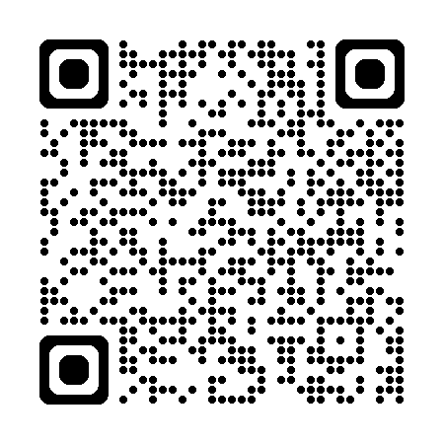
Log in with Game Code and select your team!

Slide 2
ANTICOAGULATION JEOPARDY
PICK YOUR
POISON
Xa MARKS
the SPOT
CTRL + Z
LONDON
BRIDGES
FRAGRANT
TWIGS
$100
$100
$100
$100
$100
$200
$200
$200
$200
$200
$300
$300
$300
$300
$300
$400
$400
$400
$400
$400
$500
$500
$500
$500
$500

Slide 3
PICK YOUR POISON - $100
These are the coagulation factors and regulatory proteins that are vitamin K dependent and that are affected by warfarin administration.
What are factors II, VII, IX, and X
and protein C and protein S?

Slide 4
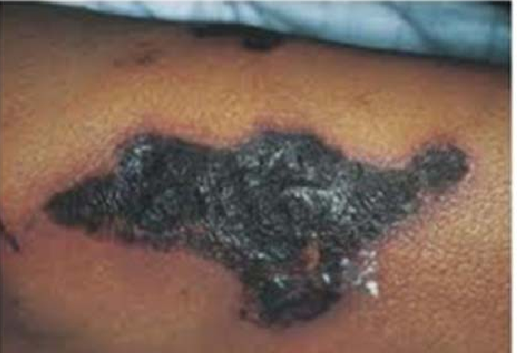
PICK YOUR POISON - $200
You started your patient on warfarin 5 days ago for atrial fibrillation. Today, she calls your office with complaints of painful skin lesions (seen below). This is what you suspect for the diagnosis AND its mechanism.
What is warfarin skin necrosis
due to protein c deficiency?

Slide 5
PICK YOUR POISON - $300
This is the appropriate management of a patient on stable warfarin dosing with therapeutic range INR who is scheduled for a tooth extraction.
What is continue warfarin without interruption?

Slide 6
PICK YOUR POISON - $400
This is the appropriate management of a patient on stable warfarin dosing with therapeutic range INR who is scheduled for procedure considered to be moderate or high risk for bleeding.
What is stop warfarin 5 days prior to procedure and resume evening after completion?

Slide 7
PICK YOUR POISON - $500
These are three reasons for which the INR goal is 2.5-3.5 (rather than the usual 2-3).
What are:
Mechanical valve in the mitral position
2. Mechanical valve + additional risk factor*
3. Systemic embolization despite adequate INR (2-3)
*Afib, prior VTE, hypercoaguable state, or LV systolic dysfunction

Slide 8
Xa MARKS THE SPOT - $100
This is the significance of an elevated INR in a patient who is on a Xa inhibitor drug such as rivaroxaban, apixaban, or edoxaban.
What is NO significance in terms of anticoagulation?

Slide 9
Xa MARKS THE SPOT - $200
This is the recommended length of time for which to hold Apixaban before a procedure with a low risk of bleeding and this is the length of time to hold Apixaban before a procedure that has moderate to high risk of bleeding.
What is 24 hours before a low-risk procedure and 48 hours prior to a moderate to high-risk procedure?

Slide 10
Xa MARKS THE SPOT - $300
This is the creatinine clearance for which rivaroxaban is contraindicated.
What is a creatinine clearance of <15 ml/min?
There is a lot of nuance about the use of apixaban in patients with ESRD, but apixaban is the preferred anti-Xa in renal insufficiency

Slide 11
Xa MARKS THE SPOT - $400
Your patient with a history of recent VTE, presents with a new PE. They are insistent on their adherence to their prescribed daily Rivaroxaban. This element in the patient’s history could explain their new PE despite adherence to medication.
What is history of bariatric surgery?
Rivaroxaban is optimally absorbed with food and is absorbed in the stomach – any procedure that shortens gastric transit time or reduces surface area of the stomach will reduce therapeutic efficacy

Slide 12
Xa MARKS THE SPOT - $500
According to the package insert, a patient with 2 of the following 3 risk factors should be dosed at 2.5 mg BID as opposed to the usual 5 mg BID of Apixaban (Eliquis) and this is the only indication for this dose adjustment.
What is:
Age ≥ 80 years;
Body weight ≤ 60 kg, and;
Creatinine ≥ 1.5 mg/dL?
Sole indication for this: non-valvular Atrial Fib

Slide 13
CTRL + Z - $100
This is the drug used to reverse the effects of unfractionated heparin in a patient with life-threatening bleeding.
What is protamine sulfate?
(1mg neutralizes 100U of heparin)
Monitor aPTT for normalization

Slide 14
CTRL + Z - $200
This is what you give to a patient who is having life-threatening bleeding or who needs emergency surgery who is on apixaban or rivaroxaban.
What is 4- factor Prothrombin Complex Concentrate?
Notes:
Can consider giving Andexanet alfa but very expensive not readily available and possible some increased rates of ischemic strokes and thrombotic risks in some studies

Slide 15
CTRL + Z - $300
These are TWO key interventions recommended in ASH 2018 guidelines for the management of a patient on warfarin who presents with a life-threatening bleed and any degree of INR elevation.
What are:
4-Factor prothrombin complex concentrate (PCC) and
IV vitamin K 5-10 mg slow infusion?
This is also consistent with the 2012 CHEST guidelines (latest version as of 2026).

Slide 16
CTRL + Z - $400
This is the ASH 2018 recommendation for the management of a patient on warfarin who presents with an INR of >4.5 but <10 who is not bleeding.
What is hold warfarin and monitor INR?
This is also consistent with the 2012 CHEST guidelines (latest version as of 2026).
Both suggest consideration for use of low dose oral vitamin K (1-2.5mg) in patients felt to be at significant risk of bleeding (recent major surgery, new permanent drug interaction)

Slide 17
CTRL + Z - $500
This is the pharmacologic therapy for a patient on dabigatran who presents with life-threatening bleeding or need for emergency surgery and its mechanism of action.
What is idarucizumab (Praxbind?)
Monoclonal antibody fragment that binds to dabigatran with a higher affinity (350x) than dabigatran binds to thrombin, neutralizing its effect immediately.

Slide 18
London Bridges - $100
This landmark trial randomized 1,884 warfarin-treated patients with atrial fibrillation to dalteparin versus placebo and found no bridging was noninferior for thromboembolism while roughly halving major bleeding.
What is the BRIDGE Trial?

Slide 19
London Bridges - $200
This is the standard therapeutic weight-based dose of enoxaparin used to overlap with warfarin, requiring a CrCl ≥30 mL/min for safe use.
What is enoxaparin 1 mg/kg twice daily (or 1.5 mg/kg once daily)?

Slide 20
London Bridges - $300
Regardless of how fast the INR rises, a heparin agent and warfarin must overlap for at least this minimum number of days.
What is 5 days?
After this, 2 consecutive INR in therapeutic range must be recorded prior to discontinuation of the heparin agent

Slide 21
London Bridges- $400
This is the specific perioperative anticoagulation strategy for a 76-year-old woman with nonvalvular atrial fibrillation, hypertension, and a stroke 3 months ago (CHA₂DS₂-VASc = 5), taking warfarin and undergoing elective hip replacement with neuraxial anesthesia. Her renal function is normal and weight is 75 kg.
What are:
Stop warfarin 5 days prior to surgery
Start 1mg/kg enoxaparin BID 3 days prior to surgery
Do not give enoxaparin day of surgery
Resume warfarin at last dose within 24 hours of surgery

Slide 22
London Bridges- $500
Certain patients with mechanical heart valves and atrial fibrillation treated with warfarin require perioperative bridging. The other population are patients with VTE and any of these 4 risk enhancing factors.
What are:
VTE in last 3 months
Antiphospholipid antibodies
Severe Thrombophilia
Certain Active Cancers*
*pancreatic, esophageal, gastric, 1* brain, and myeloproliferative disorders

Slide 23
Fragrant Twigs- $100
This is the first thing you order for a patient who presents with dyspnea and a high pre-test probability for PE by Well’s criteria who is hemodynamically stable.
What is an order for therapeutic anticoagulation?

Slide 24
Fragrant Twigs- $200
A patient with a provoked VTE should not undergo a hypercoagulable workup.
For cases of UNPROVOKED VTE, a patient should be worked up for a hypercoagulable state if they are < 50 years of age and have one of the following of these FOUR risk factors:
What is one of the following:
Positive family history (first degree relative)
Unusual vascular bed (splanchnic, cerebral)
On oral contraception/pregnancy,
Warfarin skin necrosis?

Slide 25

Fragrant Twigs- $300
Use of a heparin drip on a patient who chronically takes apixaban requires monitoring of this lab value to make decisions on titration adjustments.
Bonus $100 if can recall name of this order set.
What is an aPTT?
Order set is "Rx Hep Conversion"

Slide 26
Fragrant Twigs- $400
A patient who develops sudden onset of hypertension, tachycardia, and fever within 30 minutes of an IV heparin bolus should have this laboratory value checked stat.
What is a platelet level?
(Diagnosis: Acute HITT)

Slide 27
Fragrant Twigs- $500
A person with any one of these three medical issues may be at increased risk of developing anaphylaxis to protamine sulfate therapy.
What are:
Diabetes mellitus on NPH
An allergy to fish (salmon)
A prior vasectomy?

