Slide 1
ACID-BASE DISORDERS
Yusef Esparza Monzavi, MD
Clinical Assistant Professor of Nephrology – Critical Care
Banner University Medical Center Phoenix
The University of Arizona College of Medicine Phoenix

Slide 2
Disclosures
N/A

Slide 3
Objectives
Define acid-base balance and explain its physiological importance.
Describe the normal ranges of blood pH, PaCO₂, and HCO₃⁻.
Classify acid-base disorders into metabolic and respiratory categories.
Explain the compensatory mechanisms involved in each disorder.
Interpret arterial blood gas (ABG) results to identify specific disorders.
Discuss common causes and clinical features of each acid-base disorder.
Outline basic treatment strategies for correcting acid-base imbalances.

Slide 4
20 y/o F with severe asthma has received supplemental oxygen, nebulized albuterol continuously, IV methylprednisolone and IV Mg but fails to improve and gets intubated. Her laboratory 10 minutes earlier reveal the following
ABG: ph 7.17, PaCO2 54, PO280 . BMP: Na 136, Cl 99, K 2.8 HCO3 21
Which acid base disorder(s) is present?
Respiratory acidosis
Respiratory acidosis plus AG metabolic acidosis
Respiratory acidosis plus NAG metabolic acidosis
Respiratory acidosis plus AG metabolic acidosis plus NAG metabolic acidosis

Slide 5
Types of Acid – Base disorders
Simple
  Respiratory
    Acidosis
    Alkalosis
  Metabolic
    Acidosis
    Alkalosis
Mixed

Slide 6
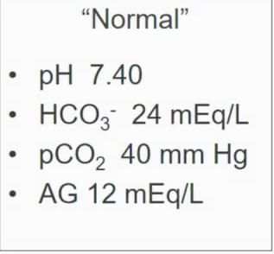
Step Wise Approach
Analyze acid base disturbance with both ABG (pH) and BMP (HCO3)
  Correct the venous blood gas add 0.05 to make it same as arterial
  Correct the venous pCO2 decrease 5 (-5) to make same as arterial
  Serum bicarbonate to arterial bicarbonate difference of 5
Verify accuracy
  Compared calculated HCO3 on ABG vs.HCO3 on electrolyte panel
Calculate Anion Gap AG = [Na] – (Cl + HCO3)
  Correct for serum albumin
    Approx 80% of serum AG is due to negative charges on circulating protein
    For each 1g/dl fall in albumin the anion gap raises by 2.5
Calculate predicted respiratory or metabolic compensation
Know causes of HAG and NAG
Compare △AG with △ HCO3 (delta/delta) > Predicted HCO3 equal to measure HCO3 (change in AG)
  <1 =AGMA + Non AGMA
  1-2 = pure AGMA
  >2 MA + Malk (look for expected change in HCO3)
Calculate serum osmolar gap when cause of HAG not know or toxic alcohol ingestion suspected
Notes:
Protein 16 + organic acid 4 + po4/so4 is 2 = 22
K5 + Ca 5+ Mg 2 = 12

Slide 7
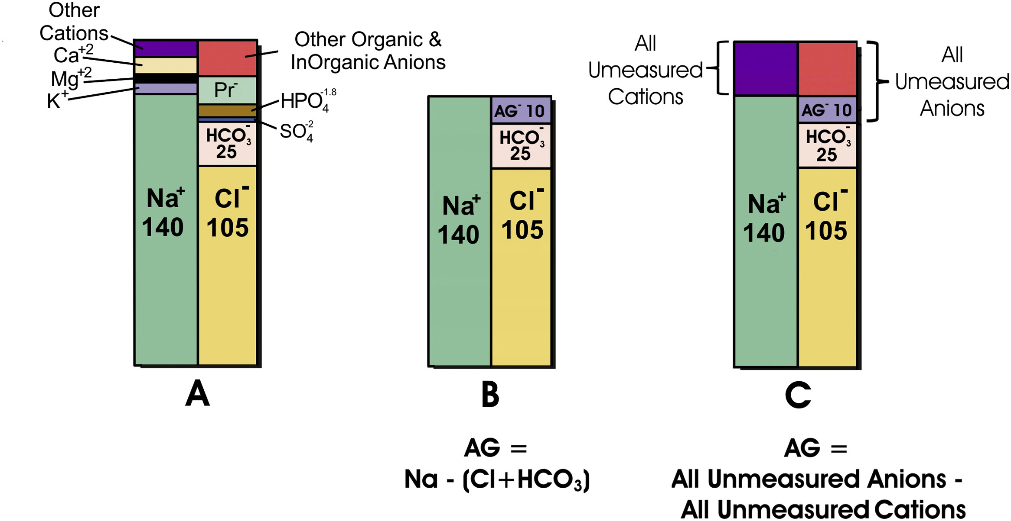
AG = [Na] – (Cl + HCO3) nl 10-12 mEq/L
Represents unmeasured anions present in the serum including anionic proteins, phosphate , sulfate and organic anions.
Correct for serum albumin

Slide 8
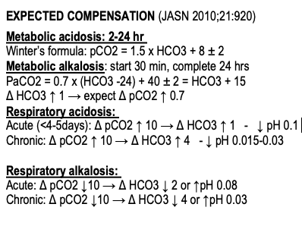
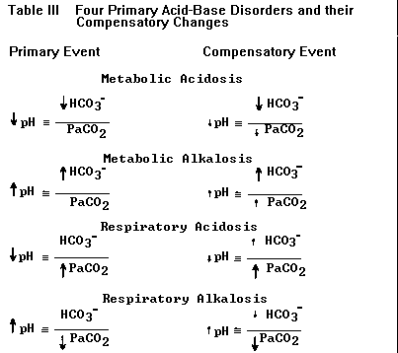

Slide 9
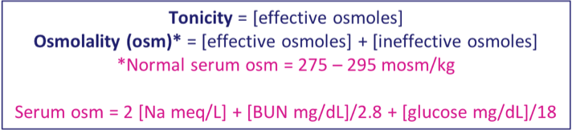
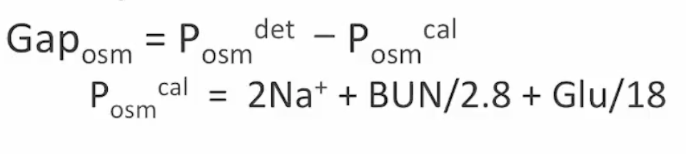
Osmolar Gap in diagnosis of Toxin-Induce AGMA
Compared measures and calculated osmolality
Gap >10 setting of possible toxin ingestion suggest EgMP (ethylene glycol, Methyl alcohol or propylene glycol)

Slide 10

20 y/o F with severe asthma has received supplemental oxygen, nebulized albuterol continuously, IV methylprednisolone and IV Mg but fails to improve and gets intubated. Her laboratory 10 minutes earlier reveal the following
ABG: ph 7.17, PaCO2 54, PO280 . BMP: Na 136, Cl 99, K 2.8 HCO3 21
Which acid base disorder(s) is present?
Respiratory acidosis
Respiratory acidosis plus AG metabolic acidosis
Respiratory acidosis plus NAG metabolic acidosis
Respiratory acidosis plus AG metabolic acidosis plus NAG metabolic acidosis

Slide 11
ABG: 7.17 / 54 / 80
Respiratory Acidosis
Na: 136 / Cl: 99 / HCO3: 21
Expected HCO3:
25.5
AG = [Na] – (Cl + HCO3)
16 (nl 10-12)
△AG / △ HCO3 =
16-12 / 24 -21 = 1.3
  <1 =AGMA + Non AGMA
  1-2 = pure AGMA
  >2 MA + Malk (look for expected change in HCO3)

Slide 12
20 y/o F with severe asthma has received supplemental oxygen, nebulized albuterol continuously, IV methylprednisolone and IV Mg but fails to improve and gets intubated. Her laboratory 10 minutes earlier reveal the following
ABG: ph 7.17, PaCO2 54, PO280 . BMP: Na 136, Cl 99, K 2.8 HCO3 21
Which acid base disorder(s) is present?
Respiratory acidosis
Respiratory acidosis plus AG metabolic acidosis
Respiratory acidosis plus NAG metabolic acidosis
Respiratory acidosis plus AG metabolic acidosis plus NAG metabolic acidosis

Slide 13
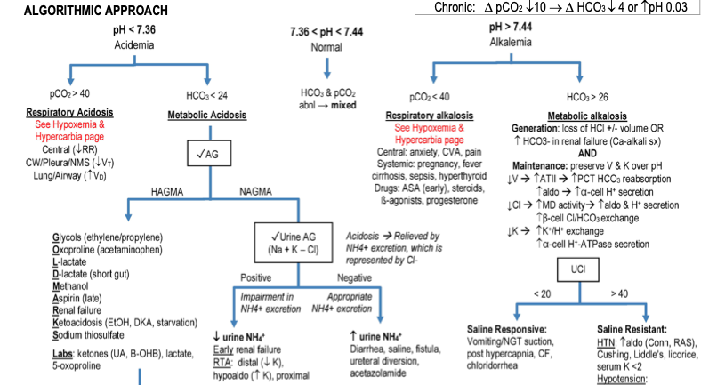
Housestaff Manual, MGH – Harvard.

Slide 14
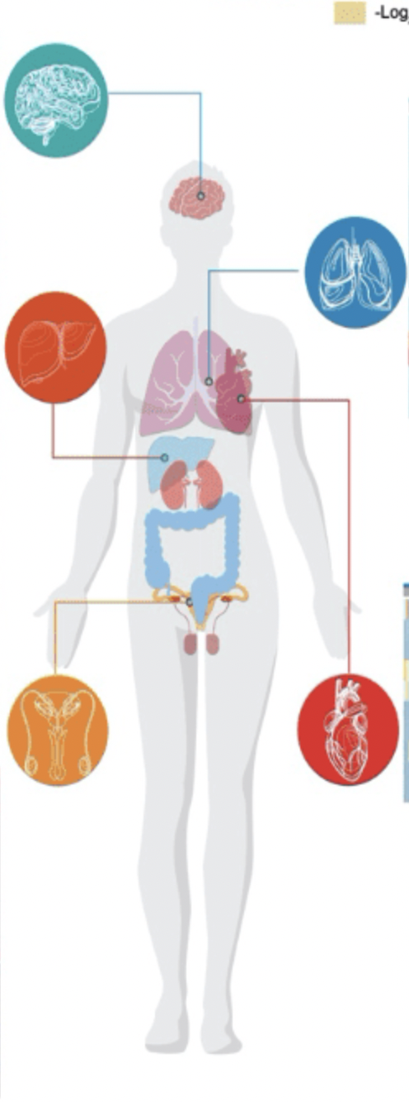

Metabolic Acidosis (AGMA)
Lethargy, coma,
Insulin resistance, inhibition of anaerobic glycolysis, protein degradation, decrease ATP synthesis,
Decrease vaso & venoconstriction -> puml. Congestion
Shift Hg-O2 diss. Curve to Right -> decrease 02 uptake and increase O2 release
Hyperventilation, reps fatigue / failure
Acute Kidney injury Nephrolithiasis
Hyperkalemia
Impaired contractility, vasodilatation, venoconstriction, decrease CO, sensitization to arrhythmias, decrease responsiveness to pressors
Multisystem Failure

Slide 15
Causes of HAGMA
Differential diagnosis of HAGMA
Glycolysis (EgMP)
Oxyproline
L - lactate
D - lactate
Methanol
Aspirin
Renal failure
Ketoacidosis
Ketoacidosis
- Diabetic
- Alcoholic
- Starvation
Lactic acidosis
- Type A
- Type B
- D Lactic acidosis

Slide 16
39 y/o M found unresponsive (>12h). GCS 6. Initial ABG pH 6.83 PCO2 101, PO2 96
Intubated. BMP: Na 133, K 6.8, Cl 101, Bicarbonate 16, BUN 38, Creatinine 3.1, glucose 229.
UTox +ve for opiates, THC, cocaine. Urine ketones -ve.
Blood ASA and acetaminophen -ve.
Serum osmolality 314. LA 1,4.
Repeat ABG pH 7.22
Which of the following is the most appropriate next step
Charcoal hemoperfusion
Insulin infusion
Fomepizole
Urine alkalinization with Bicarbonate in D5W
ABG ph 6.83, PCO2 101 PO2 96 HCO3 16
Respiratory Acidosis
Na: 133 / Cl: 101 / HCO3: 16
Expected HCO3:
(24+6) = 30 ~
Respiratory Acidosis + Metabolic acidosis
AG = [Na] – (Cl + HCO3)
16 (nl 10-12)
△AG /HCO3 =
16-12 / 24 - 16 = 0.5
Respiratory Acidosis + HAGMA + NAGMA
Calculated osmolality:
2Na + BUN/2.8 + Glucose/18
OG = SO – CO
OG = 314 – 292
OG = 21.7

Slide 17
39 y/o M found unresponsive (>12h). GCS 6. Initial ABG pH 6.83 PCO2 101, PO2 96
Intubated. BMP: Na 133, K 6.8, Cl 101, Bicarbonate 16, BUN 38, Creatinine 3.1, glucose 229.
UTox +ve for opiates, THC, cocaine. Urine ketones -ve.
Blood ASA and acetaminophen -ve.
Serum osmolality 314. LA 1,4.
Repeat ABG pH 7.22
Which of the following is the most appropriate next step
Charcoal hemoperfusion
Insulin infusion
Fomepizole
Urine alkalinization with Bicarbonate in D5W
ABG ph 6.83, PCO2 101 PO2 96 HCO3 16
Respiratory Acidosis
Na: 133 / Cl: 101 / HCO3: 16
Expected HCO3:
~30
Respiratory Acidosis + Metabolic acidosis
AG = [Na] – (Cl + HCO3)
16 (nl 10-12)
△AG /HCO3 =
16-12 / 24 - 16 = 0.5
Respiratory Acidosis + HAGMA + NAGMA
Calculated osmolality:
2Na + BUN/2.8 + Glucose/18
OG = SO – CO
OG = 314 – 292
OG = 21.7

Slide 18
Causes of HAGMA
Differential diagnosis of HAGMA
Glycolysis (EgMP)
Oxyproline
L - lactate
D - lactate
Methanol
Aspirin
Renal failure
Ketoacidosis
Ketoacidosis
- Diabetic
- Alcoholic
- Starvation
Lactic acidosis
- Type A
- Type B
- D Lactic acidosis

Slide 19
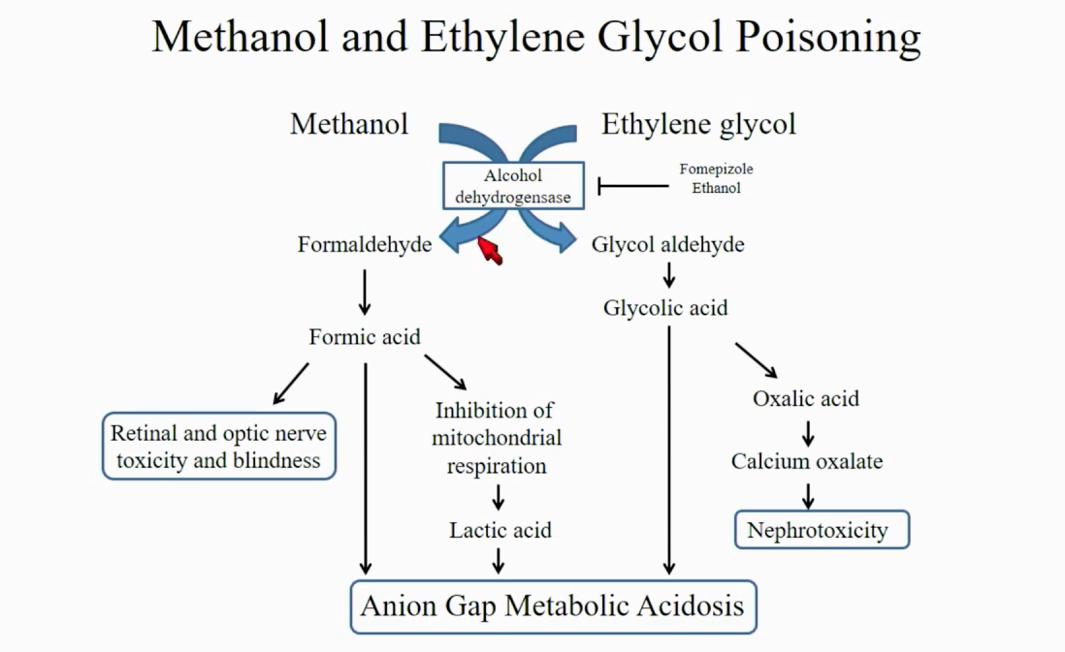








Toxins / drugs:
INCREASE OSMOLAR GAP

Slide 20
Increase AG (Eg-M-P)
  Ethylene glycol
    Impaired conversion of lactate to glucose , increase NADH/NAD ratio,
      Converted to glycolic acid > glycoxylic acid > oxalic acid
    Automobile antifreeze (deicing / cooling fluid)
    Can have lactate gap (discrepancy between measure lactate and blood gas lactate, due to artificial elevation of LA in ABG)
    3 stages of symptoms
      Neuro (seizures, coma), N/V
      Shock, pulmonary edema
      AKI, Oliguria, Ca+OxC.
    Tx:
      - Fomepizole (competes with ETOH dehydrogenase & no conversion to acids; give every 4h if HD (gets dialyze) - IV fluids containing HCO3
        Initial dose is 15 mg/kg, with subsequent doses of 10 mg/kg every 6 h until the toxin is cleared (EG <20)
      - HD > if there is severe metabolic acidosis (pH <7.25), AKI, ethylene glycol level >50 mg/dL, or glycolate level >10 mg/dL (if available)
        HD is generally continued until the EG level is <20 mg/dL.

Slide 21
  Methanol > Blindness (retinal edema) , hyperemic optic disc, cerebral edema
    Windshield fluids, paint thinner, photocopier fluid.
    Methanol is metabolized to formic acid
    Emergent dialysis
      Refractory acidosis (pH<7.2), neurological / ocular manifestation
  Propylene glycol > BZD ggt, phenobarbital, phenytoin, etomidate
    It’s a vehicle of IV sedatives
    Can be another form of D lactic acidosis > But can have normal AG
    Can produce AKI
    Role of fomepizole is unproven
  Diethyl glycol = automobile break fluid , cerebral palsy
Normal AG:
  Isopropyl glycol
    ketones and fruity odor , rubbing alcohol, mouthwash, solvents
    Treatment is supportive care

Slide 22
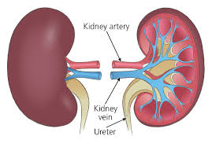
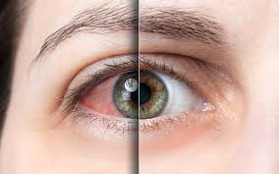

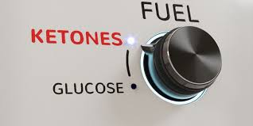
 | Ethylene Glycol | Methanol | Propylene Glycol | Isopropyl Glycol
OG | ✔️ | ✔️ | ✔️ | ✔️
AG | ✔️ | ✔️ | ✔️

Slide 23
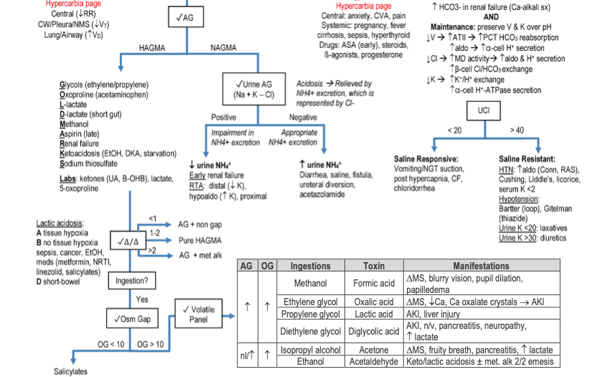

Slide 24
Causes of HAGMA
Differential diagnosis of HAGMA
Glycolysis (EgMP)
Oxyproline
L - lactate
D - lactate
Methanol
Aspirin
Renal failure
Ketoacidosis
Ketoacidosis
- Diabetic
- Alcoholic
- Starvation
Lactic acidosis
- Type A
- Type B
- D Lactic acidosis

Slide 25
Type A vs. Type B
Lactic Acidosis

Slide 26
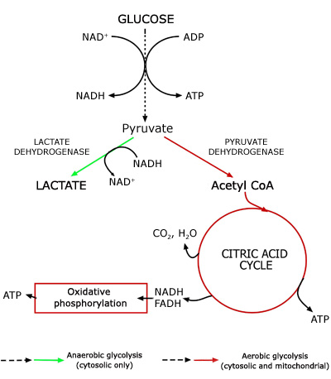
Notes:
Glycolysis: One molecule of glucose (6 carbons) is broken down into two molecules of pyruvate >> 2 Pyruvate, 2 ATP (net) (4 made – 2 used) 2 NADH
ATP (Adenosine Triphosphate)> ATP is like a charged battery — when it’s used, it becomes ADP (a drained battery), and then it's recharged in processes like glycolysis, the Krebs cycle, and oxidative phosphorylation.
NADH (Nicotinamide Adenine Dinucleotide – reduced form) NADH is like a shuttle that carries high-energy electrons to the power plant (electron transport chain) to generate more ATP.

Slide 27
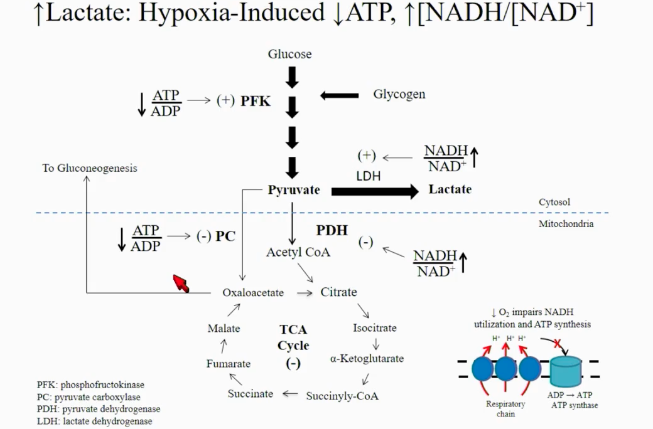


Type A
Notes:
No enough O2 impaired the ability to synthetize ATP in the electron transport system and impaired NADH utilization and impairs PDH and favors LDH , and reduction of ATP decrease gluconeogenesis
NADH stimulates LDH
NADH inhibits PDH
Low ATP inhibits (PC) pyruvate carboxylase and can lead to hypoglycemia

Slide 28
Type A (tissue hypoperfusion) = INCREASE LACTATE - PYRUVATE RATIO
  Hypoxic = imbalance between oxygen supply and oxygen demand
    Anaerobic metabolism drives pyruvate toward lactate > increasing lactate to pyruvate ratio
  Seen in states if low DO2 (low cardiac output (HR/SV), severe anemia, CO poisoning, Hypoxia
  Tx:
    CAREFUL with administration of NaHCO3
      can increase lactate production (usually given with pH<7.1)
      can retain / produce more CO2 worsening hypoventilation

Slide 29
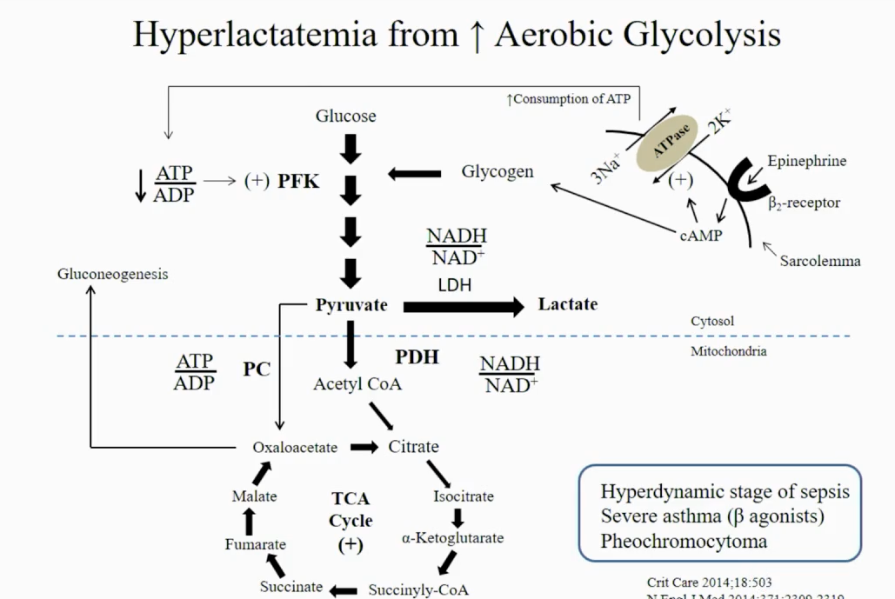
Type B
Notes:
Absence of hypoxia like infection due to increase catecholamine disease which in skeletal muscle increase generation of cAMP
1. supplies glucose for glycolysis
2. activation of N/K ATPase and increase consumption of ATP that favors glycolytic pathway to pyruvate with some going to lactate but as opposed with type some moves to ACoA

Slide 30
Type B : (LACTATE - PYRUVATE RATIO NORMAL)
Oxygen delivery normal but phosphorylation impaired
  Seen more with catecholamines (anaerobic does NOT play a role)
  Accelerated glycolysis > (High catecholamines production which stimulate anaerobic, sepsis , seizures, cocaine)
  Reduce clearance (Hepatic dysfunction )
  Mitochondrial dysfunction

Slide 31
Drugs :
  HIV (zidovudine, didanosine, lamivudine) decrease oxidation of pyruvate with mitochondrial dysfunction
  ASA, ethanol (increase NADH/NAD ratio which increase lactate and ketoacid, exacerbated with thiamine deficiency)
  Linezolid
  Thiamine deficiency (essential enzyme cofactor in glycolysis (pyruvate dehydrogenase complex), the citric acid cycle (α-ketoglutarate dehydrogenase complex)
  Isoniazid
  Propofol (mitochondrial dysfunction)
  Metformin
Malignancy (large tumor burden and cell lysis)
Sorbitol , fructose (consumes ATP = stimulating glycolysis)

Slide 32
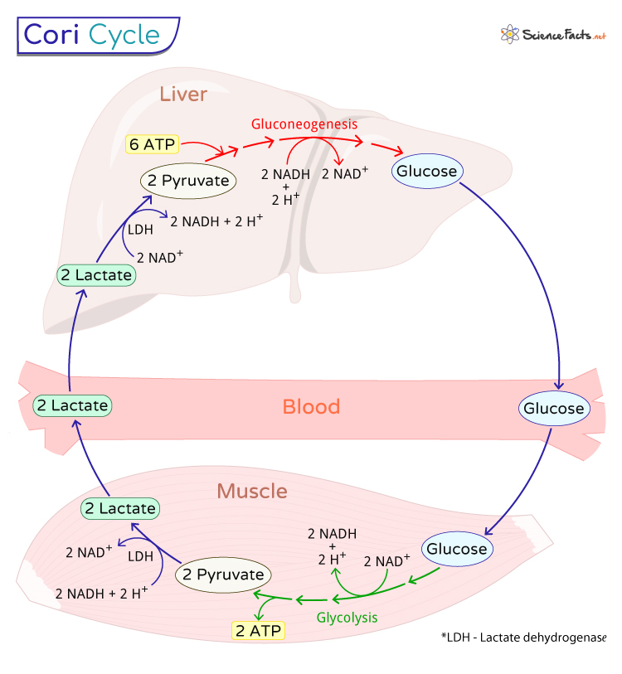
Lactic Acidosis clearance
Notes:
All day long there is a massive production of lactate from the skeletal muscle which is taken by the liver and synthetized to glucose
- Of course if there is a reason of massive production of lactate (seizures) or decrease metabolism by the liver will have higher level of lactate in our system
Lactate Synthetized to glucose by phosphoenolpyruvate carboxykinase = cycle know as coru cycle.
Can have more even high production (seizures) or decrease synthetize
(liver disease)
Produced all day long

Slide 33
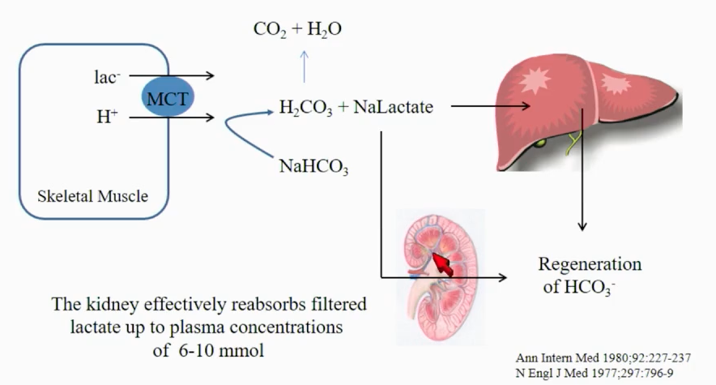
NH4
Notes:
Lactate metabolize and form sodium lactate and on liver can be generated to bicarbonate
Also in kidney can be filtered )sodium lactate) and regenerate bicarbonate in distal loop
3 mechanism is if sodium lactate can be excreted as ammonia
All this keep system close and does not require exogenic administration

Slide 34
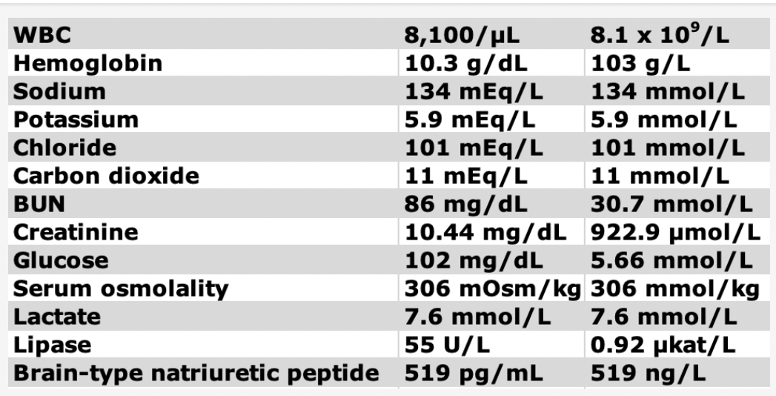
55 y/o F with Hx of CHF, T2DM, HTN presents with decrease UOP, nausea, diarrhea and fatigue. Medications she has continued to take despite Nausea include ( ASA, metformin, lisinopril, metoprolol). VS 90/70 HR 135 RR 13 Sat 99% RA.
Labs in Fig ; ABG ph 7.07, PCO2 15 PO2 120 HCO3 6
Serum tox: ASA , Tylenol and Ethanol level all normal.
Despite 1.5L of LR she has progressive hypotension and levophed is initiated.
New LA is 16.9.
Which of the following interventions is indicated
Infusion of glucagon
Infusion of D5W
Hemodialysis
Fomepizole

Slide 35
55 y/o F with Hx of CHF, T2DM, HTN presents with decrease UOP, nausea, diarrhea and fatigue. Medications she has continued to take despite Nausea include ( ASA, metformin, lisinopril, metoprolol). VS 90/70 HR 135 RR 13 Sat 99% RA.
Labs in Fig , ABG ph 7.07, PCO2 15 PO2 120 HCO3 6
Serum tox: ASA , Tylenol and Ethanol level all normal.
Despite 1.5L of LR she has progressive hypotension and levophed is initiated.
New LA is 16.9.
ABG ph 7.07, PCO2 15 PO2 120 HCO3 6
Metabolic Acidosis
Na: 134 / Cl: 101 / HCO3: 11
AG = [Na] – (Cl + HCO3)
22 (nl 10-12)
HAG Metabolic acidosis
Expected CO2:
Winters formula: (1.5 x HCO3) + 8 +/- 2
24.5 +/- 2
HAG Metabolic acidosis + Respiratory Alkalosis
△AG /HCO3 =
22-12 / 24 -11 = 0.7
HAG Metabolic acidosis + Respiratory Alkalosis + NAG metabolic acidosis

Slide 36
55 y/o F with Hx of CHF, T2DM, HTN presents with decrease UOP, nausea, diarrhea and fatigue. Medications she has continued to take despite Nausea include ( ASA, metformin, lisinopril, metoprolol). VS 90/70 HR 135 RR 13 Sat 99% RA.
Labs in Fig ; ABG ph 7.07, PCO2 15 PO2 120 HCO3 6
Serum tox: ASA , Tylenol and Ethanol level all normal.
Despite 1.5L of LR she has progressive hypotension and levophed is initiated.
New LA is 16.9.
Which of the following interventions is indicated
Infusion of glucagon
Infusion of D5W
Hemodialysis
Fomepizole

Slide 37
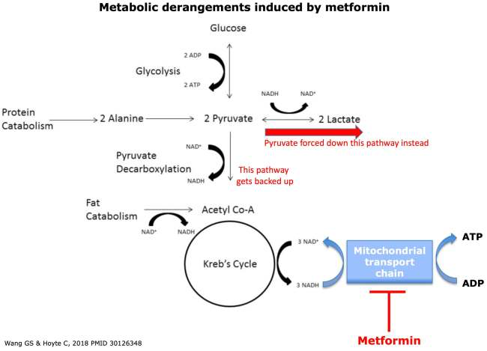
Metformin
MA : decrease gluconeogenesis, inhibits pyruvate dehydrogenase, E: 100% renal) decrease 50% in CKD3 and stop in CKD4
  in Kidney failure (CKD) =more accumulation = binds to mitochondrial complex = increase LDH = increase lactate
  MALA (intoxication) = p/w N,V,D AMS, tachycardia, SOB , AGMA (>LA ,Ex: ~10 or more; pH <7.1 )
  Tx:
    RRT (small V/ distribution) : Failure to improve with supportive care (IV fluids, pressors), pH <7, and/or lactic acid >20 mmol/L
      5h of HD and then CRRT with high dose
      Usually does not result in hypoglycemia

Slide 38
19-y/o, admitted with acute hemiparesis following recreational cocaine use. CTH showed ICH.
Patient was intubated and sedated with propofol and underwent craniectomy with hemorrhage evacuation.
Systemic inflammation led to treatment with vancomycin and meropenem, but cultures were negative. Neurological findings were unimproved, New imaging showed worsened cerebral edema.
On day 6, decompressive craniectomy was performed.
The immediate postoperative VS : HR 130-140/min, BP 85/55 requiring vasoactive therapy. TTE EF 55%, but no regional wall abnormalities. SV 65 mL (with vasoactive meds). ScvO2 0.78.
He became anuric, fever worsened, and laboratory values showed hyperkalemia, elevated creatine kinase (73,000 U/L [1,219.10 μkat/L]), and lactic acidosis (9 mmol/L). Ventricular premature beats became increasingly frequent. Hydrocortisone was given, and renal replacement therapy was initiated to control serum potassium levels. Bradycardia led to transcutaneous pacing.
Despite maximal supportive treatment, profound ventricular dysrhythmias ensued, and the patient died 24 h following the second craniectomy.
Which of one of the following mechanisms best explains this patient's postsurgical deterioration?
Globally depressed oxygen transport to tissues
Sepsis induce microvascular dysfunction
Mitochondrial impairment
Drug related Anaphylactic reaction

Slide 39
PRIS
Propofol related infusion syndrome
*Mitochondrial impairment (The mechanism of PRIS involves inhibition of mitochondrial fatty acid oxidation and electron transport ).
Lactic acidosis 88%
Cardiac arrhythmia / Brugada type coved ST elevation , BBB 70% , bradycardia
Rhabdomyolysis 65% (elevated CK)
Hypotension 50%
Renal failure 47%, Uric acid crystalluria > just monitor
Hyperkalemia 44%
Hyperlipidemia 20%
Pancreatitis , hypertriglyceridemia
Tx:
Discontinuing propofol
Supportive therapy
Prolonged dialysis > CRRT (cuz is poorly cleared)

Slide 40
D lactic acidosis (lactate measured in lab is not D lactic acidosis)
Mostly seen with small bowel resection > carbohydrate meal reaches colon > bacterial fermentation > generates organic acid including D lactate
Presents with encephalopathy (ataxia, slurred speech) following carbohydrate meal where in colon bacterial fermentation generated organic acid to include D lactate
Dg
  Confirmed by demonstrating high levels of D-lactate in urine and/or in serum. D-lactic acid level is usually greater than 3 mmol/L in D-lactic acidosis. D-lactate level is measured enzymatically using a D-lactic dehydrogenase specific assay.

Slide 41
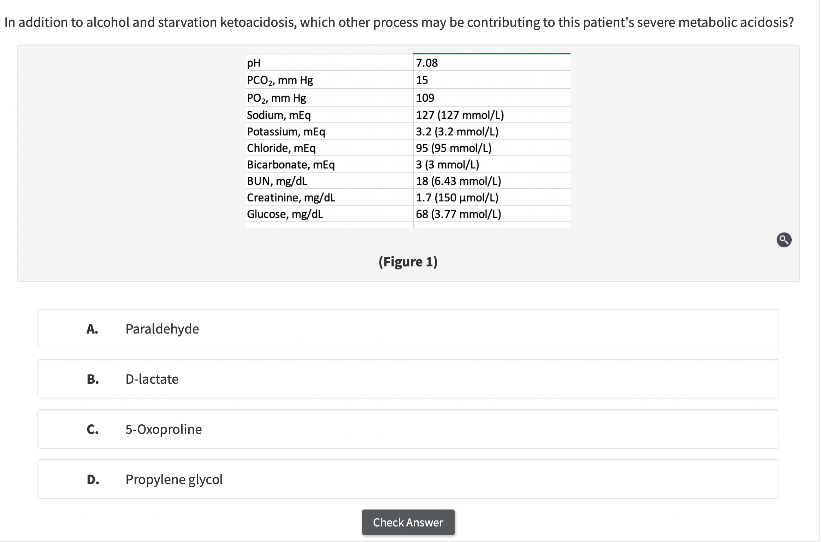
57 y/o w is admitted for SOB and AMS. She has hx of polysubstance abuse, COPD, depression. 3 weeks ago, had a mechanical fall while intoxicated, sustaining a right radius fx. Current medications include oxycodone and Tylenol prn. She has been heavily drinking since the fall.
Patient requires to be intubated due to respiratory failure. Blood work shows WBC 14k, ALT 150/AST 61. Albumin 2. Toxicology + for opiates. Tylenol level 7ug/ml. Osmolar gap is nl. Rest of chemistry in fig 1. CXR with RUL consolidation. Started on ceftriaxone, azithromycin, thiamine, folate and IV fluids.
In addition to alcohol and starvation ketoacidosis, which process is contributing to severe metabolic acidosis.
Paraldehyde
D lactate
5 oxyproline
Propylene glycol

Slide 42
ABG ph 7.08, PCO2 15 PO2 109 HCO3 - 3
Acidosis
Na: 127 / Cl: 95 / HCO3: 3
AG = [Na] – (Cl + HCO3)
29 (nl 10-12)
29 + 5 = 34
HAG Metabolic acidosis
Expected CO2:
Winters formula: (1.5 x HCO3) + 8 +/- 2
12.5 +/- 2
HAG Metabolic acidosis
△AG /HCO3 =
34-12 / 24 - 3 = 1.04
HAG Metabolic acidosis
Osmolar Gap is normal
Paraldehyde
D lactate
5 oxyproline
Propylene glycol

Slide 43
57 y/o w is admitted for SOB and AMS. She has hx of polysubstance abuse, COPD, depression. 3 weeks ago, had a mechanical fall while intoxicated, sustaining a right radius fx. Current medications include oxycodone and Tylenol prn. She has been heavily drinking since the fall.
Patient requires to be intubated due to respiratory failure. Blood work shows WBC 14k, ALT 150/AST 61. Albumin 2. Toxicology + for opiates. Tylenol level 7ug/ml. Osmolar gap is nl. Rest of chemistry in fig 1. CXR with RUL consolidation. Started on ceftriaxone, azithromycin, thiamine, folate and IV fluids.
In addition to alcohol and starvation ketoacidosis, which process is contributing to severe metabolic acidosis.
Paraldehyde
D lactate
5 oxyproline
Propylene glycol

Slide 44
Causes of HAGMA
Differential diagnosis of HAGMA
Glycolysis (EgMP)
Oxyproline
L - lactate
D - lactate
Methanol
Aspirin
Renal failure
Ketoacidosis
Ketoacidosis
- Diabetic
- Alcoholic
- Starvation
Lactic acidosis
- Type A
- Type B
- D Lactic acidosis

Slide 45
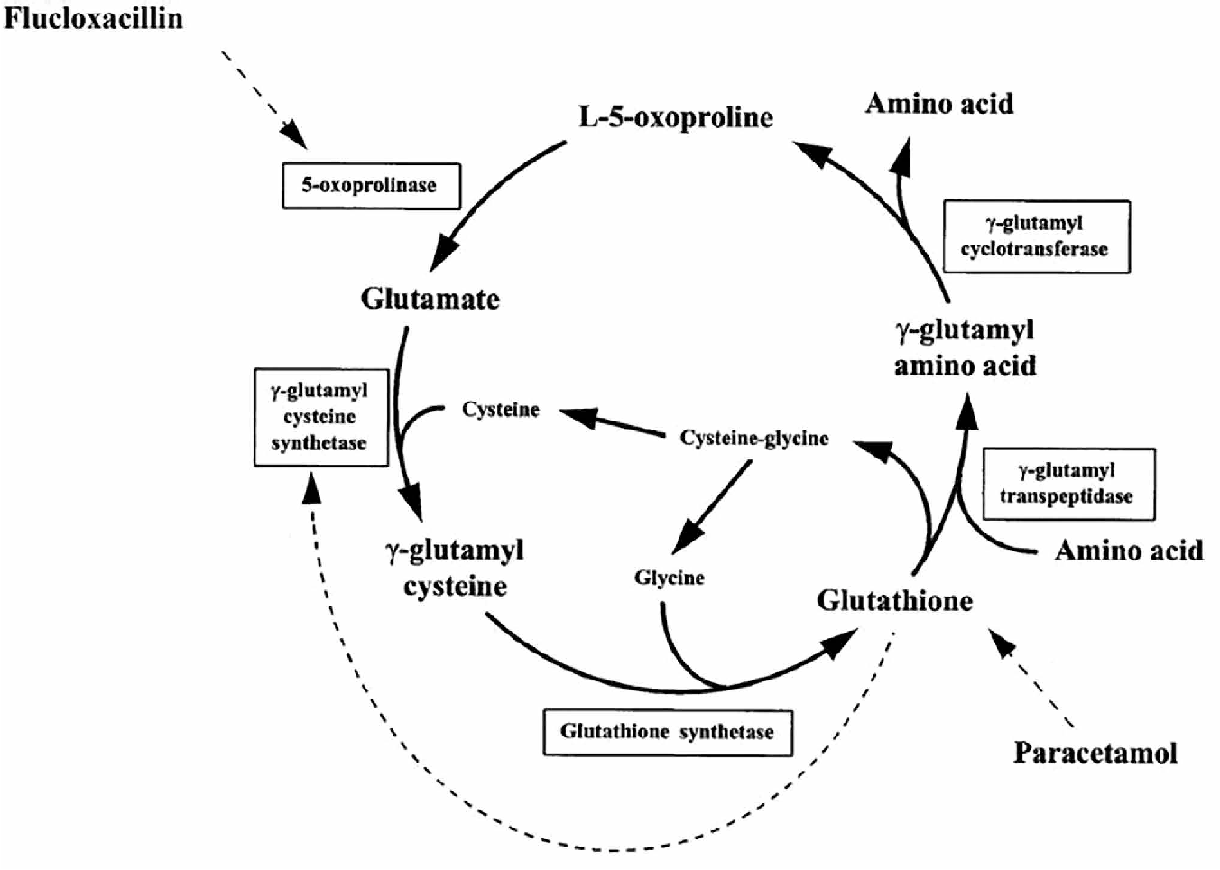
5-Oxyproline (pyroglutamic acid)
  Decrease glutathione > glutamate unable to be used for synthesis and auto cyclizes in ATP depleting cycle to 5 oxyproline
  More seen in infection and use of Acetaminophen , poor nutrition, cirrhosis
  Profound / severe AG elevation , w/ NO osmolar gap / Can have Normal LA
  Dg:
    5 oxyproline in serum
    urine analyses for organic acid screen > pyroglutamic acids (Tylenol) > look for urinary organic acid screen
    do if RRTx is needed chose CRRT

Slide 46
Causes of HAGMA
Differential diagnosis of HAGMA
Glycolysis (EgMP)
Oxyproline
L - lactate
D - lactate
Methanol
Aspirin
Renal failure
Ketoacidosis
Ketoacidosis
- Diabetic
- Alcoholic
- Starvation
Lactic acidosis
- Type A
- Type B
- D Lactic acidosis

Slide 47
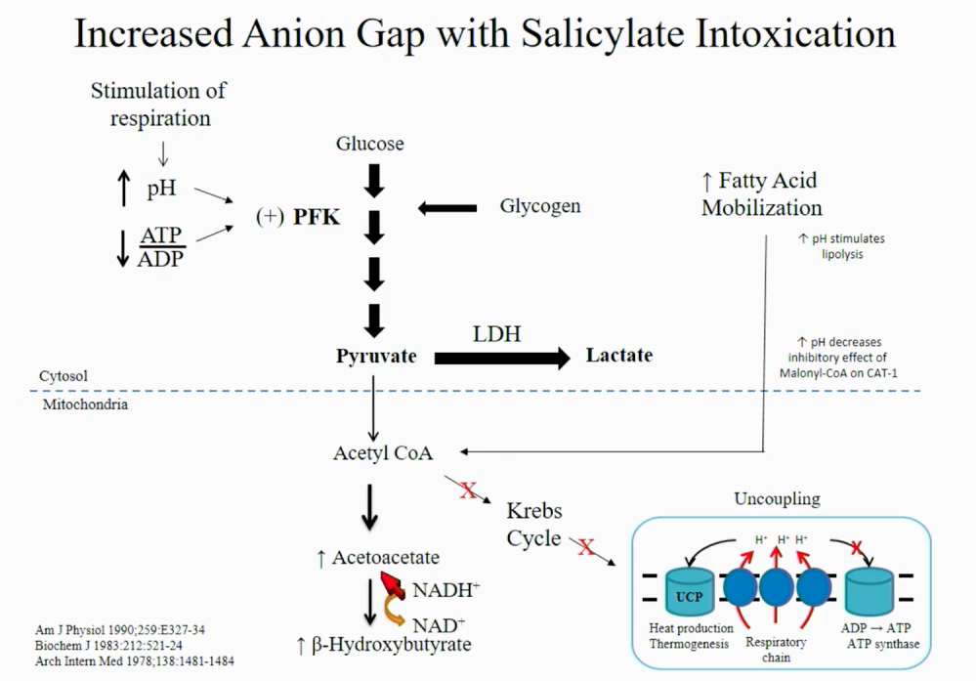
Salicylate Intoxication
Notes:
ASA is direct stimulatory of respiratory system in the medulla independent of the aortic and carotid bodies, Incrase ph causes increase PFK (phosphofructokinase – also due to uncoupling of electron transport) which increase metabolism of glucose (that why are hypoglycemic) and increase lactate also increases fatty acid mobilization to ACA and increase ketones
mostly 2/2 keto and endogenous lactic acid (salicylic acid alters phosphorylation in mitochondria > low ATP )
Inhibitory effect of ASA on oxidative phosphorylation

Slide 48
Salicylate intoxication
Respiratory alkalosis + AG Metabolic Acidosis
Symptoms
  Presents with CNS (cerebral edema, seizures , AMS, coma, neuroglycopenia)
  Volume overload (non cardiogenic Pulmonary edema, also seen in opioid intoxication) , AKI, tachypnea, tinnitus , N,V, hyperpyrexia
  Decrease reabsorption of uric acid in proximal tubule = hypouricemia and hyperuricosuria
  Hypokalemia
  Elevated lactic acid , high production of ketones
Tto:
  Alkalization (IV sodium bicarbonate alone or + dialysis if indications) goal keep pH 7.4-7.6
    Alkalinization will trap drug .
    Empiric use of dextrose (ASA can have CNS effect due to neuroglycopenia > even with normal serum glucose)
  Dialysis (small V/ distribution) --->>>. At least 4-6h of HD > then can do CRRT <<<-----
    ASA level >100,
    ASA > 90 + persistent AKI,
    Fluid overload/pulmonary edema,
    AMS cerebral edema
    Severe acidemia
Notes:
Vd tells us how widely a drug distributes throughout the body.
It's a theoretical volume that reflects where the drug goes:
Low Vd → mostly stays in the blood/plasma
High Vd → spreads out into tissues, fat, or organs
Vd. What it means: Dialysis effectiveness
Low (<1 L/kg) Drug stays mostly in plasma More dialyzable
High (>1 L/kg) Drug is mostly in tissues Poorly dialyzable

Slide 49
Ketoacidosis
Diabetic Ketoacidosis
Alcoholic Ketoacidosis
Starvation ketoacidosis

Slide 50
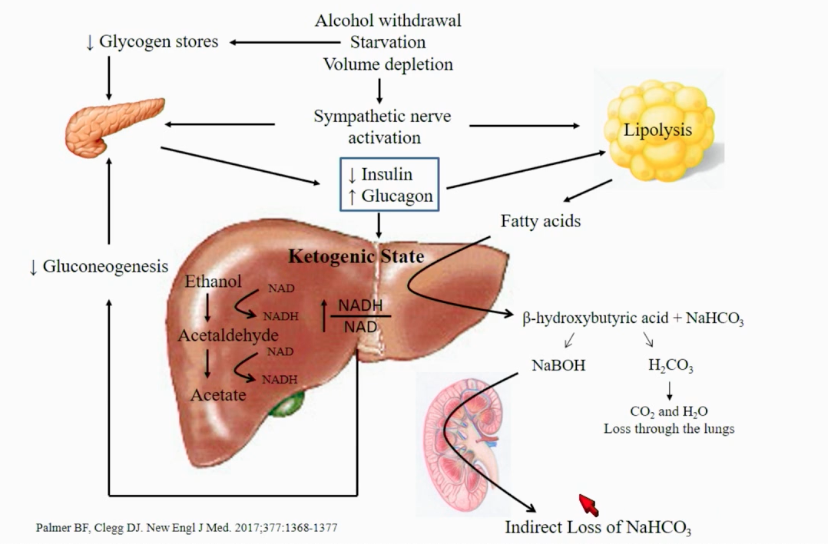
Notes:
Low insulin & high glucagon generates a ketogenic state in the liver
Alcohol withdrawal / starvation / volume depletion > sympathetic nerve activation with low I/ high G > low glycogen stores decrease insulin release by pancreas with decrease gluconeogenesis
Goes to lipolysis with production of fatty acids and generation of ketones
Tx: thiamine , glucose, volume
Is rapid reversable with Initial therapy is 5% dextrose in 0.9% NS , restore ECF and lower sympathetic and provides Cl for correction of metabolic alkaloses

Slide 51
Diabetic ketoacidosis
  Potassium : If Serum K is low = really low K
    Reduced level due to osmotic diuresis, but serum level can remain normal because potassium shifts out of cells in response to insulin deficiency and increased osmolality
    Hyperglycemia solvent drag of K to serum
    Hypovolemia : RASS > aldosterone excrete K
  Can also present as NAGMA at beginning & end
    NAGMA: Beginning (when there is preserved kidney function there is loss of ketones in urine (ketones are converted into HCO3 by liver if not excreted)
    AGMA : when there is massive ketogenesis with volume contraction and AKI
    NAGMA: fluids + insulin makes ketogenesis ceases due ue to increase ketones excretion
  Tx:
    Careful if you give bicarbonate cuz it can overshoot alkalosis (insulin/fluids will metabolize ketones to NaHCO3) , Also can cause hypocalcemia
      Can be used in severe acidosis
      NaHCO3 only if pH <7.1
    Use LR as resuscitation (subgroup of SALT ED & SMART showed that DKA resolves 4h earlier with balance fluids (Acetate and lactate are metabolized to HCO3)
    Add D5W when glucose level 200-250mg/dl)
      Don’t stop insulin , you can just cut it in 1/2 (you only stop for hypokalemia)
Euglycemic DKA (SGLT2I, pregnancy, anorexia, chronic liver disease, ETOH ingestion)
  Glucose level <250, metabolic acidosis and ketosis (LA is normal)
    For euglycemic DKA treatment is the same just need to mores dextrose

Slide 52
Alcoholic ketoacidosis
  Decrease insulin secretion > increase other hormones (glucagon Epi, cortisol)> lipolysis > ketones production > acetoacetate > metabolize to B hydroxy by NADH = more lactate
  Tto:
    Thiamine >to help metabolization of pyruvate to energy and also to decrease risk of Wernicke encephalopathy (if D5 is given it will consume thiamine)
    D5-NS
      Treatment with dextrose will increase insulin and decrease glucagon secretion and will also stop ketosis, while saline will repair any volume deficit
  Careful D5 can worsen hypophosphatemia given that will raise insulin and will increase PO4 intake
Bicarb infusion almost never used, careful with hypocalcemia = can worsen hypocalcemia
Starvation ketoacidosis
  Decrease insulin secretion (starvation) > increase other hormones (glucagon Epi, cortisol)> lipolysis > ketones production > acetoacetate > metabolize to B hydroxy by NADH

Slide 54
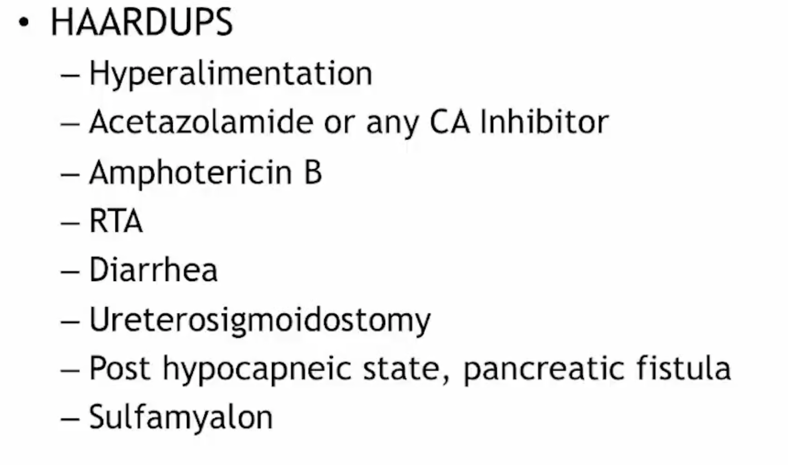
Non Anion Gap Metabolic Acidosis (NAGMA)
Causes NAGMA
Notes:
RTAs (proximal and distal (hypokalemia), type 4 (hyperkalemia)
Ureteral diversion (ex ileal loop , ureter sigmoidoscopy)
Drugs (CA inhibitors (acetazolamide, topiramate,), amphotericin B , CaCxl, MgSO4, acid loads (NH4CL)
Increased unmeasured cations (Ca, Mg, Li+, IgG paraproteinemia (MM) ≠ IgA)
Sulfamylon (Mafenide Acetate)?
Class: Sulfonamide antibiotic (related to sulfa drugs)
Form: Typically comes as a 5% topical cream or solution
Used for: Prevention and treatment of bacterial infections in burn wounds, especially second- and third-degree burns
Covers: Both Gram-positive and Gram-negative bacteria, including Pseudomonas aeruginosa

Slide 55
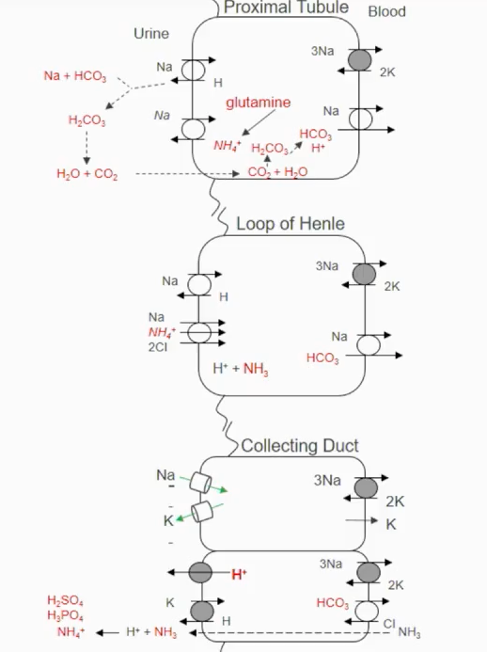
NAGMA
Role of the kidney (Renal vs. non-Renal)
Reclamation of filtered bicarbonate (PCT / DCT)
Impaired H secretion (DCT)
- Ammonia production and excretion increases with dietary acid load (protein)

Slide 56
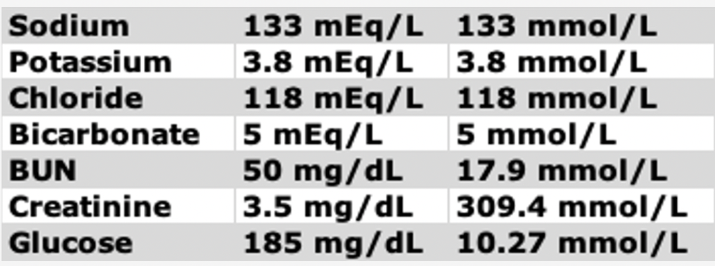
68 y/o F w/hx of HTN, T2DM, p/w diarrhea for 3 days. Her medications include lisinopril, furosemide, spironolactone, and recent use of amoxicillin-clavulanate for sinusitis. Has been drinking just electrolytes solutions. She reports some decrease urine output over the last 24h. labs in fig.
ABG pH 7.22, PCO2 20, PO2 102, HCO3 5.
Urine studies: Una 31, UK 12, UCl 60
What can best explain the patient’s acid base picture?
Type 4 RTA
Starvation ketosis
Amoxicillin – clavulanate related LA
Diarrhea

Slide 57
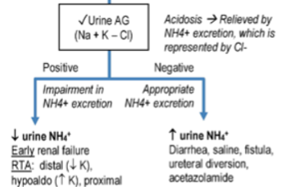
68 y/o F w/hx of HTN, T2DM, p/w diarrhea for 3 days. Her medications include lisinopril, furosemide, spironolactone, and recent use of amoxicillin-clavulanate for sinusitis. Has been drinking just electrolytes solutions. She reports some decrease urine output over the last 24h. labs in fig.
ABG pH 7.22, PCO2 20, PO2 102, HCO3 5.
Urine studies: Una 31, UK 12, UCl 60
What can best explain the patient’s acid base picture?
Type 4 RTA
Starvation ketosis
Amoxicillin – clavulanate related LA
Diarrhea
ABG ph 7.22, PCO2 20 PO2 102 HCO3 5
Acidosis
Na: 133 / Cl: 118 / HCO3: 5
AG = [Na] – (Cl + HCO3)
10 (nl 10-12)
Non Anion Gap Metabolic Acidosis
UAG= (Una + UK ) – UCl
UAG = (31 + 12) – 60
UAG = -17
Diarrhea

Slide 58
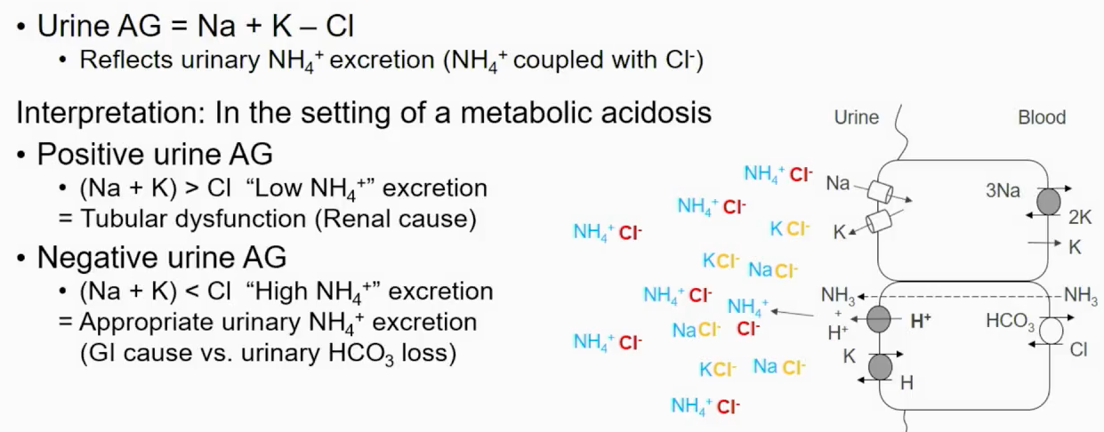
Renal vs non-Renal
Notes:
Limitation of UAG is that Amonia can be coupled with other anions than CL (Ex ketonuria, toluene abuse) is this scenario you have to calculate the UOG

Slide 59
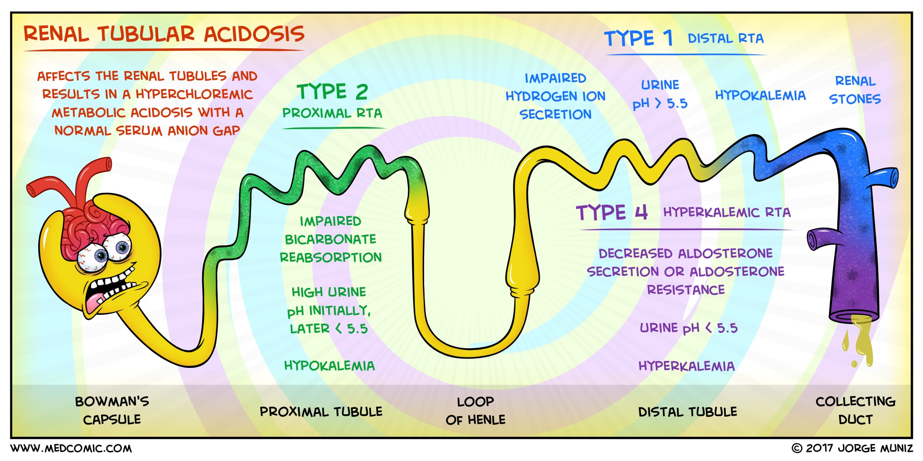
Types of Renal acidosis
Hypokalemic forms
  Proximal RTA (Type 2)
  Classical Distal (Type 1)
Hyperkalemic forms
  Type 4 (many forms depending renin / aldosterone ratio)
Normokalemic
  RTA of CKD 2-4
  Uremic Acidosis
Notes:
T1: Fracional excreation of bicarbonate is high (>15mEq)
T2: no Cl secreation (not ammonia)
Proximal RTA (type 2)
-Acquired : Fancony (all hypo Ca,Mg, PO4, UA) , MM, heavy metal toxins,.
Medications : Cai (acetazolamide) aminoglucosydes, cisplatin) Lead,
Distal (type 1)
Autoimmune (Sjogren, SLE, RA, hyperPTH), cryoglobulin, toluene
Na Hco3 650mg Tab (7.6mEq)

Slide 60
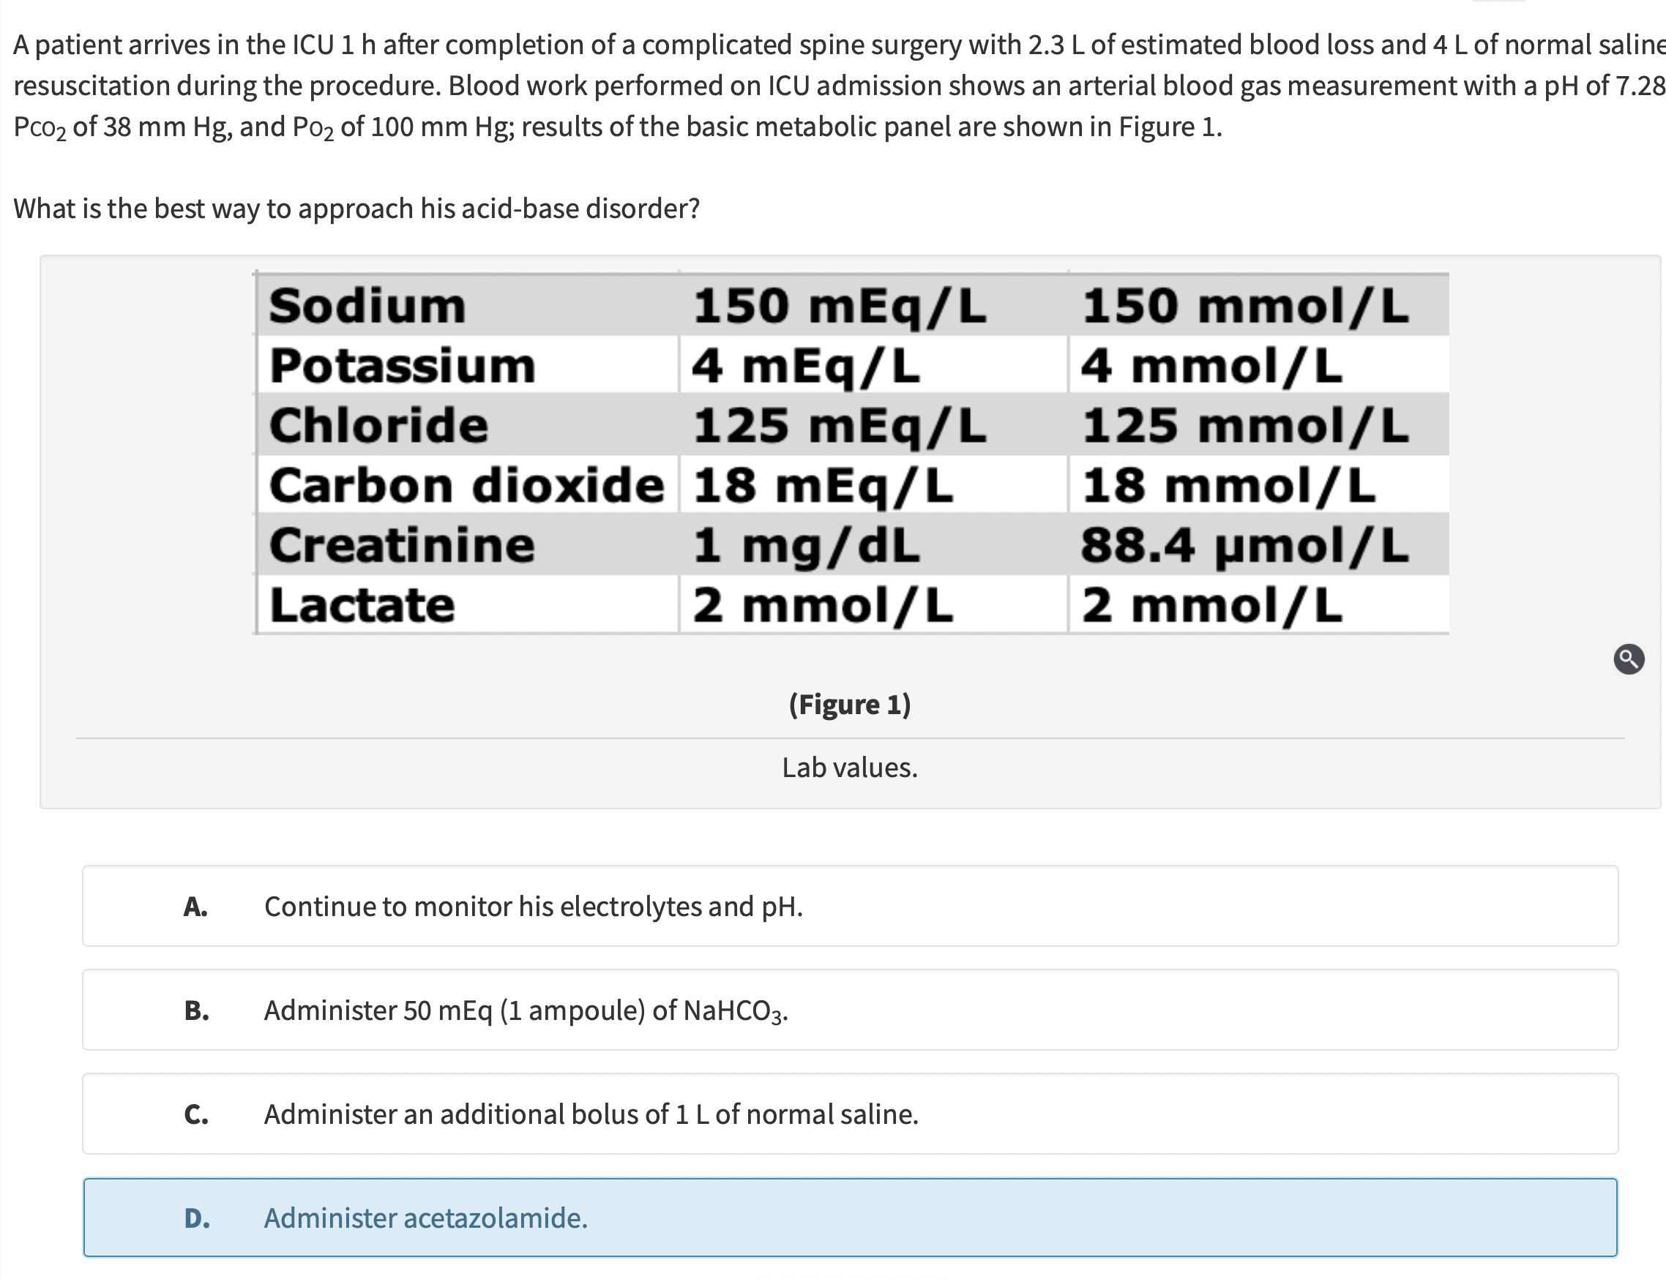
A patient arrives to the ICU 1h after a Spinal Sx w/2.3 L of estimated blood loss and 4L of NS resuscitation during the procedure. ICU ABG: ph 7.28, PCO2 38, PO2 100. BMP in fig
What is the best way to approach this acid base disorder?
Continue to monitor his electrolytes and pH
Administer 50 mEq (1 amp) of NaHCO3
Administer an additional bolus of 1L NS
Administer acetazolamide
ABG ph 7.28, PCO2 38 PO2 100
Acidosis
Na: 150 / Cl: 125 / HCO3: 18
AG = [Na] – (Cl + HCO3)
7 (nl 10-12)

Slide 61
A patient arrives to the ICU 1h after a Spinal Sx w/2.3 L of estimated blood loss and 4L of NS resuscitation during the procedure. ICU ABG: ph 7.28, PCO2 38, PO2 100. BMP in fig
What is the best way to approach this acid base disorder?
Continue to monitor his electrolytes and pH
Administer 50 mEq (1 amp) of NaHCO3
Administer an additional bolus of 1L NS
Administer acetazolamide
ABG ph 7.28, PCO2 38 PO2 100
Acidosis
Na: 150 / Cl: 125 / HCO3: 18
AG = [Na] – (Cl + HCO3)
7 (nl 10-12)

Slide 62
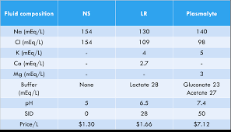
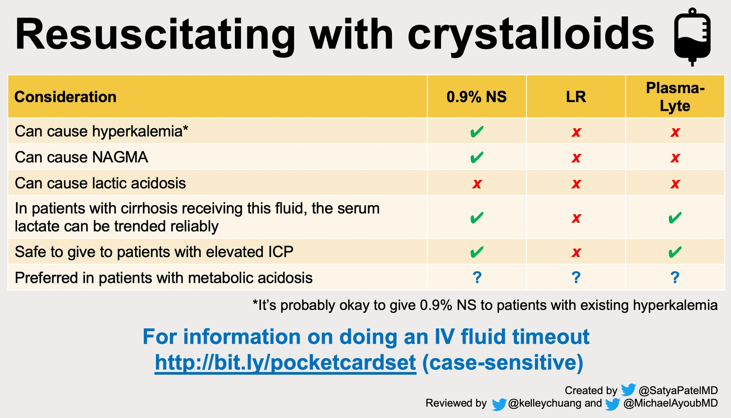

Slide 63
Metabolic alkalosis
GI losses:
  H+ losses (Vomiting, NGT), laxative abuse (hypokalemia), hereditary Cl losing diarrhea, use of PPI.
Urinary:
  Diuretic use / abuse
  Loss ability to excrete HCO3
    Volume depletion w/ decreased HCO3 filtration due to GFR decline
    Proximal tubular Na and HCO3 reabsorption increased
    Cl depletion (inability to excrete HCO3 in collecting duct)
    K depletion (extracellular shift of K in exchange for H+
Exogenous administration alkali (milk alkali syndrome – Ca carbonate ingestion)
Mineralocorticoid / glucocorticoid excess
Hypokalemia
Post hypercapnic metabolic alkalosis (seen in chronic CO2 retainers with compensatory HCO3 retention when MV increased)

Slide 64
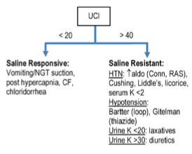
Metabolic alkalosis
Interventions: Cl back?
Cl sensitive
  Replace NaCl, replace Mg, K, stop offending agent diuretic / laxative, PPI for gastric losses, acetazolamide (ongoing diuretic requirement)
Cl resistant
  Stop alkali , cause specific

Slide 65
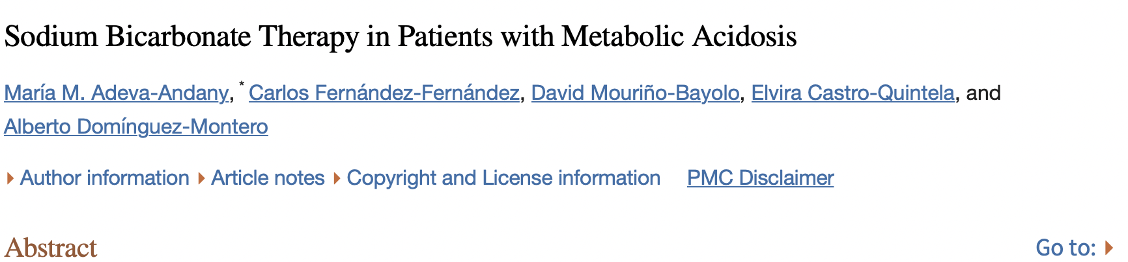
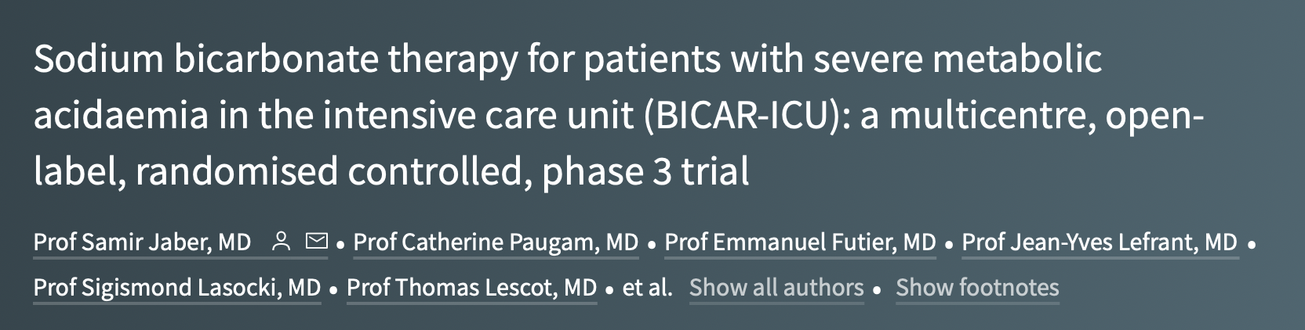
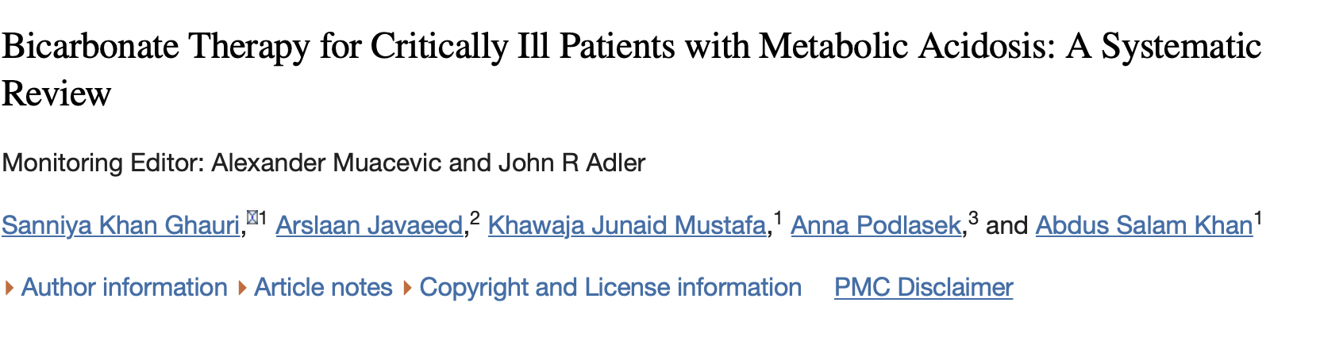
- Sodium bicarbonate had no effect on the primary composite outcome
Metabolic alkalosis, hypernatremia, and hypocalcemia were observed more frequently in the bicarbonate group than in the control group
BICAR ICU trial: ICU patients with severe metabolic acidosis did not have improvement in all cause mortality at day 28 or the presence of >1 organ failure at day 7. However, there was a reduction of AKI (in pre specified group)

Slide 66
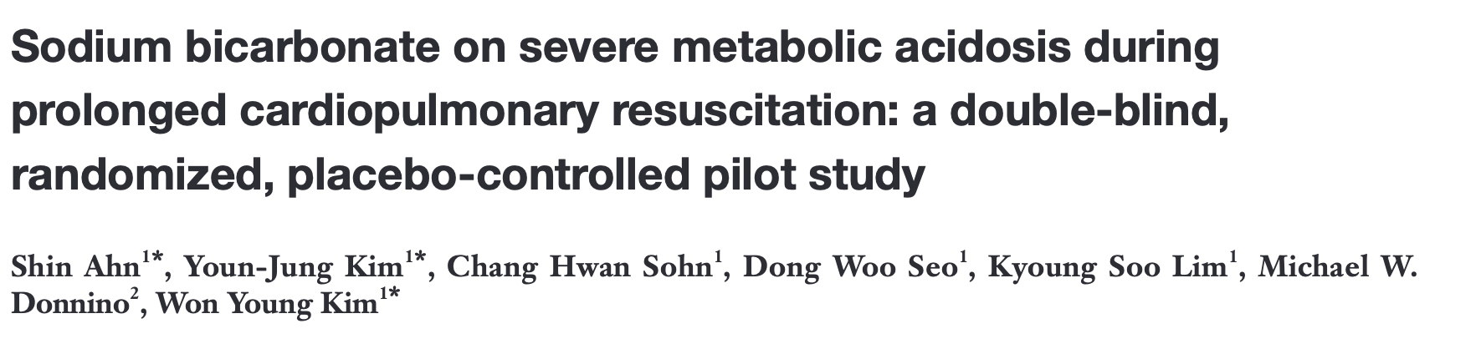
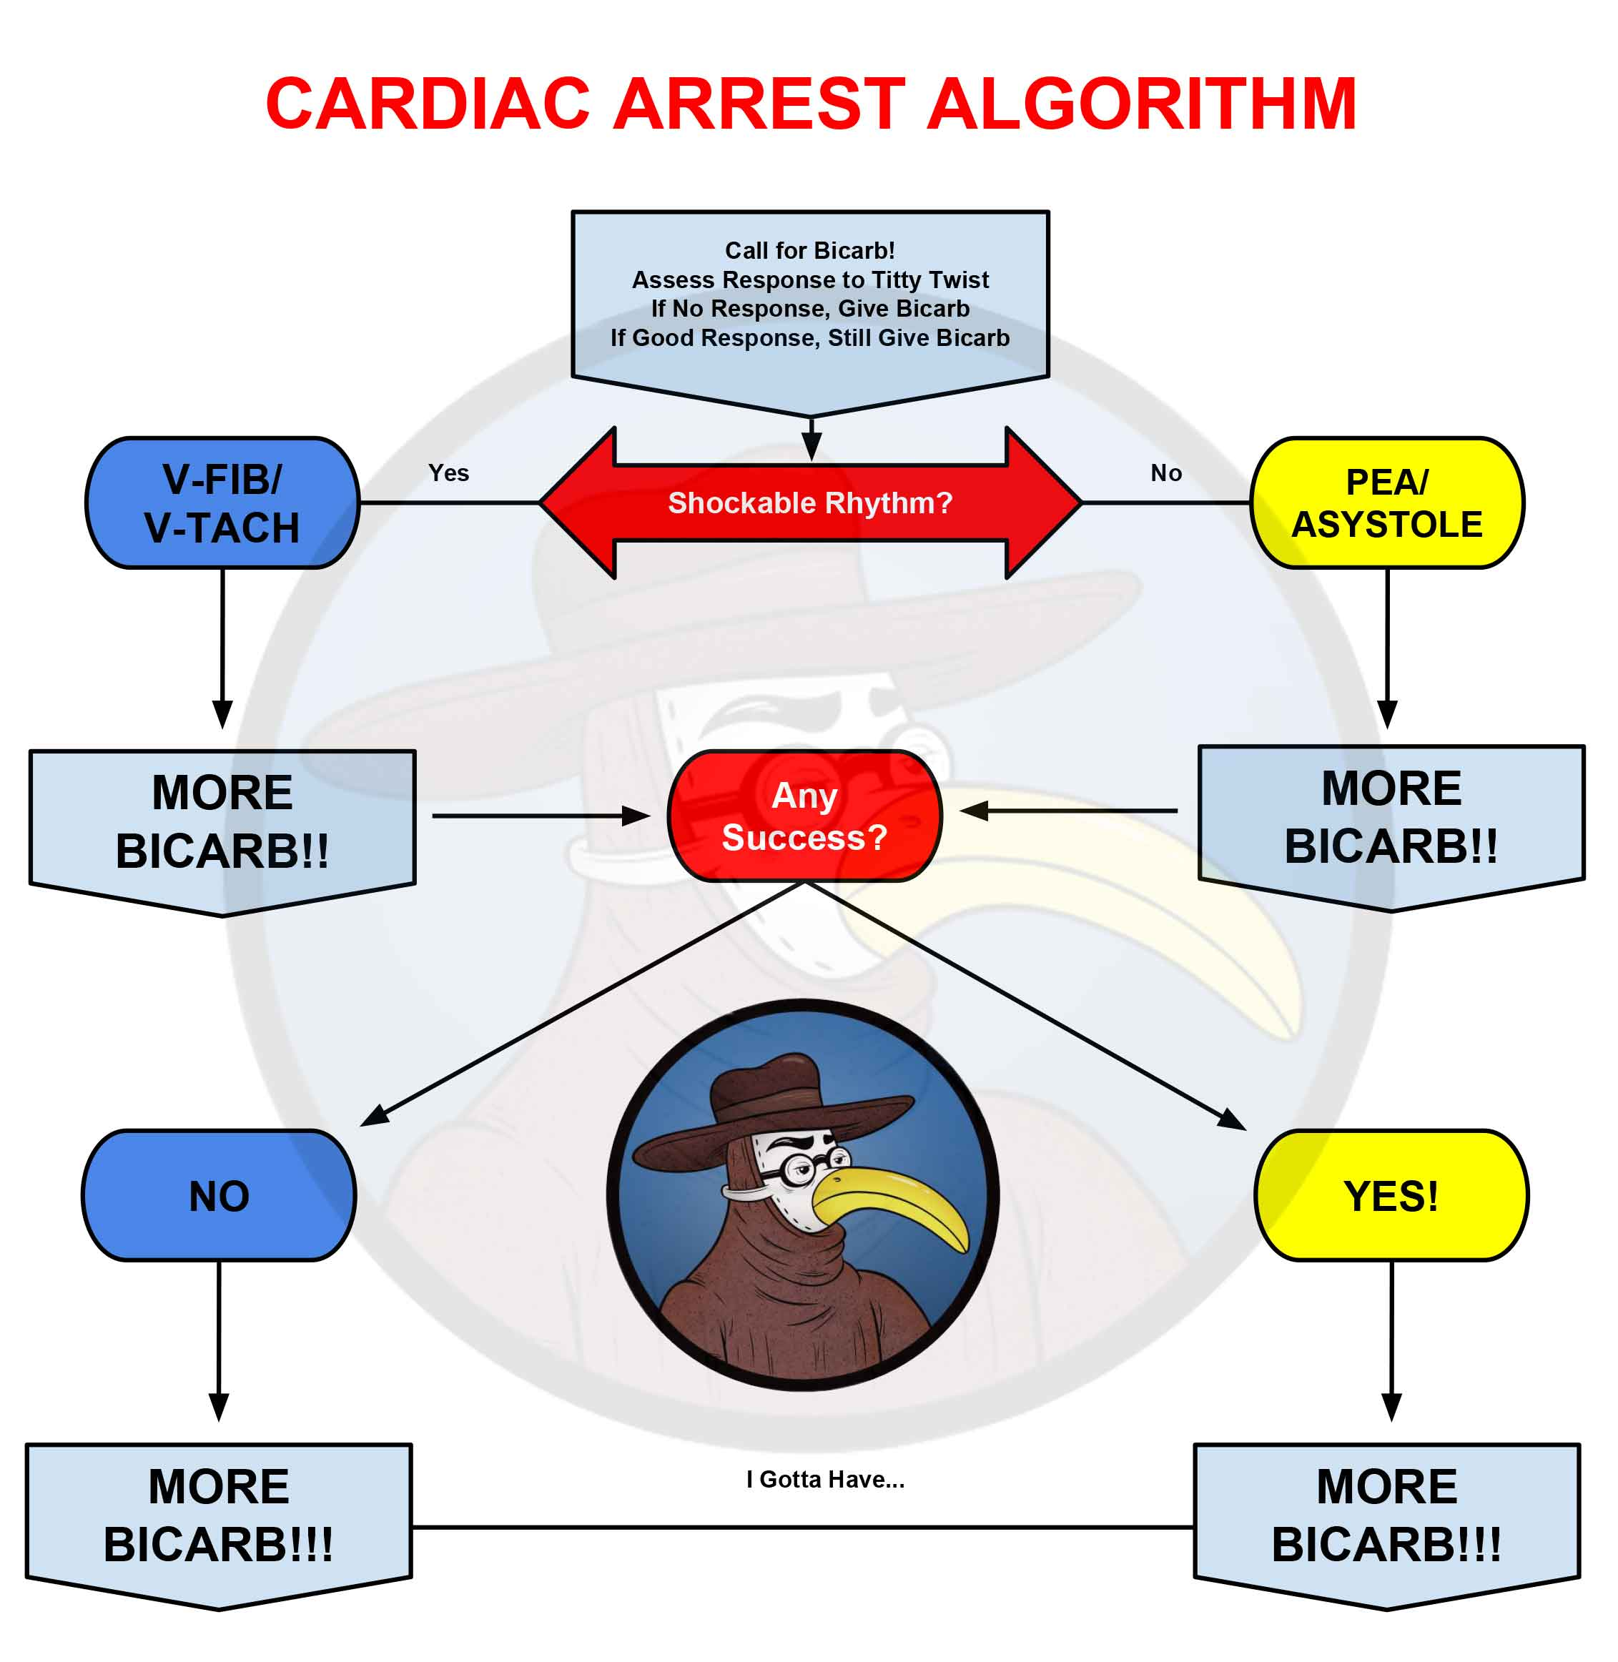
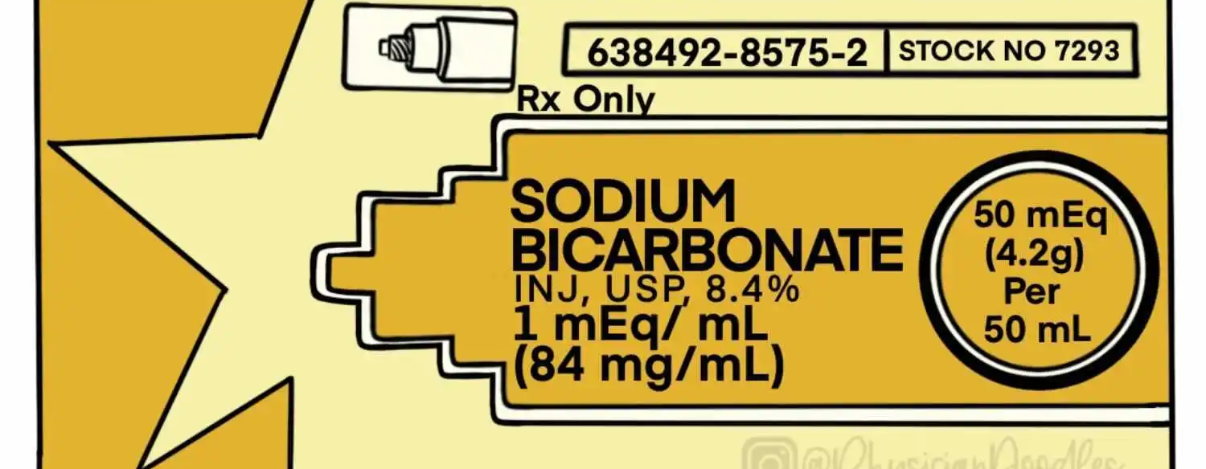

Slide 67
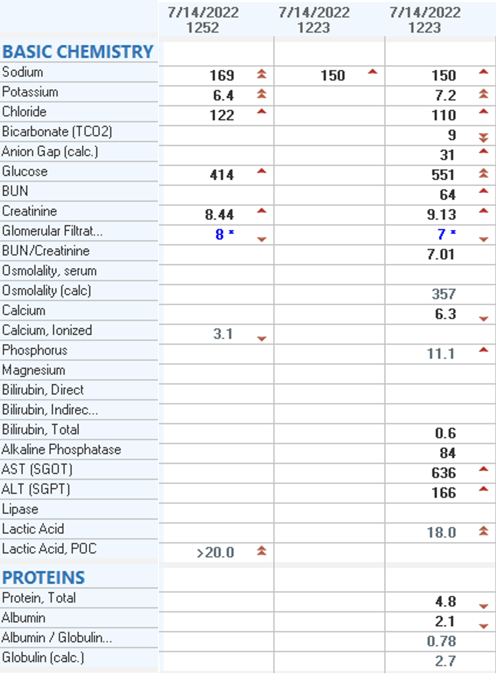
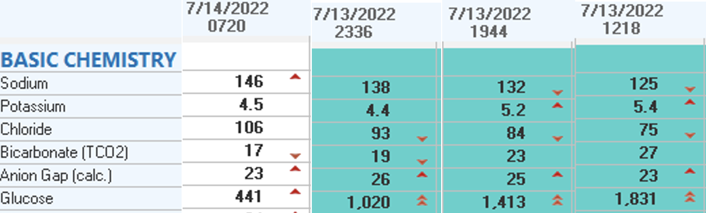
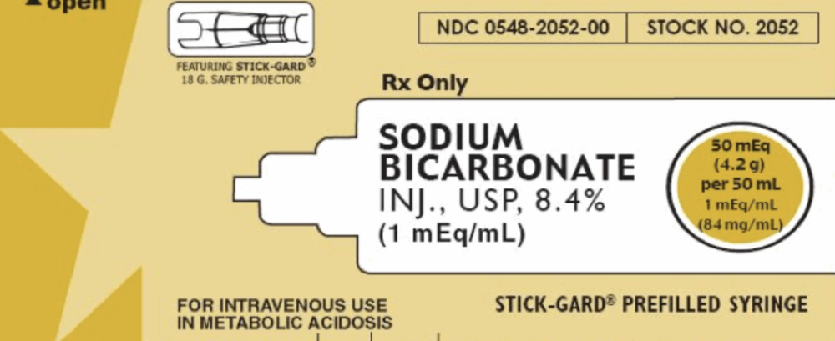
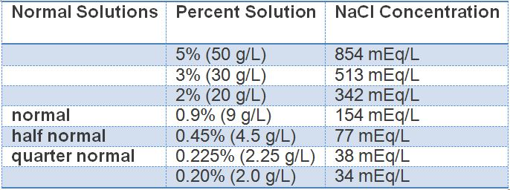
Notes:
8 % = 1366 mEq/L

Slide 68
Complications of Bicarbonate Therapy
Overshoot alkalosis
Exogenously administered NaHCO3 must be added to endogenously produced by metabolism of ketones, lactate, etc
Increase in lactate generation
Volume expansion with ARF and ESRD
Increase CO2 production
Hypocalcemia

Slide 70
Thanks.

