Slide 1
Question 1
A 45-year-old woman is evaluated for a positive interferon-gamma release assay (IGRA) obtained before starting adalimumab for rheumatoid arthritis. She grew up in Uganda and immigrated to the United States 10 years ago. She received the bacille Calmette-Guérin vaccination in childhood. She is unaware of any previous tuberculosis exposure. She has no cough, dyspnea, weight loss, or night sweats. Medications are methotrexate and folic acid.
On physical examination, vital signs are normal. The examination is significant for metacarpophalangeal joint tenderness and swelling bilaterally. Other findings are unremarkable.
HIV testing is negative.
Which of the following is the most appropriate next step in management?
  Acid-fast bacilli smear and culture of sputum
  Chest radiography
  Repeat IGRA
  Rifampin
  No further management

Slide 2
Question 1
A 45-year-old woman is evaluated for a positive interferon-gamma release assay (IGRA) obtained before starting adalimumab for rheumatoid arthritis. She grew up in Uganda and immigrated to the United States 10 years ago. She received the bacille Calmette-Guérin vaccination in childhood. She is unaware of any previous tuberculosis exposure. She has no cough, dyspnea, weight loss, or night sweats. Medications are methotrexate and folic acid.
On physical examination, vital signs are normal. The examination is significant for metacarpophalangeal joint tenderness and swelling bilaterally. Other findings are unremarkable.
HIV testing is negative.
Which of the following is the most appropriate next step in management?
  Acid-fast bacilli smear and culture of sputum
  Chest radiography
  Repeat IGRA
  Rifampin
  No further management

Slide 3
Exclude active tuberculosis with chest radiography in a patient with a positive interferon-gamma release assay.
Persons treated with biologic agents such as tumor necrosis factor (TNF) inhibitors or Janus kinase (JAK) inhibitors have a markedly increased risk of reactivation tuberculosis and death from disseminated tuberculosis disease and should be evaluated for tuberculosis before starting therapy
Patients with a positive interferon-gamma release assay or positive tuberculin skin test should be evaluated for active tuberculosis, with a full medical history, physical examination, and chest radiography

Slide 4
Question 2
A 39-year-old patient is evaluated for a 1-day history of abdominal pain and watery diarrhea. Two days ago, they completed a course of cephalexin for cellulitis. Medical history is otherwise noncontributory, and they take no medications.
On physical examination, vital signs are normal. Abdominal examination reveals normal bowel sounds and minimal tenderness to palpation, with no guarding or rebound.
Labs: leukocyte count 11,000/µL (11 × 10⁹/L) and creatinine 1.1 mg/dL (97.2 µmol/L)
Stool testing for Clostridioides difficile is positive.
Which of the following is the most appropriate treatment?
  Intravenous vancomycin
  Oral fidaxomicin
  Oral metronidazole
  Oral rifaximin
  Oral vancomycin plus intravenous metronidazole

Slide 5
Question 2
A 39-year-old patient is evaluated for a 1-day history of abdominal pain and watery diarrhea. Two days ago, they completed a course of cephalexin for cellulitis. Medical history is otherwise noncontributory, and they take no medications.
On physical examination, vital signs are normal. Abdominal examination reveals normal bowel sounds and minimal tenderness to palpation, with no guarding or rebound.
Labs: leukocyte count 11,000/µL (11 × 10⁹/L) and creatinine 1.1 mg/dL (97.2 µmol/L)
Stool testing for Clostridioides difficile is positive.
Which of the following is the most appropriate treatment?
  Intravenous vancomycin
  Oral fidaxomicin
  Oral metronidazole
  Oral rifaximin
  Oral vancomycin plus intravenous metronidazole

Slide 6
Treat a first episode of nonsevere Clostridioides difficile infection
Risk factors for CDI include exposure to antibiotic and chemotherapeutic agents, older age, severe underlying comorbidities, presence of inflammatory bowel disease, solid organ transplantation, gastrointestinal surgery, and (possibly) gastric acid suppression with proton pump inhibitors
Oral fidaxomicin is the preferred therapy for an initial episode of nonsevere or severe Clostridioides difficile infection, although oral vancomycin is an acceptable alternative
Nonsevere C. difficile infection is defined by a leukocyte count of less than 15,000/µL (15 × 10⁹/L) and a serum creatinine level of less than 1.5 mg/dL (132 µmol/L)

Slide 7
Question 3
A 66-year-old woman is evaluated in the emergency department for a 2-day history of fever and nonbloody diarrhea. She recently completed a 10-day course of cephalexin.
On physical examination, temperature is 39.0 °C (102.2 °F), blood pressure is 98/60 mm Hg, pulse rate is 110/min, and respiration rate is 23/min. Her abdomen is distended, bowel sounds are decreased, and palpation elicits tenderness and guarding.
Labs: 30,000/µL (30 × 10⁹/L) (80% neutrophils, 15% band forms) creatinine 2.5 mg/dL (221 µmol/L)
A toxin assay is positive for Clostridioides difficile. Abdominal imaging reveals evidence of toxic megacolon.
Which of the following is the most appropriate medical treatment?
  Fecal microbiota transplant
  Oral fidaxomicin
  Oral vancomycin and intravenous metronidazole
  Oral vancomycin and oral metronidazole

Slide 8
Question 3
A 66-year-old woman is evaluated in the emergency department for a 2-day history of fever and nonbloody diarrhea. She recently completed a 10-day course of cephalexin.
On physical examination, temperature is 39.0 °C (102.2 °F), blood pressure is 98/60 mm Hg, pulse rate is 110/min, and respiration rate is 23/min. Her abdomen is distended, bowel sounds are decreased, and palpation elicits tenderness and guarding.
Labs: 30,000/µL (30 × 10⁹/L) (80% neutrophils, 15% band forms) creatinine 2.5 mg/dL (221 µmol/L)
A toxin assay is positive for Clostridioides difficile. Abdominal imaging reveals evidence of toxic megacolon.
Which of the following is the most appropriate medical treatment?
  Fecal microbiota transplant
  Oral fidaxomicin
  Oral vancomycin and intravenous metronidazole
  Oral vancomycin and oral metronidazole

Slide 9
Treat fulminant Clostridioides difficile infection
Fulminant Clostridioides difficile infection (CDI) requires oral vancomycin plus intravenous metronidazole; vancomycin enemas may be added if ileus is present
Fulminant CDI is defined as severe infection complicated by ileus, hypotension, shock, or toxic megacolon

Slide 10
Question 4
A 60-year-old woman is evaluated in the emergency department for worsening headache, fever, and confusion that began yesterday. She was previously healthy and takes no medications.
On physical examination, she is not oriented to person, place, or time. Temperature is 39.1 °C (102.4 °F), blood pressure is 150/85 mm Hg, pulse rate is 115/min, and respiration rate is 19/min. Oxygen saturation is 97% with the patient breathing ambient air. Neck stiffness and photophobia are appreciated. Pupils are equal, round, and reactive to light and accommodation. The patient is unable to participate in motor and sensory examinations.
Blood cultures are obtained.
Which of the following is the most appropriate diagnostic test to perform next?
  CT of the head
  HIV testing
  Lumbar puncture
  MRI of the brain

Slide 11
Question 4
A 60-year-old woman is evaluated in the emergency department for worsening headache, fever, and confusion that began yesterday. She was previously healthy and takes no medications.
On physical examination, she is not oriented to person, place, or time. Temperature is 39.1 °C (102.4 °F), blood pressure is 150/85 mm Hg, pulse rate is 115/min, and respiration rate is 19/min. Oxygen saturation is 97% with the patient breathing ambient air. Neck stiffness and photophobia are appreciated. Pupils are equal, round, and reactive to light and accommodation. The patient is unable to participate in motor and sensory examinations.
Blood cultures are obtained.
Which of the following is the most appropriate diagnostic test to perform next?
  CT of the head
  HIV testing
  Lumbar puncture
  MRI of the brain

Slide 12
Recognize indications for head CT before performing a lumbar puncture in a patient with suspected bacterial meningitis
Head CT should be performed before lumbar puncture (LP) in adults suspected of having bacterial meningitis if they have:
  Immunocompromise
  New-onset seizures
  Altered mental status
  History of central nervous system disease (e.g., mass lesions, stroke, focal infections)
  Focal neurologic deficits
  Papilledema

Slide 13
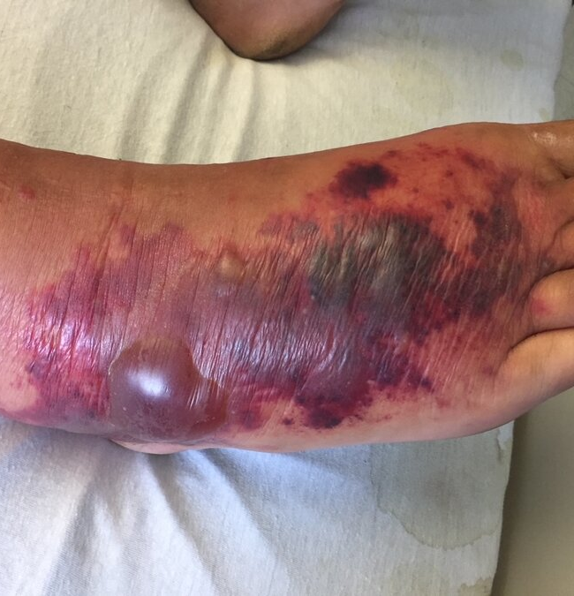
Question 5
A 35-year-old man is evaluated for rapidly progressive cellulitis 4 days after sustaining minor lacerations on his foot while swimming in brackish water. He has alcoholic cirrhosis.
Skin findings are shown.
Which of the following is the most likely infectious agent?
  Bartonella henselae
  Clostridium sordellii
  Mycobacterium marinum
  Vibrio vulnificus

Slide 14
Question 5
A 35-year-old man is evaluated for rapidly progressive cellulitis 4 days after sustaining minor lacerations on his foot while swimming in brackish water. He has alcoholic cirrhosis.
Skin findings are shown.
Which of the following is the most likely infectious agent?
  Bartonella henselae
  Clostridium sordellii
  Mycobacterium marinum
  Vibrio vulnificus

Slide 15
Diagnose Vibrio vulnificus infection
This patient has rapidly progressing necrotizing fasciitis caused by Vibrio vulnificus infection. V. vulnificus is found in warm waters throughout the world and is responsible for many serious infections in the United States each year because of exposure to shellfish and seawater, especially in patients with cirrhosis or other liver diseases

