Slide 1
Hepatocellular Carcinoma
Rohit Nathan, DO
rohit.nathan@bannerhealth.com

Slide 2
Case
57 yo F with history of DM2, HLD, hypothyroidism and elevated BMI. She presents to your clinic for routine follow up. She has no specific complaints and. Physical exam notes a non distressed, obese female. No jaundice or scleral icterus. Abdomen is non distended and non tender. Spider angiomas are present on the upper chest and there is evidence of muscle wasting in the thenar eminence b/l.
Recent blood work shows normal Hb and WBC count, Plt 114. Normal renal function and electrolytes. Tbili 1.2, AST 54, ALT 43, ALP 115, Alb 3.4. A1c 8.4.
She had a recent ER visit for diarrhea and a non contrast CT suggested nodularity to the liver contour and splenomegaly.

Slide 3
Epidemiology
HCC is 5th most prevalent cancer worldwide
  3rd leading cause of cancer related mortality
Incidence rates highest in East Asia and Sub Saharan Africa
  Lower in Mediterranean region, north America
  Lowest in northern Europe
Hep B remains the biggest risk factor for HCC
  Vaccination programs have made significant impact on incidence of HCC in high endemic regions.
Notes:
Brings the questions of genetic vs environmental factors as risk for

Slide 4
HCC risk factors
Cirrhosis!
  Any etiology (HCV, HBV, etoh, NAFLD etc)
  HCV, HBV, HH, PBC appear to have higher risk than other etiologies.
Chronic HBV (non cirrhotic)
  sAg+ and eAg negative ~9x relative risk
  sAg+ and eAg positive ~25-30x relative risk
  Degree of viremia not correlative to HCC risk
Unclear if non cirrhotic NAFLD conveys increased risk
“Advanced fibrosis” probably conveys increased risk but not clearly quantified
Glyc storage disease, chronic Wilson disease, chronic A1AT probably convey increased risk

Slide 5
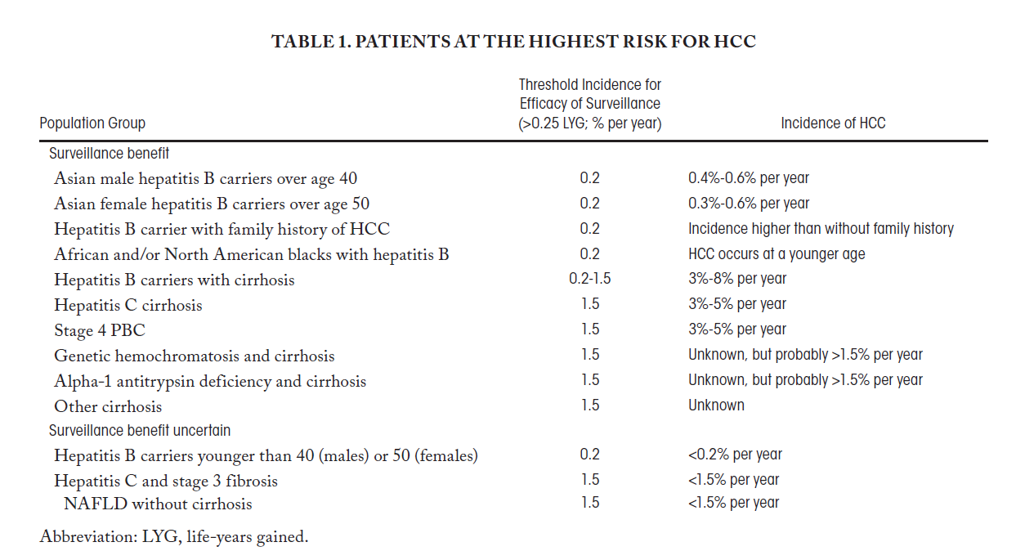

Slide 6
Q1
A 53 yo F presents to clinic as a new consult. She recently immigrated from Vietnam. She tells you that she has a history of HBV and has been on entecavir for about 15 years. She reports a biopsy was done about a year ago and did not show cirrhosis. She brings with her recent labs that note normal LFT, undetectable HBV DNA, HBsAg+, HBcAb+, HBeAg-. There is no family history of HCC. How will you counsel her on recommendations for HCC screening.
  Check AFP q6 months
  u/s +/- AFP q6 months
  u/s +/- AFP q12 months
  No screening needed since she is not cirrhotic and HBV DNA undetectable

Slide 7
Q1
A 53 yo F presents to clinic as a new consult. She recently immigrated from Vietnam. She tells you that she has a history of HBV and has been on entecavir for about 15 years. She reports a biopsy was done about a year ago and did not show cirrhosis. She brings with her recent labs that note normal LFT, undetectable HBV DNA, HBsAg+, HBcAb+, HBeAg-. How will you counsel her on recommendations for HCC screening.
  Check AFP q6 months
  u/s +/- AFP q6 months
  u/s +/- AFP q12 months
  No screening needed since she is not cirrhotic and HBV DNA undetectable

Slide 8
HCC screening
Cost effective, accessibility, improve survival, ability to comply and undergo treatment if positive result.
Who to screen:
  Cirrhotic patients of any etiology
    Except for CPT-C cirrhosis unless on LT waitlist.
  Chronic Hep B
    Male > 40, Female >50; earlier if +Fam history
  Non cirrhotic HH, NAFLD, HCV unclear data

Slide 9
How to screen for HCC
Cost effective, accessibility, improve survival, ability to comply and undergo treatment if positive result.
Choices:
  AFP (Alpha fetoprotein)
  Ultrasound
  CT
  MRI

Slide 10
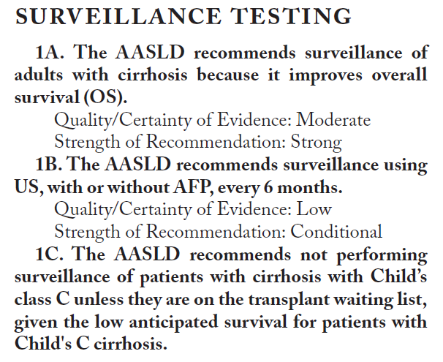
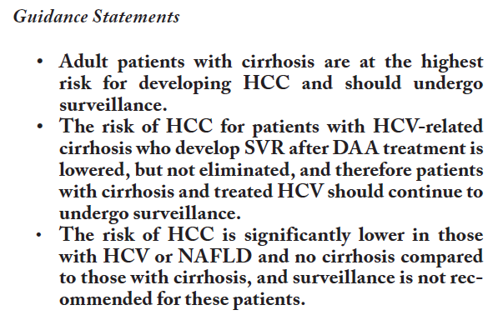

Slide 11
Q2
52 yo M with HCV related cirrhosis. He undergoes routine screening for HCC with ultrasound which noted a 2.2 cm hyperechoic nodule in the right lobe of the liver. You then correctly order a CT Abdomen w/ and w/o contrast (liver protocol/”triphasic”). The patient is in your clinic for follow up and to discuss the results. Which of the following findings would likely represent HCC?
  A. Hypoenhancing lesion containing simple appearing fluid
  B. Hyperenhancing lesion that ‘washes out’ on delayed phase
  C. Hyperenhancing lesion that remains bright on delayed phase
  D. Geographic area of hypoenhancement

Slide 12
Q2
52 yo M with HCV related cirrhosis. He undergoes routine screening for HCC with ultrasound which noted a 2.2 cm hyperechoic nodule in the right lobe of the liver. You then correctly order a CT Abdomen w/ and w/o contrast (liver protocol/”triphasic”). The patient is in your clinic for follow up and to discuss the results. Which of the following findings would likely represent HCC?
  A. Hypoenhancing lesion containing simple appearing fluid
  B. Hyperenhancing lesion that ‘washes out’ on delayed phase
  C. Hyperenhancing lesion that remains bright on delayed phase
  D. Geographic area of hypoenhancement

Slide 13
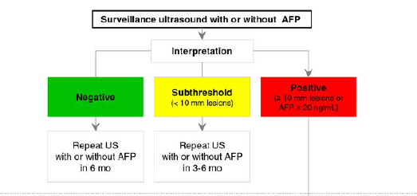

Slide 14
Diagnosing HCC
Almost always diagnosed by imaging alone
  Multiphase CT or MRI
    Arterial, venous and delayed phase imaging
    HCC’s derive blood supply solely from hepatic artery
    Normal liver parenchyma derives blood flow mostly from portal vein
  Li-RADS staging system
    Liver Imaging Reporting and Data System
    2011
    >10mm lesions

Slide 15
Diagnosing HCC
Li-RADS 5 criteria:
  Lesion ≥ 20mm
    Arterial HYPERenhancement plus ≥ 1 of the following
      Delayed phase ‘washout’
      Pseudocapsule formation
      Threshold growth
  Lesion 10-19mm
    Arterial HYPERenhancement plus ALL of the following
      Delayed phase ‘washout’
      Pseudocapsule formation
      Threshold growth

Slide 16
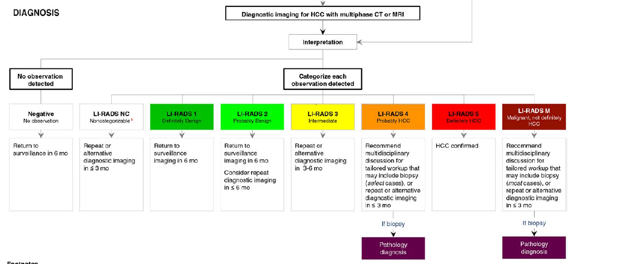

Slide 17
 | Probability of HCC | Probability of HCC At 24 months | Imaging follow up
LR-1 | 0% | 0% | Return to u/s
LR-2 | 11% | 0-6% | Return to u/s or repeat in 6 months
LR-3 | 33% | 6-15% | Q6 month x 1-2 years
LR-4 | 80% | 46-68% | Repeat in 3 months or Bx
LR-5 | 95-99%
LR-M | 42% |  | Bx

Slide 18
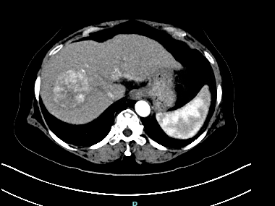
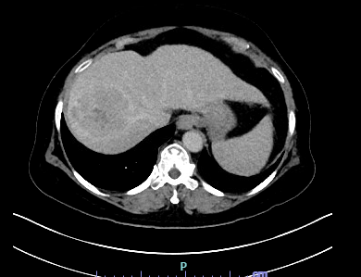
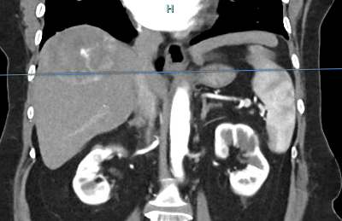
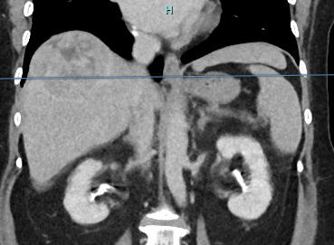

Slide 19
Q3
62 yo F with NASH cirrhosis decompensated with ascites, well managed with diuretics. BMP/LFTs and INR are normal (AKA low MELD), CBC normal aside form mild thrombocytopenia. Routine u/s showed a new liver lesion and follow up Multiphase MRI shows a 3.6cm LR5 lesion in the R hepatic lobe, trace ascites and mild splenomegaly. She otherwise has well controlled DM2 and BMI 30. She is here for counselling regarding next steps. After discussion of risks/benefits you tell her the best approach would be:
  A. Partial hepatectomy/surgical resection
  B. Repeat MRI in 3 months to assess for any changes
  C. Liver Transplant evaluation
  D. Biopsy of liver lesion

Slide 20
Q3
62 yo F with NASH cirrhosis decompensated with ascites, well managed with diuretics. BMP/LFTs and INR are normal (AKA low MELD), CBC normal aside form mild thrombocytopenia. Routine u/s showed a new liver lesion and follow up Multiphase MRI shows a 3.6cm LR5 lesion in the R hepatic lobe, trace ascites and mild splenomegaly. She otherwise has well controlled DM2 and BMI 30. She is here for counselling regarding next steps. After discussion of risks/benefits you tell her the best approach would be:
  A. Partial hepatectomy/surgical resection
  B. Repeat MRI in 3 months to assess for any changes
  C. Liver Transplant evaluation
  D. Biopsy of liver lesion

Slide 21
HCC treatment
Multidisciplinary approach
Surgical resection
Locoregional therapy
  TACE, TARE, MWA, etc
Liver transplant
Systemic chemo/immunotherapy
Palliative

Slide 22
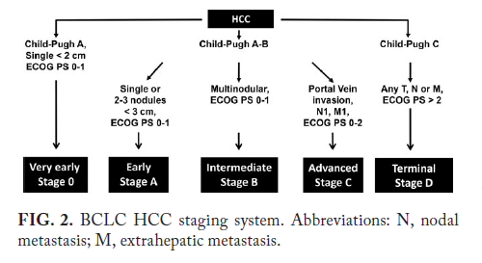

Slide 23
HCC Treatment
Surgical resection
  Reserved for select cases, can be curative
  Normal synthetic function
  No portal hypertension
  Single lesion/single lobe
  No extrahepatic disease

Slide 24
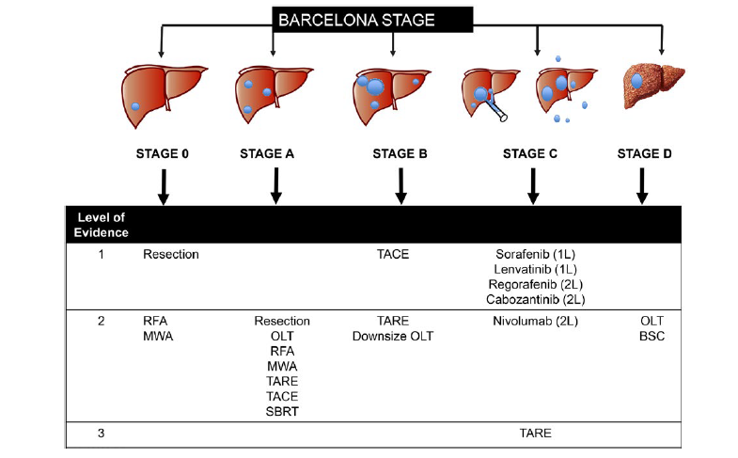
HCC treatment
Locoregional therapy (LRT)
  TACE, TARE, MWA, etc
  Bridge therapy
  Based on liver function
  Based on Txp candidacy
  Typically well tolerated
  Can be palliative tx

Slide 25
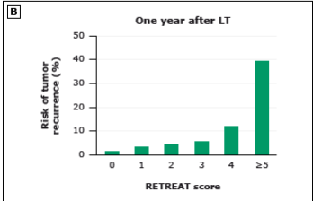
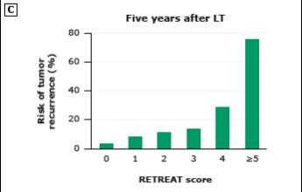
HCC treatment
Liver transplant
  Curative in appropriately selected patients
  Milan Criteria:
    Single lesion max 5cm
    2-3 lesions with no lesion greater than 3cm
    No vascular invasion or extrahepatic spread
  UCSF Criteria:
    Single lesion max 6cm
    Up to 5 lesions with max cumulative tumor burden 8cm
    Able to downstage to within Milan before acceptable for WL
  AFP < 1000
    AFP < 500 if previously > 1000

Slide 26
HCC treatment
Systemic Therapy
  Reserved for advanced disease
  Palliative
  Not used pre transplant
  Dependent on liver function
  Immunotherapy
    BEV/ATE

Slide 27
Summary
Screen for HCC in cirrhotic and CHB patients
Use cross sectional imaging appropriately
Li-RADS system for liver lesions almost always will lead to diagnosis
Milan/UCSF criteria for LT candidacy
LRT typically used as a bridge to LT
Systemic therapy typically reserved for metastatic disease/palliative intent
Questions?
Thanks!

Slide 28


