Slide 1
Infective Endocarditis

Slide 2
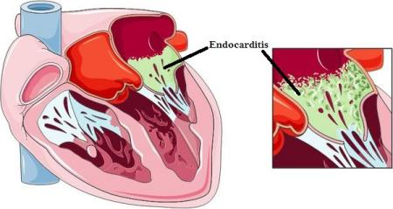
General Characteristics
Acute → S. Aureus (usually normal valves), fatal if untreated
Subacute → Strep Viridians and Enterococcus (damaged valves)
Native valve endocarditis – Most common – S. Viridians, Staph species, (HACEK group)
Prosthetic valve endocarditis – Early onset → Staph (within 60 days of surgery, s. epidermidis >> s. aureus), strep is late onset
Endocarditis in IV Drug user – right sided, s. aureus
Complications: Heart failure, abscess, solid organ damage and glomerulonephritis

Slide 3
Diagnosis
DUKE'S CRITERIA
Diagnosis of IE = 2 Major OR 1 Major + 3 Minor
Major | Minor
Sustained bacteremia | Predisposing condition
Endocardial involvement | Fever
Remember FROM JANE | Vascular phenomena: septic arterial or PE, mycotic aneurysms, intracranial hemorrhage, Janeway lesions
 | Immune phenomena: Glomerulonephritis, Osler's nodes, Roth's spots, rheumatoid factor.
 | Positve blood cultures (not meeting major)
 | Positive echo cardiogram (not meeting major)
Blood Cultures ( from 2 sites)
TTE usually 1st, but TEE high sensitivity (> 90% sensitive)
EKG changes: 1st AV Block, BBB, AV Dissociation → paravalvular abscess
Notes:
Fever//Roth's spots// Osler's nodes// Murmur//Janeway lesions// Anemia// Nail hemorrhage (splinter hemorrhages)// Emboli

Slide 4
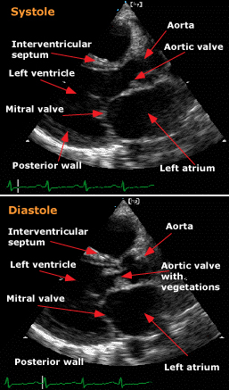

Slide 5
Treatment
IV antibiotics based on culture results (4- 6 weeks)
If cultures are negative but high suspicion, empiric tx with Vancomycin + an aminoglycoside.
Don’t forget about Libman Sacks Endocarditis - aortic valves and SLE – BOTH sides of the valves with systemic embolization. Treat SLE and anticoagulate!
IE Antibiotic Prophylaxis? –Prosthetic heart valves, history of IE, congenital heart disease(unrepaired cyanotic congenital heart disease or repaired congenital heart defect with prosthesis or shunt (≤6 months post-procedure), valvulopathy following cardiac transplant
What if you find strep bovis bacteremia? Colonoscopy!

Slide 6
MKSAP High Yield
In patients with a cardiac murmur… infective endocarditis should be suspected in the presence of fever, anemia, hematuria, and physical findings suggestive of embolization.
Early surgery is indicated valve stenosis or regurgitation resulting:
heart failure
left-sided infective endocarditis caused by Staphylococcus aureus, fungal, or other highly resistant organisms;
complicated by heart block, annular or aortic abscess, or destructive penetrating lesion
persistent bacteremia or fever lasting longer than 5 to 7 days after starting antibiotic therapy.
Surgery is recommended for patients with prosthetic valve endocarditis and relapsing infection.

Slide 7
Value
Avoid prophylactic antibiotics for the treatment of mitral valve prolapse.
Antibiotic prophylaxis is no longer indicated in patients with mitral valve prolapse for prevention of infective endocarditis. The risk of antibiotic-associated adverse effects exceeds the benefit (if any) from prophylactic antibiotic therapy. Limited use of prophylaxis will likely reduce the unwanted selection of antibiotic-resistant strains and their unintended consequences such as C. difficile-associated colitis.
Choosing Wisely – IDSA

