Slide 1

Academic Tuesday:
Diabetic foot osteomyelitis
(and other bone and joint infections)
Jonas Marschall, MD
Division of Infectious Diseases
August 12, 2025
No relevant conflicts of interest

Slide 2
Case 1
67-yo F with PMH of DM2, HTN, chronic right ankle ulcers and chronic left foot ulcer who is followed by wound care clinic where she was seen on 7/17 and then referred for admission.
She states that the left foot ulcer underneath the great toe MP has been around for 1.5 years.
Over the last couple of days, she was Uber driving with a new pair of supposedly wide shoes, however, using the new shoes (and forgetting the inlays) made the ulcer get larger, more tender and starting to drain.
No f/c/ns, no lymphangitis, no other symptoms.
She has not been started on oral antibiotics before the admission. No previous infections that required antibiotics (per the patient).
She was given 1 dose of Unasyn on 7/17 and now is on empiric vancomycin 3x1g and cefepime 3x2g. NKDA.

Slide 3
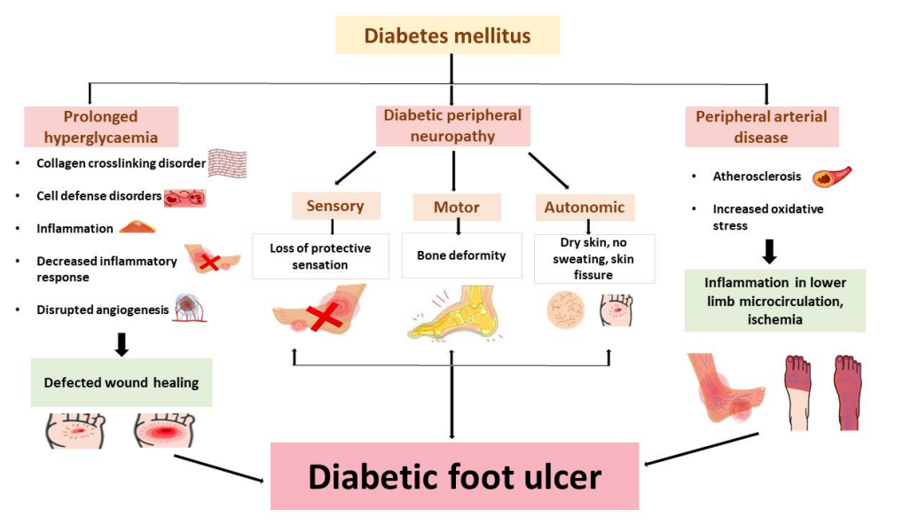
What’s the pathogenesis of an ulcer?
Ansari et al, Appl Sciences 2022.

Slide 4
What are risk factors for infection?
Depth of the wound
Long-standing (6+ weeks)
Recurrent
Traumatic etiology
Concomitant renal failure

Slide 5
Epidemiology of diabetic foot ulcers and infectious complications
Approximately 38 million with diabetes in the US (11%)
  Another 98 million with prediabetes (38%)
Up to 34% lifetime risk of developing a foot ulcer among diabetics
1.6 million with DFU each year
  800k with wound infection (~50%)
  80k-400k with osteomyelitis (10-50%)
Clinic visits, wound care, antibiotics, surgical procedures, and costs of care

Slide 6
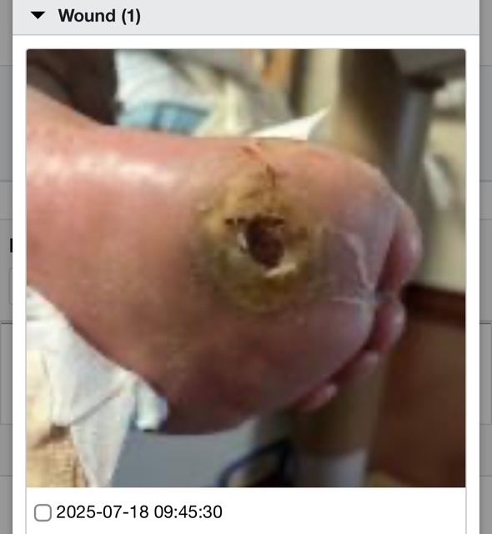
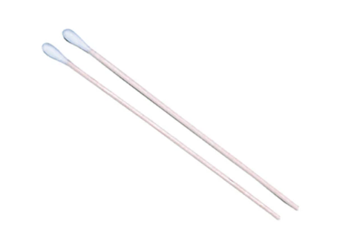
Physical exam
Moderate size ulcer, ½-1 inch deep
Tender to palpation
No redness
Drainage on the dressing
What’s next?

Slide 7
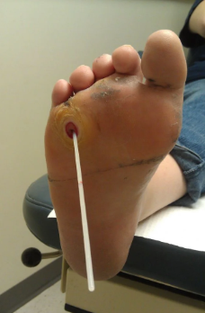
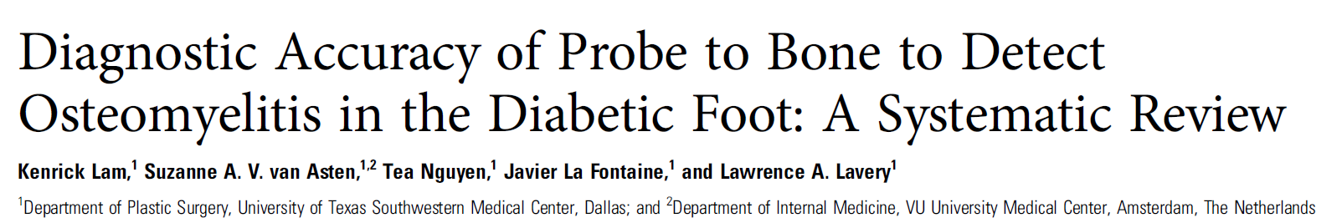
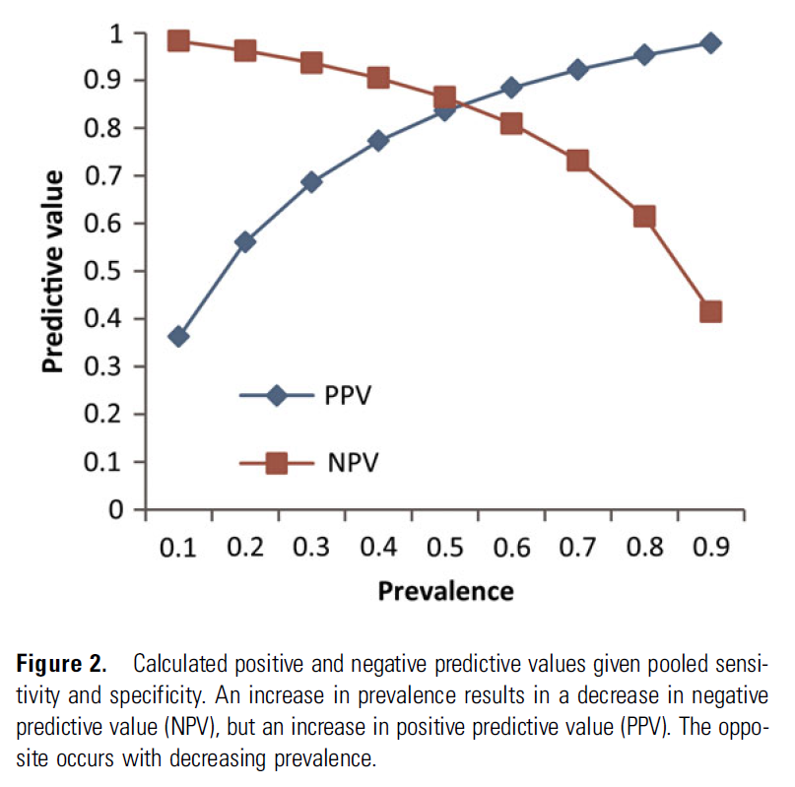
Metaanalysis of 7 studies:
  Pooled sensitivity 0.87
  Pooled specificity 0.83
Conclusion: «PTB can accurately rule in diabetic foot OM in high-risk patients and rule out OM in low-risk patients»

Slide 8
And labs?
WBC 9.6 / no left shift
CRP 21.5
Didn’t get ESR, procalcitonin

Slide 9
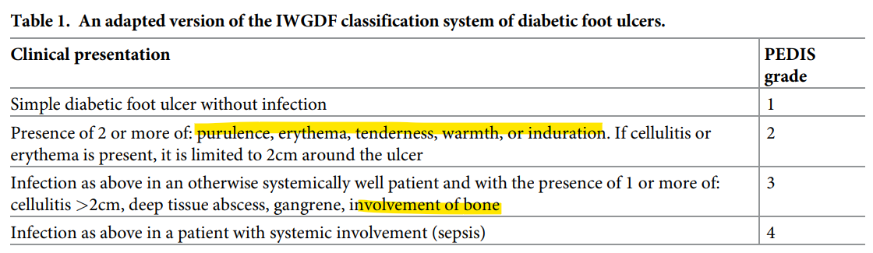
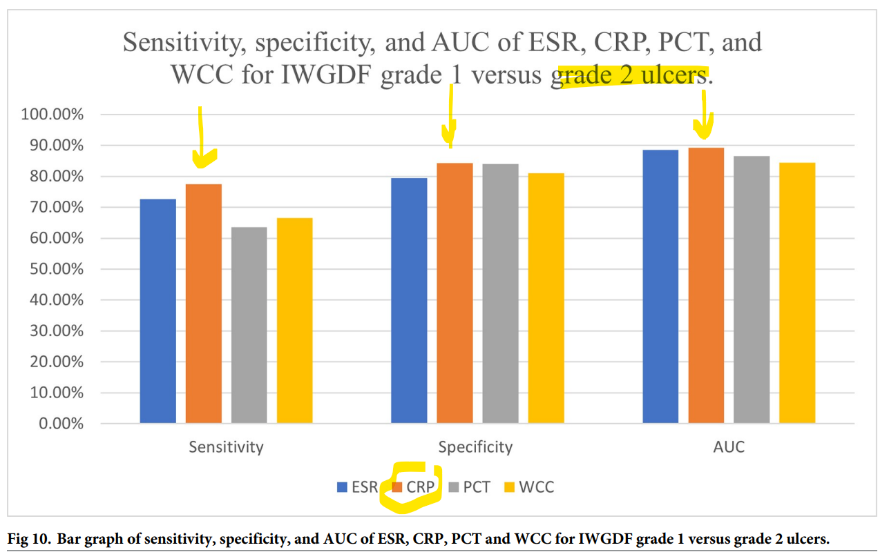
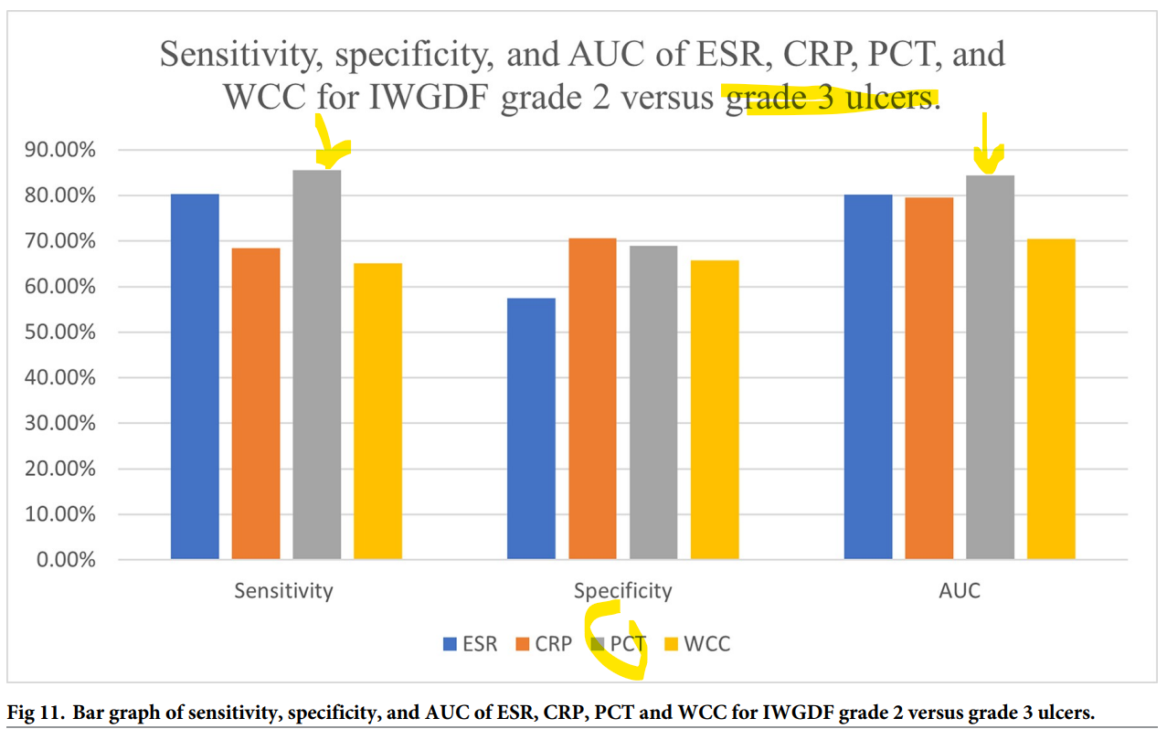
Role of labs in diabetic foot infection
Caveat: cut-offs in the source studies varied; severity of illness not always clear; no analysis of test combos!
Sharma et al, PLOS One 2022

Slide 10
Labs - recommended
WBC (comes with basic labs anyway)
CRP & ESR
  For initial work-up
  For trending over the treatment course
Procalcitonin’s role is emerging

Slide 11
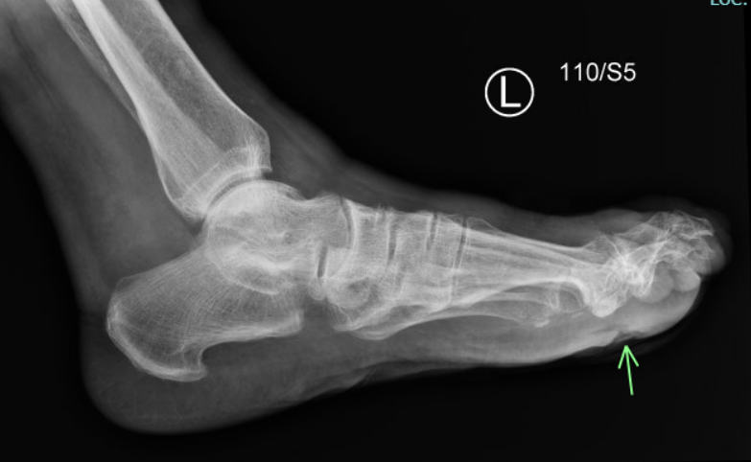
What about imaging in diabetic foot ulcers?
Ulcer visible on plain film
“No bony erosions”
What next?

Slide 12
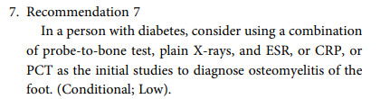
PTD negative
Plain films negative
CRP elevated

Slide 13
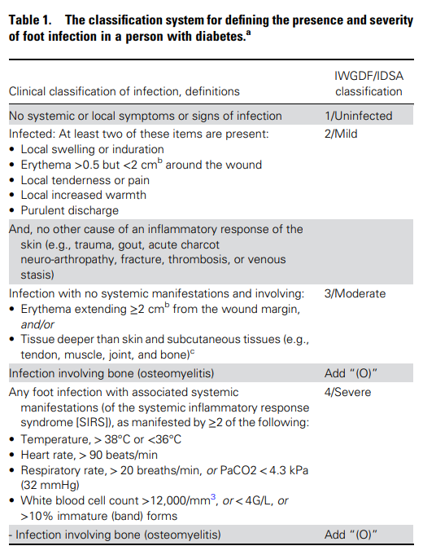

Let’s classify this!
Yes
Possibly
No
Senneville et al, Clin Infect Dis 2023 (IWGDF/IDSA guidelines)

Slide 14
Imaging modalities
If diagnosis “osteomyelitis” in doubt, consider MRI
Alternatives are PET, leukocyte scintigraphy, or SPECT

Slide 15
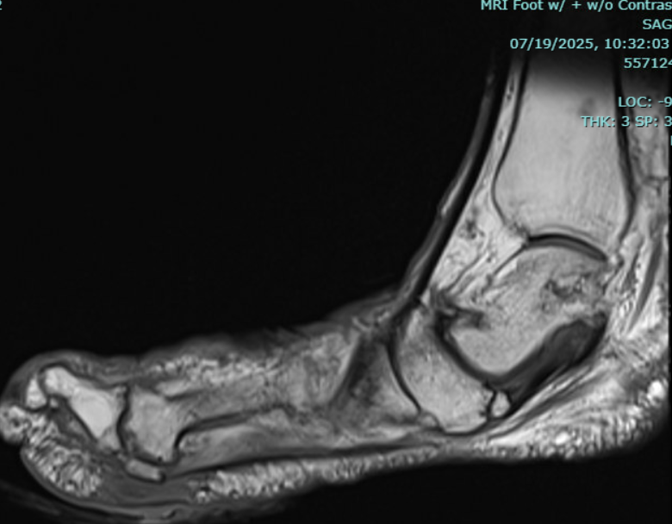
MRI foot
Cortical irregularity of the first MTP joint. There is enhancement in the head of the first metatarsal on the plantar aspect as well as in the plantar aspect of the first proximal phalanx adjacent to the patient’s plantar ulceration which also demonstrates peripheral enhancement. Flexor retinaculum is grossly intact. Tarsal bones and calcaneus are grossly intact.
Inflammatory changes along the first and second intermetatarsal spaces. No other areas of enhancement in the foot.
Osteomyelitis of the first metatarsophalangeal joint with adjacent plantar ulceration and cellulitis.

Slide 16
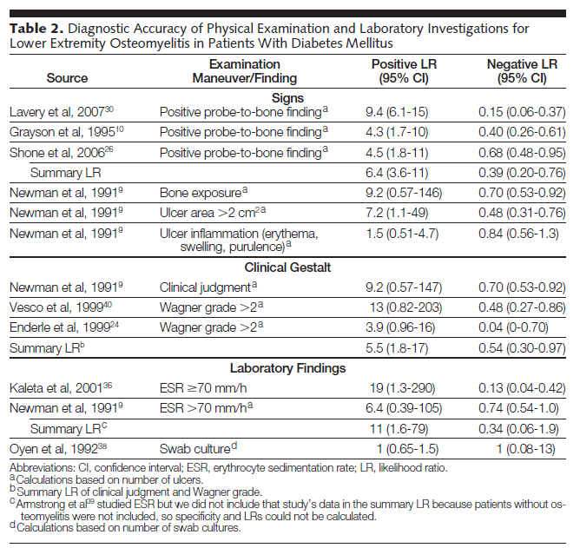
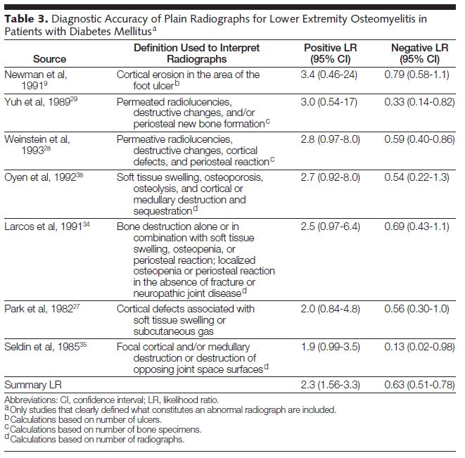
Predictors of diabetic foot osteomyelitis
Systematic review of 21 studies
MRI:
LR 3.8 (2.5-5.8) for positive findings
LR 0.14 (0.08-0.26) for negative findings
PTB
Ulcer size
XR
ESR
Butalia et al, JAMA 2008;299:806.

Slide 17
Calling for support – this is best managed as a team!
Podiatry
Wound care
ID
±vascular team
±general surgery
±physical therapy

Slide 18
Osteo-
myelitis (DFO)
Diabetic foot infection (DFI)
Diabetic foot ulcer (DFU)
Diabetes
Debridement, ?amputation
Antibiotics x 6 wks
Wound care
Antibiotics x 1-2 wks
Wound care
ABI, ?revascularization
Glycemic control, pressure off-loading
Evaluation for angiopathy, neuropathy

Slide 19
Obtaining a microbiological diagnosis
Podiatrist was consulted and did debridement (including tissue sampling)
Bone biopsy = gold standard
  Better than soft tissue culture
  Culture 7/21 - negative
  Pathology - First metatarsal bone, biopsy: Cartilage, cortical bone and trabecular bone with fatty marrow. No significant inflammation.
Superficial culture / swab may detect colonizing flora

Slide 20
What empiric antibiotics to start
In this case, vancomycin and cefepime….
MILD
  Staphylococci, streptococci → Augmentin, cephalexin, clindamycin
  If MRSA history or risk factors → Bactrim, doxycycline
MODERATE TO SEVERE:
  Staphylococci (incl MRSA), streptococci, Gram-negatives, anaerobes → vancomycin and Unasyn, vancomycin and ceftriaxone and Flagyl, other combos (eg, daptomycin, ciprofloxacin and Flagyl)

Slide 21
Definitive antibiotic and treatment duration
Following the microbiological findings & reported susceptibilities
SSTI: 1-2 weeks
Osteomyelitis: 6 weeks
Following amputation, with positive margin culture: 3 weeks

Slide 22
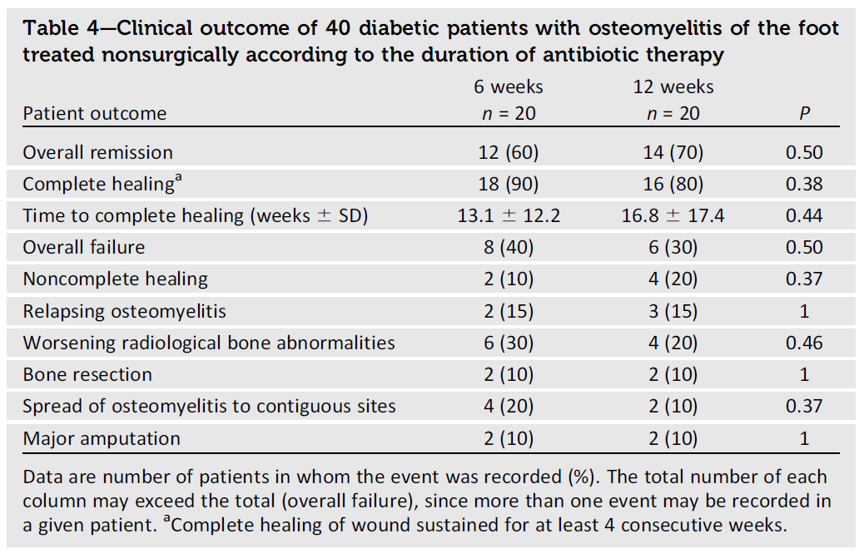
Treatment duration for DFO
Multi-center RCT
6 vs 12 weeks
Endpoint: complete and sustained cure without amputation
«6 weeks could be sufficient»
Single center RCT
S/p surgical debridement
3 vs 6 weeks
Endpoint: remission
«3 weeks non-inferior»

Slide 23
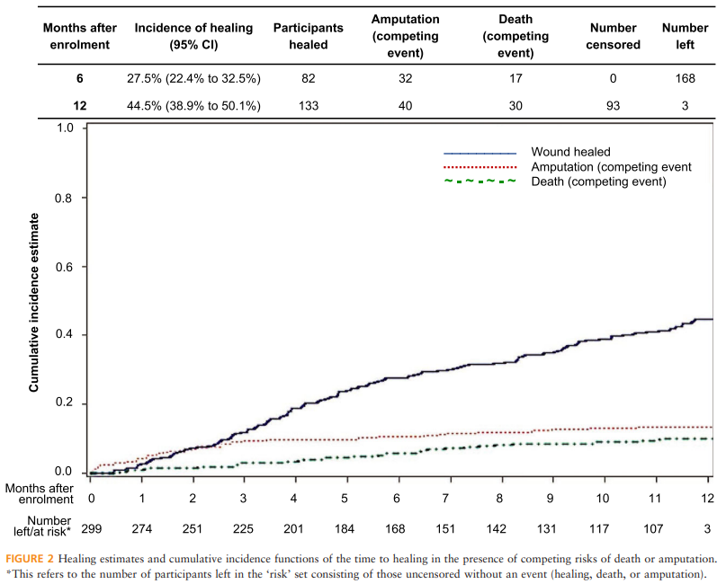
Outcomes of infected DFUs – not so good!
Prospective study, UK
Enrollment at time of culture
299 pts followed x 12 months
Ulcer healed in 45% but recurred in 10%
Amputation required in 17%
Ndosi et al, Diabet Med 2018.

Slide 24
Management of diabetic foot ulcer with possible infection - in a nutshell
Document the ulcer/wound
Probe it!
Get XR and maybe MRI
Check inflammatory markers
Invite podiatry, wound care and ID to weigh in
Make a joint plan (debridement? antibiotics?)
Ensure close follow-up
Is there a BUMCP protocol for DFU/DFI/DFO?

Slide 25
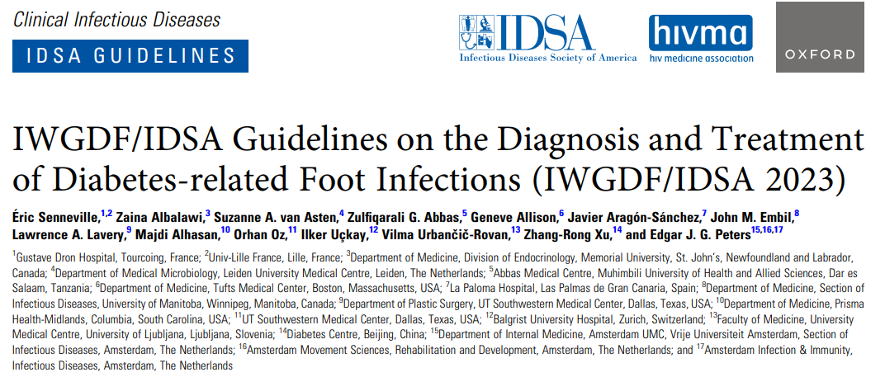
A good resource, succinct, with 25 recs
Senneville et al, Clin Infect Dis 2023

Slide 26
DO NOT
Give antibiotics if the ulcer is not infected
Treat for Pseudomonas unless detected
Use hyperbaric oxygen
Use topical treatments
Reflex-start vancomycin & cefepime on a non-septic patient

Slide 27
Our patient:
Wanted to go home urgently
After 5d of vancomycin & cefepime, transition to doxycycline and Augmentin with a plan to treat x 6 weeks
Follow-up in clinic

Slide 28
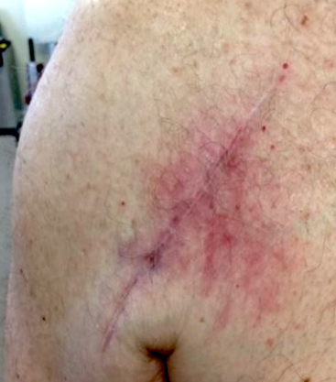
Case 2
65-yo M with PMH of bilateral shoulder arthroplasty, bilateral knee implants, C5-7 instrumentation, and recent T8-11 hardware placement following an MSSA vertebral osteomyelitis at OSH 3/24/25.
The R shoulder arthroplasty was implanted in 2021 by an external orthopedic surgeon.
His recent history started with pneumonia for which he was hospitalized at an OSH on 2/7/25. At that time he was found to be bacteremic with MSSA and given a course of cefazolin. Early on, he also noticed R shoulder pain that was not evaluated any further given that the focus was on the back infection. Following surgery and hardware placement, he was given a 6-week course of cefazolin and PO rifampin and then transitioned to Keflex which was meant to be continued for one year as chronic suppression.
The patients admits that he was using his shoulder at work-outs despite the pain because he wanted to get fit again quickly. In April, the pain in the R shoulder became more accentuated and then two weeks ago, he noticed redness and a bulge to the front of the shoulder.

Slide 29
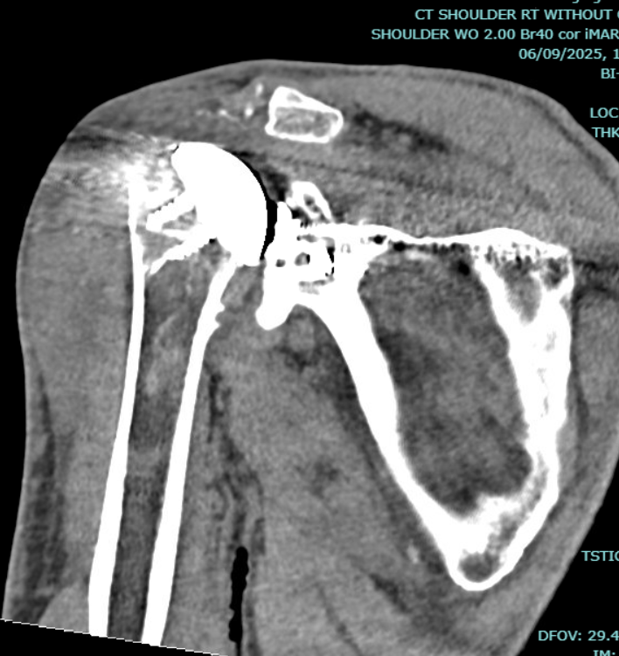
CT right shoulder, 6/9/25
s/p right TSA without evidence of hardware failure. Trace glenohumeral joint effusion. Mild subscapularis muscle atrophy.

Slide 30
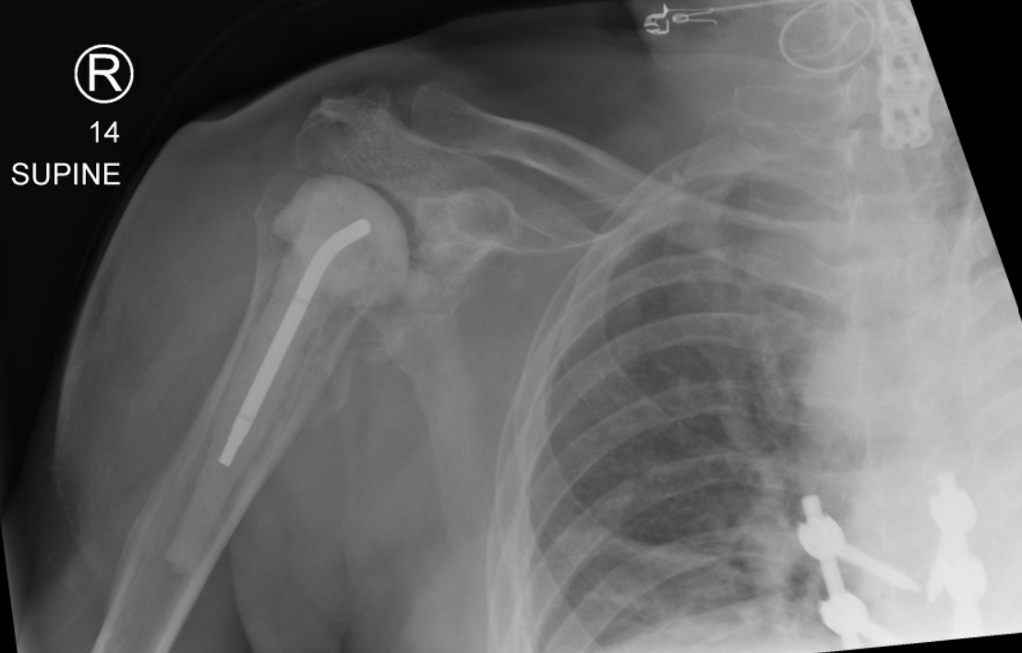
XR, right shoulder, 6/10
S/p removal of previous prosthesis and placement of new prosthesis (spacer)

Slide 31
Labs
WBC 10.4
CRP 173
ESR 68
(both post OR, on 6/12)

Slide 32
OR note, 6/10
The OR report notes “gross purulence in the joint”
An antibiotic-impregnated spacer was placed
Cultures were taken

Slide 33
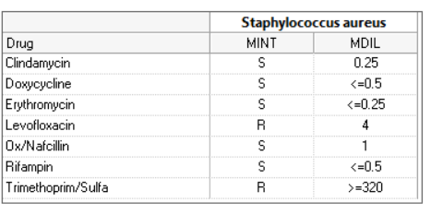

Intraoperative cultures
6/10 (2 positive cultures)

Slide 34
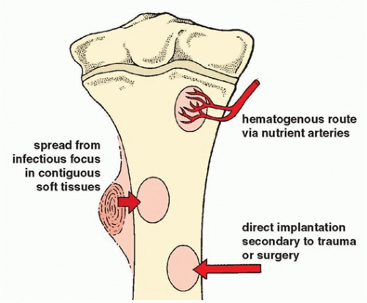
Pathogenesis of bone and joint infection: local vs systemic

Slide 35
Risk factors
Immunosuppression, rheumatoid arthritis, diabetes mellitus, obesity
Smoking
Previous joint surgeries (bone stock, scar tissue)
Previous joint infections
Long and complicated surgery
Trauma (eg, periprosthetic fracture)
Staphylococcus aureus bacteremia

Slide 36
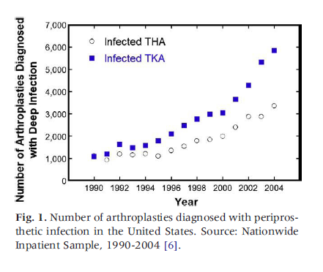
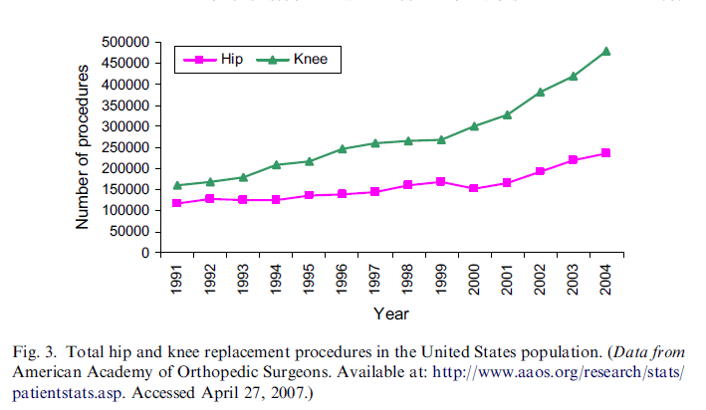
Epidemiology
PJI complicates up to 2% of joint replacement surgeries, aka arthroplasty, and up to 20% of revisions
Infection risk with arthroplasty of knee > hip > shoulder
Numbers of procedures going up given aging populations, so are PJI
Sampedro et al, IDCNA 2007;21:785. Kurtz et al, J Arthroplasty 2008;23:984.

Slide 37
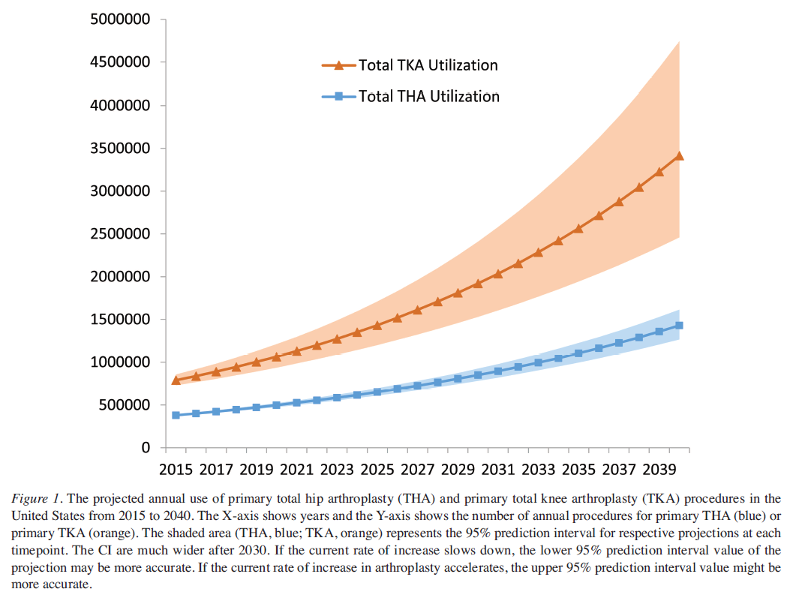
Projection of joint replacement surgeries
Singh et al, J Rheumatol 2019;doi:10.3899.

Slide 38
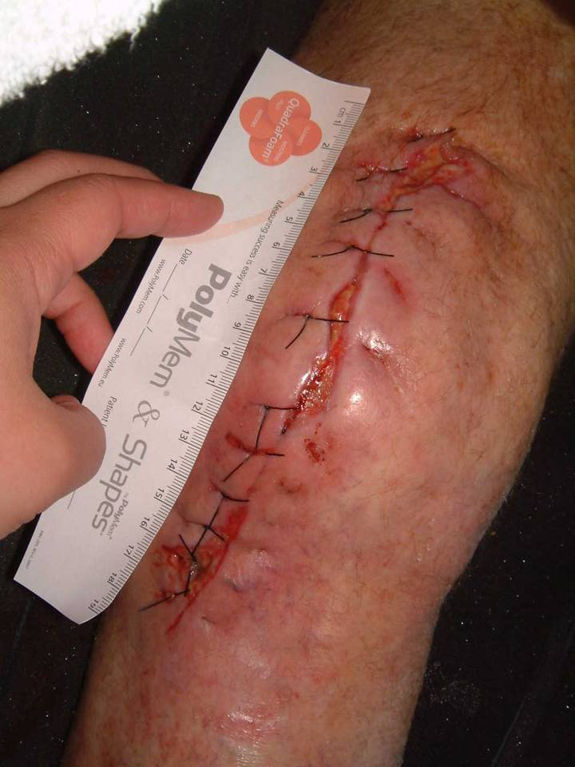
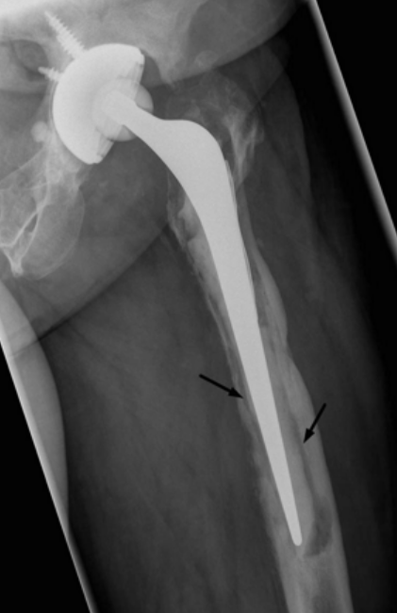
How does PJI present?
Symptoms: Acute or chronic pain, drainage, fever
Signs: Swelling, redness, warmth, tenderness to touch, effusion, dehiscence (early postop), sinus tract formation (chronic infection)
Labs: WBC, CRP, ESR may be abnormal
Conventional imaging: Loosening of implant (chronic infection)
Matthews et al, BMJ 2009.

Slide 39
Diagnostic work-up
Preoperative
Intraoperative
Postoperative
Inflammatory markers
Joint aspiration (cell count, culture, crystals)
Plain films
Additional imaging (CT, MRI)
Aspect (purulent fluid, non-viable tissue)
Gram stain, cultures
Pathology
CT imaging

Slide 40
Inflammatory markers
30 studies including 3,909 THA/TKA revisions (33% of which infected)
Meta-analysis of Lc, CRP, ESR, and serum IL-6 as predictors of PJI
Only three studies on IL-6 (a cytokine, several tests in the pipeline)
→ No single laboratory test can be used to make the diagnosis of PJI
Note. Maybe 4% of patients with PJI have normal ESR and CRP per one study.
 | Pooled sensitivity | Pooled specificity
Lc | 45% | 87%
CRP | 88% few false(-) | 74%
ESR | 75% | 70% most false(+)
IL-6 | 97% | 91%
Berbari et al, J Bone Joint Surg Am 2010;92:2102. McArthur et al, Bone Joint J 2015;97-B:939-44. Li et al, J Orthop Surg Res 2022;17:564.

Slide 41
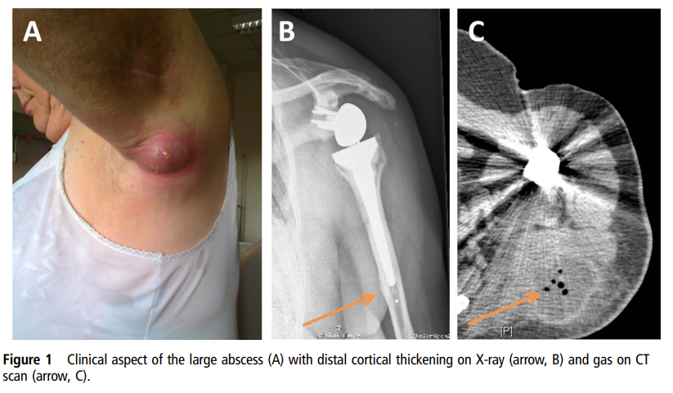
Imaging studies
Lorillou et al, BMJ Case Rep 2013 (Propionibacterium acnes abscess 2/2 shoulder PJI).

Slide 42
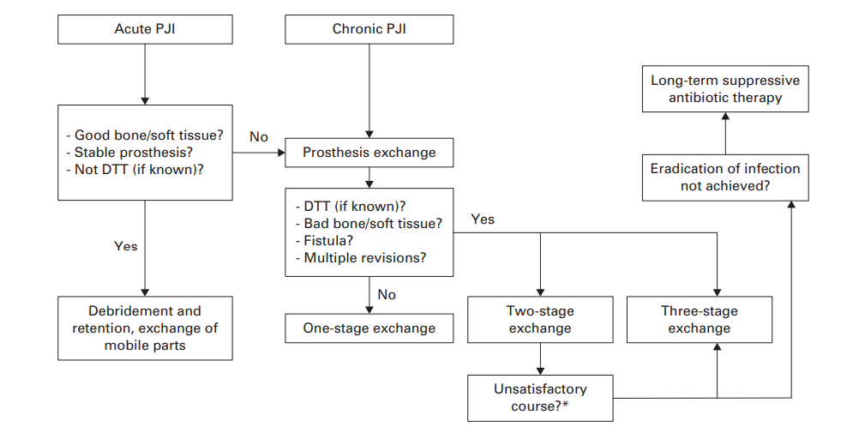
Surgical approach in one slide
Options
(no surgery)
I&D
Debridement and exchange of movable parts
One-stage exchange
Two-stage exchange with Girdlestone
Two-stage exchange with spacer placement for the interval
Removal of prosthesis without plan for re-implant
Arthrodesis
Amputation
Irrigation and debridement (I&D)
It can get complicated…
Karczewski et al, Bone Joint J 2019.

Slide 43
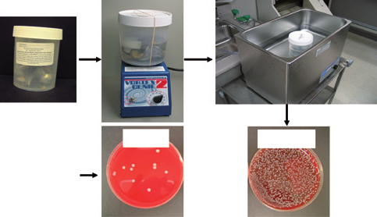
Intraoperative cultures
Take before starting antibiotics
Bone culture is gold standard, synovial tissue, joint fluid
Aerobic & anaerobic; may add mycobacterial and fungal cultures if indolent course, immunosuppressed patient
How many samples are needed? (data from PJI, with gold standard being histopathology)
  1/3 samples positive – 13% likelihood of infection
  2/3 samples positive – 20% likelihood of infection
  3/3 samples positive – 94% likelihood of infection
Atkins et al, JCM 1998;36:2932. Trampuz et al, NEJM 2007;357:654-63.

Slide 44
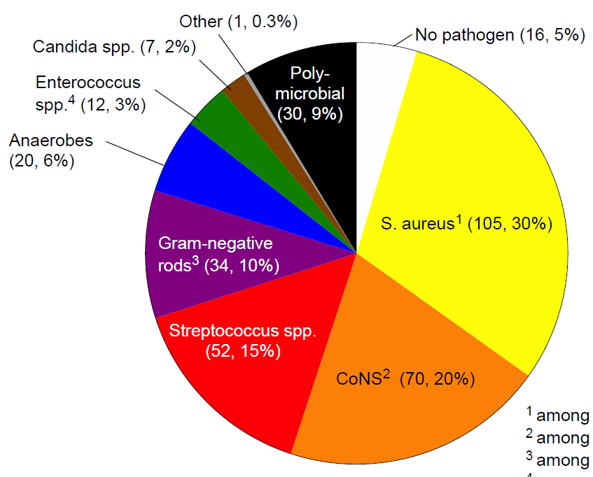
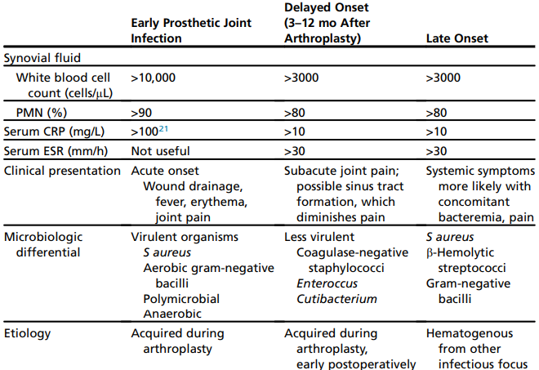
Culture results
Beam & Osmon, Infect Dis N Am 2018.

Slide 45
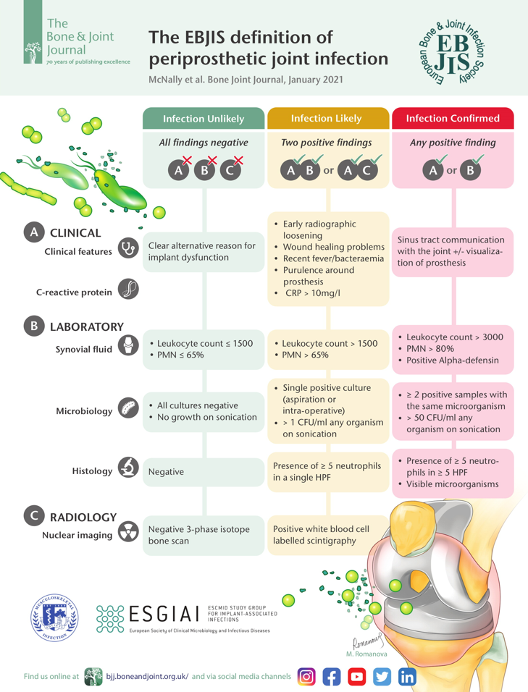
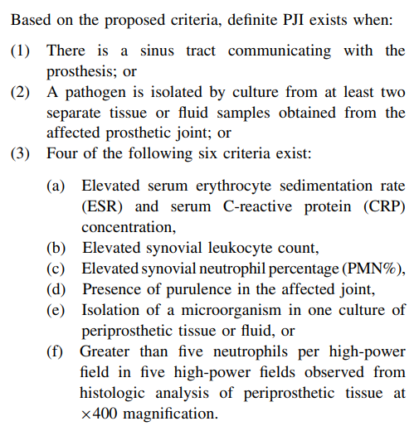
Two useful diagnostic criteria scores: MSIS and EBJIS
Parvizi et al, Clin Orthop Relat Res 2011. Parvizi et al, J Arthropl 2018. McNally et al, Bone Joint J 2021.

Slide 46
Antibiotic treatment in one slide
If chronic infection and implant retained, with no surgical options, treat for 6 months or longer
If early, acute infection and implant retained after I&D, treat for 12 weeks (if staph, combine with rifampin)
12 weeks of antibiotics (if staph, combine with rifampin)
IV antibiotics for 6 weeks
Monitor clinical response, inflammatory markers
Safe to transition to oral antibiotics after a few weeks if desired
Antibiotic-free window before re-implant

Slide 47
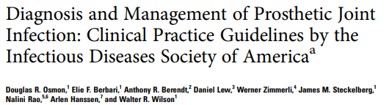
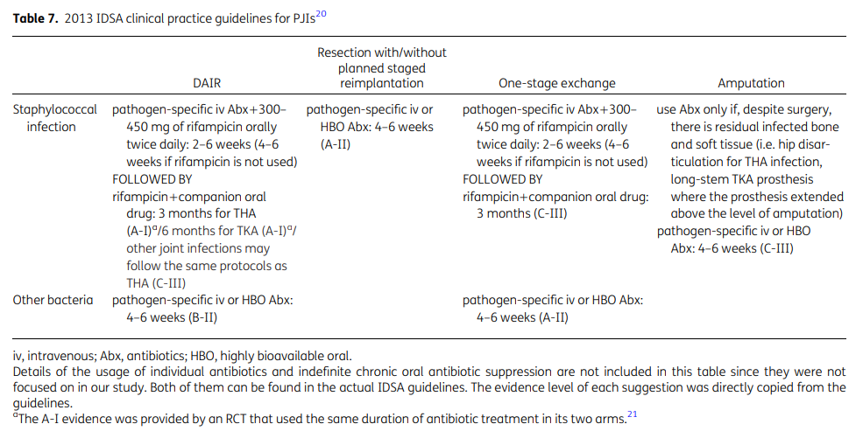
“U.S.” approach, IDSA treatment guidelines
Based on 2-stage exchange
6 weeks of IV antibiotics
Follow-up at 3 and 6 weeks
Reimplant after antibiotic-free window of 2-6 weeks
Adapted from: Yen et al, J Antimicrob Chemother 2019. Osmon et al, Clin Infect Dis 2013.

Slide 48
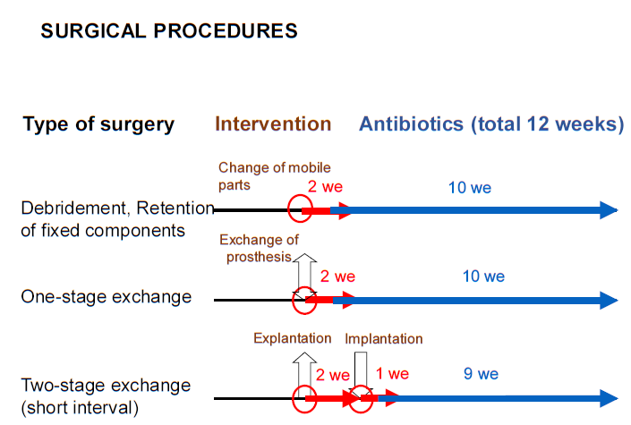

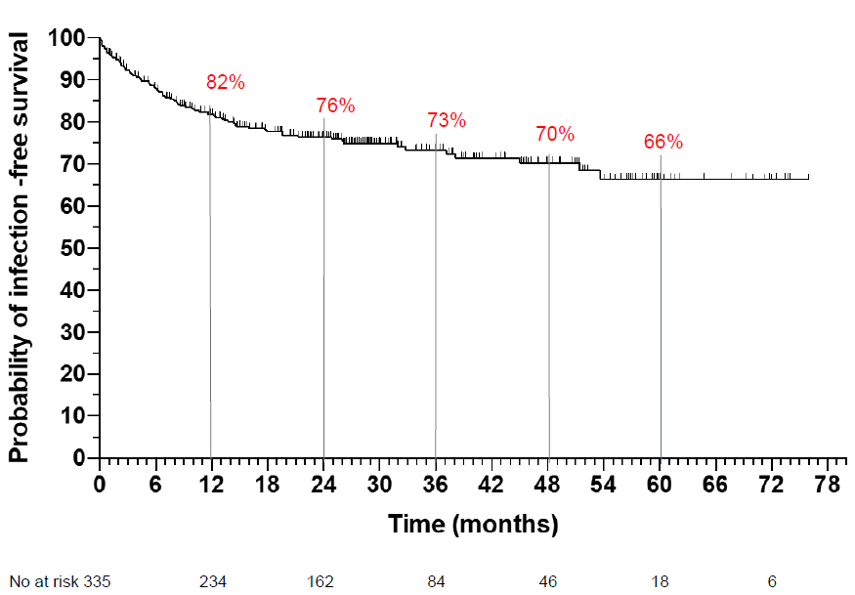
“European” approach
DAIR and 1-stage common
12 weeks duration as standard
Transition to orals within 1-2 weeks
Oral antibiotics combined with rifampin, if susceptible and no drug interactions
www.pro-implant-foundation.org (Berlin, Germany)

Slide 49
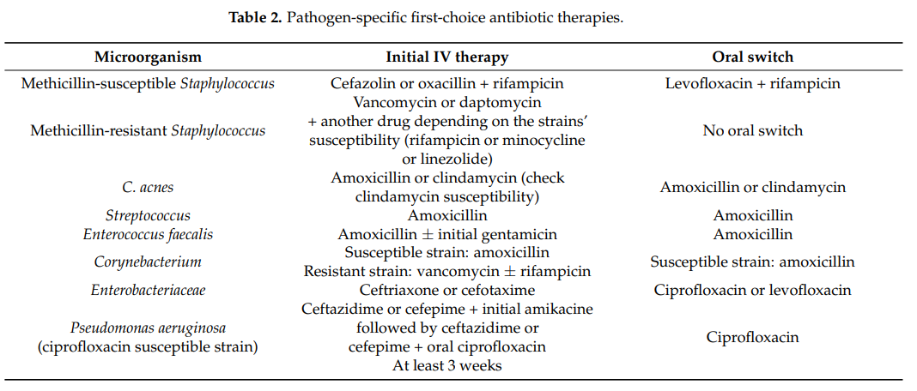
Comparative effectiveness of antibiotics?
Limited data, mostly from bone & joint infection cohort studies
Le Vavasseur & Zeller, Antibiotics 2022. Wieland et al, Clin Infect Dis 2012. Liang et al, EJCMID 2014.

Slide 50
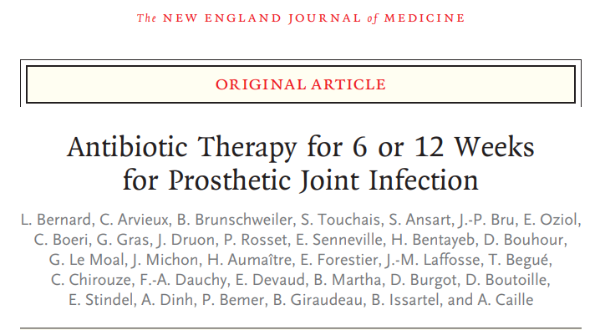
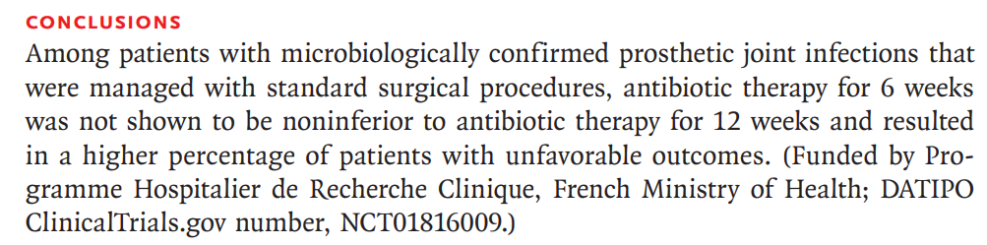
We do not know the optimal duration (yet)
40% DAIR
38% 1-stage
22% 2-stage
Persistent infection in 18.1% (6 weeks) vs 9.4% (12 weeks)
Bernard et al, NEJM 2021;384:1991.

Slide 51
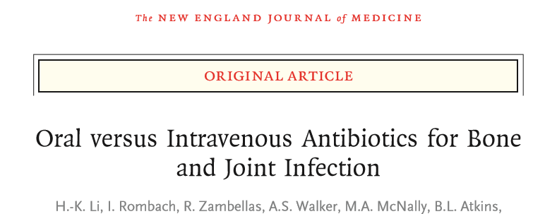
We may underutilize oral options: The OVIVA trial
Bone and joint infections, including a subset of PJI
Multicenter study with 1,054 patients – max 7d empiric IV
Randomization to IV (n=506) vs. PO (n=509) for the first 6 weeks of treatment
PO follow-up permitted in both arms, similar proportion
1-y treatment failure in 14.6% (IV arm) vs. 13.2% (oral arm)
→ Oral treatment is non-inferior
Notes:
sAE 27.7% vs. 26.2%
Catheter complications 9.4% vs. 1.0%

Slide 52
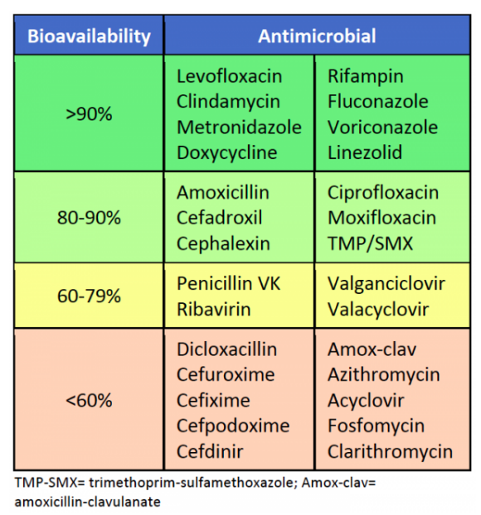
Oral bioavailability of antibiotics
https://www.idstewardship.com/gut-works-use-five-important-considerations-switching-iv-po-antibiotics/

Slide 53
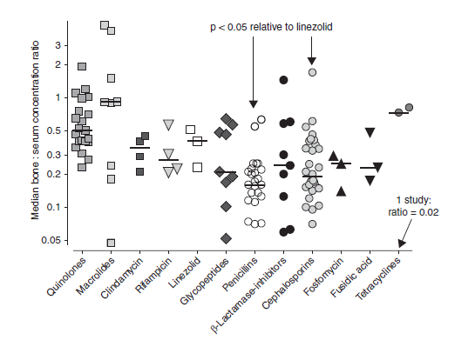
Bone:serum or bone:plasma ratios for various antibiotic groups
Each point = one study
Excellent bioavailability
Landersdorfer et al, Clin Pharmacokinet 2009;48:89. Thabit et al, Int J Infect Dis 2019,81:128.

Slide 54
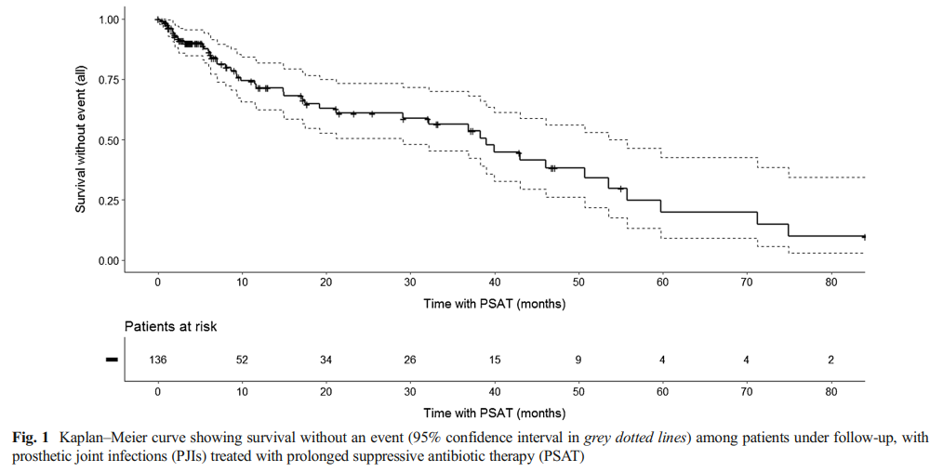
Antibiotic suppression – postponing failure?
If surgery is not an option
Optimal duration unknown
No comparative data available
May be overused
Data from a cohort of 136 patients s/p PJI age >75, no surgery:
  18% AE
  6% progression to sepsis
  10% died
Prendki et al, EJCMID 2017;36:1577.

Slide 55
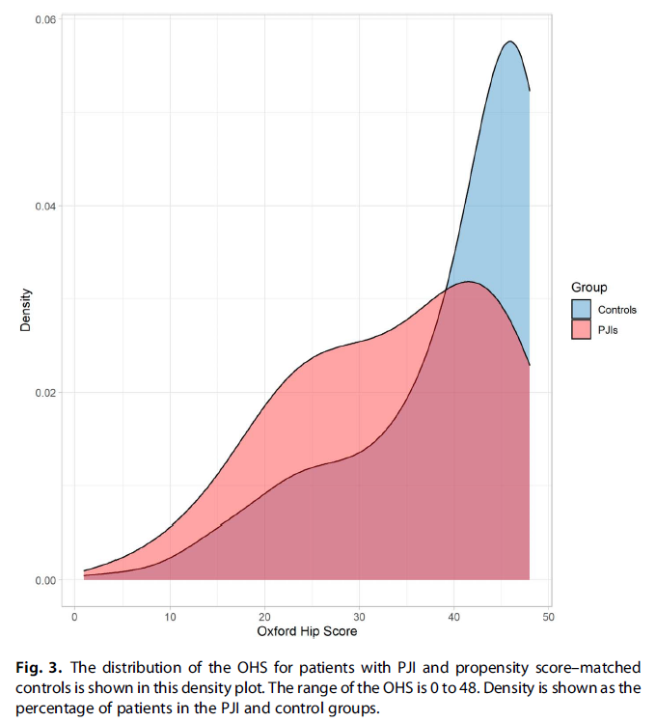
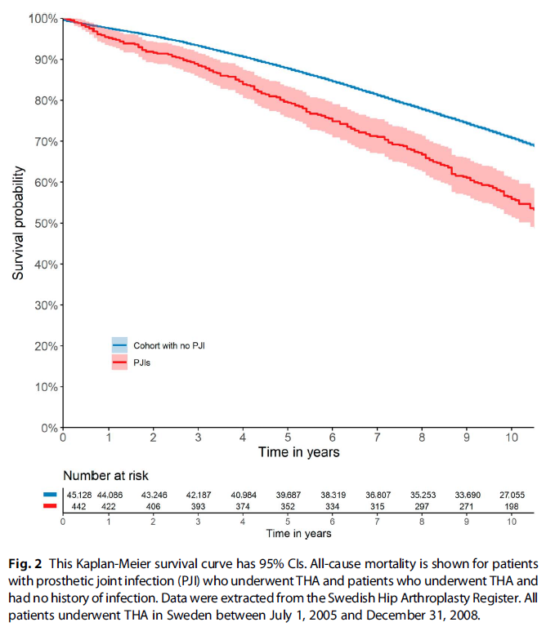
Impact of PJI on joint function, mortality
Survey of 442 patients with hip PJI vs controls
Euro-QoL-5D-5L, Oxford hip score, need for assisted living and ambulatory aids, mortality
Wildeman et al, Clin Orthop Relat Res 2021;479:2203-13.

Slide 56
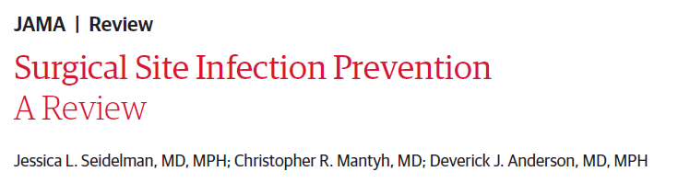
Preventive measures, by timing
Seidelman, JAMA, January 17, 2023
Hair removal
Decolonization
Antibiotic prophylaxis
Checklist
Skin antisepsis
Normothermia
Glucose control
Negative pressure wound therapy
Hospital-wide surveillance
preoperative
intraoperative
postoperative

Slide 57
Management of PJI – in a nutshell
Antibiotic decision-making follows the surgical plan (and there’s a variety of surgical approaches)
Management benefits from interdisciplinary approach
The optimal treatment is unknown (surgical plan, antibiotic choice, duration, route, additional measures) and may differ case-by-case – usually 6 weeks of IV antibiotics
Transition to oral antibiotics is non-inferior to continuing IV

Slide 58
Our patient:
Empiric treatment with vancomycin & ceftriaxone
Ceftriaxone x 6 weeks (alternatives cefazolin and oxacillin require at least 3 administrations per day, not as suited for home IV)
3-week follow-up: No pain, no fevers, CRP 173 → 10
Anticipate oral antibiotics for another 6 weeks
Plan for new implant tbd

Slide 59
Thank you for the attention!
jmarschall@arizona.edu
Banner ID team: 480-724-9035

