Slide 1
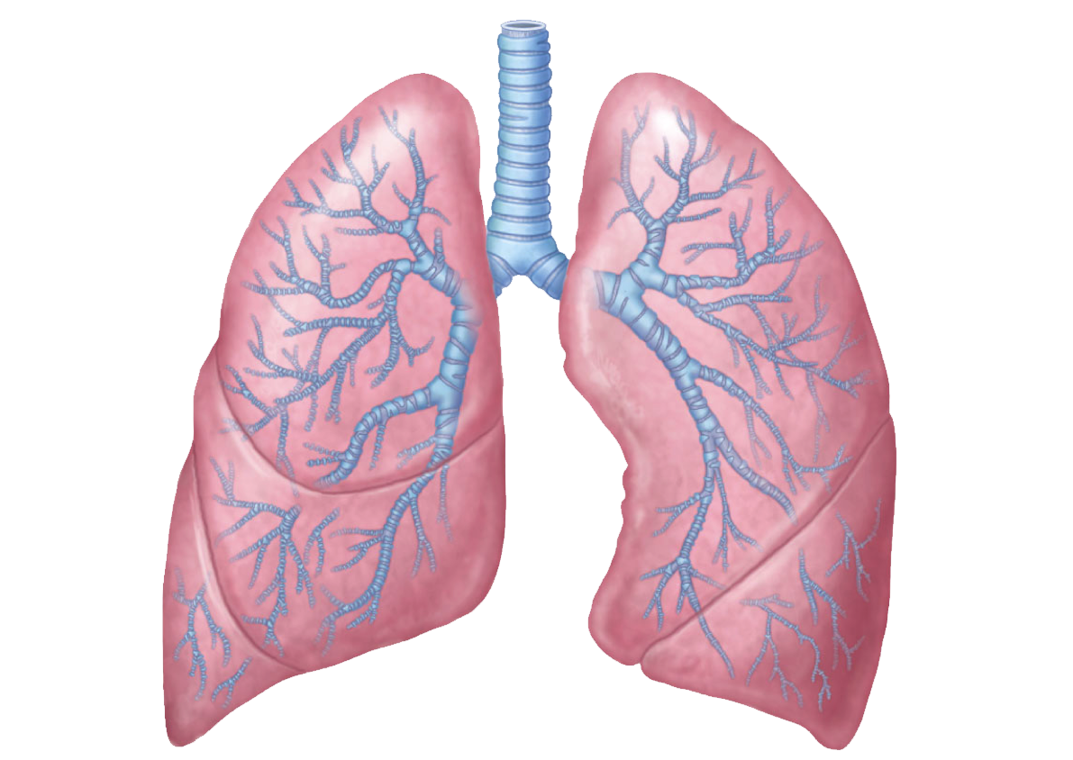
Treatment of COPD Exacerbations
Aishwarya Puri
Chief Resident
This Photo by Unknown author is licensed under CC BY-NC.

Slide 2
A 62-year-old man presents to your clinic with a 2-year history of increasing shortness of breath. His symptoms are worse when he walks up steps or lifts heavy objects. He also has a mild occasional nonproductive cough. His medical history is significant for hypertension, and his only medication is chlorthalidone. He is a construction worker and worked in a steel mill when he was in high school. He quit smoking 1 year ago. His physical exam is significant for a mildly prolonged expiratory phase on lung auscultation but is otherwise normal; no wheezes or crackles are noted. Chest radiograph shows mildly increased lung markings but no focal findings.
Spirometry shows an FEV1/FVC ratio of 60, an FEV1 of 48% of predicted, and an FVC of 80% of predicted. Lung volumes show a total lung capacity of 112% of predicted, a residual volume of 125% of predicted and a DLCO of 69% of predicted. What is his grade of airflow limitation?
A. Mild
B. Moderate
C. Severe
D. Very Severe

Slide 3
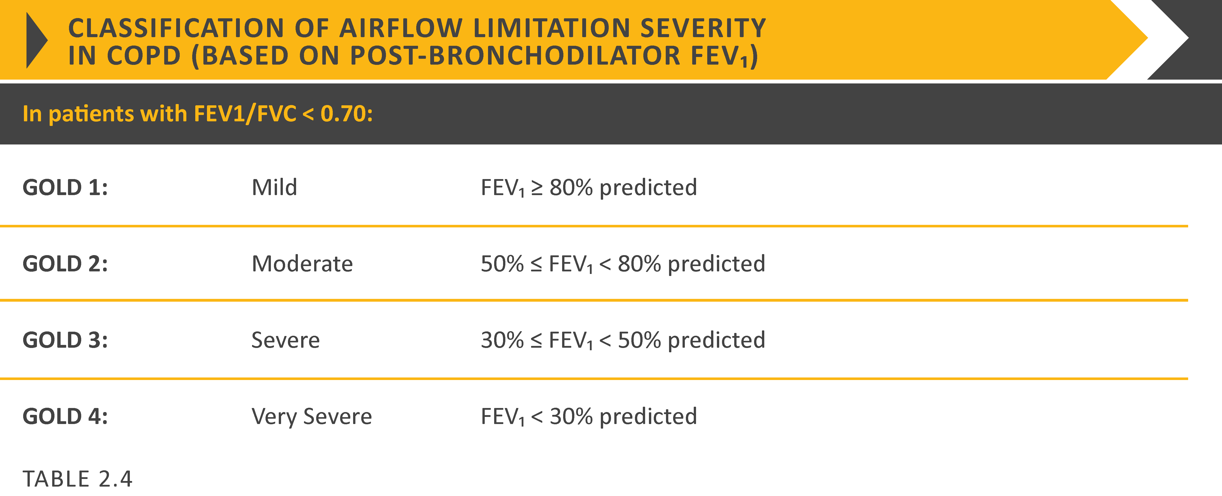
Global Initiative for Obstructive Lung Disease(GOLD)

Slide 4
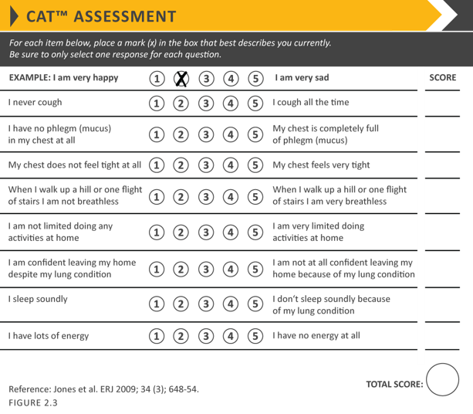
Once you have diagnosed someone with COPD, you have to determine symptom severity
Modified British Medical Research Council

Slide 5
Why so many scales for symptomatic measurement and grading of disease?
Because of heterogeneity in clinical presentation ranging from cough, mucus hypersecretion leading to sputum production to dyspnea secondary to hyperinflation
All this for an individualized management plan.

Slide 6
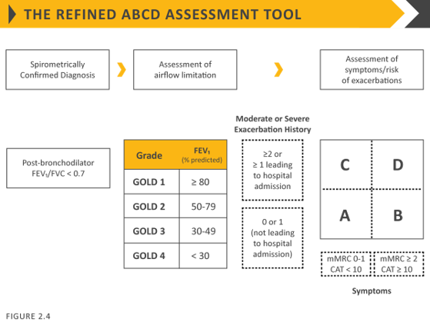
Severe disease
Mild disease
LABA eg. Salmeterol, formoterol
LAMA eg. Tiotropium, Umeclidinium
ICS eg. Budesonide, fluticasone, mometasone, beclomethasone
Any short acting bronchodilator eg. Albuterol, terbutaline(SABA), ipratropium, oxitropium(SAMA)
Definition of abbreviations: eos: blood eosinophil count in cells per microliter; mMRC: modified Medical Research Council dyspnea questionnaire; CAT™: COPD Assessment Test™.

Slide 7
Outpatient stable COPD patient
3 step process from diagnosis to treatment
PFTs to diagnose COPD with GOLD staging with the FEV1
Symptomatic assessment with CAT and mMRC scales
Fitting into ABCD assessment tool to start most appropriate bronchodilator therapy

Slide 8
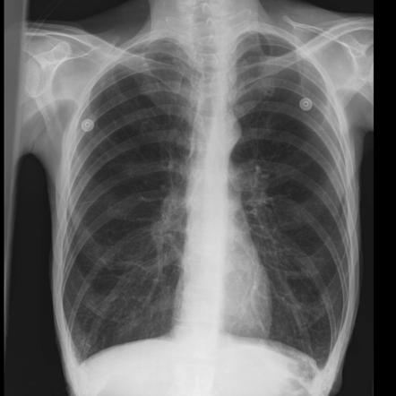
Common findings in Chest X ray of a chronic COPD patient
Tubular heart(narrowing of transverse diameter of heart)
Hyperinflated lung
Flattening of diaphragm(loss of normal crescent shape of diaphragm)(limits ability to increase breath volume especially during exertion, which triggers compensatory use of accessory muscles to increase Tv and increased RR to increase minute ventilation
Hyperlucency(appear a bit darker) of lung fields with less prominent vascular markings
This Photo by Unknown author is licensed under CC BY-SA-NC.

Slide 9
A 67-year-old woman who presents to the ED with a 2-day history of fever, dyspnea, and increased cough with production of green sputum. You are asked to evaluate her for admission. She has severe COPD, which was diagnosed 2 years ago. She used albuterol several times yesterday with no relief of dyspnea, and she was unable to sleep last night. Her last spirometry, performed 6 months ago, showed an FEV1 of 48% of predicted. She is a current smoker with a 24- pack-year history. Medications are tiotropium and as-needed albuterol. Vitals are significant for a temperature of 38.9 °C (102.0 °F), HR of 118/min, and RR of 30/min. Oxygen saturation is 82% breathing ambient air. Pulmonary examination reveals bilateral diffuse expiratory wheezing.
After an albuterol nebulizer treatment and breathing 2 L of oxygen by nasal cannula, oxygen saturation is 91%. She remains tachypneic with bilateral expiratory wheezing. Chest radiograph shows no infiltrate. What defines this women’s condition as an acute exacerbation of COPD?
A. Active tobacco use
B. Presence of a respiratory infection
C. Acute worsening of respiratory symptoms
D. Exclusion of other causes of dyspnea

Slide 10
What constitutes a COPD Exacerbation?
"an acute event characterized by a worsening of the patient’s respiratory symptoms that results in additional therapy"
Cough increases in frequency and severity
Sputum production increases in volume and/or changes character
Dyspnea increases
Exacerbations of COPD can be precipitated by several factors. The most common causes are respiratory tract infections(viral-rhinovirus or bacterial), smoking, non-compliance of home inhalers, pulmonary embolism, pollution.
Exacerbations are classified as :
Mild (treated with short acting bronchodilators only, SABDs)
Moderate (treated with SABDs plus antibiotics and/or oral corticosteroids) or
Severe (patient requires hospitalization or visits the emergency room). Severe exacerbations may also be associated with acute respiratory failure.

Slide 11
Management of Exacerbations
Bronchodilators, Steroids, and Antibiotics
The goal for treatment of COPD exacerbations is to minimize the negative impact of the current exacerbation and to prevent subsequent events.
In the inpatient setting, corticosteroids decrease hospital length of stay and increase the rate of recovery in addition to the benefits mentioned above.
However, there is no improvement in mortality with steroids.
Short courses are not inferior to longer courses and oral is not inferior to IV
Antibiotics are to be reserved for patients with at least 2 of the following:
Increased cough
Increased sputum volume
Increased sputum purulence

Slide 12
You are asked to evaluate a 62-year-old woman with a history of moderate COPD who presents to the emergency department for increasing dyspnea, cough, and sputum production. She had been doing well until 4 days ago when she developed rhinorrhea and a cough productive of purulent sputum. During the past two days she has noted increasing dyspnea on exertion that responds transiently to her albuterol inhaler. This is the patient's first episode of this nature. She stopped smoking 18 months ago. Current medications are albuterol and tiotropium inhalers.
On physical examination, temperature is 38.1 °C (100.6 °F), blood pressure is 130/80 mm Hg, pulse rate is 102/min, and respiration rate is 22/min. Oxygen saturation is 90% on ambient air. The patient is tachypneic and catches her breath between sentences but improves after a treatment of albuterol. She has diffuse end-expiratory wheezing.
A chest radiograph shows the lungs to be clear but hyperinflated.
Arterial blood gases on 2L/min of oxygen through nasal cannula show a pH 7.38, a PCO2 of 42 mm Hg (5.58 kPa), and a PO2 of 70 mm Hg (9.31 kPa).
A. Azithromycin and prednisone
B. Clarithromycin and fluticasone
C. Doxycycline and salmeterol/fluticasone
D. Erythromycin and roflumilast
Notes:
Would any be able to identify the severity of this type of exacerbation?

Slide 13
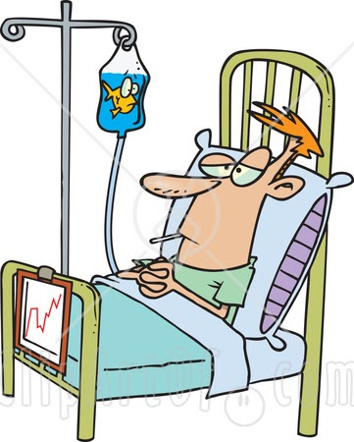
When to Admit a Patient?
This Photo by Unknown author is licensed under CC BY-NC-ND.

Slide 14
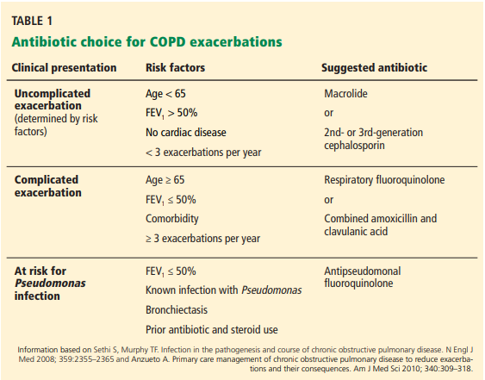
Notes:
Macrolide-azithromycin
Respiratory quinolones like cipro, levo, moxifloxacin

Slide 15
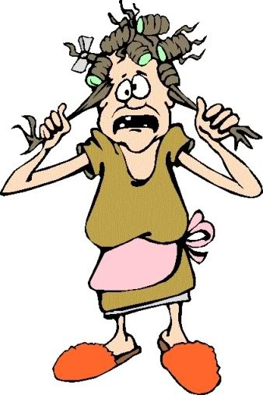
#Acute on Chronic Hypoxic, Hypercapnic Respiratory Failure #COPD in mild (1 of 3 symptoms), moderate (2/3), severe (3/3 + severe symp + insufficient bronchodilator response) acute exacerbation
GOLD Stage _. CAT Score=_, mMRC Score=_. On _ L home O2.
PFTs (_): _
Home regimen: _
On exam satting _ on _ with _, EKG _, troponin _, BNP_, D-dimer_ CXR _ have ruled out ddx of PNA, PTX, pleural effusion, pulmonary edema, HF, cardiac arrythmia.
-Procal (less supporting data)_, sputum cx, respiratory viral panel, ABG(especially if pt. subdued or somnolent)
-Titrate O2 to 88-92%. Would escalate to NIV, invasive ventilation as indicated.
-monitor fluid balance
-albuterol/ipratropium(duonebs) scheduled nebulizers q4h + prn albuterol MDI.
-hold tiotropium
-continue home _ (ICS-LABA)
s/p IV methylprednisone in the ED, starting prednisone 40mg qday x5d (_-_)
-Abx _ given imaging findings _ and GOLD strategy recommends antibiotics for moderately or severely ill patients with COPD exacerbations who have increased cough and sputum purulence.
Ceftriaxone x5d (_-_), Azithromycin 500 x5d (_-_)
-smoking cessation encouraged, supportive services and medications offered and _
-anticipated vaccines on discharge: influenza _, COVID-19_, pneumonia (PCV15 in series with PPSV23 or PCV20 alone)_
-Respiratory rehab
Nebulizer is a machine that aerosolizes medication, converts it into mist and delivers deep into airways, pt. just has to breathe normally
Inhaler(most common form MDI) delivers powder form of medication, pt. has to be educated about the technique for full efficacy
They are intermediate acting steroids
If a diabetic then adjust insulin dose accordingly with anticipating post-prandial spikes in blood glucose(so instead of dividing insulin 50-50 with lispro and glargine divide it 70%-30%)
Beware of steroid induced delirium in these patients!!!!
This Photo by Unknown author is licensed under CC BY-SA-NC.
Notes:
This is how you should document a COPD exacerbation patient and make sure all the orders are also reflected in cerner

Slide 16
A 70-year-old man is evaluated in follow-up for COPD, which was diagnosed 1 year ago. He has had two exacerbations in the last year, with the second exacerbation 1 month ago. At baseline, he has a chronic cough with mucoid sputum consistently for the last 3 years. Sputum culture 6 months ago grew Haemophilus influenzae and mycobacterium avium complex. He has to stop to catch his breath after walking 100 meters (328 feet). His inhaler technique is good. He quit smoking 2 years ago and completed a pulmonary rehabilitation program 4 months ago. His medications are tiotropium, fluticasone/salmeterol, and as-needed albuterol.
Spirometry performed 3 months ago showed an FEV1 of 32% of predicted and an FEV1/FVC ratio of 50%. Chest radiograph performed last month showed no infiltrate, mass, or increased vascular congestion.
On physical examination, vital signs are normal. Oxygen saturation is 92% breathing ambient air. Pulmonary examination reveals diminished breath sounds.
Which of the following is the most appropriate longterm COPD treatment?
A. Daily prednisone
B. Roflumilast
C. Azithromycin
D. Simvastatin

Slide 17
Prevention of Future Exacerbations
Avoid in long QT interval and atypical mycobacterial infections
Azithromycin(Macrolides have antimicrobial + antiinflammatory function):
NEJM 2011: Azithromycin 250 mg daily reduced the risk of exacerbation by 27%
COLUMBUS Trial 2014: Azithromycin 500 mg 3 times weekly decreased exacerbation rates by 42%
Roflumilast(Phosphodiesterase-4 inhibitor):
Lancet 2009: Roflumilast reduced exacerbations by 17%
Lancet 2015: Roflumilast + LABA/ICS decreased exacerbations by 14%
Reserved for patients with severe COPD who have either primarily symptoms of chronic bronchitis or frequent exacerbation
Notes:
Several clinical trials to assess prophylactic use and benefit have demonstrated a reduction in the rate of exacerbation in patients with moderate to severe COPD with one or more moderate or severe exacerbations in the previous year despite optimal maintenance inhaler therapy. The duration and exact dosage of macrolide therapy are unknown. The primary concerns with long-term macrolide therapy are development of antibiotic resistance, including macrolide-resistant strains of nontuberculous mycobacteria. In addition, hearing loss and potentially fatal arrhythmias due to prolongation of the QT interval have occurred in association with azithromycin.

Slide 18
Shortness of Breath

Slide 19
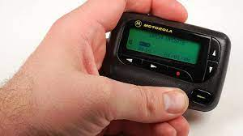
Beep, beep, beep! Patient is feeling short of breath, what do you do?
Talk to your nurse
Symptoms: Onset and progression, is this new?
Associated symptoms
Vitals: Febrile? HR? Pulse ox? Hemodynamic stability
Code status? DNR/DNI
Orders:
Hypoxic? Order oxygen, remember your oxygenation goals
Meds, EKG, ABG
See the patient!

Slide 20
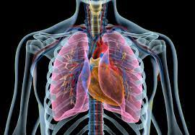
Assessing your patient
Gather history
Quality
Positional dependence
Exacerbation/alleviation factors
Exertional
PMH: Cardiac, pulm, recent procedures
Accessory muscle usage, cyanosis, conversational dyspnea
Does the patient appear in distress
Crackles/rhonchi/wheezing
JVP, heart sounds, edema
Mental status
Physical exam
Vitals
Cardiopulmonary exam
Sometimes their chest is so tight that you don't hear any air flow/wheezing

Slide 21
Differential Diagnosis
COPD/Asthma
Pneumonia
Pulmonary Embolism
Aspiration
Pneumothorax(if has emphysema the bullae can spontaneously rupture)
CHF (COPD patients at high risk for cor pulmonale)
Arrhythmias such as atrial fibrillation
Anxiety
There is a high prevalence of PE in COPD exacerbation which can be overlooked

Slide 22
Management of shortness of breath rapid response/cross-cover
Especially useful if a COPD patient becomes somnolent, get STAT ABG to see if his hypercapnia worsened, then decide between BiPAP(for ventilatory support) vs intubation(if obtunded and cannot tolerate NIPPV)
Get a STAT Chest X-ray, get vitals(look at SaO2)
Supplemental Oxygen (NC->Mask->Nonrebreather… ICU eval)
Get ABG, labs(CBC, CMP, blood glucose-especially if mental status changes, BCx, lactic acid, EKG, flu/COVID test, viral respiratory panel, troponin, BNP, d-dimer)
Bipap for obstructive airway disease or volume overload
Contraindications NIPPV: Cardiac/respiratory arrest, inability to protect airway, uncooperative pt, facial trauma, facial/esophageal/gastric surgery, apnea, reduced consciousness, copious secretions
Call RT to give a breathing treatment-Nebulizers: albuterol +/- ipratropium
If appears fluid overload/crackles on exam- Lasix challenge
Ask bedside nurse what medications were given to patient during her shift, if suspect Narcotics OD -> naloxone
Think about suspicion for PE
INTUBATION!
Failure of oxygenation or ventilation, Airway protection, Decline in mental status, No improvement with NIPPV

Slide 23
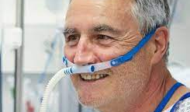
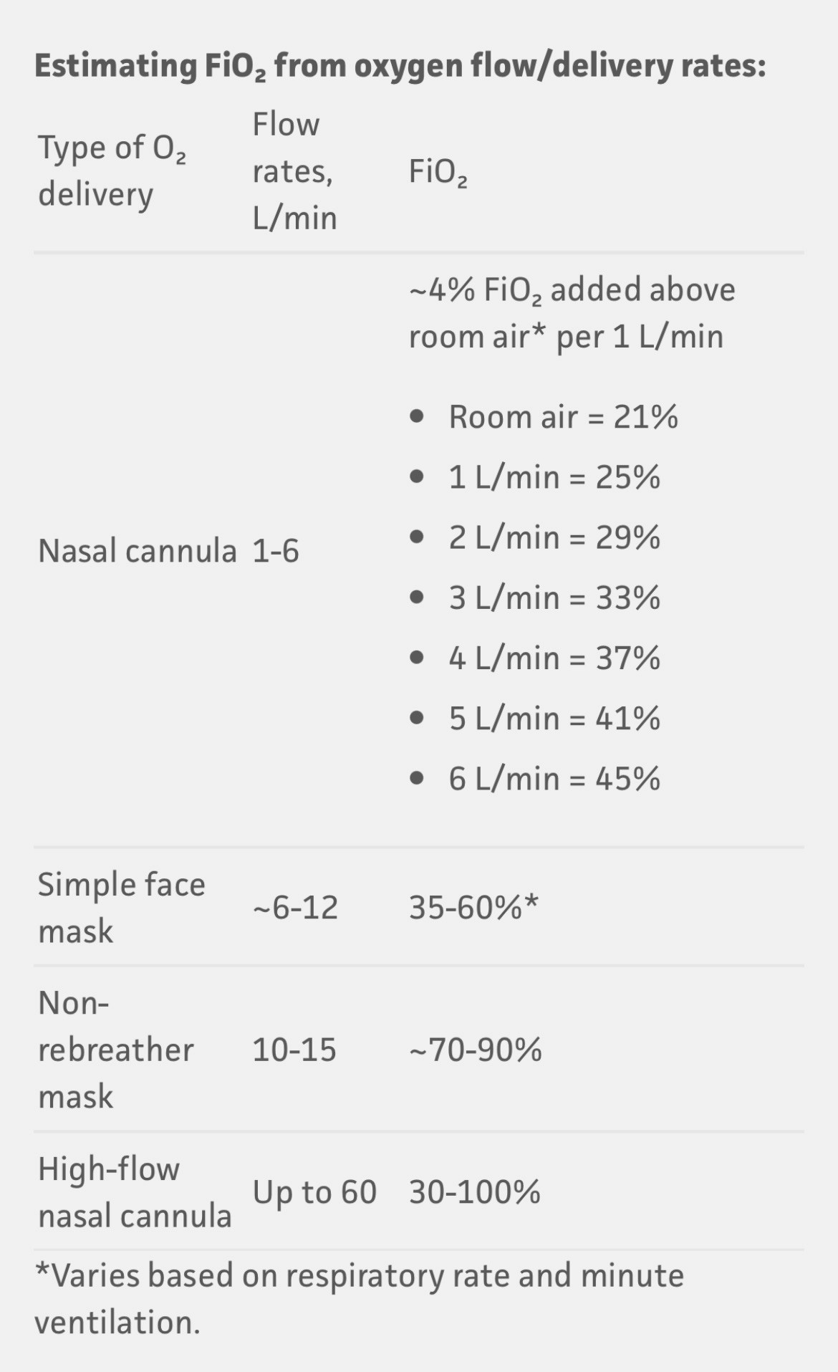
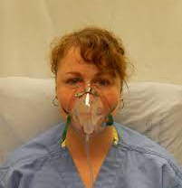
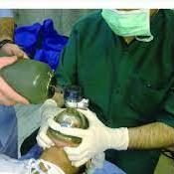
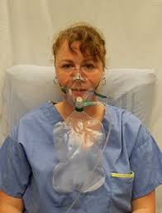
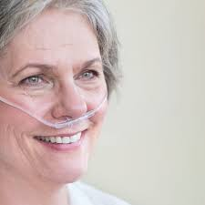
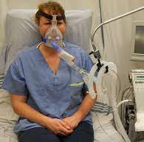

Slide 24
Questions?
This Photo by Unknown author is licensed under CC BY-NC-ND.

