Slide 1


Oncologic Emergencies
Matthew Ulrickson, MD
Banner MD Anderson Cancer Center
July 21, 2026
Matthew.ulrickson@bannerhealth.com

Slide 2


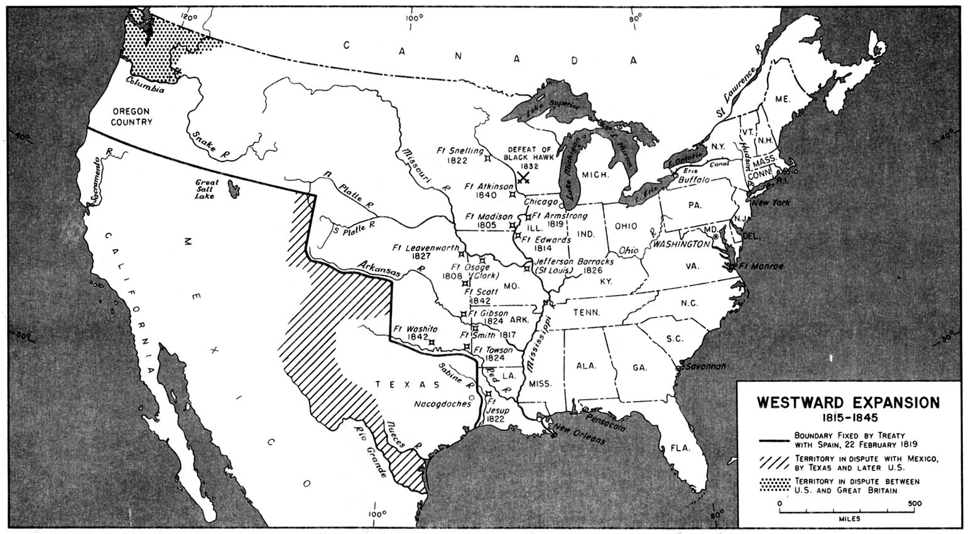







Where are you from?

Slide 3
Objectives
Provide an overview of the diagnosis and management of common oncologic emergencies
Help determine which situations are truly emergent
Discuss the most common cancer types contributing to each presentation
Help lower your pulse rate whenever you encounter these patients

Slide 4
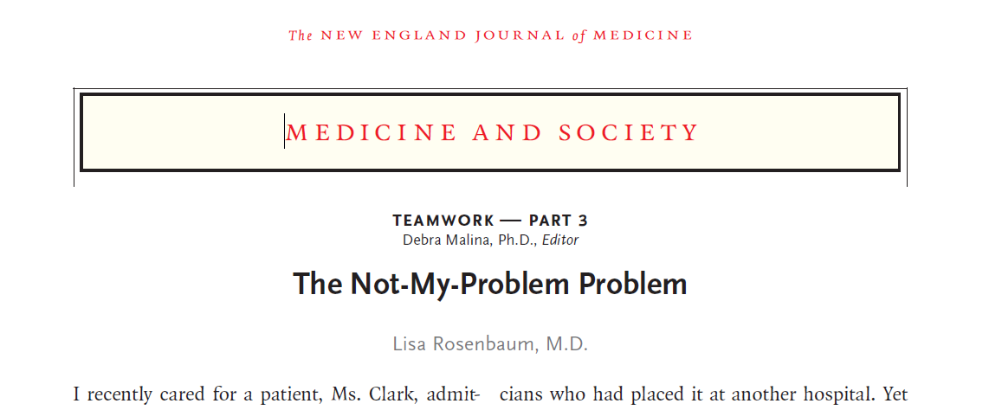
Oncologic Emergencies
Is the situation truly emergent?
Is the problem related to malignancy?
Is the tumor sensitive to chemotherapy, radiation, targeted agents?
The not-my-problem problem
The Not-My-Problem Problem | New England Journal of Medicine

Slide 5

Case 1
You are called to the ED at the VA to evaluate a 44yo woman with dyspnea, weight loss, and fevers for two weeks
Exam: BP 111/60, HR 110, RR 20
  2cm R axillary adenopathy, bilateral cervical adenopathy. No papilledema (do you know where an ophthalmoscope is in the hospital?)
  Decreased breath sounds over left lung base, no stridor
  No organomegaly
  ALT 150, AST 23, LDH 620, Alk Phos 250, Uric Acid 6.5
  CBC 3.5>12<95 ANC 2000

Slide 6
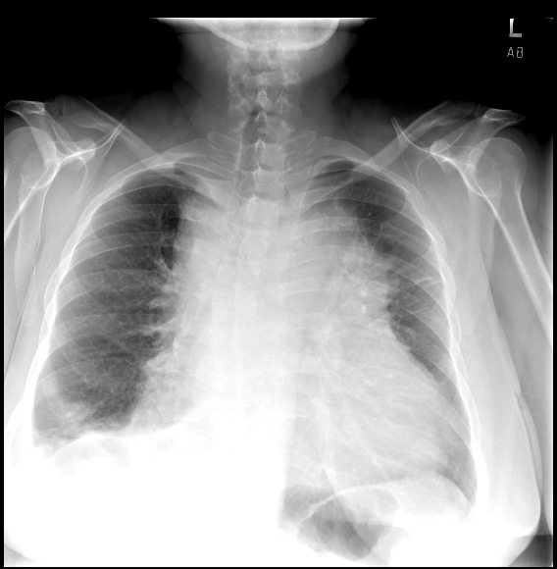
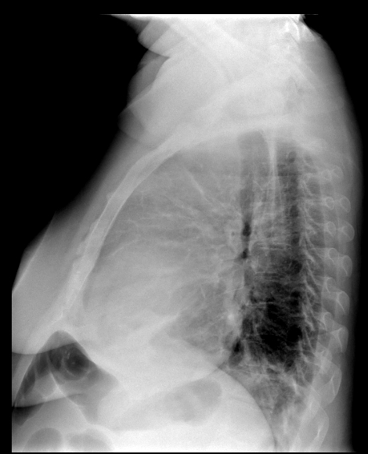

Slide 7
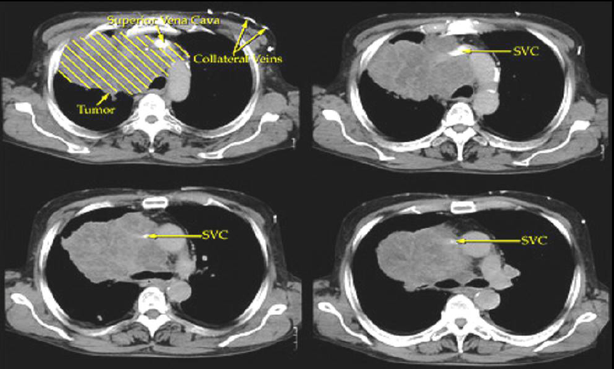

Slide 8
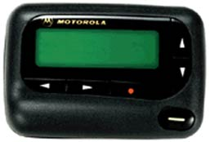
What do you recommend?
STAT: CT scan on BB/123456, complete occlusion of the SVC by large mass

Slide 9
SVC Syndrome
Which of the following do you recommend as a next best step?
A) Radiation
B) Vascular Stent
C) Tissue Biopsy
D) Chemotherapy
E) Steroids

Slide 10
SVC Syndrome
Which of the following do you recommend as a next best step?
A) Radiation
B) Vascular Stent
C) Tissue Biopsy
D) Chemotherapy
E) Steroids

Slide 11
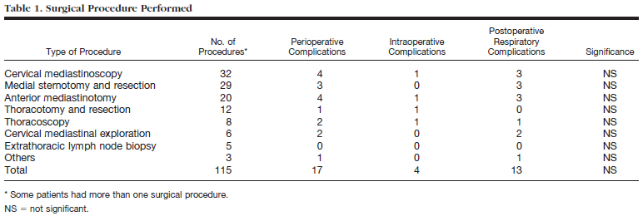
Biopsy in SVC Syndrome
2 of the 4 were AF
5 of 13 were Abx
Intraoperative complications
inability to ventilate or peak pressure >40 cm H2O
severe pulmonary shunt (pulse oximetry <95% at FIO2 of 100%)
hemodynamic instability (systolic BP <70 mmHg for 5 min or pulse rate <40 or >120 beats/min) necessitating treatment
Postoperative respiratory complications
occurring within 10 days after surgery and necessitating treatment
(1) Reintubation
(2) Noninvasive mechanical ventilation
(3) Bronchoscopy
(4) Inhalation therapy (racemic epinephrine, helium–oxygen mixture)
(5) Antibiotics
Dx: 31% lymphoma, 15% thymoma, 14% mets
Bechard Anesthesia 2004

Slide 12
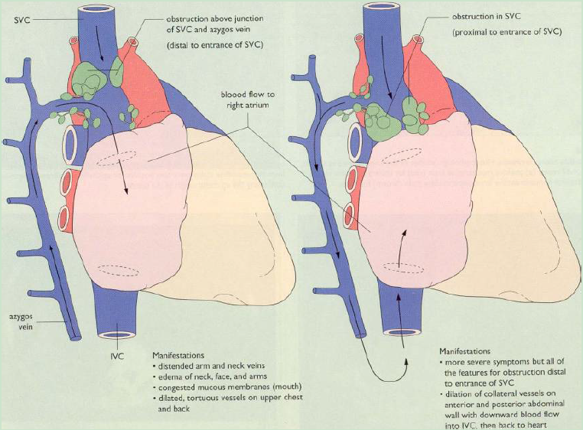

Slide 13
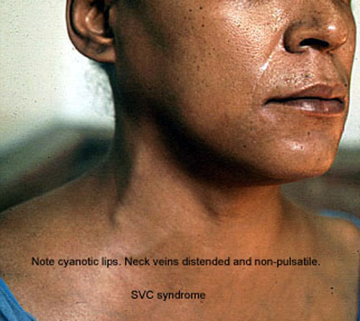
Pulmonary Advanced Physical Diagnosis (luc.edu)

Slide 14
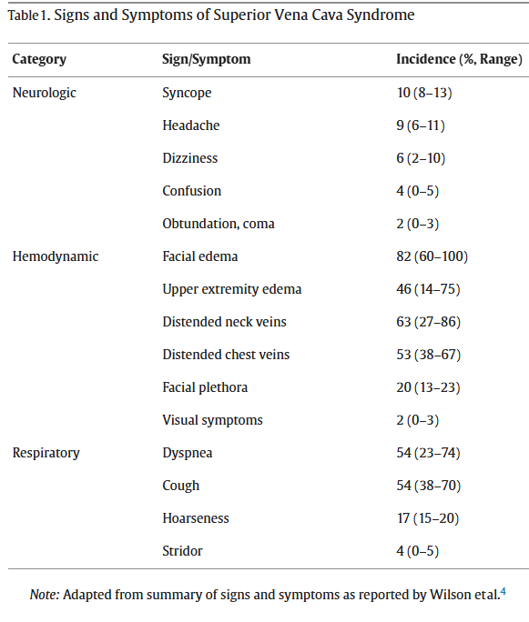
SVC Syndrome
Physiology
  Partial or complete obstruction of the SVC and collaterals
Manifestations
  Dyspnea, dysphagia, cough, edema (sometimes none of these)
  Rare: coma, syncope, HA, stridor
POC u/s may help with diagnosis (J Clin Ultrasound 2020 Apr 25. doi: 10.1002)

Slide 15
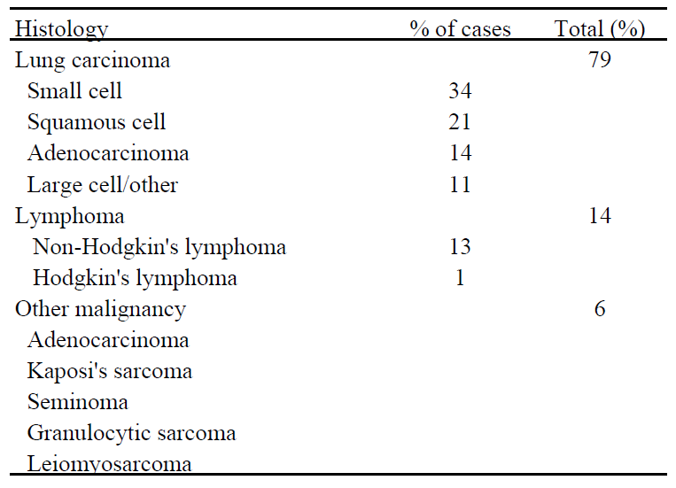
SVC Syndrome
Etiology
  Malignant in 65-85% of cases
  Benign
    CVC/thrombus, pacemaker, infection (TB, histo)
    More pacers have increased non-malignant cases
Lymphoma
Lung

Slide 16
SVC Syndrome
Immediate interventions:
  Upright position (improve drainage), oxygen prn
  No significant benefit of diuresis
  Obtain necessary imaging
  Biopsy
    FNA usually inadequate for lymphoma diagnosis - so at least core biopsy
    For flow cytometry, sample cannot go into formalin so send some in saline – talk with IR and/or path prior to procedure
  Is this an emergency?

Slide 17
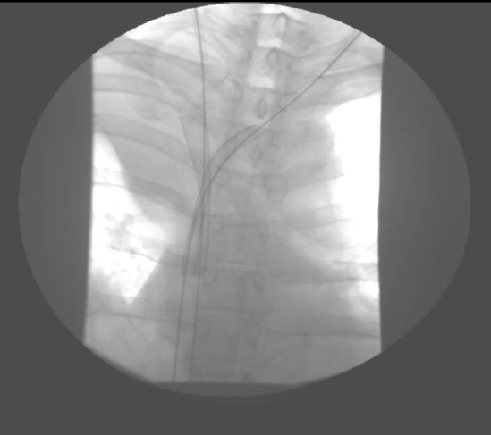
SVC Syndrome
Tracheal obstruction or cerebral edema are the only true emergencies
  Have you found the ophthalmoscope yet???
Tissue diagnosis is most important
  (bronchoscopy, node biopsy, trans-thoracic needle biopsy, mediastinoscopy, VATS, etc)
  Low risk even with general anesthesia
Treatment
  Chemo/targeted tx for sensitive tumors
  Corticosteroids after biopsy while
  awaiting tissue diagnosis
  Radiation for other tumors
  Surgery or stent in selected cases
    Unlikely to need stent if due to lymphoma
    NCCN guidance if NSCLC combined with XRT
    Gd3 Stent complication rate 14% (Takeuchi et al Supp Care Cancer 2019)
      PE, hypotension
      No survival benefit

Slide 18
SVC Syndrome
Biopsy (IR or Surgery)
Most aren’t truly emergent
Steroids while waiting for pathology after biopsy (Onc consult)
STAT: CT scan on BB/123456, complete occlusion of the SVC by large mass
S. V. C. = Bi. Op. Sy.

Slide 19
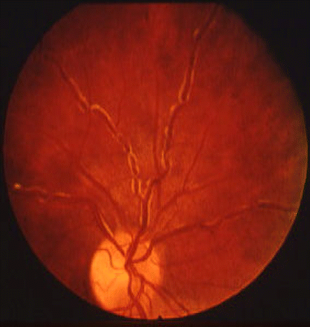
Case 2
Stone. Blood 2012. 119(10)
A 62yo man presents with fatigue, headaches, blurry vision, and epistaxis.
He has generalized lymphadenopathy and a palpable spleen tip. Fundoscopic exam with enlarged retinal veins.
  What is the thing called that you look in the eyes with?
CBC 6.5>7.4<155
Cr 1.4 Ca 9.1
T Prot 8.4 Alb 2.2
Head CT negative
What do you suspect?
Re: WM/237654. Head CT negative, should we transfuse him?

Slide 20
Hyperviscosity
Increase in serum viscosity (above 4 cp) can cause sludging/microvascular insufficiency
  Most commonly neurologic, pulmonary symptoms
Waldenstrom Macroglobulinemia is a common cause due to IgM secretion (10-30% pts)
  80% IgM intravascular; therefore can remove with plasmapheresis( viscosity with IgM above 4-5gm)
  After reducing viscosity, then treat disease
    chemotherapy and targeted agents for lymphoplasmacytic lymphoma (LPL)
Notes:
Usually with IgM >5gm, but can happen at 3-5gm as well

Slide 21
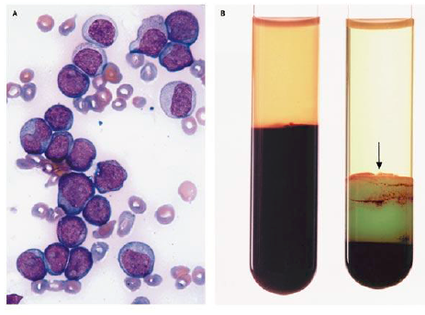
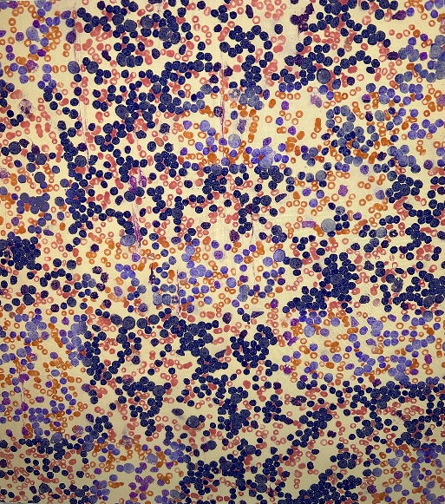
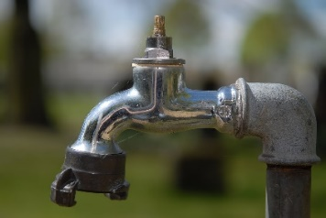
Leukostasis
Can also cause hyperviscosity-like symptoms
  Myeloid blast count >50k (AML)
  Lymphoid blast count >400k (ALL)
  Rare in CML, CLL, Leukemoid reaction
  RBC transfusion increases viscosity, so delay until after cytoreduction if not urgent need/ no bleeding
  Preferable to start chemotherapy
    Can temporize with leukapheresis
Mauro MJ NEJM 2003. 349:767

Slide 22
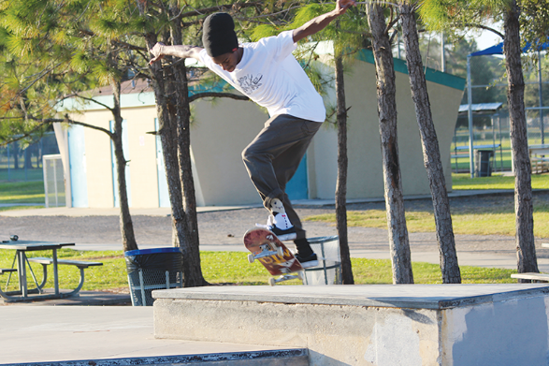
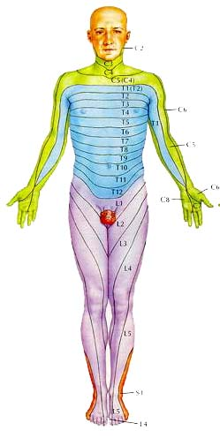
Case 3
22yo male presents to the ER with weight loss, back pain, dyspnea, fatigue, and difficulty walking. He did three kickflips while posting to TikTok prior to presentation.
Exam: BP 110/72, HR 100, RR 18
  Back tender to palpation
  Decreased sensation in a band starting at T5, LE weakness with 3/5 in BLE
  Phone seems inseparable from his R hand, with 6+/5 grip strength noted. Thenar hypertrophy.
Chest xray and Thoracic spine xray negative
– (theweeklychallenger.com)

Slide 23
ADMIT: CC/89234. Can’t walk but Xray fine. Admit for pain control, OK?
The ED physician calls to send him to the floor, where your team is busy admitting 4 new arrivals. You say:
A) “Sure, as long as you put in some holding orders and check a calcium”
B) “How about an MRI?”
C) “How about starting dexamethasone, then getting an MRI?”
D) “I’m capped, save him for the night float”
E) “Ivermectin”; works for everything

Slide 24
ADMIT: CC/89234. Can’t walk but Xray fine. Admit for pain control, OK?
The ED physician calls to send him to the floor, where your team is busy admitting 4 new arrivals. You say:
A) “Sure, as long as you put in some holding orders and check a calcium”
B) “How about an MRI?”
C) “How about starting dexamethasone, then getting an MRI?”
D) “I’m capped, save him for the night float”
E) “Ivermectin”; works for everything

Slide 25
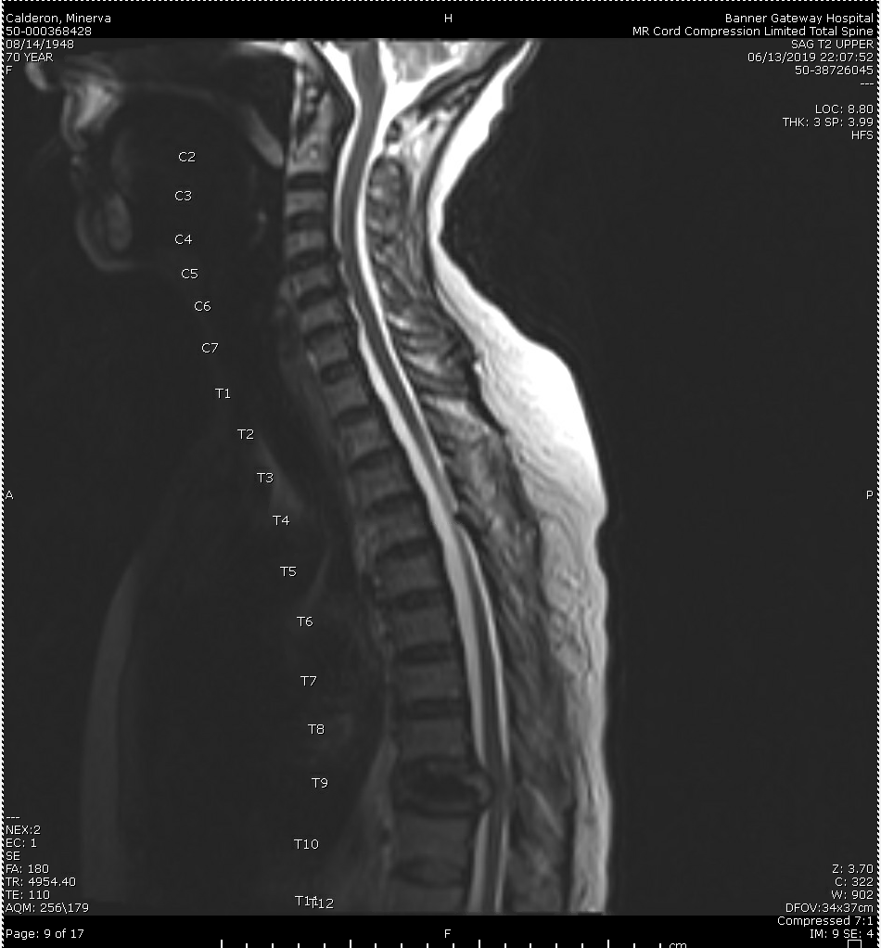
MRI entire spine (cord compression protocol)
Consider PSA, breast exam, CXR, SPEP as indicated if no prior diagnosis

Slide 26
Epidural cord compression
Compression of spinal cord by tumor extending from vertebral body or through foramina.
Location
  Thoracic (70%) > lumbar > cervical spine
Manifestations
  Pain (95%), weakness, sensory changes, bowel/bladder dysfunction
PreTest Probability
  Patient with known advanced malignancy and new back pain = MRI
  Patient in a primary care clinic with new back pain – no MRI (usually)

Slide 27
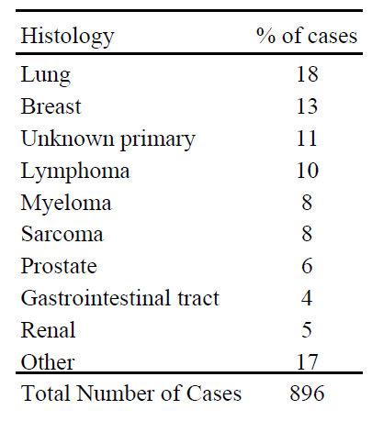
Cord Compression
Malignant in >90% of cases
  Benign causes include trauma, DJD, osteoporosis and fracture, spinal stenosis, abscess
Diagnosis
  MRI
    If cord compression is suspected, image the ENTIRE spine (‘cord compression protocol’)
    >50% patients with multi-level involvement

Slide 28
Cord Compression
Treatment
  Dexamethasone 10mg (some use 100mg) IV x 1 then 4mg IV q6hrs. Taper once compression resolved/XRT completed
  Surgery then XRT vs Radiation alone
    (Patchell et al. Lancet 2005. 366:643)
      Primary endpoint, ability to walk
      N=101
      Had to be symptomatic (pain included)
      Could not have been paraplegic for >48hrs
      Tumor in one single area (could be multiple contiguous vertebrae)
      Excluded ‘very radiosensitive tumors’
        Lymphoma, myeloma, leukemia

Slide 29
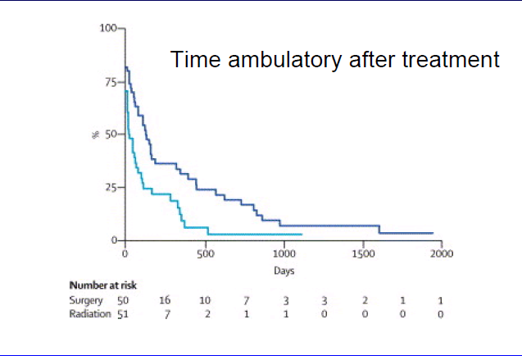
Back on their feet
Surgery median 122 days
Radiation median 13 days

Slide 30
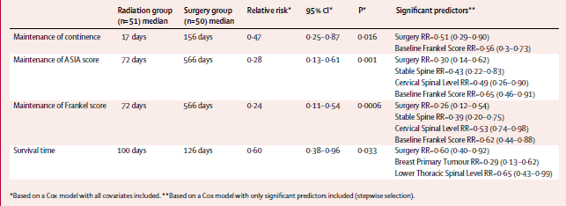
Other Outcomes
Patients who entered treatment unable to walk
  Surgery/radiation: 62% were ambulatory after treatment
  Radiation alone: 19% ambulatory
Patchell, Lancet 2005

Slide 31
Modified Tokuhashi Score
Ann R Coll Surg Engl 2012; 94: 28–33 and Spine 1990. 15:1110-1113
Original study suggested aggressive interventions for score >9 and less invasive if <5.
Feature | Score 0 | Score 1 | Score 2
Performance status | KPS 10-40%) | KPS 50-70% | KPS 80-100%
# Extraspinal bone mets | >3 | 1-2 | 0
# vertebral body mets | >3 | 1-2 | 0
Visceral Mets | Unresectable | Resectable | None
Primary Tumor*** (**note if targetable mutation present) | Lung/ Stomach | Kidney/liver/ uterine | Thyroid, prostate, breast, rectal
Spinal cord palsy | Complete | Incomplete | None
There are 9 score models for this same question

Slide 32

Cord Compression
Empiric steroids as soon as suspicious
Diagnose with MRI (even if pain alone with no neuro symptoms and suspicious)
Decompression (Neurosurgery/Ortho, RadOnc)
  Surgery better than radiation alone in selected patients
ADMIT: CC/89234. Can’t walk but Xray fine. Admit for pain control, OK?

Slide 33
Case 4
24yo woman with stage IV Burkitt Lymphoma is admitted for urgent treatment with R-hyper-CVAD
Exam: BP 120/70, HR 90, RR 26
Hepatosplenomegaly
Cr 2.4 (baseline 0.7), CO2 14, Uric acid 20, Potassium 6.4, Ionized Ca 1.9, Phosphate 9.0
Diagnosis?

Slide 34
Tumor Lysis Syndrome
Metabolic derangements associated with tumor necrosis (spontaneous or due to chemo)
  Release of cellular purines, phosphate, potassium
Hyperuricemia with acidemia induces crystal formation and obstructive uropathy
Etiology: Lymphoma, Leukemia, Small cell lung,
High risk features: tumor >10 cm, LDH > 2x ULN, leukemic cells > 25k/uL, pre-existing renal failure.
(JCO 2008;26:2767)

Slide 35
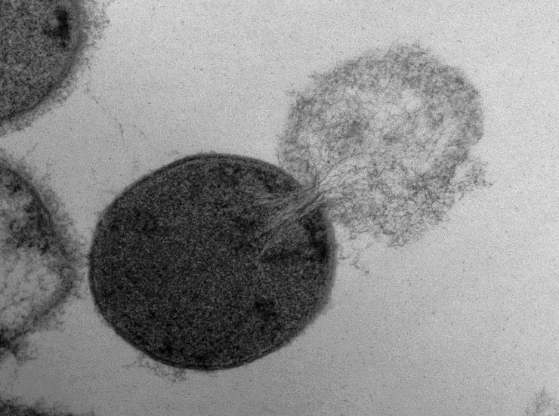
TLS Diagnosis
Cairo-Bishop laboratory definition
  At least two of the following:
    Uric acid > 6.5-8 mg/dL or >25% above baseline
    K > 6 mEq/L or > 25% above baseline
    Phos > 6.5mg/dL or > 25% above baseline
    Ca < 7mg/dL or < 25% below baseline
Clinical complications:
  Acute kidney injury
  Arrhythmia (hyperK, hypoCa)
  Seizure (from hypocalcemia)
Image: Daniel Nelson, UMD

Slide 36
TLS prevention and Treatment
Prophylaxis
  Hydration: 0.9% NS (No potassium in IVF). Goal UOP 80-100 mL/hr (in high risk I usually start at 200cc/hr as long as no cardiac concerns)
  Allopurinol: allopurinol 300mg PO daily (or can use BID/TID)
  Check labs often - don’t just order them, make sure they result
Treatment (as above plus:)
Electrolyte abnormalities:
  Phosphate Binders (decrease GI absorption of phos)
  HyperK treatments
  Use caution prior to repleting for hypocalcemia
    remove automated electrolyte plans
    Ca x PO4 >60 increases risk of precipitation
  Severe cases may require hemodialysis.
  Loop diuretics can assist with uric acid excretion when patient no longer hypovolemic.
Do not suggest alkalinizing the urine
  (alkalinization makes uric acid more soluble – but phosphate less soluble, so may trigger precipitation esp when Ca x PO4 is >60mg/dL. With rasburicase available, alkalinization is rarely indicated)

Slide 37
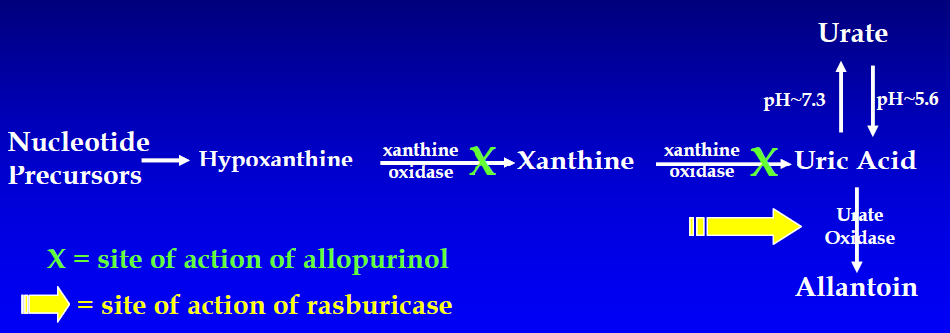

TLS Treatment
- Rasburicase: (recombinant urate oxidase enzyme) for selected high-risk patients (uric acid >10), treat with 3mg IV x 1
  may repeat after 8 hours in rare cases, esp if uric acid remains >8.5mg/dL
  Caution: agent can cause hemolysis in G6PD deficient patients.
Check level 3-6 hours after dose: Note well: Uric acid samples taken after administration of rasburicase must be collected in chilled heparin tubes, kept in ice, and run within 4 hours of collection as the enzyme will continue to be active within the tube and cause spuriously low results (Use RASBURICASE uric acid level order).
Aggressive IVF can often avoid need for rasburicase in borderline cases and increase value

Slide 38
Case Continued
Patient was managed aggressively with control of her electrolyte abnormalities and her Cr improved without dialysis
She completed 8 cycles of hyper-CVAD, entered remission, and was cured

Slide 39

Case 5
36yo woman with no PMHx presents with RUQ abdominal pain, nausea/vomiting, and jaundice.
No bleeding or bruising, no fevers

Slide 40
CBC 10.5>7 <12
INR 1.2, PTT 30
LDH 1,059
Cr 1.7, TBili 4.8
Albumin 3.6
Abdominal ultrasound reveals pericholecystic fluid and mild gallbladder wall thickening
She is planned for cholecystectomy

Slide 41
Next Steps?
Pt in 1504 planned for surgery. Platelets low. Please manage.

Slide 42
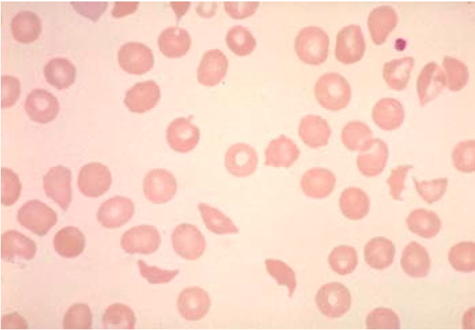
Peripheral Smear
CellaVision allows viewing of PB smear from any computer

Slide 43
Thrombotic Thrombocytopenic Purpura (TTP)
Thrombocytopenia and microangiopathic hemolytic anemia (MAHA) are only requirements to suspect diagnosis
Treat with emergent plasma exchange (large bore pheresis line)
  Replace the ultralarge vWF with normal spectrum of vWF
  UL vWF is more adhesive than shorter vWF
  Platelets bind to vWF
Many cases are autoimmune (inhibitor against ADAMTS13) – steroids can be helpful
Confirm diagnosis with ADAMTS13 activity level with reflex to inhibitor
  This test takes many days to return, so don’t wait on TPE for this

Slide 44
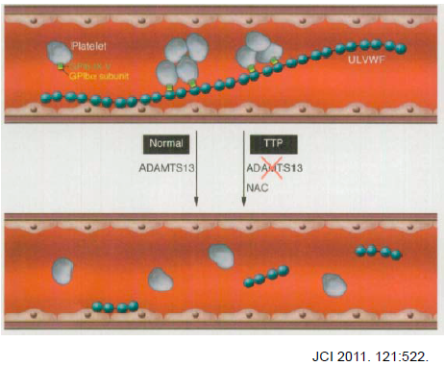

TTP Physiology
Early plasma exchange decreases mortality from 90% to 15%
Caplacizumab – anti vWF Immunoglobulin that prevents interaction between VWF and Platelets
Speeds time to normalization of platelets in TTP with TPE
Scully, NEJM 2019

Slide 45
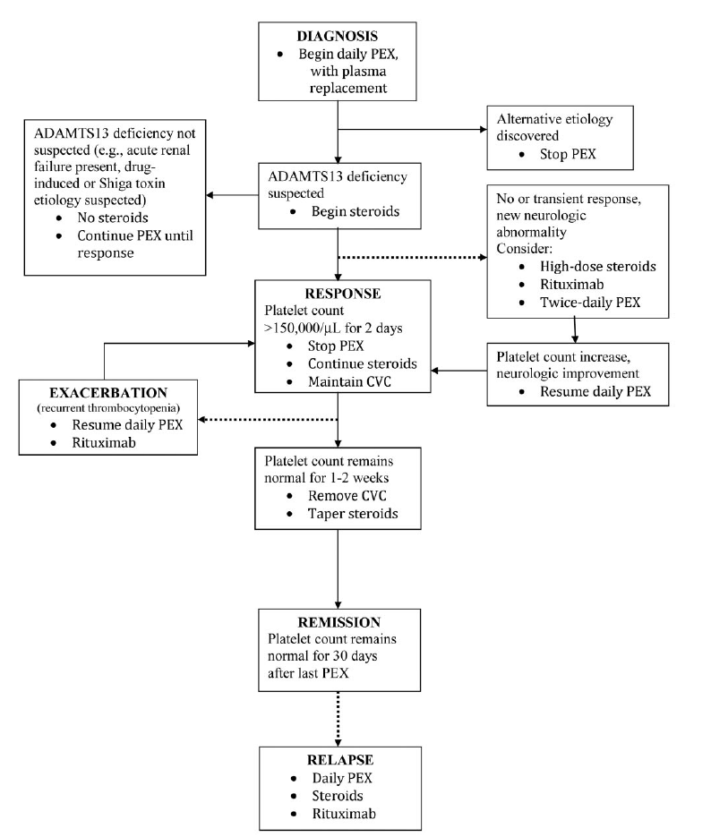
Treatment
Platelet transfusion?
  Minimize
  Likely ok if required to get line placed
caplacizumab
J George Blood 2010. 116:4060

Slide 46
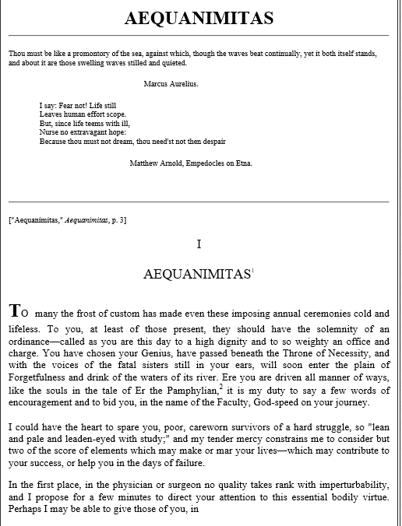

Questions
Sir William Osler, 1889
Matthew.ulrickson@bannerhealth.com
480-280-5757

Slide 47
Case 6
55yo man with a prior history of treated non-small cell lung cancer (NSCLC) you see in clinic with weight loss, fatigue, and dyspnea for two weeks
Exam: BP 90/60, HR 130, RR 38
  Crackles and dullness at both lung bases, LE edema, hepatomegaly, JVP 15cm H2O

Slide 48
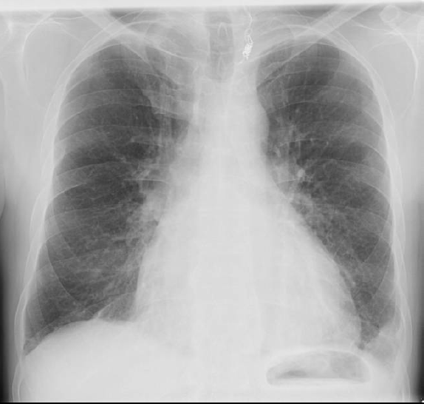

Slide 49
What do you suspect?
STAT: Your patient in room 5 doesn’t look well. What do you want to do??

Slide 50
Cardiac Tamponade
Impairment of diastolic filling by fluid/tissue in pericardium
Rate of fluid accumulation is most important determinant of severity of symptoms
Symptoms
  Dyspnea, tachycardia, hypotension, elevated JVP, increased pulsus

Slide 51
Pulsus Paradoxus
Also can be seen in severe obstructive lung disease
Exaggerated decrease in Systolic BP with inspiration (10-12mmHg is normal (6+/- 3))
To Measure:
  1. Find a manual BP cuff (don’t tell the patient you are watching their breathing)
  2. Stop cuff when first Korotkoff sounds heard
    Notice that the sounds come and go
  3. Gradually decrease the cuff pressure 2mmHg at a time
    Wait a few respirations at each level to confirm sounds come and go
  4. Once sounds continually present, record and take difference (Step 2 – Step 4)
  5. When sounds disappear completely, this is DBP, which is not significantly influenced in tamponade
INHALE EXHALE INHALE EXHALE INHALE
I I I I I I I I I I I I I
INHALE EXHALE INHALE EXHALE INHALE
I I I I I I I I I I I I I I I I I I I I I I I I I I I I I I I I I
INHALE EXHALE INHALE EXHALE INHALE
Notes:
98% of patients with tamponade have pulsus >10
The finding of pulsus >12 discriminates patients with pericardial effusion with tamponade from those without with 98% sensitivity, 83% specificity (+LR 5.9 and –LR 0.03) Curtiss et al. Am Heart J 1988. 115:391.
Inspiration increases R heart return, which then causes IV septum to expand into LV, decreasing cardiac output

Slide 52

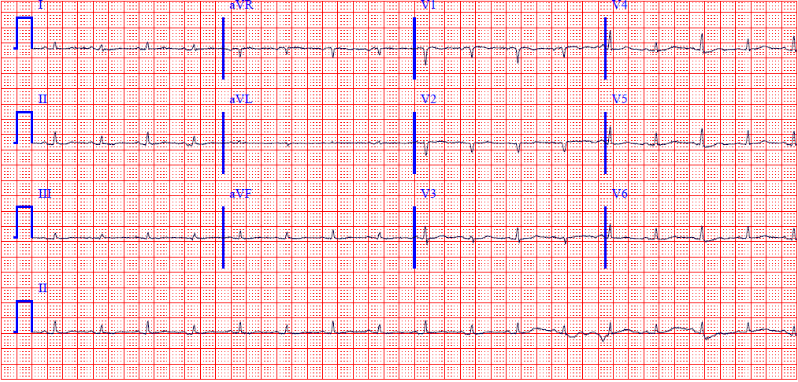
Cardiac Tamponade
Diagnosis
  CXR: pleural effusion, increased cardiac silhouette, widened mediastinum
  Echo: RA/RV diastolic collapse
  Cardiac Cath: equalization of pressures
Etiology
  Most common malignancies:
    Lung Ca, Breast Ca, Lymphoma
  EKG: low voltage, electrical alternans, may have ST elevations in pericarditis pattern

Slide 53
Cardiac Tamponade
Treatment
  O2, IVF (no diuresis even if CHF symptoms/pleural effusions), pressors if needed
  Pericardiocentesis, emergently if unstable
    Drain may remain in situ
  Chemotherapy can transiently control ~70% of malignant cases
  Pericardial window or pericardiectomy
  Sclerosis with bleomycin, minocycline rarely used

Slide 54
Cardiac Tamponade
IVF and BP support as needed
Check pulsus
STAT Echo (Cardiology)
Drain Fluid (If suspect malignant, Onc)
STAT: Your patient in room 5 doesn’t look well. What do you want to do??

Slide 55
Case 4
85yo male with a history of multiple myeloma recently stopped therapy after entering a remission. His wife calls you while you are covering calls for the clinic.
  Worsening rib pain
  Previously functional, his wife reports that he is more confused and lethargic

Slide 56
You advise him to present to ED for evaluation
CBC: 11.1>32%<325 ANC 8000
Lytes: Na 134, Cr 1.3, LFTs WNL
CXR: Normal
No sensory loss or other neurologic changes.
Due to the negative evaluation, they send the patient home for outpatient management
What else should they have checked?

Slide 57
The next day
Patient returns home from ED at 1am; the next afternoon he is brought back to the ED by EMS with worsening confusion and pain
Your pt HC/8675309 is back again. Wife wants pain meds for him. Can you take care of it?

Slide 58
The next day
Patient returns home from ED at 1am; the next afternoon he is brought back to the ED by EMS with worsening confusion and pain
Serum Calcium = 14.2 (Alb 3.2)

Slide 59
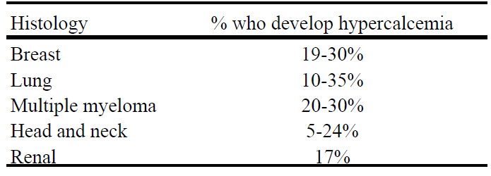
Hypercalcemia
Occurs in 10-20% of patients with cancer
Malignancy most common cause inpatient (hyperPTH most common in clinic)
  NSCLC, Breast Ca, Myeloma
  **15% of patients with hypercalcemia AND malignancy have a separate cause for the hypercalcemia
    PTH, thiazide, milk-alkali, granuloma, hyperthyroid, etc
Physiology
  PTHrP
  Increased 1,25 Vit D (lymphoma)
  Increased bone breakdown (bony lesions)

Slide 60

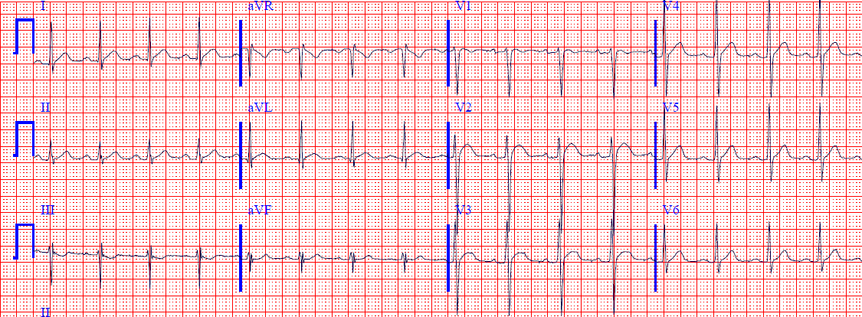

Hypercalcemia
Symptoms
  Nausea, emesis, polyuria/ polydipsia, confusion/ somnolence, psychosis, pain, hyporeflexia, constipation, AKI, bradycardia, ECG changes
    Prolonged PR, short QT, wide T
Notes:
ECG for hypercalcemia (13.9 mg/dl here). Note the very abbreviated ST segment such that the T wave looks like it takes off directly from QRS in some leads. High take-off of ST segment in V2/V3 is also sometimes seen in this context. May have Osborne waves.
Hypocalcemia is just the opposite: prolonged QT due to long ST segment (corresponding to changes in action potential plateau phase duration).

Slide 61
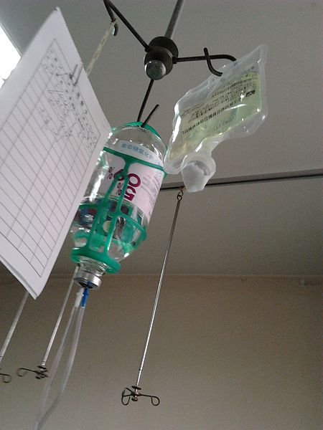
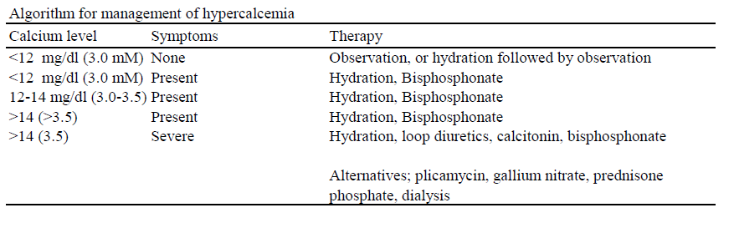
Hypercalcemia
Treatment
  Treat underlying malignancy
  Hydration (~3-7 liters in 24-36hrs)
  Hydration (Goal UOP >75cc/hr)
  Hydration
  Diuretics (furosemide or other loop)
  Bisphosphonate
  Dialysis if necessary
  Calcitonin can help slightly for a few days
    NOT nasal; must be SQ

Slide 62
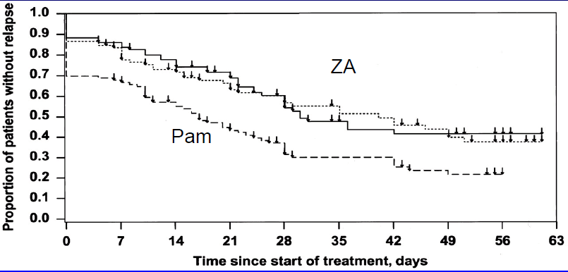
Bisphosphonates
With first infusion, can cause ‘acute phase’ symptoms: fever, nausea, pain
  Usually does not recur with later infusions
Zoledronic acid 4mg or Pamidronate 90mg
  May cause hypocalcemia in vit D deficiency
  Rarely osteonecrosis of the jaw
  Onset of benefit in 24-48hrs
  Duration of effect 30-40 days
  If CrCl <30,
  use pamidronate
JCO 2001. 19:558

Slide 63
Hydration
Bisphosphonates if symptomatic
Identify cause (History, PTH, PTHrp, 1,25 VitD)
Consider furosemide, calcitonin, HD
Your pt HC/8675309 is back again. Wife wants pain meds for him. Can you take care of it?

Slide 64
Case 6
24yo with new diagnosis of AML was treated with idarubicin and cytarabine 10 days ago. He has had some intermittent diarrhea since discharge. He felt febrile at home, so presented to the ED per advice of his oncologist.
Exam: Temp 39.5 BP 110/64 HR 90
He otherwise looks and feels well
Next step?

Slide 65

CBC: 0.1>25%<15k ANC 0
How do you treat him?
Public Domain https://commons.wikimedia.org/w/index.php?curid=1685144

Slide 66
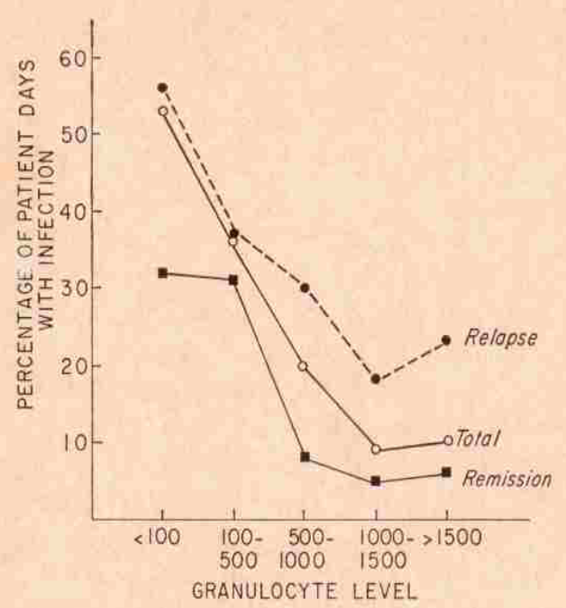
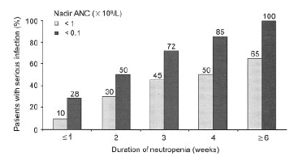
Depth and Duration
The risk of infection in patients with neutropenia correlates with both the depth and duration of the neutropenia
(Bodey et al. Ann Int Med 1966, 2:328 and Viscoli, Clin Inf Ds 2005).

Slide 67
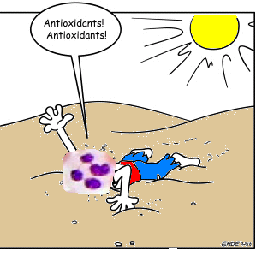
Definitions
Fever
  single oral temperature >38.3°C (101°F) or >38.0°C (100.4°F) that persists for 1 hour
Neutropenia
  ANC <500 cells/mm³
  ANC <1000 cells/mm³ and expected to nadir below 500 cells/mm³

Slide 68
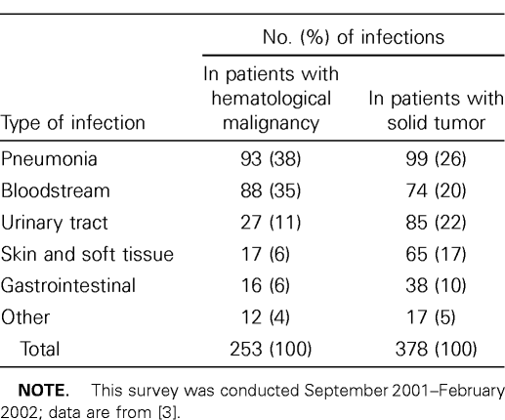
Evaluation and Etiology
Physical Examination | Testing
Orthostatic vital signs | CBC with differential
Evaluate for sinus tenderness | Blood cultures x 2 (either one culture from each central line lumen or one central culture and one peripheral) Urine culture (UA is an unreliable screen during neutropenia)
Examine CVC site | Chest x-ray
Thorough skin exam | Review prior culture and resistance data
Perineal exam (no digital rectal exam) | Other imaging as directed by symptoms
  Thorough evaluation for source should be undertaken
Yadegarynia, Clin Inf Ds 2003

Slide 69
Treatment
Empiric cefepime (ceftazidine) 2gm q8hrs
  PCN-allergic: Aztreonam 2gm q8hrs
No trial has ever shown improved outcome with empiric addition of vancomycin in febrile neutropenia (so, direct use as clinically indicated)

Slide 70
Special Situations
Duration of neutropenia >20 days (higher risk of gram negative bacteremia)
  Consider adding empiric aminoglycoside, esp if unstable
Past history of frequent cephalosporin exposure (increased risk of resistant gram-negatives)
  Consider adding aminoglycoside OR use carbapenem
Potential or witnessed aspiration (risk for anaerobic infection)
  Consider adding clindamycin OR use carbapenem
Clinical tunneled line infection
  Add empiric vancomycin
Severe mucositis (possible S. viridans bacteremia)
  Consider adding 72hr trial of empiric vancomycin
For patients with resistant colonizing organisms on rectal/nasal swab or prior culture:
  MRSA or PCN-resistant S. pneumonia: consider 72hr trial of empiric vancomycin
  VRE: consider empiric linezolid or daptomycin
  Non-albicans candida species: consider adding amphotericin product
  Prior mold (aspergillus, fusarium): consider adding voriconazole
  Resistant pseudomonas, stenotrophomonas, enterobacter: consider empiric gentamicin

Slide 71
Vitamin Vanco
If a patient is placed on an empiric trial of vancomycin, the following “endpoints” should be assessed at 72hrs:
  Presence of gram positive organisms on blood culture
  Presence of clinical catheter tunnel infection
  Clinical response to vancomycin (e.g., patient becomes afebrile after vancomycin was instituted)
If none of the above are true, consider stopping vancomycin at that time

Slide 72
Persistent febrile neutropenia (>72hrs)
F/N on antibiotics for >72hrs without identified source of infection
  Consider Infectious disease consult
  Probability of invasive fungal infection increases after 3-5 days of persistent fever (without other identified focus) in high-risk patients
    allogeneic SCT patients
    neutropenia >20 days
    patients known to be colonized with mold or fluconazole-resistant yeast, who have not yet received antifungals other than fluconazole – amphotericin B (or other appropriate agent) should be started.
    In patients not known to be colonized with the above pathogens, the risk of invasive fungal infection and need for additional therapy should be determined with the aid of the following risk factors:
      History of invasive fungal infection prior to transplantation
      History of culture negative febrile neutropenia during previous chemotherapy
      History of ongoing steroid therapy or steroid therapy prior to transplantation
      Underlying hematologic malignancy (particularly when not in remission)
      Allogeneic transplantation (with cord blood recipients at highest risk)
      Duration of neutropenia > 20 days
      Age > 40
      Prior history of CMV disease
In Patients without risk factors, or if neutropenia is expected to resolve within three days – additional diagnostic testing (eg CT Chest to look for invasive aspergillosis, CT abdomen with contrast to evaluate for hepatic candidiasis, and/or CT sinuses) can be performed prior to initiating empiric antifungal therapy. Biopsy of abnormalities seen by CT imaging and/or BAL is strongly encouraged to help establish a microbiologic diagnosis to allow more specific antimicrobial therapy.

Slide 73
Empiric Management of Septic Shock:
For patients with signs of septic shock (i.e. hemodynamic instability), empiric antibiotics should be ordered and administered immediately (<1hr from time of evaluation) since the time to antibiotic receipt is a strong predictor of outcomes. If the patient is diagnosed with sepsis and neutropenia in the clinic, antibiotics should be started prior to transfer to the hospital for further management. (after blood cultures drawn)

Slide 74
In the absence of empiric treatment, mortality in severely neutropenic patients with gram-negative bacteremia approaches 40%
  Schimpff et al. NEJM 1971. 284:1061, Klastersky Am J Med 1986. 80:2.
Over 50% of neutropenic patients present with fever as the only symptom of infection
  (Klastersky J Cancer Clin Onc 1988. 24:S35)
Antibiotics do not cure infections, neutrophils do

