Slide 1
Small and Medium Vessel Vasculitis
Trent Smith, MD
UACOM-P & BUMC-P Internal Medicine Housestaff Educational Lectures
March, 2026

Slide 2
Objectives
Promote accurate classification and differentiation of vasculitis types
Recognize the diverse clinical presentations of disease
Learn appropriate diagnostic strategies
Understand treatment principles and strategies
Emphasize prompt recognition and interdisciplinary collaboration

Slide 3
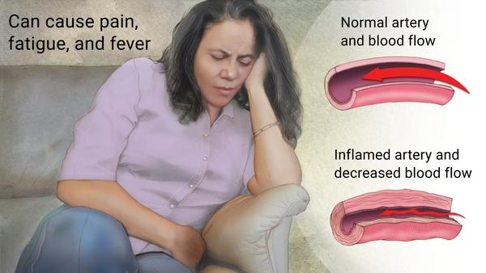
Vasculitis (FROM GOOGLE, May 17, 2021)
Also called: angiitis
Source
Description
An inflammation of the blood vessels that causes changes in the blood vessel walls.
Vasculitis can cause vessel walls to thicken and narrow, cutting off vital blood supply to tissues and organs.
Symptoms include fever, fatigue, weight loss, and muscle and joint pain.
Some forms of vasculitis improve on their own. Others require medications.
Rare
Fewer than 200,000 US cases per year
Treatment can help, but this condition can't be cured
Requires a medical diagnosis
Lab tests or imaging always required

Slide 4
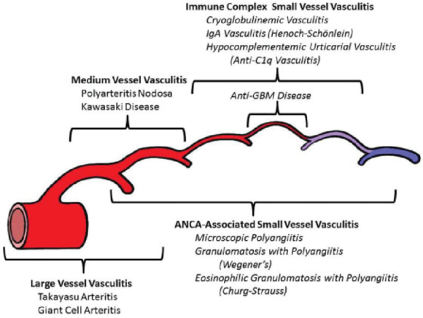
Clin Exp Nephrol. 2013 Oct; 17(5): 603–606.

Slide 5

The humble vessel
Taking water to a plant,
Like taking blood to a vital organ

Slide 6
For all types of vasculitis
What is the damage from affected vessels?
  Jaw claudication, vision loss (GCA)
  Absent pulse, challenging BP measurement (Takayasu’s)
  Glomerulonephritis (GPA/MPA)
  Renal artery involvement, Hypertension (PAN)
  Testicular pain (PAN)
  Pulmonary Renal syndromes(GPA, Goodpasture’s)
  Palpable purpura (Cut vasculitis) vs “punched out” ulcers (medium)
Course of disease?
  Monophasic (Polyarteritis nodosa, Giant cell arteritis)
  Recurring (GPA, MPA)
Mimics? (SBE, Cholesterol emboli, Hep B/C, medications, HZ in CNS vasculopathy)

Slide 7
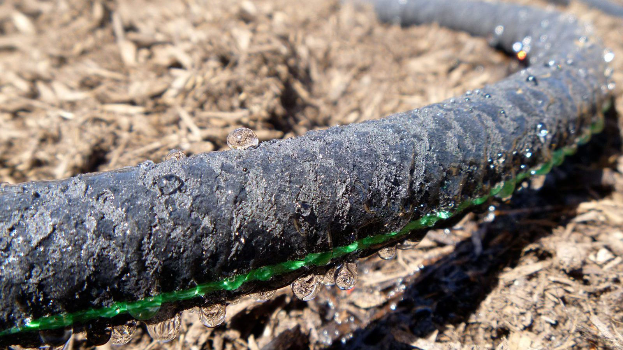


Small vessel vasculitis

Slide 8
Let’s start with nephrology:
MKSAP 18 Neph Q21
An 83-year-old man is evaluated for a 1-week history of poor appetite, myalgia, fatigue, arthralgia, and low-grade fever. He was previously healthy and active. His only medication is acetaminophen as needed.
On physical examination, the patient is afebrile. Blood pressure is 155/95 mm Hg, and pulse rate is 80/min; there are no orthostatic changes. There is trace lower extremity edema. A faint red-blue reticular rash is present over the lower extremities.

Slide 9
MKSAP 18 Neph Q21 (cont)
.
Hemoglobin | 12 g/dL (120 g/L)
Calcium | 9.8 mg/dL (2.5 mmol/L)
Creatinine | Current: 3.1 mg/dL (274 µmol/L); Baseline 2 months ago: 0.9 mg/dL (79.6 µmol/L)
Urinalysis | 3+ blood; 2+ protein; 20-30 dysmorphic erythrocytes/hpf; 5-10 leukocytes/hpf
Chest radiograph shows no acute infiltrates. Kidney ultrasound shows no masses or obstruction

Slide 10
MKSAP 18 Neph Q21 (cont)
Which of the following is the most likely diagnosis:
ANCA associated glomerulonephritis
Anti-glomerular basement membrane antibody disease
Minimal change glomerulonephropathy
Myeloma cast nephropathy
Proliferative lupus nephritis

Slide 11
Small Vessel Vasculitis– ANCA associated
Granulomatosis with Polyangiitis (formerly Wegener’s)
Microscopic Polyangiitis
Eosinophilic Granulomatosis with Polyangiitis (formerly Churg-Strauss)
Renal limited ANCA associated vasculitis (uncommon)

Slide 12
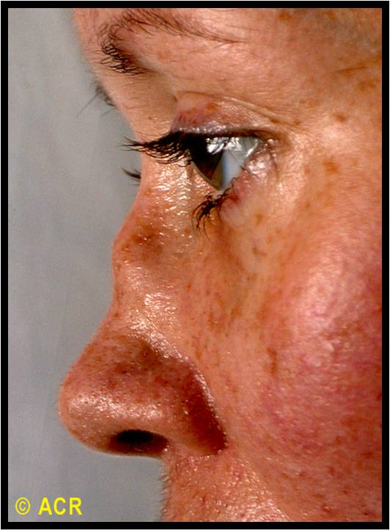
Small Vessel Vasculitis – ANCA associated
When to suspect?
  Pulmonary-Renal Syndromes
  Pulmonary Hemorrhage, especially Diffuse Alveolar Hemorrhage
  Acute Renal Failure, often Rapidly Progressive Glomerulonephritis
  Mononeuritis
GPA Predominant
  Sinusitis, upper airway, Subglottic stenosis
  Pulmonary nodules “cannonball lesions”
  Saddle nose deformity
  Granulomas!
EGPA
  Asthma & eosinophilia, neuropathy

Slide 13
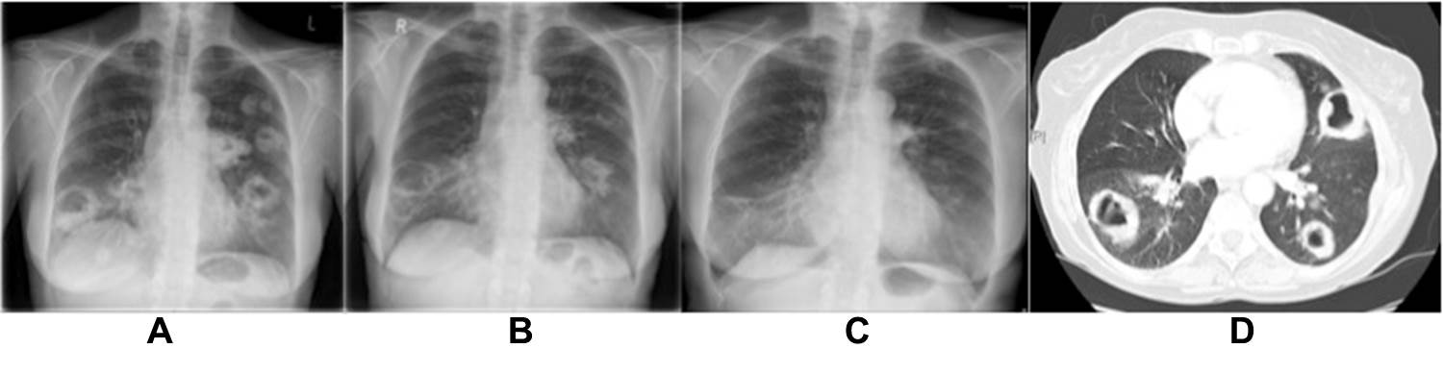
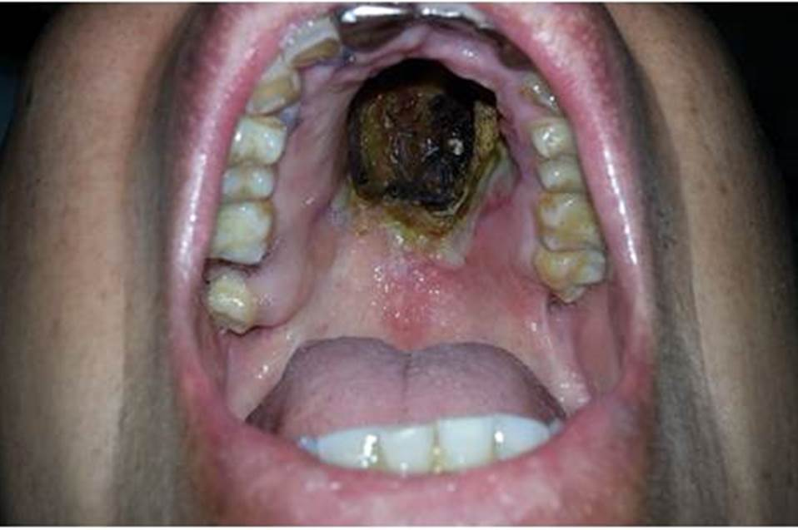
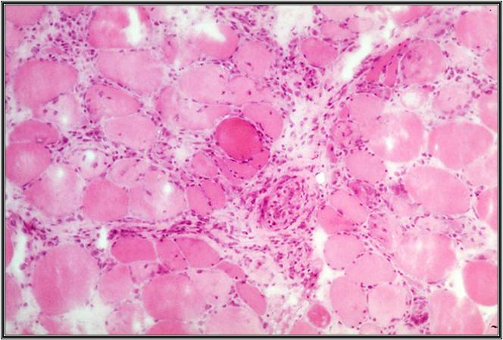
ANCA associated vasculitis

Slide 14
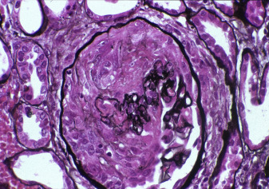
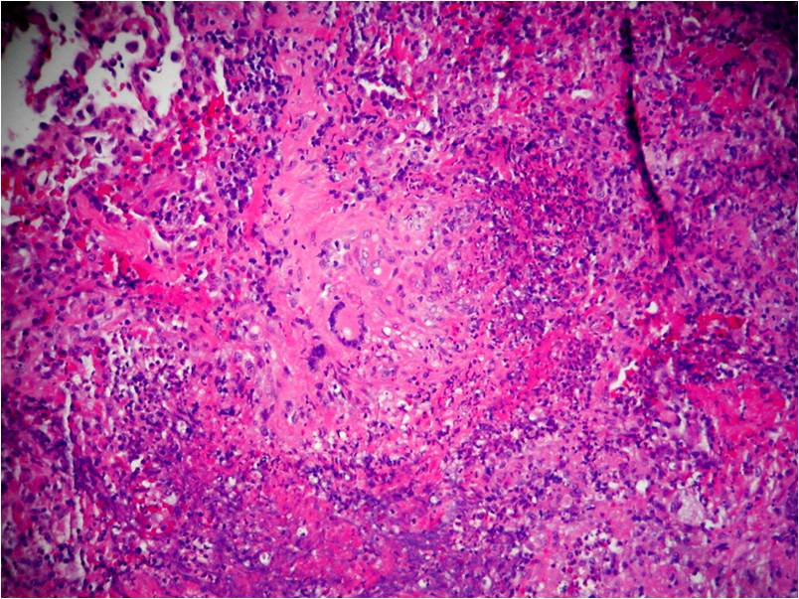
ANCA associated histology

Slide 15
Differences between ANCA diseases
Granulomatosis with Polyangiits
  Upper AND lower airway
  Kidney
Microscopic Polyangiitis (no granulomas)
  Kidney
  Nerve
  Fibrosis
EGPA
  Triad of granulomatous inflammation, vasculitis, tissue eosinophilia
  asthma, eosinophila >10% of WBC
  Cardiac endomyocarditis

Slide 16
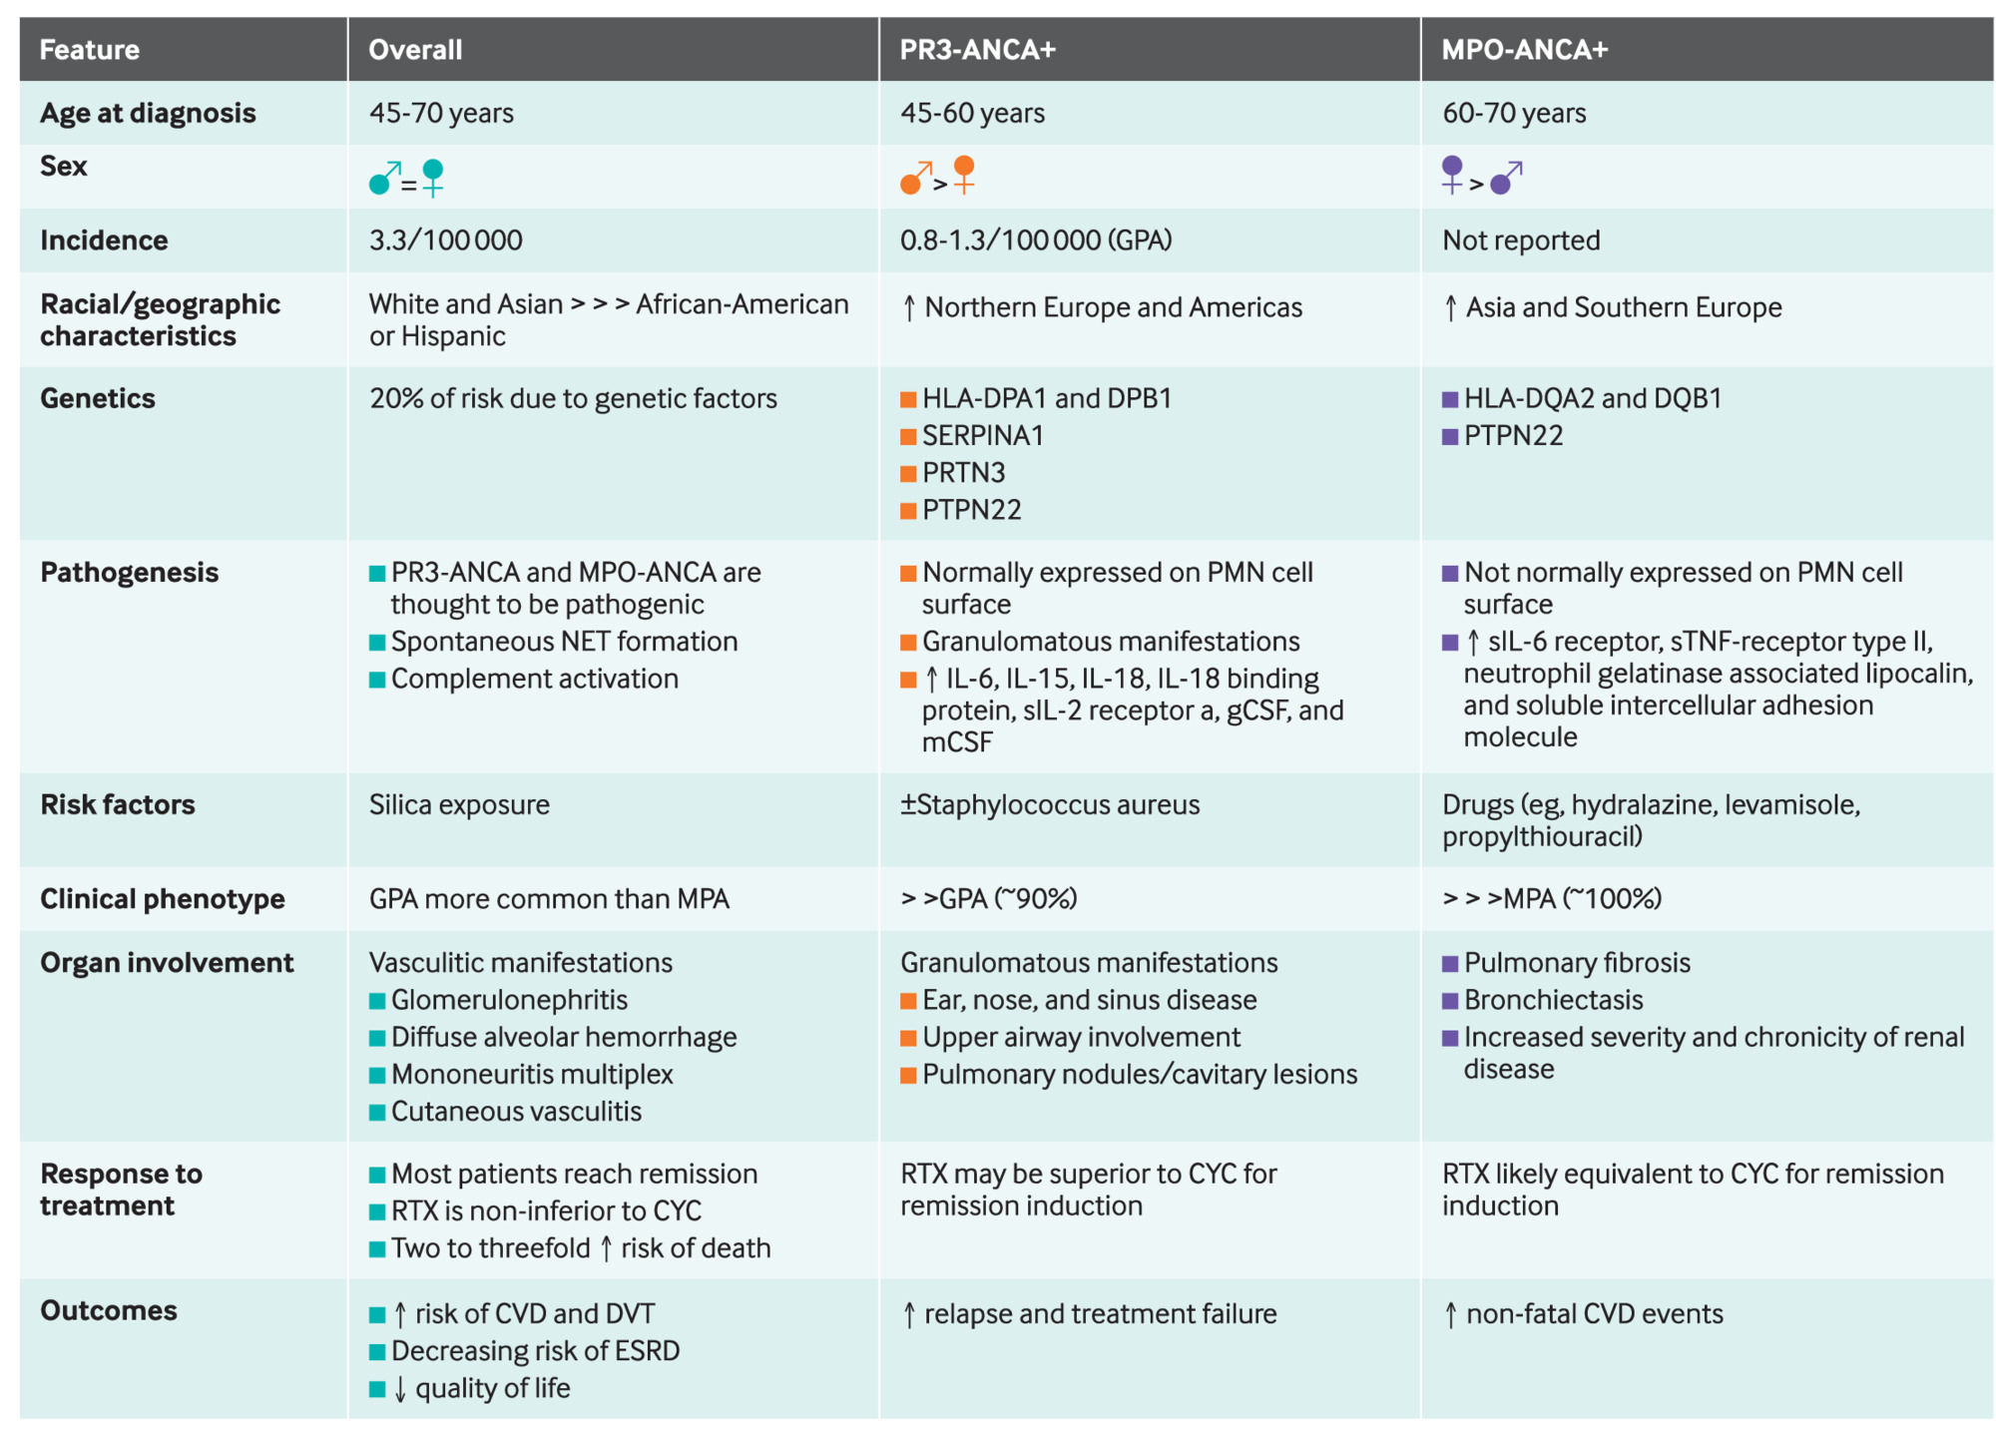

Slide 17
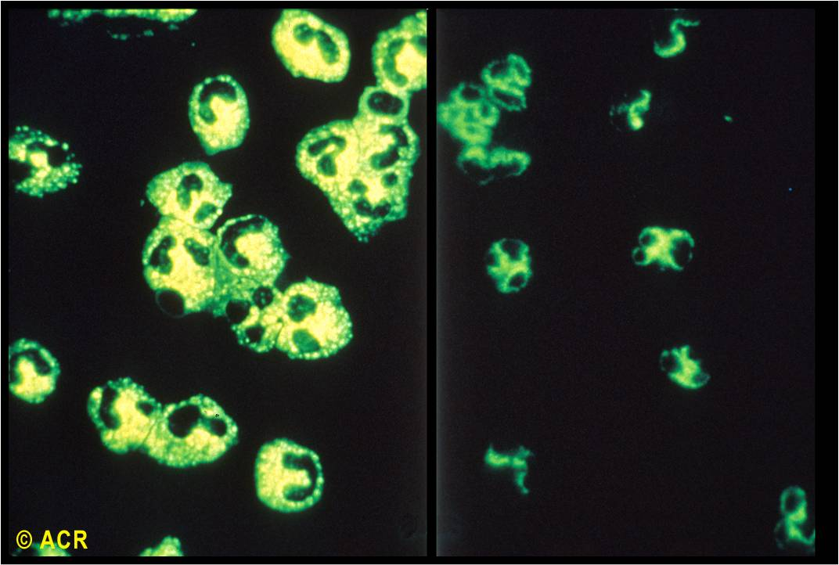
What are cANCA and pANCA?
Should do BOTH the
Immunofluorescence
and
ELISA testing against PR3 and MPO

Slide 18
ANCA -- Frequency
GPA is 95% PR3+
MPA is 50-75% MPO+
EGPA sometimes (50%) MPO+, so not reliable
What about atypical pANCA? What the heck is that?
Staining for pANCA without MPO/PR3 positivity
Consider alternate diagnoses
  Infection (like sinusitis?)
  Inflammatory bowel disease

Slide 19
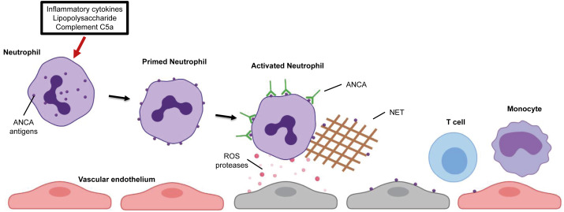
ANCA associated vasculitis Pathogenesis
Am Jour Kidney Dis 2020

Slide 20
ANCA associated vasculitis
So can we just use the ANCA testing to make a diagnosis?
NO!
BIOPSY IS PREFERRED!
Think of vasculitis as analogous to malignancy-do you treat cancer with multidrug cytotoxic therapy regimens without a biopsy?
NO!
Where to biopsy?
Kidney, Lung, Upper airway
Sometimes nerve (sural), skin not helpful

Slide 21
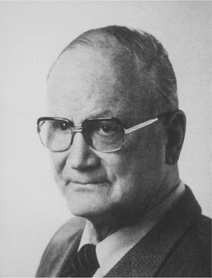
Dr. Friedrich Wegener
By Source, Fair use, https://en.wikipedia.org/w/index.php?curid=33284421

Slide 22
MKSAP 18 – Question 29
A 66-year-old man is hospitalized for progressive dyspnea for the past 10 days. He was diagnosed with granulomatosis with polyangiitis 5 years ago; at that time, cyclophosphamide was initiated, with resolution of all symptoms. He was subsequently switched to maintenance azathioprine therapy. Today he was started on intravenous methylprednisolone.
On physical examination, temperature is 37.8 °C (100.0 °F), blood pressure is 140/85 mm Hg, pulse rate is 100/min, respiration rate is 25/min, and oxygen saturation is 90% on 2 L of oxygen by nasal cannula. Bilateral crackles are heard in the lower lung fields.

Slide 23
MKSAP 18 – Question 29
Erythrocyte sedimentation rate | 90 mm/h
Hemoglobin | 12 g/dL (120 g/L)
Leukocyte count with differential | Normal
Platelet count | 450,000 (450 × 10⁹/L)
ANCA | Positive with a cytoplasmic pattern and a titer of 1:160; positive proteinase 3 antibodies
Urinalysis | Normal
Chest radiograph shows hazy opacification and a few nodules in the mid and lower lung zones. Sputum and bronchoalveolar lavage, Gram stain, and cultures are negative. Blood cultures are negative.

Slide 24
MKSAP 18 – Question 29
In addition to discontinuing azathioprine, which of the following is the most appropriate treatment?
A Cyclophosphamide
B Etanercept
C Methotrexate
D Rituximab

Slide 25
Treatment – Small Vessel Vasculitis
GPA & MPA vasculitis
Steroids! When & where?
Induction therapy
  Cyclophosphamide (Fauci & Wolff)
  Rituximab (RAVE trial)
  Plasma exchange (PEXIVAS trial)
Maintenance therapy
  Azathioprine
  Methotrexate (limited disease)
  Mycophenolate
  Rituximab (best for relapse, maybe good for everything?)
  Trimethoprim/Sulfamethoxazole

Slide 26
Treatment – Small Vessel Vasculitis
EGPA
  Glucocorticoids
  Rituximab
  Cyclophosphamide
  Mepolizumab (anti-IL5)
  Benralizumab (anti-IL5)
For all ANCA associated Vasculidities, how do you monitor disease?

Slide 27
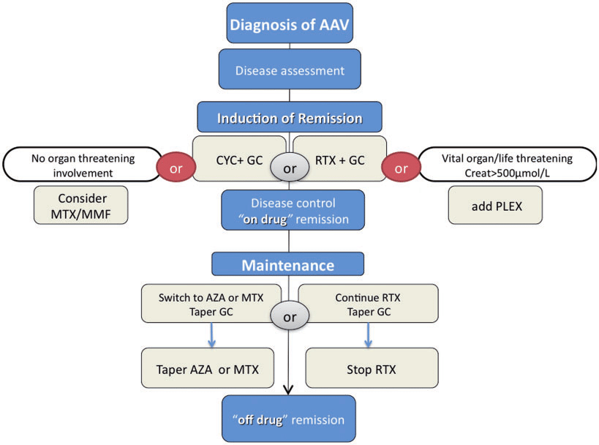

Slide 28
For ANCA associated vasculitis
Statement:
Since ANCA associated vasculitis is pauci-immune in nature on biopsy, complement is relatively uninvolved in its disease pathogenesis.
True or false??

Slide 29
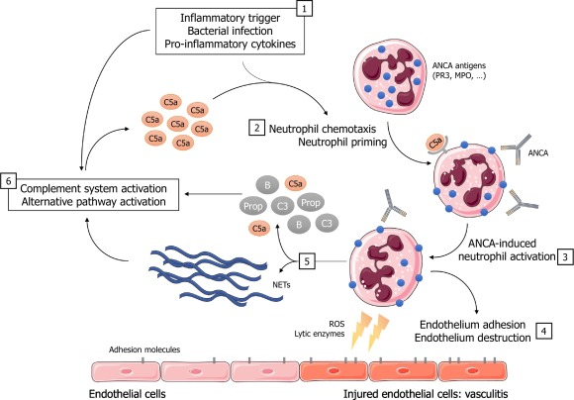
Complement in AAV
Low complement levels seem to perpetuate disease
C5a from alternative complement pathway
Anti-C5aR inhibitor (Avacopan) which blocks neutrophil attraction & activation
Steroid sparing
Benefit in early disease
$150,000-200,000/yr
CONTROVERSIAL! FDA requests voluntary withdrawal
Autoimmunity Reviews Volume 19, Issue 1, January 2020, 102424

Slide 30
Other ANCA related diseases?
Mimicks
Medication induced ANCA
  Often both PR3 and MPO positive, atypical pANCA
  Hydralazine
  Propothiouracil
Infection induced
  Bacterial endocarditis
  Inflammatory bowel disease
Drug induced….

Slide 31
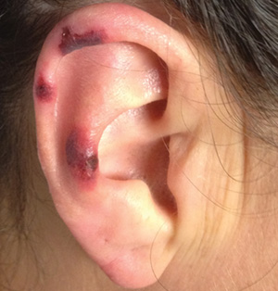
Levimasole induced vasculitis
Present in 80% cocaine
Neutrophil Extracellular Traps “NETosis”
Human anti-neutrophil elastase antibodies
Series from Mass Gen Hospital 2009-2010
-Arthralgias (83%)
-cutaneous esp LCV, ears/nose (61%)
-constitutional (72%)
-MPO + (100%), PR3+ (50%)
Am Fam Physician.
2016 Jan 1;93(1):57-58.

Slide 32
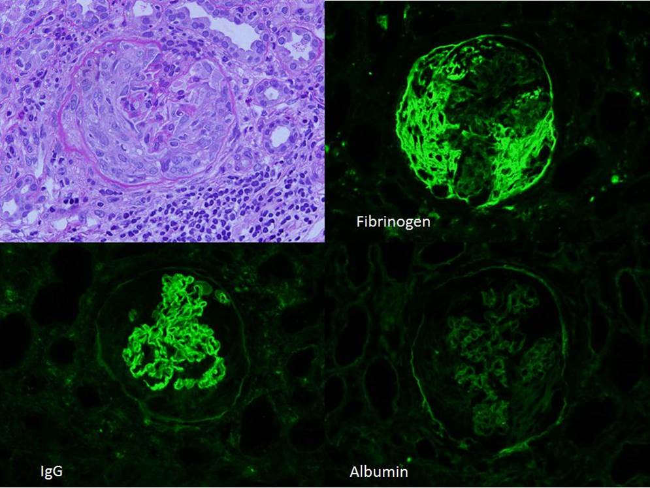
Anti-GBM Antibody Disease
Formerly Goodpasture’s Disease
Pulmonary-Renal Syndrome
Linear staining of GBM
Anti GBM Antibodies in the blood
Uncertain ANCA status:
  If + then high risk ESRD
  If – then lower risk ESRD
GC, Rituximab / Cyclophosphamide

Slide 33
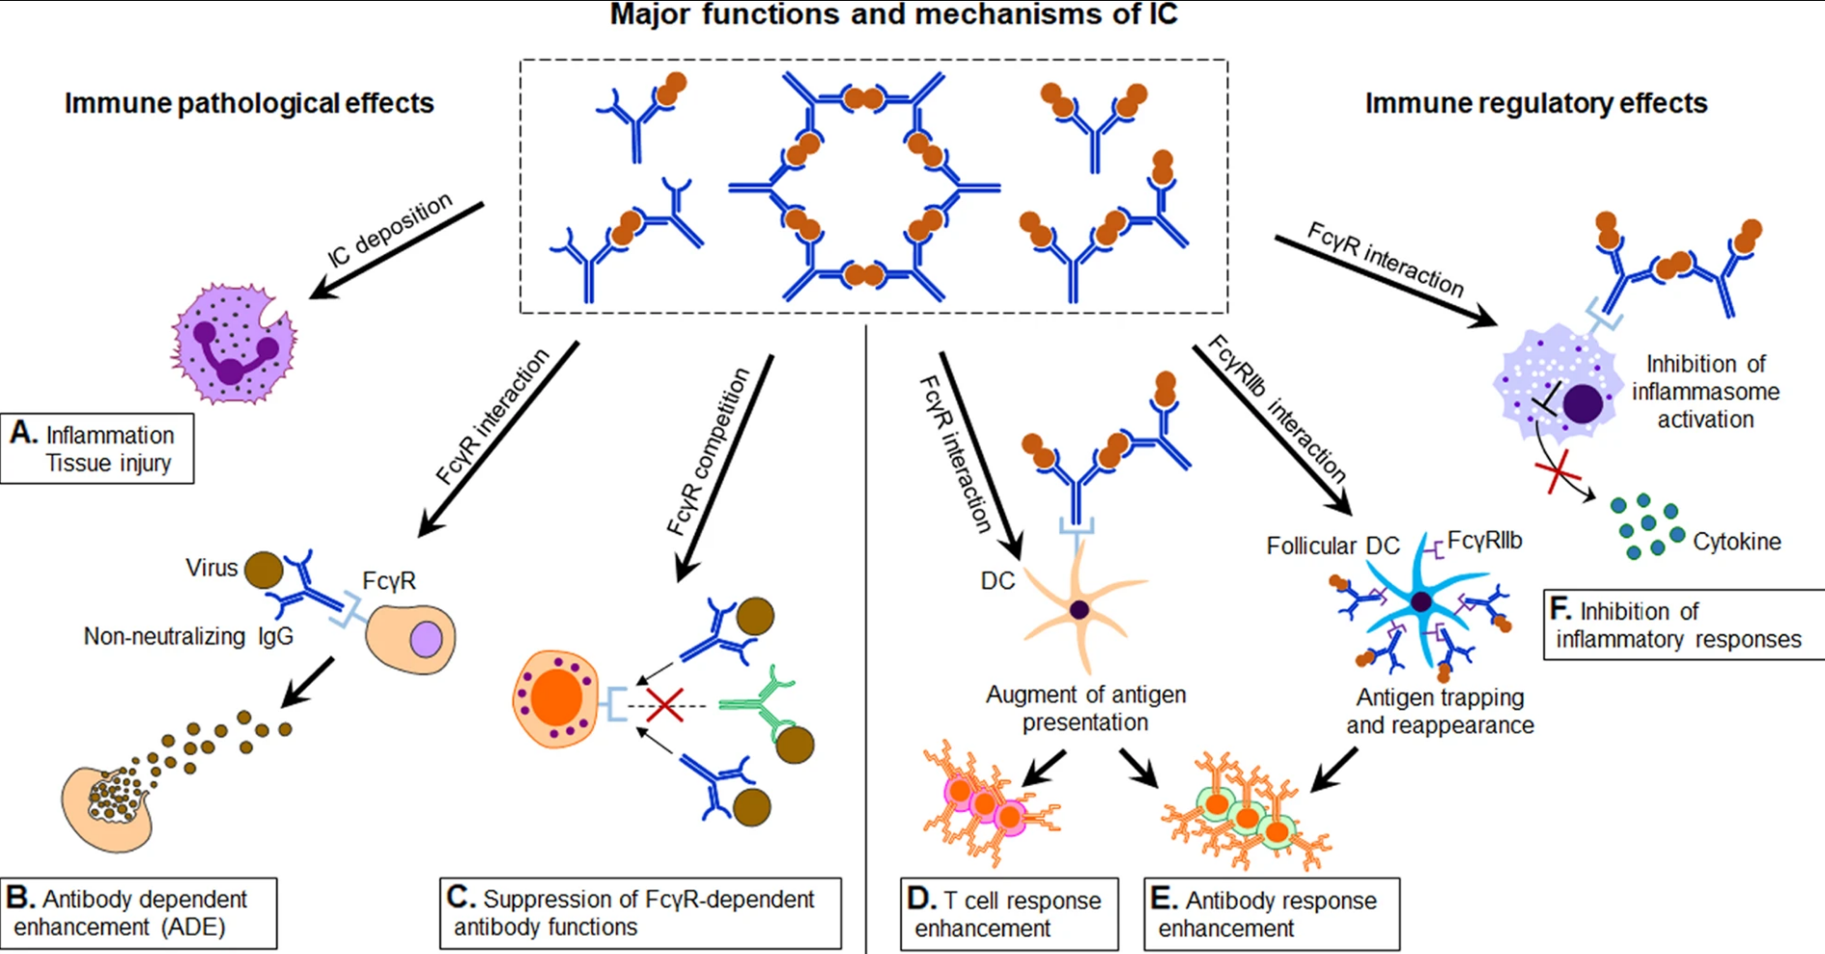
Immune Complex Disease
Cryoglobulin
IgA Vasculitis
Hypersensitivity Vasculitis
What is an immune complex? “Dirty snowball”
  Antigen antibody complex
  Opsonization
Deposition in organs – bad!
How do we measure? Directly or indirectly?

Slide 35
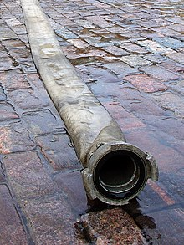
Medium vessel vasculitis

Slide 36
MKSAP 18 Question 65
A 30-year-old woman is evaluated in the emergency department for worsening abdominal pain over past 2 days as well as a rash starting in the feet and spreading up to the thighs and buttocks. She feels generally achy in the joints and muscles. She reports no diarrhea, vomiting, or nausea. She was previously healthy. She takes no medications.
On physical examination, vital signs are normal. A palpable purpuric rash is noted on the feet, legs, and buttocks. There is peri-umbilical tenderness to palpation.
Stool is positive for occult blood.

Slide 37
MKSAP 18 Question 65
Complete blood count with differential | Normal
Erythrocyte sedimentation rate | 70 mm/h
Antinuclear antibodies | Negative
ANCA | Negative
Urinalysis | Normal
CT of the abdomen shows a short segment of small bowel thickening and edema.

Slide 38
MKSAP 18 Question 65
Which of the following is most important in establishing the diagnosis?
A Kidney biopsy
B Mesenteric angiography
C Serum IgA levels
D Skin biopsy with immunofluorescence

Slide 39
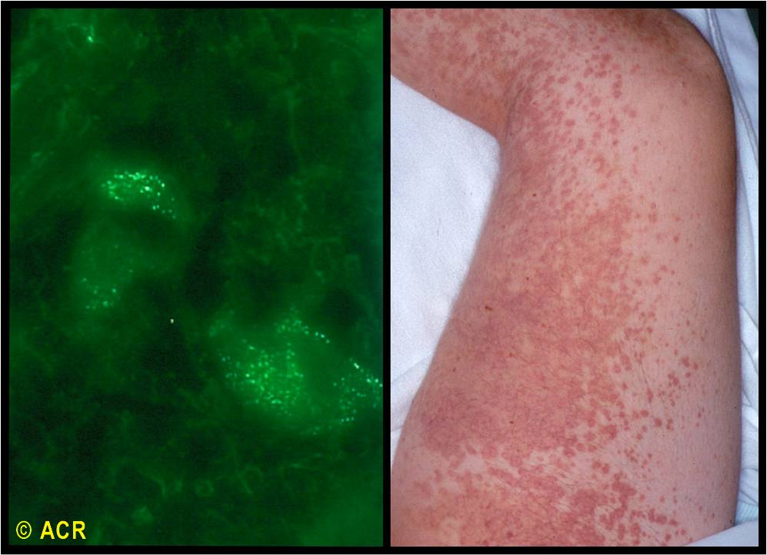
MKSAP 18 – Question 65

Slide 40
Henoch-Schonlein Purpura (IgA Vasculitis)
Remember the mnemonic JARS?
Palpable Purpura
Alimentary
Renal (often late manifestation)
Skin
Biopsy is key
These are not big kids—you treat adults!
Choice of therapy is glucocorticoids plus ???

Slide 41
MKSAP 18 Question 83
A 52-year-old man is evaluated for an episodic rash on the legs for the past month; diffuse arthralgia and Raynaud phenomenon for 2 months; and burning pain and tingling of the feet for 3 months. He has a remote history of intravenous drug use. He takes no medications.
On physical examination, vital signs are normal. Cyanosis of the fingertips is noted. There is no sclerodactyly, dilated capillary loops of fingernail beds, or digital pitting. Palpable purpura is present on the lower legs. Reduced sensation to pinprick of the soles of the feet is noted. The remainder of the examination is normal.

Slide 42
MKSAP 18 Question 83
Erythrocyte sedimentation rate | 70 mm/h
C3 | Normal
C4 | Low
Rheumatoid factor | Positive
Antinuclear antibodies | Negative
Cryoglobulins | Positive
Urinalysis | 1+ blood; 2+ protein

Slide 43
MKSAP 18 Question 83
Which of the following is the most appropriate test to perform next?
A Anticentromere antibodies
B Anti–cyclic citrullinated peptide antibodies
C Anti–Jo-1 antibodies
D Anti-U1-ribonucleoprotein antibodies
E Hepatitis C antibodies

Slide 44
Cryoglobulins
Immune complex mediated ; not pauci-immune
Precipitate below 37 deg C
Several types, Mixed types
  Type II monoclonal IgM rheumatoid factor (anti-Fc)
  Type III polyclonal IgM rheumatoid factor (anti-Fc)
Not ANCA positive!
Kidney with thrombi, rich in IgM & IgG
HIGHLY CORRELATED WITH HEPATITIS C
  Treat Hep C if present
  If Hep C neg---then GC and Cyclophosphamide or Rituximab

Slide 45
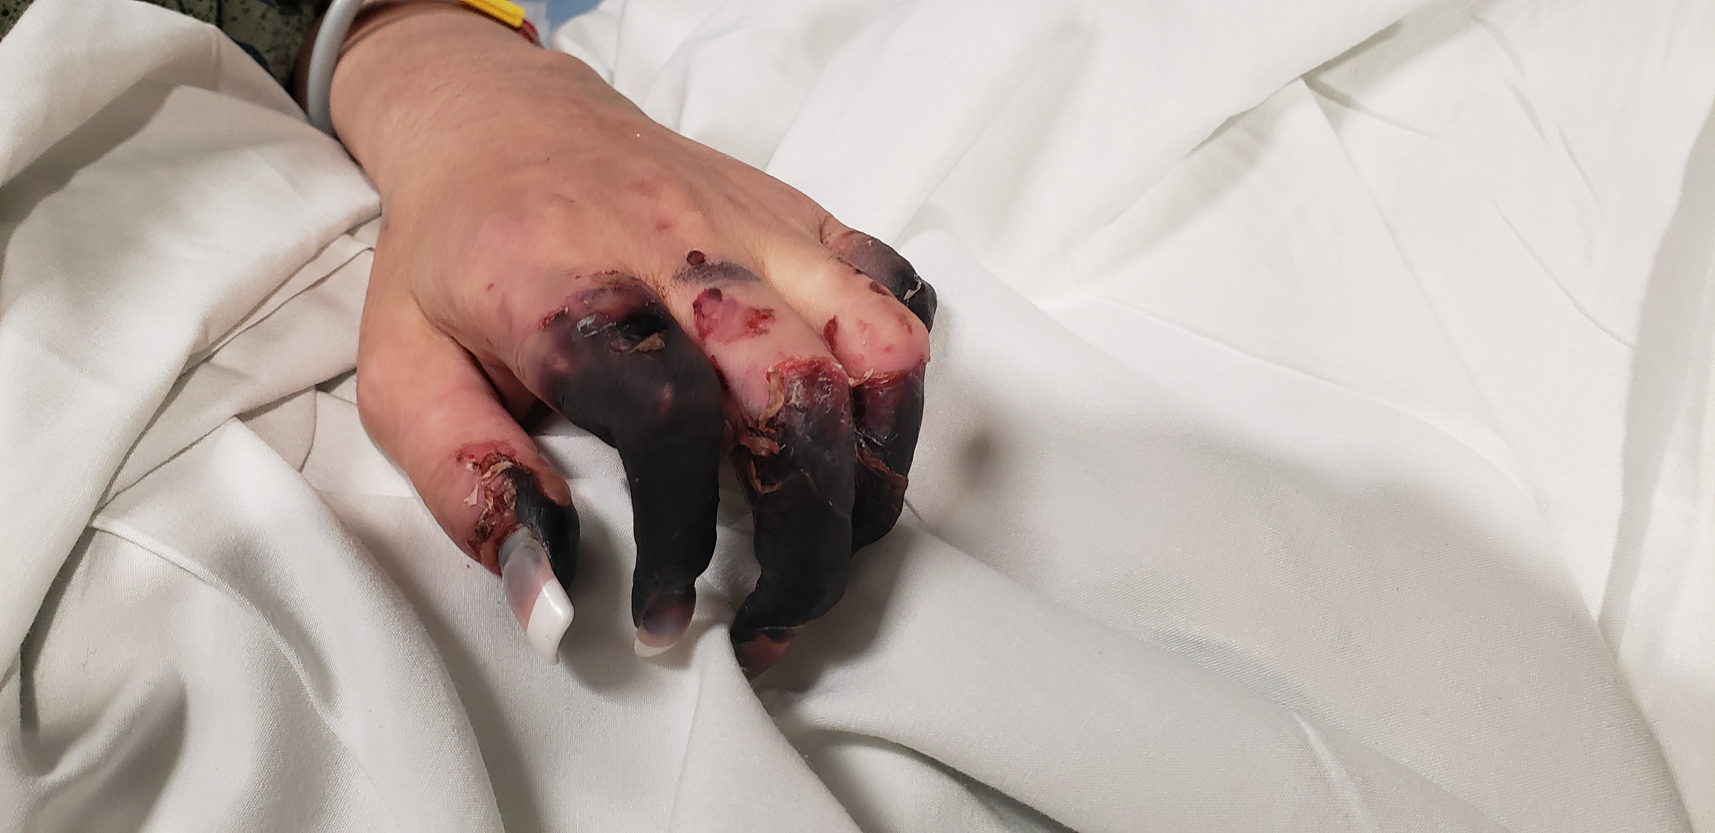

Slide 46
Hypersensitivity Vasculitis
Small vessel vasculitis
Immune complex mediated
Skin limited – Palpable Purpura
s/p drug administration
Skin biopsy with leukocytoclastic vasculitis
  Perivascular PMNs about the arteriole/venule
  Extravascular
Stop drug self limited
GCs, dapsone, colchicine

Slide 47

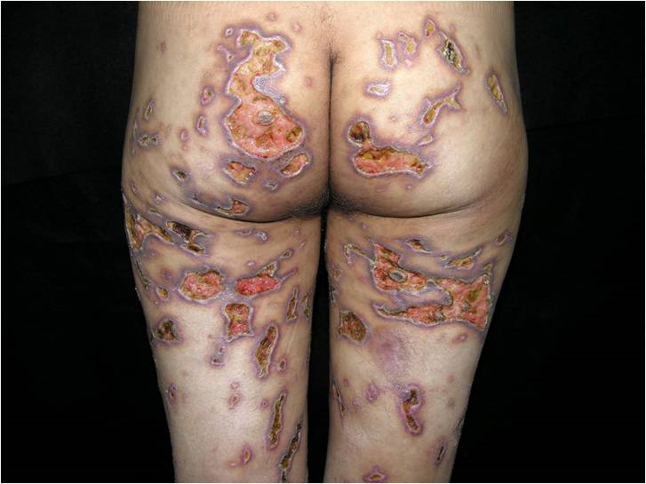
Is this hypersensitivity vasculitis?
Yes, this is thought to be immune complex mediated.
Is it autoimmune?

Slide 48
Medium Vessel Vasculitis
Polyarteritis Nodosa
Primary angiitis of the Central Nervous System
Kawasaki’s Disease

Slide 49
Polyarteritis Nodosa
Who first described this?
When?
“Human worm aneurysm”
This is the CLASSICAL vasculitis!

Slide 50
Polyarteritis Nodosa – When to suspect?
Systemic symptoms – think weight loss!
Neuropathy (mononeuritis multiplex)
Arthralgias
Cutaneous (livedo, purpura)
Renal disease (less common, less GN)
Abdominal pain, postprandial – classic! Celiac/SMA/IMA
Hypertension, new onset
Respiratory
CNS (stroke)
Orchitis– testicular artery occlusion, unilateral
Cardiomyopathy/pericarditis
Peripheral Vascular disease

Slide 51
Polyarteritis Nodosa – exam & testing
Usually organ specific symptoms
  Mesenteric angina
  Peripheral nerves (foot/wrist drop)
  Kidney pain (flank pain from thrombus/infarct)
  Testicular pain
Usual faire like CBC, CMP
Inflammatory markers
Hepatitis B
Angiography
Nerve testing (electromyelography)
Organ biopsy? Maybe if possible – expect “necrotic vasculitis”
This is one of the most challenging conditions to diagnose in rheumatology!

Slide 52
Polyarteritis Nodosa - treatment
Exciting new engineered monoclonal antibodies? No!
This is decidedly old school
  Glucocorticoids
  Cyclophosphamide generally
  Question of maintenance therapy—azathioprine, methotrexate
  Hepatitis B treatment too if present
This is generally NOT felt to be immune complex mediated
Monophasic illness
Does ANCA guide you here? No! Not at all!

Slide 53
Polyangiitis of the Central Nervous System
Isolated to one organ
Suspect with stroke & ischemia in younger person
Testing
  Angiogram with narrowing/dilation of vessels “pearls on a string”
  CSF with elevated protein, lymphocytic pleiocytosis
  Brain biopsy? +in 30-40%
Treatment
  Glucocorticoids
  Cyclophosphamide
Prognosis poor, permanent disability

Slide 54
Kawasaki’s Disease
Disease of children
Fever, rash, lymphadenopathy, mucositis, conjunctival injection
Cardiac complications notable for the internist
  Coronary aneurysms into adulthood
  Occasionally heart failure/pericarditis
  ASA chronically
  Warfarin sometimes

Slide 55
Thromboangiitis Obliterans (Buerger’s Disease)
Small/medium vessel vasculitis
Male, <45 yo
Linked to TOBACCO smoking (cannabis)
Treatment – stop all tobacco products (including replacement)

Slide 56
END OF SMALL/MEDIUM VESSEL Vasculitis
Questions?

Slide 57
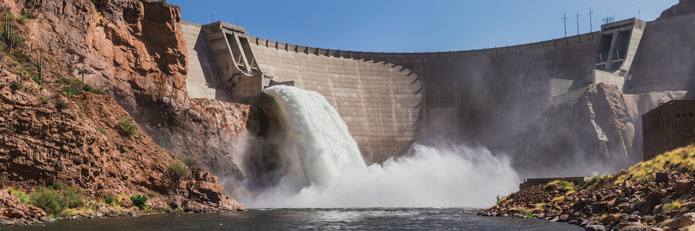
Large Vessel Vasculitis

Slide 58
MKSAP 19, Question 55
65 yo M seen for “pain everywhere.” 2 mo ago developed neck & upper back pain, fatigue, malaise. Over weeks developed stiffness, achiness of shoulders and upper arms. No headache, vision change, jaw discomfort. On no medications.
On PEx, vitals normal. No scalp tenderness. Temp artery pulses normal. No swollen/tender joints. Discomfort limits ROM shoulders bilaterally & difficulty rising from sit->standing position. Strength/DTRs normal.
Lab with normal CBC, TSH, CRP elevated at 6.8.

Slide 59
MKSAP 19, Question 55
Which of the following is MOST appropriate management?
Measure rheum factor, antinuclear antibodies, and ANCA
Prednisone, 15 mg/d
Prednisone, 60 mg/d
Pregabalin

Slide 60
Large vessel vasculitis
Takayasu’s arteritis
Giant cell arteritis
Other
  Infectious aortitis (bacterial, syphilitic)
  IgG4-Related Disease (retroperitoneal fibrosis -> “storiform fibrosis”)
    Rituximab
    (Inebilizumab – an anti CD19 therapy)

Slide 61
Giant Cell Arteritis
Triad >50 yrs
  Headache
  Jaw claudication
  Pain over temporal artery , scalp pain
  Polymyalgia rheumatica (up to 50%)
Dreaded ischemic optic neuropathy
Extracranial disease – up to 50%
Elevated ESR/CRP, anemia, low platelets
Ultrasound, biopsy
Treatment- steroids, tocilizumab, (upadacitinib)

Slide 62
Polymyalgia Rheumatica
Likely part of spectrum of disease with GCA
Stiffness of shoulder, hip girdle AND response to steroids
Medium or small joint? Less common
10-20% have concominant GCA
Therapy
  Steroids (prednisone <20 mg/d)
  Sarilumab (anti-IL6R antagonist, like tocilizumab)

Slide 63
Takayasu’s Arteritis
<50 yo, female
Stenotic lesions
Aneurysms in 30%
Vascular imaging (angiography)
Labs - inflammation
Treatment
  Steroids
  TNF inhibitors (adalimumab, infliximab)
  Stenting vs vascular repair

Slide 64
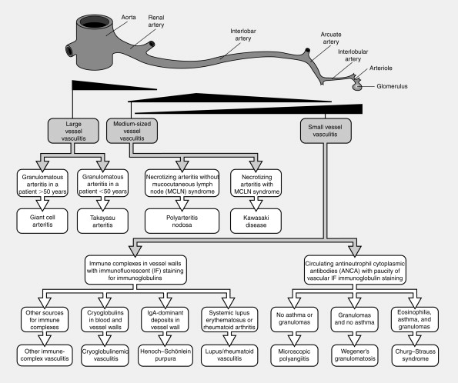
Nephrology Secrets (Third Edition) 2012, Pages 271-277

Slide 65
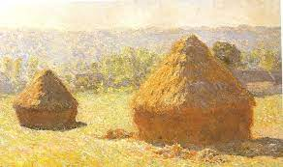
Vasculitis in a nutshell
Like Monet painting his series of Haystacks, the diagnosis & treatment of vasculitis means examining similar situations in changing circumstances to show nuanced differences over time in our patients.

Slide 66
Thank you! Questions?

Slide 69


Slide 70
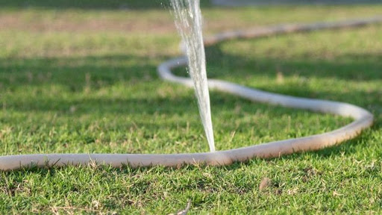

Slide 71
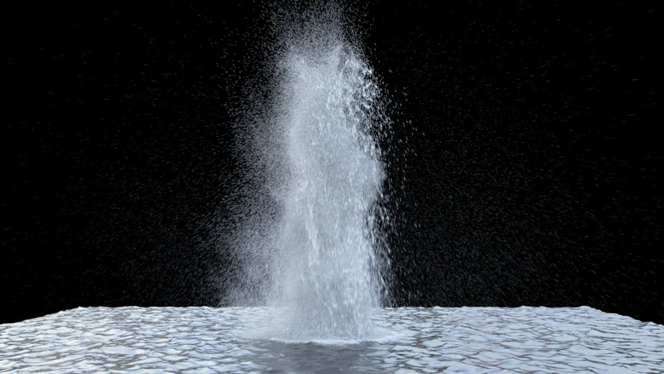

Slide 72
