Slide 1


Primary Prevention of ASCVD
Doing Our Best to Predict the Future
Presented by:
Gabriel Ruiz,MD, RPVI
Noninvasive and Preventive Cardiologist at Astra Healthcare

Slide 2
Objectives:
Review the history of ASCVD Risk Calculators and the updated AHA PREVENT calculator and understand how to interpret 10-year ASCVD risk to guide lifestyle + pharmacologic therapy.
Describe when to use coronary artery calcium (CAC) scoring and use biomarkers/lipoproteins in primary prevention.
Explain key differences between non-contrast CAC scoring and contrast CT coronary angiography (CTA).
Discuss the role of Coronary CTA in the evaluation of patients with chest pain and how this can be helpful in primary prevention.

Slide 3
First, a few questions…

Slide 4
Question 1:
The best option to incorporate coronary artery calcification scores into ASCVD risk estimation is:
  ACA/AHA Pooled Cohort Equation
  AHA PREVENT Calculator
  MESA (Multi-Ethnic Study of Atherosclerosis)
  Framingham Risk Score
  Coronary Artery Calcification Primary Prevention Score of Peace Calculator
  There is no calculator available that uses coronary artery calcifications

Slide 5
Question 2:
According to the 2019 National Lipid Association Statement on Use of Lipoprotein (a) in Clinical Practice, Lp (a) should be tested in the following:
  African Americans
  Patients with Aortic Stenosis
  Only patients with significant family history of ASCVD
  Patients with a premature history of ASCVD
  All adults should be tested at least once

Slide 6
Question 3:
Your patient wants to know what is the recommended level of activity that they need to participate in to lower their risk of cardiovascular events and death. You, being an astute clinician, recommend which of the following:
  150 minutes of low-intensity exercise every 2 days
  2 hours of high intensity interval training every day
  Water aerobics classes every day
  150 minutes of moderate-intensity exercise in a week
  95 minutes of vigorous-intensity aerobic physical activity

Slide 7
Question 4:
Mrs. F is a 48 year-old-female with no past medical history comes to you for a preventive visit to discuss lowering her cardiovascular risk. You calculate her cardiovascular risk using the AHA PREVENT Calculator as “borderline” (between 5-7.5%). She has no diabetes, family history of premature coronary disease, and does not smoke. The patient would like to not take medications daily and wants more information. You decide to order which of these tests to help guide your decision:
  CT Coronary Calcium Score
  Hs-CRP
  Lipoprotein (a) level
  Apolipoprotein B level
  Ankle-Brachial-Index
  No further testing is needed. She does not need a statin.
  Number 1 and 3
  Number 1 through 5

Slide 8
Question 5:
A 58-year-old woman with a history of hypertension presents with intermittent brief episodes of left-sided stabbing chest discomfort that occur at rest, last only a few seconds, and are not provoked by exertion. She is concerned and wants to know if her coronary arteries are blocked. Her ECG is normal apart from nonspecific ST-T changes in leads V1-V6. HS-Cardiac Troponin is negative x3. She is otherwise healthy. Which test would you recommend?
  Exercise Treadmill Stress Test
  Exercise Treadmill MPI
  CT Coronary Artery Calcium Score
  Lexiscan MPI
  CT Coronary Angiogram

Slide 9
A Few Statistics:
Cardiovascular disease (CVD) is STILL the leading cause of death in the US
In 2022, there were 941,652 CVD related deaths in the US
On average, someone in the US has a myocardial
infarction every 40 seconds
CVD accounts for ~11-12% of total US health care expenditures
48% of US adults have some form of CVD
By 2050, 61% of US adults projected to have some form of CVD; HTN prevalence projected to rise from 51.2% → 61%
In 2022, approximately 165,393 US deaths were due to stroke
Martin SS, Aday AW, Allen NB, et al.; on behalf of the American Heart Association Council on Epidemiology and Prevention Statistics Committee and Stroke Statistics Committee. 2025 Heart disease and stroke statistics: a report of US and global data from the American Heart Association. Circulation. Published online January 27, 2025.
Notes:
CVD Consists of coronary artery disease, CVD, Heart Failure, PAD, Aortic disease, hypertensive heart disease, sometimes arrhthmias

Slide 10
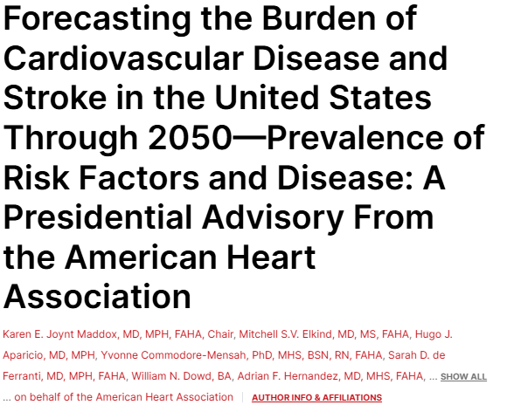
Projections:
By 2050, CVD-related costs could triple to $1.8 trillion/year especially due to projected rise in cardiovascular risk factors
Notes:
- Researchers used two large national survey source from National Health and Nutrition Examination Survey from 2015 to 2020 and Medical Expenditure panel Survey (MEPS form 2015 to 2019) to project their data that took into consideration trends in RF prevalence, demographic changes and projected population growth

Slide 11
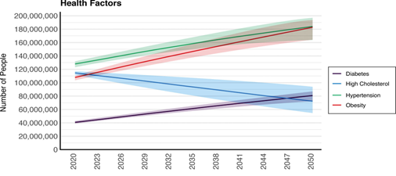
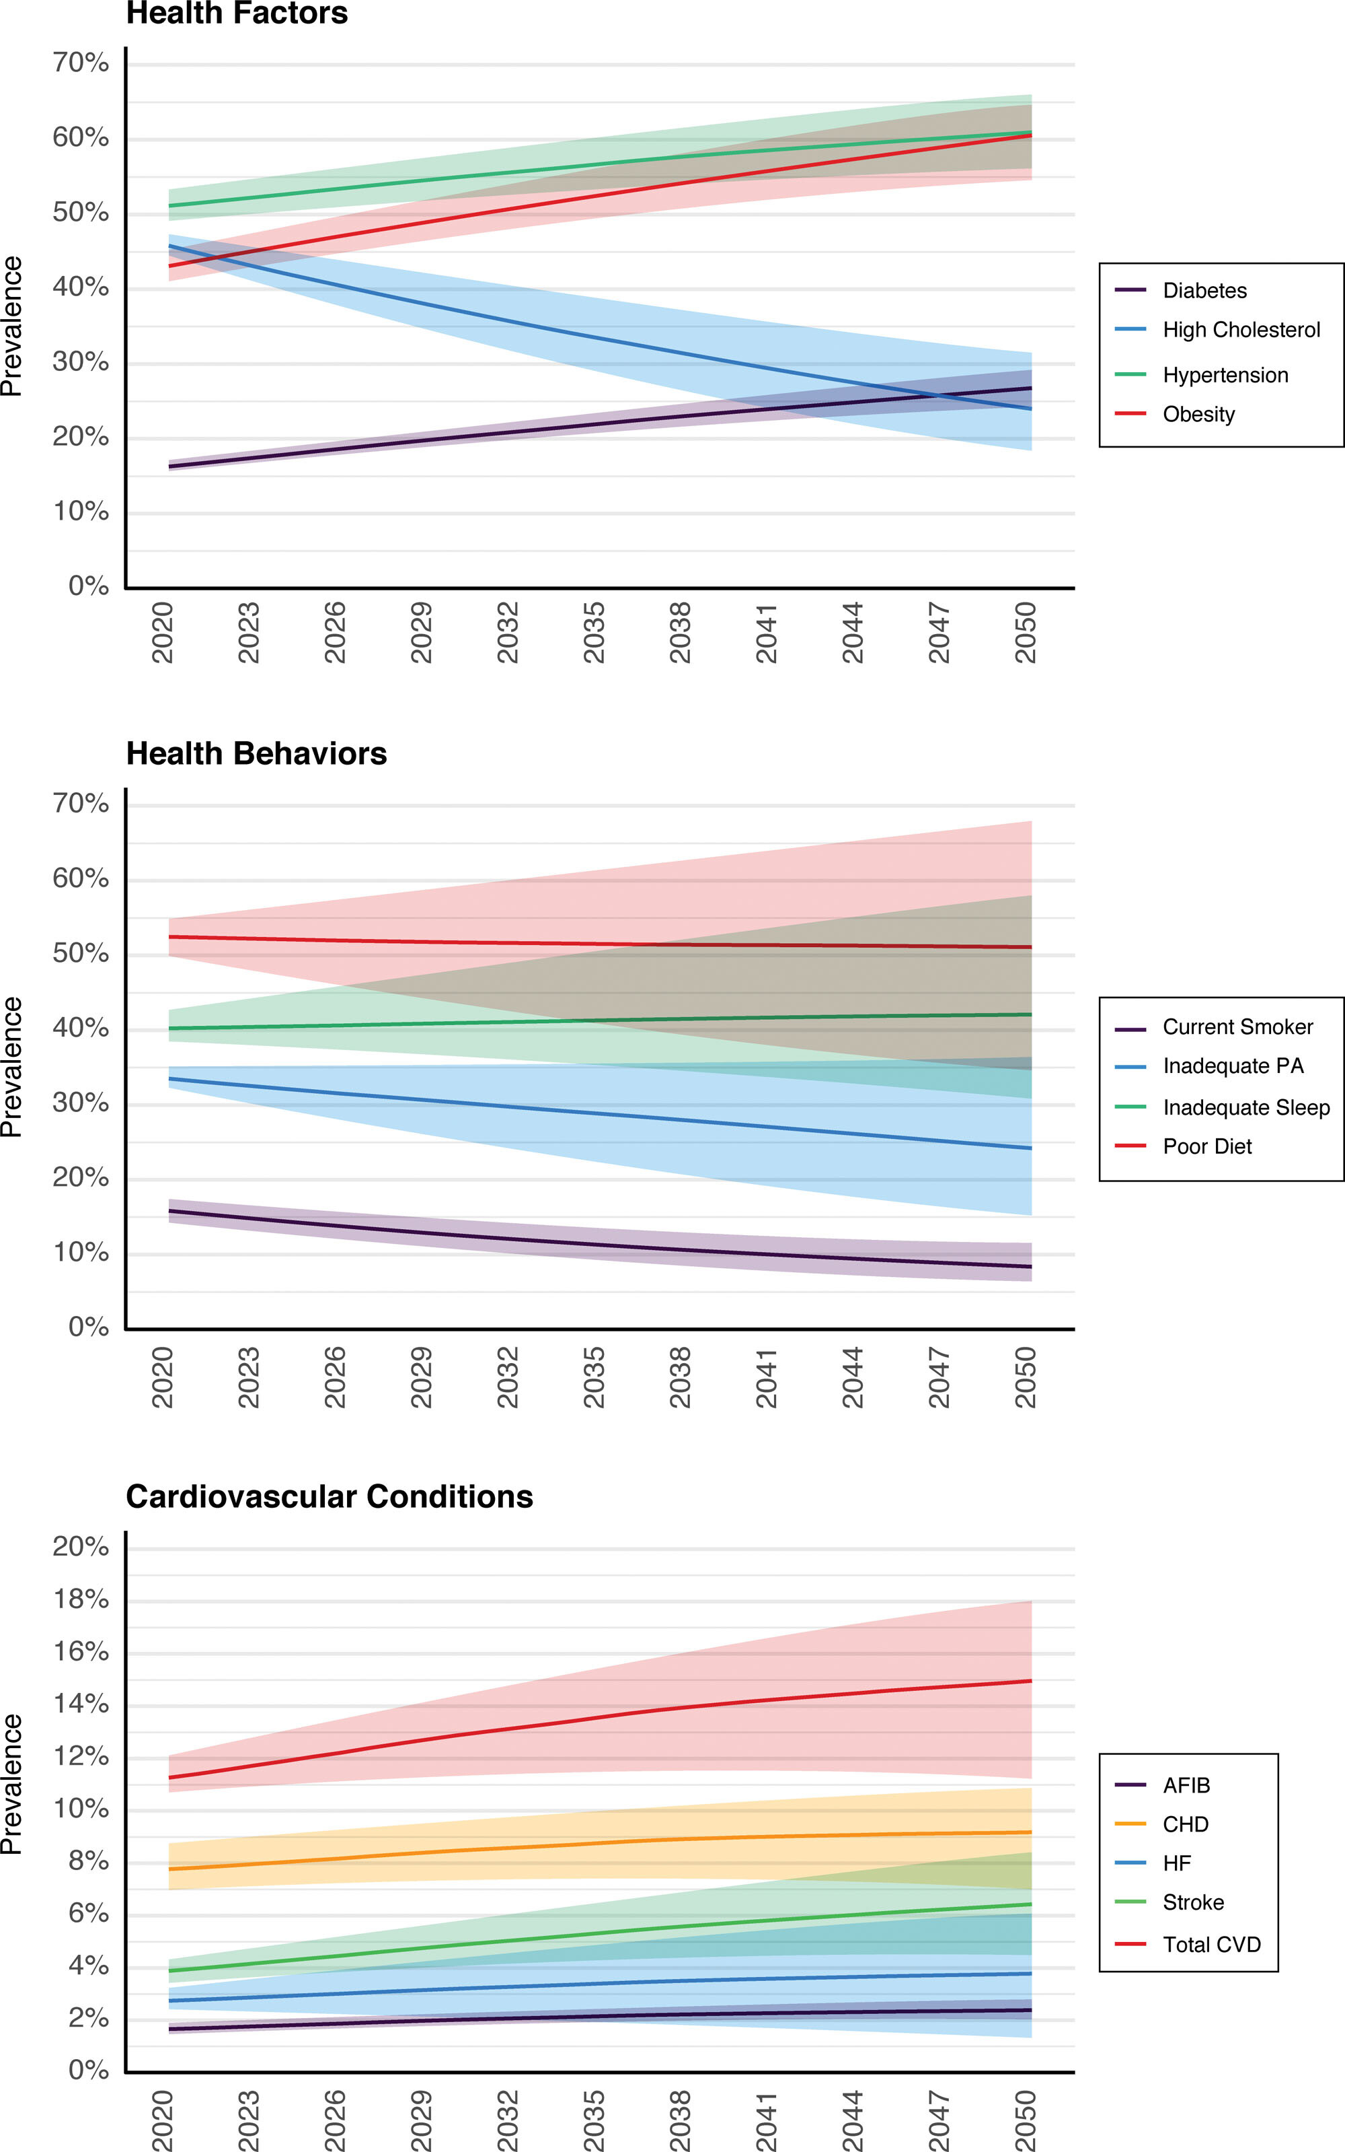
Karen E. Joynt Maddox. Circulation. Forecasting the Burden of Cardiovascular Disease and Stroke in the United States Through 2050—Prevalence of Risk Factors and Disease: A Presidential Advisory From the American Heart Association, Volume: 150, Issue: 4, Pages: e65-e88, DOI: (10.1161/CIR.0000000000001256)
Notes:
TOP LEFT:
-Hypertension will increase from 51.2% in 2020 to 61.0% in 2050.
-Larger increases were projected for diabetes (16.3% to 26.8%) and obesity (43.1% to 60.6%).
-Surprising continued projected decline in hypercholesterolemia (45.8% to 24.0%). ? Better screening and treatment
Graph on bottom left:
**Clinical CVD (not including hypertension): prevalence rising from ~11.3% → ~15.0% by 2050. Pure+1
**Combining CVD + hypertension: more than 61% of U.S. adults expected to be affected by 2050 (i.e., >184 million people). Pure+1
Specific disease projections:
-Coronary disease: 7.8% → 9.2%
-Heart failure: 2.7% → 3.8%
-Stroke: 3.9% → 6.4% Pure+1
Also: the increase will disproportionately impact Black, Hispanic, American Indian/Alaska Native or multiracial populations.

Slide 12

It is clear…
Notes:
There is work to do

Slide 13
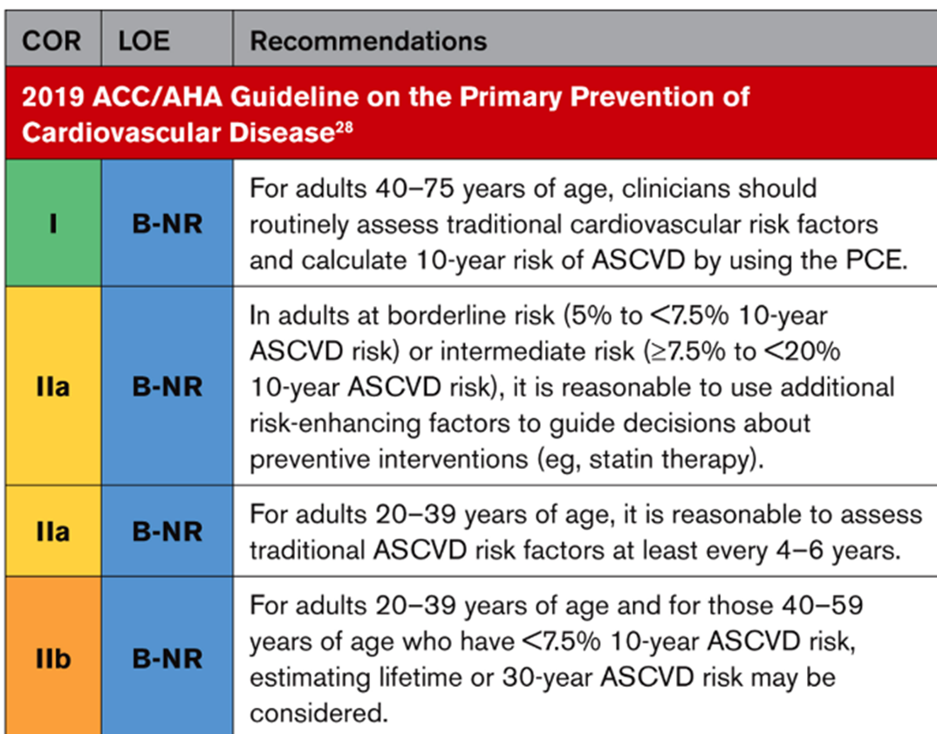

A Little Background First…
Multivariable risk prediction equations are recommended to guide primary prevention efforts for cardiovascular disease (CVD)
Risk directly correlates with intensity of prevention
Models to assess risk continue to evolve
The Pooled Cohort Equation (PCE) is what is currently recommended by the ACC/AHA for assessing CVD risk as of 2019…
Notes:
As of the most recent 2019 guidelines,
Class 1 recommendation to calculate 10 year risk for patients aged 40-75 years of age
Use risk enhancing factors for patients who are borderline or intermediate risk
20-39 yo? Keep reassess every 4-6 years
Age 20-39? Or 40-59? With <7.5% 10 year risk, its okay to estimate 30 year risk… we do that through Framingham 30 year risk score vs the Lifetime ASCVD risk calculator on ACC website

Slide 14






First, a quick, high-yield tour through the evolution of risk prediction….
Drawbacks:
  Only includes adults age 40-79
  Does not account for total burden of CVD (ie. Does not include heart failure)
  Does not include other races and ethnicity groups
  Limited by older data (all data obtained before 2000)
  OVERESTIMATES risk a lot of the time
  No biomarkers or imaging included
  Does not include CKD ( a known CV risk factor)
  Not great for borderline or intermediate risks
Benefits:
  Predicts 10 year risk of MI AND Stroke
  Larger sample size; included African Americans and good representation of women
  Includes Diabetes as a risk factor
  Easy to use
2023 –
The PREVENT Era
“Bigger, Better, More Handsome” Equation
We also fixed the Math
2013-2022
The Statin-for Everyone Era or the Pooled Cohort Equation Era
2015
The Year of Seeing it to Believe It
MESA Calculator
“Turns out the best way to know your risk is to just look”
Drawbacks:
  Derived from white middle-class individuals in geographically restricted sample
  Predicted only CAD outcomes
  Did not include patients with diabetes
Benefits:
  Uses CAC score to REFINE risk in borderline-intermediate risk patients
  Personalizes risk assessment
  CAC of 0→ maybe can even defer a statin
  Includes actual atherosclerotic burden instead of just risk factors
  Provides your Coronary age
  Family history of MI included
  Includes Caucasian, Chines, AA, and hispanics
1970s-1990s
The Stone Age of Risk:
When a Single Massachusetts Town Decided Everyone’s Fate
The Framingham Risk Score
The first tool based on Framingham cohort study, over 5000 patients
Estimated 10-year risk using age, sex, BP, cholesterol, smoking and diabetes
Benefits:
  Ground-Breaking
  Simple
  Easy to use
  It is all we had
BUT
Drawbacks:
  Not useful for patient’s below 40
  Includes only Calcium measured in the coronaries
  Requires radiation and out of pocket cost
Notes:
-Framingham-derived in Framingham→ population not generalizable, under and over predicts in ethnic groups, Did not include stroke risk or other modern risk modifiers
Pooled Cohort Equation White women 11240, White men 9098, 2641 black women, 1647 black men in PCE

Slide 15
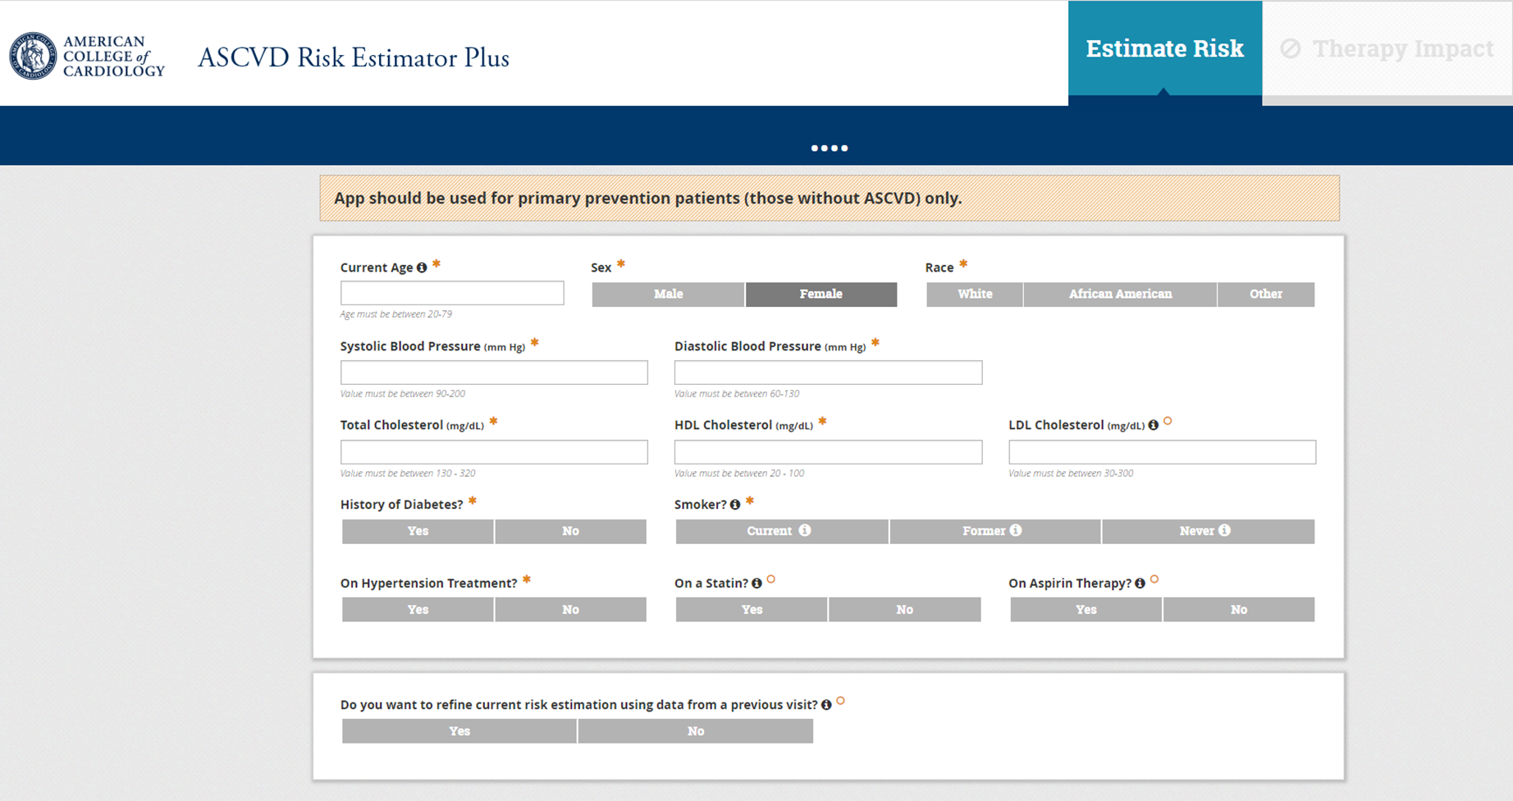
This is what we use now…

Slide 16

Like we discussed before,
Ony included adults age 40-75
Does not include other races and ethnicity groups
Based off of older data
National samples have predicted that the PCE mean score is ~8% (Anderson, et al.)
Occasionally the PCE will overestimate risk
  Cohort study of 30,000 patients found that observed event rates were lower than PCE predicted for risk categories >10% (Medina, et al)
  Cohort study of 26,689 adults demonstrated overestimation of risk especially among black adults (Yadlowsky, et al)
Does not include Heart Failure as a CVD outcome
Does not include renal function
Does not include CKD
Notes:
-8% places patient in the intermediate risk category→ meaning more data is needed prior to decision of statins
Drawbacks:
Only includes adults age 40-79
Does not account for total burden of CVD (ie. Does not include heart failure)
Does not include other races and ethnicity groups
Limited by older data (all data obtained before 2000)
OVERESTIMATES risk a lot of the time
No biomarkers or imaging included
Does not include CKD ( a known CV risk factor)
Not great for borderline or intermediate risks

Slide 17

AHA PREVENT Equation
AHA has started to address growing burden of CVD, both ASCVD and HF related to cardiovascular-kidney-metabolic (CKM) syndrome
Also focuses on the need for prediction that involves total CVD (ASCVD and HF) and integrate predictors to CKM risk applicable to young populations
Notes:
-AHA identifies these as life's essential 8- Don’t smoke, 7-9 hours of sleep, Mediterranean/DASH Diet, 150 minutes of aerobic exercise a week, good blood sugar control, healthy weight, reduce cholesterol and BP <120/80
-CKM health increasing in prevalence→ associated with earlier onset of CVD and disproportionately affects racial and ethnic minorities who experience greater burden of adverse social factors (ie. Neighborhoods with low income)

Slide 18
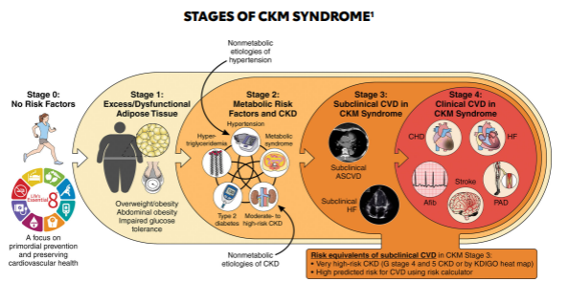
What is CKM Syndrome?
A systemic disorder driven by interactions among metabolic risk factors (ie. Obesity with dysfunctional adipose, insulin resistance, dyslipidemia), CKD, and cardiovascular dysfunction
Staging System
Leads to multi-organ effects and high CV event rates
Encompasses people at risk and those with established CVD related to metabolic or kidney disease
Modulated by Social Determinants of health, policy, environment and structural inequities
Ndumele CE, Rangaswami J, Chow SL, Neeland IJ, Tuttle KR, Khan SS, Coresh J, Mathew RO, Baker-Smith CM, Carnethon MR, Després JP, Ho JE, Joseph JJ, Kernan WN, Khera A, Kosiborod MN, Lekavich CL, Lewis EF, Lo KB, Ozkan B, Palaniappan LP, Patel SS, Pencina MJ, Powell-Wiley TM, Sperling LS, Virani SS, Wright JT, Rajgopal Singh R, Elkind MSV; American Heart Association. Cardiovascular-Kidney-Metabolic Health: A Presidential Advisory from the American Heart Association. Circulation. 2023;148(20):1606-1635. doi:10.1161/CIR.0000000000001184.
Notes:
“CKM syndrome represents the biologic intersection of metabolic disease, kidney dysfunction, and cardiovascular risk, and the PREVENT equation attempts to quantify this risk using objective surrogate markers—including clinical labs and social determinants—rather than race-based inputs, to better reflect the true drivers of disease.”
CKM is all the things we know that directly affect cardiovascular health but now we can grade it

Slide 19
AHA PREVENT Equation
Tries to BRIDGE THE GAP left by the PCE:
  Uses more recent cohort data
  Larger sample size
  Includes CKD as a core variable
  Includes more metabolic markers (ie. HbA1c, urine albumin creatinine ratio)
  Adds risk prediction across a wider age span
  Generates 10- and 30-year risk
  Eliminates race as a variable
  Uses Zip code to correlate with variables difficult to quantity such as:
    Access to food, walkability, pollution, income inequality and healthcare access
Notes:
-Good calibration determined by slope of observed to predicted risk of close to 1 for the PREVENT indicating a WELL-CALIBRATED model
-In contrast, the slope of the PCEs ranged from 0.5 to 0.54 for ASCVD which represents overestimation of risk by approximately 50%

Slide 20
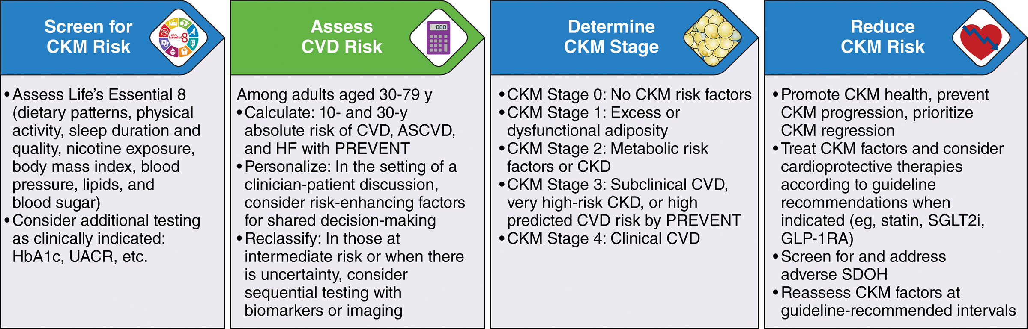
AHA PREVENT Calculator addresses US adults 30 to 79 years of age without CVD at baseline
Khan, S. S., Coresh, J., Pencina, M. J., Ndumele, C. E., Rangaswami, J., Chow, S. L., … Lloyd-Jones, D. M. (2023). Circulation, 148(24), 1982–2004. doi:10.1161/cir.0000000000001191

Slide 21
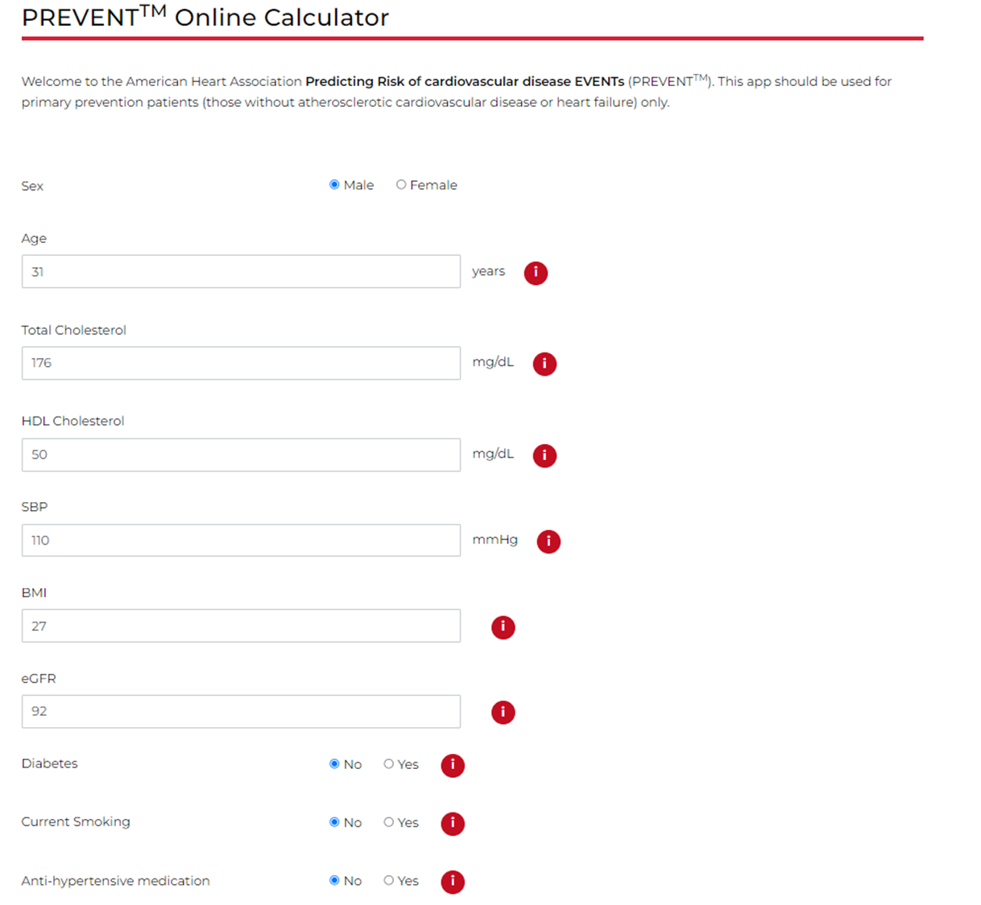
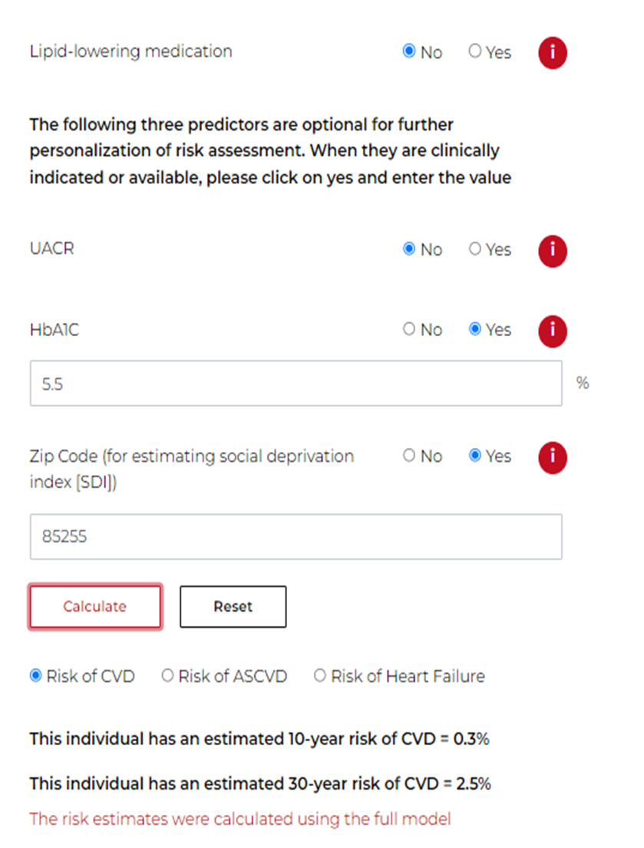

Slide 22
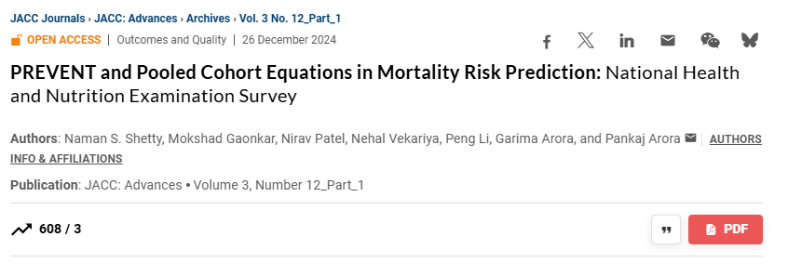
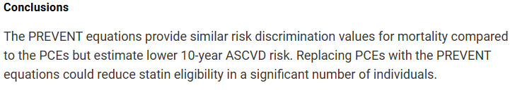

Nobody is perfect…
EMR data used to derive sample data
Biomarkers of cardiac injury (Hs Trop, NT pro BNP), CT and Echo not included (despite robust association CVD), due to absence of recommendations for widespread testing in general population, issue of cost, and downstream implications
Hs CRP, CIMT, ABI not used given lack of routine clinical measurements in asymptomatic individuals
Baseline for included data sets spanned >3 decades
Age used as time scale → may result in overestimation of risk
Individual level social determinants of health not readily available, zip code used as this was available in the data sets
Shetty, N, Gaonkar, M, Patel, N. et al. PREVENT and Pooled Cohort Equations in Mortality Risk Prediction: National Health and Nutrition Examination Survey. JACC Adv. 2024 Dec, 3 (12_Part_1) .https://doi.org/10.1016/j.jacadv.2024.101372
Notes:
Limited Biomarkers and Imaging
Excluded markers: High-sensitivity troponin, NT-proBNP, CT imaging, echocardiography.
Reason: These tests are not recommended for routine screening in the general population due to cost, uncertain net benefit, and potential downstream interventions.
Implication: Despite their strong predictive value for cardiovascular events, their absence may reduce the model’s accuracy for detecting subclinical disease.
Exclusion of Certain Subclinical Measures
Hs-CRP, CIMT, ABI were not included.
Reason: They are not routinely measured in asymptomatic patients, limiting availability in large EMR datasets.
Implication: Some inflammatory and vascular risk signals are not captured.
Temporal Heterogeneity
Baseline data spans more than 30 years, across which clinical practice, treatments, and population risk profiles changed.
Implication: Risk estimates may not perfectly reflect modern-day populations.
Age as the Time Scale
Age is used as the primary time scale in modeling.
Implication: This can overestimate risk for certain individuals, particularly younger adults, because it does not account fully for competing risks or life-course changes in exposures.
Limited Individual-Level Social Determinants
EMR datasets generally lacked detailed SDOH at the individual level; zip-code–level proxies were used instead.
Implication: Zip-code measures may not fully capture the social, economic, or environmental conditions affecting a person’s cardiovascular and metabolic risk.

Slide 23
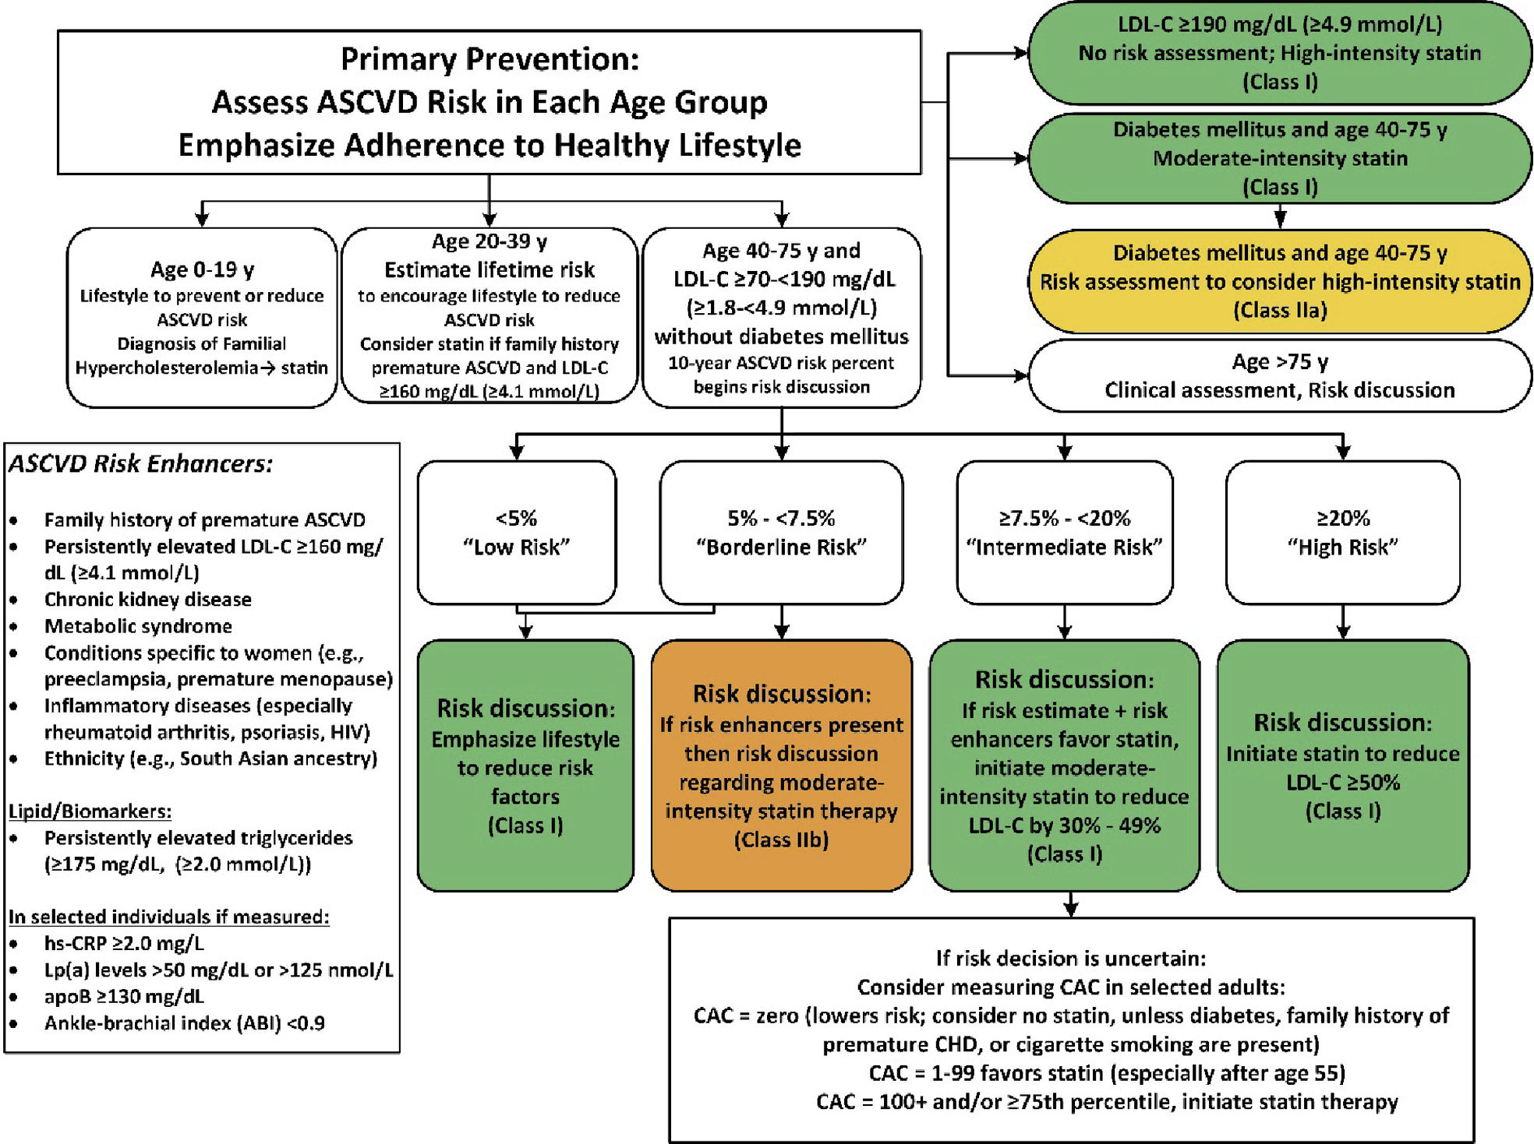
AHA PREVENT MESA
Pooled Cohort Equation Framingham
ESTIMATING RISK
Notes:
Were going to stay here for the purposes of this talk

Slide 24
How do we classify risk with these equations?
We must remember:
LDL-C > 190? → High Intensity Statin (Class I)
DM and age 40-75 yo?→ Moderate Intensity statin (Class I)
DM and age 40-75?→ only use calculator if considering high intensity statin
LOW RISK: <5%
BORDERLINE RISK: 5%-7.5%
INTERMEDIATE RISK: 7.5% - 20%
HIGH RISK: >20%
Assess for ASCVD risk ENHANCERS
HIGH INTENSITY STATIN
NEED 50% reduction in LDL
Donna K. Arnett et al. JACC 2019; 74:e177-e232.

Slide 25
Risk Enhancers
Family History of Premature ASCVD (Males <55 yo, Females <65 yo)
Persistent LDL cholesterol >160 mg/dL
Chronic Kidney Disease
Metabolic Syndrome, 3 of 5 of the following
  Increased waist circumference (men >40 in, Women >35 in; can be different for different ethnicities)
  TGL >150 mg/dL, or on drug therapy for elevated TGL
  BP >130/80 or on antihypertensive treatment
  Low HDL (Men <40 mg/dL, Women <50 mg/dL)
  Elevated fasting glucose, >100 mg/dL, or on drug therapy for hyperglycemia
Conditions specific to women (ie. Preeclampsia, gestational DM, gestational HTN, premature menopause)
Inflammatory conditions (ie. Lupus, RA, MCTD, HIV)
Ethnicity, south Asian descent
Arnett DK, Blumenthal RS, Albert MA, et al. 2019 ACC/AHA Guideline on the Primary Prevention of Cardiovascular Disease: A Report of the American College of Cardiology/American Heart Association Task Force on Clinical Practice Guidelines. Circulation. 2019;140(11):e596-e646. doi:10.1161/CIR.0000000000000678.
Notes:
Abdominal obesity
Waist circumference:
Men: >102 cm (40 in)
Women: >88 cm (35 in)
(Ethnic-specific cutoffs can vary.)
Elevated triglycerides
≥150 mg/dL, or on drug therapy for elevated TG.
Low HDL cholesterol
Men: <40 mg/dL
Women: <50 mg/dL
Or on therapy for low HDL.
Elevated blood pressure
≥130/85 mmHg, or on antihypertensive treatment.
Elevated fasting glucose
≥100 mg/dL, or on drug therapy for hyperglycemia.

Slide 26
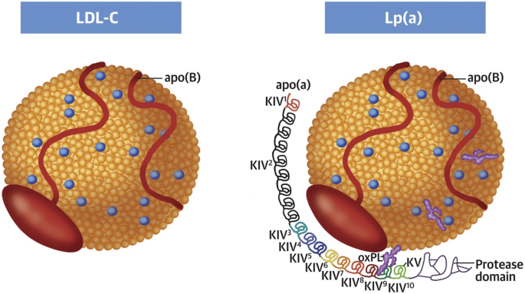
Let’s keep going…
Biomarkers
  Hs CRP >2 mg/L
    JUPITER trial demonstrated markers for systemic inflammation was strongly associated with future ASCVD events (independent of LDL-C)
      Trial demonstrated Rosuvastatin was associated with reduction in Hs-CRP <2 mg/L which was associated with lowered CV event rates (HR ~0.38)
  Lipoprotein (a) levels >50 mg/dL or >125 nmol/L
    LDL like particle that is genetically determined
    Elevated in ~20% of population; strong heritability
    Pro atherogenic, pro-inflammatory, and pro thrombotic
    Not lowered by statins
    2019 NLA Focused update and ESC/EAS 2022Guidelines: Lp (a) should be measured once in all adults
Ference BA, Kastelein JJP, Ray KK, et al. Association of Genetic Variants Related to ApoB With Cardio-metabolic Risk.
Koschinsky ML, Bajaj A, Boffa MB, et al. A focused update to the 2019 NLA scientific statement on the use of lipoprotein(a) in clinical practice. J Clin Lipidol. 2024;18(3):00033-3. doi:10.1016/j.jacl.2024.03.001
Sniderman AD, Thanassoulis G, Wilkins JT, et al. ApoB in clinical care: A review of evidence and recommendations from the NLA.
Notes:
Lp(a) levels are genetically determined, with little to no influence from environmental or lifestyle factors, and adult levels are reached in childhood, typically by 5 years of age. Studies have shown that inflammatory conditions,² pregnancy,³ hypothyroidism,⁴ growth hormone therapy,⁵ and kidney disease⁶ increase levels of Lp(a). Lp(a) levels are decreased in the settings of severe acute phase conditions,⁷ postmenopausal hormone replacement,⁸ hyperthyroidism, and liver disease.⁹ Hence, checking levels at steady states is advised.

Slide 27
Case Presentation
Mr. Z is a 58-year-old male with a past medical history of metabolic syndrome, obesity, BMI 32, hypertension, elevated fasting insulin level, metabolic associated fatty liver disease. He has a family history of premature CAD.
  Fasting Lipid panel: LDL-C 96 mg/dL, HDL-C: 37 mg/dL, Triglycerides 286 mg/dL
  CAC Score of 172
What should we check next?
Notes:
Problem: LDL-C appears “near goal,” but elevated TG suggests discordance and possible underestimation of atherogenic particles.
ApoB Result: 118 mg/dL (high risk ≥90)
→ Reveals increased atherogenic particle number (VLDL/IDL/LDL) despite “normal” LDL-C.
Additional Risk Stratification:
CAC = 172 → confirms subclinical atherosclerosis.

Slide 28
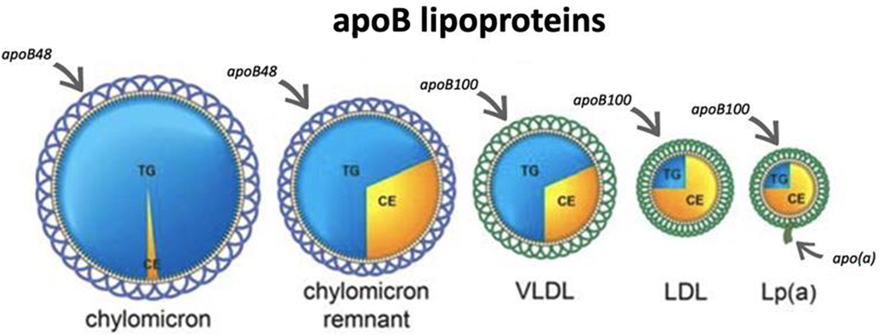
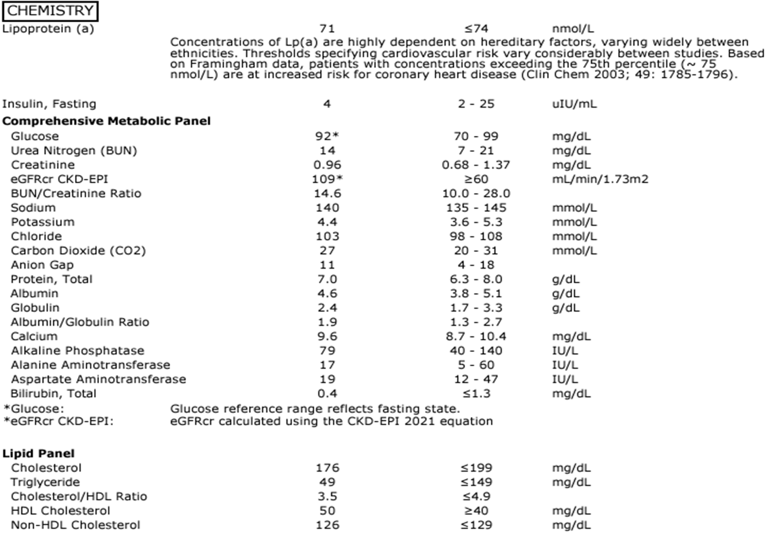
Let’s keep going…
REMEMBER
Most Lipid Panels will CALCULATE the LDL level using either Friedwald or Martin Hopkins equation.
This helps with simplicity and cost effectiveness in high volume testing
Can be inaccurate with TGL levels above 150 or altered lipid composition
Biomarkers
  Apo B >130 mg/dL
    A more detailed view of atherogenic lipid particles→ reflects total particle numbers
    Includes LDL, VLDL, Lp (a)
    ApoB more accurately quantifies atherogenic burden
      Useful with elevated TGL, metabolic syndrome or diabetes present, discordance between LDL-C and particle number
    Associated with greater plaque progression and higher cardiovascular risk
    Watch for Discordant patients who are at elevated risk (Normal LDL-C, high ApoB)→ risk will follow ApoB levels
Ference BA, Kastelein JJP, Ray KK, et al. Association of Genetic Variants Related to ApoB With Cardio-metabolic Risk.
Sniderman AD, Thanassoulis G, Wilkins JT, et al. ApoB in clinical care: A review of evidence and recommendations from the NLA.
Notes:
-Friedwald Equation or Martin Hopkins
-assume a fixed relationship between TGL, VLDL-C and LDL composition
-Breaks down with: Elevated TGL, LDL particles are depleted (common in insulin resistance, diabetes, obesity, metabolic syndrome)
-Patients have a high Lp (a) which is counted as LDL-C, inflating the value
-Many patients can have a normal LDL-C→ but high ApoB
-Watch for this in DM, Obesity, Hypertriglyceridemia, Metabolic Syndrome, Lp (a) elevation
-90-129→ intermediate/moderate risk
-<90 desirable for primary prevention
Less than 80, reasonable in high risk individuals
-Cholesterol and TGL are not water soluble so they don’t just float around our blood stream they need vehicles to move them around and these vehicles are called lipoproteins
-in 90% of patients apo B correlates with LDL

Slide 29
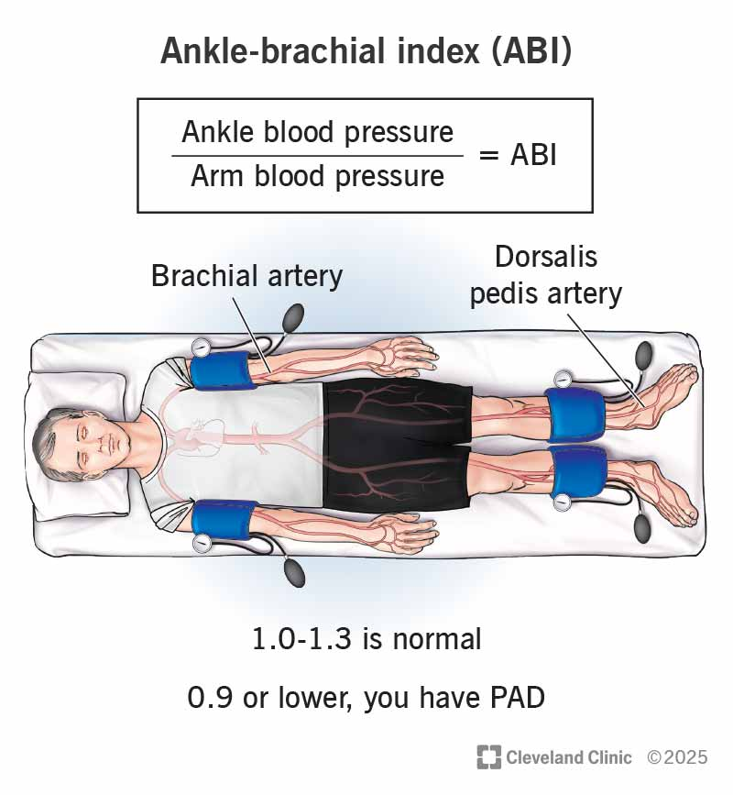
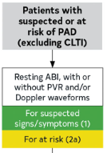
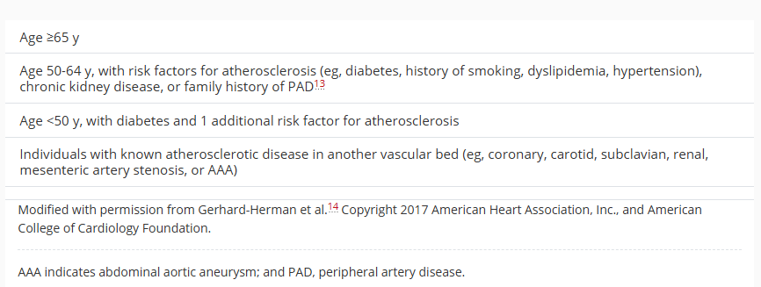
Last One I Promise…
The Ankle-Brachial Index (<0.9)
  The quick and easy way to check for artery disease
  Current 2024 guidelines for lower extremity PAD give a class IIa recommendation for obtaining ABIs in patients “at risk” of lower extremity PAD
  Only 30% of patients will present with typical claudication symptoms
  Abnormal ABI in asymptomatic patients have poor CV morbidity and mortality outcomes (Risk rises almost 2-3x higher for cardiovascular mortality)
Who is at risk?
Mach F, Baigent C, Catapano AL, et al. 2019 ESC/EAS Guidelines for the management of dyslipidaemias: Lipid modification to reduce cardiovascular risk. Eur Heart J. 2020;41(1):111-188. doi:10.1093/eurheartj/ehz455.
Notes:
-“Patients with an abnormal ABI who are asymptomatic (asymptomatic PAD) have poorer cardiovascular morbidity and mortality outcomes than do patients with normal ABI.”
-Great test, no radiation, cheap,
-An ABI ≤ 0.90 is associated with:
2–3× higher risk of total mortality
2–3× higher risk of cardiovascular mortality
~2× increased risk of major coronary events
These risks persist even in people without symptoms of PAD.
10-year CV mortality rises from ~5–7% (normal ABI) to ~15–20% (ABI ≤ 0.90).
Major vascular events (MI, stroke, vascular death) increase from ~10% to ~25% over ~10 years when ABI ≤ 0.90.

Slide 30
The moment we have all been waiting for…
Notes:
Problem: LDL-C appears “near goal,” but elevated TG suggests discordance and possible underestimation of atherogenic particles.
ApoB Result: 118 mg/dL (high risk ≥90)
→ Reveals increased atherogenic particle number (VLDL/IDL/LDL) despite “normal” LDL-C.
Additional Risk Stratification:
CAC = 172 → confirms subclinical atherosclerosis.

Slide 31
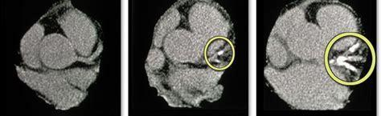
CT Calcium Scoring
Coronary Artery Calcium detected by CT is a powerful predictor of ASCVD events
Agatston score
  Semi automated calculation of summed score of all coronary calcified lesions and max density of CAC
Widely available, quick, 1 msV of radiation, cheap, provides an evaluation of atherosclerotic burden , no contrast
Allows for recategorizing risk in borderline and intermediate risk patients
Calcium score of 0 → low risk for future events
We know now, higher calcium score→ higher risk
Notes:
-Lets just take a look ourselves

Slide 32
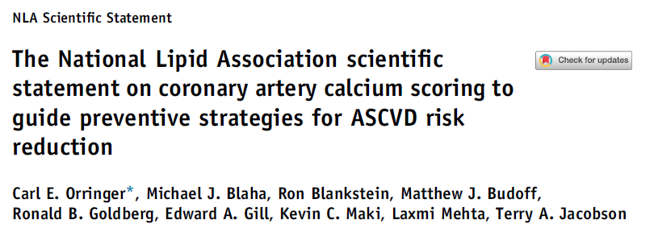
Notes:
-Prevalence of CHD, CVD and all cause mortality is directly linked with burden of CAC regardless of age group
-its important to recognize this because we can make a difference with lipid lowering therapies

Slide 33
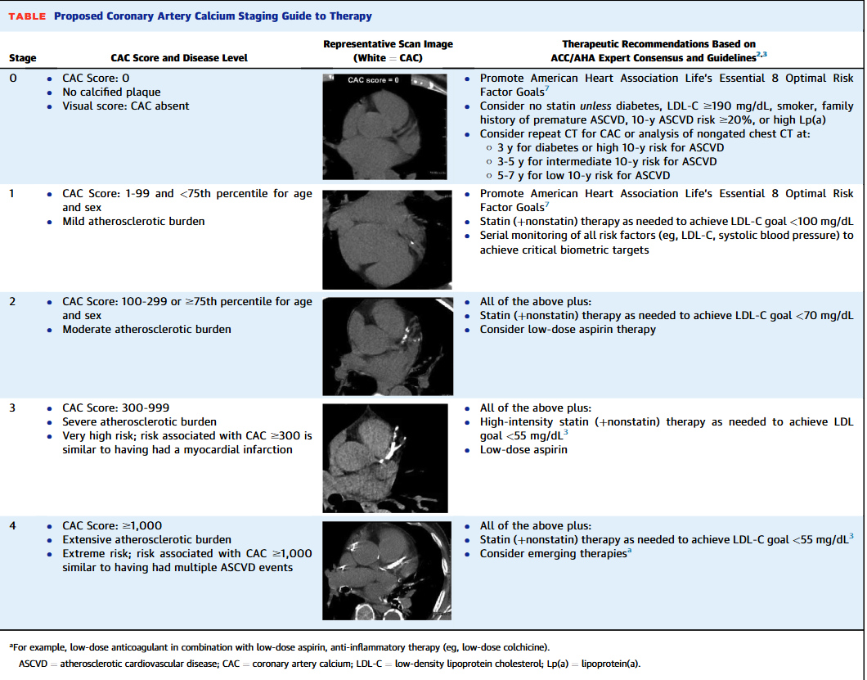
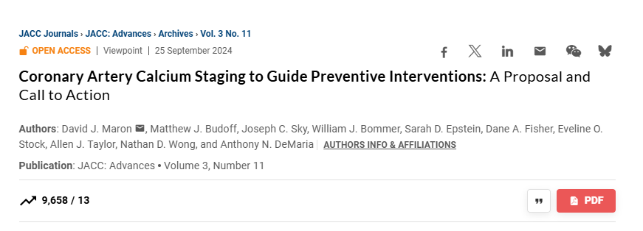
Maron, D, Budoff, M, Sky, J. et al. Coronary Artery Calcium Staging to Guide Preventive Interventions: A Proposal and Call to Action. JACC Adv. 2024 Nov, 3 (11) .
https://doi.org/10.1016/j.jacadv.2024.101287
Notes:
-Great article proposing a grading system to CAC scores and really details how significant CAC scores can correlate with adverse outcomes
-Like we talked about, the higher the risk the more aggressive we need to be with primary prevention

Slide 34
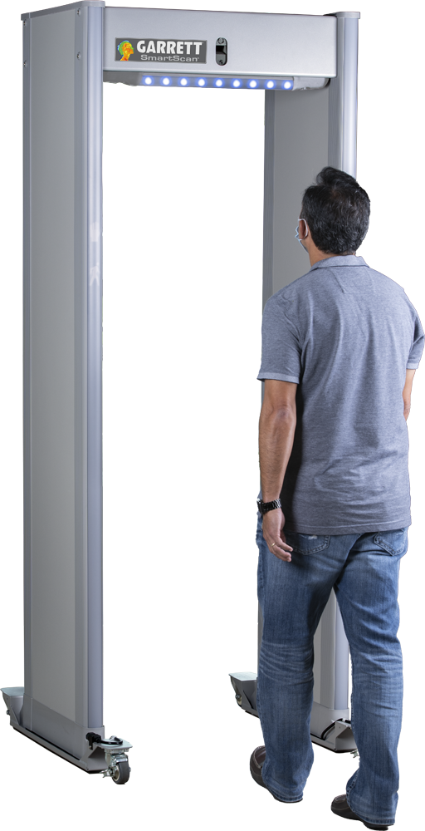
The Coronary CT Calcium Score
Notes:
Coronary Calcium Score = Metal Detector at the Airport
-It only detects metal objects (calcified plaque).
-If the detector goes off, you know something is there…
But you don’t know how big it is, where it is, or whether the person has:
plastic items (soft plaque)
dangerous items
multiple objects hidden
It’s a good screening tool, but limited.
CCTA = TSA Full Body Scanner
Shows everything: metal + plastic + liquids (calcified + non-calcified + mixed plaque).
Identifies:
exact location
size
severity
dangerous features
It gives the complete picture.

Slide 35

The CT Coronary Angiogram
Notes:
CCTA = TSA Full Body Scanner
Shows everything: metal + plastic + liquids (calcified + non-calcified + mixed plaque).
Identifies:
exact location
size
severity
dangerous features
It gives the complete picture.
Coronary Calcium Score = Metal Detector at the Airport
-It only detects metal objects (calcified plaque).
-If the detector goes off, you know something is there…
But you don’t know how big it is, where it is, or whether the person has:
plastic items (soft plaque)
dangerous items
multiple objects hidden
It’s a good screening tool, but limited.

Slide 36
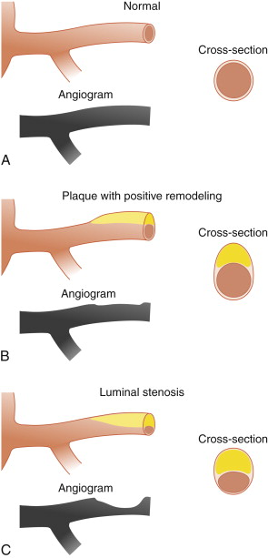
CT Coronary Angiogram
Uses contrast to assess luminal stenosis
Has good temporal and spatial resolution, and only getting better with multi-detector CT systems and contemporary technology
Low-radiation
Needs a regular rhythm with a heart rate around ~60 bpm for adequate gating of the coronary arteries
  Must also watch for lots of coronary calcium (blooming artifact)
  Significant ectopy
  Atrial fibrillation
94% sensitivity, 97% specificity, 87% positive predictive value, and 99% negative predictive value for coronary stenoses over 50%
  Specificity for identifying CAD is 74-78% (Hold this thought)
ALSO, calculates a CAC score
Class 1 indication for assessment of acute chest pain with intermediate risk and no known history of CAD
  Avoids risk of invasive coronary angiography
Also details other high-risk features of stenoses (ie. Positive remodeling, spotty calcifications, low attenuation plaque )

Slide 37
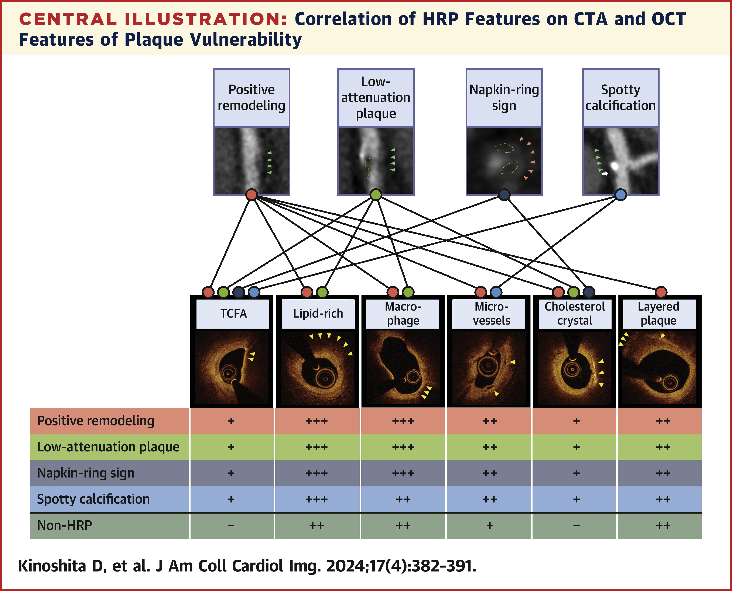
Notes:
-All 4 HRP features on CTA were associated with features of vulnerability on OCT.

Slide 38
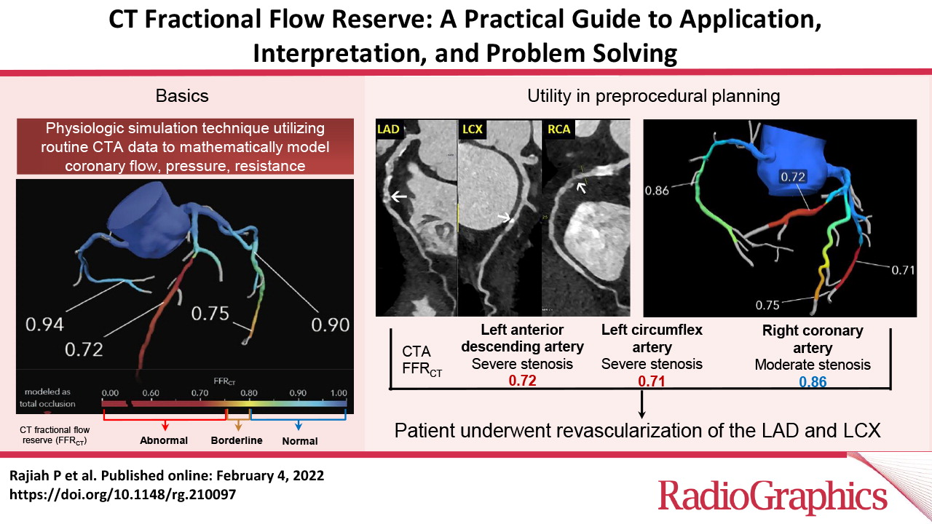
If the lesion is 50%, how do we know if its significant or not?
Notes:
-We now have technology that uses a physiologic simulation technique that models coronary blood flow to evaluate lesion specific ischemia
-This technology remodels in a 3D analysis that assess flow across the vessel
-Greater than 0.8 is normal
-0.76 to 0.8 is borderline
-0.75 or less is abnormal
-This technology improves its specificity by evaluating lesion-specific ischemia, enhances its role as a gatekeep for ICA
This tool increases the specificity of CCTA in the assessment of acute chest pain

Slide 39
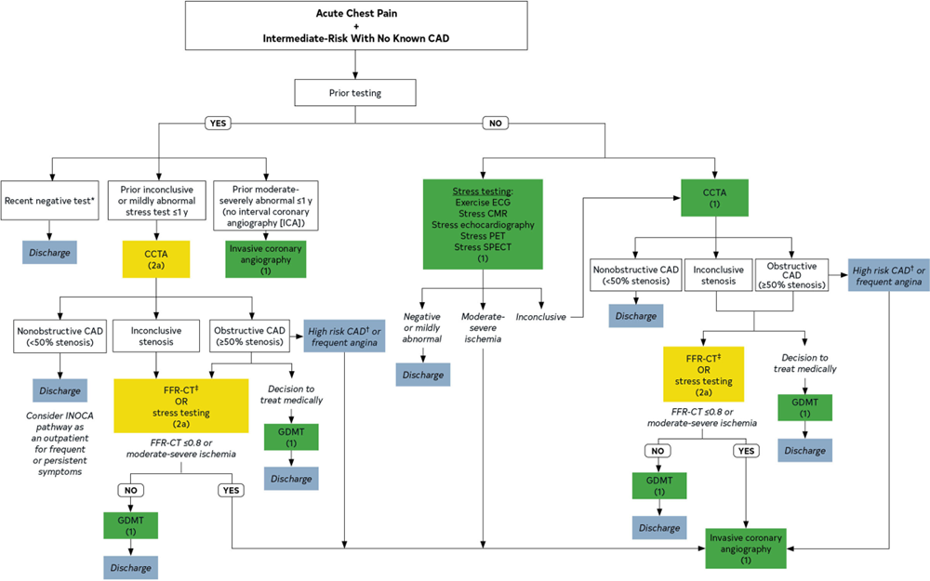
So, when do we use a Coronary CT Angiography then?
Martha Gulati. Circulation. 2021 AHA/ACC/ASE/CHEST/SAEM/SCCT/SCMR Guideline for the Evaluation and Diagnosis of Chest Pain: A Report of the American College of Cardiology/American Heart Association Joint Committee on Clinical Practice Guidelines, Volume: 144, Issue: 22, Pages: e368-e454, DOI: (10.1161/CIR.0000000000001029)
Notes:
-According to the 2021 guidelines, CCTA is a class 1 recommendation in the assessment of stable acute chest pain with intermediate risk and no known history of CAD

Slide 40
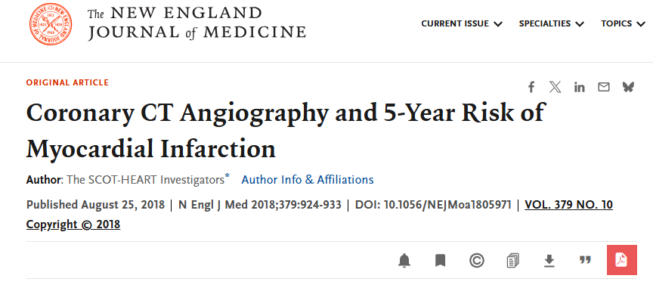
Hold on a second, I thought this was a talk on prevention…
4146 patients: 2073 randomized to standard of care and CCTA and 2073 to standard care alone
3 to 7 years of clinical outcomes assessed
Primary endpoint: death from CHD or nonfatal MI at 5 years
Newby DE, Adamson PD, Berry C, et al. Coronary CT Angiography and 5-Year Risk of Myocardial Infarction. N Engl J Med. 2018;379(10):924-933. doi:10.1056/NEJMoa1805971.

Slide 41
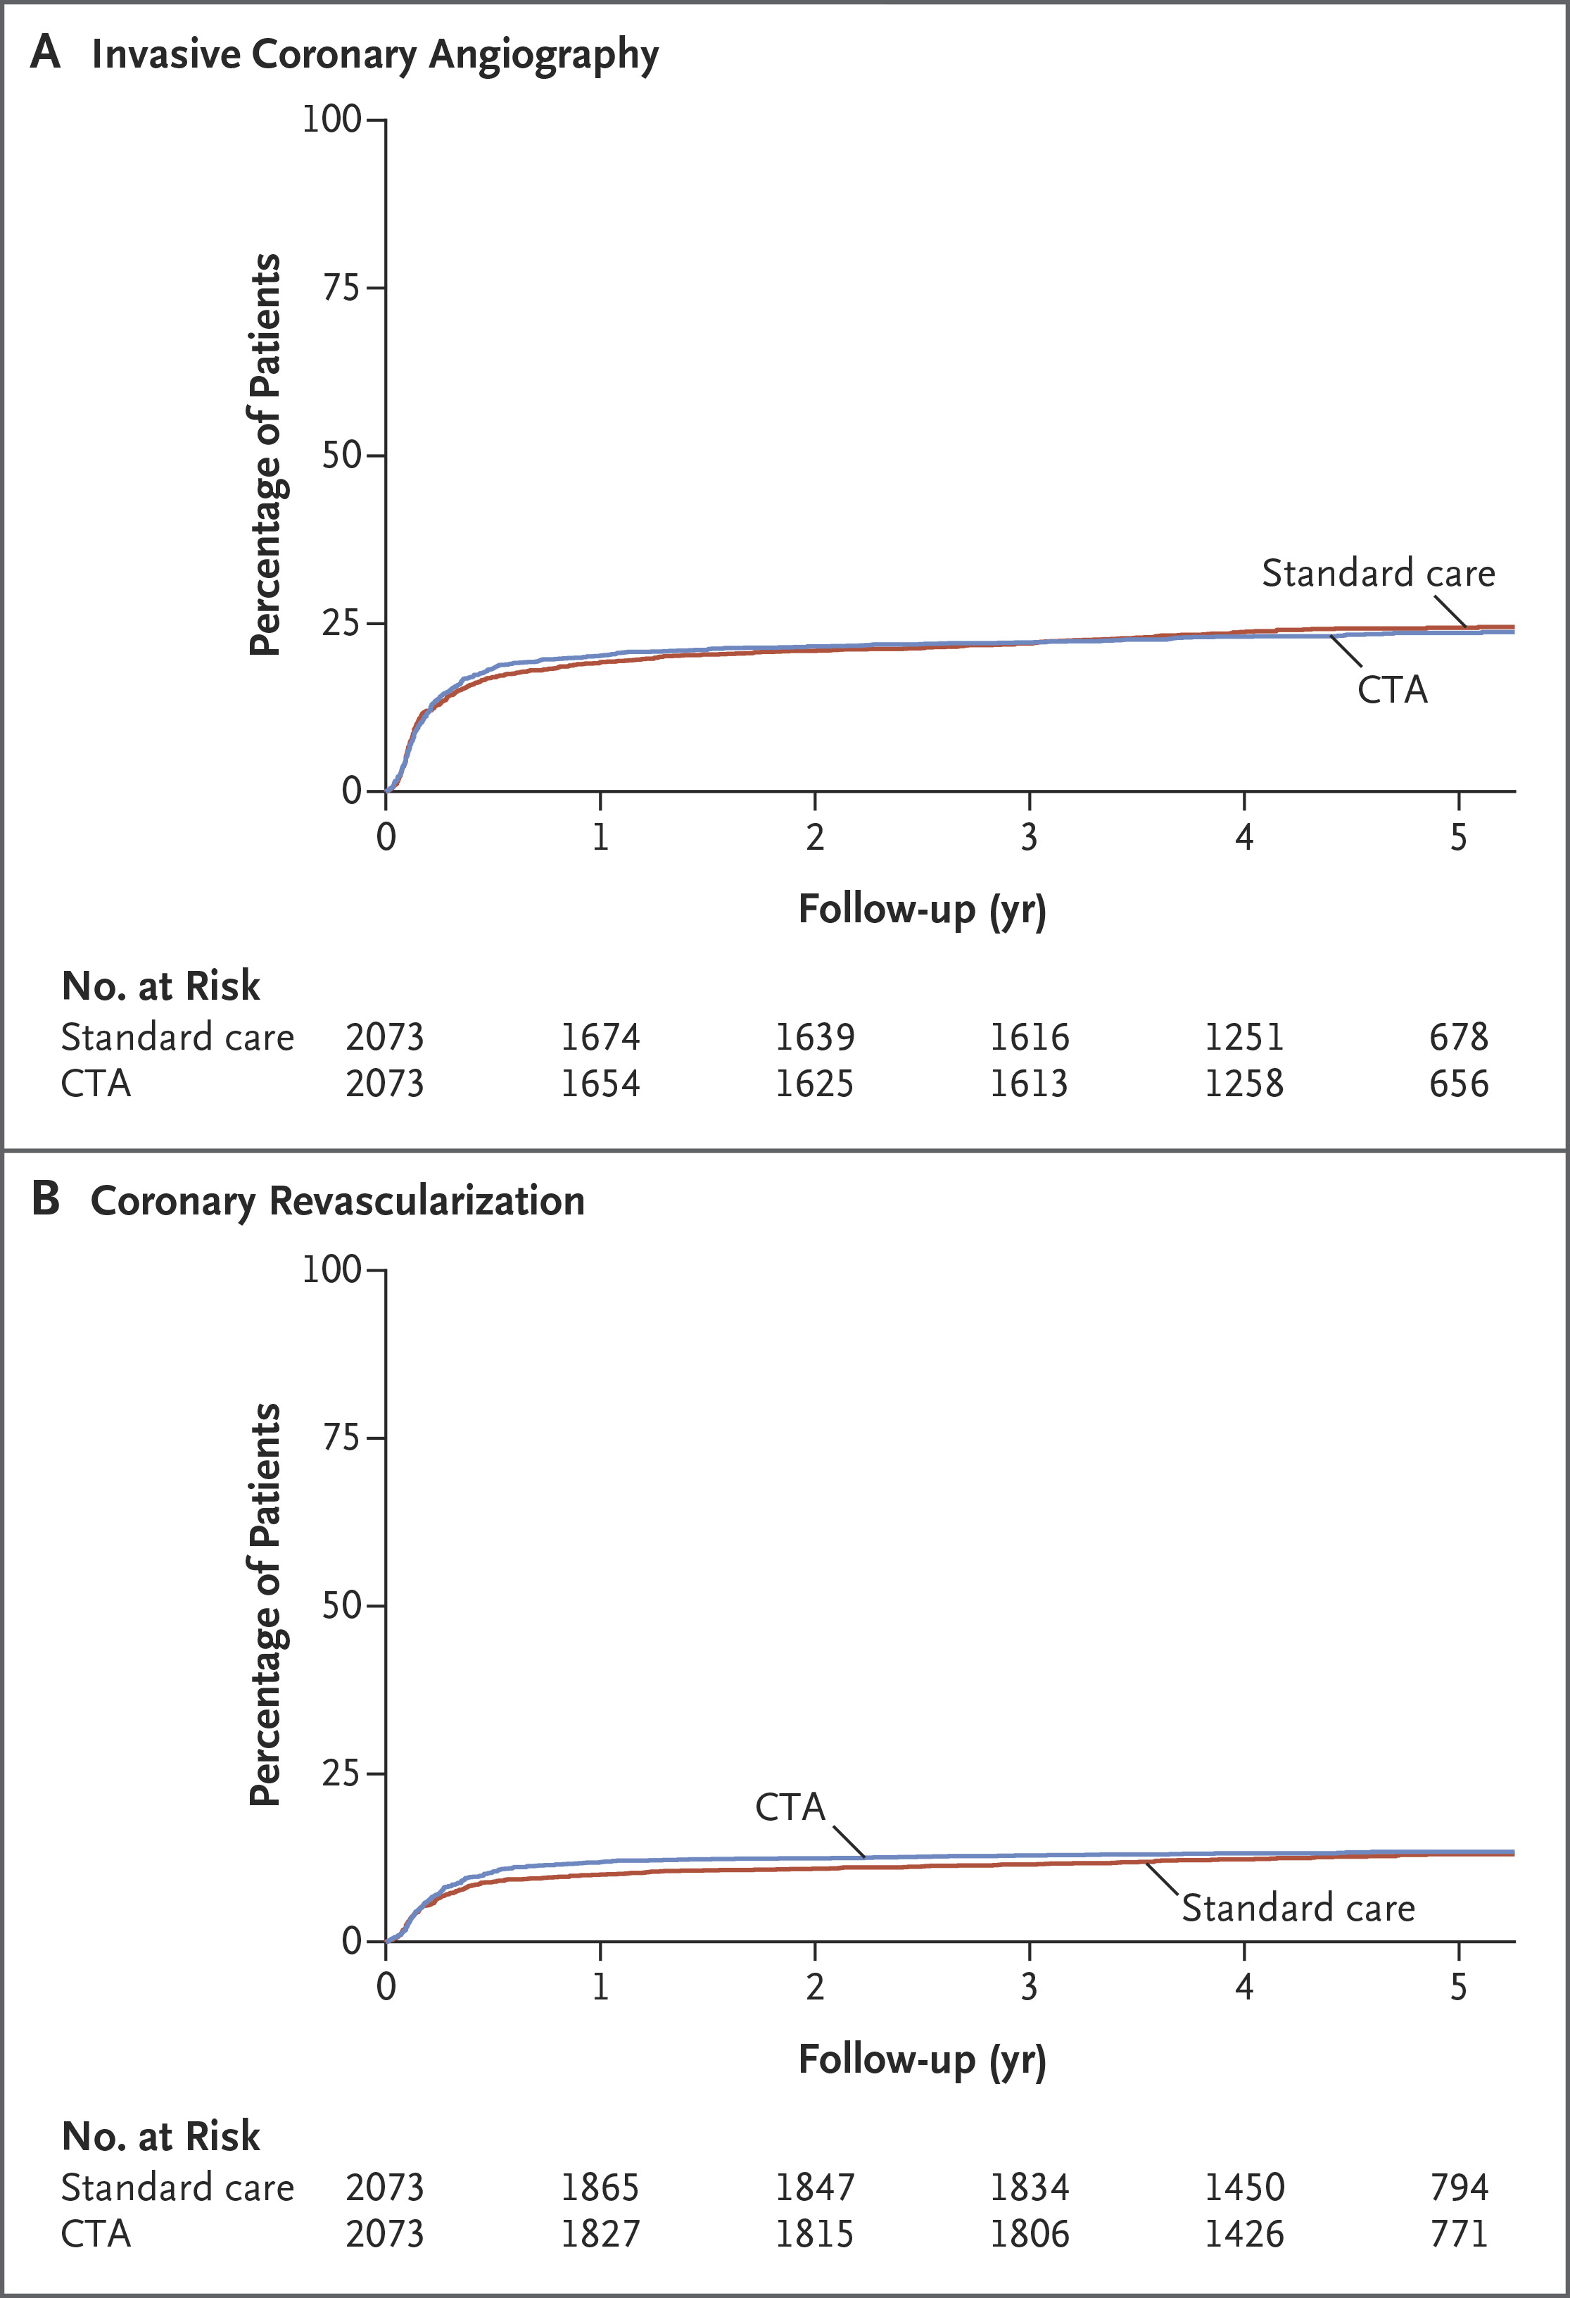
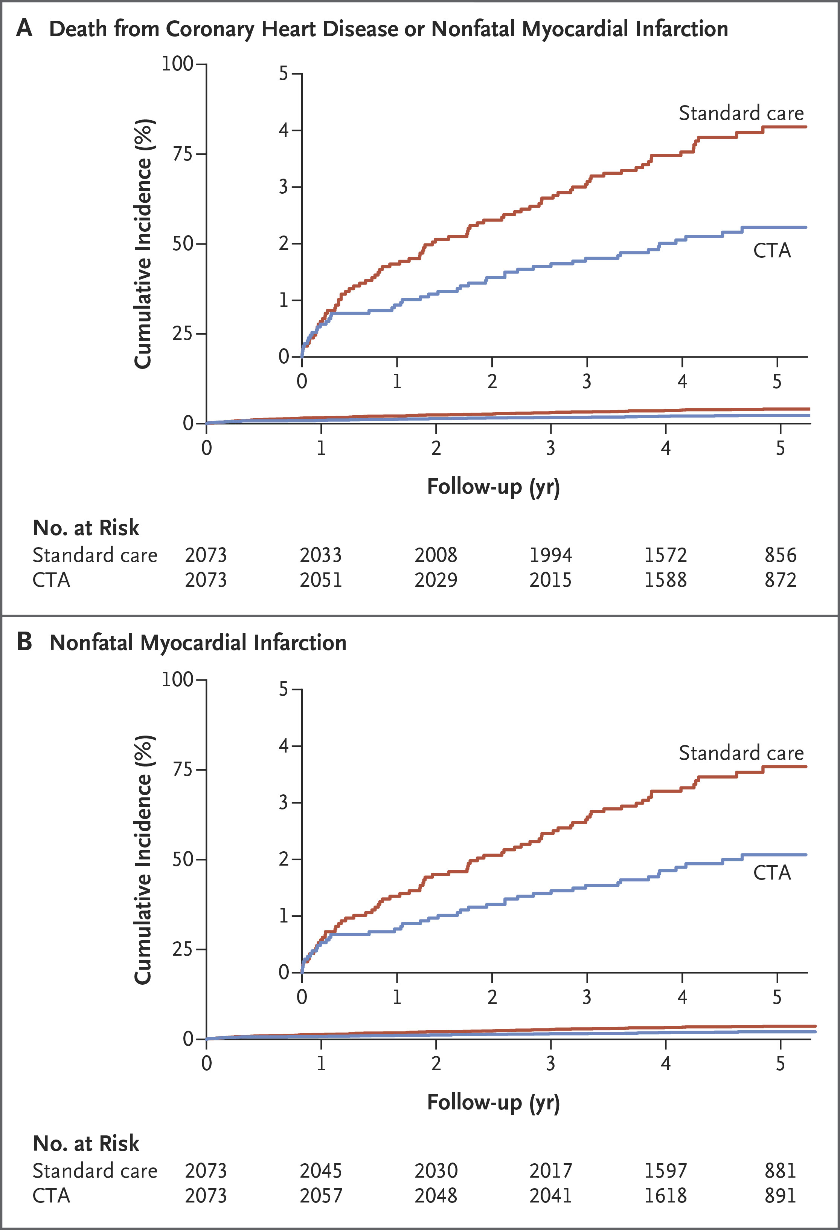
Notes:
-No difference in rates of patients sent for ICA or had coronary revascularization
-The rate of the primary long-term end point (death from coronary heart disease or nonfatal myocardial infarction) was lower in the CTA group than in the standard-care group (2.3% [48 patients] in the CTA group vs. 3.9% [81 patients] in the standard-care group; hazard ratio, 0.59; 95% CI, 0.41 to 0.84; P=0.004)
-Driven by lower rate of nonfatal MI

Slide 42
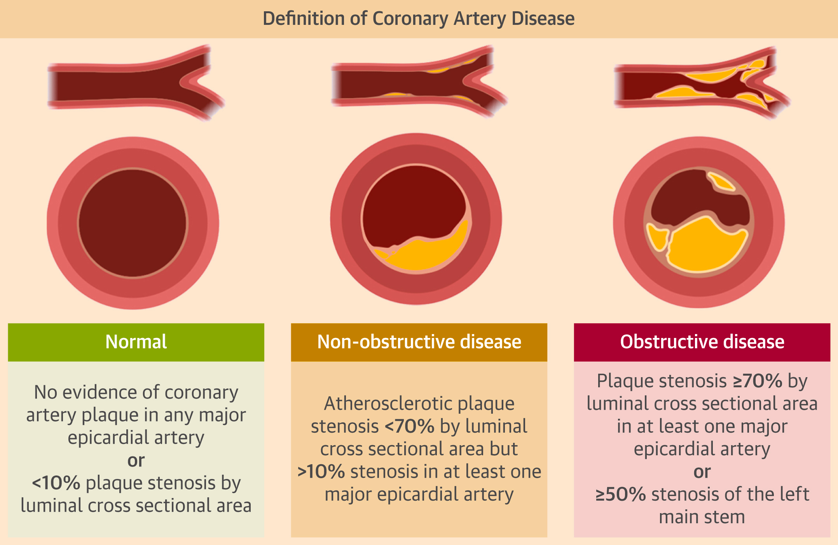
Why the Difference?
CCTA provokes change in treatment resulting in a significantly lower rate of death from CHD or nonfatal MI
Patients who receive a correct diagnosis are more likely to receive appropriate therapies and may have greater motivation to implement healthy lifestyle modifications
Patients in the CTA group, approximately ½ of subsequent MI was in patients who had nonobstructive disease at baseline

Slide 43

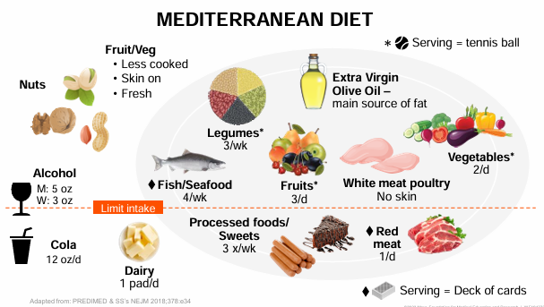
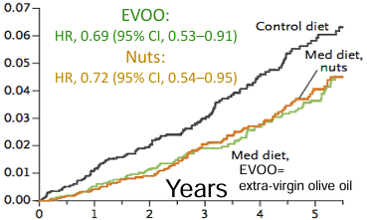
So we have identified risk, what do we recommend?
EXERCISE→ 150 minutes of moderate aerobic intensity a week or 75 minutes of vigorous intensity exercise a week
  Observed ~20% reduction in mortality from all causes! (Adamson)
Don’t Smoke! (Obviously)
Sleep 7-9 hours of quality sleep a night
  Those who sleep less have a 14% risk of higher mortality
  Long Sleepers >9 hours, had a trend to 34% risk of higher mortality (Ungvari)
DIET, DIET, DIET-> Mediterranean Diet
  PREDIMED Study demonstrated Mediterranean diet supplemented with virgin olive oil or nuts led to 30% reduction in MI, CVA, and cardiovascular mortality (driven by lower stroke)
  DASH diet shown to aid in reducing HTN
  Avoidance of trans fats, saturated fats, >2g Na daily, >14 g/d of red meat and sugar-sweetened beverages
Reduction in events early, likely an anti-inflammatory effect
Adamson PD, Fordyce CB, Newby DE, et al. Coronary CT Angiography and 5-Year Risk of Myocardial Infarction. N Engl J Med. 2018;379(10):924-933. doi:10.1056/NEJMoa1805971.
Ungvari Z, Fekete M, Varga P, Fekete JT, Lehoczki A, Buda A, Szappanos Á, Purebl G, Ungvari A, Győrffy B. Imbalanced sleep increases mortality risk by 14-34%: a meta-analysis. Geroscience. 2025 Jun;47(3):4545-4566. doi: 10.1007/s11357-025-01592-y. Epub 2025 Mar 12. PMID: 40072785; PMCID: PMC12181477.
Notes:
-Moderate intensity is its difficult to complete a sentence, brisk walking, biking, ballroom dancing, active yoga, recreational swimming
-Vigorous is jogging, running, biking, singles tennis swimming laps
(Prevención con Dieta Mediterránea

Slide 44
So we have identified risk, what do we recommend?
Cholesterol Management
  Optimal LDL-C for all adults is <100 mg/dL
  LDL C-190 mg/dL? ASCVD risk between 7.5-19.9%?→ Goal LDL <100 mg/dL
  High risk of CVD events (ie. T2DM, clinical ASCVD, Calculated risk >20%, CAC score >100)→ Goal LDL-C is <70 mg/dL
  Very high risk patients (Major ASCVD events, HeFH, DM, HTN, CKD, smoking)→ Goal LDL-C is <55 mg/dL
Jackson et al., LDL cholesterol management simplified in (adults)—Lower for longer is better: Guidance from the National Lipid
Association, Journal of Clinical Lipidology, https://doi.org/10.1016/j.jacl.2025.06.002
Notes:
Doubling dose of statin will only give you an additional 6% lower reduction in LDL C

Slide 45
So we have identified risk, what do we recommend?
Blood pressure Management
  <130/80 is the goal for all adults
  Classify your patients early and often:
    Elevated blood pressure as 120 to 129 mm Hg systolic and <80 mm Hg diastolic
    Stage 1 hypertension as 130 to 139 mm Hg systolic or 80 to 89 mm Hg diastolic
    Stage 2 hypertension as ≥140 mm Hg systolic or ≥90 mm Hg diastolic
  Low sodium diet (<1.5 gm) per day→ 2-8 mmHg reduction
  Physical activity→ 4-9 mmHg reduction
  Moderate alcohol use→ 2-4 mmHg
  Avoidance of NSAIDS→ 5mmHg
  Weight Loss → 1mmHg/1 kg weight loss
  SGLT2-I to address CKM→ 1-6 mmHg SBP lowering
  Treat OSA→ 10 mmHg reduction
Obesity
  Maintaining healthy bodyweight, monitoring waist circumference, visceral/peripheral adiposity, and preservation of muscle mass
Diabetes Management
  Maintaining healthy weight, using Metformin, SGLT2-I/GLP-1 RA to aid in improving insulin resistance
Ndumele CE, et al.; American Heart Association. Cardiovascular-Kidney-Metabolic Health: A Presidential Advisory from the American Heart Association. Circulation. 2023;148(20):1606-1635. doi:10.1161/CIR.0000000000001356
Notes:
Doubling dose of statin will only give you an additional 6% lower reduction in LDL C

Slide 46
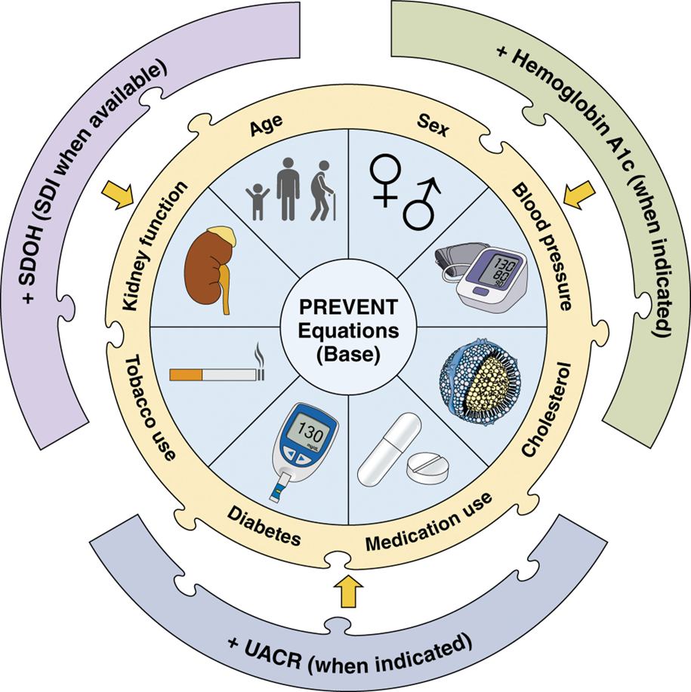
Lastly,
Staying connected
Reducing Stress and screening for depression
Addressing Social Determinants of Health
Notes:
There is work to do

Slide 47
Question 1:
The best option to incorporate coronary artery calcification scores into ASCVD risk estimation is:
  ACA/AHA Pooled Cohort Equation
  AHA PREVENT Calculator
  MESA (Multi-Ethnic Study of Atherosclerosis)
  Framingham Risk Score
  Coronary Artery Calcification Primary Prevention Score of Peace Calculator
  There is no calculator available that uses coronary artery calcifications

Slide 48
Question 1:
The best option to incorporate coronary artery calcification scores into ASCVD risk estimation is:
  ACA/AHA Pooled Cohort Equation
  AHA PREVENT Calculator
  MESA (Multi-Ethnic Study of Atherosclerosis)
  Framingham Risk Score
  Coronary Artery Calcification Primary Prevention Score of Peace Calculator
  There is no calculator available that uses coronary artery calcifications

Slide 49
Question 2:
According to the 2019 National Lipid Association Statement on Use of Lipoprotein (a) in Clinical Practice, Lp (a) should be tested in the following:
  African Americans
  Patients with Aortic Stenosis
  Only patients with significant family history of ASCVD
  Patients with a premature history of ASCVD
  All adults should be tested at least once

Slide 50
Question 2:
According to the 2019 National Lipid Association Statement on Use of Lipoprotein (a) in Clinical Practice, Lp (a) should be tested in the following:
  African Americans
  Patients with Aortic Stenosis
  Only patients with significant family history of ASCVD
  Patients with a premature history of ASCVD
  All adults should be tested at least once

Slide 51
Question 3:
Your patient wants to know what is the recommended level of activity that they need to participate in to lower their risk of cardiovascular events and death. You, being an astute clinician, recommend which of the following:
  150 minutes of low-intensity exercise every 2 days
  2 hours of high intensity interval training every day
  Water aerobics classes every day
  150 minutes of moderate-intensity exercise in a week
  95 minutes of vigorous-intensity aerobic physical activity

Slide 52
Question 3:
Your patient wants to know what is the recommended level of activity that they need to participate in to lower their risk of cardiovascular events and death. You, being an astute clinician, recommend which of the following:
  150 minutes of low-intensity exercise every 2 days
  2 hours of high intensity interval training every day
  Water aerobics classes every day
  150 minutes of moderate-intensity exercise in a week
  95 minutes of vigorous-intensity aerobic physical activity

Slide 53
Question 4:
Mrs. F is a 48 year-old-female with no past medical history comes to you for a preventive visit to discuss lowering her cardiovascular risk. You calculate her cardiovascular risk using the AHA PREVENT Calculator as “borderline” (between 5-7.5%). She has no diabetes, family history of premature coronary disease, and does not smoke. The patient would like to not take medications daily and wants more information. You decide to order which of these tests to help guide your decision:
  CT Coronary Calcium Score
  Hs-CRP
  Lipoprotein (a) level
  Apolipoprotein B level
  Ankle-Brachial-Index
  No further testing is needed. She does not need a statin.
  Number 1 and 3
  Number 1 through 5

Slide 54
Question 4:
Mrs. F is a 48 year-old-female with no past medical history comes to you for a preventive visit to discuss lowering her cardiovascular risk. You calculate her cardiovascular risk using the AHA PREVENT Calculator as “borderline” (between 5-7.5%). She has no diabetes, family history of premature coronary disease, and does not smoke. The patient would like to not take medications daily and wants more information. You decide to order which of these tests to help guide your decision:
  CT Coronary Calcium Score
  Hs-CRP
  Lipoprotein (a) level
  Apolipoprotein B level
  Ankle-Brachial-Index
  No further testing is needed. She does not need a statin.
  Number 1 and 3
  Number 1 through 5

Slide 55
Question 5:
A 58-year-old woman with a history of hypertension presents with intermittent brief episodes of left-sided stabbing chest discomfort that occur at rest, last only a few seconds, and are not provoked by exertion. She is concerned and wants to know if her coronary arteries are blocked. Her ECG is normal apart from nonspecific ST-T changes in leads V1-V6. HS-Cardiac Troponin is negative x3. She is otherwise healthy. Which test would you recommend?
  Exercise Treadmill Stress Test
  Exercise Treadmill MPI
  CT Coronary Artery Calcium Score
  Lexiscan MPI
  CT Coronary Angiogram

Slide 56
Question 5:
A 58-year-old woman with a history of hypertension presents with intermittent brief episodes of left-sided stabbing chest discomfort that occur at rest, last only a few seconds, and are not provoked by exertion. She is concerned and wants to know if her coronary arteries are blocked. Her ECG is normal apart from nonspecific ST-T changes in leads V1-V6. HS-Cardiac Troponin is negative x3. She is otherwise healthy. Which test would you recommend?
  Exercise Treadmill Stress Test
  Exercise Treadmill MPI
  CT Coronary Artery Calcium Score
  Lexiscan MPI
  CT Coronary Angiogram

Slide 57







Slide 58
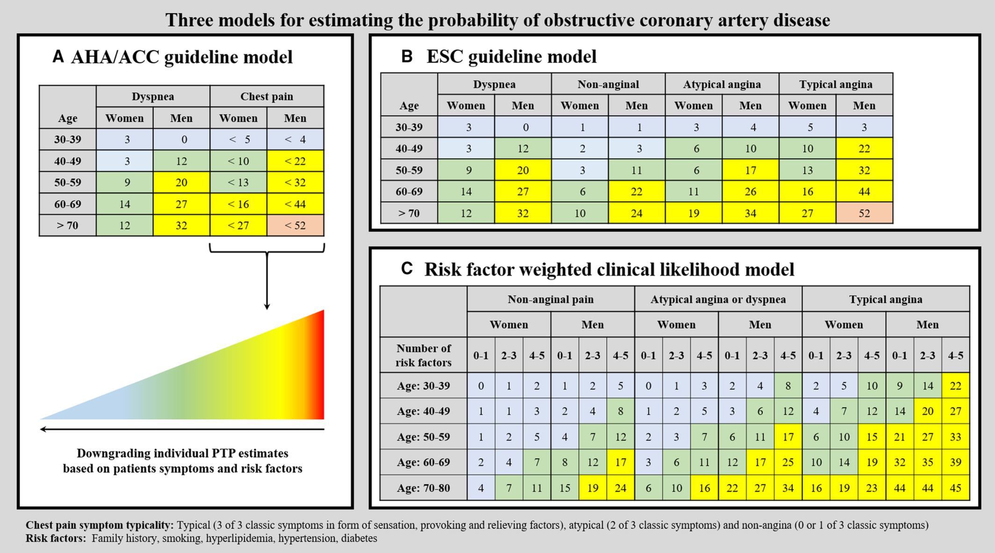
Simon Winther. Journal of the American Heart Association. Performance of the American Heart Association/American College of Cardiology Guideline‐Recommended Pretest Probability Model for the Diagnosis of Obstructive Coronary Artery Disease, Volume: 11, Issue: 24, DOI: (10.1161/JAHA.122.027260)

Slide 59
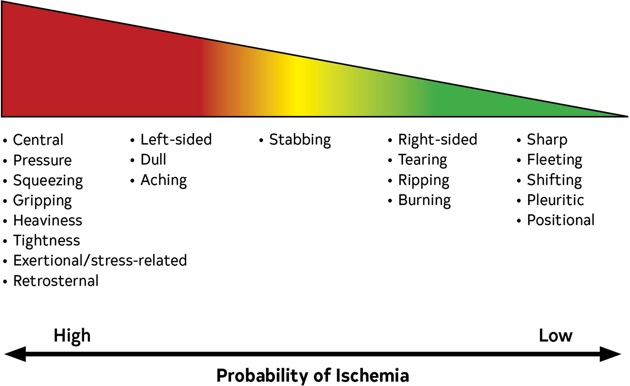

Slide 60
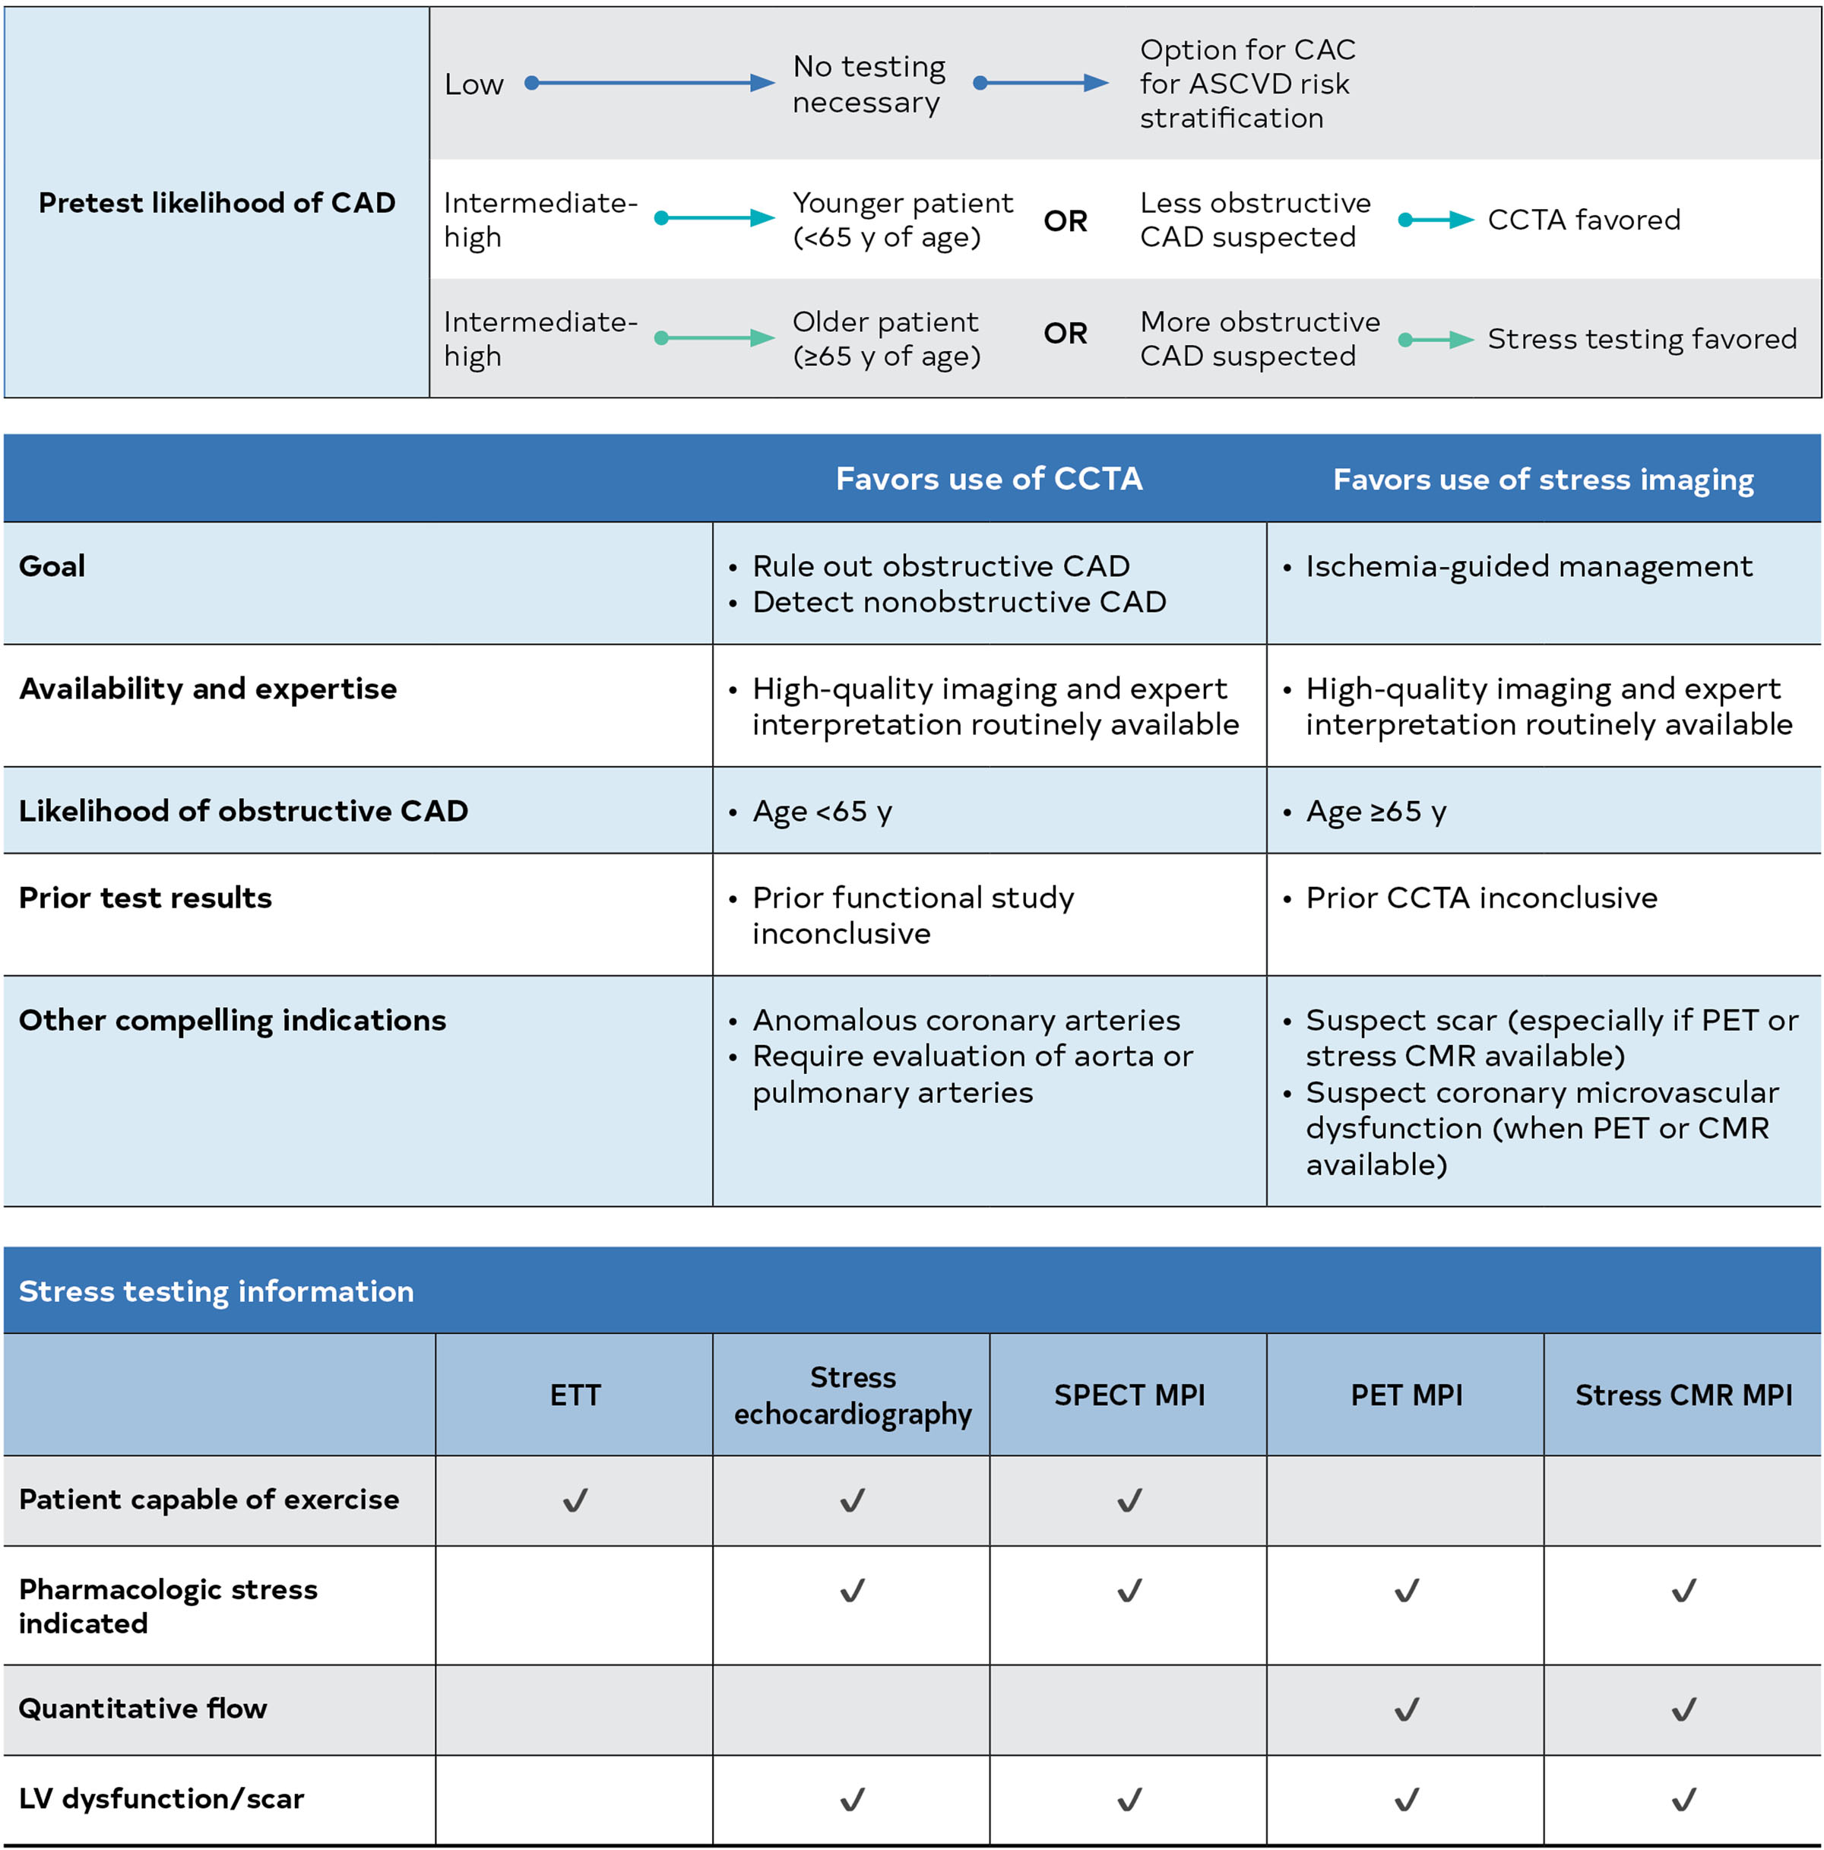

Slide 61
Citations:
Adamson PD, Fordyce CB, Newby DE, et al. Coronary CT Angiography and 5-Year Risk of Myocardial Infarction. N Engl J Med. 2018;379(10):924-933. doi:10.1056/NEJMoa1805971.
Arnett DK, Blumenthal RS, Albert MA, et al. 2019 ACC/AHA Guideline on the Primary Prevention of Cardiovascular Disease.
Anderson TS, Wilson LM, Sussman JB. Atherosclerotic Cardiovascular Disease Risk Estimates Using the Predicting Risk of Cardiovascular Disease Events Equations. JAMA Intern Med. 2024 Aug 1;184(8):963-970. doi: 10.1001/jamainternmed.2024.1302. PMID: 38856978; PMCID: PMC11165411.
Donna K. Arnett et al. JACC 2019; 74:e177-e232.
Ference BA, Kastelein JJP, Ray KK, et al. Association of Genetic Variants Related to ApoB With Cardio-metabolic Risk.
Karen E. Joynt Maddox. Circulation. Forecasting the Burden of Cardiovascular Disease and Stroke in the United States Through 2050—Prevalence of Risk Factors and Disease: A Presidential Advisory From the American Heart Association, Volume: 150, Issue: 4, Pages: e65-e88, DOI: (10.1161/CIR.0000000000001256)
Koschinsky ML, Bajaj A, Boffa MB, et al. A focused update to the 2019 NLA scientific statement on the use of lipoprotein(a) in clinical practice. J Clin Lipidol. 2024;18(3):00033-3. doi:10.1016/j.jacl.2024.03.001
Khan, S. S., Coresh, J., Pencina, M. J., Ndumele, C. E., Rangaswami, J., Chow, S. L., … Lloyd-Jones, D. M. (2023). Circulation, 148(24), 1982–2004. doi:10.1161/cir.0000000000001191
Mach F, Baigent C, Catapano AL, et al. 2019 ESC/EAS Guidelines for the management of dyslipidaemias: Lipid modification to reduce cardiovascular risk. Eur Heart J. 2020;41(1):111-188. doi:10.1093/eurheartj/ehz455.
Maron, D, Budoff, M, Sky, J. et al. Coronary Artery Calcium Staging to Guide Preventive Interventions: A Proposal and Call to Action. JACC Adv. 2024 Nov, 3 (11) https://doi.org/10.1016/j.jacadv.2024.101287
Martin SS, Aday AW, Allen NB, et al.; on behalf of the American Heart Association Council on Epidemiology and Prevention Statistics Committee and Stroke Statistics Committee. 2025 Heart disease and stroke statistics: a report of US and global data from the American Heart Association. Circulation. Published online January 27, 2025.
McClelland RL, Jorgensen NW, Budoff M, Blaha MJ, Post WS, Kronmal RA, Bild DE, Shea S, Liu K, Watson KE, Folsom AR, Khera A, Ayers C, Mahabadi AA, Lehmann N, Jöckel KH, Moebus S, Carr JJ, Erbel R, Burke GL. 10-Year Coronary Heart Disease Risk Prediction Using Coronary Artery Calcium and Traditional Risk Factors: Derivation in the MESA (Multi-Ethnic Study of Atherosclerosis) With Validation in the HNR (Heinz Nixdorf Recall) Study and the DHS (Dallas Heart Study). J Am Coll Cardiol. 2015 Oct 13;66(15):1643-53. doi: 10.1016/j.jacc.2015.08.035. PMID: 26449133; PMCID: PMC4603537.
Ndumele CE, Rangaswami J, Chow SL, Neeland IJ, Tuttle KR, Khan SS, Coresh J, Mathew RO, Baker-Smith CM, Carnethon MR, Després JP, Ho JE, Joseph JJ, Kernan WN, Khera A, Kosiborod MN, Lekavich CL, Lewis EF, Lo KB, Ozkan B, Palaniappan LP, Patel SS, Pencina MJ, Powell-Wiley TM, Sperling LS, Virani SS, Wright JT, Rajgopal Singh R, Elkind MSV; American Heart Association. Cardiovascular-Kidney-Metabolic Health: A Presidential Advisory from the American Heart Association. Circulation. 2023;148(20):1606-1635. doi:10.1161/CIR.0000000000001184.
Ridker PM, Rifai N, Rose L, et al. Rosuvastatin to Prevent Vascular Events in Men and Women with Elevated High-Sensitivity C-Reactive Protein. N Engl J Med. 2008;359(21):2195-2207. doi:10.1056/NEJMoa0807646
Sniderman AD, Thanassoulis G, Wilkins JT, et al. ApoB in clinical care: A review of evidence and recommendations from the NLA.

Slide 62

Thank you!
For all questions or further inquiries please do not hesitate to contact me:
  Gabriel Ruiz, MD , RPVI
  Noninvasive and Preventive Cardiologist
  Cell Phone: 480-612-3360
  Email: Gabriel@astra-healthcare.com
  Website: www. Astra healthcare.com/teams/dr-gabriel-ruiz

