Slide 1
Addressing Seizures in the Inpatient Setting
Samuel Durojaye, MD
Neurology | Neurocritical Care

Slide 2
Objectives
Define a seizure & learn what defines status epilepticus
Briefly discuss the pathophysiology of status epilepticus
Go over Anti-seizure med choices for the seizing patient
Discuss an approach to seizure work up & in the process discuss etiologies for why a patient might seize
Discuss differential diagnoses of seizures
Highlight some psychosocial effects of the diagnosis

Slide 3
Seizure – what is?
“The physical manifestations (such as convulsions, sensory disturbances, or loss of consciousness) resulting from abnormal electrical discharges in the brain.” – Merriam Webster Medical
“A sudden and temporary change in the electrical and chemical activity in the brain which leads to a change in a person’s movement, behaviour, level of awareness, and/or feelings.” – Epilepsy foundation Australia
Simply put, “a seizure is a physical manifestation of an aberrant electrochemical activity in the brain.”
  The physical manifestations can include changes to level of consciousness & sensorium, changes to motor activity, sensory changes & changes to autonomic function.
Notes:
https://www.merriam-webster.com/dictionary/seizure
https://epilepsyfoundation.org.au/understanding-epilepsy/seizures/what-is-a-seizure/

Slide 4
Seizure(s) – classification of
Simplified version of ILAE (Int. league against epilepsy) classification
  4 broad classes
    Generalized, Focal, Unknown (whether focal or generalized) & Unclassified
  Focal & Unknown subdivided based on assessment of consciousness
    Focal/unknown seizures with impaired consciousness
    Focal/unknown seizures with preserved consciousness
  Focal & Unknown subclassified based on progression
    Focal to bilateral tonic clonic seizures
    Unknown bilateral tonic clonic seizures
Notes:
https://onlinelibrary.wiley.com/doi/10.1111/epi.18338

Slide 5
For this lecture
Abridged classification
  Seizures
    Generalized & Focal
    Focal seizures – (level of consciousness)?
      Focal seizures with impaired consciousness
      Focal seizures with preserved consciousness
      Focal seizures (did it stay focal or did it generalize)?
        with secondary generalization

Slide 6
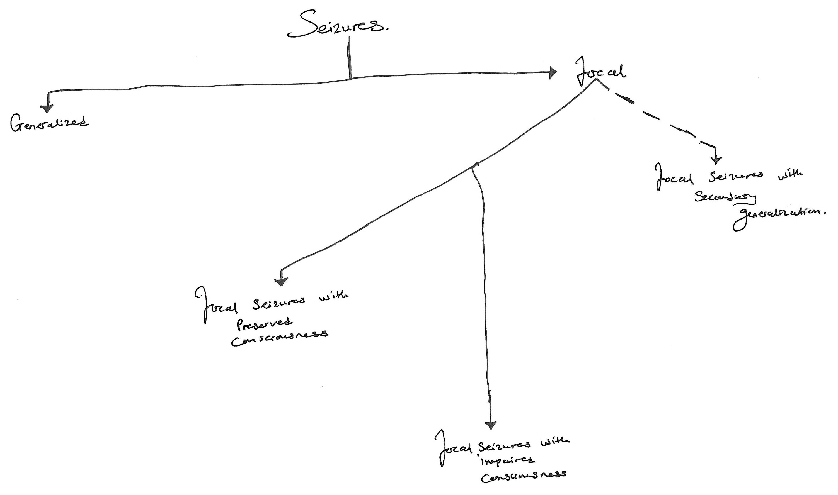

Slide 7

StAtUs ePiLePtIcUs – what is this phenomenon?!
Notes:
.

Slide 8
Status epilepticus
  A seizure lasting 5 or more minutes
            And Or
  A series of seizures without return to pre-seizure baseline level of consciousness
Notes:
4. Neurocritical care Edited by Andrew M. Naidech published by Cambridge.
5. Neurocritical care Edited by Lori A Shutter & Bradley J Mlyneaux, series editor John A. Kellum published by Oxford

Slide 9
Status Epilepticus – classification
Status epilepticus
  Convulsive
    Obvious or overt seizures noted on clinical exam
  Nonconvulsive
    There is absence of or presence of subtle clinical signs; no clear evidence of ongoing seizures
      Persistent encephalopathy
      Unexplained & arbitrary negative signs
  Note that
    Generalized & focal seizures can go on to become status epilepticus if they persist long enough or they recur without return to baseline level of consciousness between the seizures.
      Any seizure can go on to status epilepticus even with preserved consciousness (as with focal seizures with preserved consciousness lasting > 5 minutes).

Slide 10
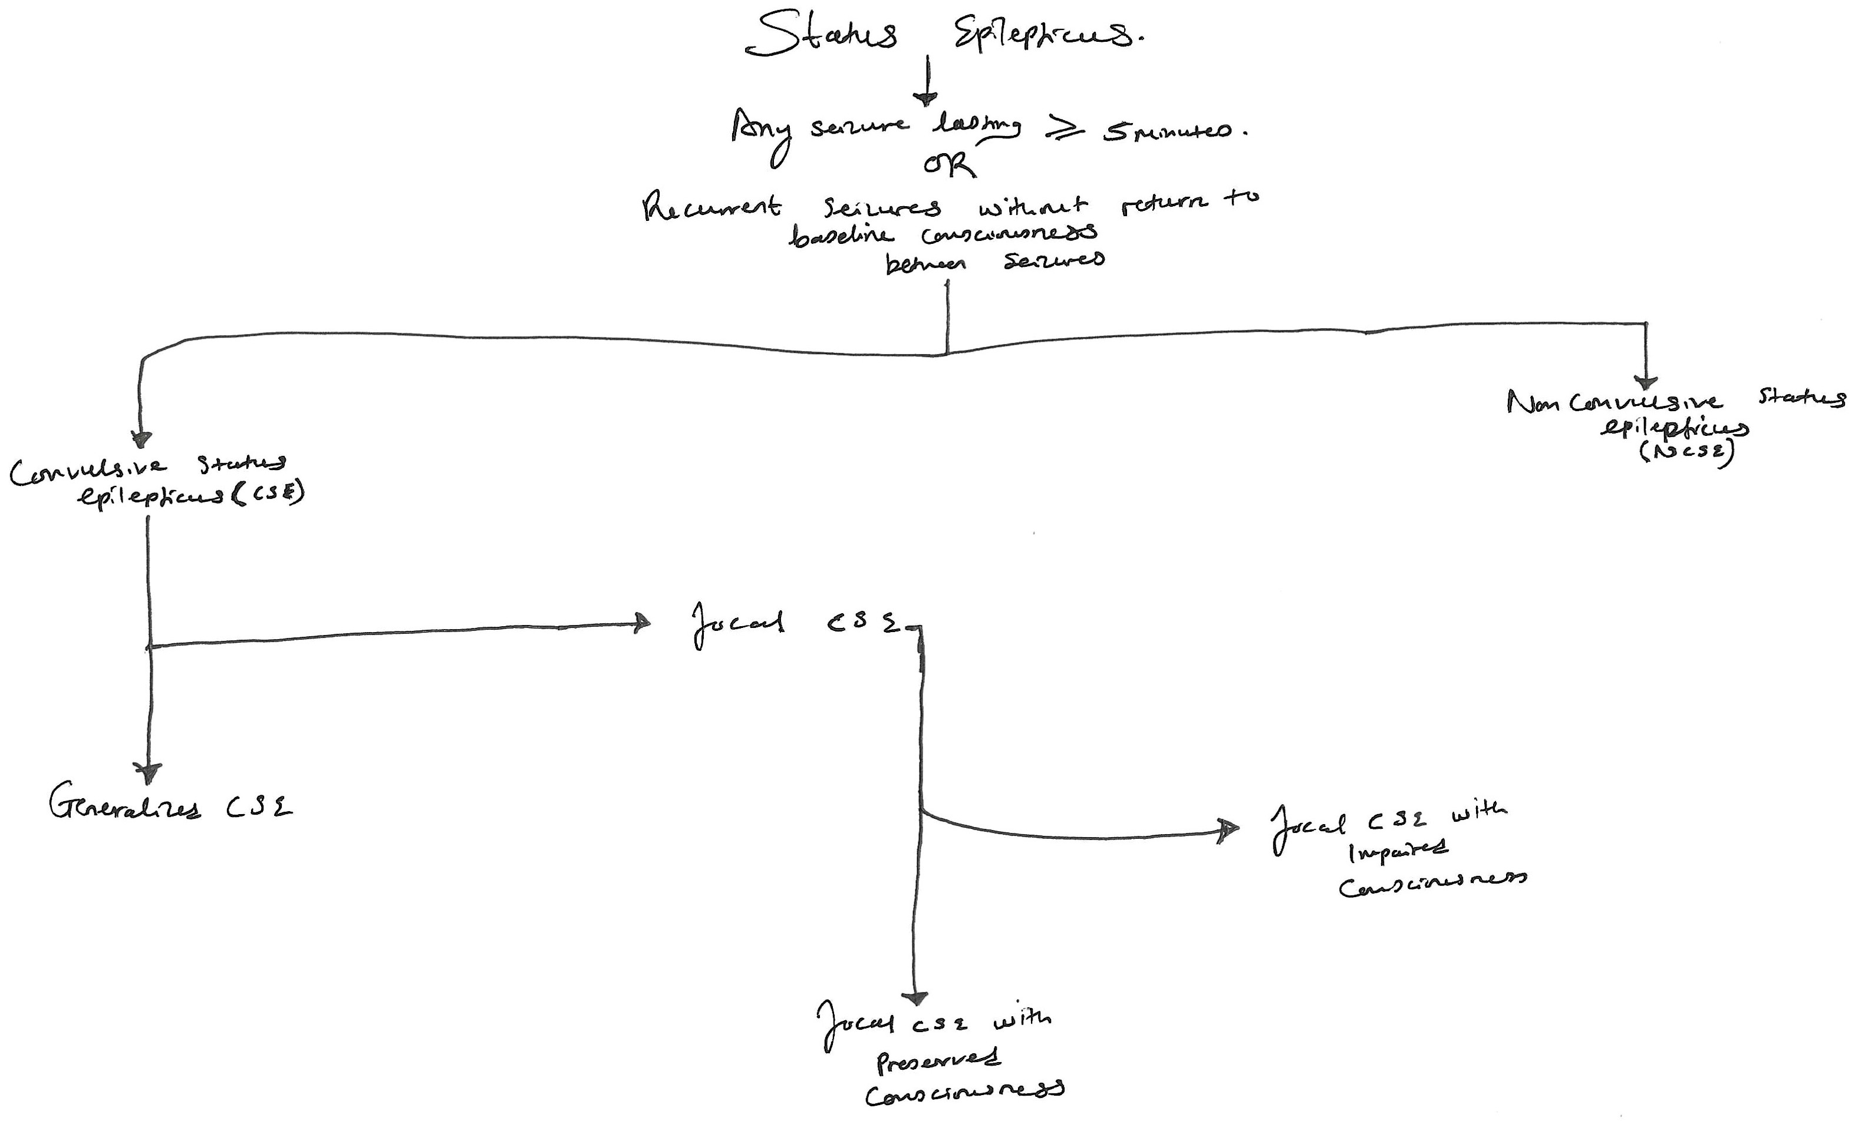

Slide 11
Basic Pathophysiology of Status Epilepticus
In summary
  Postulated that there is & imbalance between neuro-inhibitory and neuro-excitatory receptor activity.
    Increased receptor trafficking
    Increased receptor endocytosis and destruction
      Resulting in
    Upregulation of excitatory neurotransmitter receptors
    Downregulation of inhibitory neurotransmitter receptors
      Resulting in
    Neuro-excitotoxicity, apoptosis & necrosis which culminate in permanent neurologic injury.

Slide 12
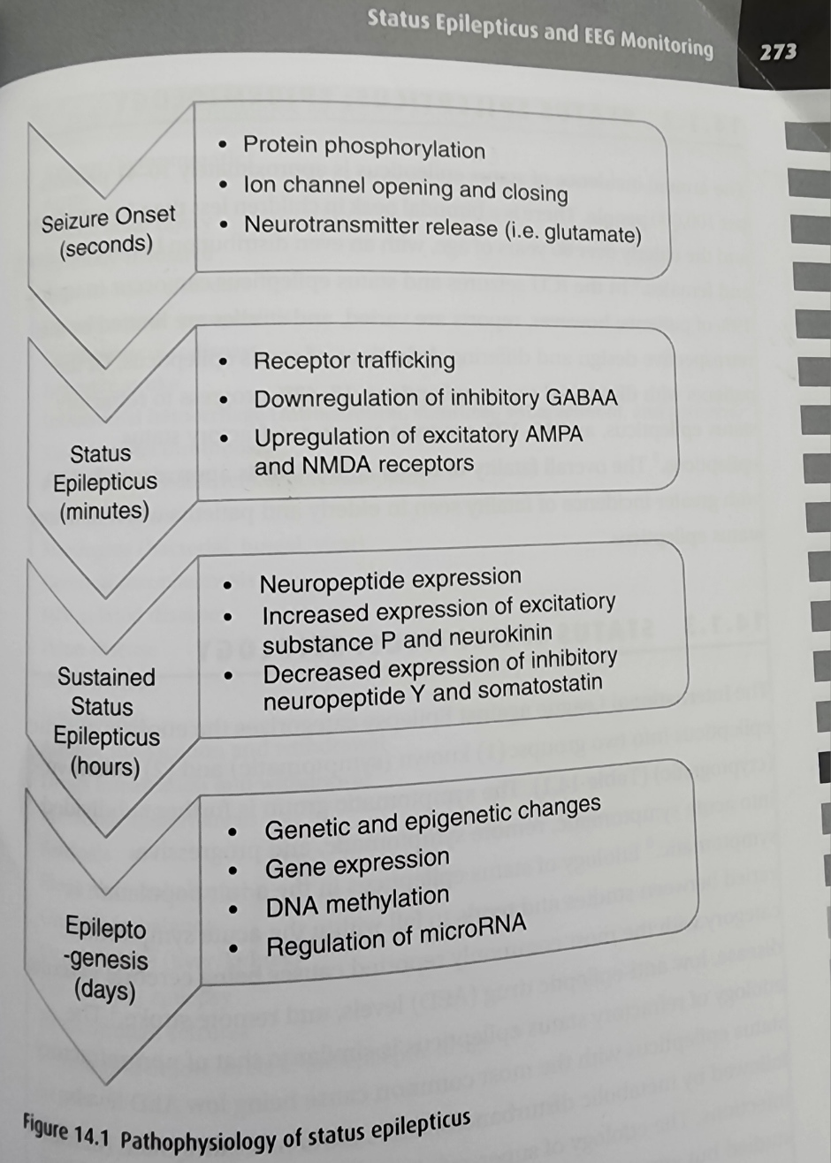

Slide 13
Some numbers
Epidemiology of status epilepticus
  Approx 10 – 41 per 100,000 annual incidence
  In the ICU – imprecise data (retrospective studies & varying definitions) but can affect up to 19% of patients in the ICU
  Bimodal peak incidence
    < 1yr of age
    > 60 yrs of age
  Fatality is up to 15%
    > in those > 60 yrs
    & those with refractory status epilepticus

Slide 14
What we’ve learnt so far
  What seizures are
  A general classification scheme of seizures
  Definition of status epilepticus, its classification & an overview of its pathophysiology

Slide 15
Let's jump into a case
This is a 25-year-old male with a PMH of Localization-related epilepsy on a number of ASMs at home who is in the ER for witnessed seizures. His brother heard a thud & found him on the floor stiff. EMS arrived & noticed a right gaze. EMS gave 5 mg of midazolam IM. The forced gaze resolved & he was no longer stiff. He arrived the ER, EM doc notes he is soiled in urine & has had at least 3 brief episodes of spontaneously resolving forced right gaze. The patient is easily awakens but he cannot maintain wakefulness & he does not follow commands. They give 5 mg of diazepam IV & decide to intubate him for airway protection using additional10 mg of diazepam IV & a paralytic. He was started on propofol and midazolam drips.
You are the intensivist on call & have been paged for admission to the ICU.
PS there are no neurointensivists & the hospital has only a MICU, so it’s your show to run ☺

Slide 16
So, what are some things you’re thinking about?
Are they stable?
Are they seizing?
Have their current seizures been adequately treated?
Are they in status?
Why are they seizing in the first place?
Will they seize again?

Slide 17
Anti-seizure medications in the seizing patient
2 broad categories
  First line agents
    Benzodiazepines
      Midazolam
      Lorazepam
      Diazepam
  Second line agents
    Antiepileptics
      Fosphenytoin
      Valproic acid
      Levetiracetam

Slide 18
First line agents
Purpose is to abort seizures
  Midazolam 0.2mg/kg IM (max 10mg)
  Lorazepam 0.1mg/kg IV (max 4mg)
  Diazepam 0.15mg/kg IV or 0.2mg/kg PR (max 10mg)
Can repeat dose Q 5 minutes x 2 (total 3 doses)

Slide 19
Second line agents
These ASM are to prevent going back into seizing
  Think of them as “Load & maintain”
  Fosphenytoin 20mg/kg load (max 2g); 100mg Q8h IV maintenance
  Valproic acid 40mg/kg load (max 3g); 500mg Q8h IV maintenance
  Levetiracetam 60mg/kg load (max 4.5g); 500mg Q12h IV maintenance

Slide 20
Back to our patient
Were they seizing?
  Lateralizing or focal signs – forced gaze, paresis, ongoing motor activity or dysesthesia, behavioral arrests
  Autonomic changes: concomitant rise in HR/RR/BP +/- lateralizing signs, loss of bowel/bladder control, yawning/nausea/rising gastric sensation
  History of seizures
  Labs: > CK, > wbc, > Lactic acid & > prolactin, home ASM levels (obtain before a loading dose)
  Electroencephalogram – to definitely identify seizures
Were seizures adequately treated?
  Depends on patient’s weight but likely received adequate 1st line agent dose based on diazepam IV
  Load & maintenance with a 2nd line agent should be in order
Are they in status epilepticus
  Yes – seizures of unclear duration however; recurrent clinical seizures without return to pre-seizure baseline.

Slide 21
What we have learnt
  What seizures are
  A general classification scheme of seizures
  Definition of status epilepticus, its classification & an overview of its pathophysiology
  Clinical features that may suggest a seizing patient
  First & second line agents for management of single seizures & status epilepticus.

Slide 22
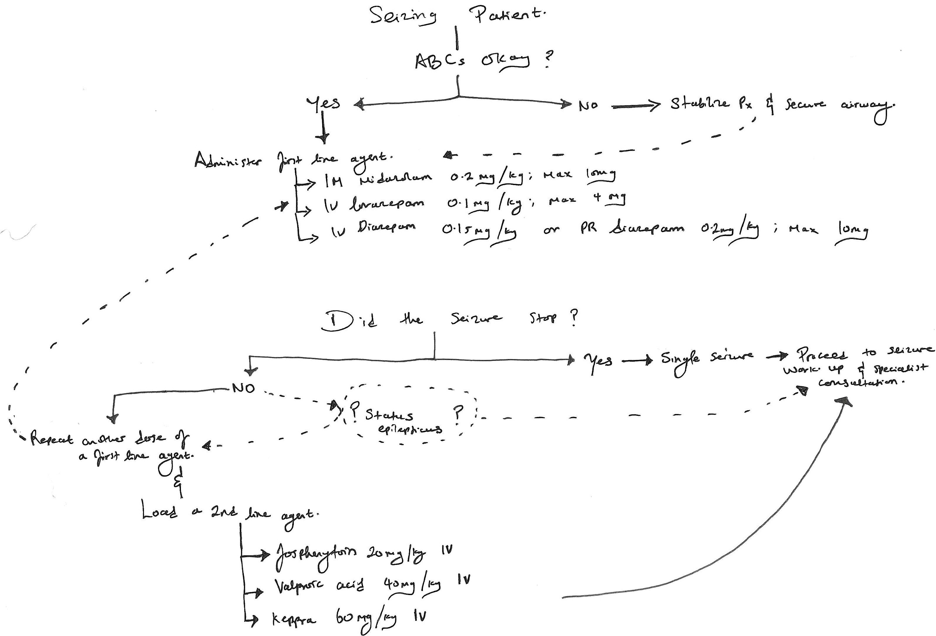

Slide 23
A Second Case
59 yr old patient with hx of CKD, HTN, T2DM & s/p renal transplant on tacrolimus presents to the emergency after she was found seizing by her daughter. Patient was still seizing upon arrival in ER with GTC per EM doc. Doc has now intubated the patient with etomidate and roc after giving her 4 of versed IV. Px is on a propofol and fentanyl drip & you have been called for admission to ICU. At the time of your evaluation, patient is HD stable on the drips and no longer seizing.

Slide 24
Why were they seizing – Thoughts?
Seizure work up
  Seizures in patients with a history of seizures
  Patients without a history of seizures
Reasons people seize
  Structural lesions & genetic preponderance (epilepsy syndromes)
  Infection (CNS & systemic)
  Autoimmune/Inflammatory (CNS & Systemic)
  Malignancy (Primary CNS & Mets)/paraneoplastic
  Metabolic derangements
  Medications (underdosing, malabsorption, drug-drug interaction & medication non adherence).
  NonRx drugs & toxicities

Slide 25
Seizure work up
Primary Structural lesions & genetic preponderance (epilepsy syndromes)
  EEG – electroencephalogram
  Non-con or contrasted CT brain
  Non-con or contrasted MRI brain
  Genetic testing – OutPx
Infection (CNS & systemic)
  Exam & vitals, CBC, Blood Cx, CSF studies (Cell count + diff, glucose, protein, gram stain & Cx)
Autoimmune/Inflammatory (CNS & Systemic)
  Exam & vitals, CBC, ANA screen with reflex, autoimmune encephalitis panel (serum & CSF)
Secondary structural lesions (TBI, hematomas) & Malignancy; (Primary CNS & Mets)/paraneoplastic
  Brain imaging, CSF & serum studies including paraneoplastic panel

Slide 26
Metabolic derangements
  CMP (Na, Ca, BUN, Glu,) Mg & NH3
Medications (underdosing, malabsorption, drug-drug interaction & medication non adherence).
  Home ASM level (pre-load); med review for any new meds (seizure threshold lowering meds), ADR of meds
Psychosocial
  Non-Rx drugs & toxicities
    EtOH level, UDS for: Benzos, opioids (Kratom) & stimulants; organophosphates
Other
  Pregnancy
  Sleep deprivation
  Increased social stress

Slide 27
At the very minimum
Exam & vitals
Electrophysiologic
  EEG
Imaging
  CT brain
  MRI brain w contrast
Serum Testing
  CBC, CMP & Mg, ASM levels, rec drug & pregnancy screen. Consider NH3 & blood culture if indicated
CSF testing (strongly consider if Hx/Exam suggest CNS infection)
  Cell count + diff, gram stain & Cx, protein & glucose. Save an extra tube for esoteric testing.
Urine
  Rec drug & pregnancy screen. (UA/UCx if indicated)

Slide 28
What we have learnt
  What seizures are
  A general classification scheme of seizures
  Definition of status epilepticus, its classification & an overview of its pathophysiology
  Clinical features that may suggest a seizing patient
  First & second line agents for management of single seizures & status epilepticus
  Basic seizure work up & why they are done
  Identified some reasons why patients seize

Slide 29
Going back to our patients
25 with localization related epilepsy on multiple AEDs
  BP 120/80, 37.2◦C, PE WNL, WBC 8, UDS neg, ASM levels; Therapeutic, studying for exams & looking for a job
  EEG: Epileptiform discharges in bilateral temporal lobes
  CTH: WNL
  MR Brain with con: concern for temporal mesial sclerosis R > L
59 with CKD, HTN, T2DM S/P renal transplant & on tacrolimus
  BP 186/120, 37.1◦C, no nuchal rigidity or hx of recent infxn, WBC 7. UDS neg
  EEG: generalized slowing with runs of periodic discharges over the bilateral occipital region
  CTH: Possible hypodensities noted within the bilateral white matter of the Occipitoparietal lobes Findings may suggest PRES in right setting but cannot exclude significant white matter disease
  MR Brain with con: PRES, no meningitis, no stroke/bleed, no masses
  Why do we think they seized?

Slide 30
Seizure differentials – Thoughts?
“As not everything that wheezes is asthma, not everything that shakes is a seizure”.
Movement d/o
  Tremors, dystonia, non-epileptic myoclonus
Somatoform d/o – Non-epileptic seizures
Convulsive syncope
Metabolic derangements
  Glucose (too high or too low), severe hypothyroidism/myxedema
Ischemic strokes
  Especially LVOs, rarely BG strokes with hyperkinetic movements
Medications
  Med induced movement d/o
    Dystonic reactions, hyperkinetic movements &

Slide 31
Beyond the hospital
Access to care
  PCP & neuro follow ups, ASM cost & adherence, substance use rehabilitation
Return to work & seizure precautions
  School bus/public transportation drivers, pilots, heavy machinery operators.
Social
  Swimming & outdoor sports
  Avoiding seizure precipitants e.g.:
    clubs/raves (flashing/strobe lights)
    Recreational drugs
  Pregnancy
    ASM & teratogenicity; ASM & breastfeeding
    Seizure risks & pregnancy
    Preeclampsia & eclampsia
State laws
  It is your responsibility to know the state law on reporting to DMV & or DPS.
  https://www.epilepsy.com/lifestyle/driving-and-transportation/laws/arizona

Slide 32
What we have learnt
  What seizures are
  A general classification scheme of seizures
  Definition of status epilepticus, its classification & an overview of its pathophysiology
  Clinical features that may suggest a seizing patient
  First & second line agents for management of single seizures & status epilepticus
  Basic seizure work up & why they are done
  Identified some reasons why patients seize
  Differential diagnoses of seizures
  Psychosocial issues post inpatient stay
  Importance of accurate documentation & need to know state laws regarding reporting LOC events to the DPS and or DMV

Slide 33
References
Swor DE, McConnell DP. Status Epilepticus and EEG Monitoring. In: Naidech AM, ed. Neurocritical Care. Cambridge Manuals in Neurology. Cambridge University Press; 2022:271-294.
Reznik ME, Claassen J. Seizures and status epilepticus. In: Shutter LA, Molyneaux BJ, eds. Neurocritical Care. Oxford University Press; 2018:68-82.
Beniczky S, Trinka E, Wirrell E, Abdulla F, Al Baradie R, Alonso Vanegas M, et al. Updated classification of epileptic seizures: Position paper of the International League Against Epilepsy. Epilepsia. 2025;66(6):1804-1823. doi:10.1111/epi.18338
Swor DE, Waybright RA; Neurocritical Care Society. Emergency Neurological Life Support: Status Epilepticus Protocol, Version 6.0. Chicago, IL: Neurocritical Care Society; July 2024. Accessed November 23, 2025. https://www.neurocriticalcare.org/Portals/0/ENLS%205.0/ENLS%206.0/Protocol%20V6_0%20Status%20Epilepticus.pdf
Merriam-Webster. Seizure. Merriam-Webster.com Dictionary. Published 2025. Accessed November 18, 2025. https://www.merriam-webster.com/dictionary/seizureEpilepsy
Foundation. What is a seizure? Epilepsy Foundation. Accessed November 18, 2025. https://epilepsyfoundation.org.au/understanding-epilepsy/seizures/what-is-a-seizure/

Slide 34


“A person has got to be careful, to never really arrive at a place where they think they’re at somewhere. You always have to realize that you’re constantly in a state of becoming.”
- Bob Dylan
“Above all, you keep your clarity; you keep your focus. You keep your sense of love and you keep your sense of purpose.”
- Lauryn Hill
Questions or Comments?
Notes:
- White winged dove tucked within a tree in my backyard when I lived in Tucson.

