Slide 1
URINALYSIS
ACADEMIC HALF DAY
October 7, 2025
Katharine Dahl, MD
kdahl1@arizona.edu

Slide 2
OBJECTIVES
1. Describe the appropriate urine specimen collection and storage in ambulatory patients and hospitalized patients with Foley catheters in order to accurately interpret the urinalysis.
2. List the possible causes of urine that is cloudy, orange, brown, or red.
3. Predict how the urinalysis will appear in disorders of volume/tonicity, glomerular diseases, tubulointerstitial disorders, and acid base disorders.
4. Describe the conditions associated with the following urine casts: Hyaline, Erythrocyte, Leukocyte, Epithelial, Granular, Fatty.

Slide 3
Specimen Collection
Avoid exercise 72 hours prior – trauma increases proteinuria and hematuria
Avoid contamination
  Males – retract foreskin
  Females – separate labia and cleanse periurethral area with sterile wipe
  Midstream “clean catch” collection or bladder catheterization

Slide 4
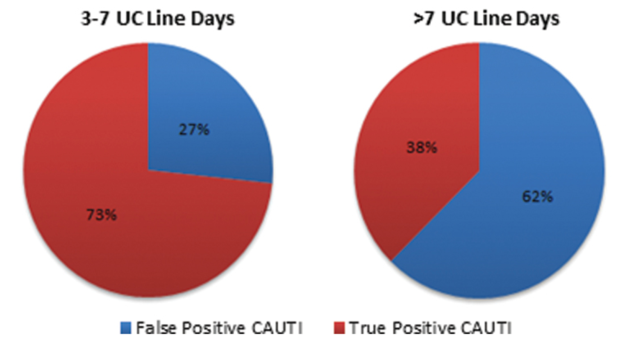
False Positives from Foley Catheters
Percentage of false positive catheter associated UTI’s increases with amount of time catheter is in.
FP defined by negative UA result and absence of bacteria performed on the same day or day prior to the culture that resulted in a reported CAUTI
Pender S, et al. Open Forum Infect Dis. 2018 Nov; 5(Suppl 1): S620.

Slide 5
Specimen Processing
Prompt processing – should be examined within 1 hour of voiding to minimize breakdown of formed elements
Macroscopic exam – color and clarity
Chemical exam - dipstick
Microscopic exam
  Centrifuge at 3000rpm for 3-5 minutes
  Pour off supernatant
  Place sediment on slide for microscopic exam

Slide 6
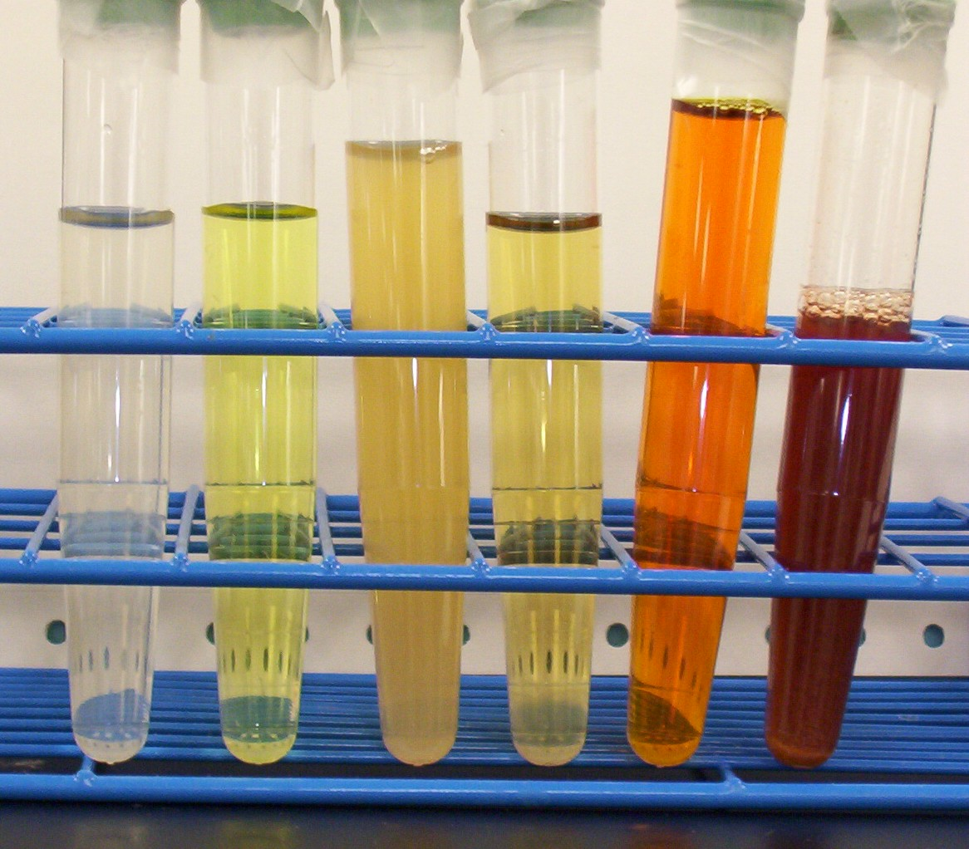
Macroscopic Exam
Color
  Lighter: dilute
  Darker: concentrated
  White: pyuria or phosphate crystals
  Green: methylene blue, amitriptyline
  Black: Malignancy, alkaptonuria
  Red: hemoglobin, myoglobin

Slide 7
Macroscopic Exam
Clarity
Normally clear
Cloudy
  amorphous phosphates: white precipitate in alkaline urine
  amorphous urates: pink precipitate dissolves when heated
  leukocytes, bacteria, cellular debris
Foamy
  proteinuria

Slide 8
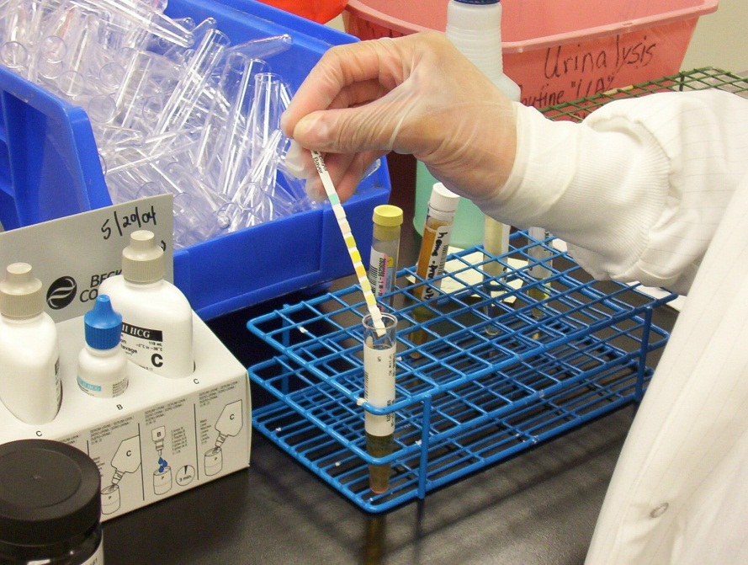
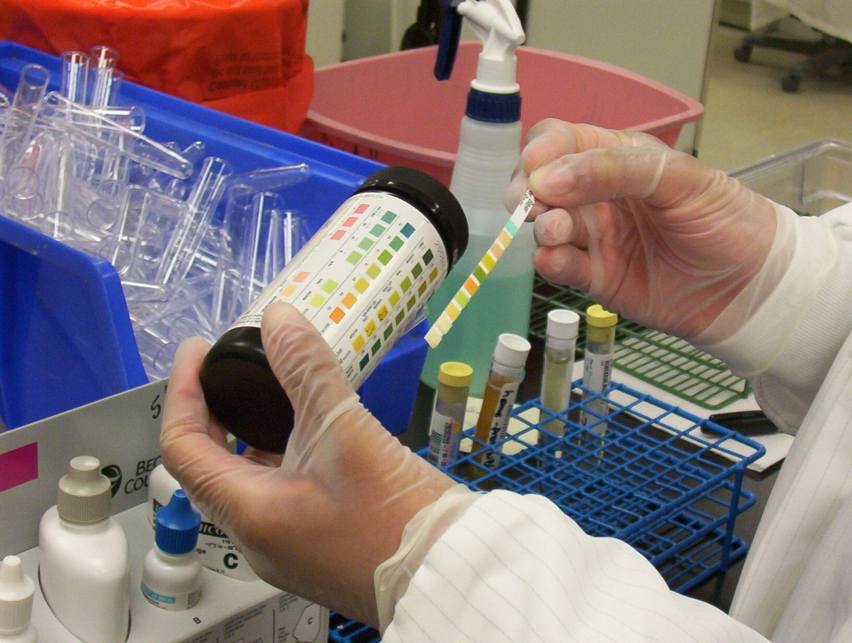
Chemical Exam
When the test strip is dipped in urine the reagents are activated and a chemical reaction occurs.
The chemical reaction results in a specific color change.
After a specific amount of time has elapsed, this color change is compared against a reference color chart provided by the manufacturer of the strips.

Slide 9
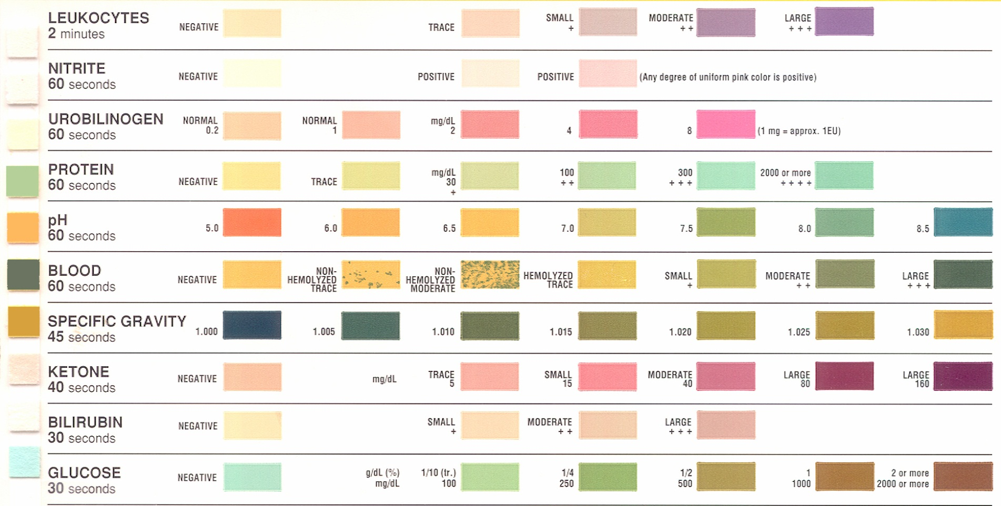
Chemical Reaction Chart

Slide 10
Urine Dipstick
 | Reference Range | Comments
Specific gravity | 1.005-1.030 | Low with dilute, high with concentrated or with hypertonic product excretion
pH | 5.0-6.5 | High with inability to excrete acid load (renal tubular acidosis), urease-splitting organisms
Blood | None | False positives: myoglobin, hemolysis
Protein | None | Dipstick detects albumin, not other proteins False positives: concentrated urine False negative: non-albumin protein
Glucose | None | Positive when plasma glucose >180mg/dL, pregnancy, Fanconi syndrome, SGLT-2 inhibitor
Ketones | None | Detects acetoacetic acid Doesn’t detect acetone or beta-hydroxybutyrate
Nitrites | None | Nitrites converted dietary nitrate by bacteria
Leukocyte esterase | None | Positive if > 3 leukocytes/hpf

Slide 11
Urine Microscopy
 | Reference Range | Comments
Erythrocytes | 0-3/hpf | Need to evaluate erythrocyte morphology
Leukocytes | 0-3/hpf
Casts | None or hyaline | Hyaline – suggest poor renal perfusion Non-hyaline casts – suggest intrinsic injury
Crystals | None | Occur when urine is supersaturated with a specific substance

Slide 12
CASE 1
You are asked to see a 25 year old man with head trauma after a motor vehicle accident for evaluation of hypernatremia. He is making 5L of urine per day. Serum sodium 159. You suspect he has central diabetes insipidus. What do you expect his urine specific gravity to be?
1.005
1.010
1.015
1.020

Slide 13
CASE 1
You are asked to see a 25 year old man with head trauma after a motor vehicle accident for evaluation of hypernatremia. He is making 5L of urine per day. Serum sodium 159. You suspect he has central diabetes insipidus. What do you expect his urine specific gravity to be?
1.005
1.010
1.015
1.020
In diabetes insipidus, the hypothalamus does not produce ADH, so there is no insertion of aquaporin channels into the apical membrane of the principle cells in the collecting duct. Water is not reabsorbed and the urine osmolality and specific gravity remain low.

Slide 14
Specific Gravity
Ratio of the weight of urine to an equal quantity of water
Normal 1.010
Can use to estimate urine osmolality
  1.010 approximately correlates with osmolality of 300mOsm/kg H2O

Slide 15
Osmolality
In order to maintain plasma osmolality (# of particles/unit mass) near 285 mOsm/kg the kidney varies urine osmolality from 50 to 1200 mOsm/kg
Children can achieve an osmolality >1000 but adults rarely can; studies have shown an age-related decline
Urine osmolality is useful when correlating it with the clinical state of the patient
High glucose concentration increases osmolality
Certain toxins can increase the osmolality of urine

Slide 16
CASE 2
A 54 year old woman with Sjögren Syndrome comes to the office for evaluation of nephrolithiasis. Her potassium is 3.2, bicarbonate 12. What is a possible diagnosis? What do you think her urine pH will be?
4.5
6.0
7.5

Slide 17
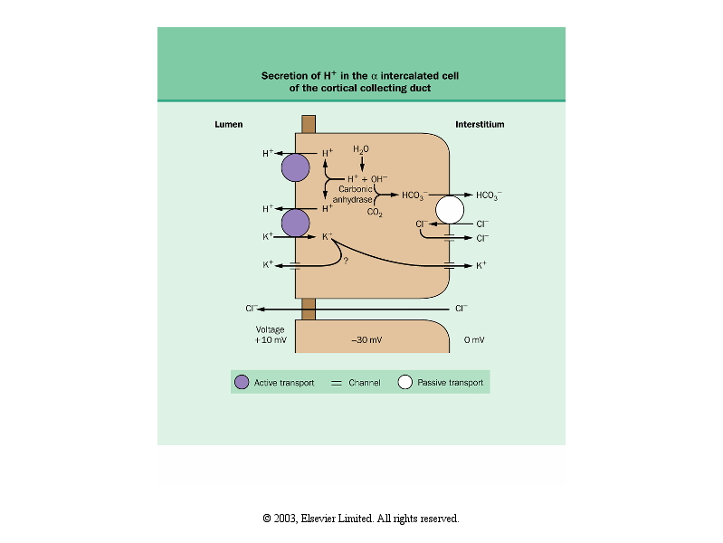
CASE 2
In a Type 1 Distal Renal Tubular Acidosis, there is a failure of the α-intercalated cell to secrete H+ ions and reclaim K+ ions.
A 54 year old woman with Sjogren Syndrome comes to the office for evaluation of nephrolithiasis. Her potassium is 3.2, bicarbonate 12. You diagnose her with a distal type 1 renal tubular acidosis. What do you think her urine pH will be?
4.5
6.0
7.5

Slide 18
pH
Acidic pH (5.0-6.0)
  Diet with animal meat generates high acid load
  Volume depletion
Alkaline pH (>7.0)
  Strict vegetarians can have alkaline urine
  Type 1 (distal) Renal Tubular Acidosis
  Infections caused by urease-splitting organisms (Proteus and Pseudomonas species)
  Acute Tubular Necrosis

Slide 19
CASE 3
A 70 year old male with a diagnosis of Multiple Myeloma comes to see to you for evaluation of proteinuria. His serum glucose is normal and his urine glucose is elevated. He has proteinuria. His serum bicarbonate is 14 , potassium is 3.2 , uric acid is 2.5 , and phosphorus is 1.8 . Dysfunction of which part of the nephron causes these lab results?
Glomerulus
Proximal tubule
Loop of Henle
Distal tubule
Collecting tubule

Slide 20
CASE 3
A 70 year old male with a diagnosis of Multiple Myeloma comes to see to you for evaluation of proteinuria. His serum glucose is normal and his urine glucose is elevated. He has proteinuria. His serum bicarbonate is 14 , potassium is 3.2 , uric acid is 2.5 , and phosphorus is 1.8 . Dysfunction of which part of the nephron causes these lab results?
Glomerulus
Proximal tubule
Loop of Henle
Distal tubule
Collecting tubule
Multiple Myeloma causes proximal tubular dysfunction. This patient has Fanconi Syndrome which is caused by proximal tubular dysfunction. Bicarbonate, glucose, phosphorus, potassium, and amino acids are all absorbed in the proximal tubule, so this patient is not reabsorbing these and they remain in his urine. He has a Type 2 Proximal Renal Tubular Acidosis

Slide 21
Protein
Dipstick only detects albumin:
  Trace (5-30mg/dL)
  1+ (30mg/dL)
  2+ (100mg/dL)
  3+ (300mg/dL)
  4+ (>1000mg/dL)
False positives
  Alkaline urine
False negatives
  Light chains
  Immunoglobulins
  Sulfosalicylic acid (SSA) test can be used to detect presence of albumin + other proteins

Slide 22
Proteinuria
Types of Proteinuria:
  Glomerular proteinuria: predominantly albumin
  Tubular proteinuria: Interference with proximal tubular reabsorption, principally due to tubulointerstitial diseases
  Overflow proteinuria: Increased excretion of low molecular weight proteins can occur with marked overproduction of a particular protein (almost always immunoglobulin light chains in multiple myeloma) – proximal tubule can’t absorb it all
  Post-renal proteinuria: Inflammation in the urinary tract, which can occur with urinary tract infection, can give rise to increases in urinary protein excretion. The excreted proteins are generally non-albumin (often IgA or IgG), and only small amounts are excreted

Slide 23
Proteinuria
Urinary protein excretion normally should be less than 150 mg per day (albumin + low molecular weight proteins)
Normal rate of albumin excretion <20 mg per day
Persistent albumin excretion between 30 and 300 mg per day is called high albuminuria (or microalbuminuria)

Slide 24
Proteinuria - quantification
24-hour urine test for protein or albumin excretion
  The amount of protein secreted varies by circadian rhythm
  Problems: it is time consuming, subject to error due to overcollection or undercollection, impractical for many patients
Protein-creatinine or albumin:creatinine ratio on a random urine sample
  Correlates well with the 24-hour urine collection
  Is easy to obtain
  Limitations: if creatinine in urine is not what it is expected to be (assumes 1g/day of creatinine excreted)

Slide 25
Glucose
When blood glucose is >180mg/dL, absorptive capacity of the proximal tubule is exceded
Fanconi Syndrome – proximal tubular dysfunction
  Glucosuria in the absence of hyperglycemia
  Also with loss of phosphate, uric acid, amino acids and bicarbonate
SGLT-2 Inhibitors
Pregnancy

Slide 26
Ketones
Dipstick detects acetoacetate but not beta-hydroxybutyrate
Positive with:
  Starvation
  Alcoholic ketoacidosis (but sometimes negative when only ketone is beta-hydroxybutyrate)
  Diabetic ketoacidosis (dipstick underestimates total ketone excretion, because the main ketone is beta-hydroxybutyrate)
  Salicylate toxicity
  Isopropyl alcohol poisoning
False positive
  Drugs with sulfydryl groups: captopril

Slide 27
CASE 4
A 25-year-old female presents to the hospital with confusion and bruising on her arms and legs. Two days prior she had a diarrheal illness. Labs reveal hemoglobin of 7.5 , platelets 16 . Peripheral smear shows schistocytes. Creatine kinase is normal. Creatinine is 3.7. Urinalysis shows no protein, 3+ blood, + urobilinogen, and microscopy shows no erythrocytes. What is her diagnosis?
Rhabdomyolysis with myoglobinuria
Thrombotic thrombocytopenic purpura with hemoglobinuria
Membranoproliferative glomerulonephritis
Obstructive jaundice

Slide 28
CASE 4
A 25-year-old female presents to the hospital with confusion and bruising on her arms and legs. Two days prior she had a diarrheal illness. Labs reveal hemoglobin of 7.5 , platelets 16 . Peripheral smear shows schistocytes. Creatine kinase is normal. Creatinine is 3.7 . Urinalysis shows no protein, 3+ blood, + urobilinogen, and microscopy shows no erythrocytes. What is her diagnosis?
Rhabdomyolysis with myoglobinuria (No – CK is normal)
Thrombotic thrombocytopenic purpura with hemoglobinuria
Membranoproliferative glomerulonephritis (No – should have dysmorphic RBCs on micro)
Obstructive jaundice (No – should not have urobilinogen in the urine)
This patient has a hemolytic anemia and TTP likely caused by an E.Coli infection. The anemia with presence of schistocytes on peripheral smear suggests hemolysis. The hemolysis increases unconjugated bilirubin which is insoluble so cannot be excreted by the kidneys, hence no bilirubin in the urine. It is conjugated in the liver and secreted in the gut where it is converted to urobilinogen, reabsorbed in the blood and excreted in the kidney. The presence of blood on urinalysis with no RBCs on microscopy indicates that there is hemoglobin in the urine without cells. Heme pigment is toxic to the tubular cells and causes Acute Tubular Necrosis.

Slide 29
Hematuria
Presence of blood or intact cells in the urine
A very alkaline urine or a urine with very low specific gravity can cause RBC to lyse
RBC can enter the urine anywhere from the glomerulus to the urethra
Reagent strips can detect 1-2 RBC/hpf
Greater than 2 RBC/hpf considered abnormal

Slide 30
Hemoglobinuria
Hemoglobinuria –presence of free hemoglobin in the urine due to intravascular hemolysis
  May lead to kidney damage – Acute Tubular Necrosis from heme pigment

Slide 31
Blood
Dipstick measures peroxidase activity
  Free hemoglobin – hemolysis
  Intact erythrocytes
1-3 erythrocytes/hpf needed for positive result
False positives
  Myoglobin
  Bacteria that express pseudoperoxidase activity: Enterobacter, Staphyloccoci, Strebtococci species
  Hypochlorite
  Rifampin
  Chloroquin
  Iodine
  Alkaline urine
  Low specific gravity
  Semen
  Oxidizing agents to clean the perineum
False negatives
  Ascorbic acid
Blood on urine dipstick with no RBCs on microscopy raises suspicion for:
  Rhabdomyolysis (myoglobin) positive for blood with no erythrocytes
  Hemolysis

Slide 32
CASE 6
A 30-year-old man presents to the hospital with severe total body aches after a day of playing basketball outside in Phoenix. His creatinine is 5.6 , potassium is 5.9 . Hemoglobin is normal. Creatine kinase is 12,000 . Urinalysis shows 3+ blood and no erythrocytes. What is the most likely diagnosis?
Rhabdomyolysis with myoglobinuria
Consumption of too many beets
Acute renal colic from nephrolithiasis
Renal cell carcinoma
Lupus nephritis

Slide 33
CASE 6
A 30 year old man presents to the hospital with severe total body aches after a day of playing basketball outside in Phoenix. His creatinine is 5.6 , potassium is 5.9 . Hemoglobin is normal. Creatine kinase is 12,000 . Urinalysis shows 3+ blood and no erythrocytes. What is the most likely diagnosis?
Rhabdomyolysis with myoglobinuria
Consumption of too many beets (No – urinalysis and micro would both be negative for blood)
Acute renal colic from nephrolithiasis (No – Micro would have intact RBCs)
Renal cell carcinoma (No – Micro would have intact RBCs)
Lupus nephritis (No – Micro would have dysmorphic RBCs or RBC casts)
This patient has rhabdomyolysis caused by breakdown of muscle. Myoglobin gets filtered by the kidneys and causes toxicity to the renal tubules – Acute Tubular Necrosis. The high CK is diagnostic of rhabdomyolysis. The potassium is high because of the ARF and also there is cellular lysis from muscle injury, and the intracellular potassium is coming out of the cells. The presence of blood on urinalysis is because the reagent for heme crossreacts with myoglobin. Whenever you see blood on urinalysis with no RBCs on micro, think rhabdomyolysis or hemolytic anemia.

Slide 34
Myoglobinuria
Myoglobinuria-small molecular weight heme protein of striated muscle found in urine
Reacts to same reagent for hemoglobin
Toxic to renal tubules, may cause acute renal failure
Cleared from plasma in the first pass, therefore serum is clear of myoglobin

Slide 35
Leukocyte Esterase and Nitrites
Leukocyte Esterase
  Enzyme present on leukocytes
  Positive when 3 leukocytes/hpf present
  False positive - high glucose or protein concentrations, in the presence of tetracycline, tobramycin, or some cephalosporins
Nitrites
  Result from the conversion of nitrates to nitrites by gram-negative bacteria
    Detects UTI’s caused by gram-negative organisms, including: Escherichia coli, Klebsiella pneumoniae, Proteus
    Does not detect UTI’s caused by gram-positive organisms such as Enterococcus that do not produce nitrite
Presence of BOTH leukocyte esterase and nitrites on urine dipstick highly suggestive of UTI
Absence of BOTH has high negative predictive value for UTI

Slide 36
Bilirubin
Bilirubin is formed from the breakdown of hemoglobin in the spleen; bound to albumin transported to liver via blood (unconjugated, insoluble can’t be filtered by kidney)
Bilirubin then is conjugated in liver and excreted via bile duct in duodenum
Very small amount of conjugated bilirubin may be reabsorbed and filtered by the kidney whenever plasma levels are high.

Slide 37
Bilirubin
Conjugated bilirubin not usually present in the urine. Thus, its presence suggests:
  Severe liver disease
  Obstructive jaundice
False positive: chlorpromazine
False negative: ascorbic acid

Slide 38
Urobilinogen
Produced in the gut from metabolism of bilirubin into urobilinogen
Most is excreted in the gut, but a small amount is reabsorbed into the blood and excreted in the urine
Positive in the urine and gut: hemolytic anemia
Negative in the urine and gut: biliary obstruction (because bilirubin does not reach the bowel to be metabolized into urobilinogen)

Slide 39
Urine Bilirubin and Urobilinogen
Condition | Urine Urobilinogen | Urine Bilirubin | Fecal Urobilinogen
normal | Normal 1-4 mg/ 24 hour | - | +
hepatitis | - Normal + | + | +/-
obstruction | - | + | -
hemolysis | ++ | - | ++

Slide 40
Urine bilirubin in liver failure
If the liver is failing, why would there be conjugated bilirubin at all? Why wouldn’t there be a lot of unconjugated bilirubin in the blood that can’t be excreted by the kidneys?
It turns out that the hepatocytes need to both conjugate and excrete bilirubin. Conjugation happens slowly but is easy for the liver to do because the unconjugated bilirubin enters the hepatocyte via passive transport. Excretion requires active transport. When the cells get damaged, they are unable to excrete the conjugated bilirubin. The concentration builds up and the conjugated bilirubin leaks back across the basolateral membrane of the hepatocyte.
Thus, urine bilirubin is a sensitive way to detect milder liver damage, because the levels or urine bilirubin will be high while serum bilirubin levels are still normal.

Slide 41
What will the urine bilirubin and urobilinogen and fecal urobilinogen look like in each of these patients?
Has a gallstone obstructing the common bile duct
Has liver cirrhosis
Has hemolytic anemia after a diarrheal illness
BILIRUBIN |  | UROBILINOGEN
 | URINE | URINE | STOOL
A | - | + | +
B | + | - | -
C | + | +/- | +/-

Slide 42
Review: what will the urine bilirubin and urobilinogen and fecal urobilinogen look like in each of these patients?
Has a gallstone obstructing the common bile duct
Has liver cirrhosis
Has hemolytic anemia after a diarrheal illness
BILIRUBIN |  | UROBILINOGEN
 | URINE | URINE | STOOL
A | - | + | +
B | + | - | -
C | + | +/- | +/-
Because no bilirubin gets into the duodenum due to the blockage, no urobilinogen is formed. The conjugated bilirubin backs up into the blood. Conjugated bilirubin is soluble and can be filtered by the kidney, so some of it comes out in the urine.

Slide 43
What will the urine bilirubin and urobilinogen and fecal urobilinogen look like in each of these patients?
Has a gallstone obstructing the common bile duct
Has liver cirrhosis
Has hemolytic anemia after a diarrheal illness
BILIRUBIN |  | UROBILINOGEN
 | URINE | URINE | STOOL
A | - | + | +
B | + | - | -
C | + | +/- | +/-

Slide 44
Review: what will the urine bilirubin and urobilinogen and fecal urobilinogen look like in each of these patients?
Has a gallstone obstructing the common bile duct
Has liver cirrhosis
Has hemolytic anemia after a diarrheal illness
BILIRUBIN |  | UROBILINOGEN
 | URINE | URINE | STOOL
A | - | + | +
B | + | - | -
C | + | +/- | +/-
Injury to the liver parenchyma leads to buildup of conjugated bilirubin. Some of it is excreted in the urine. Some of it goes into the duodenum via the common bile duct, is converted to urobilinogen and a small amount reabsorbed and excreted in the kidney.

Slide 45
What will the urine bilirubin and urobilinogen and fecal urobilinogen look like in each of these patients?
Has a gallstone obstructing the common bile duct
Has liver cirrhosis
Has hemolytic anemia after a diarrheal illness
BILIRUBIN |  | UROBILINOGEN
 | URINE | URINE | STOOL
A | - | + | +
B | + | - | -
C | + | +/- | +/-

Slide 46
Review: what will the urine bilirubin and urobilinogen and fecal urobilinogen look like in each of these patients?
Has a gallstone obstructing the common bile duct
Has liver cirrhosis
Has hemolytic anemia after a diarrheal illness
BILIRUBIN |  | UROBILINOGEN
 | URINE | URINE | STOOL
A | - | + | +
B | + | - | -
C | + | +/- | +/-
The bilirubin formed from hemolysis is unconjugated. Unconjugated bilirubin is insoluble and can’t be filtered by kidney. Therefore, no bilirubin gets into the urine from this patient. This bilirubin then is conjugated in liver and excreted via bile duct in to the duodendum. The bilirubin is metabolized into urobilinogen and a small amount is reabsorbed into the blood and excreted in the urine.

Slide 47
Urine Microscopy

Slide 48
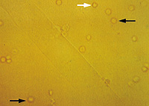
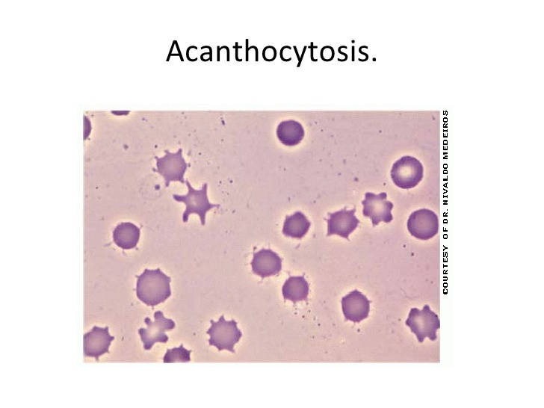
Erythrocytes
Causes:
  Glomerular injury
  Genitourinary tract bleeding
Isomorphic– urologic process
  Stone
  Tumor
  Infection
Dysmorphic – glomerular process
  Acanthocytes – have vesicle-shaped protrusions – highly specific for glomerulonephritis

Slide 49
Leukocytes
Pyuria: >4 leukocytes/hpf
Sterile pyuria: leukocytes in the urine with negative urine bacterial culture
  Acute Interstitial Nephritis
    Often with low-grade proteinuria
    Causes
      Drugs: antibiotics, NSAIDs, proton pump inhibitors
      Kidney transplant rejection (lymphocytes)
      Kidney stones
  Mycobacterium tuberculosis (infectious cause of sterile pyuria)

Slide 50
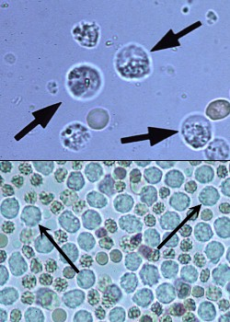
Leukocytes

Slide 51
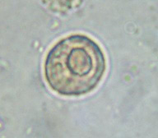
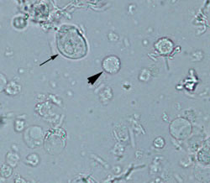
Epithelial Cells
Renal tubular epithelial cells
  Large central nuclei
  1.5-3 x larger than leukocytes
  Seen along with pigmented casts in Acute Tubular Necrosis
Transitional epithelial cells
  Larger than tubular epithelial cells
  Originate anywhere from renal pelvis to proximal urethra
Squamous epithelial cells
  Large and irregular with small central nuclei
  Originate from distal urethra or external genitalia
  Suggests urine contamination

Slide 52
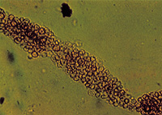
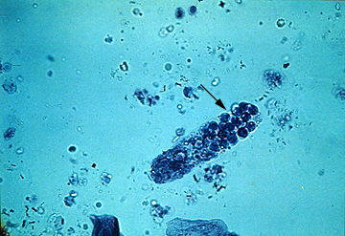
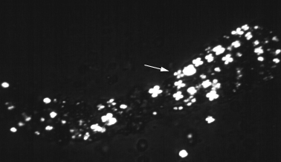
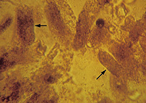
CASE 5
An 18-year-old man comes to your office for evaluation of periorbital edema and leg swelling. Creatinine is 0.8. Urinalysis has 4+ protein and no blood. The urine is foamy. On microscopy, which casts are you most likely to see?
A
C
D
B

Slide 53
CASE 5
A 18-year-old man comes to your office for evaluation of periorbital edema and leg swelling. Creatinine is 0.8. Urinalysis has 4+ protein and no blood. The urine is foamy. On microscopy, which casts are you most likely to see?
This patient has nephrotic syndrome with high grade proteinuria from Minimal Change Disease. Nephrotic syndrome causes hyperlipidemia and lipiduria. Fatty casts formed by the breakdown of lipid-rich epithelial cells are seen with nephrotic syndrome. Fatty casts have a Maltese Cross appearance under polarized light.

Slide 54
Casts
Casts containTamm-Horsfall mucoprotein, cells or cellular debris, or liprotein droplets
Cylindrical because formed in the tubular lumen
Types:
  Hyaline casts – do not indicate disease (seen with diuretic therapy of concentrated urine)
  Pigmented granular casts (muddy brown casts) – Acute Tubular Necrosis
  Erythrocyte casts – Glomerulonephritis
    Specific but not sensitive for GN
  Leukocyte casts – Tubulointerstitial inflammation
    Pyelonephritis
  Fatty casts – Nephrotic range proteinuria
    Maltese Cross appearance of cholesterol

Slide 55
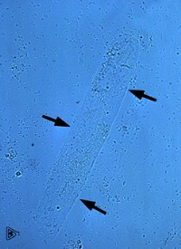
Hyaline casts
Not indicative of disease
Seen with diuretic therapy or with small volumes of concentrated urine

Slide 56
Red Blood Cell Casts
Diagnostic of glomerulonephritis or vasculitis

Slide 57
White Blood Cell Casts
Seen with tubulointerstitial disease or acute pyelonephritis

Slide 58
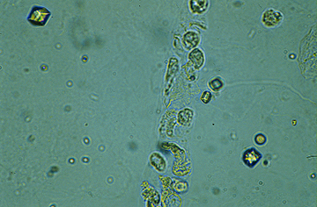
Epithelial Cell Casts
Seen with acute tubular necrosis and acute glomerulonephritis

Slide 59
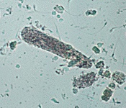
Granular casts
Represents degenerating cellular casts

Slide 60
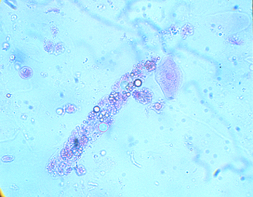
Fatty Casts: seen with nephrotic syndrome
Nephrotic syndrome causes hyperlipidemia and lipiduria
Fatty casts are formed by the breakdown of lipid-rich epithelial cells
Fatty casts have a Maltese Cross appearance under polarized light.

Slide 61
Eosinophils
Wright or Hansel stains
Causes:
  UTI
  Allergy
  Atheroembolic disease
  Small vessel vasculitis
  Rapidly progressive glomerulonephritis
  Parasitic infections – urinary schistosomiasis
Poor sensitivity and specificity limit its utility

Slide 62
Crystals
Type | Morphology | Comment
Calcium Oxalate | Envelope Dumbell | Not pH dependent Ethylene glycol ingestion
Uric Acid | Amorphous Rosettes Needles | Acid urine, pH <5.8 Polarize light
Calcium Phosphate | Amorphous | Alkaline urine Resemble amorphous uric acid
Triple phosphate (Magnesium ammonium phosphate) | Coffin lid | Alkaline urine Struvite stones
Cystine | Hexagonal plates | Acidic urine Cystinuria
Indinavir | Needle

Slide 63
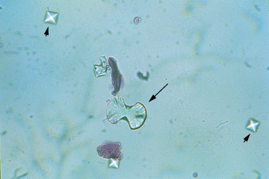
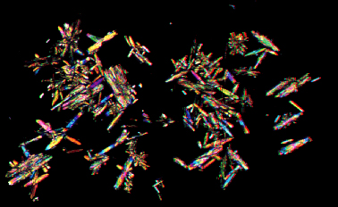
Calcium Oxalate Crystals
More likely to be formed in acidic urine (pH 4.5-5.5)
Seen with ethylene glycol ingestion
Monohydrate-dumbell
Dihydrate-letter envelope
Polarized monohydrate

Slide 64
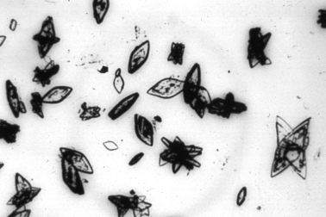
Uric Acid Crystals
Are seen in an acidic urine pH 5.4-5.8
Polarize light

Slide 65
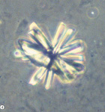
Calcium Phosphate Crystals
Form in alkaline urine
Polarize light

Slide 66

Calcium Phosphate Crystals-Amorphous
Only form in a relatively alkaline urine (6.2-7.0)
Do not polarize light
Resemble amorphous uric acids but don’t polarize light

Slide 67
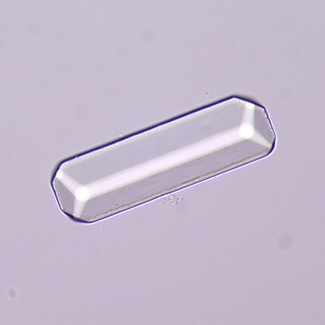
Triple Phosphate
Magnesium ammonium phosphate
Crystals of triple phosphate
  colorless, “coffin-lid” prism
  Only form in alkaline urine (pH >7.0)
  Component of struvite stones

Slide 68
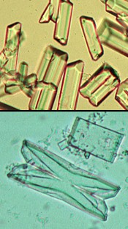
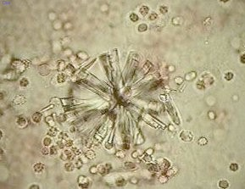
Struvite
Magnesium ammonium phosphate crystals — (struvite)
Normal urine
  undersaturated with ammonium phosphate
Stone formation – 2 requirements
  1. struvite stone formation occurs only when ammonia production is increased
  2. the urine pH is elevated to decrease the solubility of phosphate.
  Both of these requirements may be met when urinary tract infection occurs with a urease-producing organism, such as Proteus or Klebsiella.

Slide 69
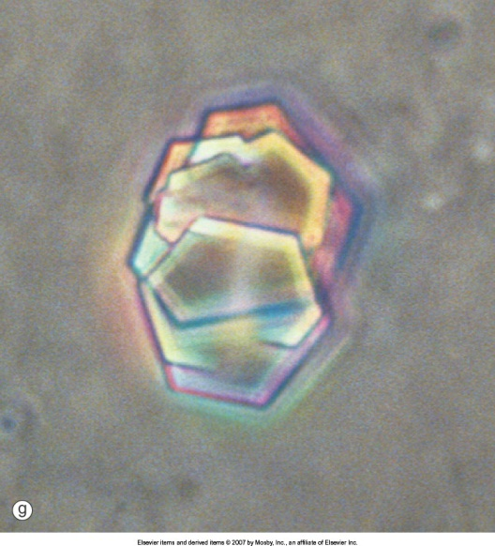
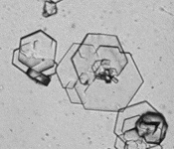
The Cystine crystals
Are diagnostic of Cystinuria
Precipitate in acidic urine (pH <6.0)

Slide 70
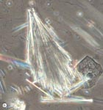
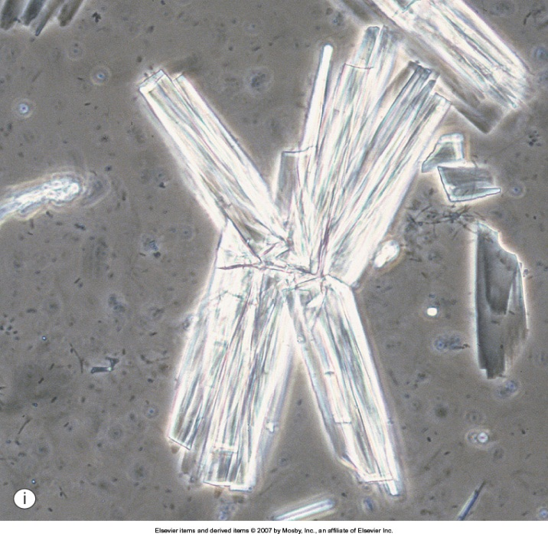
Crystals Due to Drugs
Amoxicillin Crystal Indinavir Crystal

