Slide 1
Intern Bootcamp: Outpt Topics
Ahsan Kamal
7/28/23

Slide 2
Diabetes

Slide 3
Diagnosis
To diagnose need 2 of the 3:
A1c > 6.5%
Fasting blood sugar > 125 or random > 200
2 Hr OGTT > 200
Random > 200 + sxs is sufficient for dx
A1c < 6.5% but > 5.6% = prediabetes
Can consider starting metformin for these pts

Slide 4
Screening
No universal guidelines. USPSTF: 40-70 YO overweight or w/1+ risk factors (family hx, ethnicity, hx of gestational DM)
Once diagnosed should be screened regularly:
Retinopathy: Annual eye exam
Nephropathy: Annual Alb/Cr ratio
Neuropathy: Annual foot exam
Begins at time of diagnosis for type 2, 5 years after diagnosis for type 1

Slide 5
Treatment
A1c goal depends on pt. Generally 7-8
Initial plan will depend on where they’re starting and compliance w/certain options
Do not forget to emphasize lifestyle interventions! Everyone should be asked about dietician referral
Often I felt silly b/c seemed obvious, but it matters

Slide 6
Per ADA monotherapy if <8%. Dual therapy if >7.5% after 3 mo. Triple therapy if still above target, then insulin
GLP1 agonists are injections-usually less preferred. SGLT2 inhibitors are pills and often pts are more amenable. Both are good options b/c of cardioprotective effects
In general, metformin --- > SGLT2 ---- > GLP1 --- > Insulin

Slide 7
Insulin therapy
When asking pts to check sugars, before bed/first thing in AM if long acting or w/meals if short acting
If w/meals, specify: just before eating, then postprandial is 2 hrs after
If comfortable w/pt using SSI you can instruct them
Glucose goals:
Fasting 90-130
Postprandial < 180

Slide 8
Titrating insulin
Calculate initial dose using weight based protocol; split 50/50 if basal/bolus plan
Lots to consider when doing this (Type 1 vs 2, weight, naïve or not, renal status, etc; err on side of caution for outpt)
Can instruct pts, ‘Take x units. If sugars are still high, go up by 2 units and use that dose for 3 days. Continue increasing until within goal’

Slide 9
Other pearls
Metformin-GI side effects common. Max dose is 2000 mg, 1000 BID. If experiencing issues can consider XR (qD)
Contraindicated if GFR < 30
Pharmacy referral is an option but usually reserved for refractory causes
Repeat A1c up to every 3 months
Have your pts keep accurate logs!
On inpt service-don’t forget about NPH insulin

Slide 10
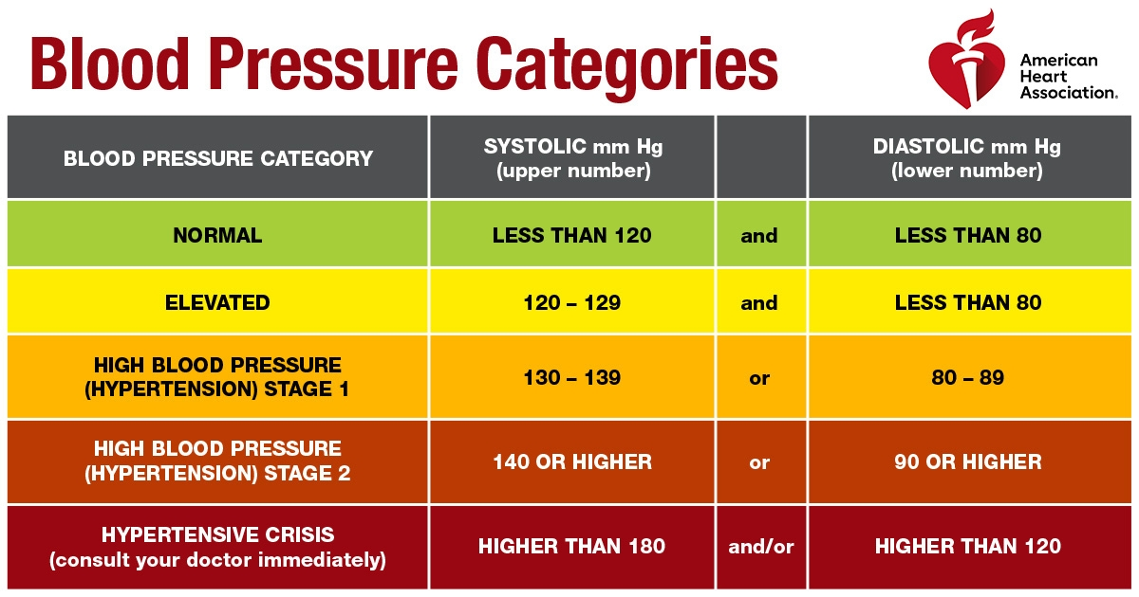
Hypertension
Many different guidelines about exact goals for pts (AHA, ACP, etc)
Best rule of thumb is target < 130/80

Slide 11
Management Principles
Remember the key is to have good, accurate data! Home BP logs are key
Emphasize consistency obtaining measurements
75% of effect achieved with 50% of dose. Thus will usually get more of effect from adding second agent then increasing dose
For pts notably below goal (SBP > 20 or DBP > 10), consider starting combo pill
Benazepril/amlodipine combo commonly used

Slide 12
Meds
ACEI/ARBs are probably best initial agents
Check BMP before starting and 2 wks after
If develop cough, switch to ARB
ARBs best for gout b/c of uricosuric effects
Remember CCB edema is common and takes time to resolve. Caution in CHF
On inpt side, remember takes ~24 hrs for effect
Among thiazides, HCTZ is least effective. Choose chlorthalidone or indapamide
Remember use of metolazone in inpt CHF
BB are not effective HTN meds

Slide 13
HTN pearls
OSA is often an underappreciated contributor to HTN
Secondary HTN-suspect in young pts, hypo K, strong family hx
Pursue workup if pt is on 3 meds, 1 of which must be a diuretic
When managing BP on inpt service, spironolactone is a valuable tool! But watch K. Also make sure to address underlying issues (pain, agitation, etc)

Slide 14
Hyperlipidemia

Slide 16
Statin Intensity

Slide 17
Statin myopathy
Notoriously known, but how real is it?
Generally will obtain LFTs +/- CK prior to initiating to obtain baseline. Serial monitoring not recommended
No hard criteria to dx myopathy; can check labs but need to interpret clinically
Often will recommend switching if pts are adamant about side effects vs alternate day/decreased dosing

Slide 18
Preop Medicine
Key hx questions to ask: Prior surg, family hx of reactions to anesthesia/hx of clots
MACE: Major adverse cardiac event. Several risk calculators available: RCRI, Gupta, NSQIP
>4 METS includes:
Climbing flight of stairs
Walking up hill w/o stopping
Running short distance
Lifting/moving heavy furniture
Moderate exertion sports such as golf, bowling

Slide 19
Cardiac risk assessment

Slide 20
Ischemic Cascade

Slide 21
Other Testing
If low risk surgery (cataract, hernia repair, carpal tunnel release, breast bx) no testing needed even if have cardiac/pulm conditions
CXR-not routinely needed, obtain if new/worsening cardiopulmonary sxs
EKG-obtain if hx of CAD, arrhythmia, CVD or PAD
ECHO-If CHF of valve dz obtain if > 1 yr. If known valve dz and sxs delay surgery
Lab-CBC and CMP, coags if on AC, liver dz, neurosurg

Slide 22
Med Mgmt
Ok to continue ACE/ARB, BB, statins
Hold diuretics and DM meds
Insulin: No dose adjustment in Type 1. Reduce by 25-50% for Type 2 based on hx of hypoglycemia
ASA: Complicated. Generally hold unless hx of PCI and high risk time window
Anticoagulation: Determine need for bridging as outlined in AC lecture

Slide 23
Hypothyroidism
Dx w/TSH and T4 lvls. Do not need to check ab unless elevated suspicion
Tx to target TSH lvl (exception is secondary hypothyroidism). Reduce starting dose in elderly/pts w/significant cardiovascular dz. Repeat labs q6-8 wks
Subclinical hypothyroidism: Nl T4 but elevated TSH. Confirm w/repeat first. Tx if TSH > 10
Remember inpt TSH/T4 lvls unreliable
Meds where timing important: Levothyroxine, PPI, iron (q48 not daily!)

Slide 24
GERD

Slide 25
PPI is preferred therapy. Trial for 4-8 wks, can increase dose to BID
If refractory likely require ambulatory pH monitor vs endoscopy
Lowest dose that controls sxs-attempt to come off PPI annually
Screening EGD recommended for male over 50, sxs > 5 yrs, risk factors (overweight, smoking, family hx)
Not routinely recommended otherwise

Slide 26
MSK pain
PT is your best friend! As is Voltaren (diclofenac gel)
General approach: 4-6 wks of conservative mgmt including PT +/- Xray, MRI if no improvement
Larger joints can perform intraarticular injection of steroids. Small joints, esp those of hands, require rheum referral, often done w/US

Slide 27
Sinusitis

Slide 28
UTI
Pyuria is stronger indicator than LE or nitrites. Look for > 5 WBC
Do not routinely obtain cx, obtain if complicated UTI, recurrent, or suspected pyelo
Uncomplicated: Healthy, nonpregnant woman
Tx with bactrim, nitrofurantoin, Augmentin/cefdinir (less prefered). Avoid FLQ
Do not tx asymptomatic bacteruria
If foley present, make sure obtain fresh sample

Slide 29
Anxiety/Depression
GAD7 and PHQ-9 are valuable tools
Often MAs will perform for you if you ask
Generally I would start SSRI and uptitrate on my own, would consider switching if no improvement, consider referring if sxs despite max dose
Offer referral to psychology-psychologytoday.com

Slide 30
Screening Guidelines
AAA: US for men 65-75 who have ever smoked
HCV: One time for all adults born 1945-65
HIV: Everybody at least once, annual if high risk case
Chlamydia and gonarrhea: All sexually active women < 24, 25+ only if high risk
Osteoporosis: DEXA for women > 65 q2 years

Slide 31
Cancer Screening
Breast cancer: Mammo every other year at 50; can start at 40
Cervical cancer: Pap every 3 years for women 21-65; 5 years for women 30-65 if HPV testing
Lung cancer: Annual low dose CT for 55-80 w/30 yr pack hx, includes former up to 15 yrs ago
Colon cancer: Screening at 45 q10 yrs depending on other risks. Colonoscopy ideal
Prostate cancer: Men 55-69, individualized

