Slide 1
Dysnatremias: All About the Salt?
Internal Medicine Resident Lecture
1/16/23
Steve Schinker, MD

Slide 2
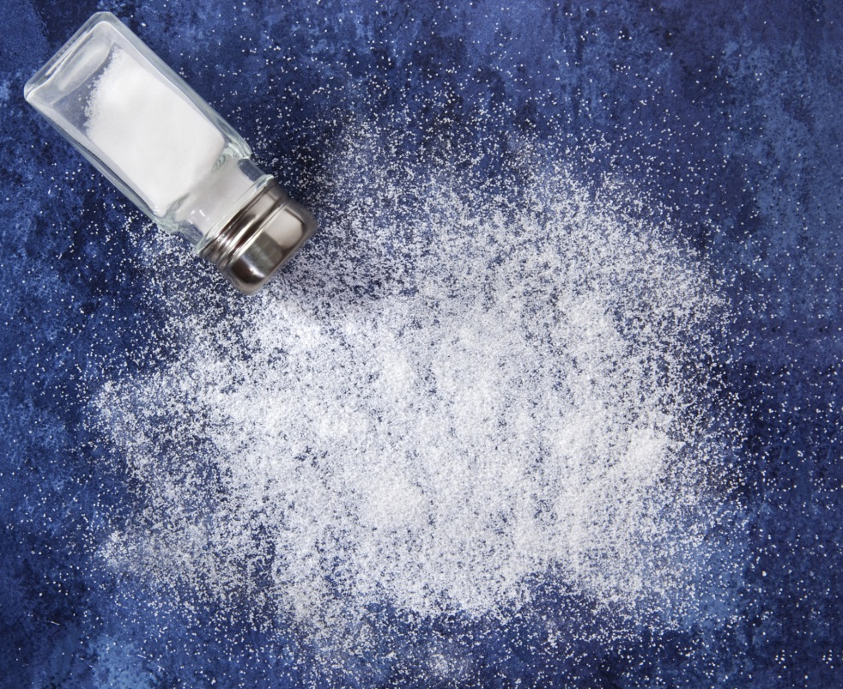
Water or salt?

Slide 3
Dysnatremias
In general, disorder of water balance, not sodium balance…
Volume status is tied to total body sodium content
Sodium concentration (ie hypo or hypernatremia) determined by proportion of total body sodium to water
The kidneys regulate sodium and water balance independently

Slide 4
Physiology of water regulation
You are in the desert w/ no access to water…
What happens physiologically

Slide 5
Physiology of water regulation
Insensible losses
Skin
500cc (possibly more in hospitalized patients)
Respiratory
400cc (more in hospitalized patients)
Stool
200cc
Urine losses
500cc (electrolyte free water loss)
Results in increase in plasma osmolality

Slide 6
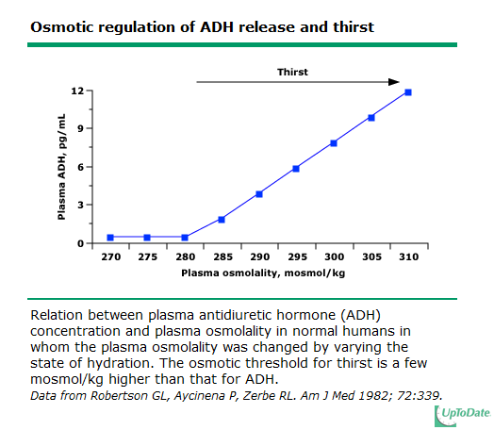

Slide 7
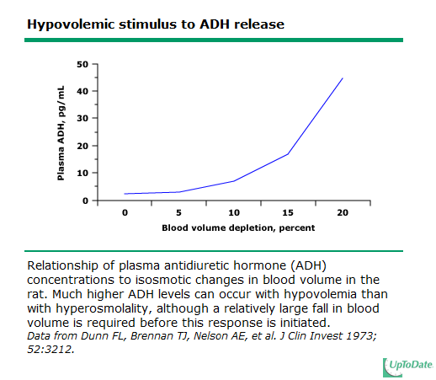

Slide 8
Physiology of water regulation
Change in plasma osmolality (increase)
ADH
Thirst
Vasopressin receptor
V1
V2
Aquaporins
Water moves down concentration gradient
Notes:
V1 volume
V2 tonicity

Slide 9
ADH physiology
Notes:
Principal cells
Apical
Basolateral

Slide 10
Hyponatremia
Simply put, hyponatremia develops in 2 situations-
Water intake which overwhelms excretory capacity (rare, such as severe psychogenic polydypsia)
Intake of a water load which cannot be excreted due to low GFR or persistent effects of ADH

Slide 11
Hyponatremia
Usually divided according to volume status
Hypovolemic hyponatremia
Total body water decreased
Volume (total body sodium) decreased more
Euvolemic hyponatremia
Total body water increased
Volume (total body sodium) no change
Hypervolemic hyponatremia
Total body water increased more
Volume (total body sodium) increased
Best to think of volume status (sodium balance) and water balance (sodium concentration) completely separately

Slide 12
Hyponatremia
My steps in evaluating hyponatremic disorders…
How much time do I have-- ie is pt symptomatic?
Hypo-osmolar (Osm <275)? Rule out----
pseudohyponatremia (hyperproteinemia/hyperlipidemia rare nowadays)
Hypertonic (hyperglycemia)
Isotonic (mannitol)
Volume status?
Signs of volume depletion?
Signs of volume excess?
If euvolemic, reason for SIADH?
Rule out thiazide diuretics, severe hypothyroidism, adrenal insufficiency
Rule out poor solute intake (“beer potomania” or “tea and toast diet”)
Working diagnosis
Treatment plan and monitoring frequency

Slide 13
Case 1
57 yo woman with PMH of hypothyroidism presents w/ a 1 week history of upper resp symptoms along w/ n/v. Very little intake other than trying to “hydrate.” Brought to ER by family for progressive confusion. The time is noon.
Exam: BP 100/54 HR 101, confused, no edema.
Labs:
Na 118 K 3.4 BUN 5 Scr 0.4 Osm 245 BG 130 TSH wnl
Urine data Osm 141 Na 36 SG <1.005 (6pm)

Slide 14
Case 1
Hyponatremia
Type?
Symptomatic?
Pt is bolused 2L NS in ED

Slide 15
Case 1
You are consulted at 9pm by admitting hospitalist however RN “kindly” holds call till the next morning. Unit secretary calls in consult after case mgmt rounds
Time is 10am
Na is 140
Pt feels better, “back to normal”
RN states pt has put out “liters of urine” and asks if pt can be discharged today
Are you concerned? What are the risks?
Notes:
Corrected 22 in 22hrs. ODS

Slide 16
Osmotic demyelination syndrome
Acute hyponatremia causes brain edema
Adaptation begins immediately and is complete around 48hrs
Loss of water, sodium, intracellular potassium, organic solutes
Rapid correction can result in ODS
Usually in pts w/ serum sodium <120 on presentation
At risk pts: cirrhosis, alcoholism, malnourished, OLTx
Current rate of correction recommendations:
No more than 8 mEq/L in 1st 24h and 16mEq/L in 1st 48h

Slide 17
Case 1
What are your recommendations???
Notes:
140→ 130= 2.7L. D5w 125. ddavp 2mcg

Slide 18
Case 1
Increase in Na ---
Goal increase ---
Therapy ---
Water deficit equation can be used
H2O def= TBW x (current Na/desired Na - 1)
Notes:
Ddavp. Would decrease to around 128. Delta of 12.
Water deficit equation- 70kg x 0.45= 37.5 and 140/128-1 x 37.5 = 3.1L without ongoing losses

Slide 19
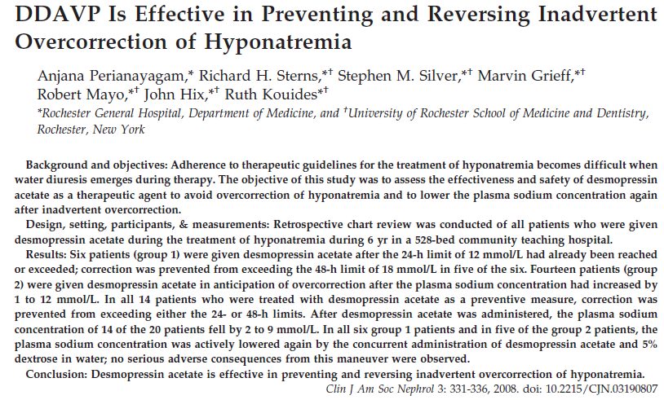
Case 1

Slide 20
Case 2
48 yo man with smoking history presents with confusion and drowsiness. Meds include combivent. BP 130/84 HR 70, JVP 4cm, clear lungs, no edema. CXR shows COPD changes. Family is concerned that he “smokes and drinks beer all day” and eats very little.
Labs- Na 117 K 3.6 SOsm 240
Una 90 Uosm 662

Slide 21
Case 2
Symptoms?
Volume status?
Differential diagnosis?
What other labs or imaging would you order?
Treatment options?

Slide 22
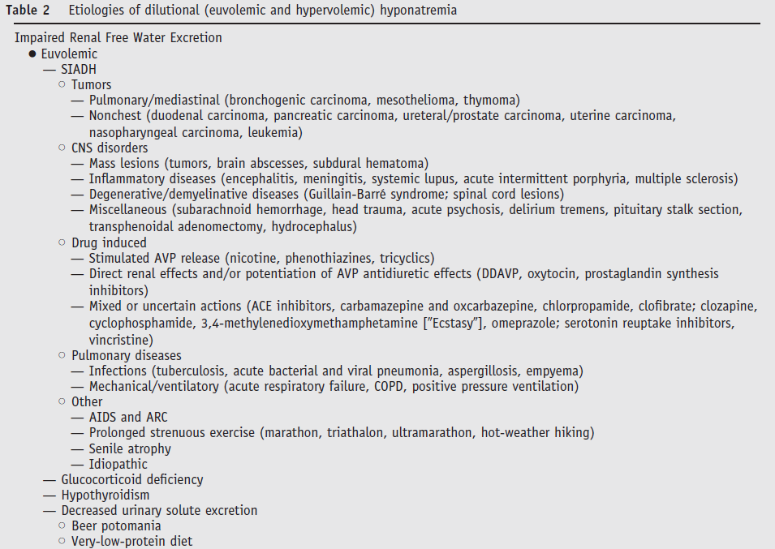

Slide 23
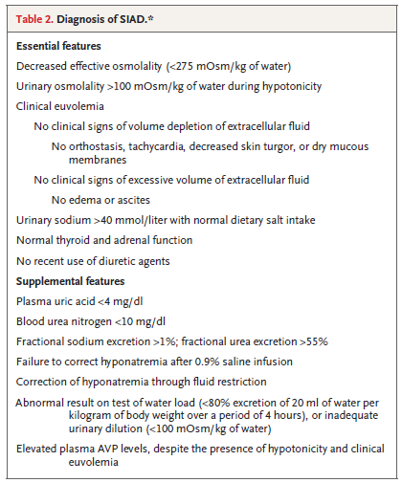
Case 2

Slide 24
Case 2
How would you treat?
A. 3% saline
B. Fluid restriction
C. Salt tabs and lasix
D. Tolvaptan

Slide 25
Case 2
3% saline
Rate
To raise serum Na by 8 meq/L over 24h assuming pt is 70kg, TBW=42L
Na needed is 336meq. Volume needed is around 650cc of 3% or a STARTING rate of 27cc/hr.
I would stop when pts symptoms ceased or when sodium >124
Close monitoring is essential

Slide 26
Case 3
58 yo woman with a history of ischemic cardiomyopathy admitted with pulmonary edema. Meds include metoprolol, spironolactone, furosemide, lisinopril.
Exam- BP 97/54 HR 85, alert and oriented, JVP 9cm, lungs w/ diffuse crackles, 1+ LE edema
Labs- Na 121 K 3.5 BUN 45 Scr 1.1
Urine data- UNa 15 UCl <5 Uosm 210 (6hrs after last diuretic dose)

Slide 27
Case 3
Symptoms?
Volume?
Workup?
Treatment options?

Slide 28
Case 3
Treatment:
Fluid restriction
Fluid restriction
Fluid restriction
Diuretics
A word about cirrhotic patients

Slide 29
Vasopressin receptor antagonists
Advantages
Addresses underlying issue
Efficacy
Allows less strict fluid restriction
Disadvantages
Hospitalization
Cost
Rapid correction
Thirst
Black Box Warnings
Notes:
30 days
No pts w/ liver disease

Slide 30
Case 4
35 yr old man s/p motorcycle vs. auto seen in SICU. Has been in ICU for 3 weeks
Multiple trips to OR for orthopedic surgeries
Prolonged vent requirements
s/p VAP with sepsis
Consulted for hypernatremia management

Slide 31
Case 4
Receiving multiple drips and antibiotics mixed in saline.
Receiving tube feeds. Surgical team added water flushes due to the hypernatremia at 100cc every 4 hours
Exam sig for : On vent, normotensive and HDS, decreased breath sounds, anasarca. External fixators present on LLE
Labs: Na 165 Cr 1.2 BUN 105

Slide 32
Case 4
What is your approach?

Slide 33
Case 4
Problems:
Hypernatremia
Hypervolemic vs. euvolemic vs. hypovolemic
Azotemia
Hypervolemia
Too much salt or too little water?

Slide 34
Case 4
Water deficit calculation:
H2O def= TBW x (current Na/140 - 1)
TBW= 45-60% of lean body wt in kg
Data: current wt 110kg IBW 85kg
Recommendations?
Notes:
85x0.5=42.5L
7.5L deficit
165→155? 3 L needed using 150 as numerator

Slide 35
Case 4
Goal decrease in sodium
10meq/L in 1st 24h max
16-18meq/L in 1st 48h
How much free water needed?
How would you administer it?
What monitoring is needed?

Slide 36
Case 4
You decide about 3 L is needed
Water flushes increased to 125cc/hr
Call parameters given to RN
Next AM you open chart
Serum sodium is 170
What happened?

Slide 37
Case 4
You study I/O and med list a bit further…
Cardiology has started pt on lasix (polydoctoring)
Intake was 4L, output was 6.5L (drains, urine output, diarrhea from TF)
Ongoing adjustment is needed to account for ongoing water losses. Impossible to quantify in most cases
In general replacement rate will underestimate amount of water needed (ie will see undercorrection)

Slide 38
Dysnatremias
In general, disorder of water balance, not sodium balance…
Volume status is tied to total body sodium content
Sodium concentration (ie hypo or hypernatremia) determined by proportion of total body sodium to water
The kidneys regulate sodium and water balance independently

Slide 39
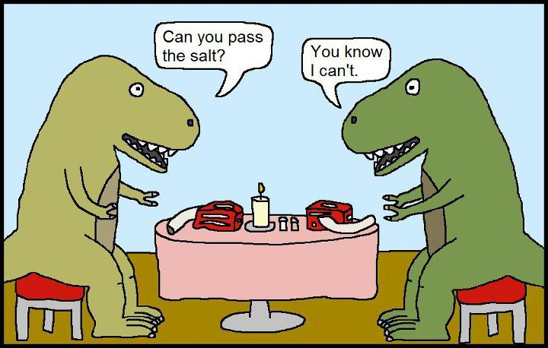
Questions?

