Slide 1

Approaching the weak patient: case illustration
Christina Chrisman, MD
Associate Professor of Neurology
DIRECTOR, Neuromuscular Medicine AND EMG, BUMC-P
Associate Program Director, Neurology Residency
Course Director, Musculoskeletal and Nervous System I, UACOM-P

Slide 2
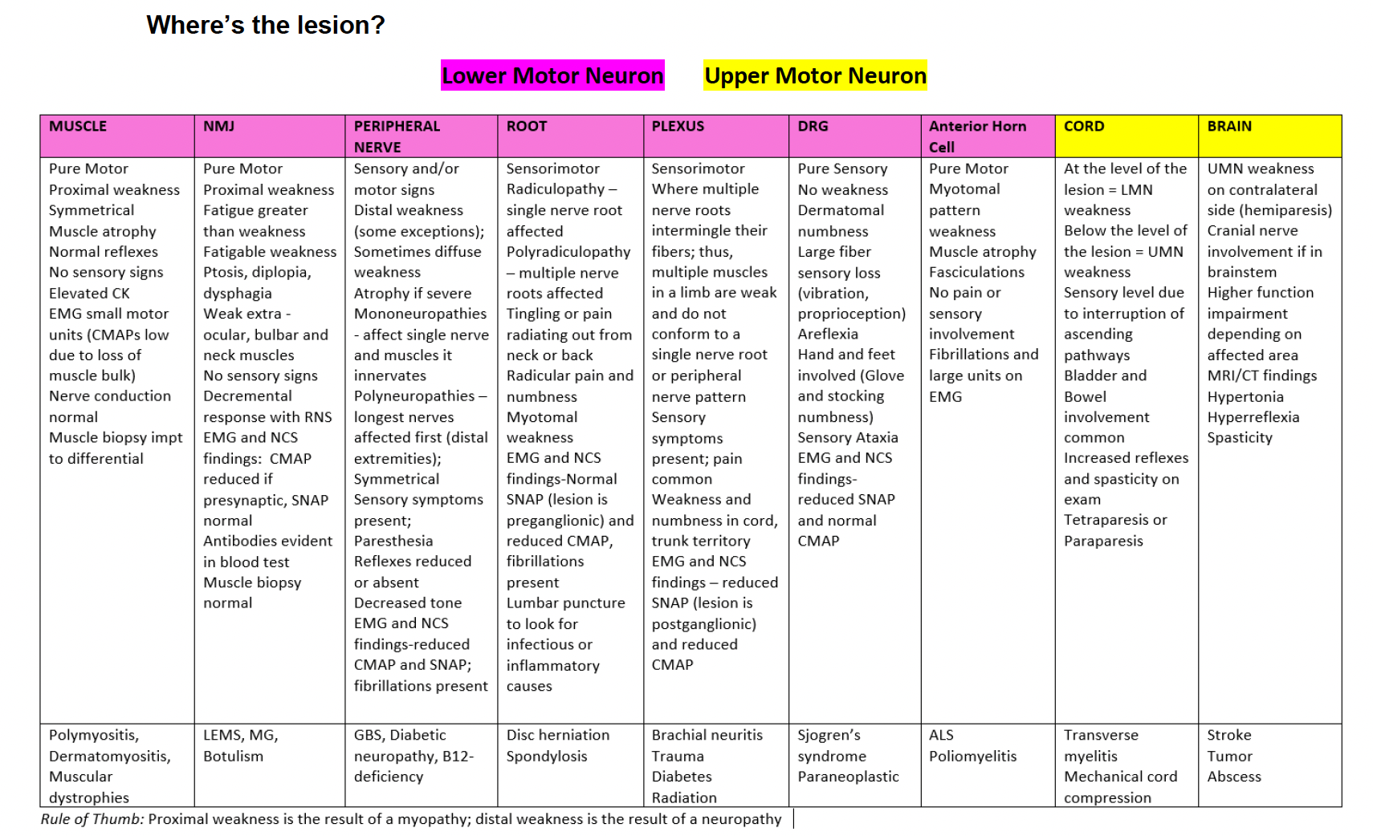

Slide 3
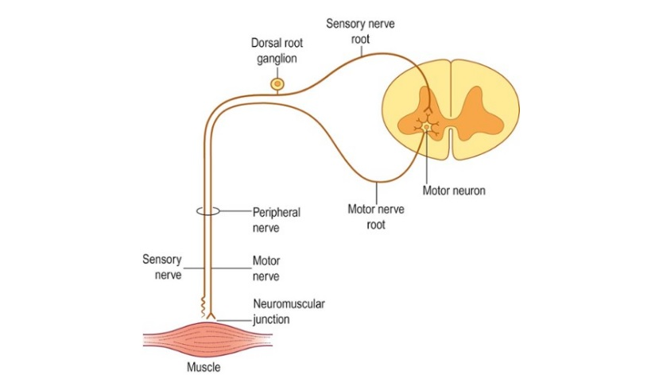
Peripheral nervous system

Slide 4
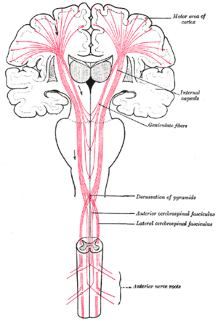
Corticospinal tract

Slide 5
Case 1, Question 1
A 40-year-old female with history of gastric bypass surgery presents with a 5-month history of progressive forgetfulness, weakness and numbness. Patient describes a shock-like sensation radiating to the feet during neck flexion. Neuro exam reveals proximal and distal weakness in upper and lower extremities which is symmetric, impaired sensation to vibration and proprioception, and brisk reflexes throughout. Where is the most likely localization of the lesion?
A. Motor neuron
B. Cervical spinal cord
C. Peripheral nerves
D. Brain

Slide 6
Case 1, Question 1
A 40-year-old female with history of gastric bypass surgery presents with a 5-month history of progressive forgetfulness, weakness and numbness. Patient describes a shock-like sensation radiating to the feet during neck flexion. Neuro exam reveals proximal and distal weakness in upper and lower extremities which is symmetric, impaired sensation to vibration and proprioception, and brisk reflexes throughout. Where is the most likely localization of the lesion?
A. Motor neuron
B. Cervical spinal cord
C. Peripheral nerves
D. Brain

Slide 7
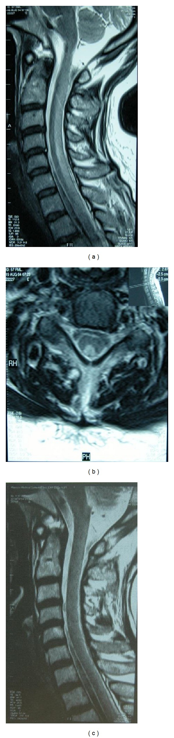

Slide 8
Case 1, Question 2
A 40-year-old female with history of gastric bypass surgery presents with a 5-month history of progressive forgetfulness, weakness and numbness. Patient describes a shock-like sensation radiating to the feet during neck flexion. Neuro exam reveals proximal and distal weakness in upper and lower extremities which is symmetric, impaired sensation to vibration and proprioception, and brisk reflexes throughout. You have localized the lesion to predominately the dorsal column and lateral tracts of the cervical spine. Which test is most likely to reveal the diagnosis?
A. Lumbar puncture
B. CBC
C. B12 level
D. HbA1c

Slide 9
Case 1, Question 2
A 40-year-old female with history of gastric bypass surgery presents with a 5-month history of progressive forgetfulness, weakness and numbness. Patient describes a shock-like sensation radiating to the feet during neck flexion. Neuro exam reveals proximal and distal weakness in upper and lower extremities which is symmetric, impaired sensation to vibration and proprioception, and brisk reflexes throughout. You have localized the lesion to predominately the dorsal column and lateral tracts of the cervical spine. Which test is most likely to reveal the diagnosis?
A. Lumbar puncture
B. CBC
C. B12 level
D. HbA1c

Slide 10
B12 deficiency
Neurological symptoms:
  Polyneuropathy, autonomic disturbances and decreased visual acuity
  Subacute combined degeneration of the spinal cord
  Personality changes, memory loss
Classic severe megaloblastic anemia is relatively rare
Pernicious anemia (Abs to parietal cells or intrinsic factor)
Accumulation of methylmalonic acid and homocysteine
B12 supplementation (IM in pernicious anemia)

Slide 11
Case 2, Question 3
A 36-year-old man presents with right back and buttock pain with radiating paresthesias into the right calf and lateral foot which began acutely 8 weeks ago when he bent over to move furniture. Exam reveals normal muscle bulk and tone. Strength assessment of the right leg reveals mild plantarflexion weakness. All reflexes intact and symmetric except absent at the right Achilles. Sensory exam reveals subtle sensory loss on the right sole and right lateral foot. Where is the most likely localization of the lesion?
A. Cauda equina
B. Tibial nerve
C. L5 nerve root
D. S1 nerve root

Slide 12
Case 2, Question 3
A 36-year-old man presents with right back and buttock pain with radiating paresthesias into the right calf and lateral foot which began acutely 8 weeks ago when he bent over to move furniture. Exam reveals normal muscle bulk and tone. Strength assessment of the right leg reveals mild plantarflexion weakness. All reflexes intact and symmetric except absent at the right Achilles. Sensory exam reveals subtle sensory loss on the right sole and right lateral foot. Where is the most likely localization of the lesion?
A. Cauda equina
B. Tibial nerve
C. L5 nerve root
D. S1 nerve root

Slide 13
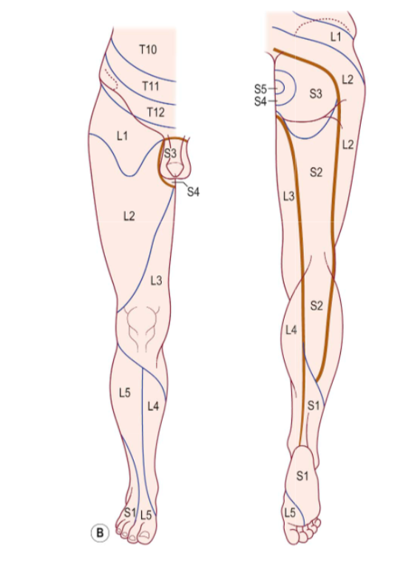
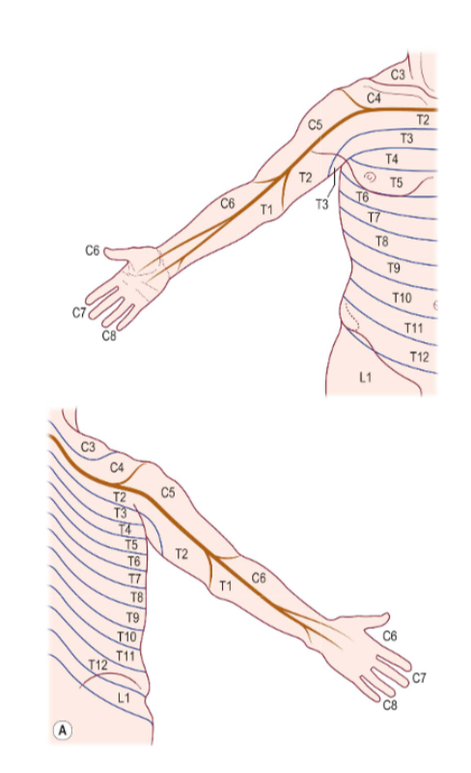

Slide 14
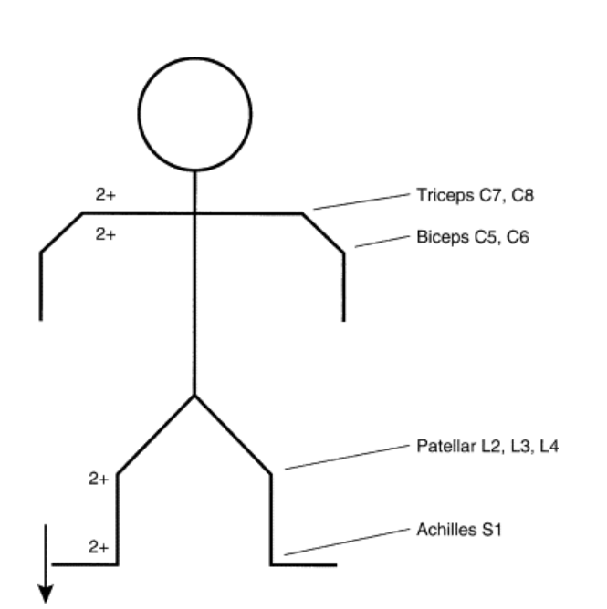

Slide 15
Case 2, Question 4
How is EMG/NCS testing likely to be helpful in this case?
A. Confirm localization to the right S1 nerve root
B. Confirm a herniated disc is causing radiculopathy
C. Rule out a stroke
D. Rule out a nerve sheath tumor

Slide 16
Case 2, Question 4
How is EMG/NCS testing likely to be helpful in this case?
A. Confirm localization to the right S1 nerve root
B. Confirm a herniated disc is causing radiculopathy
C. Rule out a stroke
D. Rule out a nerve sheath tumor

Slide 17
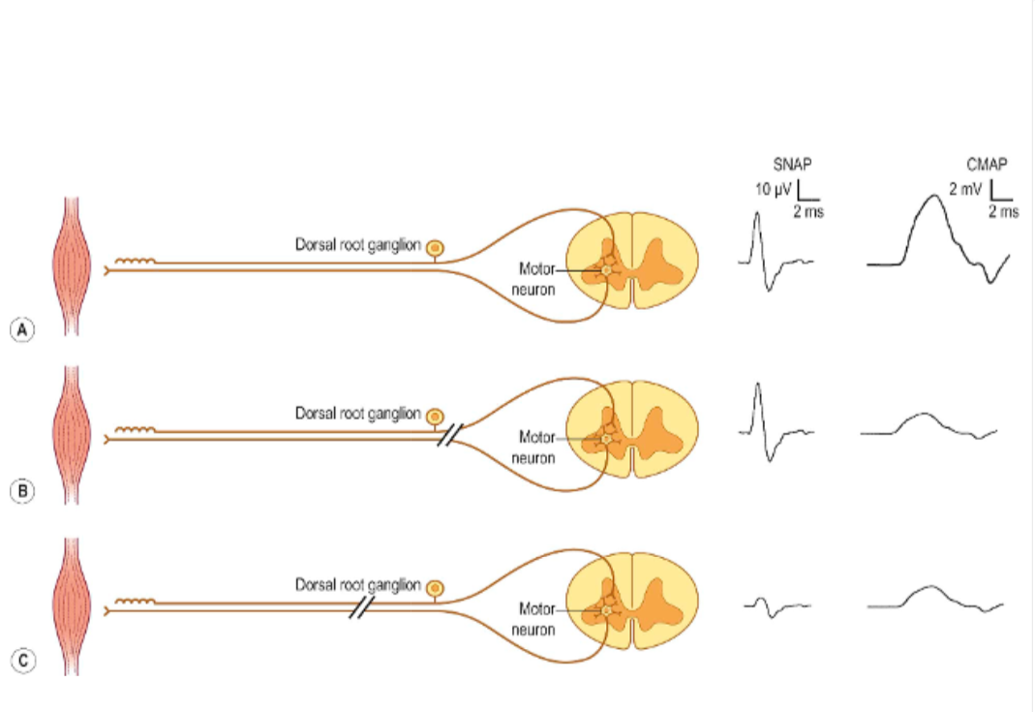

Slide 18
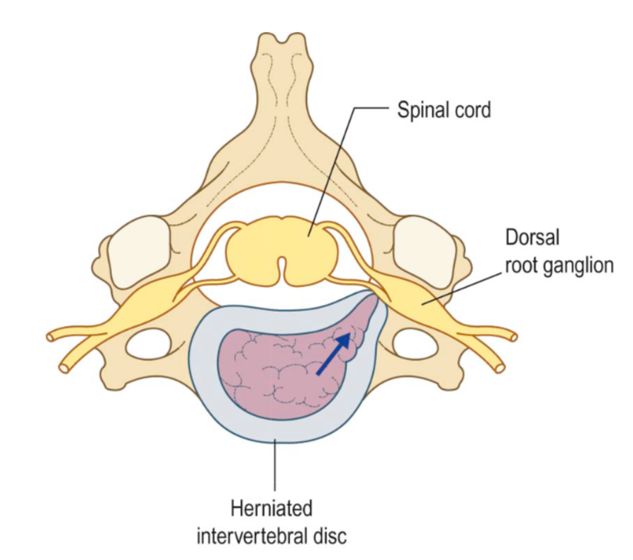

Slide 19
Case 3, Question 5
A 32-year-old woman was admitted for progressive weakness and numbness. 3 weeks prior she developed diarrhea and fever that persisted for several days then remitted. 10 days ago, she developed pins-and-needles paresthesias in both feet and both hands. Those symptoms were followed by clumsiness of gait and progressive weakness of both arms and leg. Examination was notable for bifacial weakness and a mild, diffuse quadriparesis. Reflexes were trace in the arms and absent in the legs. A mild distal sensory loss to pinprick, light touch and vibration was present in both upper and lower extremities. What is the next appropriate course of action?
A. Start steroids
B. Start IVIg
C. Obtain EMG/NCS testing
D. Start antivirals

Slide 20
Case 3, Question 5
A 32-year-old woman was admitted for progressive weakness and numbness. 3 weeks prior she developed diarrhea and fever that persisted for several days then remitted. 10 days ago, she developed pins-and-needles paresthesias in both feet and both hands. Those symptoms were followed by clumsiness of gait and progressive weakness of both arms and leg. Examination was notable for bifacial weakness and a mild, diffuse quadriparesis. Reflexes were trace in the arms and absent in the legs. A mild distal sensory loss to pinprick, light touch and vibration was present in both upper and lower extremities. What is the next appropriate course of action?
A. Start steroids
B. Start IVIg
C. Obtain EMG/NCS testing
D. Start antivirals

Slide 21
AIDP
Acute inflammatory demyelinating polyradiculoneuropathy
Prodrome: URI or GI illness 1-3 weeks prior
Associations with CMV, Campylobacter jejuni
Usually progresses over 2-4 weeks followed by a plateau before recovery
Paresthesias, sensory loss in extremities
Weakness: symmetric, proximal and distal, most often symptomatic in legs
Areflexia/hyporeflexia
May be mild facial weakness
Quadriparesis in 30% of patients
  1/3 of these patients require intubation due to respiratory failure
Autonomic dysregulation in 60% of cases

Slide 22
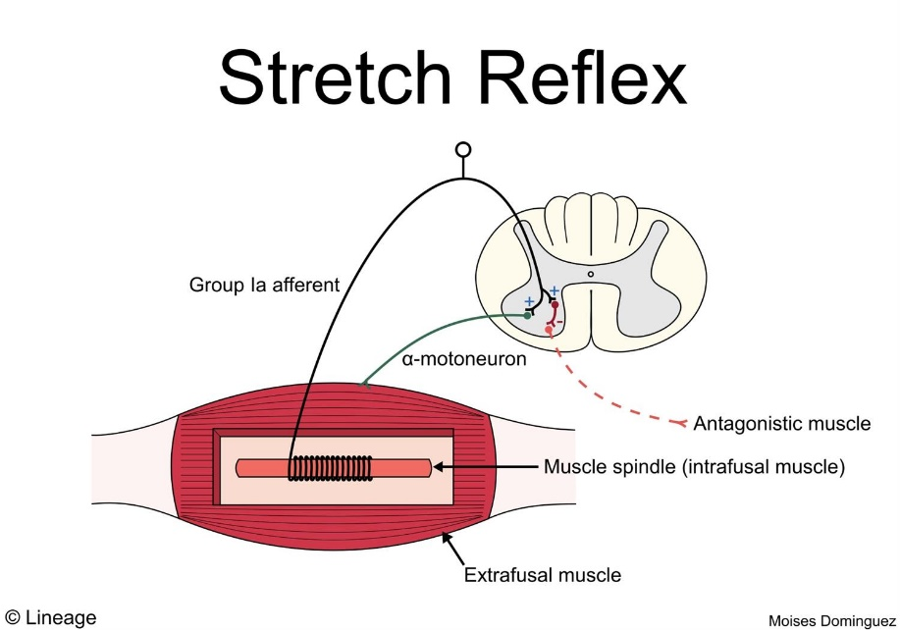
Afferent: Type 1A sensory fibers of muscle spindle (heavily myelinated)

Slide 23
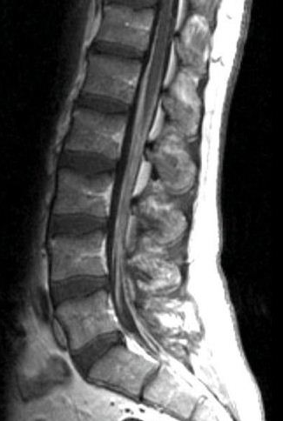
AIDP
Elevated CSF protein with no or only a few mononuclear cells
  >80% patients after 2 weeks
  1/3 patients have normal CSF protein in first week
CSF pleocytosis
  Lyme disease
  HIV
  Sarcoid
MRI spine can reveal enhancement of nerve roots
Anti-ganglioside antibodies
EMG/NCS may be normal up to 2-3 weeks after onset

Slide 24
Case 3, Question 6
A 32-year-old woman was admitted for progressive weakness and numbness. 3 weeks prior she developed diarrhea and fever that persisted for several days then remitted. 10 days ago, she developed pins-and-needles paresthesias in both feet and both hands. Those symptoms were followed by clumsiness of gait and progressive weakness of both arms and leg. Examination was notable for bifacial weakness and a mild, diffuse quadriparesis. Reflexes were trace in the arms and absent in the legs. A mild distal sensory loss to pinprick, light touch and vibration was present in both upper and lower extremities.
The patient recovers well with treatment but has residual neuropathic pain in the distal extremities. She has no other medical conditions and is not on any medications. What would be appropriate for first-line treatment of her symptoms?
A. hydrocodone/acetaminophen
B. topiramate
C. valproic acid
D. amitriptyline

Slide 25
Case 3, Question 6
A 32-year-old woman was admitted for progressive weakness and numbness. 3 weeks prior she developed diarrhea and fever that persisted for several days then remitted. 10 days ago, she developed pins-and-needles paresthesias in both feet and both hands. Those symptoms were followed by clumsiness of gait and progressive weakness of both arms and leg. Examination was notable for bifacial weakness and a mild, diffuse quadriparesis. Reflexes were trace in the arms and absent in the legs. A mild distal sensory loss to pinprick, light touch and vibration was present in both upper and lower extremities.
The patient recovers well with treatment but has residual neuropathic pain in the distal extremities. She has no other medical conditions and is not on any medications. What would be appropriate for first-line treatment of her symptoms?
A. hydrocodone/acetaminophen
B. topiramate
C. valproic acid
D. amitriptyline

Slide 26
Treatment of Neuropathic Pain
(Best Evidence for Diabetic Neuropathy)
1st line
  Antidepressants
    TCA, e.g. amitriptyline
    SNRI: duloxetine or venlafaxine
  Gabapentinoid antiepileptics
    gabapentin
    pregabalin
  Topical capsaicin
Possibly effective
  alpha-lipoic acid
  valproic acid
  carbamazepine
  lidocaine patches
  Electrical nerve stimulation (TENS)
  Spinal cord stimulator
  Acupuncture
Probably not effective
  The following AEDs: topiramate, oxcarbazepine, lamotrigine, lacosamide
  clonidine
  pentoxifylline
  mexiletine
  magnetic field treatment
  low intensity laser therapy
  Reiki
Not recommended
  opioids

Slide 27
Case 4, Question 7
A 22-year-old woman was referred for fatigue and generalized weakness. 2 months ago, she developed a mild fatigue after exercising at the gym. Recently, she noted a change in her voice after talking for several minutes. During the last several days, she complained of intermittent double vision and drooping of the left eye late in the day. On examination, there was a mild left ptosis that fatigued with 1 minute of upgaze. Otherwise, there was no weakness of extraocular or bulbofacial muscles. The voice was normal. Muscle bulk and tone with normal throughout. There was mild weakness of both upper and lower extremity proximal muscles, including neck extensors. Deep tendon reflexes and sensation were normal throughout. Which test is most likely to reveal the diagnosis?
A. Serum CK
B. Acetylcholine receptor antibodies
C. P/Q-type voltage gated calcium channel antibodies
D. Stool botulinum toxin

Slide 28
Case 4, Question 7
A 22-year-old woman was referred for fatigue and generalized weakness. 2 months ago, she developed a mild fatigue after exercising at the gym. Recently, she noted a change in her voice after talking for several minutes. During the last several days, she complained of intermittent double vision and drooping of the left eye late in the day. On examination, there was a mild left ptosis that fatigued with 1 minute of upgaze. Otherwise, there was no weakness of extraocular or bulbofacial muscles. The voice was normal. Muscle bulk and tone with normal throughout. There was mild weakness of both upper and lower extremity proximal muscles, including neck extensors. Deep tendon reflexes and sensation were normal throughout. Which test is most likely to reveal the diagnosis?
A. Serum CK
B. Acetylcholine receptor antibodies
C. P/Q-type voltage gated calcium channel antibodies
D. Stool botulinum toxin

Slide 29
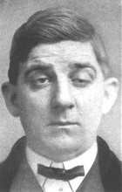
Myasthenia gravis
Autoimmune neuromuscular junction disorder
  Acetylcholine receptor antibodies
  MuSK (muscle specific kinase) antibodies
Fatigable weakness: extraocular, bulbar, generalized, respiratory
Treatment
  Pyridostigmine (Mestinon): acetylcholinesterase inhibitor
  Prednisone
  Other immunotherapies: IVIg, plasmapheresis, mycophenolate, azathioprine, complement inhibitors (eculizumab, ravulizumab, zilucoplan), FcRN blockers (efgartigamod, rozanolixizumab-noli)
  Rituximab particularly in MuSK myasthenia
  Role for thymectomy, rule out thymoma
Posey & Spiller: The Eye and Nervous System, 1906
Fatigue (Ptosis) in a patient with MG

Slide 30
Case 5, Question 8
A 42-year-old woman was referred for progressive weakness of several months’ duration. She had a long history of asthma treated with low-dose oral prednisone. Her initial symptoms were difficulty going up and down stairs and getting out of chairs. In addition, she developed mild difficulty with swallowing. The process was symmetric and progressive with little pain. Symptoms do not vary with time of day or activity. Neurologic examination showed mild proximal weakness in both upper and lower extremities. There was mild weakness of neck flexion with preserved neck extension. Muscle bulk and tone were normal. No facial or bulbar weakness was noted. Deep tendon reflexes and sensation were normal. Where is the lesion?
A. Neuromuscular junction
B. Muscle
C. Peripheral nerve
D. Motor neuron

Slide 31
Case 5, Question 8
A 42-year-old woman was referred for progressive weakness of several months’ duration. She had a long history of asthma treated with low-dose oral prednisone. Her initial symptoms were difficulty going up and down stairs and getting out of chairs. In addition, she developed mild difficulty with swallowing. The process was symmetric and progressive with little pain. Symptoms do not vary with time of day or activity. Neurologic examination showed mild proximal weakness in both upper and lower extremities. There was mild weakness of neck flexion with preserved neck extension. Muscle bulk and tone were normal. No facial or bulbar weakness was noted. Deep tendon reflexes and sensation were normal. Where is the lesion?
A. Neuromuscular junction
B. Muscle
C. Peripheral nerve
D. Motor neuron

Slide 32
Myopathy
Proximal weakness
Difficulty going up and down stairs, getting out of low chairs
Absence of sensory symptoms
Lack of fatigability
EMG can confirm myopathic changes
Muscle biopsy if indicated can reveal more specific diagnosis
  Inflammatory myopathy such as polymyositis
  Muscular dystrophy/inherited myopathy
  Choice of muscle biopsied is important: should be weak but not too severely or chronically atrophied

Slide 33
Case 6, Question 9
A 54-year-old woman was referred for progressive weakness over the past 8 months. Weakness began as a foot drop in the left lower extremity, and similar symptoms developed in the contralateral leg 2 months later. There was no history of trauma, pain, paresthesias, or sensory loss. Exam revealed atrophy and slight weakness in intrinsic hand muscles bilaterally. Spasticity with prominent wasting and fasciculations was noted in all muscles below the knees. Bilateral foot drops were noted. In addition, there was weakness in plantarflexion, eversion and inversion of the ankles. There was mild weakness of hip flexion, extension, abduction and adduction. Reflexes were present and normal in upper extremities and pathologically brisk in lower extremities with clonus at the ankles. Plantar responses were extensor bilaterally. Sensory examination was normal to all modalities. What diagnosis would be highest on your differential?
A. Bilateral peroneal neuropathies
B. Vasculitis
C. Motor neuron disease
D. Lumbosacral radiculopathy

Slide 34
Case 6, Question 9
A 54-year-old woman was referred for progressive weakness over the past 8 months. Weakness began as a foot drop in the left lower extremity, and similar symptoms developed in the contralateral leg 2 months later. There was no history of trauma, pain, paresthesias, or sensory loss. Exam revealed atrophy and slight weakness in intrinsic hand muscles bilaterally. Spasticity with prominent wasting and fasciculations was noted in all muscles below the knees. Bilateral foot drops were noted. In addition, there was weakness in plantarflexion, eversion and inversion of the ankles. There was mild weakness of hip flexion, extension, abduction and adduction. Reflexes were present and normal in upper extremities and pathologically brisk in lower extremities with clonus at the ankles. Plantar responses were extensor bilaterally. Sensory examination was normal to all modalities. What diagnosis would be highest on your differential?
A. Bilateral peroneal neuropathies
B. Vasculitis
C. Motor neuron disease
D. Lumbosacral radiculopathy

Slide 35
ALS (motor neuron disease)
Degenerative progressive disorder that affects UMNs and LMNs
Age 55-60 most commonly, slight male predominance (can affect any age)
LMN: muscle atrophy, weakness, fasciculations and cramps
UMN: stiffness, slowness of movement, spasticity, weakness, pathologic hyperreflexia, and Babinski responses
Asymmetric
Bulbar involvement
Respiratory involvement
UMN and LMN findings in same myotome
Mean duration of illness from symptom onset to death 3 years
Association with frontotemporal dementia
90% sporadic, 10% familial
Treatments: riluzole, edaravone may slow progression
  Tofersen for SOD1 mutation associated ALS
Supportive treatments: BiPAP, g-tube, adaptive speech devices, treatment of PBA, sialorrhea, spasticity, cramps, neurogenic bladder, palliative care, caregiver support

Slide 36
Thank you!

