Slide 1
Subarachnoid Hemorrhage
Mai Kau Yang, MD
Assistant Professor of Clinical Neurology
Division of Neurocritical Care
9 December 2025

Slide 2
Learning Objectives
Evaluate the etiologies of subarachnoid hemorrhage
Determine the initial work-up of subarachnoid hemorrhage
Define the classification systems of aneurysmal subarachnoid hemorrhage
Describe neurologic complications of subarachnoid hemorrhage
Summarize treatment options for complications of subarachnoid hemorrhage
Identify systemic complications of subarachnoid hemorrhage

Slide 3
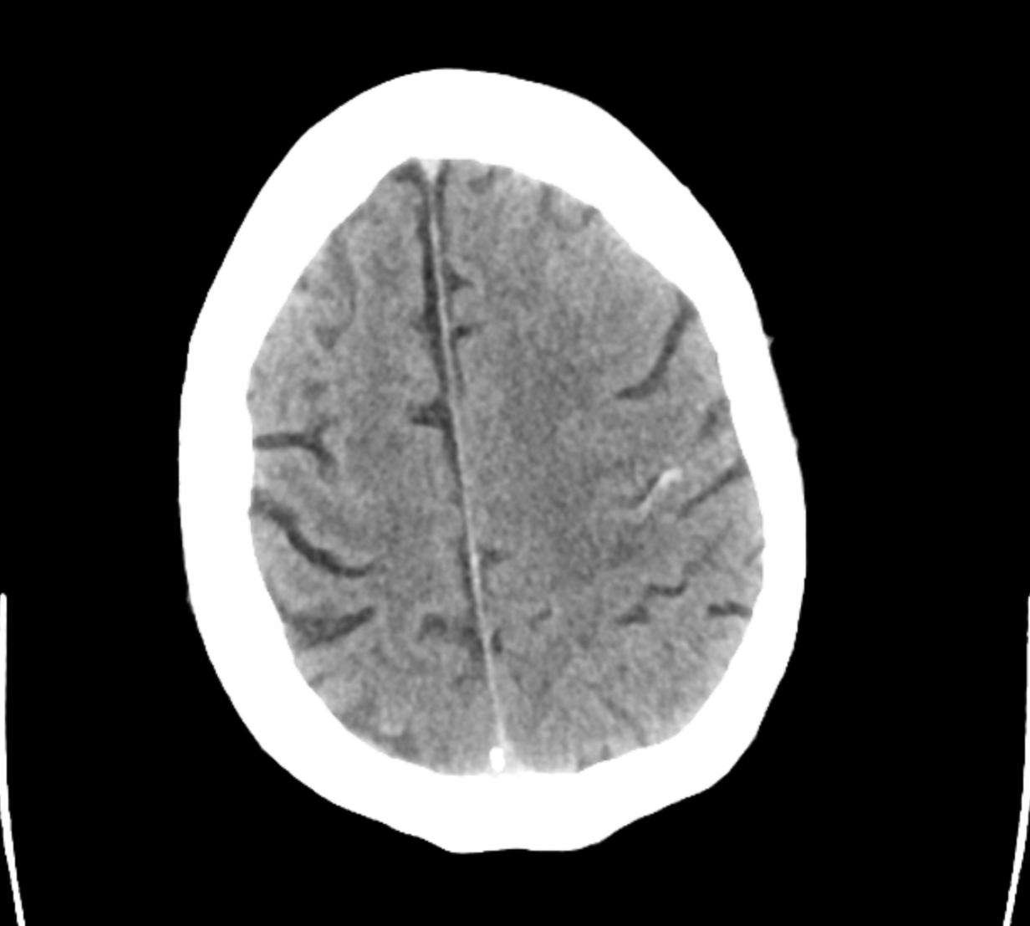
An 89-year-old man…
…with mild cognitive impairment and hypertension was evaluated in the ED with new onset headache and altered mental status.
Radiopedia

Slide 4
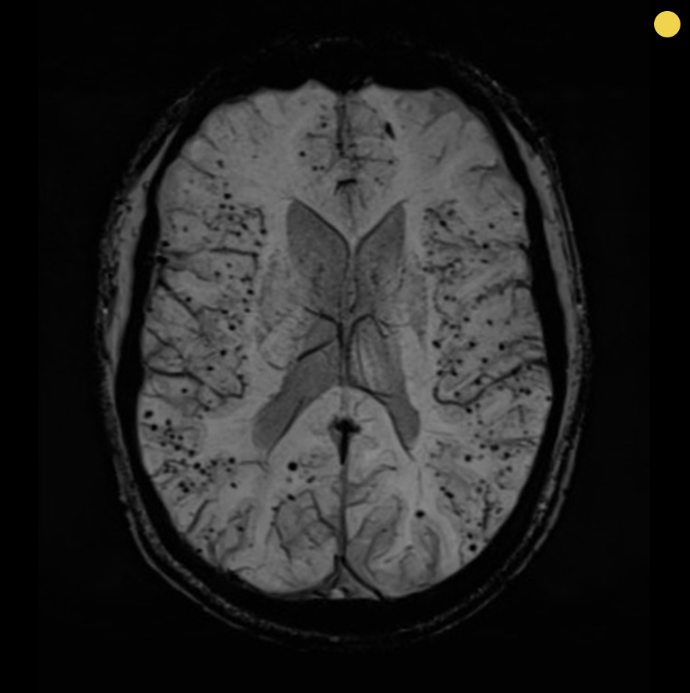
An 89-year-old man…
…with mild cognitive impairment and hypertension was evaluated in the ED with new onset headache and altered mental status.
Radiopedia
Notes:
Superficial siderosis

Slide 5
An 89-year-old man…
…with mild cognitive impairment and hypertension was evaluated in the ED with new onset headache and altered mental status.
Cerebral amyloid angiopathy
Radiopedia

Slide 6
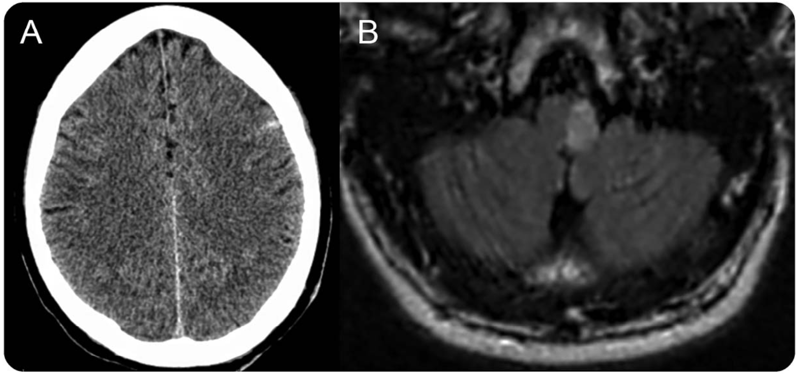
A 38-year-old woman…
…presents with sudden onset, worst headache of her life that has improved while in the hospital.
Selvan and Levin, Neurology e149-e150, 2017

Slide 7
A 38-year-old woman…
…presents with sudden onset, worst headache of her life that has improved while in the hospital. She develops recurrent headache left hemiparesis, right hemisensory loss, and nystagmus.
Selvan and Levin, Neurology e149-e150, 2017

Slide 8
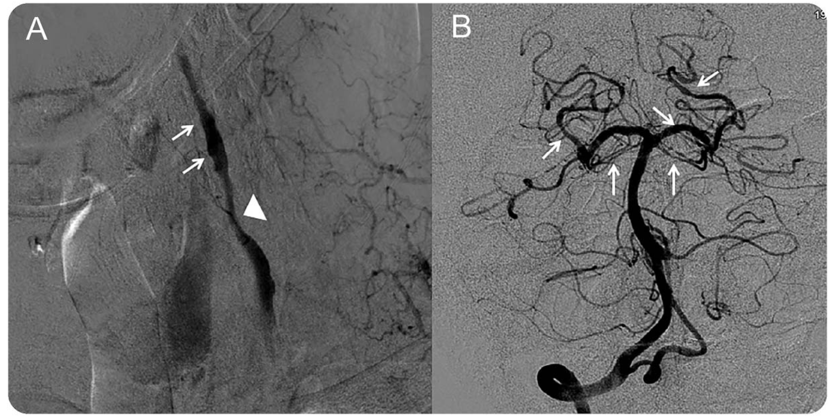
A 38-year-old woman…
…presents with sudden onset, worst headache of her life that has improved while in the hospital, she develops left hemiparesis, right hemisensory loss, and nystagmus.
Selvan and Levin, Neurology e149-e150, 2017

Slide 9
A 38-year-old woman…
…presents with sudden onset, worst headache of her life that has improved while in the hospital, she develops left hemiparesis, right hemisensory loss, and nystagmus.
Reversible cerebral vasoconstriction syndrome (RCVS)
Selvan and Levin, Neurology e149-e150, 2017

Slide 10
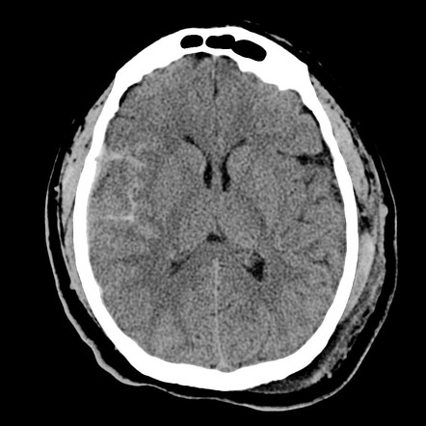
An unknown man who appears to be in his 50s…
…was found down intoxicated with superficial lacerations. He was also found to have orbital floor fracture and non-displaced fracture of the left radius.

Slide 11
An unknown man who appears to be in his 50s…
…was found down intoxicated with superficial lacerations. He was also found to have orbital floor fracture and non-displaced fracture of the left radius.
Trauma

Slide 12
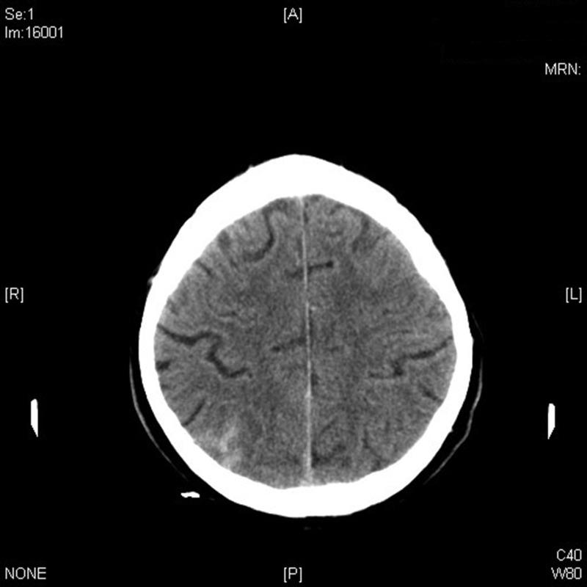
A 27-year-old woman…
… presented with severe headache and blurry vision. Urine pregnancy test is negative, she reports using birth control patch that contains estrogen.
Arévalo-Lorido and Carretero-Gómez, Clinical Med & Research 430-437, 2015

Slide 13
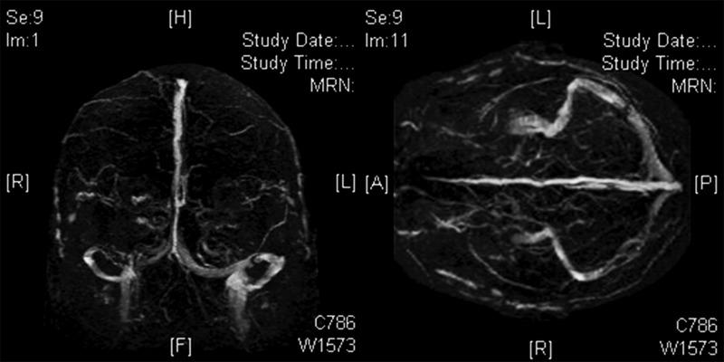
A 27-year-old woman…
… presented with severe headache and blurry vision. Urine pregnancy test is negative, she reports using birth control patch that contains estrogen.
Arévalo-Lorido and Carretero-Gómez, Clinical Med & Research 430-437, 2015

Slide 14
A 27-year-old woman…
… presented with severe headache and blurry vision. Urine pregnancy test is negative, she reports using birth control patch that contains estrogen.
Venous sinus thrombosis/cortical vein thrombosis
Arévalo-Lorido and Carretero-Gómez, Clinical Med & Research 430-437, 2015

Slide 15
Etiologies of subarachnoid hemorrhage
Trauma/TBI
Venous sinus thrombosis/cortical vein thrombosis
Reversible cerebral vasoconstriction syndrome
Cerebral amyloid angiopathy
Arterial dissection
Recreational drugs (cocaine)
Sickle cell disease
Posterior reversible encephalopathy syndrome (PRES)

Slide 16
Etiologies of subarachnoid hemorrhage
Trauma/TBI
Venous sinus thrombosis/cortical vein thrombosis
Reversible cerebral vasoconstriction syndrome
Cerebral amyloid angiopathy
Arterial dissection
Recreational drugs (cocaine)
Sickle cell disease
Posterior reversible encephalopathy syndrome (PRES)
Aneurysm

Slide 17
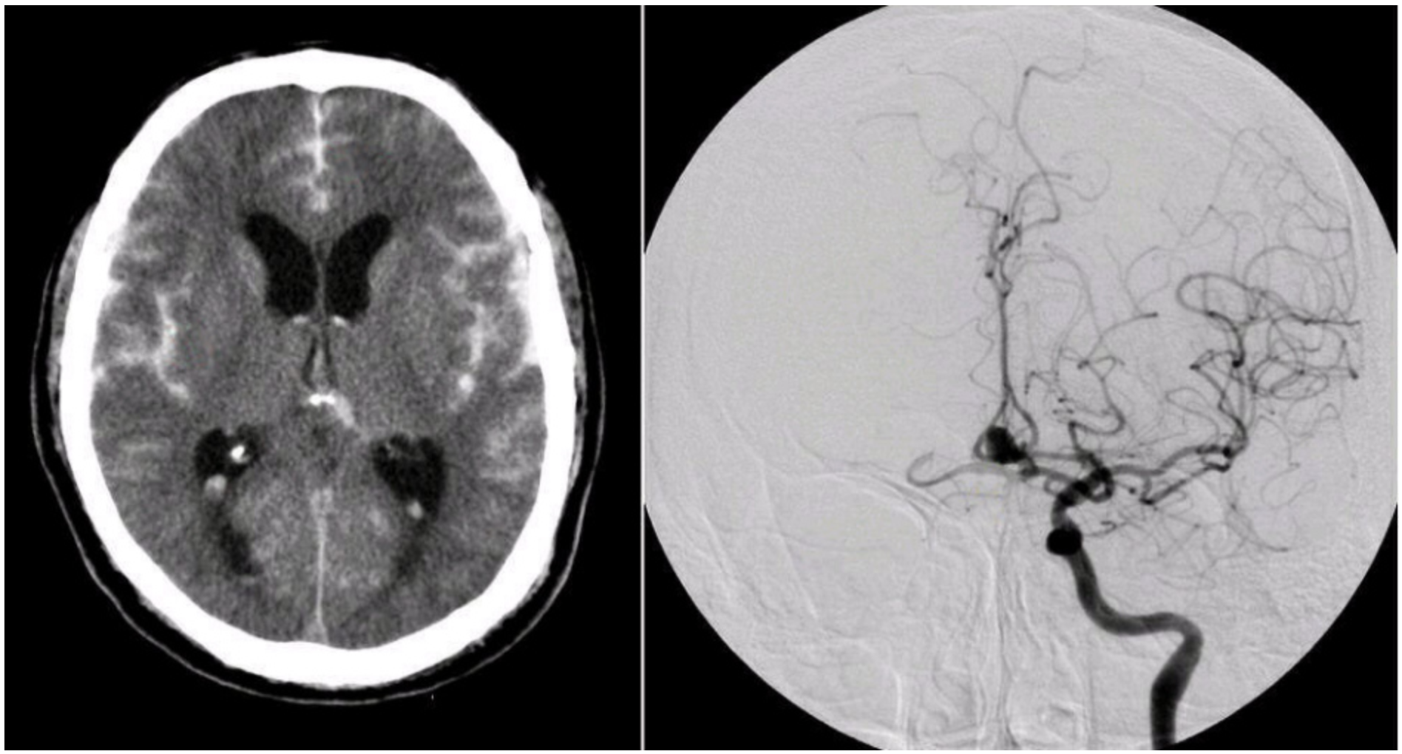
Aneurysmal subarachnoid hemorrhage
https://case.edu/med/neurology/NR/SubarachnoidHemorrhageAComm4.htm

Slide 18
Aneurysmal subarachnoid hemorrhage
In the US, 10 -14 cases per 100,000 every year
85% of subarachnoid hemorrhages are due to aneurysm rupture
Risk factors: smoking, hypertension, female sex, family history
Mortality rate of ~40-50%
Increased dependence on ADLs

Slide 19
Aneurysmal subarachnoid hemorrhage
Non-contrast head CT (sensitive within the first day, declines with time)
If NCCT is negative, high suspicion, and presented within 6-12 hours of symptom onset, perform lumbar puncture
Evaluation of tubes 1 and 4 - compare “dilutional” effect
Assess for xanthochromia (breakdown of blood)
Digital subtraction angiography (DSA)

Slide 20
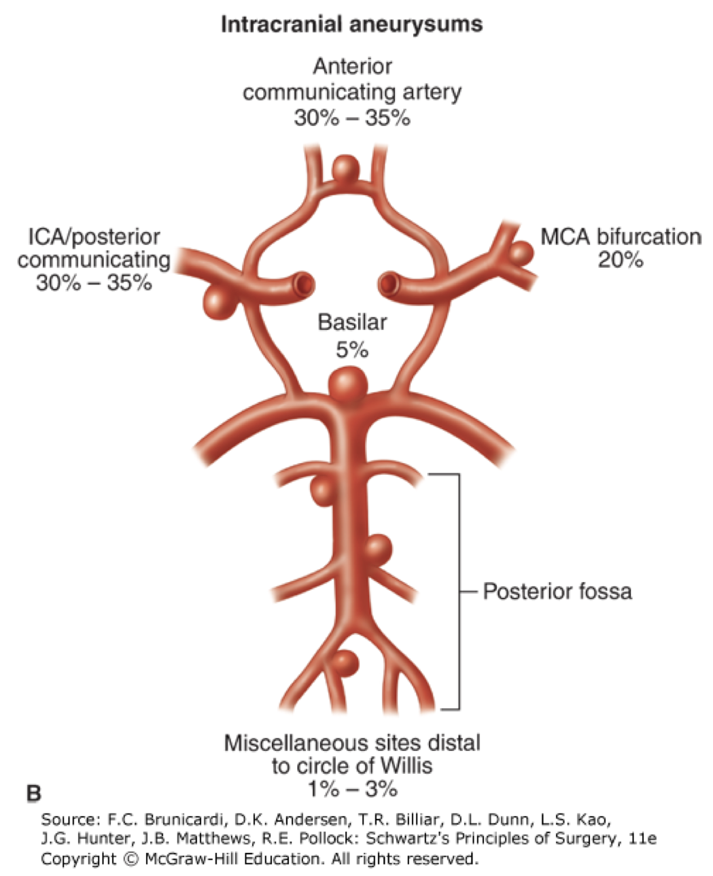
Aneurysmal subarachnoid hemorrhage

Slide 21
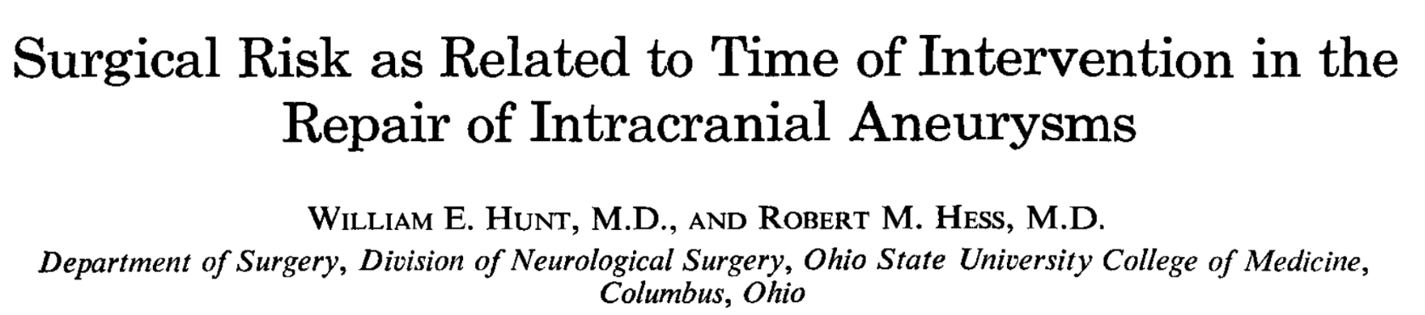
Classification

Slide 22
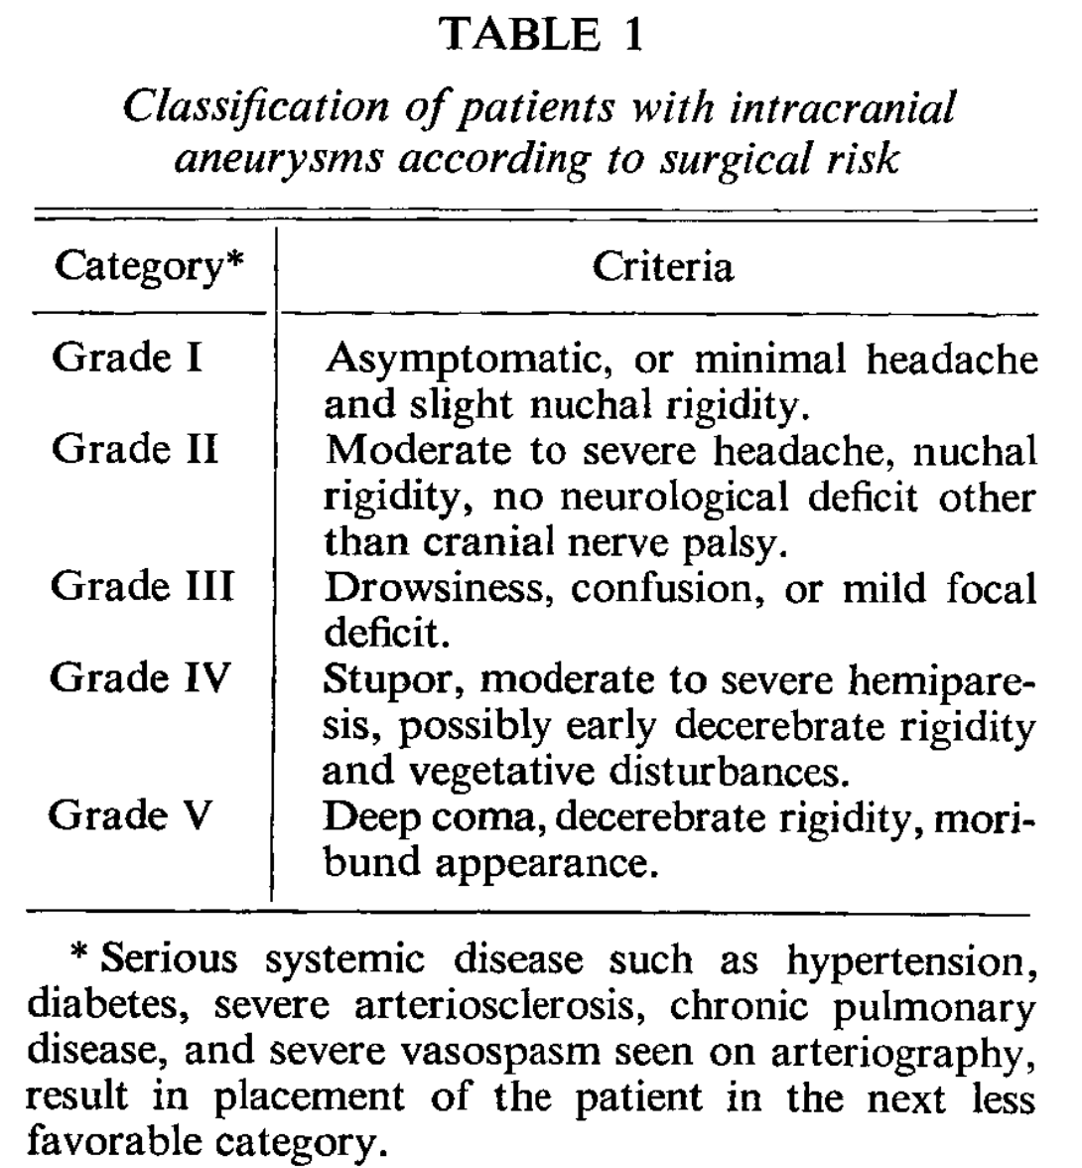
Hunt-Hess
Hunt et al. J Neurosurg, 1968

Slide 23
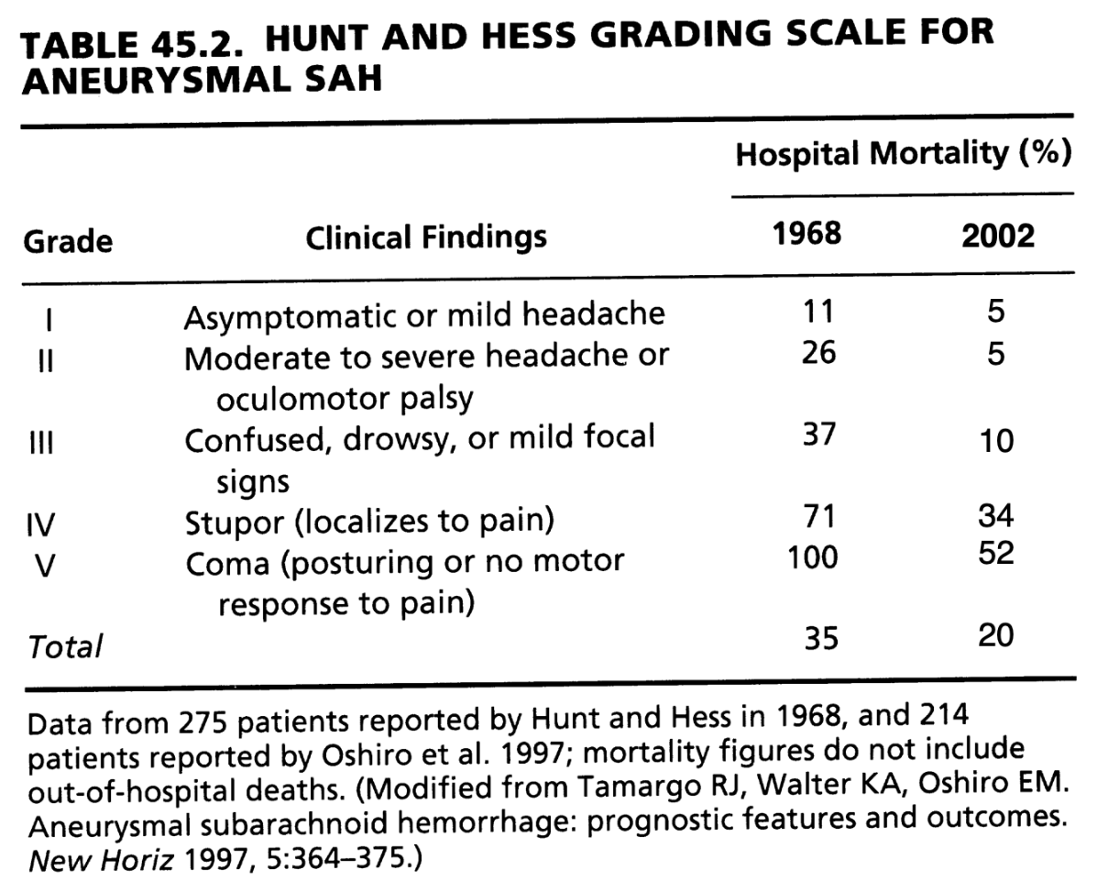
Hunt-Hess
Hunt et al. J Neurosurg, 1968

Slide 24
Management
Aneurysm clipping or coiling
Management of acute hydrocephalus
Management of seizures
Prevent & treat vasospasm
Prevent delayed cerebral ischemia
Treatment of systemic complications

Slide 25
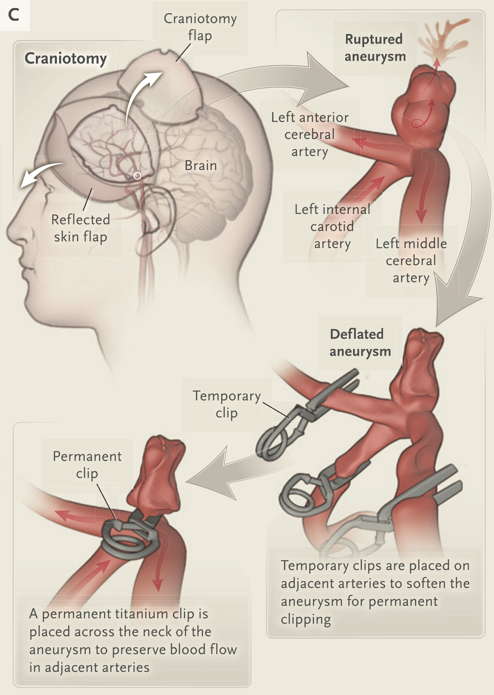
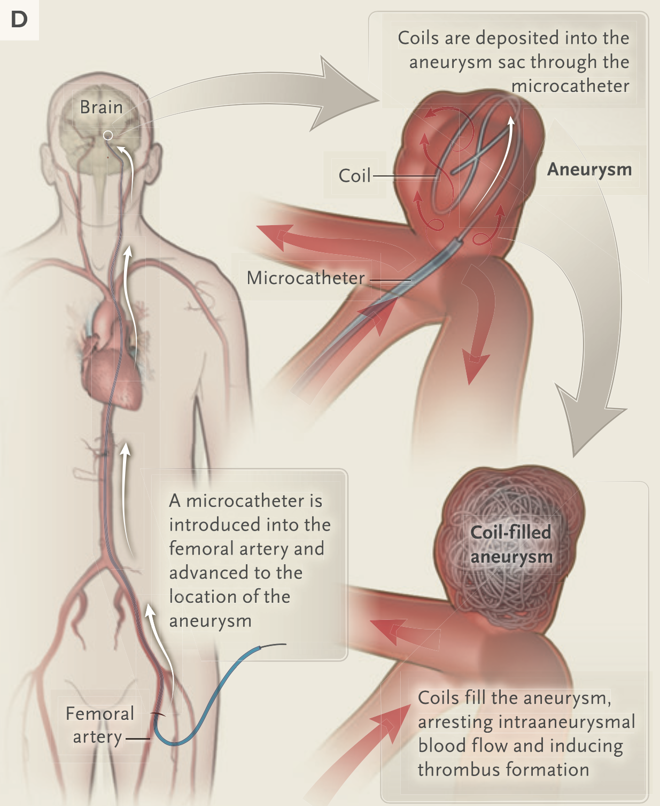
Aneurysm clipping and coiling

Slide 26
Management
Aneurysm clipping or coiling
Management of acute hydrocephalus
Management of seizures
Prevent & treat vasospasm
Prevent delayed cerebral ischemia
Treatment of systemic complications

Slide 27
Hydrocephalus
External ventricular drain
Lumbar drain

Slide 28
Management
Aneurysm clipping or coiling
Management of acute hydrocephalus
Management of seizures
Prevent & treat vasospasm
Prevent delayed cerebral ischemia
Treatment of systemic complications

Slide 29
Seizure prophylaxis
Prior to aneurysm securement (clip or coil) in hopes of avoiding rerupture or elevated ICP
Seizure prophylaxis: may be reasonable for high risk features (high grade SAH, ruptured MCA, ICH, hydrocephalus, cortical infarction)
Typically for <7 days

Slide 30
Management
Aneurysm clipping or coiling
Management of acute hydrocephalus
Management of seizures
Prevent & treat vasospasm
Prevent delayed cerebral ischemia
Treatment of systemic complications

Slide 31
Classification

Slide 32

Classification

Slide 33
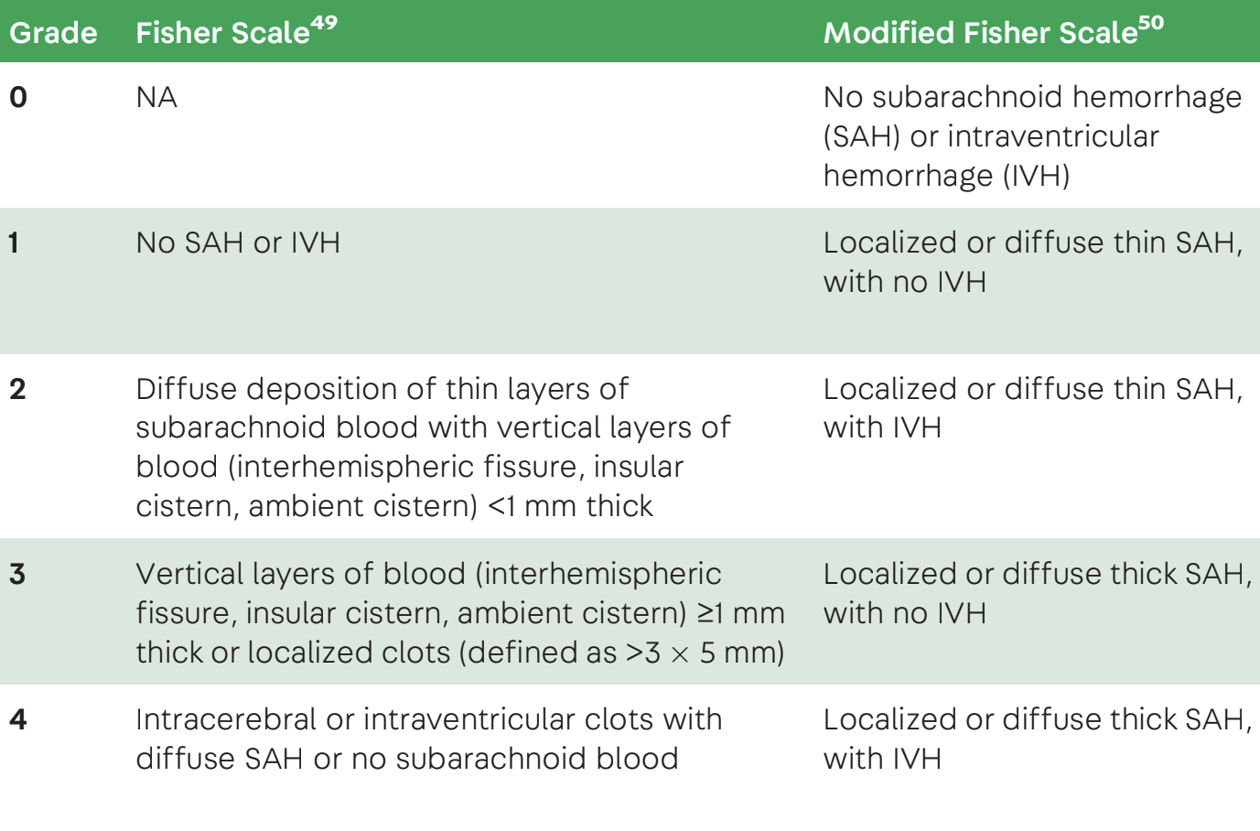
Modified Fisher
Modified Fisher & risk of symptomatic vasospasm
0: –
1: 6-24%
2: 15-33%
3: 33-35%
4: 34-40%
Hshiang-Yi Chou, Continuum, 2021

Slide 34
Vasospasm
Up to 14 days after initial bleed, peak at post-bleed day 6-10
Transcranial Dopplers (TCDs)
Mean velocity, Lindegaard Ratio
Pulsatility index (PI) >1.2

Slide 35
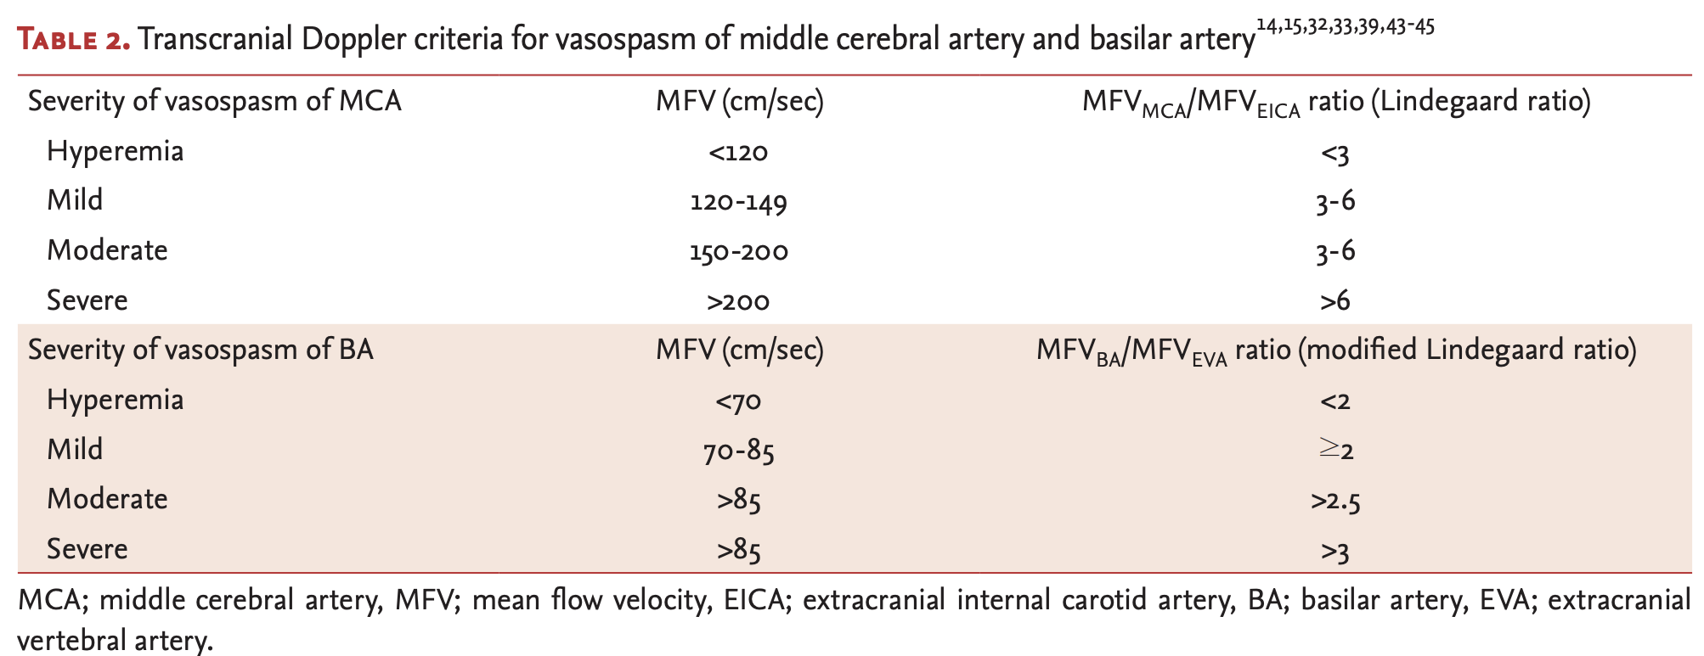
Transcranial Dopplers
Park et al., Journal of Neurosonology and Neuroimaging, 2022

Slide 36
Management of symptomatic vasospasm
Intra-arterial vasodilators: verapamil, milrinone
Intrathecal nicardipine
Cerebral angioplasty with endovascular balloons
Proximal vessels only
Risk of vessel rupture
Induced hypertension, IV milrinone

Slide 37
Management
Aneurysm clipping or coiling
Management of acute hydrocephalus
Management of seizures
Prevent & treat vasospasm
Prevent delayed cerebral ischemia
Treatment of systemic complications

Slide 38
Delayed cerebral ischemia: pathophysiology
Vasospasm (prevention of vasospasm alone does not prevent DCI)
Vascular dysfunction (elevated ICP, lowered CPP)
Endothelial injury and microthrombi
Disruption of blood brain barrier
Inflammation due to endothelial injury and free hemoglobin in CSF results in proinflammatory vascular vasospasm and cellular apoptosis
Cortical spreading depression → hyperemia resulting in hypoperfusion and ischemia

Slide 39
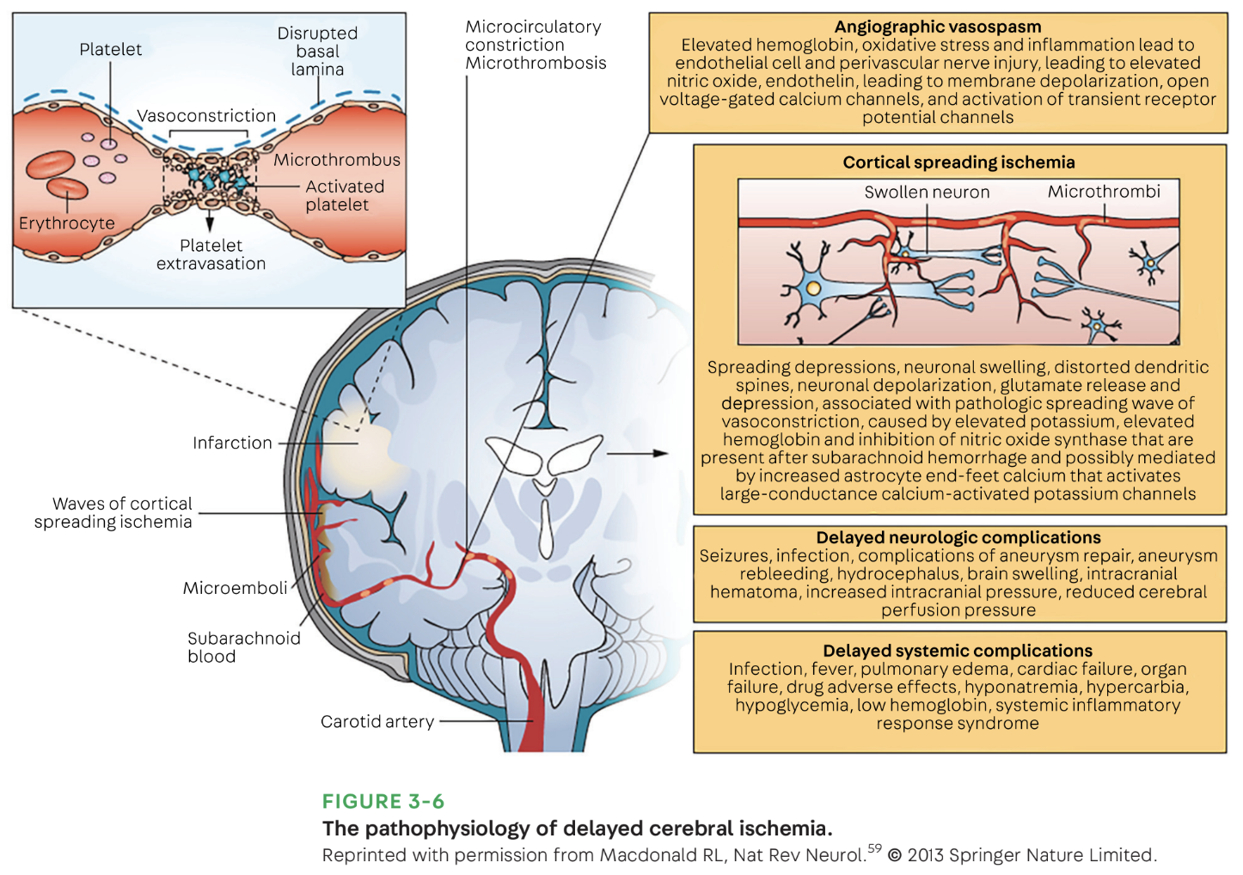

Slide 40
Delayed cerebral ischemia
Nimodipine
Improved outcomes by reducing ischemic effects, neuroprotection
No consistent data to suggest nimodipine reduces vasospasm
Euvolemia

Slide 41
Management
Aneurysm clipping or coiling
Management of acute hydrocephalus
Management of seizures
Prevent & treat vasospasm
Prevent delayed cerebral ischemia
Treatment of systemic complications

Slide 42
Systemic complications of subarachnoid hemorrhage
Cerebral salt wasting (hyponatremia)
Neurogenic pulmonary edema
Takotsubo cardiomyopathy
Terson syndrome

Slide 43
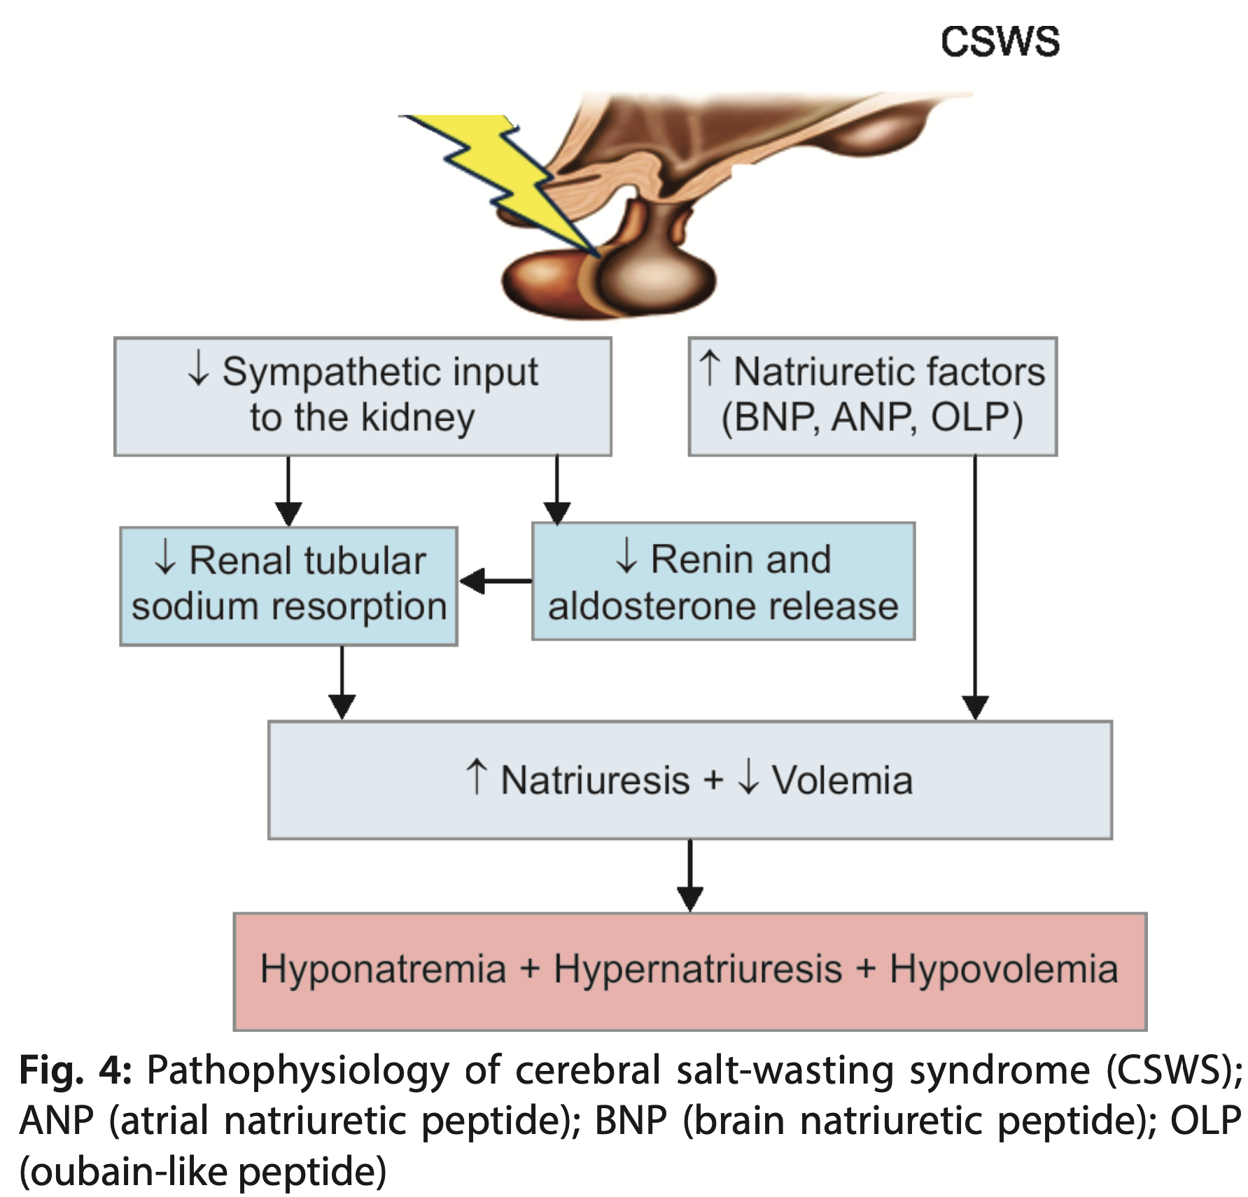
Cerebral Salt Wasting
Natriuretic peptide release in response to CNS injury
Hyponatremia is responsive to fluids
Elevated urine Na+
Yazidi et al., World Journal of Endocrine Surgery, 2020.
Notes:
SIADH not responsive to fluids

Slide 44
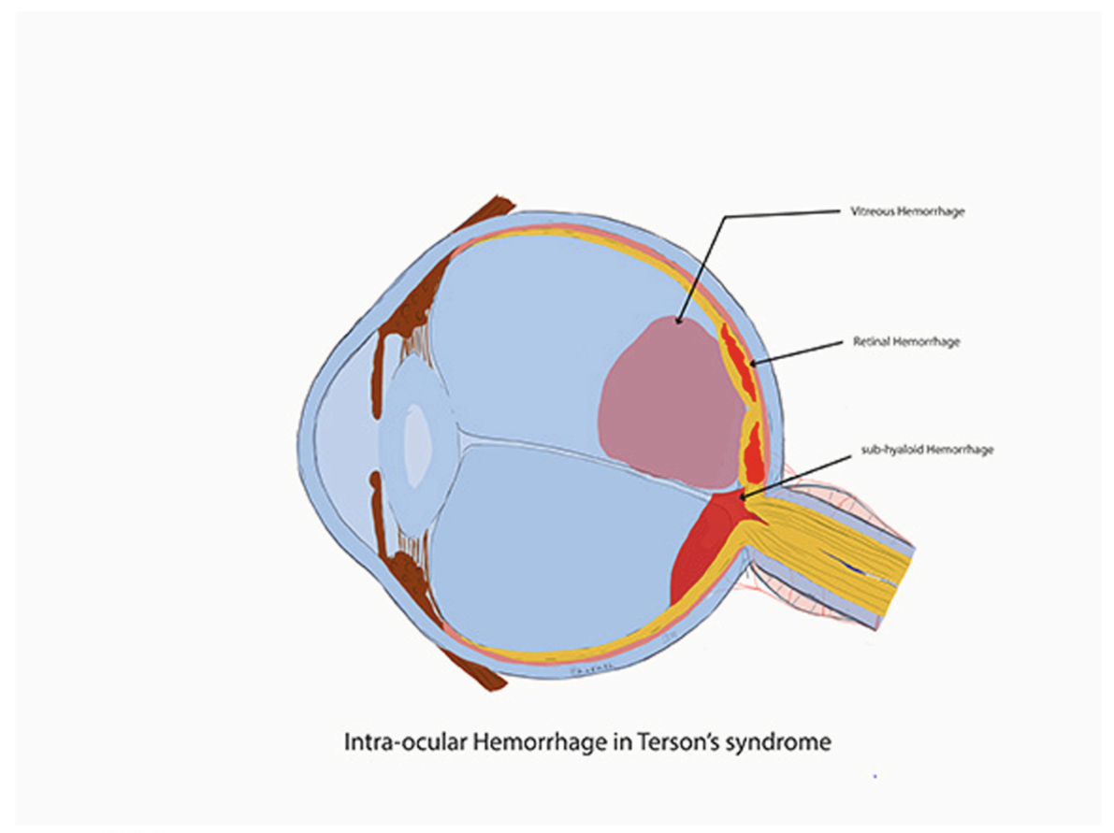
Terson syndrome
Transmission of subarachnoid blood through the optic nerve sheath
Intraocular hemorrhages secondary to elevated ICP
Compression of the retinal veins
Rupture of capillaries
Aboulhosn et al, Clinical Neurology and Neurosurgery, 2021.

Slide 45
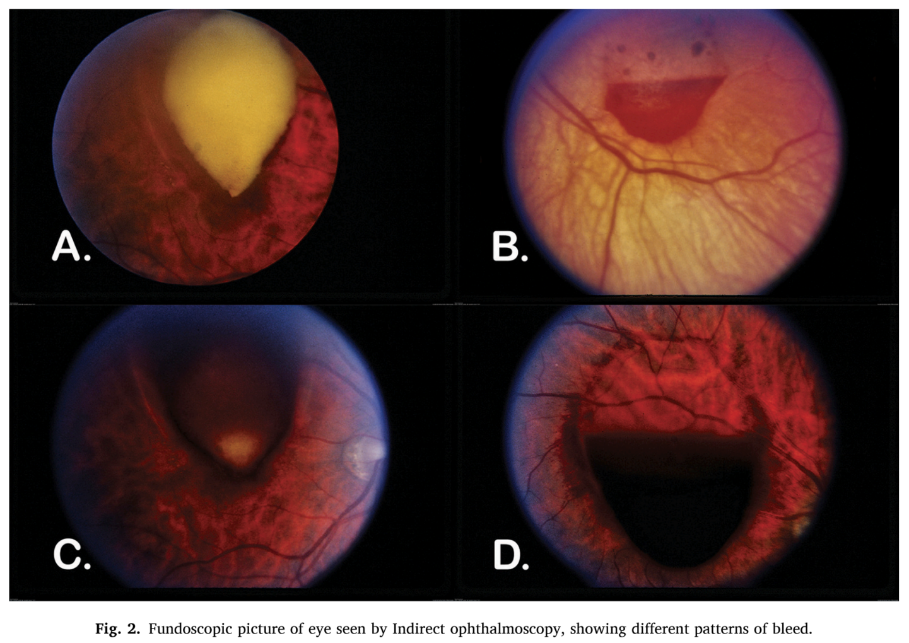
Terson syndrome
Transmission of subarachnoid blood through the optic nerve sheath
Intraocular hemorrhages secondary to elevated ICP
Compression of the retinal veins
Rupture of capillaries
Aboulhosn et al, Clinical Neurology and Neurosurgery, 2021.

Slide 46
Terson syndrome
Associated with higher grade SAH
Poorer neurologic outcomes
Aboulhosn et al, Clinical Neurology and Neurosurgery, 2021.

Slide 47
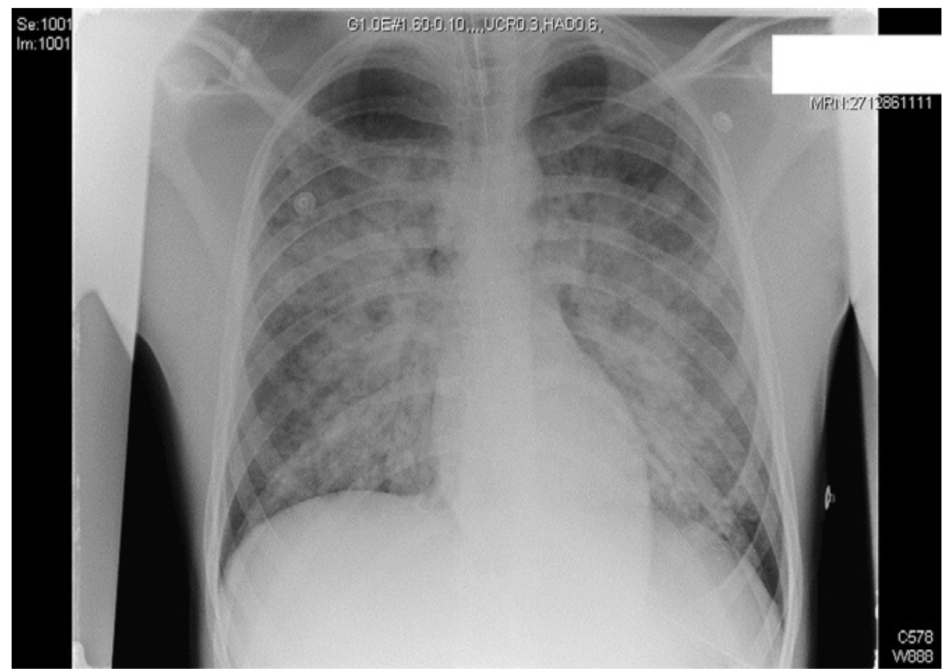
Neurogenic pulmonary edema
Ahrens et al, Journal of Clinical Anesthesia, 2008

Slide 48
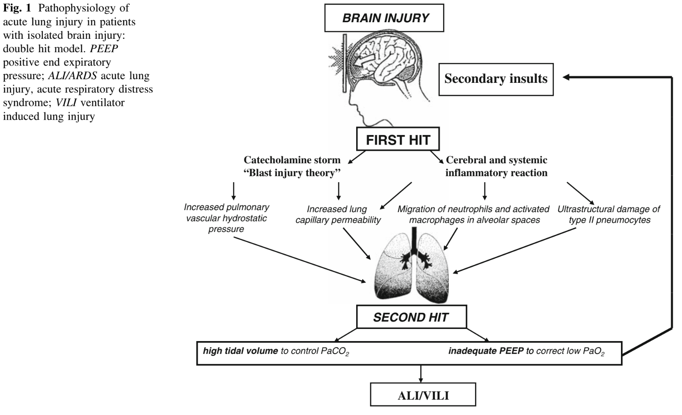
Neurogenic pulmonary edema
Mascia, Neurocritical Care, 2009.

Slide 49
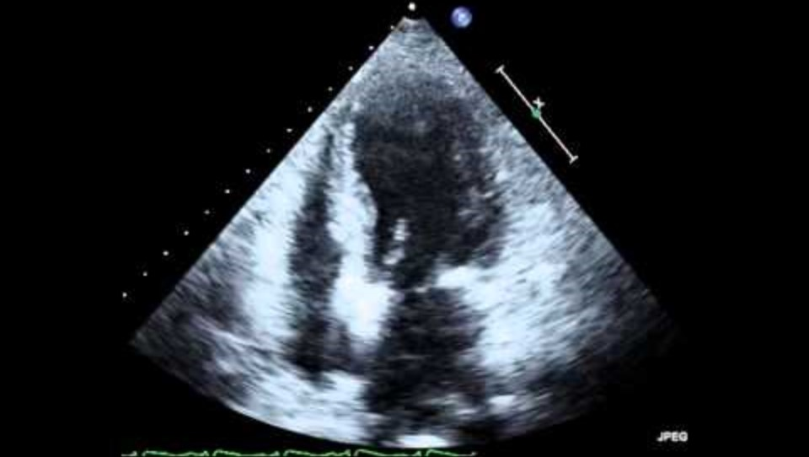
Takotsubo cardiomyopathy/Neurogenic stunned myocardium
https://www.youtube.com/watch?v=n9HS_Mm5OOA

Slide 50
Management
Aneurysm clipping or coiling
Management of acute hydrocephalus
Management of seizures
Prevent & treat vasospasm
Prevent delayed cerebral ischemia
Treatment of systemic complications

Slide 51
Thank you

